Slide 1
AN ICE-SHELF PHYTOPLANKTON BLOOM:
MIXING, GROWTH AND BIOMASS ACCUMULATION NEAR THE ROSS SEA ICE SHELF
Question
Chlorophyll and POC concentrations were extremely elevated near the ice shelf, and integrated concentrations are among the highest ever observed in the Southern Ocean (and anywhere else)
Given the extremely deep mixing, how can such high standing stocks be generated?

Slide 2
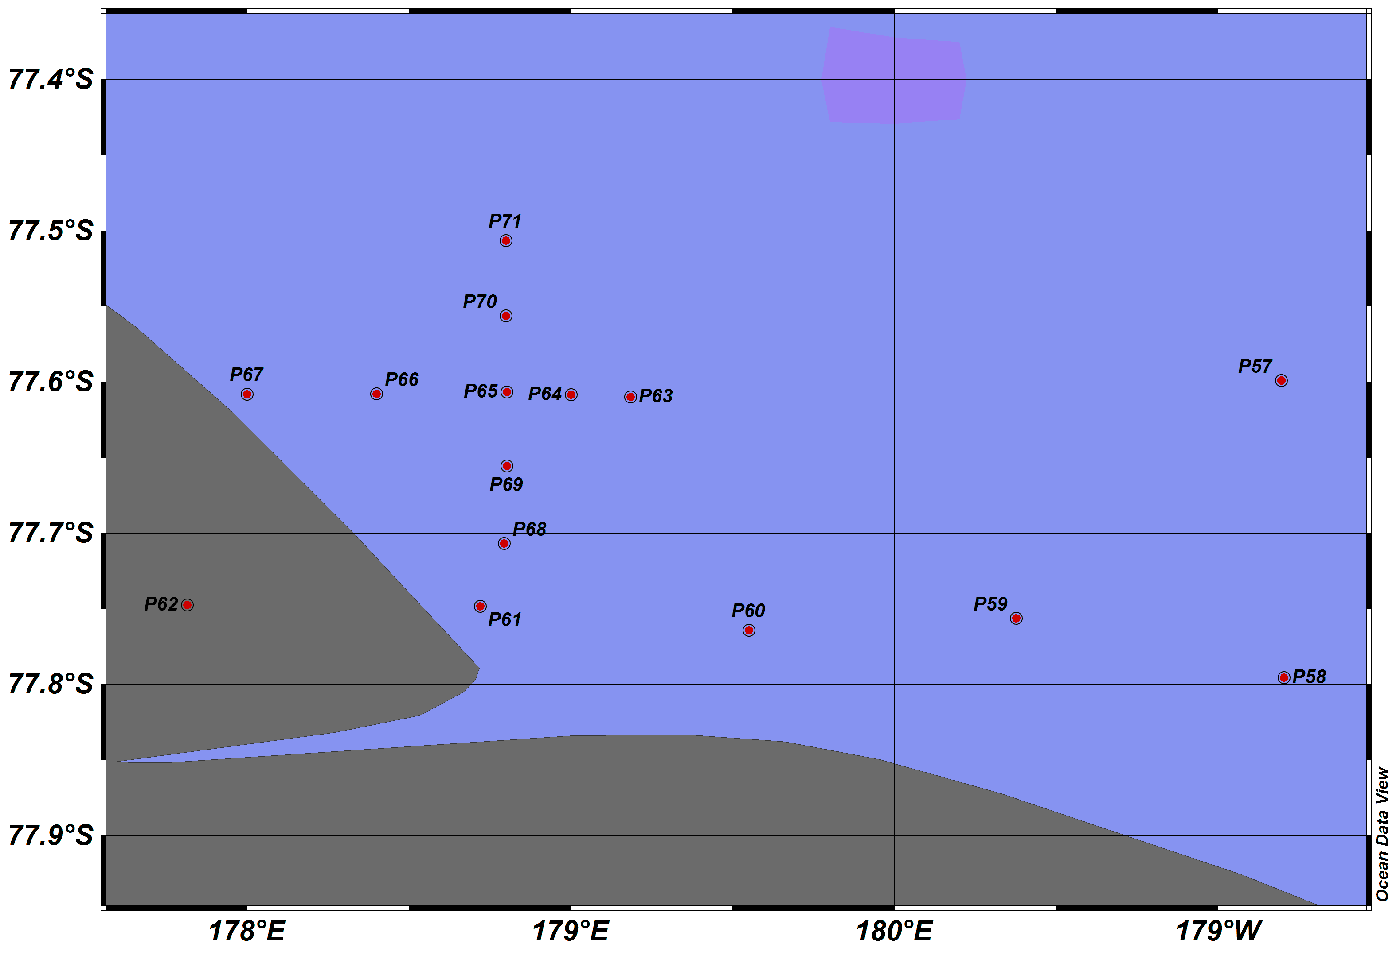

Slide 3
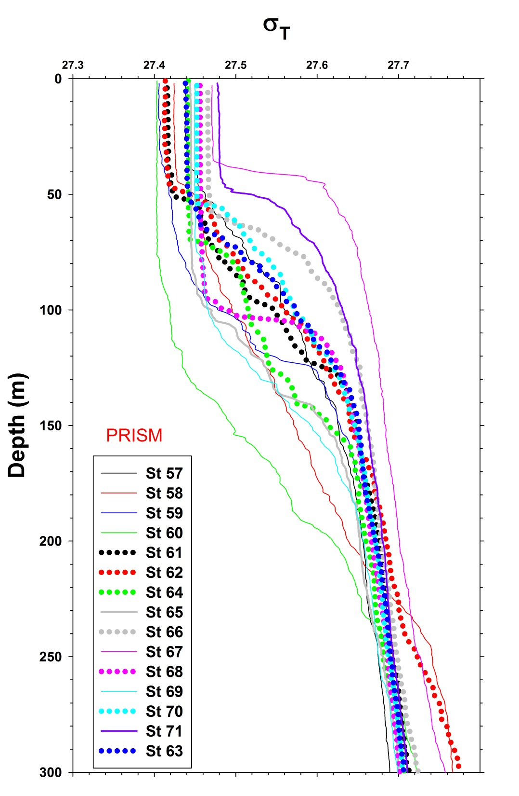

Slide 4
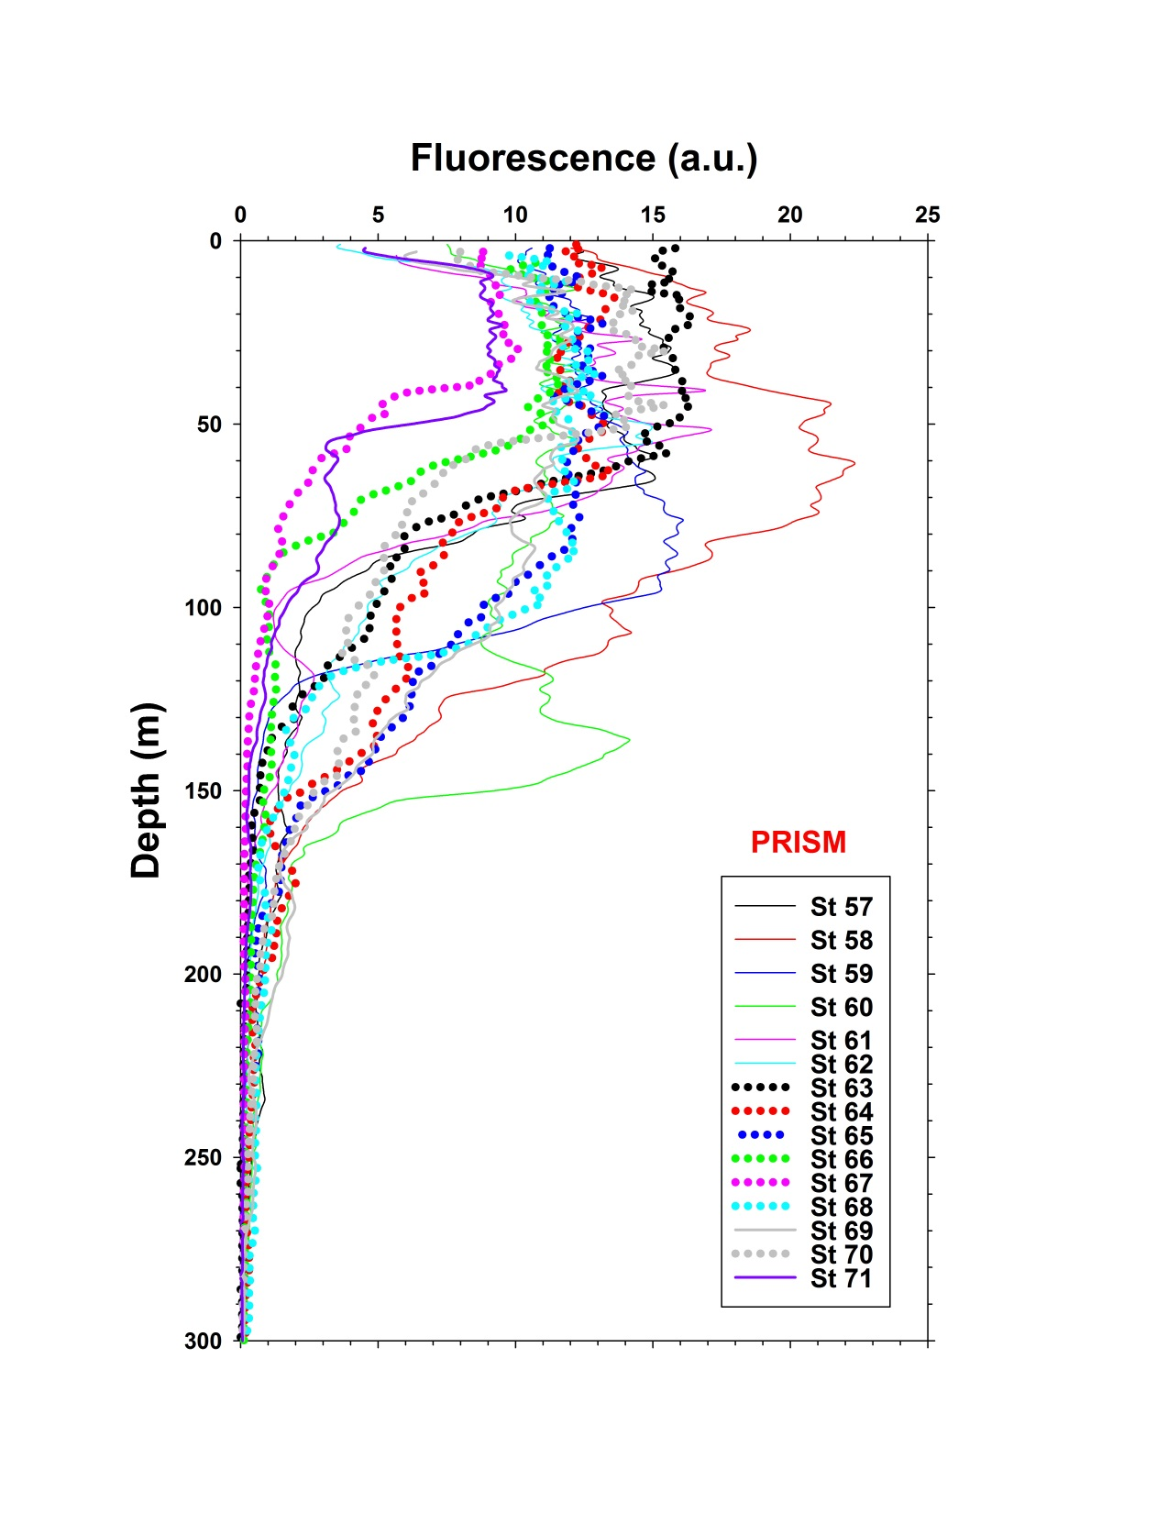
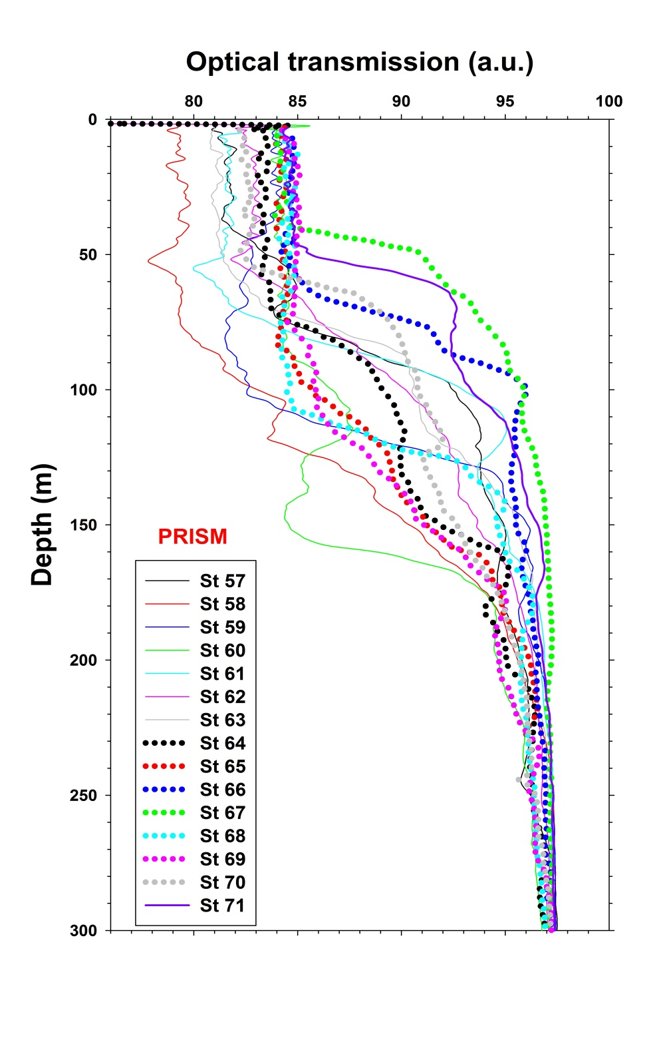

Slide 5
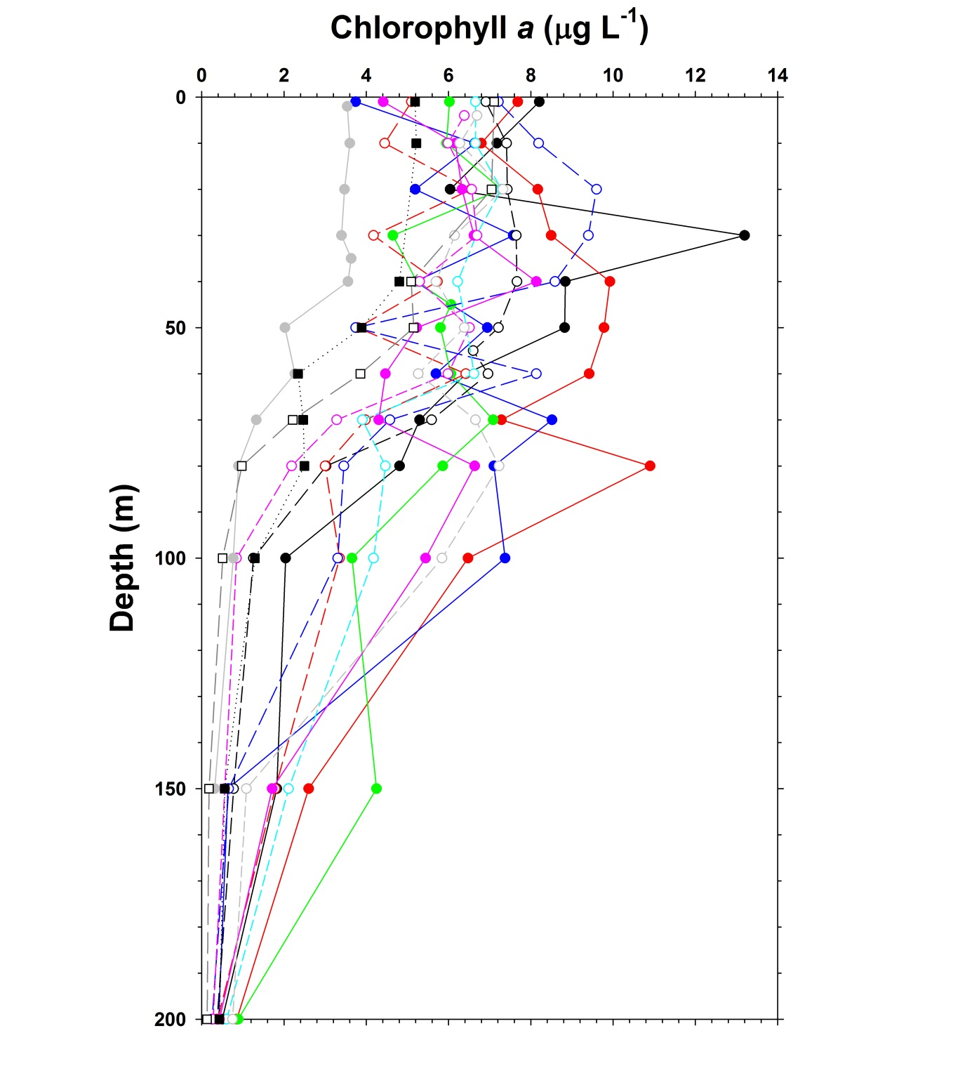

Slide 6
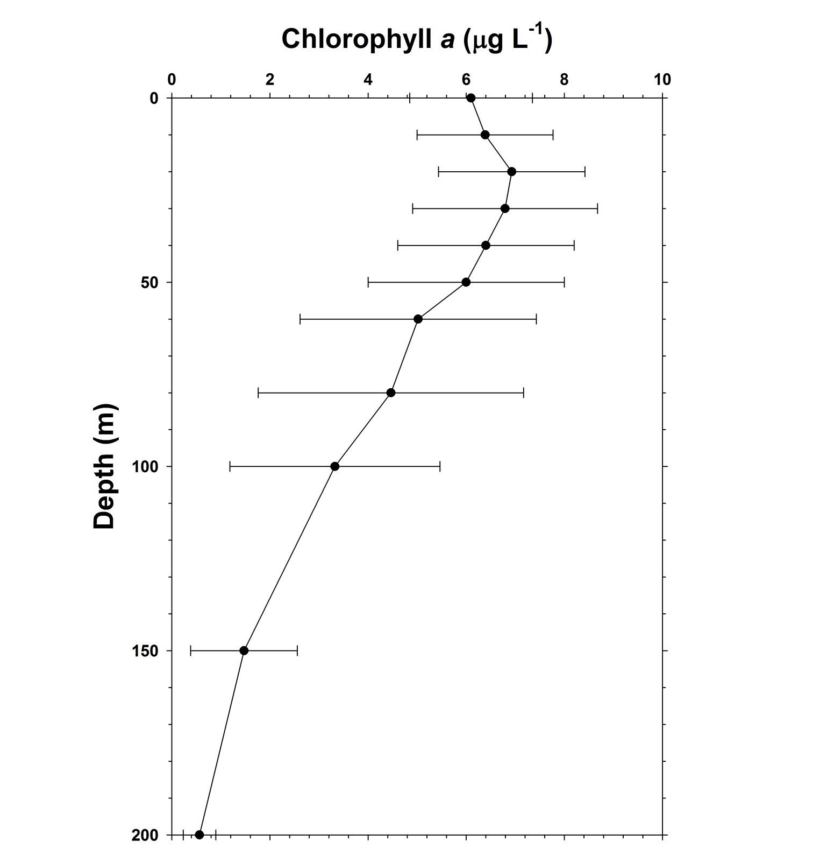

Slide 7
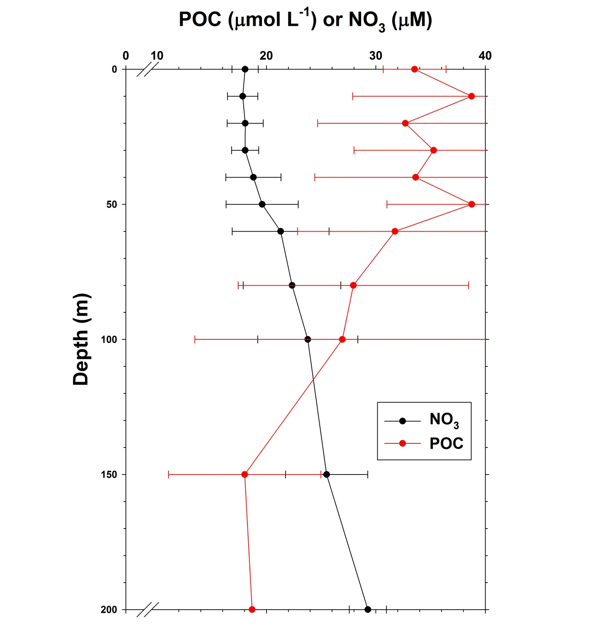

Slide 8
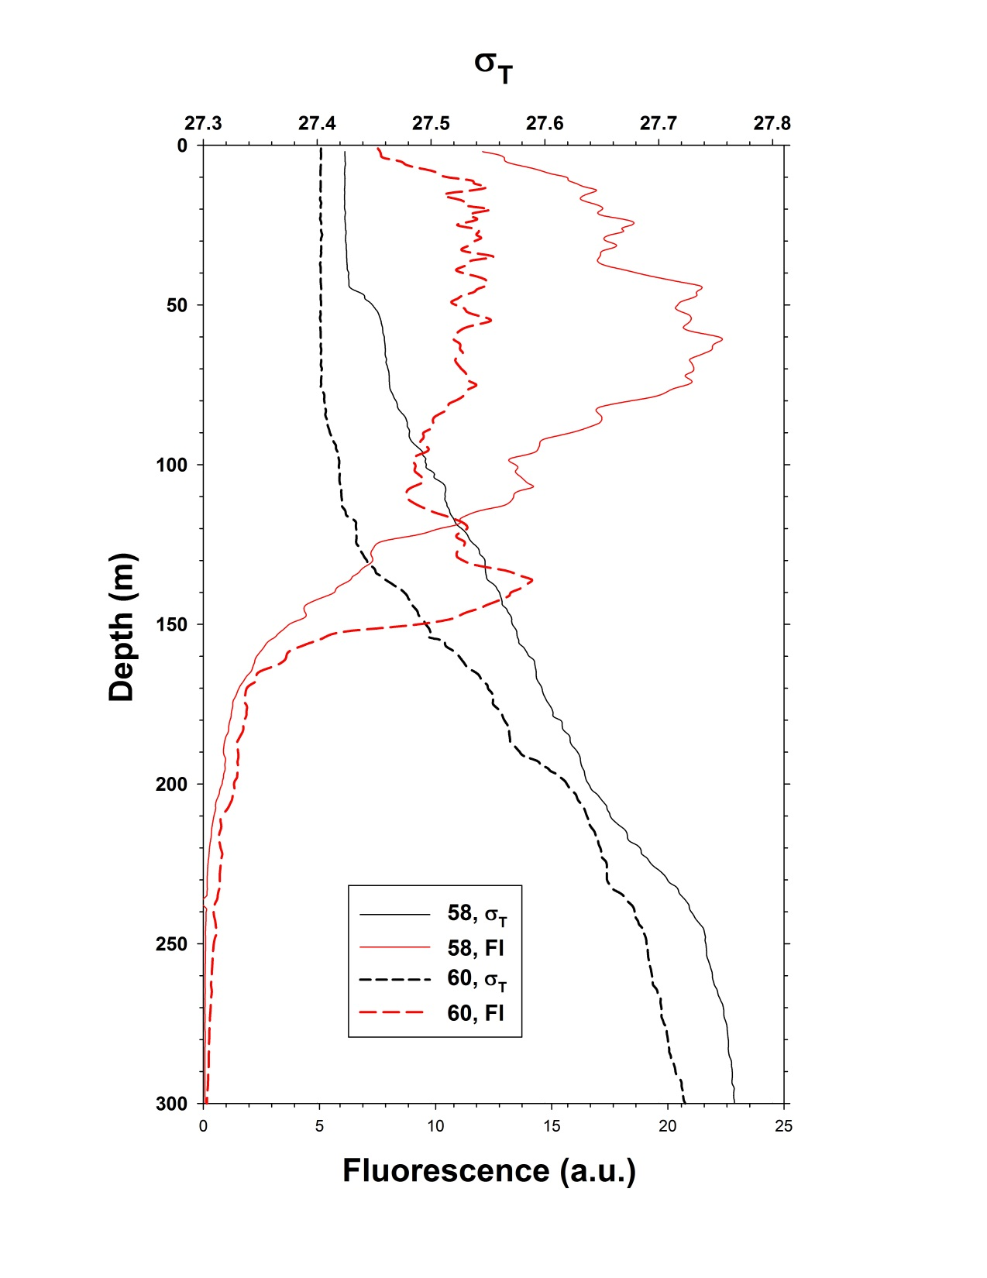

Slide 9
In the SeaBASS data base (NASA compendium), only 14 out of 9395 chlorophyll values have been reported being greater than our maximum of 24.6 μg L⁻¹. That means that only 0.15% of all values were greater.
A similar claim of “extremeness” was made by Arrigo et al.(2012) for their values in the Arctic. They published POC values that ranged from 28.7 – 32.5 g m⁻². At our ice shelf stations (n = 16), we had averaged integrated chl values (through 100 m) of 578 mg m⁻² (± 162). Similarly, our measured POC concentrations averaged 39.8 g C m⁻² (± 8.23), giving a mean C/chl ratio of 68.9.
It is clear that the ice-shelf eddy not only was physically unusual, but extremely rich in biomass.

Slide 10
Smith et al. 2000

Slide 11
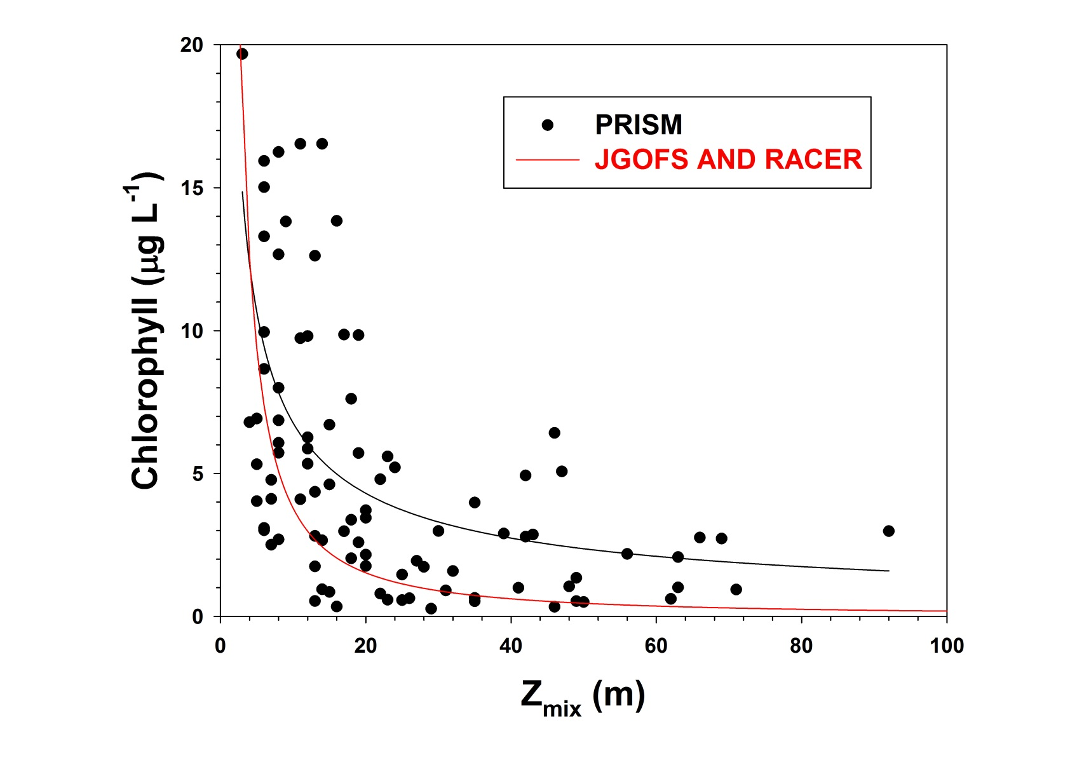

Slide 12
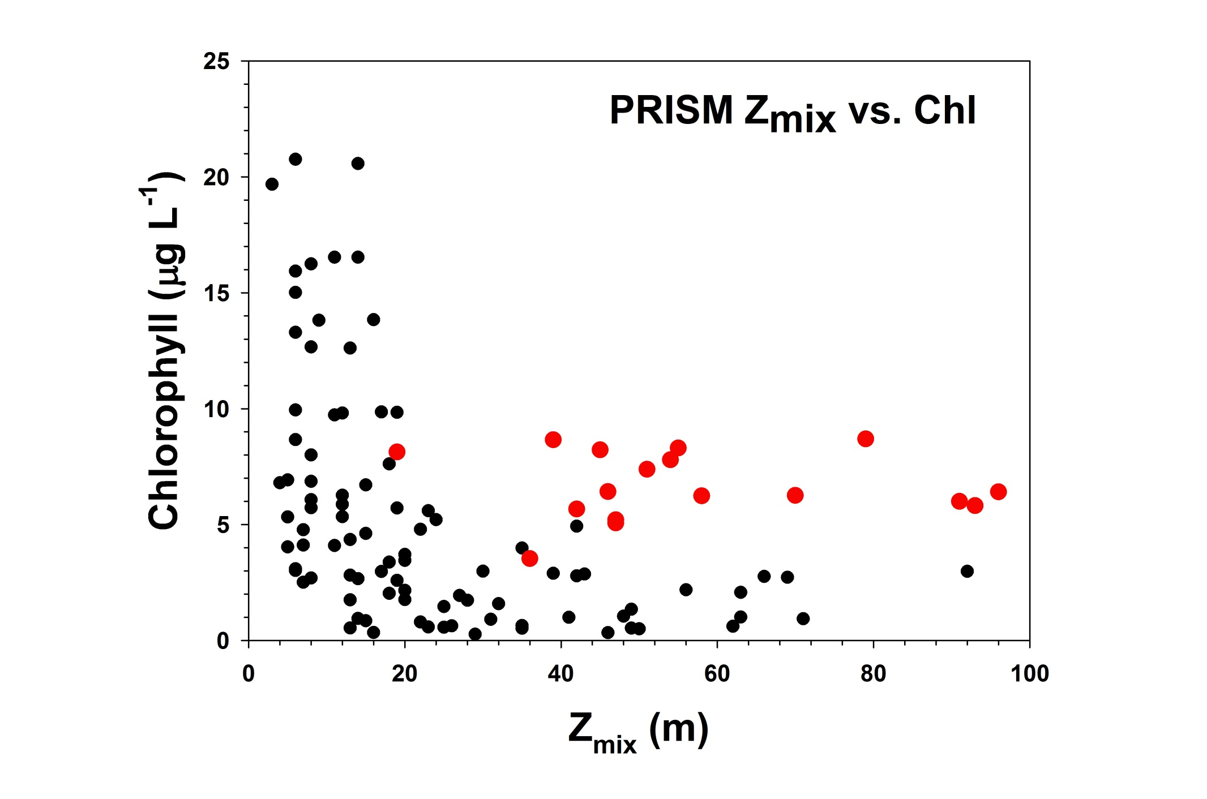

Slide 13
The PRISM stations are clearly unusual, with deep mixed layers and very high biomass. How did they get this way?
Tentative conclusion: the ice shelf is the site of periodic intense katabatic winds which overcome the local vertical stratification and redistribute water properties though the mixed layer; the periodic nature of these winds allows for growth over “short” time scales, followed by redistribution of biomass over even shorter time scales
The phytoplankton assemblage is dominated by Phaeocystis, suggesting it is acclimated to low irradiance levels induced by deep vertical mixing and high biomass

Slide 14
The to-do list:
Analyze other stations occupied in the region where both hydrographic and biological data were collected (note Italica data from 6 cruises provided by G. Buddion)
Check for weather station data from the ice shelf (none terribly close, however) for temporal nature of winds
Make estimate of growth rates, accumulation rates needed to get biomass level assuming no losses
1D model???

Slide 16
