Slide 1
NPZD-Iron lower level ecosystem model of the Ross Sea: a study of the processes controlling the seasonal cycle of biological production.
Elodie Salmon
Mike Dinniman
Hofmann Eileen

Slide 2
NPZD-FbFd type model
Diagram of equations
Fietcher et al., 2009
NO3
Phytoplankton
Phyt-Fe
Diss-Fe
Detritus
zooplankton
Zoop-Fe2
Remineralization, δ
Growth, Vm, K_{N}
Remineralization of a fraction, frem
Growth + Fe uptake , Vm, K_{N}, C/N, a, b, t_{Fe}
Grazing, Rm, Λ, fsc, fc
Excretion, ν_{N}, Rm, Λ
Mortality, σ_{d}

Slide 3
NSiPPPZZDDFbFd type model
Diagram of equations
Phyt1:
Phaeocystis solitary cells
Phyt-Fe1
NO3
Phyt2:
Phaeocystis colony cells
Det1:
Suspended particles
Phyt-Fe2
Diss-Fe
Phyt3:
Diatoms
Phyt-Fe3
Det2:
Fast sinking particles
Si
microzoop1
microZ-Fe1
mesozoop2
mesoZ-Fe2
Remineralization, δ
Growth, Vm, K_{N}
Remineralization of a fraction, frem
Growth + Fe uptake , Vm, K_{N}, C/N, a, b, t_{Fe}
Grazing, Rm, Λ, fsc, fc
Excretion, ν_{N}, Rm, Λ
Mortality, σ_{d}
Grazing on Bacteria

Slide 4
NSiPPPZZDDFbFd type model

Slide 5
NSiPPPZZDDFbFd type model

Slide 6
NSiPPPZZDDFbFd type model

Slide 7
NSiPPPZZDDFbFd type model

Slide 8
NSiPPPZZDDFbFd type model
Cells
+
mucus
f_{cwm}
1- f_{cwm}
Cells
Mucus
Phytoplankton 1
Detritus 1

Slide 9
NSiPPPZZDDFbFd type model

Slide 10
NSiPPPZZDDFbFd type model

Slide 11
NSiPPPZZDDFbFd type model
Grazing +
Mortality
Bacteria loop

Slide 12
NSiPPPZZDDFbFd type model
Detritus 2
f_{D2RN}
f_{D2RSi}
Nitrate
Silica

Slide 13
NSiPPPZZDDFbFd type model

Slide 14
NSiPPPZZDDFbFd type model
← Phytoplankton senescence
← Grazing
Uptake →

Slide 15
NSiPPPZZDDFbFd type model
k_{sc}
F_{d} + D
F_{PI}
k_{diss}

Slide 16
Bio_Toy model
N
E
W
S
North, South, East, West periodic
Runs start in January
Sea ice formation and melting
Southerly wind
Ligth cycles
568 m

Slide 17
NSiPPPZZDDFbFd type model
 | Model | Parameters
Reference | NPPPZZDD_FdFb | Iron relaxed to 0.3nM/L every year
Light |  | Testing different values of Attphy1, 2, 3, alpha and AttSW
Iron sources:
Sediment /CDW |  | Iron relaxation upon k=1; k=1,2,3; k=1,2,3,4,5; …until k=1 to 30
Aerosol/sea ice |  | Iron relaxation upon k=32
Iron scavenging | NPPZZDD_FdFbFip | Iron relaxed to 0.3nM every year
Silicon concentration
 | NPPZZDD_FdFbFip
 | NPPPZZDD_FdFb

Slide 18
Reference simulation
depth
days
days
days
winter
summer
winter
summer
winter
summer
spring
spring
spring

Slide 19
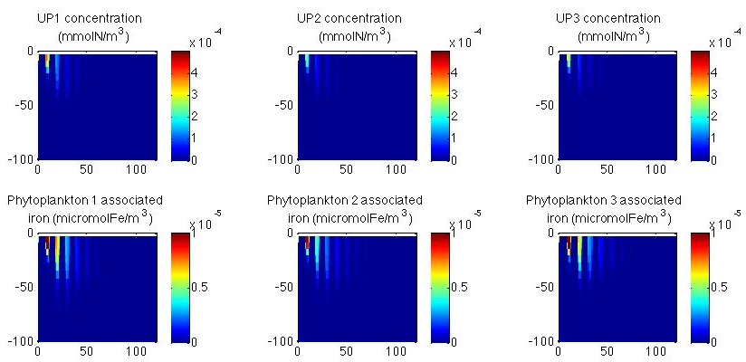
Reference simulation
Phaeocystus antarctica
Diatoms
Solitary cells
Cells in colony
depth
days
Arpil 10th
depth
days
Arpil 10th

Slide 20
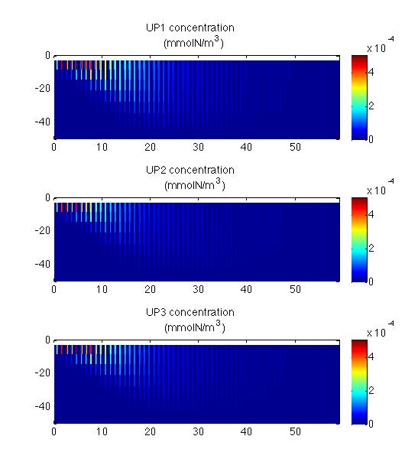
Reference simulation
Phaeocystus antarctica
Solitary cells
depth
days
February 18th
Cells in colony
Diatoms

Slide 21
Questions and discussions
Suggestion to improve simulations?
Past meeting:
Ocean Carbon and Biogeochemistry (OCB) Summer Workshop
July 22-25, 2013 -Poster
Meetings
International Symposium on Sea Ice in a Changing Environment
9–14 March 2014-Talk
Ocean Sciences Meeting
23-28 February 2014-Talk

