Slide 1
Assessment of benthic iron efflux
Ocean Sciences 2014 talk:
An assessment of benthic iron efflux on the Ross Sea continental shelf and its contribution to surface water dissolved iron supply.
C. Marsay, P. Sedwick, M. Dinniman, B. Sohst, D. McGillicuddy

Slide 2
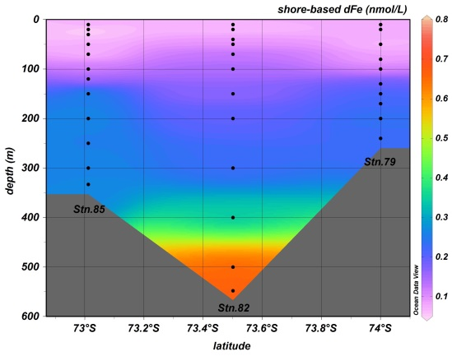
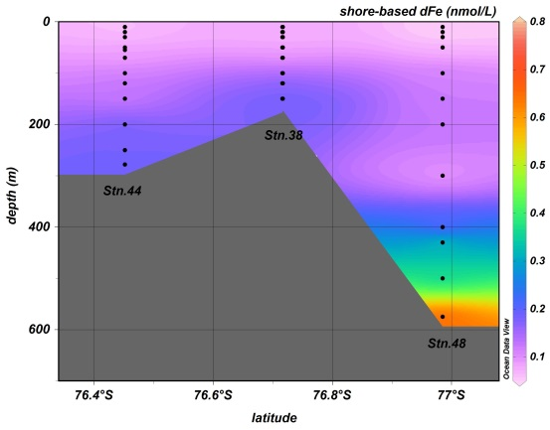
Introduction: dissolved iron distribution
47 on-shelf stations
40 stations included a sample within 30m of seafloor; within 20m at 26.
dFe concentration in upper 50m:
0.08 ± 0.07 nM (n = 169).
dFe concentration within 50m of seafloor:
0.74 ± 0.47 nM (n = 55).

Slide 3
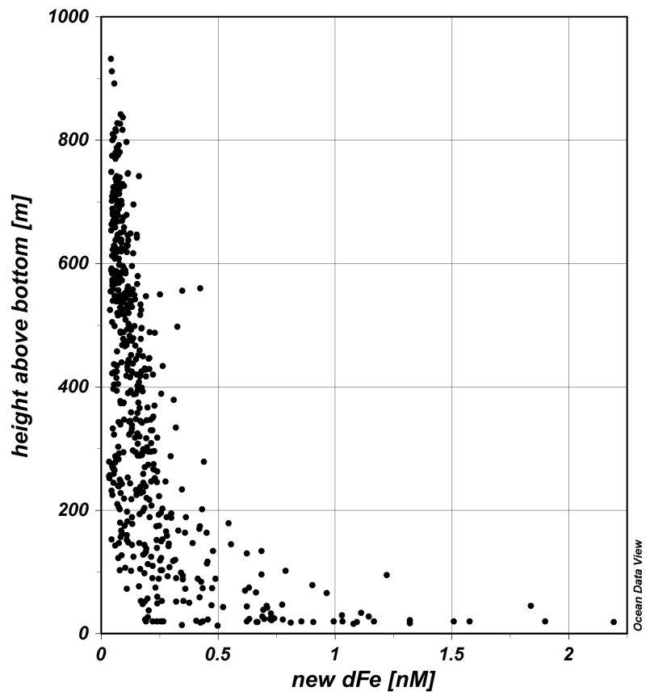
Introduction: dissolved iron distribution
~40 % of total water column dFe within 100m of the seafloor*.
*casts in >300m water depth.
McGillicuddy et al., in prep

Slide 4
Depth profiles of dissolved iron
“Typical” profile shape showed quasi-exponential increase towards the seafloor (stations of >350m depth).
Suggests a benthic dFe source – diffusion from sediments and/or sediment resuspension
(Nedelec et al. 2007; Cullen et al. 2009; de Jong et al. 2012).
Possible to calculate a diffusive efflux of dFe using Fick’s Law, if the near-bottom profile gradient and the vertical eddy diffusivity coefficient, k_{z}, are known:
→ Flux = k_{z}.δ[dFe]/δz

Slide 5
Depth profiles of dissolved iron
Data from >100m were fitted to:
[dFe] = 0.1 + A.exp^{B.z}
z = depth
0.1 (nM) is an assumed background concentration of dFe.
A, B varied by station to give least-squares fit to data
Profiles were extrapolated from surface to seafloor.
[dFe] range at seafloor:
0.3 – 2.7 nM
relatively low for near-bottom [dFe]
Cullen et al.: 1-6nM
de Jong et al.: 10-20nM
Nedelec et al.: 0.3-6nM

Slide 6
Depth profiles of dissolved iron
[dFe] = 0.1 + A.exp^{B.z}
δ[dFe]/δz = B.A.exp^{B.z}
Range of δ[dFe]/δz at the seafloor (stations >350m depth):
0.7 – 73.4 nmol m⁻⁴.

Slide 7
Vertical eddy diffusivity: k_{z}
Extracted from ROMS circulation model.
Average summertime (11/29/11 – 02/26/12) k_{z} values for the deepest vertical layer by station.
Range: 1–58 x 10⁻⁴ m² s⁻¹.
Mean: 9.3±10.6 x 10⁻⁴ m² s⁻¹
Median: 6.7x10⁻⁴ m² s⁻¹
cf. 30 x 10⁻⁴ (de Jong et al. 2013);
2–50 x 10⁻⁴ (Broecker et al. 1968).

Slide 8
Estimates of flux
dFe flux = kz.δ[dFe]/δz
For stations of >350m depth only (n=37).
dFe flux range:
0.03 – 8.23 µmol m⁻² d⁻¹
Mean: 1.1±1.9 µmol m⁻² d⁻¹
Median: 0.31 µmol m⁻² d⁻¹

Slide 9
Estimates of benthic flux across the shelf
~45 x 10¹⁰ m² of Ross Sea Shelf is >350m deep.
1.8 ± 3.1 x 10⁸ mol dFe (using mean)
0.5 x 10⁸ mol dFe
(using median)

Slide 10
Estimates of flux: context
Benthic dFe mixed through the water column by winter mixing.
dFe flux range:
0.03 – 8.23 µmol m⁻² d⁻¹
Atlantic sector of S.Ocean (de Jong et al. 2012): 1.3-15.5 µmol m⁻² d⁻¹.
Used a relatively high literature estimate of k_{z}, applied to 4 stations; higher [dFe] measured at near-bottom depths (2 – 20 nM).
Other shelf environments, using other methods (in situ incubations, pore-water profiles): <0.02 – 1000 µmol m⁻² d⁻¹.
May be an under-estimate, due to well-oxygenated water column and rapid loss of released dFe by oxidisation and precipitation/scavenging(?)
Particulate iron profiles show a similar shape, with concentrations of >10 nM in some near-bottom samples, also coincident with benthic nepheloid layers.

Slide 11
Shallow bathymetry stations
10 stations of <350m depth.
dFe profiles had a more linear increase with depth, or showed little variation between the deepest samples.

Slide 12
Shallow bathymetry stations
Deepest samples at shallow stations relatively low in dFe, relative to deeper stations.

Slide 13
Effect of shallow bathymetry
Comparison of shallow stations (<350m depth) and stations >500m deep.
Using dFe data from 100-300m depth interval, median concentrations at the shallow stations are slightly higher.
Difference between the two is significant (Mann-Whitney Rank Sum Test; P<0.001).

Slide 14
Summary
Difference in dFe concentration between the upper 50m and the lower water column a prominent feature.
At most stations, dFe profile shows a distinctive shape, suggesting a benthic source – diffusion from sediments/release of pore-waters from suspended material.
Fluxes measured by combining dFe data with k_{z} values from the circulation model are relatively low compared to other measurements of benthic dFe efflux.
Near-bottom dFe concentrations generally lower at shallow stations, but elevated relative to the surrounding water.

Slide 17
With tides vs. without tides
WITH:
k_{z} range = 1.1–58 x10⁻⁴ m⁻² s⁻¹.
Mean = 10.4±11.3 x10⁻⁴ m⁻² s⁻¹.
Median = 6.7x10⁻⁴ m⁻² s⁻¹.
WITHOUT:
k_{z} range = 0.52-65 x10⁻⁴ m⁻² s⁻¹.
Mean = 8.5±11.7 x10⁻⁴ m⁻² s⁻¹.
Median = 5.6x10⁻⁴ m⁻² s⁻¹.
% change by station: from -57 to +406 %
Mean % change: +74 %
% change in mean k_{z}: +22 %

Slide 18
With tides vs. without tides
WITH:
Flux range = 0.03 – 8.23 µmol m⁻² d⁻¹.
Mean = 1.1 ± 1.9 µmol m⁻² d⁻¹.
Median = 0.31 µmol m⁻² d⁻¹.
WITHOUT:
Flux range = 9x10⁻³ – 5.5 µmol m⁻² d⁻¹.
Mean = 0.8 ± 1.4 µmol m⁻² d⁻¹.
Median = 0.26 µmol m⁻² d⁻¹.

Slide 21
