Slide 1
Ross Bank
Blair Greenan
Bedford Institute of Oceanography
PRISM-RS PIs Meeting
Old Dominion University
11-12 June 2013

Slide 2
The role of submarine banks in iron supply on Antarctic shelf seas
Objective: Use in situ and remotely sensed data along with computer models to determine the role of Ross Bank in the supply of dissolved iron to the euphotic zone in the Ross Sea. Based on the results of our analysis, we will attempt to generalize this other submarine banks on the continental shelves surrounding Antarctica.

Slide 3
Available Data Sets
SeaHorse mooring for 5-day period (hourly vertical profiles of temperature, conductivity, dissolved oxygen, fluorescence, irradiance, currents) – Blair
  Initial processing of ADCP currents is consistent with the Padman tidal model
  Tidal cycle evident in hydrographic fields (CTD, DO)
  Fluorescence is lower than observed in other SeaHorse deployments
Vessel-mounted ADCP from Palmer transects of Ross Bank – Dennis
  VM-ADCP results also appear consistent with Padman model
  Sub-tidal flow computed by removing the Padman-predicted flow from the measured currents

Slide 4
Available Data Sets
Shipboard hydrography (CTD/DO/nutrients) – John, Dennis & Walker
  Water mass changed during the period of the SeaHorse deployment
  What can we say from the nutrients?
  What can we say from the oxygen?
Video Plankton Recorder (hydrography & plankton) – Dennis
  VPR observed higher fluorescence over the side of the bank relative to the top of the bank where the SeaHorse was moored
  What can we say about the plankton from the VPR?
Moving Vessel Profiler (hydrography, LOPC) – Blair/Dennis
  Need to merge the hydrographic data from the MVP/VPR/Shipboard CTD to map out the hydrographic fields as best possible

Slide 5
Available Data Sets
Dissolved Iron – Pete
  Reduced evidence of dFe enhancement over Ross Bank.
  Elevated levels of dFe evident at base of slope
Particulate Iron – Pam
  Will we be able to use the combination of particulate Fe and dFe to say anything about the source of the iron above Ross Bank?

Slide 6
Available Data Sets
Phytolankton – Tom & Walker
  Tom’s results indicate that the phytoplankton collected above Ross Bank were not iron stressed, which is consistent with this area being a local source of dFe.
  Are there other phytoplankton results that we want to incorporate?
Underway measurements
  Can we make use of the underway measurements in this area to objectively map the surface fields ?
Satellite imagery (SST, color, ice cover) – Dennis
  Only certain ocean color climatologies indicate that Ross Bank is a hot spot for primary production.
  What further remote sensing data and analysis could we incorporate? If we are trying to extrapolate results to other shelf sea we may need to use ocean color data to provide some validation

Slide 7
Models
Mike has 5km resolution ROMS model running and can quickly test scenarios
  Mike will look at the wind forcing for the period of the SeaHorse deployment to make sure that this forcing is represented properly in the model. He will then look at the impact of this event on circulation and Ekman transport over Ross Bank.
  Will tides be added in 2013?
Stephanie will have 2.5 and 1.25 km resolution ROMS models running in 2013
  The higher-resolution models will be better able to represent mesoscale processes on the continental shelf.
  These higher-resolution models will take significantly longer to run, so testing various scenarios will take much longer
  Plan is to include tides in the high-resolution models
Pierre has a high-resolution model that could be used for idealized testing of the role of tides and topography
  John indicated that Pierre could include a bank in his model to study the effects of tides and wind forcing in this more idealized model.

Slide 8
Questions
Is Ross Bank a conduit to the surface for dFe?
Can we generalize the Ross Bank measurements to other parts of the Antarctic continental shelves?
Does the apparent lack of dFe enhancement above the bank indicate that such features are not a significant source of surface dFe?
What was the impact of the wind event during the SeaHorse deployent?
If the vertical transport of dFe is predominantly driven by the tides, is this an area that has a source of dFe year-round?
Is the source of dFe at Ross Bank intermittent because of the spring-neap tidal cycle? Is Ross Bank a “puffy chimney”?

Slide 9
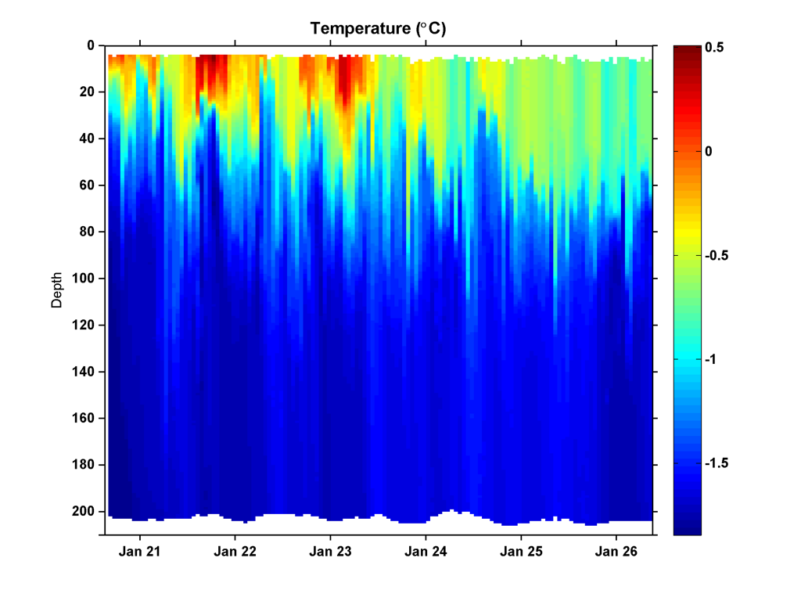
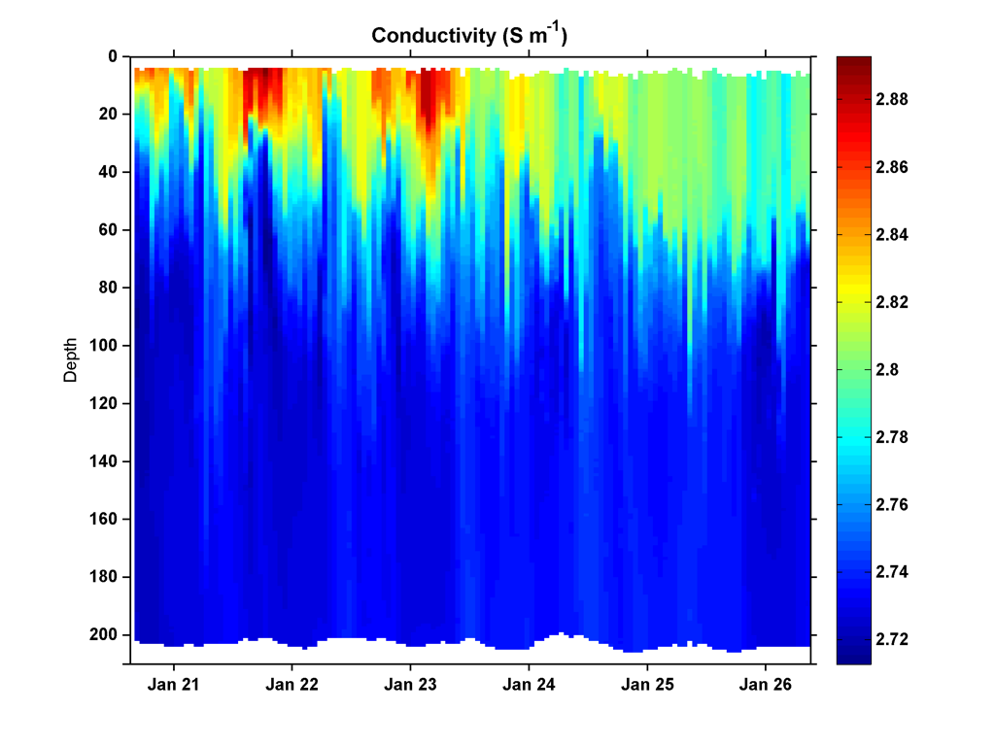
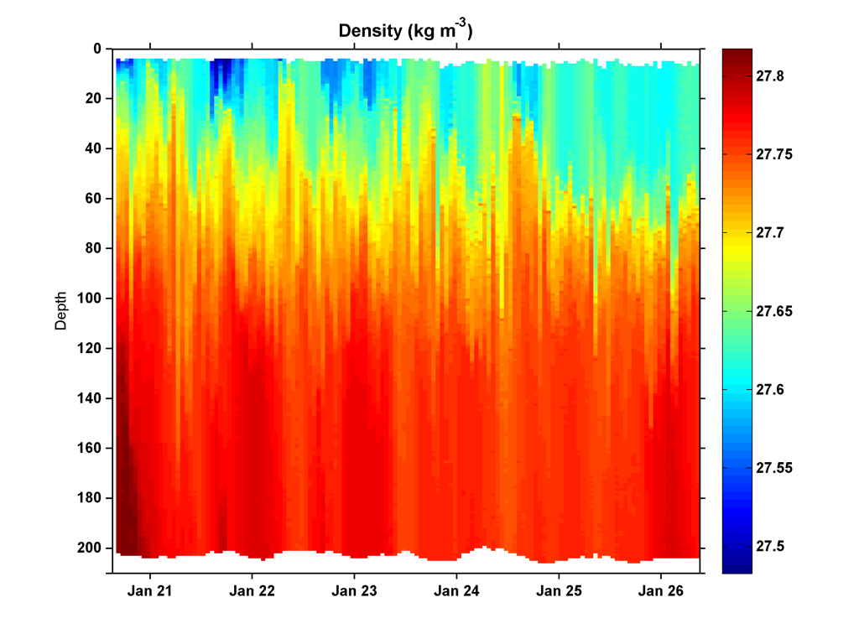
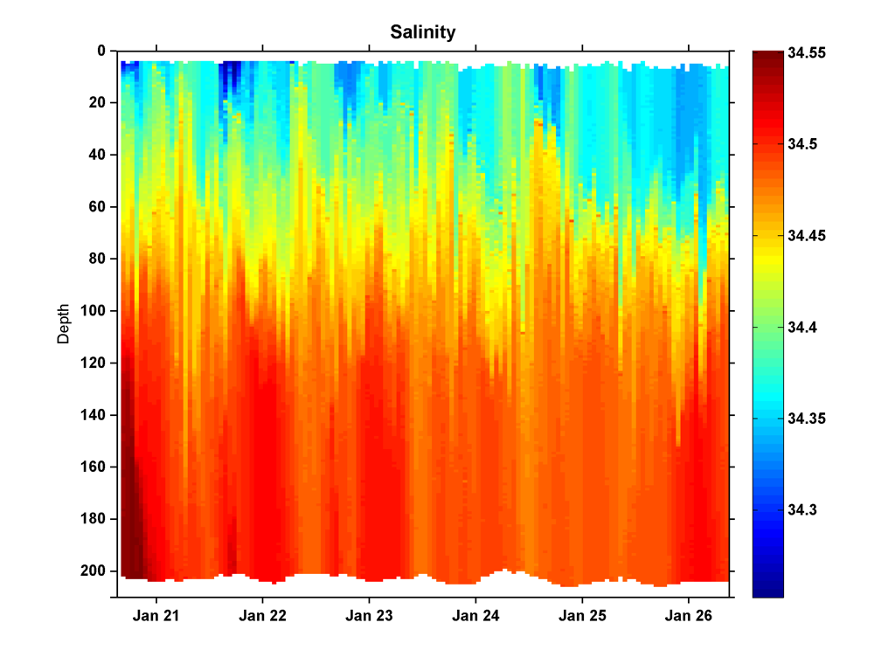
SeaHorse Deployment 3 - Ross Bank
Temperature (°C)
Conductivity (S m⁻¹)
Pressure (dB)
Pressure (dB)
Density (kg m⁻³)
Salinity
Pressure (dB)
Pressure (dB)

Slide 10
SeaHorse and Ship CTD
Separation: < 0.5 km
SeaHorse: 21 Jan 2012 03:39:01
Ship: 21 Jan 2012 03:05:46

Slide 11
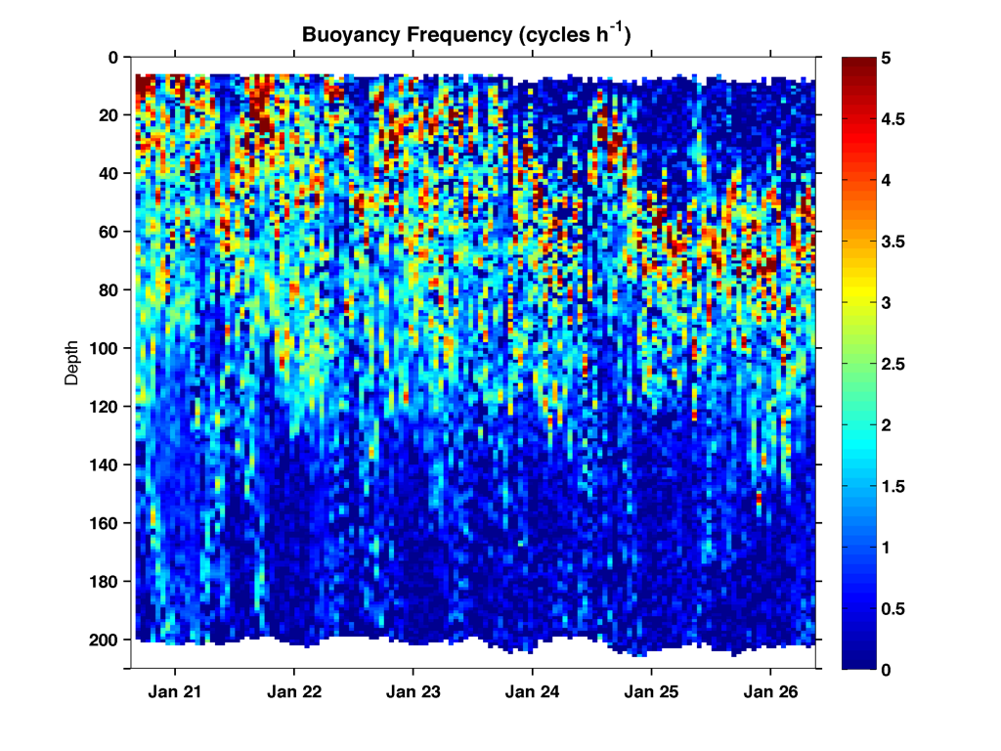
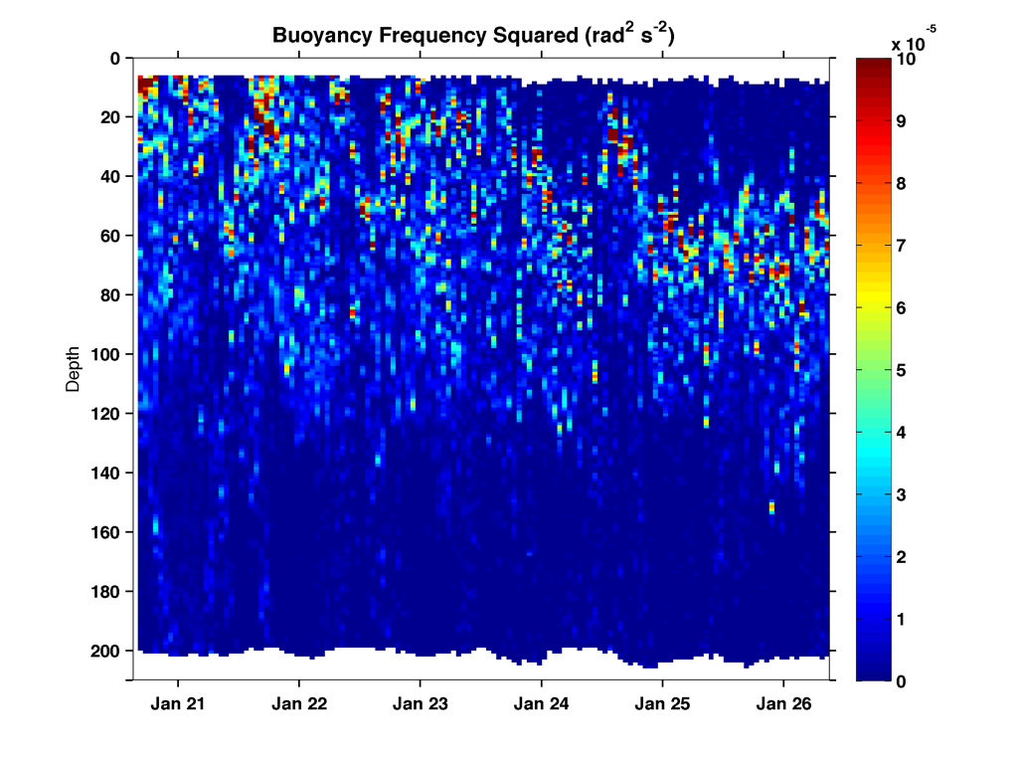
SeaHorse Deployment 3 - Ross Bank
Buoyancy frequency (cycles hr⁻¹)
Buoyancy frequency squared (rad² sec⁻²)
Pressure (dB)
Pressure (dB)

Slide 12
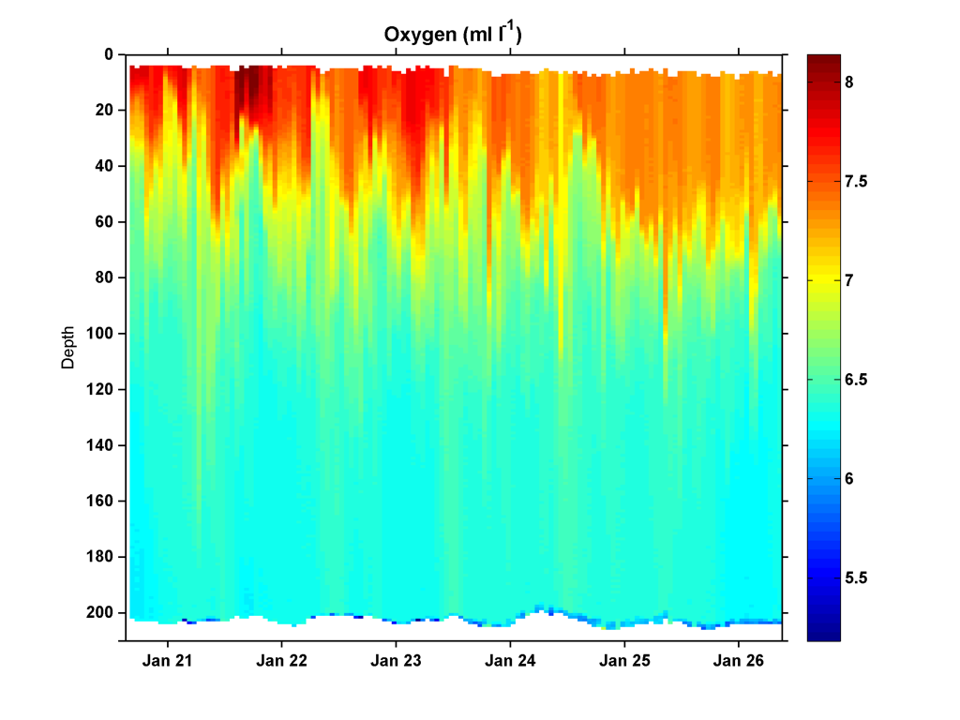
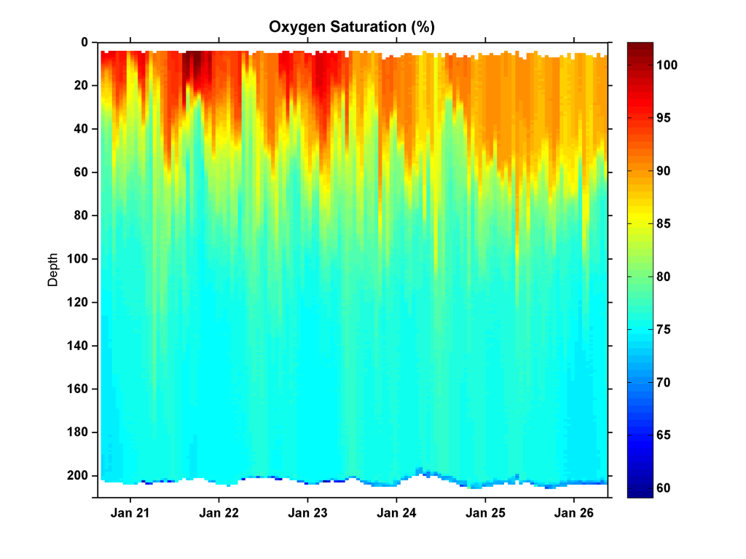
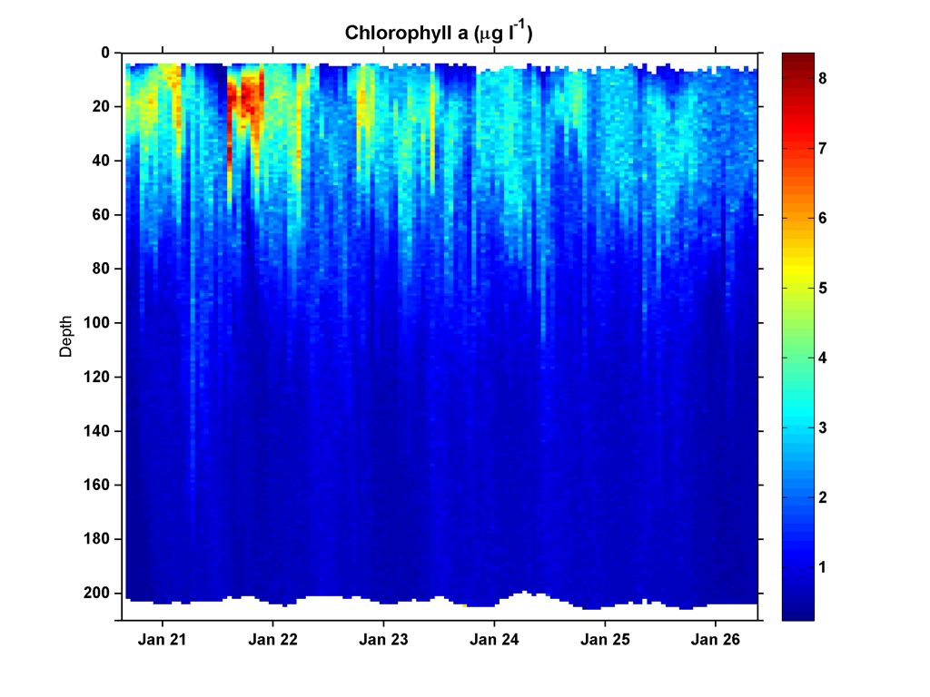
SeaHorse Deployment 3 - Ross Bank
Oxygen concentration (mL L⁻¹)
Oxygen saturation (%)
Pressure (dB)
Pressure (dB)
Approximate Chl concentration (μg L⁻¹)
Pressure (dB)

Slide 13
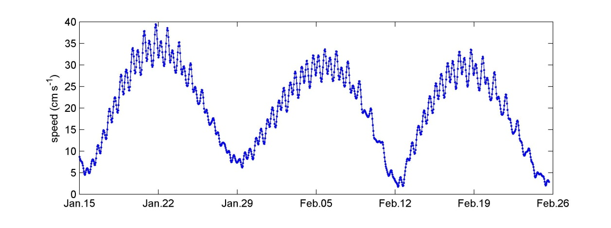
Ross Bank tidal velocity amplitude (OSU/ESR model)
SeaHorse

Slide 14
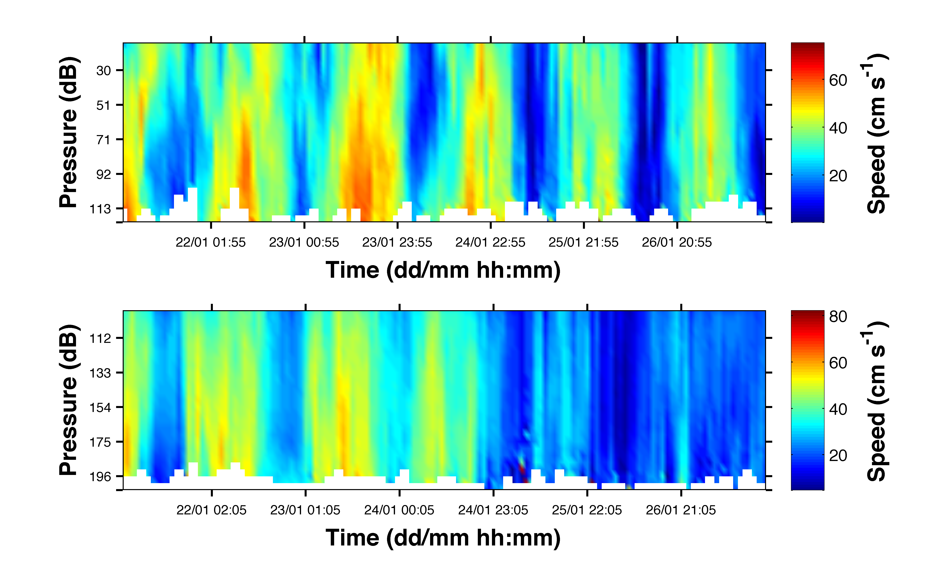
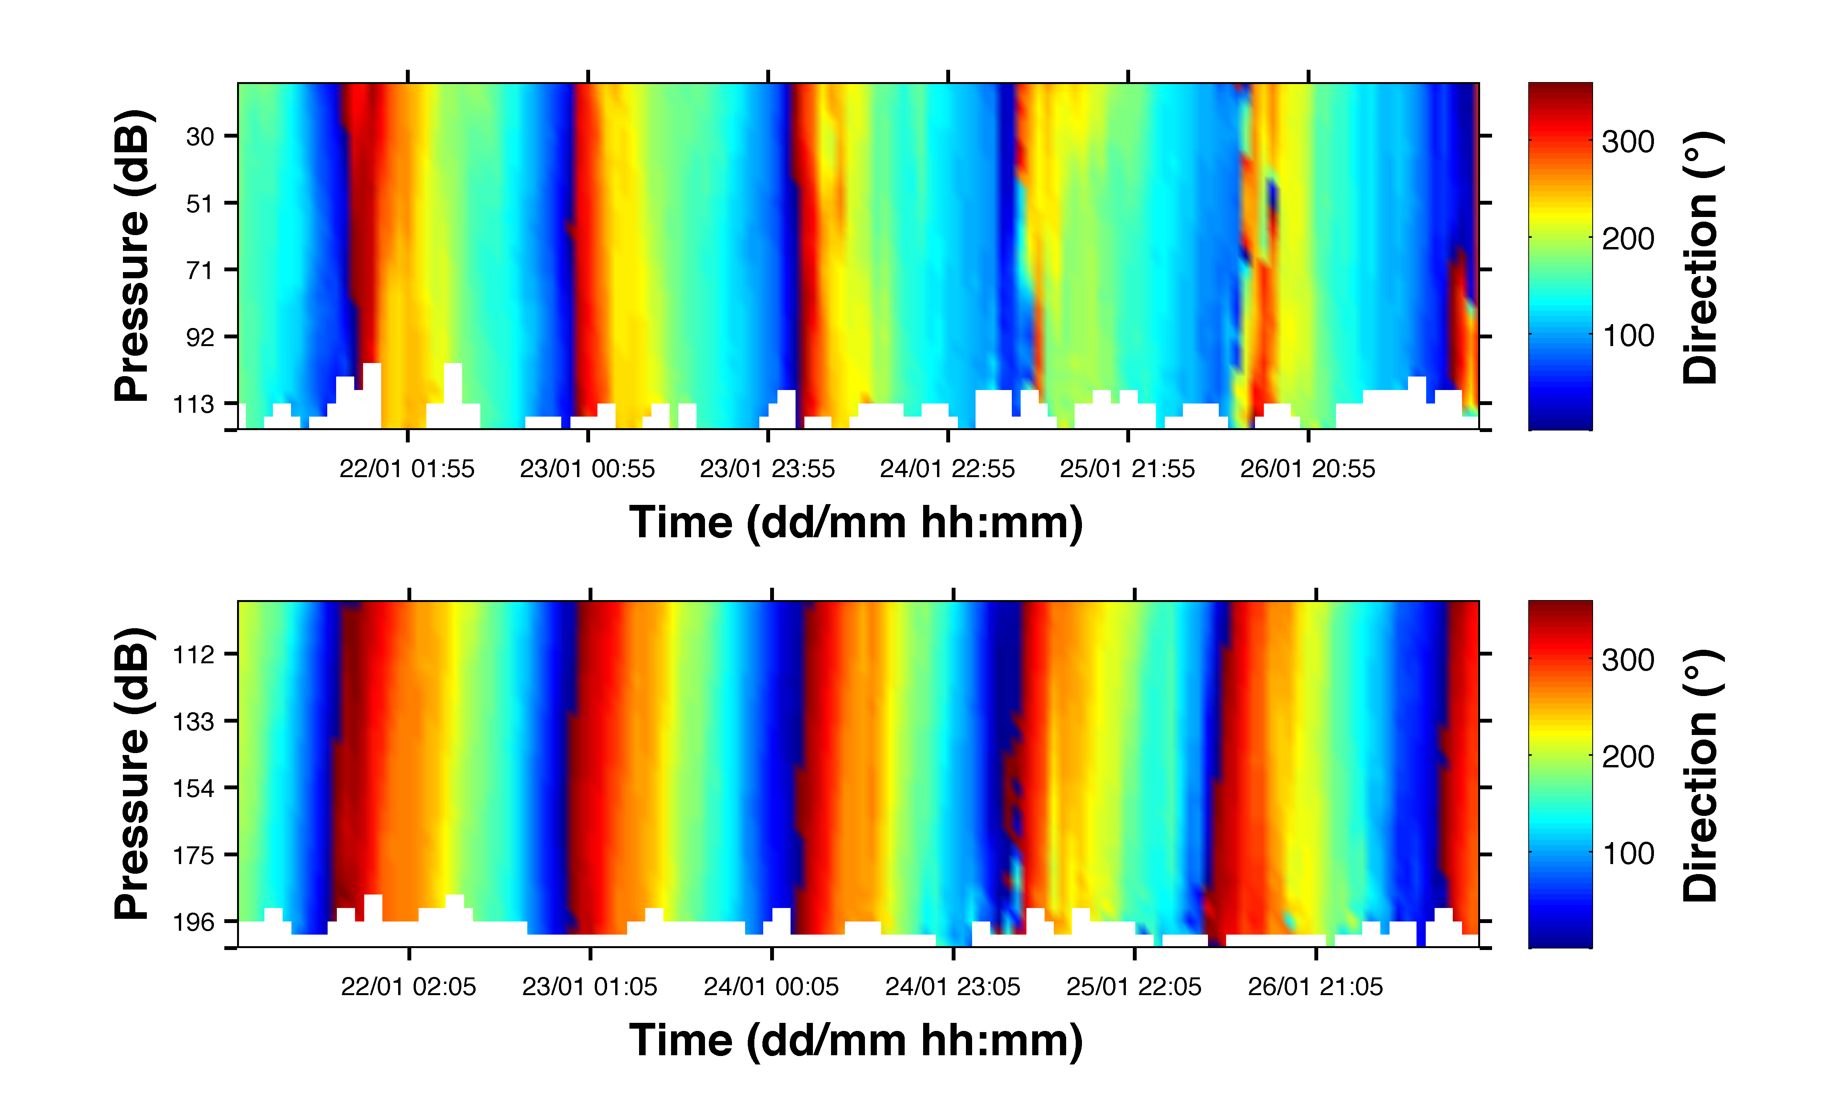
ADCP Deployment 3 - Ross Bank

