Slide 1
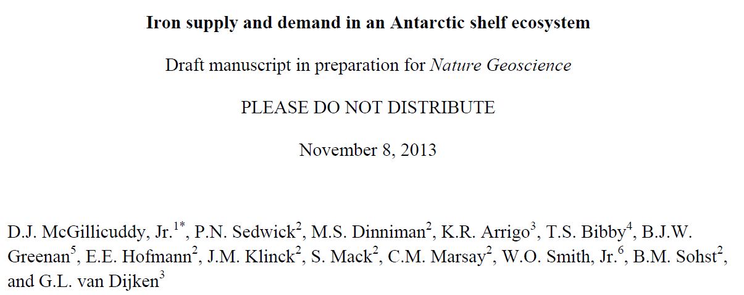
Changes since last PI meeting
Final Fe numbers
Budgets computed for mixed layer rather than upper 10m
Use of tidally resolving model
Figure 1a replaced by satellite PP

Slide 2
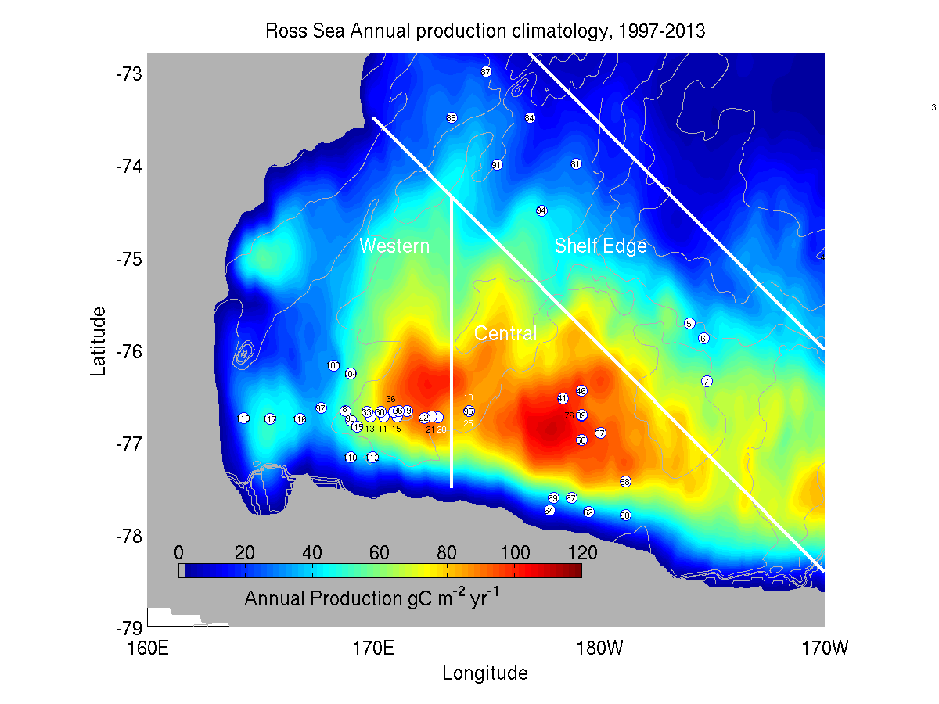
Regional subdomains
Arrigo et al. satellite-based productivity (1997-2013)

Slide 3
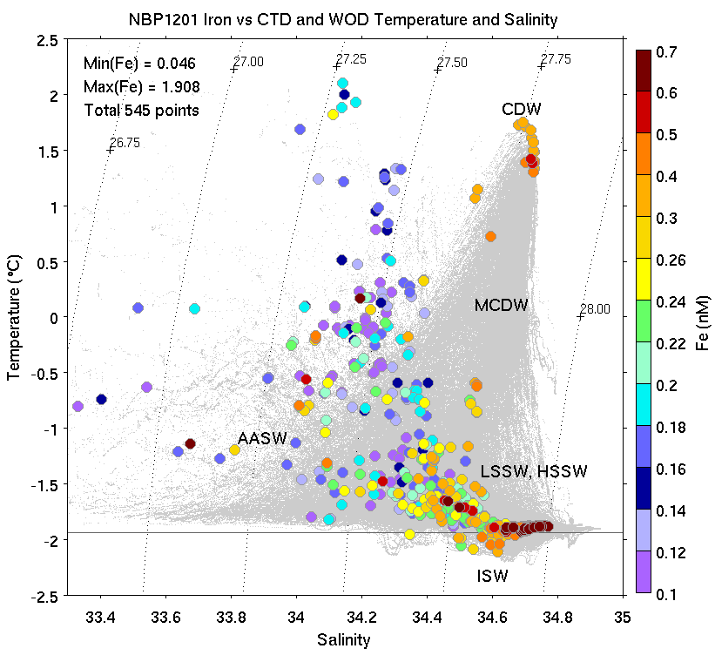
Toward an Iron Budget for the Ross Sea: PRISM Iron Observations

Slide 4
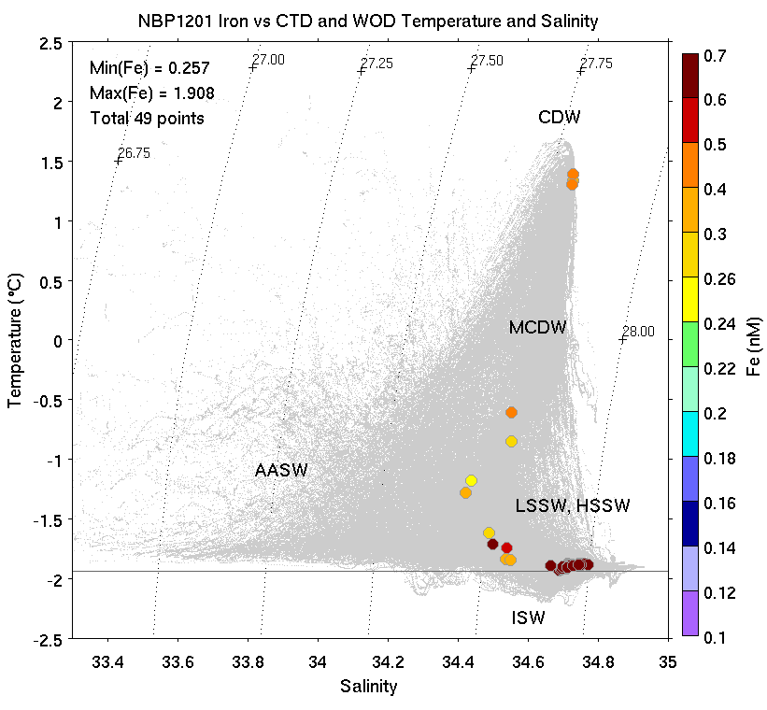
PRISM Iron Observations:
Deepest Sample at Every Cast

Slide 5
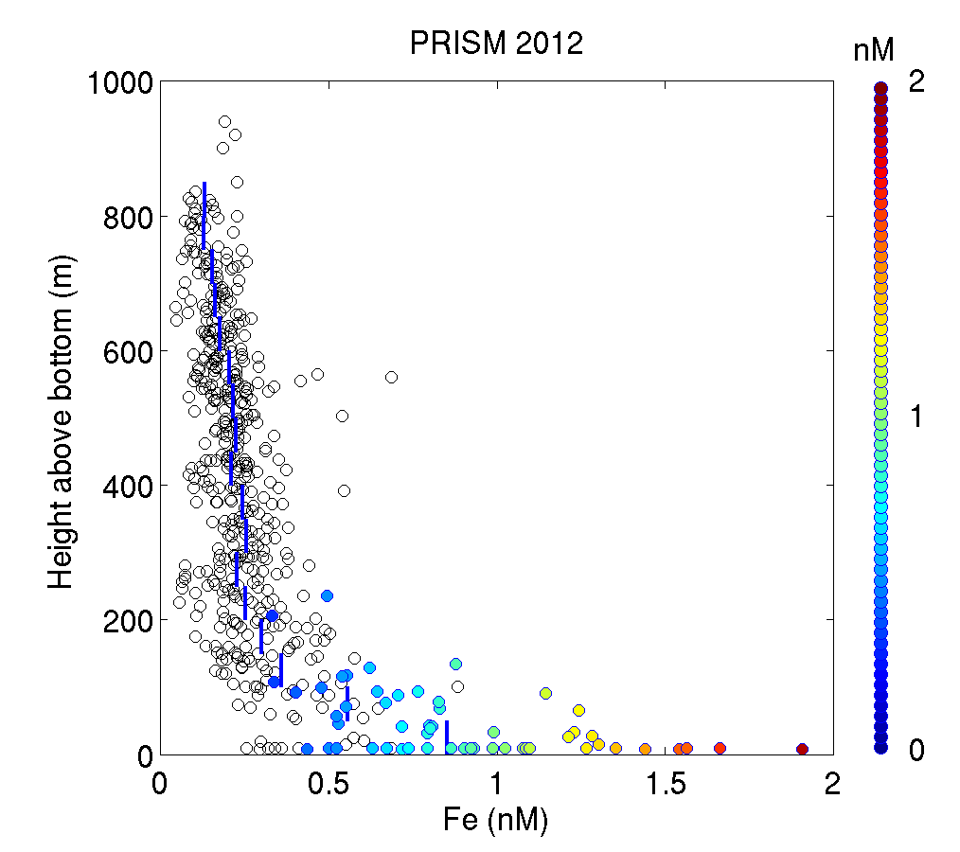
Composite profiles of dFe
Colored circles: samples within benthic nepheloid layer

Slide 6
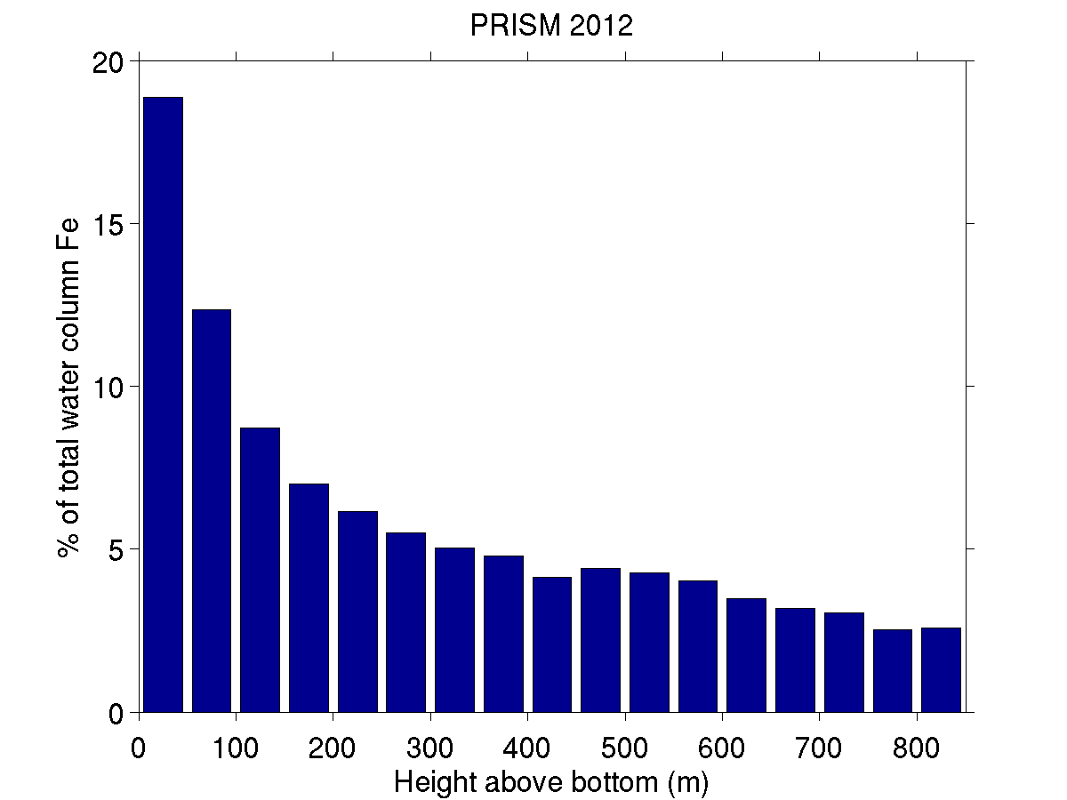
>30% of dFe resides within 100 mab

Slide 7
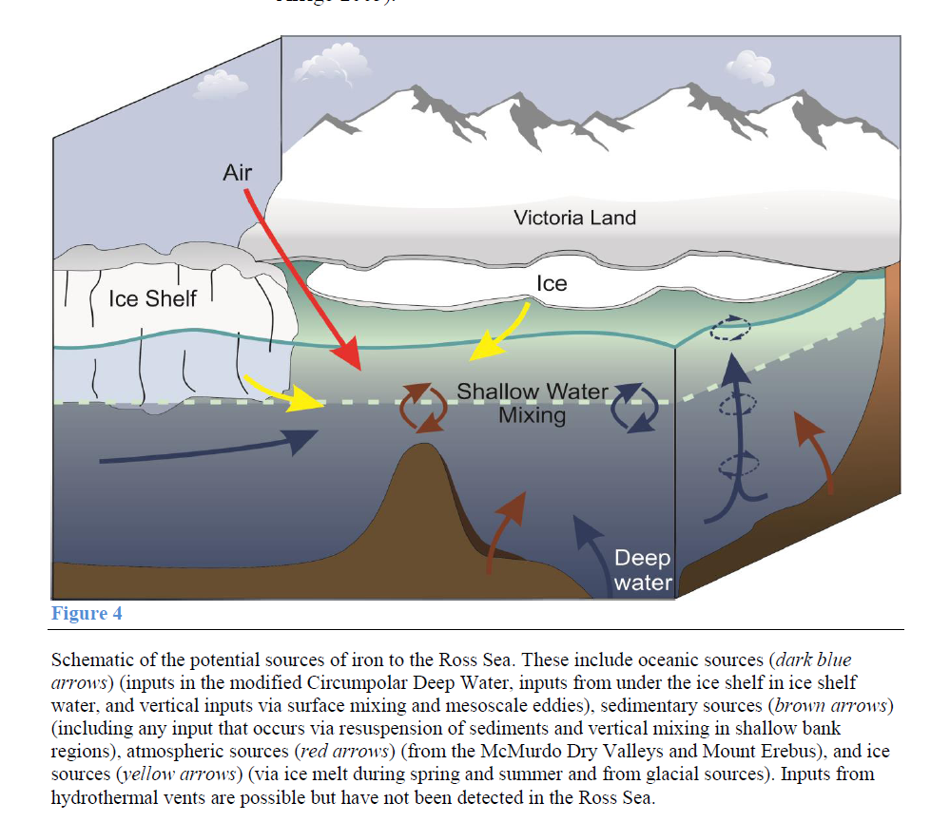
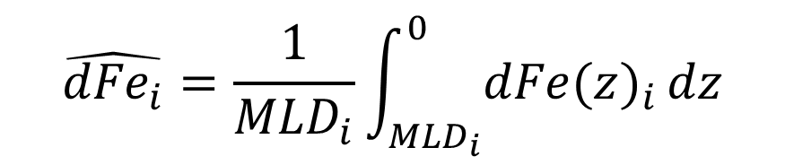
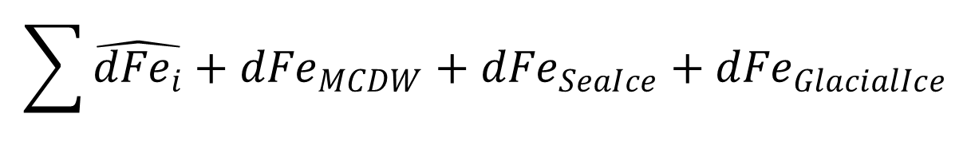

Toward an iron budget for the Ross Sea
Observations:
Winter Reserve:
Iron Sources:
$${dFe(z)}_{i}$$
Smith et al. (in press)
$$\hat{{dFe}_{i}}=\frac{1}{{MLD}_{i}}\int_{{MLD}_{i}}^{0}{{dFe(z)}_{i}}dz$$
$$\sum{\hat{{dFe}_{i}}+{dFe}_{MCDW}+{dFe}_{SeaIce}+{dFe}_{GlacialIce}}$$

Slide 8
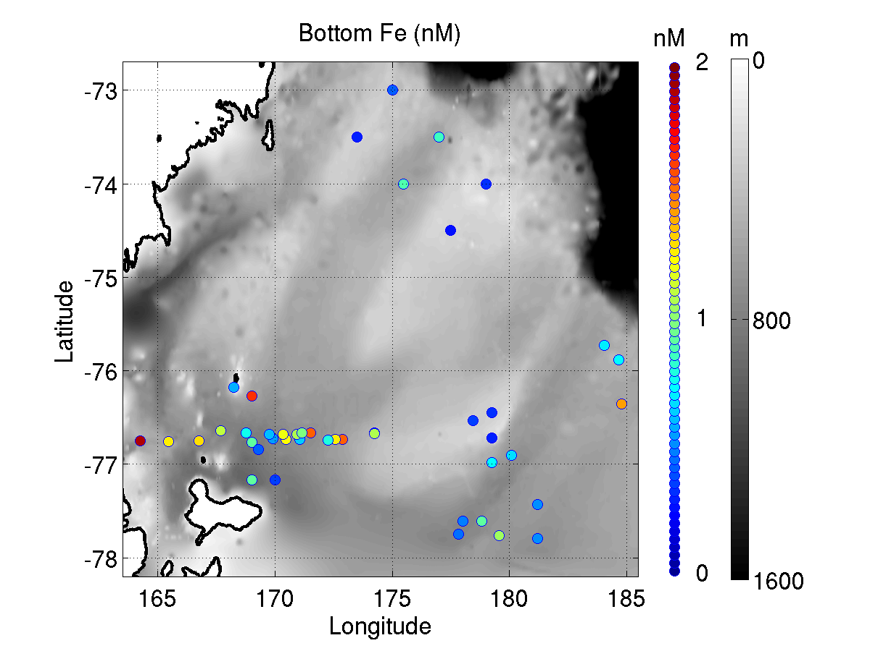
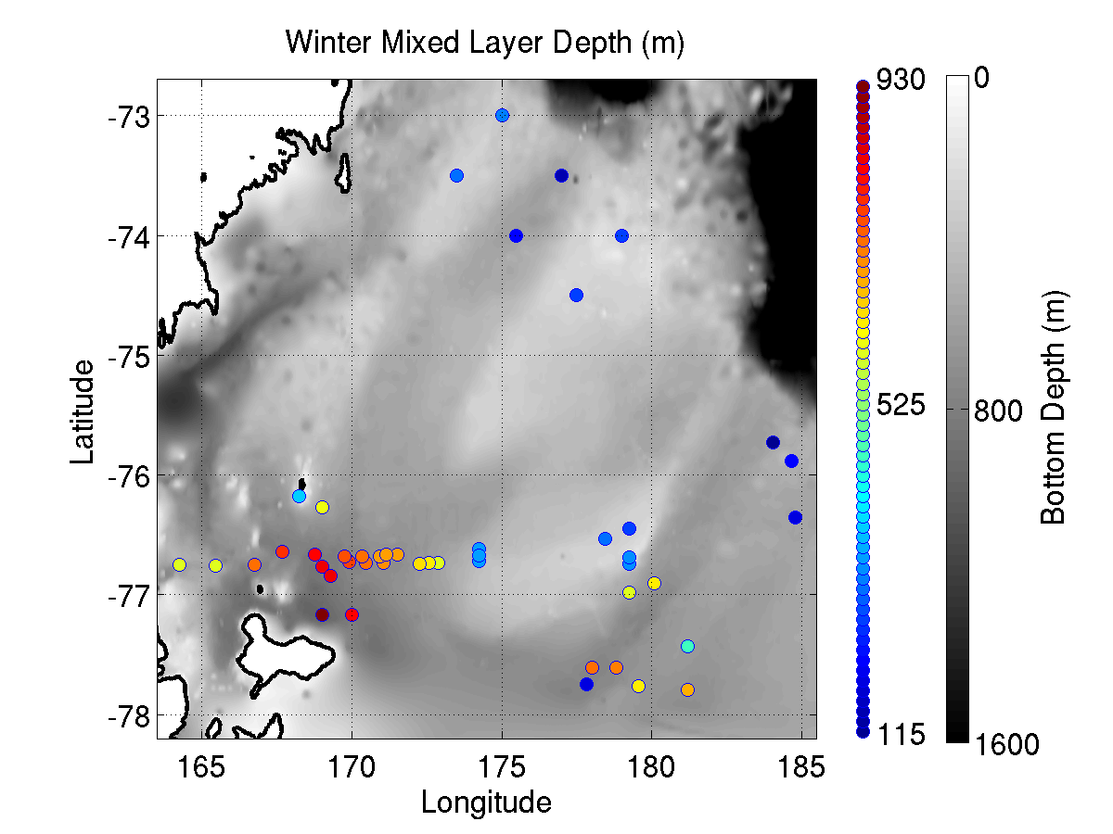
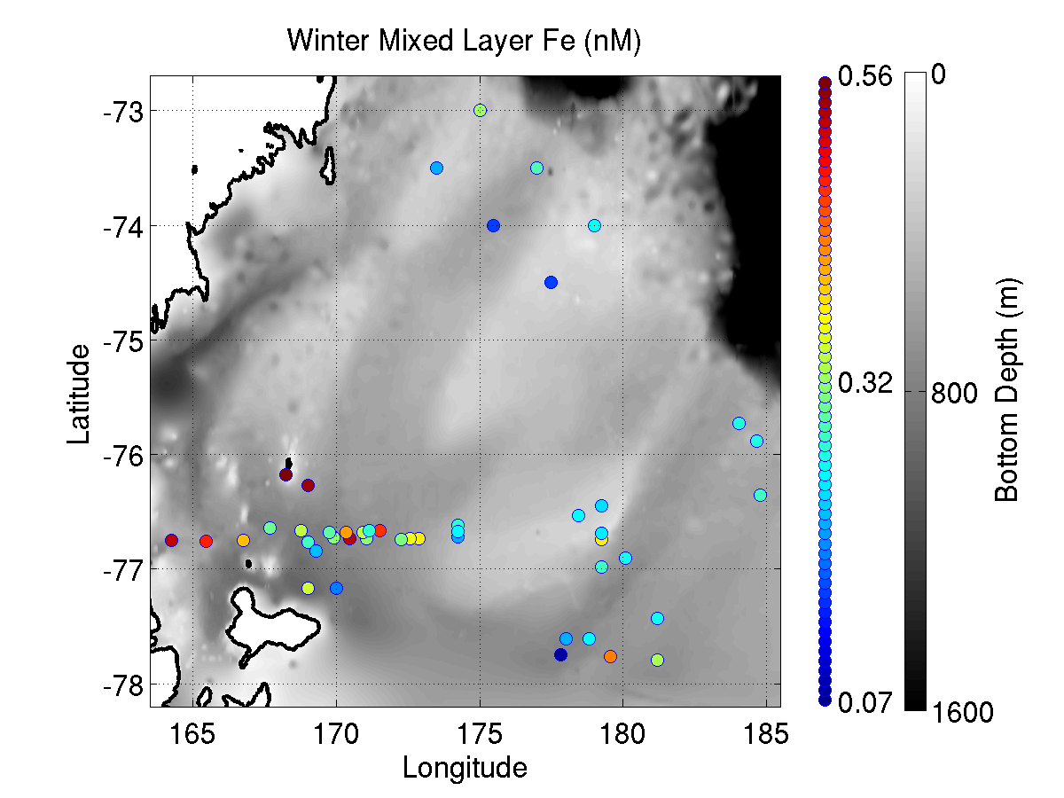
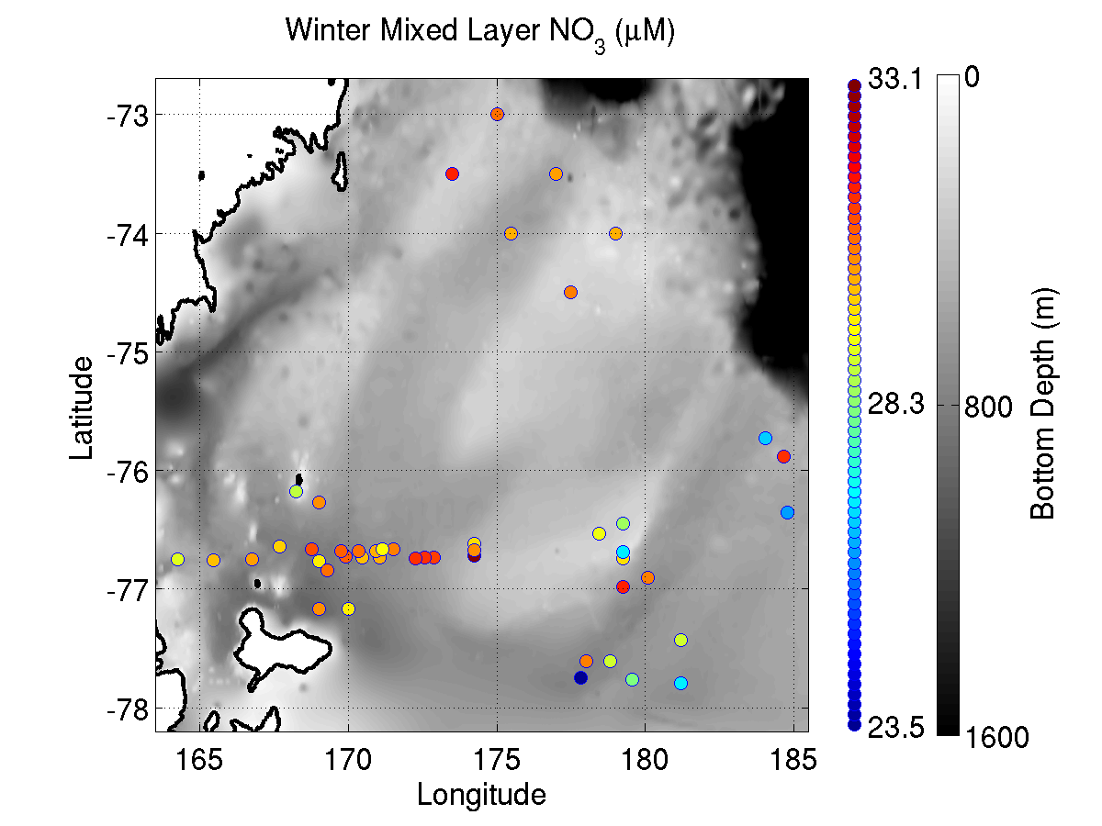
Winter reserves
Bottom Fe
Winter MLD
Winter ML Fe
Winter ML NO₃

Slide 9
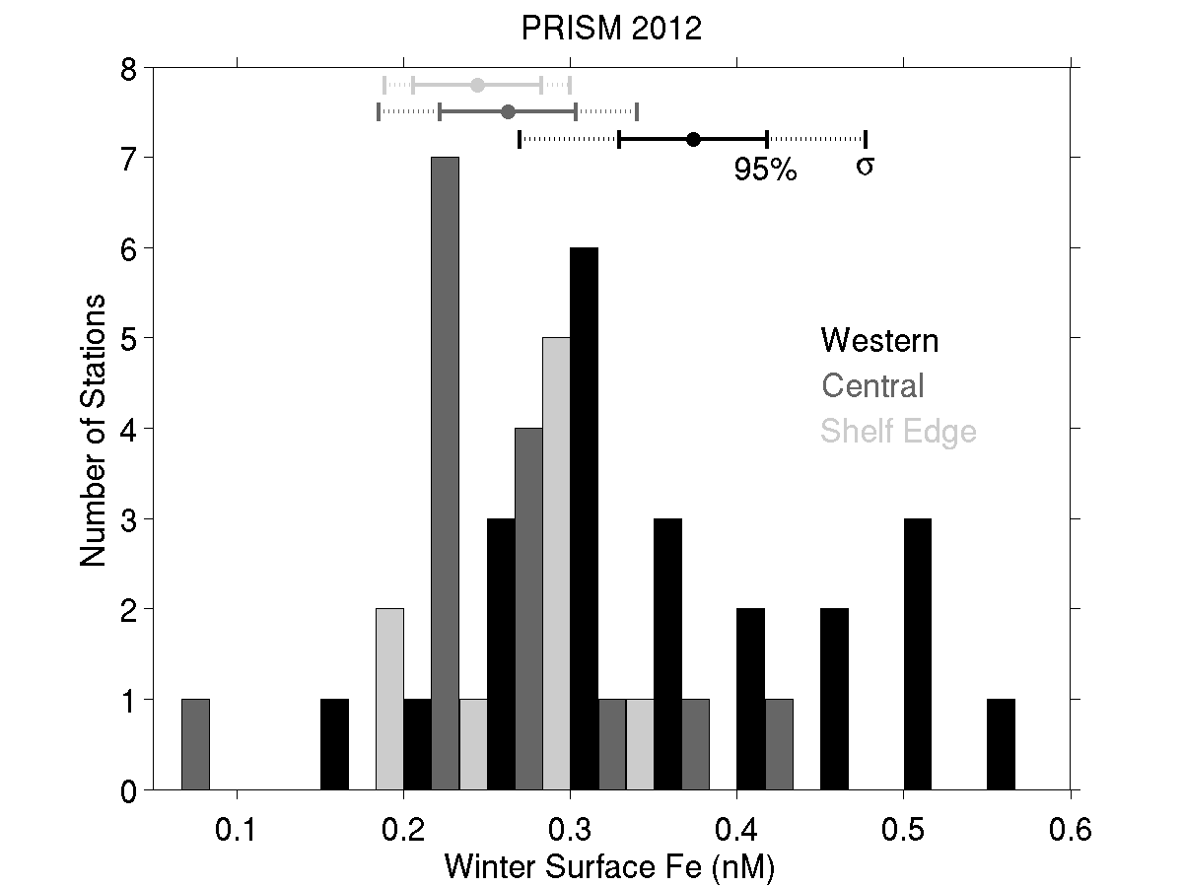
Fe winter reserve

Slide 10
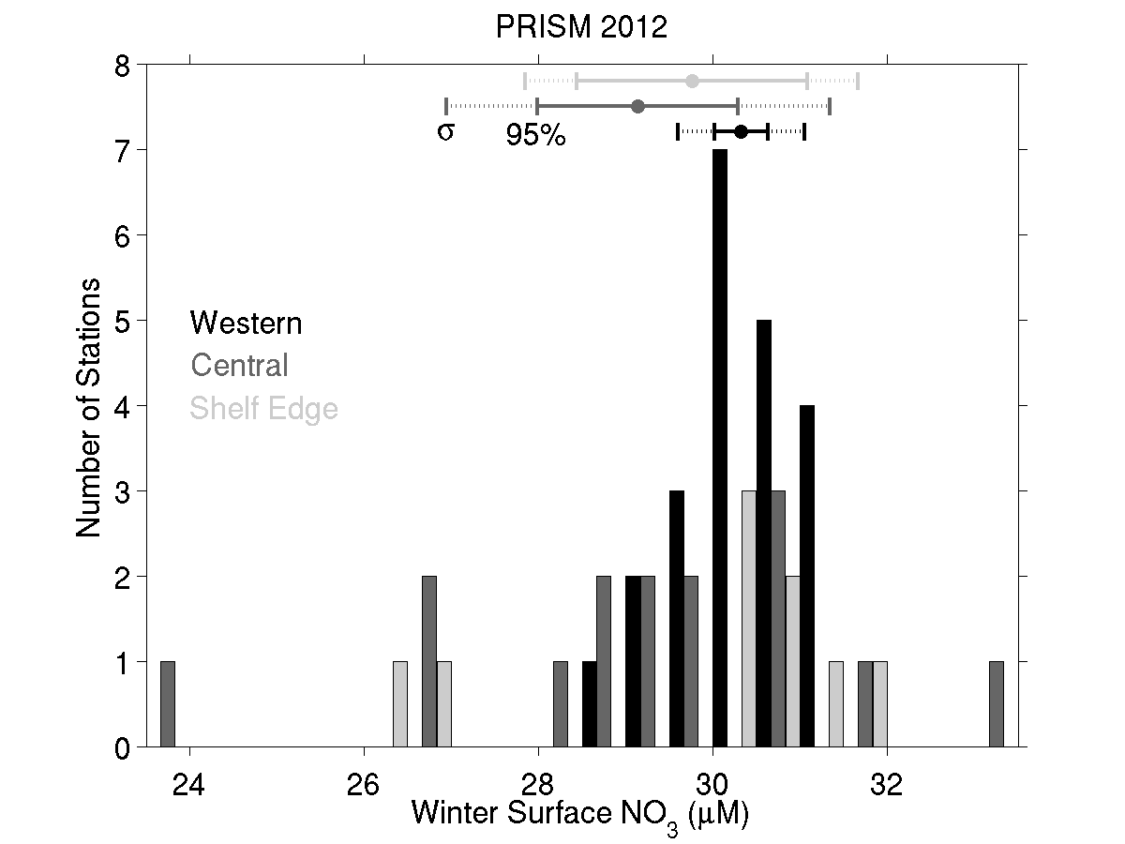
NO₃ winter reserve

Slide 11
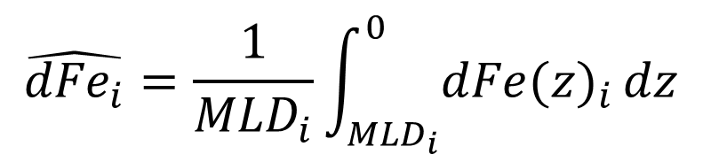
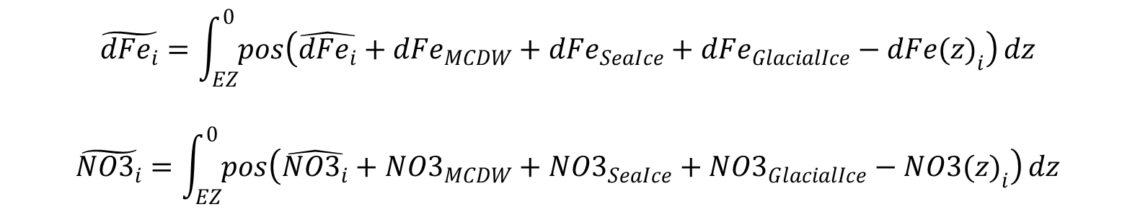
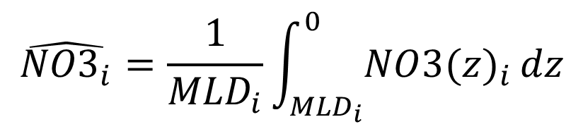
Calculating drawdown ratios
Winter reserves
Apparent drawdown
$$\hat{{dFe}_{i}}=\frac{1}{{MLD}_{i}}\int_{{MLD}_{i}}^{0}{{dFe(z)}_{i}}dz$$
$$\hat{{NO3}_{i}}=\frac{1}{{MLD}_{i}}\int_{{MLD}_{i}}^{0}{{NO3(z)}_{i}}dz$$
$$\tilde{{dFe}_{i}}=\int_{EZ}^{0}{pos\left({\hat{{dFe}_{i}}+{dFe}_{MCDW}+{dFe}_{SeaIce}+{dFe}_{GlacialIce}−dFe(z)}_{i}\right)}dz$$
$$\tilde{{NO3}_{i}}=\int_{EZ}^{0}{pos\left({\hat{{NO3}_{i}}+{NO3}_{MCDW}+{NO3}_{SeaIce}+{NO3}_{GlacialIce}−NO3(z)}_{i}\right)}dz$$

Slide 12
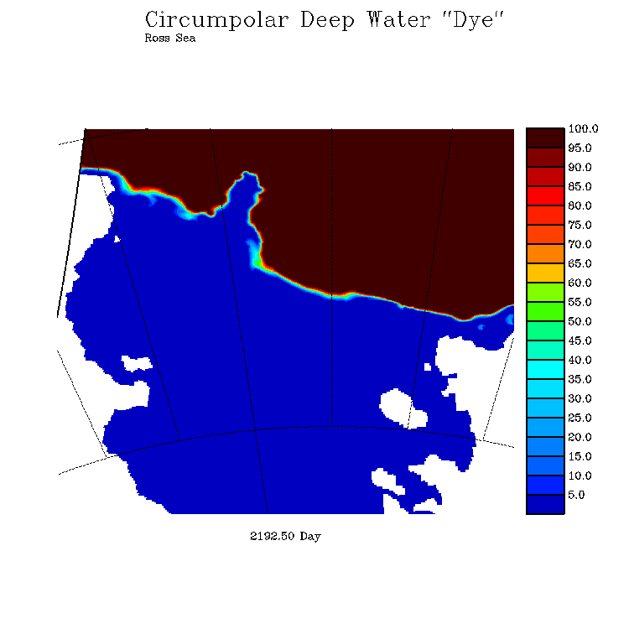
Simulation of CDW penetration onto the continental shelf
5 km
(1.5 km)
End-member concentrations
dFe = 0.27 ± 0.05 nM
NO₃ = 29.9 ± 1.4 µM
Mike Dinniman
Stefanie Mack
ODU

Slide 13
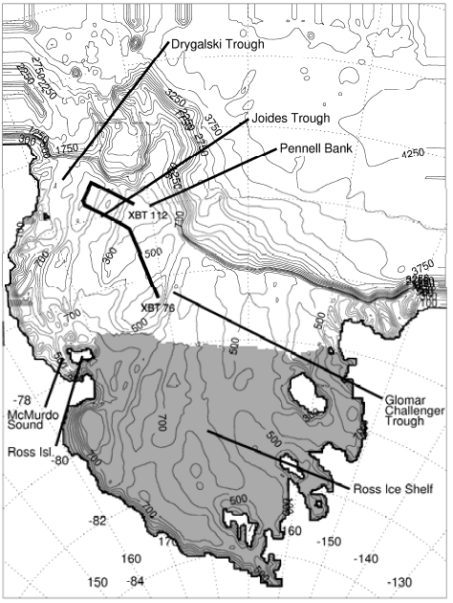
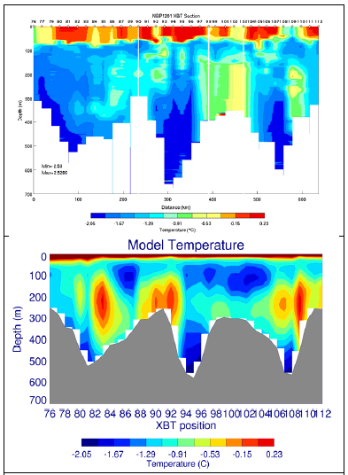
Evaluation of MCDW transport

Slide 14
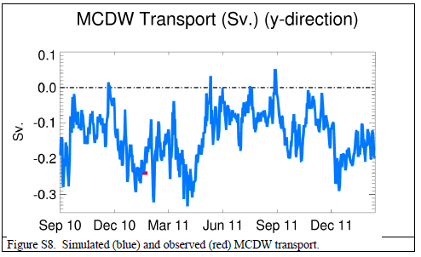
Evaluation of MCDW transport

Slide 15
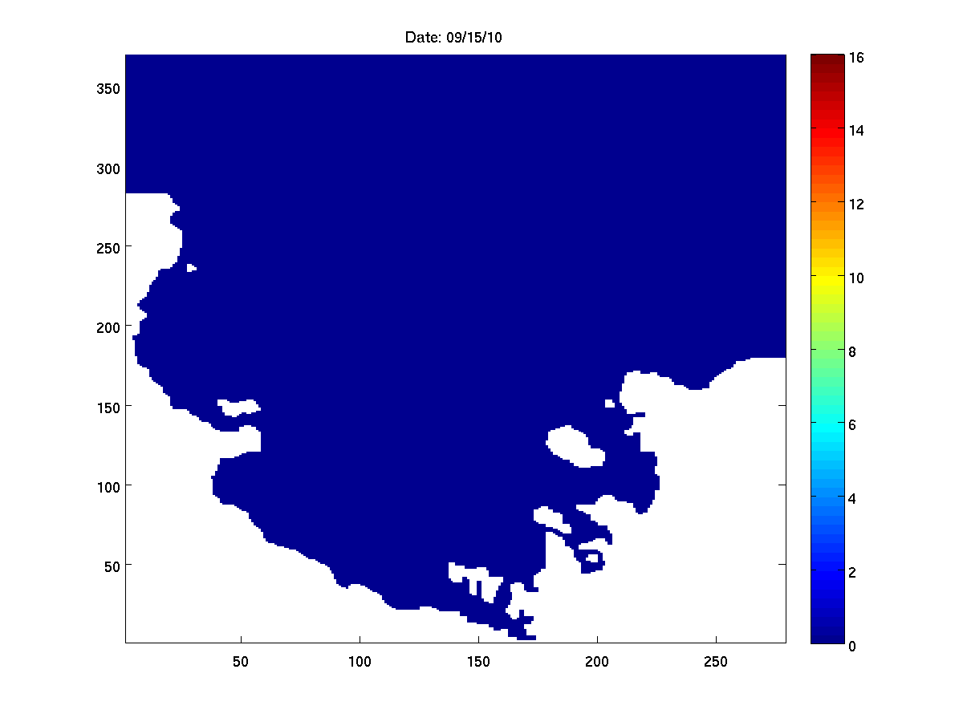
Simulation of sea ice melt
End-member concentrations
dFe = 10 ± 5 nM
NO₃ = 0
Mike Dinniman
Stefanie Mack
ODU

Slide 16
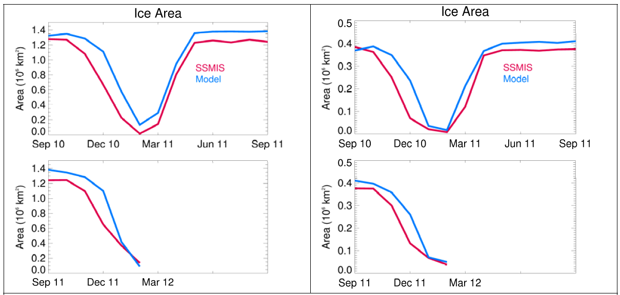
Evaluation of the sea ice model

Slide 17
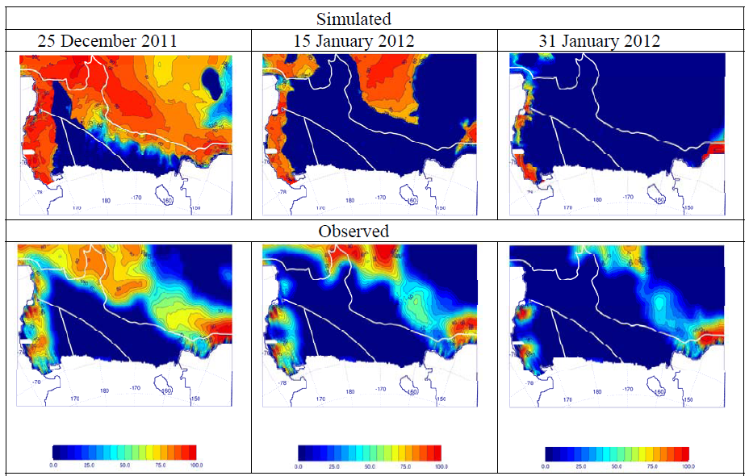
Evaluation of the sea ice model

Slide 18

Simulation of Glacial Ice Melt
End-member concentrations
dFe = 29 ± 21 nM
NO₃ = 0.0
Mike Dinniman
Stefanie Mack
ODU

Slide 19
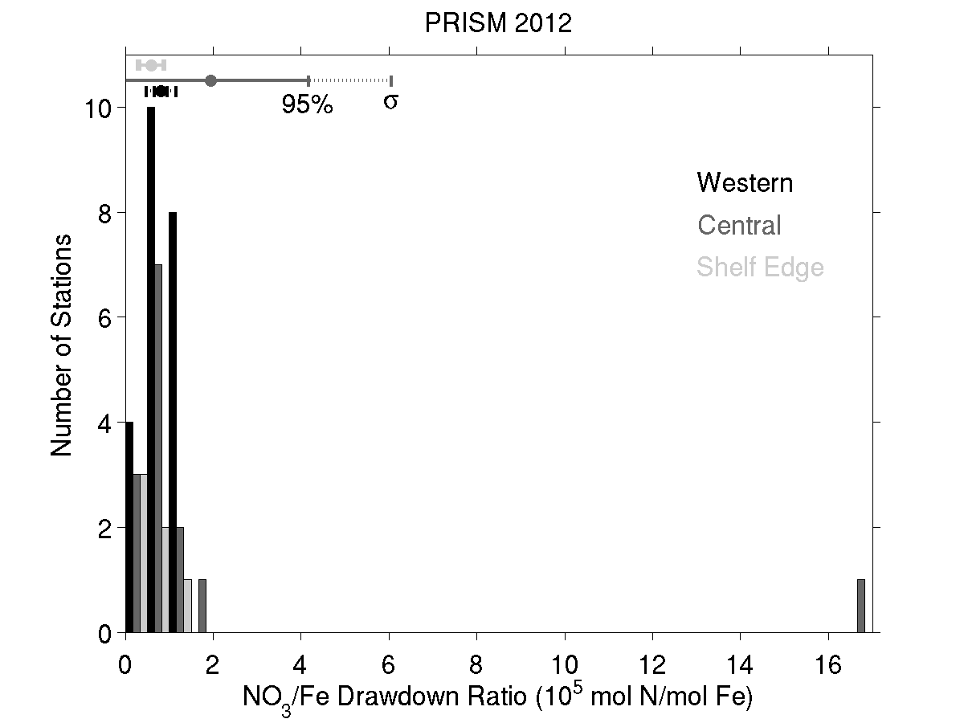
NO₃:Fe drawdown ratio
Mean NO₃:Fe drawdown ratio: 1.2 x 10⁵ mol N / mol Fe
Including inputs from MCDW, sea ice, glacial ice:
59,000 ± 22,000 mol N / mol Fe
Using Redfield to convert to carbon units:
390,000 ± 150,000 mol C / mol Fe
Algal C:Fe assimilation ratios
Feng et al. 2000 250,000-400,000
Twining et al. 2004 166,000-390,000
Boyd et al. 2012 5000-450,000
Strzepek et al. 2011,2012 10,000-2,500,000
Notes:
Need to verify 1.2e5; that is probably the old mld from the non-tidally resolving run.

Slide 20
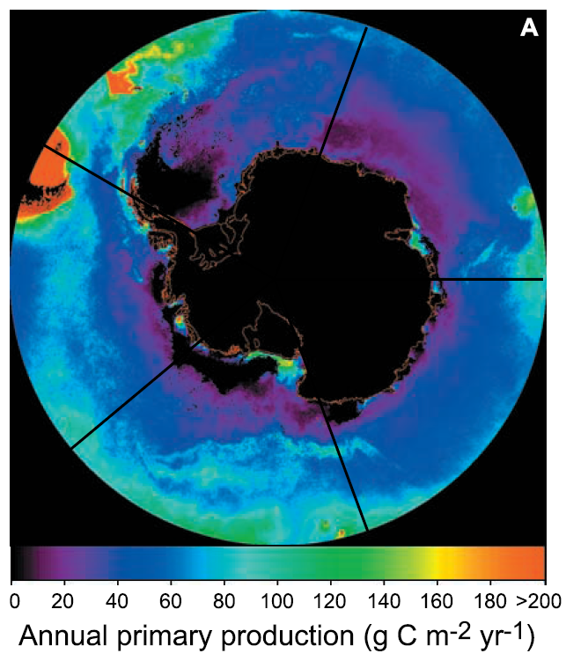
Toward an iron budget for the Ross Sea: estimating demand
Arrigo et al. 2008 satellite-based estimate of primary productivity, updated using MODIS 2002-2013:
8.8 mol C m⁻² yr⁻¹
Using an f-ratio of 0.5
Asper and Smith 1999
Sweeney et al. 2000
Long et al. 2011
Annual new production: 4.4 mol C m⁻² yr⁻¹
Assuming C:Fe of 390,000: 8.8 µmol Fe m⁻² yr⁻¹

Slide 21
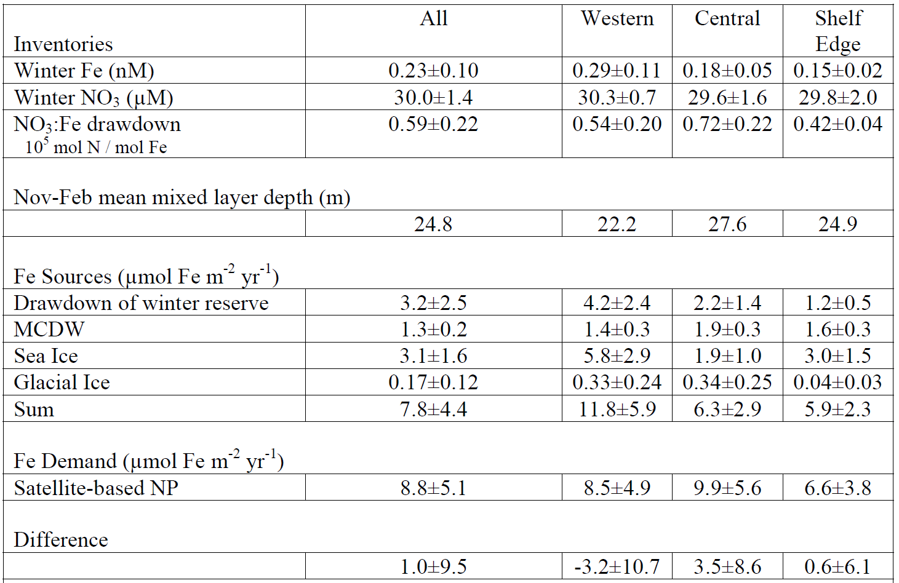
Iron Supply and Demand in the Ross Sea

Slide 22
Conclusions
Ross Sea iron supply and demand are in approximate balance
Winter reserve, sea ice are the largest sources (80%)
Benthos plays a large role in winter reserve
MCDW also a significant contributor (20%)
Glacial ice input negligible
(c.f. Amundsen Sea, Pine Island Glacier)
Heterogeneity in iron supply processes along the Antarctic continental margin
Notes:
Atmospheric sources
Extraterrestrial sources

Slide 23
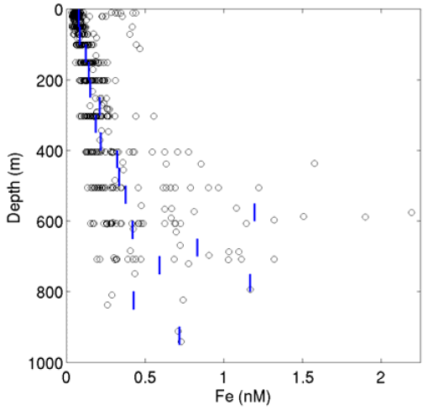
PRISM Composite Fe profile

Slide 24
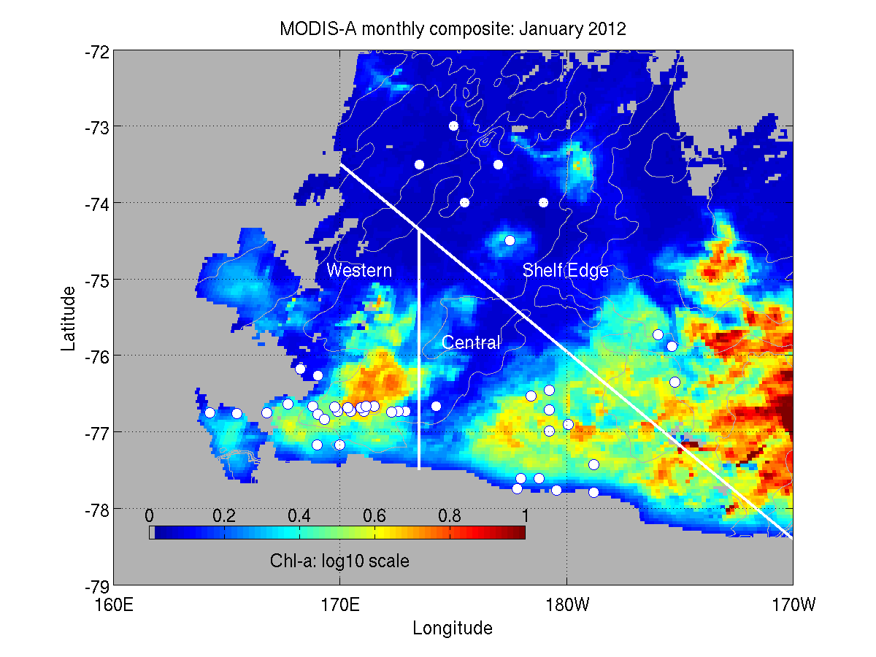
Regional subdomains
MODIS-A monthly composite: January 2012

Slide 25
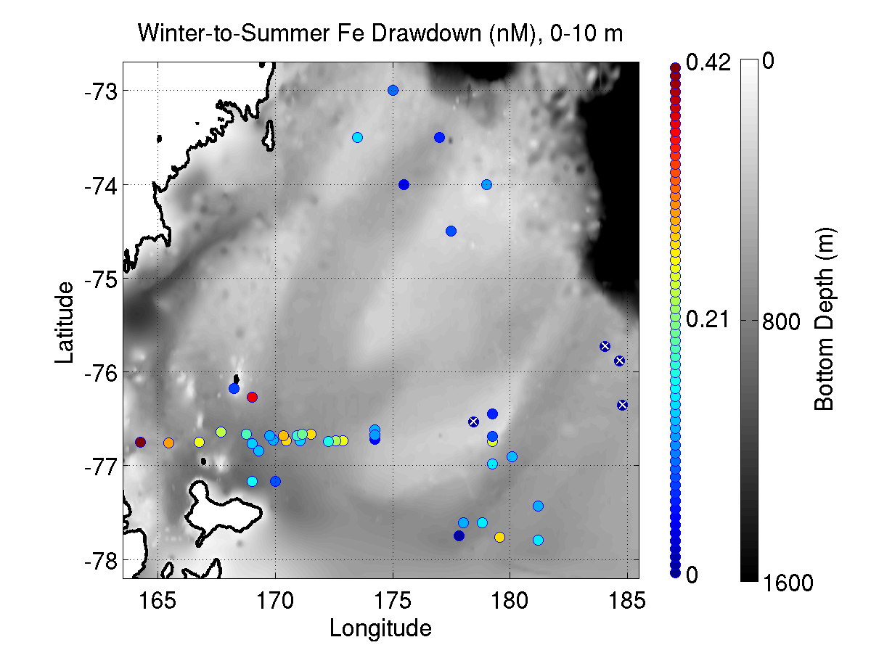
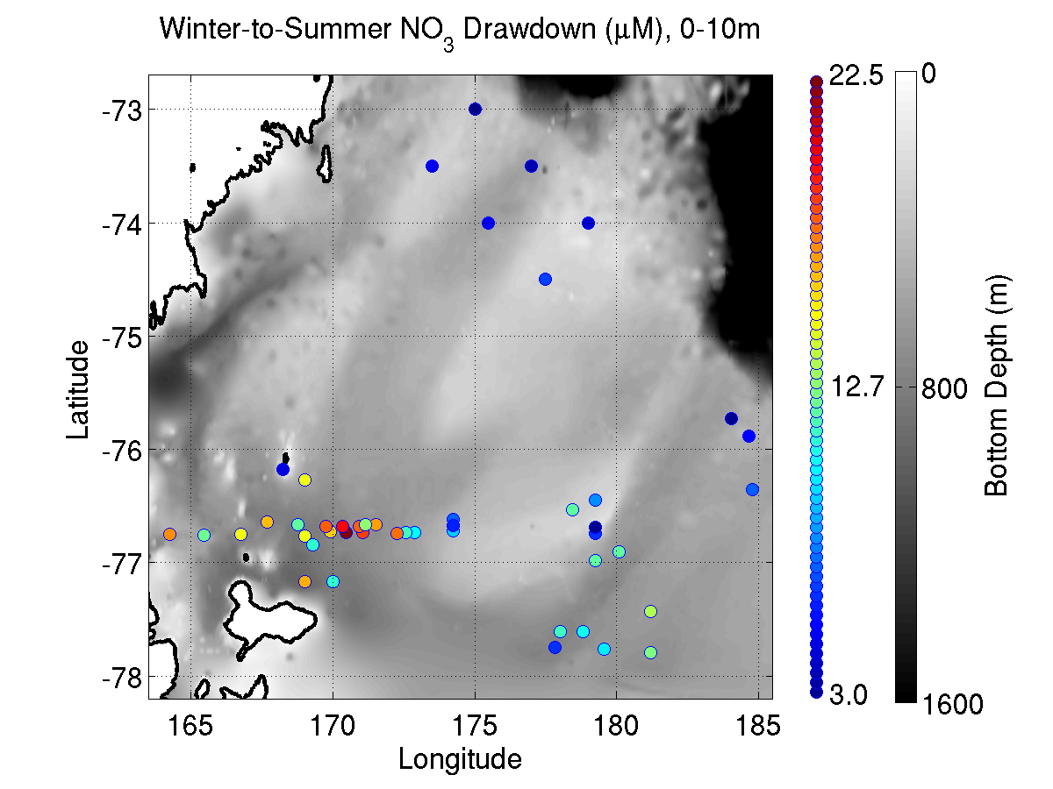
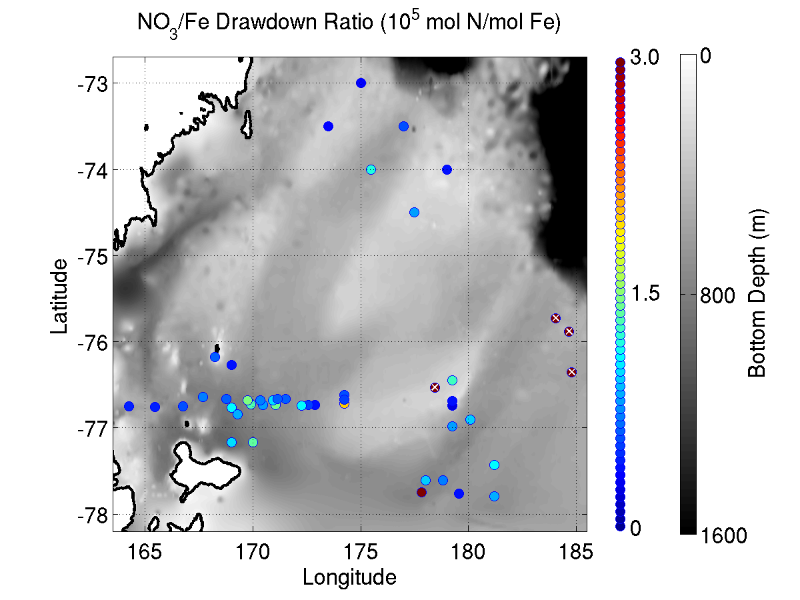
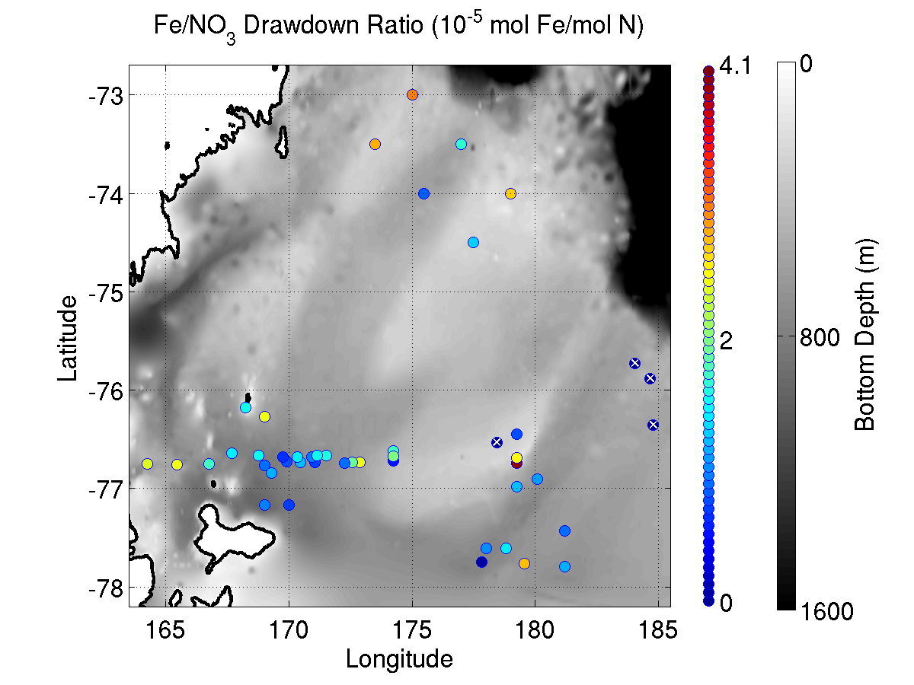
Drawdown
0-10m
Fe drawdown NO₃ drawdown
NO₃:Fe drawdown (10⁵ mol:mol) Fe:NO₃ drawdown (10⁵ mol:mol)

Slide 26
End

Slide 27
Iron Supply and Demand in the Ross Sea

Slide 28
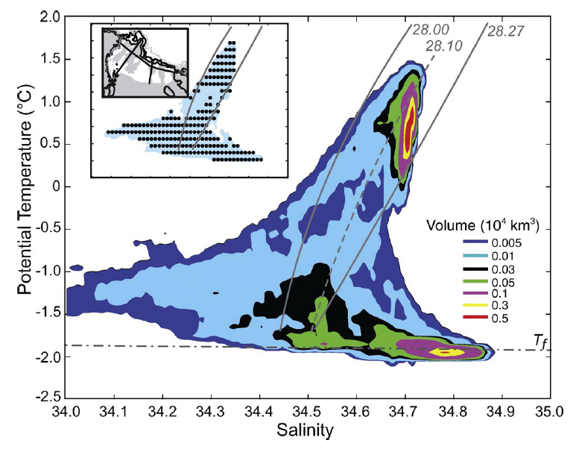
Orsi water mass volumes

Slide 29
Conceptual model of Fe sources to the Ross Sea
Smith et al. (in press) Annual Reviews of Marine Science

