Slide 1
Ross Sea circulation modeling for PRISM
Mike Dinniman
Center for Coastal Physical Oceanography
Old Dominion University
November 29, 2012

Slide 2
Outline
Ross Sea model and new PRISM run
Including three dye tracers for glacial melt, sea-ice melt and MCDW
Comparison of model glacial melt, sea-ice
extent and MCDW transport, location and
temperature to observations
Model dissolved Fe estimates from glacial melt,
sea-ice melt and MCDW
Summary
Notes:
Picked model/obs comparisons to give confidence that the model is doing reasonable things with respect to the dye tracers we care about.

Slide 3
Ross Sea Model
ROMS: 5 km horizontal resolution, 24 levels (see other talks on resolution issues)
Ice shelves (mechanical and thermodynamic)
Dynamic sea-ice
Different wind forcing, but typically either from Antarctic Mesoscale Prediction System (AMPS) or ERA-Interim
Lateral boundary conditions from WOA, OCCAM and SSM/I ice concentrations
Bathymetry from BEDMAP and Davey
Experiments w/ dye representing CDW
No tides in this version (coming soon…)
Notes:
ROMS: Regional Ocean Modeling System: hydrostatic finite difference OGCM with a terrain following vertical coordinate. BEDMAP (ice thickness and subglacial topo model of the Ant.). Explain AMPS. Note that 5km isn’t really eddy resolving over the shelf. Pierre to talk about the importance of grid resolution and Stefanie to talk about our future plans wrt grid resolution.

Slide 4
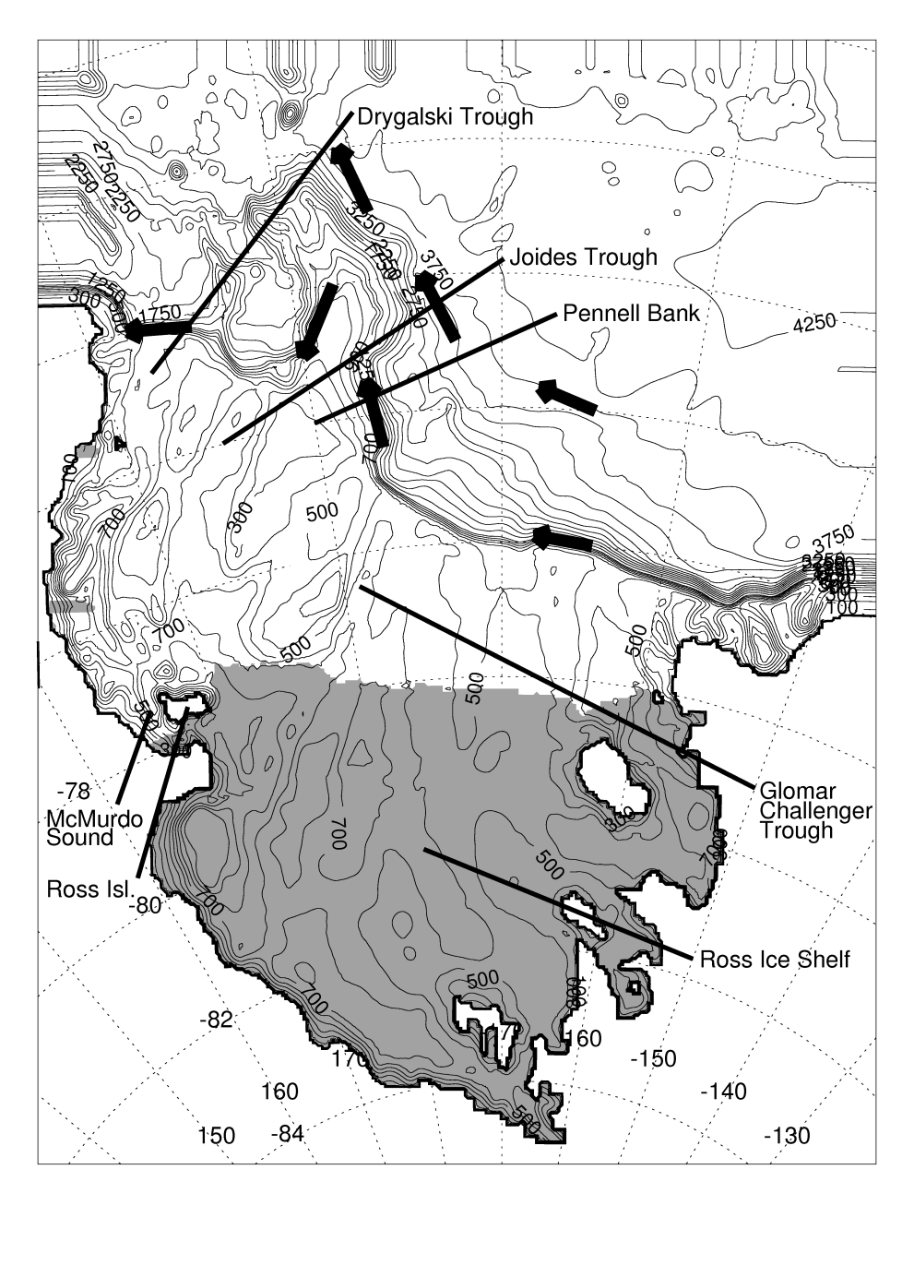
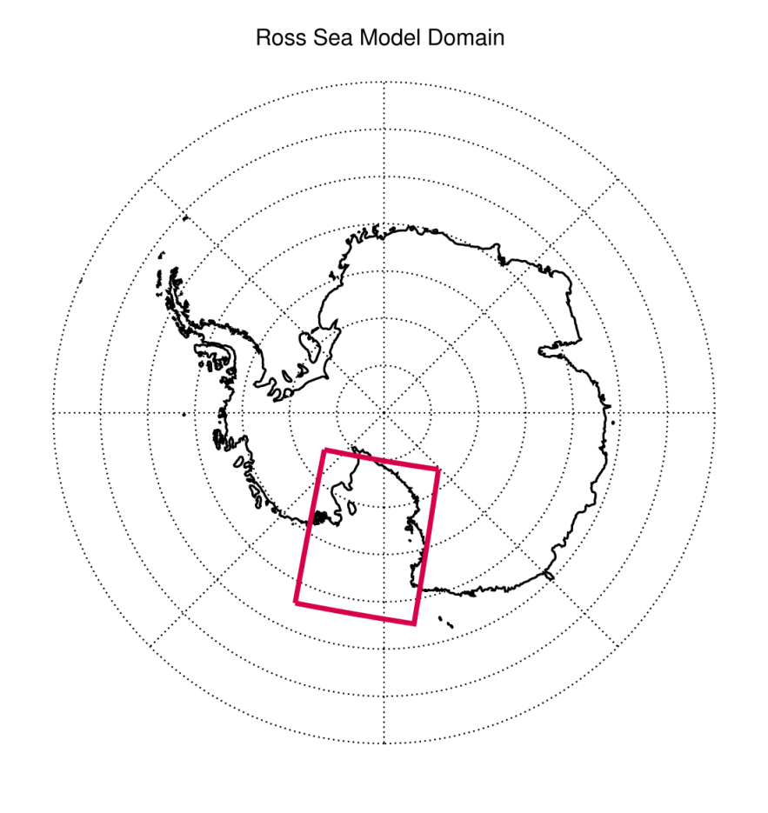
Notes:
Shaded areas represent Ice Shelves. Note that ACC is well north of this model domain and CDW comes around in the Ross Gyre and is a little cooler at the shelf break here compared to the WAP. Mention that the CDW at the shelf break here is LCDW?

Slide 5
New Model Run for PRISM
Sept. 15, 2010 – Feb. 29, 2012
Model fields saved every 5 days for entire run and every day from Sept. 15, 2011 (finer temporal resolution available upon request)
Forced with 6-hourly winds and air temperatures from the new higher resolution (0.75°) ERA-Interim product
Had to switch to coarser (25-km) SSMIS sea-ice from AMSR-E (12.5-km)
Fixed small bug in the sea-ice code
Two new dye tracers: Ice shelf meltwater and sea-ice meltwater
Notes:
AMSR-E ice no longer available past October, 2011.

Slide 6
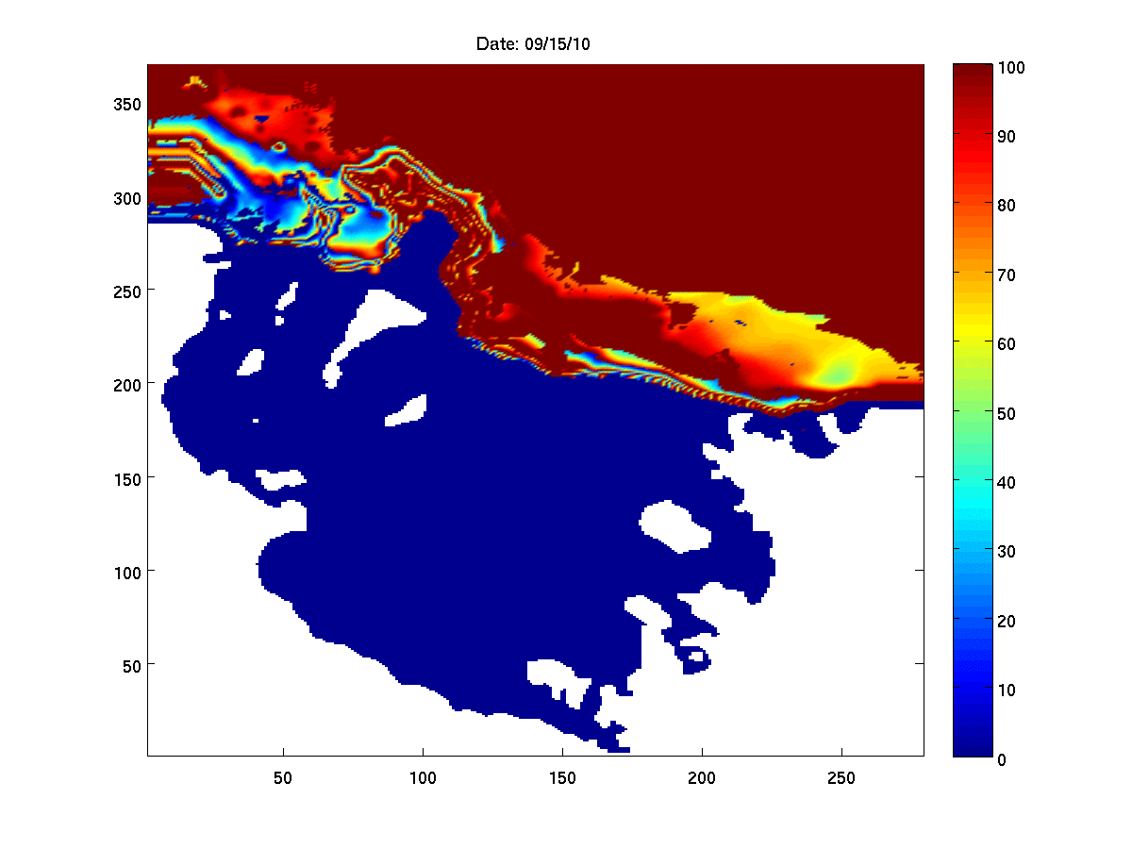
CDW dye at 300 m:
9/15/2010 – 2/22/2012

Slide 7
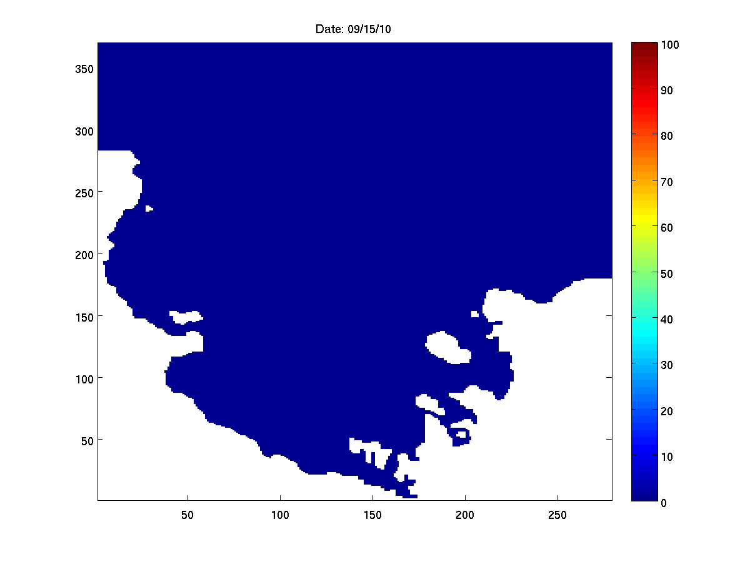
Glacial melt dye at 1 m:
9/15/2010 – 2/22/2012
Notes:
Little puffs of water from under RIS?

Slide 8
Sea-ice melt dye at 1 m:
9/15/2010 – 2/22/2012

Slide 9
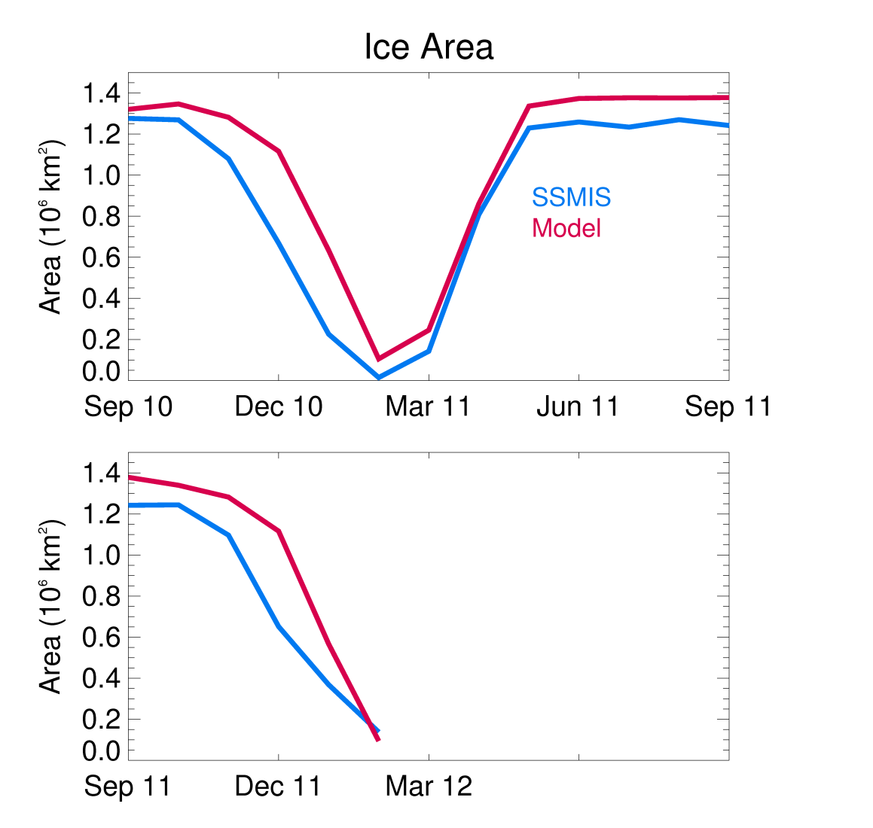
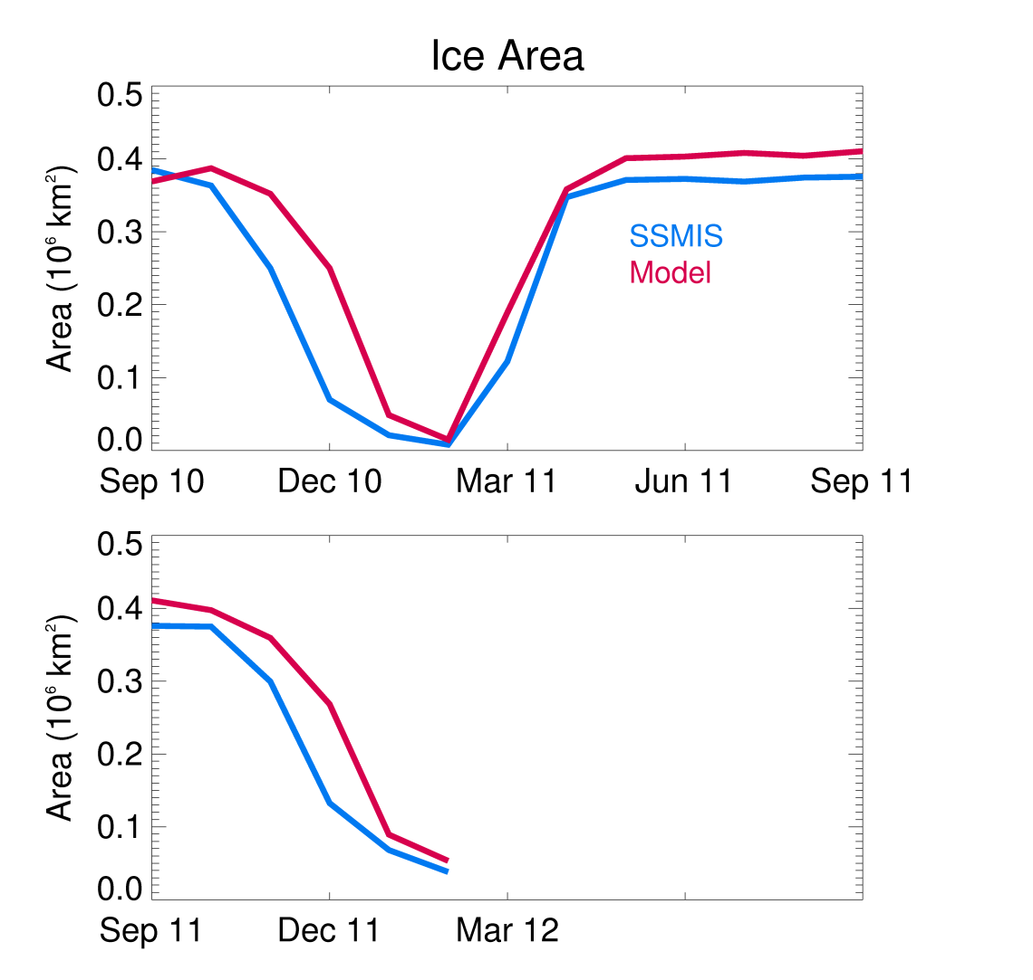
Entire model domain Continental shelf only
(r² = 0.91) (r² = 0.90)
Monthly modeled sea-ice area (red line) vs. SSMIS sea-ice (blue line) area.
Notes:
Start of the model/data comparisons. Integrated ice concentration times area. Model has a little too much ice at maximum extent (extent is the same, model just has slightly higher ice concentrations in the pack ice vs. SSMIS) and the initial melt is a little too slow. Does a good job in summer with timing and minimum area and bringing the ice back in fall.

Slide 10
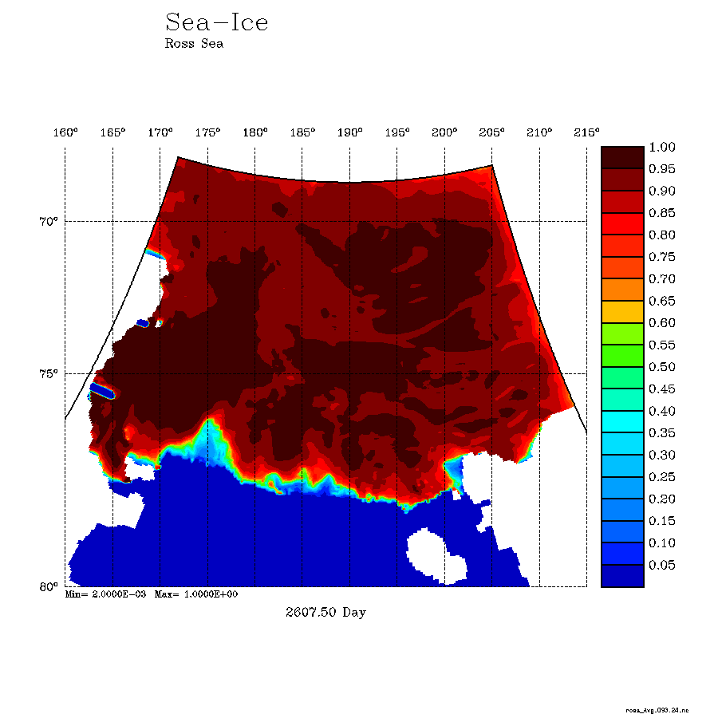
Notes:
Daily ice concentration over last 5.5 months of model run.

Slide 11
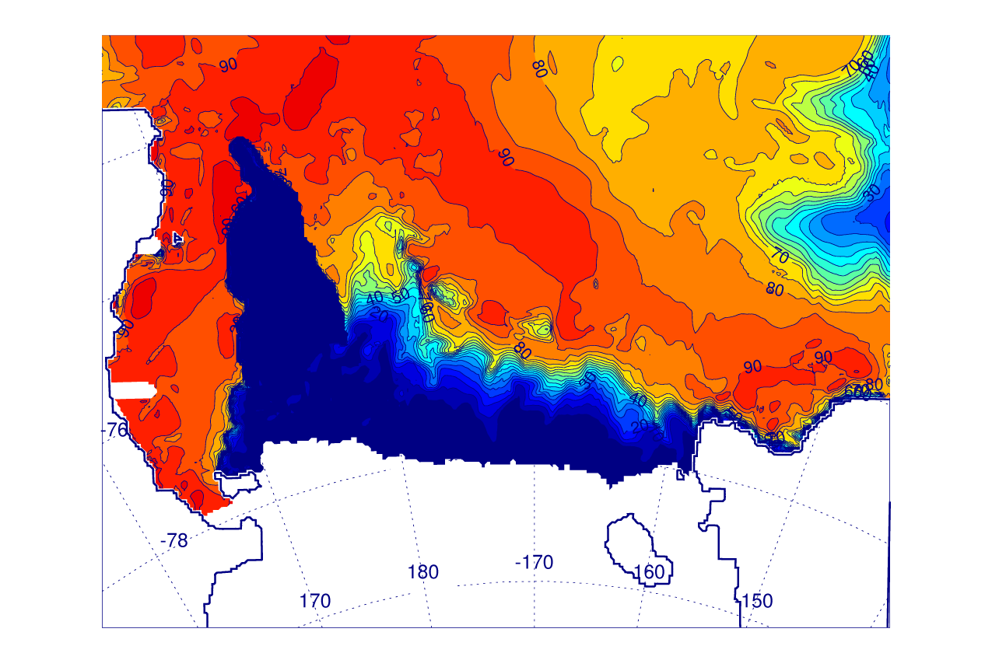
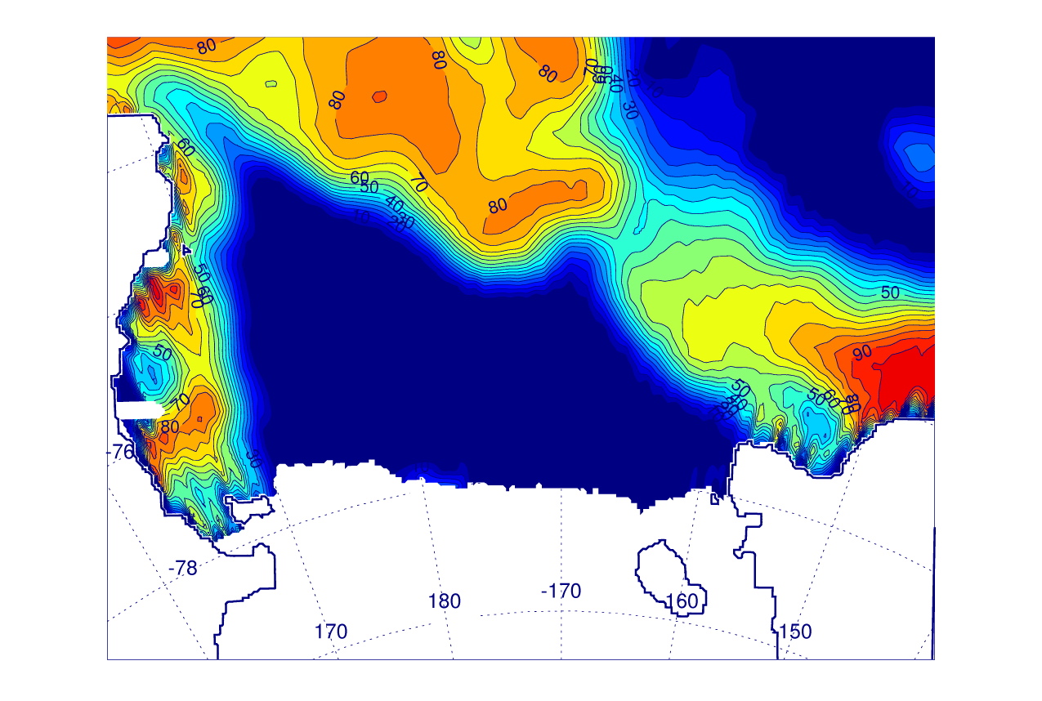
Model (top) vs. SSMIS (bottom) sea-ice concentration for 12/25/2011
Notes:
Modeled ice edge is sharper, but some of that is from interpolating the 25-km ice to the model grid. Too much ice in NE, but RSP looks pretty good.

Slide 12
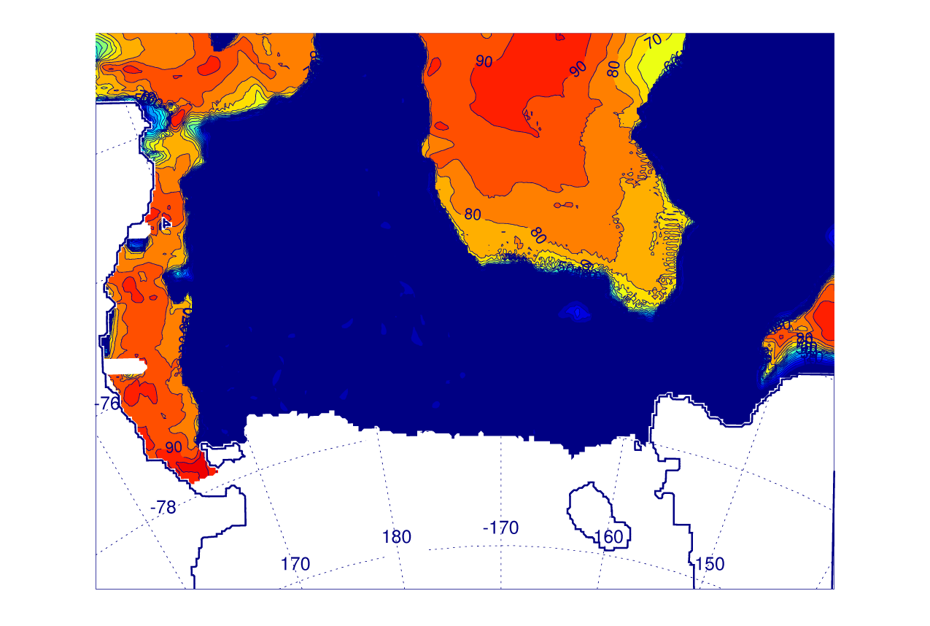
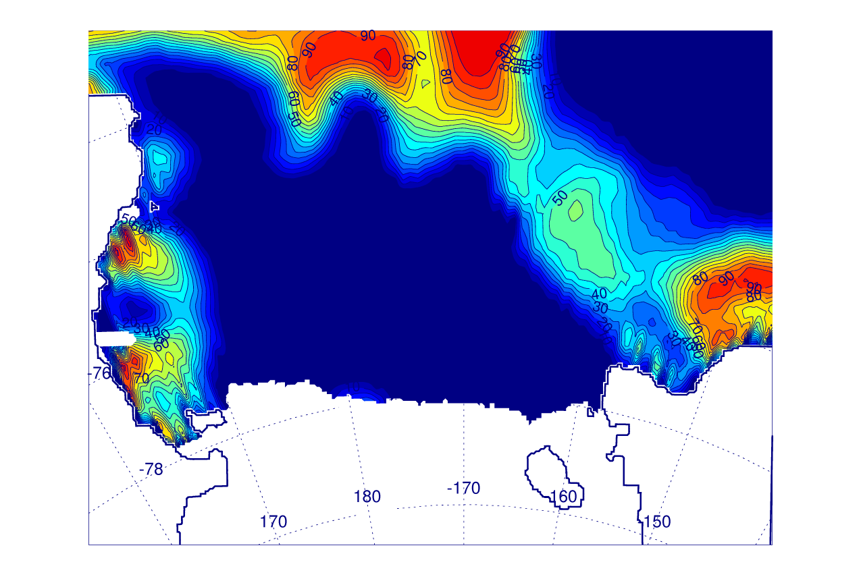
Model (top) vs. SSMIS (bottom) sea-ice concentration for 1/15/2012
Notes:
By now, RSP has opened up considerably in the model and obs.

Slide 13
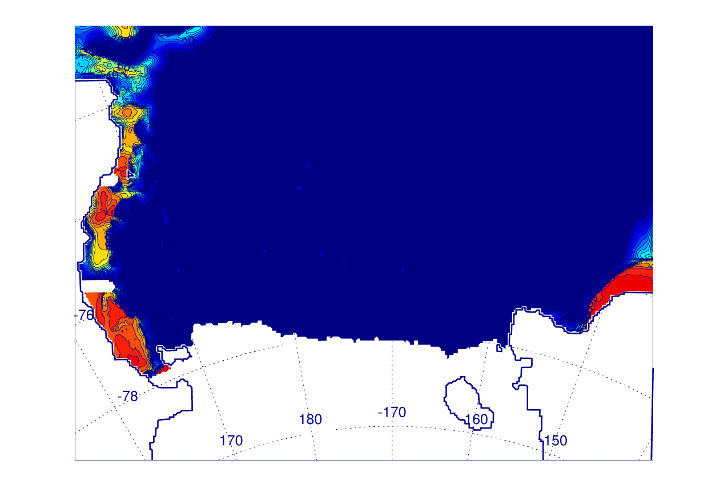
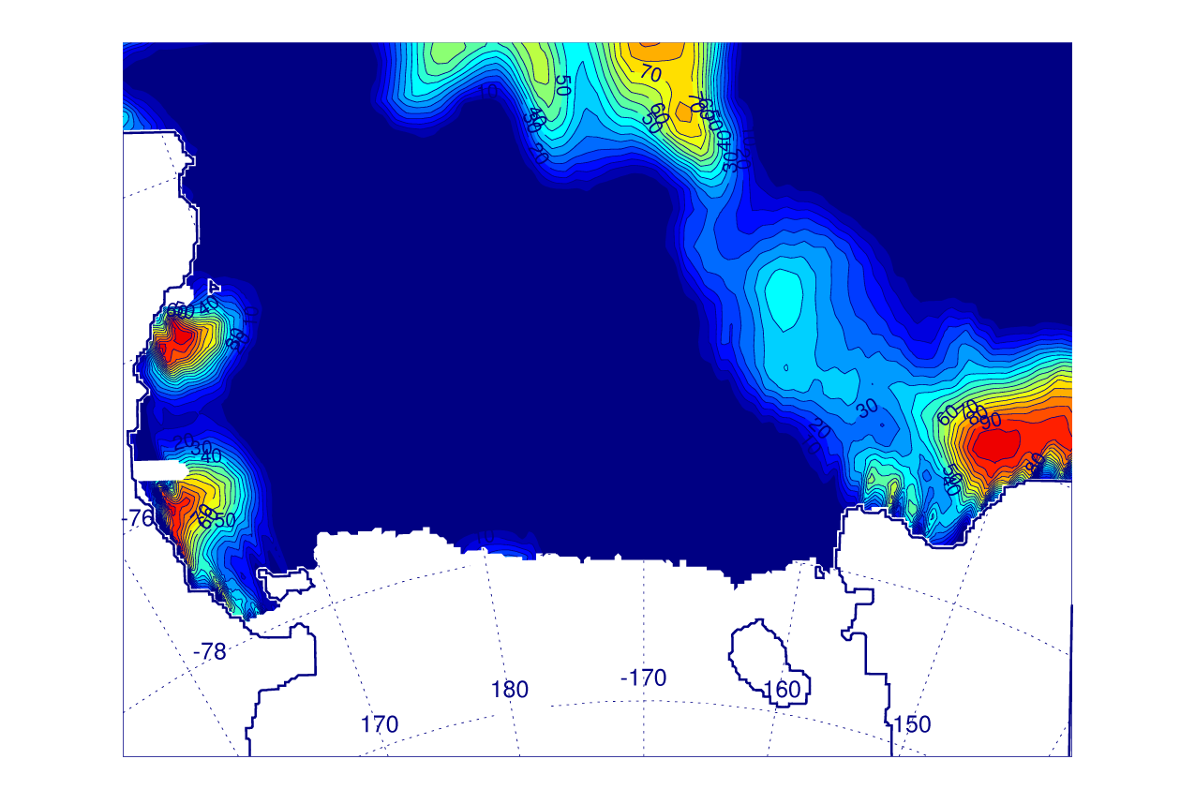
Model (top) vs. SSMIS (bottom) sea-ice concentration for 1/31/2012
Notes:
Obs. still have some ice along the eastern continental slope, but rest of area (no ice except along Victoria Land and east coast) looks pretty good.

Slide 14
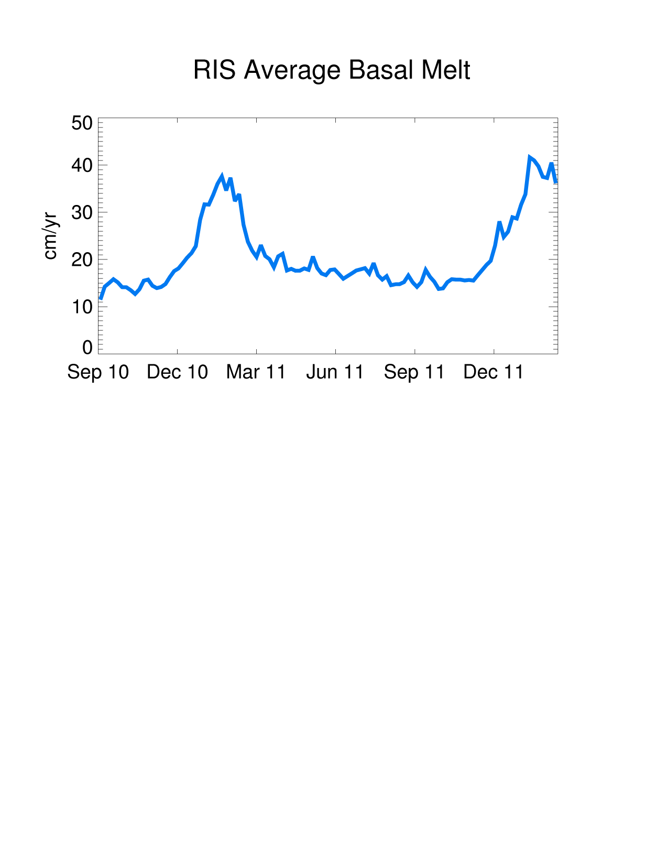
Ross Ice Shelf Basal Melt Rate
Model average (last year of run):
21 ± 7 cm/yr
or
89 ± 32 km³/yr
Observations:
30 – 95 km3/yr
Notes:
Note the big summer spike and that last year average will be higher number. Converted to km³/yr for reasons that will become clear…

Slide 15
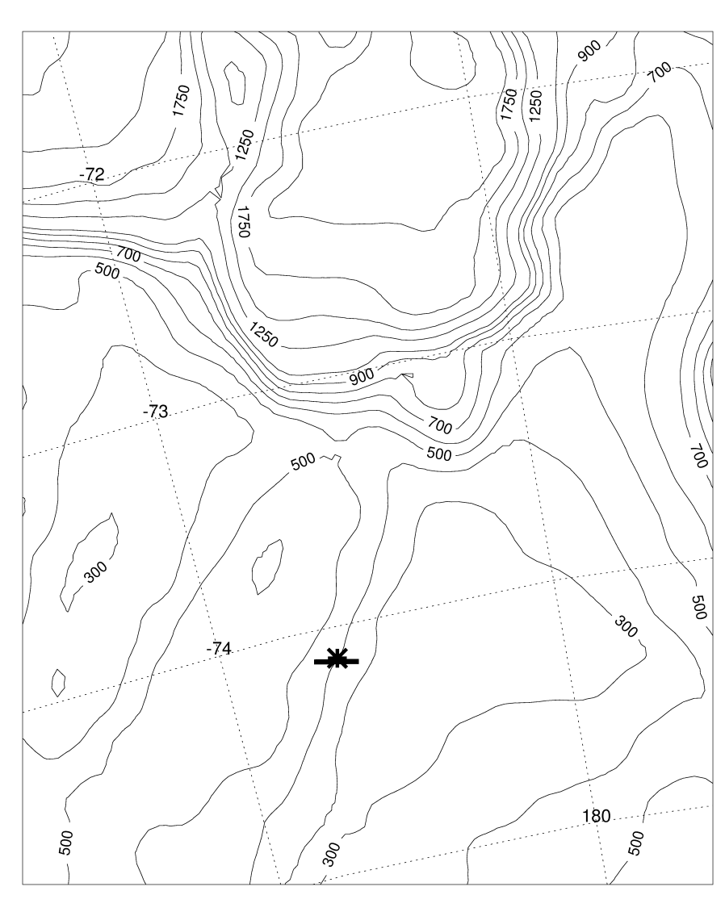
Model transport (Sv.) in the along-slope direction (5-day average fields) over 180–280 m depth across a 20 km section near where Bruce Huber’s mooring was
Southward cross section transport (Sv.):
0.13 ± 0.06 (model total)
0.16 ± 0.05 (model summer)
0.20 ± 0.01 (model during
time of mooring deployment)
0.24 (mooring, Kohut et al., 2012,
submitted)
Notes:
Explain red line.

Slide 16
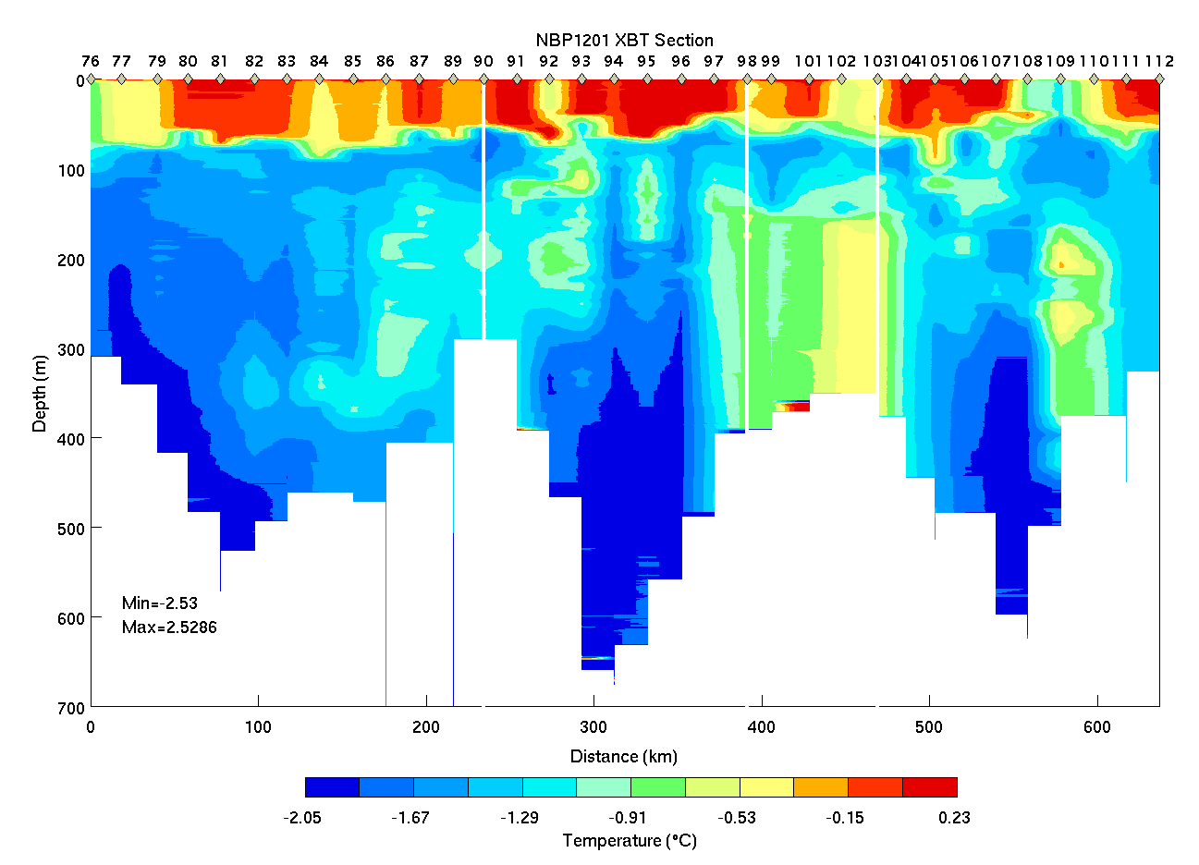
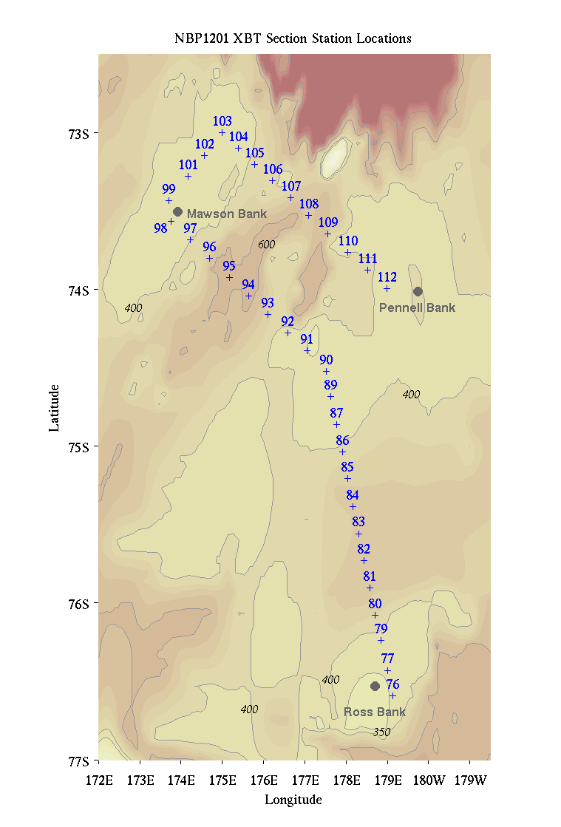
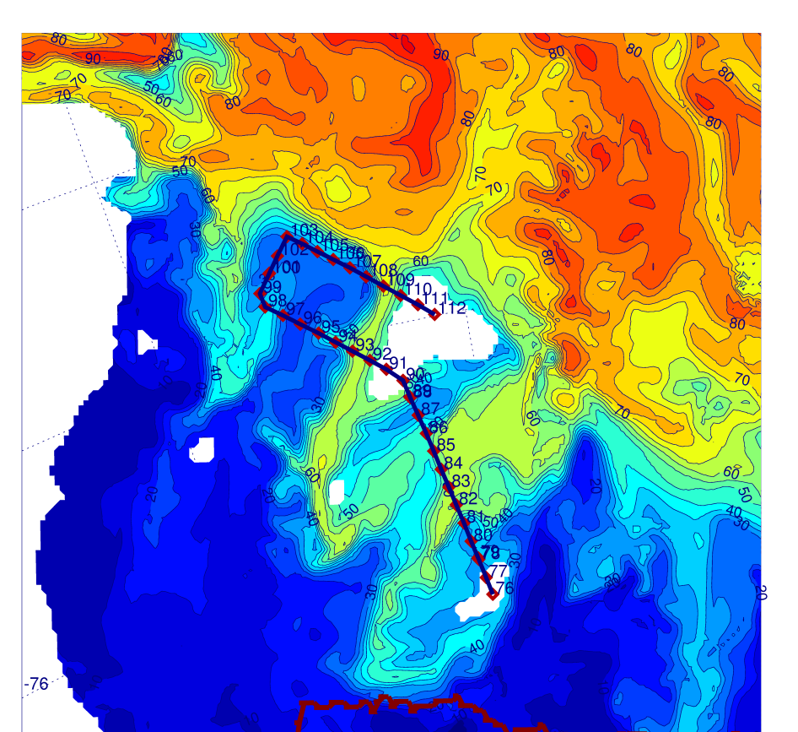
Notes:
New results from 093 model and match time of observations (2/2/2012). Dye is at 275m. Model is a little too warm (not enough vertical mixing?). Does a good job with the dye intrusion west of Pennell Bank, maybe not as good (has dye west of, but not so much on top of) for Mawson Bank.

Slide 17
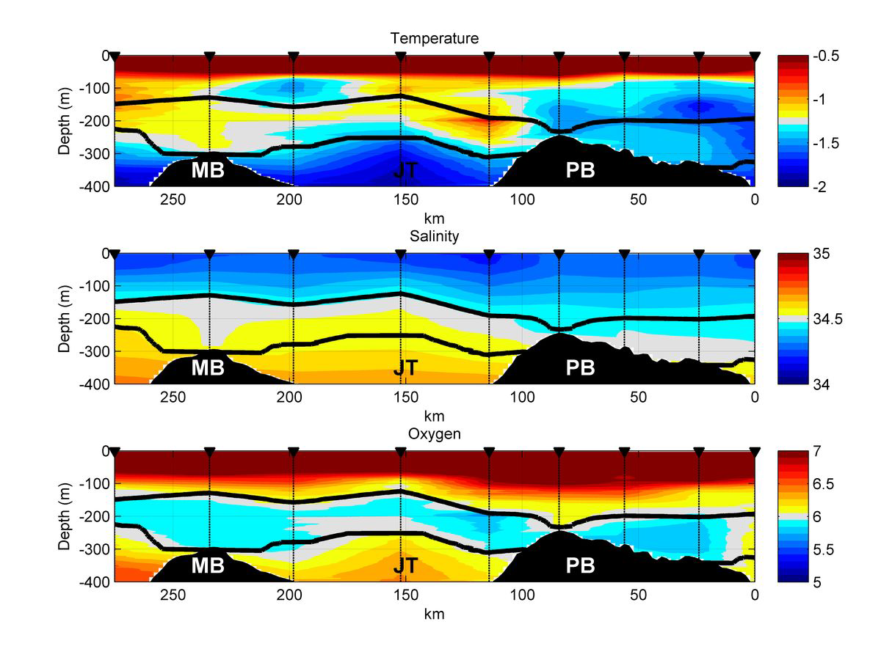
Kohut et al., 2012 (submitted)
Notes:
Could model miss be a timing issue? Look at temp just west of Mawson from Josh’s cruise. Note…some warm water on top of MB (although not as warm as to the west) but no warm water on top of PB.

Slide 18
CDW dye at 250 m
2/3/2012
CDW dye at 250 m
2/20/2012
Notes:
Note the dye wrapping around and getting on top of Mawson Bank…timing issue? Could also be lack of tides? Missing mesoscale effects?

Slide 19
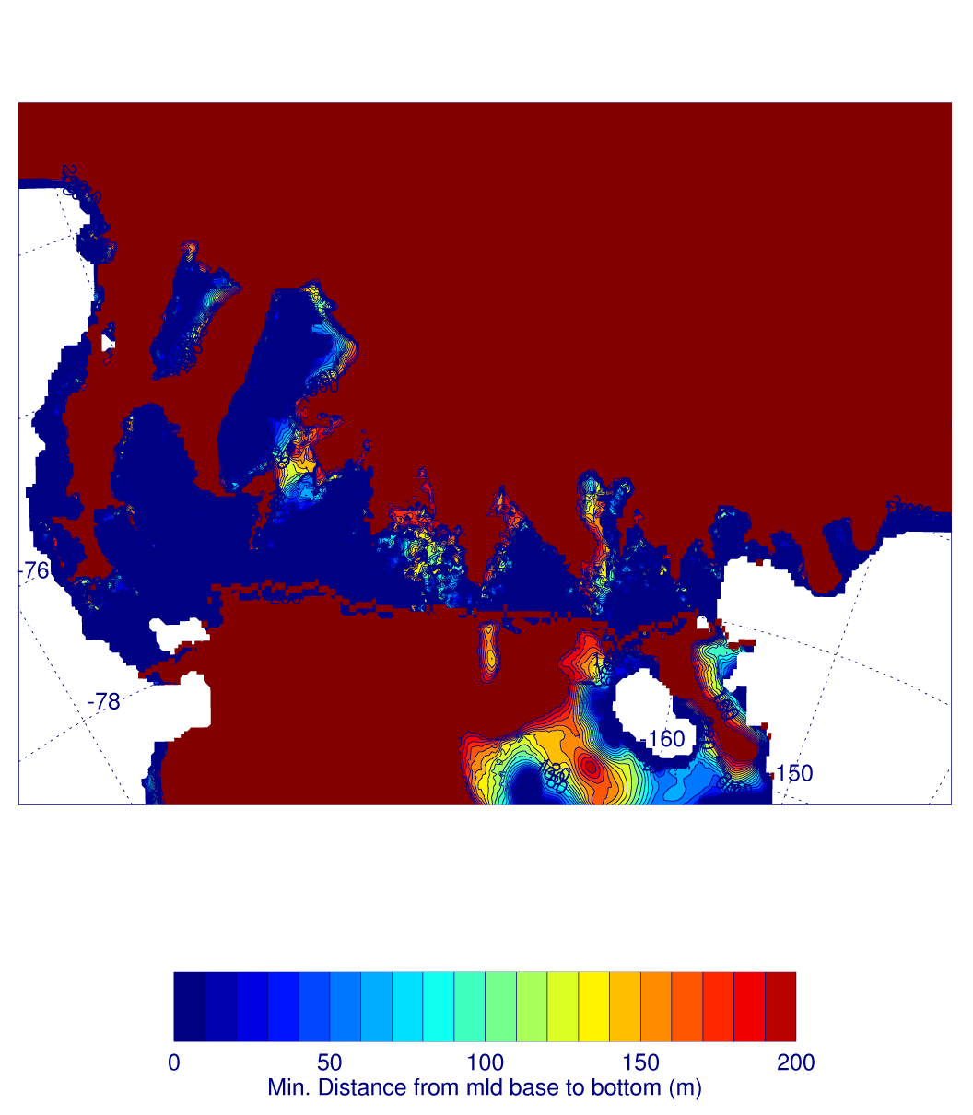
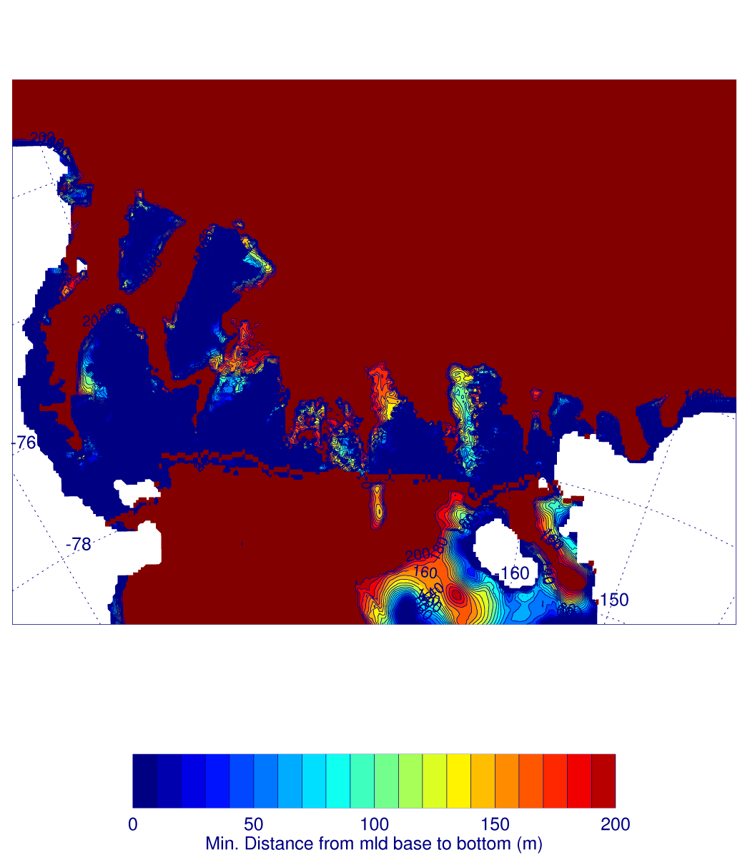
(Sept. 2003 – Sept. 2005
simulated minimum distance
from mld base to bottom)
(Sept. 2010 – Feb. 2012
simulated minimum distance
from mld base to bottom)
Notes:
Model calculations of the minimum distance between the base of the mixed layer and the model terrain using the 9/2003 – 9/2005 and new Ross Sea simulations.

Slide 20
Model Estimates of Fe fluxes from MCDW, glacial melt and sea-ice melt
At the end of model spinup, dye representing CDW is placed in water (initial and boundary conditions) off the continental shelf (initial offshelf concentration = 100)
Initial glacial melt dye is zero everywhere and is put into the model as a surface flux proportional to the ice shelf basal melt rate
Initial sea-ice melt dye is zero everywhere and is put into the model as a surface flux proportional to the sea-ice melt rate

Slide 21
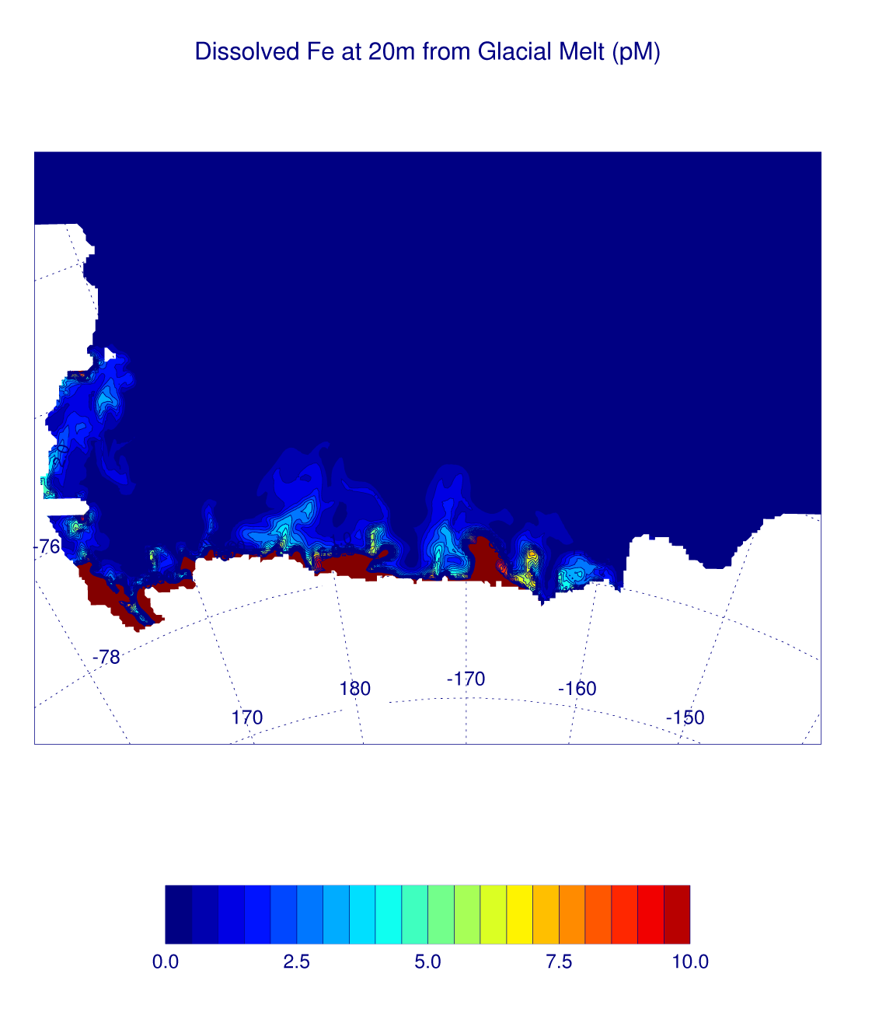
Dissolved Fe from model glacial melt
Assume: 5 nM for glacial ice in the Ross Ice Shelf
Very small estimates for glacial melt contribution:
Annual estimate for top 10m of entire continental shelf = 1.4 pM
Back of the envelope estimate:
Assume: 30-95 km³/yr melt
4-7 yr ice cavity
residence time
Meltwater mixed over top 150 – 300m of open shelf
1.7 – 0.2 pM
Notes:
5 nM comes from Pete. Picture is at end of model run. Remember the ice shelf water comes out at depth

Slide 22
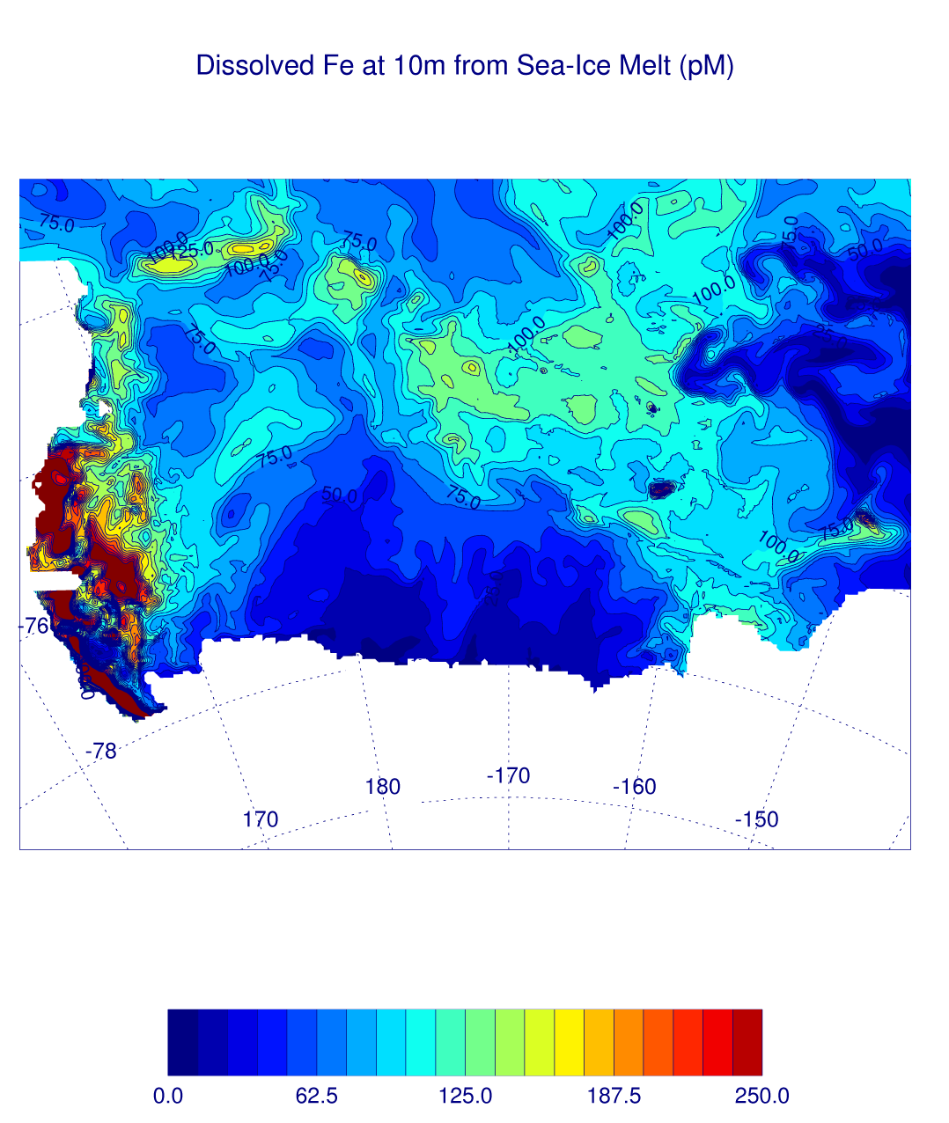
Dissolved Fe from model sea-ice melt
Assume: 5 nM for sea-ice
Much larger estimates for sea ice melt contribution w/ greatest contribution in the west
Annual estimate for top 10m of entire continental shelf = 88 pM
Back of the envelope estimate:
Assume: 0.3 – 0.9 m ice thickness
All ice removed by local
melt over the shelf
(known false)
Summer mixed layer thickness 10 -30m
450 - 50 pM
Notes:
Picture is late January 2012 (note scale difference wrt previous picture). Ross Sea is known to be a net exporter of ice.

Slide 23
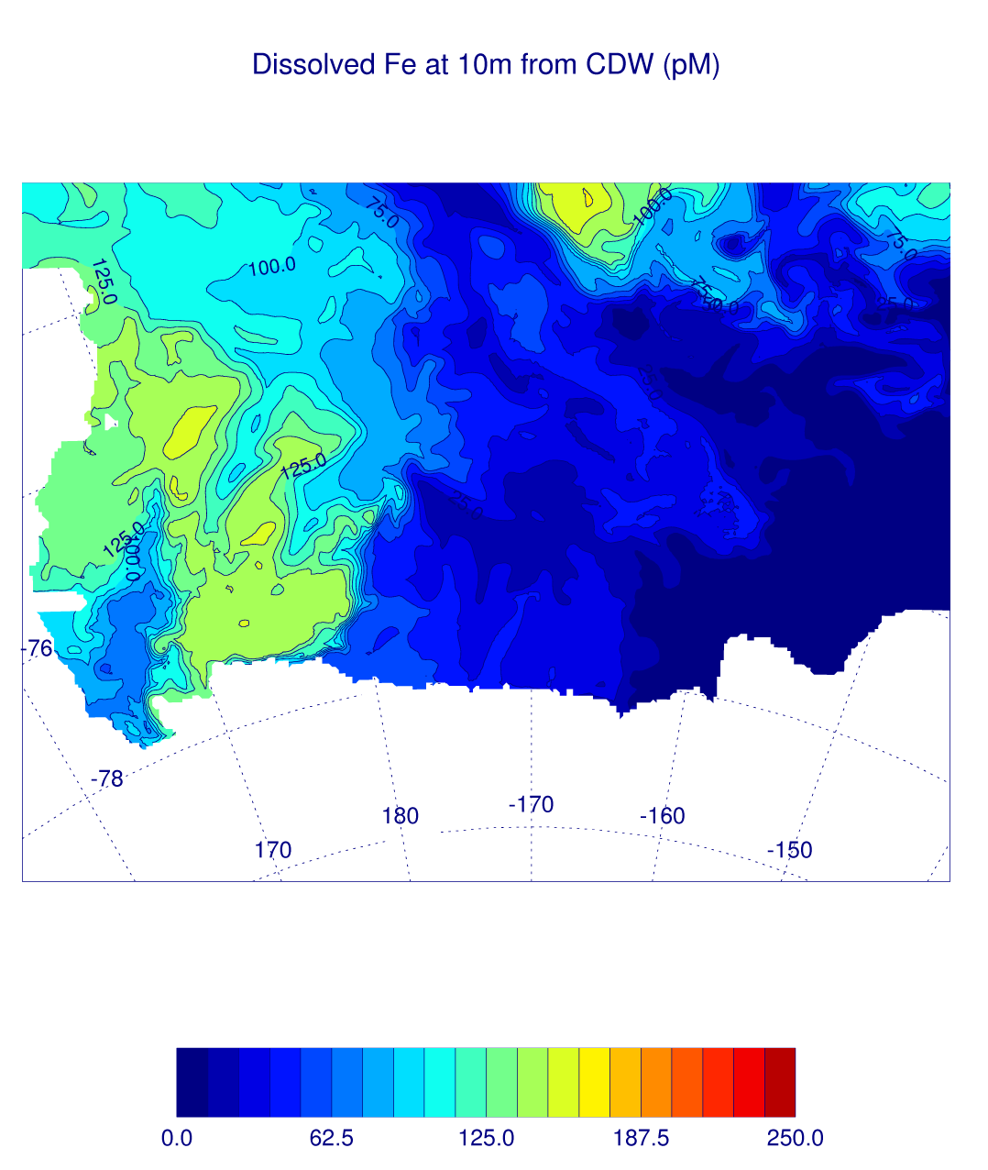
Dissolved Fe from model MCDW transport
Assume: 0.4 nM for CDW (Pete’s measurements)
Similar to sea-ice melt estimate over entire shelf, but smaller in west and greater in central with different temporal evolution
Annual estimate for top 10m of entire continental shelf = 76 pM
Back of the envelope estimate:
??? (Don’t have a good non-model estimate of CDW flux onto the shelf…yet)
Notes:
Picture is late January 2012 (same scale as previous picture).

Slide 24
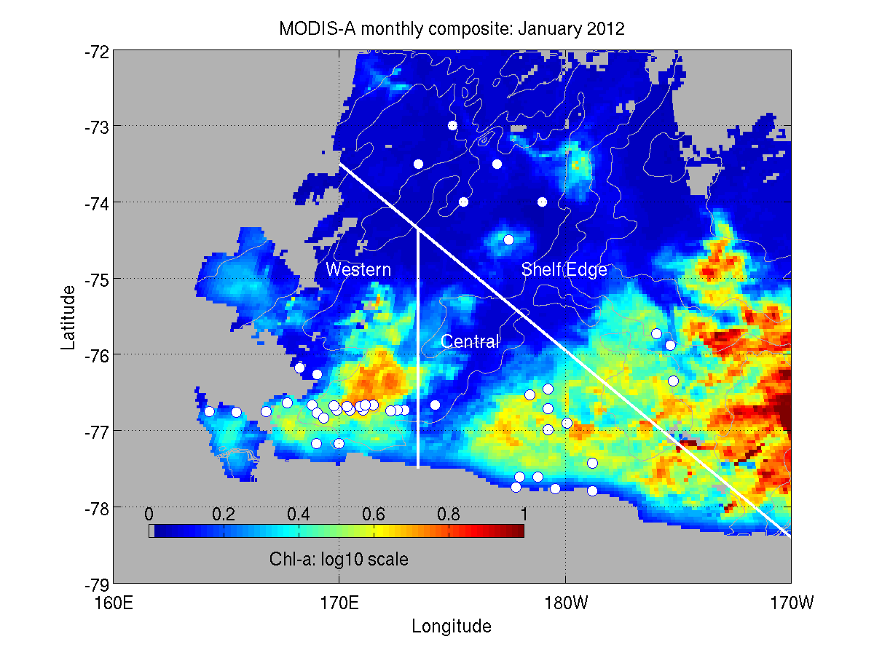
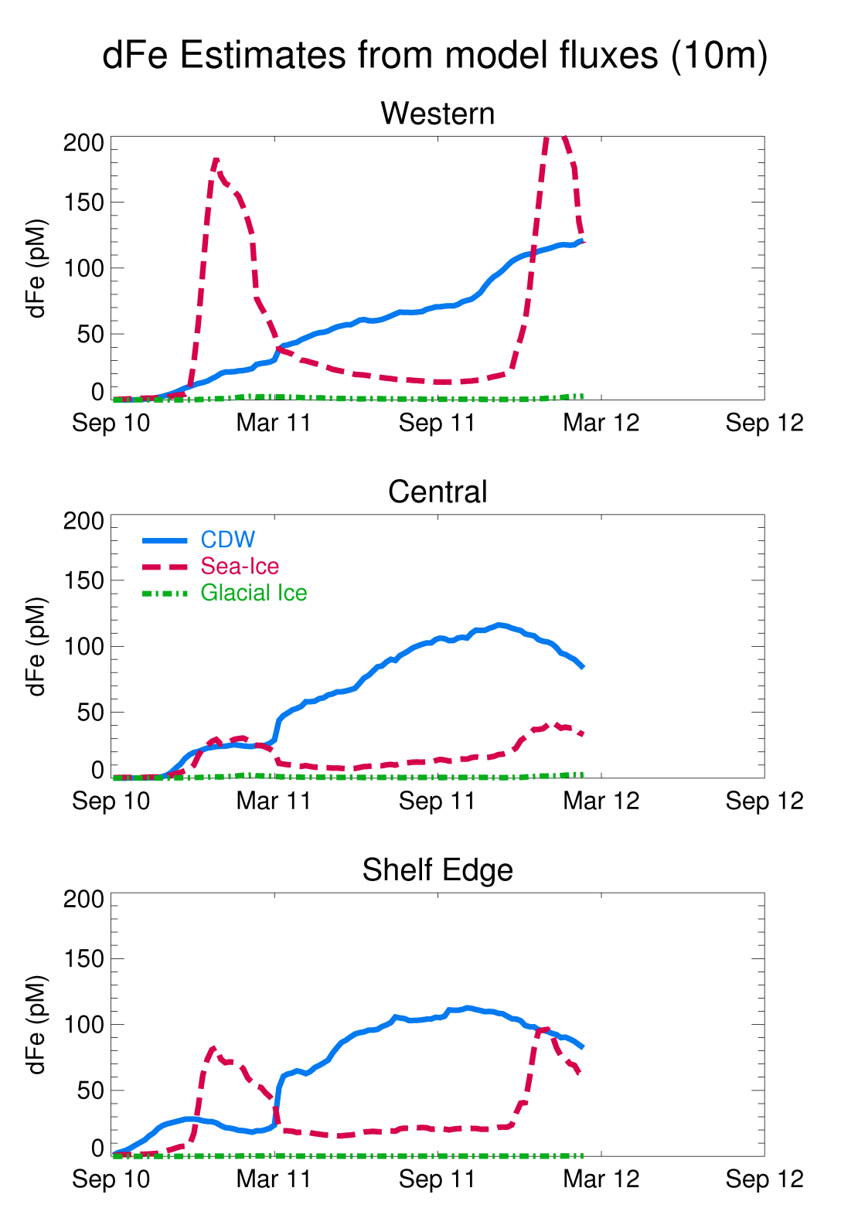
Notes:
Go through temporal evolution of different sources. Mention how the numbers for Table 2 came about and that time series is limited to 170W.

Slide 25
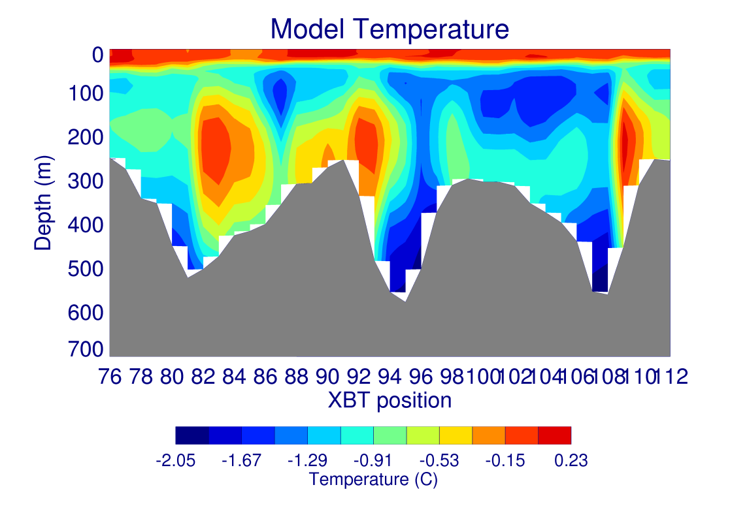
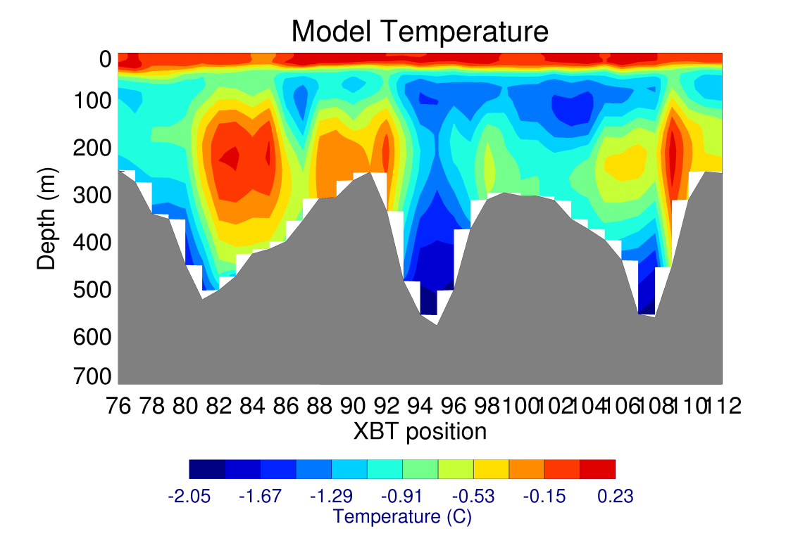
Future Plans
I’ll leave most of this to Stefanie, except…
Just completed new run (right panel) with bottom boundary
formulation (bottom KPP)…should have better bottom
vertical diffusivities for Pete, but haven’t looked at it yet

Slide 26
Summary
New model run seems to do a pretty good job in simulating the sea-ice extent over the time of the PRISM cruise
New model run does a pretty good job with the CDW intrusion along the east side of the Joides trough (except too warm?), but not so sure about the intrusion along the west side of Mawson Bank (too warm and maybe not getting enough MCDW on top of Bank?)
Model dyes can help define the dissolved Fe budget: Glacial melt not important, but MCDW and sea-ice melt could be significant sources
What do you want to see from the model?

Slide 28
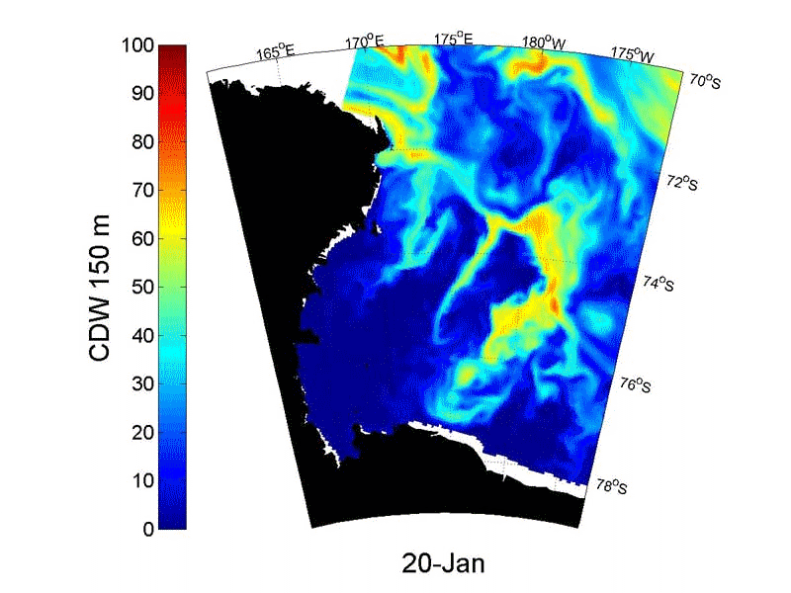
(courtesy Kim Goetz, UCSC)
Notes:
Kim Goetz and Dan Costa were looking at the seal CTD data and found several seals hanging out where it looked like (in the CTD’s) there was a layer of MCDW that had gotten up to ~150m in the water column. Kim made this animation w/ model MCDW dye (so what mixes up to 150m) vs. seal locations. Look at the ones away from the coast (esp. in winter) …a bunch seem to be hanging out in the MCDW. Don’t know if there’s some causality or it’s just a coincidence.

Slide 29
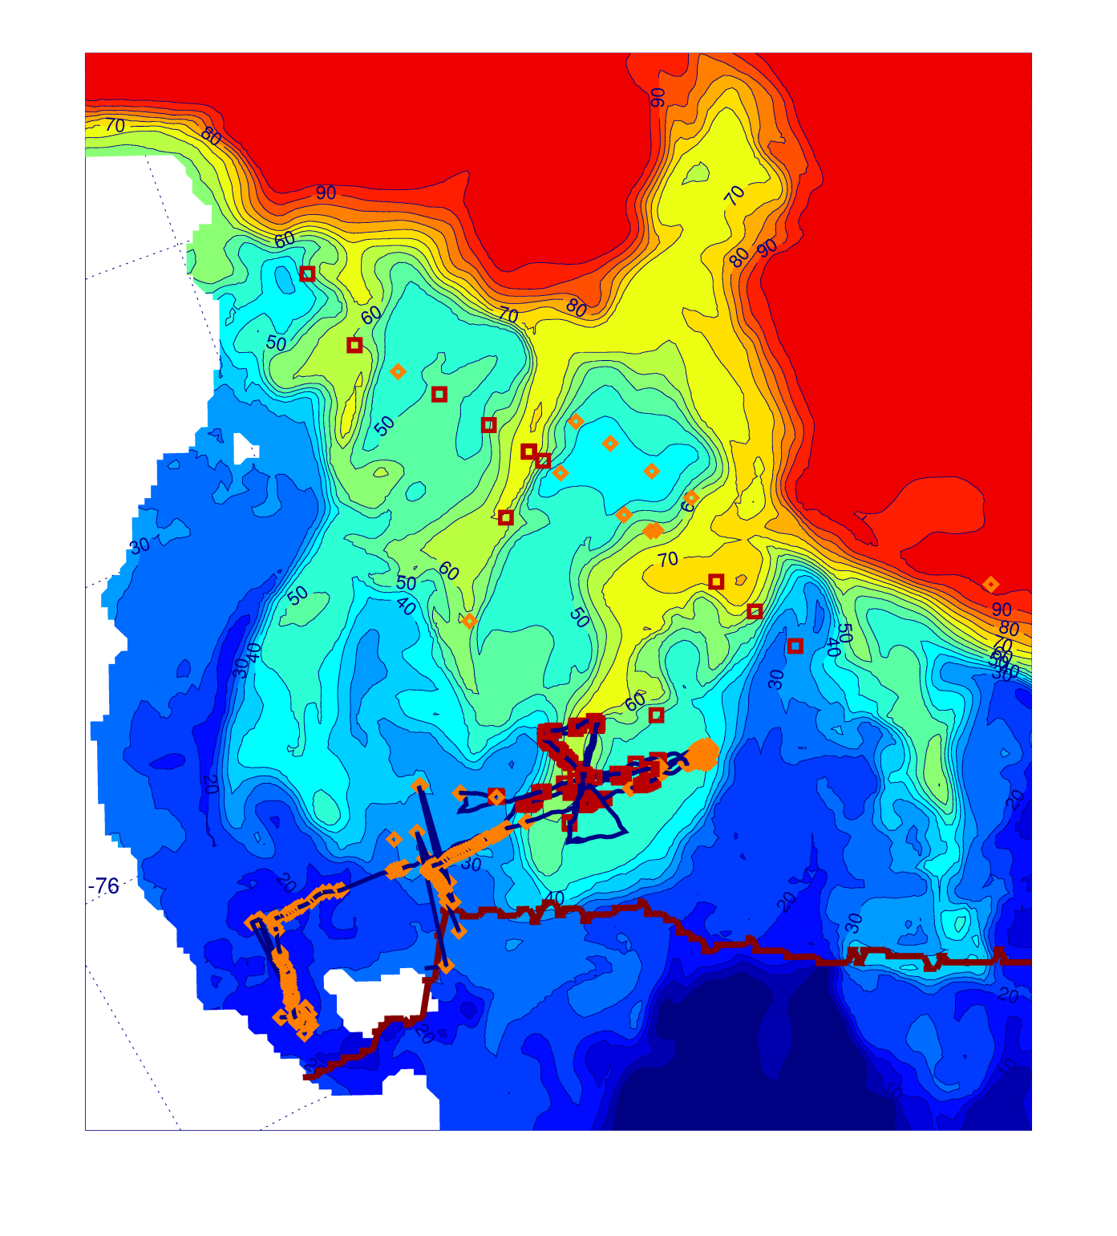
Model dye concentration (mid-depth)
vs.
observations of MCDW (red squares) or no-MCDW (orange diamonds)
Notes:
Mention observations are from cruise and glider data

Slide 30
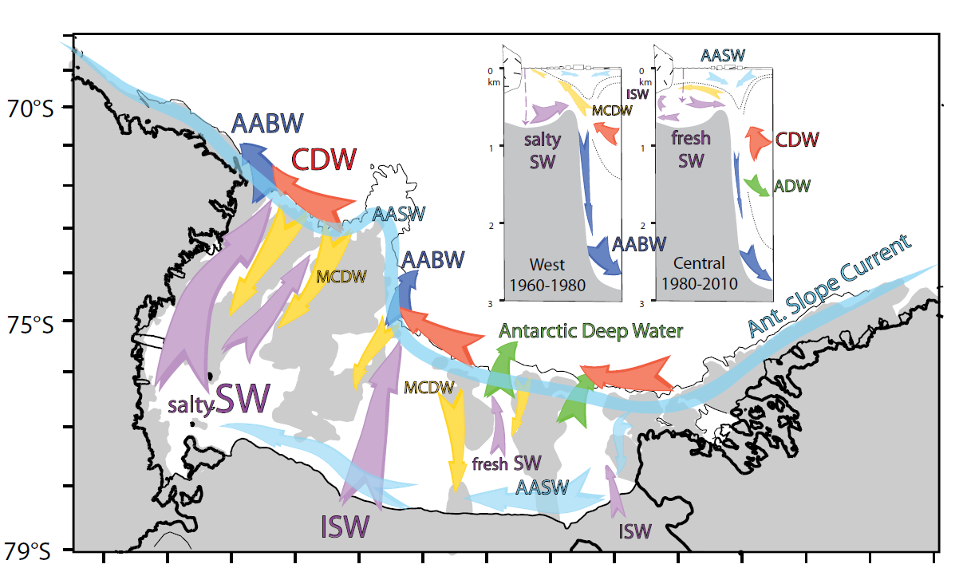
Smith et al., 2012

Slide 31
Dynamic Sea Ice Model
Budgell (2005) model (built into ROMS)
Thermodynamics based on Mellor and Kantha (1989) with two ice layers, a snow layer, surface melt ponds and a molecular sub layer at the ice/ocean interface
Dynamics based on an elastic-viscous-plastic rheology after Hunke and Dukowicz (1997) and Hunke (2001)
Los Alamos CICE available, but not using yet due to time constraints
Notes:
CICE is much more complicated thermodynamically (has several ice classes w/ several layers), but the dynamics are similar. Sinan had it working for the Ross, but it just about doubles the time. Budgell’s model is only ~20% more expensive since it’s less complicated and integrated into the code.

Slide 32
Ice Shelf Modeling
Ice Shelf does not change in time in model
Three equation viscous sub-layer model for heat and salt fluxes (Holland and Jenkins, 1999)
Conservation of Heat
Conservation of Salt
Freezing point of sea water (function of pressure and salinity)
PGF calculation assumes the ice shelf has no flexural rigidity and pressure at the base comes from the floating ice
Notes:
No flexural rigidity assumption is fine except w/i a few km of the coast. Assumes viscous sub-layer is at freezing. Can have fancy physics in the transfer coeffs. Three eqns. can be solved simultaneously

