Slide 1
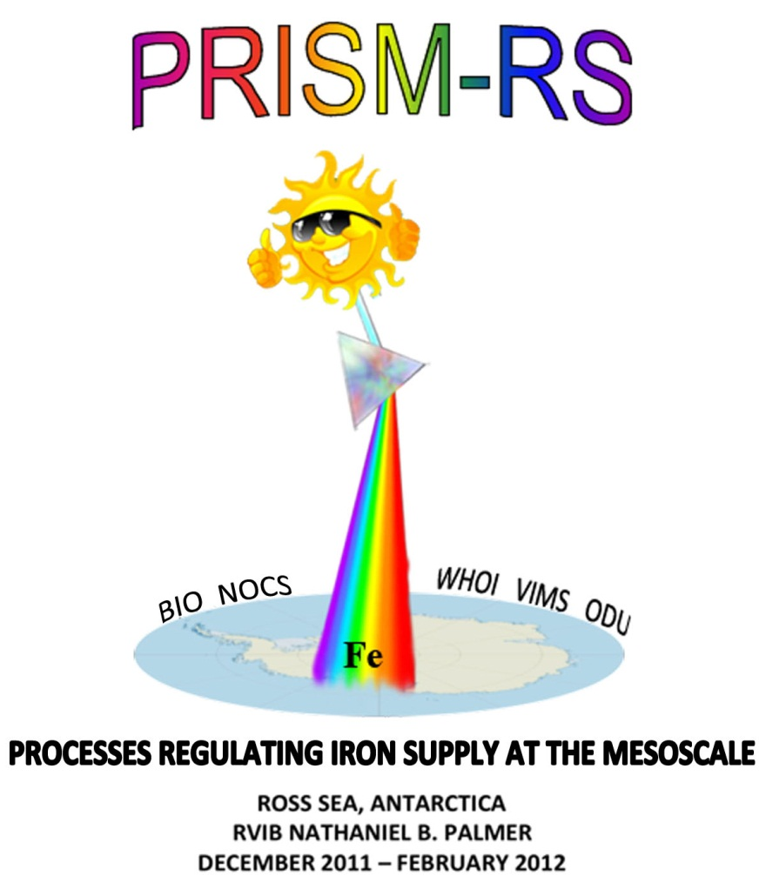
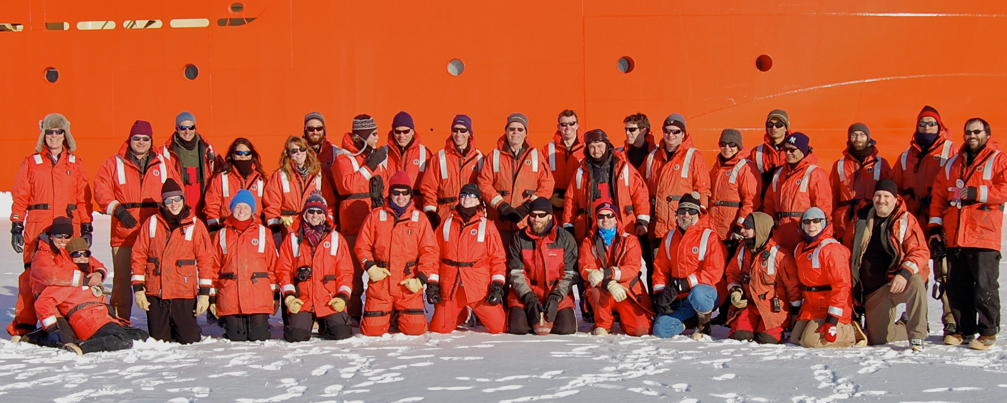
(PRISM)

Slide 2
Plankton Production in the
Open Ocean
Sea Surface
100m
Notes:
The scientific question motivating this study revolves around the issue of what controls new production in the open ocean. This cartoon schematizes the process of new production, in which phytoplankton…
CO2 is a greenhouse gas – a good thing – without it the earth’s sfc temp would be 30C colder
How do phytoplankton affect CO2 in the atmosphere? The biological pump.
The biological pump is strong: without it, 2X pCO2, no polar ice caps, sea level 100m higher.
Industrial revolution, CO2 release, 1/3 atm, 1/3 land, 1/3 ocean.

Slide 3
The biological pump
Sea Surface
Photosynthesis
100m
Respiration
Notes:
The scientific question motivating this study revolves around the issue of what controls new production in the open ocean. This cartoon schematizes the process of new production, in which phytoplankton…
CO2 is a greenhouse gas – a good thing – without it the earth’s sfc temp would be 30C colder
How do phytoplankton affect CO2 in the atmosphere? The biological pump.
The biological pump is strong: without it, 2X pCO2, no polar ice caps, sea level 100m higher.
Industrial revolution, CO2 release, 1/3 atm, 1/3 land, 1/3 ocean.

Slide 4
Plankton Production in the
Open Ocean
Sea Surface
Fe
CO₂ + H₂O CH₂O + O₂
100m
Notes:
The scientific question motivating this study revolves around the issue of what controls new production in the open ocean. This cartoon schematizes the process of new production, in which phytoplankton…
CO2 is a greenhouse gas – a good thing – without it the earth’s sfc temp would be 30C colder
How do phytoplankton affect CO2 in the atmosphere? The biological pump.
The biological pump is strong: without it, 2X pCO2, no polar ice caps, sea level 100m higher.
Industrial revolution, CO2 release, 1/3 atm, 1/3 land, 1/3 ocean.

Slide 5
Scientific Background
Productivity of the Southern Ocean mediates changes in atmospheric CO₂ over glacial to interglacial time scales
Brovkin et al., 2007; Kohfeld et al., 2005; Kumar et al., 1995; Martin, 1990; Sigman and Boyle, 2000; Watson and Liss, 1998
Future warming may impact Southern Ocean productivity due to changes in stratification, ice, and dust deposition
Boyd and Doney, 2002; Boyd et al., 2008; Mahowald and Luo, 2003; Sarmiento et al., 1998; Sarmiento et al., 2004; Tagliabue et al., 2008
Mechanistic understanding of the underlying processes and feedbacks between physical forcing, phytoplankton productivity, and the biological pump are needed to understand past variations and predict future changes.

Slide 6
Antarctic continental shelves are among the most productive regions of the Southern Ocean
Summertime polynya
Phaeocystis antarctica
diatoms
Fe regulation
macronutrients not depleted
low grazing pressure
Polynya area Chlorophyll Primary Production

Slide 7
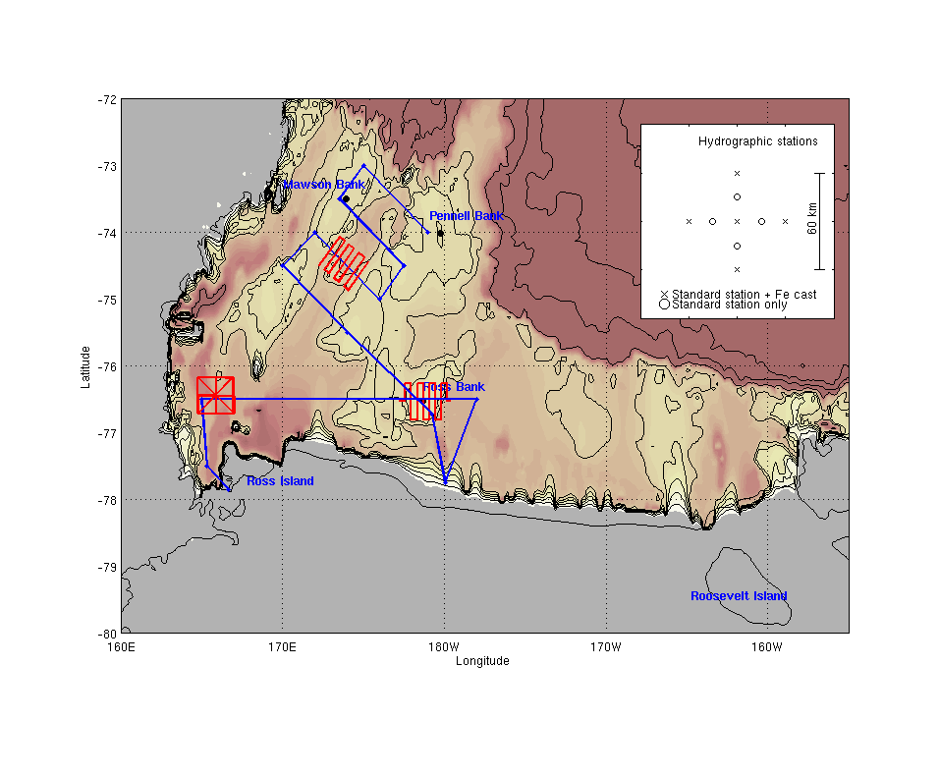
PRISM cruise plan
H₁: Circumpolar deep water (CDW)
H₂: Sediment: banks/coastal
H₃: Sea ice
H₄: Glacial melt
H₅: Ice Shelf Water
(ISW)
H₆: Dry Valleys
H₇: Vents
H₁,
H₃
H₁,
H₃
H₂,
H₃
H₂,
H₃
PHS
H₂
PHS
HV
H₁
HV
H₂
H₄
H₄
HV: Hydrothermal vent near Franklin Island
PHS: penguin hotspots - WOS
HV: Hydrothermal vent near Franklin Island
PHS: penguin hotspots - WOS

Slide 8
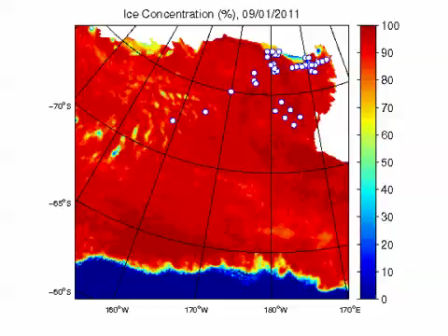
SSMI/S Ice coverage 9/1/11 – 2/5/12
http://www.iup.uni-bremen.de:8084/ssmis/index.html

Slide 9
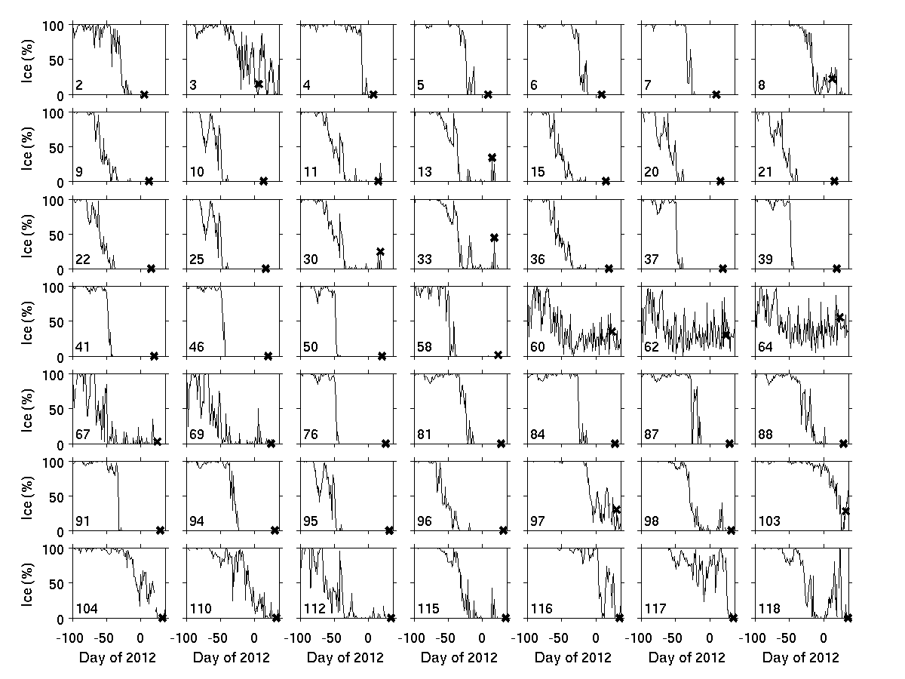
Sea ice time-series at PRISM stations

Slide 10
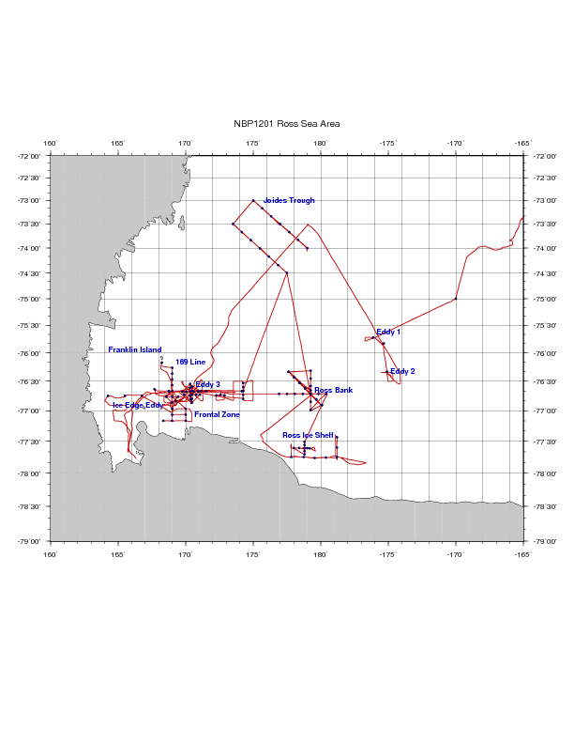
PRISM cruise track
H₁: CDW
H₂: Sediment: banks/coastal
H₃: Sea ice
H₄: Glacial melt
ACC Sea Ice
H₅: ISW
H₆: Dry Valleys
H₇: Vents
I. ACC Sea Ice
II. Eastern Ross Sea Eddies
III. Western Ross Sea
IV. Ross Bank
V. Ross Ice Shelf
VI. Joides Trough
VII. Western Ross Sea II

Slide 11
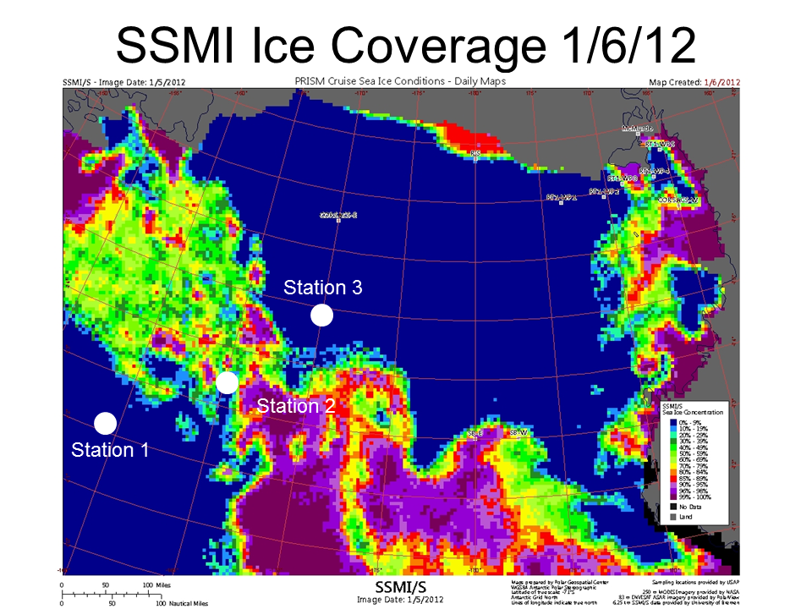
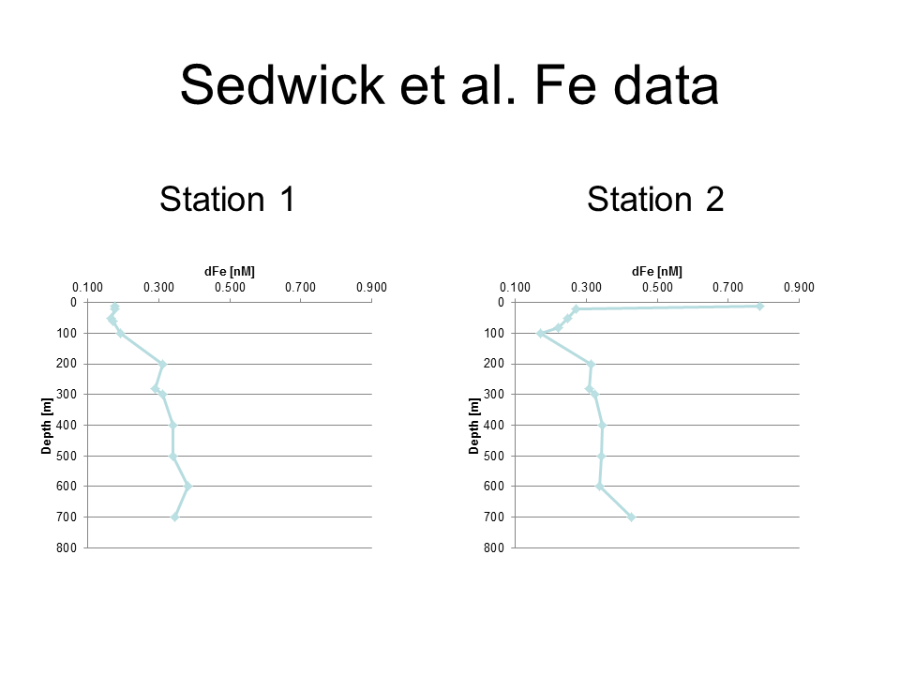
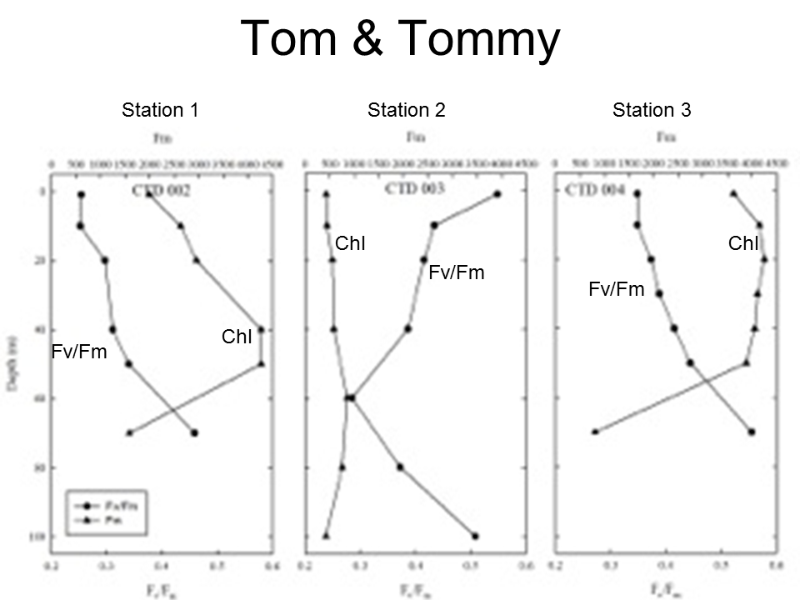
ACC Sea Ice
H₁: CDW
H₃: Sea ice
Station 3
Station 2
Open ocean sea ice a source of iron that improves physiological condition of phytoplankton
Iron measurements in CDW end-member consistent with previous studies.

Slide 12
PRISM cruise track
H₁: CDW
H₂: Sediment: banks/coastal
H₃: Sea ice
H₄: Glacial melt
ACC Sea Ice
H₅: ISW
H₆: Dry Valleys
H₇: Vents
I. ACC Sea Ice
II. Eastern Ross Sea Eddies
III. Western Ross Sea
IV. Ross Bank
V. Ross Ice Shelf
VI. Joides Trough
VII. Western Ross Sea II

Slide 13
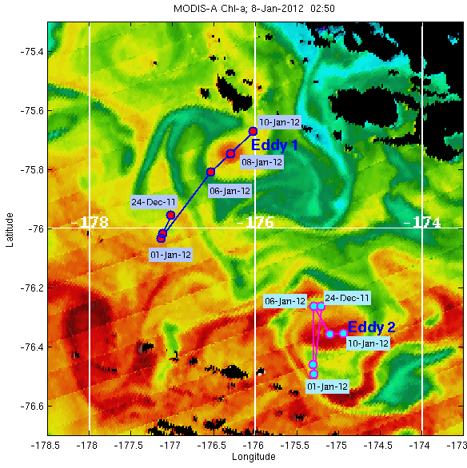

Eastern Ross Sea Eddies
MODIS Chl a Jan 8, 2012

Slide 14
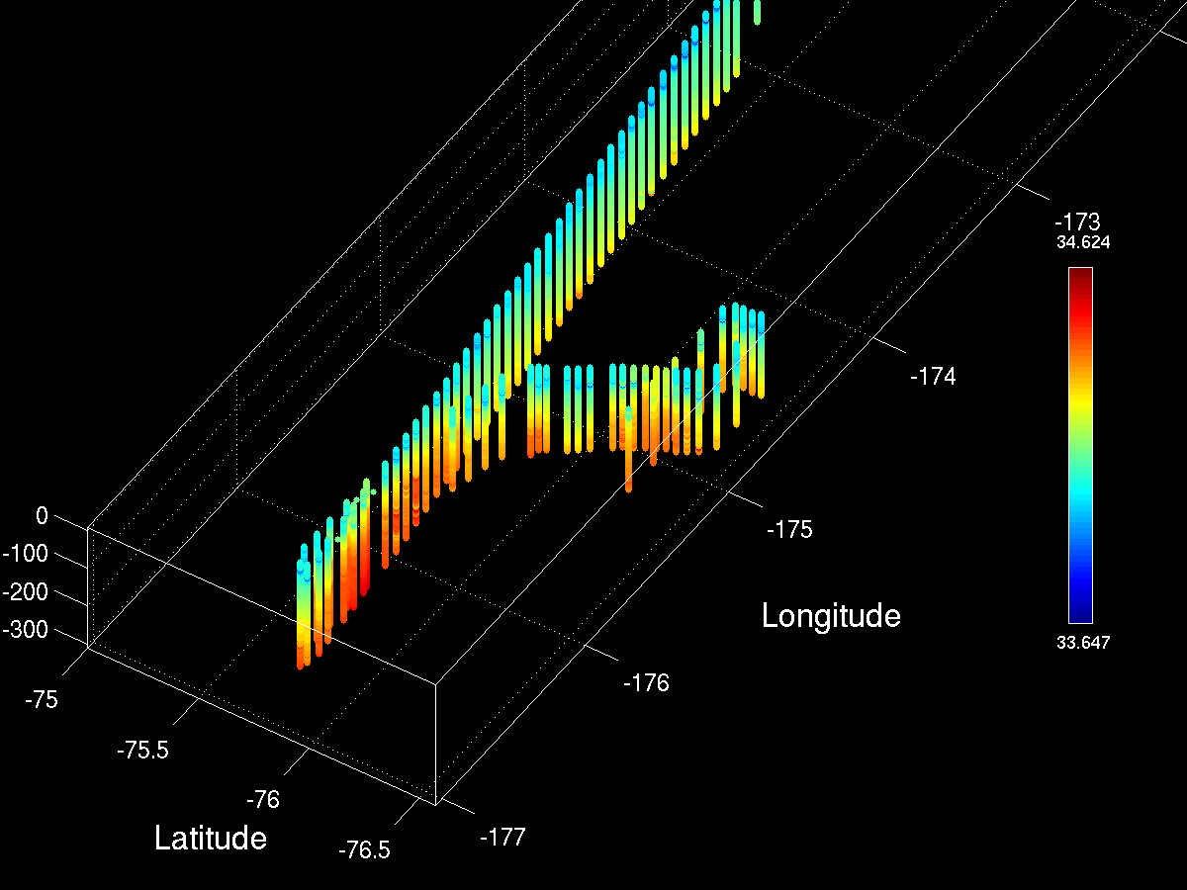
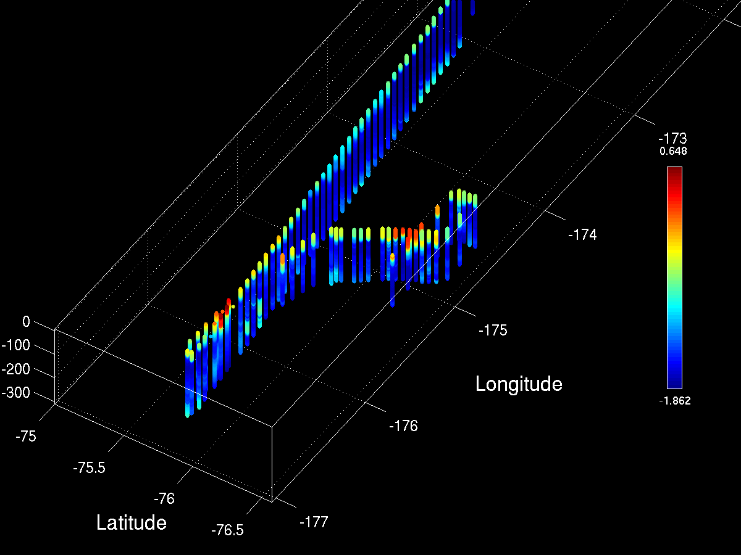
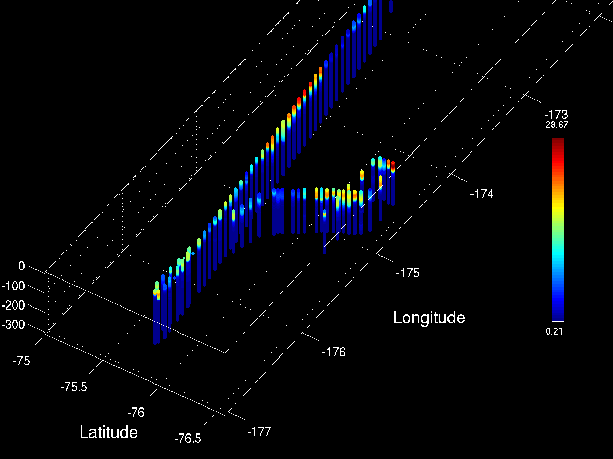
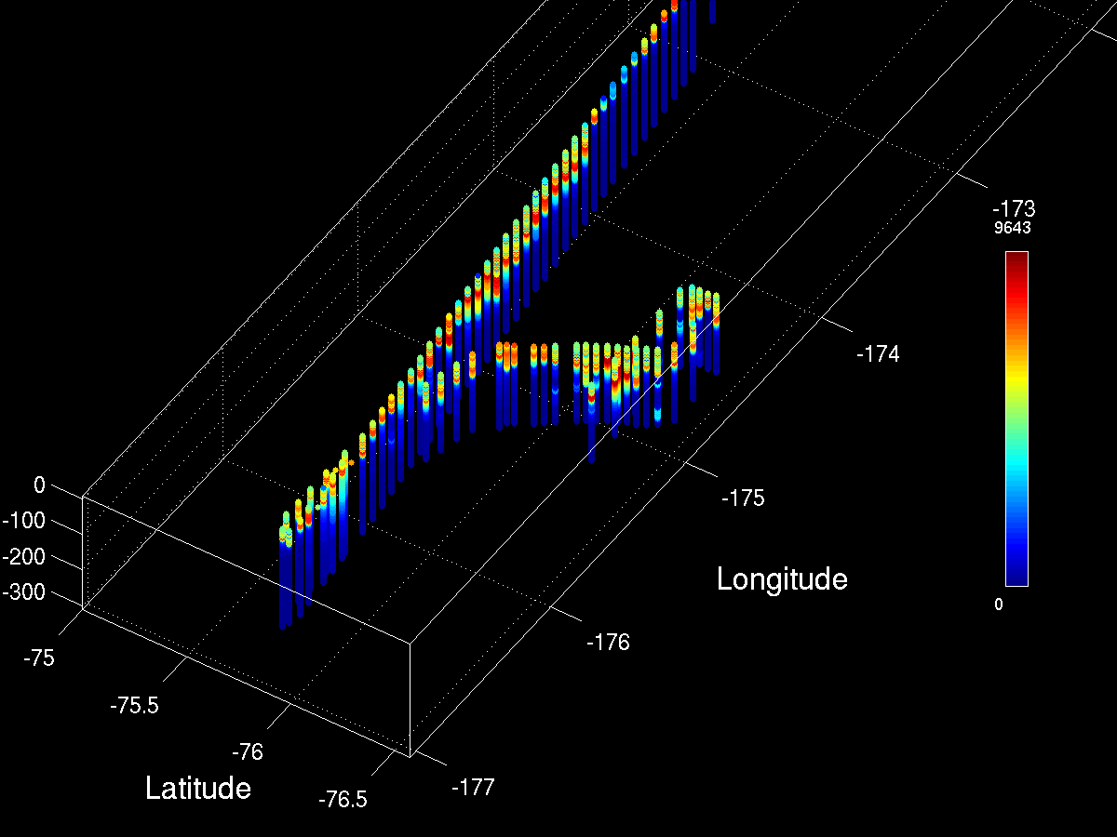
MVP Survey of Eddies 1 and 2: View from the SW
Salinity
Temperature
Eddy 1
Eddy 2
Fluorescence
LOPC

Slide 15
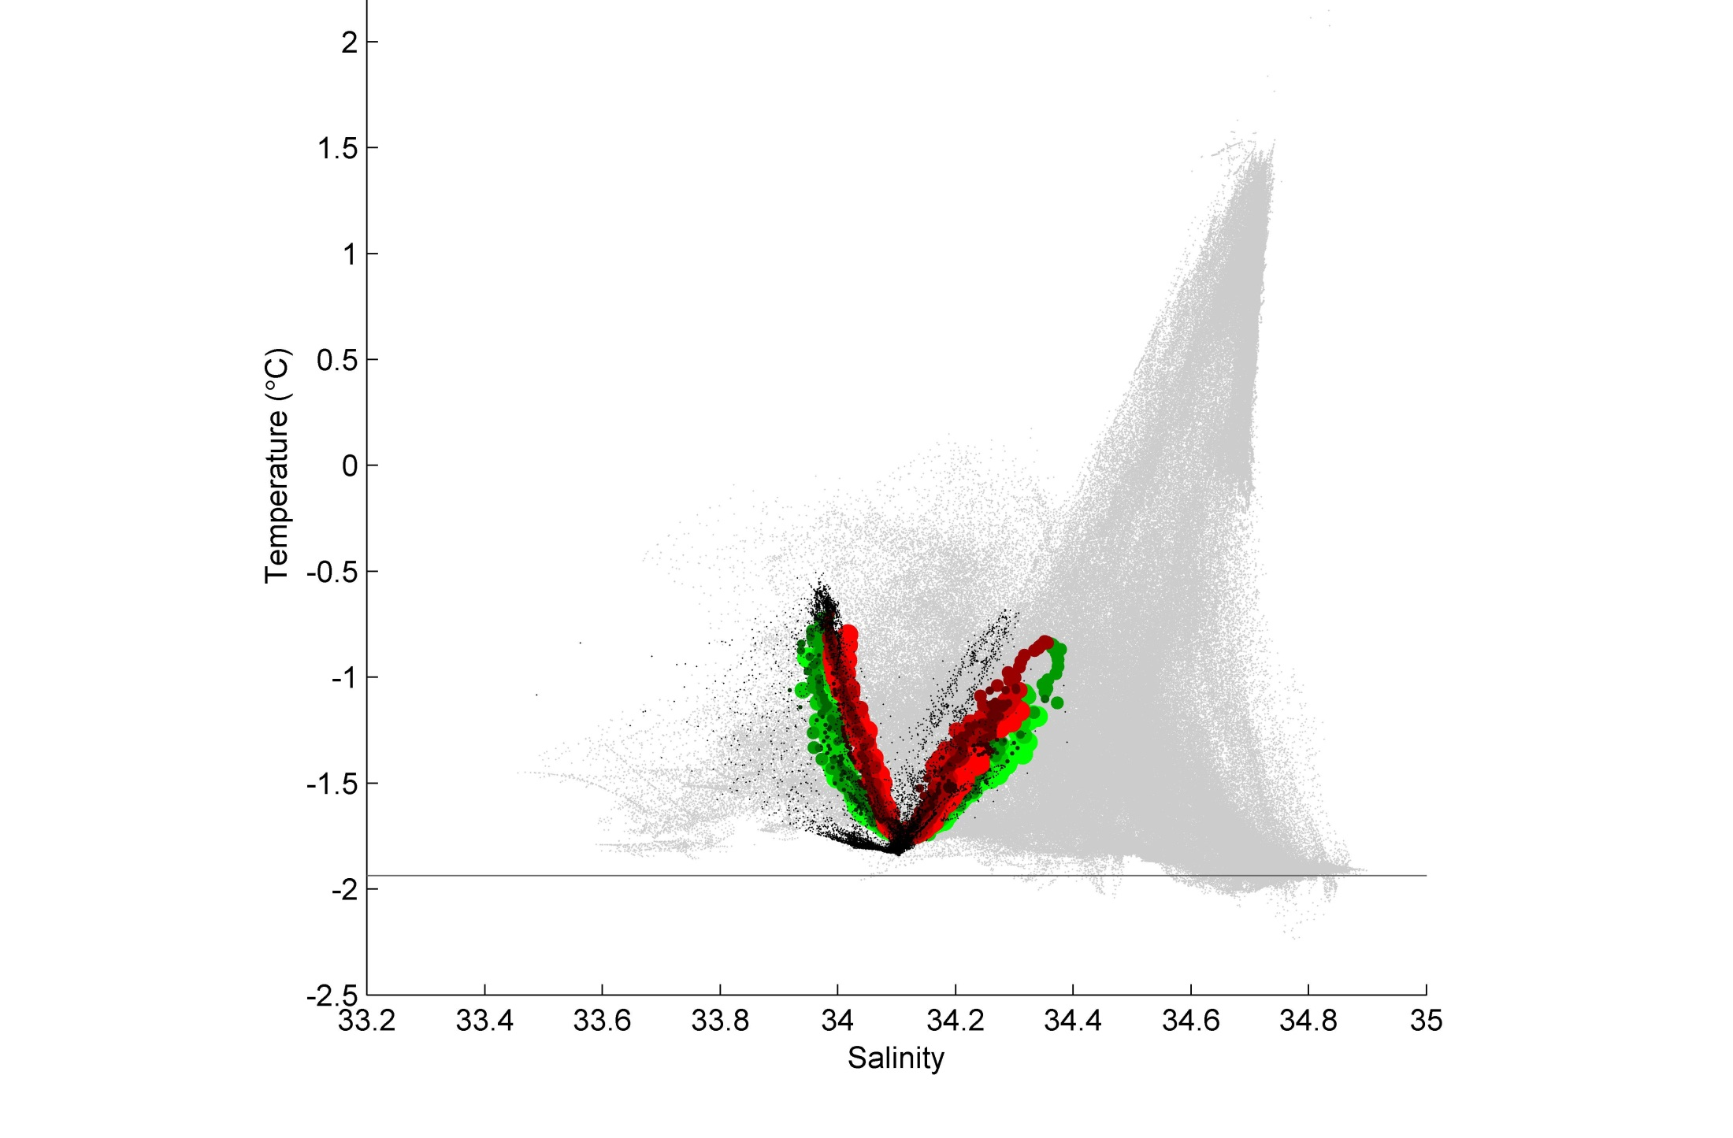
The MVP MCDW-o-meter
CDW
MCDW
AASW
LSSW, HSSW
ISW

Slide 16
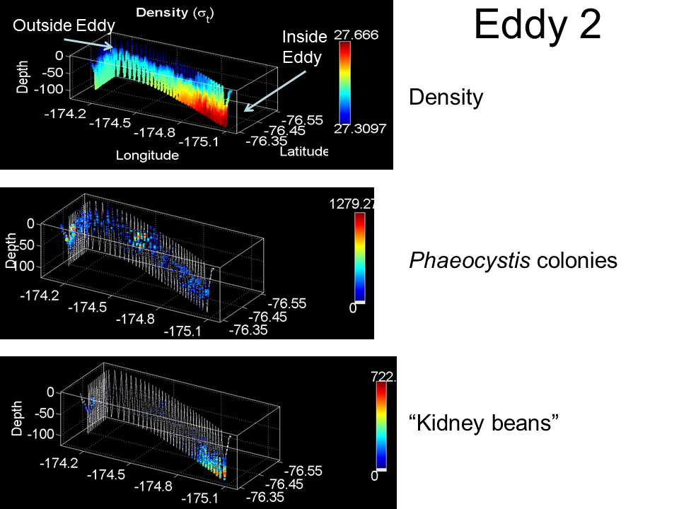
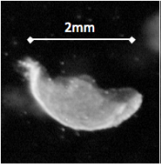
Eastern Ross Sea Eddies
Ghost colonies

Slide 17
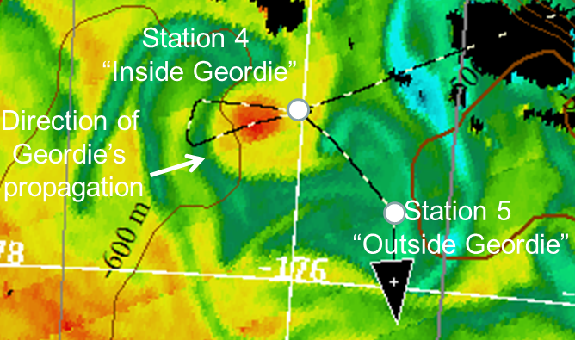
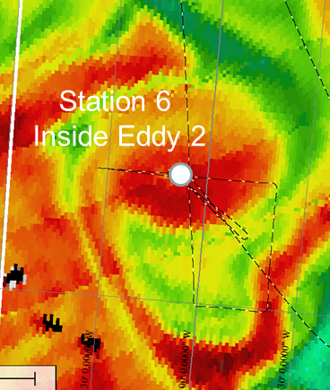
Eastern Ross Sea Eddies
MODIS Chlorophyll a
Ghost colonies
Cyclonic eddies driven by doming of the halocline yield elevated Chl
Phaeocystis present as both individual colonies and aggregated colonies
Covariance in the distribution of individual and aggregated colonies, both deeper in the eddy interior than outside the eddy
High abundance of abandoned colonies and marine snow at depth at eddy center
Near-surface iron concentrations of 0.3-0.4 nM both inside and outside eddies

Slide 18
PRISM cruise track
H₁: CDW
H₂: Sediment: banks/coastal
H₃: Sea ice
H₄: Glacial melt
ACC Sea Ice
H₅: ISW
H₆: Dry Valleys
H₇: Vents
I. ACC Sea Ice
II. Eastern Ross Sea Eddies
III. Western Ross Sea
IV. Ross Bank
V. Ross Ice Shelf
VI. Joides Trough
VII. Western Ross Sea II

Slide 19
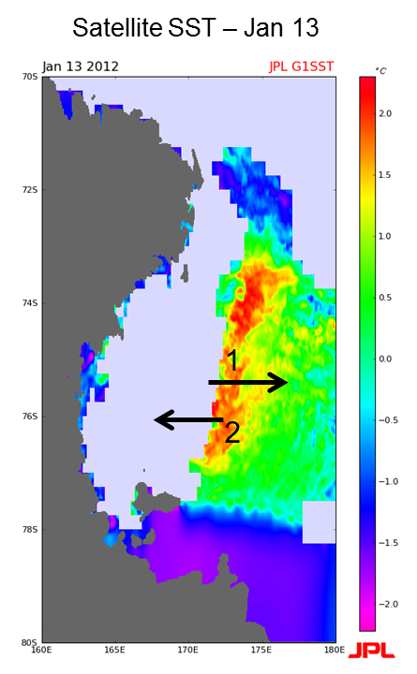
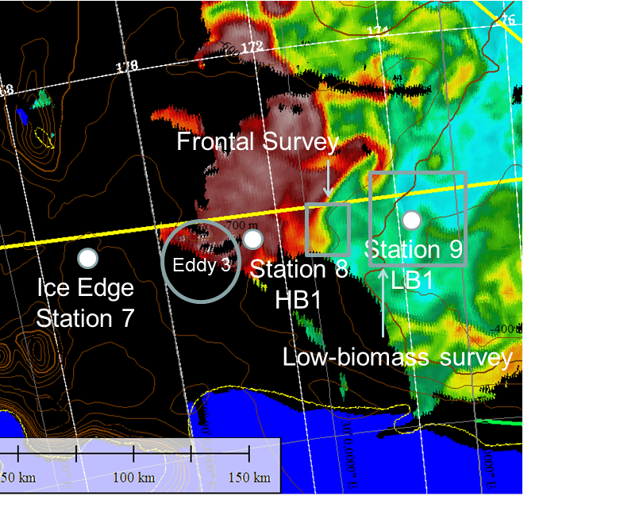
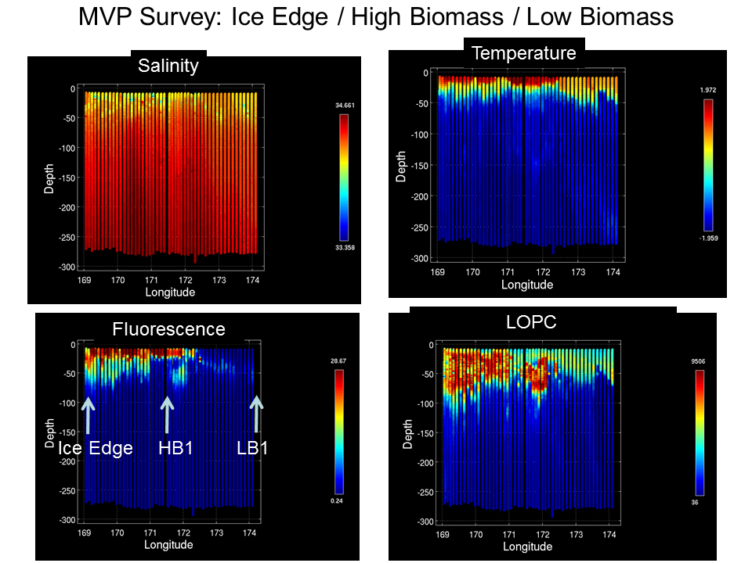
Western Ross Sea Process Study
Frontal boundary separates warm, fresh, higher iron (0.2 nM) surface waters to the west from cold, salty, lower iron (0.1 nM) surface waters to the east; pattern consistent with a wake of retreating sea ice
At depth, zonal trends are reversed: salinity decreases and iron increases to the east (HSSW production, bathymetry, respectively)
Warm, fresh, higher iron near-surface waters high in biomass: diatoms near the surface, Phaeocystis down deep; phytoplankton condition better than in low-biomass waters
Trends in macronutrient data consistent with a diatom bloom (silicate drawdown)

Slide 20
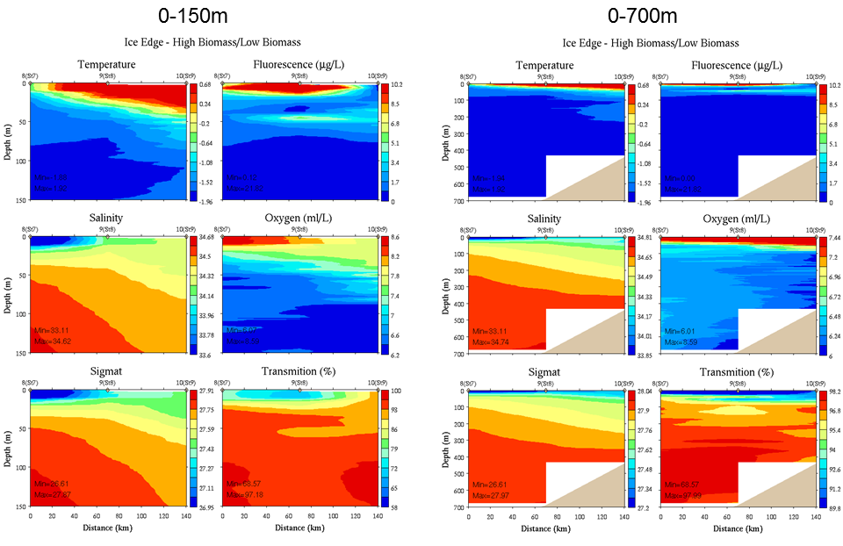
Hydrography

Slide 21
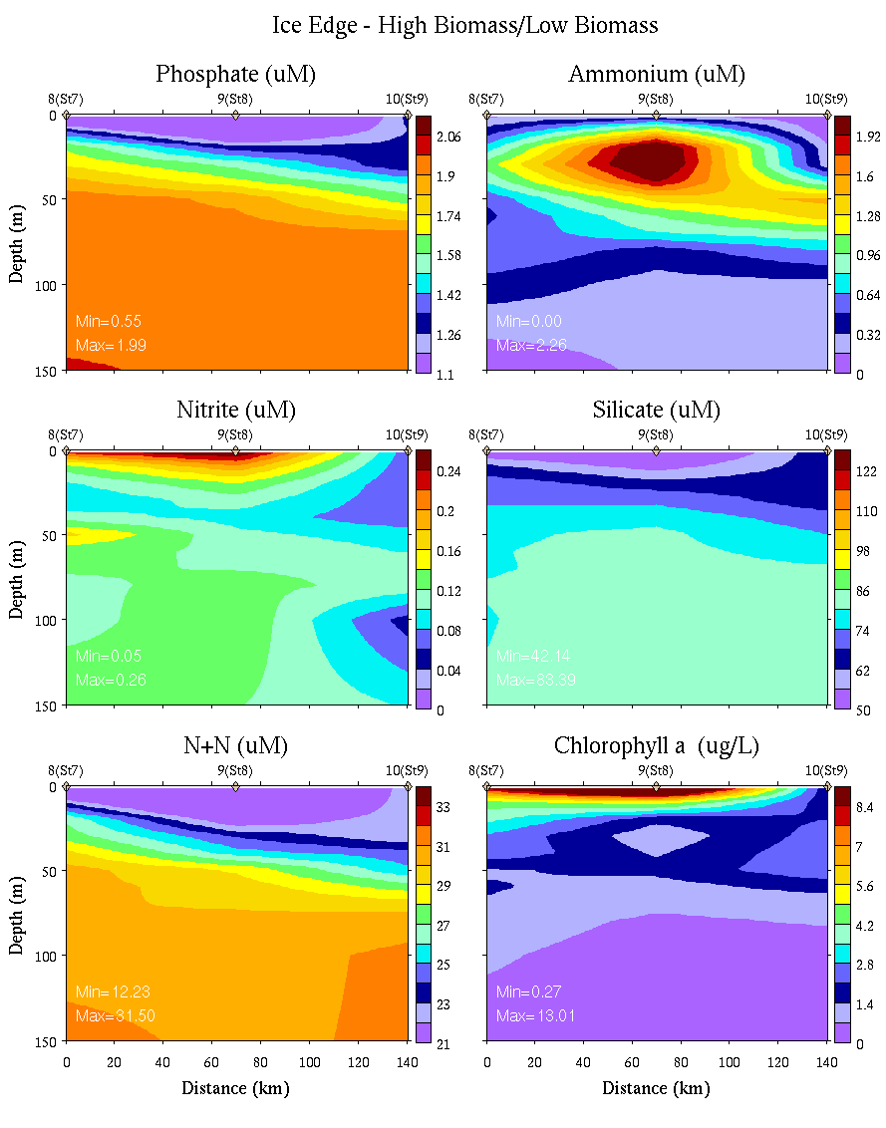
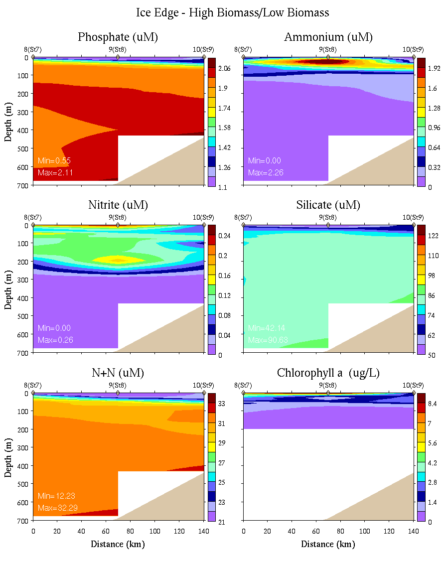
Nutrients and chlorophyll
0-150m 0-700m

Slide 22
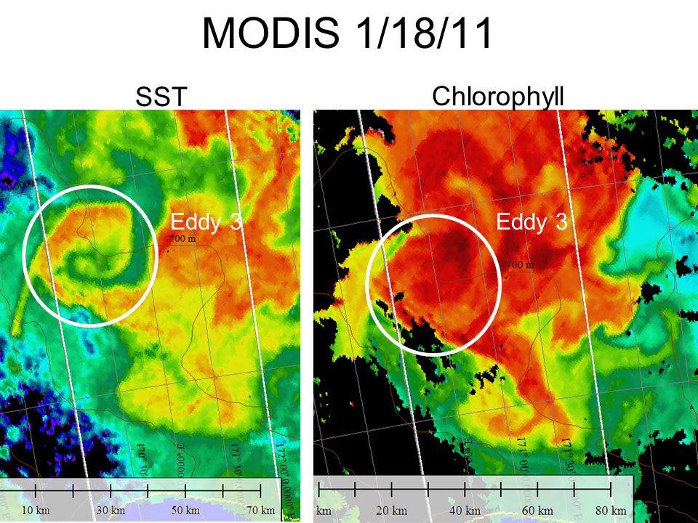
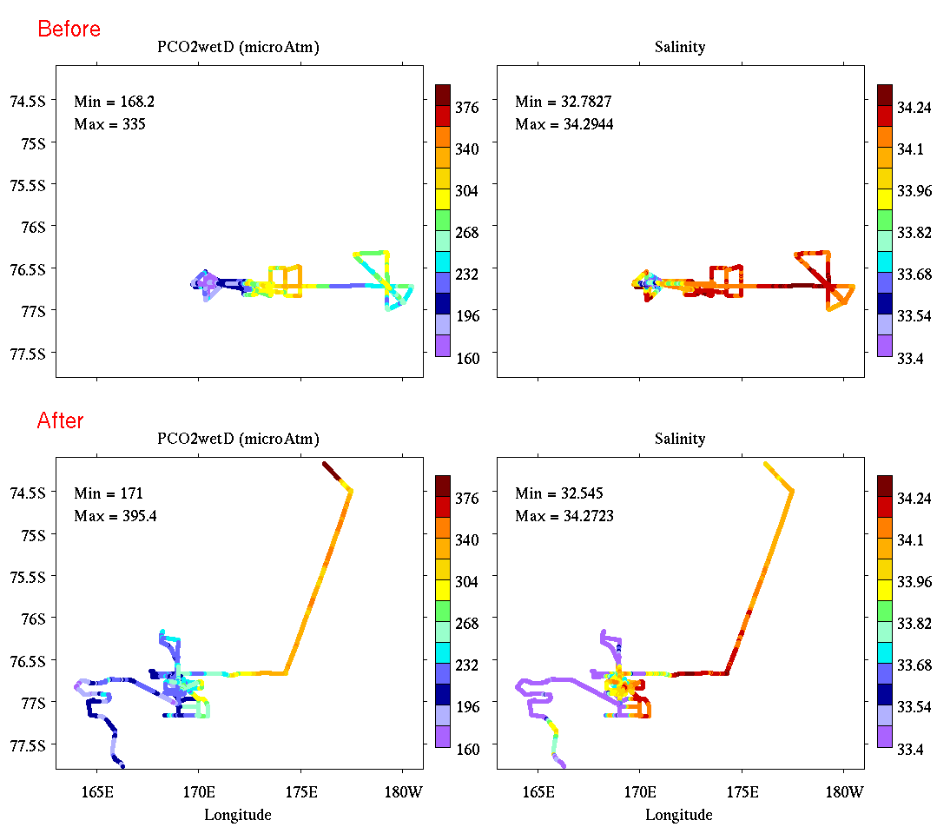
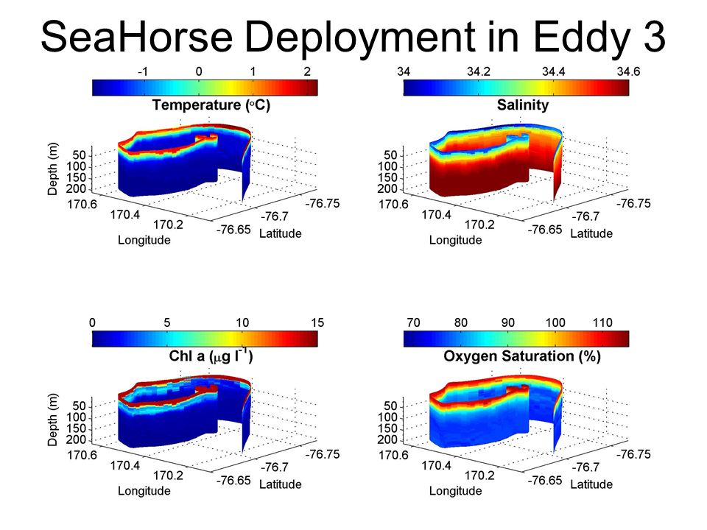
Western Ross Sea Process Study
Cyclonic eddy further elevates biomass in the high-biomass region; domed halocline and ferrocline consistent with increased iron supply, yet near-surface waters depleted in iron
Temporal increase (ca. 50%) in nitrite concentration 50-150m
Eddy heat content distinct from surrounding waters, indicating non-local origin; deep salinity suggests formation to the west
Eastward eddy flux of warm, fresh, (previously) high-iron meltwater?
Iron depletion and decrease in chlorophyll from 1st to 2nd occupation

Slide 23
PRISM cruise track
H₁: CDW
H₂: Sediment: banks/coastal
H₃: Sea ice
H₄: Glacial melt
ACC Sea Ice
H₅: ISW
H₆: Dry Valleys
H₇: Vents
I. ACC Sea Ice
II. Eastern Ross Sea Eddies
III. Western Ross Sea
IV. Ross Bank
V. Ross Ice Shelf
VI. Joides Trough
VII. Western Ross Sea II

Slide 24
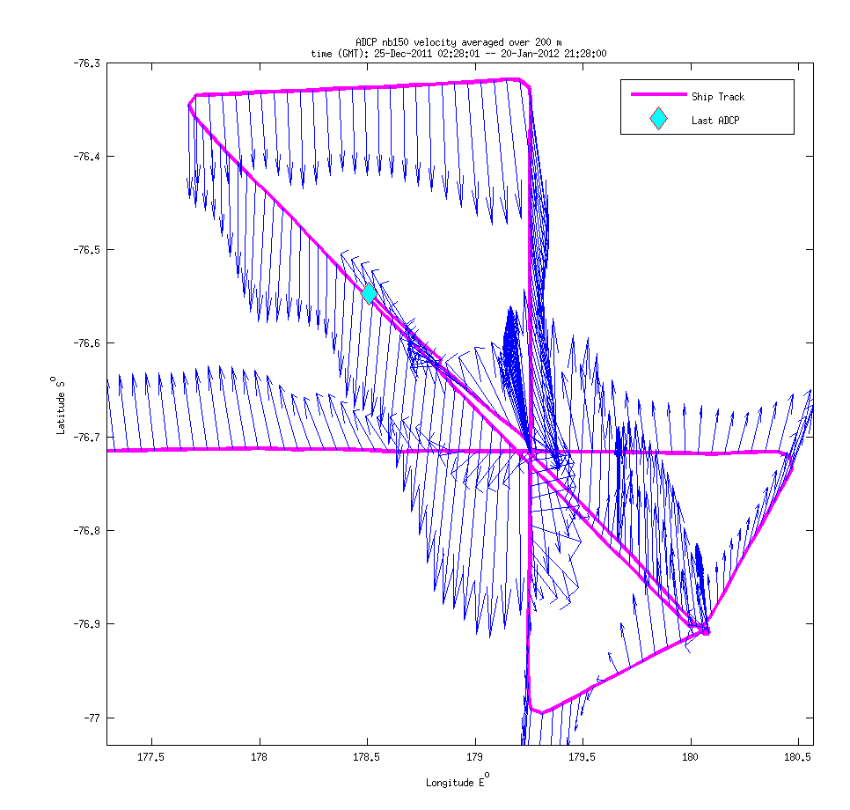
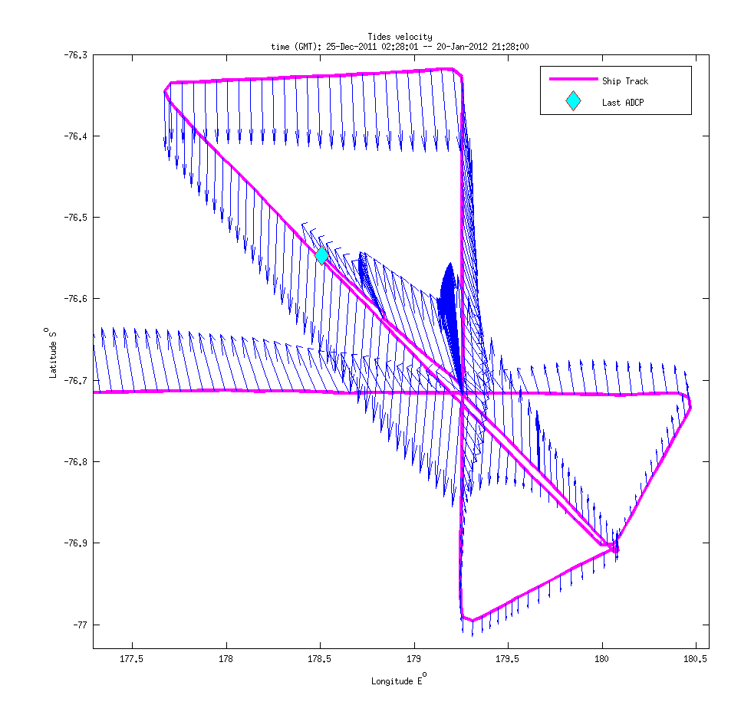
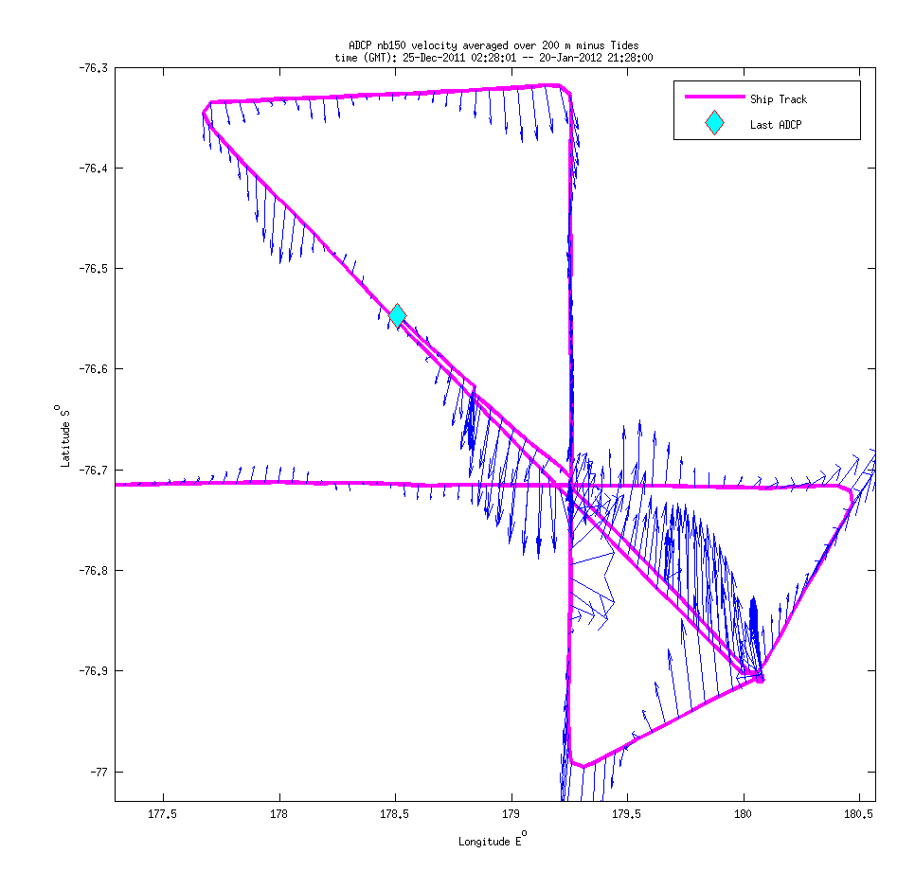
Ross Bank VPR/ADCP Survey
ADCP, 0-200m Padman et al. tidal model Subtidal currents
Notes:
Dear Laurie,
Just wanted to send along a note of thanks for making your Ross Sea tidal model available. We are using it in real-time to detide the underway ADCP data in order to estimate the subtidal flow. The attached figure shows some recent results from a survey of Ross Bank, with the central crossing point of all the tracks located on the crest. Note that the line running SE-NW has been occupied twice, once when the tide was running north, and the other when the tide was running south (middle panel; two tracks indicated by black arrows). Close examination of the predicted subtidal flow (right panel) shows a consistent depiction of the residual current, which is to the north SE of the crest and to the south NW of the crest. The direction of the around-bank flow is qualitatively consistent with expectation from the Dinniman et al. ROMS model results, and we will certainly make detailed comparisons in due course. In any case, we thought you might enjoy hearing about our initial findings. Once again, thanks for providing this great resource!
Best Wishes,
Dennis McGillicuddy

Slide 25
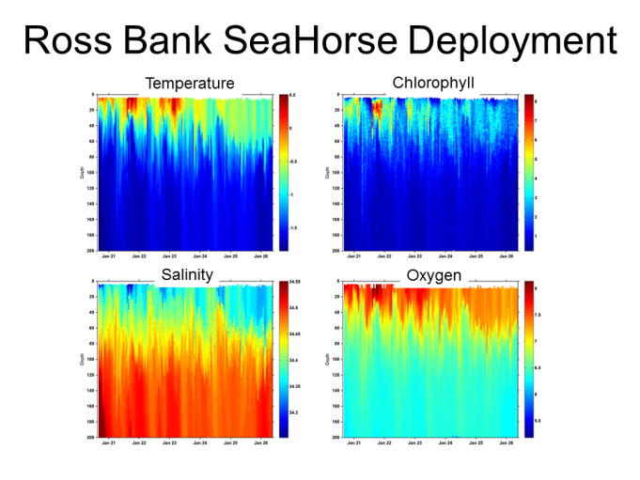
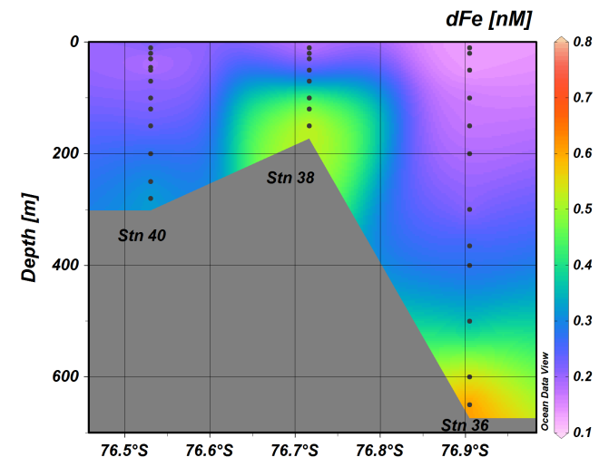
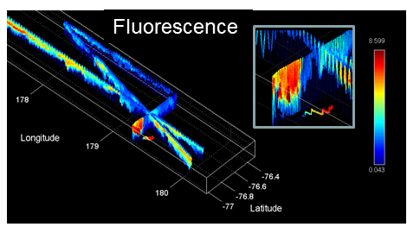
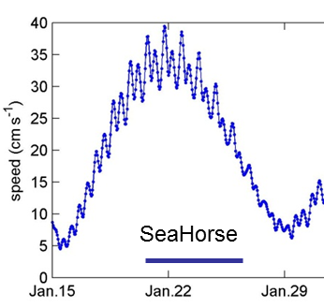
Ross Bank
Hydrographic characteristics
Crest colder, saltier, less stratified
Fluorescence enhanced on the more stratified periphery
ADCP velocity suggests counter-clockwise around-bank flow
Strong spring-neap cycle, tidal speeds ranging from 35 to 15 cm s⁻¹
Dissolved iron enhanced on the crest during spring tides, much less on neap tide
Rapid removal of iron from the aphotic zone on the crest suggests advective loss; hydrographic time-series also indicative of advection
Impact of iron supply from Ross Bank could be spread into the interior Ross Sea via advection
Iron also enhanced in benthic nepheloid layers on the flanks of Ross Bank

Slide 26
PRISM cruise track
H₁: CDW
H₂: Sediment: banks/coastal
H₃: Sea ice
H₄: Glacial melt
ACC Sea Ice
H₅: ISW
H₆: Dry Valleys
H₇: Vents
I. ACC Sea Ice
II. Eastern Ross Sea Eddies
III. Western Ross Sea
IV. Ross Bank
V. Ross Ice Shelf
VI. Joides Trough
VII. Western Ross Sea II

Slide 27
Ross Ice Shelf Circulation
Smethie and Jacobs, 2005

Slide 28
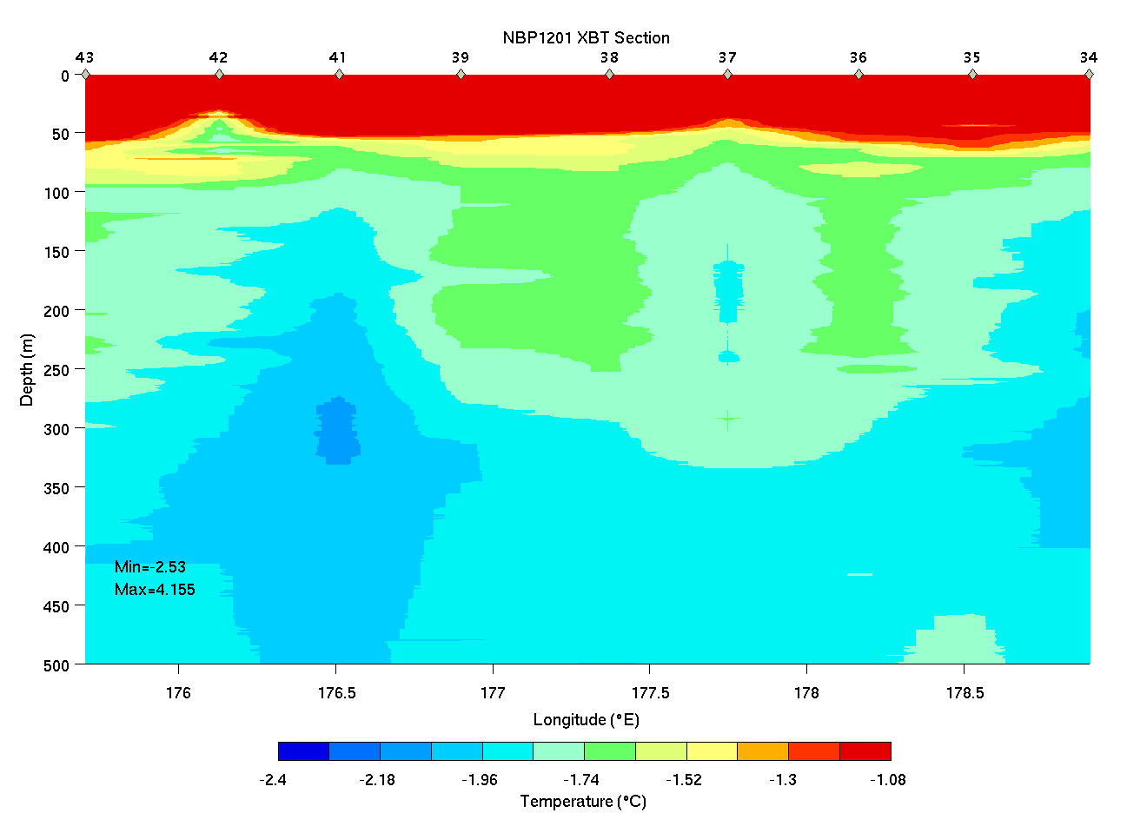
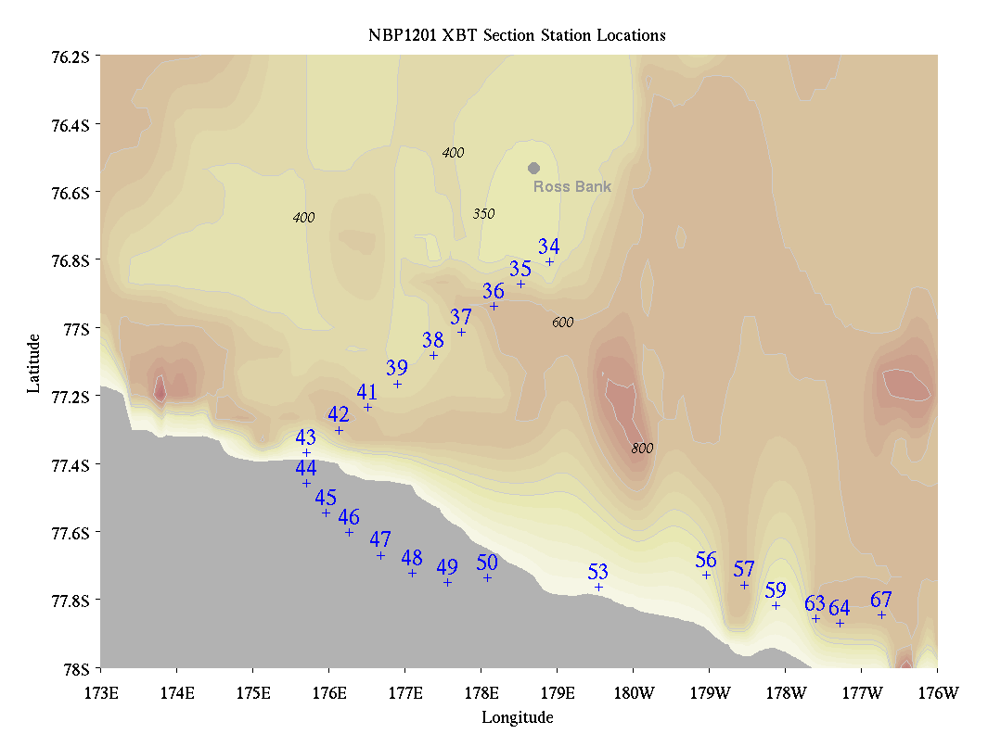
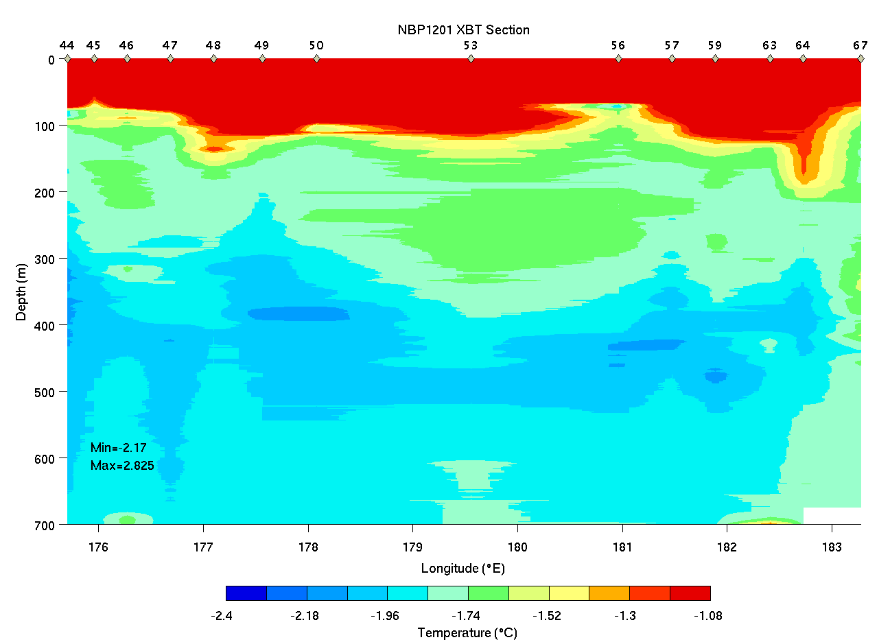
Ross Bank to Ice Shelf XBT Survey

Slide 29
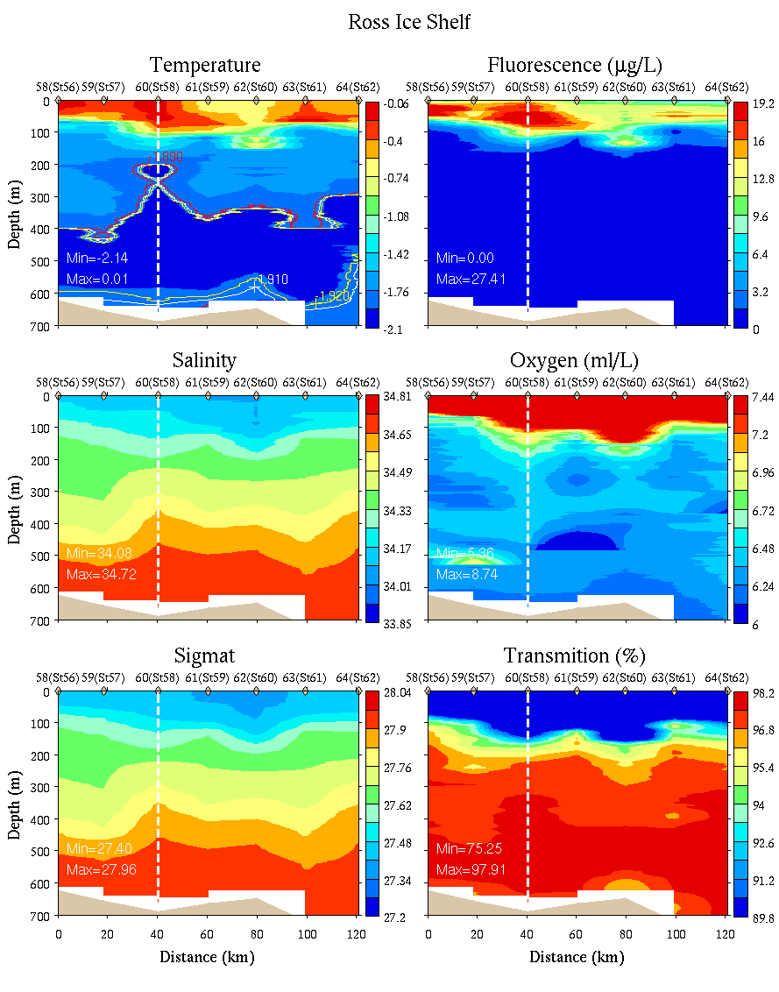
Ice Shelf CTD Survey
0-700m

Slide 30
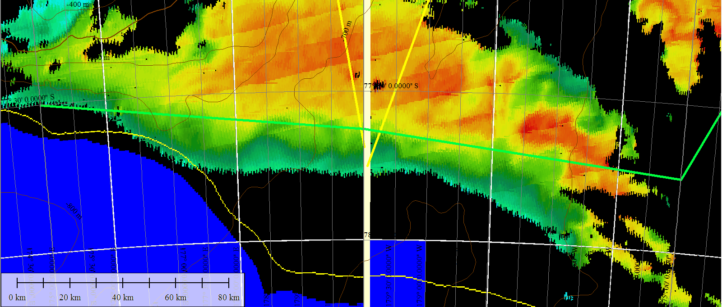
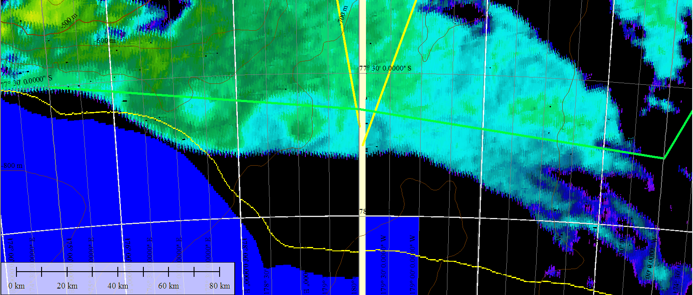
Ross Ice Shelf satellite imagery – Jan 22
Chl
SST

Slide 31
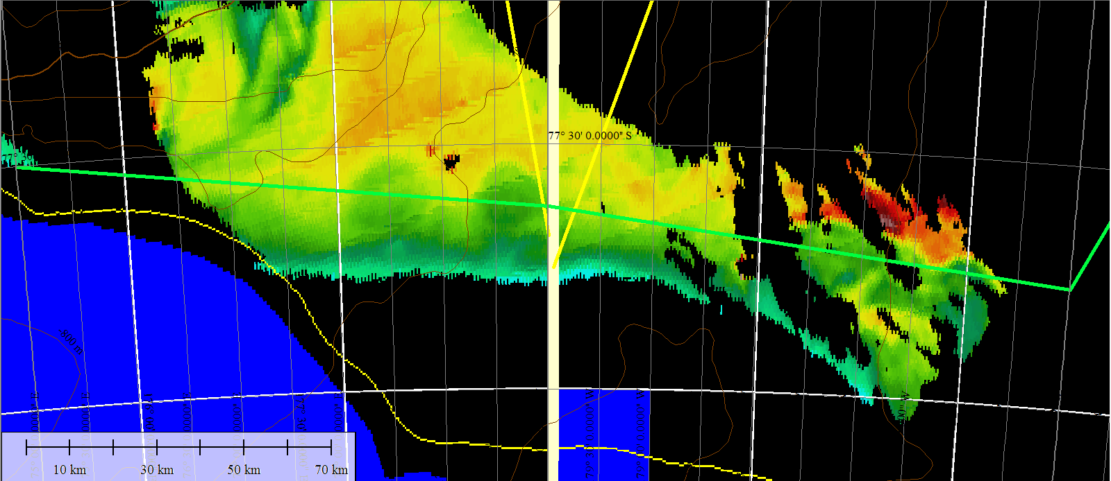
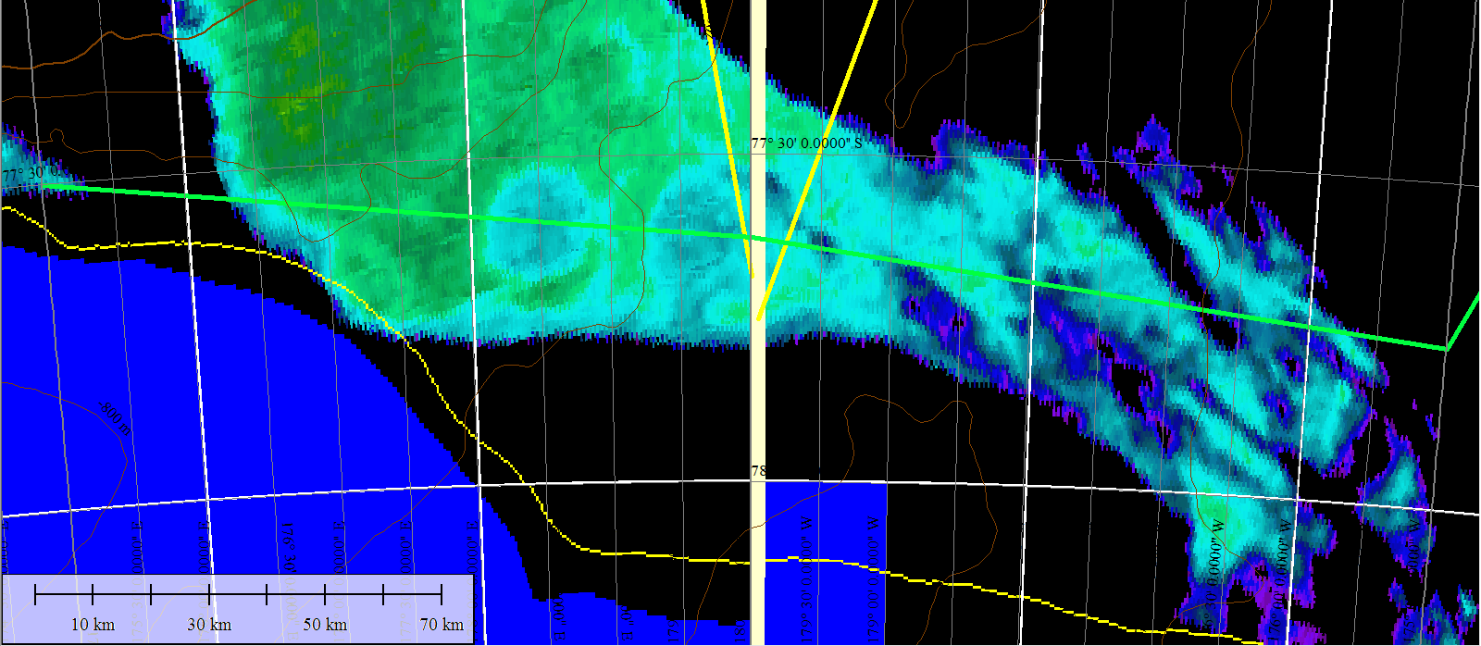
Ross Ice Shelf satellite imagery – Jan 25
Chl
SST

Slide 32
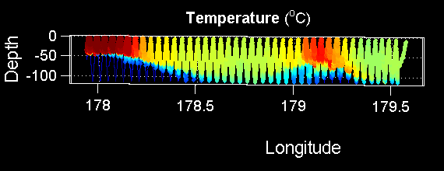
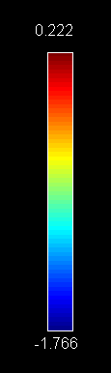
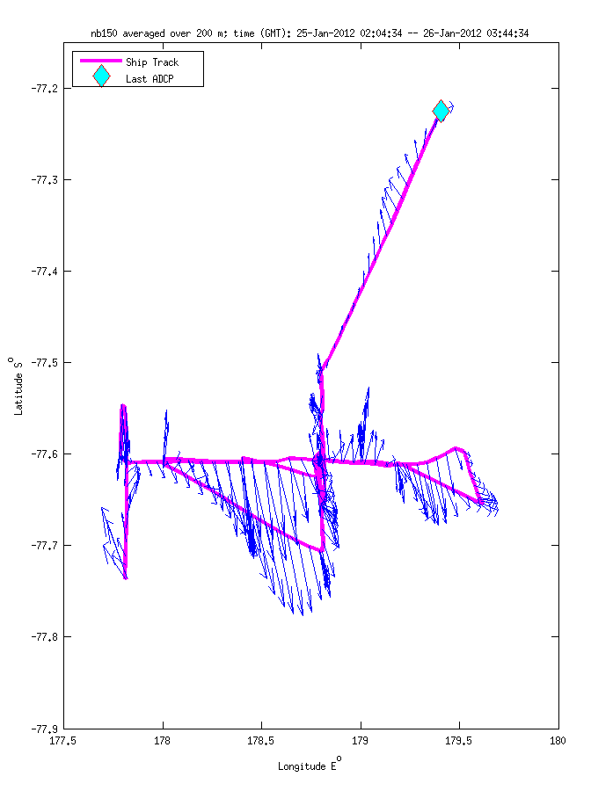
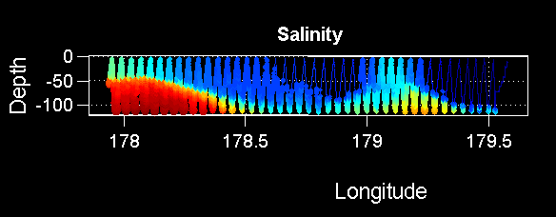
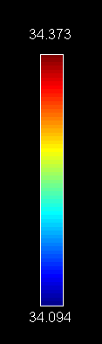
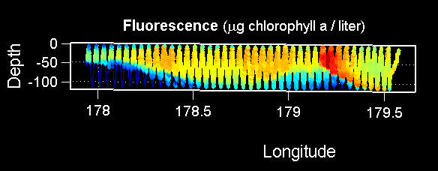
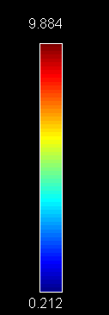
Ross Ice Shelf Eddy (VPR9, 1/26)
Temperature
Salinity
Fluorescence

Slide 33


Ross Ice Shelf
First ever iron measurements in Ice Shelf Water; concentrations similar to the MCDW end-member at 0.3-0.5 nM
Near-surface waters adjacent to the RIS were cold, fresh, and relatively enhanced in iron (ca. 0.2 nM) apparently due to glacial meltwater
Upper-ocean anticyclonic eddies can transport (previously) iron-rich waters northward, producing substantial blooms of Phaeocystis

Slide 34
PRISM cruise track
H₁: CDW
H₂: Sediment: banks/coastal
H₃: Sea ice
H₄: Glacial melt
ACC Sea Ice
H₅: ISW
H₆: Dry Valleys
H₇: Vents
I. ACC Sea Ice
II. Eastern Ross Sea Eddies
III. Western Ross Sea
IV. Ross Bank
V. Ross Ice Shelf
VI. Joides Trough
VII. Western Ross Sea II

Slide 35




Ross Bank – Pennell Bank – Joides Trough – Mawson Bank VPR Survey (VPR10)
Temperature
Salinity
Fluorescence
Backscatter

Slide 36


Ross Bank – Pennell Bank – Joides Trough – Mawson Bank XBT section
Ross Pennell Mawson Pennell

Slide 37



Joides Trough
MCDW present on both eastern and western flanks of Pennell Bank, as well as its crest
Most prominent expression of MCDW on the crest of Mawson Bank; also present on the eastern flank (western flank not sampled).
Except for an area of high Phaeocystis abundance on the southwestern transect across Pennell Bank, VPR observations suggest high abundance of small chain-forming diatoms and copepods, particularly in the northwest part of the survey
Surface dissolved Fe values higher (~0.2 nM) on the northern transect, perhaps reflecting the lesser time that these waters have been free of sea ice cover.
Benthic Fe sources from shelf depressions (rather than banks) may be at least as important in supplying Fe to surface waters as intrusions of MCDW.

Slide 38
PRISM cruise track
H₁: CDW
H₂: Sediment: banks/coastal
H₃: Sea ice
H₄: Glacial melt
ACC Sea Ice
H₅: ISW
H₆: Dry Valleys
H₇: Vents
I. ACC Sea Ice
II. Eastern Ross Sea Eddies
III. Western Ross Sea
IV. Ross Bank
V. Ross Ice Shelf
VI. Joides Trough
VII. Western Ross Sea II

Slide 39
End

Slide 40


Toward an Iron Budget for the Ross Sea: PRISM Iron Observations
CDW
Temperature
Temperature
MCDW
AASW
LSSW, HSSW
ISW
Salinity
Oxygen

Slide 41


PRISM Iron Observations
Deepest Sample at Every Cast
CDW
Temperature
Temperature
MCDW
AASW
LSSW, HSSW
ISW
Salinity
Oxygen

Slide 42

Orsi water mass volumes

Slide 43

Composite profiles of dFe
Colored circles: samples within benthic nepheloid layer

Slide 44

Profiles of Fe, beam-c, NO₃
Red line: top of BNL
Blue line: max MLD (ROMS hindcast)

Slide 45


>30% of dFe resides within 100 mab

Slide 46

Regional subdomains

Slide 47


Toward an iron budget for the Ross Sea: estimating the “winter reserve”
Observations: dFe(z)_{i}
$$\hat{{dFe}_{i}}=\frac{1}{{MLD}_{i}}\int_{{MLD}_{i}}^{0}{{dFe(z)}_{i}}dz$$
$$\hat{{NO3}_{i}}=\frac{1}{{MLD}_{i}}\int_{{MLD}_{i}}^{0}{{NO3(z)}_{i}}dz$$

Slide 48




Winter reserves
Bottom Fe
Winter MLD
Winter ML Fe
Winter ML NO₃

Slide 49

Fe winter reserve

Slide 50

NO₃ winter reserve

Slide 51




Calculating drawdown ratios
Winter reserves
Apparent drawdown
$$\hat{{dFe}_{i}}=\frac{1}{{MLD}_{i}}\int_{{MLD}_{i}}^{0}{{dFe(z)}_{i}}dz$$
$$\hat{{NO3}_{i}}=\frac{1}{{MLD}_{i}}\int_{{MLD}_{i}}^{0}{{NO3(z)}_{i}}dz$$
$$\tilde{{dFe}_{i}}=\int_{EZ}^{0}{pos\left({\hat{{dFe}_{i}}−dFe(z)}_{i}+dFesea ice+dFeglacial ice\right)}dz$$
$$\tilde{{NO3}_{i}}=\int_{EZ}^{0}{pos\left({\hat{{NO3}_{i}}−NO3(z)}_{i}\right)}dz$$

Slide 52




Drawdown
0-10m
Fe drawdown NO₃ drawdown
NO₃:Fe drawdown (10⁵ mol:mol) Fe:NO₃ drawdown (10⁵ mol:mol)

Slide 53


Fe, NO₃ drawdown ratios
Mean NO₃:Fe drawdown ratio: 1.2 ± 0.7 x 10⁵ mol N / mol Fe [± 95% conf]
Using Redfield to convert to carbon units: C:Fe ratio of 800,000 ± 460,000
including modeled sea ice: 328,000 ± 47,000
Algal assimilation ratios
Feng et al. 2000 250,000-400,000
Twining et al. 2004 166,000-390,000
Boyd et al. 2012 5000-450,000
Strzepek et al. 2011,2012 10,000-3,000,000

Slide 54

Toward an iron budget for the Ross Sea: estimating demand
Arrigo et al. 2008 satellite-based estimate of primary productivity 1997-2006:
5.7 mol C m⁻² yr⁻¹
Using an f-ratio of 0.5
Asper and Smith 1999
Sweeney et al. 2000
Long et al. 2011
Annual new production: 2.85 mol C m⁻² yr⁻¹
Assuming C:Fe of 450,000: 6.7 µmol Fe m⁻² yr⁻¹

Slide 55

An iron budget for the Ross Sea
43% of the iron budget is “missing”
Potential “fixes” to the problem
Decreasing f-ratio from 0.5 to 0.215
Decreasing C:Fe assimilation ratio from 450,000 to 193,500
PRISM data: C:Fe = 800,000 ± 460,000
including modeled sea ice: 328,000 ± 47,000

Slide 56
End

Slide 57


Summertime excess Fe

Slide 58

Extras

Slide 59
Iron Sources
MCDW 0.3-0.5 nM offshore source; volume decreases shoreward
ISW 0.3-0.5 nM large volume on shelf
Benthic
Nepheloid
Layer 0.6-1.9 nM more available in shallow / less stratified areas
Ice melt variable most proximal source for phytoplankton
Vents - -

Slide 60





An iron budget for the Ross Sea
Winter reserves
Apparent drawdown
Remaining dFe at time of observations
$$\hat{{dFe}_{i}}=\frac{1}{{MLD}_{i}}\int_{{MLD}_{i}}^{0}{{dFe(z)}_{i}}dz$$
$$\hat{{NO3}_{i}}=\frac{1}{{MLD}_{i}}\int_{{MLD}_{i}}^{0}{{NO3(z)}_{i}}dz$$
$$\tilde{{dFe}_{i}}=\int_{EZ}^{0}{pos\left({\hat{{dFe}_{i}}−dFe(z)}_{i}\right)}dz$$
$$\tilde{{NO3}_{i}}=\int_{EZ}^{0}{pos\left({\hat{{NO3}_{i}}−NO3(z)}_{i}\right)}dz$$
$${dFe}_{i}^{′}=\int_{EZ}^{0}{pos\left(d{Fe(z)}_{i}−{dFe}_{min}\right)}dz$$

Slide 61
Evidence for iron supply from sea ice
Pre-bloom conditions consist of
High Fe
High Fv/Fm
Low Chl
Where did we find those conditions?
Offshore sea ice
Franklin Island
Joides Trough, northern transect
All areas in which ice was melting or recently cleared
[sea ice movie]

Slide 62

PRISM nutrient data
Phosphate
Silicate
Nitrate + Nitrite
Nitrate + Nitrite
Thank you, Lindsey!!!

Slide 63

PRISM NutrientsChl, Fe
Phosphate Nitrite Nitrate+Nitrite
Ammonium Silicate Chlorophyll
N+N / P N+N/Si Fe
Thank you, Olga!!!

Slide 64

Delta Fv/Fm (48 hrs) All stations
Biggest response (52% increase in Fv/Fm at 48 hours was HMB region, 1st occupation - Also highest fluorescence (biomass)
Franklin Island – Highest in situ Fv/Fm – Fv/Fm went down in experimental controls but was maintained in Fe treatment.

Slide 65
Example 1: Ross Bank / Pennell Bank – Little signal of iron-addition effect at Ross Bank?

Slide 66
Example 2: Ice Shelf – Enhanced effect of iron addition further from Ice?

Slide 67
Example 3: Eddy comparison: Very strong iron-addition effect in Eddy 3 (High Biomass/Diatoms)

Slide 68
Dataset Summary
CTD – Bottle FRRF data (Fv/Fm is on cruise DVD)
Underway FRRF – Continuous
Short-Term and Long-Term Bioassays (Chl, Nutrients, FRRF, Community Structure and Samples for Protein Analysis)
CTD (Surface and Subsurface Chlorophyll Maximum) Samples for Protein Analysis
Combine these datasets with Fe, HPLC, Nutrients, Community Composition (Microscopy) and the physical environment.

Slide 69



N-S Section at 169E
Salinity
Geostrophic velocity

Slide 70
Extras

Slide 71

PRISM Iron Observations
CDW
Temperature
Temperature
MCDW
AASW
LSSW, HSSW
ISW
Salinity
% oxygen saturation

Slide 72


Sea Ice and Chlorophyll Climatologies
Arrigo et al.

Slide 73
Western Ross Sea Process Study

Slide 74
Ross Bank

Slide 75
Eddy 1 and Eddy 2

Slide 76
Ross Ice Shelf

Slide 77
Joides Trough

Slide 78

Sedwick group Fe data towfish samples

Slide 79
Science Meeting Feb 8

Slide 80
PRISM cruise track
I. ACC Sea Ice
II. Eastern Ross Sea Eddies
III. Western Ross Sea
IV. Ross Bank
V. Ross Ice Shelf
VI. Joides Trough
VII. Western Ross Sea II

Slide 81




MVP Survey: Ice Edge / High Biomass / Low Biomass
Temperature
Salinity
Fluorescence
LOPC
Ice Edge HB1 LB1

Slide 82




MVP Survey: Ice Edge / High Biomass / Low Biomass – 2nd
Salinity
Temperature
Fluorescence
LOPC
Ice Edge HB1 LB1

Slide 83


Ice Edge – High Biomass – Low Biomass
0-150m
0-700m

Slide 84


Ice Edge – High Biomass – Low Biomass: 2nd
0-150m
0-700m

Slide 85


Sedwick group Fe data
Jan 11-20
Jan 30 – Feb 6

Slide 86
Underway pCO₂ and salinity
pCO₂
Salinity
Jan 15-20
pCO₂
Salinity
Jan 30 – Feb 6

Slide 87


Western Ross Sea
0-150m
0-700m

Slide 88
Sedwick group Fe data
Jan 11-20
Jan 30 – Feb 6

Slide 89




Ice Edge Eddy VPR Survey (VPR11)
Temperature
Salinity
Fluorescence
Backscatter

Slide 90

Ice Edge Eddy ADCP Survey
Anticyclone #2

Slide 91


Ice Edge Eddy: East-West
0-150m
0-700m

Slide 92


Ice Edge Eddy: North-South
0-150m
0-700m

Slide 93

Ice Edge Eddy SeaHorse Deployment
Temperature
Chlorophyll
Salinity
Oxygen

Slide 94

Ice Edge Eddy SeaHorse Deployment
Temperature
Chlorophyll
Salinity
Oxygen

Slide 95




Ice Edge Eddy SeaHorse Deployment
Temperature
Chlorophyll
Salinity
Oxygen

Slide 96




Ice Edge Eddy VPR Survey (VPR13)
Temperature
Salinity
Fluorescence
Backscatter
W,F,H
C,S,L

Slide 97


Ice Edge Eddy – Feb 4 MODIS
Chlorophyll
SST
Eddy center
Eddy center

Slide 98


N-S Section at 169E
0-150m
0-700m

Slide 99

North-South Section at 169E
0-700m
Sedwick et al. Fe data

Slide 100


VPR Frontal Survey Feb 3
MODIS Feb 1
112
106
111
107
109
110
108

Slide 101




Frontal Area VPR Survey (VPR12)
Temperature
Salinity
Fluorescence
Backscatter

Slide 102


Front - North
0-150m
0-700m

Slide 103


Front - middle
0-150m
0-700m

Slide 104


Front - South
0-150m
0-700m

Slide 105


N-S Section at 170E
0-150m
0-700m

Slide 106

Western Ross Sea – McMurdo Sound
VPR Survey trackline overlayed on Feb 4 MODIS image

Slide 107




Western Ross Sea – McMurdo Sound
VPR Survey (VPR14-15)
Temperature
Salinity
Fluorescence
Backscatter

Slide 108

And now for the exciting conclusion of the mystery of the planktonic beans…

Slide 109



Eddy 2
Outside Eddy
Inside
Eddy
Density
Phaeocystis colonies
“Kidney beans”

Slide 110

Images from dissecting scope
16x, 1mm
16x
16x
40x
16x, 1mm

Slide 111

High (Hai) magnification image of bean from St. 96, 100/120m pooled sample

Slide 112
Gut content analysis (Hai)
Hoop net, station 113
Ice Edge Eddy Center
Krill – empty
Pteropod – empty
Isopod – lots of diatoms
Phaeocystis present in copepod fecal pellets

Slide 113
PRISM cruise track
I. ACC Sea Ice
II. Eastern Ross Sea Eddies
III. Western Ross Sea
IV. Ross Bank
V. Ross Ice Shelf
VI. Joides Trough
VII. Western Ross Sea II

Slide 114

Short Term Experiment Locations

Slide 115
Long-Term: Incubation Experiment 1 – Eddy 2

Slide 116
Long-Term: Incubation Experiment 2 – Ross Bank

Slide 117
Long-Term: Incubation Experiment 3 – Ross Ice Shelf

Slide 118
Extras

Slide 119

Feb 5 MODIS

Slide 120

Extracted Chl versus CTD Fluorometer

Slide 121

Ice Edge – High Biomass – Low Biomass: 2nd
0-700m
Sedwick et al. Fe data

Slide 122


Ross Bank Survey: E-W transect
0-150m
0-700m

Slide 123


Ross Bank Survey: N-S transect
0-150m
0-700m

Slide 124


Ross Bank Survey: SE-NW transect
0-150m
0-700m

Slide 125
Science Meeting 2/5/12
Joides Trough

Slide 126
Ross Bank – Pennell Bank – Joides Trough – Mawson Bank VPR Survey (VPR10)
Temperature
Salinity
Fluorescence
Backscatter

Slide 127
Ross Bank – Pennell Bank – Joides Trough – Mawson Bank XBT section
Ross Pennell Mawson Pennell

Slide 128


Joides Trough – Northeastern Section
0-700m
Sedwick et al. Fe data
Note axis reversal

Slide 129


Joides Trough – Southwestern Section
0-700m
Sedwick et al. Fe data
Note axis reversal

Slide 130




Joides Trough to Western Ross Sea MVP Survey
Temperature
Salinity
Fluorescence
LOPC

Slide 131


Pennell Bank – Western Ross Sea XBT section
Pennell WRS

Slide 132

Joides Trough – Southwestern Section
0-150m
0-700m

Slide 133


Joides Trough – Northeastern Section
0-150m
0-700m

Slide 134

Joides Trough – Northeastern Section
0-150m
0-700m

Slide 135
Science Meeting1/29/12
Ross Bank Process Study
Ross Ice Shelf Process Study

Slide 136





Ross Bank VPR Survey (VPR9, 1/20-1/21)
Temperature
Salinity
Fluorescence
Backscatter

Slide 137


Ross Bank Survey: E-W transect
0-150m
0-700m

Slide 138


Ross Bank Survey: N-S transect
0-150m
0-700m

Slide 139


Ross Bank Survey: SE-NW transect
0-150m
0-700m

Slide 140


Dissolved Fe on Ross Bank
SE-NW section
N-S section

Slide 141

Ross Bank tidal velocity amplitude
SeaHorse

Slide 142




Ross Bank SeaHorse Deployment
Temperature
Chlorophyll
Salinity
Oxygen

Slide 143
Ross Bank Survey: SE-NW transect
0-150m
0-700m

Slide 144


Ross Bank Survey #2: SE-NW transect
0-150m
0-700m

Slide 145

Ross Bank SE-NW transect before and after

Slide 146
Fe on the crest of Ross Bank: before and after
Ross Bank Summit, 21 Jan 2012
dissolved Fe (nM)
depth
(m)
Ross Bank Summit, 26 Jan 2012
dissolved Fe (nM)
depth
(m)

Slide 147
Ross Bank VPR/ADCP Survey
ADCP, 0-200m Padman et al. tidal model Subtidal currents
Notes:
Dear Laurie,
Just wanted to send along a note of thanks for making your Ross Sea tidal model available. We are using it in real-time to detide the underway ADCP data in order to estimate the subtidal flow. The attached figure shows some recent results from a survey of Ross Bank, with the central crossing point of all the tracks located on the crest. Note that the line running SE-NW has been occupied twice, once when the tide was running north, and the other when the tide was running south (middle panel; two tracks indicated by black arrows). Close examination of the predicted subtidal flow (right panel) shows a consistent depiction of the residual current, which is to the north SE of the crest and to the south NW of the crest. The direction of the around-bank flow is qualitatively consistent with expectation from the Dinniman et al. ROMS model results, and we will certainly make detailed comparisons in due course. In any case, we thought you might enjoy hearing about our initial findings. Once again, thanks for providing this great resource!
Best Wishes,
Dennis McGillicuddy

Slide 148



VPR Section toward Ross Bank
(VPR8, 1/20-1/21)
Temperature
Salinity
Fluorescence

Slide 149




Ross Ice Shelf MVP Survey
Temperature
Salinity
LOPC
Fluorescence

Slide 150

Ross Ice Shelf MVP Survey

Slide 151
Ross Bank to Ice Shelf XBT Survey

Slide 152

Ice Shelf Survey
0-150m
0-700m

Slide 153


Ice Shelf Survey
Sedwick et al. Fe
0-700m

Slide 154
Ross Ice Shelf satellite imagery – Jan 22
Chl
SST

Slide 155
Ross Ice Shelf satellite imagery – Jan 25
Chl
SST

Slide 156
Ross Ice Shelf Eddy (VPR9, 1/26)
Temperature
Salinity
Fluorescence

Slide 157


Ice Shelf Eddy: East- West Section
0-150m
0-700m

Slide 158


Ice Shelf Eddy: North-South Section
0-150m
0-700m

Slide 159

Ice Shelf Eddy: East- West Section
0-700m
Sedwick et al. Fe
Lateral eddy flux of (iron) and biomass?

Slide 160
Extras

Slide 161
Ice Edge – High Biomass – Low Biomass
0-150m
0-700m

Slide 162


Ice Edge – High Biomass – Low Biomass
0-150m
0-700m

Slide 163


SST Jan 13 MODIS Chl Jan 12

Slide 164

SSMI Time-series Dec 24-Jan 26

Slide 165

Ross Ice Shelf ADCP Survey

Slide 166

Ross Ice Shelf ADCP Survey
178 30E 179 45W

Slide 167
Science Meeting1/22/12

Slide 168

SeaHorse Deployment in Eddy 3

Slide 169

SeaHorse Deployment in Eddy 3

Slide 170

Ross Bank Survey

Slide 171
PRISM cruise plan
H₁: CDW
H₂: Sediment: banks/coastal
H₃: Sea ice
H₄: Glacial melt
H₅: ISW
H₆: Dry Valleys
H₇: Vents
H₁,
H₃
H₁,
H₃
H₂,
H₃
H₂,
H₃
PHS
H₂
PHS
HV
H₁
HV
H₂
H₄
H₄
HV: Hydrothermal vent near Franklin Island
PHS: penguin hotspots - WOS
HV: Hydrothermal vent near Franklin Island
PHS: penguin hotspots - WOS

Slide 172

PRISM Sampling
H₁: CDW
H₂: Sediment: banks/coastal
H₃: Sea ice
H₄: Glacial melt
H₅: ISW
H₆: Dry Valleys
H₇: Vents
Outside ice
H₁
In ice
H₃
H₁
H₁
Outside ice
Deploy MVP,
TM Towfish
UW XBTs
H₂
H₂
Stations in MCDW
H₃
H₄
H₁
H₅
Stations in ISW

Slide 173
Science Meeting1/19/12
Western Ross Sea Mesoscale Process Study: Jan 11-19
Large-scale transect: Ice edge – High Biomass – Low Biomass
MVP
CTD transect (stations 7-9)
Eddy 3:
VPR survey (VPR 4)
CTD grid – 1st occupation (stations 10-18)
VPR survey (VPR 7)
CTD grid – 2nd occupation (stations 27-35)
Frontal region
VPR survey (VPR 5)
CTD transect (stations 19-21)
Low Biomass region
VPR survey (VPR 6)
CTD transect (stations 22-26)
Revisit Eddy 2

Slide 174

Western Ross Sea Process Study: Jan 11-19
Frontal Survey
Station 9
LB1
Eddy 3
Station 8
HB1
Ice Edge
Station 7
Low-biomass survey

Slide 175

Western Ross Sea Process study Jan 11-19

Slide 176
MVP Survey: Ice Edge / High Biomass / Low Biomass
Temperature
Salinity
Fluorescence
LOPC
Ice Edge HB1 LB1

Slide 177

Sedwick group Fe data

Slide 178

Ice-Edge to Low Biomass (With Front)

Slide 179

Frontal and low-biomass area surveys
22
23
24
25
26
21
20
19

Slide 180




VPR Frontal Survey 1/16-17
Temperature
Salinity
Fluorescence
Backscatter
Station 19
20
Station 21

Slide 181

Frontal ADCP Survey (VPR5)

Slide 182


High Biomass / Low Biomass Frontal Region
0-150m
0-700m

Slide 183

High Biomass / Low Biomass Frontal Region
0-700m CTD: Note x-axis reversal
Sedwick group Fe data

Slide 184


High Biomass / Low Biomass Frontal Region
0-150m
0-700m

Slide 185

Nutrient data stations 1-12
Phosphate Nitrite Nitrate+Nitrite
Ammonium Silicate Chlorophyll
N+N / P N+N/Si CORSACS Fe

Slide 186

Nutrient data stations 1-12
Phosphate
Silicate
Nitrate + Nitrite
Nitrate + Nitrite

Slide 187




Low biomass area survey – 1/17/12
Temperature
Salinity
Fluorescence
Backscatter
Station 22
Station 26

Slide 188

Low Biomass ADCP Survey (VPR6)

Slide 189


Low Biomass CTD transect
0-150m
0-700m

Slide 190


Low Biomass Area
0-150m
0-700m

Slide 191

Fm
FvFm
Low Biomass

Slide 192


CTD Fluorometer vs. Extracted Pigments
Smith lab extracted Chl
CTD
Sfc
150m
Frontal
region
Sfc
150m
Low
Biomass

Slide 193


Eddy 3 VPR Survey: VPR 4, Jan 14-15
Station 10
Station 9

Slide 194




VPR Survey of Eddy 3
Temperature
Salinity
Fluorescence
Optical Backscatter

Slide 195
Eddy 3 CTD Survey, 1st occupation
18
17
10
13
14
12
11
16
15

Slide 196


Eddy 3, First Occupation: East-West Transect
0-150m
0-700m

Slide 197


Eddy 3, First Occupation: East-West Transect
0-150m
0-700m

Slide 198


Eddy 3, First Occupation: North-South Transect
0-150m
0-700m

Slide 199


Eddy 3, First Occupation: North-South Transect
0-150m
0-700m

Slide 200

Eddy 3, First Occupation: East-West Transect
0-700m
Sedwick group Fe data

Slide 201

Fm
Fv/Fm
EDDY 3 – First Pass

Slide 202


CTD Fluorometer vs. Extracted Pigments
Smith lab extracted Chl
CTD
Sfc
150m
East-
West
Sfc
150m
North-
South

Slide 203


MODIS 1/18/11
SST
Chlorophyll
Eddy 3
Eddy 3

Slide 204




VPR Survey of Eddy 3
Temperature
Salinity
Fluorescence
Optical Backscatter

Slide 205

ADCP from 2nd VPR Survey of Eddy 3

Slide 206

SeaHorse Trajectory

Slide 207


Eddy 3, 2nd Occupation: East-West Transect
0-150m
0-700m

Slide 208


Eddy 3, 2nd Occupation: East-West Transect
0-150m
0-700m

Slide 209


Eddy 3, 2nd Occupation: North-South Transect
0-150m
0-700m

Slide 210


Eddy 3, 2nd Occupation: North-South Transect
0-150m
0-700m

Slide 211

Eddy 3, 2nd Occupation: East-West Transect
0-700m
Sedwick group Fe data

Slide 212

Hai’s microscopy

Slide 213
Analysis of VPR observations
Focus on Eddy 3 survey
Temperature, Salinity and Fluorescence in top 100 m

Slide 214


Low Salinity near surface (20 m)
High Salinity at depth (100 m)
Density is mainly controlled by salinity at these temperatures.
Dense core eddy is a cyclone.
Circulation is clockwise.

Slide 215


High temperature on the western side of the eddy center.
Higher temperatures extend through 60 m but not much deeper.

Slide 216

Max Heat at
-76.74
170.25
Total heat content relative to in-situ freezing integrated 0 to 100 m.
Largest heat content is west of eddy center.

Slide 217



Section at 76.74 S
Higher Fluor west of high Temp which is west of eddy center.
Less stratification to west.

Slide 218



Section at 170.25
Warmer and fresher on west side.
Higher fluor to the west.

Slide 219
Where did the warm water in Eddy 3 come from?
Satellite SST – Jan 13

Slide 220
Well, how did it get here?
Satellite SST – Jan 13
Eastward eddy flux of warm, fresh, (previously) high-iron meltwater?
Retreating sea ice leaves a wake of warm, fresh, (previously) high-iron meltwater?
Either way, these highly stratified conditions favor diatom blooms in the Ross Sea
Deep salinity anomaly in eddy 3
1
2

Slide 221

Eddy 2
Station 6
Inside Eddy 2

Slide 222


Eddy 2 VPR Survey
Outside Eddy
Inside
Eddy

Slide 223
Eddy 2 (VPR 3) Image Categories
Phaeocystis - Many
Phaeocystis - Individual
Marine Snow
Other
“Kidney Beans”
Blurry

Slide 224

Phaeocystis distribution
Covariance of individuals and aggregated colonies
Population center of mass deeper inside the eddy than at the periphery

Slide 225

Kidney beans and marine snow
Both abundant at depth inside the eddy

Slide 226


Slide 227
Next Up
1. Finish Ross Bank Survey
2. Deploy SeaHorse
3. CTD transect on Ross Bank
4. Ross Ice Shelf – in search of ISW
5. Return to Ross Bank
6. 2nd CTD occupation
7. Recover SeaHorse
8. Joides Trough

Slide 228
Ross Bank Survey

Slide 229

PRISM Cruise Track

Slide 230
Ice edge – High Biomass – Low Biomass
Jan 11-12
Frontal Survey
Station 9
LB1
Eddy 3
Station 8
HB1
Ice Edge
Station 7
Low-biomass survey

Slide 231
Fuel Earlier?
Current plan
Feb 5 – arrive ice edge
Earlier fueling – best case
Feb 9 – arrive ice edge
Transit – .5d
Science – 6d
Transit – .5d
Fueling – 1 d
Feb 1 - arrive ice edge
Net: -4 + 6 = 2
Earlier fueling – worst case
Feb 9 – arrive ice edge
Transit – 1.5d
Science – 2.5d
Transit – 1.5d
Fueling – 2.5d
Feb 1 - arrive ice edge
Net: -4 + 2.5 = -1.5

Slide 232
Science Meeting1/15/12

Slide 233
Ice edge – High Biomass – Low Biomass
Jan 11-12
Station 9
LB1
Ice Edge
Station 7
Station 8
HB1

Slide 234
MVP Survey: Ice Edge / High Biomass / Low Biomass
Temperature
Salinity
Fluorescence
LOPC
Ice Edge HB1 LB1

Slide 235
Eddy 3 VPR Survey: Jan 14-15
Station 10
Station 9

Slide 236
Eddy 3 VPR Survey: Jan 14-15
18
17
10
13
14
12
11
16
15

Slide 237
VPR Survey of Eddy 3
Temperature
Salinity
Fluorescence
Optical Backscatter

Slide 238
Hai’s microscopy

Slide 239
Next Up
1. Finish VPR survey at eddy center
2. Deploy SeaHorse
3. CTD at Eddy Center
4. CTD grid survey

Slide 240
Science Meeting1/11/12

Slide 241

PRISM Sampling of Eddies 1 and 2
MODIS Jan 8
Station 4
Inside Geordie
H₁
Station 5
Outside Geordie
H₃
Station 6
Inside Eddy 2
H₂
H₂
H₃
H₄

Slide 242
MVP Survey of Eddies 1 and 2: View from the SW
Salinity
Temperature
Eddy 1
Eddy 2
Fluorescence
LOPC

Slide 243
The MVP MCDW-o-meter
CDW
MCDW
AASW
LSSW, HSSW
ISW

Slide 244



Sedwick Fe data

Slide 245

Eddy 1 “Geordie”
Station 4
“Inside Geordie”
Direction of
Geordie’s
propagation
Station 5
“Outside Geordie”

Slide 246

Geordie’s Velocity Field
Station 5
“Inside Geordie”
Station 6
“Outside Geordie”

Slide 247
Tom and Tommy

Slide 248
Eddy 2
Station 6
Inside Eddy 2

Slide 249

Eddy 2’s Velocity Field
VPR
Survey
Station 6
Inside Eddy 2

Slide 250




VPR Survey of Eddy 2
Temperature
Salinity
Fluorescence
Optical Backscatter

Slide 251
Sample VPR Images 1/10/12
Phaeocystis-
most abundant and very thick at surface
Collapsed Colonies?-
abundant at depth
Marine Snow-
abundant at depth
Other Stuff- rare

Slide 252
Science Planning 1/11/12
H₁: CDW
H₂: Sediment: banks/coastal
H₃: Sea ice
H₄: Glacial melt
H₅: ISW
H₆: Dry Valleys
H₇: Vents
Option 1
Ice Shelf
Ross Bank
Joides Trough
Western Ross
Opportunistic mesoscale studies
Option 2
Mesoscale process study of E-W Chl gradient
Ice Shelf
Ross Bank
Joides Trough
Western Ross
Opportunistic mesoscale studies

Slide 253

MODIS 1/11/12

Slide 254

MODIS 1/11/12

Slide 255
MODIS 1/11/12
MVP/towfish survey to high biomass area
CTD/TMC Station
VPR Survey
Deploy SeaHorse
MVP/towfish survey to low biomass area
CTD/TMC Station (s)
MVP/SeaHorse survey to high biomass area
CTD/TMC Station (s)
VPR Survey vicinity of SeaHorse
Recover SeaHorse
Stations
Stations

Slide 256
Science Planning 1/11/12
Assessment of the impact of the rescue on science operations
Develop a position on the possibility of adding days to NBP1201
Plan for what to sample next

Slide 257
Lost science time
Fueling – 2 days
Rescue
  Time of breakoff (0330 Tues) to time of departure from McMurdo
  Time of breakoff to time of recommencement of sampling
  Time of breakoff to time of return to Eddy 2
  Time of breakoff to time of location and resurvey of Eddy 2

Slide 258
Science Meeting1/8/12

Slide 259

SSMI Ice Coverage 1/6/12
Station 3
Station 2
Station 1
Station 1

Slide 260
Sedwick et al. Fe data
Station 1
Station 2

Slide 261

Tom & Tommy
Station 1 Station 2 Station 3
Chl
Chl
Fv/Fm
Fv/Fm
Chl
Fv/Fm

Slide 262

Sedwick & Di Tullio (1997)

Slide 263
PRISM Sampling
H₁: CDW
H₂: Sediment: banks/coastal
H₃: Sea ice
H₄: Glacial melt
H₅: ISW
H₆: Dry Valleys
H₇: Vents
MODIS Jan 8
Outside ice
H₁
In ice
H₃
H₁
H₁
Outside ice
Deploy MVP,
TM Towfish
UW XBTs
H₂
H₂
Stations in MCDW
H₃
H₄
H₁
H₅
Stations in ISW

Slide 264

The MVP MCDW-o-meter
CDW
MCDW
AASW
LSSW, HSSW
ISW

Slide 265
Mission planning 1/6/12

Slide 266
SSMI Ice Coverage 1/6/12
NBP

Slide 267
Orsi water mass volumes
Ross Sea < 2000m
CDW
MCDW
HSSW
AASW
LSSW
ISW

Slide 268

Sedwick Fe data on Orsi Climatology
CDW
Note change in contour interval at 0.3nM
MCDW
AASW
LSSW, HSSW
ISW

Slide 269
PRISM Sampling
H₁: CDW
H₂: Sediment: banks/coastal
H₃: Sea ice
H₄: Glacial melt
H₅: ISW
H₆: Dry Valleys
H₇: Vents
Outside ice
H₁
In ice
H₃
H₁
H₁
Outside ice
Deploy MVP,
TM Towfish
UW XBTs
H₂
H₂
Stations in MCDW
H₃
H₄
H₁
H₅
Stations in ISW

Slide 270

Simulation of CDW penetration onto the continental shelf

Slide 271

Cruise track on CDW tracer simulation

Slide 272
Phase 1 sampling overview
Station #1 – offshore of sea ice
Station #2 – inside sea ice
Station #3 – inshore of sea ice
Deploy TM Towfish
Deploy MVP
Underway XBTs
Survey toward Ross Ice Shelf, ca. 78S, 175W
Stations in MCDW along the way
Survey along Ross Ice Shelf
Transect of stations across ISW outflow

Slide 273
Station #1
Surface TMC for incubation water - 1200
CTD
TMC cast
Work permits
Lunch

Slide 274
Mission planning 1/3/12

Slide 275

SSSMI Ice Coverage
1/1/12

Slide 276
SSSMI Ice Coverage
1/1/12

Slide 277

SSMI Ice Coverage 1/3/12

Slide 278
Initial VPR results

Slide 279




VPR data Jan 1-3
Salinity
Temperature
Fluorescence
1 m s⁻¹

Slide 280










NBP1201 Plankton images: VPR2 Jan 1-3
Scale 1-10mm

Slide 281
Overview Presentation

Slide 282
Plankton Production in the
Open Ocean
Sea Surface
100m
Notes:
The scientific question motivating this study revolves around the issue of what controls new production in the open ocean. This cartoon schematizes the process of new production, in which phytoplankton…
CO2 is a greenhouse gas – a good thing – without it the earth’s sfc temp would be 30C colder
How do phytoplankton affect CO2 in the atmosphere? The biological pump.
The biological pump is strong: without it, 2X pCO2, no polar ice caps, sea level 100m higher.
Industrial revolution, CO2 release, 1/3 atm, 1/3 land, 1/3 ocean.

Slide 283
The biological pump
Sea Surface
Photosynthesis
100m
Respiration
Notes:
The scientific question motivating this study revolves around the issue of what controls new production in the open ocean. This cartoon schematizes the process of new production, in which phytoplankton…
CO2 is a greenhouse gas – a good thing – without it the earth’s sfc temp would be 30C colder
How do phytoplankton affect CO2 in the atmosphere? The biological pump.
The biological pump is strong: without it, 2X pCO2, no polar ice caps, sea level 100m higher.
Industrial revolution, CO2 release, 1/3 atm, 1/3 land, 1/3 ocean.

Slide 284
Plankton Production in the
Open Ocean
Sea Surface
Fe
CO₂ + H₂O CH₂O + O₂
100m
Notes:
The scientific question motivating this study revolves around the issue of what controls new production in the open ocean. This cartoon schematizes the process of new production, in which phytoplankton…
CO2 is a greenhouse gas – a good thing – without it the earth’s sfc temp would be 30C colder
How do phytoplankton affect CO2 in the atmosphere? The biological pump.
The biological pump is strong: without it, 2X pCO2, no polar ice caps, sea level 100m higher.
Industrial revolution, CO2 release, 1/3 atm, 1/3 land, 1/3 ocean.

Slide 285
Scientific Background
Productivity of the Southern Ocean mediates changes in atmospheric CO₂ over glacial to interglacial time scales
Brovkin et al., 2007; Kohfeld et al., 2005; Kumar et al., 1995; Martin, 1990; Sigman and Boyle, 2000; Watson and Liss, 1998
Future warming may impact Southern Ocean productivity due to changes in stratification, ice, and dust deposition
Boyd and Doney, 2002; Boyd et al., 2008; Mahowald and Luo, 2003; Sarmiento et al., 1998; Sarmiento et al., 2004; Tagliabue et al., 2008
Mechanistic understanding of the underlying processes and feedbacks between physical forcing, phytoplankton productivity, and the biological pump are needed to understand past variations and predict future changes.

Slide 286
Antarctic continental shelves are among the most productive regions of the Southern Ocean
Summertime polynya
Phaeocystis antarctica
diatoms
Fe regulation
macronutrients not depleted
low grazing pressure
Polynya area Chlorophyll Primary Production

Slide 287

CORSACS data

Slide 288
Simulation of CDW penetration onto the continental shelf

Slide 289
Hypotheses
H₁: Iron is supplied via episodic intrusions of CDW at specific sites along the shelf break. Mesoscale processes provide the vertical and horizontal transport of the CDW and associated iron to surface waters of the polynya.
H₂: Iron is supplied by sediment on banks and in nearshore areas. Mesoscale processes provide a conduit for transporting this iron into the euphotic zone.
H₃: Iron is supplied to the surface waters of the Ross Sea via melting of sea ice on the perimeter of the polynya. Mesoscale processes drive lateral transport of the iron-enriched surface meltwaters to the central polynya.
H₄: Iron is supplied to the Ross Sea through glacial ice-shelf meltwater. Mesoscale processes transport this iron-enriched meltwater laterally and vertically to surface waters of the polynya.

Slide 290
The PRISM Team
Sedwick – Iron: TMC Rosette, TM Towfish
Smith – Phytoplankton community, biomass, productivity
Bibby – Phytoplankton physiological status / response
Klinck – Physical oceanography / O₂ / multibeam
Greenan – Phys. oceanogr., bio-topics: MVP,SeaHorse
McGillicuddy – Plankton community structure: VPR
Adaptive sampling
Ice
Mesoscale structure
MVP, VPR, ADCP
MODIS imagery

Slide 291
Cruise plan in an ice-free ocean
H₁,
H₃
H₁,
H₃
H₂,
H₃
H₂,
H₃
PHS
H₂
PHS
HV
H₁
HV
H₂
H₄
H₄
HV: Hydrothermal vent near Franklin Island
PHS: penguin hotspots - WOS
HV: Hydrothermal vent near Franklin Island
PHS: penguin hotspots - WOS

Slide 292


Yesterday’s MODIS Image

Slide 293
Summary of Measurements
Large-scale surveys
MVP
Trace metal towfish
Underway FRRF
ADCP
Multi-beam
Alongtrack CTD
Process studies – 5d each
VPR – 1.5 d
Deploy SeaHorse – 0.1d
CTD – 1d
VPR – 1d
CTD – 1d
Recover SeaHorse - 0.4d

Slide 294


Towed instrumentation: Large Scale Surveys
Moving Vessel Profiler (MVP)
Trace
Metal
Towfish

Slide 295


Towed instrumentation: process studies
Video Plankton Recorder

Slide 296




Process Studies: SeaHorse Buoy

Slide 297
Sedwick Fe Climatology

Slide 298
Sedwick Fe data on Orsi Climatology
CDW
Note change in contour interval at 0.3nM
MCDW
AASW
LSSW, HSSW
ISW

Slide 299
Sedwick Fe data on Orsi Climatology
CDW
Note change in contour interval at 0.3nM
MCDW
AASW
LSSW, HSSW
ISW

Slide 300
Orsi water mass volumes

Slide 301


Slide 302


Slide 303


Slide 304


Slide 308


Eddy 3 Water mass distribution
VPR 4-5-6-7
Weiderwohl PhD thesis
All data
Climatology

Slide 309
PRISM cruise track

