Slide 1
Phytoplankton Biomass and Productivity Component
W. Smith
L. Delizo
A. Mosby

Slide 2
Variables Measured
Chlorophyll a
Particulate organic carbon/nitrogen
Biogenic silica
Photosynthesis/irradiance responses
Phytoplankton taxonomy
Zooplankton biomass/taxonomy
PAR
Phytoplankton pigments
Chl a – complete; POM – 80% complete; BSi – complete
PAR – complete; P/E – complete; Taxonomy – in progress; Zooplankton – in progress; Pigments – dreaming about them

Slide 3
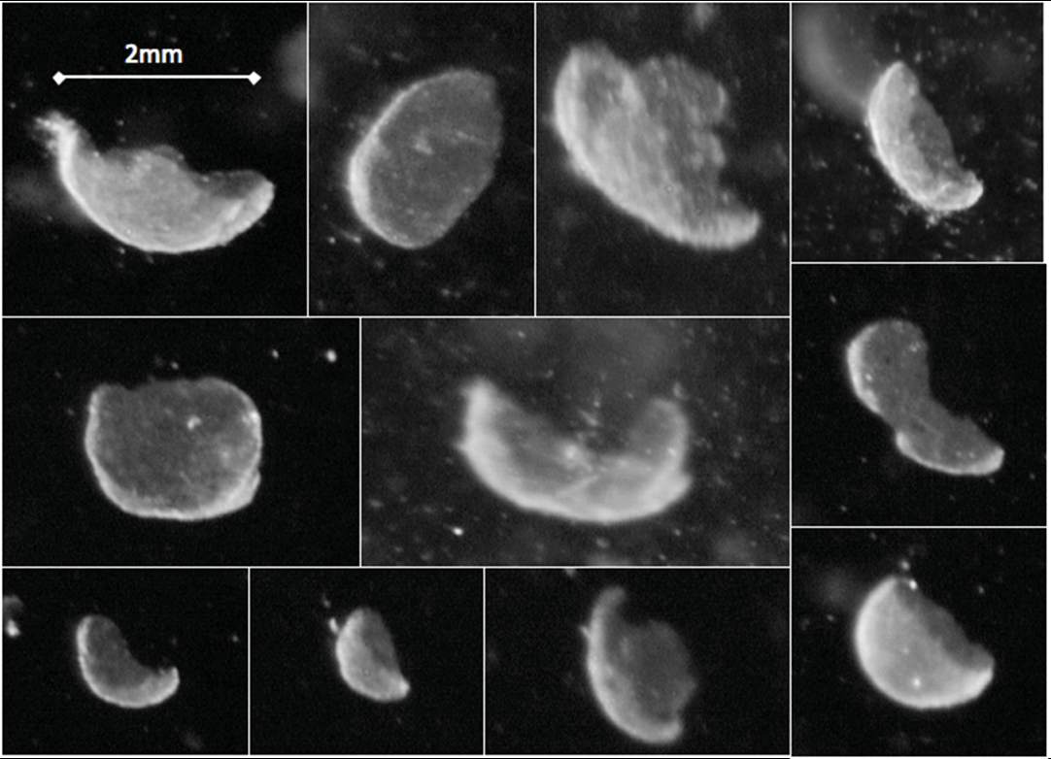
A PRISM Ghost Story
During the cruise (once upon a time), many strange particles were observed by the VPR and called kidney beans and other names.

Slide 5
Intact Phaeocystis colonies

Slide 6
Results and Conclusions
One of the most abundant classes of objects observed in VPR images consisted of irregular spheres. They appeared as opaque, white objects with slightly deformed spherical shapes; their depth distribution showed a maximum generally between 70 and 120 m. Their sizes were similar to living Phaeocystis colonies, but their maximum abundance was always below the depth of maximum concentrations of Phaeocystis antarctica colonies.
Wassmann et al. (1990, MEPS), during a mass sedimentation event of Phaeocystis pouchetii in the Barents Sea, observed that “ghost colonies” occurred at depth. These were colonies in which the individual cells had been liberated from the mucopolysaccharide envelope, leaving the organic matrix behind. Because of the method of sampling they employed (traditional Niskin bottles), they were unable to determine the actual concentrations of the ghost colonies.

Slide 7
We conclude based on VPR images that the objects we observed were Phaeocystis ghost colonies. Furthermore, because the VPR can resolve the distribution of ghost colonies with depth and space, we believe that these ghost colonies are being produced in large number and are a major component of the P. antarctica life cycle. Furthermore, they significantly contribute to the vertical flux of organic matter from the euphotic zone to depth. Because the mean depth of the Ross Sea is ca. 550 m, much of this material is remineralized within the water column. However, some of it undoubtedly reaches the sediments and contributes to long-term carbon sequestration.

Slide 8
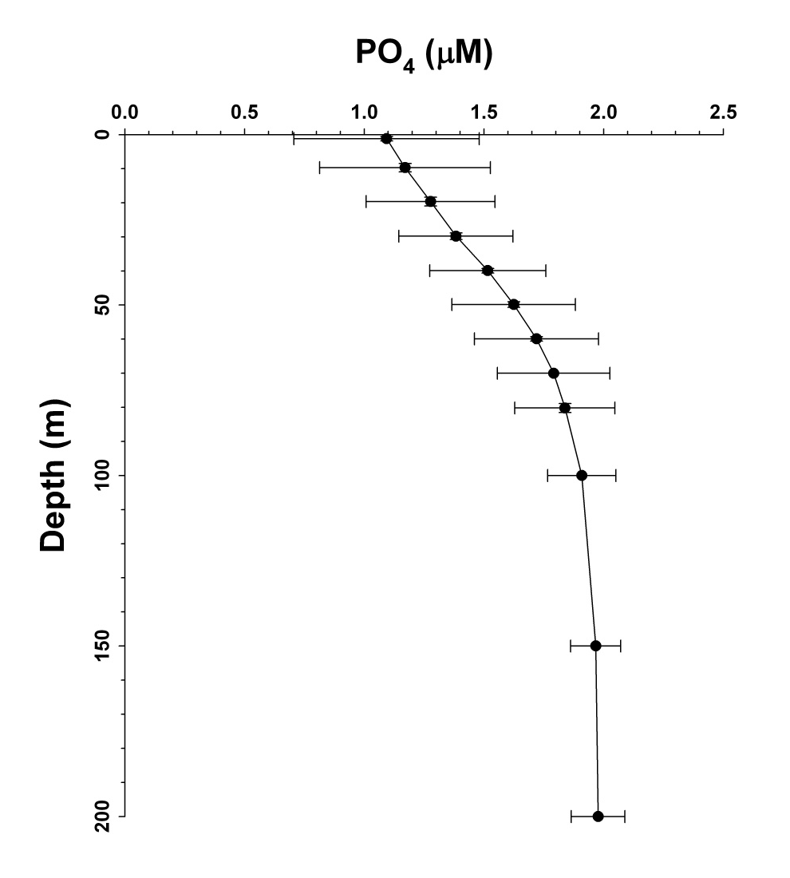
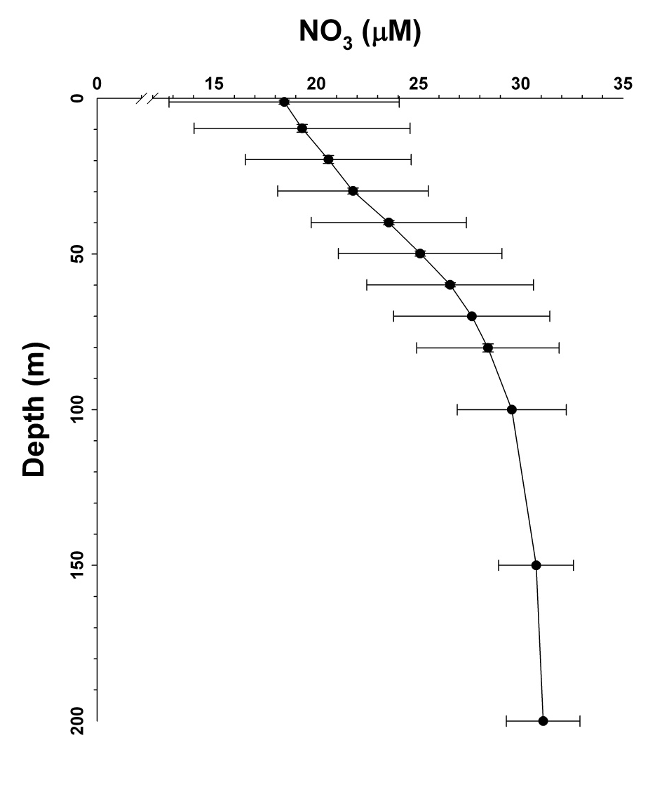
Mean Inorganic Nutrient Distributions

Slide 9
Si(OH)₄ concentrations we depleted at the surface by ca. 20 μM, but BSi concentrations were only ca. 11 μM at the surface. In a simple 1D system (since there is no other Si phase), the difference between the total Si and the sum at depth (200 m) reflects the potential export.
Hence on the mean, we had ca. 9 μM Si lost from the surface.
Obvious caveats: these are means and it would be better to look at means from diatom-dominated stations and transects.

Slide 10
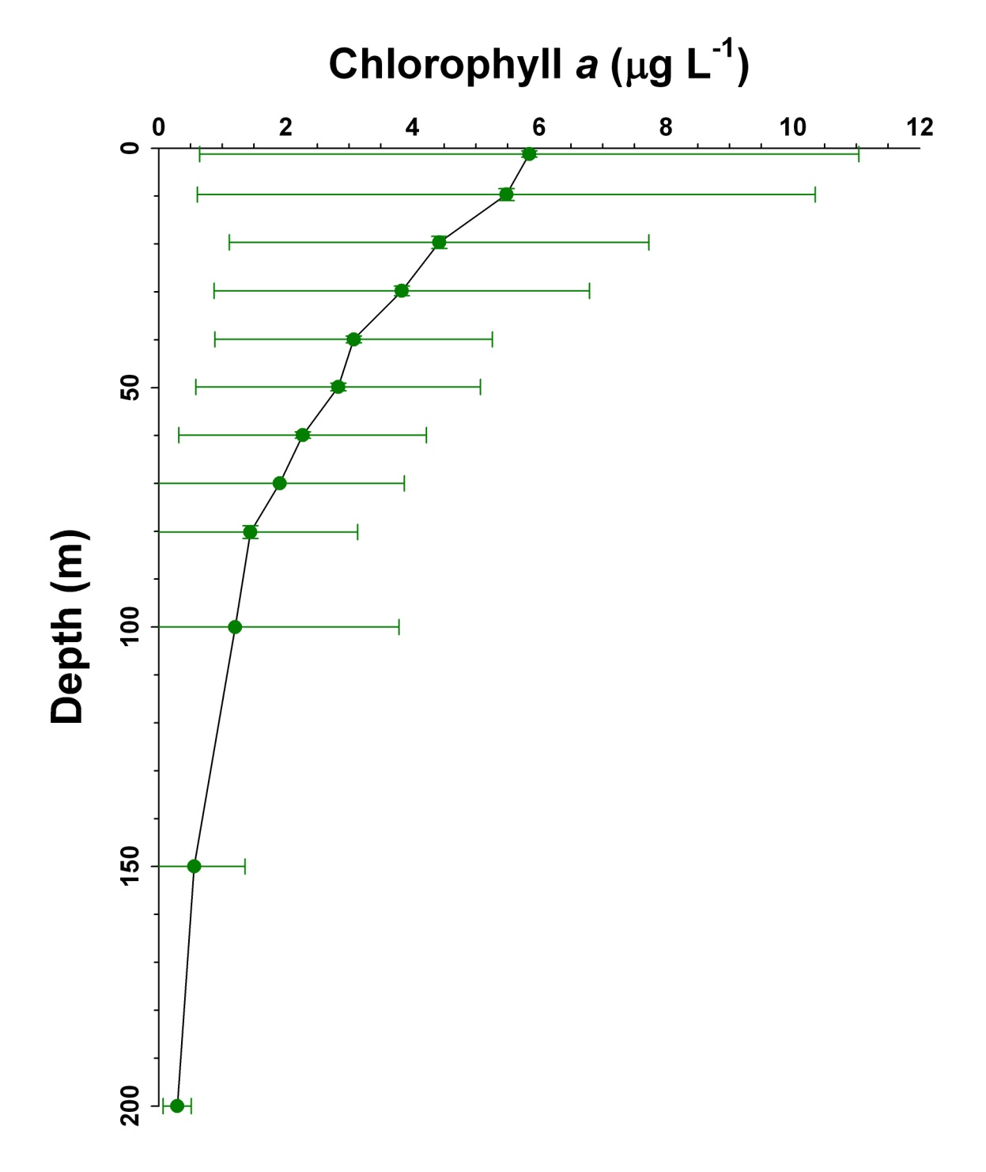
Depth Mean Min Max
Surface 5.84 0.35 22.4
10 m 5.48 0.22 24.6
20 m 4.42 0.29 16.6
30 m 3.83 0.32 14.1
40 m 3.07 0.34 10.4
50 m 2.83 0.27 10.8
60 m 2.27 0.25 9.42
70 m 1.91 0.20 10.2
80 m 1.44 0.22 10.9
100 m 1.20 0.11 7.38

Slide 11
In the SeaBASS data base (NASA compendium), only 14 out of 9395 chlorophyll values have been reported being greater than our maximum observed value of 24.6 μg L⁻¹. That means that only 0.15% of all values were greater.
A similar claim of “extremeness” was made by Arrigo et al.(2012) for their values in the Arctic. They published POC values that ranged from 28.7 – 32.5 g m⁻². At our ice shelf stations, we had integrated chl values (through 100 m) of 710, 691, 865, 656 and 597 mg m⁻², which are approximately equal to 23.9 – 34.6 g m⁻² using a conservative C/chl conversion of 40. Although this is slightly “apples to oranges”, it is clear that the ice-shelf eddy not only was physically unusual, but very rich in biomass.

Slide 12
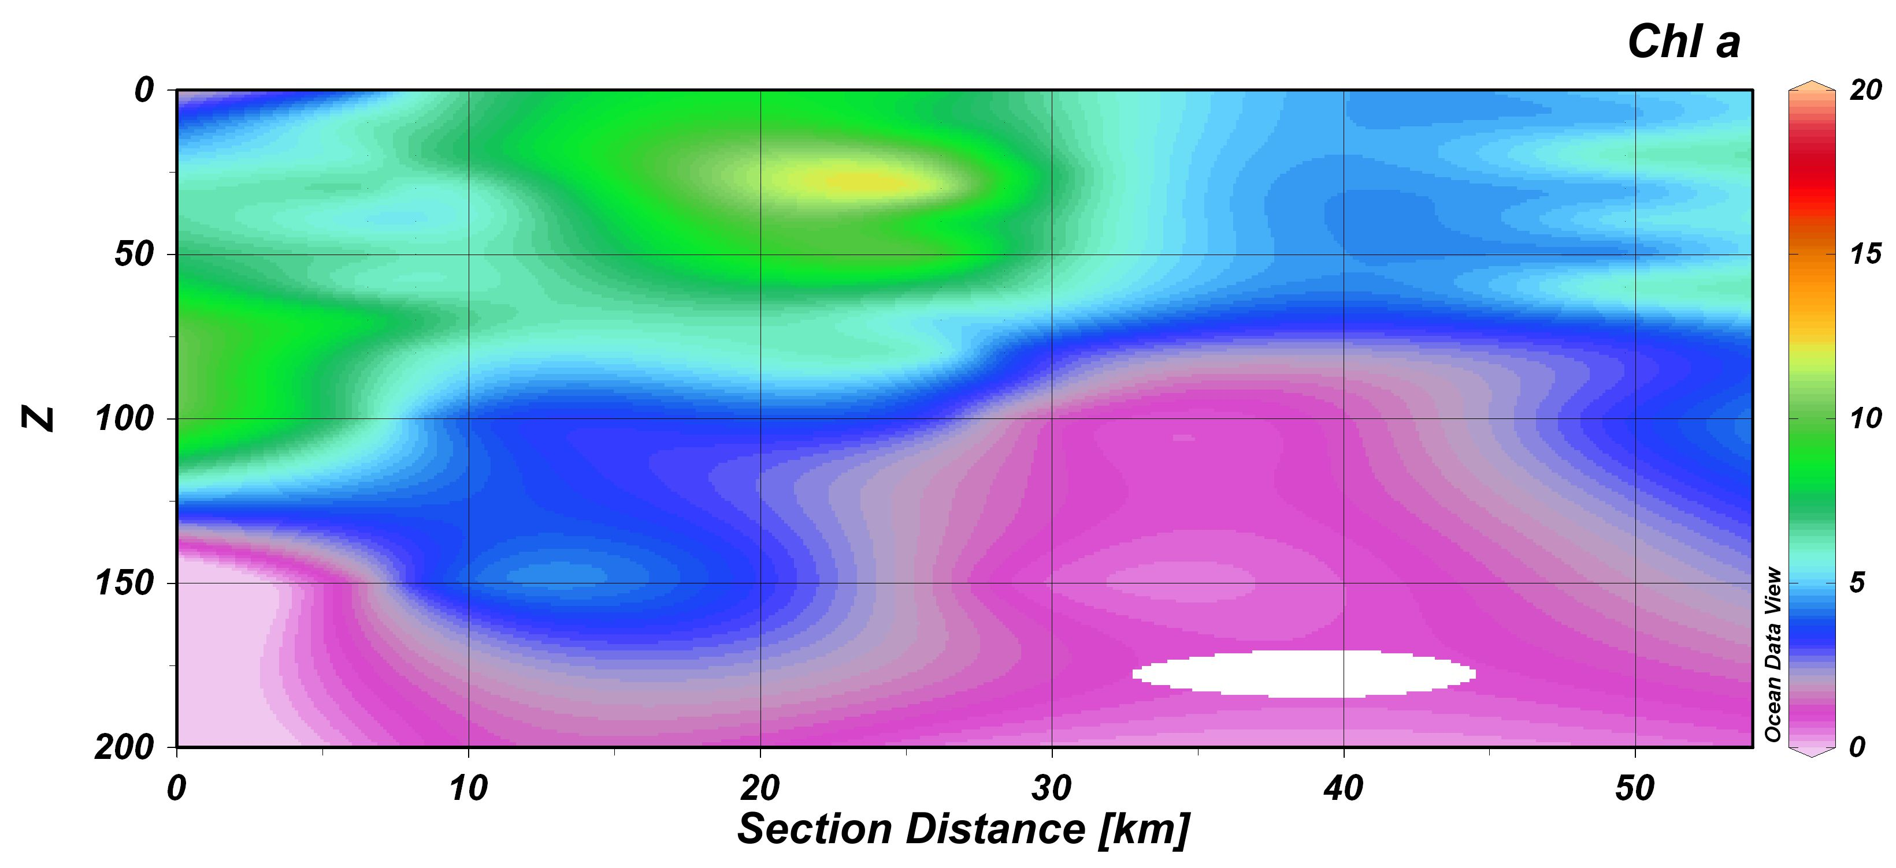

Slide 13
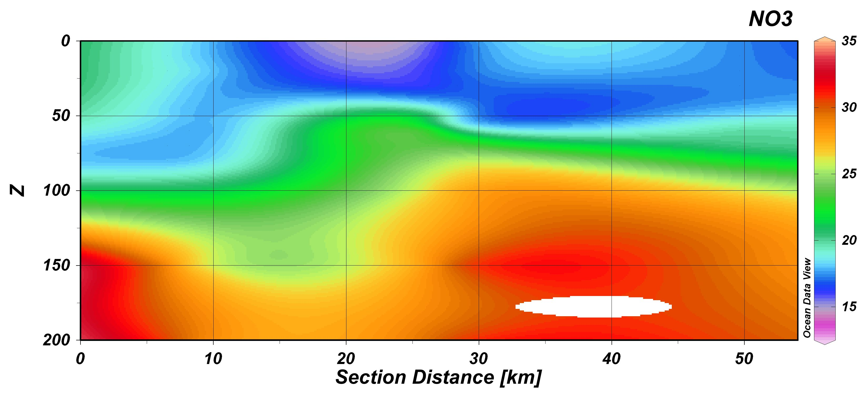

Slide 14
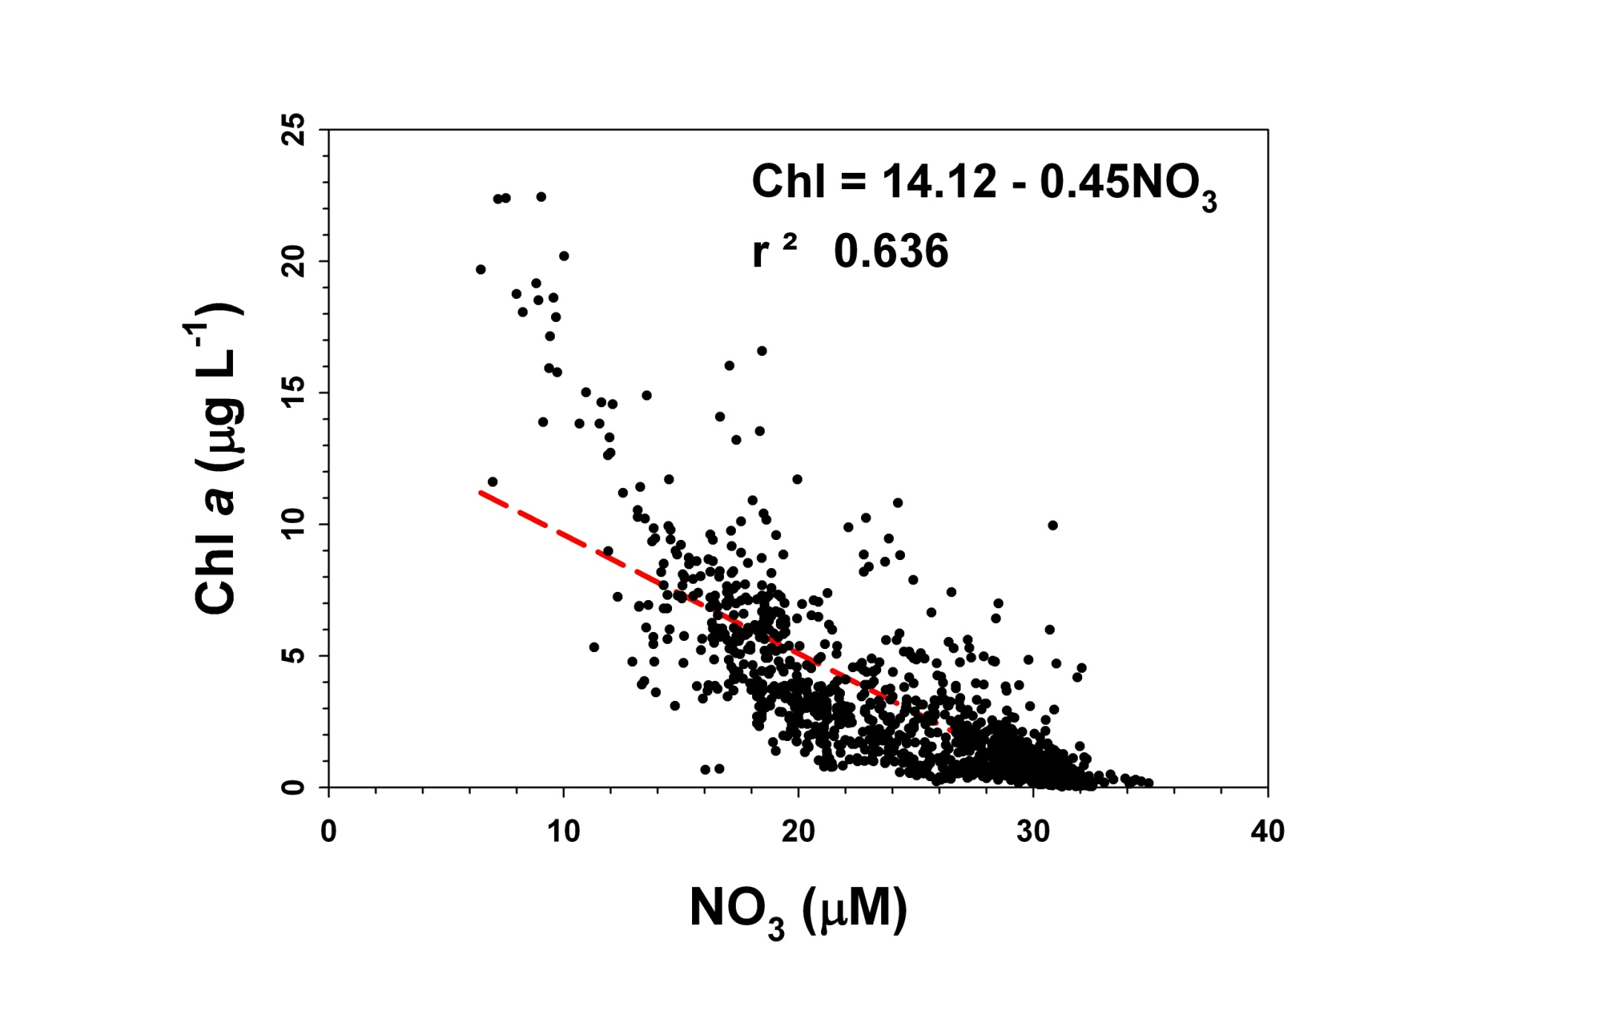
=

Slide 15
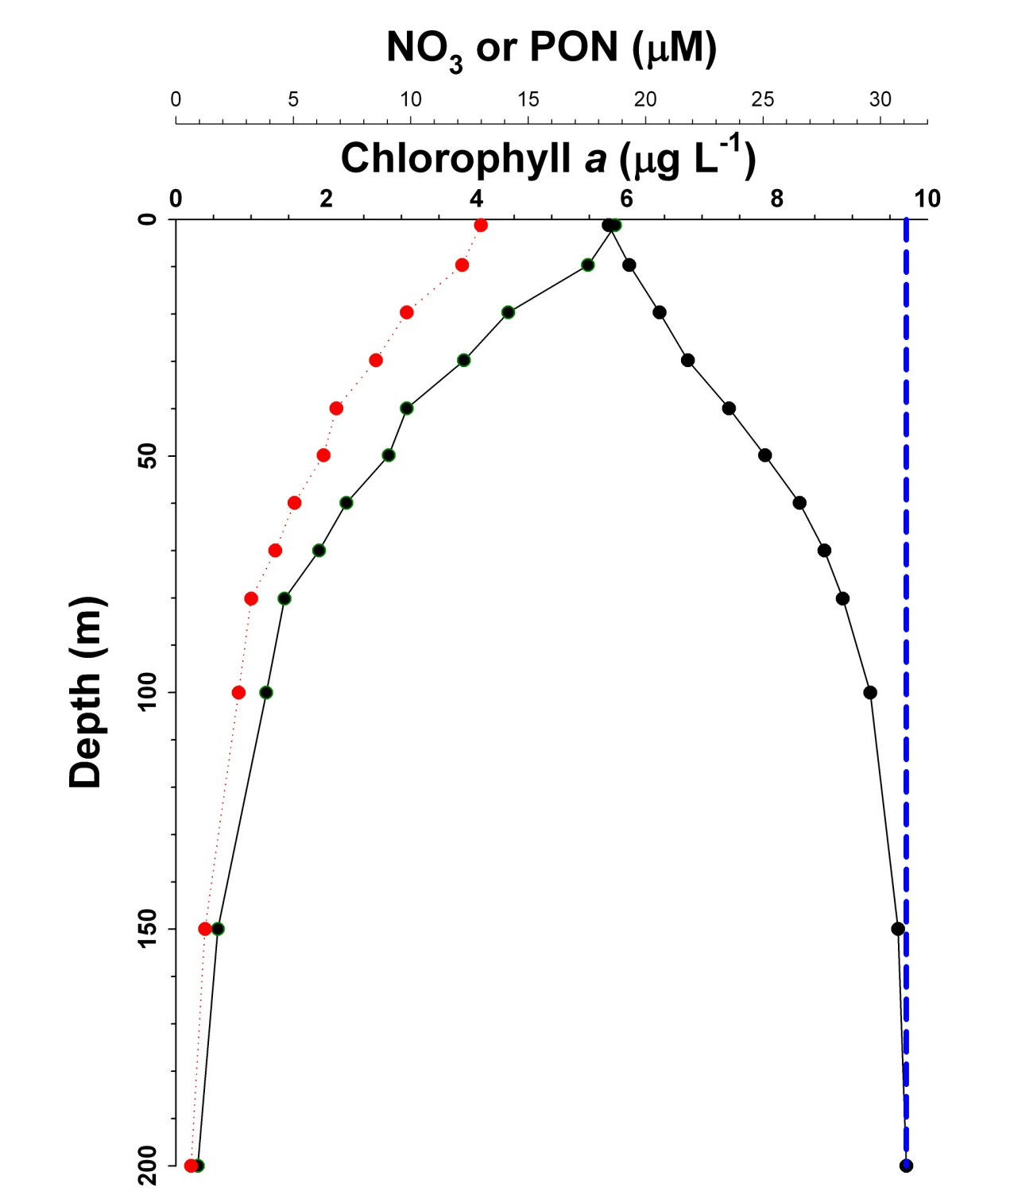
Doing a similar exercise for N as for Si, the surprising result is that N appears to be largely conserved in the upper water column.
This result is highly dependent on the ratios used for conversion (N/chl) which should be regulated by the assemblage composition
PON
NO₃
Chl

Slide 16
Photosynthesis-Irradiance Relationships
a= αE/ P^{B} _{s} b= βE/P^{B} _{s}
P^{B}= chl normalized photosynthesis; P^{B}_{S}= photosynthesis at saturating irradiance (E), α= slope of linear response, and β=photoinhibition term (set to zero here)

Slide 17
PRISM Results
n = 62
Mean P^{b}_{max} = 1.172 ± 0.588 μg C (μg chl)⁻¹ h⁻¹
Mean α = 0.122 ± 0.170 μg C (μg chl )⁻¹ h⁻¹ (µmol photons m⁻² s⁻¹)⁻¹
Mean E_{K} = 20.8 ± 22.8 µmol photons m⁻² s⁻¹
Indicates that overall phytoplankton were acclimated to relatively low irradiance levels
Compared to IVARS, slightly lower P^{b}_{max} & E_{K} values

Slide 18
Estimation of Primary Productivity
Take chlorophyll vertical distributions, surface PAR measurements, P/E response, and attenuation coefficients to calculate (based on the Platt equation) carbon fixation over short time periods
Convert to daily rates
Problems
hourly to daily rates assume constant irradiance, or that measured at CTD cast
irradiance values depend on ship location, not in situ measurements
respiration not explicitly included

Slide 19
Estimation of Primary Productivity
Mean Daily Productivity 2.89 ± 1.59 g C m⁻² d⁻¹
(N = 71)
(Min = 0.71 at St. 76)
(Max = 8.54 at St. 16)
Conclusion: PRISM sampled a hugely productive regime, but the productivity is certainly within the range observed in other cruises
Question: How is this productivity supported? Or, does Fe really matter?

Slide 20
Modeling related to future changes in the Ross Sea’s biogeochemistry
Using the ODU ROMS-based numerical model (e.g., Dinniman et al., 2011), we investigated the effects of changes in atmospheric temperatues and winds on cross-shelf transport and ice distributions
Project winds 50 & 100 years from present were taken from the A1B scenario of the ECHAM5 model
Temperature data from the same climate scenario were adjusted from the climatological temperatures using the ERA-Int temperatures
Ice concentrations decreased by 57% in summer by 2050, and by 78% by 2100
Advection of Modified Circumpolar Deep Water was reduced slightly by the changed forcing
vertical stratification in the southern Ross Sea increased significantly in 2050 and 2100
Taken together, these results suggest that the phytoplankton production in the future will increase on an annual basis, and that the plankton composition will become more diatomaceous
Other components of the Ross Sea food web will be severely disrupted, especially those that rely on crystal krill (Euphausia crystallorophias) as a major food source (e.g., baleen whales, crabeater seals, and Emperor penguins)

