Slide 1
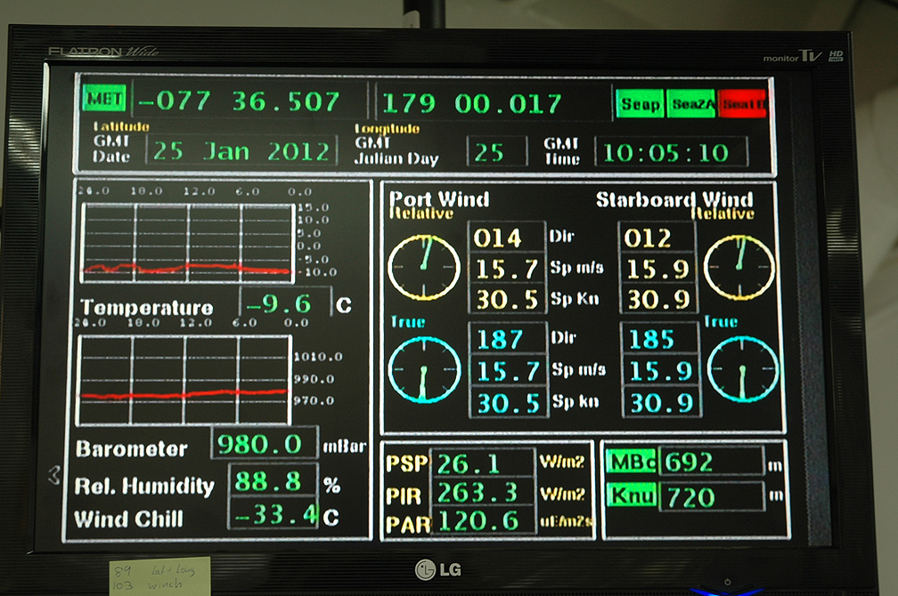
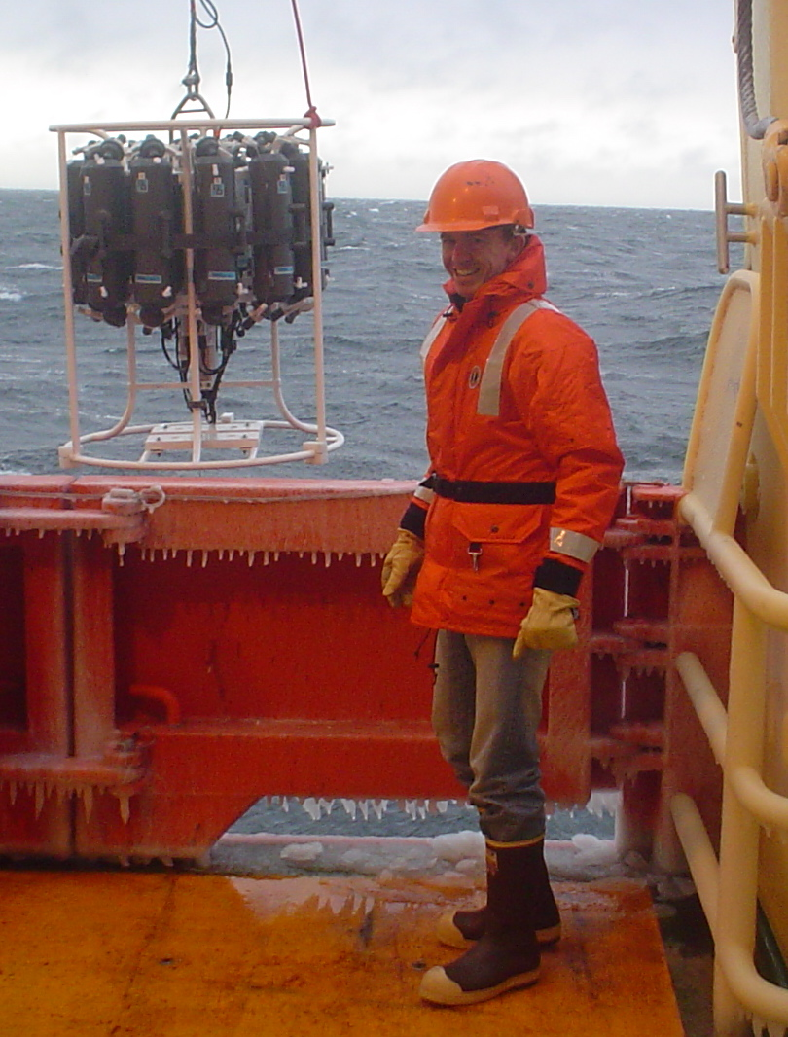
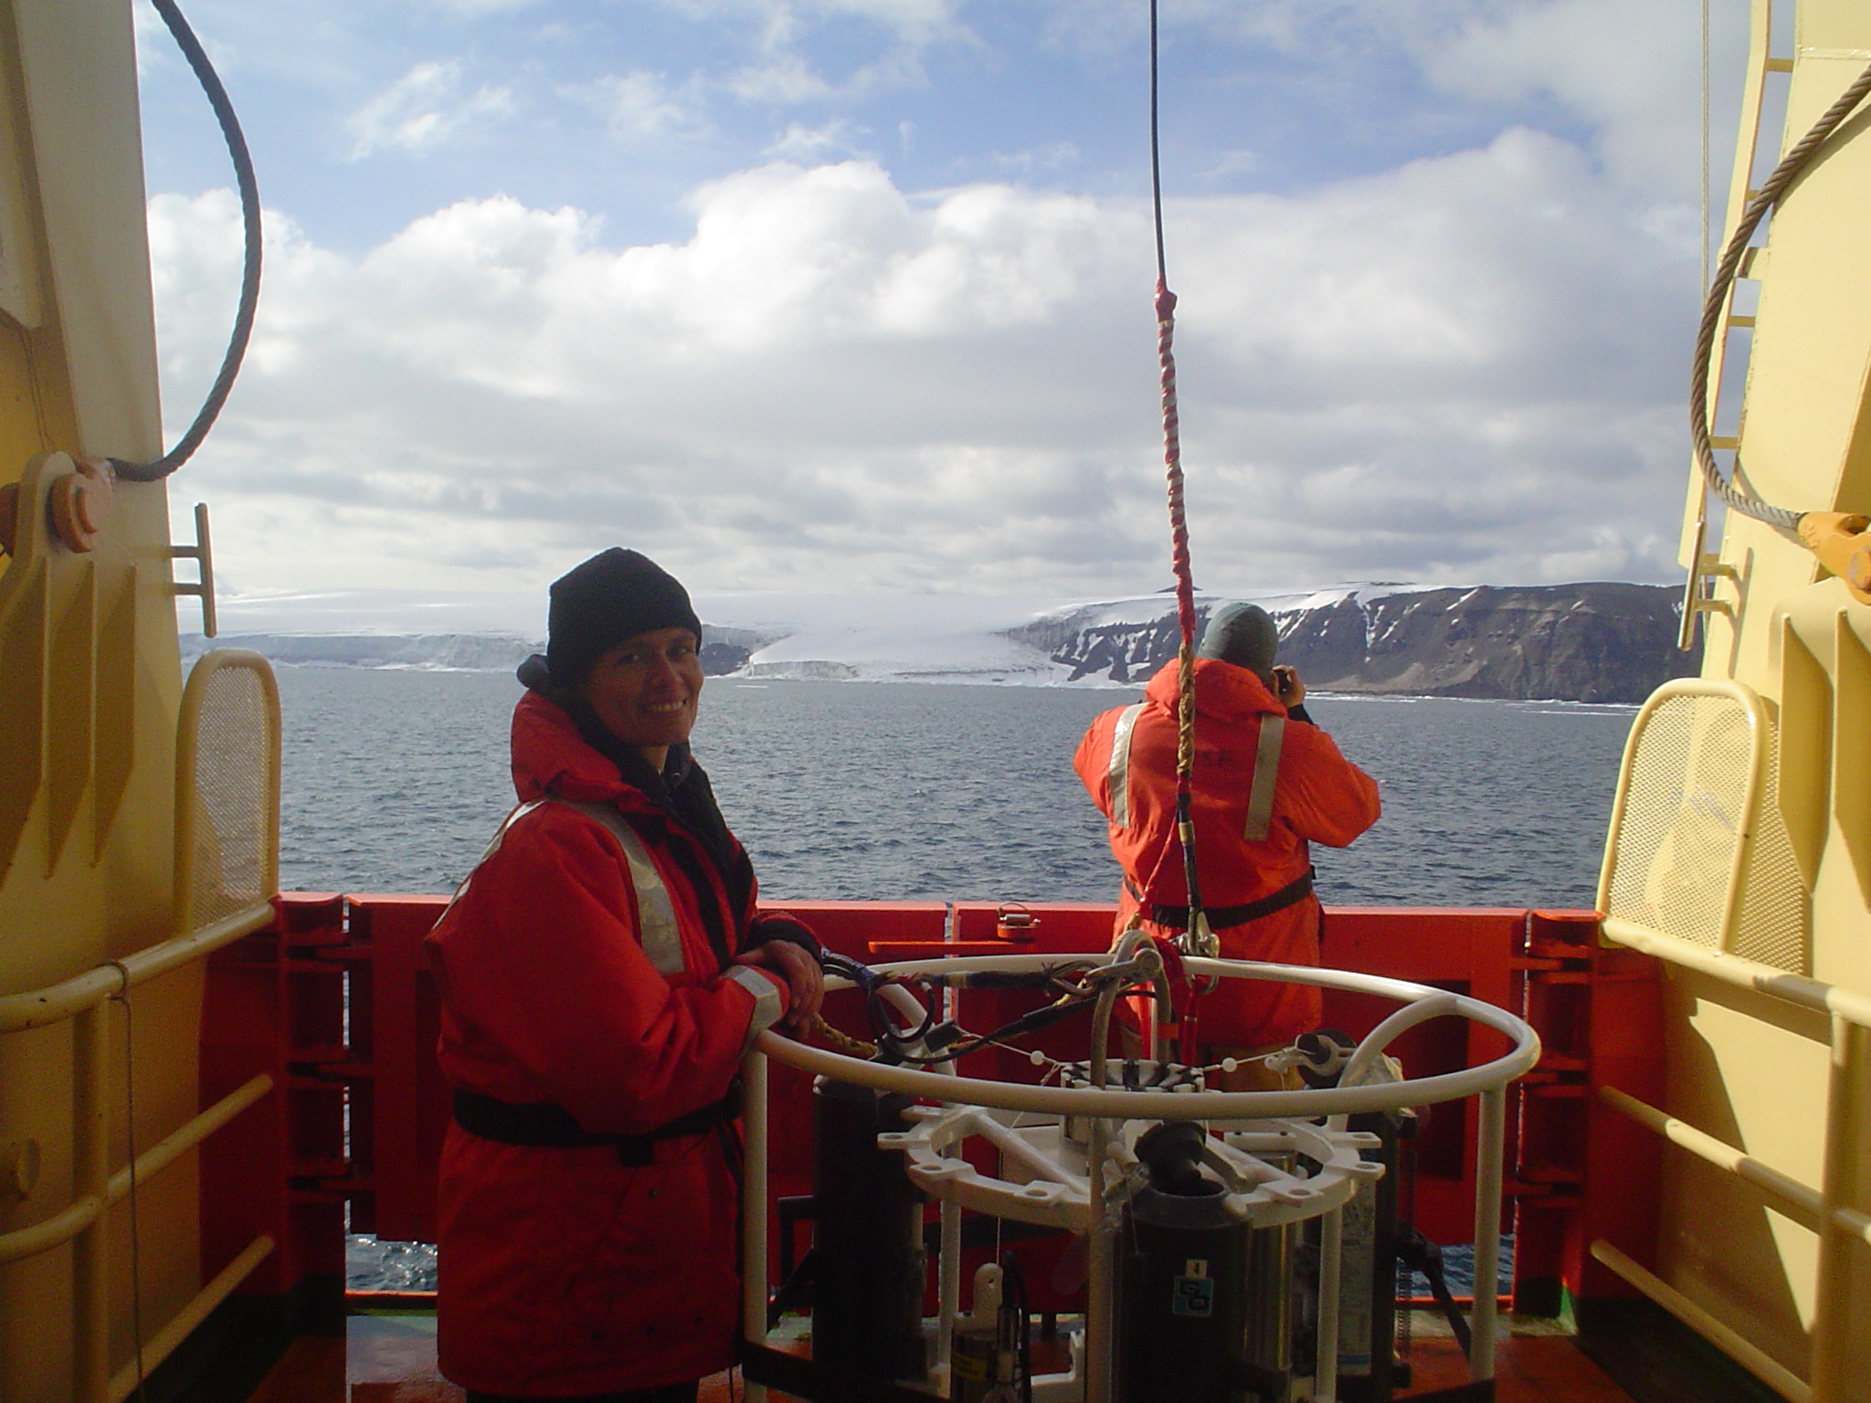
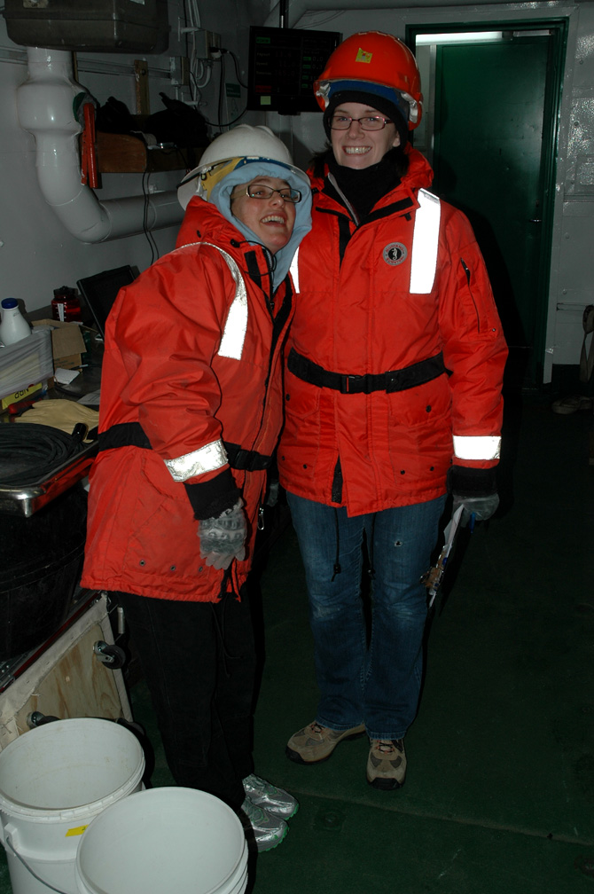
PRISM: Iron Measurement Component

Slide 2
PROGRESS:
Cruise:
• completed shipboard measurements of dissolved iron (dFe) in water-
column samples from 46 stations, and in surface samples from 4 transects
Post-cruise:
• synthesis of shipboard dFe results, ancillary data and model simulations
to constrain iron budget (manuscript in progress, ASLO talk in Feb)
• beginning re-analysis of cruise dFe samples as part of Chris Marsay’s
postdoctoral work, expected completion in spring 2013
• other analytical work: ICP-MS analyses of dMn and dAl in water column
samples (Chris, Bettina, Pete, in summer 2013)
• other work: estimate of benthic dFe fluxes (Chris, Mike, Pete), to inform
iron budget manuscript and for possible stand-alone paper

Slide 3
Summary of Shipboard Fe Results:
1. Modified Circumpolar Deep Water (MCDW):
• CDW/MCDW was sampled in northeast Ross Sea on entering polynya
• shipboard analyses indicate dFe concentrations of ~0.3-0.5 nM in warm,
salty core of CDW/MCDW at ~400-600 m depth (see stations 1 & 2, below)

Slide 4
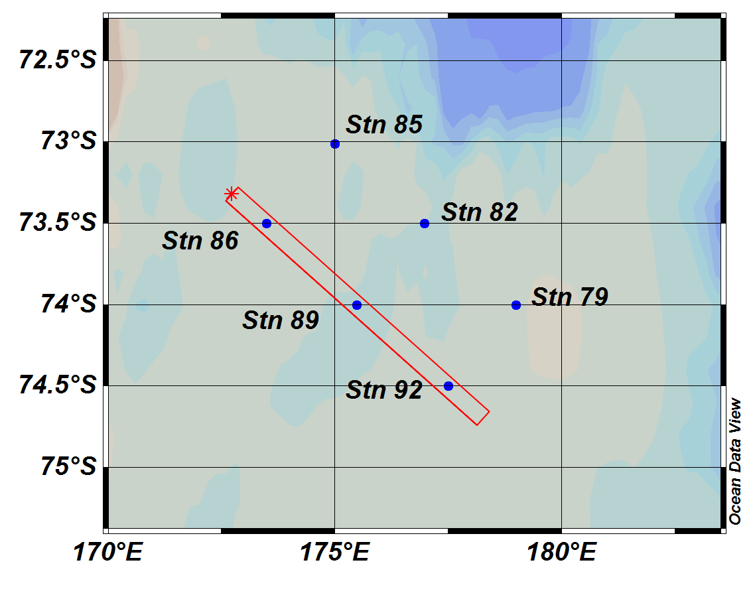
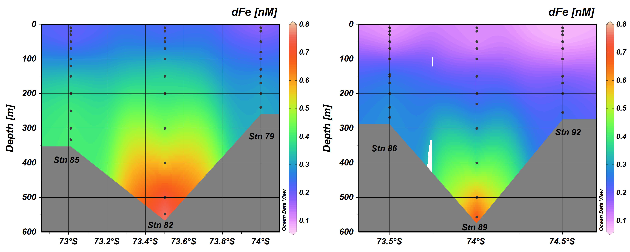
Summary of Shipboard Fe Results:
1. Modified Circumpolar Deep Water (MCDW):
• transects across JOIDES Trough yielded similar results, where MCDW was
observed over both banks
Mawson Bank
JOIDES Trough
Pennell Bank
NW
SE

Slide 5
Summary of Shipboard Fe Results:
2. Melting Sea Ice:
• dFe enriched (~0.6 nM) in near-surface waters adjacent melting pack ice (station 2, below) in northeast Ross Sea, suggesting input from sea ice
melting pack ice

Slide 6
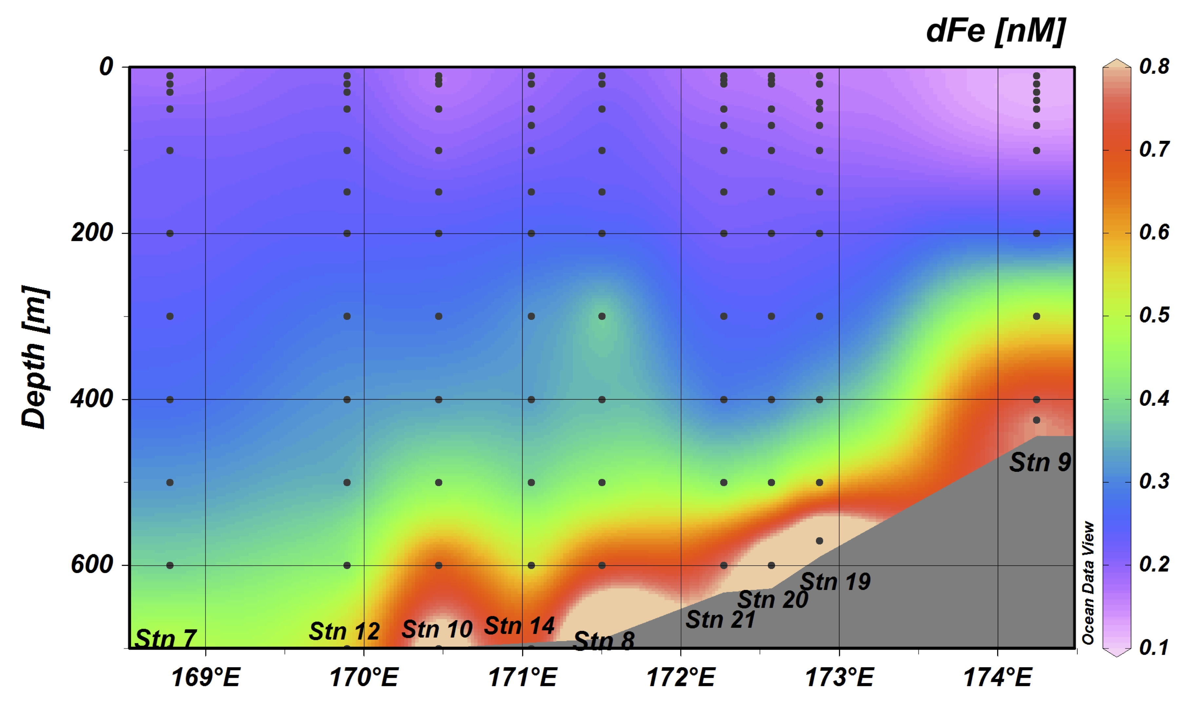
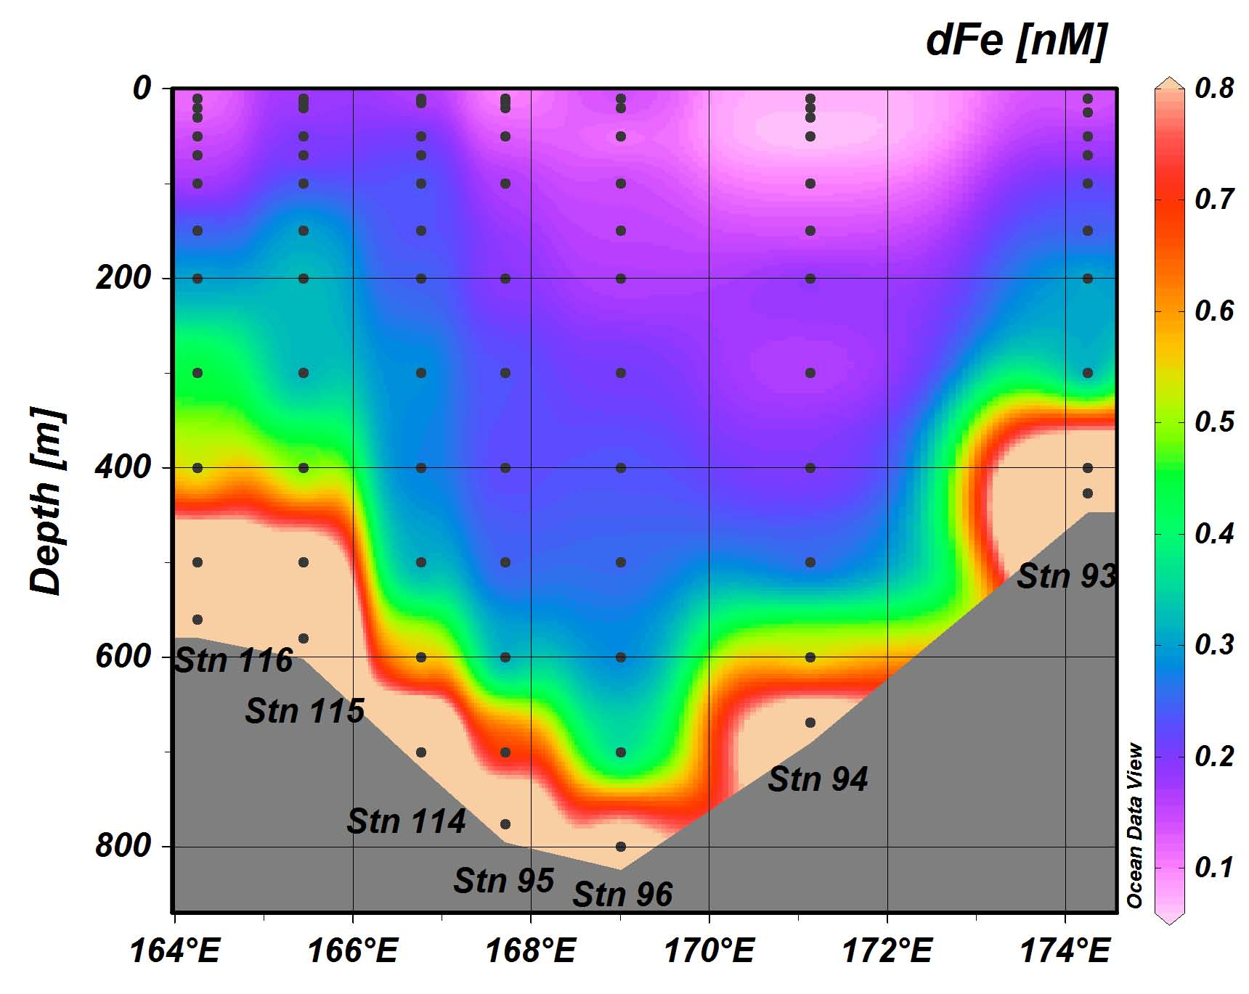
Summary of Shipboard Fe Results:
2. Melting Sea Ice:
• however, dFe was not significantly enriched in surface waters adjacent to
melting pack ice on western perimeter of polynya near 76°45’ S
ice edge
ice edge

Slide 7
Summary of Shipboard Fe Results:
2. Melting Sea Ice:
• discrepancy may reflect timing of water sampling relative to release of dFe
in brine (‘rule of fives’) and subsequent uptake by phytoplankton
• uptake of ~0.6 nM dFe could produce ~5-11 µg L⁻¹ Chl -- consistent with
observations -- given 10-20 mol mol⁻¹ Chl:Fe (Sunda and Huntsman, 1997)
sea ice
sea ice

Slide 8
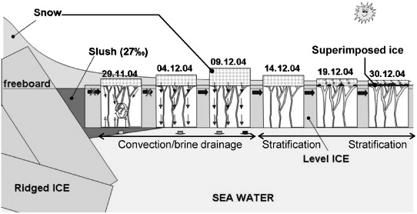
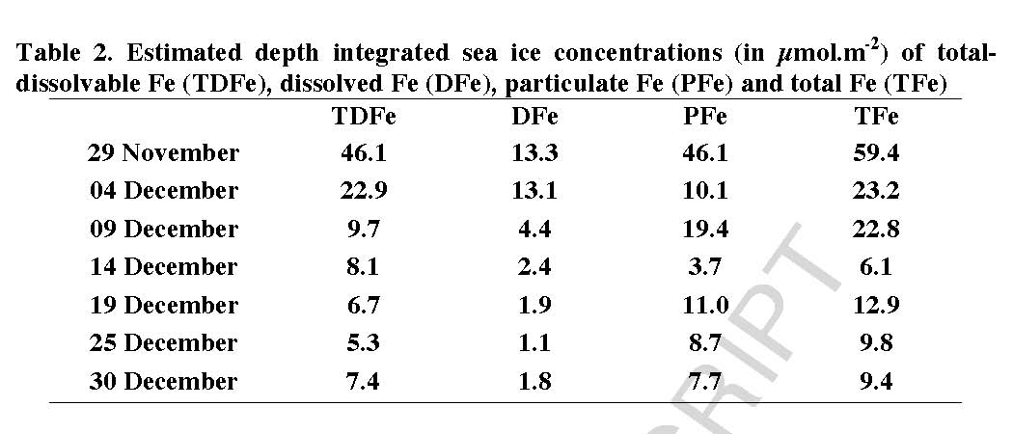
Summary of Shipboard Fe Results:
2. Melting Sea Ice:
• time-series observations of sea ice in Weddell Sea suggest loss of dFe via
brine drainage to underlying seawater during the growing season
Tison et al. (2008)
Lannuzel et al. (2008)

Slide 9
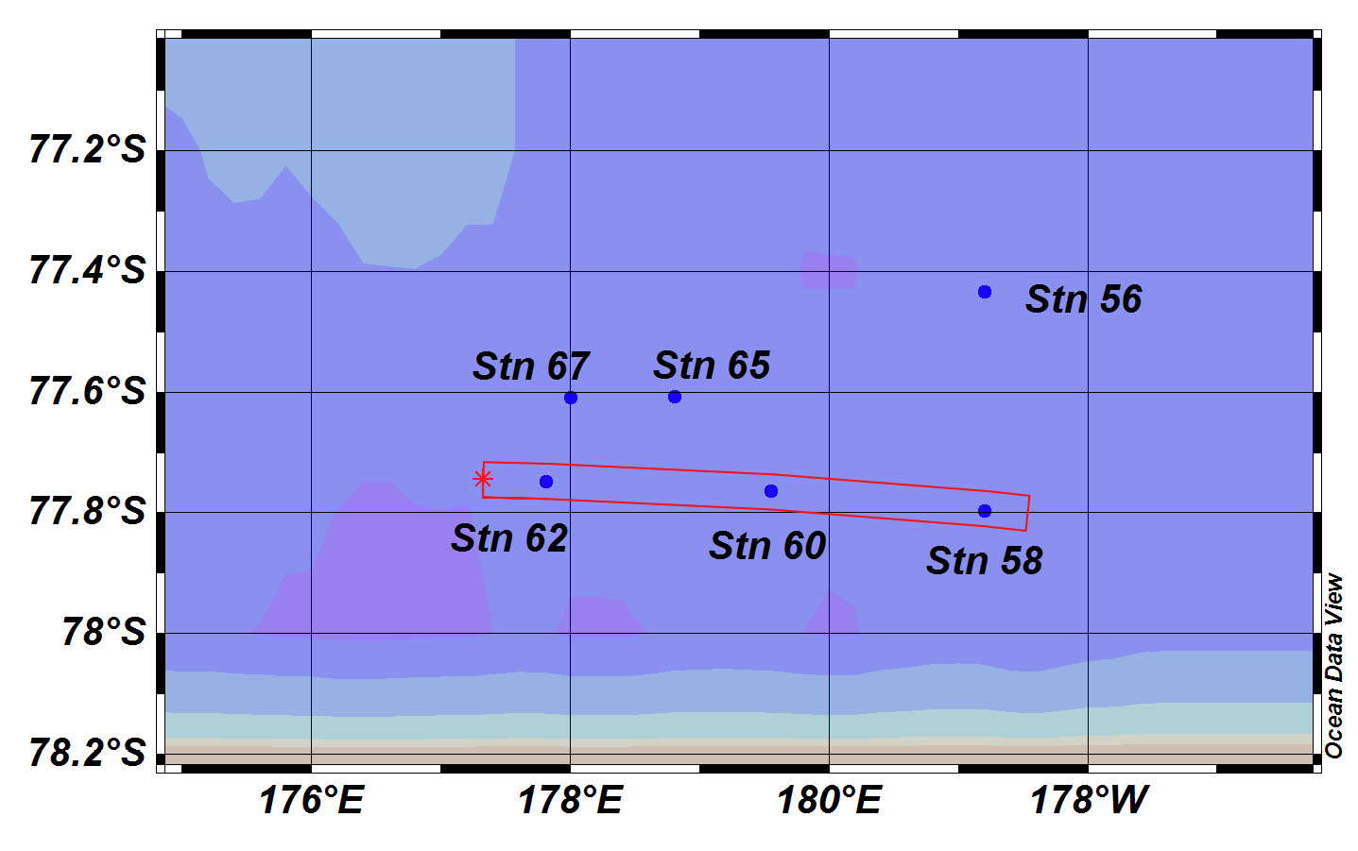
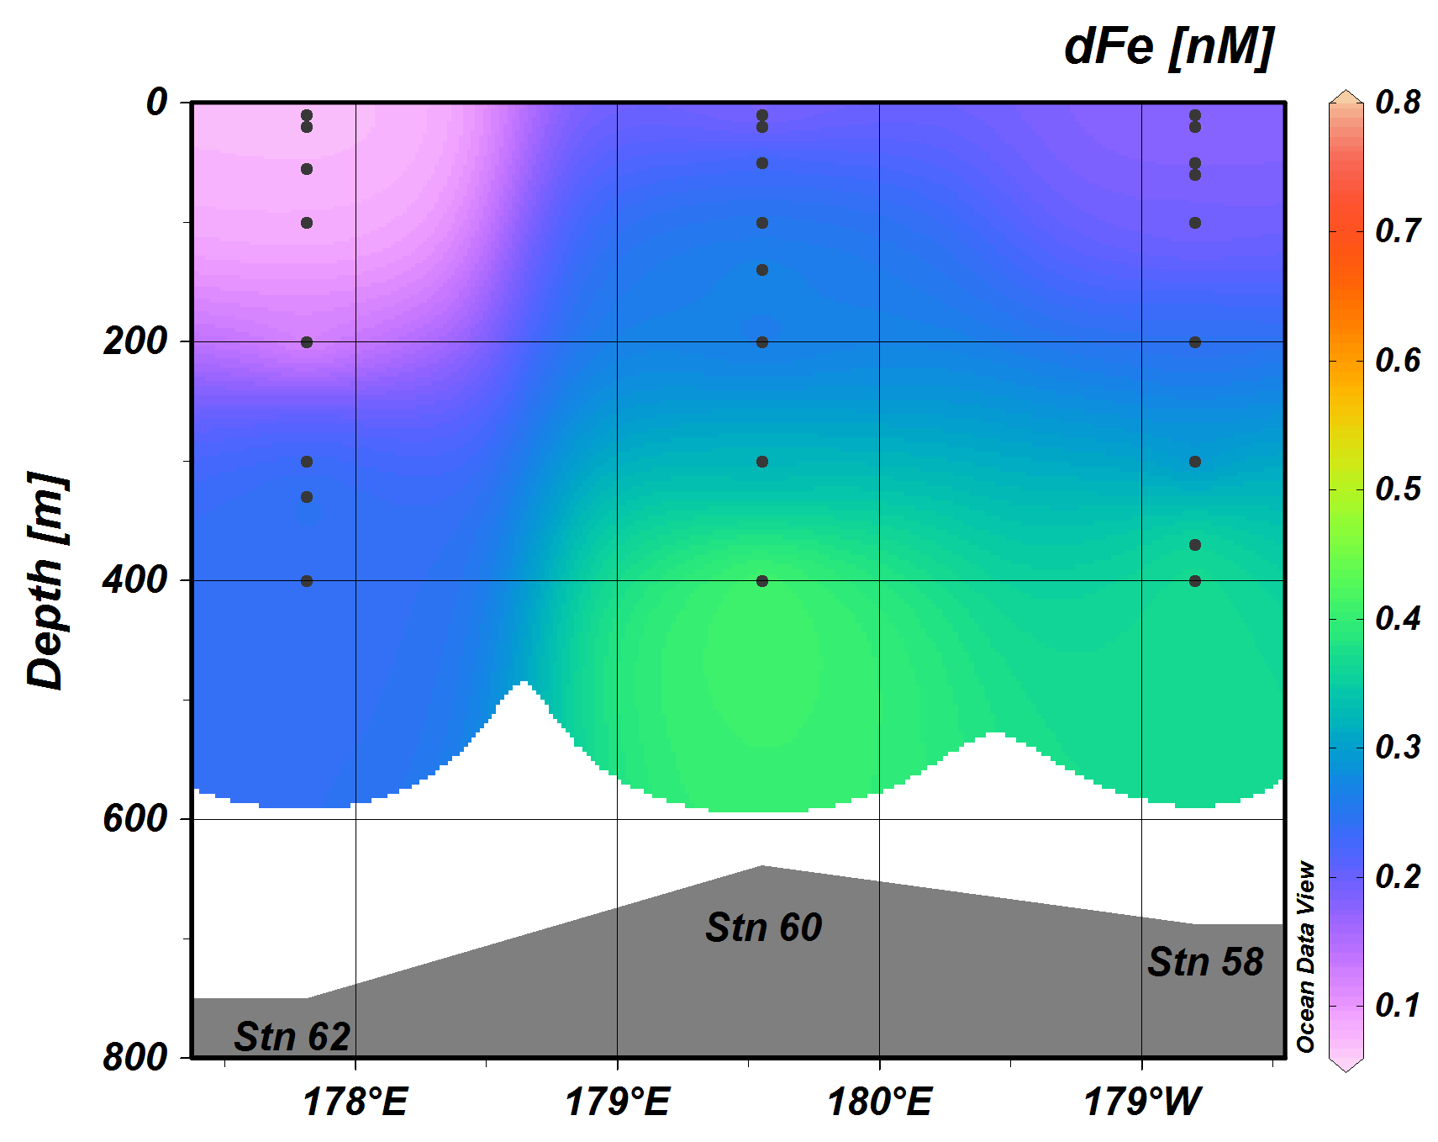
Summary of Shipboard Fe Results:
3. Ice Shelf Water (ISW) and Surface Glacial Meltwater:
• zonal XBT transect along Ross Ice Shelf identified cold (<-1.9°C) ISW
layers in the 300-400 m depth range at Stations 58 and 62 (see below)
• dFe concentrations in ISW ~0.3-0.5 nM, similar to CDW parent, whereas
surface waters show no strong enrichment associated with glacial melt
Ross Ice Shelf
high deep dFe values omitted

Slide 10
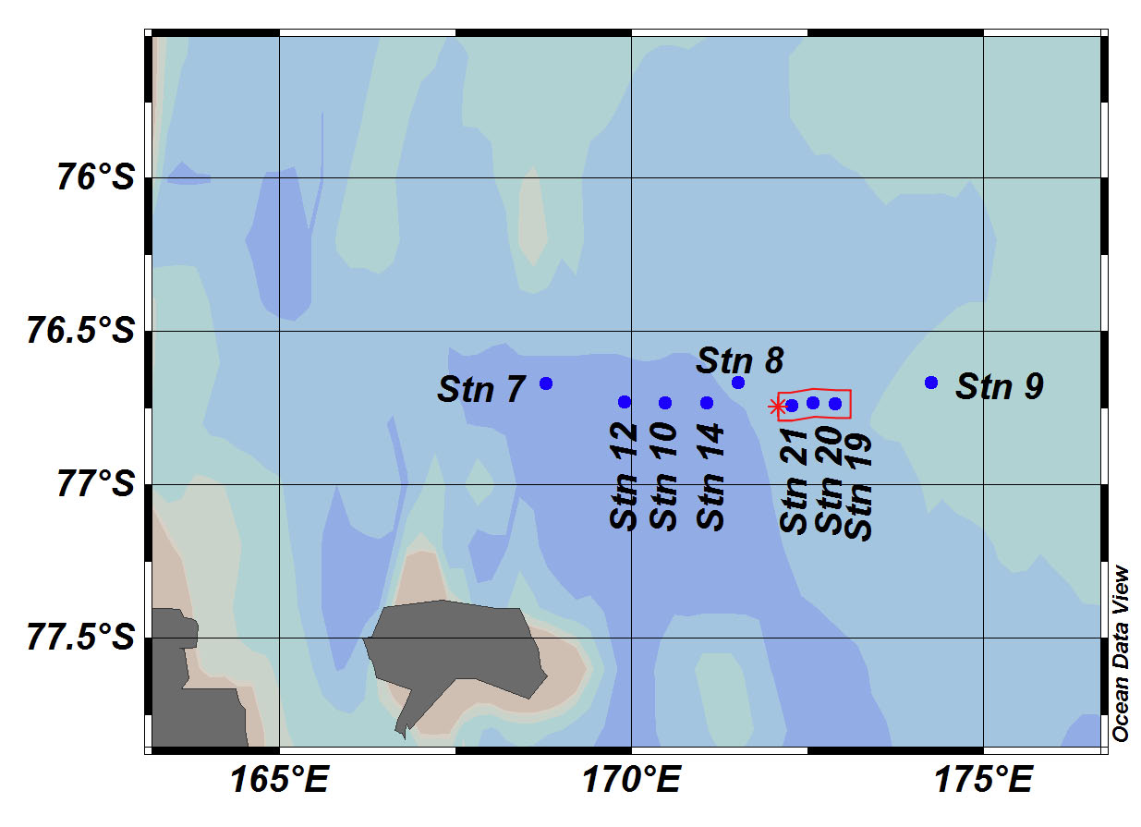
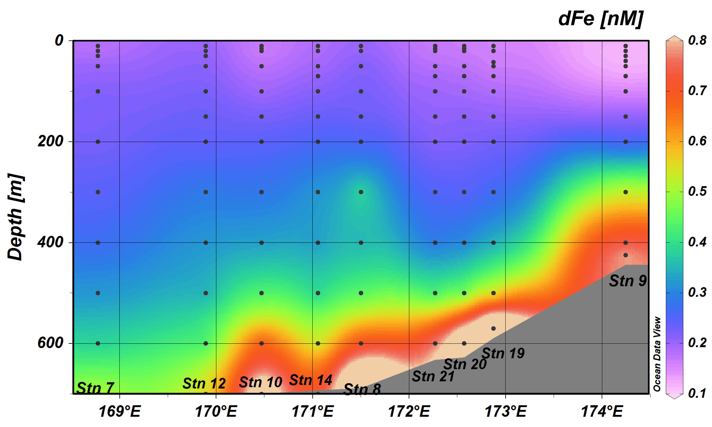
Summary of Shipboard Fe Results:
4. Benthic Sources:
• strong enrichment of dFe (>0.5 nM) generally observed up to ~100-200 m
above seafloor, often associated with turbidity maximum
• below surface mixed layer, deep dFe enrichment allows estimate of winter
resupply via deep convective mixing (a lower limit, since efflux continuous)

Slide 11
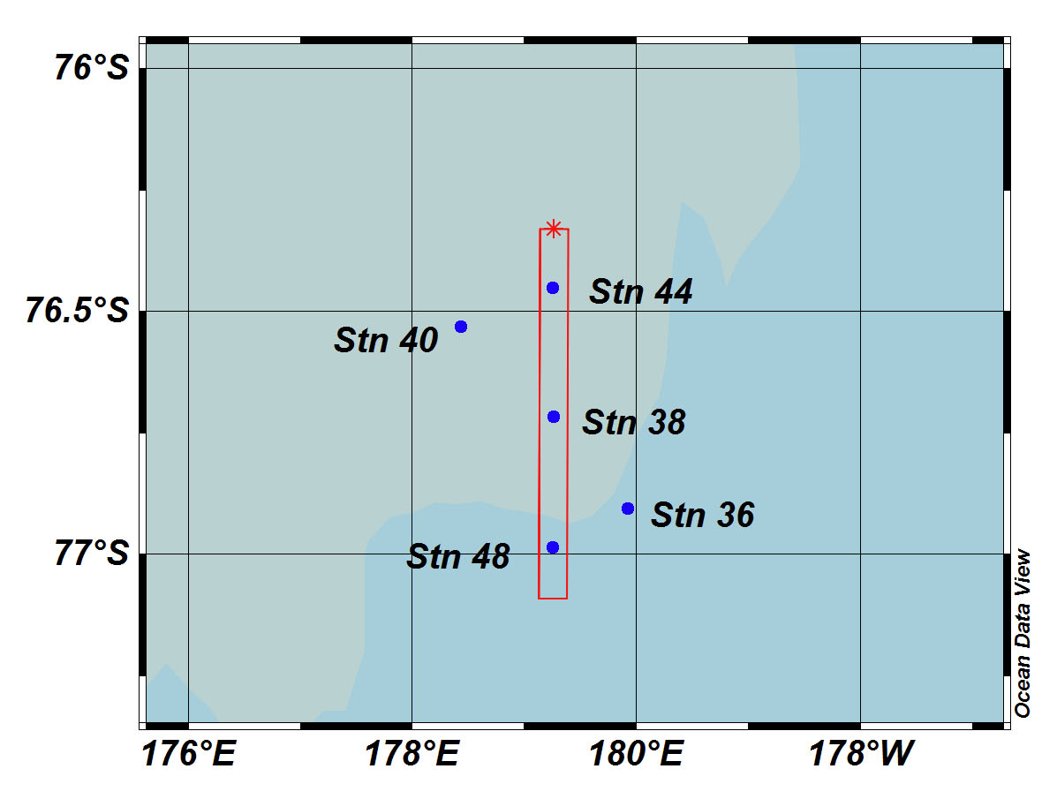
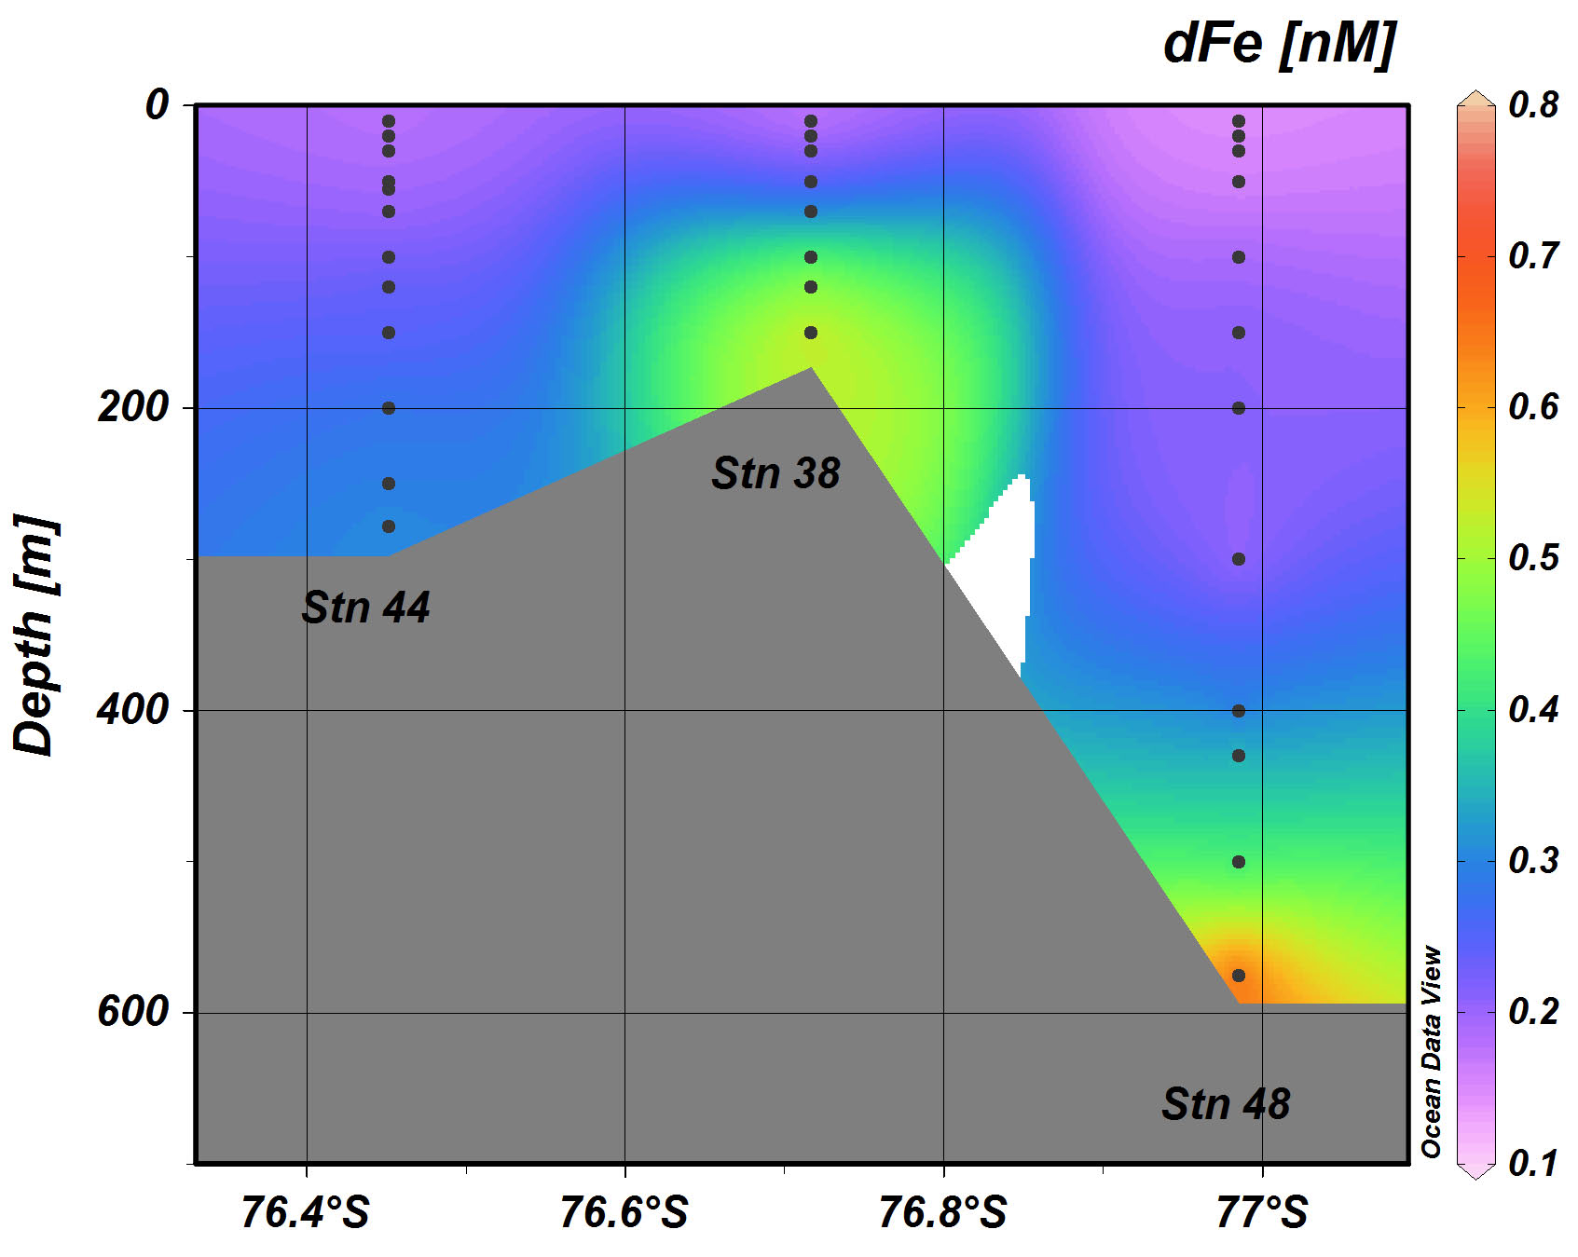
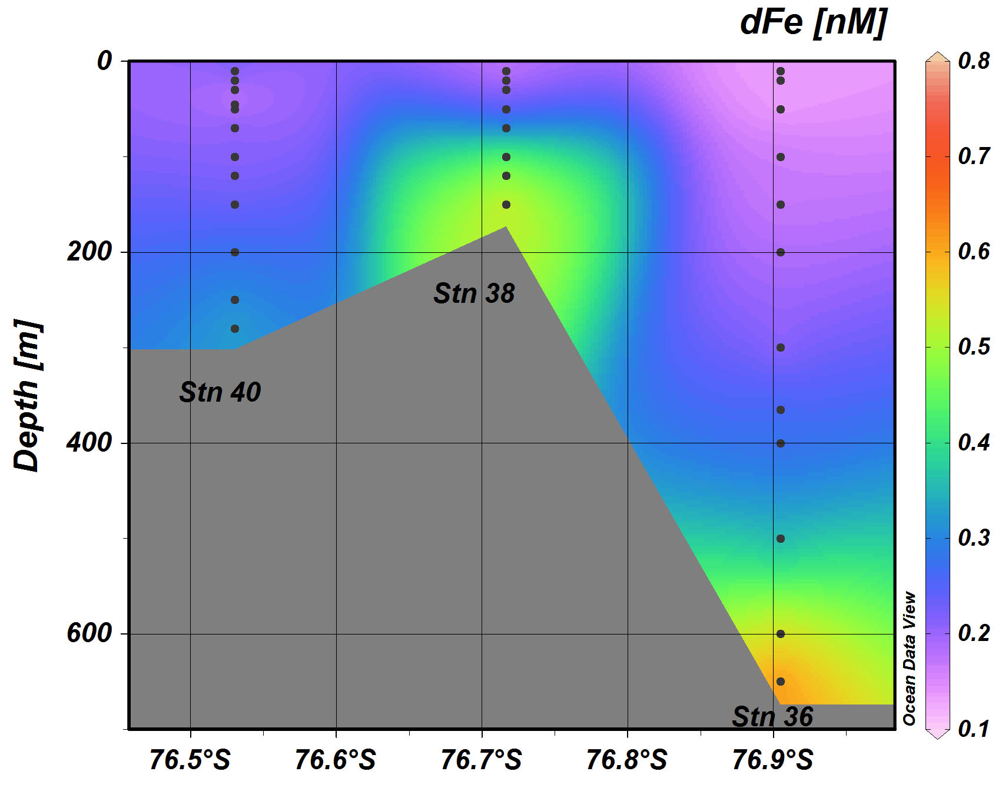
Summary of Shipboard Fe Results:
4. Benthic Sources:
• in shallow areas, such as Ross Bank and near Franklin Island, benthic dFe
can be directly introduced into the euphotic zone
Ross Bank

Slide 12
Summary of Shipboard Fe Results:
4. Benthic Sources:
• however, in such shallow areas, benthic dFe can be rapidly redistributed by
vertical and lateral mixing driven by synoptic weather events
dFe (nM)
dFe (nM)
depth (m)
depth (m)
Ross Bank summit before weather event Ross Bank summit after weather event

Slide 13
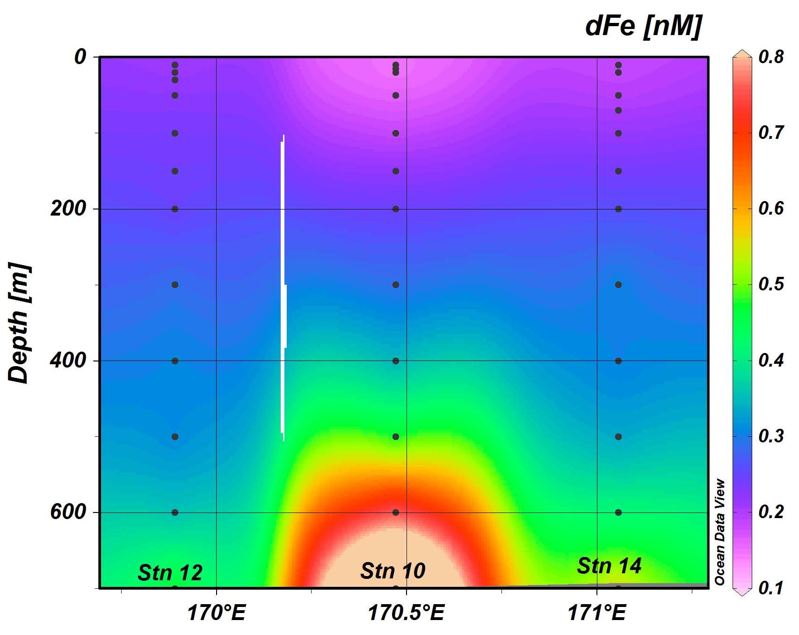
Summary of Shipboard Fe Results:
5. Role of Eddies:
• eddies typically showed surface dFe depletion and elevated biomass,
possibly as a result of algal growth stimulated by initially elevated dFe
• two eddies revealed an updoming ferricline below euphotic zone, which
may enhance vertical resupply of dFe from subsurface waters (see below)
eddy core
eddy

Slide 14
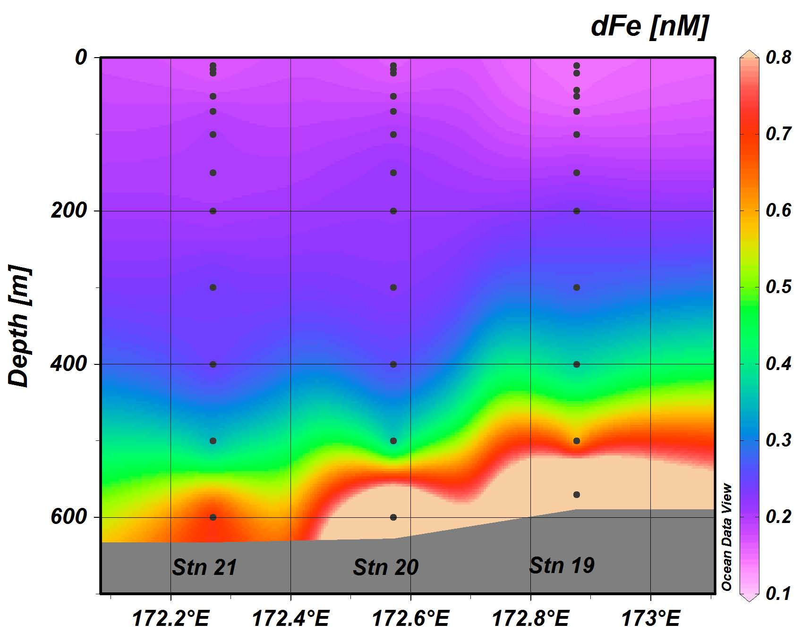
Summary of Shipboard Fe Results:
6. Role of Fronts:
• conversely, zonal front between high (to west) and low (to east) biomass
waters shows slightly higher dFe in fresher, warmer waters west of front
• may reflect Fe-stimulated production in wake of retreating sea ice, and/or
southwards advection of low-Fe, low-biomass waters (Reddy & Arrigo, 2006)
front
front

Slide 15
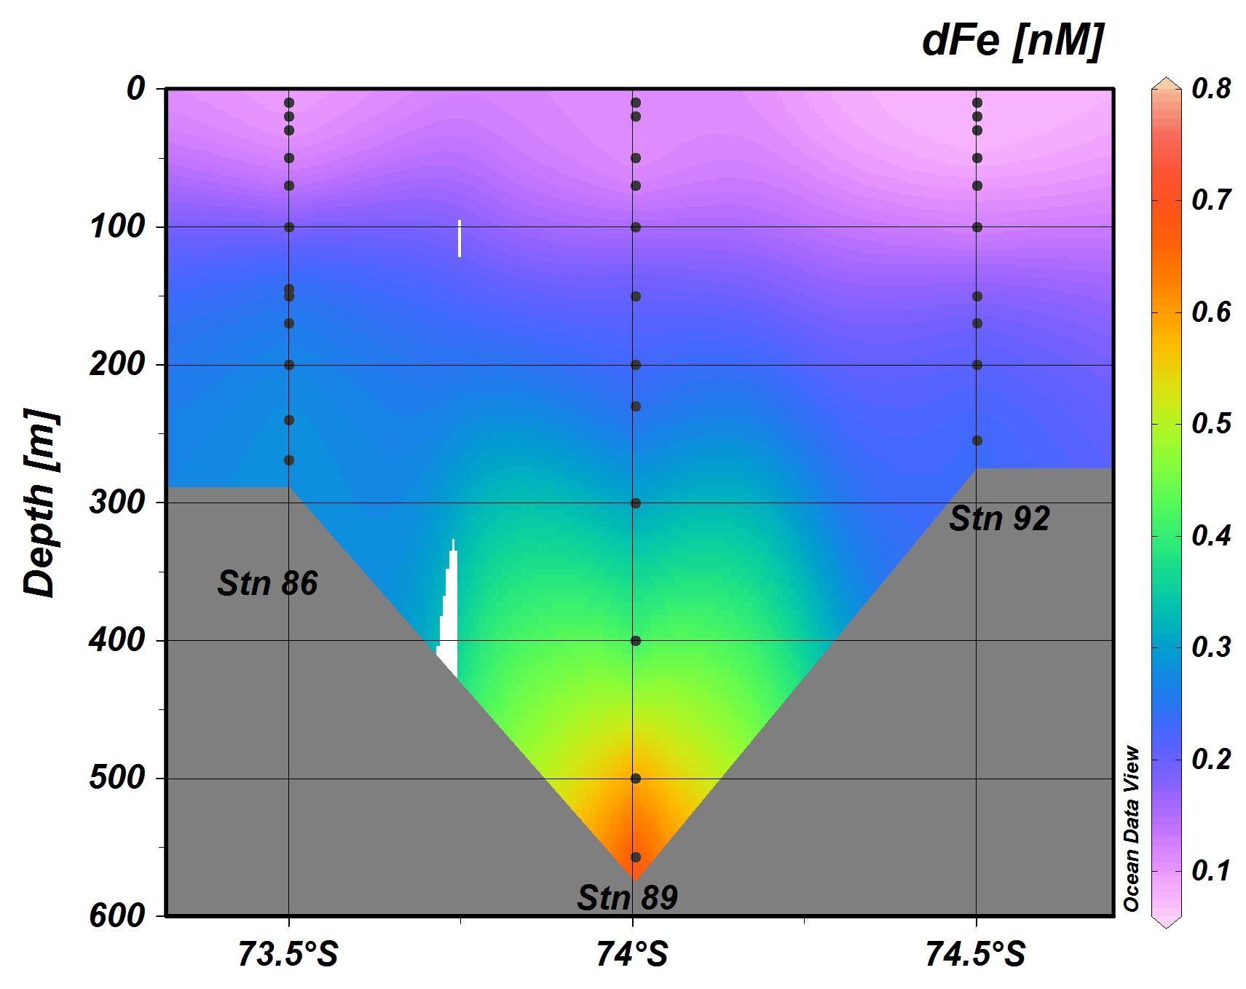
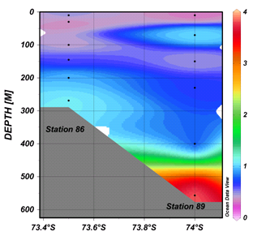
Summary of Shipboard Fe Results:
7. Particulate Iron: A Wildcard
• important research question is biological availability of particulate iron (pFe),
which reaches 0.5-1 nM in euphotic zone and 4-8 nM near seafloor
JOIDES Trough
pFe [nM]
data: Pamela Barrett, UW

Slide 16
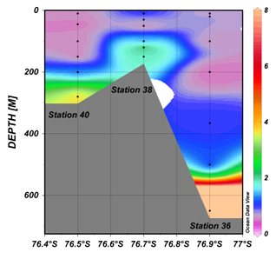
Summary of Shipboard Fe Results:
7. Particulate Iron: A Wildcard
• important research question is biological availability of particulate iron (pFe),
which reaches 0.5-1 nM in euphotic zone and 4-8 nM near seafloor
Ross Bank
pFe [nM]
data: Pamela Barrett, UW

Slide 17
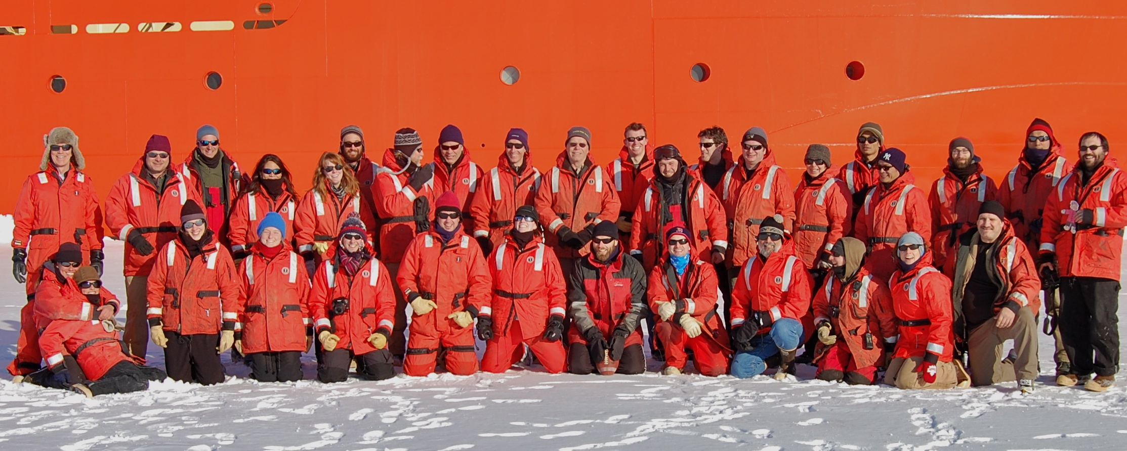
And last, but not least, a big thanks to all the PRISM inmates!

