Slide 1
Phytoplankton growth rates in the Ross Sea, Antarctica
Anna Mosby
Prism PI Meeting
29 November 2012
Notes:
5-10 minutes

Slide 2
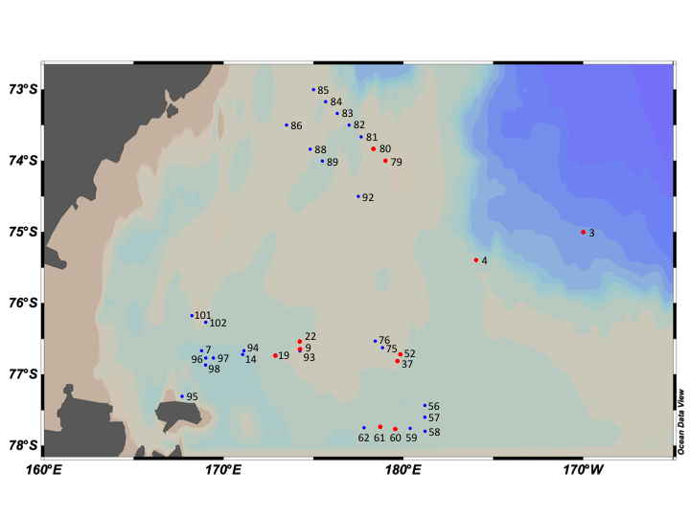
Site Overview
NBP12-01
Total Stations:
37 ¹⁴C-incubations
11 dilution experiments
Dates:
01/08/12- 02/02/12
Figure 1. Map of stations sampled from 8 January 2012 to 2 February 2012 on NBP12-01. Eleven
stations were sampled for both dilution experiments and ¹⁴C-incubations (red dots) and 26 stations
were sampled for ¹⁴C-incubations (blue dots). Created in Ocean Data View.

Slide 3
Determination of growth rates by isotopic tracers

Slide 4
Preliminary Results
Figure 2. ¹⁴C uptake (g C m⁻² d⁻¹) in the Ross Sea from 08 January 2012 to 02 February 2012 for 24 h (diamond), 48 h (triangle), and 72 h (circle) incubations.
Notes:
-something like this or focus on single timepoint?
-omitted points that seemed way out of the norm (1 for 24 hours and 1 for 48 hrs)

Slide 5
Preliminary Results
=24 h
=48 h
Figures 3-5.24 h (upper left), 48 h (upper right), and 72 h (lower right). Growth rates determined from experimentally determined primary productivity and initial chlorophyll values using an assumed C: Chl a ratio of 40.
=72 h
Notes:
Label w/ time and colors
-POC data is currently being processed but have values for primary production
-these figures present primary production against initil chlorophyll values
-chlorophyll (ug/l) ranged from 0.222 ug/l (Station 79 on Jan 29 Joides Trough) – 10.53 ug/l (Station 14 on Jan 16)
PP values:
24 hours 0.139 (Station 83) - 3.27(Station 4) mg C m-2 d-1
48 hours 0.137 (Station 83) – 2.79 (Station 4)
72 hours 0.0974 (Station 80)- 4.64 (Station 4)
Station 4 consistenly had highest PP values, general trend to increasing PP with increasing chl a

Slide 6
Determination of growth rates by the dilution method

Slide 7
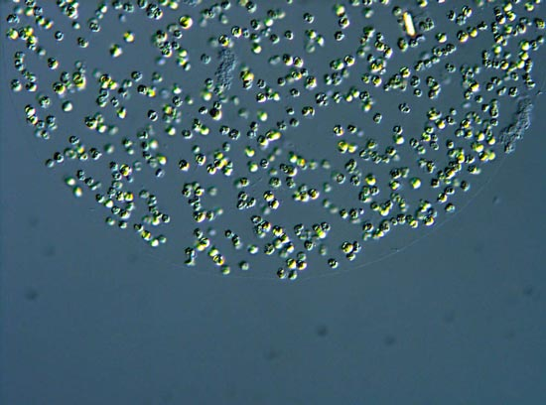
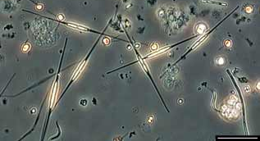
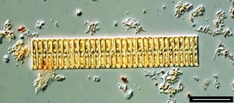
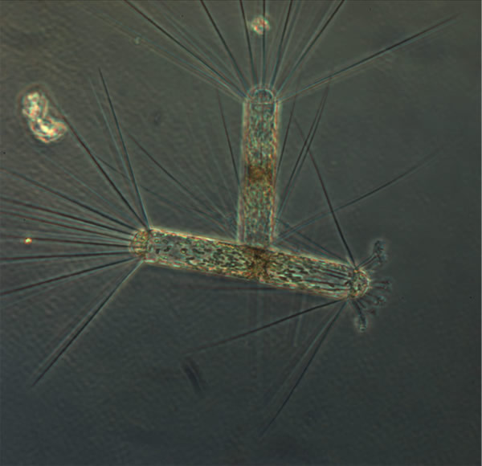
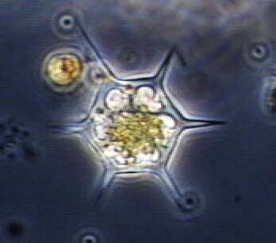
Microscopy
Species Present
Dominant species
Phaeocystis antarctica
(colonial and solitary)
Cylindrotheca closterium
Present in concentrations >1 cell/ml
Fragilariopsis sp.
Nitzschia longissima
Pseudo-nitzschia sp.
Chaetoceros sp.
Dactyliosolen antarcticus
Seen but not counted
Dictyocha sp.
Corethron criophilum
Figures 6-12. Diatom species. From top to bottom: P. antarctica (colonial), C. closterium, D. antarcticus (left), Fragilariopsis sp.(right), N. longissima, C. criophilum (left), and Dictyocha sp.
Notes:
Phaeocystis:http://www.c3.uts.edu.au/multimedia/gallery/katherina_petrou.html
Cylindrotheca: http://www.itameriportaali.fi/en/tietoa/algaline_seuranta/lajistoraportit/lajistoraporttiarkisto/2004/en_GB/2291/
Frag: http://www.itameriportaali.fi/en/tietoa/algaline_seuranta/lajistoraportit/lajistoraporttiarkisto/2006/en_GB/3277/
Nitzschia longissima:http://planktonnet.awi.de/index.php?contenttype=image_details&itemid=55184#content
Dactyliosolen antarcticus: http://literacynet.org/polar/elements/elements_journals/week4_hot.html (Chris Hewes, Scripps)
Corethron criphilum:http://literacynet.org/polar/elements/elements_journals/week4_hot.html (Chris Hewes, Scripps)
Dictyocha: http://www.jochemnet.de/fiu/bot4404/BOT4404_21.html

Slide 8
Station 3 (Outside Ice Station)
Chl a initial: 0.917 μg/l
100% WSW Net Growth Rate: -0.0177 d⁻¹
20% WSW Net Growth Rate: 0.148 d⁻¹
Grazing Rate: 0.161 d⁻¹
 | P. antarctica colonial (cells/ml) | P. antarctica individual (cells/ml) | Cylindrotheca closterium (cells/ml) | Other Diatoms (cells/ml)
Stn 3
t₀ | 17.00 (39.76%) | 0 (0%) | 10.44 (24.42%) | 15.32 (35.82%)
72 h | 0 (0%) | 123.7 (67.30%) | 23.88 (13.00%) | 36.20 (19.70%)

Slide 9
Station 4 (Eddy Center)
Chl a initial: 7.00 μg/l
100% WSW Net Growth Rate: -0.00453 d⁻¹
20% WSW Net Growth Rate: -0.0804 d⁻¹
Grazing Rate: -0.0759 d⁻¹
 | P. antarctica colonial (cells/ml) | P. antarctica individual (cells/ml) | Cylindrotheca closterium (cells/ml) | Other Diatoms (cells/ml)
Stn 4
t₀ | 149.8 (2.57%) | 0 (0%) | 5513 (94.73%) | 157.3 (2.70%)
24 h | 10420 (30.50%) | 4887 (14.30%) | 18780 (54.96%) | 82.6 (0.24%)
48 h | 3292 (15.57%) | 4781 (22.61%) | 13040 (61.67%) | 29.54 (0.15%)
72 h | 12690 (23.64%) | 13960 (26.00%) | 27010 (50.31%) | 28.2 (0.05%)

Slide 10
Station 19 (Frontal Region)
Chl a initial: 1.91 μg/l
100% WSW Net Growth Rate: 0.467 d⁻¹
20% WSW Net Growth Rate: 0.483 d⁻¹
Grazing Rate: 0.192 d⁻¹
 | P. antarctica colonial (cells/ml) | P. antarctica individual (cells/ml) | Cylindrotheca closterium (cells/ml) | Other Diatoms (cells/ml)
Stn 19
t₀ | 0 (0%) | 0 (0%) | 4325 (94.77%) | 238.8 (5.23%)
72 h | 179.2 (0.54%) | 0 (0%) | 32865 (99.03%) | 141.6 (0.43%)

Slide 11
Station 60 (Ross Ice Shelf)
Chl a initial: 6.07 μg/l
100% WSW Net Growth Rate: -0.0946 d⁻¹
20% WSW Net Growth Rate: -0.0642 d⁻¹
Grazing Rate: -0.00721 d⁻¹
 | P. antarctica colonial (cells/ml) | P. antarctica individual (cells/ml) | Cylindrotheca closterium (cells/ml) | Other Diatoms (cells/ml)
Stn 60
t₀ | 50.19 (8.38%) | 206.1 (34.38%) | 6.6 (1.10%) | 336.6 (56.14%)
72 h | 958.5 (17.60%) | 4365 (80.15%) | 67.8 (1.25%) | 54.32 (1.00%)
Notes:
-one grazing and this
Pis and anyone from VIMS and ODU

