Slide 1
Ross Sea (Model) Overview
Stefanie Mack
11/29/2012
PRISM PI Meeting

Slide 2
Outline
Water mass analysis
  Large scale circulation
Future plans for the model
Tides

Slide 3
Water Mass Analysis
Model reflects climatology from observations on shelf
Contains more information over winter months
5-day snapshot volume census shows how water masses on shelf change over time
Time series of water mass volume

Slide 4
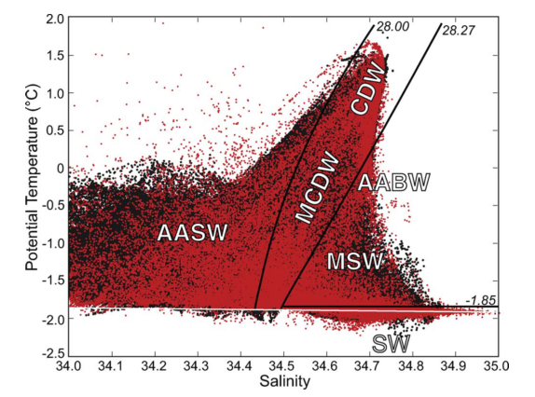
Ross Sea Water Masses
Orsi & Wiederwohl, DSRII, 2009

Slide 5
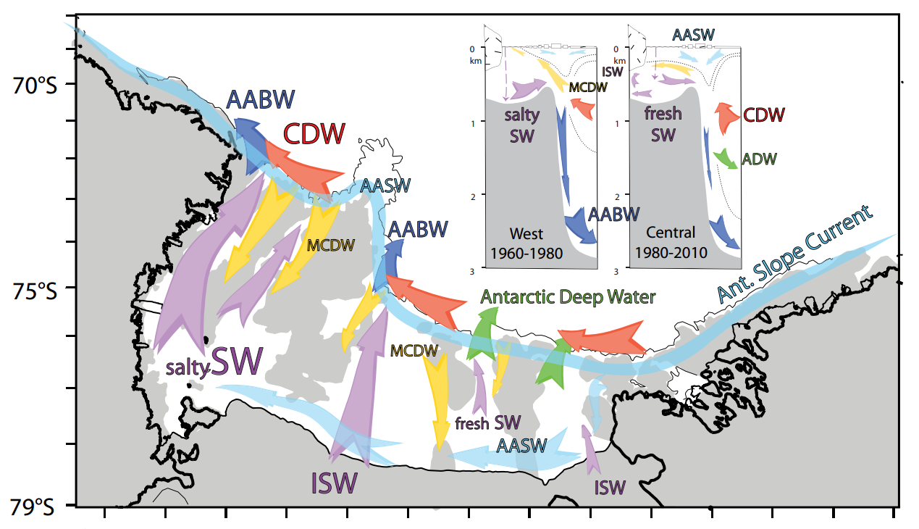
Large Scale Circulation
Smith et al, Oceanography, 2012

Slide 6
Definitions of water masses
Water Mass | Density | Temperature | Salinity
AASW | <28.0 | All | All
(M)CDW | [28, 28.27] | All | All
ISW | >28.27 | <-1.95 | All
MSW | >28.27 | >-1.85 | All
SW | >28.27 | [-1.95, -1.85] | All
LSSW | >28.27 | [-1.95, -1.85] | <34.62
HSSW | >28.27 | [-1.95, -1.85] | >34.62
Orsi & Wiederwohl, DSRII, 2009

Slide 7
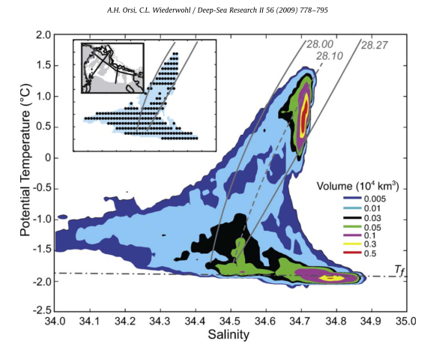
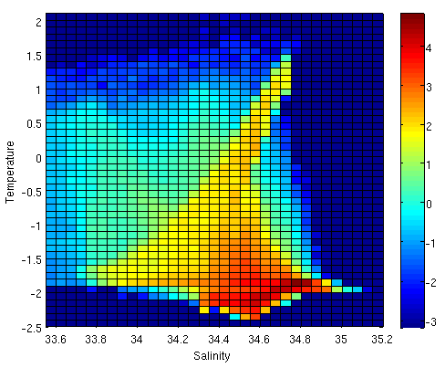
T/S Volumetric Analysis
log(Volume in km³)
Observations – Mostly Summer
Model Data – Yearly Average

Slide 8
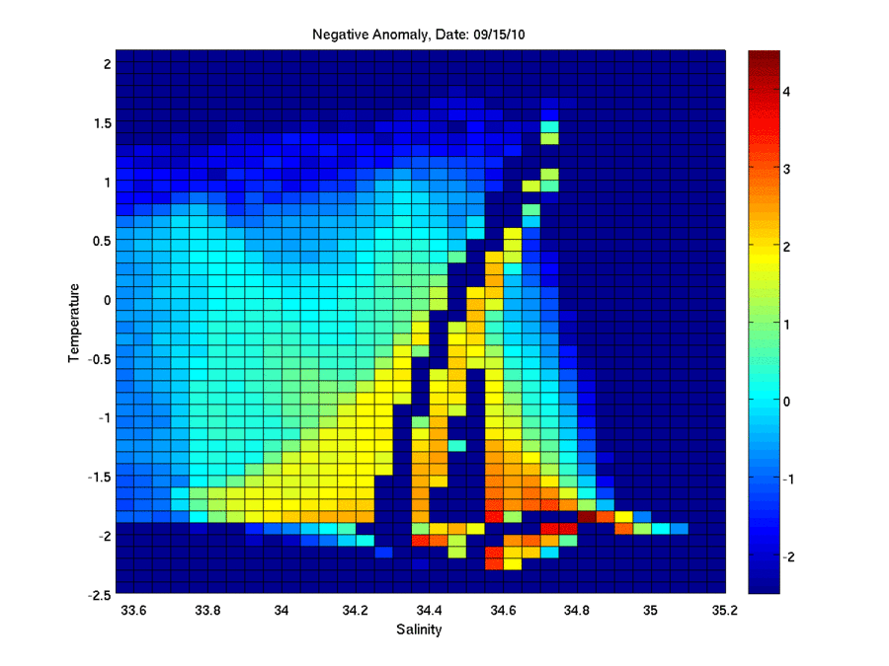
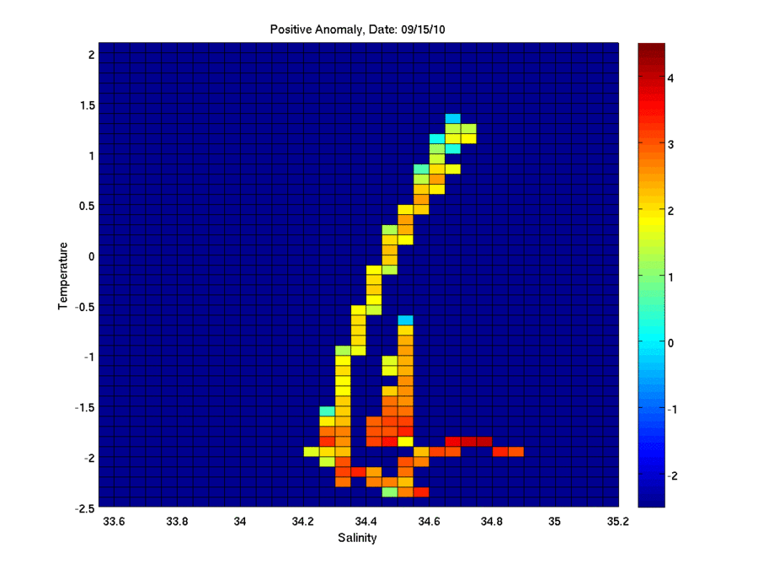
T/S Volumetric Analysis
Negative Anomaly
Positive Anomaly

Slide 9
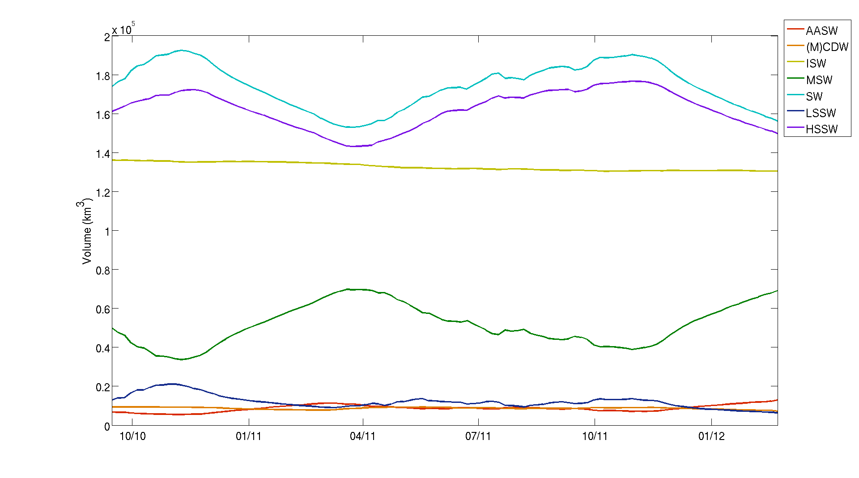
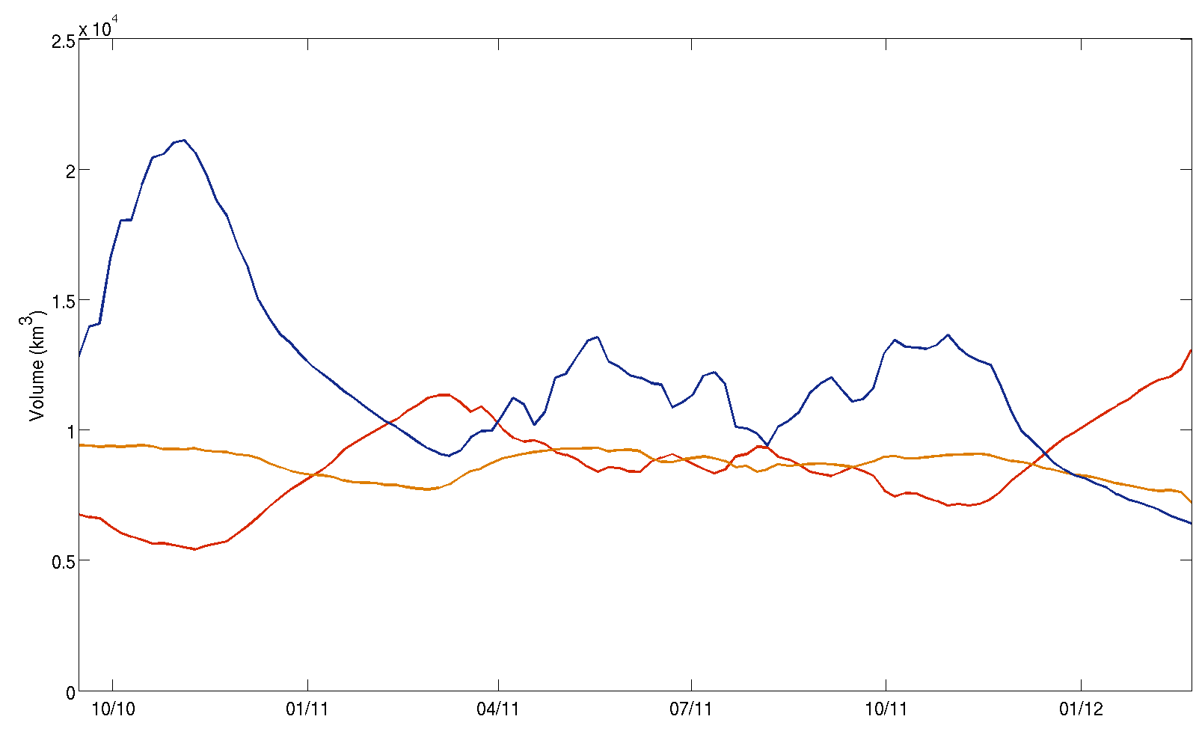
Water Mass Volume

Slide 10
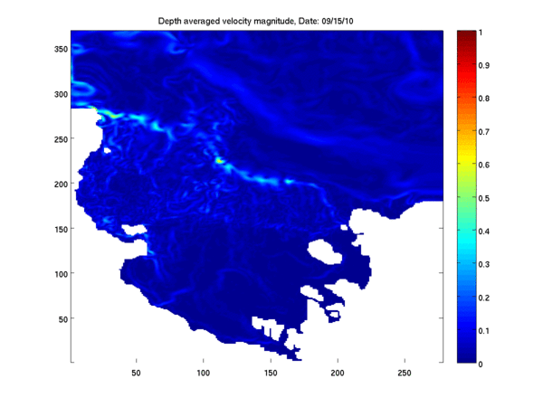
Depth-Averaged Velocity

Slide 11
Future Plans
Increase model resolution
  Currently at 5km
  Run at 2.5km and 1.25km resolution
Add tides
  Already done successfully by Padman & Springer group
Mesoscale variability
  Of sea ice
  Of transport on and off shelf
  And whatever else looks interesting

Slide 12
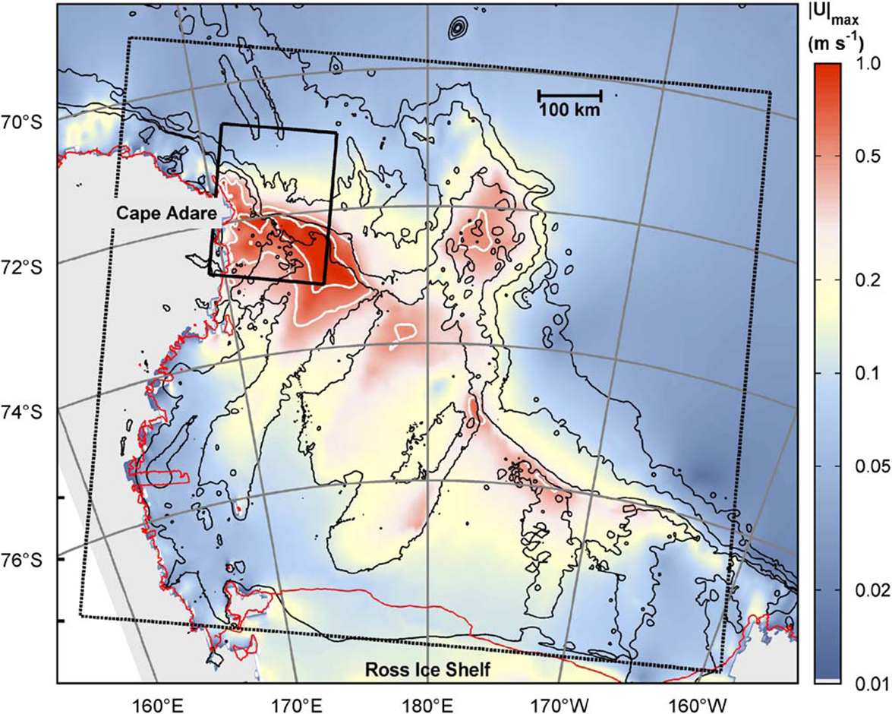
Ross Sea Tides
Padman et al, DSRII, 2009

Slide 13
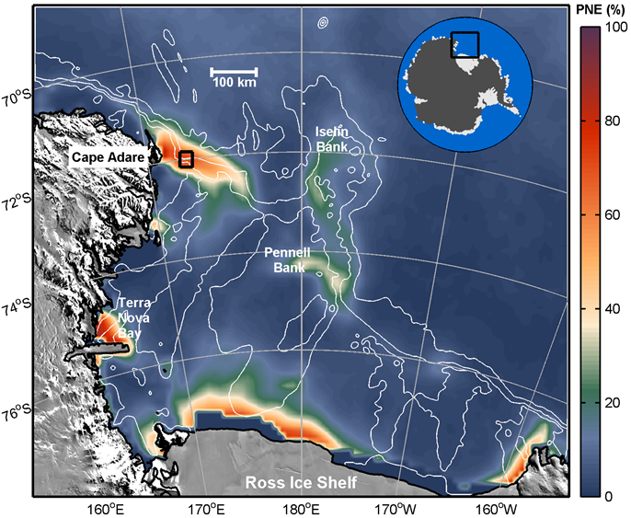
Tides & Sea Ice
Winter variability of sea ice concentration
Mack et al, GRL, under review

Slide 14
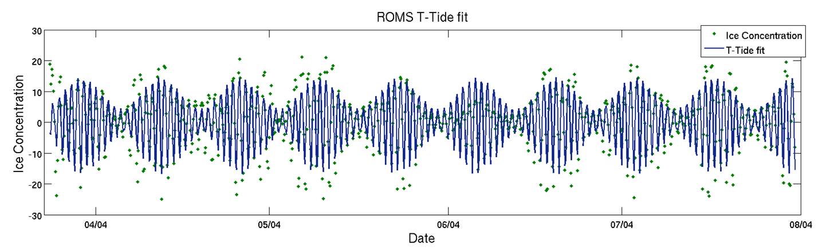
Tides & Sea Ice
Analysis for 2004, ROMS matches satellite predictions well.
 | O1 Amplitude (ice %) | K1 Amplitude(ice %) | O1/K1 Ratio
AMSR-E | 7.2 | 4.4 | 1.65
ROMS | 9.4 | 5.0 | 1.89

Slide 15
Tidal Modeling
Tidal forcing is imposed by adding tidal velocities and sea surface height variations from Laurie Padman’s CATS model at the boundaries
Current focus is on tidal effects on sea-ice (and its impact on HSSW formation) and ice shelf basal melt
Will be looking at effects on transport and mixing of CDW in future

Slide 16
Conclusions
Current model configuration represents overall circulation and water masses well
A higher resolution version can shed light on mesoscale processes and tidal effects
Stay tuned for more results

Slide 17
Ross Sea Model
ROMS: 5 km horizontal resolution, 24 levels
Ice shelves (mechanical and thermodynamic)
Dynamic sea-ice
Different wind forcing, but typically either from Antarctic Mesoscale Prediction System (AMPS) or ERA-Interim
Lateral boundary conditions from WOA, OCCAM and SSM/I ice concentrations
Bathymetry from BEDMAP and Davey
Experiments w/ dye representing CDW
Notes:
ROMS: Regional Ocean Modeling System: hydrostatic finite difference OGCM with a terrain following vertical coordinate. BEDMAP (ice thickness and subglacial topo model of the Ant.). Explain AMPS.

Slide 18
New Model Run for PRISM
Sept. 15, 2010 – Feb. 29, 2012
Model fields saved every 12 hours for entire run
Forced with 6-hourly winds and air temperatures from the new higher resolution (0.75°) ERA-Interim product
Had to switch to coarser (25-km) SSMIS sea-ice from AMSR-E (12.5-km)
Fixed small bug in the sea-ice code
Two new dye tracers: Ice Shelf meltwater and sea-ice meltwater
Notes:
AMSR-E ice no longer available past October, 2011.

