Slide 1
Phytoplankton physiology
in the Ross Sea
PRISM Cruise Meeting
ODU Nov 2012
Tom Bibby & Tommy Ryan-Keogh
Ocean and Earth Science
University of Southampton
Southampton, U.K.
tsb@noc.soton.ac.uk

Slide 2
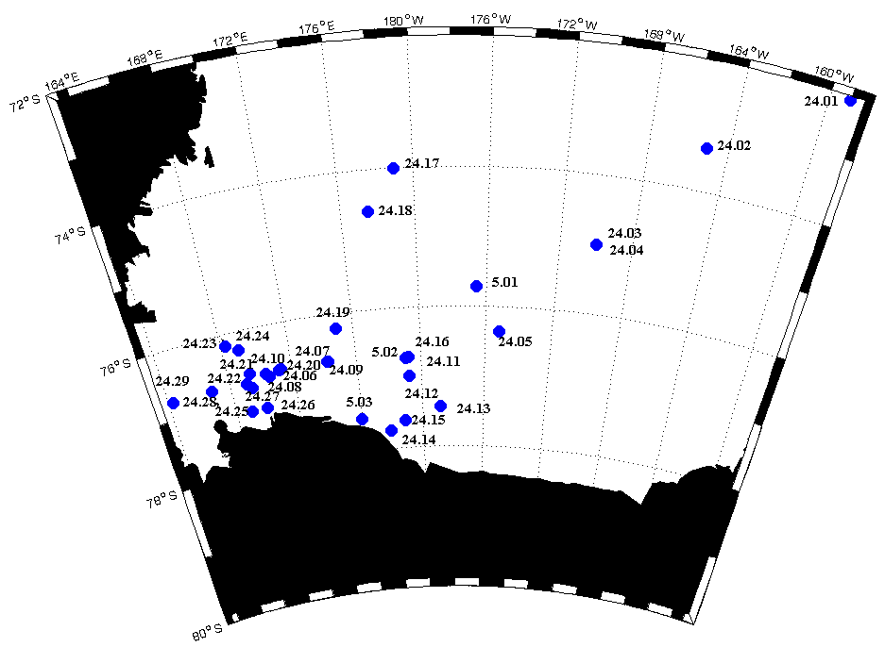
Aims and Objectives:
Aims
To map the spatial/temporal extent of iron-limitation ‘physiologically’ throughout the Ross Sea
To gain an understanding of the molecular level responses by phytoplankton to low iron concentrations in the Ross Sea

Slide 3
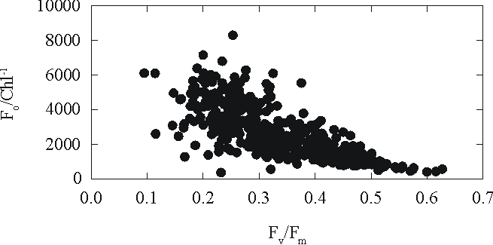
Aims and Objectives:
Also:
There is growing evidence that under nutrient limitation significant amounts of chlorophyll are ‘uncoupled’ not directly involved in photosynthesis – consequences for remotely sensed estimates of primary production.

Slide 4
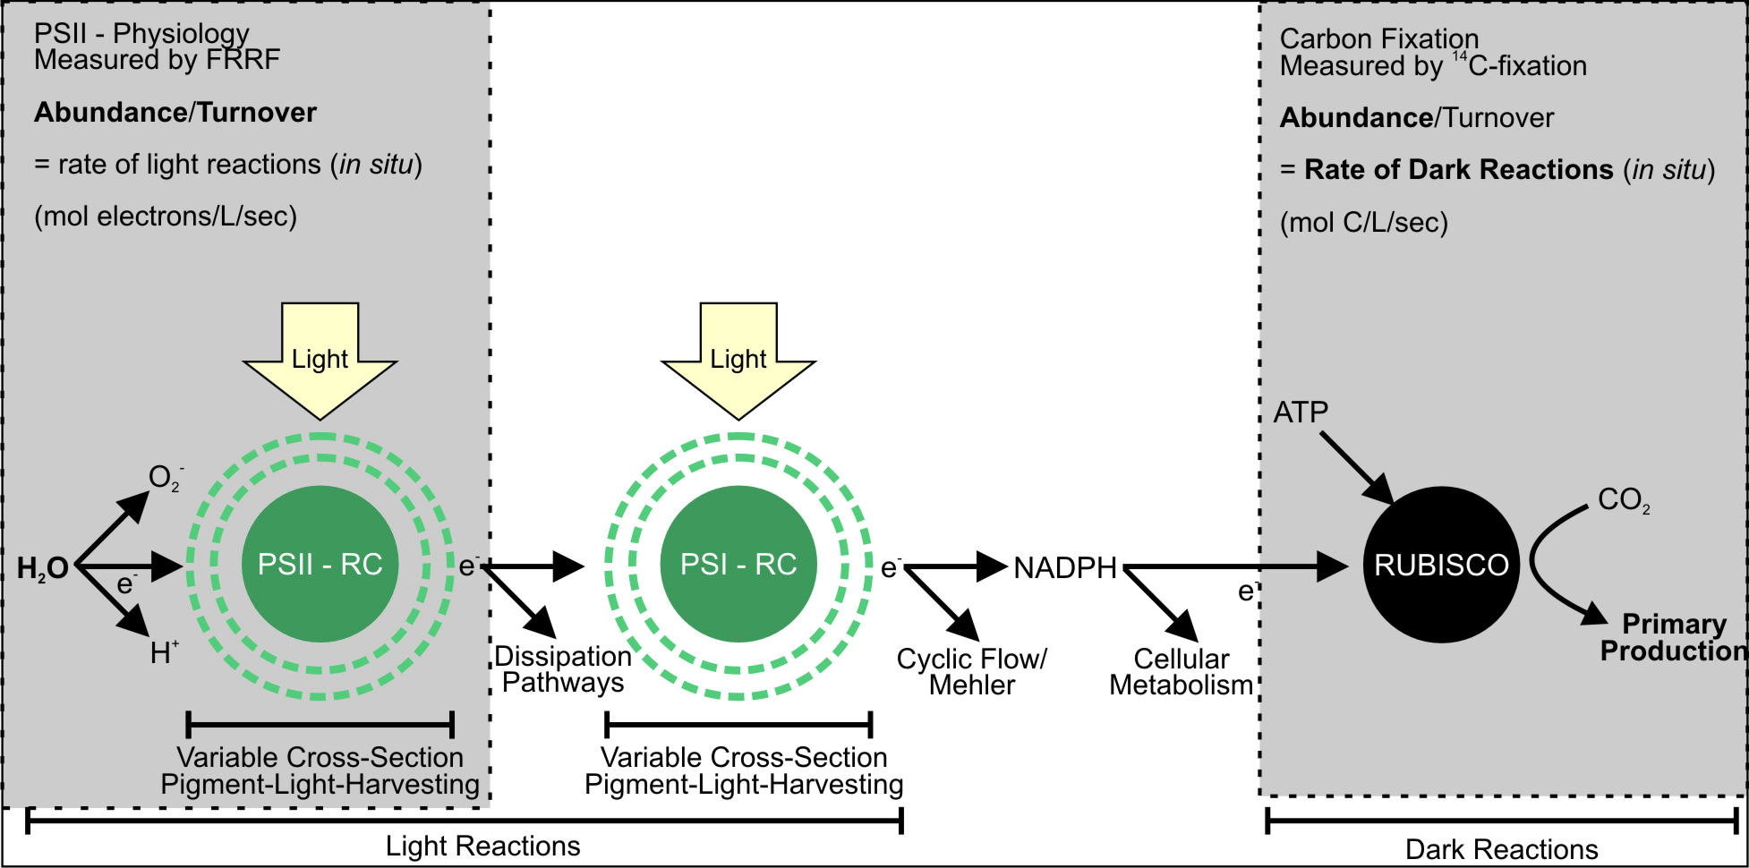
Key enzymes in biogeochemical cycles
The enzymes (protein diversity) that mediate the chemical reactions of biogeochemically important reactions are highly conserved
We use two techniques to enable us to interrogate these enzymes in mixed microbial communities

Slide 5
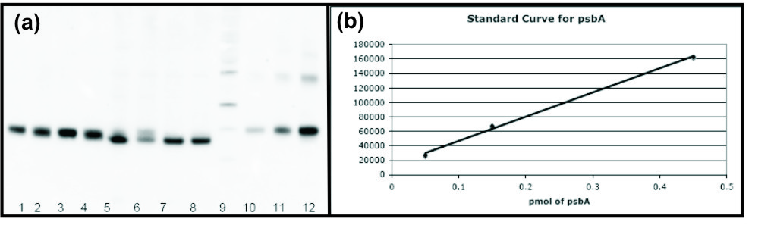
Method 1: Quantitative immunodetection
Antibodies raised to conserved peptide sequences of metabolic proteins to quantify abundance of these targets in mixed microbial communities
‘Global-antibodies’ – http://www.agrisera.com/
Known ratio of peptide to functional complex
e.g. PsbA 1:1
abundance PsbA abundance of PSII
Figure from Prof. Doug Campbell, Mount Allison

Slide 6

Method 1: Quantitative immunodetection
ADVANTAGES
It allows us to quantify the following key metabolic proteins (fmol):
1. Absolute protein quantification
2. Data from complex microbial communities
3. High spatial/temporal resolution
PsaC: Core subunit of PSI
PsbA: D1 protein of PSII
RbcL: Large subunit of RUBISCO
AtpB: CF1 beta-subunit of ATP synthase
1- Absolute protein quantification,
2- Highly conserved targets,
3- High spatial/temporal resolution

Slide 7
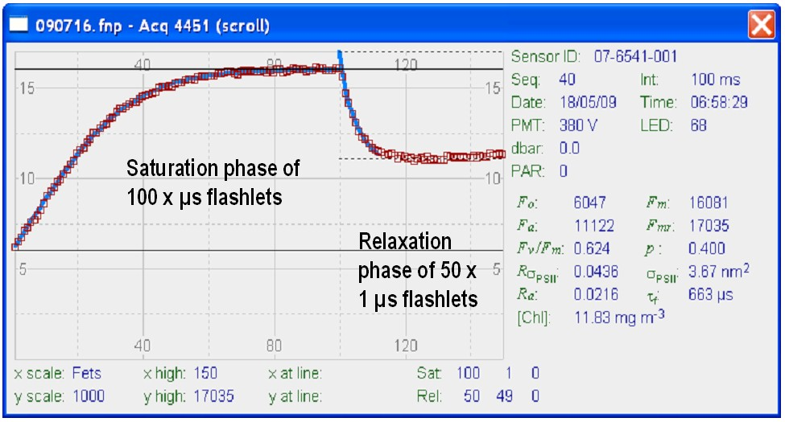
Method 2: Fast Repetition Rate Fluorometry
Biophysical method
Specific interrogation of PSII
F_{v}/F_{m} – Maximum quantum efficiency of PSII photochemistry
Maximum efficiency by which light absorbed by PSII is used to reduce Q_{A}
From Baker 2008 Ann Rev Plant Biol
ADVANTAGES
1. In vivo
2. In real time
3. High spatial/temporal resolution
Fluorescence kinetic emission from PSII

Slide 8
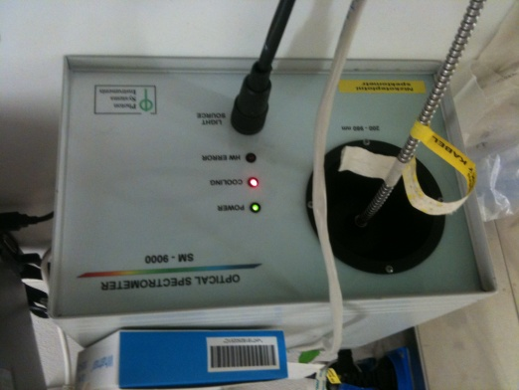
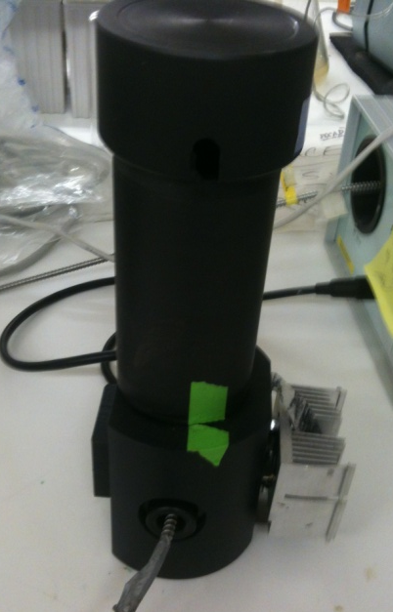
Method 3: 77K Fluorometry
Provides multiple datasets from 6 different diodes (385 nm, 425 nm, 457 nm, 516 nm, 534 nm & 588 nm)
Allows interrogation of different accessory pigments across complex microbial communities
Ondrej Prasil (Trebon - Czech Republic)
ADVANTAGES
Relative protein ratios
Data from complex microbial communities
High spatial/temporal resolution

Slide 9
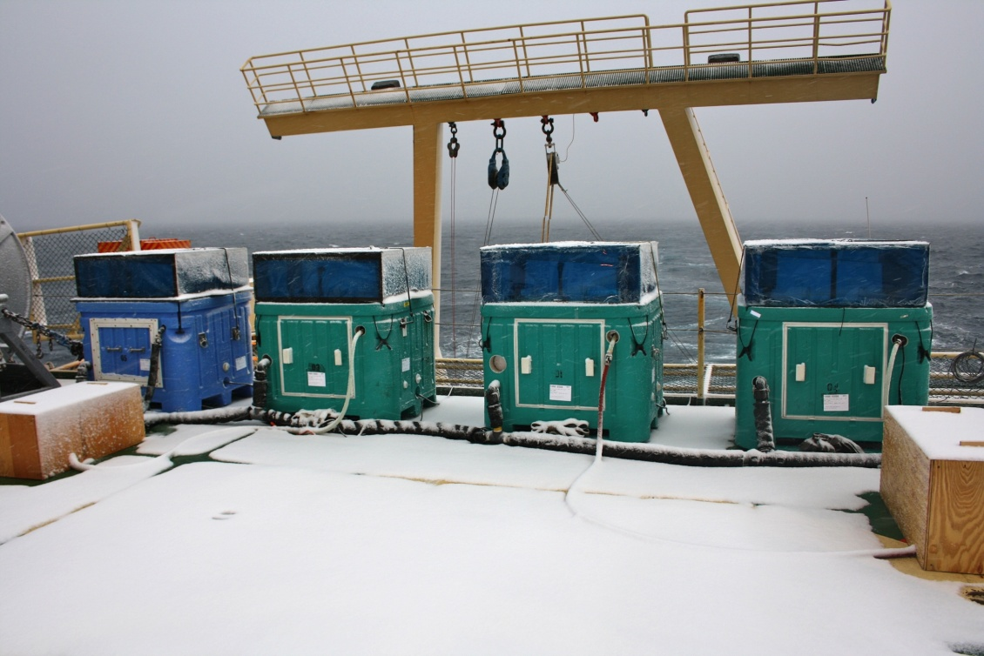
Long-term bioassay experiments
3–4 days biomass response to added Fe
Data on community, physiology, protein
Low spatial resolution
Community composition shifts – differences in F_{v}/F_{m} are as large between species as within species (Suggett et al MEPS 2009)
Removal from in situ environment
Bottle effects

Slide 10
24-hr bioassay incubations
ADVANTAGES
Physiological response in 24 hr
High spatial and temporal resolution
Small volume – complex nutrient additions
Identify limiting nutrients for the phytoplankton community
Compare relative levels of limitation

Slide 11
Overview of Measurements
Measurements Collected | Processed?
FRRf CTD | ☑
FRRf Underway | ☒
FRRf incubation experiments | ☑
77K Fluorescence CTDs | ☑
77K Fluorescence incubation experiments | ☑
Nutrients incubation experiments | ☑
Proteins CTD | ☒
Proteins incubation experiments | ☒
Lugol’s samples experiments | ☒

Slide 12
Long-term Incubation Experiment 1
Experiment set up in Eddy 3
Other data processed:
Nutrients
77K fluorescence
Still to be processed:
Proteins
Lugol’s Community counts

Slide 13
Long-term Incubation Experiment 2
Experiment set up over Ross Bank
Other data processed:
Nutrients
77K fluorescence
Still to be processed:
Proteins
Lugol’s Community counts

Slide 14
Long-term Incubation Experiment 3
Experiment set up in proximity to Ross Ice Shelf
Other data processed:
Nutrients
77K fluorescence
Still to be processed:
Proteins
Lugol’s Community counts

Slide 15
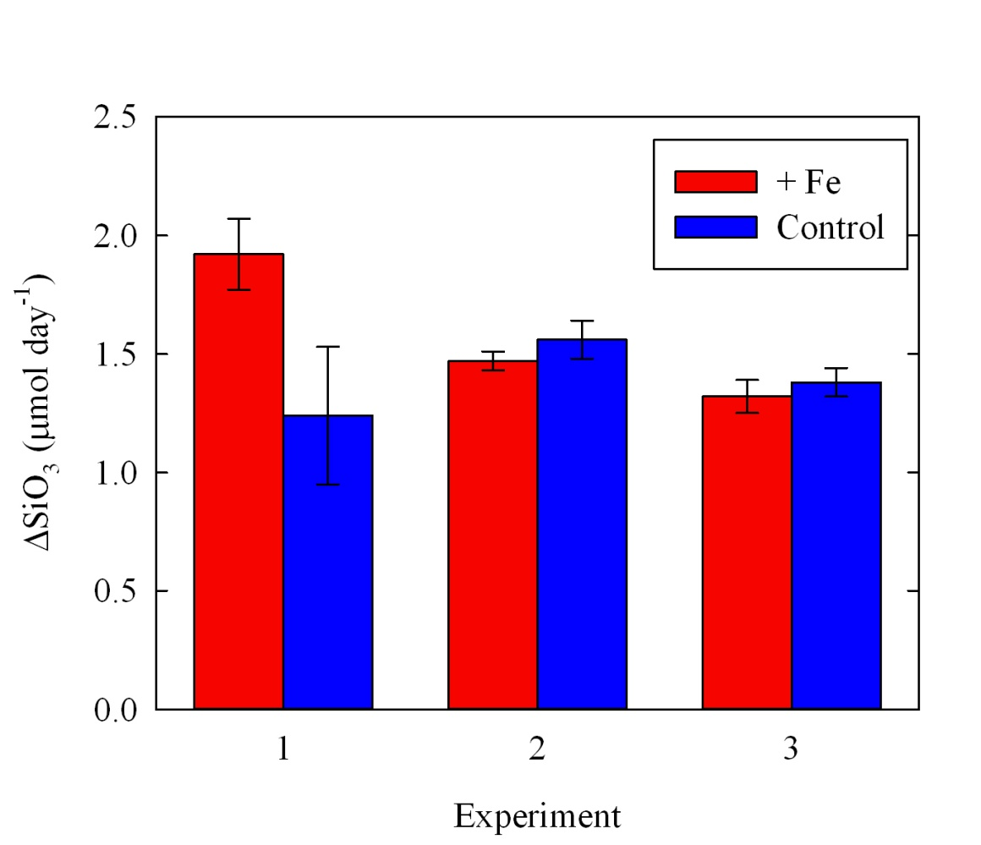
Long-term Incubation
Starting to look at community composition and nutrient drawdown

Slide 16
Short-term Incubation Experiments
Variable responses in F_{v}/F_{m} across the Ross Sea
Response in F_{v}/F_{m} from 24 hours, biomass responses from 48 hours

Slide 17
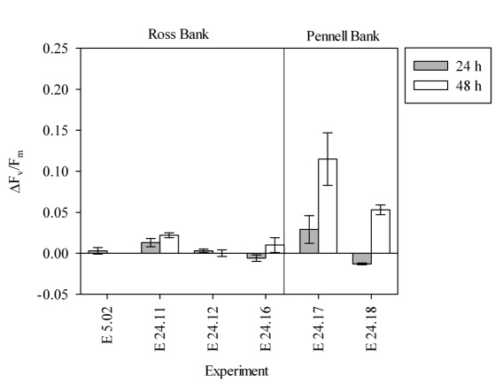
Short-term Incubation Experiments
Responses of Δ(F_{v}/F_{m}) in regions study regions
Plot Fe:N drawdown against Δ(F_{v}/F_{m}) ?

Slide 18
Preliminary 77K Fluorescence Results
There is growing evidence that under nutrient limitation significant amounts of chlorophyll are ‘uncoupled’ not directly involved in photosynthesis – consequences for remotely sensed estimates of primary production.
The results can be used to look at PSII:PSI ratios, which can be compared to absolute quantifications of proteins.

Slide 19
Iron:Biomass Interactions
Ryan-Keogh TJ, et al (2012) Spatial and temporal development of phytoplankton iron stress in relation to bloom dynamics in the high latitude North Atlantic Ocean. Limnology and Oceanography (in press)

Slide 20
Iron:Biomass Interactions
Ryan-Keogh TJ, et al (2012) Spatial and temporal development of phytoplankton iron stress in relation to bloom dynamics in the high latitude North Atlantic Ocean. Limnology and Oceanography (in press)

Slide 21
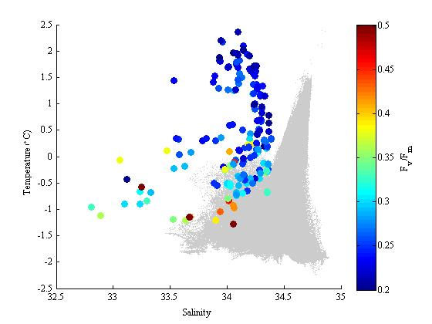
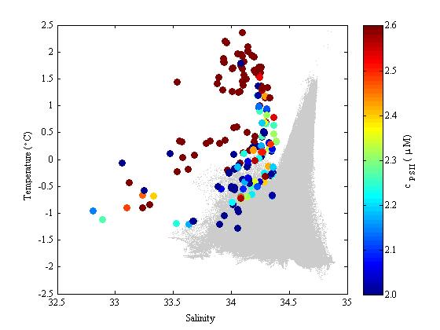
TS vs FRRf Data – Surface Only
Variability of iron-stress with stage of bloom? Time since ice-melt?

Slide 23
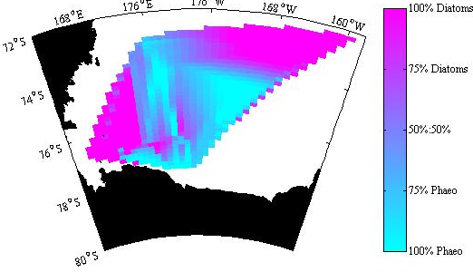
Calculation of Si Deficit
Need to consider community composition data (HPLC, VPR, Microscopy?)

Slide 24
Plan for papers
Somewhere between 1 and 3
Mapping Fe limitation in Ross Sea
in situ Fv/Fm, bioassay
2. Molecular basis of photosynthesis of phytoplankton communities in Ross Sea (implications for remote sensing)
Protein Abundance , 77k, PSII rate, Rubisco rate (Walker PP)
3. Seasonality of iron-limitation in phytoplankton populations in Ross Sea
Ice cover data etc

Slide 25
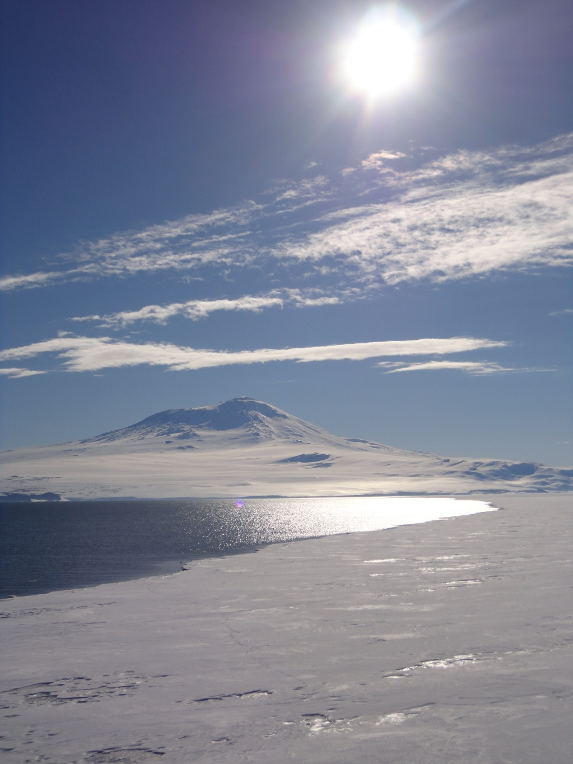
Acknowledgements:
Captain and Crew
R/V NBP
Mark Moore
Ocean and Earth Science
University of Southampton
Ondrej Prasil
Trebon , Creck Republic

