Slide 1
Cruise Hydrography
Overview of stations
Selected Analysis
Two Joides trough sections:
Compare to Kohut et al. JGR 2013
Northward transport of ISW
from Ross Ice shelf Section

Slide 2
Overview of CTD measurements
Cruise track
T-S from CTD
118 CTD stations and 144 XBT drops

Slide 4
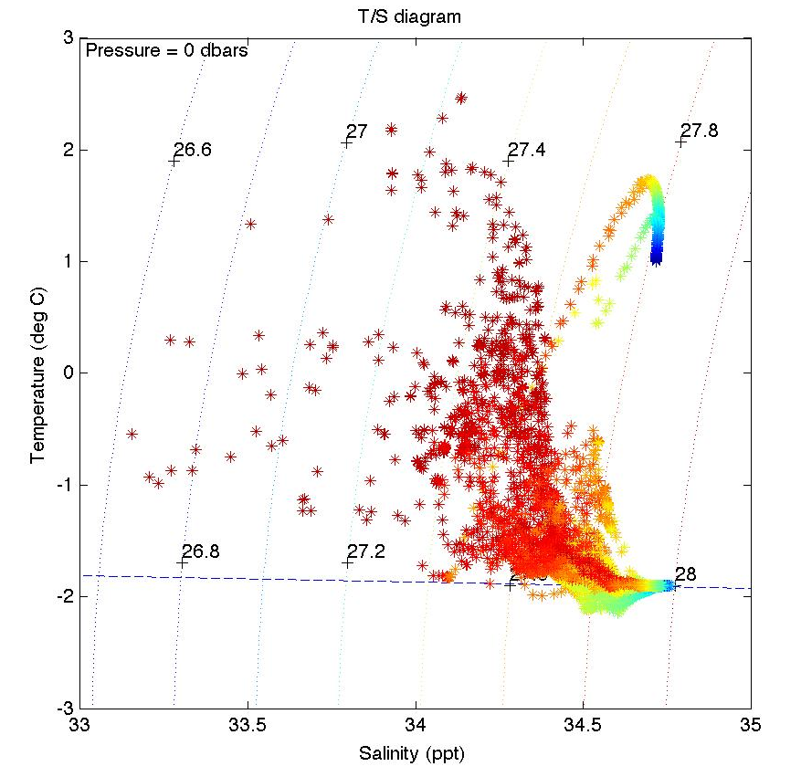
T/S structure from all CTD casts.
Color indicates depth

Slide 5
mCDW transport in Joides Trough
Use neutral density (28.0 – 28.27)
Use geostrophic flow relative to the bottom
Look for temperature and Oxy signal

Slide 6
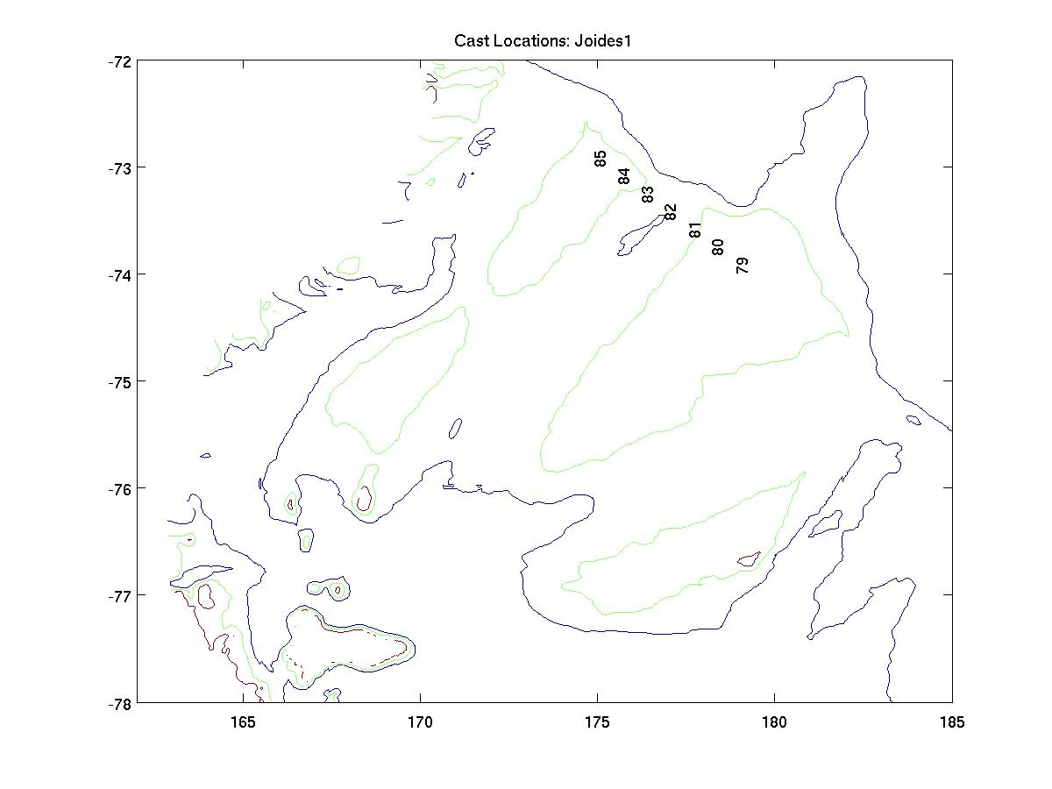
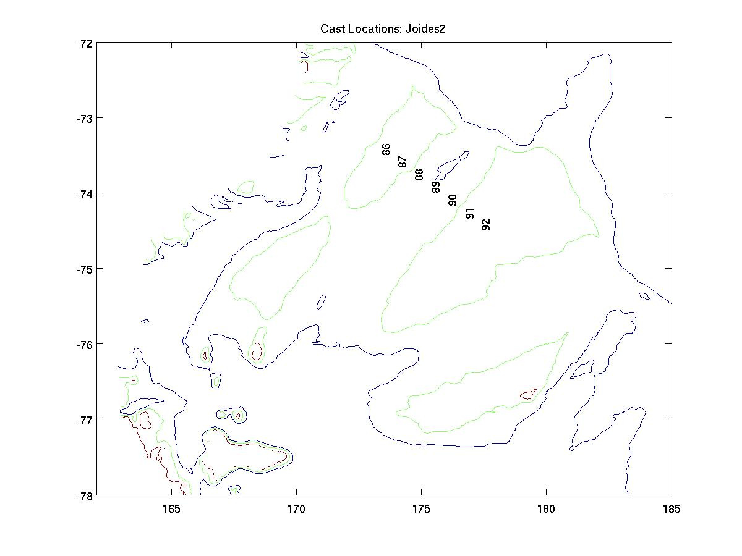

Slide 7
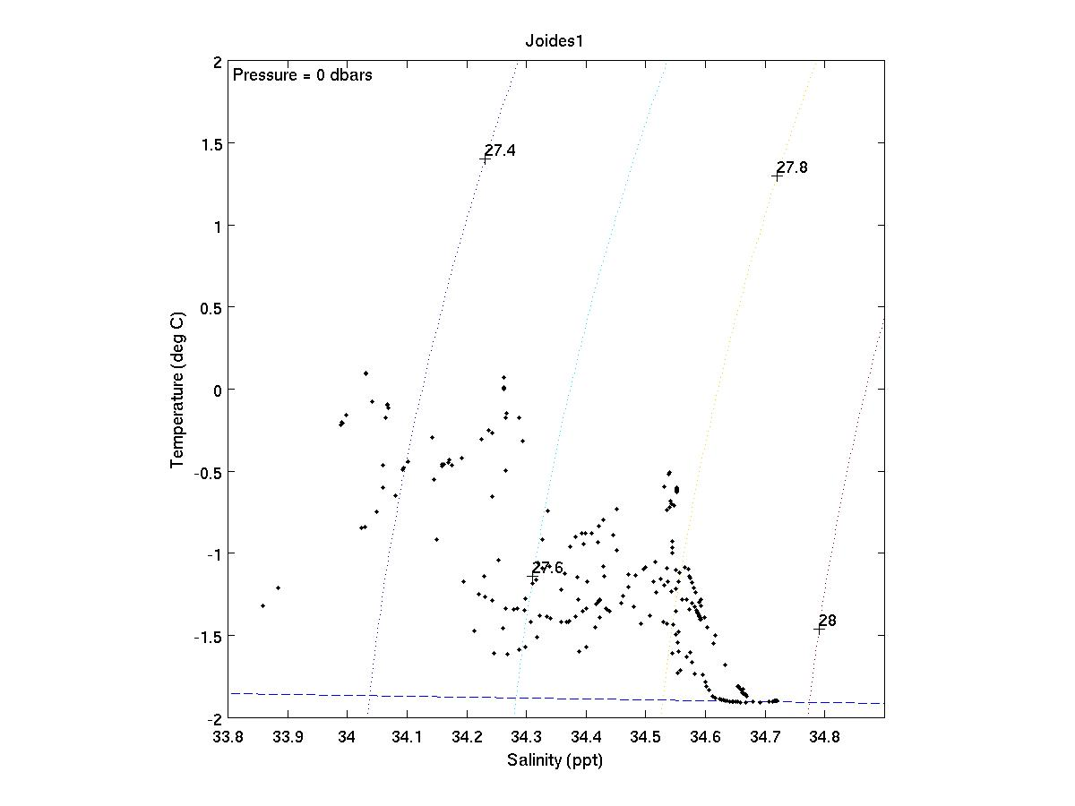
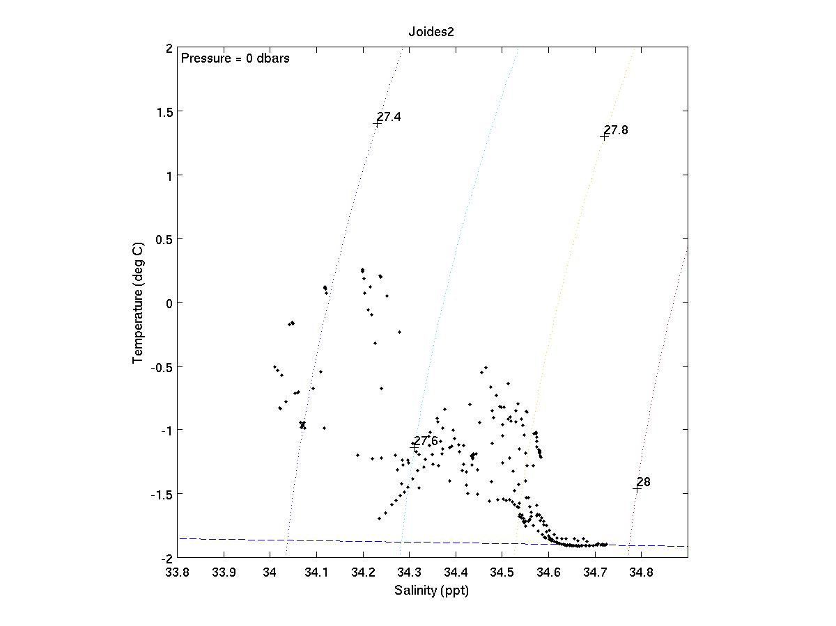

Slide 8
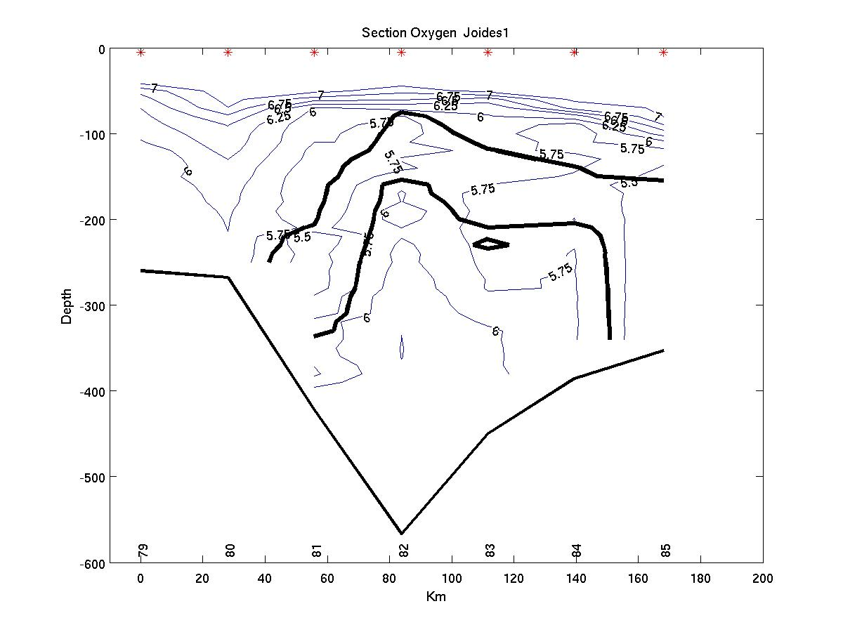
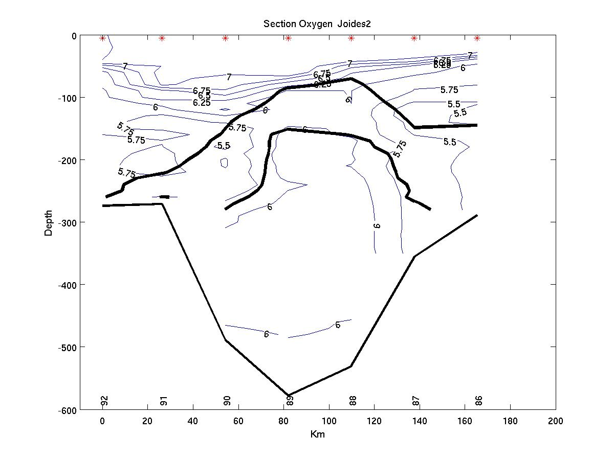

Slide 9
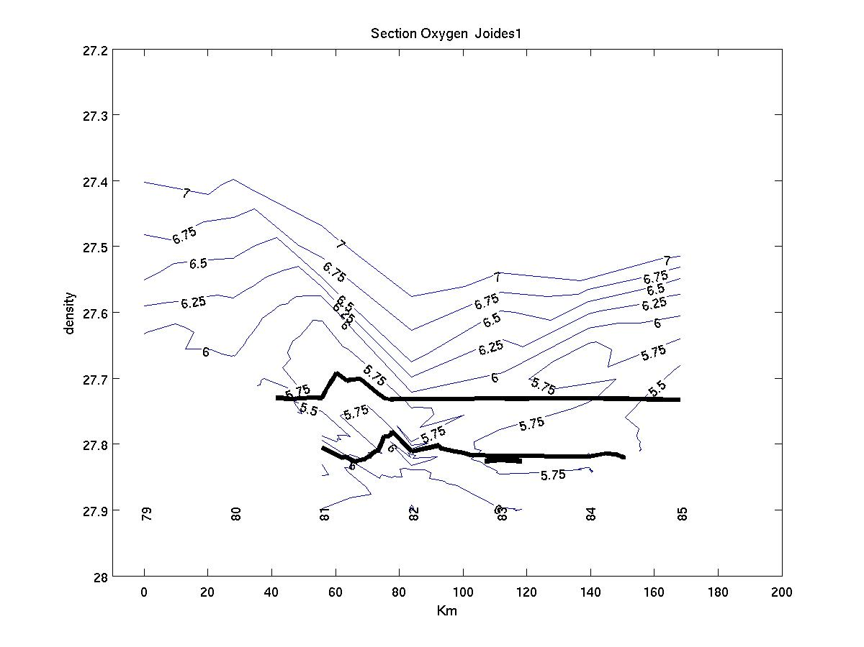
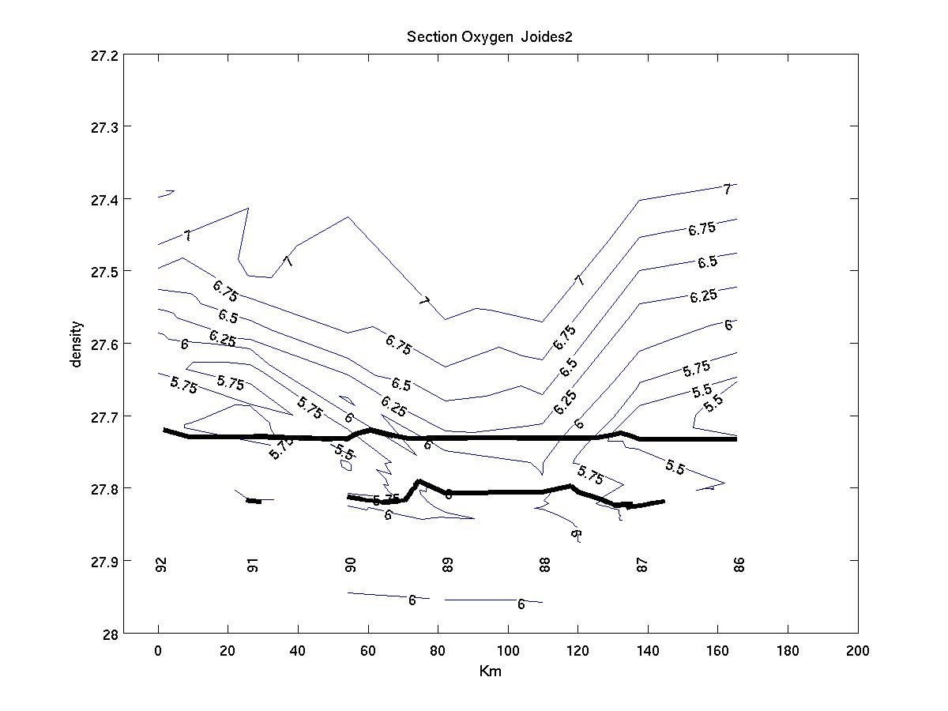

Slide 10
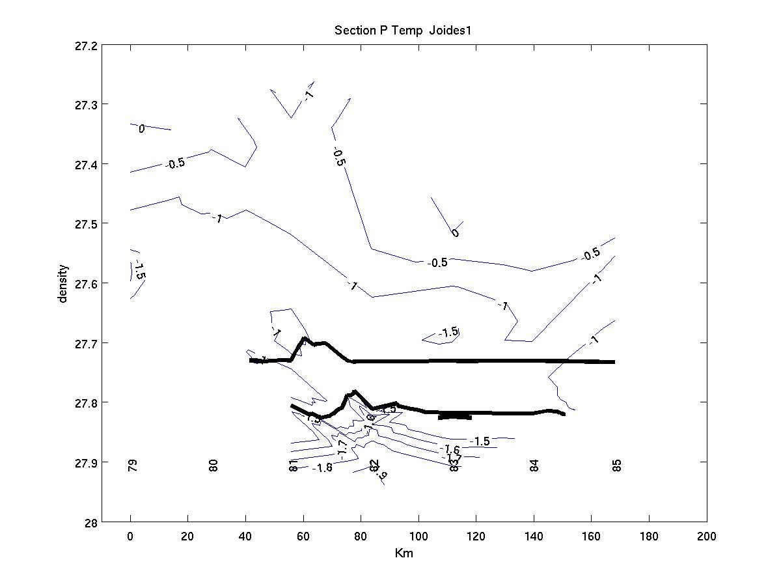
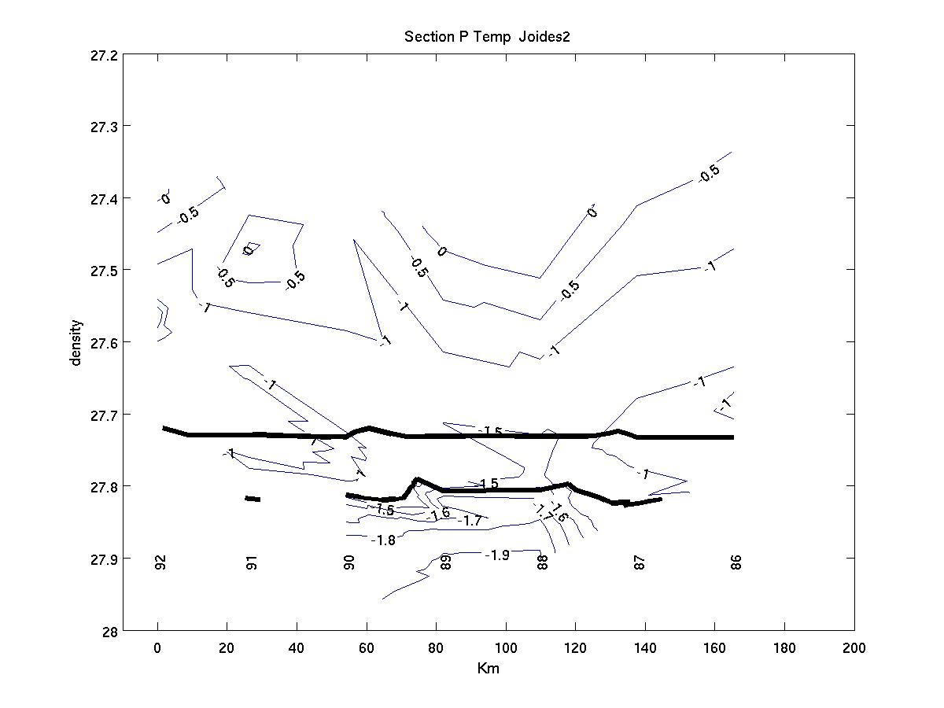

Slide 11
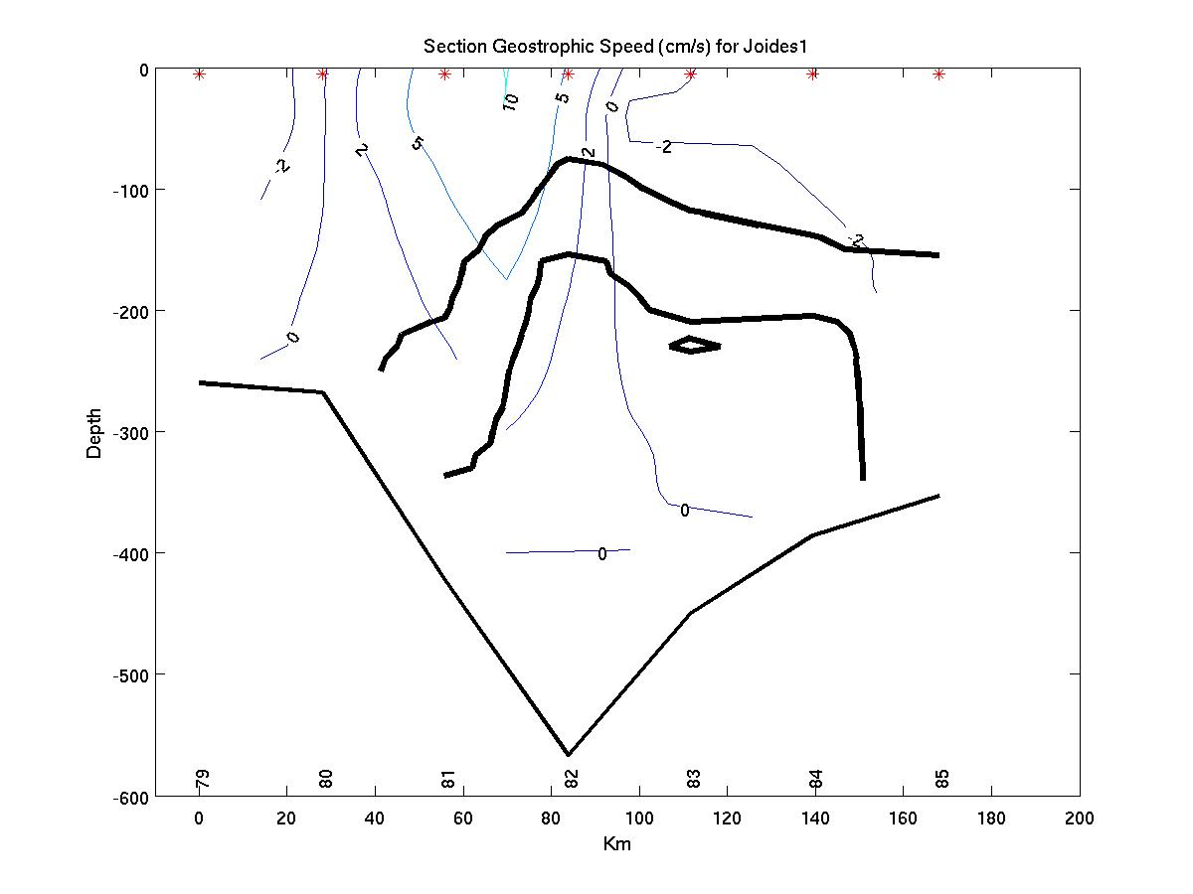
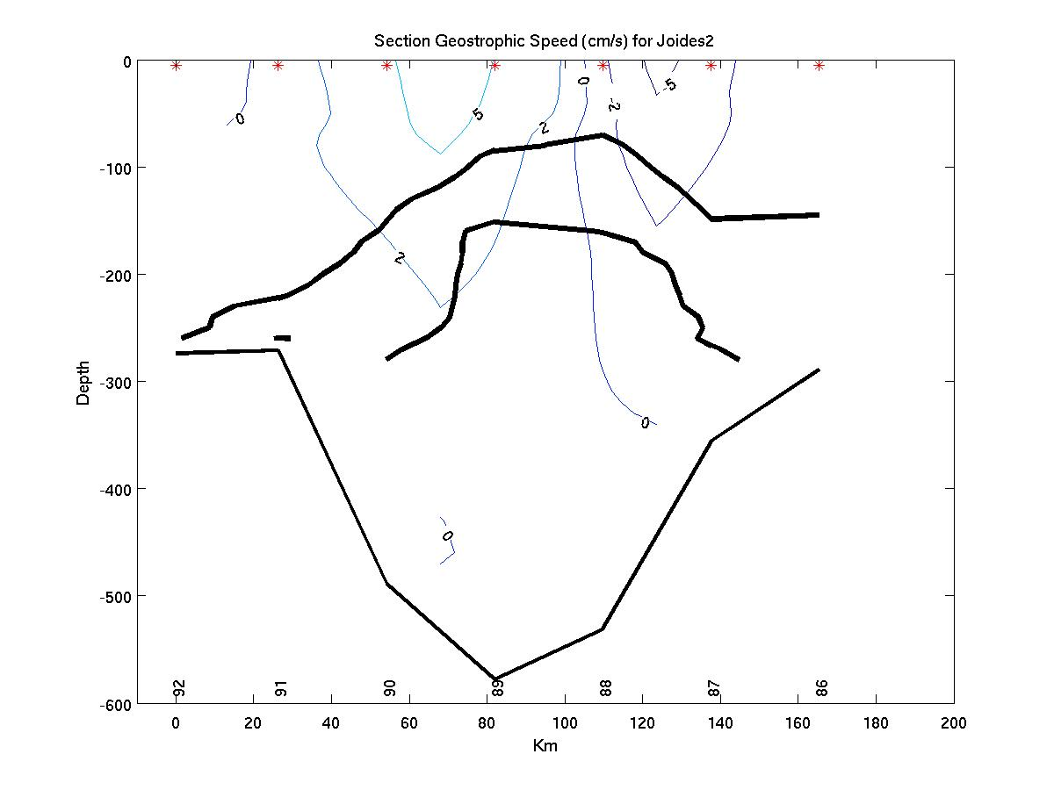
mCDW trans: 0.18 Sv, 0.11 Sv
South trans: .67 Sv, .55 Sv
Positive flow is into page (southward)

Slide 12
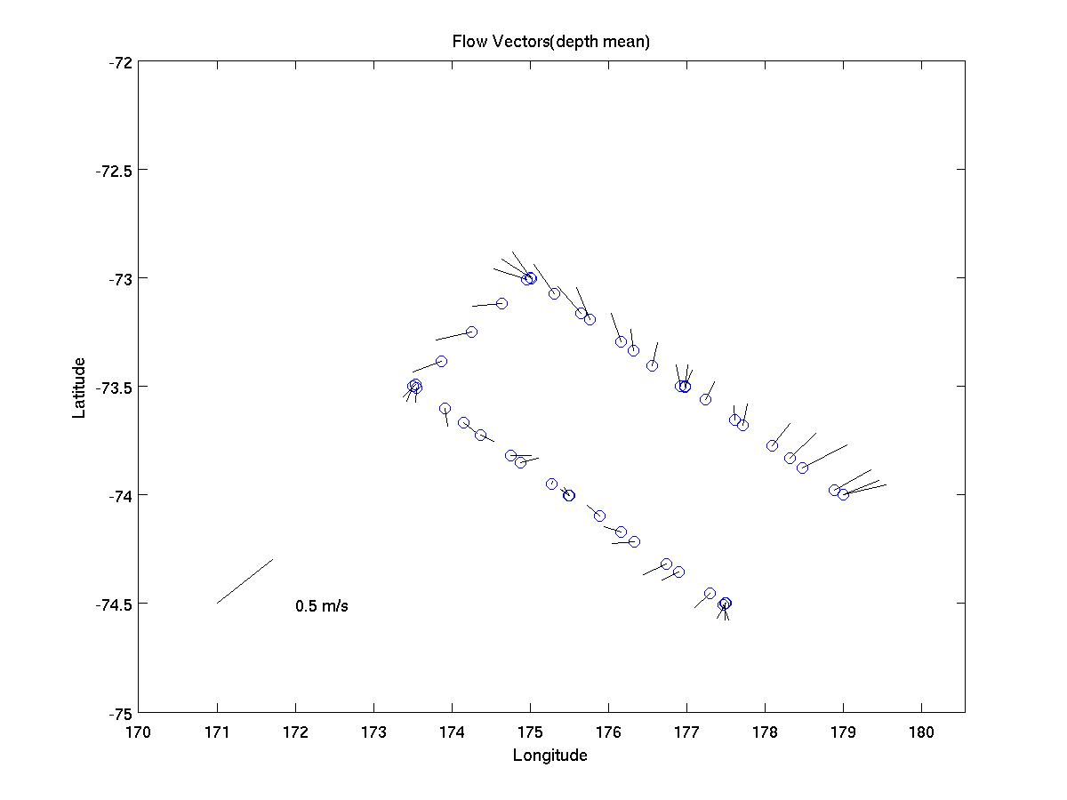
ADCP vertical mean (tides removed?)

Slide 13
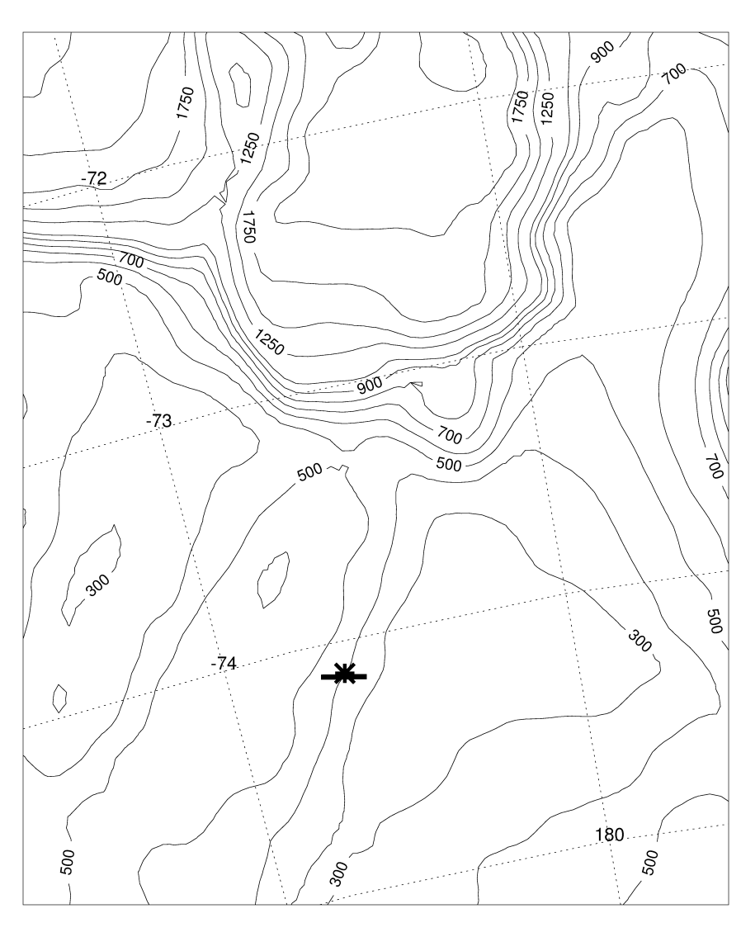
Model transport (Sv.) in the along-slope direction (5-day average fields) over 180–280 m depth across a 20 km section near where Bruce Huber’s mooring was
Southward cross section transport (Sv.):
0.13 ± 0.06 (model total)
0.16 ± 0.05 (model summer)
0.20 ± 0.01 (model during
time of mooring deployment)
0.24 (mooring, Kohut et al., 2013)

Slide 14
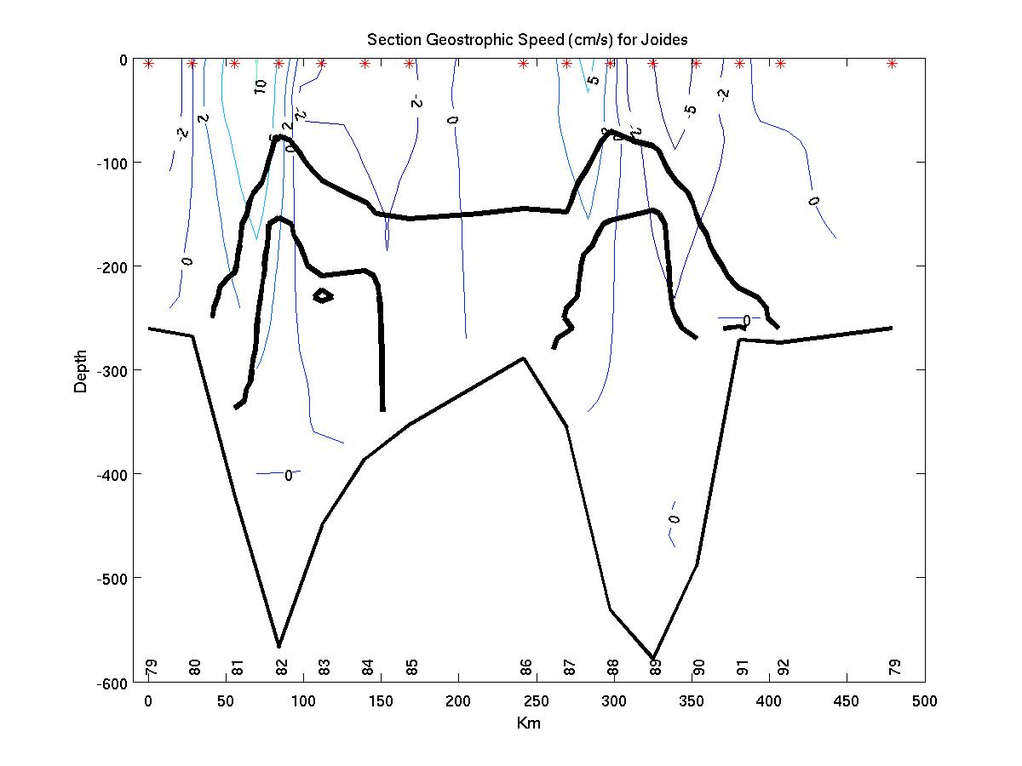
Use closed section to do inverse calculation (?)

Slide 16
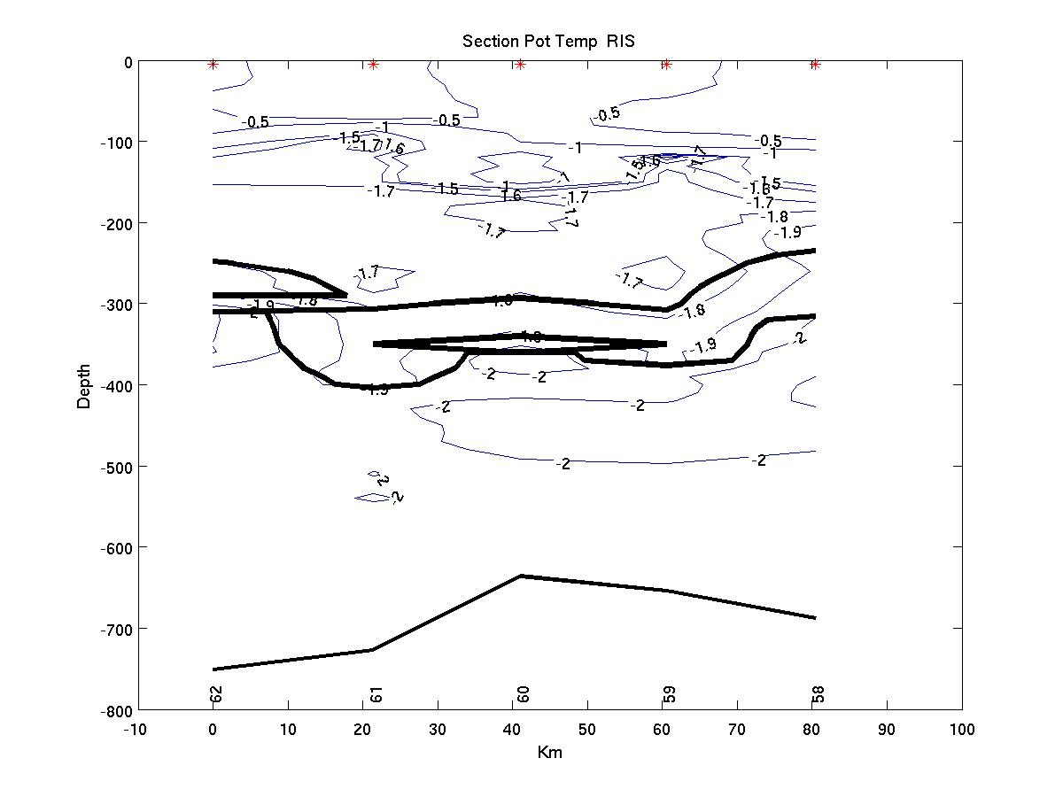
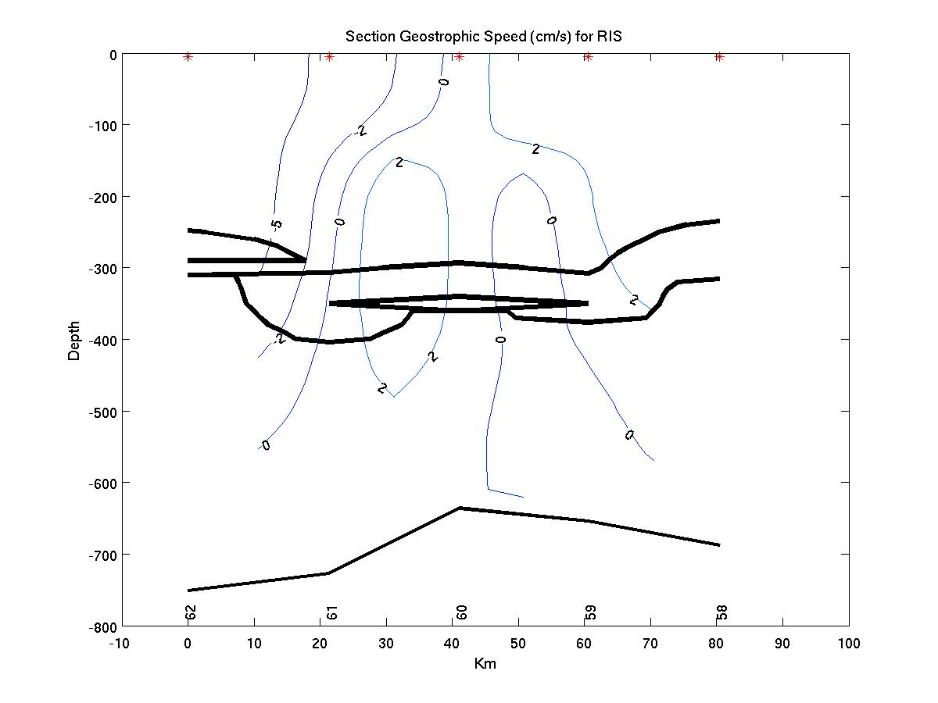
Positive flow is into page (northward)

Slide 18
Comments
Ross Bank analysis by Mike
Ross model update by Stefanie

Slide 20
