Slide 1
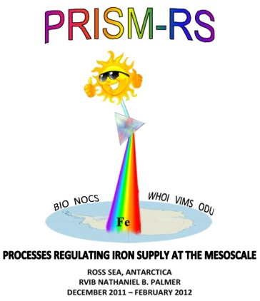
Re-analysis of dFe samples
Filtered samples acidified at sea and analysed by FIA from 1 hour after acidification
expecting semi-quantitative data: a first estimate of dFe distribution
possible problems with clogged column/s during intensive use
2nd set of filtered samples acidified and kept for >6 months, before analysis back in the lab.
~650 samples analysed in early 2013.

Slide 2
“At-sea” versus lab-based results

Slide 3
“At-sea” versus lab-based results

Slide 4
Sample coverage
50 hydrocasts:
sea-ice
eastern Ross Sea eddies
western Ross Sea
Ross Bank
Ross Ice Shelf
Joides Trough
western Ross Sea
4 towfish tows

Slide 5
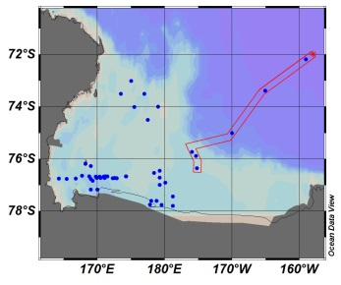
Sea-ice and eastern Ross Sea
At-sea
Elevated near-surface dFe in sea-ice region (up to ~0.8 nM at Stn.2, cf. ~0.2 nM at Stn.1).
dFe of 0.4 – 0.7 nM in surface waters at stations 4-6.
High dFe near seafloor at on-shelf stations (up to 1.4 nM)
1st eddy
in sea-ice
outside sea-ice
2nd eddy
Notes:
Towfish samples collected from ~2 m depth near station 4 were all low (<0.1nM), cf. ~0.4 nM at 10m at station 4
Station 6: 550m 1.44 nM at sea, 1.08nM in lab; 500m 1.24 nM at sea, 0.96 nM in lab

Slide 6
Sea-ice and eastern Ross Sea
At-sea
New data
1st eddy
in sea-ice
outside sea-ice
2nd eddy
Notes:
Towfish samples collected from ~2 m depth near station 4 were all low (<0.1nM), cf. ~0.4 nM at 10m at station 4
Station 6: 550m 1.44 nM at sea, 1.08nM in lab; 500m 1.24 nM at sea, 0.96 nM in lab

Slide 7
Sea-ice and eastern Ross Sea
At-sea
New data
core of CDW
1st eddy
in sea-ice
outside sea-ice
2nd eddy
Notes:
Towfish samples collected from ~2 m depth near station 4 were all low (<0.1nM), cf. ~0.4 nM at 10m at station 4
Station 6: 550m 1.44 nM at sea, 1.08nM in lab; 500m 1.24 nM at sea, 0.96 nM in lab

Slide 8
Sea-ice and eastern Ross Sea
Still shows elevated near-surface dFe at station 2 (and 3) relative to station 1.
Notes:
Towfish samples collected from ~2 m depth near station 4 were all low (<0.1nM), cf. ~0.4 nM at 10m at station 4
Station 6: 550m 1.44 nM at sea, 1.08nM in lab; 500m 1.24 nM at sea, 0.96 nM in lab

Slide 9
Sea-ice and eastern Ross Sea
Still shows elevated near-surface dFe at station 2 (and 3) relative to station 1.
Core of CDW had dFe of ~0.27 nM.
Notes:
Towfish samples collected from ~2 m depth near station 4 were all low (<0.1nM), cf. ~0.4 nM at 10m at station 4
Station 6: 550m 1.44 nM at sea, 1.08nM in lab; 500m 1.24 nM at sea, 0.96 nM in lab

Slide 10
Sea-ice and eastern Ross Sea
Still shows elevated near-surface dFe at station 2 (and 3) relative to station 1.
Core of CDW had dFe of ~0.27 nM.
10m samples at stations 4-6 still elevated (0.32 – 0.42 nM) relative to station 1.
Towfish samples from 2m depth collected near Station 4 have much lower dFe (<0.1 nM).
Notes:
Towfish samples collected from ~2 m depth near station 4 were all low (<0.1nM), cf. ~0.4 nM at 10m at station 4
Station 6: 550m 1.44 nM at sea, 1.08nM in lab; 500m 1.24 nM at sea, 0.96 nM in lab

Slide 11
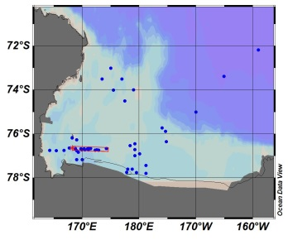
Ice edge to low biomass region
At-sea
~0.2nM
~0.2nM
~0.1nM
dFe somewhat elevated (~0.2nM) in photic zone near the ice edge and in the high biomass region.
Lower dFe (<0.1nM) in photic zone of low biomass region.
Increase in dFe at depth from W to E.
ice edge
high biomass
low biomass
Notes:
Stn.8: 670m 1.54 nM at sea, 1.09 nM in lab; 600m 0.71 nM at sea, 0.41 nM in lab
Stn.9: 425m 0.93 nM at sea, 0.86 nM in lab
Stn.10: 700m 1.23 nM at sea, 1.11 nM in lab; 600m 0.88 nM at sea, 0.69 nM in lab
Stn.19: 570m 1.56 nM at sea, 1.51 nM in lab
Stn.20: 600m 1.28 nM at sea, 1.14 nM in lab
Stn.21: 600m 0.79 nM at sea, 0.73 nM in lab

Slide 12
Ice edge to low biomass region
At-sea
New data
~0.2nM
~0.2nM
~0.1nM
ice edge
high biomass
low biomass
Notes:
Stn.8: 670m 1.54 nM at sea, 1.09 nM in lab; 600m 0.71 nM at sea, 0.41 nM in lab
Stn.9: 425m 0.93 nM at sea, 0.86 nM in lab
Stn.10: 700m 1.23 nM at sea, 1.11 nM in lab; 600m 0.88 nM at sea, 0.69 nM in lab
Stn.19: 570m 1.56 nM at sea, 1.51 nM in lab
Stn.20: 600m 1.28 nM at sea, 1.14 nM in lab
Stn.21: 600m 0.79 nM at sea, 0.73 nM in lab

Slide 13
Ice edge to low biomass region
Upper water column differences not as pronounced.
10m depth dFe:
0.09 nM at ice-edge (station 7)
0.11 nM at high biomass (station 8)
0.07 nM at low biomass (station (9)
No significant enrichment adjacent to pack ice
By 300m depth, dFe at station 9 significantly higher – due to shoaling of sea-floor?
Notes:
Towfish samples collected from ~2 m depth near station 4 were all low (<0.1nM), cf. ~0.4 nM at 10m at station 4
Station 6: 550m 1.44 nM at sea, 1.08nM in lab; 500m 1.24 nM at sea, 0.96 nM in lab

Slide 14
Ice edge to low biomass region
At-sea
eddy 3
frontal boundary
Notes:
Stn.8: 670m 1.54 nM at sea, 1.09 nM in lab; 600m 0.71 nM at sea, 0.41 nM in lab
Stn.9: 425m 0.93 nM at sea, 0.86 nM in lab
Stn.10: 700m 1.23 nM at sea, 1.11 nM in lab; 600m 0.88 nM at sea, 0.69 nM in lab
Stn.19: 570m 1.56 nM at sea, 1.51 nM in lab
Stn.20: 600m 1.28 nM at sea, 1.14 nM in lab
Stn.21: 600m 0.79 nM at sea, 0.73 nM in lab

Slide 15
1st E-W transect of Eddy 3
At-sea
New data
Shoaling of ferrocline at eddy centre
dFe <0.1nM in upper 50m
Notes:
Stn.10: 700m 1.23 nM at sea, 1.11 nM in lab; 600m 0.88 nM at sea, 0.69 nM in lab

Slide 16
Across frontal boundary
At-sea
Front
Lower dFe to east of front
Notes:
Stn.19: 570m 1.56 nM at sea, 1.51 nM in lab
Stn.20: 600m 1.28 nM at sea, 1.14 nM in lab
Stn.21: 600m 0.79 nM at sea, 0.73 nM in lab

Slide 17
Across frontal boundary
At-sea
New data
Front
Front
Lower dFe to east of front
Lower dFe from 50-150m depth
Notes:
Stn.19: 570m 1.56 nM at sea, 1.51 nM in lab
Stn.20: 600m 1.28 nM at sea, 1.14 nM in lab
Stn.21: 600m 0.79 nM at sea, 0.73 nM in lab

Slide 18
2nd E-W transect of Eddy 3
At-sea
New data
Notes:
Stn.29: 700m 1.21 nM at sea, 1.03 nM in lab
Stn.35: 680m 1.08 nM at sea, 0.91 nM in lab

Slide 19
Ross Bank transects
At-sea
NW
SE
N
S

Slide 20
SE-NW section across Ross Bank
At-sea
New data

Slide 21
N-S section across Ross Bank
At-sea
New data

Slide 22
Revisiting Ross Bank (stations 38 & 74)
At-sea data
Same station over Ross Bank occupied on 20th January (Stn.38) and 26th January (Stn.74).
Significantly lower dFe values in the 75-150m depth interval during the second occupation.

Slide 23
Revisiting Ross Bank (stations 38 & 74)
At-sea data
New data
All values lower for both stations.
Very little difference in dFe between the two occupations.

Slide 24
N-S section of Ross Ice Shelf
At-sea
New data

Slide 25
E-W section of Ross Ice Shelf
At-sea
New data
Notes:
Stn.60: 615m 1.08 nM at sea, 0.70 nM in lab; 600m 0.99 nM at sea, 0.69 nM in lab

Slide 26
E-W section of Ross Ice Shelf
At-sea
New data
ISW: 0.20 – 0.35 nM
Notes:
Stn.60: 615m 1.08 nM at sea, 0.70 nM in lab; 600m 0.99 nM at sea, 0.69 nM in lab

Slide 27
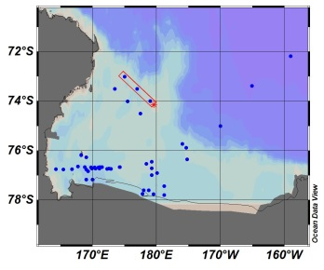
Joides Trough transects
NE transect
At-sea data
SW transect values lower than those during NE transect for surface and mid-water depths (e.g. upper 50m: 0.06 – 0.11nM compared to 0.14 – 0.24nM).
Highest dFe concentrations found in the trough on both transects.
SW transect
Notes:
Stn.89: 557 nM 0.90 nM at sea, 0.81 nM in lab

Slide 28
NE transect across Joides Trough
At-sea
New data
Notes:
Stn.82: 548m 0.86 nM at sea, 0.67 nM in lab; 500m 0.83 nM at sea, 0.66 nM in lab

Slide 29
SW transect across Joides Trough
At-sea
New data
Notes:
Stn.89: 557 nM 0.90 nM at sea, 0.81 nM in lab

Slide 30
Comparison of transects
NE transect
New data
SW transect surface values still slightly lower (0.03 – 0.06 nM) than those during NE transect (0.07 – 0.08 nM).
Highest dFe concentrations still found in the trough on both transects.
SW transect
Notes:
Stn.89: 557 nM 0.90 nM at sea, 0.81 nM in lab

Slide 31
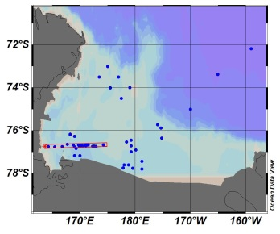
western Ross Sea transect
At-sea
New data
Notes:
Stn.96: 800m 0.92 nM at sea, 0.74 nM in lab
Stn.102: 575m 1.66 nM at sea, 1.90 nM in lab; 550m 1.62 nM at sea, 1.84 nM in lab; 500m 1.15 nM at sea, 1.22 nM in lab
Stn.108: 920m 1.02 nM at sea, 0.73 nM in lab; 900m 0.80 nM at sea, 0.71 nM in lab.

Slide 32
169°E section
At-sea
Near-surface depletion in eddy centre
Mid-depth enhancement in south
Benthic enhancement in north
Notes:
Stn.96: 800m 0.92 nM at sea, 0.74 nM in lab
Stn.102: 575m 1.66 nM at sea, 1.90 nM in lab; 550m 1.62 nM at sea, 1.84 nM in lab; 500m 1.15 nM at sea, 1.22 nM in lab
Stn.108: 920m 1.02 nM at sea, 0.73 nM in lab; 900m 0.80 nM at sea, 0.71 nM in lab.

Slide 33
169°E section
At-sea
New data
Near-surface depletion in eddy centre
Mid-depth enhancement in south
Benthic enhancement in north
Notes:
Stn.96: 800m 0.92 nM at sea, 0.74 nM in lab
Stn.102: 575m 1.66 nM at sea, 1.90 nM in lab; 550m 1.62 nM at sea, 1.84 nM in lab; 500m 1.15 nM at sea, 1.22 nM in lab
Stn.108: 920m 1.02 nM at sea, 0.73 nM in lab; 900m 0.80 nM at sea, 0.71 nM in lab.

Slide 34
Towfish samples
At-sea
New data
NOTE: different scale used for towfish dFe

Slide 35
Towfish samples
At-sea
New data
Contaminated sample:
~3 nM cf. ~1 nM at sea
NOTE: different scale used for towfish dFe

Slide 36
Summary
At-sea analyses tended to over-estimate dFe concentrations, particularly at the lower end of the range (≤0.1nM).
Most features/trends identified from at-sea analyses still valid, but some not:
summit of Ross Bank
comparison of NE and SW Joides Trough transects
dFe signal from pack-ice in western Ross Sea.
CDW dFe was 0.27nM; ISW dFe was 0.20 - 0.35nM.
Highest near-surface dFe values measured in eastern Ross Sea, around melting sea-ice.
Highest dFe values found within 100m of seafloor (values up to and above 1.5nM).

Slide 37
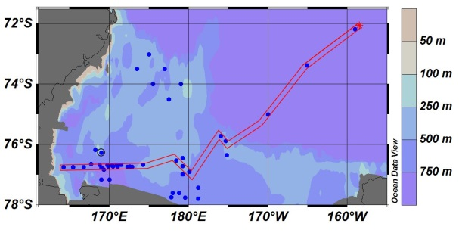
Long E-W section
(sample collection spans ONE MONTH from Stn.1 in the east to Stn.116 in the west)
Notes:
Stn.96: 800m 0.92 nM at sea, 0.74 nM in lab
Stn.102: 575m 1.66 nM at sea, 1.90 nM in lab; 550m 1.62 nM at sea, 1.84 nM in lab; 500m 1.15 nM at sea, 1.22 nM in lab
Stn.108: 920m 1.02 nM at sea, 0.73 nM in lab; 900m 0.80 nM at sea, 0.71 nM in lab.

