Slide 1
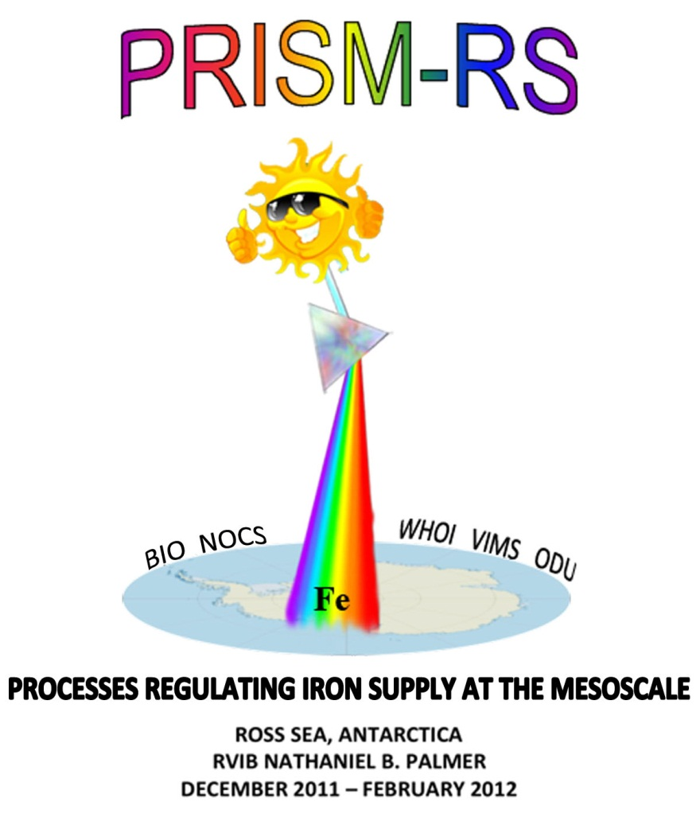
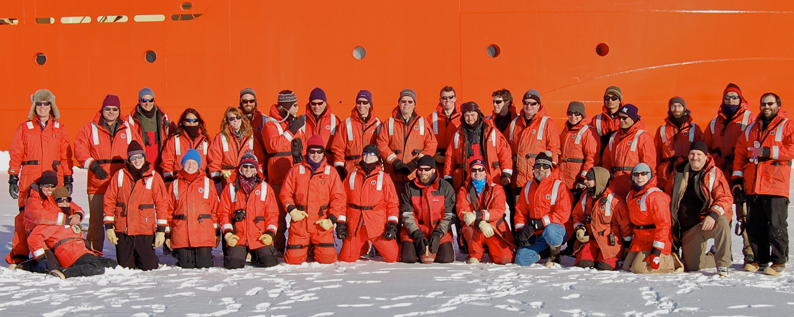
(PRISM)

Slide 2
Plankton Production in the
Open Ocean
Sea Surface
Fe
CO₂ + H₂O CH₂O + O₂
100m
Notes:
The scientific question motivating this study revolves around the issue of what controls new production in the open ocean. This cartoon schematizes the process of new production, in which phytoplankton…
CO2 is a greenhouse gas – a good thing – without it the earth’s sfc temp would be 30C colder
How do phytoplankton affect CO2 in the atmosphere? The biological pump.
The biological pump is strong: without it, 2X pCO2, no polar ice caps, sea level 100m higher.
Industrial revolution, CO2 release, 1/3 atm, 1/3 land, 1/3 ocean.

Slide 3
Scientific Background
Productivity of the Southern Ocean mediates changes in atmospheric CO₂ over glacial to interglacial time scales
Brovkin et al., 2007; Kohfeld et al., 2005; Kumar et al., 1995; Martin, 1990; Sigman and Boyle, 2000; Watson and Liss, 1998
Future warming may impact Southern Ocean productivity due to changes in stratification, ice, and dust deposition
Boyd and Doney, 2002; Boyd et al., 2008; Mahowald and Luo, 2003; Sarmiento et al., 1998; Sarmiento et al., 2004; Tagliabue et al., 2008
Mechanistic understanding of the underlying processes and feedbacks between physical forcing, phytoplankton productivity, and the biological pump are needed to understand past variations and predict future changes.

Slide 4
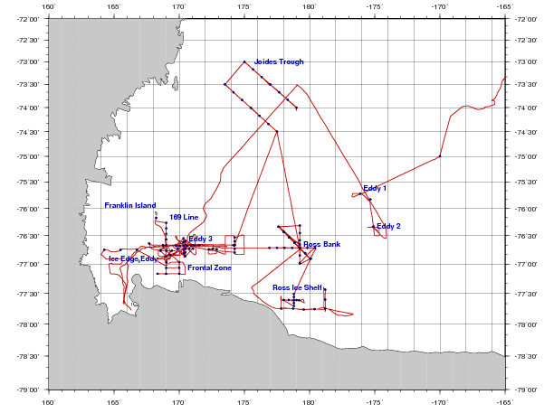
PRISM cruise track
H₁: CDW
H₂: Sediment: banks/coastal
H₃: Sea ice
H₄: Glacial melt
ACC Sea Ice
H₅: ISW
H₆: Dry Valleys
H₇: Vents
I. ACC Sea Ice
II. Eastern Ross Sea Eddies
III. Western Ross Sea
IV. Ross Bank
V. Ross Ice Shelf
VI. Joides Trough
VII. Western Ross Sea II

Slide 5
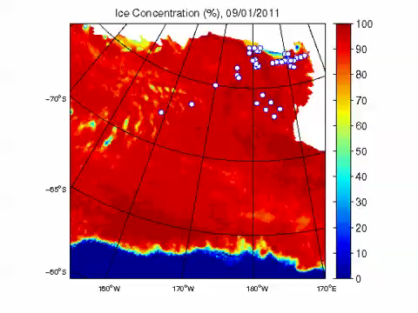
SSMI/S Ice coverage 9/1/11 – 2/5/12
http://www.iup.uni-bremen.de:8084/ssmis/index.html

Slide 6
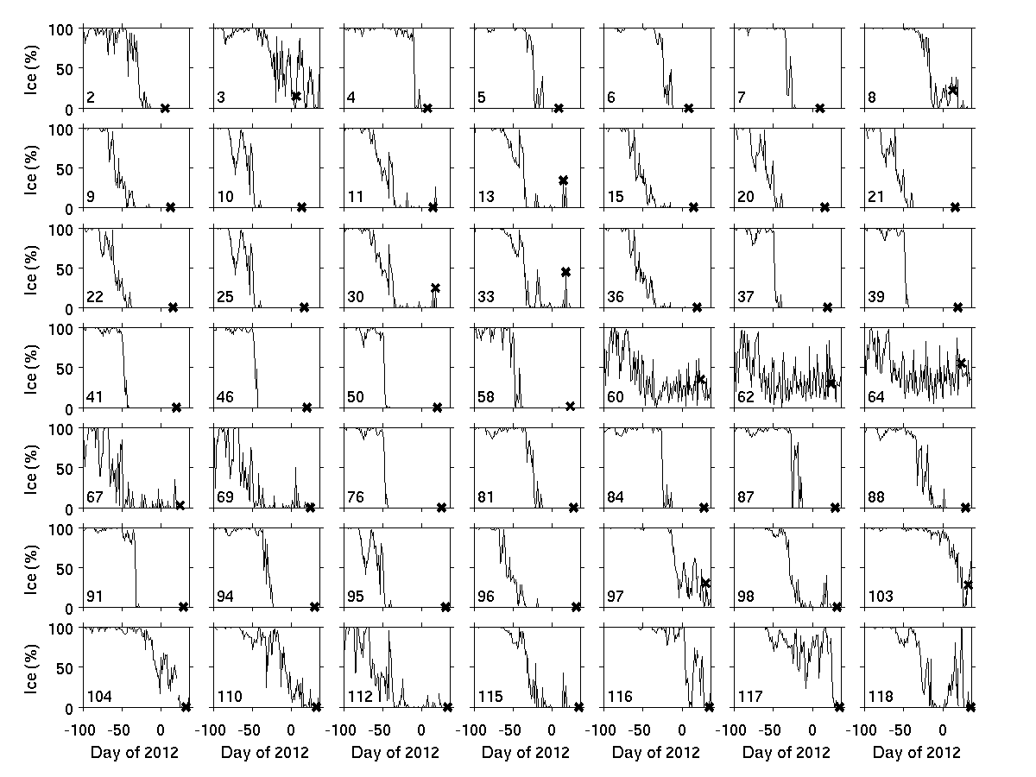
Sea ice time-series at PRISM stations

Slide 7
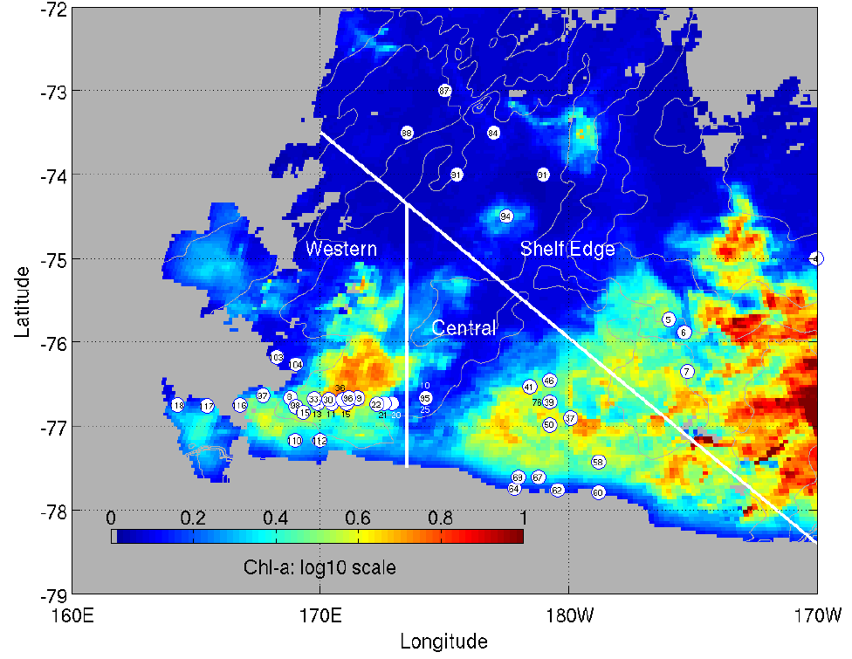
MODIS January composite

Slide 8
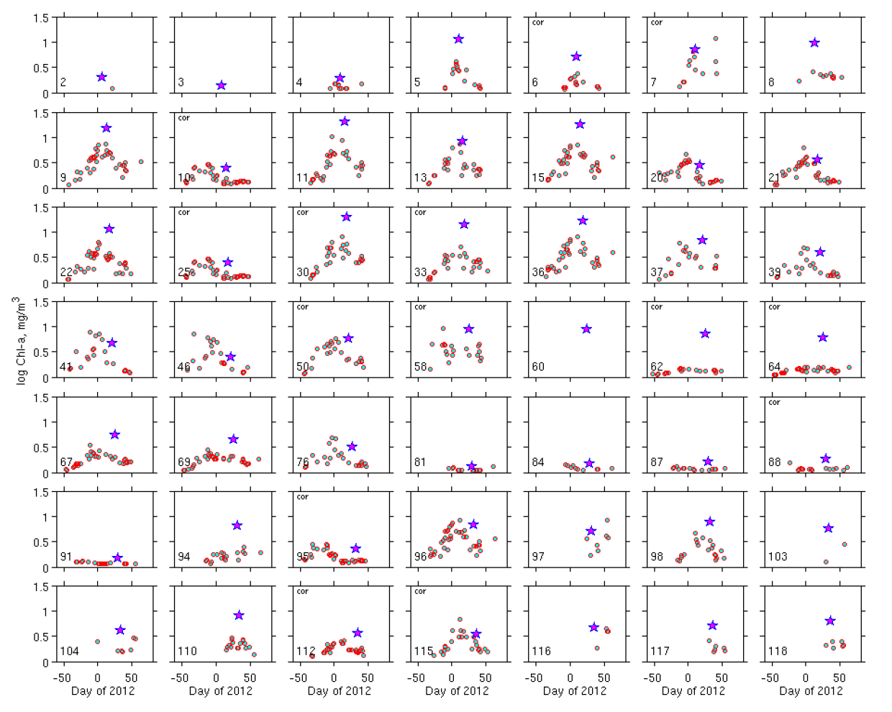
MODIS vs. in situ surface Chl-a
Sea ice
ERS
WRS
CRS
RIS

Slide 9
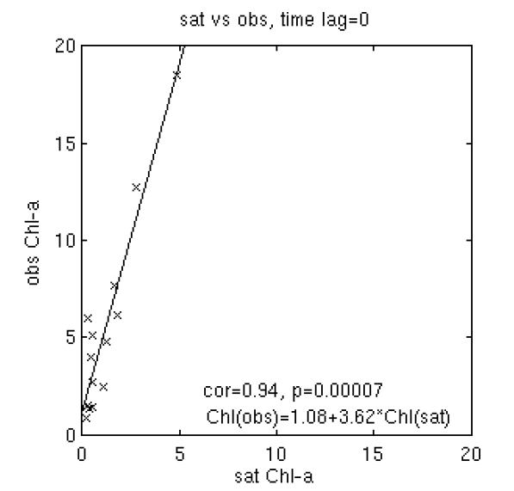
MODIS vs. in situ surface Chl-a

Slide 10
PRISM cruise track
H₁: CDW
H₂: Sediment: banks/coastal
H₃: Sea ice
H₄: Glacial melt
ACC Sea Ice
H₅: ISW
H₆: Dry Valleys
H₇: Vents
I. ACC Sea Ice
II. Eastern Ross Sea Eddies
III. Western Ross Sea
IV. Ross Bank
V. Ross Ice Shelf
VI. Joides Trough
VII. Western Ross Sea II

Slide 11
For more information about NBP1201
-- Cruise report
-- Presentations from the November 2012 PI meeting
http://science.whoi.edu/users/olga/PRISM_RS/PRISM_RS.html
Username: prism
Password: data4PIuse!

Slide 12
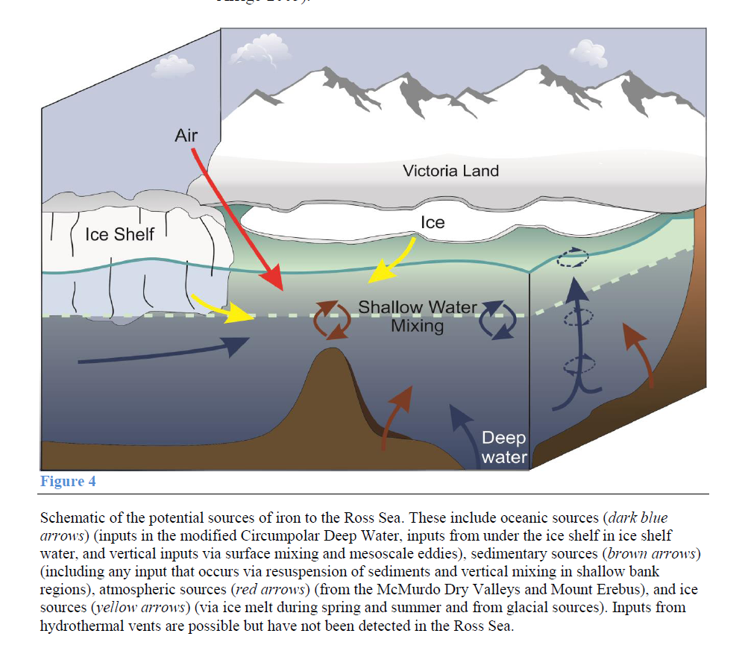
Conceptual model of Fe sources to the Ross Sea
Smith et al. (in press) Annual Reviews of Marine Science

Slide 13
End

