Slide 1
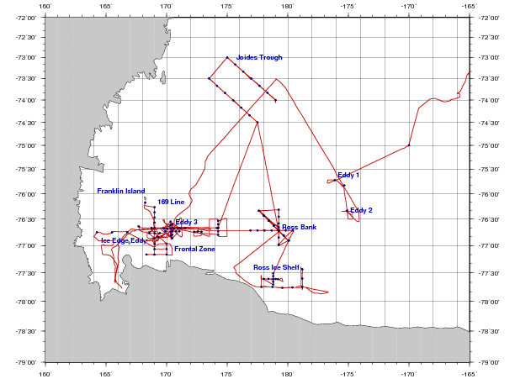
PRISM cruise track
H₁: CDW
H₂: Sediment: banks/coastal
H₃: Sea ice
H₄: Glacial melt
ACC Sea Ice
H₅: ISW
H₆: Dry Valleys
H₇: Vents
I. ACC Sea Ice
II. Eastern Ross Sea Eddies
III. Western Ross Sea
IV. Ross Bank
V. Ross Ice Shelf
VI. Joides Trough
VII. Western Ross Sea II

Slide 2
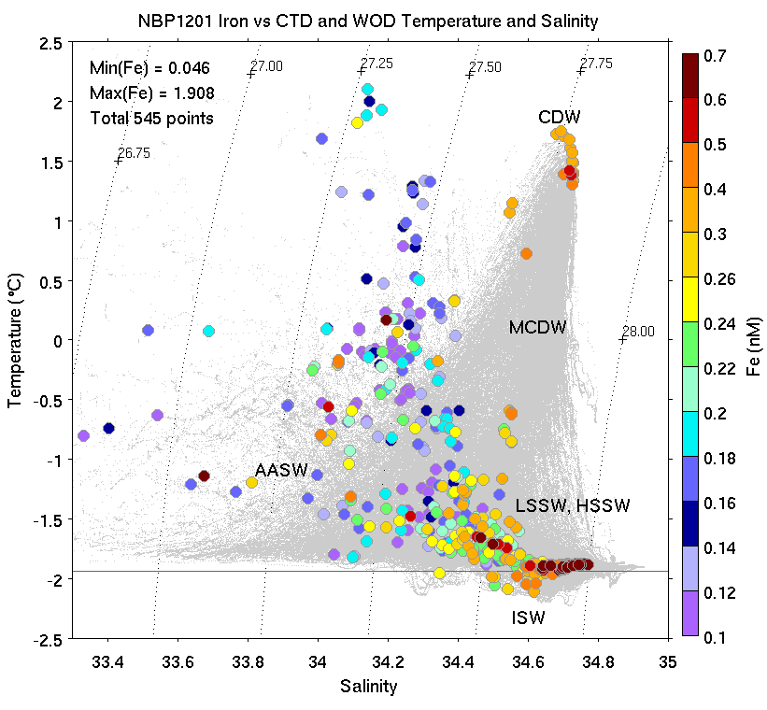
Toward an Iron Budget for the Ross Sea: PRISM Iron Observations

Slide 3
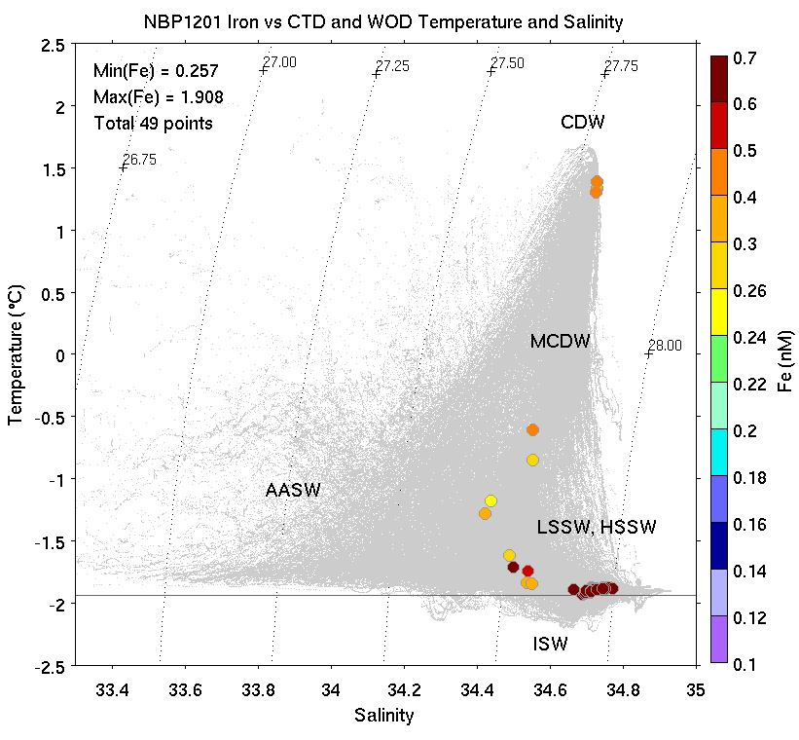
PRISM Iron Observations: Deepest Sample at Every Cast

Slide 4
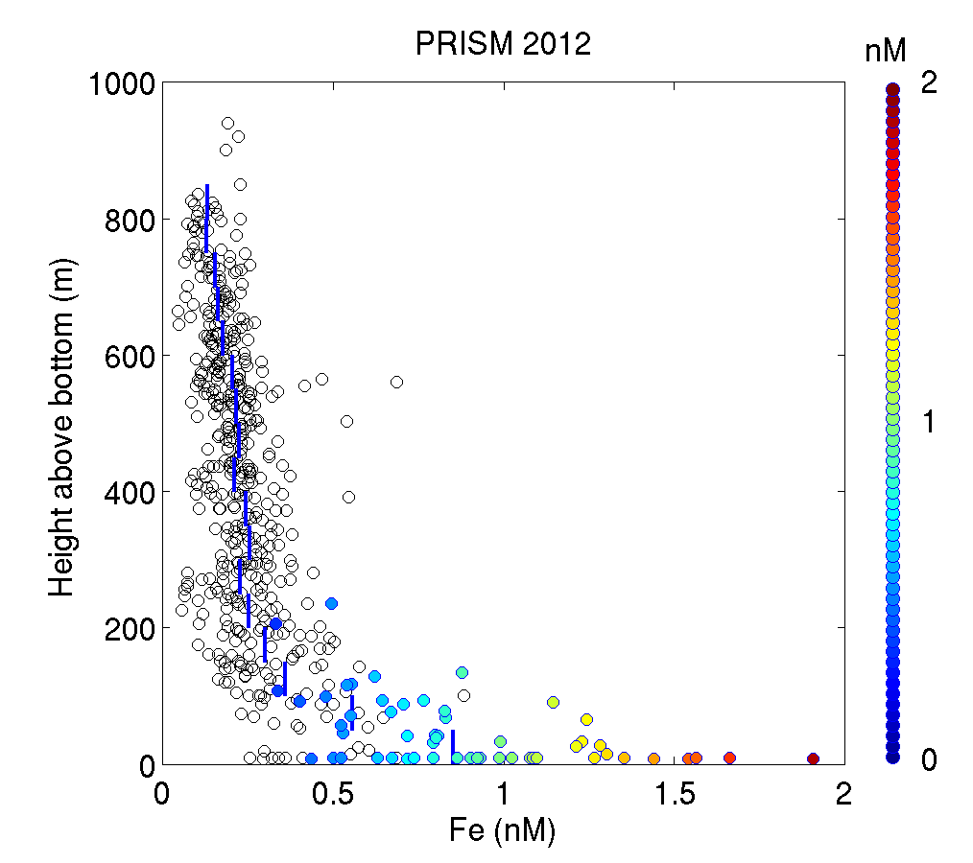
Composite profiles of dFe
Colored circles: samples within benthic nepheloid layer

Slide 5
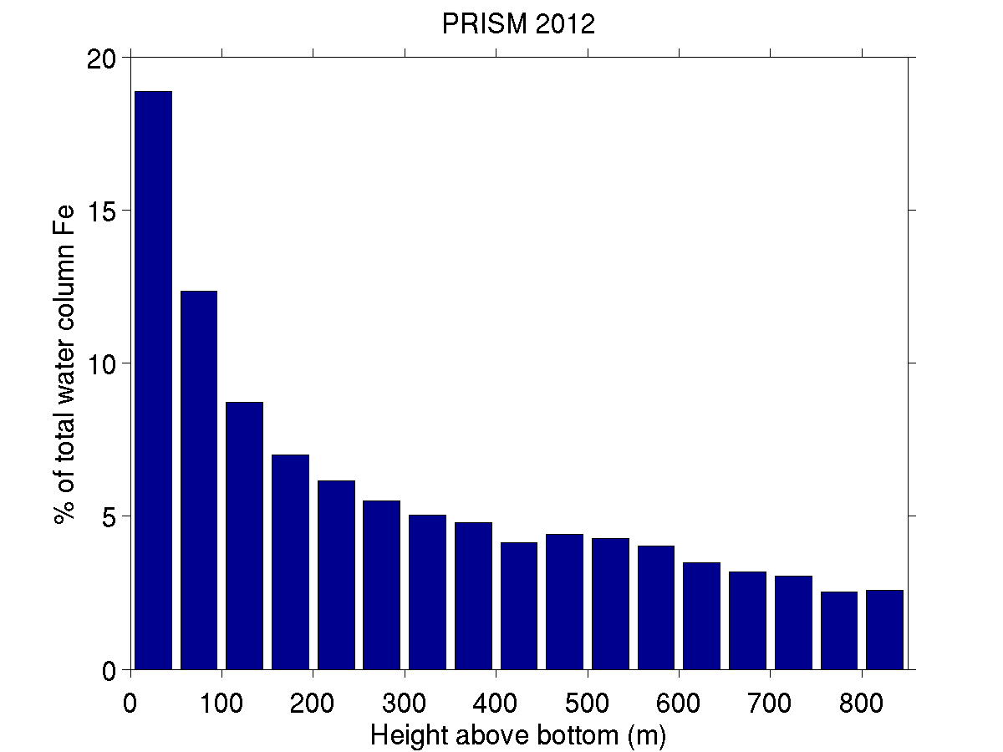
>30% of dFe resides within 100 mab

Slide 6
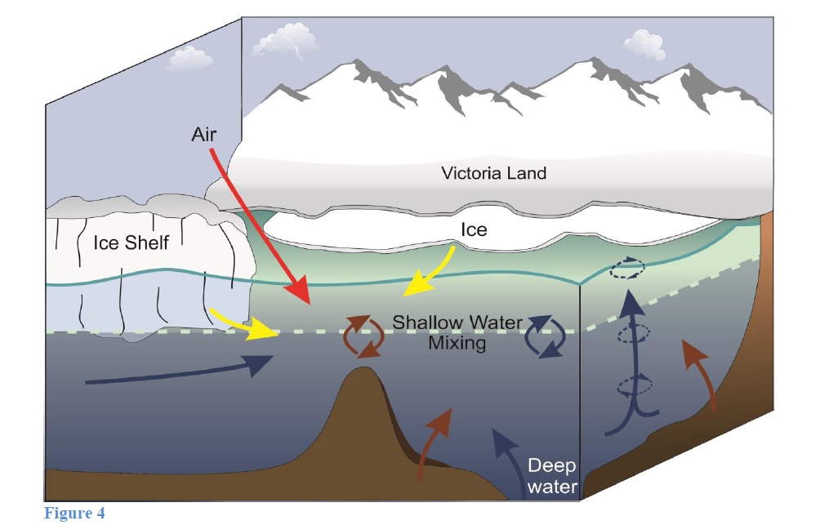
Toward an iron budget for the Ross Sea
Observations:
Winter Reserve:
Iron Sources:
$${dFe(z)}_{i}$$
Smith et al. (in press)
$$\hat{{dFe}_{i}}=\frac{1}{{MLD}_{i}}\int_{{MLD}_{i}}^{0}{{dFe(z)}_{i}}dz$$
$$\sum{\hat{{dFe}_{i}}+{dFe}_{MCDW}+{dFe}_{SeaIce}+{dFe}_{GlacialIce}}$$

Slide 7
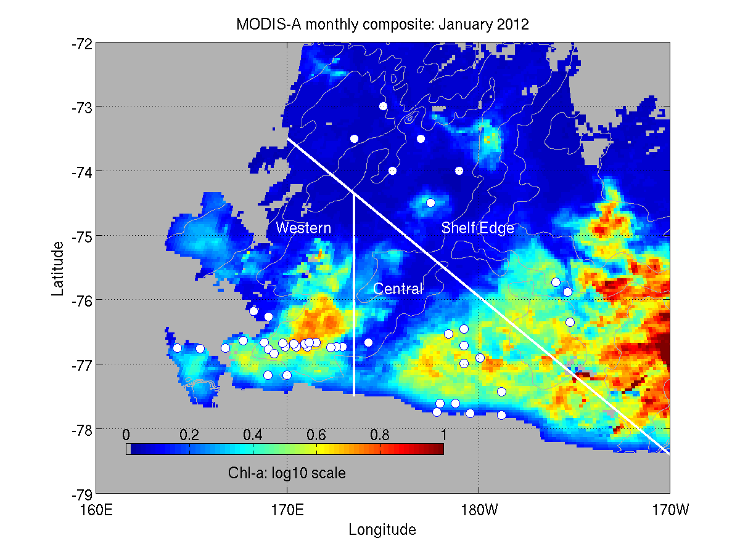
Regional subdomains

Slide 8
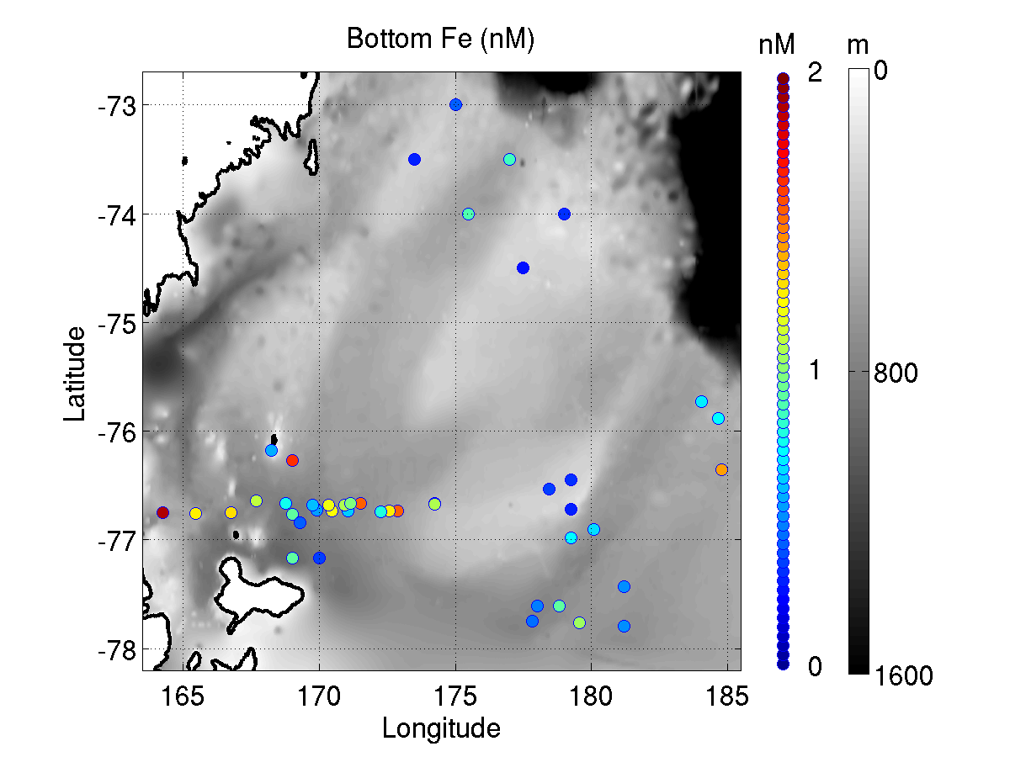
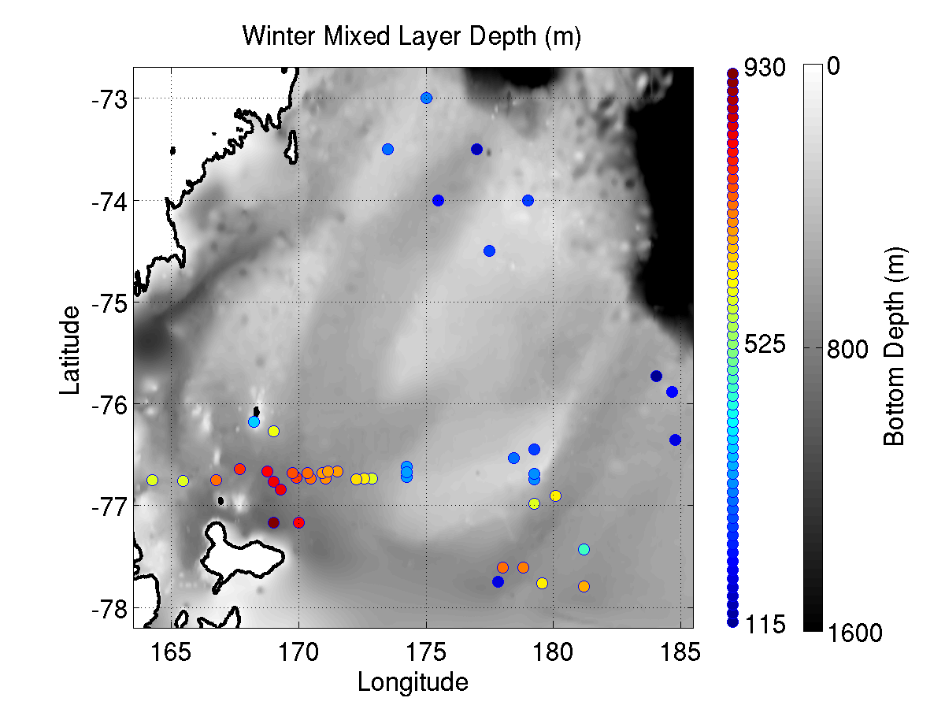
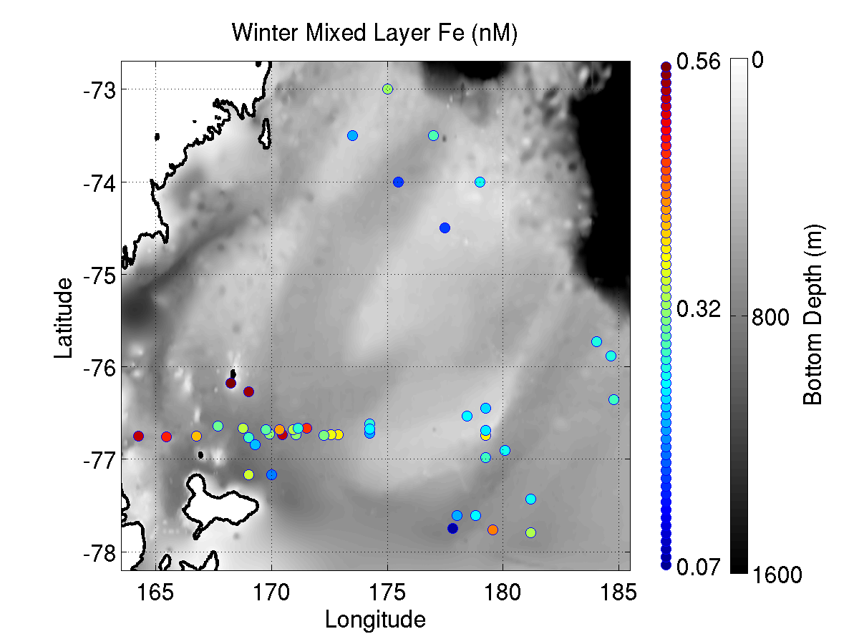
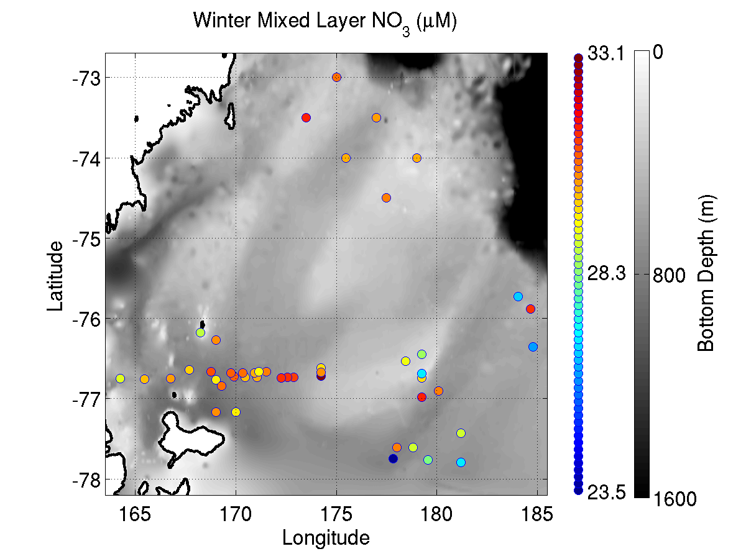
Winter reserves
Bottom Fe
Winter MLD
Winter ML Fe
Winter ML NO₃

Slide 9
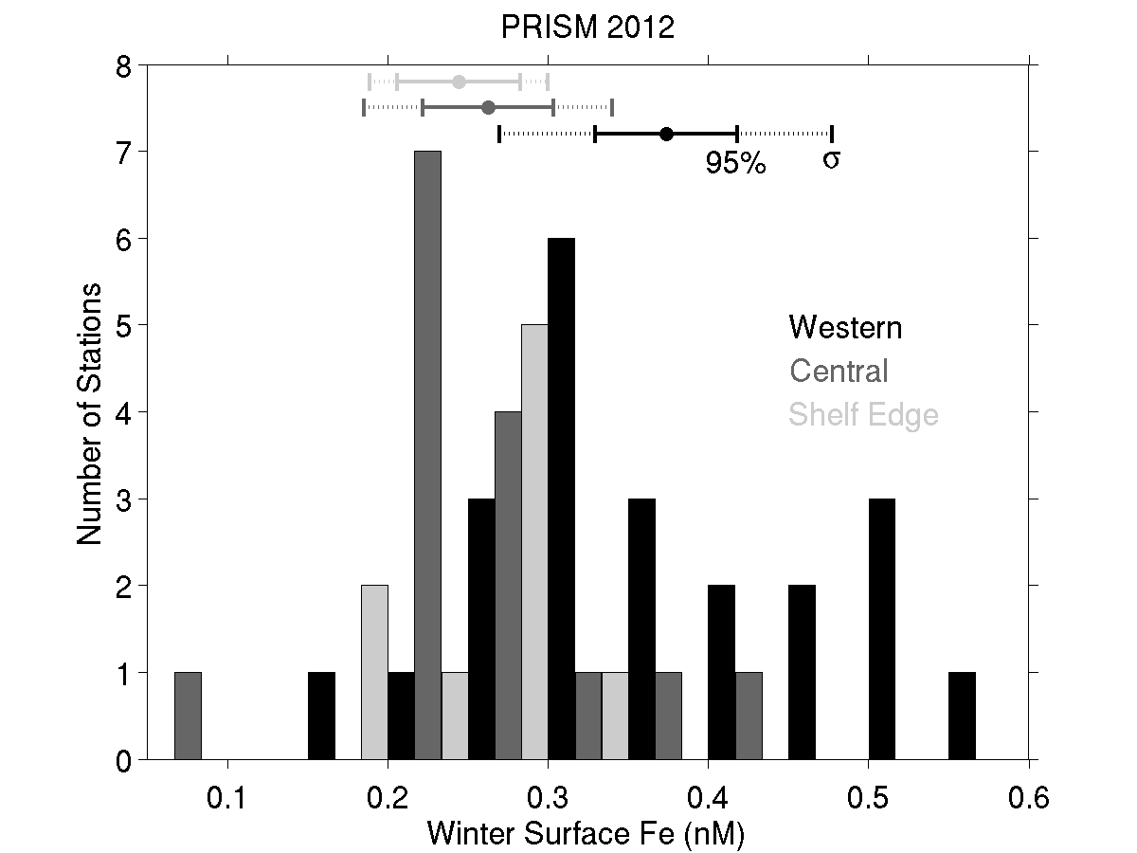
Fe winter reserve

Slide 10
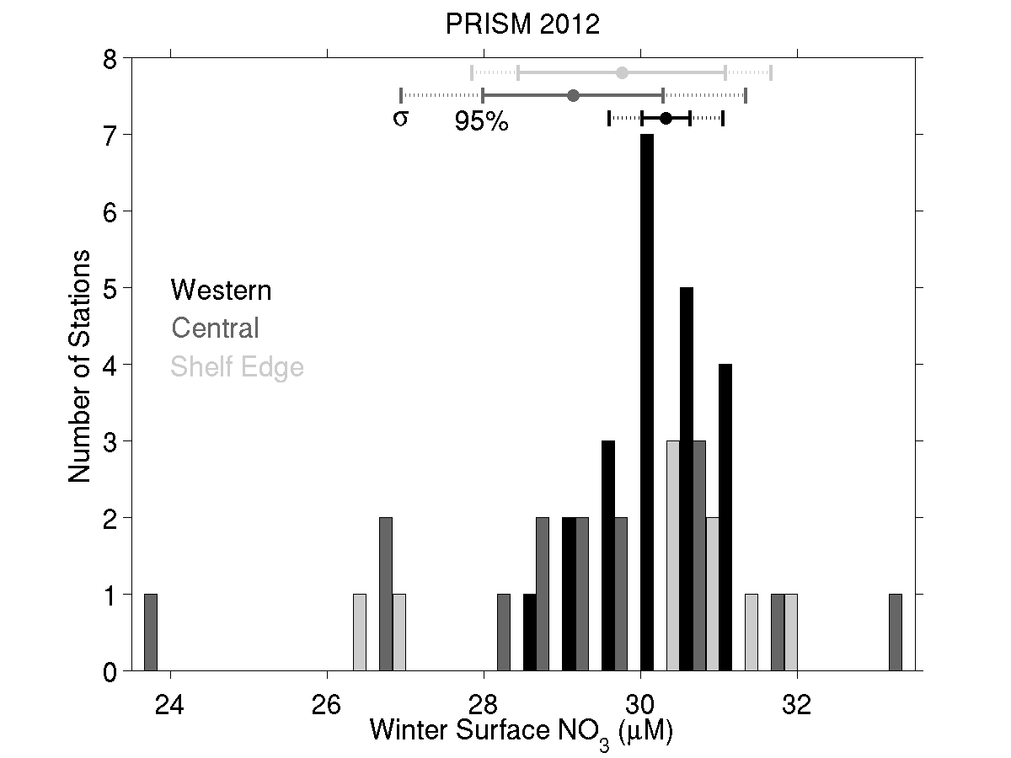
NO₃ winter reserve

Slide 11
Calculating drawdown ratios
Winter reserves
Apparent drawdown
$$\hat{{dFe}_{i}}=\frac{1}{{MLD}_{i}}\int_{{MLD}_{i}}^{0}{{dFe(z)}_{i}}dz$$
$$\hat{{NO3}_{i}}=\frac{1}{{MLD}_{i}}\int_{{MLD}_{i}}^{0}{{NO3(z)}_{i}}dz$$
$$\tilde{{dFe}_{i}}=\int_{EZ}^{0}{pos\left({\hat{{dFe}_{i}}+{dFe}_{MCDW}+{dFe}_{SeaIce}+{dFe}_{GlacialIce}−dFe(z)}_{i}\right)}dz$$
$$\tilde{{NO3}_{i}}=\int_{EZ}^{0}{pos\left({\hat{{NO3}_{i}}+{NO3}_{MCDW}+{NO3}_{SeaIce}+{NO3}_{GlacialIce}−NO3(z)}_{i}\right)}dz$$

Slide 12
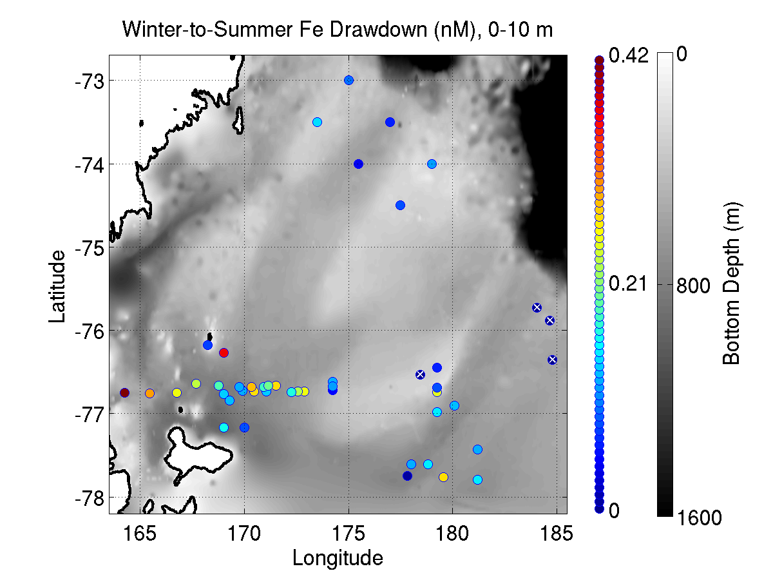
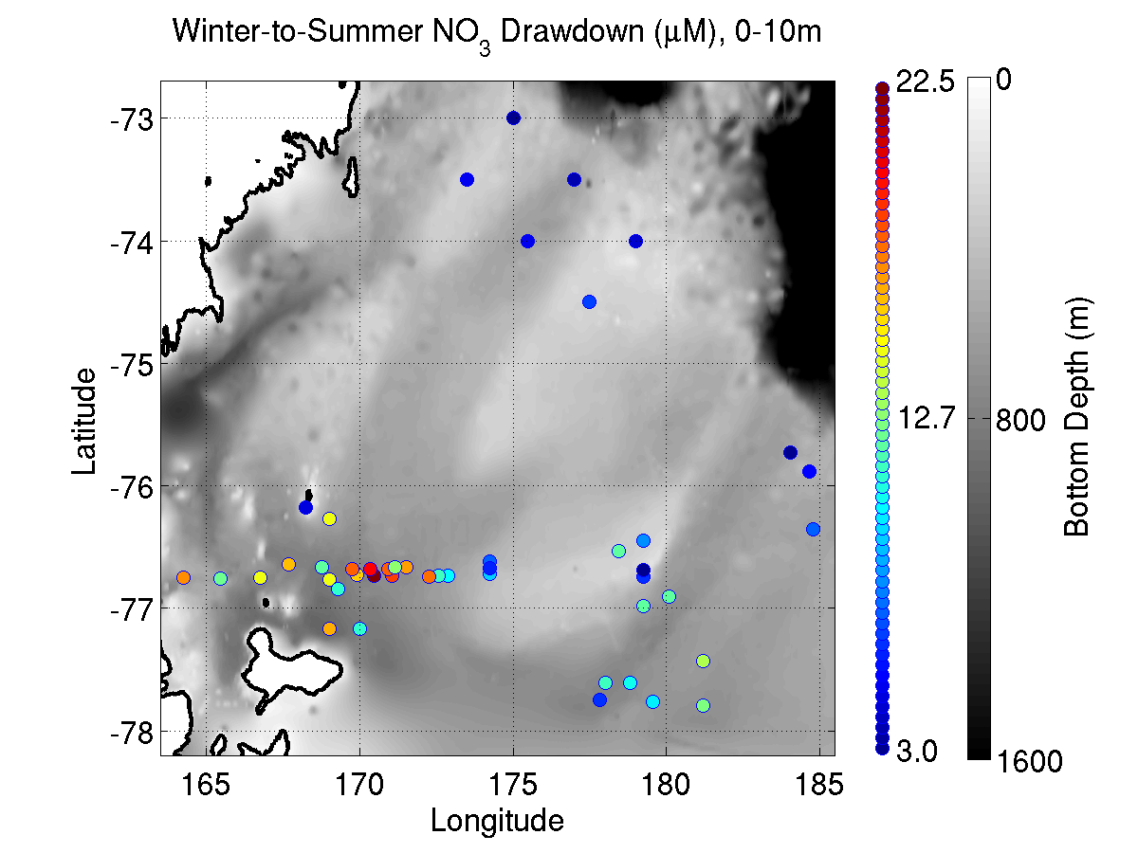
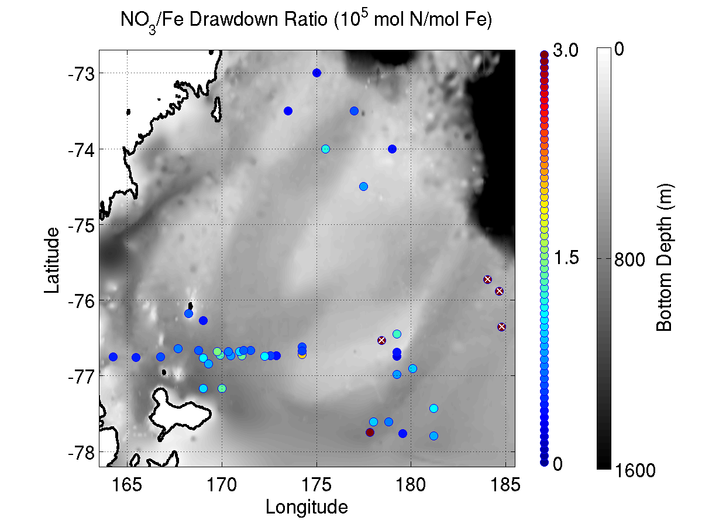
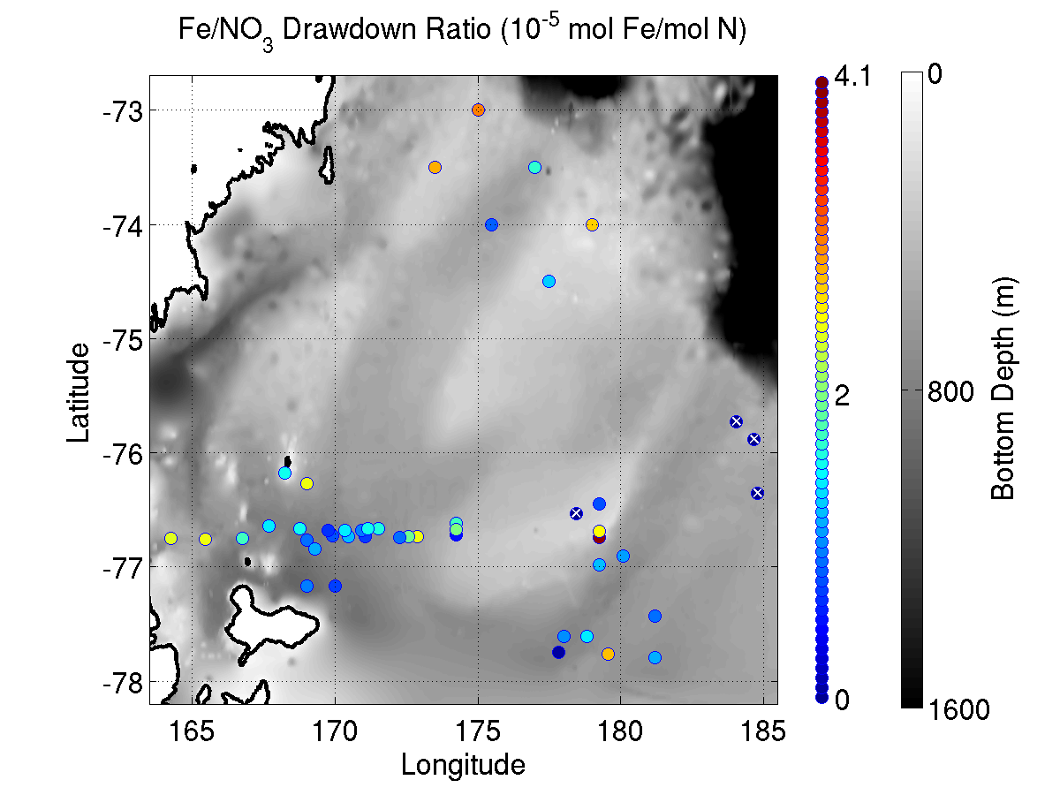
Drawdown 0-10m
Fe drawdown NO₃ drawdown
NO₃:Fe drawdown (10⁵ mol:mol) Fe:NO₃ drawdown (10⁵ mol:mol)

Slide 13
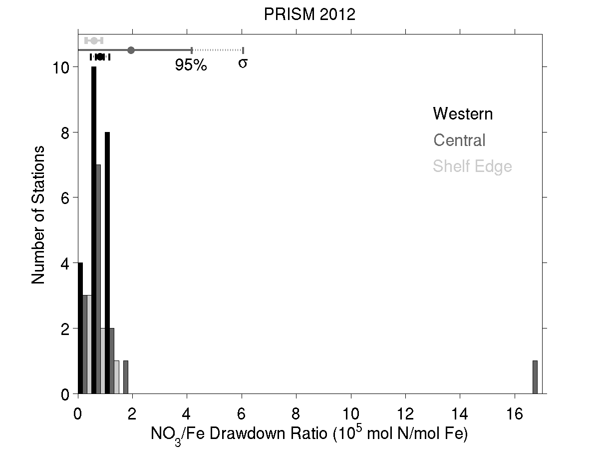
NO₃:Fe drawdown ratio
Mean NO₃:Fe drawdown ratio: 1.2 x 10⁵ mol N / mol Fe
Including inputs from MCDW, sea ice, glacial ice:
64,000 ± 24,000 mol N / mol Fe
Using Redfield to convert to carbon units:
420,000 ± 160,000 mol C / mol Fe
Algal C:Fe assimilation ratios
Feng et al. 2000 250,000-400,000
Twining et al. 2004 166,000-390,000
Boyd et al. 2012 5000-450,000
Strzepek et al. 2011,2012 10,000-3,000,000

Slide 14
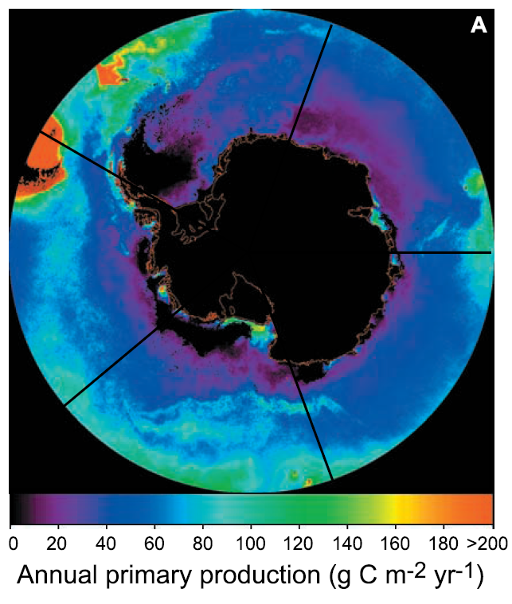
Toward an iron budget for the Ross Sea: estimating demand
Arrigo et al. 2008 satellite-based estimate of primary productivity, updated using MODIS 2002-2013:
7.8 mol C m⁻² yr⁻¹
Using an f-ratio of 0.5
Asper and Smith 1999
Sweeney et al. 2000
Long et al. 2011
Annual new production: 3.9 mol C m⁻² yr⁻¹
Assuming C:Fe of 424,000: 8 µmol Fe m⁻² yr⁻¹

Slide 15
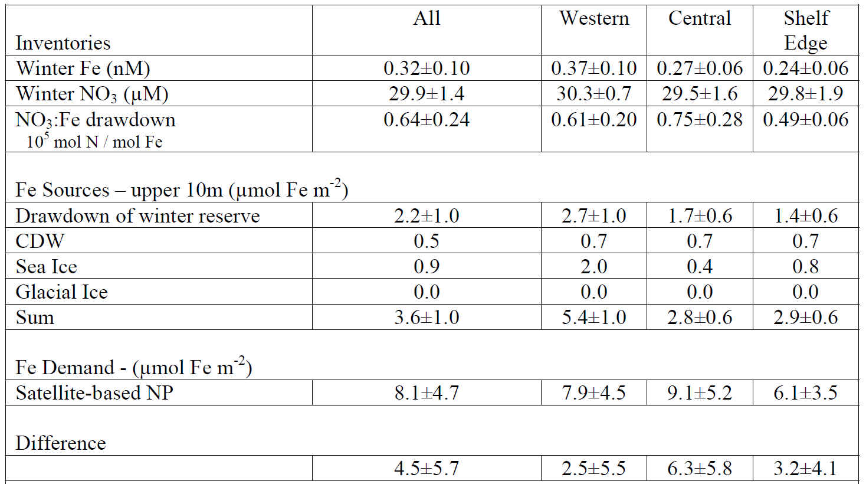
Iron Supply and Demand in the Ross Sea

Slide 16
Conclusions
Mean demand exceeds mean supply by 56%
Difference is within error bounds
Potential “fixes” to the problem
Decreasing f-ratio from 0.5 to 0.22
Decreasing C:Fe assimilation ratio from 420,000 to 187,000
PRISM inference: C:Fe = 420,000 ± 160,000
Benthic resupply
Sea ice end-member concentration
Atmospheric sources
Extraterrestrial sources
Is the satellite-based estimate 3.6X too low?

Slide 17
Composite profiles of dFe
Colored circles: samples within benthic nepheloid layer

Slide 18
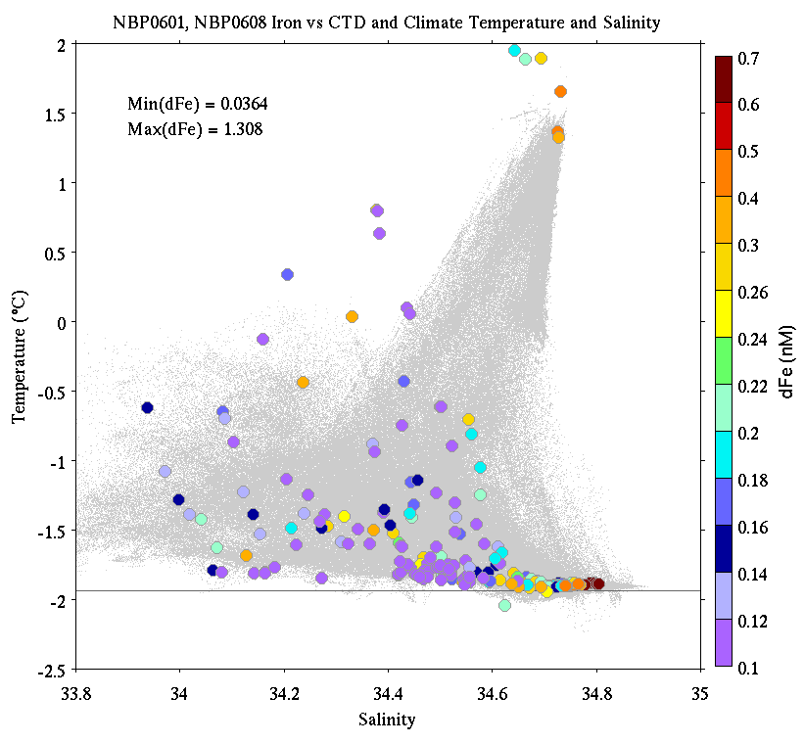
CORSACS Fe data

Slide 19
End

Slide 20
Estimating iron demand
Arrigo et al. 2008 satellite-based estimate of primary productivity 1997-2006:
5.7 mol C m⁻² yr⁻¹
Using an f-ratio of 0.5
Asper and Smith 1999
Sweeney et al. 2000
Long et al. 2011
Annual new production: 2.85 mol C m⁻² yr⁻¹
Assuming C:Fe of 450,000: 6.7 µmol Fe m⁻² yr⁻¹
Algal assimilation ratios Feng et al. 2000 250,000-400,000
Twining et al. 2004 166,000-390,000
Boyd et al. 2012 5000-450,000
Strzepek et al. 2011,2012 10,000-3,000,000

Slide 21
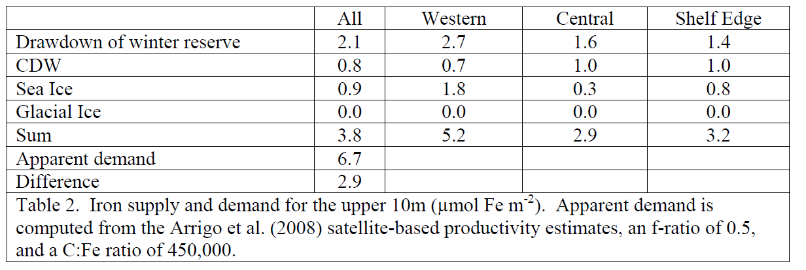
Iron supply and demand in the Ross Sea
43% of the iron budget is “missing”
Potential “fixes” to the problem
Decreasing f-ratio from 0.5 to 0.215
Decreasing C:Fe assimilation ratio from 450,000 to 193,500
WACCM to the rescue, thanks Dan!

Slide 22
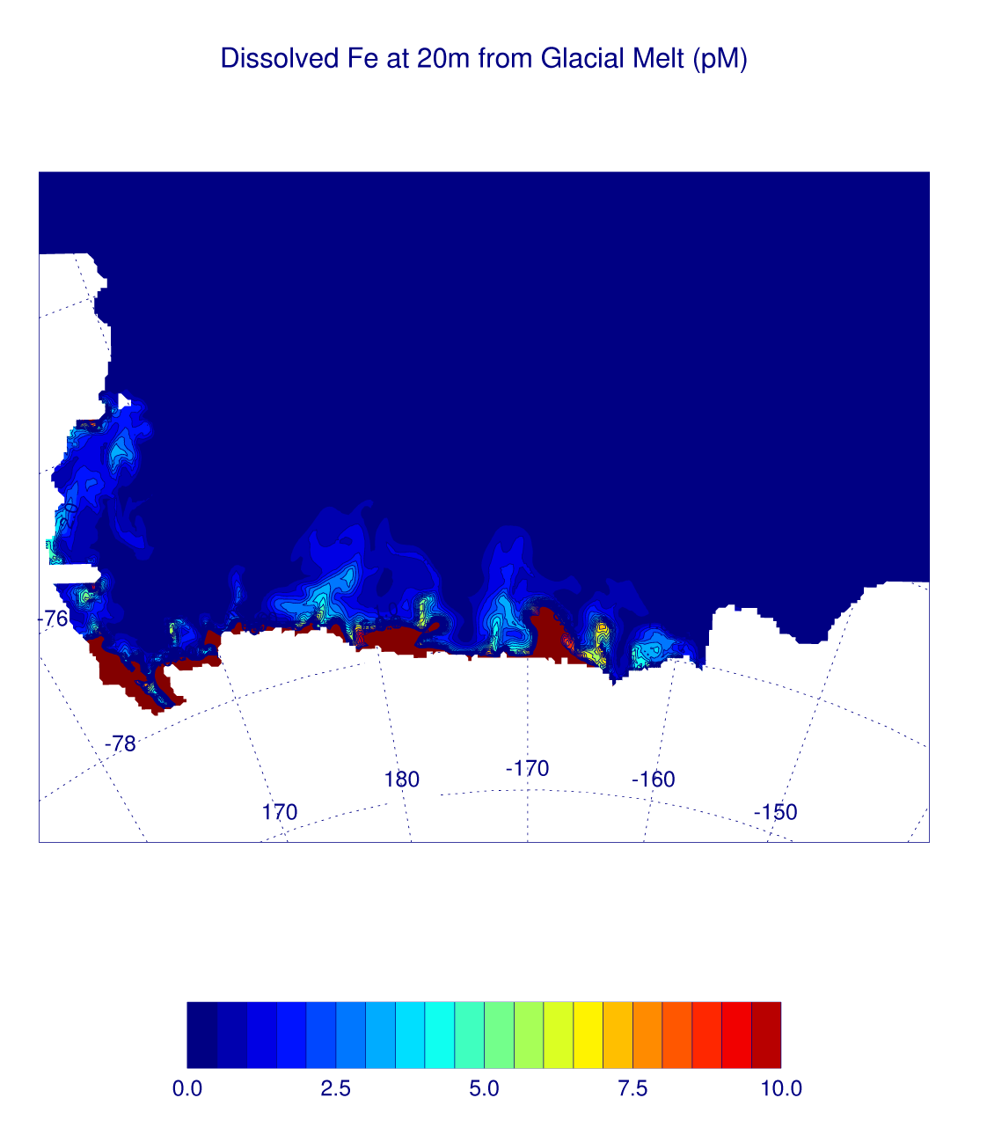
Dissolved Fe from model glacial melt
Assume: 5 nM for glacial ice in the Ross Ice Shelf
Very small estimates for glacial melt contribution:
Annual estimate for top 10m of entire continental shelf = 1.4 pM
Back of the envelope estimate:
Assume: 30-95 km³/yr melt
4-7 yr ice cavity
residence time
Meltwater mixed over top 150 – 300m of open shelf
1.7 – 0.2 pM
Notes:
5 nM comes from Pete. Picture is at end of model run. Remember the ice shelf water comes out at depth

Slide 23
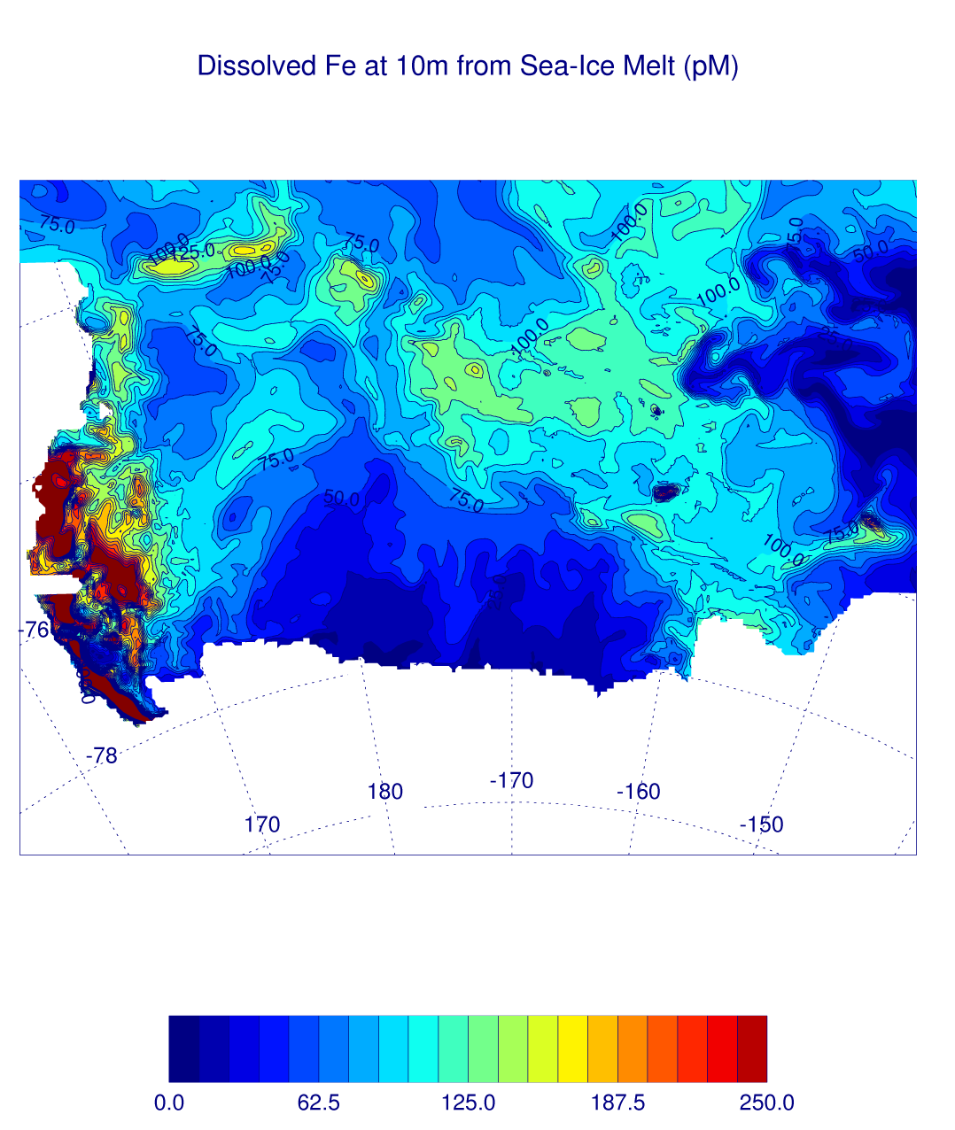
Dissolved Fe from model sea-ice melt
Assume: 5 nM for sea-ice
Much larger estimates for sea ice melt contribution w/ greatest contribution in the west
Annual estimate for top 10m of entire continental shelf = 88 pM
Back of the envelope estimate:
Assume: 0.3 – 0.9 m ice thickness
All ice removed by local
melt over the shelf
(known false)
Summer mixed layer thickness 10 -30m
450 - 50 pM
Notes:
Picture is late January 2012 (note scale difference wrt previous picture). Ross Sea is known to be a net exporter of ice.

Slide 24
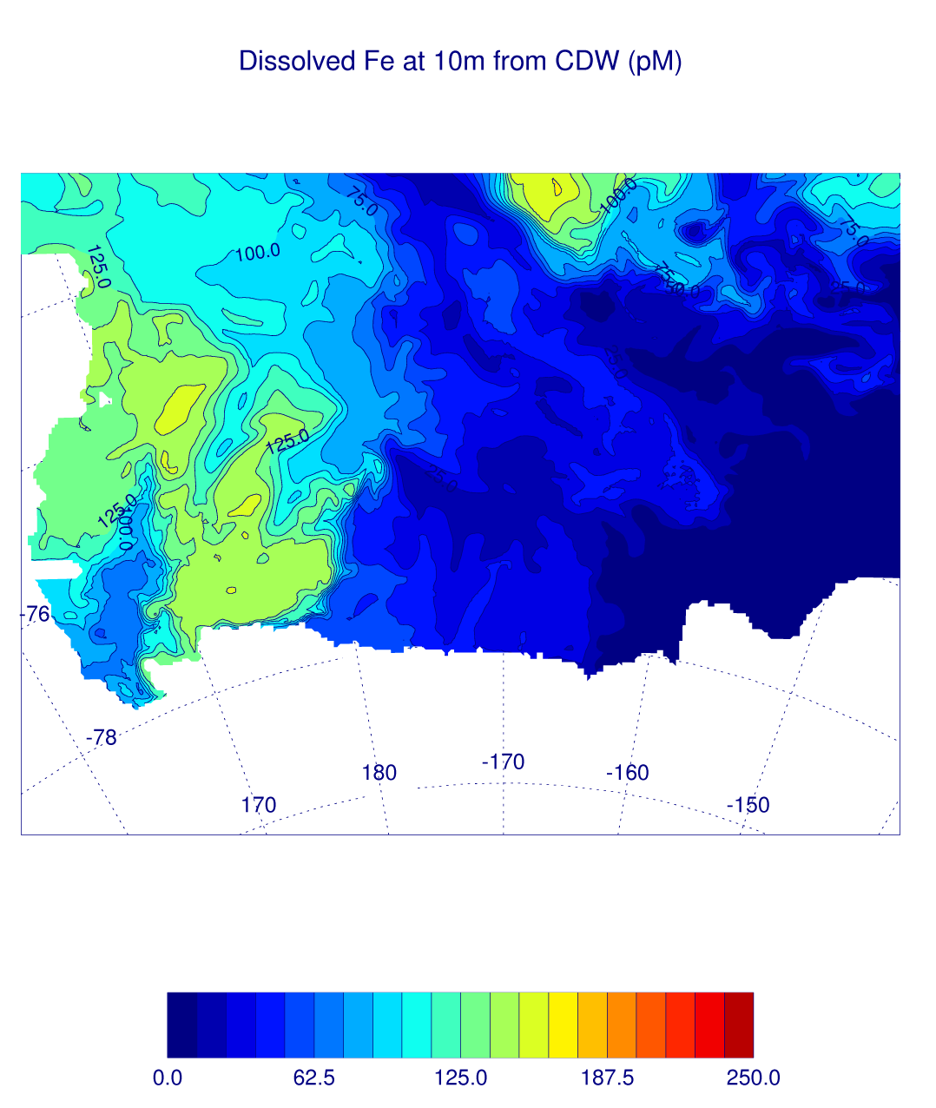
Dissolved Fe from model MCDW transport
Assume: 0.4 nM for CDW (Pete’s measurements)
Similar to sea-ice melt estimate over entire shelf, but smaller in west and greater in central with different temporal evolution
Annual estimate for top 10m of entire continental shelf = 76 pM
Back of the envelope estimate:
??? (Don’t have a good non-model estimate of CDW flux onto the shelf…yet)
Notes:
Picture is late January 2012 (same scale as previous picture).

Slide 25
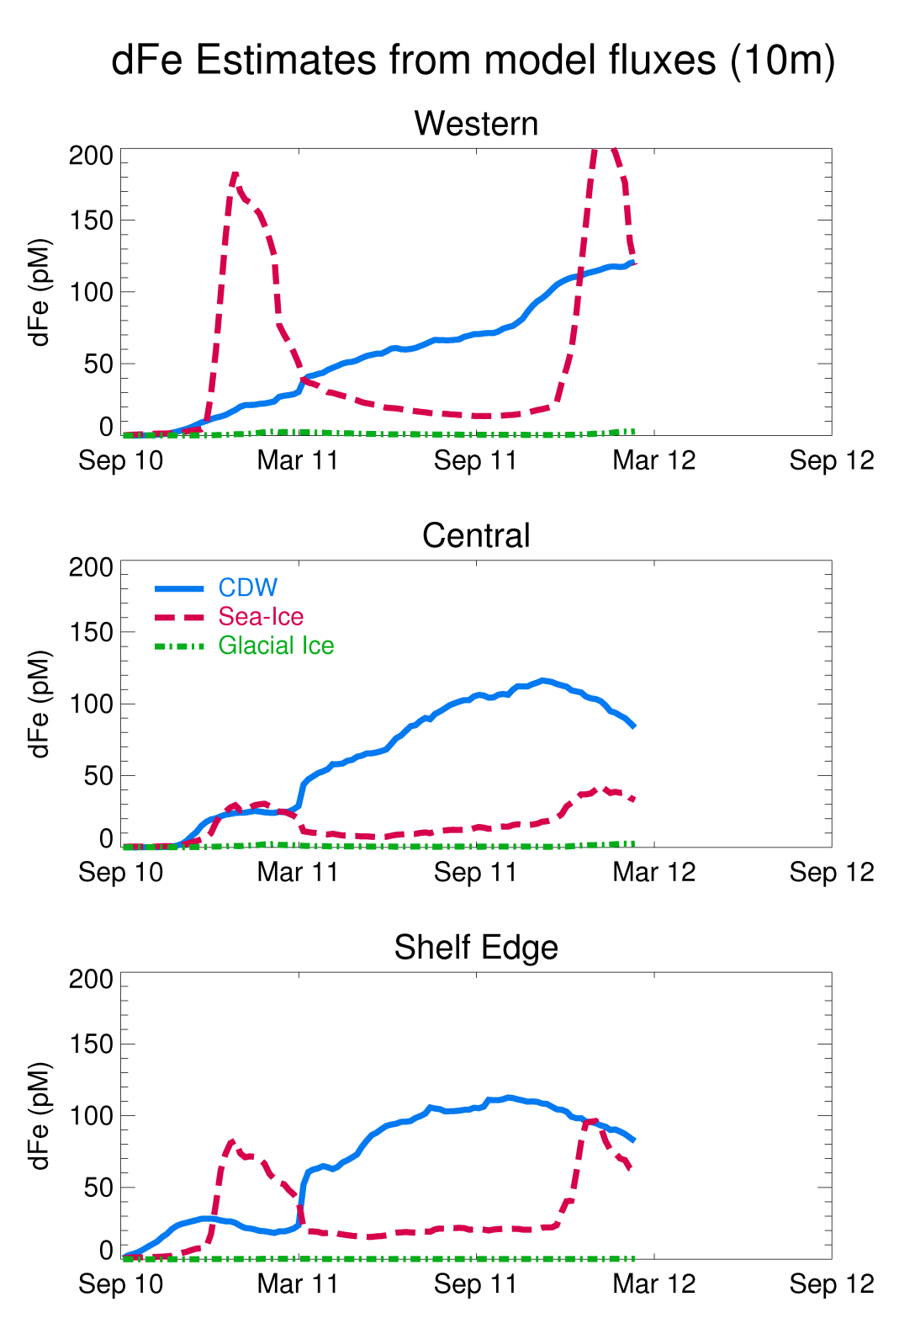
Notes:
Go through temporal evolution of different sources. Mention how the numbers for Table 2 came about and that time series is limited to 170W.

Slide 26
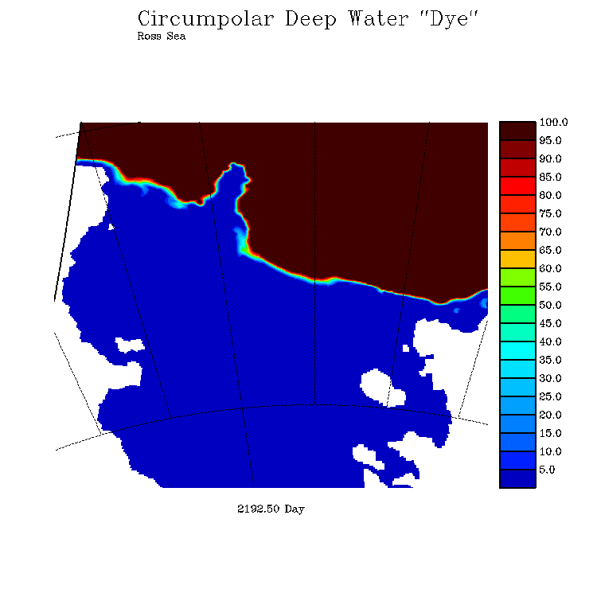
Simulation of CDW penetration onto the continental shelf
Mike Dinniman
ODU

Slide 27
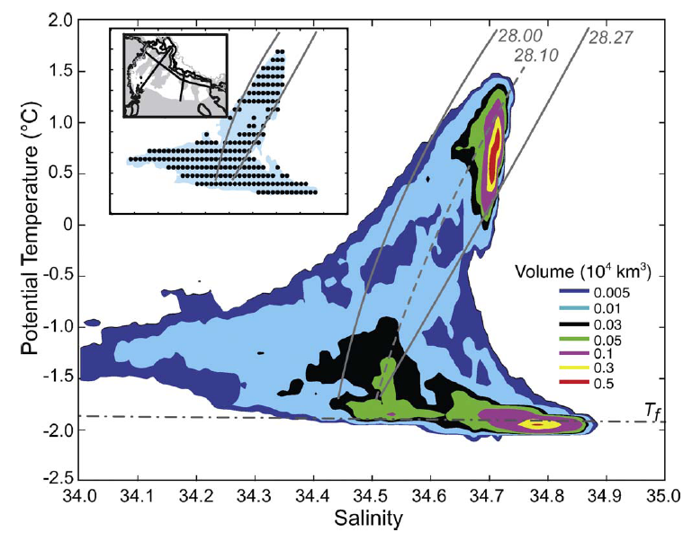
Orsi water mass volumes

Slide 28
Toward an iron budget for the Ross Sea: estimating the “winter reserve”
Observations: dFe(z)_{i}
$$\hat{{dFe}_{i}}=\frac{1}{{MLD}_{i}}\int_{{MLD}_{i}}^{0}{{dFe(z)}_{i}}dz$$
$$\hat{{NO3}_{i}}=\frac{1}{{MLD}_{i}}\int_{{MLD}_{i}}^{0}{{NO3(z)}_{i}}dz$$

