Slide 1
Sensitivity of Water Masses in the Ross Sea to Changes in Winds and Atmospheric Temperatures
Mike Dinniman
John Klinck
Center for Coastal Physical Oceanography
Old Dominion University
Walker Smith
Virginia Institute of Marine Science
College of William and Mary
May 1, 2013

Slide 2
Introduction
Strengthening of the cold southerly winds over the Ross Sea is thought to be one cause for the observed increases in ice extent in the area
Could this be affecting other aspects of the ocean circulation (Modified Circumpolar Deep Water transport, ice shelf basal melt, bottom water formation) and how might this change in the future?
Examine these questions with an ocean model using idealized and AR4 simulated atmospheric forcing changes

Slide 3
Ross Sea Model
ROMS: 5 km horizontal resolution, 24 levels
Ice shelves (mechanical and thermodynamic)
Dynamic sea ice
Different wind forcing, but typically either from Antarctic Mesoscale Prediction System (AMPS) or ERA-Interim
Lateral boundary conditions from WOA, OCCAM and SSM/I ice concentrations
Bathymetry from BEDMAP and Davey

Slide 4
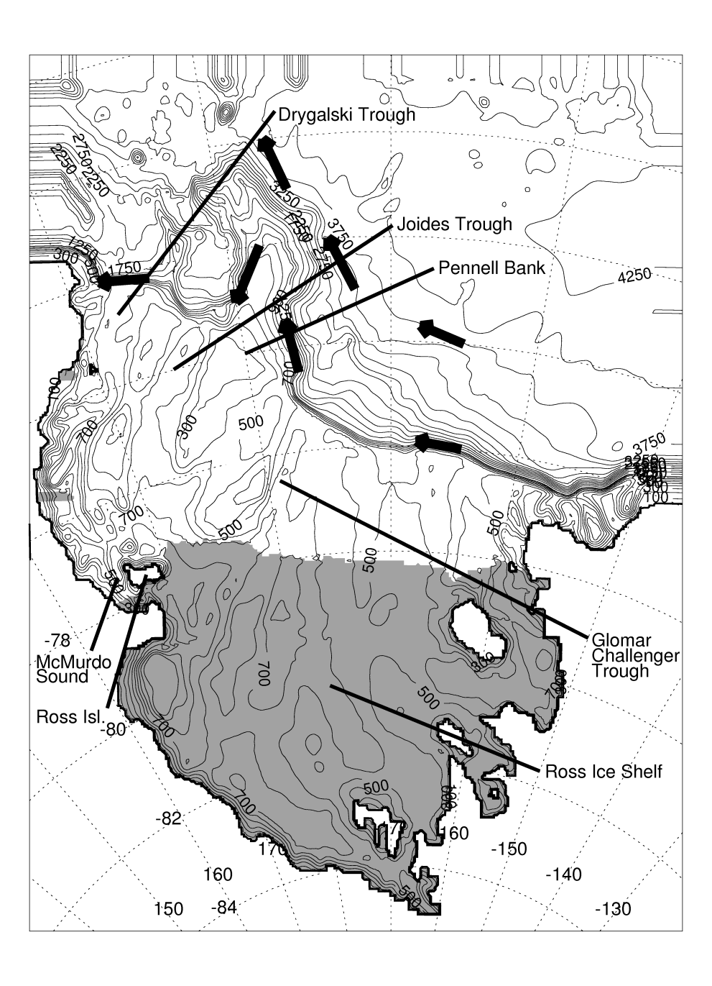
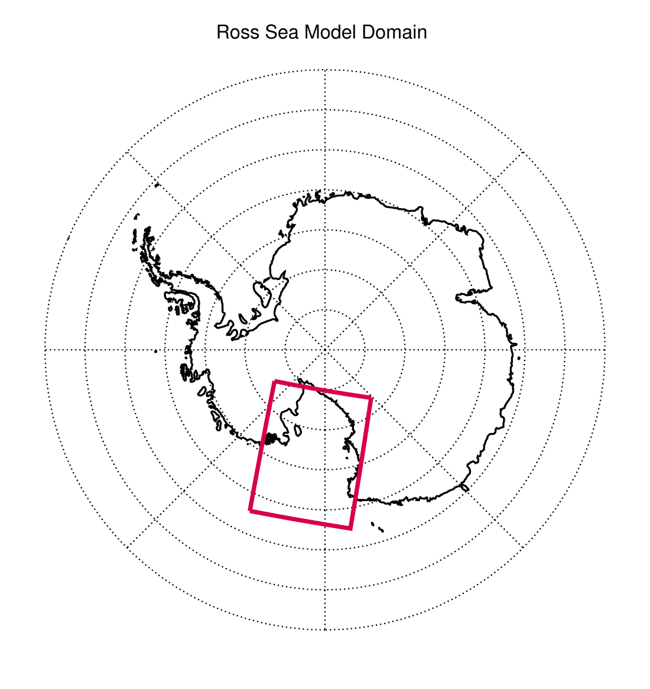
Ross Sea bathymetry

Slide 5
Idealized Forcing Simulations
Reference case: Daily AMPS winds and air temperatures for Sept. 2003 – Sept. 2005
Winds sped up or slowed down by simply multiplying both wind components by a constant factor
Atmospheric temperatures changed by a constant offset everywhere
Simulation | Wind Strength | Atmospheric Temperature
Base | Current | Current
Wind*0.8 | Current*0.8 | Current
Wind*1.2 | Current*1.2 | Current
T-1.0C | Current | Current – 1.0 °C
T-1.0C+ | Current*1.2 | Current – 1.0 °C

Slide 6
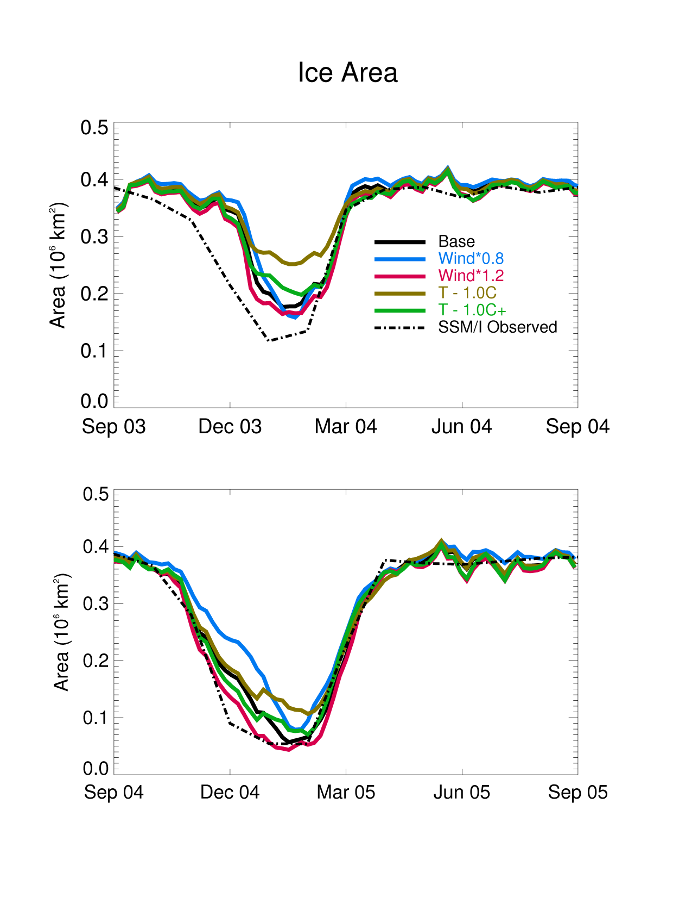
Increases in just the wind speed reduced the summer sea-ice extent and increased the polynya duration (opposite of what has been observed)
However, increases in the wind speed combined with decreases in the atmospheric temperature led to an increase in the summer sea-ice extent
Notes:
This is simulated ice-area over just the continental shelf.

Slide 7
AR4 Forcing Simulations
Used 20th Century and AR4 SRES A1B Scenario (midrange) simulations from the MPI ECHAM5 model
Daily winds for 1996-2000, 2046-2050, 2096-2100
20th Century temperatures were too cold so used ERA-Interim climatology for 1996-2000 and added ECHAM5 A1B anomalies for 2046-2050 (+1.7 ± 2.6) and 2096-2100 (+2.5 ± 2.3)
Two additional simulations with fresher
(-0.12) boundary salinity to mimic possible continued freshening of the Ross Sea
Notes:
ECHAM5 temperatures were way too cold (esp. near the coast).

Slide 8
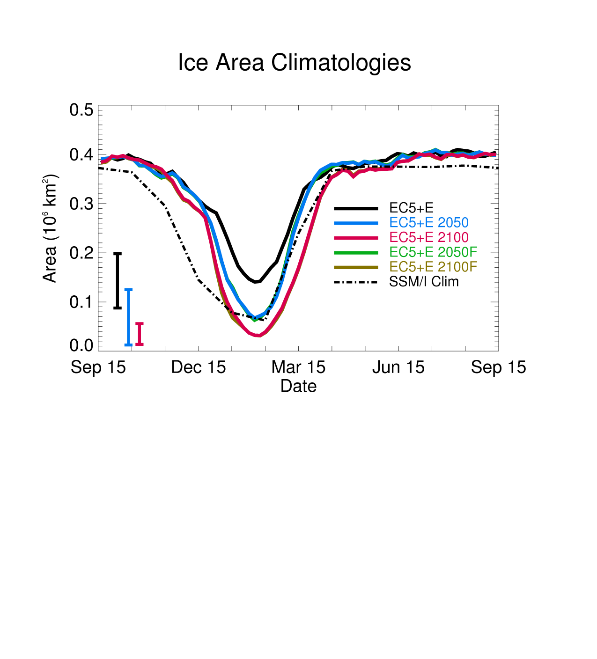
Difference between simulations varies from year to year, but the Ross Sea Polynya generally opens up more in 2050 and even more so in 2100
Little difference due to fresher boundary conditions
Entire continental shelf is covered with ice most of the year in all simulations
Notes:
This is simulated ice-area over just the continental shelf.

Slide 9
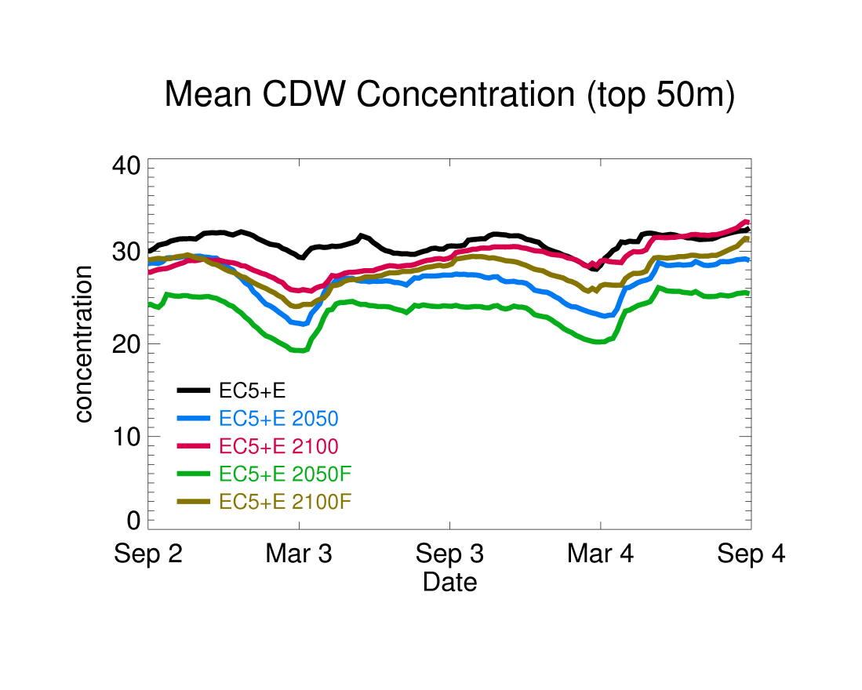
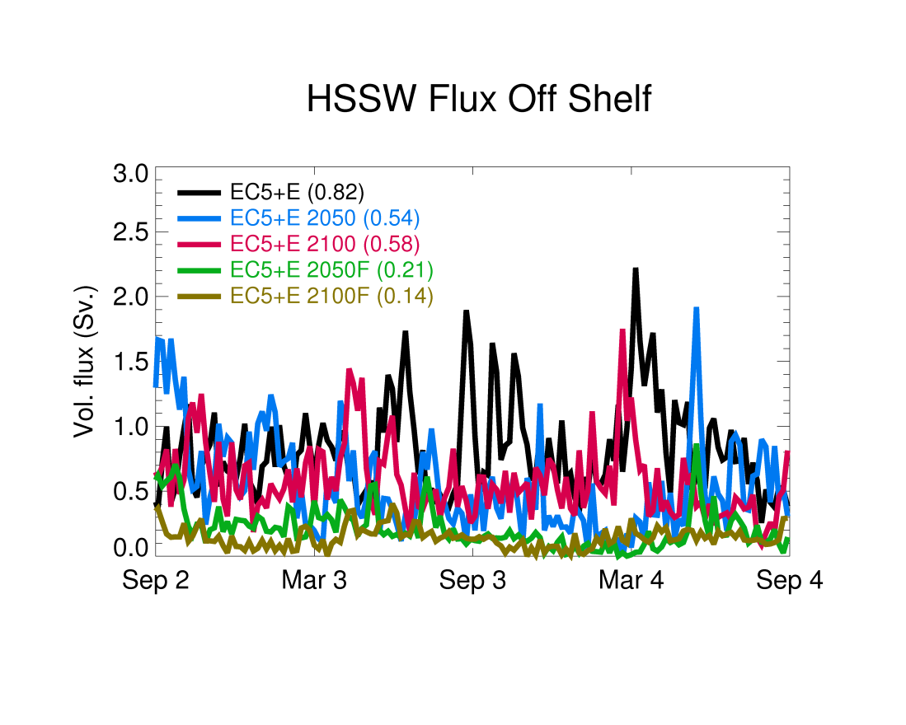
Warmer air temperatures (2050 and idealized cases) reduce the MCDW that gets to the shelf and upper shelf waters, but these are balanced out by changes in the winds by 2100.
Fresher waters slightly lower MCDW transport but have a bigger reduction on vertical mixing of MCDW into the upper water column.
Fresher waters also significantly reduce the creation and export of dense water from the shelf.

Slide 10
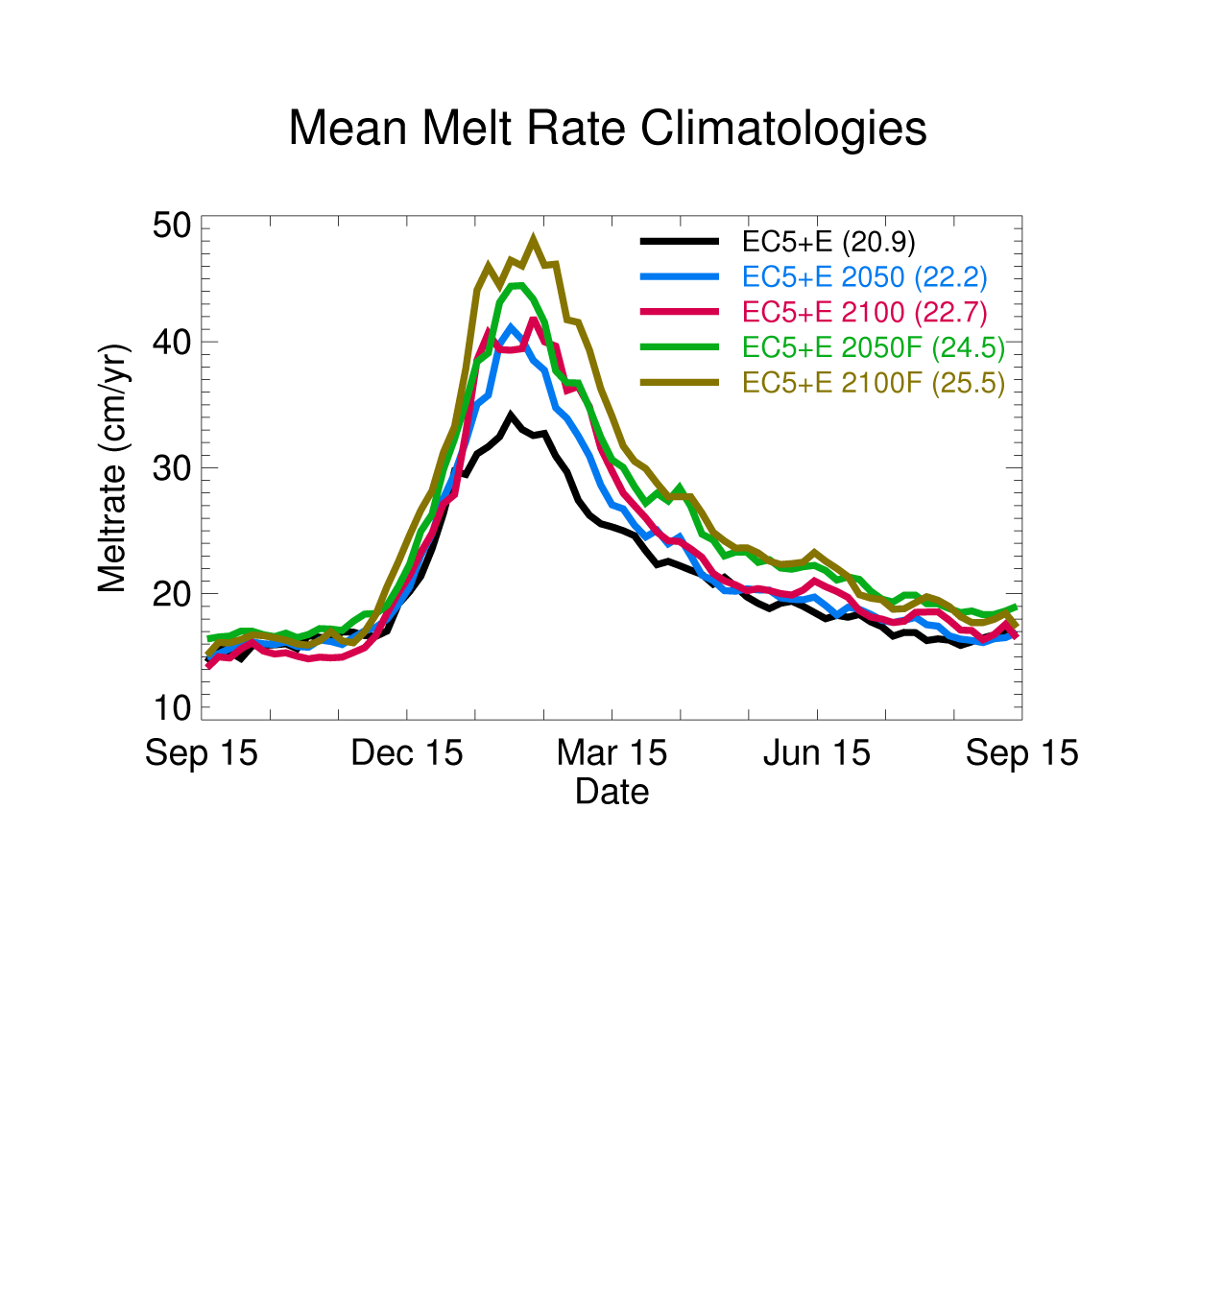
Basal melt rate underneath RIS increased slightly for both 2050 (6%) and 2100 (9%) and most of the increase was in summer
Difference due to warmer surface summer waters
Stronger basal melt rate increase (17% for 2050, 22% for 2100) with fresher boundary conditions and more of the difference is in fall/winter
Due to less mixing of heat out of CDW
Notes:
Note observed estimates are 12-22 cm/yr.

Slide 11
Conclusions
Warmer future air temperatures could reduce MCDW transport and vertical mixing, but this may be balanced by changes in the winds
Continued freshening of the Ross Sea could reduce the creation and export of dense shelf water
The basal melt rate of the RIS only increases slightly by 2050 (6%) or 2100 (9%) unless a freshening of the Ross Sea is added (increased to 17% for 2050 and 22% for 2100)

Slide 12
Acknowledgements
Thanks to everyone who supplied the different data bases needed (ocean and ice shelf bathymetry, atmospheric forcing, satellite sea-ice concentration, ocean conditions)
Computer facilities and support provided by the Center for Coastal Physical Oceanography
Financial support from the U.S. National Science Foundation (ANT-0838948 and OCE-0927797).

Slide 14
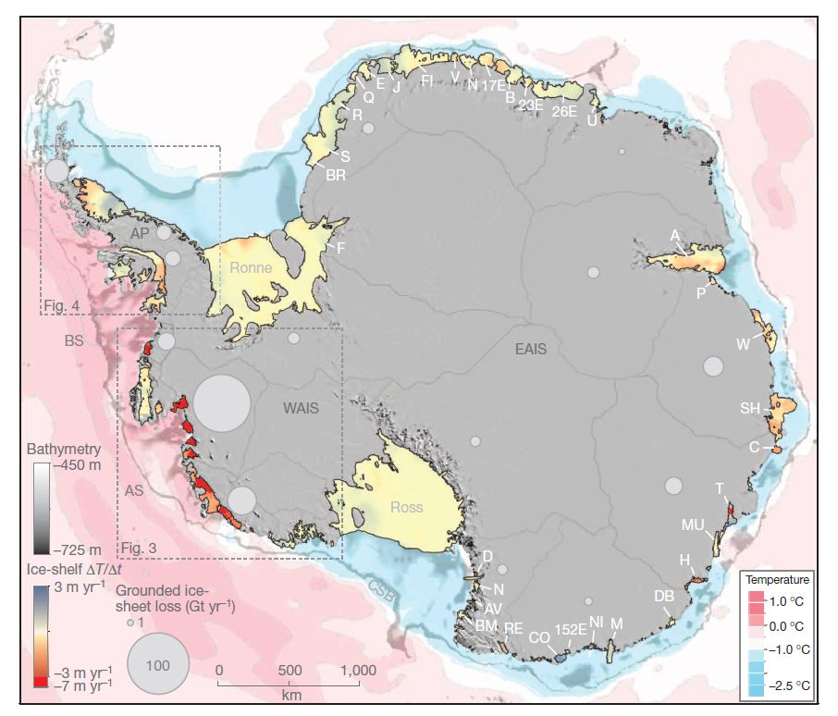
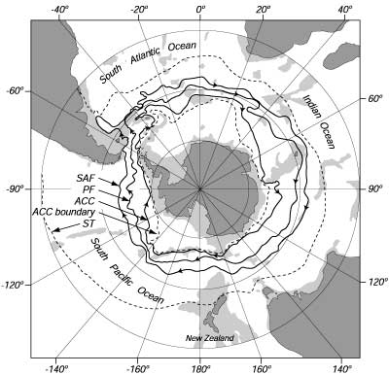
Pritchard et al., 2012
Orsi, 1995

Slide 15
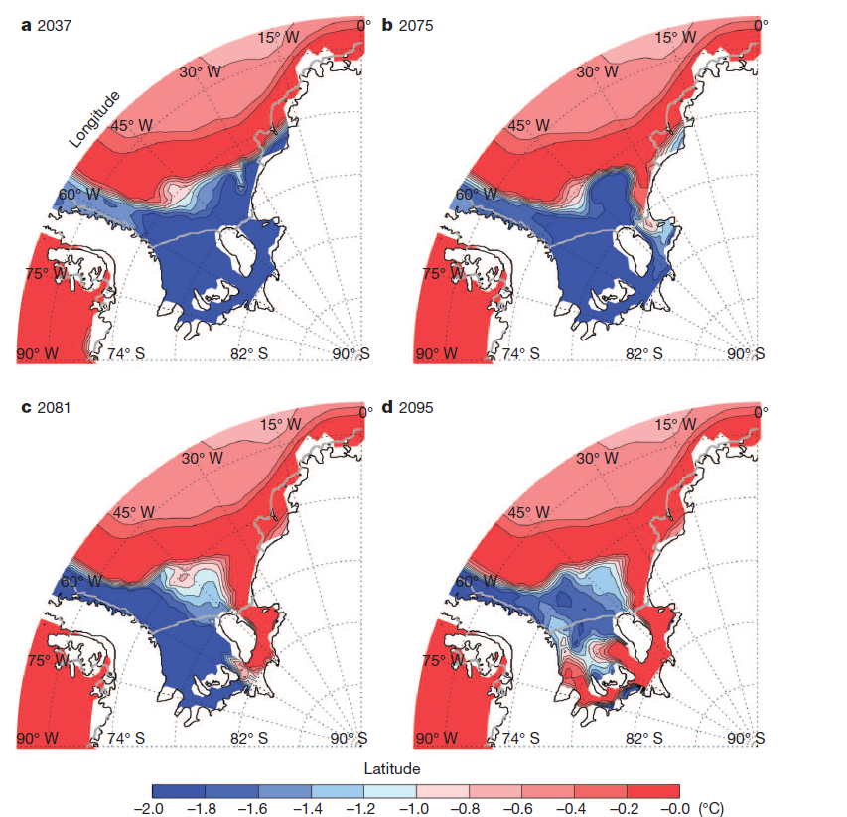
Modeled ocean changes lead to a 20x (0.2 to 4.0 m/yr) increase in the Filchner-Ronne basal melt
(Hellmer et al, 2012)
Notes:
Temp 60m above bottom.

Slide 16
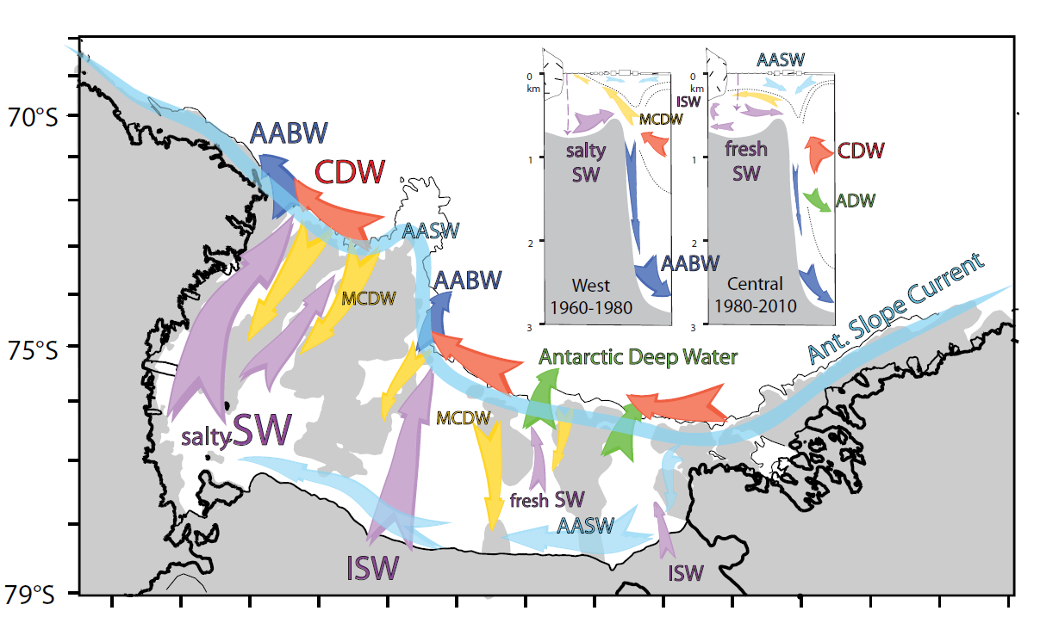
Smith et al., 2012

Slide 17
Major Water Masses
Antarctic Surface Water (AASW)
Modified Circumpolar Deep Water (MCDW)
Shelf Water
High Salinity Shelf Water (HSSW)
Low Salinity Shelf Water (LSSW)
Ice Shelf Water (ISW)
Modified Shelf Water
Volume on the shelf is distributed nearly equally among SW, AASW, MCDW and MSW
Orsi and Wiederwohl, 2009

Slide 18
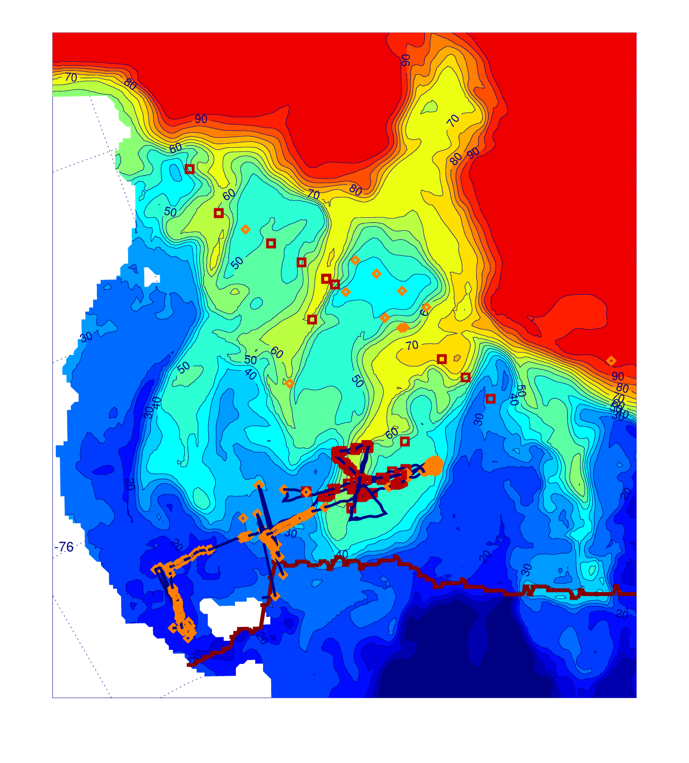
Model dye concentration (mid-depth)
vs.
observations of MCDW (red squares) or no-MCDW (orange diamonds)
Notes:
Observations are from cruise and glider data

Slide 19
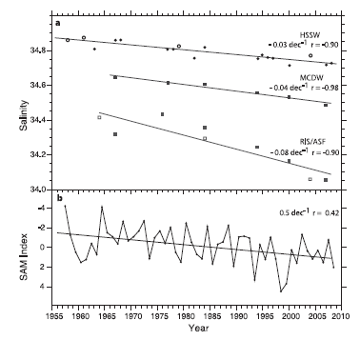
Notes:
Jacobs and Giulivi, 2010. FIG. 5.

Slide 20
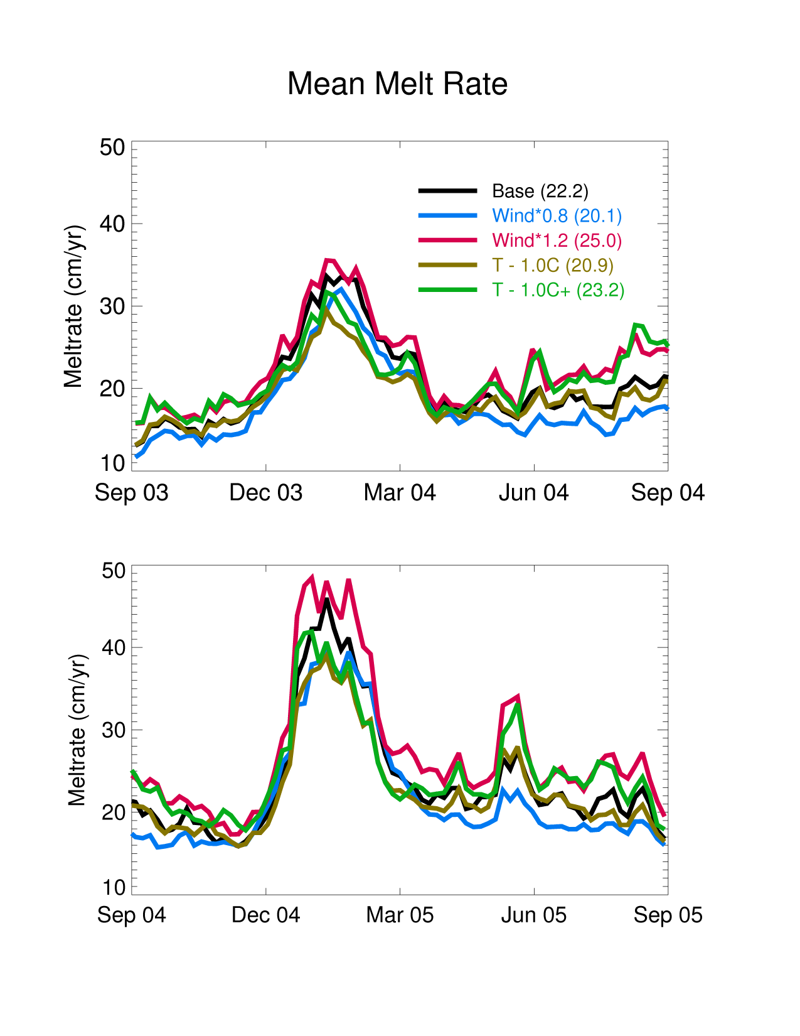
Basal melt rate underneath RIS increased with increased winds, decreased with lower temperatures and increased slightly with combined stronger winds and lower temperatures
Note that the stronger wind effect is year round while the reduced temperature effect is primarily only in the summer

Slide 21
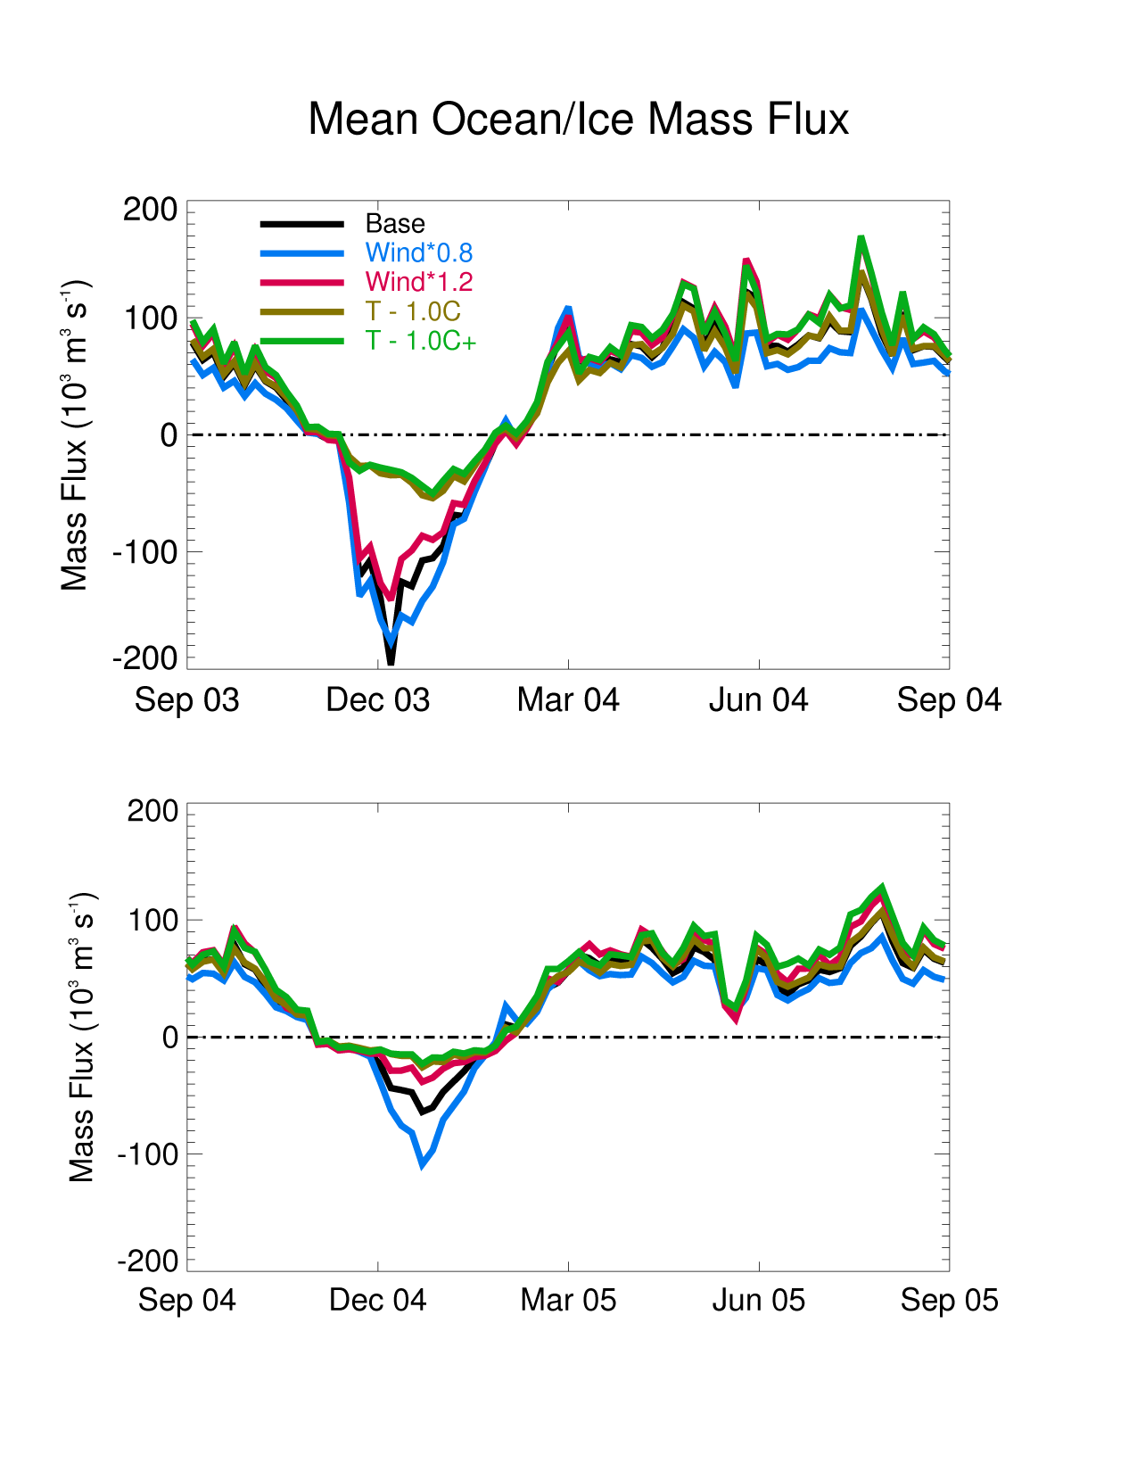
Increases in just the wind speed slightly increase the local (thermodynamic) creation of ice (and flux of salt to the water), but also advect more ice off the continental shelf
Decreasing the atmospheric temperature strongly reduces the summer melt

Slide 22
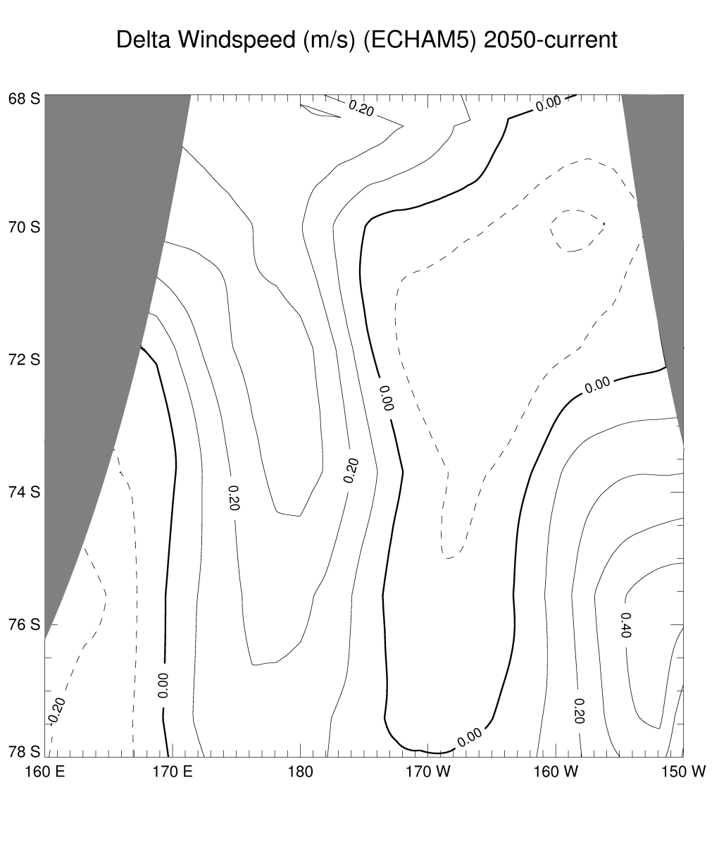
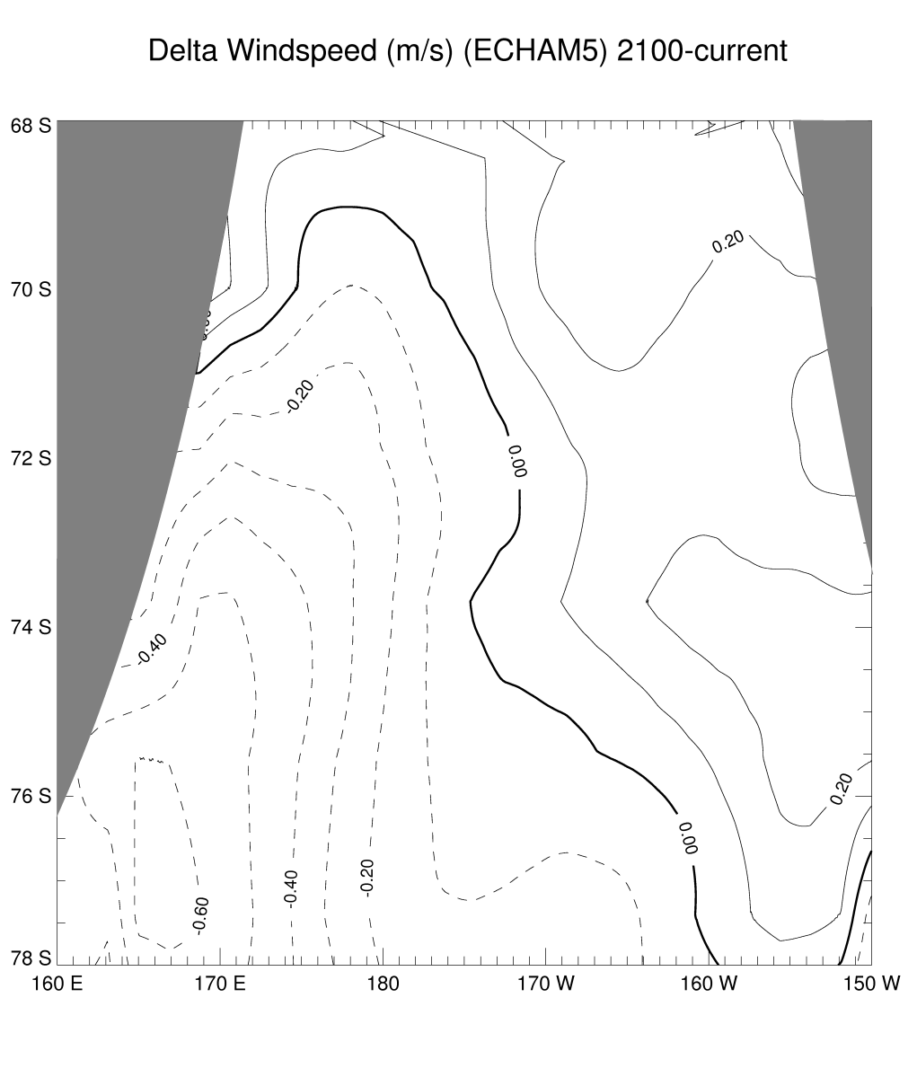
Air temperatures (not shown) are warmer over the model domain in 2046-2050 (1.7 ± 2.6 °C) and 2096-2100 (2.5 ± 2.3 °C). Mean southerlies are stronger over most of the shelf (weaker over shelf break) by 2050, but are weaker (stronger over shelf break) by 2100.

Slide 23
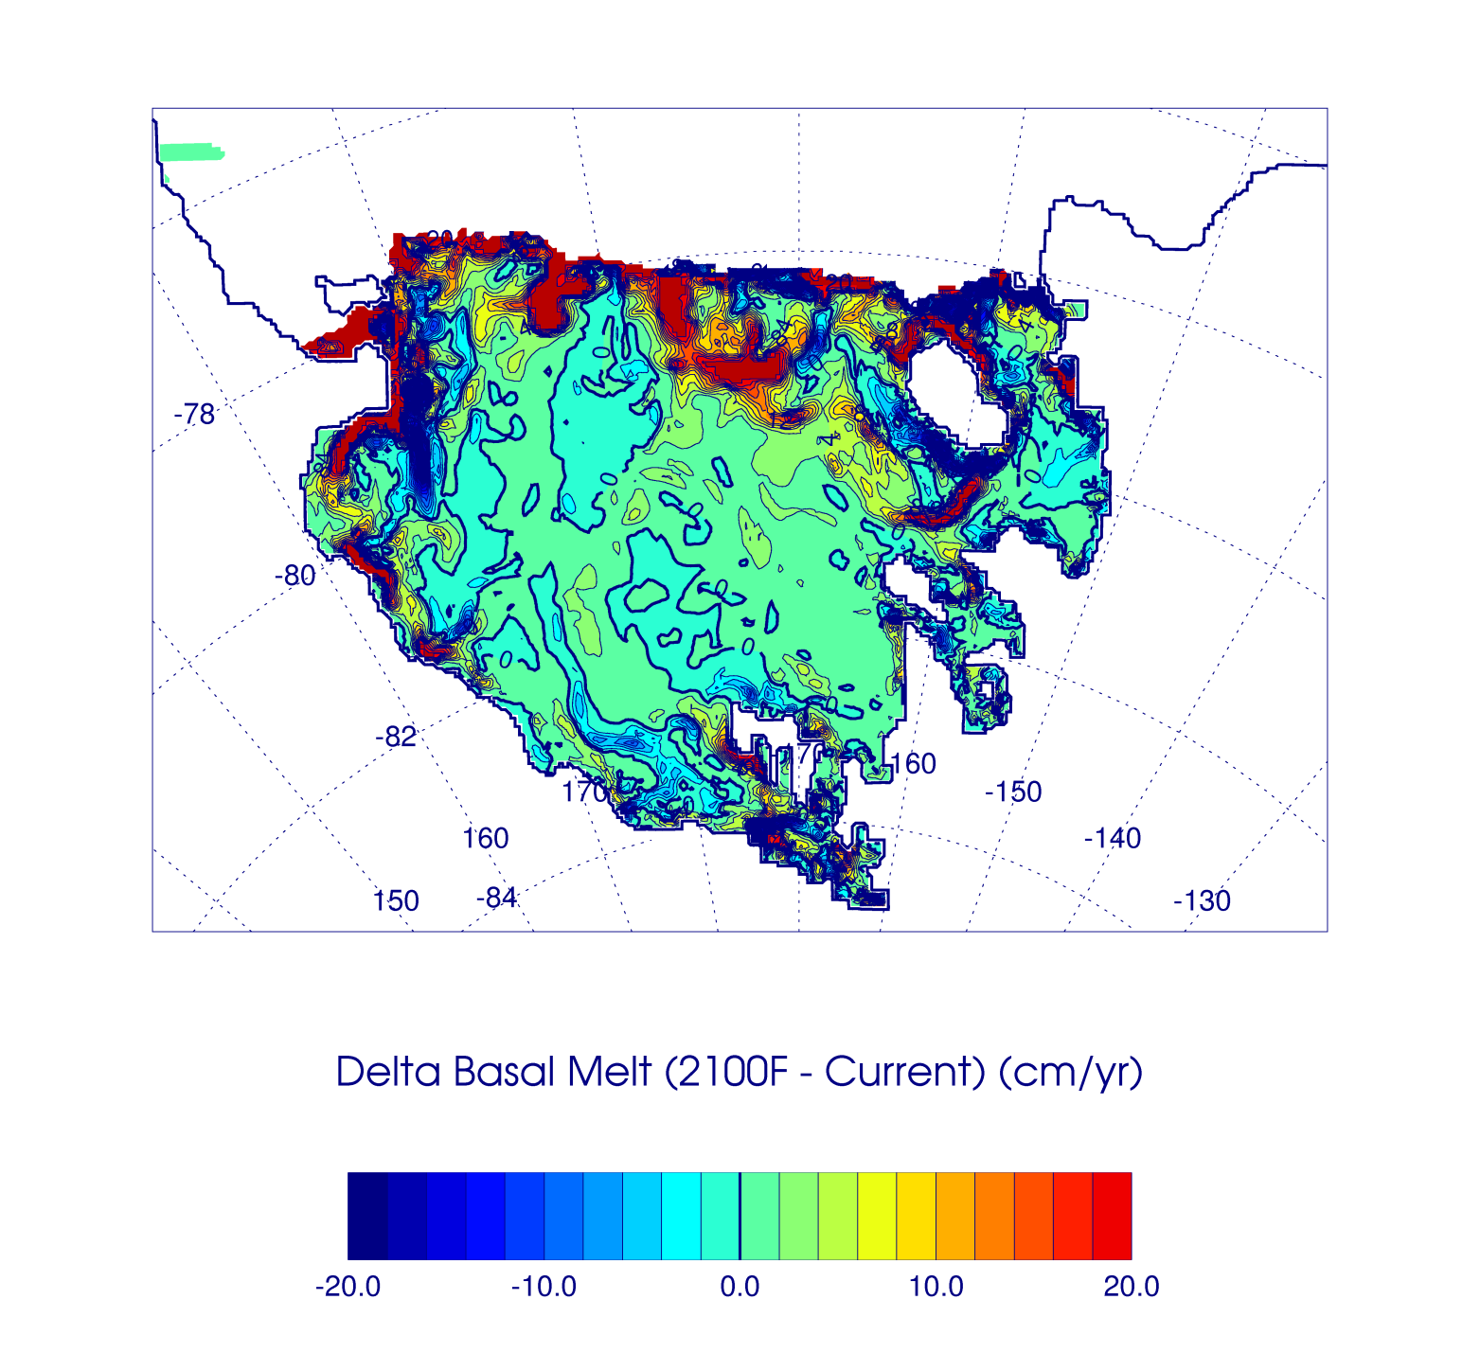
Notes:
This is actually 2050F, not 2100F as it says

Slide 24
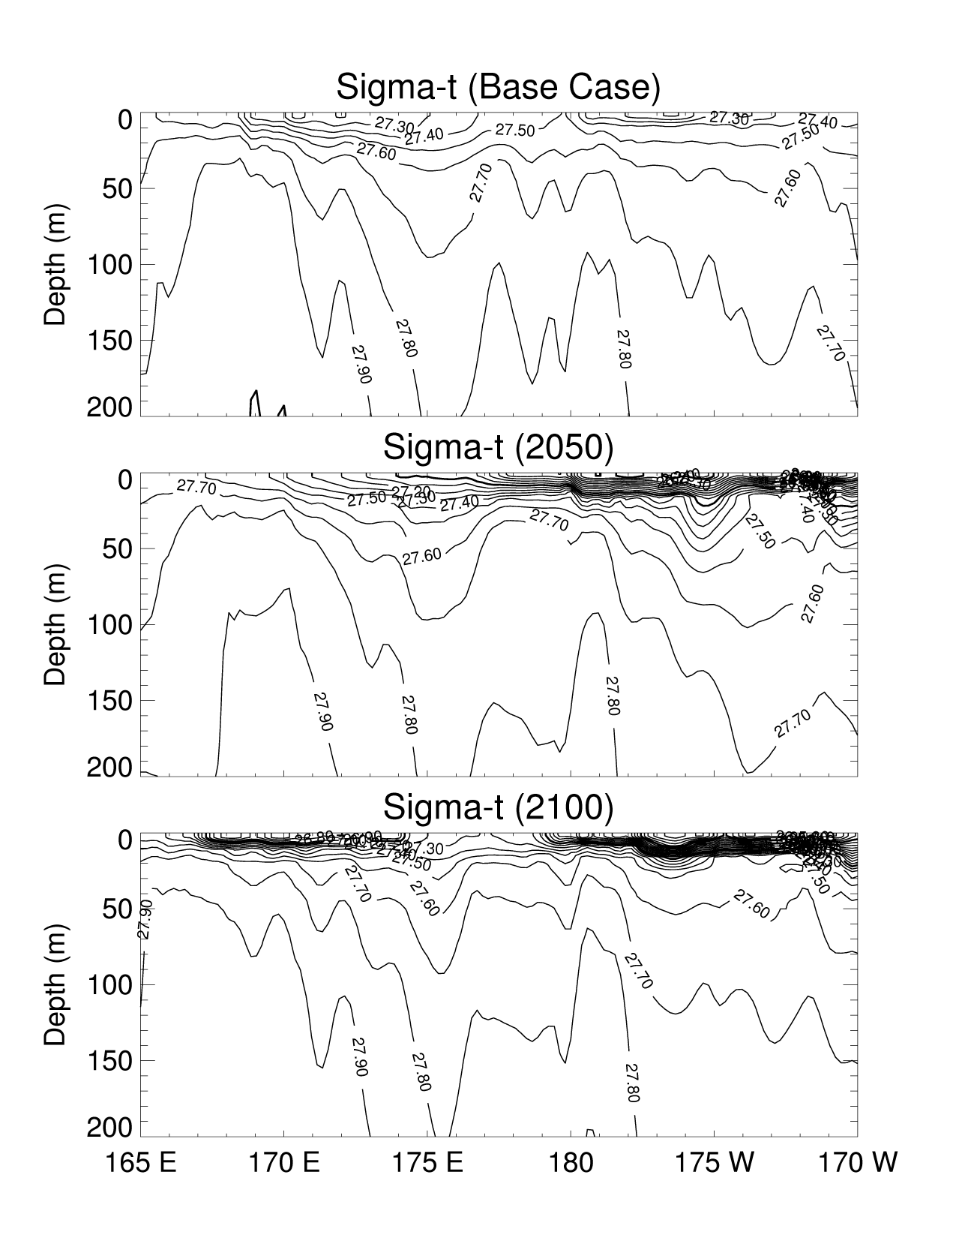

Slide 25
