Slide 1
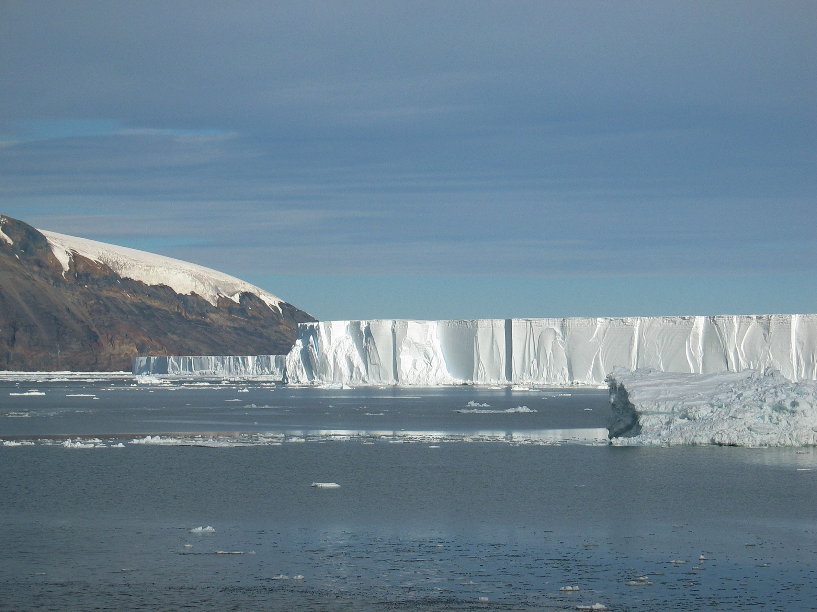

PRISM circulation modeling update
Mike Dinniman
Center for Coastal Physical Oceanography
Old Dominion University
June 12, 2013

Slide 2
Outline
PRISM Ross Sea model review and non-PRISM projects the model is being used for
Model simulation of Ross Bank area during the SeaHorse deployment
Future Plans (short…see other talks)
Summary

Slide 3
Ross Sea Model
ROMS: 5 km horizontal resolution, 24 levels
Ice shelves (mechanical and thermodynamic)
Dynamic sea-ice
Different wind forcing, but typically either from Antarctic Mesoscale Prediction System (AMPS) or ERA-Interim
Lateral boundary conditions from WOA, OCCAM and SSM/I ice concentrations
Bathymetry from BEDMAP and Davey
Experiments w/ dye representing CDW
Notes:
ROMS: Regional Ocean Modeling System: hydrostatic finite difference OGCM with a terrain following vertical coordinate. BEDMAP (ice thickness and subglacial topo model of the Ant.). Note that 5km isn’t really eddy resolving over the shelf. Stefanie to talk about our future plans wrt grid resolution.

Slide 4
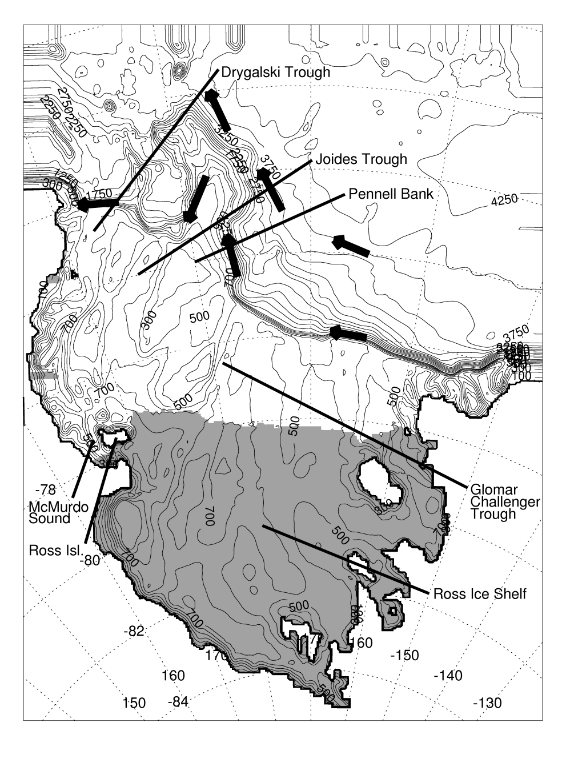
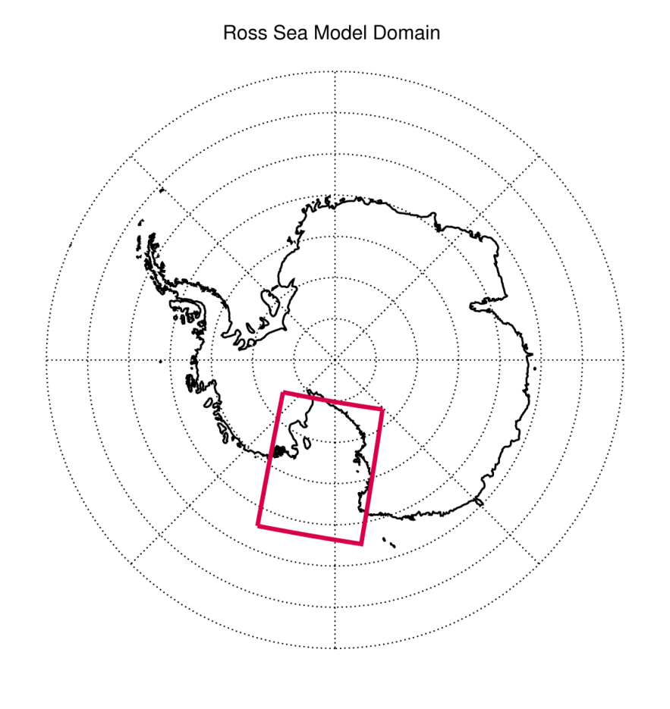
Notes:
Shaded areas represent Ice Shelves. Note that ACC is well north of this model domain and CDW comes around in the Ross Gyre and is a little cooler at the shelf break here compared to the WAP. Mention that the CDW at the shelf break here is LCDW?

Slide 5
PRISM Model Run
Sept. 15, 2010 – Feb. 29, 2012
Model fields saved every 5 days for entire run and every day from Sept. 15, 2011 (finer temporal resolution available upon request)
Forced with 6-hourly winds and air temperatures from the new higher resolution (0.75°) ERA-Interim product
Had to switch to coarser (25-km) SSMIS sea-ice from AMSR-E (12.5-km)
Two new dye tracers: Ice shelf meltwater and sea-ice meltwater
No tidal forcing (yet…)
Notes:
AMSR-E ice no longer available past October, 2011.

Slide 6
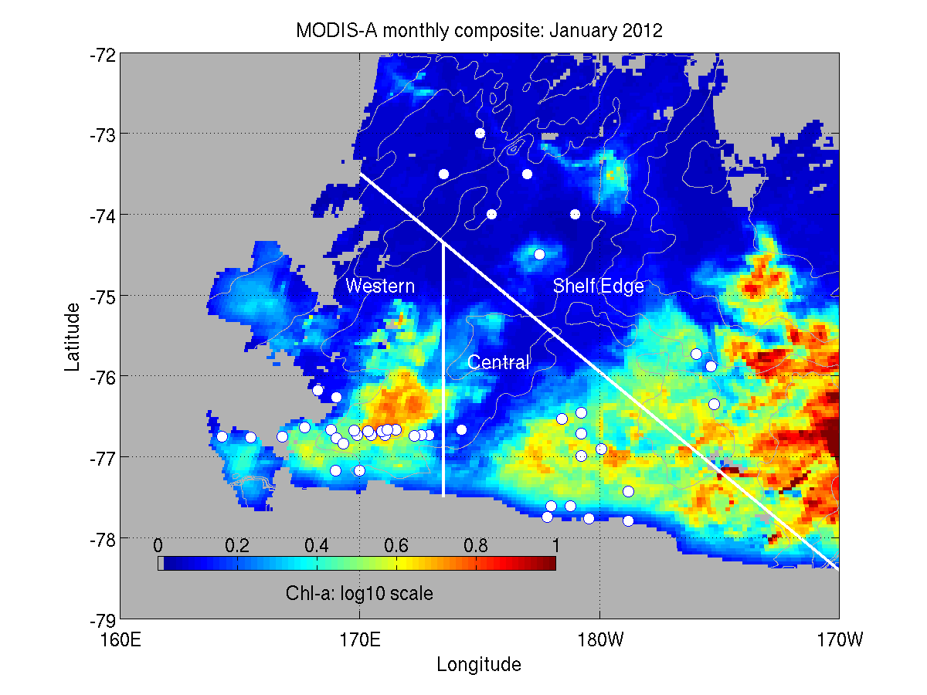
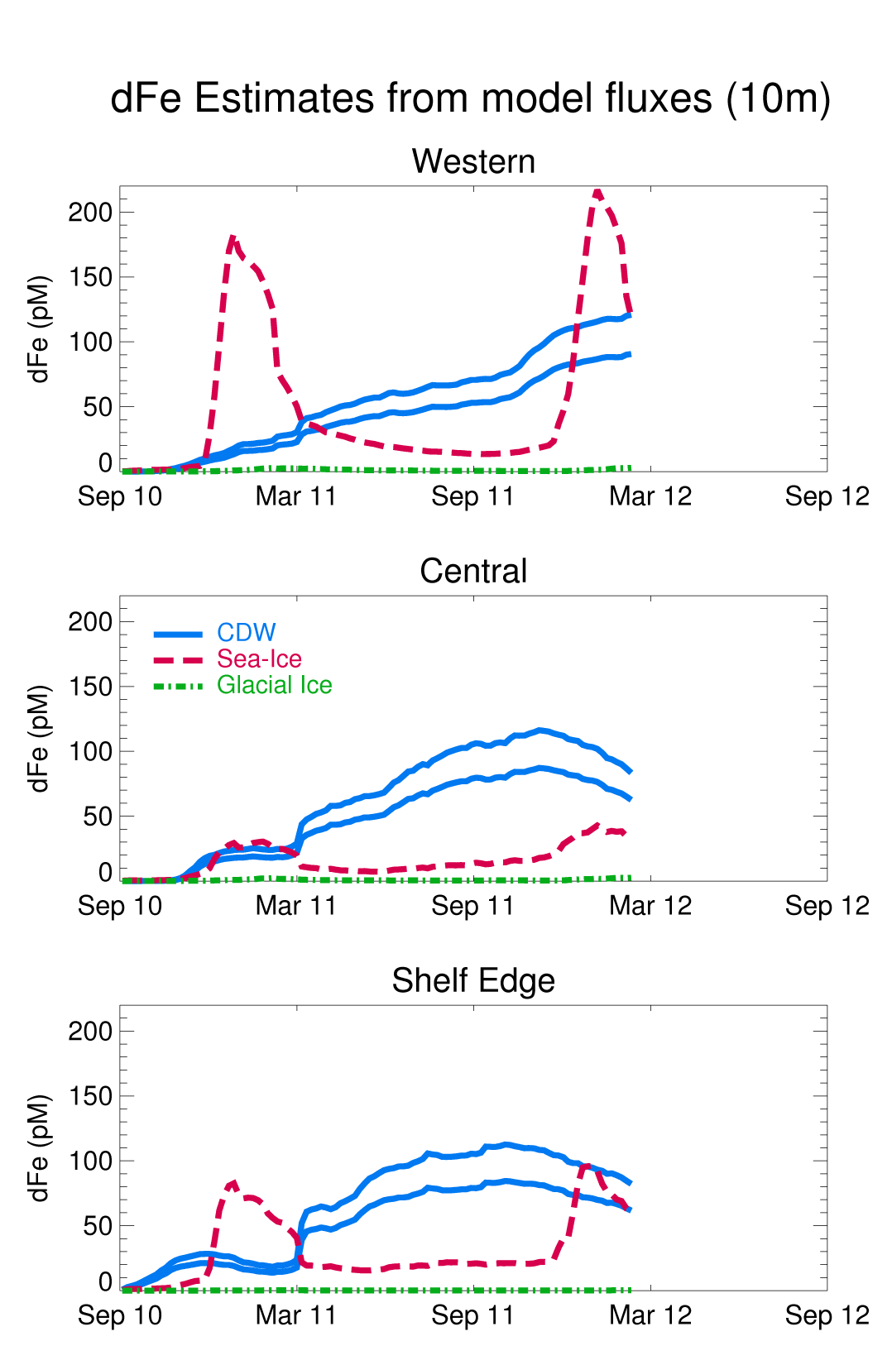
Changing CDW end-member dFe from 0.4 nM to 0.3 nM does not change relative importance of different sources

Slide 7
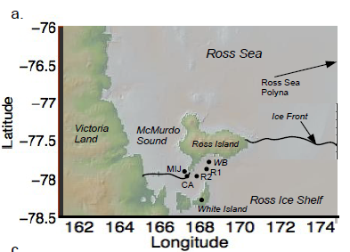
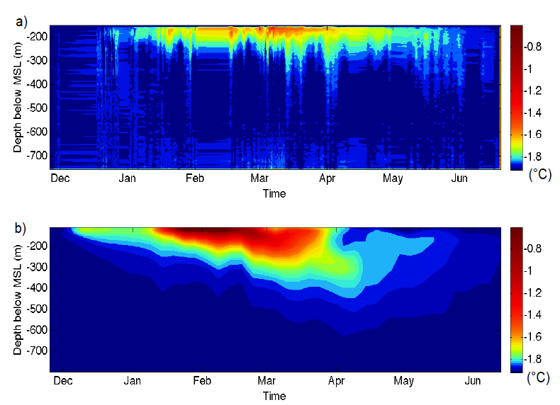
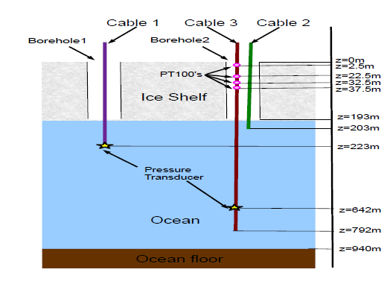
Distributed Temperature Sensor beneath McMurdo Ice Shelf
Figures courtesy Alon Stern
(Stern et al., JGR, provisionally accepted)
Notes:
Note delay of peak heating wrt surface waters in the area.

Slide 8
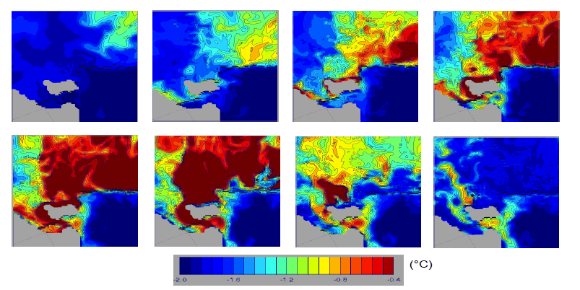
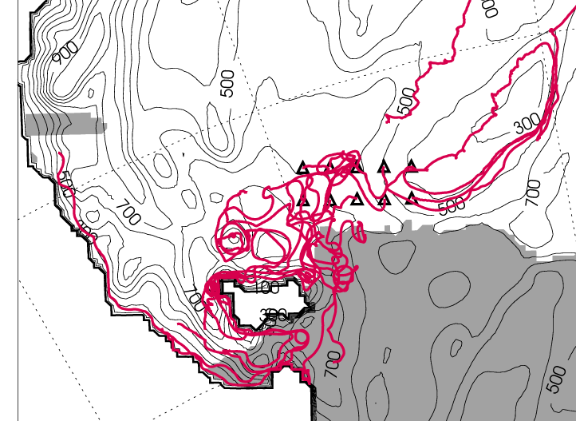
Distributed Temperature Sensor beneath McMurdo Ice Shelf
Warm water underneath McMurdo Ice Shelf originates in western summer Ross Ice Shelf Polynya
(N.B. Can easily do drifter runs on request if anyone has a good idea…)
Notes:
December to March model layer 20 temperature. These drifters are January start, followed 120 days. Can do drifter runs if anyone interested.

Slide 9
Model Run for UCSC
Sept. 15, 2009 – Dec. 15, 2012
Model fields saved every day for entire run
Same exact code as base case PRISM run
Same forcing, other than time period, as base case PRISM run
For sea ice, initial ice conditions are not thought to be critical for multi-year simulations around Antarctica => Is this still true in Ross though with all the multi-year ice?

Slide 10
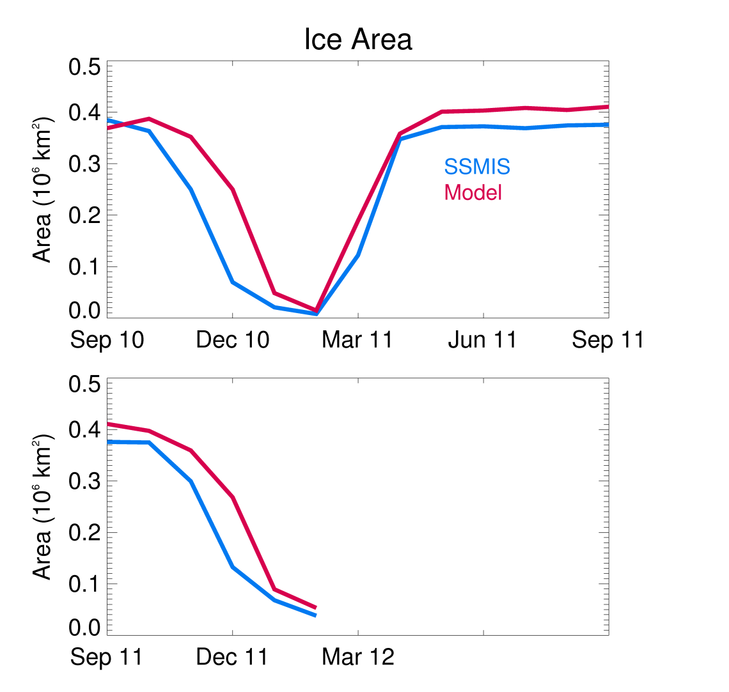
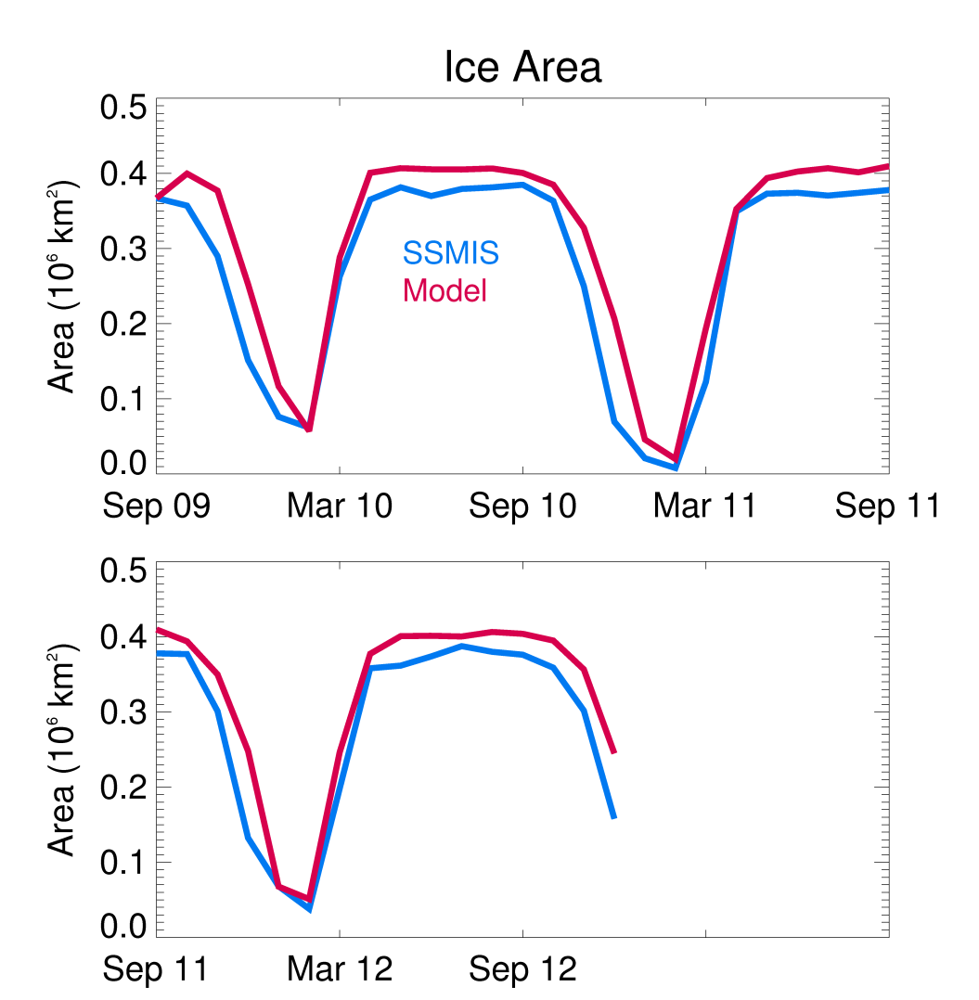
Starting 9/15/2010 Starting 9/15/2009
(r² = 0.90) (r² = 0.94)
Monthly modeled sea-ice area over the continental shelf (red line) vs. SSMIS sea-ice (blue line) area.
Notes:
Worried about effect of initial condtions => seems to be OK wrt simulated sea-ice. Integrated ice concentration times area. Model has a little too much ice at maximum extent (extent is the same, model just has slightly higher ice concentrations in the pack ice vs. SSMIS) and the initial melt is a little too slow. Does a good job w/ interannual differences in the ice area minima.

Slide 11
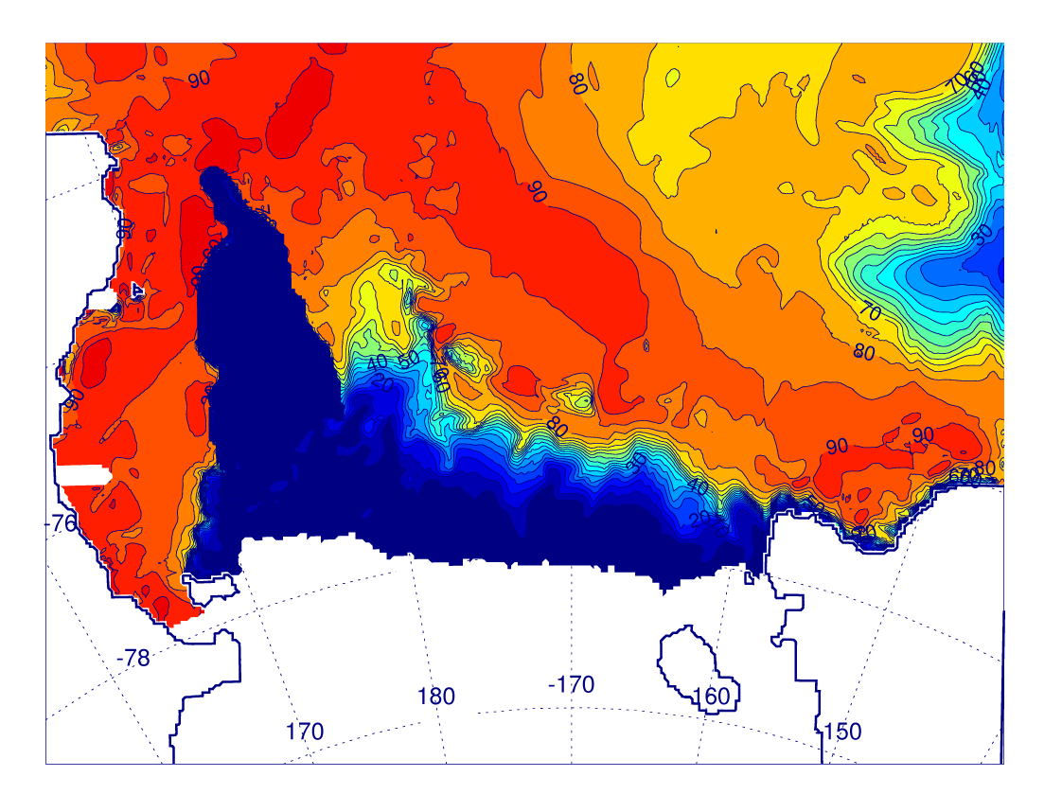
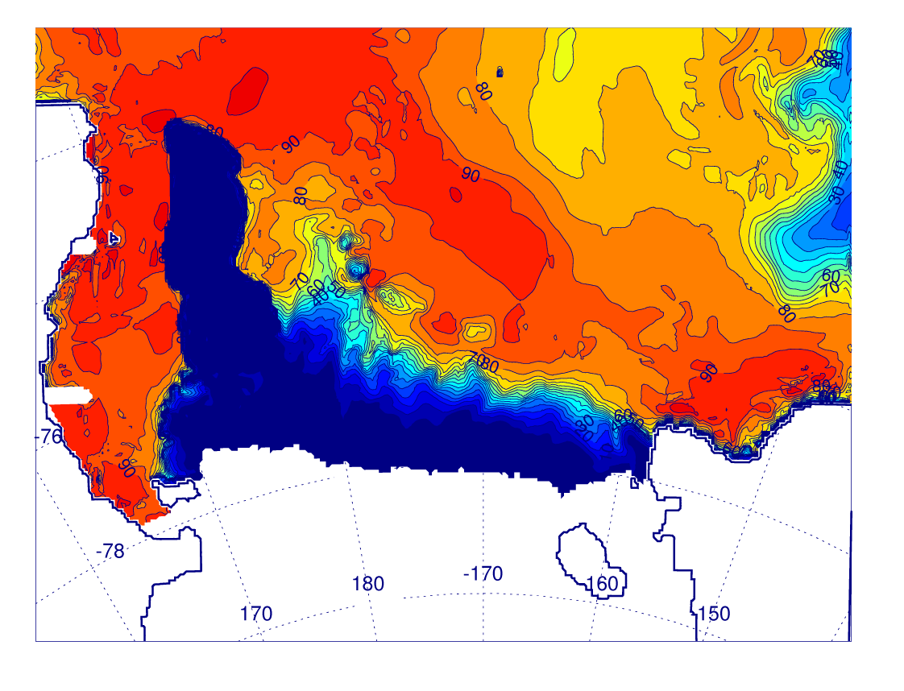
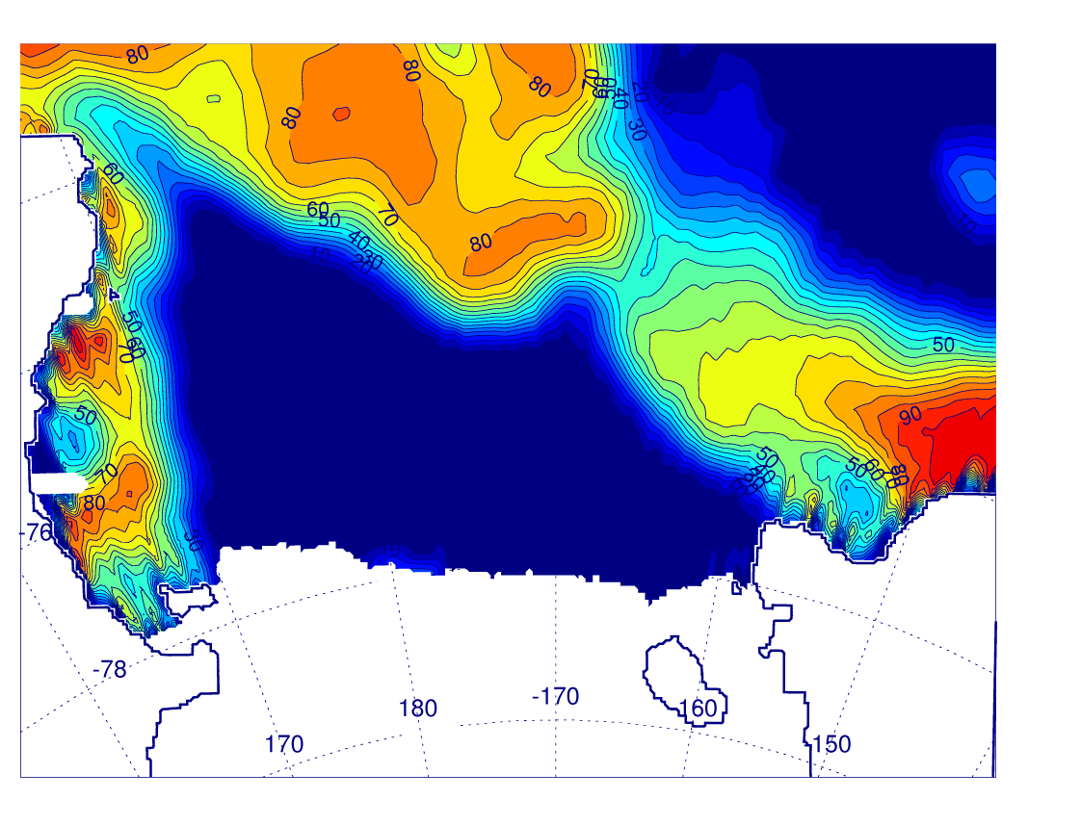
Model starting in Sep. 2010 (top left) vs. model starting in Sep. 2009 (top right) vs. SSMIS (bottom) sea-ice concentration for 12/25/2011
Notes:
Modeled ice edge is sharper, but some of that is from interpolating the 25-km ice to the model grid. Too much ice in NE, but RSP looks pretty good.

Slide 12
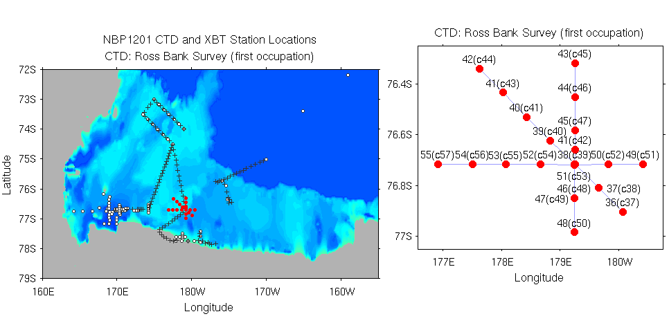
Ross Bank Survey
1st NW/SE Section: Jan 20/21, 2012
NS Section: Jan 21, 2012
EW Section: Jan 22, 2012
SeaHorse Deployment: Jan 20-26, 2012
2nd NW/SE Section: Jan 26, 2012

Slide 13
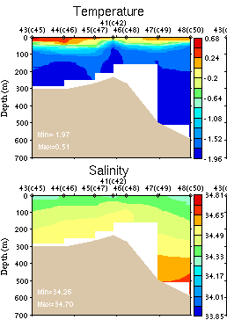
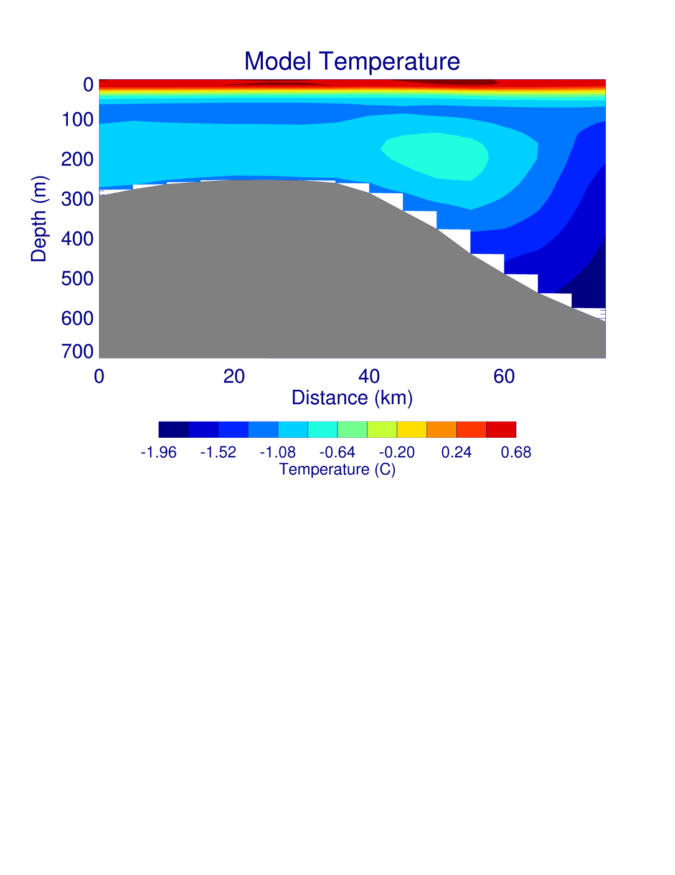
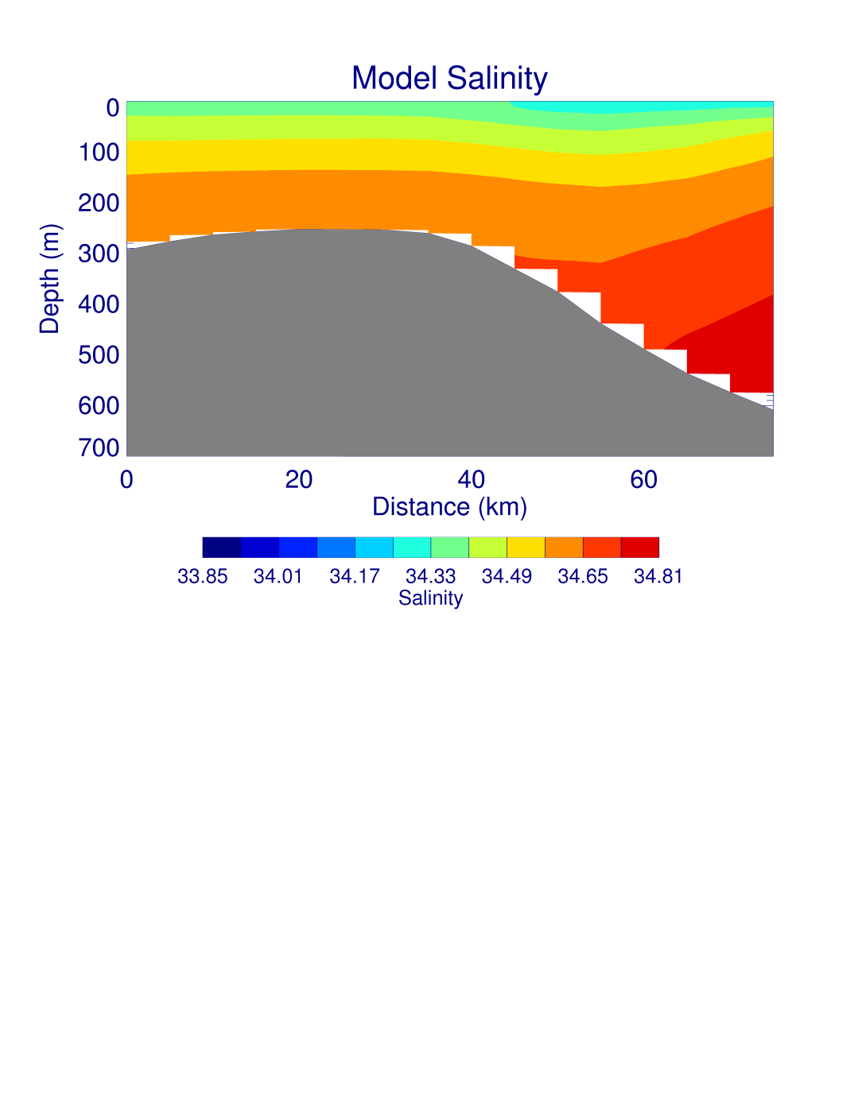
N/S Section
Notes:
North on left. One day averages and no tides. Model is a bit too warm and salty at depth in this area. The warm “bubble” at 200m around 50km is from a small tendril of MCDW that, in the model, has advected around to the south side of Ross Bank and isn’t there very long (a couple of days). Remember that the obs are snapshots (w/ strong tidal variability) and the model data are daily averages.

Slide 14
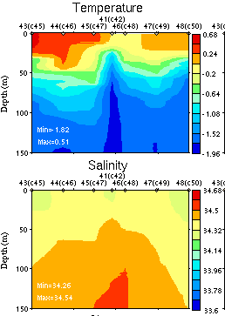
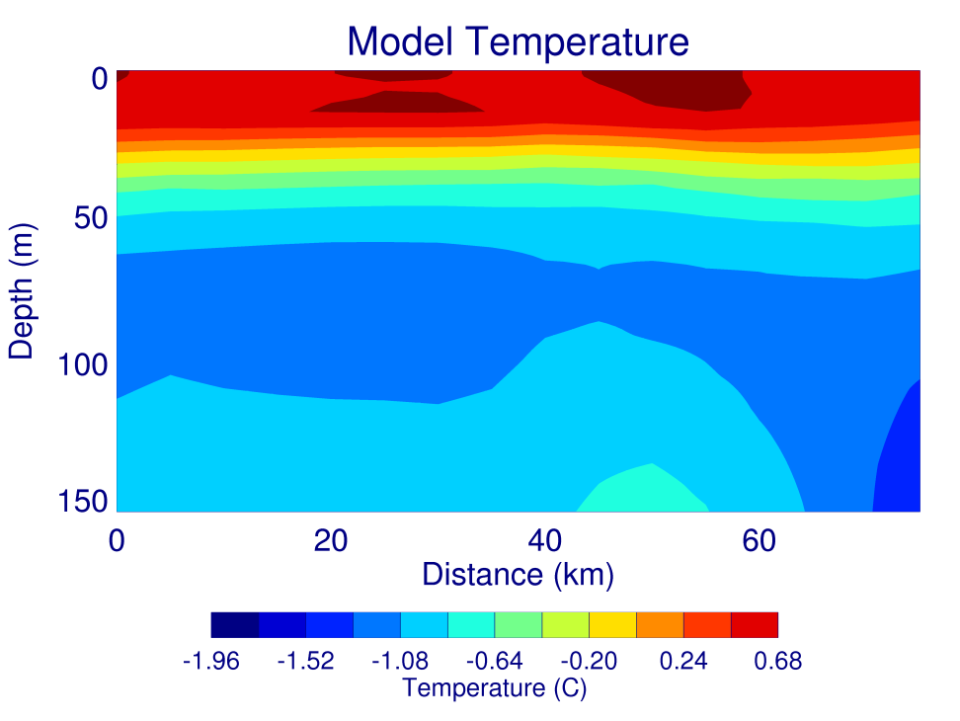
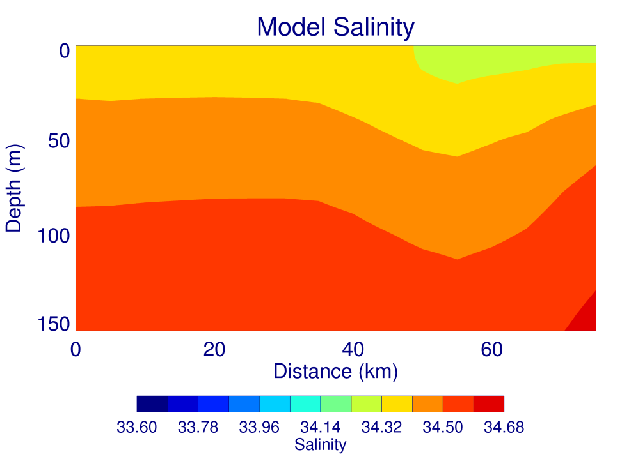
N/S Section
Notes:
North on left. The model seems to do a good job with at least the upper waters in the area (doesn’t really get doming, but does get fresher surface water in the south). Again, snapshots (in a strongly tidal region vs. daily average).

Slide 15
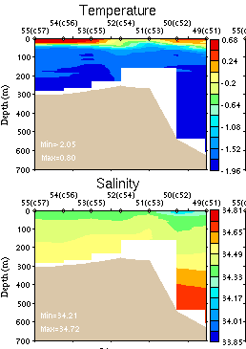
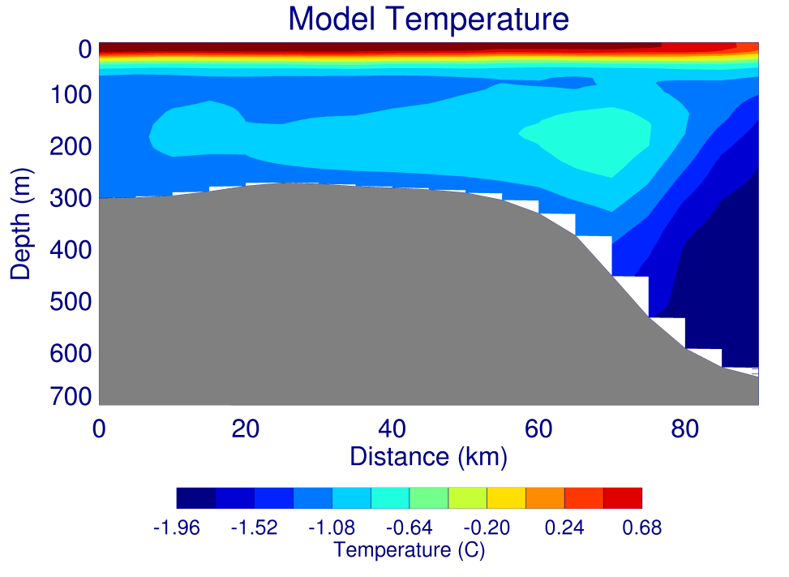
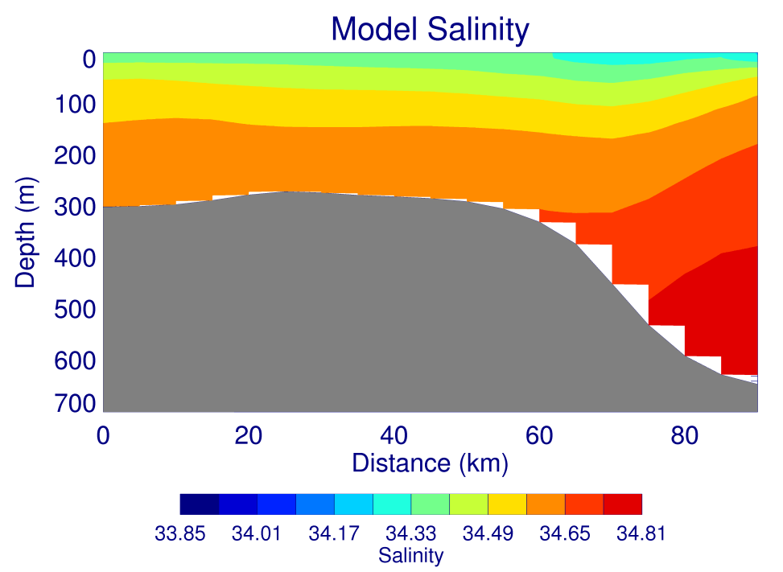
E/W Section
Notes:
West on the left (looking north). The E/W model section also shows that the model is too warm and salty at depth, but the general structure looks reasonable. The warm “bubble” in the model around 70km (east side) is from a tendril of MCDW advecting up the east side of Ross Bank. This is connected to the bubble on the south side as the flow is going CCW around the bank.

Slide 16
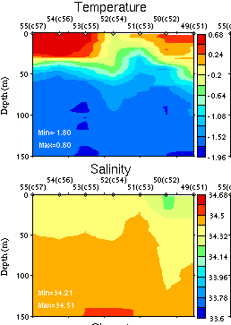
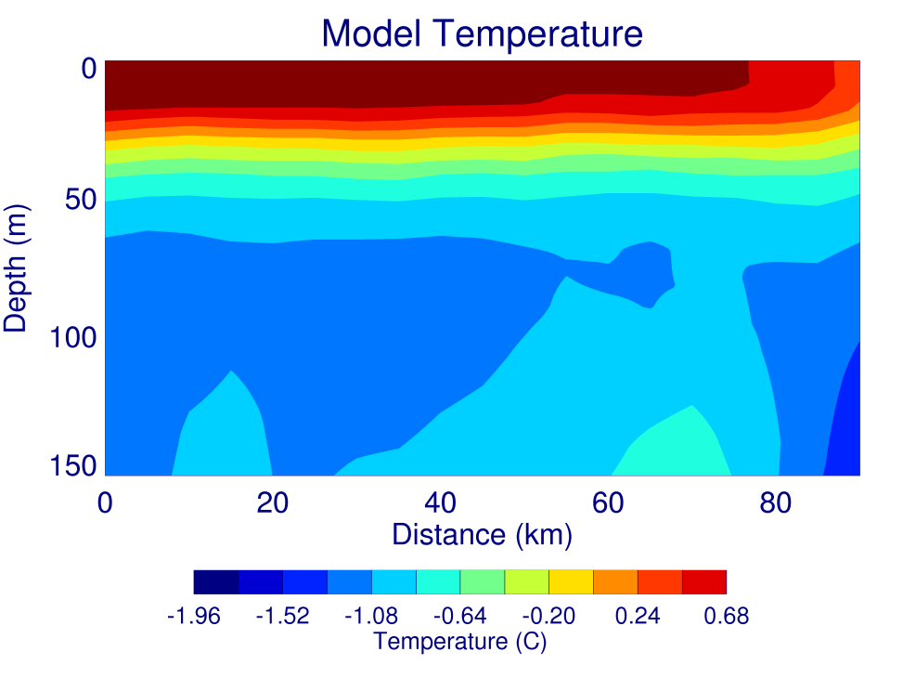
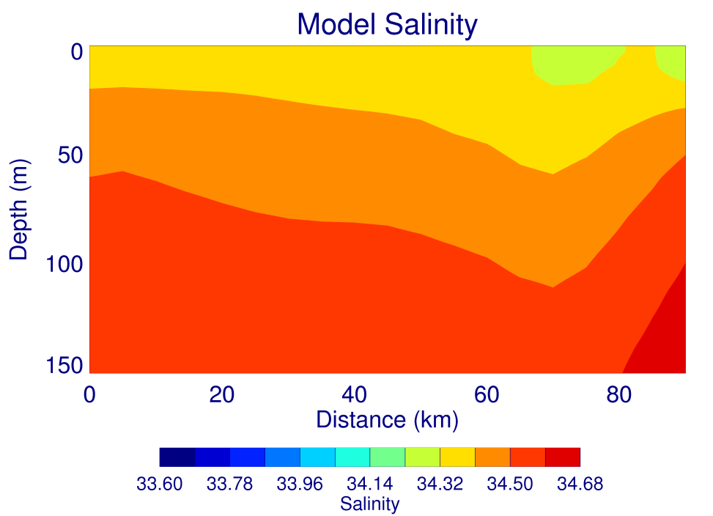
E/W Section
Notes:
West on the left (looking north). Again, the model does a better job in the upper waters (including the fresher surface waters in the east at ~70-85km which becomes important later).

Slide 17
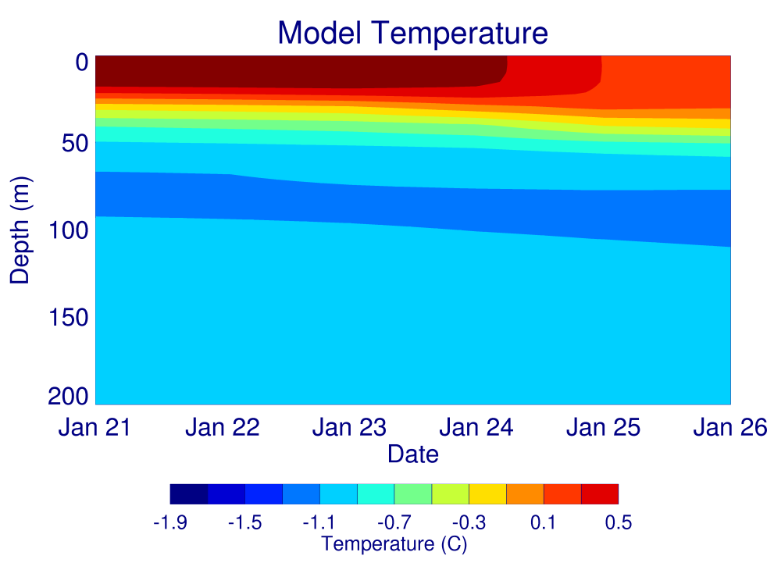
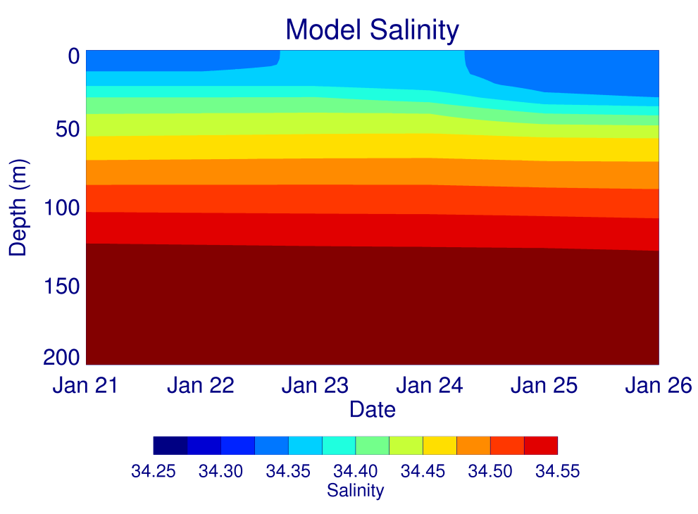
Time series over Ross Bank
Notes:
The model comparison with the SeaHorse mooring obviously (since the model has no tides and the results are 1 day averaged fields) isn’t going to show all the temporal variability that was observed. However, the model did show the observed overall trend of cooling, freshening and deepening of the mixed layer. 1-d response to increased winds would deepen and warm the mixed layer, but where did the freshening come from?

Slide 18
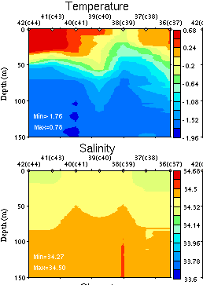
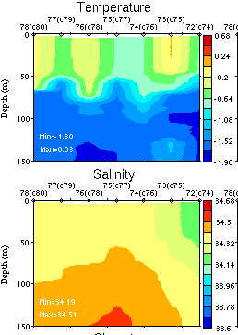
NW/SE Sections
Jan 20/21, 2012
Jan 26, 2012
Notes:
West on the left (looking north-east). In general, deepening and cooling of the mixed layer. Surface salinity increased in the west but decreased in the east.

Slide 19
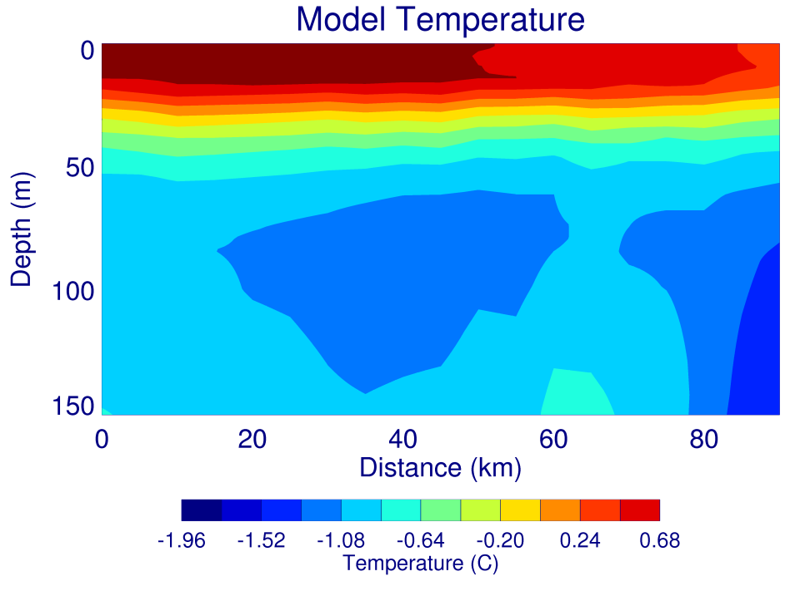
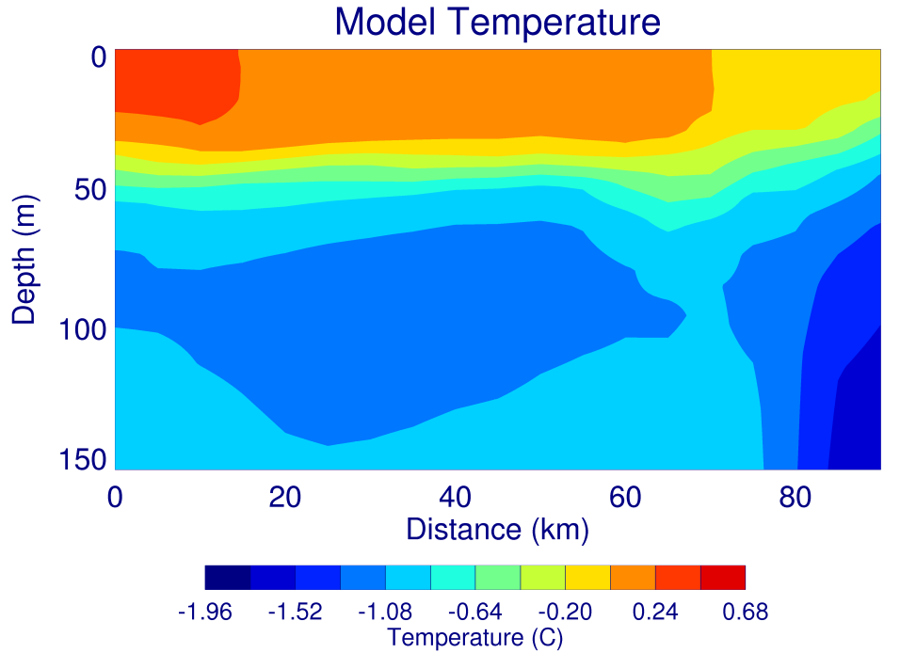
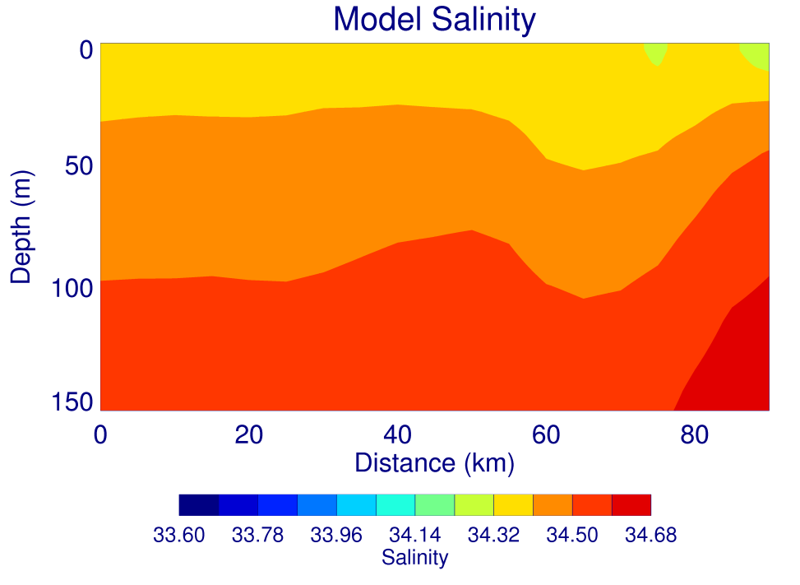

NW/SE Sections
Jan 20, 2012
Jan 26, 2012
Notes:
West on the left (looking north-east). The model also shows deepening and cooling of the mixed layer, although not to the extent of the observations. Missing mixing energy (tides?).

Slide 20
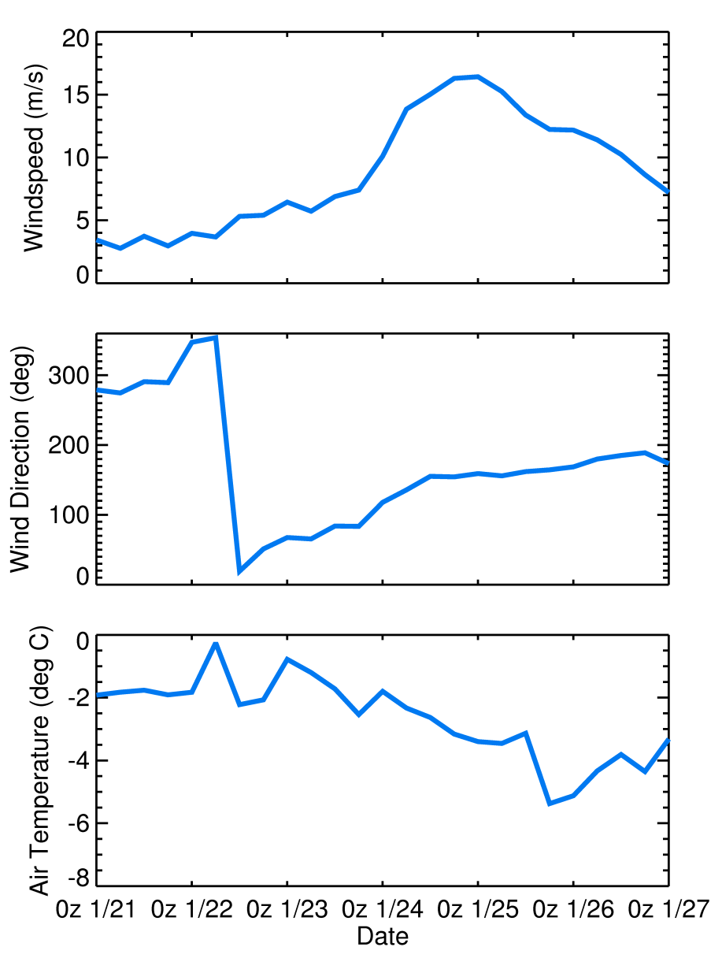
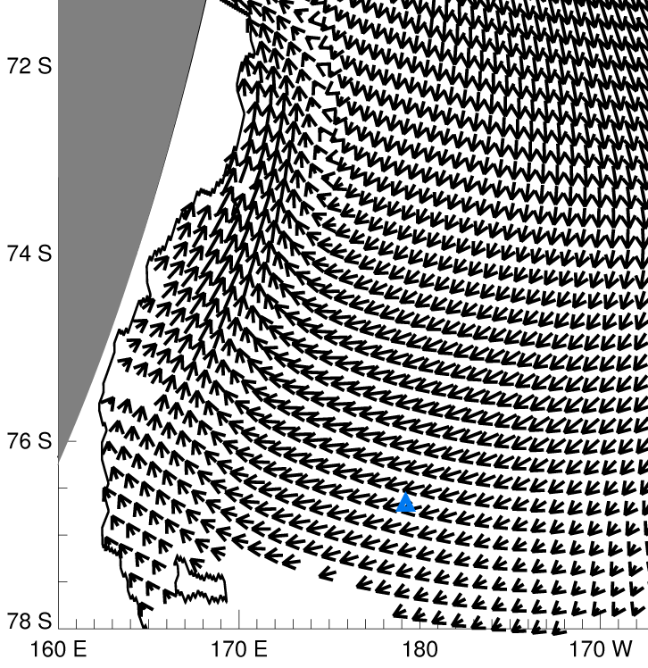
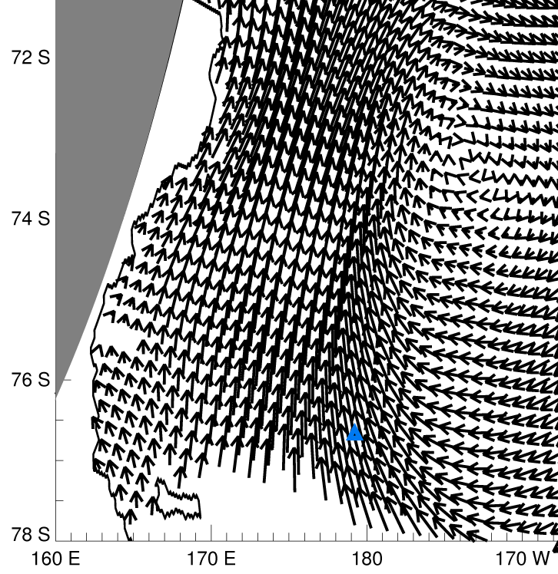
ERA-Interim wind:
1/23/2012 0Z
ERA-Interim wind:
1/25/2012 0Z
ERA-Interim weather at SeaHorse mooring

Slide 21
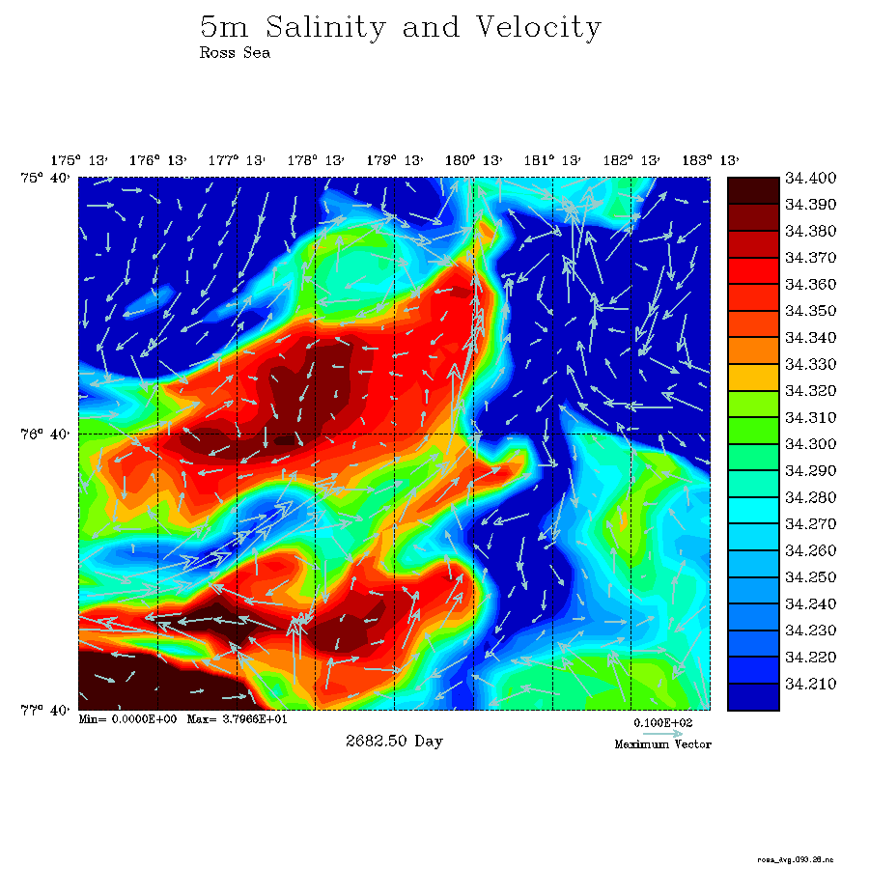

Slide 22
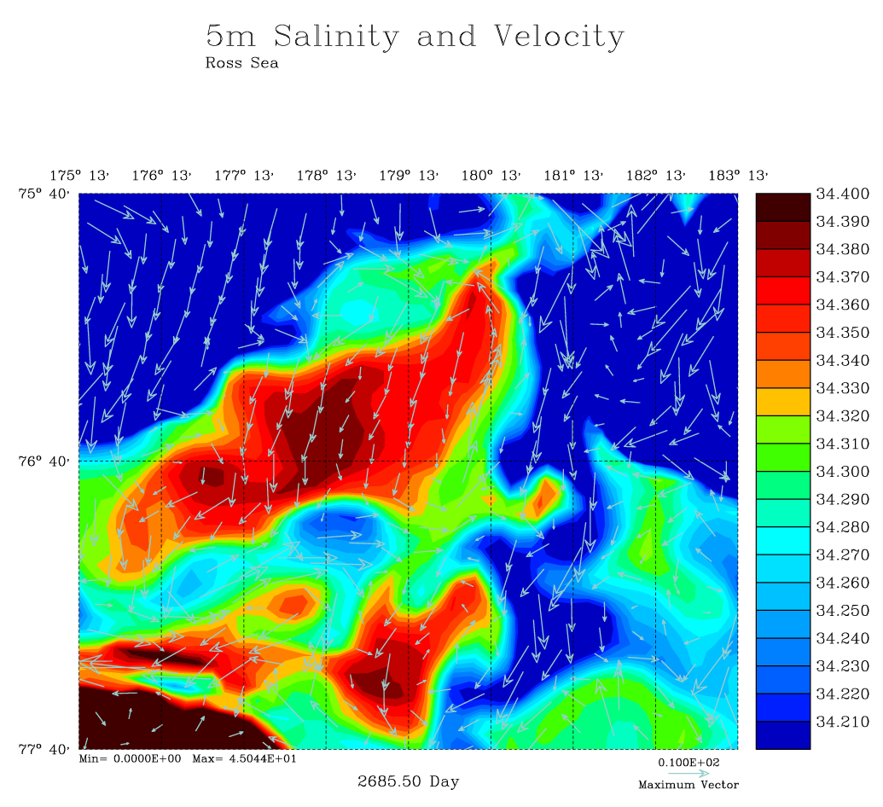
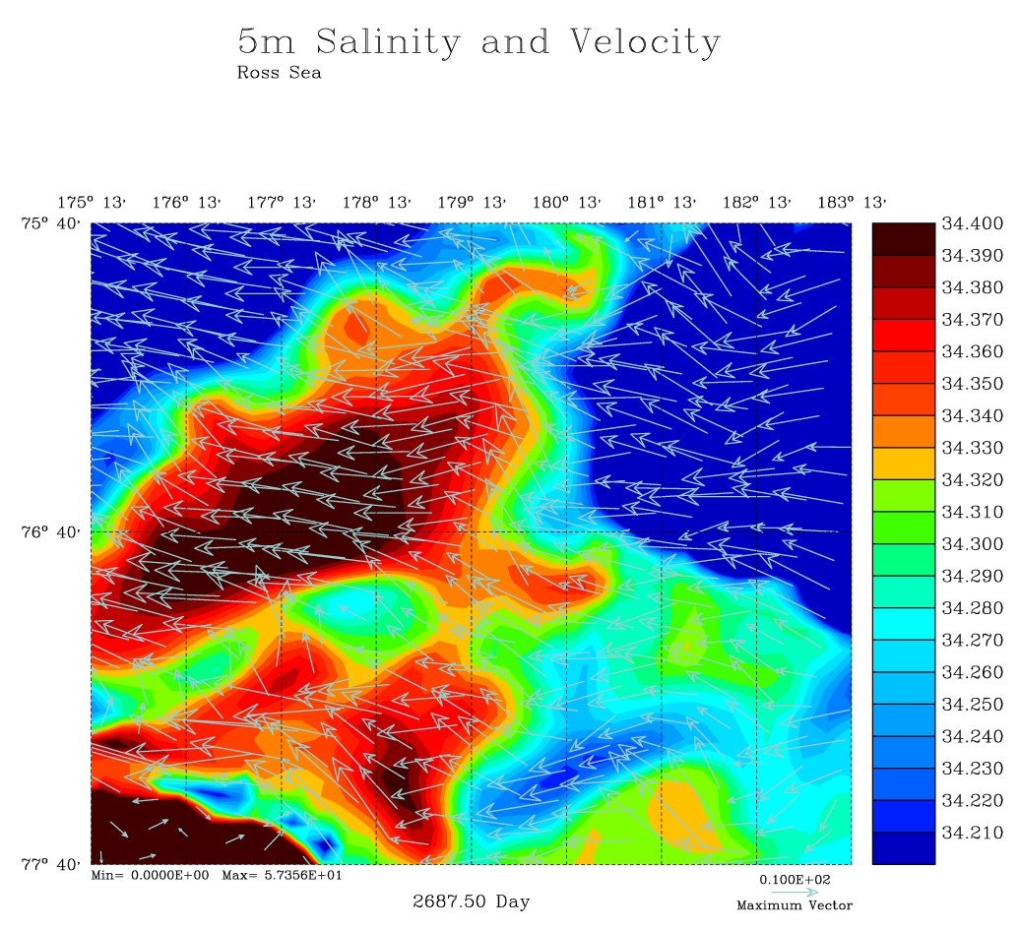
Model 5m Salinity and Velocity
Jan 23, 2012
Jan 25, 2012
Notes:
Surface salinity is, in general, greater by 1/25 (vertical mixing), but a gradient has been advected westward by the strong, wind induced, surface currents.

Slide 23
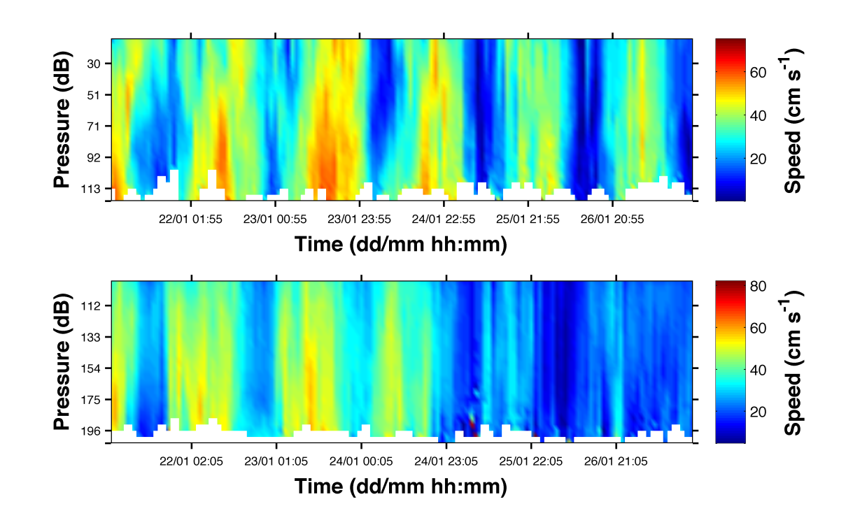
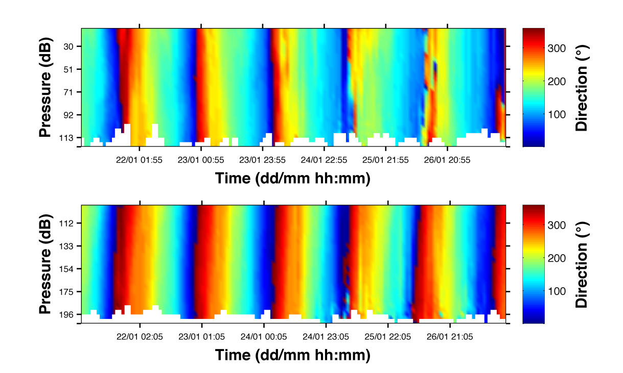
SeaHorse ADCP velocities (from Blair’s presentation at last meeting)
Don’t know if this supports idea of strong westward surface currents during the later part of the SeaHorse deployment, but something happened around 0Z 1/25/2012
(If direction is magnetic north and given magnetic declination is 120E here
Decrease in the amount of “red” velocities (~320° magnetic = ~80° true) would indicate more westward flow)

Slide 24
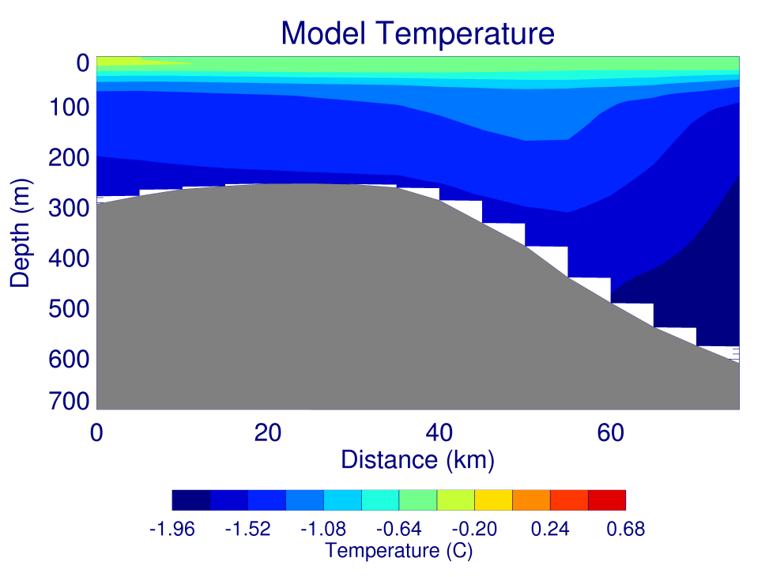
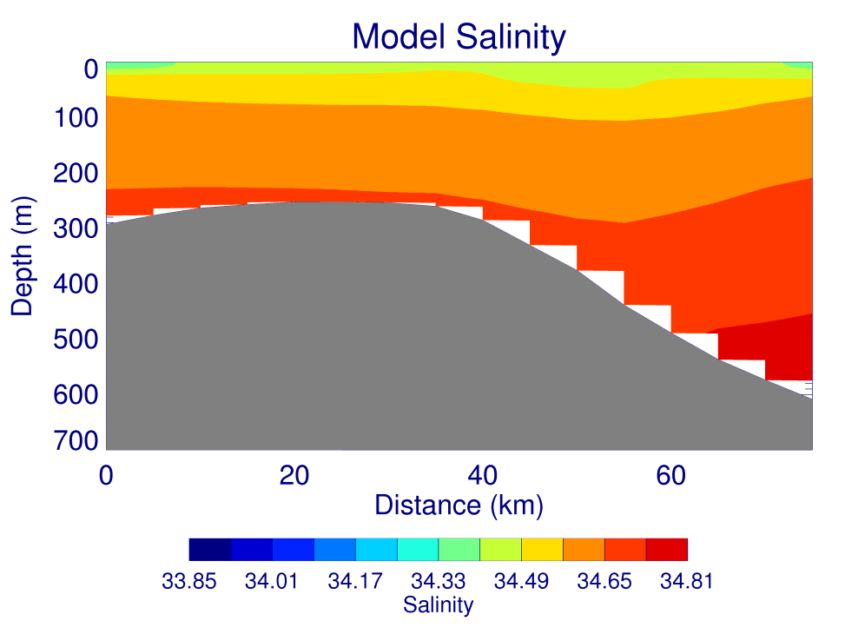
N/S Sections (different forcing, 2001 run includes tides)
Jan 21, 2012
Jan 21, 2001
Notes:
West on the left (looking north-east). Don’t yet have a run to do an apples to apples comparison. Deep salinity doesn’t change but deep temperature does => due to tides?

Slide 25
Future Plans
I’ll leave most of this to the following talks, except…
New run with bottom boundary formulation (bottom KPP) which should have better bottom vertical diffusivities for Pete and Geordie
Continue to explore Ross Bank area (runs with and w/o tides)
Other areas/time frames for comparisons?
Assimilation of ice concentration (Wang et al., 2013)

Slide 26
Summary
PRISM model run used to help show the origin of observed seasonal warm water underneath McMurdo Ice Shelf
Model sea-ice simulation results are very repeatable when starting simulation on different dates
The model simulation has some issues over Ross Bank (tides may help), but it simulates some observations well enough to be helpful in determining the dynamics over the bank
The observed cooling, freshening and deepening of the mixed layer over Ross Bank during the SeaHorse deployment appears to be driven by a wind event leading to a deepening of the mixed layer and an advection of a surface salinity gradient

Slide 28
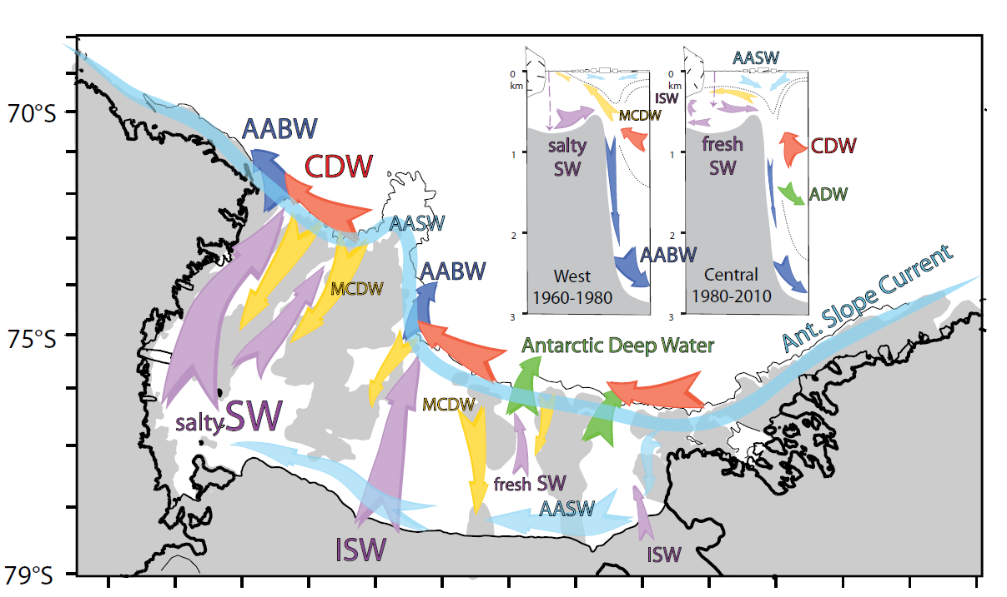
Smith et al., 2012

Slide 29
Dynamic Sea Ice Model
Budgell (2005) model (built into ROMS)
  Thermodynamics based on Mellor and Kantha (1989) with two ice layers, a snow layer, surface melt ponds and a molecular sub layer at the ice/ocean interface
  Dynamics based on an elastic-viscous-plastic rheology after Hunke and Dukowicz (1997) and Hunke (2001)

Slide 30
Ice Shelf Modeling
Ice Shelf does not change in time in model
Three equation viscous sub-layer model for heat and salt fluxes (Holland and Jenkins, 1999)
  Conservation of Heat
  Conservation of Salt
  Freezing point of sea water (function of pressure and salinity)
PGF calculation assumes the ice shelf has no flexural rigidity and pressure at the base comes from the floating ice
Notes:
No flexural rigidity assumption is fine except w/i a few km of the coast. Assumes viscous sub-layer is at freezing. Can have fancy physics in the transfer coeffs. Three eqns. can be solved simultaneously

Slide 31
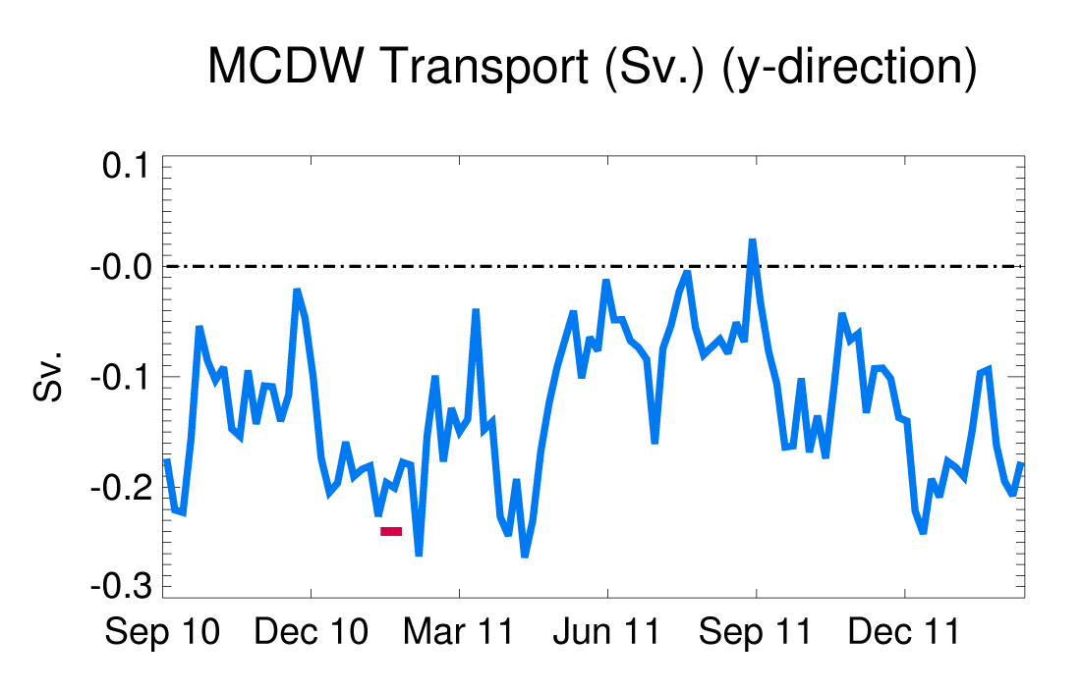
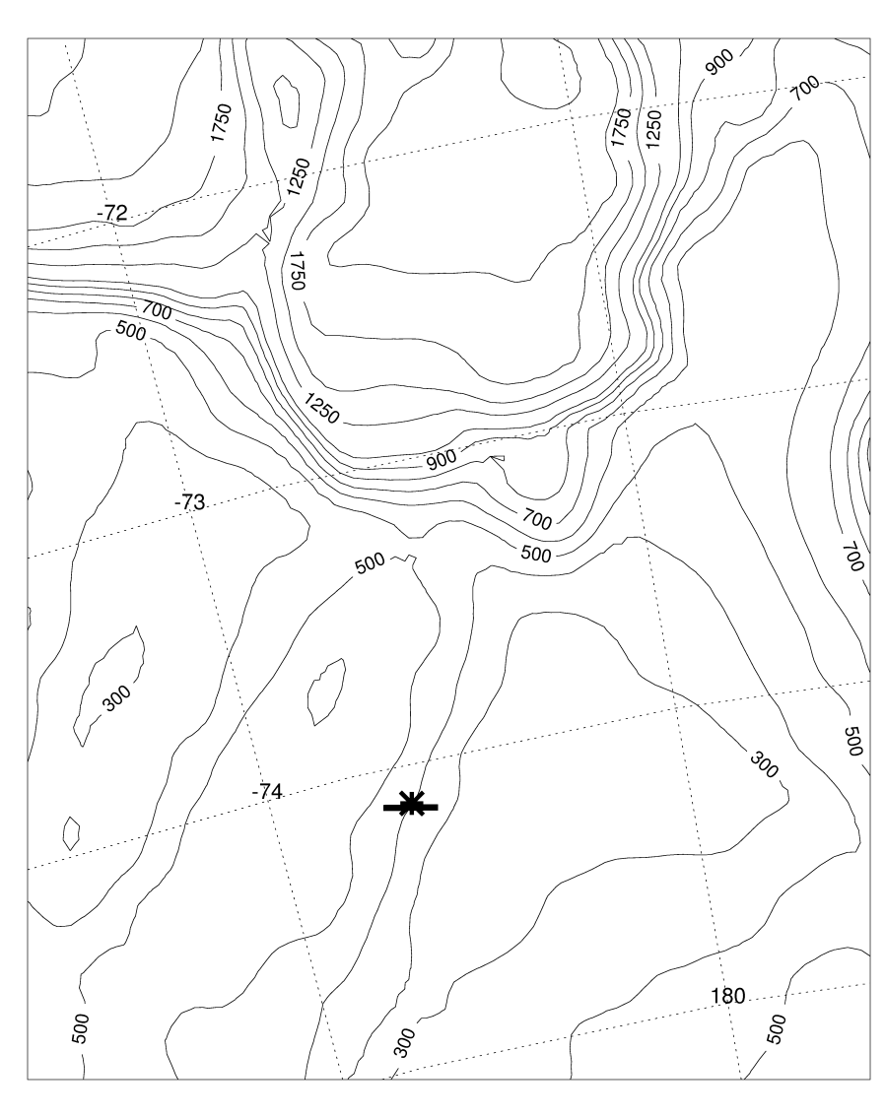
Model transport (Sv.) in the along-slope direction (5-day average fields) over 180–280 m depth across a 20 km section near where Bruce Huber’s mooring was
Southward cross section transport (Sv.):
0.13 ± 0.06 (model total)
0.16 ± 0.05 (model summer)
0.20 ± 0.01 (model during
time of mooring deployment)
0.24 (mooring, Kohut et al., 2013)

