Slide 1
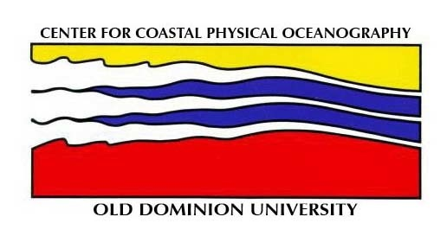
Krill and Silverfish Distributions in the Ross Sea
Linnea Brynn Davis
Center for Coastal Physical Oceanography
Old Dominion University

Slide 2
Presentation Outline
Introduction Methods Results Conclusion
Research Objective
Data Collection
Distribution maps
Euphausia superba
Euphausia crystallorophias
Pleuragramma antarcticum
Summary
Future Work

Slide 3
Research Objective
To develop a climatological distribution of 3 key species in the Ross Sea that serve as the principal control between primary production and the upper trophic levels in the food web.

Slide 4
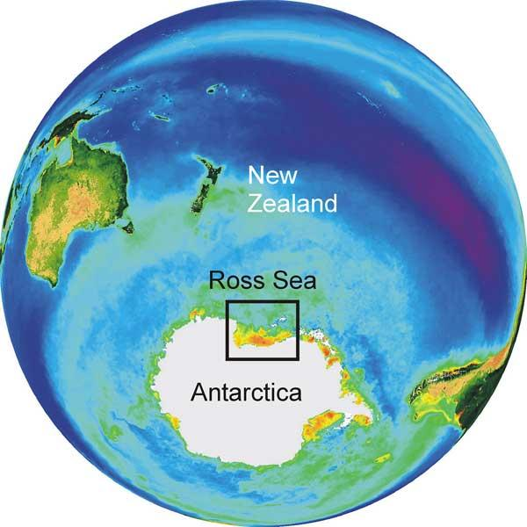
Introduction Methods Results Conclusions

Slide 5
Data Collection
Introduction Methods Results Conclusions
Cruise Timeline
Research Methods
Euphausia superba
1 cruise from 1989- 1990
2 cruises from 1994
1 cruise from 1997
2 cruises from 2000
Euphausia crystallorophias
1 cruise from 1988
1 cruise from 1994
1 cruise from 1997
2 cruises from 2000
Pleuragramma antarcticum
2 cruises from 1987- 1988
1 cruise from 1989- 1990
2 cruises from 1994- 1995
1 cruise from 1996
1 cruise from 1998
1 cruise from 2000
1 cruise from 2004
Data collection was done by trawling with standard plankton nets.
The sampling timeframe covered the late spring (November) through the end of summer (February).
Data were collected from the Northwestern half of the Ross Sea.

Slide 6
Data Methods
Introduction Methods Results Conclusions
Data were digitized
Converted to a common unit
Constructed maps of the distribution of
Euphausia superba
Euphausia crystallorophias
Pleuragramma antarcticum

Slide 7
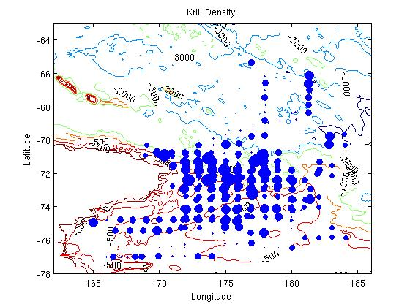
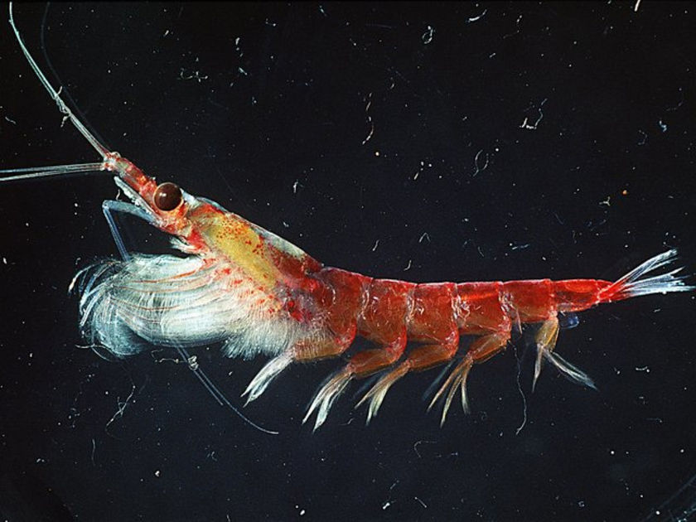
Euphausia superba Distribution
Introduction Methods Results Conclusion
What a cutie!!!

Slide 8
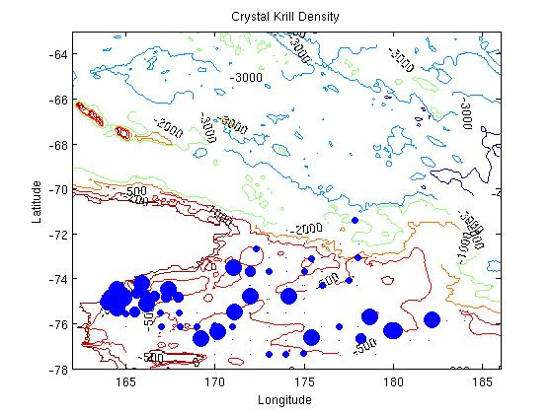
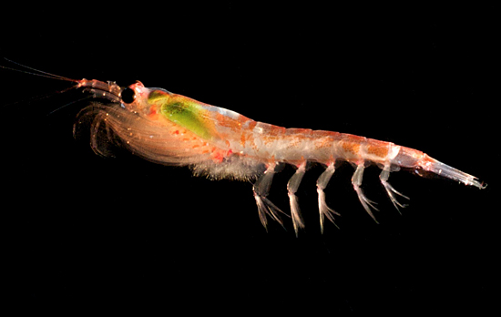
Euphausia crystallorophias Distribution
Introduction Methods Results Conclusions
Handsome Devil!

Slide 9
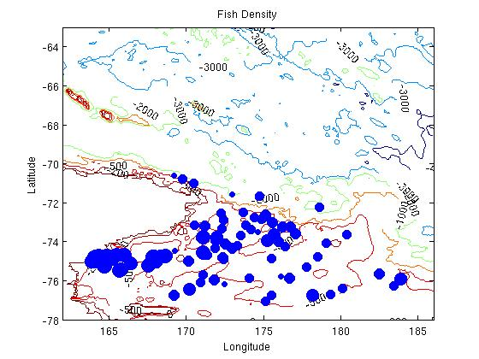
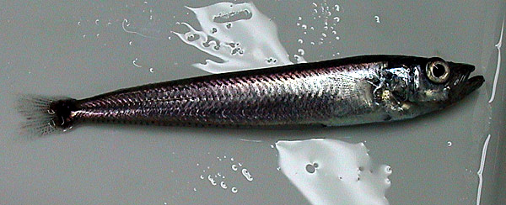
Pleuragramma antarcticum Distribution
Introduction Methods Results Conclusions
Adelie feast!

Slide 10
Summary!!
Introduction Methods Results Conclusions
Euphausia superba concentrate in deeper waters off the continental shelf at depths of 1,000 meters.
Euphausia superba tend to be associated with changes in bathymetry.
Euphausia crystallorophias are found in shallow waters on the continental shelf at depths of 200-500 meters.
Maxima in distribution differ from the Euphausia superba.
Pleuragramma antarcticum are found throughout the continental shelf and slope ranging from depths of 200 meters to as deep at 1,000 meters.
Maxima is located in the intershelf of the Ross Sea.

Slide 11
Future Work
Construct error analysis on data used in climatology
Use statistics to look at the characteristics of the distributions
Determine correlations between patterns and bathymetry, sea ice distribution and Circumpolar Deep Water distribution
Work with Andrea Piñones to understand the role of circulation in producing the patterns that are observed

