Slide 1
NPZD-iron lower trophic level ecosystem model of the Ross sea
Elodie Salmon

Slide 2
Physical-Biological modeling
Wroblewski/Powell type model (Fietcher et al., 2009)
1 phytoplankton/ 1 zooplankton/ 1 detritus
Diagram of equations
Parameters for the Ross sea
Generic model results
1 iron source: dFe relaxed to a given value
2 iron sources: CDW intrusion/ winter convective mixing
Perspectives:
Add 2 or 3 iron sources: sea-ice / glacial ice / aerosol
Wroblewski/Powell /Fasham type model
3 phytoplankton/ 2 zooplankton/ 2 detritus
Diagram of equations
Parameters for the Ross sea
Nitrogen fluxes
Perspectives:
Implement equations in the generic model
Add 3 to 4 iron sources

Slide 3
Wroblewski/Powell type model
Diagram of equations
Fietcher et al., 2009
NO3
Phytoplankton
Phyt-Fe
Diss-Fe
Detritus
zooplankton
Zoop-Fe2
Remineralization, δ
Growth, Vm, K_{N}
Remineralization of a fraction, frem
Growth + Fe uptake , Vm, K_{N}, C/N, a, b, t_{Fe}
Grazing, Rm, Λ, fsc, fc
Excretion, ν_{N}, Rm, Λ
Mortality, σ_{d}

Slide 4
Wroblewski/Powell type model
Parameters for the Ross sea
Initial conditions
Nitrate | $$N$$ | 17 | mmolN.m⁻³
Phytoplankton | $$P$$ | 0.01 | mmolN.m⁻³
Zooplankton | $$Z$$ | 0.01 | mmolN.m⁻³
Detritus | $$D$$ | 0.01 | mmolN.m⁻³
Dissolved iron | dFe | 0.00005 | μmolFe.m⁻³
Phytoplankton –associated iron | PFe | 0.00005 | μmolFe.m⁻³

Slide 5
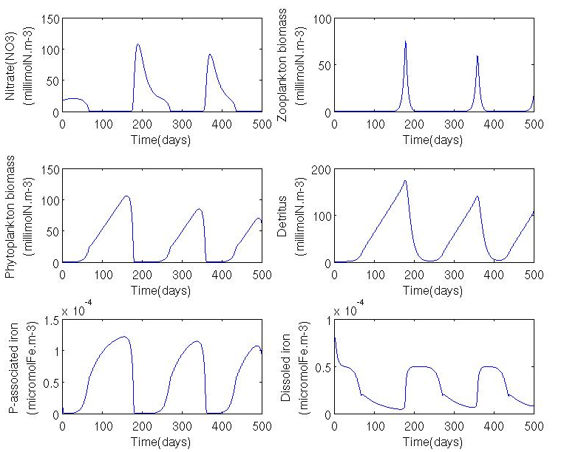
Wroblewski/Powell type model
Parameters for the Ross sea

Slide 6
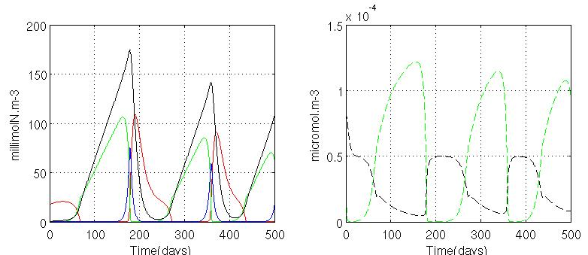
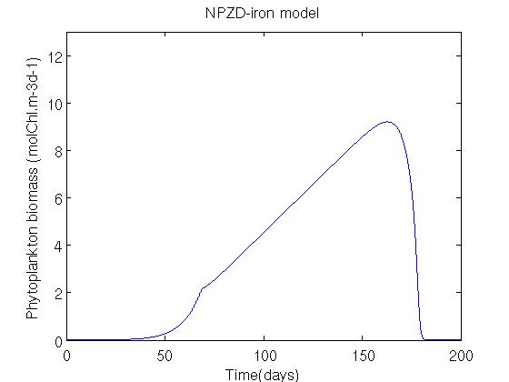
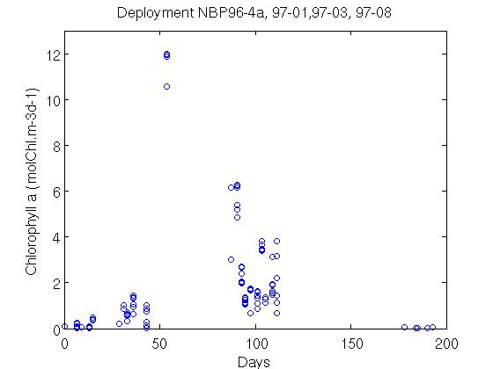
Wroblewski/Powell type model
Parameters for the Ross sea

Slide 7
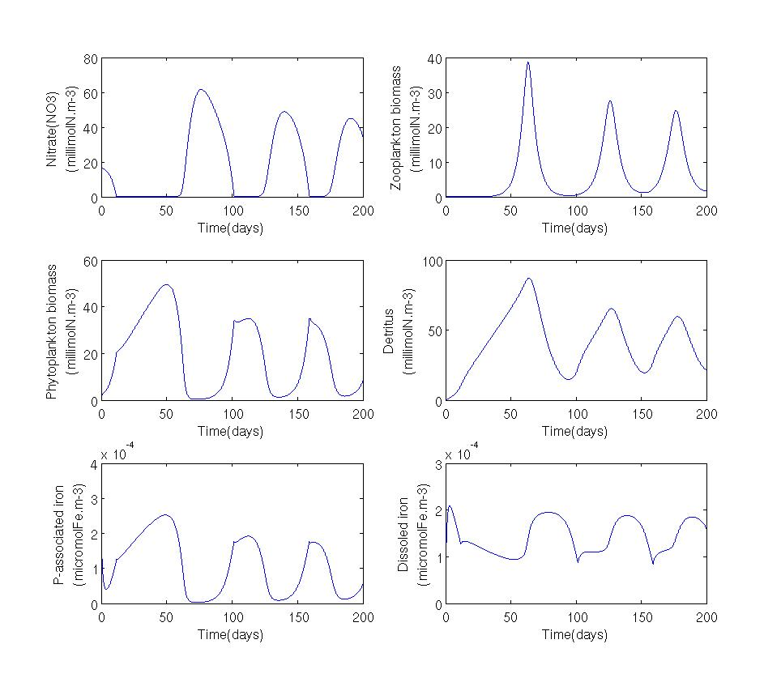
Wroblewski/Powell type model
Parameters for the Ross sea
First set of parameters
Second set of parameters

Slide 8
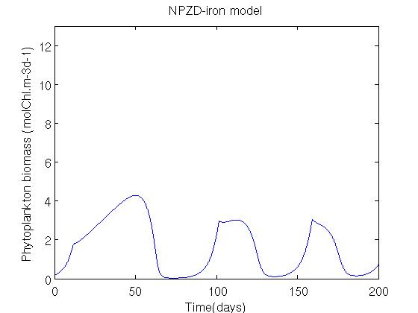
Wroblewski/Powell type model
Parameters for the Ross sea

Slide 9
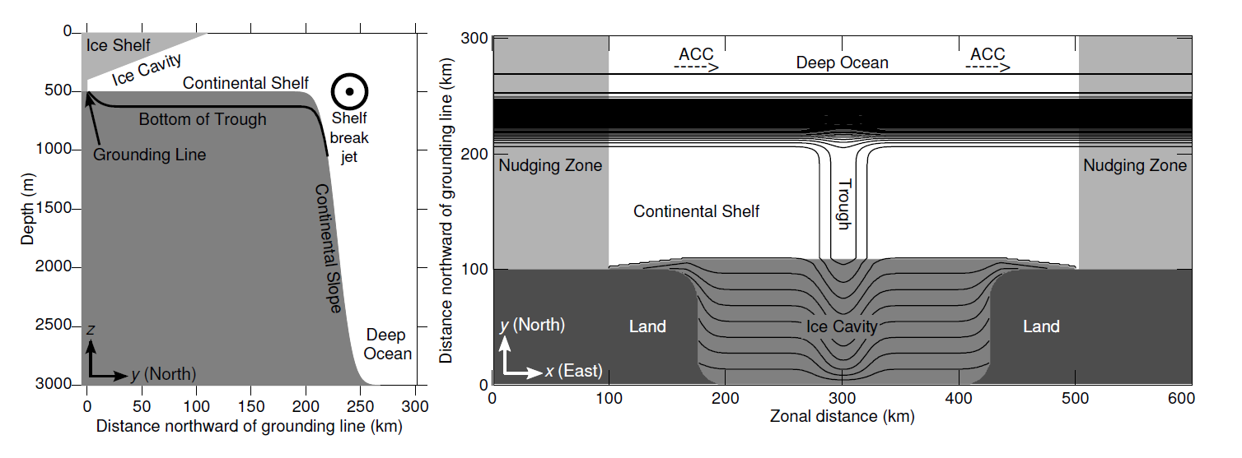
Wroblewski/Powell type model
Generic model : St Laurent et al. 2013, JPO
Bathymetry:
From May 1 to Nov 1 → 99% sea- ice covered
Constant South wind

Slide 10
Wroblewski/Powell type model
Generic model
First set of parameters
Initial conditions
Nitrate | $$N$$ | 20 | mmolN.m⁻³
Phytoplankton | $$P$$ | 2 | mmolN.m⁻³
Zooplankton | $$Z$$ | 2 | mmolN.m⁻³
Detritus | $$D$$ | 2 | mmolN.m⁻³
Dissolved iron | dFe | 0.1 | μmolFe.m⁻³
Phytoplankton –associated iron | PFe | 0.0004 | μmolFe.m⁻³

Slide 11
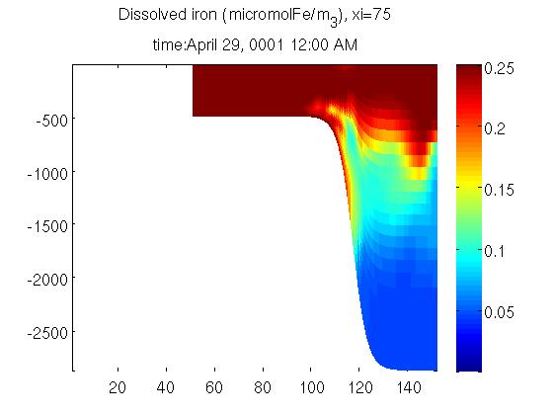
Wroblewski/Powell type model
Generic model
1 iron source: dFe relaxed to a given value
dFe relaxed to 0.25 μmol Fe.m⁻³ every 5 days (Fietcher et al., 2009)

Slide 12
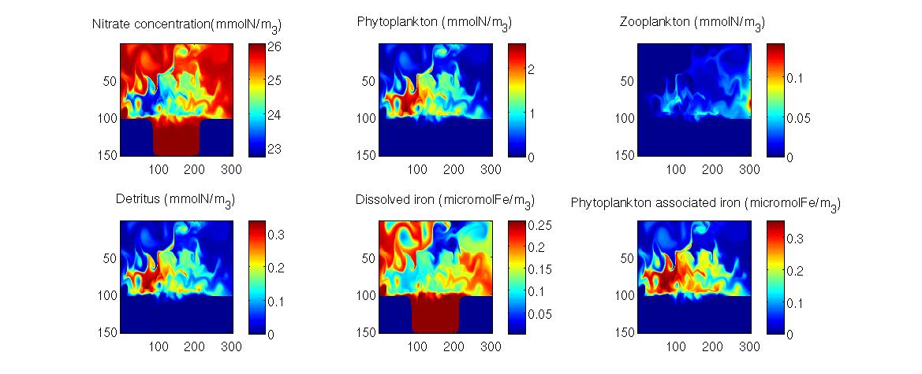
Wroblewski/Powell type model
Generic model
1 iron source: dFe relaxed to a given value
dFe relaxed to 0.25 μmol Fe.m⁻³ every 5 days

Slide 13
Wroblewski/Powell type model
Generic model
1 iron source: dFe relaxed to a given value

Slide 14
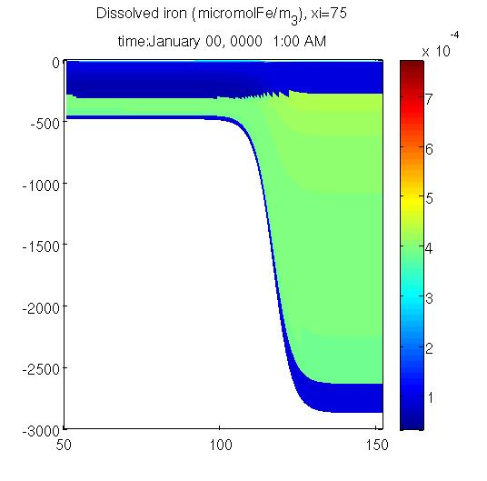
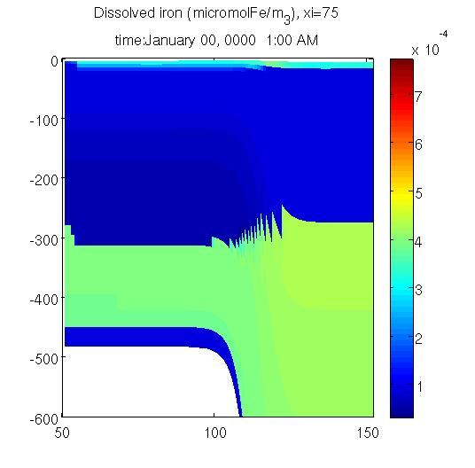
Wroblewski/Powell type model
Generic model: multiple iron sources
Two iron sources:
CDW intrusion/ winter (0.4nM)
convective mixing (0.1nM)
0.8nM
0.05nM
0.05nM
0.4nM
0.4nM
0.1nM
0.1nM

Slide 15
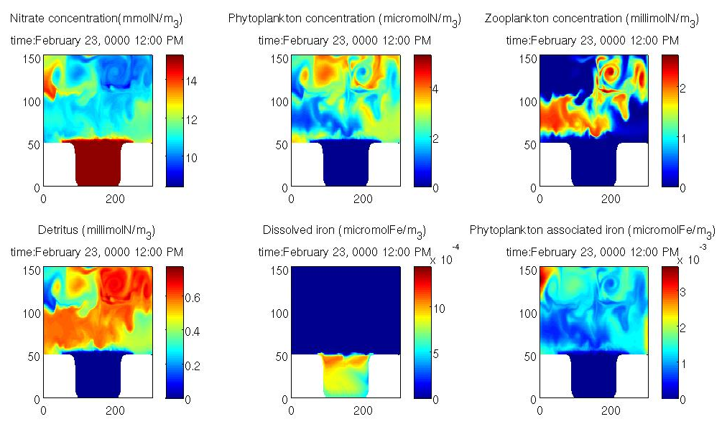
Wroblewski/Powell type model
Generic model: multiple iron sources

Slide 16
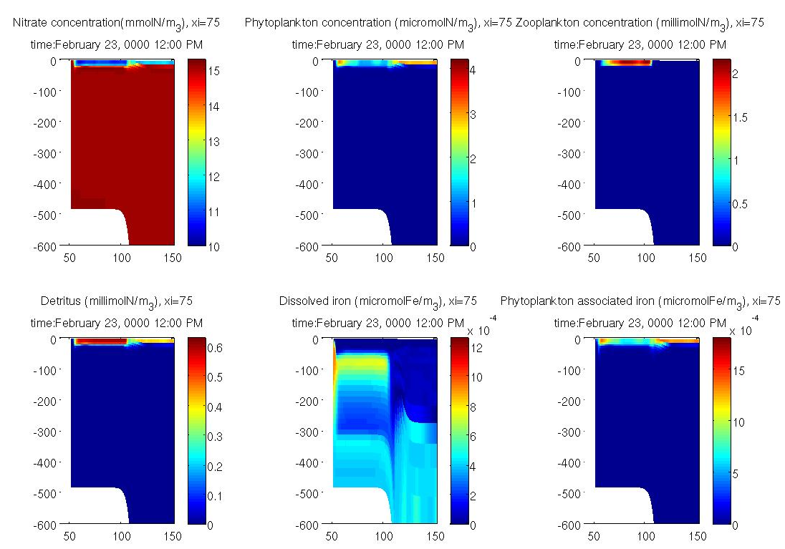
Wroblewski/Powell type model
Generic model: multiple iron sources

Slide 17
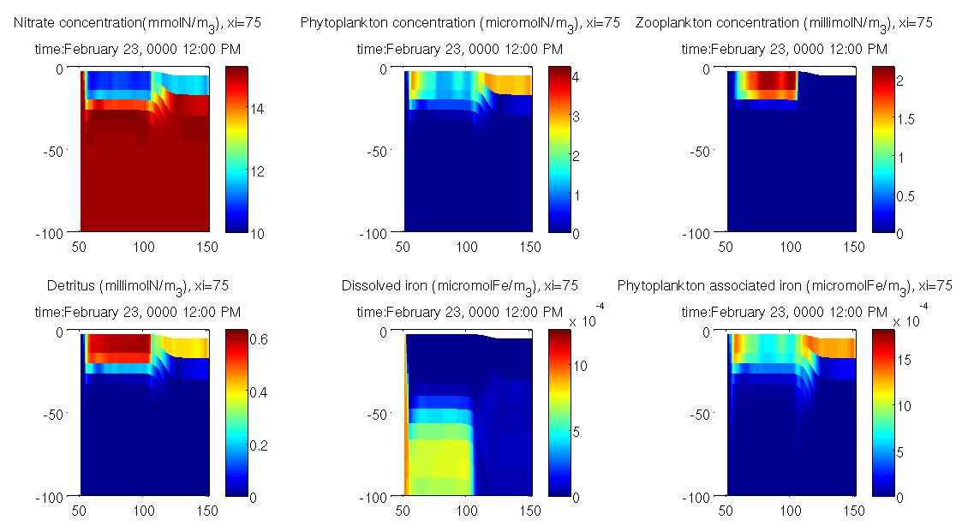
Wroblewski/Powell type model
Generic model: multiple iron sources

Slide 18
Wroblewski/Powell type model
Generic model: multiple iron sources

Slide 19
Fasham type model
Diagram of equations
Phyt1:
Phaeocystis solitary cells
Phyt-Fe1
NO3
Phyt2:
Phaeocystis colony cells
Det1:
Suspended particles
Phyt-Fe2
Diss-Fe
Phyt3:
Diatoms
Phyt-Fe3
Det2:
Fast sinking particles
Si
microzoop1
microZ-Fe1
mesozoop2
mesoZ-Fe2
Remineralization, δ
Growth, Vm, K_{N}
Remineralization of a fraction, frem
Growth + Fe uptake , Vm, K_{N}, C/N, a, b, t_{Fe}
Grazing, Rm, Λ, fsc, fc
Excretion, ν_{N}, Rm, Λ
Mortality, σ_{d}
Grazing on Bacteria

Slide 20
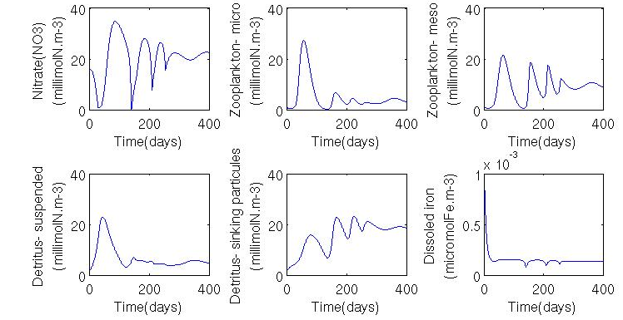
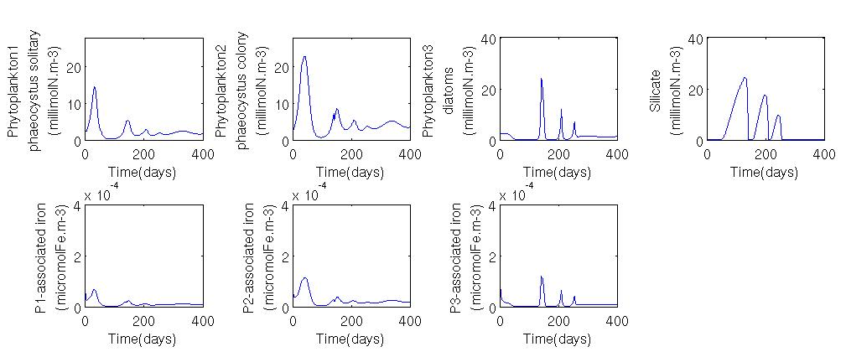
Fasham type model
Parameters for the Ross sea

Slide 21
Fasham type model
Nitrogen Fluxes
Unit nM nitrogen per year
Phyt1:
Phaeocystis solitary cells
10.3
-0.5
Phyt-Fe1
NO3
1.2
5.5
-0.2
4.6
Phyt2:
Phaeocystis colony cells
0.01
Det1:
Suspended particles
7.7
Phyt-Fe2
Diss-Fe
-0.0002
Phyt3:
Diatoms
Phyt-Fe3
-0.00007
Det2:
Fast sinking particles
1.8
Si
microzoop1
microZ-Fe1
22.2
-222.0
8.5
mesozoop2
mesoZ-Fe2
-222.0

Slide 22
Questions and discussions
Suggestion to improve parameterization?
Methodology for the validation of the model?
Scientific questions to explore:
Add ammonium ?
Iron sources?
Carbon export to deeper water layers? to sediments?
Specific species of zooplankton?

Slide 23
Fasham type model
Nitrogen Fluxes
Unit millimol nitrogen per day
Phyt1:
Phaeocystis solitary cells
284.2x10⁻¹⁰
-15.5x10⁻¹⁰
Phyt-Fe1
NO3
31.6x10⁻¹⁰
150.8x10⁻¹⁰
-6.4x10⁻¹⁰
126.4x10⁻¹⁰
Phyt2:
Phaeocystis colony cells
0.3x10⁻¹⁰
Det1:
Suspended particles
212.5x10⁻¹⁰
Phyt-Fe2
Diss-Fe
-0.006x10⁻¹⁰
Phyt3:
Diatoms
Phyt-Fe3
-0.002x10⁻¹⁰
Det2:
Fast sinking particles
51.6x10⁻¹⁰
Si
microzoop1
microZ-Fe1
607.2x10⁻¹⁰
-6081.9x10⁻¹⁰
233.2x10⁻¹⁰
mesozoop2
mesoZ-Fe2
-6081.9x10⁻¹⁰

