Slide 1
Phytoplankton Biomass and Productivity Component
W. Smith
L. Delizo
Mosby
And associated riff-raff
Dennis

Slide 2
Variables Measured
Chlorophyll a – measure of phytoplankton biomass
Particulate organic carbon/nitrogen – measure of organic material in water
Biogenic silica – measure of diatom biomass
Photosynthesis/irradiance responses – measure of photosynthetic capacity
Phytoplankton taxonomy – what is there to eat
Zooplankton biomass/taxonomy – what is there eating
PAR – driving photosynthesis
Phytoplankton pigments – proportion of chlorophyll in each functional group
Chl a – complete; POM – complete; BSi – complete;
PAR – complete; P/E – complete; Taxonomy – in progress; Zooplankton – in progress; Pigments – initiated

Slide 3
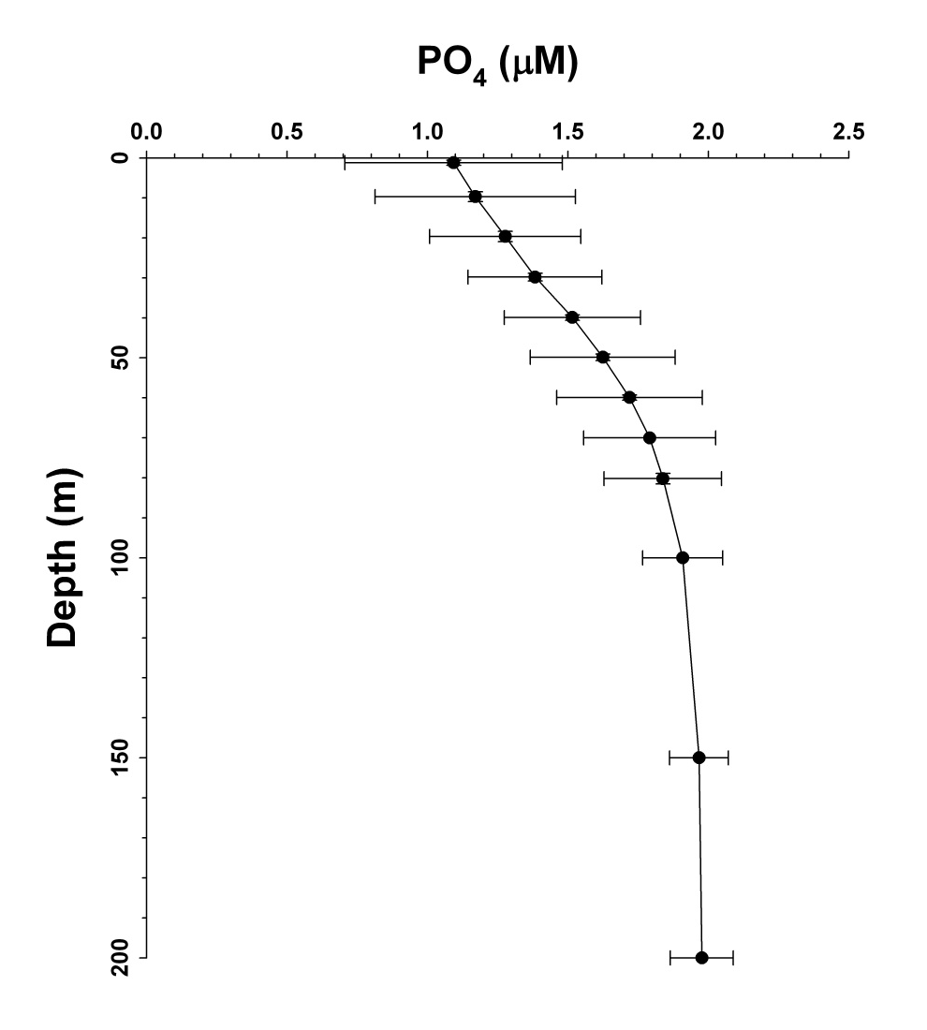
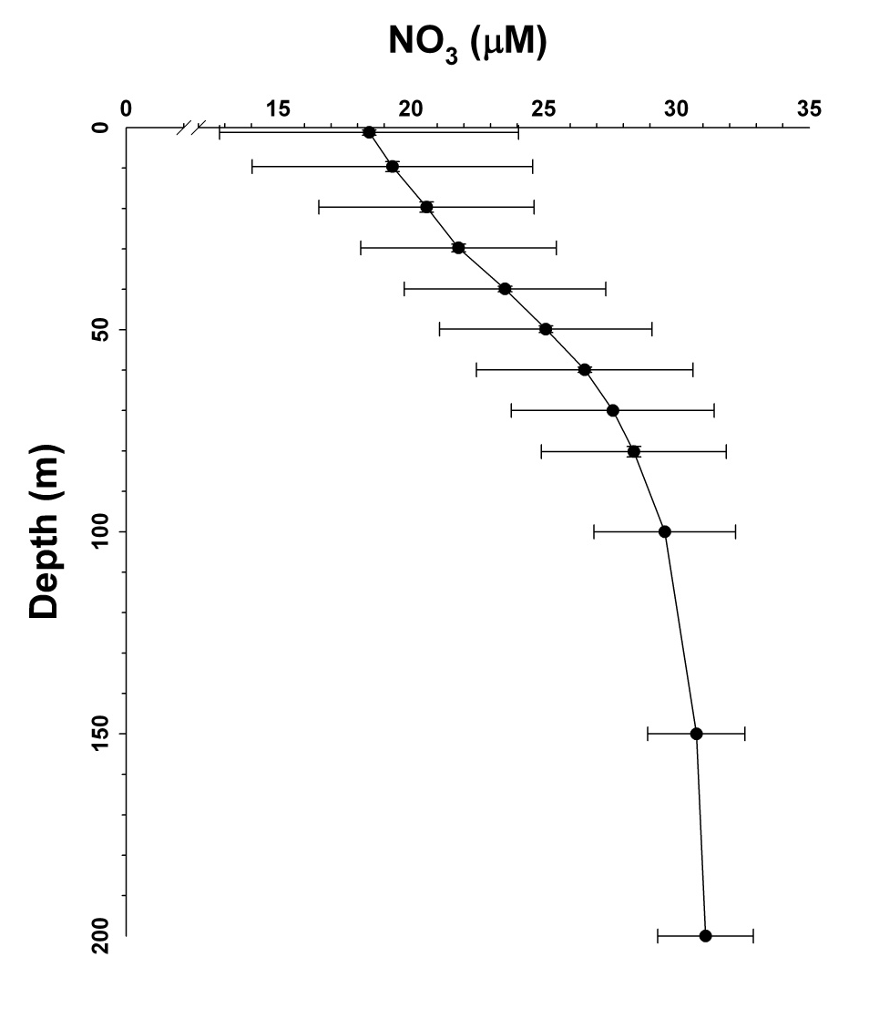
Mean Inorganic Nutrient Distributions

Slide 4
Si(OH)₄ concentrations were mildly depleted at the surface by ca. 20 μM, but BSi concentrations were only ca. 11 μM at the surface. In a simple 1D system (since there is no other Si phase), the difference between the total Si and the sum at depth (200 m) reflects the potential export.
Hence on the mean, we had ca. 9 μM Si lost from the surface.
Obvious caveats: these are means and it would be better to look at means from diatom-dominated stations and transects. Reducing the number of stations potentially introduces additional error.

Slide 5
Nutrient Budget Calculations: Nitrogen
where z the depth of integration,
(NO₃)_{winter} the winter nitrate concentration, and
(NO₃)_{min} the nitrate minimum observed

Slide 6
Nutrient Budget Calculations: Si
Winter maxima derived from the mean maxima shelf values observed during PRISM
[NO₃]_{winter} = 31 µM and [Si(OH)₄]_{winter} = 80 µM

Slide 7
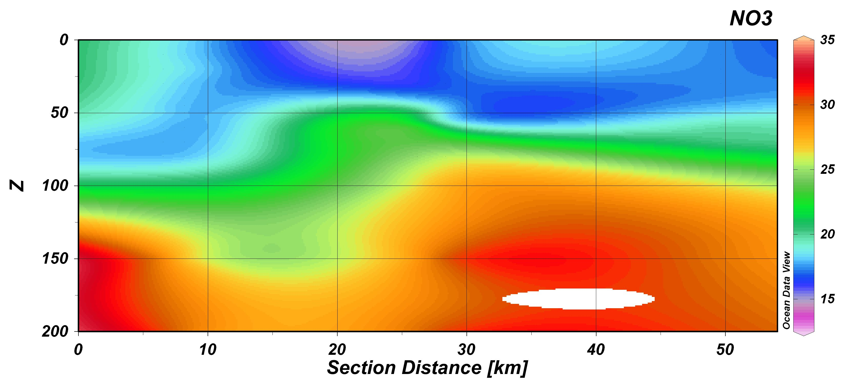
“Typical” Transect
Illustrates variability in deep-water values

Slide 8
Caveats
Deep-water concentrations are spatially constant; winter particulate concentrations tiny
Nitrite, DON and ammonium insignificant pools in N; can include NH₄, but it appears to be incorporated and recycled much faster
Physical (vertical) flux of both PN and nutrients insignificant
Nitrification rates small
Conversion into C units constant in time
Winter
Nutrients
Difference represents nitrogen or silicon productivity on seasonal basis
Summer
Nutrients
Summer PM

Slide 9
Nitrogen Estimates
 | ΔNO₃ (mmol m⁻²) | NO₃ Uptake (mmol m⁻² d⁻¹)
Mean | 0.745 | 8.87
N | 110 | 110
St. Dev. | 0.284 | 3.24
Min | 0.167 | 1.80
Max | 1.76 | 21.0
Daily N | 8.87
C equivalents | 58.8 | mmol C m⁻² d⁻¹
Daily C | 706 | mg C m⁻² d⁻¹
Need to follow up by using the observed C/N ratios for conversion

Slide 10
Silicon Estimates
 | ΔSi (mmol m⁻²) | Si UPtake (mmol m⁻² d⁻¹)
Mean | 1.18 | 14.0
N | 110 | 110
St. Dev. | 0.708 | 7.85
Min | 0.364 | 4.23
Max | 6.07 | 71.4
Daily Si | 14.0
C equivalents | 0.27 | mmol C m⁻² d⁻¹
Daily C | 270 | mg C m⁻² d⁻¹
Si/N** | 1.57 | Dogma of non-Fe limited diatoms: 1:1 ratio
Diatom Contribution (%) | 38.3 | See Mosby comments
** biased due to non-siliceous uptake
Used Si/C conversion value of 0.62 (Nelson & Smith, 1986)

Slide 11
Surface 5.84 0.35 22.4
10 m 5.48 0.22 24.6
20 m 4.42 0.29 16.6
30 m 3.83 0.32 14.1
40 m 3.07 0.34 10.4
50 m 2.83 0.27 10.8
60 m 2.27 0.25 9.42
70 m 1.91 0.20 10.2
80 m 1.44 0.22 10.9
100 m 1.20 0.11 7.38

Slide 12
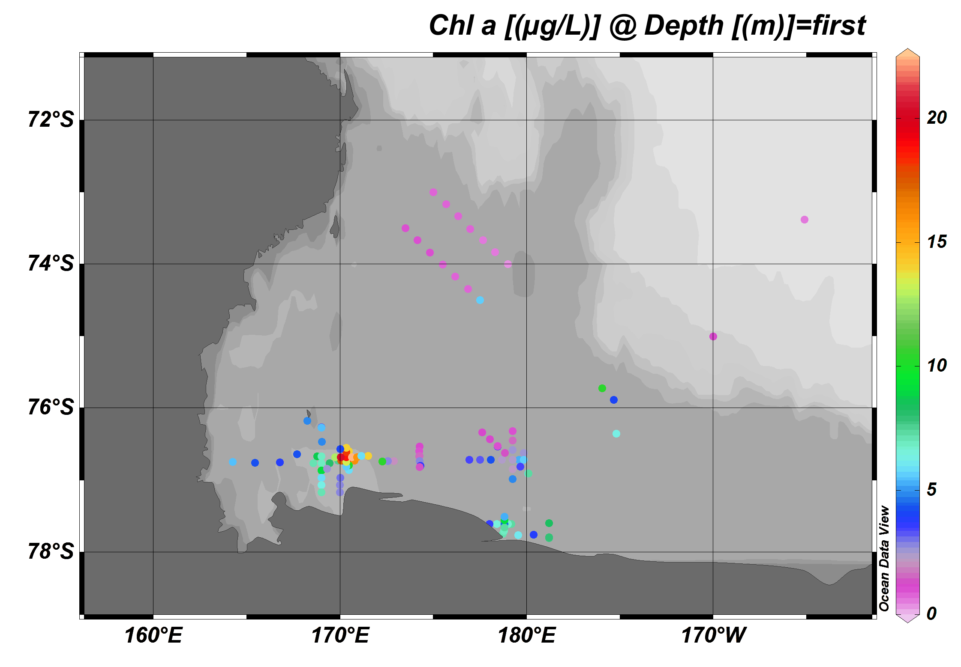

Slide 13
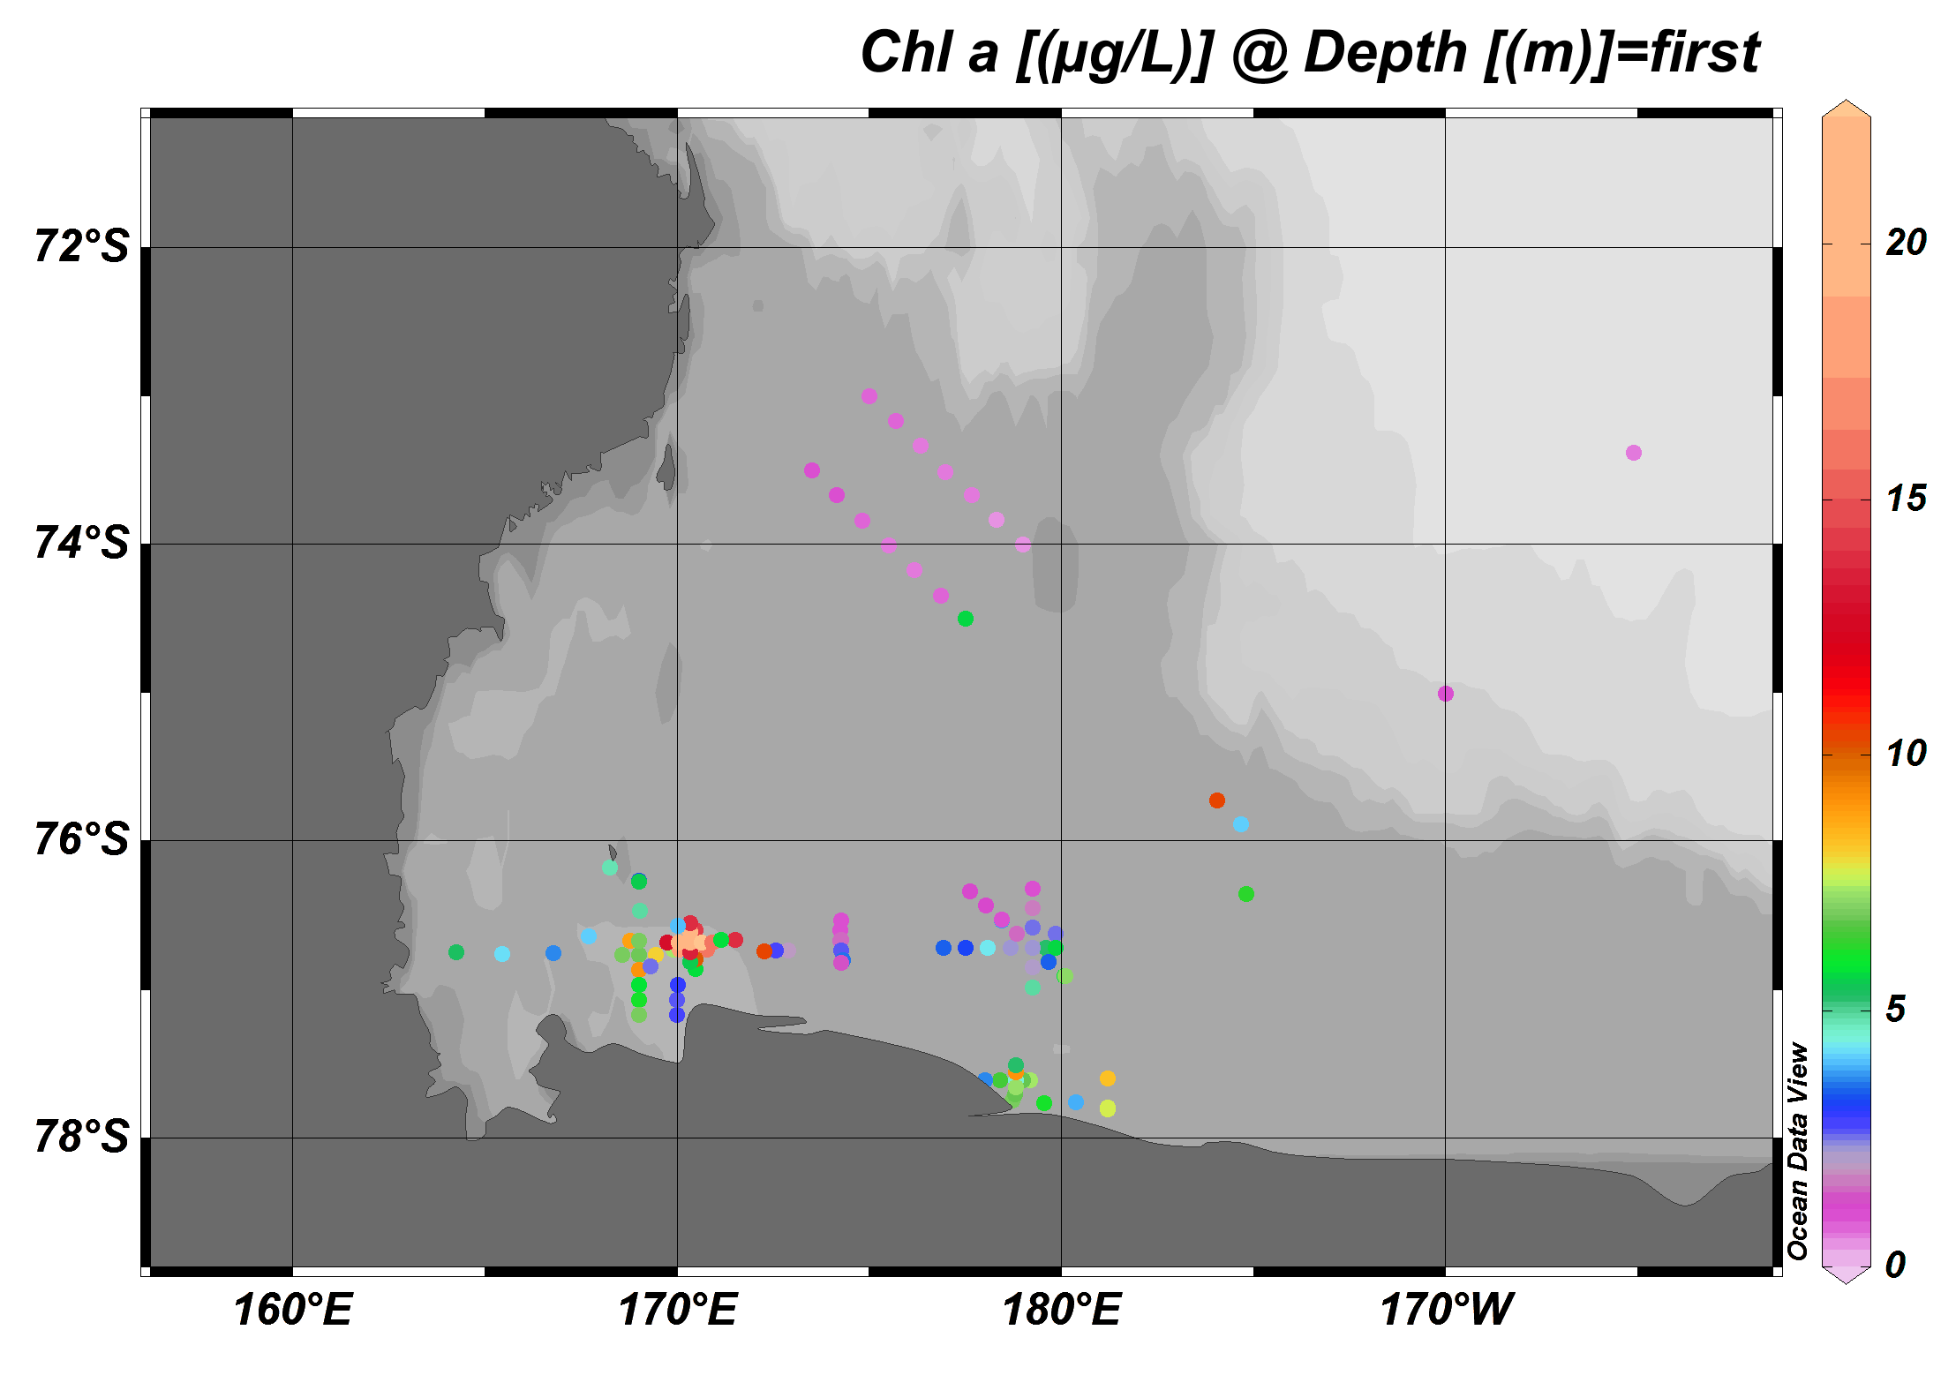

Slide 14
In the SeaBASS data base (NASA compendium), only 14 out of 8623 chlorophyll values have been reported being greater than our maximum of 24.6 μg L⁻¹. That means that only 0.17% of all values were greater. Mean chl concentrations below 60⁰S is 1.09 μg L⁻¹. Note this data base has none of individual cruises from the Ross Sea – synthesis begun!
A similar claim of “extremeness” was made by Arrigo et al.(2012) for their values in the Arctic. They published POC values that ranged from 28.7 – 32.5 g m⁻². At our ice shelf stations (e.g., St. 58), we measured POC values of ca. 60 g m⁻² (integrated through 100 m). These may approach the highest POC concentrations measured in an open-ocean system. It is clear that the ice-shelf eddy not only was physically unusual, but very rich in biomass.
There are far fewer compendia of POC values, but again, using all of the data from the Ross Sea we have collected since 1983, a comparison and synthesis has begun.

Slide 15
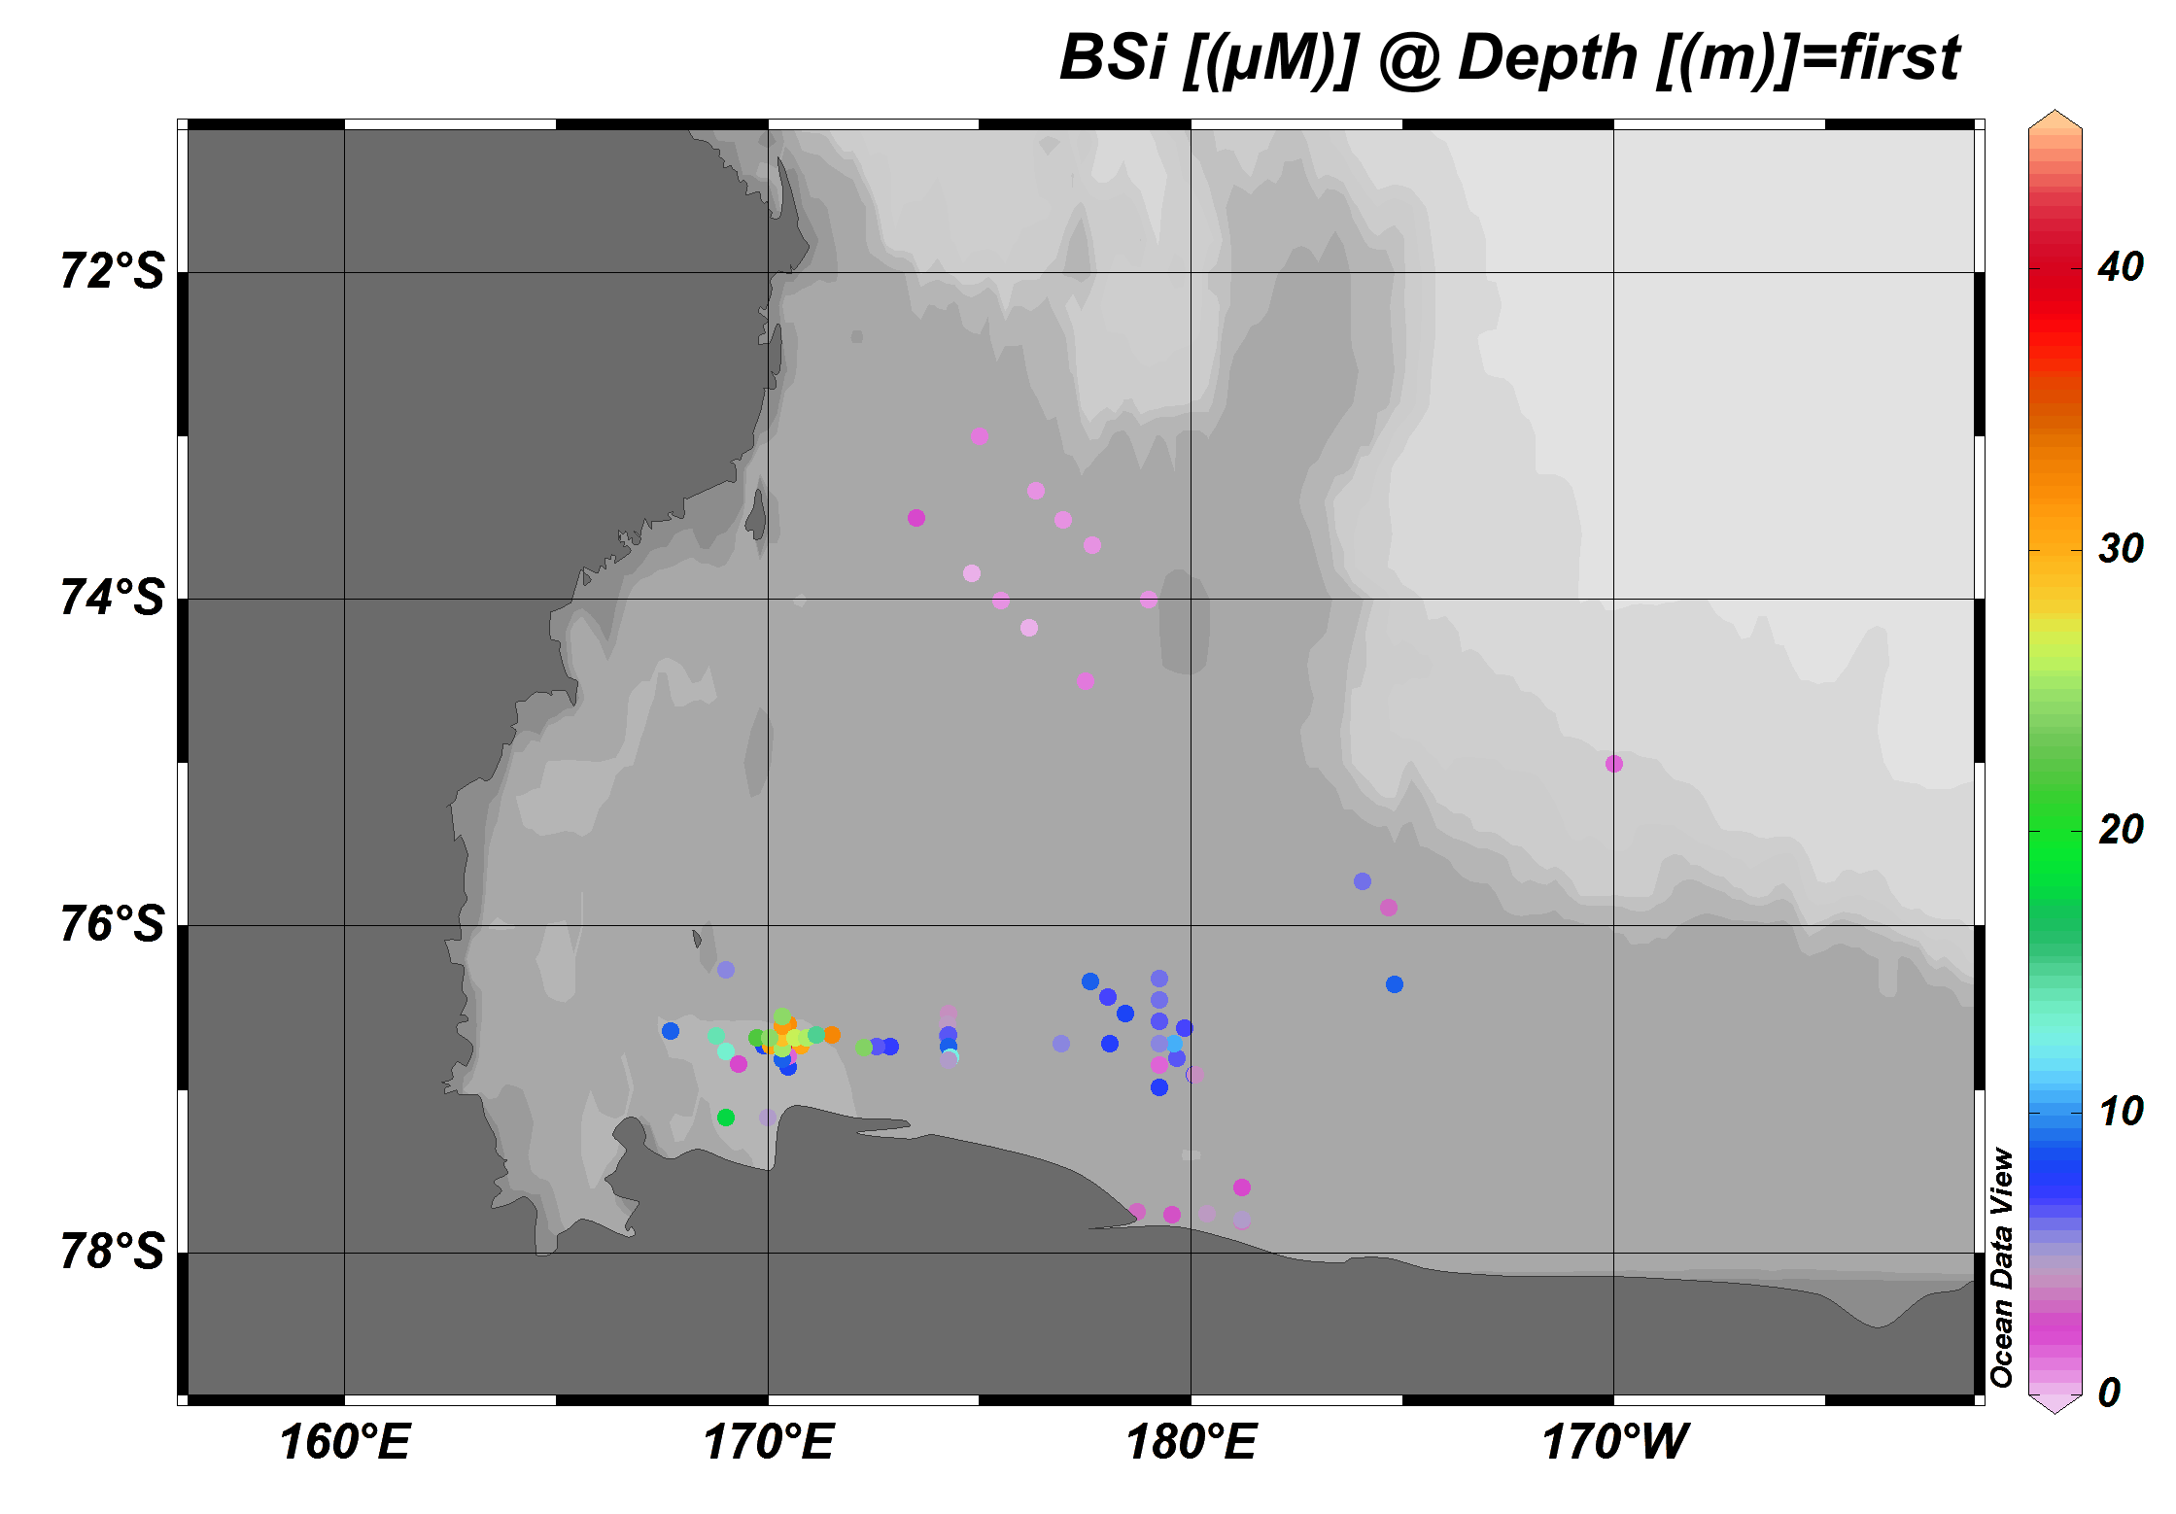

Slide 16
Conclusion: The PRISM cruise represents a very high biomass condition overall, and the phytoplankton group will try to understand the mechanisms behind this biomass generation, compare it to long-term conditions in the Ross Sea, and its implications
We would hope to include MODIS estimates of chlorophyll as well to add spatial aspects to our in situ measurements

Slide 17
Estimation of Primary Productivity
Mean Daily Productivity 2.89 ± 1.59 g C m⁻² d⁻¹
(N = 71)
(Min = 0.71 at St. 76)
(Max = 8.54 at St. 16)
Conclusion: PRISM sampled a hugely productive regime, but the productivity is certainly within the range observed in other cruises; in fact, productivity per unit biomass may not be exceptionally great
Question: How is this productivity supported?
Or, does Fe really matter?

Slide 18
Modeling related to future changes
in the Ross Sea’s biogeochemistry and ecology
Using the ODU ROMS-based numerical model (e.g., Dinniman et al., 2011), we investigated the effects of changes in atmospheric temperatures and winds on cross-shelf transport and ice distributions
Project winds 50 & 100 years from present were taken from the A1B scenario of the ECHAM5 model
Temperature data from the same climate scenario were adjusted from the climatological temperatures using the ERA-Int temperatures (details to be provided by Dinniman later this afternoon)

Slide 19
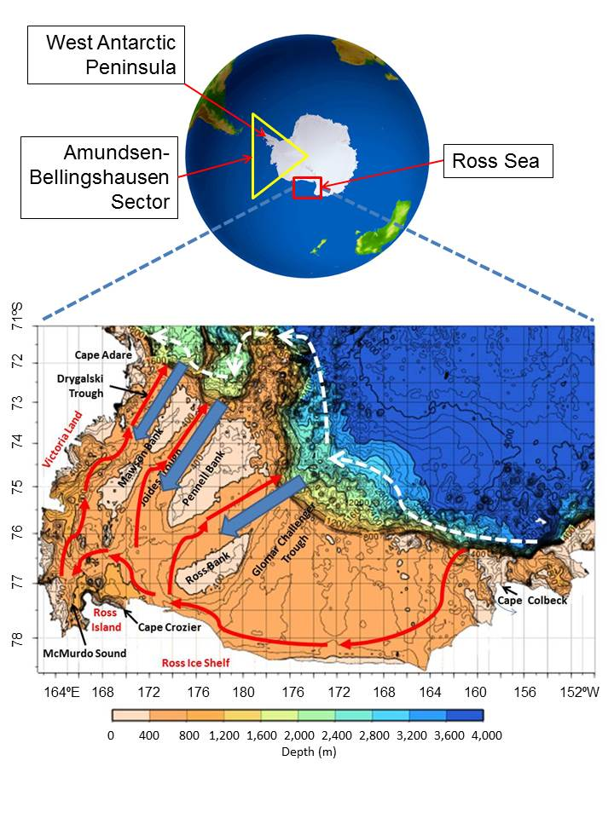

Slide 20
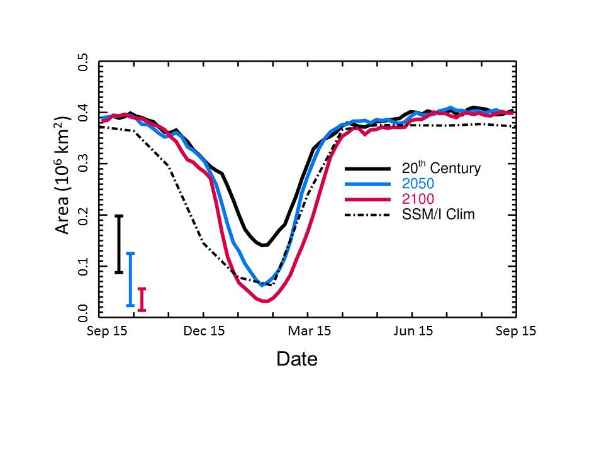

Slide 21
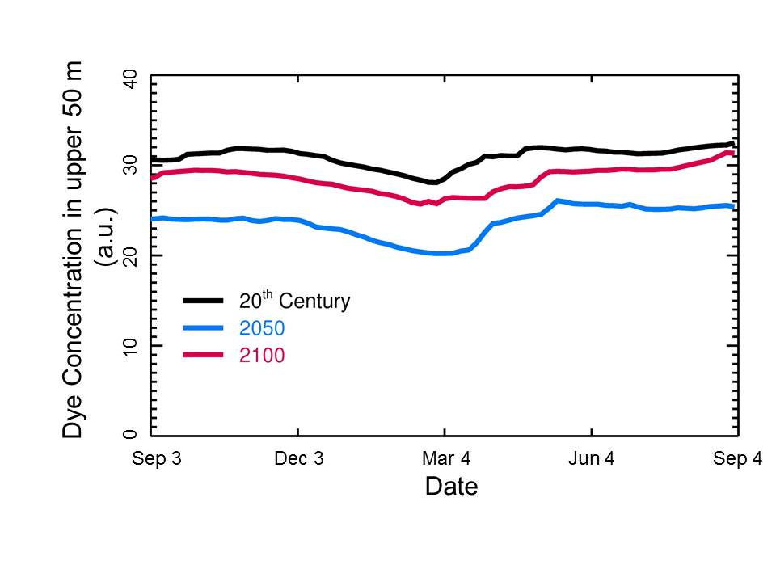

Slide 22
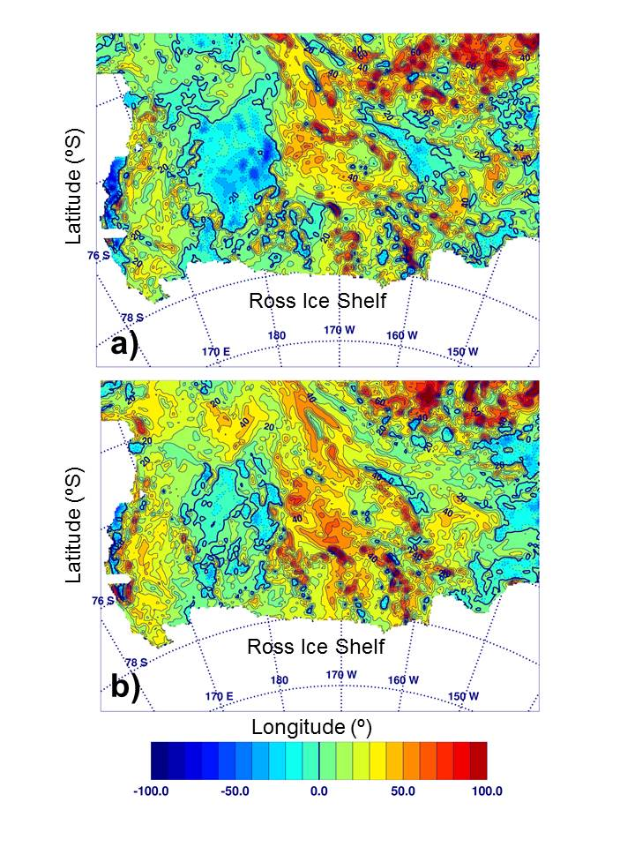
Change in the duration (days) of summer mixed layers shallower than 25 m
25 m chosen as the approximate depth that limits diatom growth yet still supports growth of Phaeocystis
Days

Slide 24
Sea Surface Temperatures
A meta-analysis has shown that the single most important (statistically) driver of phytoplankton composition is temperature.
In short, at cold temperatures (<-1.5°C) phytoplankton at overwhelmingly dominated by Phaeocystis. In waters above 0°C, phytoplankton are largely dominated by diatoms.
Present 2050 2100

