Slide 1
Data Summary for the
Moving Vessel Profiler &
SeaHorse
Blair Greenan
Bedford Institute of Oceanography
PRISM-RS PIs Meeting
Old Dominion University
11-12 June 2013

Slide 2
Data Summary
SeaHorse
3 deployments (Eddy3, Ross Bank, Ice Edge Eddy):
  CTD
  Chlorophyll fluorescence
  Downwelling irradiance, Ed, at 4 λs
  O2 concentration & saturation
  ADCP currents
Moving Vessel Profiler (MVP)
  605 profiles
  CTD
  Chlorophyll fluorescence
  Laser optical plankton counter (LOPC)

Slide 3
MVP CTD downcasts exhibit salinity & density ‘spiking’
Downcast MVP m1 file
Upcast MVP m1 file
spike due to differing sensor response times
spike absent in corresponding upcast
Temperature (°C)
Temperature (°C)
Conductivity (S m⁻¹)
Conductivity (S m⁻¹)
Salinity
Salinity

Slide 4
Lagging Exercise
Raw data interpolated to a higher frequency: 0.04 m (75 Hz)
Raw conductivity lagged with respect to pressure and temperature: 40 lags tried
Salinity calculated for each lag
Spiking improved, but not completely eliminated
When conductivity leads temperature, negative spikes result (SeaBird Processing notes)
Lag Matrix: Lags = 0.04-1.6 m
Pressure (dB)
Lags 21-23 (= 0.84-0.92 m) give best result
Salinity

Slide 5
MVP CTD Processing
Examples of downcast salinity and density corrected with lagging and low pass filter

Slide 6
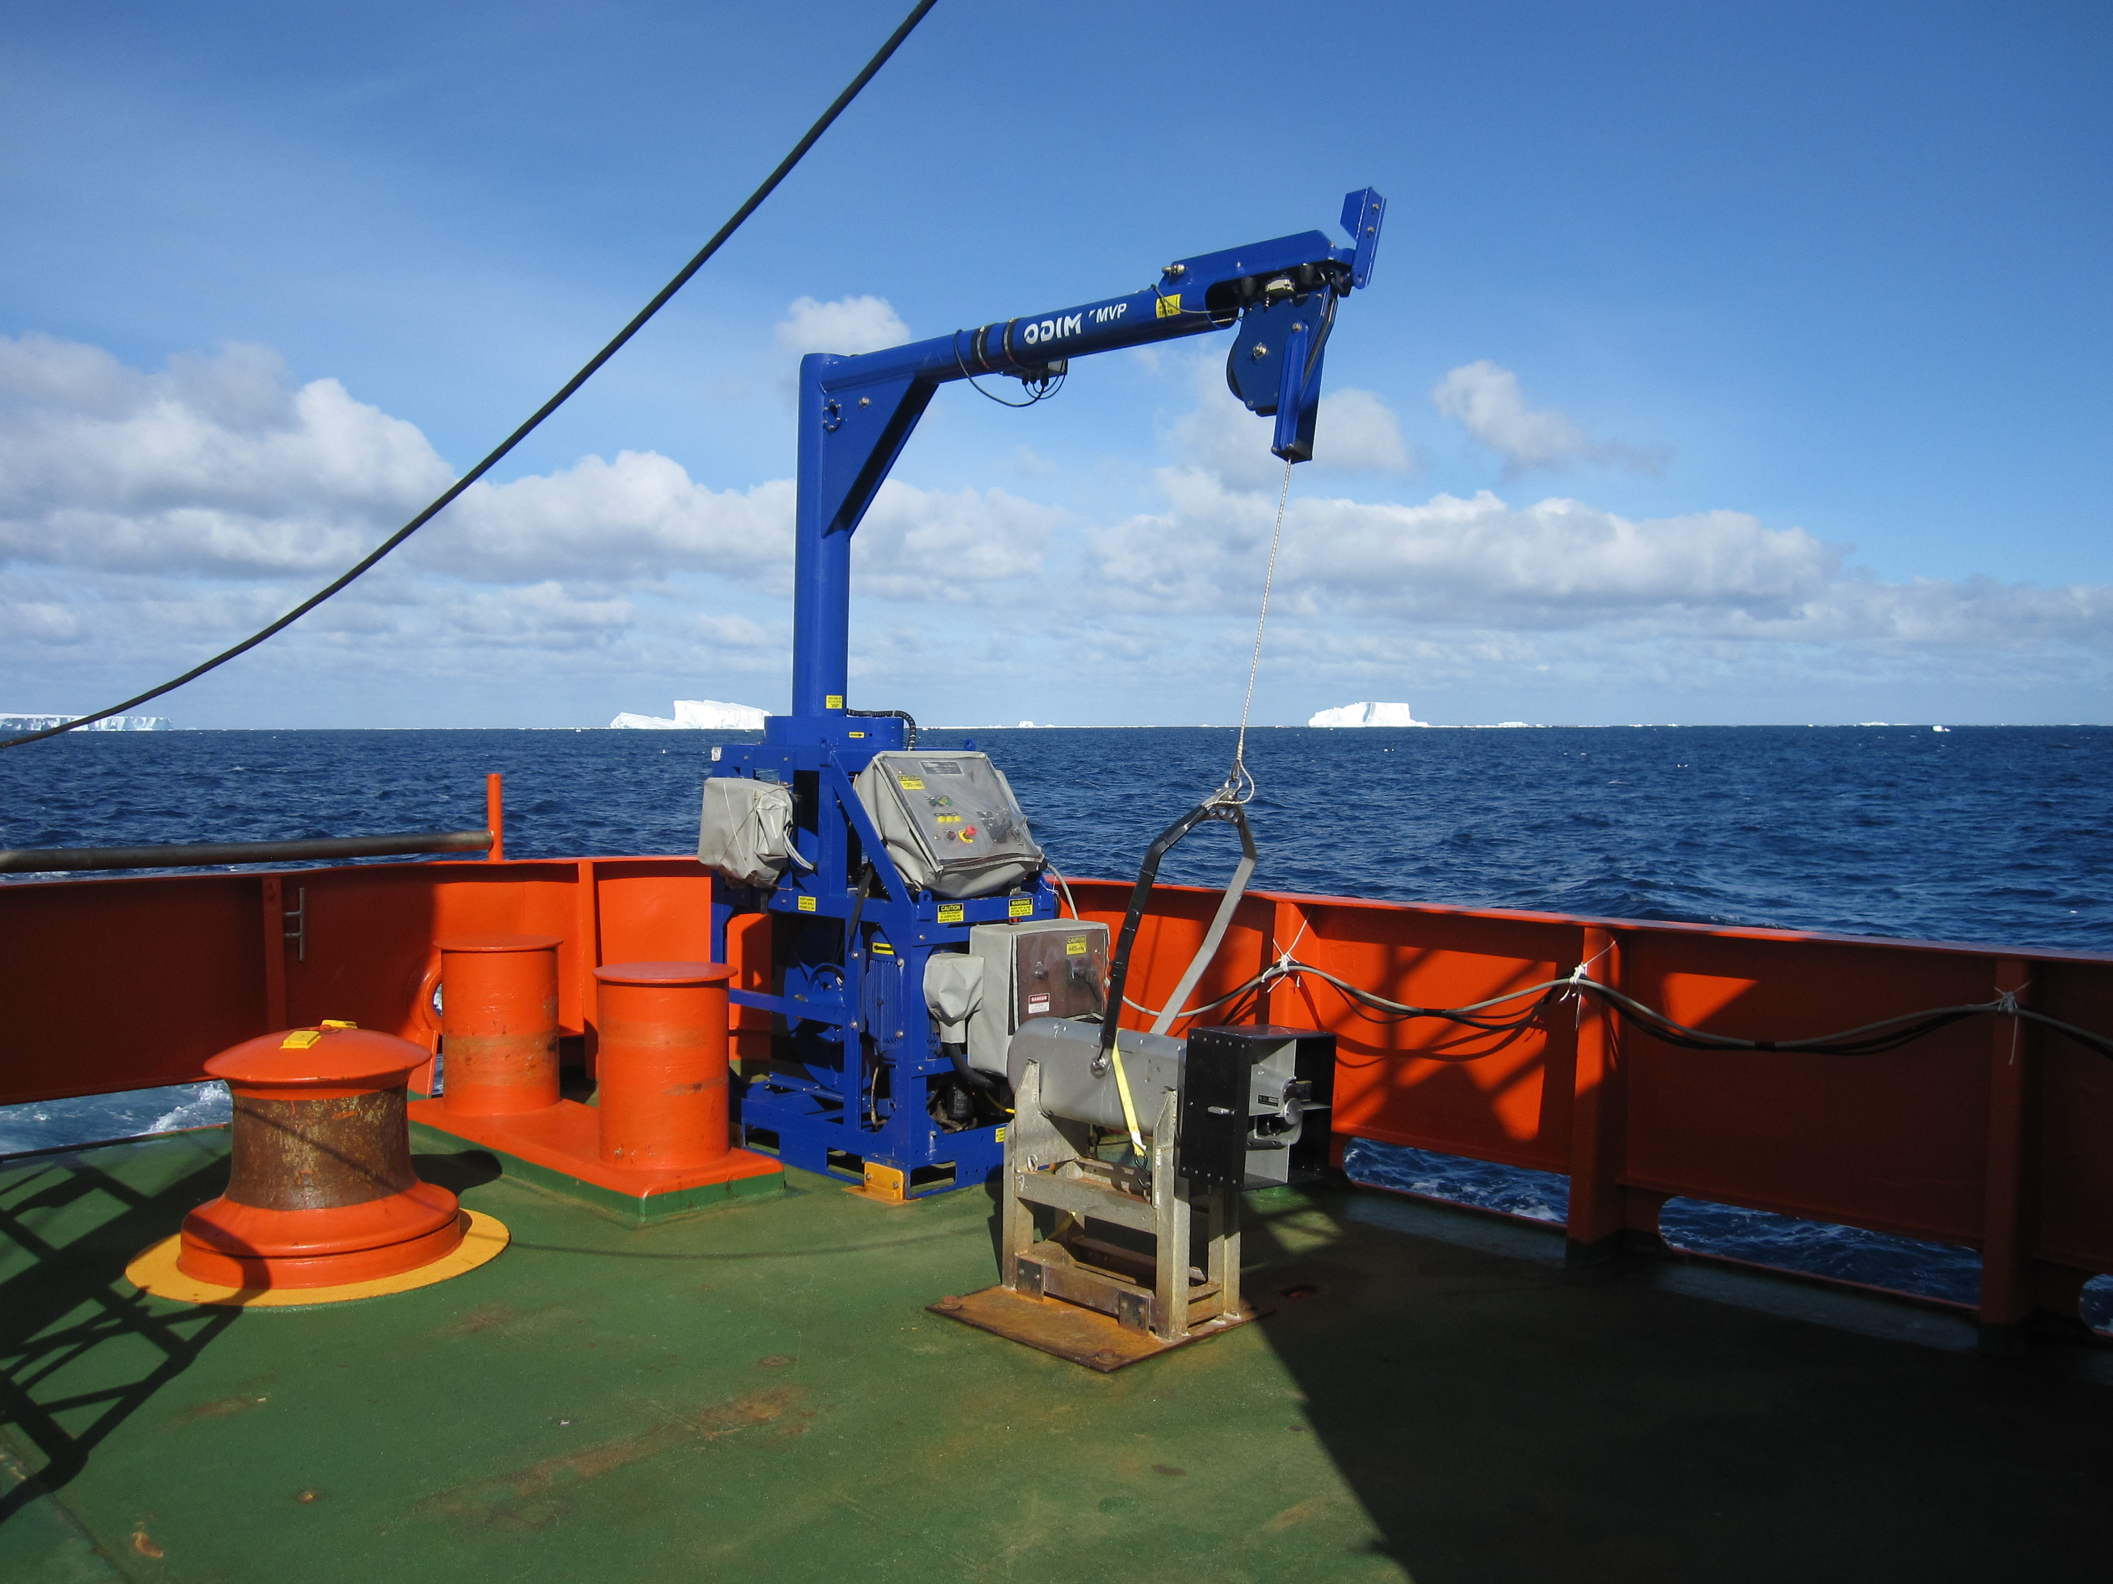
Summary of BIO Data Status
Moving Vessel Profiler (MVP)
MVP CTD processing completed
Procedure developed to minimize salinity ‘spiking’
Data organized into Matlab structure arrays – one per cast
Posted on PRISM website
LOPC not processed

Slide 7
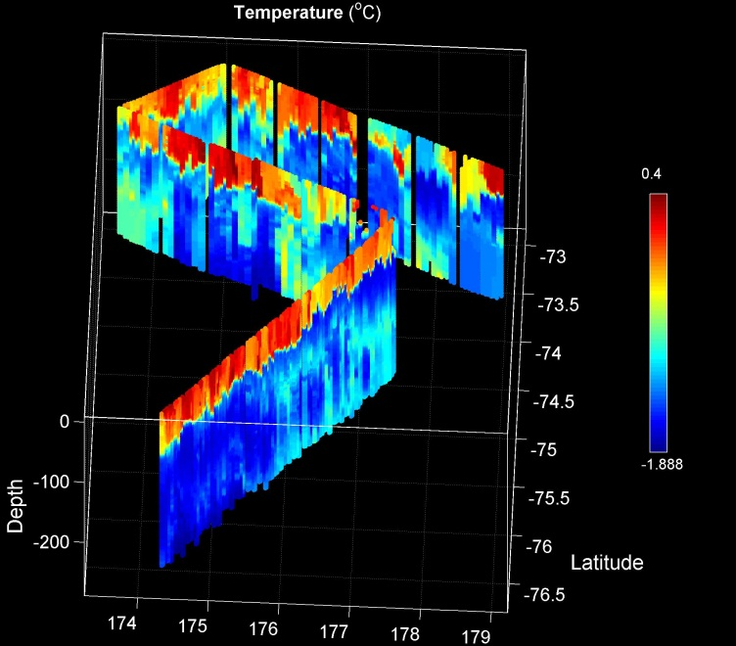
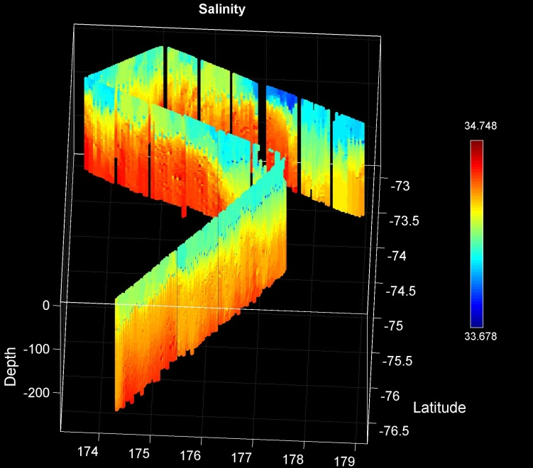
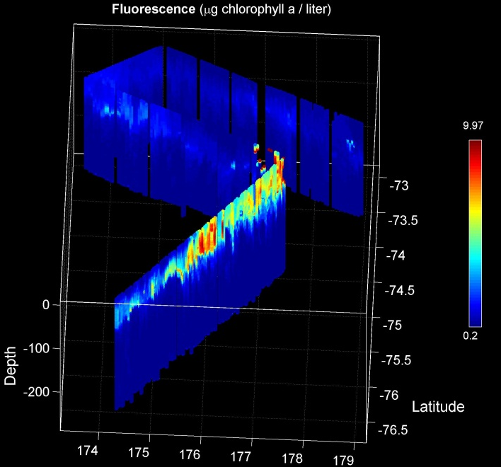
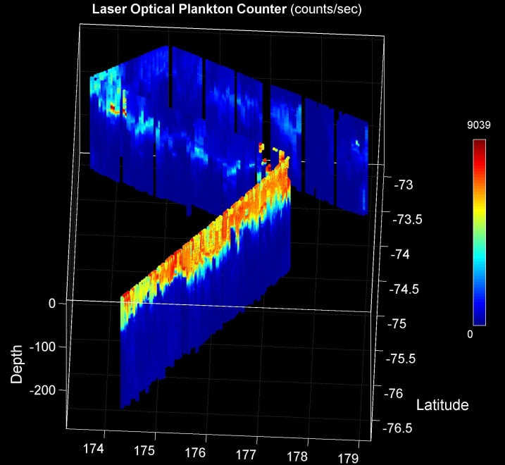
Joides Trough to Western Ross Sea MVP Survey
Temperature
Salinity
Fluorescence
LOPC

Slide 8
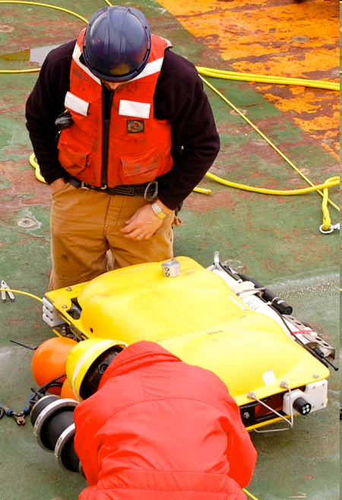
Summary of BIO Data Status
SeaHorse
ADCP
ADCP data processed, although some work required to merge upward and downward looking datasets
CTD
CTD data (incl. fluorescence and O₂ sat & %) processed and ready to post, subject to very minor QC/QA
We have not yet attempted to compare the O₂ sensor against bottle samples
What file format would be most useful for PRISM – NetCDF, Matlab?

Slide 9
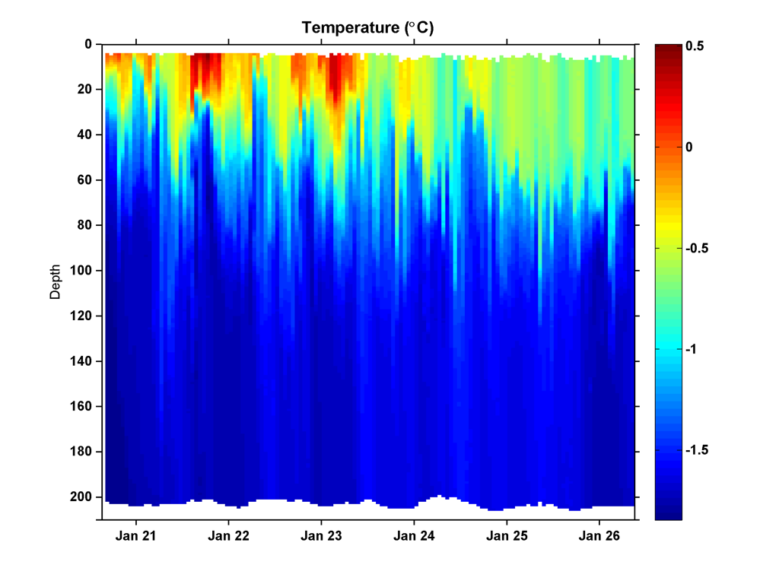
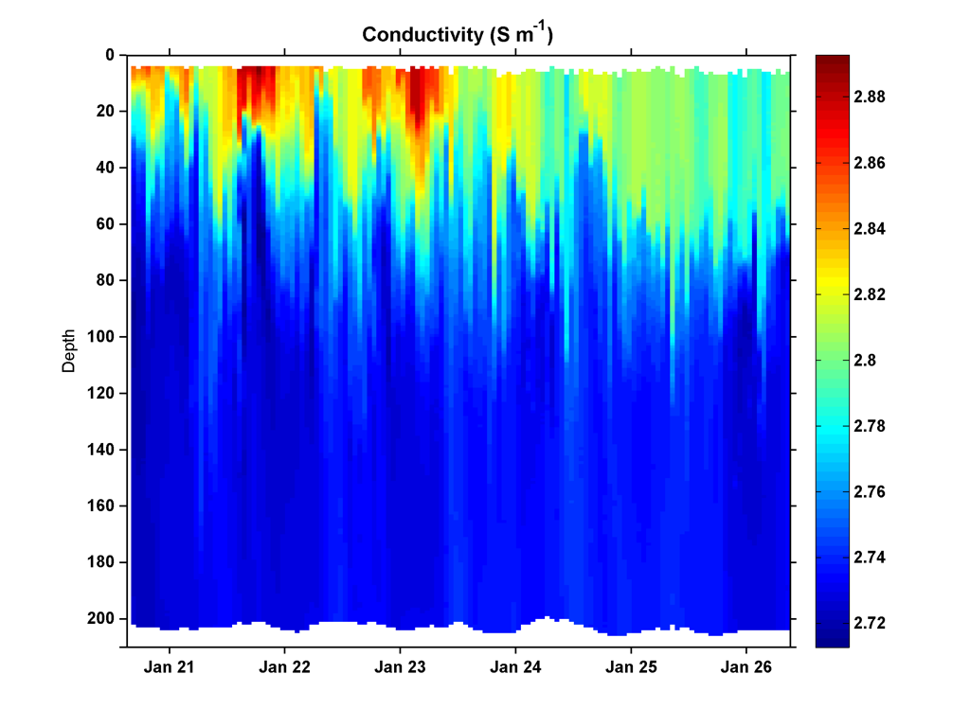
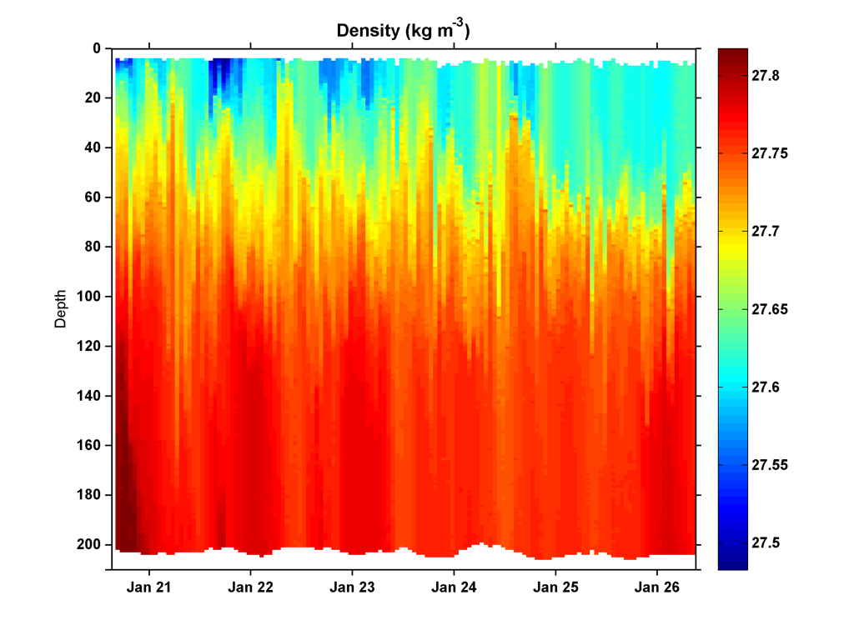
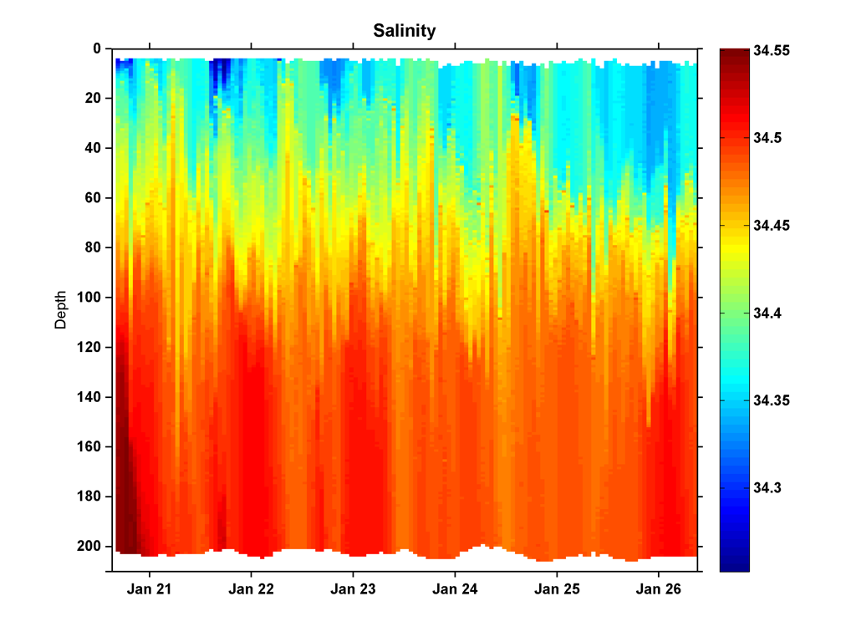
SeaHorse Deployment 3 - Ross Bank
Temperature (°C)
Conductivity (S m⁻¹)
Pressure (dB)
Pressure (dB)
Density (kg m⁻³)
Salinity
Pressure (dB)
Pressure (dB)

Slide 10
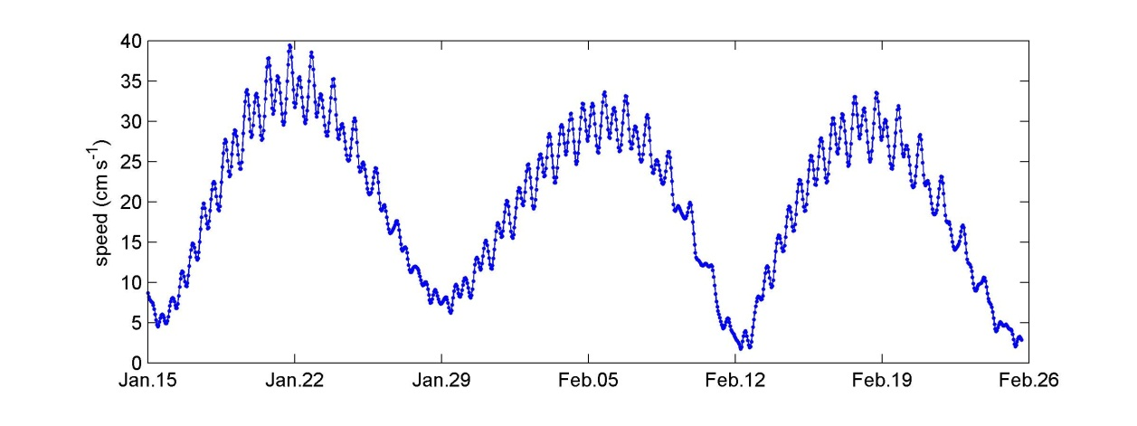
Ross Bank tidal velocity amplitude (OSU/ESR model)
SeaHorse

Slide 11
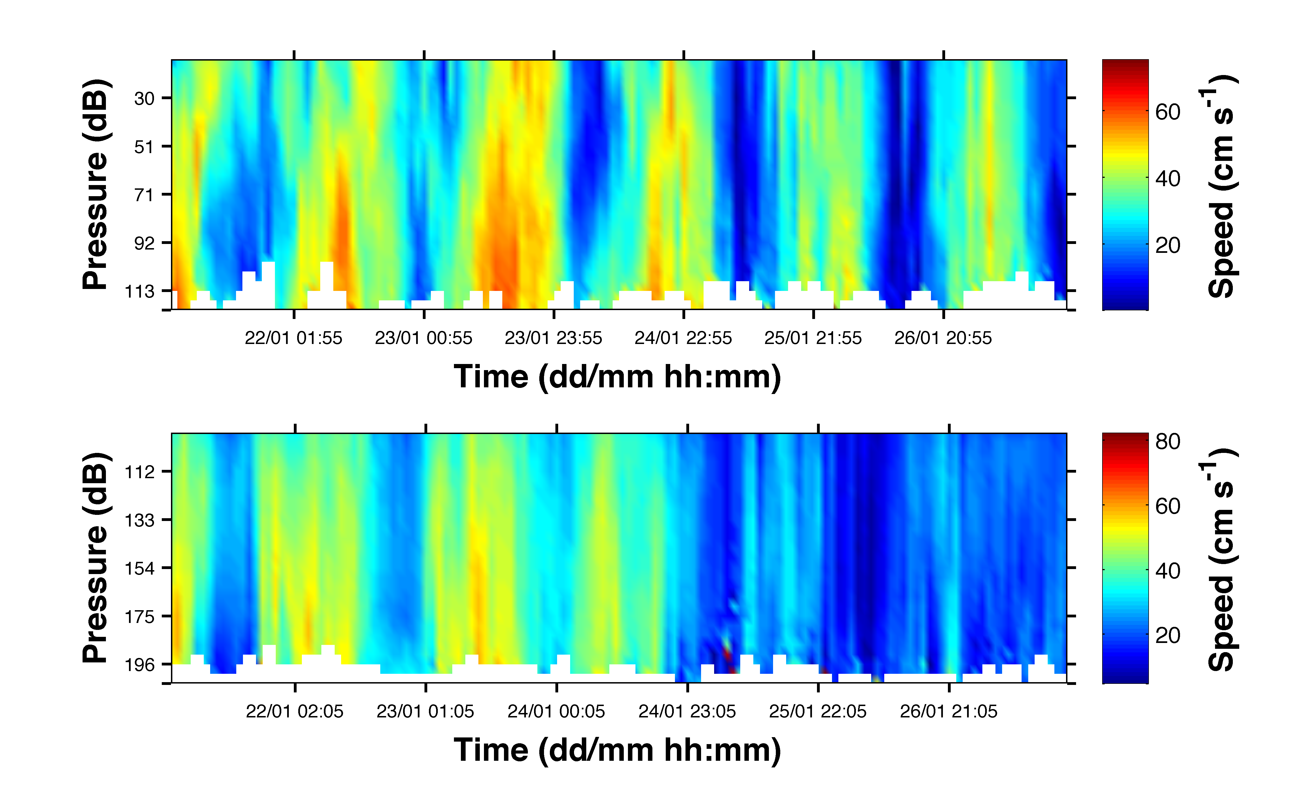
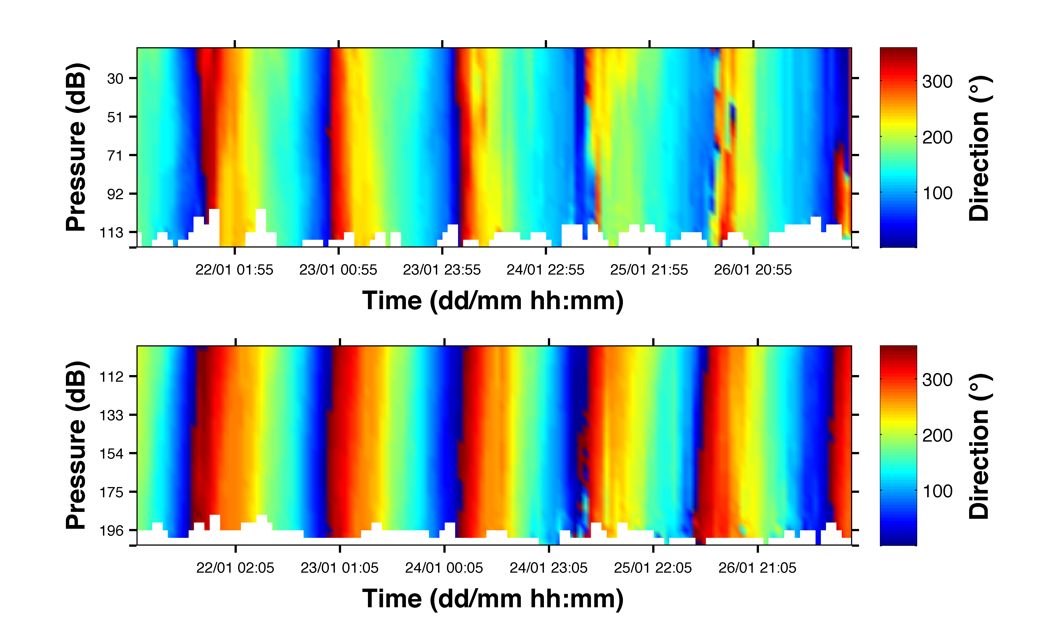
ADCP Deployment 3 - Ross Bank

Slide 12
Summary of BIO Data Status
SeaHorse cont’d
OCR
OCR data processed
Index of phytoplankton biomass derived from downwelling irradiance sensor (E_{d})
Could be used to ‘fill in’ the gaps caused by fluorescence sensor saturation during deployments 2 and 4
Diffuse attenuation coefficient can be easily calculated – required for defining euphotic depth

Slide 13
Qualitative index of phytoplankton biomass derived from Ed(λ,z)
Example of fluorometer saturation from deployment 2
SeaHorse Chl fluorometer saturated
Depth (m)
Chl estimated from Ed(λ,z) measurements (Nahorniak et al., JAOT, 2001. )
Estimates are qualitative at this stage, but could perhaps be refined
Ed derived Chl (approx. μg L⁻¹)
Fluorescence derived Chl (approx. μg L⁻¹)
Notes:
Add some explanation of model.

Slide 14
Satellite Fluorescence Quantum Yield, φ_{f}
There is potential for a study to compare in situ measurements of fluorescence quantum yield with those derived from satellite
Requirements
Extraction of various parameters from satellite data – Dennis and colleagues have provided Matlab scripts for extracting parameters of interest from MODIS Aqua level 3 products
Quite a substantial investment in time required to generate satellite φ_{f}
Is there presently sufficient interest/momentum/researcher time?

