Slide 1
Ross Bank
Blair Greenan
Bedford Institute of Oceanography
PRISM-RS PIs Meeting
Old Dominion University
11-12 June 2013

Slide 2
The role of submarine banks in iron supply on Antarctic shelf seas
Objective: Use in situ and remotely sensed data along with computer models to determine the role of Ross Bank in the supply of dissolved iron to the euphotic zone in the Ross Sea. Based on the results of our analysis, we will attempt to generalize this other submarine banks on the continental shelves surrounding Antarctica.

Slide 3
Available Data Sets
SeaHorse mooring for 5-day period (hourly vertical profiles of temperature, conductivity, dissolved oxygen, fluorescence, irradiance, currents) – Blair
  Initial processing of ADCP currents is consistent with the Padman tidal model
  Tidal cycle evident in hydrographic fields (CTD, DO)
  Fluorescence is lower than observed in other SeaHorse deployments
Vessel-mounted ADCP from Palmer transects of Ross Bank – Dennis
  VM-ADCP results also appear consistent with Padman model
  Sub-tidal flow computed by removing the Padman-predicted flow from the measured currents

Slide 4
Available Data Sets
Shipboard hydrography (CTD/DO/nutrients) – John, Dennis & Walker
  Water mass changed during the period of the SeaHorse deployment
  What can we say from the nutrients?
  What can we say from the oxygen?
Video Plankton Recorder (hydrography & plankton) – Dennis
  VPR observed higher fluorescence over the side of the bank relative to the top of the bank where the SeaHorse was moored
  What can we say about the plankton from the VPR?
Moving Vessel Profiler (hydrography, LOPC) – Blair
  Need to merge the hydrographic data from the MVP/VPR/Shipboard CTD to map out the hydrographic fields as best possible
  LOPC – can we do anything by combining this with the VPR?

Slide 5
Available Data Sets
Dissolved Iron – Pete
  High dFe observed over the top of Ross Bank at the start of the SeaHorse deployment (peak tidal velocities).
  dFe returned to background values upon return to Ross Bank from the ice shelf survey
  Final processing of the dFe results from the lab work will be available in 2013.
Particulate Iron – Pam
  Will we be able to use the combination of particulate Fe and dFe to say anything about the source of the iron above Ross Bank?

Slide 6
Available Data Sets
Phytolankton – Tom & Walker
  Tom’s results indicate that the phytoplankton collected above Ross Bank were not iron stressed, which is consistent with this area being a local source of dFe.
  Are there other phytoplankton results that we want to incorporate?
Underway measurements
  Can we make use of the underway measurements in this area to objectively map the surface fields ?
Satellite imagery (SST, color, ice cover) – Dennis
  Only certain ocean color climatologies indicate that Ross Bank is a hot spot for primary production.
  What further remote sensing data and analysis could we incorporate? If we are trying to extrapolate results to other shelf sea we may need to use ocean color data to provide some validation

Slide 7
Models
Mike has 5km resolution ROMS model running and can quickly test scenarios
  Mike will look at the wind forcing for the period of the SeaHorse deployment to make sure that this forcing is represented properly in the model. He will then look at the impact of this event on circulation and Ekman transport over Ross Bank.
  Will tides be added in 2013?
Stephanie will have 2.5 and 1.25 km resolution ROMS models running in 2013
  The higher-resolution models will be better able to represent mesoscale processes on the continental shelf.
  These higher-resolution models will take significantly longer to run, so testing various scenarios will take much longer
  Plan is to include tides in the high-resolution models
Pierre has a high-resolution model that could be used for idealized testing of the role of tides and topography
  John indicated that Pierre could include a bank in his model to study the effects of tides and wind forcing in this more idealized model.

Slide 8
Questions
Is Ross Bank a conduit to the surface for dFe?
Can we generalize the Ross Bank measurements to other parts of the Antarctic continental shelves? - Eileen
Did the high dFe that Pete observed come from the top of the bank or was it transported from the deeper area at the base of the bank?
What was the role of the wind event in dispersing the elevated dFe observed over Ross Bank?
If the vertical transport of dFe is predominantly driven by the tides, is this an area that has a source of dFe year-round?
Is the source of dFe at Ross Bank intermittent because of the spring-neap tidal cycle? Is Ross Bank a “puffy chimney”?

Slide 9
Ross Bank Literature Review
Preliminary literature review completed summarizing current knowledge of the supply of iron to Antarctic shelf systems for use in Ross Bank paper
Key Points
Ross Sea continental shelf is the most productive region on Antarctic continental margin
Iron limitation identified in this region by several studies (e.g. Bertrand et al., 2007; Coale et al., 2003; Martin et al., 1991; Sedwick & Di Tullio 1997; Sedwick et al., 2011)
Four potential mechanisms involved in supply of Fe to surface waters:
  Circumpolar Deep Water (CDW) intrusion from the shelf
  Sediments resuspension from shallow banks and coastal areas
  Sea ice meltwater from perimeter of polynya
  Glacial meltwater from Ross Ice Shelf

Slide 10
Ross Bank Literature Review – Key Points cont’d
Sedwick et al. (2011) conducted a study of the Ross Sea that included a transect over Ross Bank. Good context for PRISM study.
Modified Shelf Water (MSW)
High particulate Fe
Resuspension of shelf sediments suggested
Shelf Water (SW)
Relatively high dFe
Modified Circumpolar Deep Water (MCDW)
Consistent with previous studies (e.g. Dinniman et al., 2011; Orsi & Wiederwohl 2009)
Fig. 3. Sedwick et al., JGR, 2011
Fig. 1. Sedwick et al., JGR, 2011

Slide 11
Ross Bank Literature Review – Key Points cont’d
Tides
Effect of tides on mixing on Ross Bank are currently not well characterized, but likely to be important
Tides may influence circulation via excitation of continental shelf waves
Interaction between barotropic tide & topographical features may generate internal tides -> shear -> mixing
Are conditions on Ross Bank conducive to set up features such as Taylor columns, tidal rectification? Currently unknown…

Slide 12
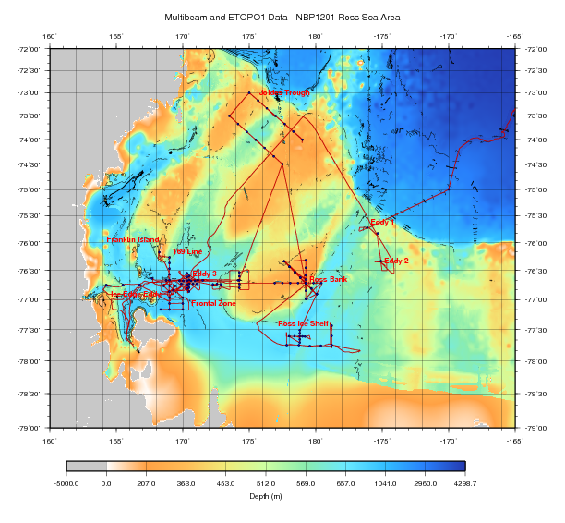
SeaHorse Deployment 3 - Ross Bank

Slide 13
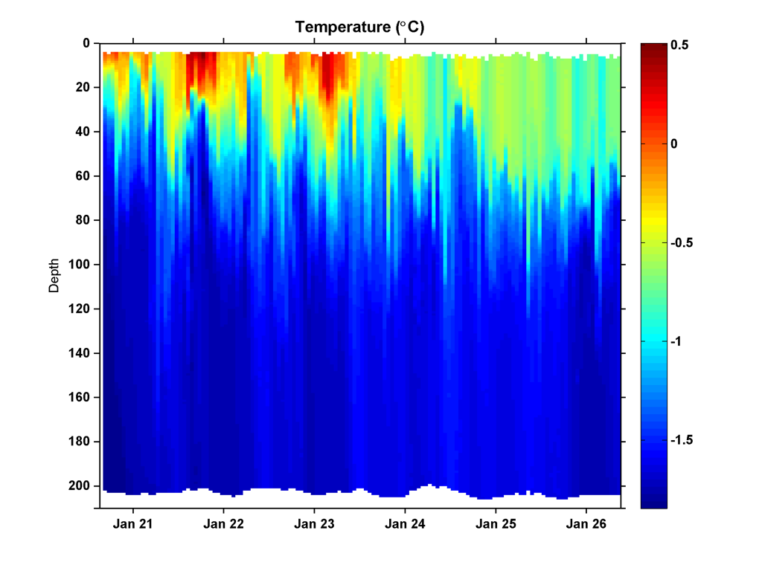
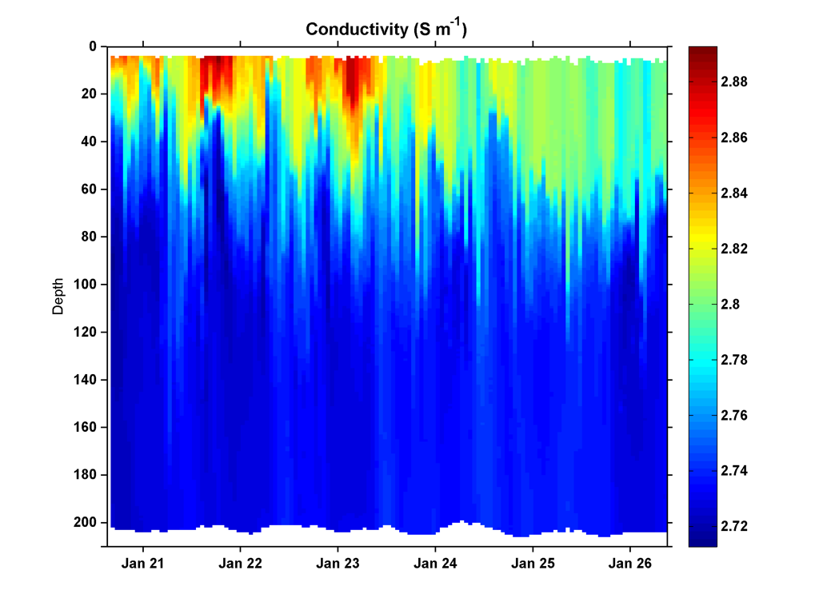
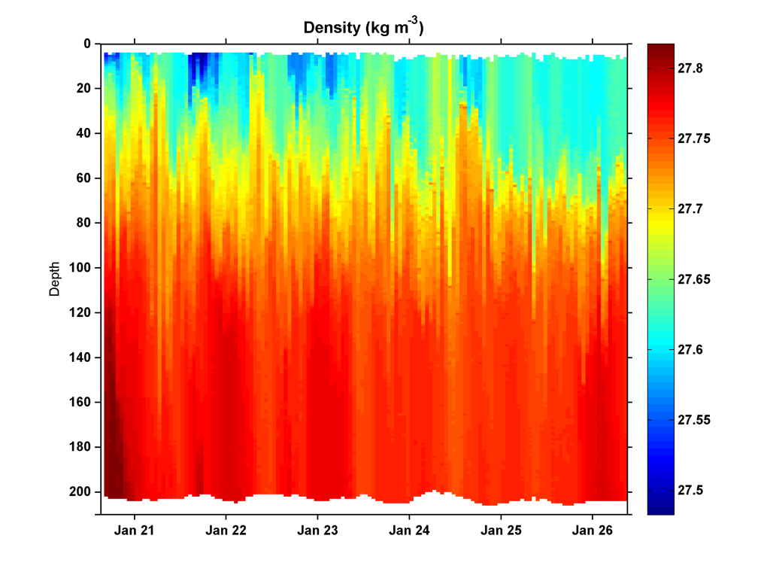
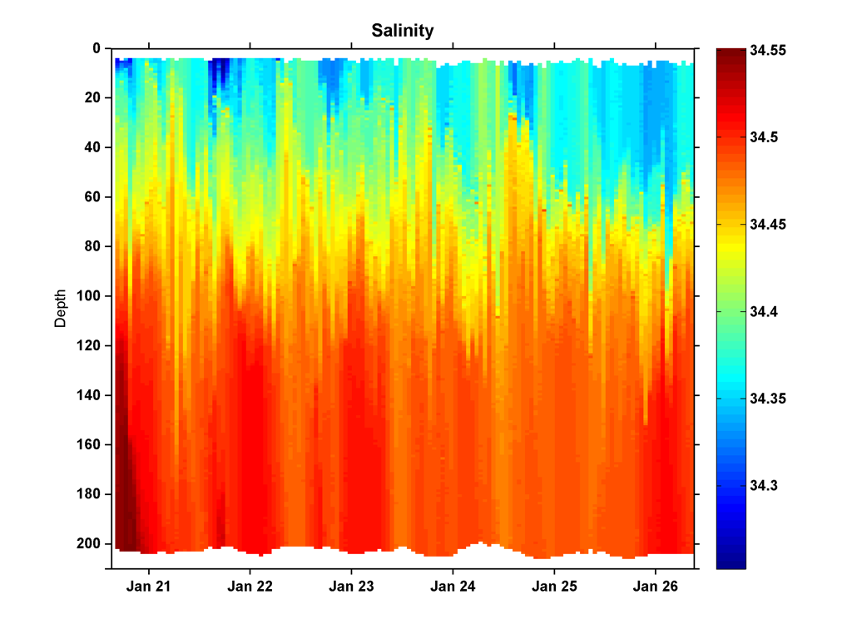
SeaHorse Deployment 3 - Ross Bank
Temperature (°C)
Conductivity (S m⁻¹)
Pressure (dB)
Pressure (dB)
Density (kg m⁻³)
Salinity
Pressure (dB)
Pressure (dB)

Slide 14
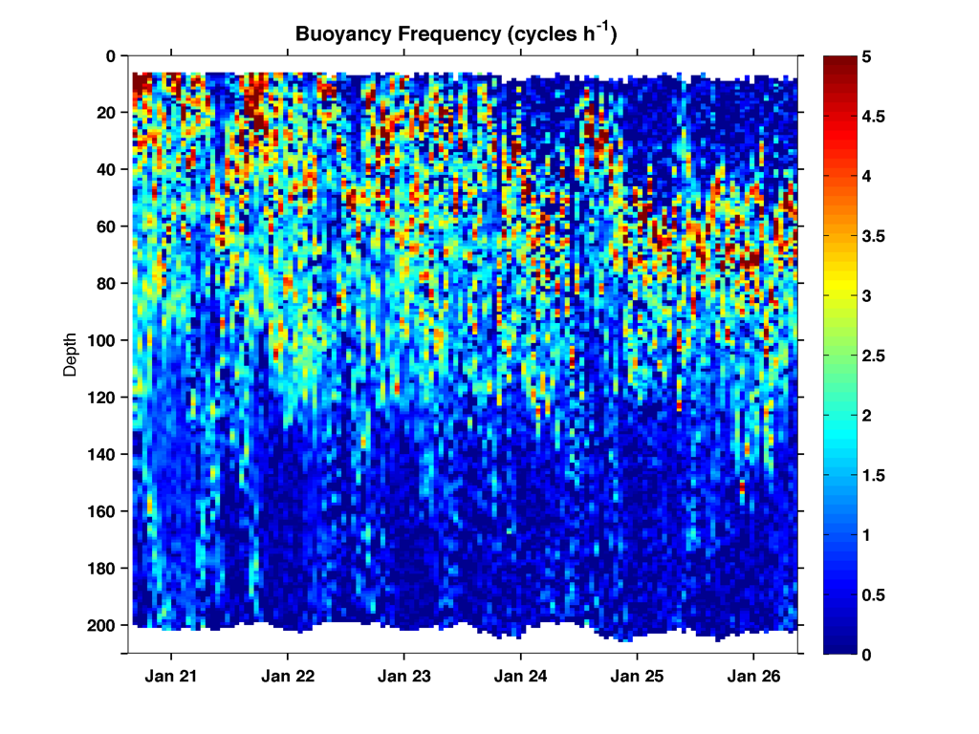
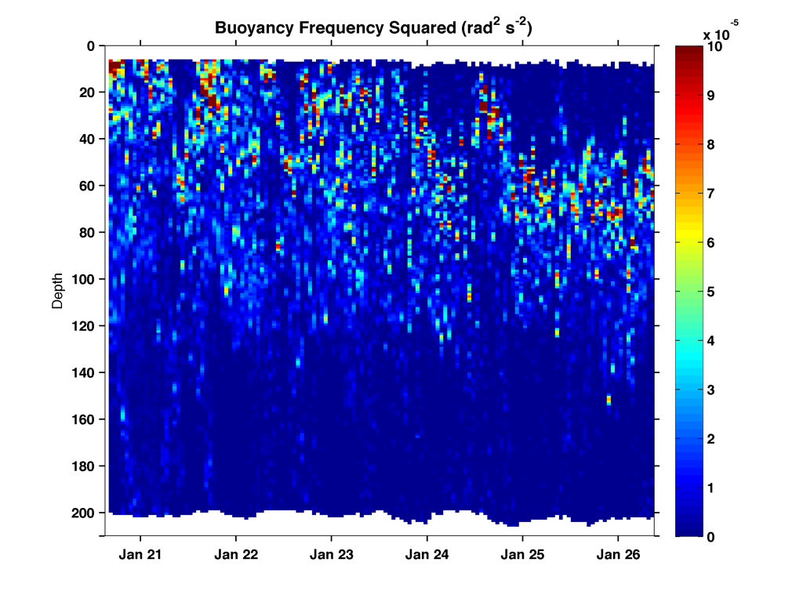
SeaHorse Deployment 3 - Ross Bank
Buoyancy frequency (cycles hr⁻¹)
Buoyancy frequency squared (rad² sec⁻²)
Pressure (dB)
Pressure (dB)

Slide 15
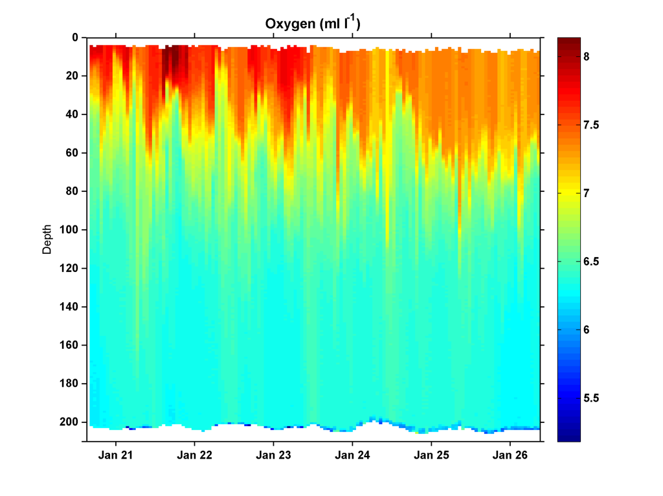
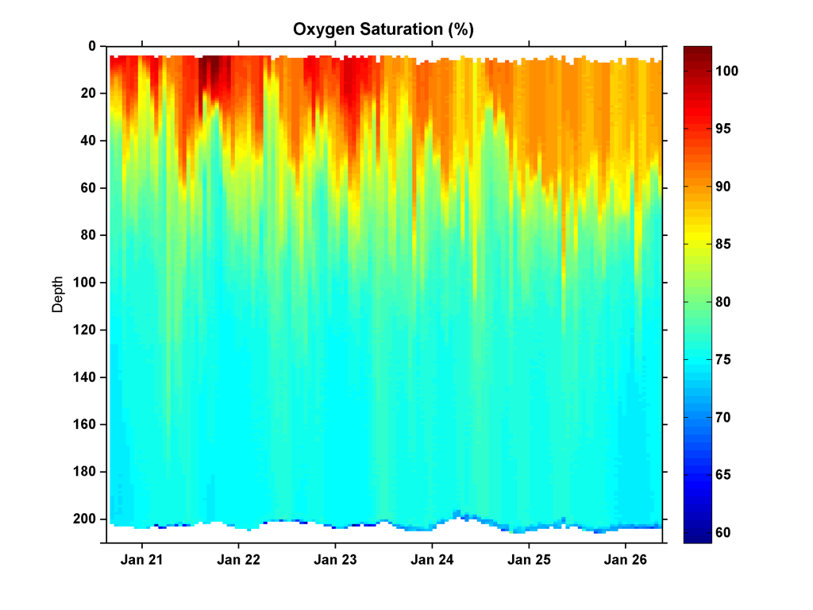
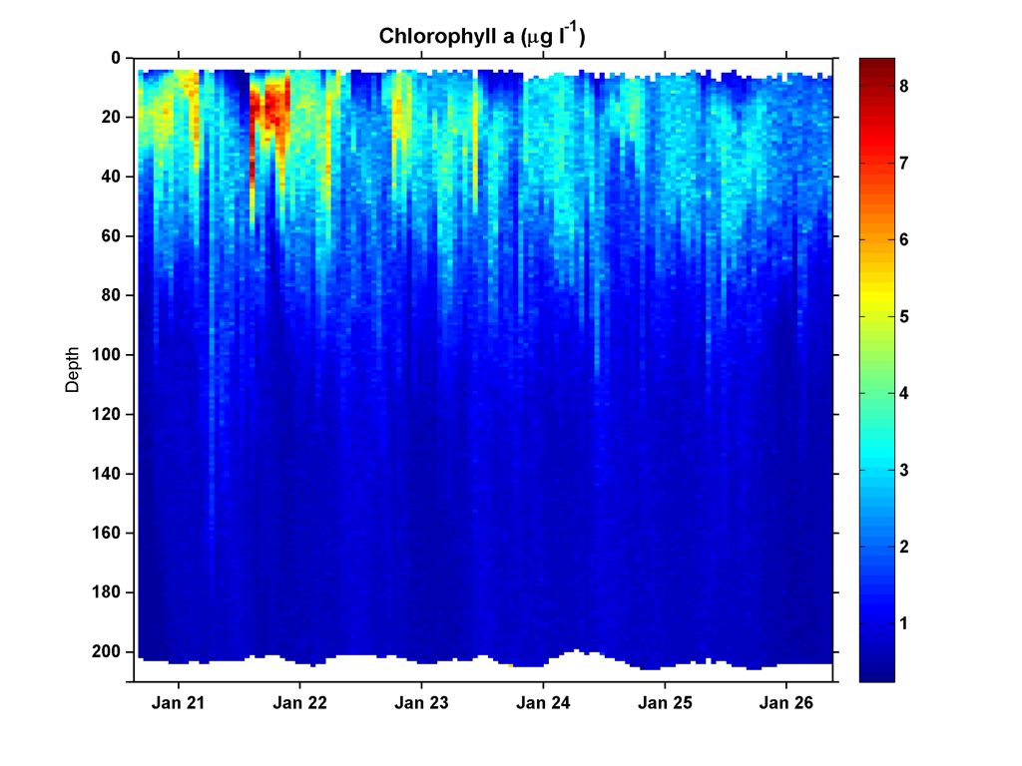
SeaHorse Deployment 3 - Ross Bank
Oxygen concentration (mL L⁻¹)
Oxygen saturation (%)
Pressure (dB)
Pressure (dB)
Approximate Chl concentration (μg L⁻¹)
Pressure (dB)

Slide 16
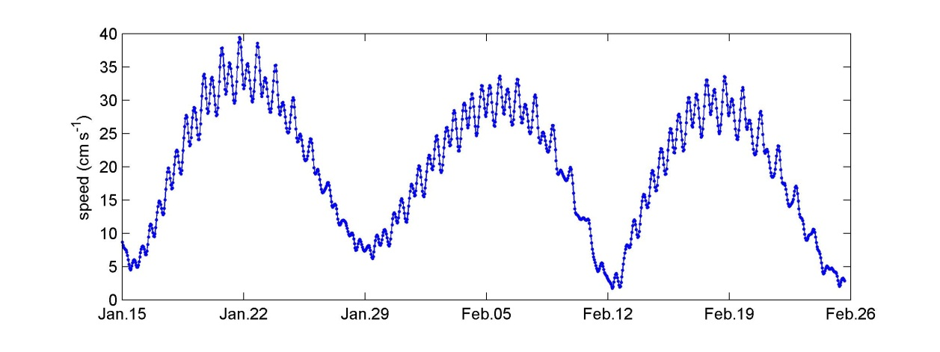
Ross Bank tidal velocity amplitude (OSU/ESR model)
SeaHorse

Slide 17
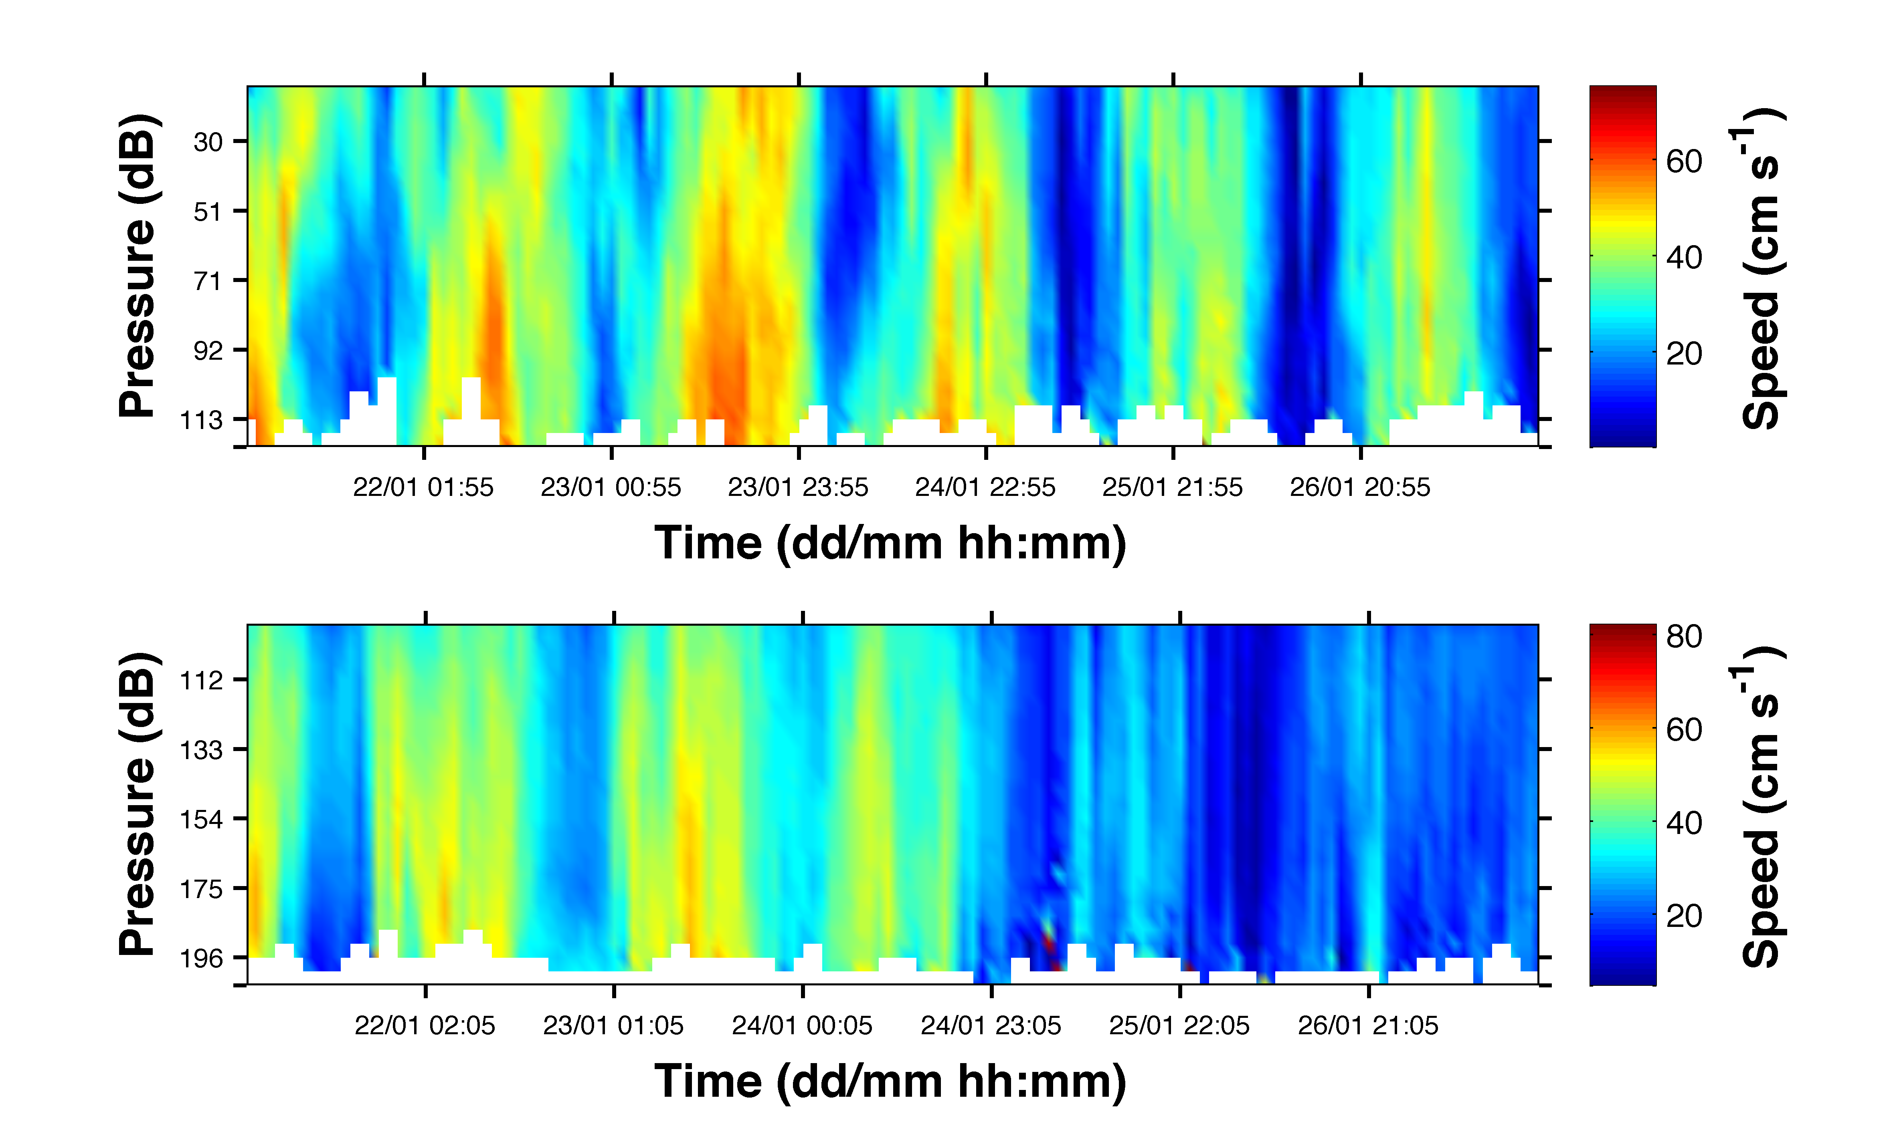
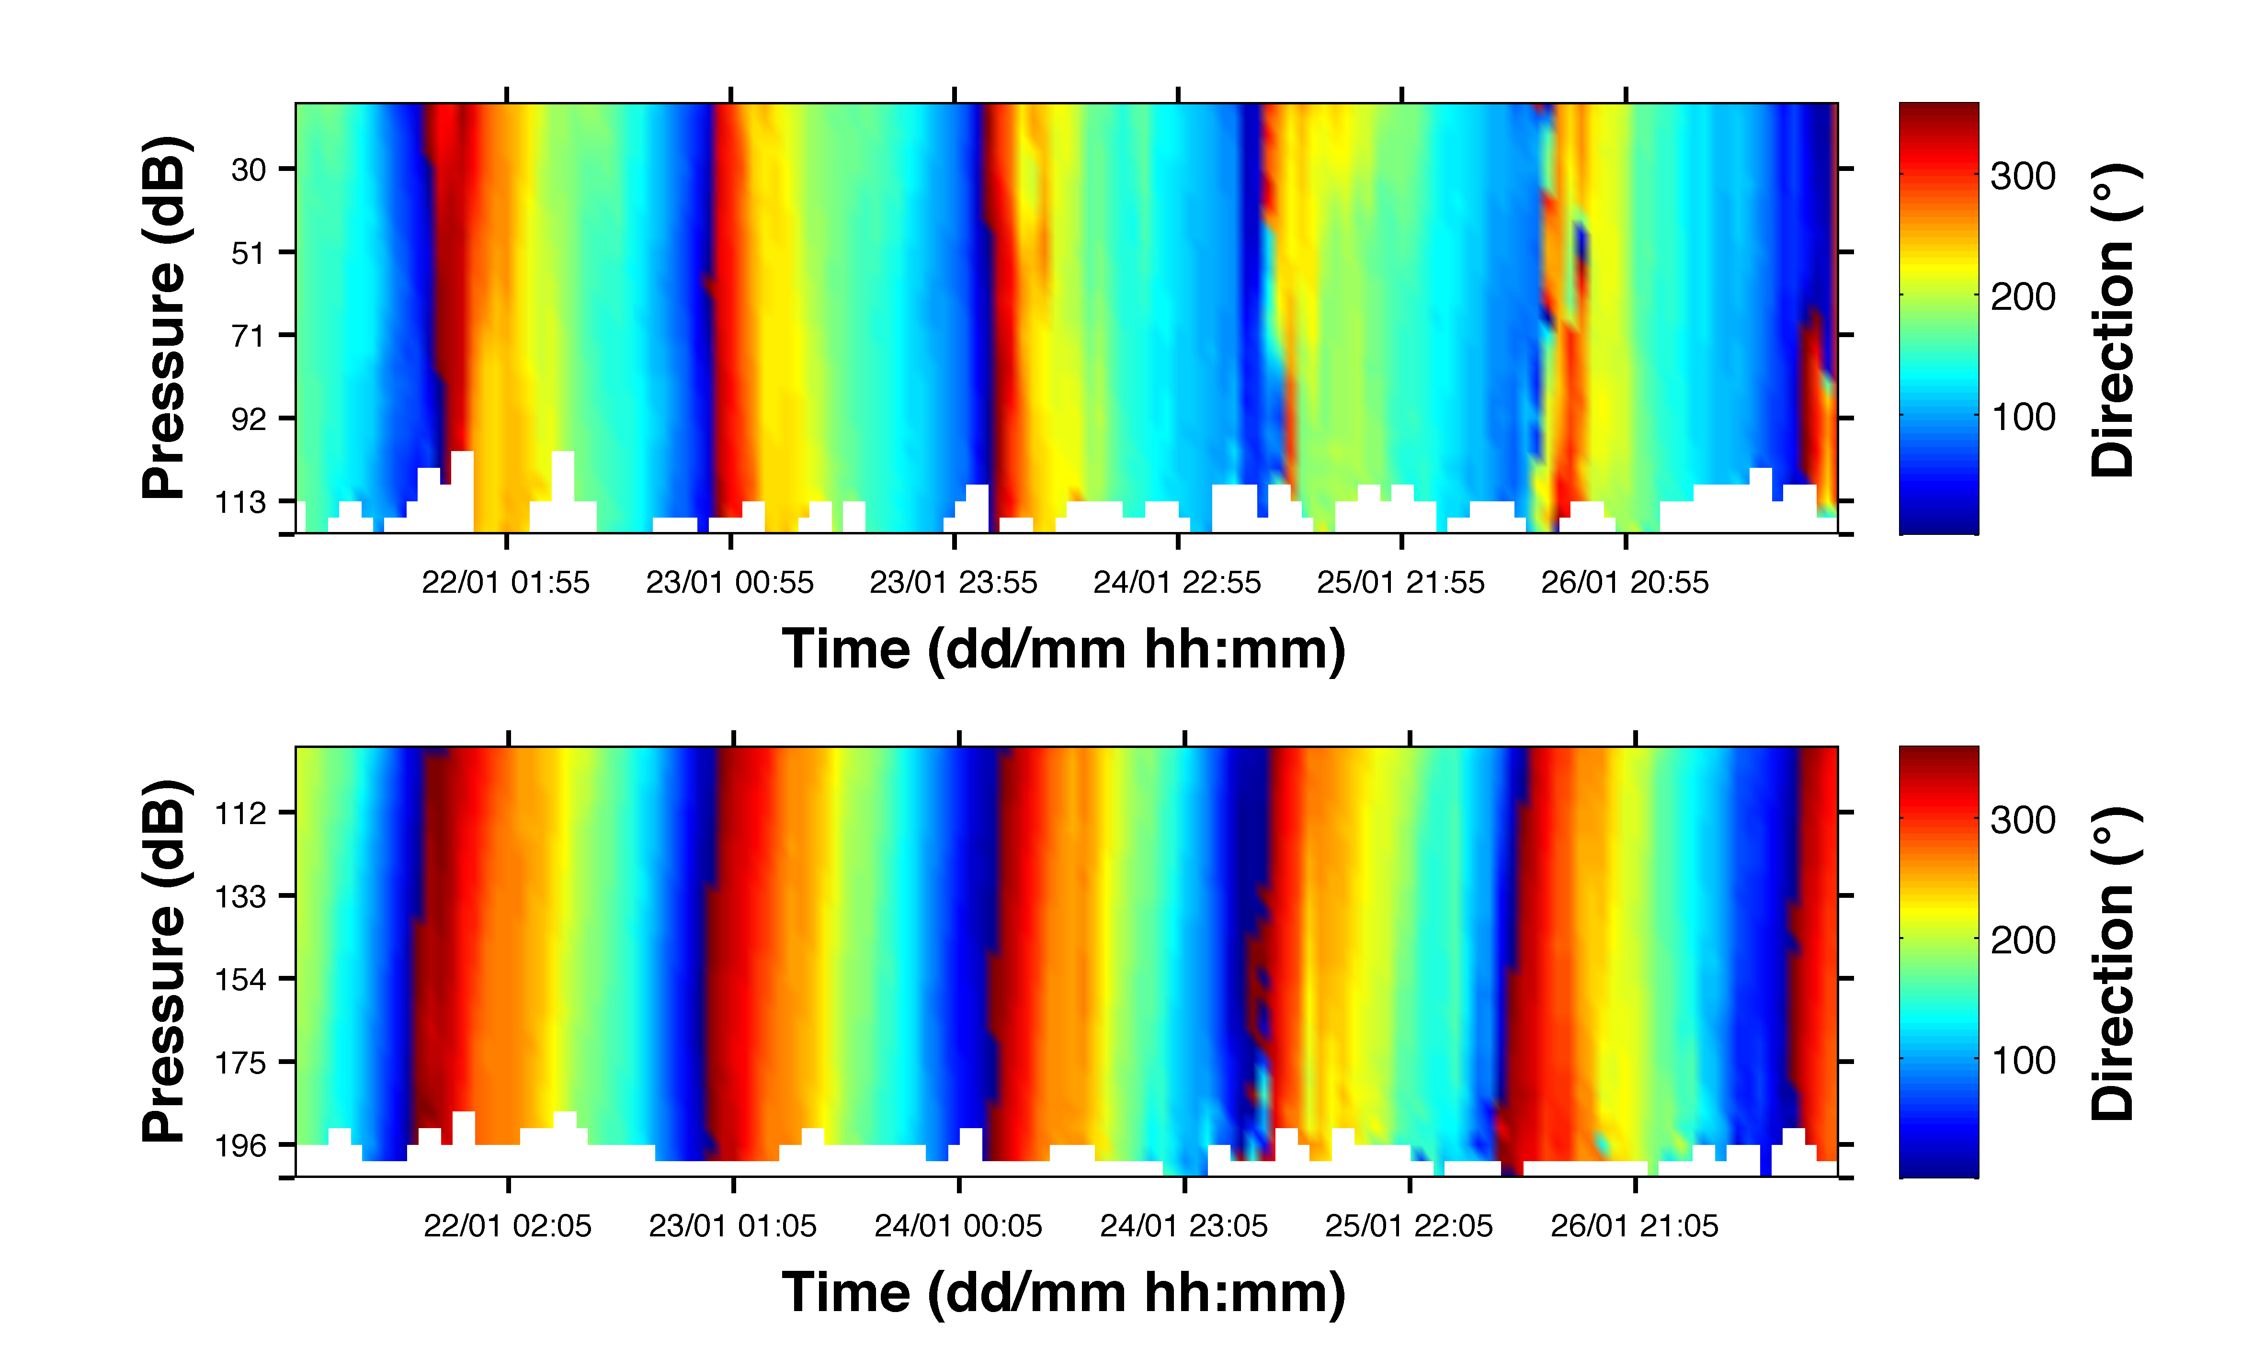
ADCP Deployment 3 - Ross Bank

