Slide 1
Phytoplankton growth rates in the Ross Sea, Antarctica
Anna Mosby
PRISM PI Meeting
11 June 2013
Notes:
-paper in press: large difference between diatoms and Phaeocystis in terms of Sigma

Slide 2
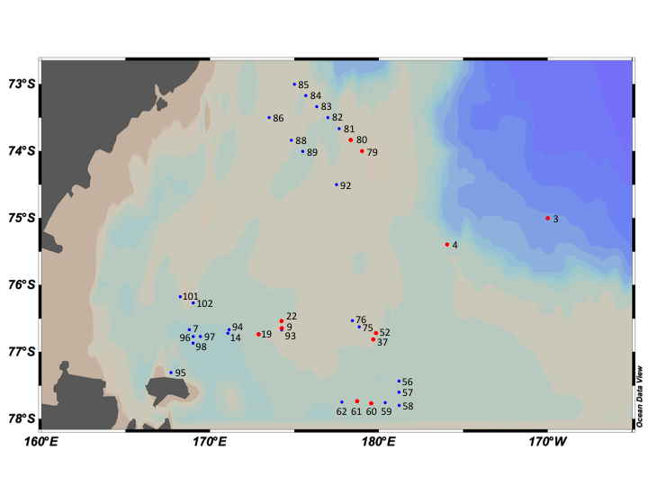
Site Overview
 | Mean | Range
Temperature (°C) | -0.11 (0.69) | -1.31-2.11
Mixed Layer Depth (m) | 27.43 (18.8) | 10-97
Chlorophyll a (μg l⁻¹) | 3.80 (3.12) | 0.22-10.53
POC (μM) | 275.1 (197.1) | 0.9-659.3
C:Chl | 111.9 (90.7) | 10.4-393.4
Figure 3. Map of stations sampled. Eleven stations were sampled for both dilution experiments and ¹⁴C-incubations (red dots) and 26 stations were sampled for ¹⁴C-incubations (blue dots). Created in Ocean Data View.

Slide 3
Dilution Experiments
Initial Assemblage Composition
Overview of Grazing Mortality and Growth Rate of Phytoplankton
Net Growth Rate by Chlorophyll vs. Net Growth Rate by Cell Counts
Shifting Carbon:Chlorophyll

Slide 4
Phytoplankton Assemblage in Dilution Experiments
Cell Abundance by Species
Biomass by Species

Slide 5
Date | Station Number | Station Description | Initial Biomass (μg l⁻¹ Chl) | Incubation Length (h) | u (d⁻¹) | g (d⁻¹) | Chlorophyll Net Growth Rate (d⁻¹) | Cell Count Net Growth Rate (d⁻¹)
8-Jan-12 | 3 | Outside Ice | 1.08 | 72 | 0.16 | 0.18 | -0.02 | 0.16
9-Jan-12 | 4 | Eddy Center | 9.45 | 24 | NA | NS | -0.29 | -0.03
9-Jan-12 |  |  |  | 48 | NA | NS | -0.08 | 0.27
9-Jan-12 |  |  |  | 72 | NA | NS | 0.00 | 0.15
14-Jan-12 | 9 | Low Biomass | 1.65 | 72 | 0.56 | 0.30 | 0.26 | 0.13
17-Jan-12 | 19 | Frontal Region | 1.71 | 72 | NA | NS | 0.47 | 0.12
17-Jan-12 | 22 | Low Biomass | 0.93 | 24 | NA | NS | 0.23 | -0.14
17-Jan-12 |  |  |  | 48 | 0.21 | -0.30 | 0.51 | -0.10
17-Jan-12 |  |  |  | 72 | 0.27 | -0.20 | 0.47 | 0.06
21-Jan-12 | 37 | Ross Bank | 4.66 | 72 | NA | NS | 0.05 | 0.16
22-Jan-12 | 52 | Ross Bank | 2.96 | 72 | NA | NS | 0.12 | 0.15
25-Jan-12 | 60 | Ross Ice Shelf | 5.95 | 72 | NA | NS | -0.09 | 0.05
25-Jan-12 | 61 | Ross Ice Shelf | 7.14 | 72 | NA | NS | -0.12 | 0.20
28-Jan-12 | 79 | Joides Trough | 0.22 | 24 | -0.29 | -0.32 | 0.05 | -0.31
28-Jan-12 |  |  |  | 48 | NA | NS | 0.11 | 0.04
28-Jan-12 |  |  |  | 72 | NS | NS | 0.10 | 0.08
28-Jan-12 | 80 | Joides Trough | 0.33 | 72 | 0.08 | 0.09 | -0.01 | 0.10

Slide 6
Date | Station Number | Station Description | Initial Biomass (μg l⁻¹ Chl) | Incubation Length (h) | u (d⁻¹) | g (d⁻¹) | Chlorophyll Net Growth Rate (d⁻¹) | Cell Count Net Growth Rate (d⁻¹)
8-Jan-12 | 3 | Outside Ice | 1.08 | 72 | 0.16 | 0.18 | -0.02 | 0.16
9-Jan-12 | 4 | Eddy Center | 9.45 | 24 | NA | NS | -0.29 | -0.03
9-Jan-12 |  |  |  | 48 | NA | NS | -0.08 | 0.27
9-Jan-12 |  |  |  | 72 | NA | NS | 0.00 | 0.15
14-Jan-12 | 9 | Low Biomass | 1.65 | 72 | 0.56 | 0.30 | 0.26 | 0.13
17-Jan-12 | 19 | Frontal Region | 1.71 | 72 | NA | NS | 0.47 | 0.12
17-Jan-12 | 22 | Low Biomass | 0.93 | 24 | NA | NS | 0.23 | -0.14
17-Jan-12 |  |  |  | 48 | 0.21 | -0.30 | 0.51 | -0.10
17-Jan-12 |  |  |  | 72 | 0.27 | -0.20 | 0.47 | 0.06
21-Jan-12 | 37 | Ross Bank | 4.66 | 72 | NA | NS | 0.05 | 0.16
22-Jan-12 | 52 | Ross Bank | 2.96 | 72 | NA | NS | 0.12 | 0.15
25-Jan-12 | 60 | Ross Ice Shelf | 5.95 | 72 | NA | NS | -0.09 | 0.05
25-Jan-12 | 61 | Ross Ice Shelf | 7.14 | 72 | NA | NS | -0.12 | 0.20
28-Jan-12 | 79 | Joides Trough | 0.22 | 24 | -0.29 | -0.32 | 0.05 | -0.31
28-Jan-12 |  |  |  | 48 | NA | NS | 0.11 | 0.04
28-Jan-12 |  |  |  | 72 | NS | NS | 0.10 | 0.08
28-Jan-12 | 80 | Joides Trough | 0.33 | 72 | 0.08 | 0.09 | -0.01 | 0.10

Slide 7
Effect of temperature on net growth rate
R = -0.93
Ρ = -0.75
Notes:
-eppley relationship on plaots

Slide 8
Difference in Growth Rate by Method Used
R²=0.35
Negative correlation between growth rate by cell count (carbon-based) and growth rate by change in chlorophyll
Apparent shift in C:chl ratio over course of incubation (result of changing light regimes in incubators?)
C:Chl | Average (SE) | Range | CV %
Initial | 55.9 (18.2) | 3.9-164.8 | 108.3
Final | 38.2 (7.7) | 5.9-85.6 | 66.9

Slide 9
Shifting C:Chl in Incubations
Ρ = -0.71
R= 0.87
R= -0.83
Ρ = 0.71

Slide 10
¹⁴C-Incubations
Growth Rate by Incubation Length
Growth Rate and Initial Biomass
Structural Equation Modeling of Growth Rate in ¹⁴C-incubations

Slide 11
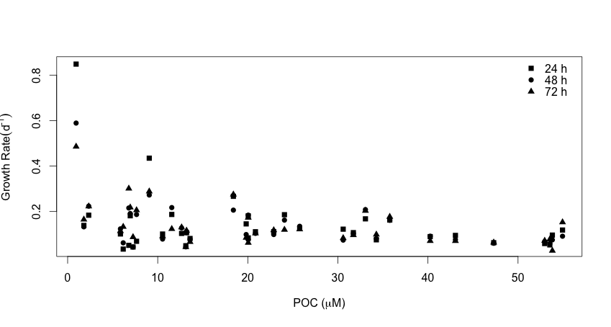
Growth Rate by Incubation Length
No significant difference in growth rate with increase in incubation length
(ANCOVA p<0.0001)

Slide 12
Growth Rate and Initial Biomass
Growth Rate in ¹⁴C-incubations decreased at increasing initial POC concentrations (p<0.001)
Ρ = -0.38

Slide 13
Structural Equation Modeling of Growth Rate
Growth Rate
Uses structural equations to evaluate direct and indirect effects in a system; basically build network and tests associations between parameters
Robust to violations of normality; uses maximum likelihood estimation
Two modes: hypothesis testing and exploratory
Temp
Carbon: chlorophyll
Mixed Layer Depth
Fe

Slide 14
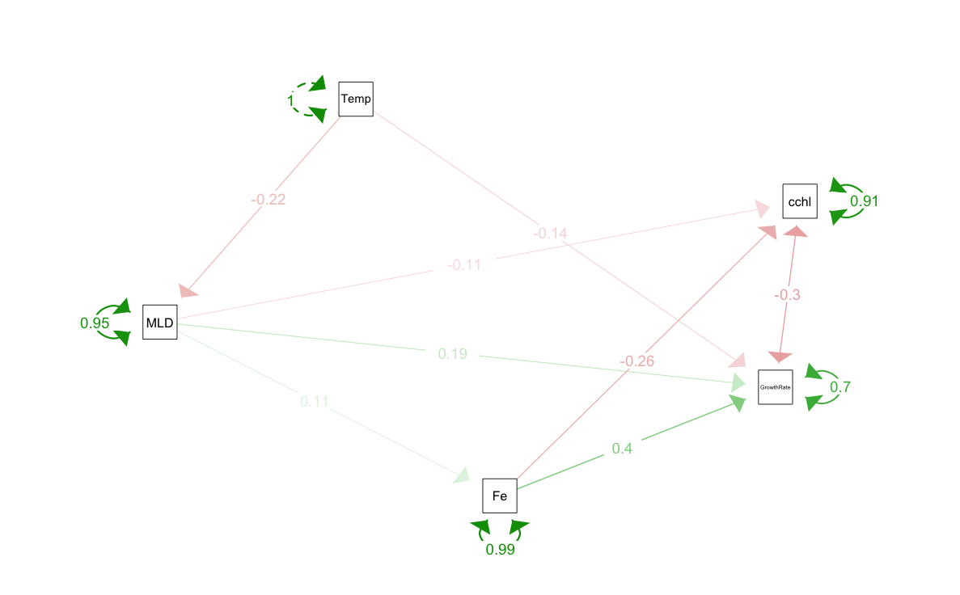
Structural Equation Modeling
Parameter | Estimate standardized | SE | Z | P-value
MLD ~
Temp | -0.22 | 0.20 | -1.10 | 0.27
C:chl ~
MLD | -0.11 | 0.20 | -0.57 | 0.57
Fe | -0.27 | 0.20 | -1.32 | 0.19
Fe ~
MLD | 0.11 | 0.21 | 0.53 | 0.60
Growth Rate ~
Temp | -0.14 | 0.17 | -0.82 | 0.41
MLD | 0.19 | 0.18 | 1.04 | 0.30
Fe | 0.43 | 0.18 | 2.43 | 0.02
Degrees of freedom: 2
P-value (Chi-square): 0.453
Root Mean Square Error of Approximation <0.05
Standardized Root Mean Square Residual: 0.077
Comparative Fit Index: 1.000
Tucker-Lewis Index: 1.364
Notes:
Null hypothesis for chi-squared: predicted model covariance matrix= observed covariance matrix

Slide 15
Factors Affecting Phytoplankton Growth
Irradiance and growth rate
MLD predicted growth rate in ¹⁴C-incubations
Initial C:Chl correlated with growth rate in ¹⁴C-incubations
Shift in C:Chl in dilution experiments in samples from varying MLD
Fe and growth rate
Fe best predictor for growth rate in ¹⁴C-incubations
Fe shows positive trend with MLD at stations sampled for growth rate
Negative correlation between C:Chl and Fe
Temperature and growth rate
Growth rates across methods below temperature-defined maximum growth rate (Eppley, 1972)
Temperature may be affecting growth rate through MLD

Slide 16
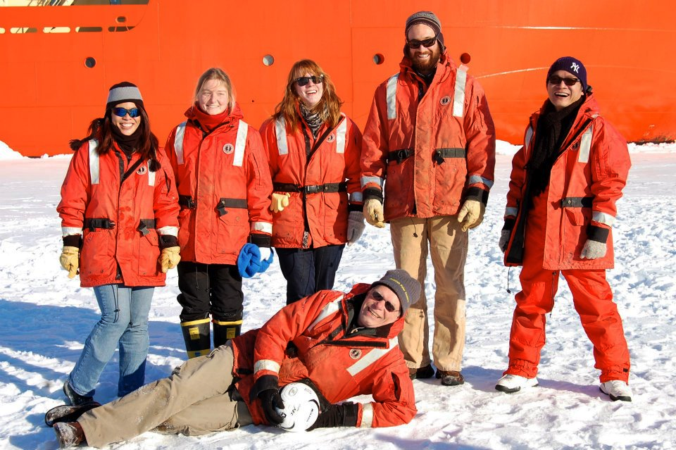
Acknowledgements
Advisor: Walker Smith
Committee: Kam Tang, Debbie Steinberg, Aaron Beck, and
Eileen Hofmann
Hai Doan, Liza Delizo,
Sean Charles, Elise Olson,
Kathleen Donaldson
PRISM Cruise and NSF/USAP
Gloucester Point Rotary Club and Warriner Family: Gloucester
Point Rotary Club
Fellowship
VIMS Foundation: William J. Hargis, Jr. Fellowship
Photo credit: Tommy Ryan-Keogh
Notes:
Include other fellowship
*send Tommy’s email address

Slide 17
Extra Slides

Slide 18
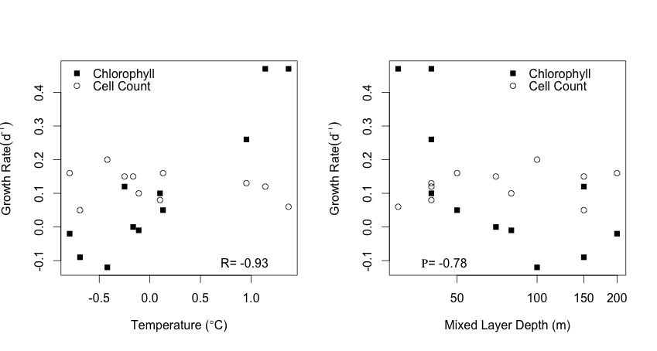
Effect of temperature on net growth rate

Slide 19
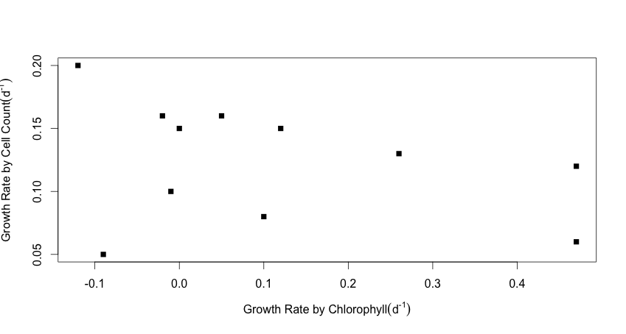
Difference in Growth Rate by Method Used
Negative correlation between growth rate by cell count (carbon-based) and growth rate by change in chlorophyll
Apparent shift in C:chl ratio over course of incubation (result of changing light regimes in incubators?)
C:Chl | Average (SE) | Range | CV %
Initial | 55.9 (18.2) | 3.9-164.8 | 108.3
Final | 38.2 (7.7) | 5.9-85.6 | 66.9

Slide 20
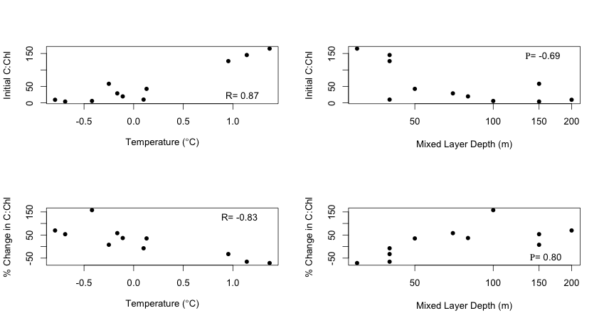
Shifting C:Chl in Incubations

Slide 21
Growth Rate by Incubation Length
No significant difference in growth rate with increase in incubation length
(ANCOVA p<0.0001)

