Slide 1
Ross Sea Model & Tides
Stefanie Mack
06/11/2013
PRISM Meeting

Slide 2
Outline
Ross Sea Tides
Model Update
Future plans

Slide 3
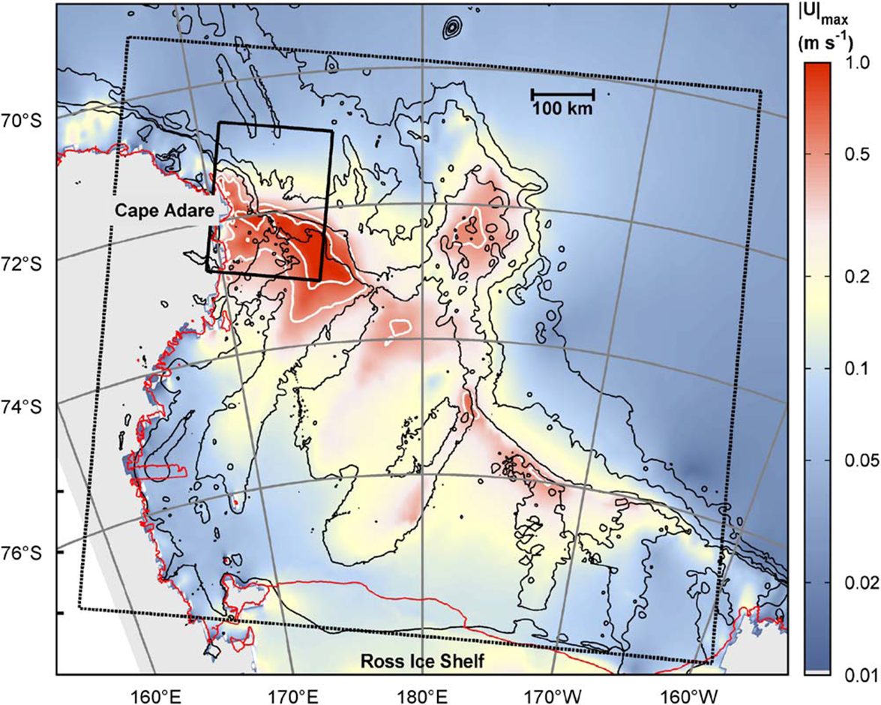
Ross Sea Tides
Padman et al, DSRII, 2009
Notes:
Map of maximum tidal velocity in the Ross Sea – on a log scale.

Slide 4
Tides & Sea Ice
Satellite data shows that tides have an impact on sea ice concentration
Mack et al, GRL, 2013
Notes:
These are maps from AMSR-E ice concentration time series that were analyzed for a tidal signal. Each bin represents one time series. The left panel is for the O1 constituent, the right for K1. Grayed out areas indicate statistical insignificance. This was done for 2004. See Mack et al, 2013.

Slide 5
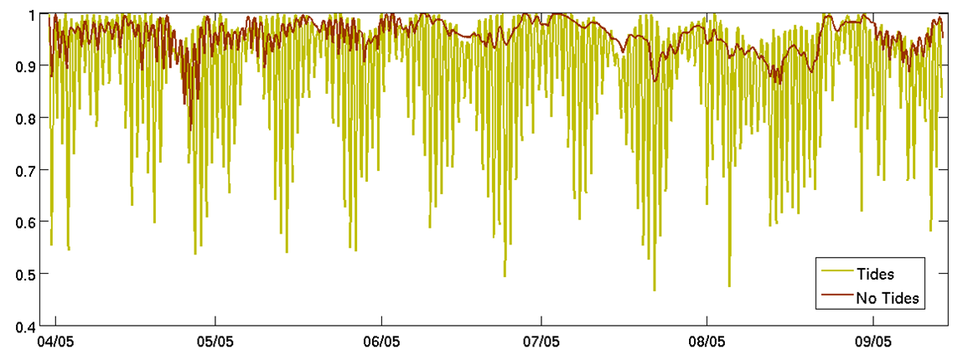
ROMS & Tides
Compare tides vs no tides runs
Sea Ice Concentration (ratio)
Notes:
Scott Springer at ESR ran ROMS v3.3 for the Ross Sea for 2005. Here we compare model runs with and without tides to identify the tidal contribution. Note the model run is not nodally corrected.

Slide 6
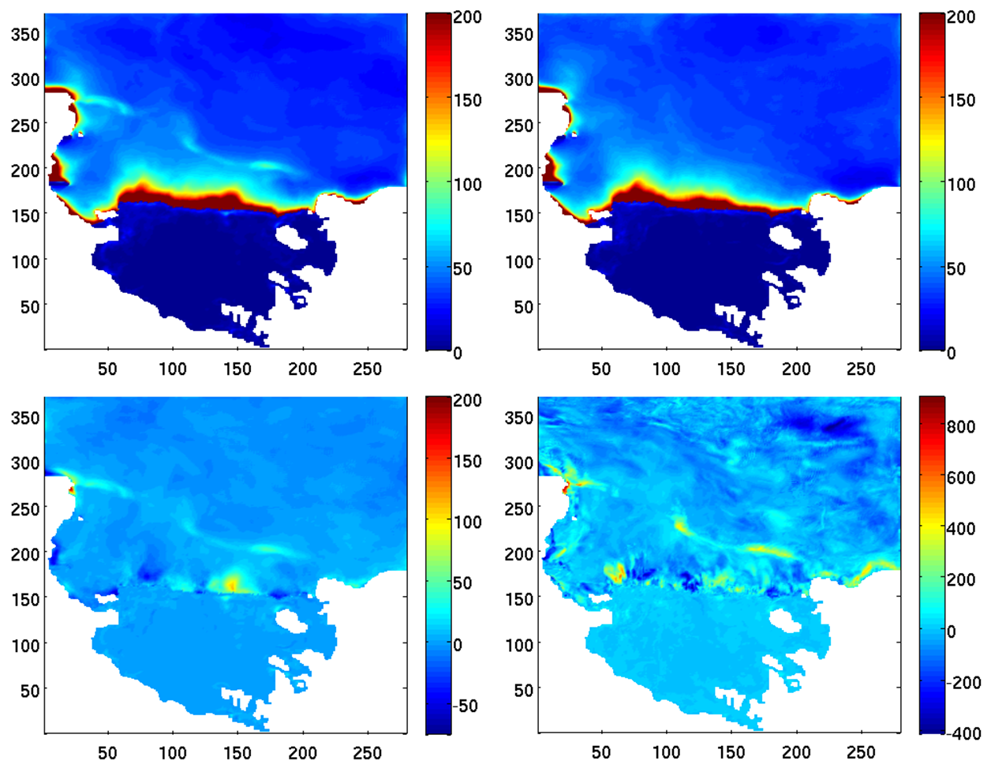
Notes:
Time-averaged surface heat flux in the Ross Sea from the model runs mentioned in the previous slide. Top left – run with tides. Top right – run without tides. Bottom left – difference between top panels (L-R). Bottom right – difference in maximum surface heat flux (not averaged).

Slide 7
Model State & Plans
Notes:
The model state as it is now, and our future plans for it.

Slide 8
Current
Future
5km resolution
Tides w/o nodal corrections
Bathymetry from BEDMAP & Davey
Upgraded to ROMS v3.6
1.5km resolution
Tides w/ nodal corrections
Update bathymetry with BEDMAP 2
Keep upgrades current
Notes:
The model state as it is now, and our future plans for it.

Slide 9
Investigation plans
Ross Bank
Water mass pulses
Ice shelf basal melt
Other effects TBD
Suggestions?
Notes:
Once we have a high resolution model with nodally corrected tidal forcing, we expect to investigate upward mixing of iron from sediment over Ross Bank. We also want to look at water mass pulses, including, but not limited to, pulses of warm CDW onto the shelf, pulses of HSSW off the shelf to form AABW, pulses of ISW from under the ice shelf. There may be other effects we decide to investigate later, and as always, we are open to suggestions and requests.

Slide 10
Conclusions
ROMS does a good job representing tidal effects
Start investigating tide contributions to PRISM run
Time frame: By end of June
Mesoscale variability best seen at higher resolution
Time frame: Uncertain, by end of summer
Notes:
From our previous work, we know that ROMS does a good job with tides. We expect to have the PRISM case with nodally corrected tides up and running by the end of the month. Next, I will begin to work on updating the resolution and bathymetry, but I would be happy to provide preliminary results from the model with tides while that is in progress. I hope to have the finer resolution model completed by the end of summer, but that time frame is hard to predict.

Slide 11
Ross Sea Model
ROMS: 5 km horizontal resolution, 24 levels
Ice shelves (mechanical and thermodynamic)
Dynamic sea-ice
Different wind forcing, but typically either from Antarctic Mesoscale Prediction System (AMPS) or ERA-Interim
Lateral boundary conditions from WOA, OCCAM and SSM/I ice concentrations
Bathymetry from BEDMAP and Davey
Experiments w/ dye representing CDW
Notes:
ROMS: Regional Ocean Modeling System: hydrostatic finite difference OGCM with a terrain following vertical coordinate. BEDMAP (ice thickness and subglacial topo model of the Ant.). Explain AMPS.

Slide 12
New Model Run for PRISM
Sept. 15, 2010 – Feb. 29, 2012
Model fields saved every 12 hours for entire run
Forced with 6-hourly winds and air temperatures from the new higher resolution (0.75°) ERA-Interim product
Had to switch to coarser (25-km) SSMIS sea-ice from AMSR-E (12.5-km)
Fixed small bug in the sea-ice code
Two new dye tracers: Ice Shelf meltwater and sea-ice meltwater
Notes:
AMSR-E ice no longer available past October, 2011.

