Slide 1
Remaining sections: colligative properties
Nonelectrolyte solutions
Vapor-pressure lowering
Fractional Distillation
BP elevation
FP depression
Osmotic pressure
Determining molar mass
Electrolyte solutions
Ion pairs
van’t Hoff factor
Colloids

Slide 2
Colligative Properties of Nonelectrolyte Solutions
Colligative properties are properties that depend only on…
the number of solute particles (atoms, ions, molecules) in the sol’n
and not on
the nature of the solute particles

Slide 3
Colligative Properties of Nonelectrolyte Solutions
Colligative properties are properties that depend only on the number of solute particles in solution and not on the nature of the solute particles.
Vapor-Pressure Lowering
$$P_{1}=X_{1}P_{1}^{0}$$
Boiling-Point Elevation
$$∆T_{b}=K_{b}m$$
Freezing-Point Depression
$$∆T_{f}=K_{f}m$$
Osmotic Pressure $(π)$
$$π=MRT$$

Slide 4
Colligative Properties of Electrolyte Solutions
$$\text{0.1 }\text{m} \text{NaCl} \text{solution}$$
$$→$$
$$\text{0.1 }\text{m} \text{Na}\text{+} \text{ions}\text{ \& 0.1 }\text{m} \text{Cl}\text{−} \text{ions}$$
Colligative properties are properties that depend only on the number of solute particles in solution and not on the nature of the solute particles.
$$\text{0.1 }\text{m} \text{NaCl} \text{solution}$$
$$→$$
$$\text{0.2 }\text{m} \text{ions} \text{in} \text{solution}$$
$$\text{van}\text{’}\text{t} \text{Hoff} \text{factor}\text{ (}\text{i}\text{)}\text{ =}\frac{\text{actual} \text{number} \text{of} \text{particles} \text{in} \text{soln} \text{after} \text{dissociation} }{\text{number} \text{of} \text{formula} \text{units} \text{initially} \text{dissolved} \text{in} \text{soln} }$$
 | i should be
nonelectrolytes | 1
$$NaCl$$ | 2
$${CaCl}_{2}$$ | 3

Slide 5
Colligative Properties of Electrolyte Solutions (1)
Boiling-Point Elevation $∆T_{b}={iK}_{b}m$
Freezing-Point Depression $∆T_{f}={iK}_{f}m$
Osmotic Pressure (π) $π = iMRT$
Copyright © McGraw-Hill Education. Permission required for reproduction or display.
Table 12.3 The van’t Hoff Factor of 0.0500 M Electrolyte Solutions at $25℃$
Electrolyte | i (Measured) | i (Calculated)
Sucrose* | 1.0 | 1.0
HCl | 1.9 | 2.0
NaCl | 1.9 | 2.0
$${MgSO}_{4}$$ | 1.3 | 2.0
$${MgCl}_{2}$$ | 2.7 | 3.0
$${FeCl}_{3}$$ | 3.4 | 4.0
*Source is a nonelectrolyte. It is listed here for comparison only.

Slide 6
Colligative Properties of Nonelectrolyte Solutions
Vapor-Pressure Lowering
0
0
P ₁
= vapor pressure of pure solvent
P₁ = X₁ P ₁
Raoult’s law
X₁ = mole fraction of the solvent
If the solution contains only one solute:
X₁ = 1 – X₂
0
- P₁ = ΔP = X₂
0
X₂ = mole fraction of the solute
P ₁
P ₁

Slide 7
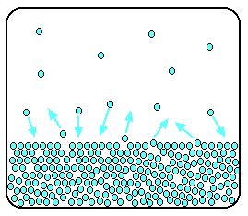
Raoult’s Law
Notes:
Dynamic equilibrium: the number of particles breaking away from the surface is exactly the same as the number sticking onto the surface again

Slide 8
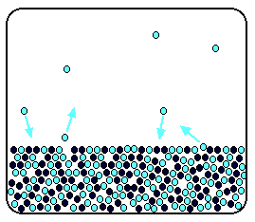
Raoult’s Law
Notes:
Now, add enough solute (like NaCl to water) so that the solvent molecules only occupy 50% of the surface of the solution.

Slide 9
Raoult’s Law
Less molecules of the solvent exchange with the space above, because there are less molecules of the solvent at the surface
Notes:
Now, add enough solute (like NaCl to water) so that the solvent molecules only occupy 50% of the surface of the solution.

Slide 10
Raoult’s Law
Less molecules of the solvent in the vapor phase = less vapor pressure!
Notes:
Now, add enough solute (like NaCl to water) so that the solvent molecules only occupy 50% of the surface of the solution.

Slide 11
Colligative Properties of Nonelectrolyte Solutions
Vapor-Pressure Lowering
0
0
P ₁
= vapor pressure of pure solvent
P₁ = X₁ P ₁
Raoult’s law
X₁ = mole fraction of the solvent
If the solution contains only one solute:
X₁ = 1 – X₂
0
- P₁ = ΔP = X₂
0
X₂ = mole fraction of the solute
P ₁
P ₁

Slide 12
Raoult’s law
#12.49 A solution is prepared by dissolving 396 g of sucrose (C₁₂H₂₂O₁₁) in 624 g of water.
What is the vapor pressure of this solution at 30°C? (P_{vap} = 31.8 mmHg at 30°C)

Slide 13
Raoult’s law
#12.49 A solution is prepared by dissolving 396 g of sucrose (C₁₂H₂₂O₁₁) in 624 g of water.
What is the vapor pressure of this solution at 30°C? (Pº_{H2O} = 31.8 mmHg at 30°C)
Find moles of water and sucrose
Calculate mole fraction of water (X_{H2O})
Calculate P’_{H2O}

Slide 14
Raoult’s law
#12.49 A solution is prepared by dissolving 396 g of sucrose (C₁₂H₂₂O₁₁) in 624 g of water.
What is the vapor pressure of this solution at 30°C? (Pº_{H2O} = 31.8 mmHg at 30°C)
P_{soln} = 30.8 mmHg

Slide 15
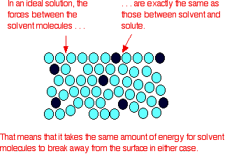
Raoult’s Law: only applies to ideal solutions

Slide 16
Raoult’s Law: only applies to ideal solutions
In real life, solute-solvent IFs are not the same as solvent-solvent IFs

Slide 17
Raoult’s Law: only applies to ideal solutions
Therefore, Raoult’s law only applies to dilute solutions (certainly not 50% NaCl solution)

Slide 18
Raoult’s law
What if solution is a mixture of liquids?
Non-volatile solution: vapor pressure depends on the concentration of the solute in the solution
Volatile solution: vapor pressure is the sum of the individual partial pressures (e.g., benzene-toluene)
See page 533-534 for the full explanation

Slide 19
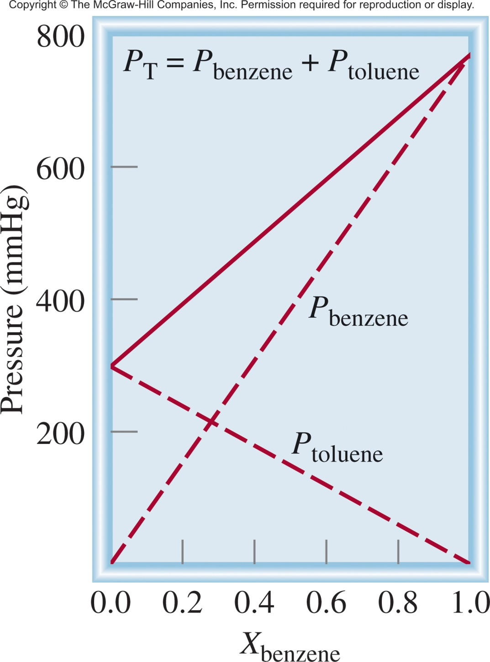
0
P_{A} = X_{A} P _{A}
Ideal Solution
0
P_{B} = X_{B} P _{B}
P_{T} = P_{A} + P_{B}
0
0
P_{T} = X_{A} P _{A}
+ X_{B} P _{B}

Slide 20
Raoult’s law
What if it’s not an ideal solution?

Slide 21
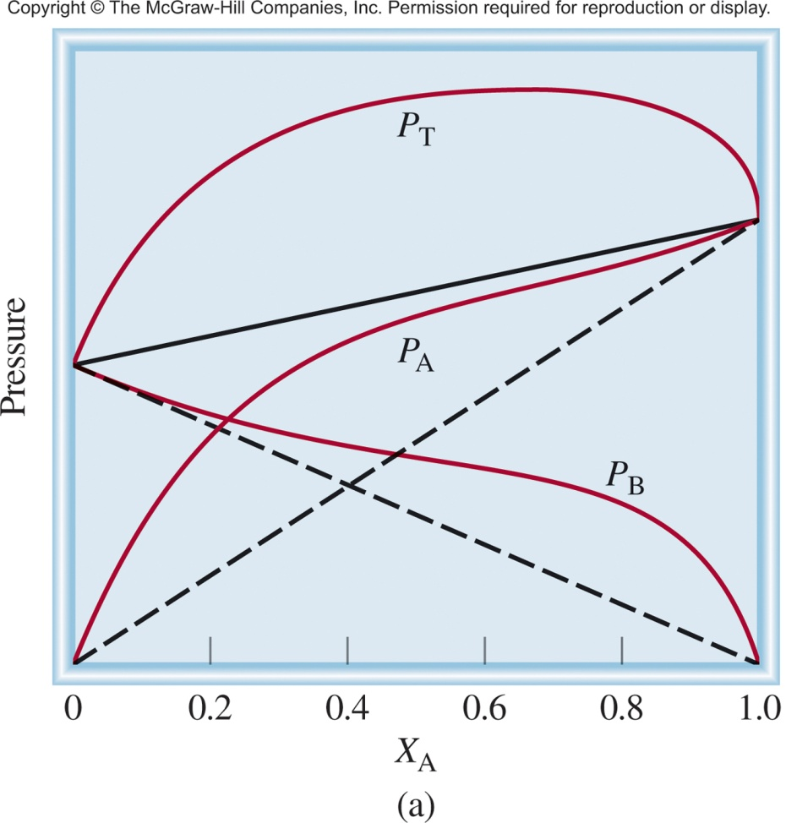
Solvent-solvent IFs are stronger then solute-solvent IFs
Stronger
Weaker
A
A
B
A
Force
A-B
Force
A-A
Force
B-B
<
&
P_{T} is greater than
predicted by Raoult’s law
Notes:
Positive deviation: vapor pressure is greater than the sum of the individual vapor pressures, mixing is endothermic

Slide 22
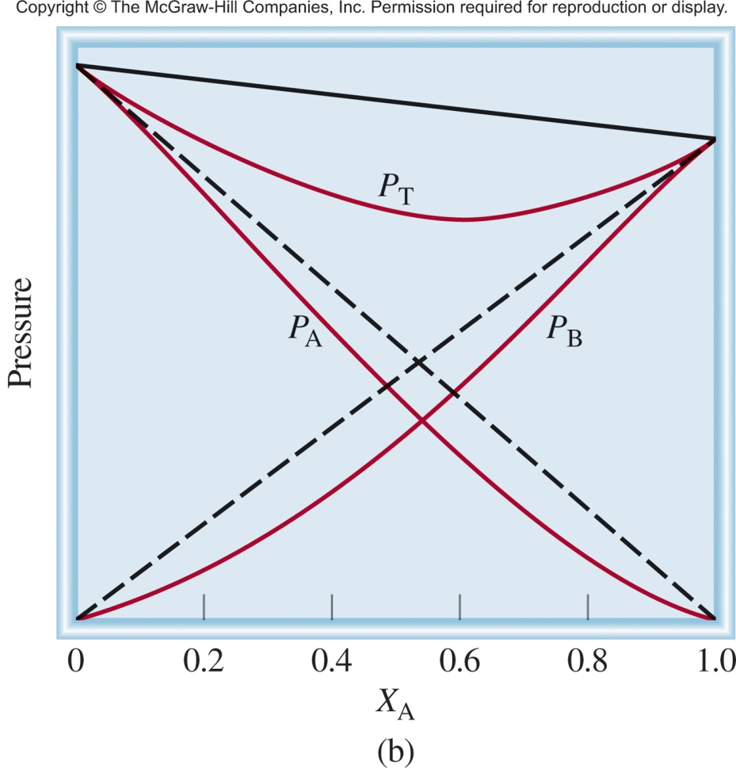
Solute-solvent IFs are stronger then solvent-solvent IFs
Weaker
Stronger
A
A
B
A
Force
A-B
Force
A-A
Force
B-B
P_{T} is less than
predicted by Raoult’s law
>
&
Notes:
Negative deviation: vapor pressure is less than the sum of the individual vapor pressures, mixing is exothermic

Slide 23
Colligative properties
How do they affect boiling point and freezing point?

Slide 24
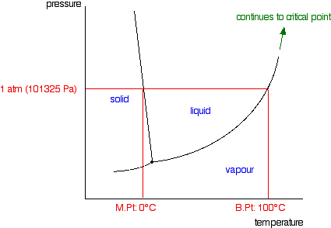
Phase diagram of water

Slide 25
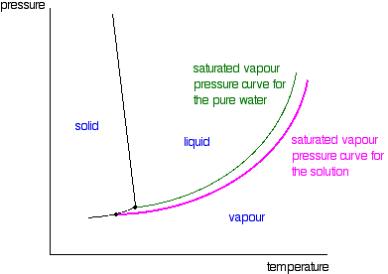
Add a non-volatile solute…
Notes:
Notice what happened to the liquid-vapor equilibrium line…it moved lower wrt pressure and temperature. Remember, that’s the triple point!
The pink line is the “boiling point”!

Slide 26
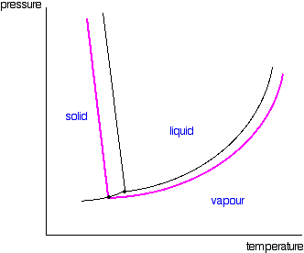
Since the liquid/vapor intersect moved…
Notes:
…so must the solid/vapor intersect.
Now we’ve changed the “melting point”!

Slide 27
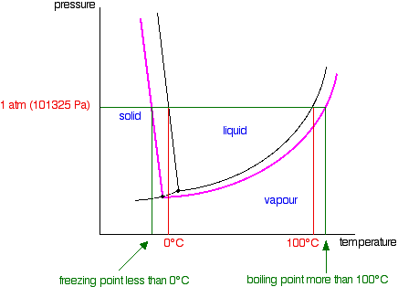
Changes to b.p. and f.p.
Notes:
At normal atmospheric pressure, when you add a non-volatile solute, the b.p. is elevated, and the m.p. is depressed.

Slide 28
Colligative properties
ΔT_{b} = K_{b} m
ΔT_{f} = K_{f} m
Notes:
At normal atmospheric pressure, when you add a non-volatile solute, the b.p. is elevated, and the m.p. is depressed.

Slide 29
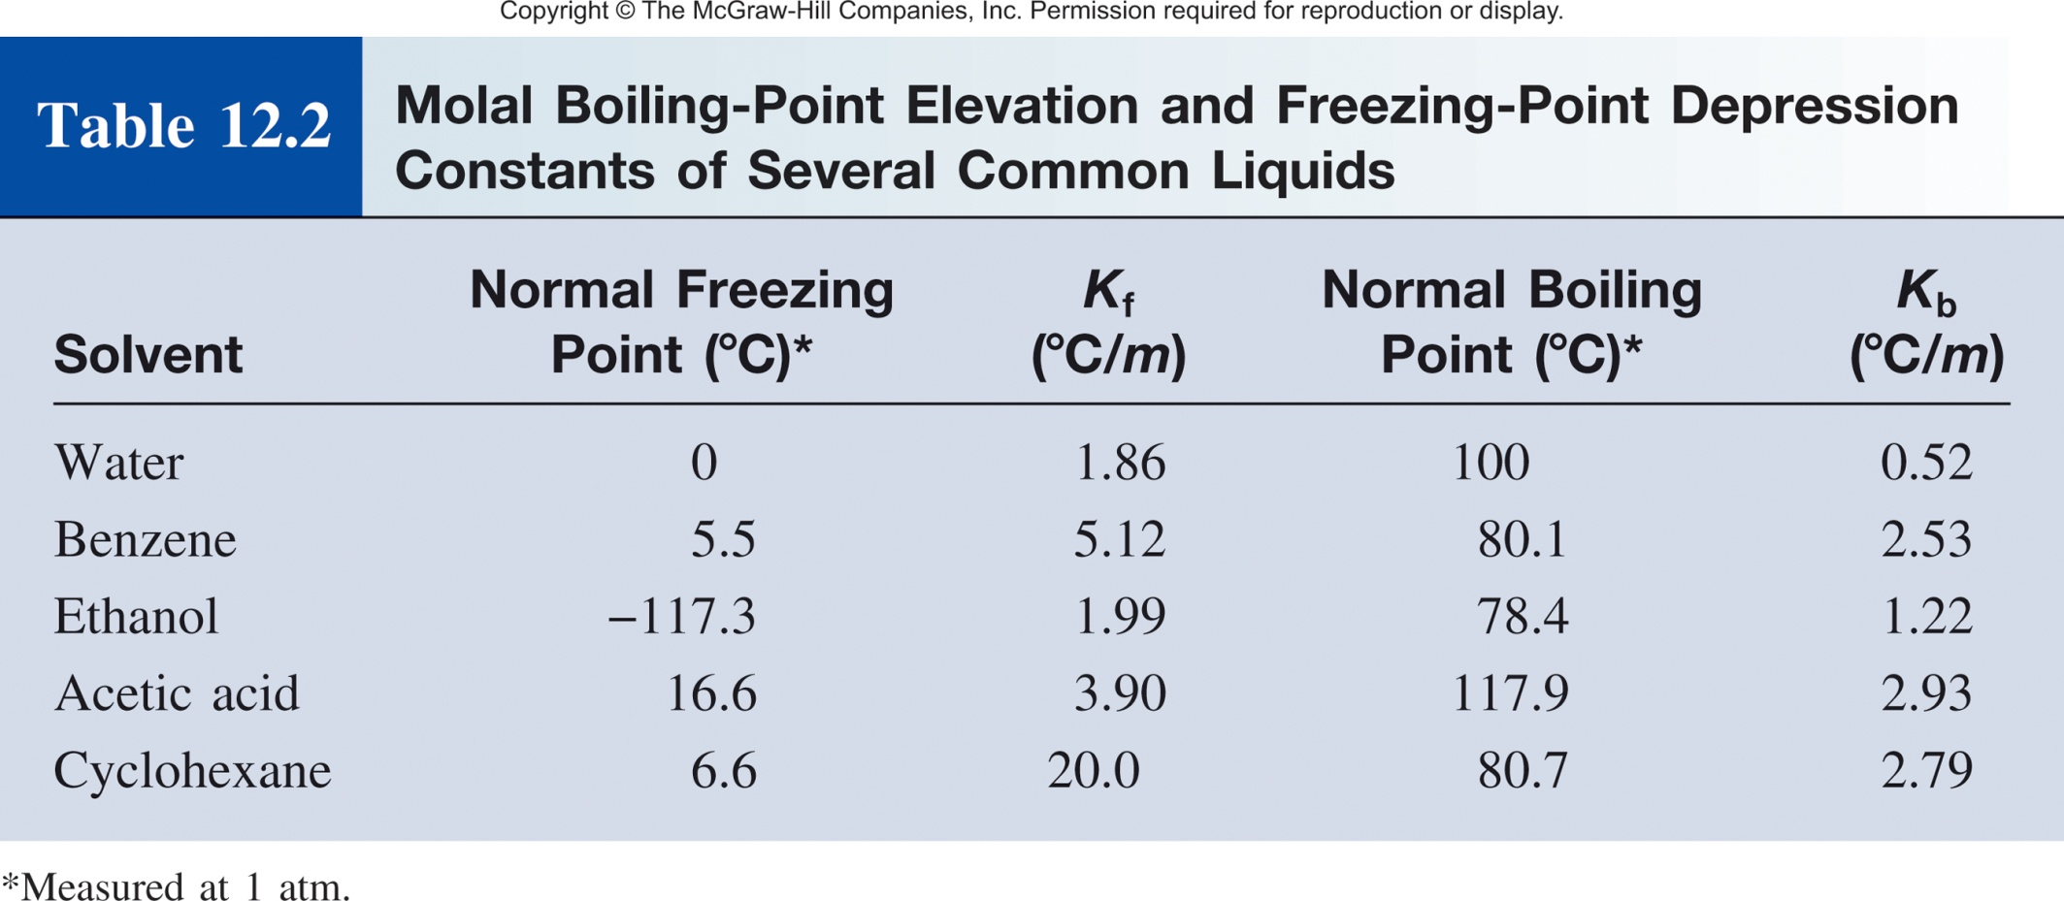

Slide 30
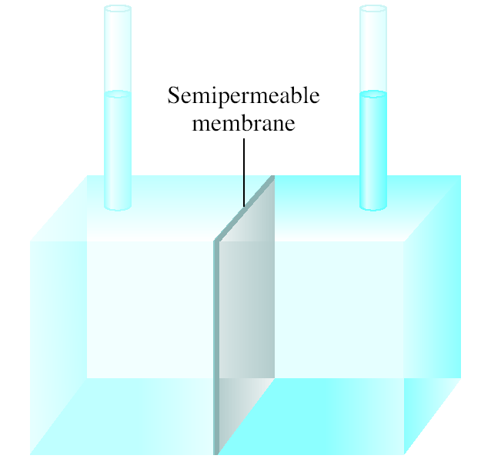
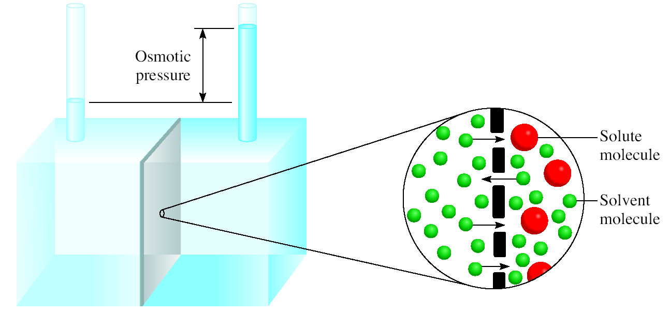
Osmotic Pressure (π)
Osmosis is the selective passage of solvent molecules through a porous membrane from a dilute solution to a more concentrated one.
A semipermeable membrane allows the passage of solvent molecules but blocks the passage of solute molecules.
Osmotic pressure (π) is the pressure required to stop osmosis.
more
concentrated
dilute

Slide 31
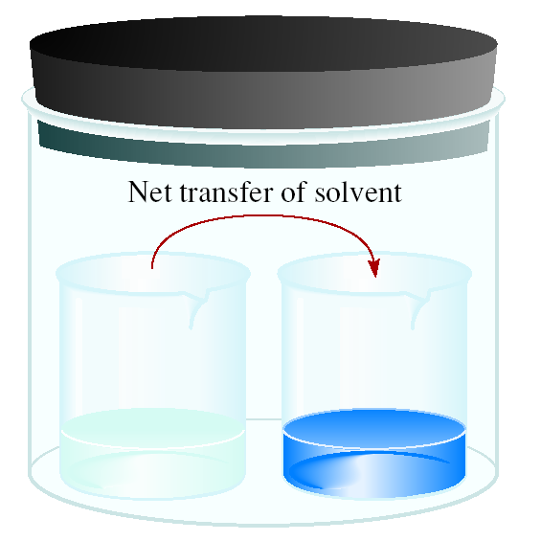
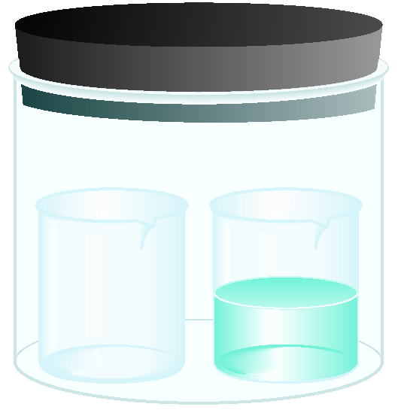
Osmotic Pressure (π)
time
solvent
solution
High
P
Low
P
π = MRT
M is the molarity of the solution
R is the gas constant (0.0821 L atm/mol K)
T is the temperature (in K)

Slide 32
Colloids
A colloid is a dispersion of particles of one substance throughout a dispersing medium of another substance.
Colloid versus solution
colloidal particles are much larger than solute molecules
colloidal suspension is not as homogeneous as a solution
colloids exhibit the Tyndall effect

Slide 33
Types of Colloids
Copyright © McGraw-Hill Education. Permission required for reproduction or display.
Table 12.4 Types of Colloids
Dispersing Medium | Dispersed Phase | Name | Example
Gas | Liquid | Aerosol | Fog, mist
Gas | Solid | Aerosol | Smoke
Liquid | Gas | Foam | Whipped cream
Liquid | Liquid | Emulsion | Mayonnaise
Liquid | Solid | Sol | Milk of magnesia
Solid | Gas | Foam | Plastic foams
Solid | Liquid | Gel | Jelly, butter
Solid | Solid | Solid sol | Certain alloys (steel), opal

Slide 34
Chapter 12 Outline
Types of solutions
Molecular View of the Solution Process
Concentration Units
Effect of Temperature on Solubility
Effect of Pressure on Solubility of Gases
Colligative Prop of Nonelectrolyte Solutions
Colligative Prop of Electrolyte Solutions
Colloids

