Slide 1
A
B
C
D
F_{m}
F’
NPQ
F’
NPQ
F₀
Partially
closed
Low
efficiency
Open
Closed
e⁻
e⁻
e⁻
e⁻
Chlorophyll
PSII
e⁻
4H⁺
2H₂O
Dark
O₂
Measuring pulses
Saturating pulse
Actinic light
(quasi-continuous)
Actinic light

Slide 2
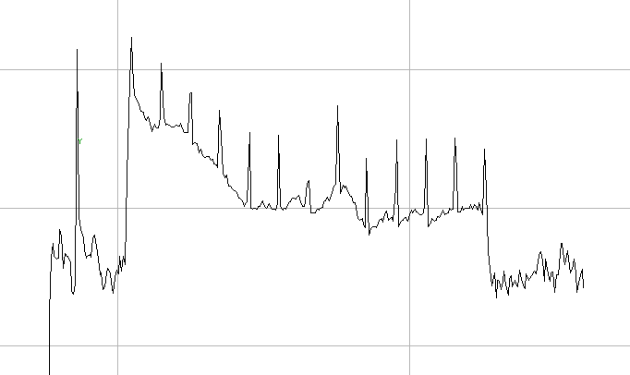
Fm
Fm’
F’
Fo
D
Actinic light
D
Saturation pulses

Slide 3
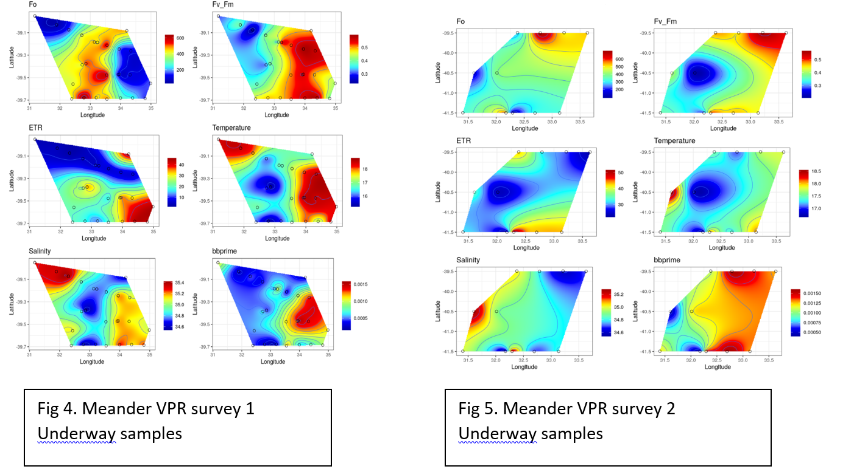

Slide 4
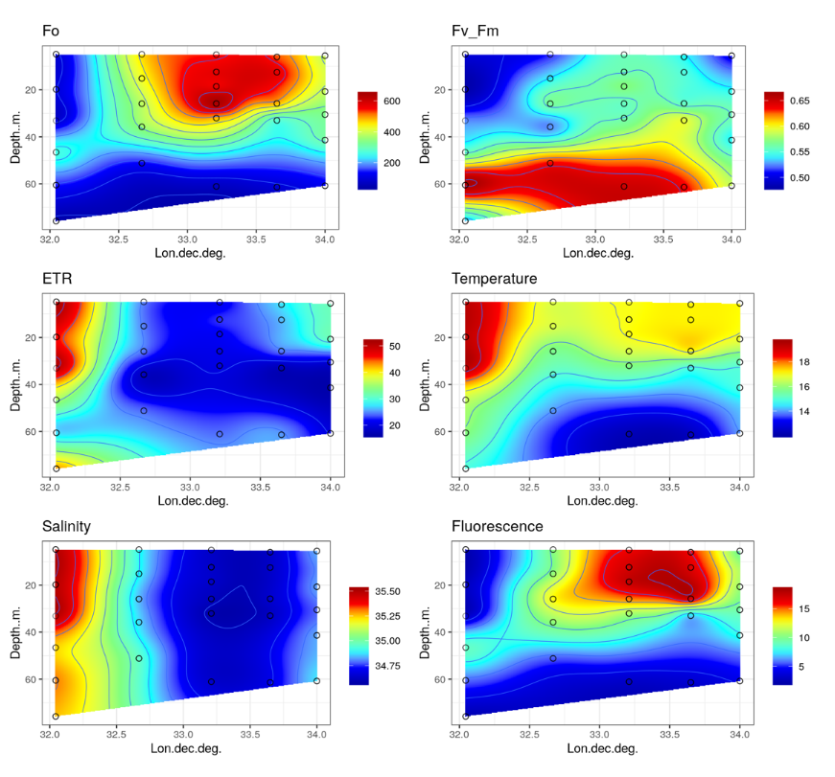
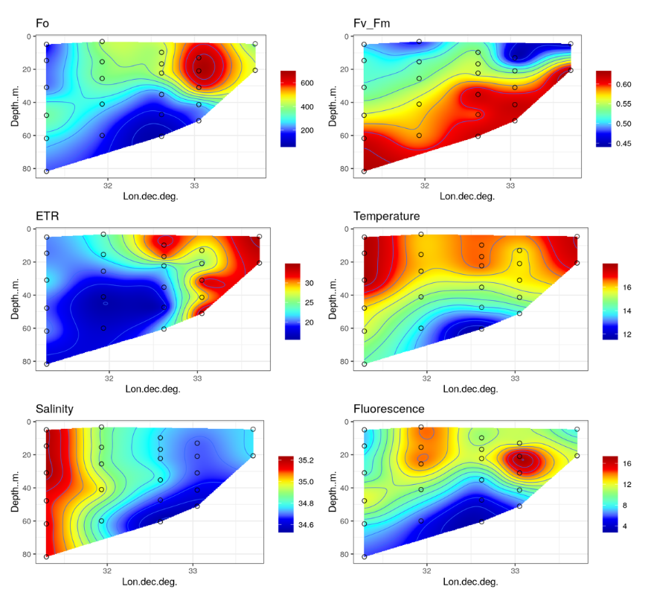
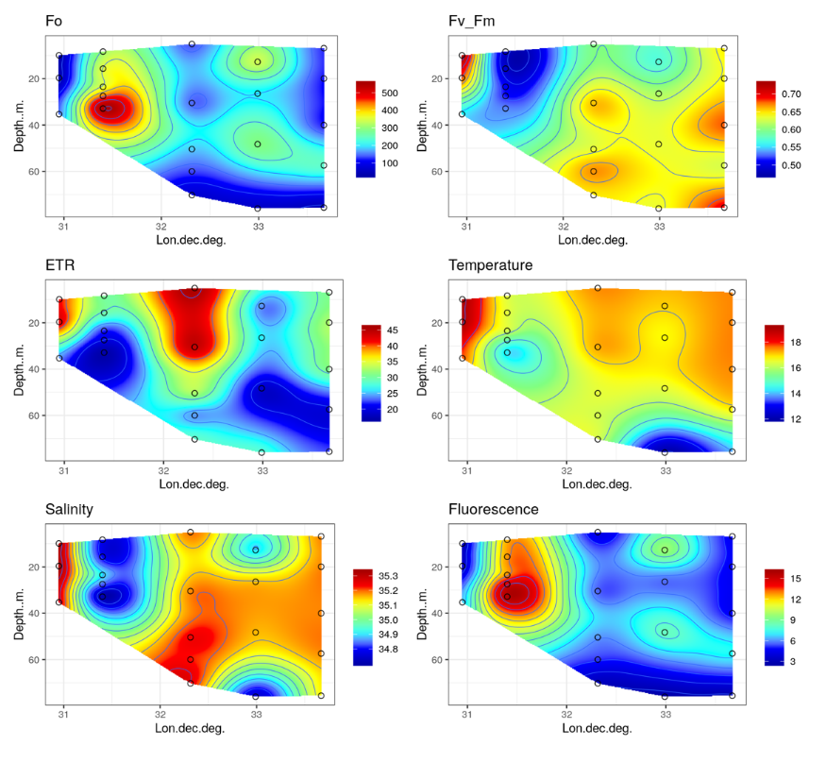
CTD depth profile Meander 2
North transect (CTD 44-52)
CTD Depth profile Meander 2
Centre transect (CTDs 35-42)
CTD Depth profile Meander 2
Southern transect (CTDs 26-34)

Slide 5
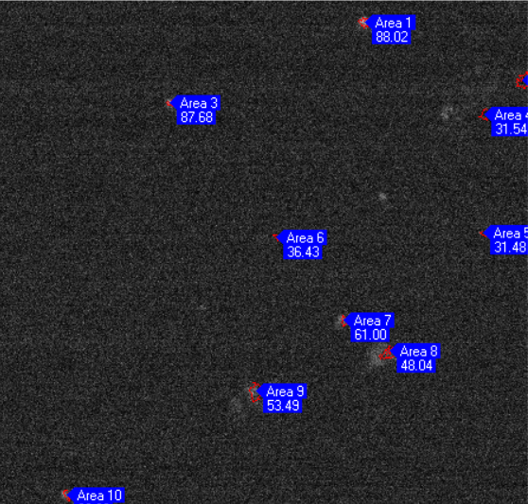
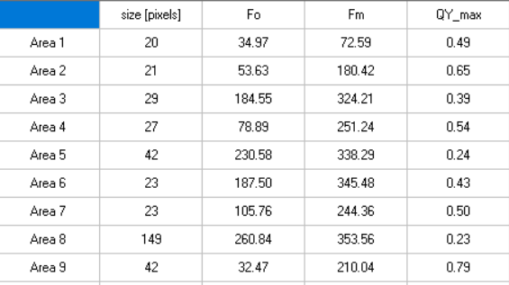
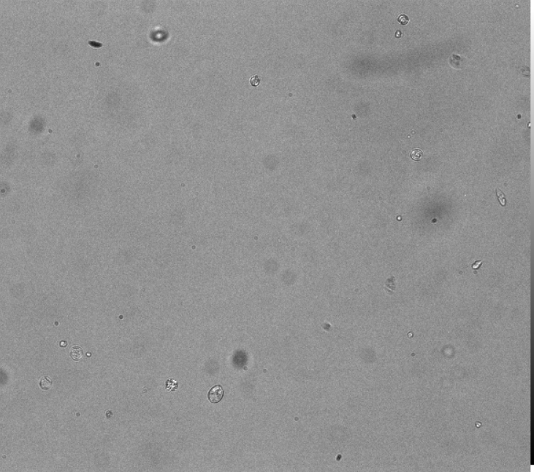
FvFm
Bright field
Polarized

