Slide 1
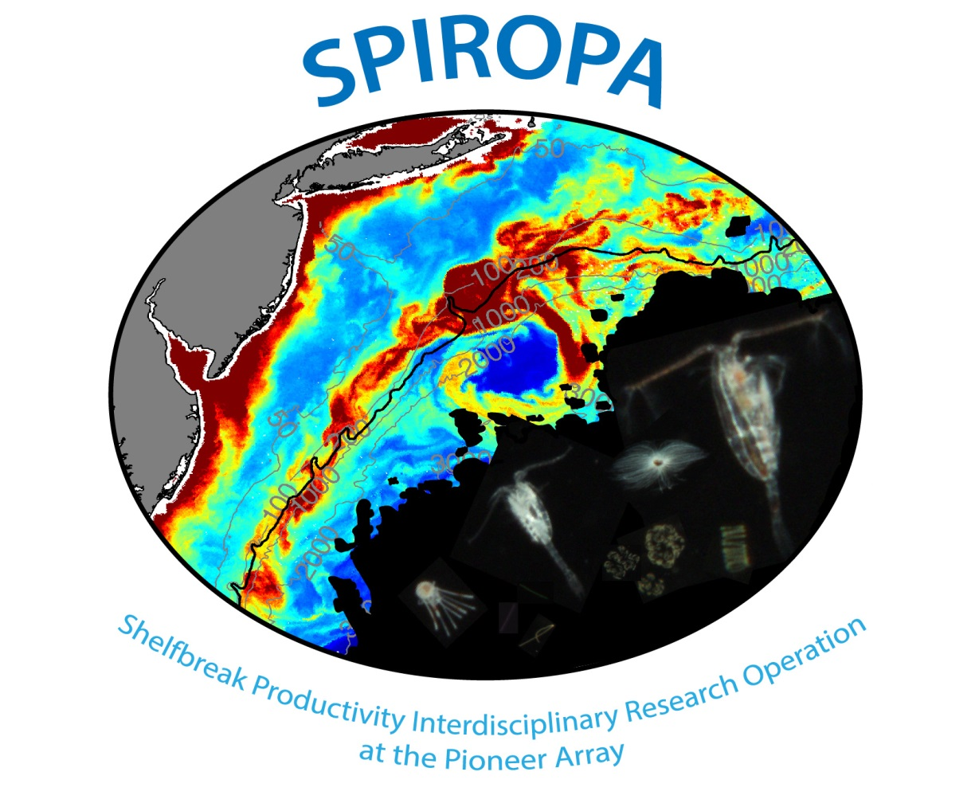

Slide 2
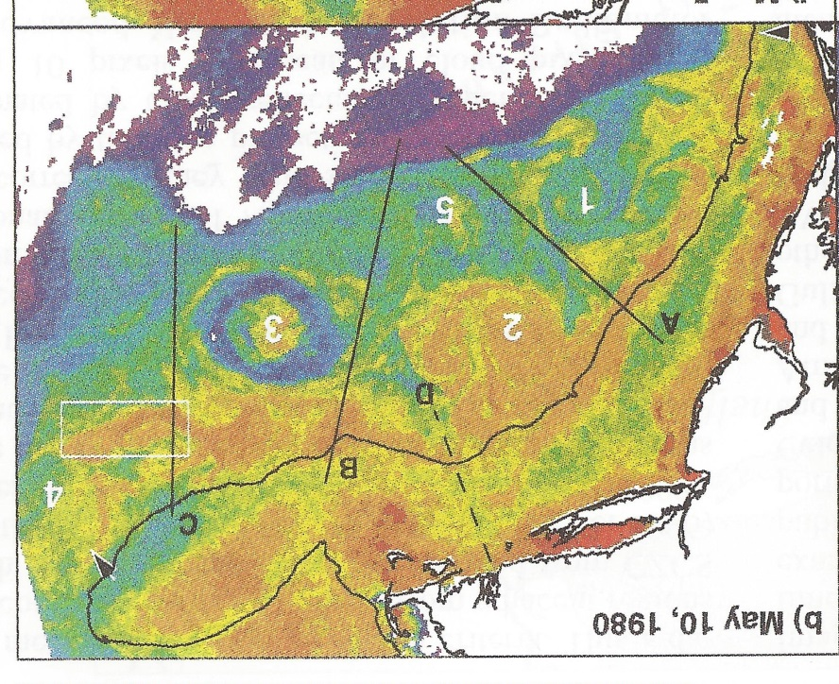
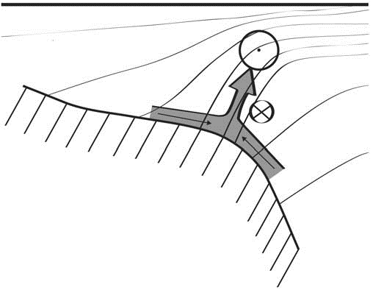
Shelfbreak frontal dynamics: mechanisms of upwelling, net community production, and ecological implications
Ryan et al. 1999
Linder et al. 2004
Gawarkiewicz and Chapman 1992
Chapman and Lentz 1994
Marra et al. 1990

Slide 3


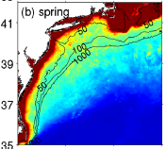

2013, JGR
Satellite CHL climatology
Why is there no mean enhancement of chlorophyll at the shelf break front?
H₁: Top-down control by zooplankton grazing
H₂: Spatial and temporal intermittency of the upwelling events causes their net impact to be smoothed out in long-term means.

Slide 4

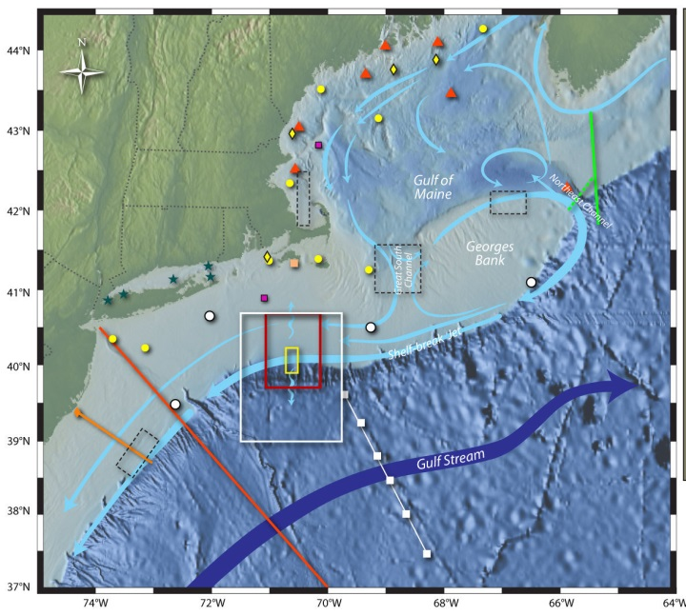
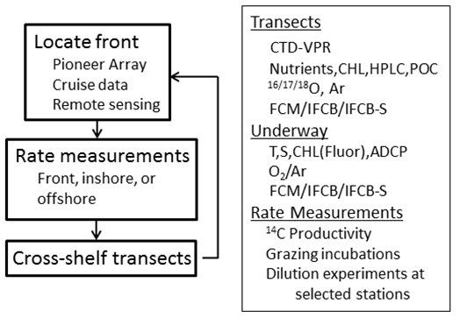
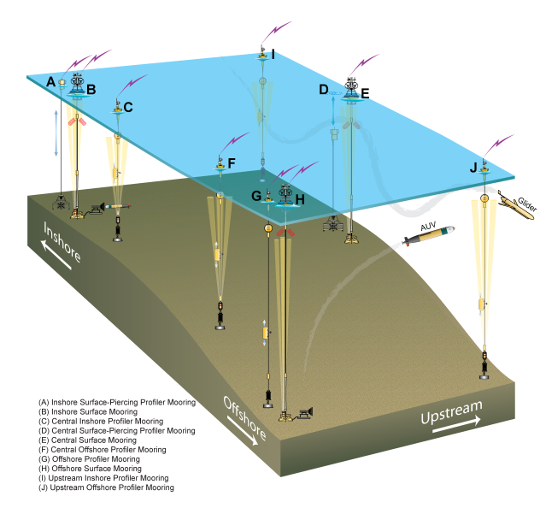
Shelfbreak frontal dynamics: mechanisms of upwelling, net community production, and ecological implications
Dennis McGillicuddy, Heidi Sosik, Gordon Zhang (WHOI)
Walker Smith (VIMS) Rachel Stanley (Wellesley College)
Jefferson Turner, Christian Petitpas (UMass Dartmouth)
3 Cruises R/V Neil Armstrong
NSF Ocean Observatory Initiative Pioneer Array

Slide 5
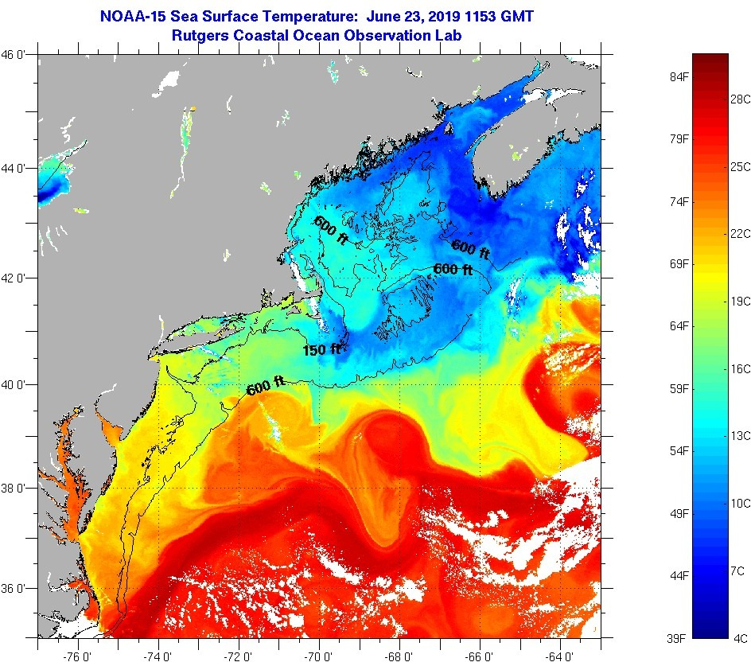
SST - June 23 2019

Slide 6
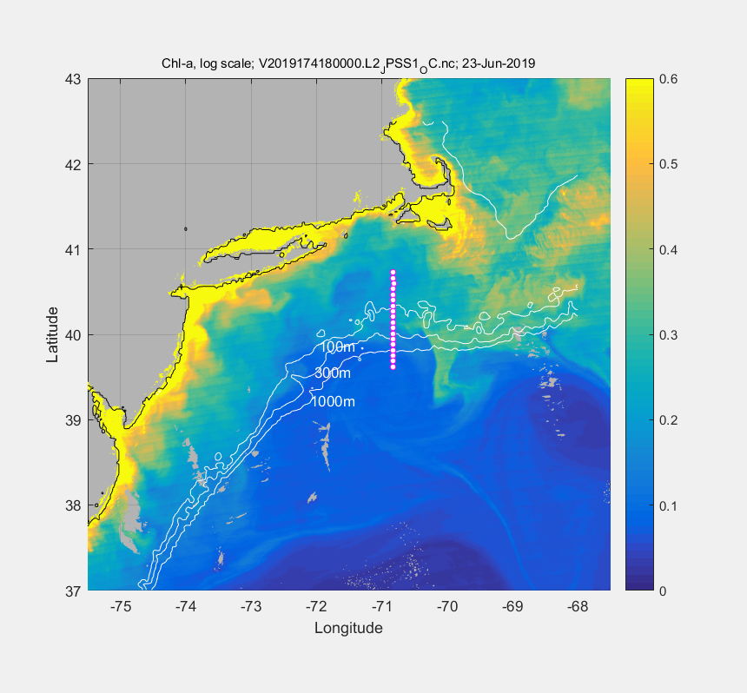
VIIRS Chl - June 23

Slide 7
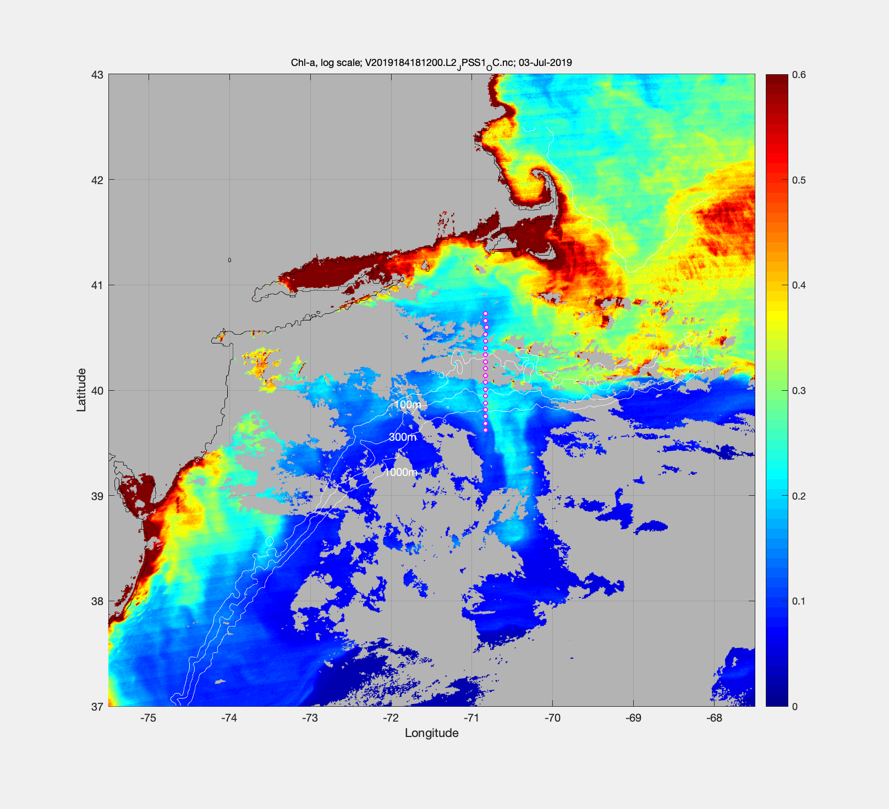
July 3 – VIIRS Chl

Slide 8
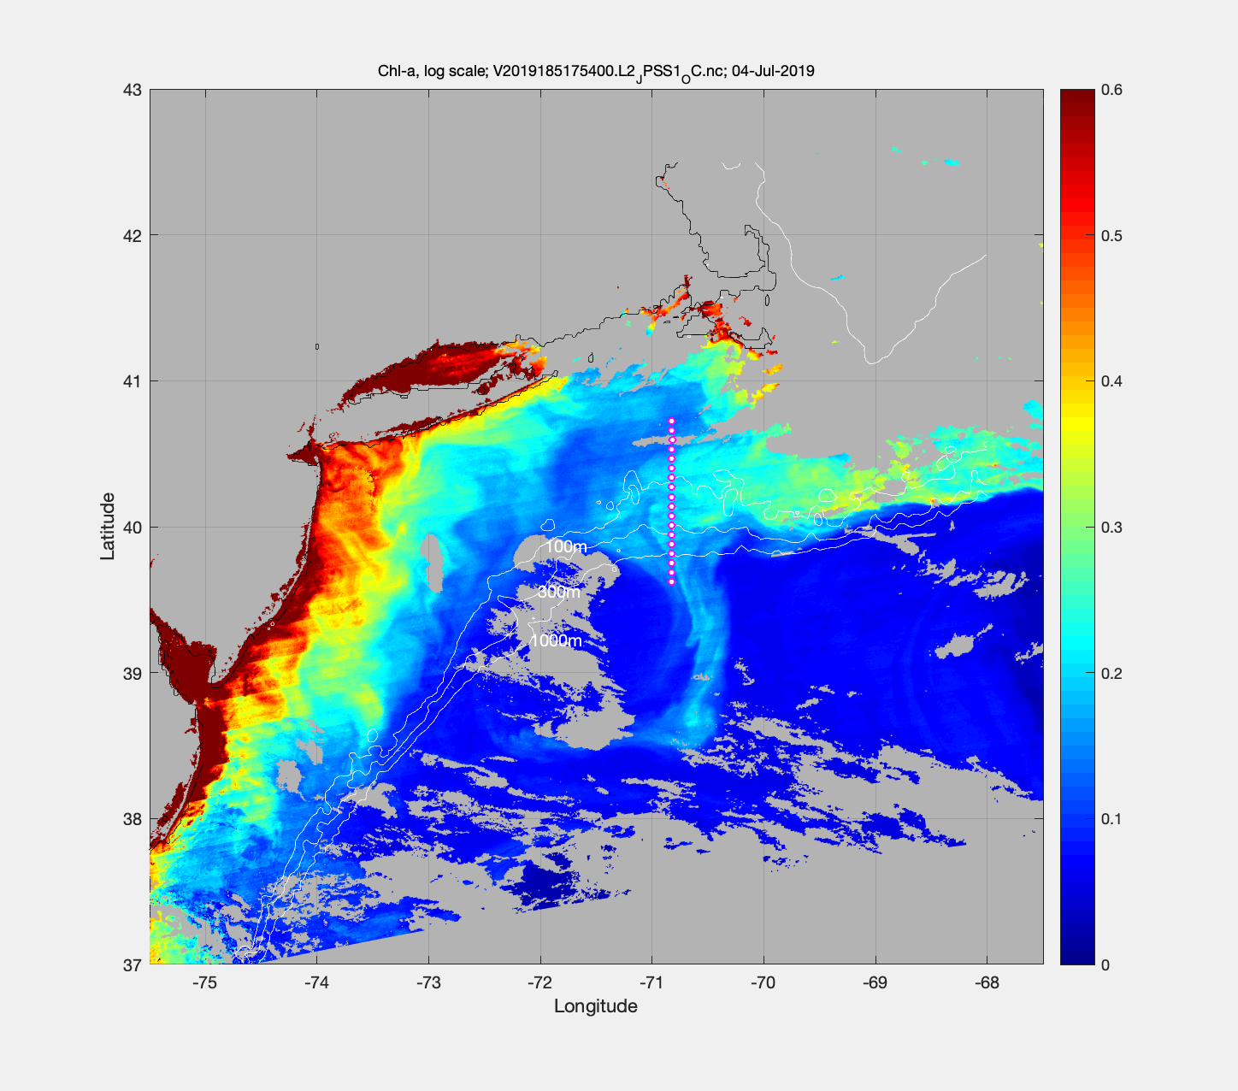
July 4 – VIIRS Chl

Slide 10
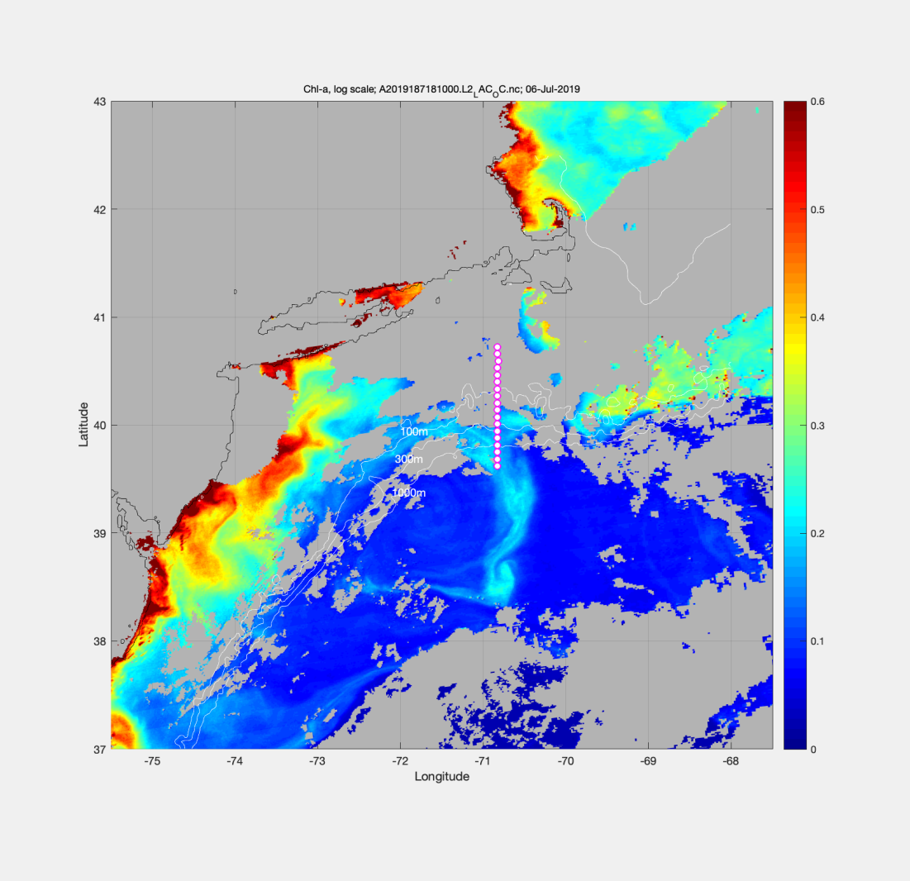
VIIRS Chl June 23 MODIS Chl July 6

Slide 11
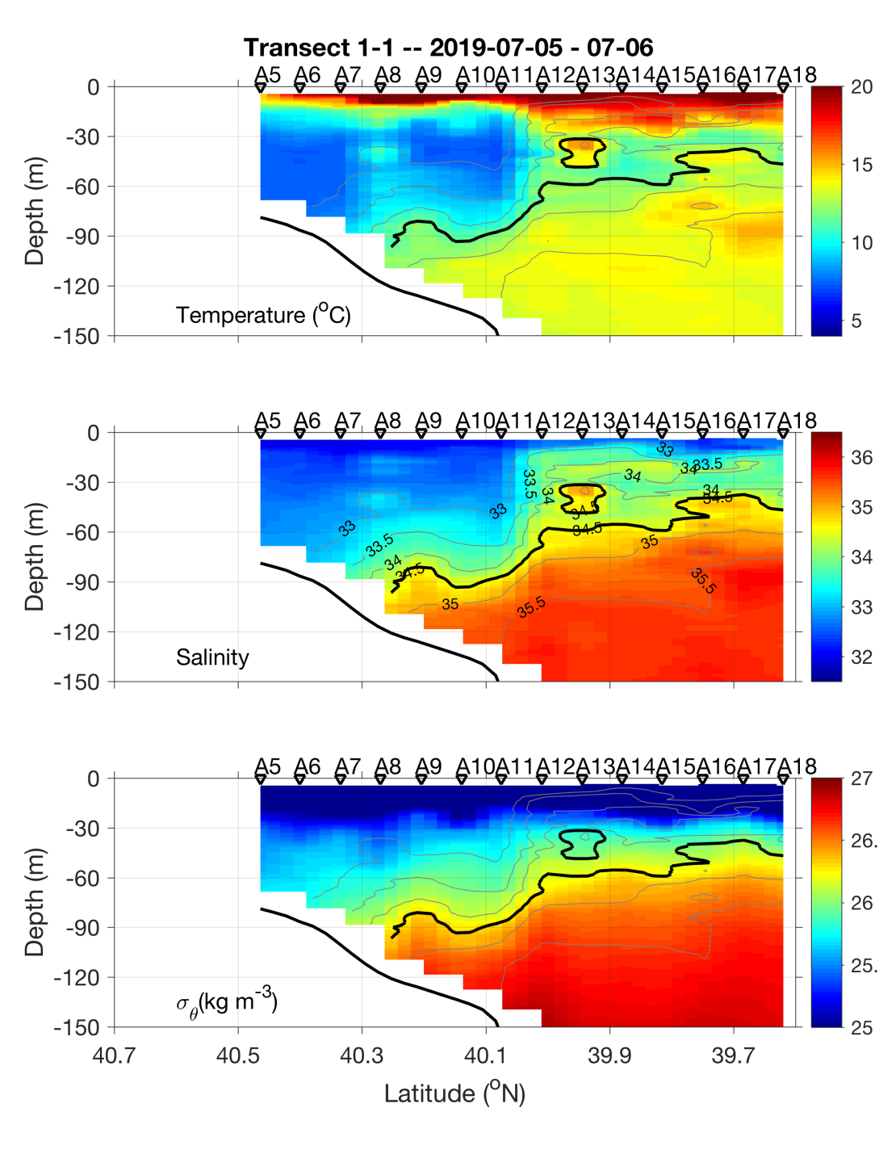
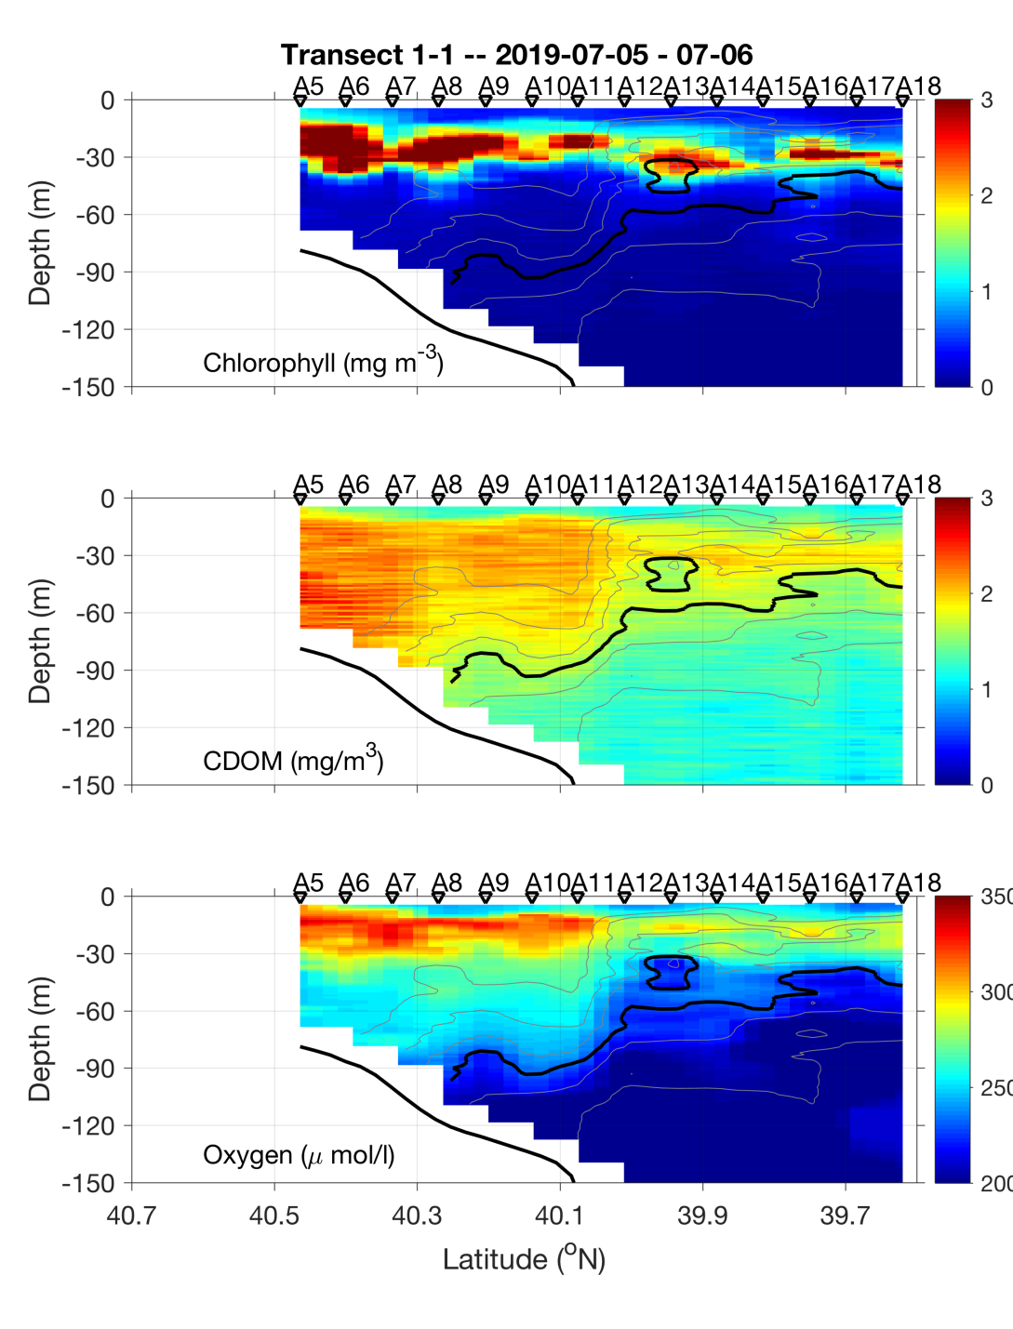
Transect 1 – July 5-6

Slide 12
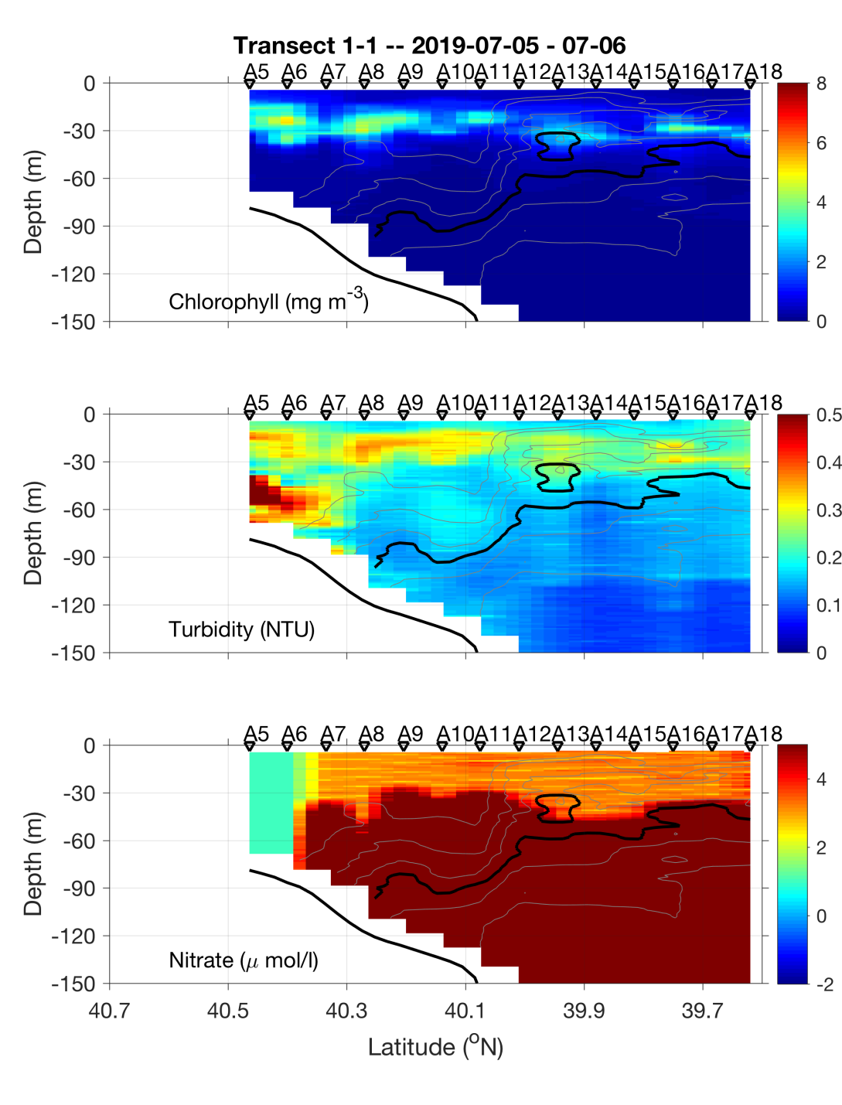
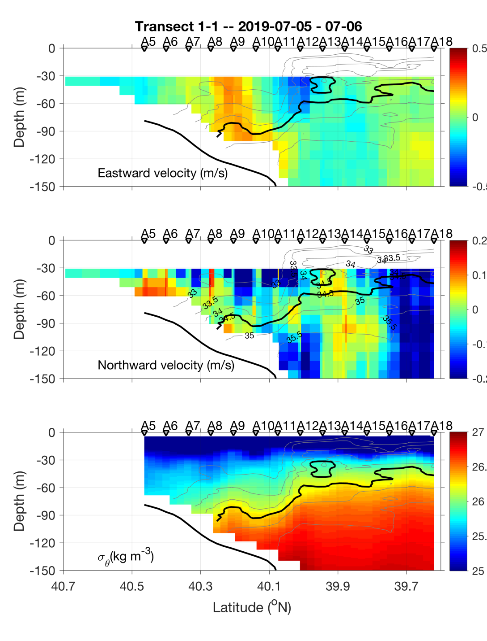
Transect 1 – July 5-6

Slide 13
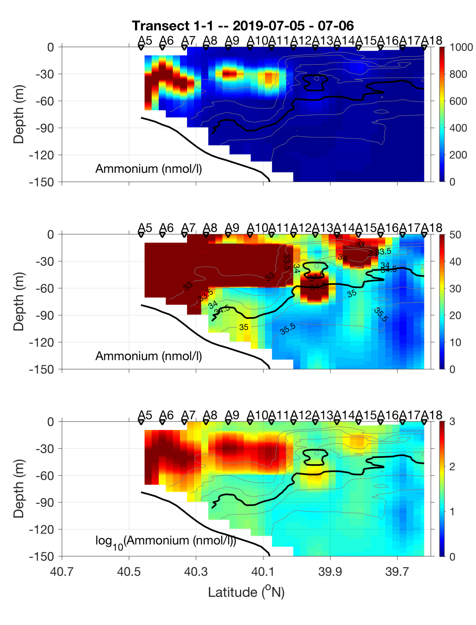
Transect 1 – July 5-6

Slide 14
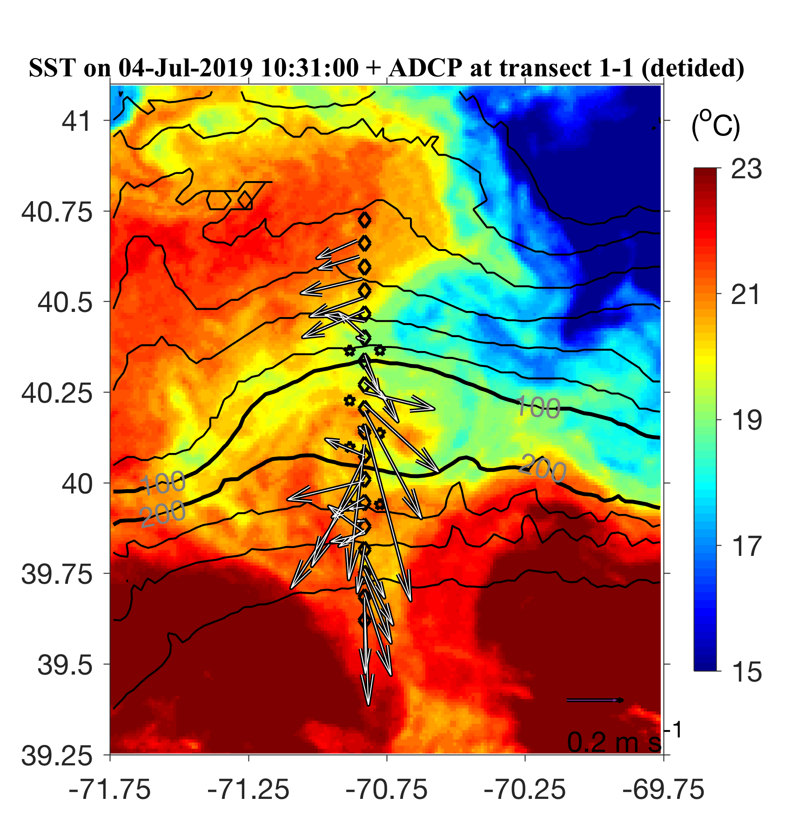
July 5-6 ADCP overlayed on July 4 SST

Slide 15
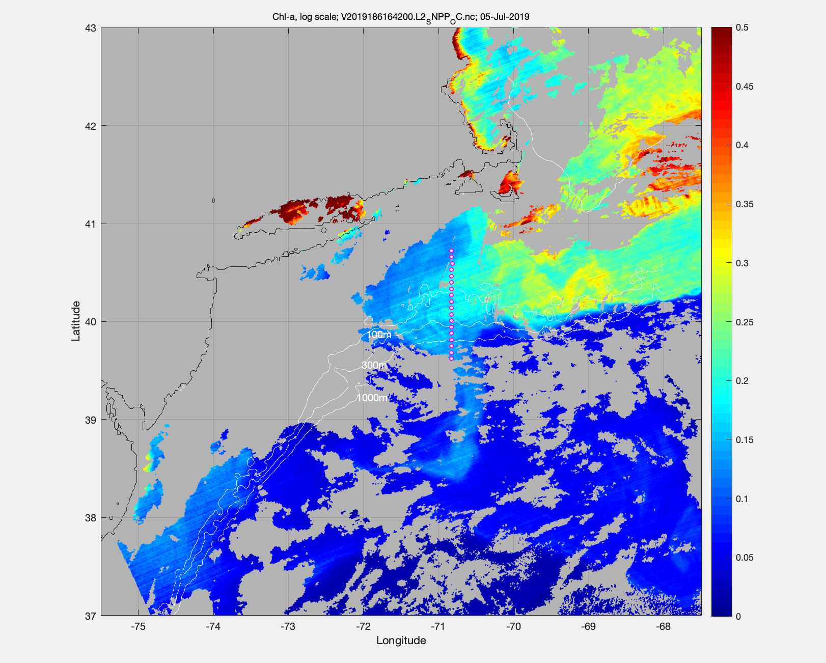
MODIS Chl July 5

Slide 16
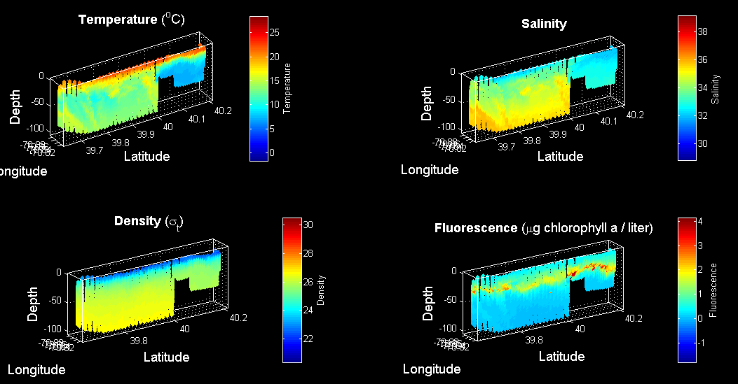
VPR survey July 6

Slide 17
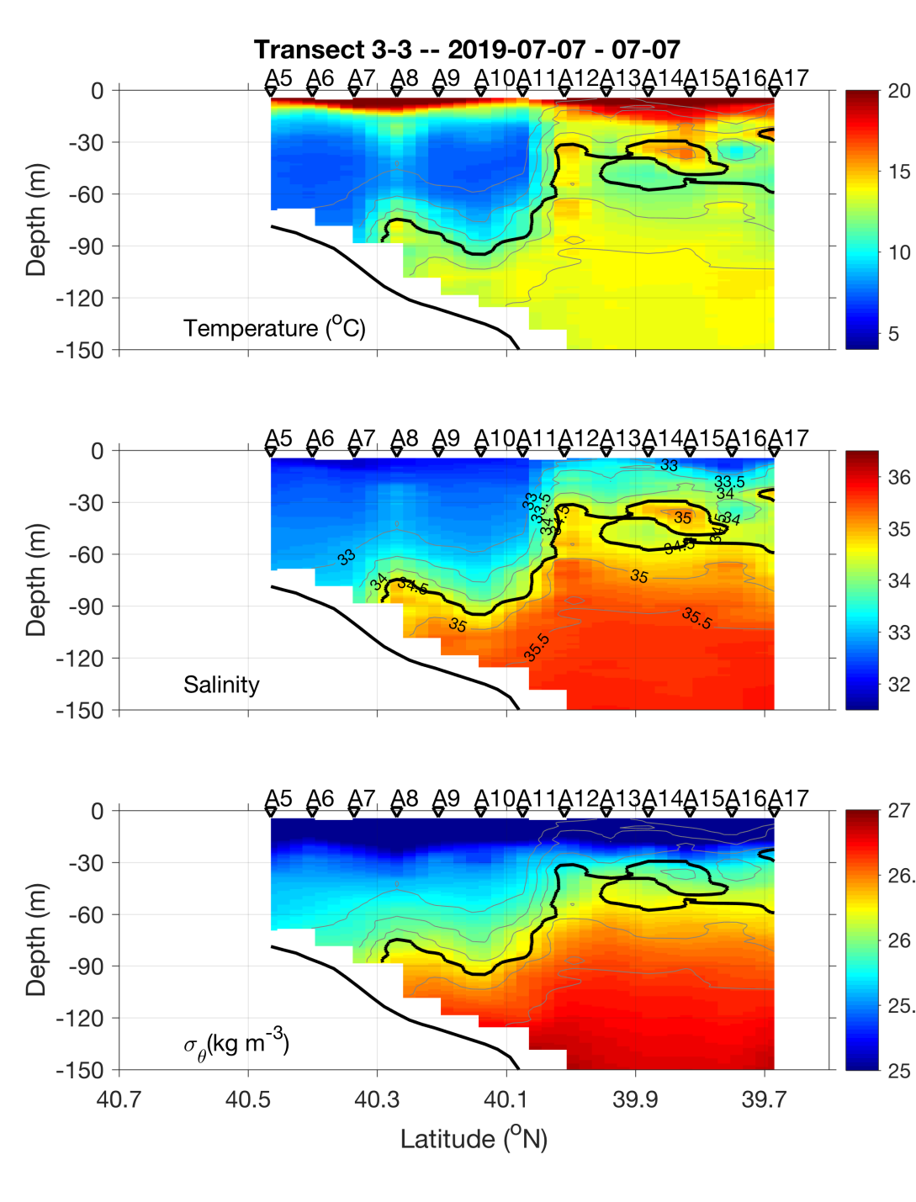
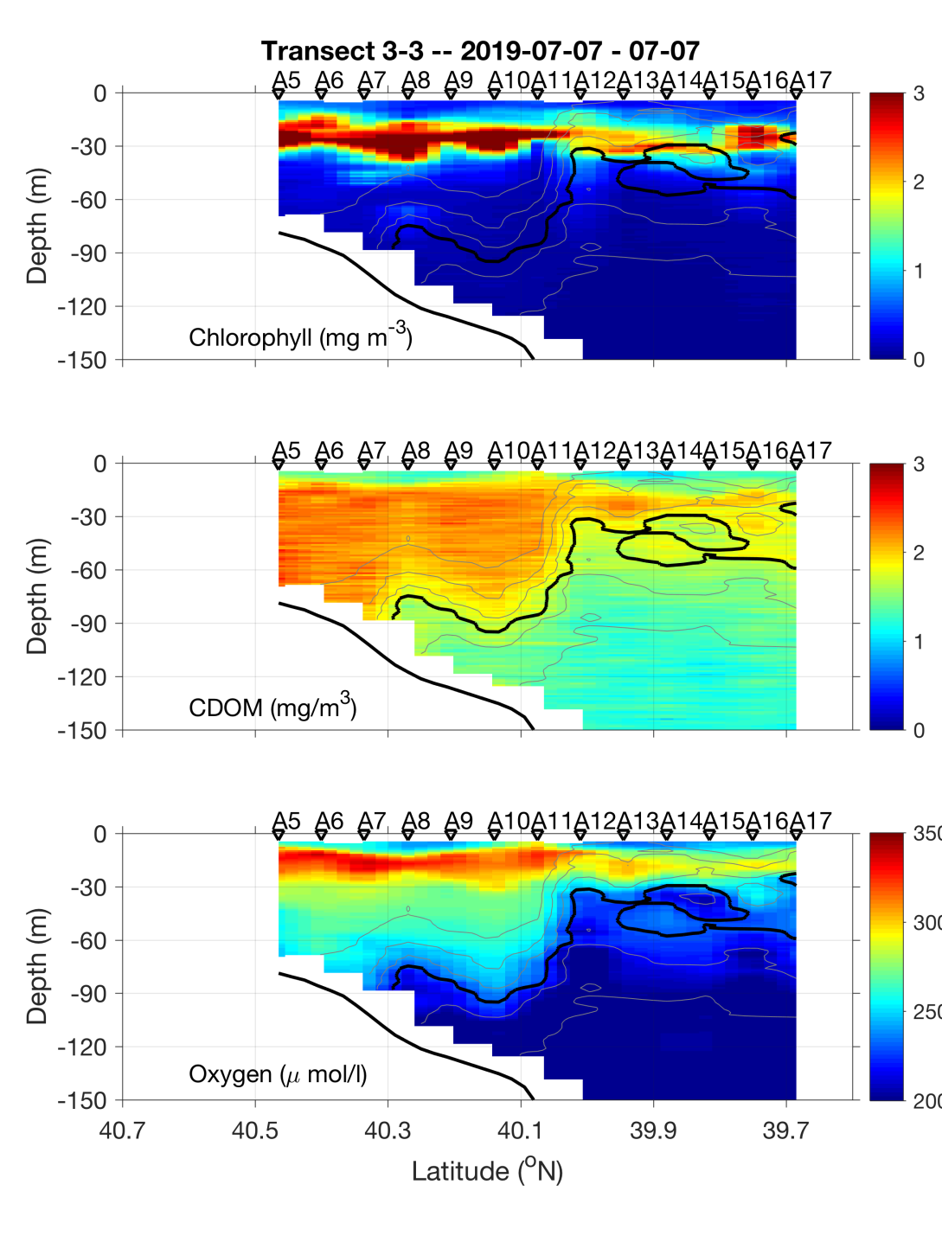
Transect 2 – July 6-7

Slide 18
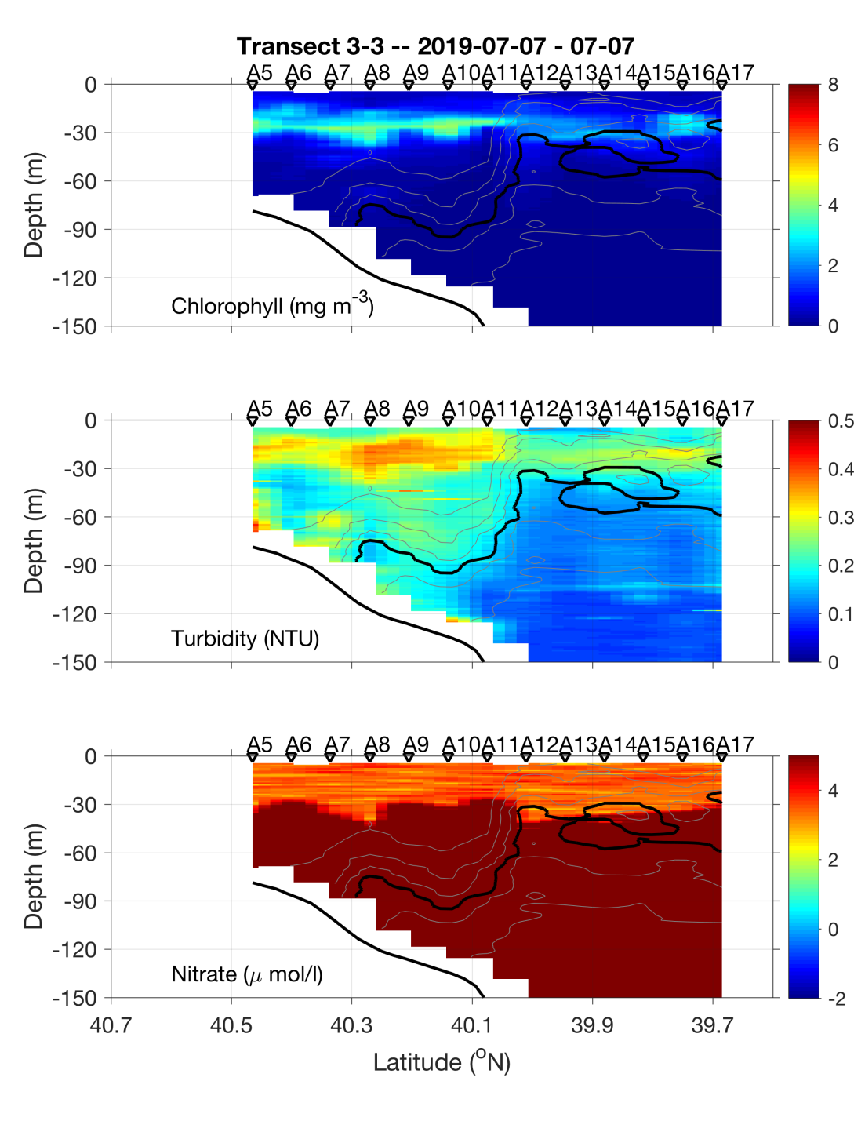
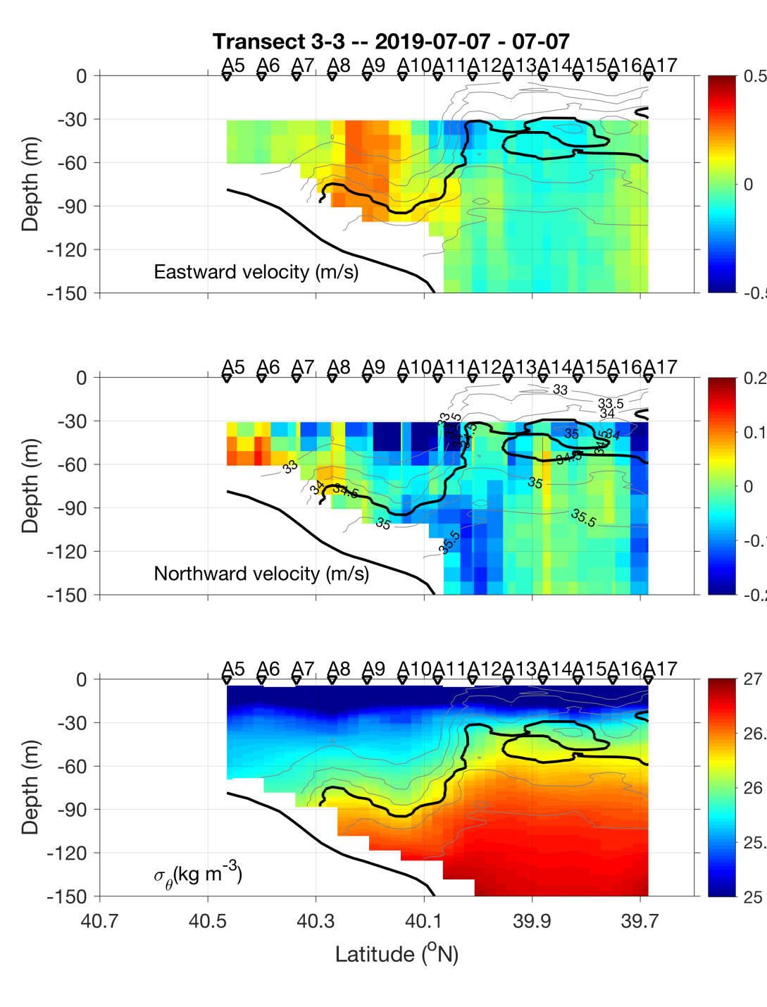
Transect 2 – July 6-7

Slide 19
Transect 2 – July 6-7

Slide 20
VIIRS Chl June 23 MODIS Chl July 6

Slide 21
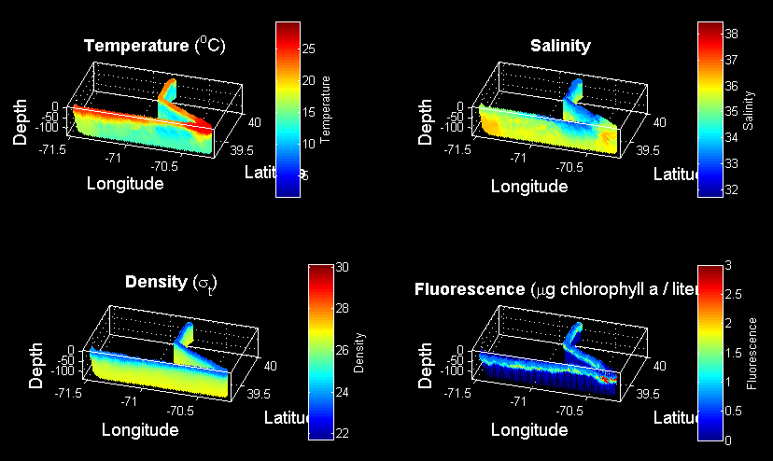
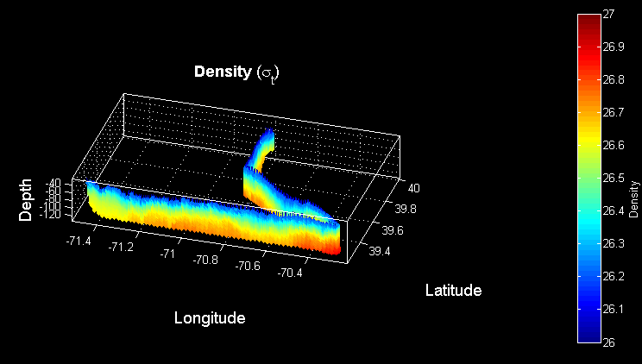
VPR Survey July 7-8
Density

Slide 22
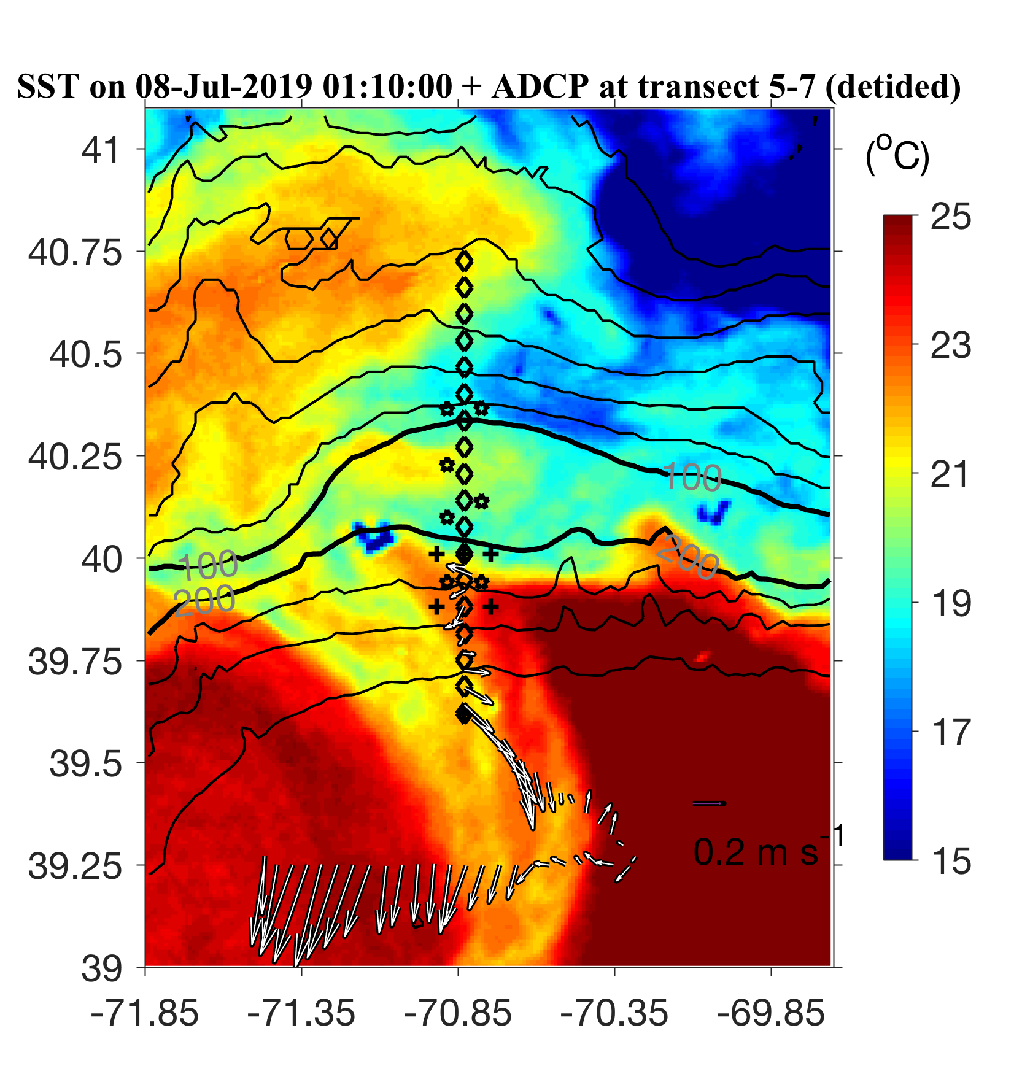
ADCP from VPR survey

Slide 23
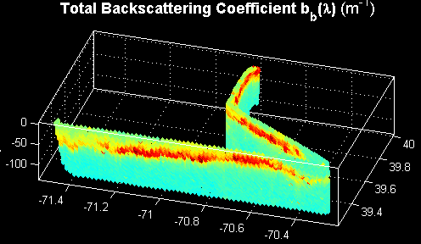


VPR Survey July 7-8

Slide 25
ADCP from VPR survey

Slide 26
VPR1 Survey July 7-8
Density

Slide 27
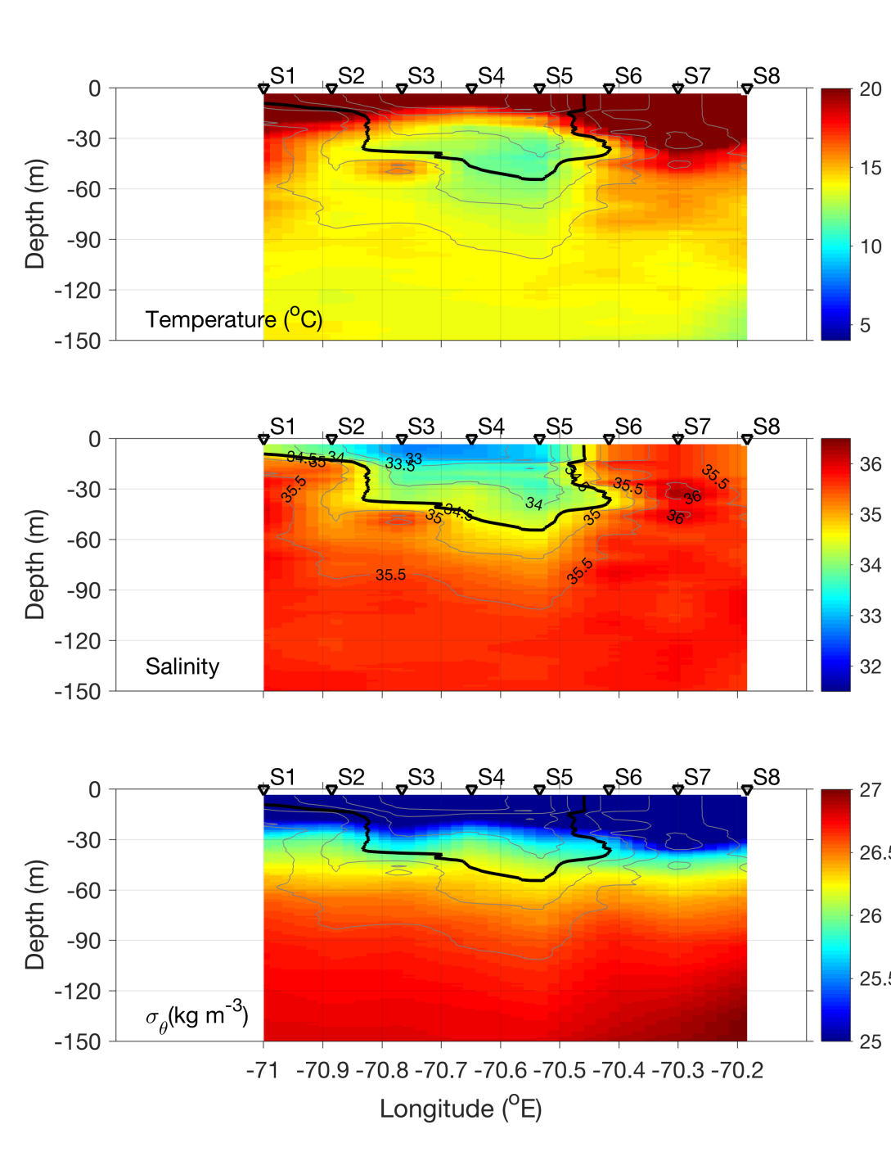
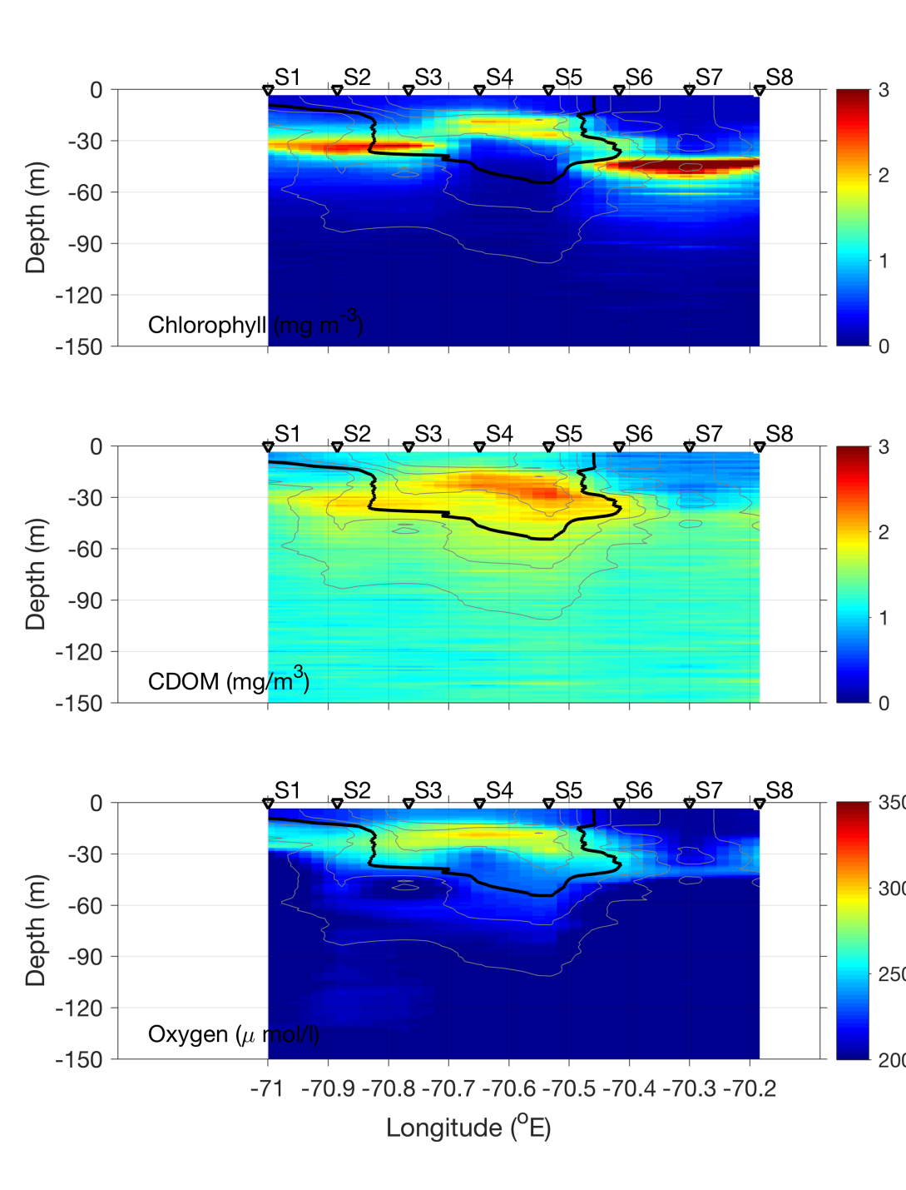
Streamer CTD transect – July 8

Slide 28
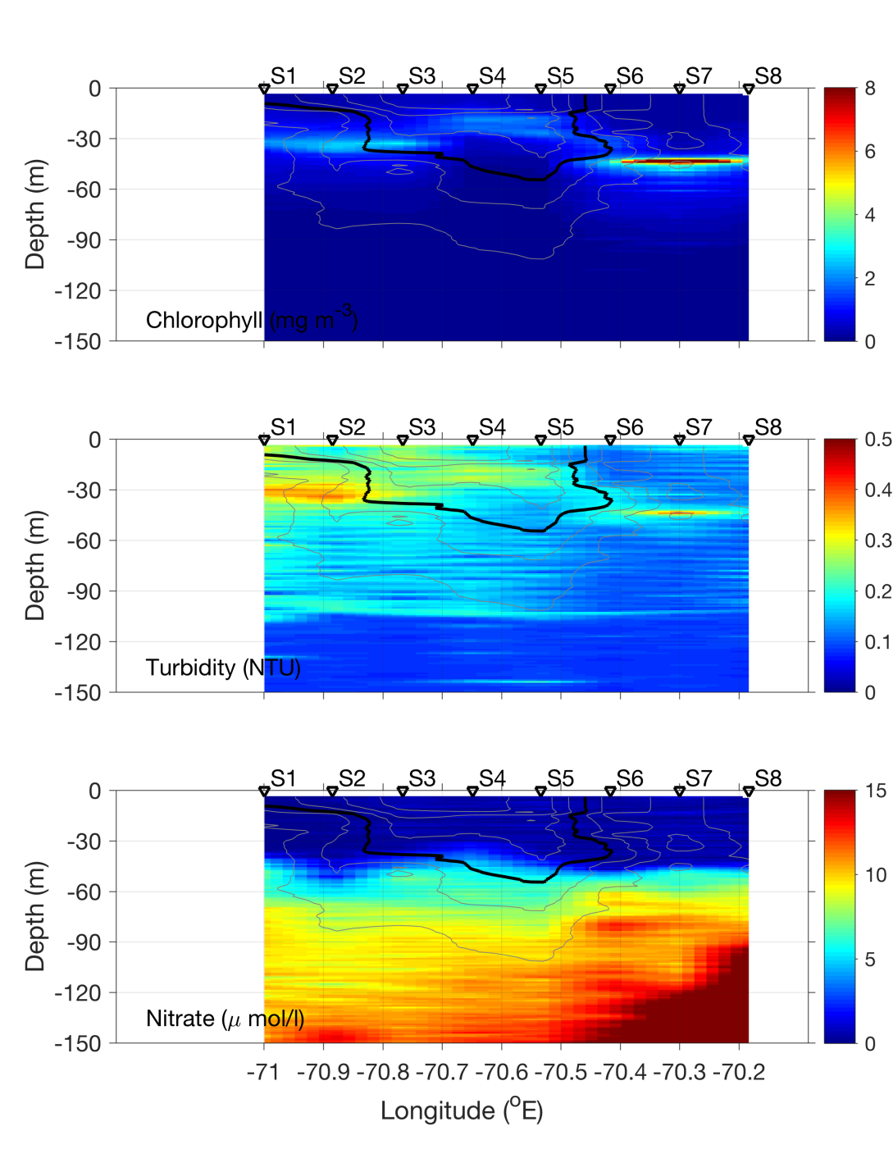
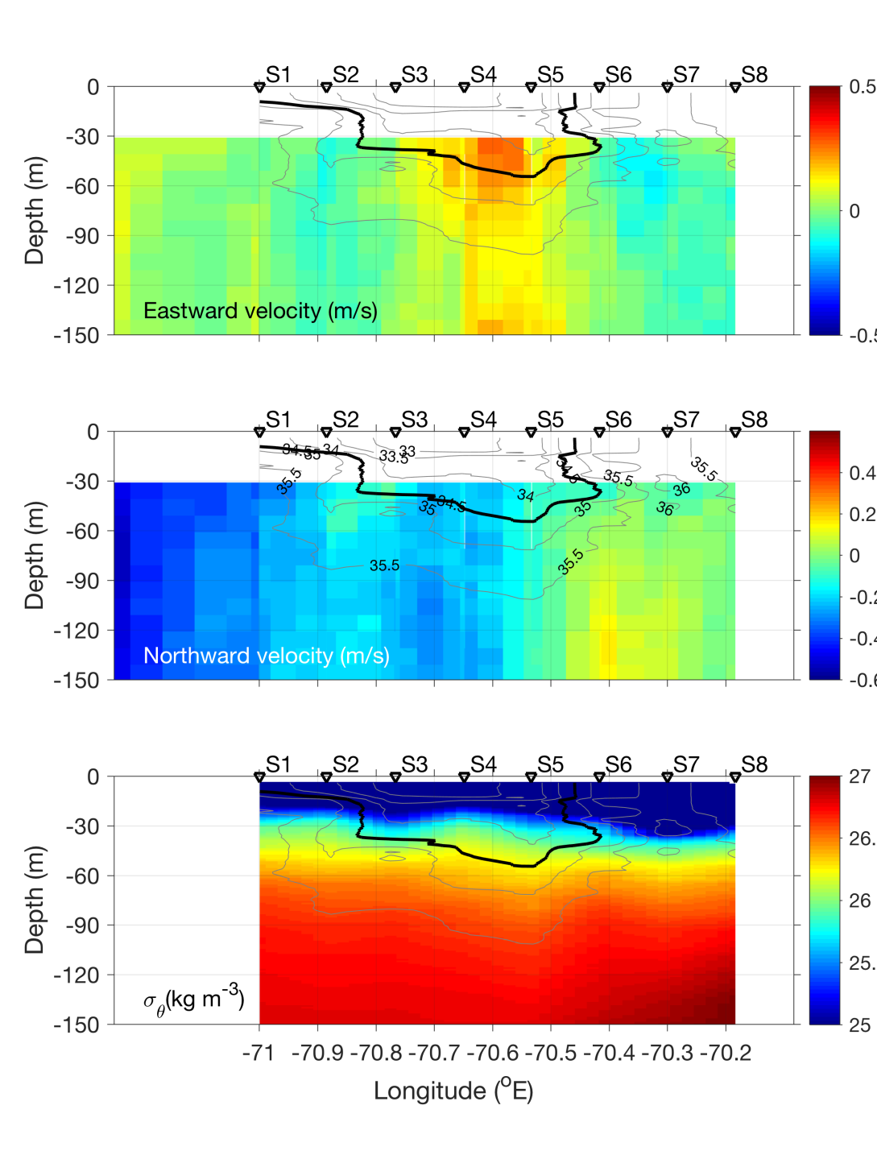
Streamer CTD transect – July 8

Slide 29
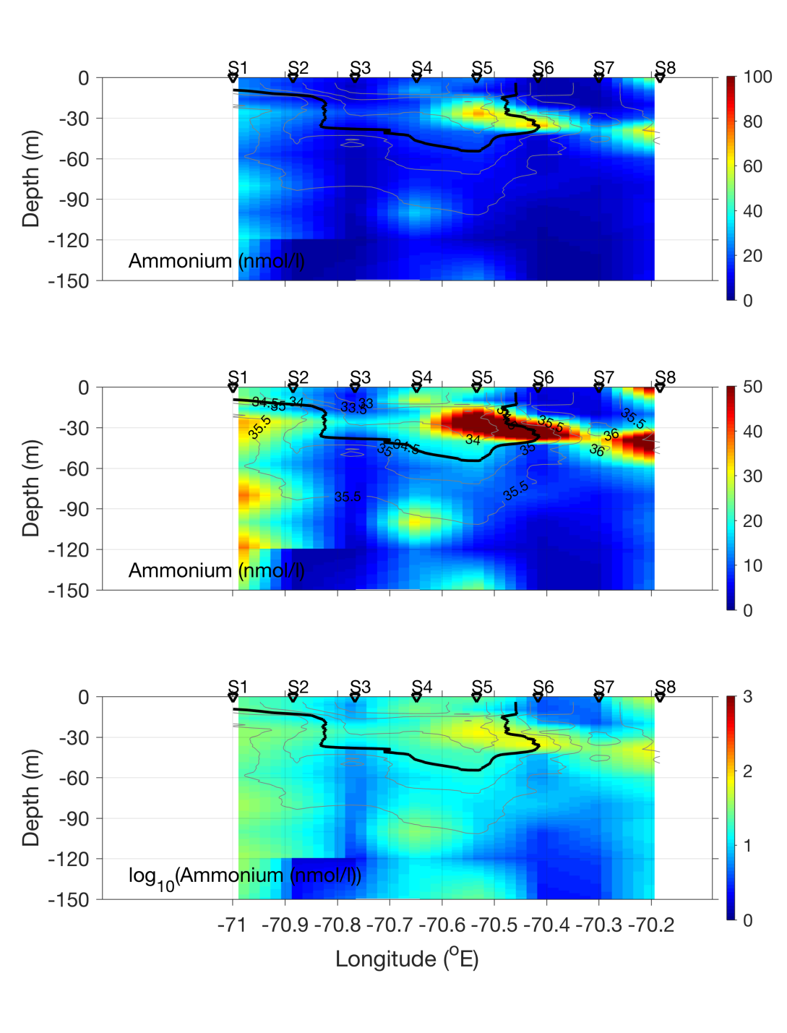
Streamer CTD transect – July 8

Slide 30
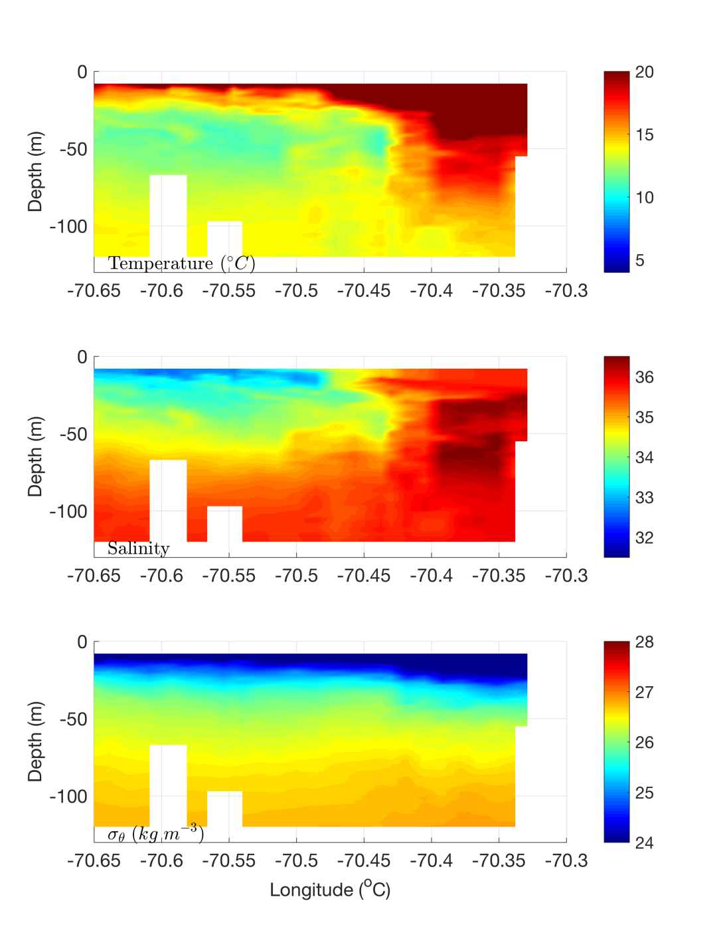
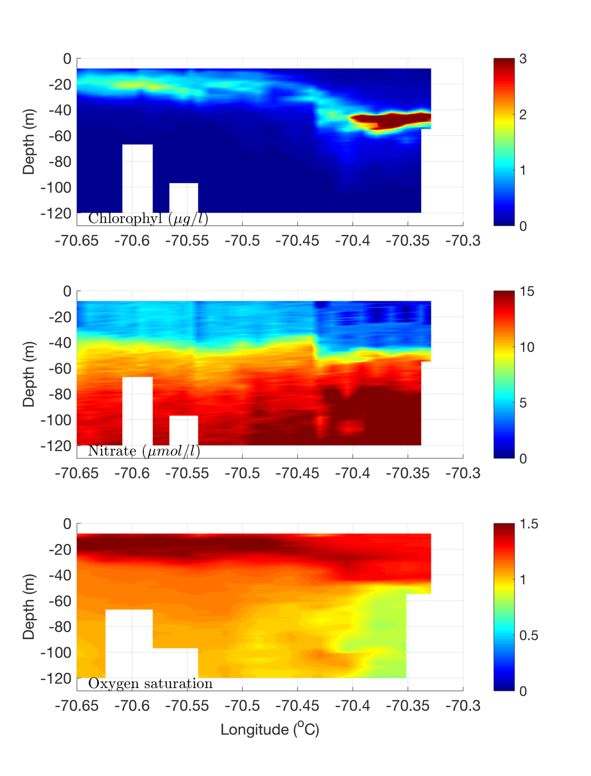
Streamer REMUS transect – July 8

Slide 31
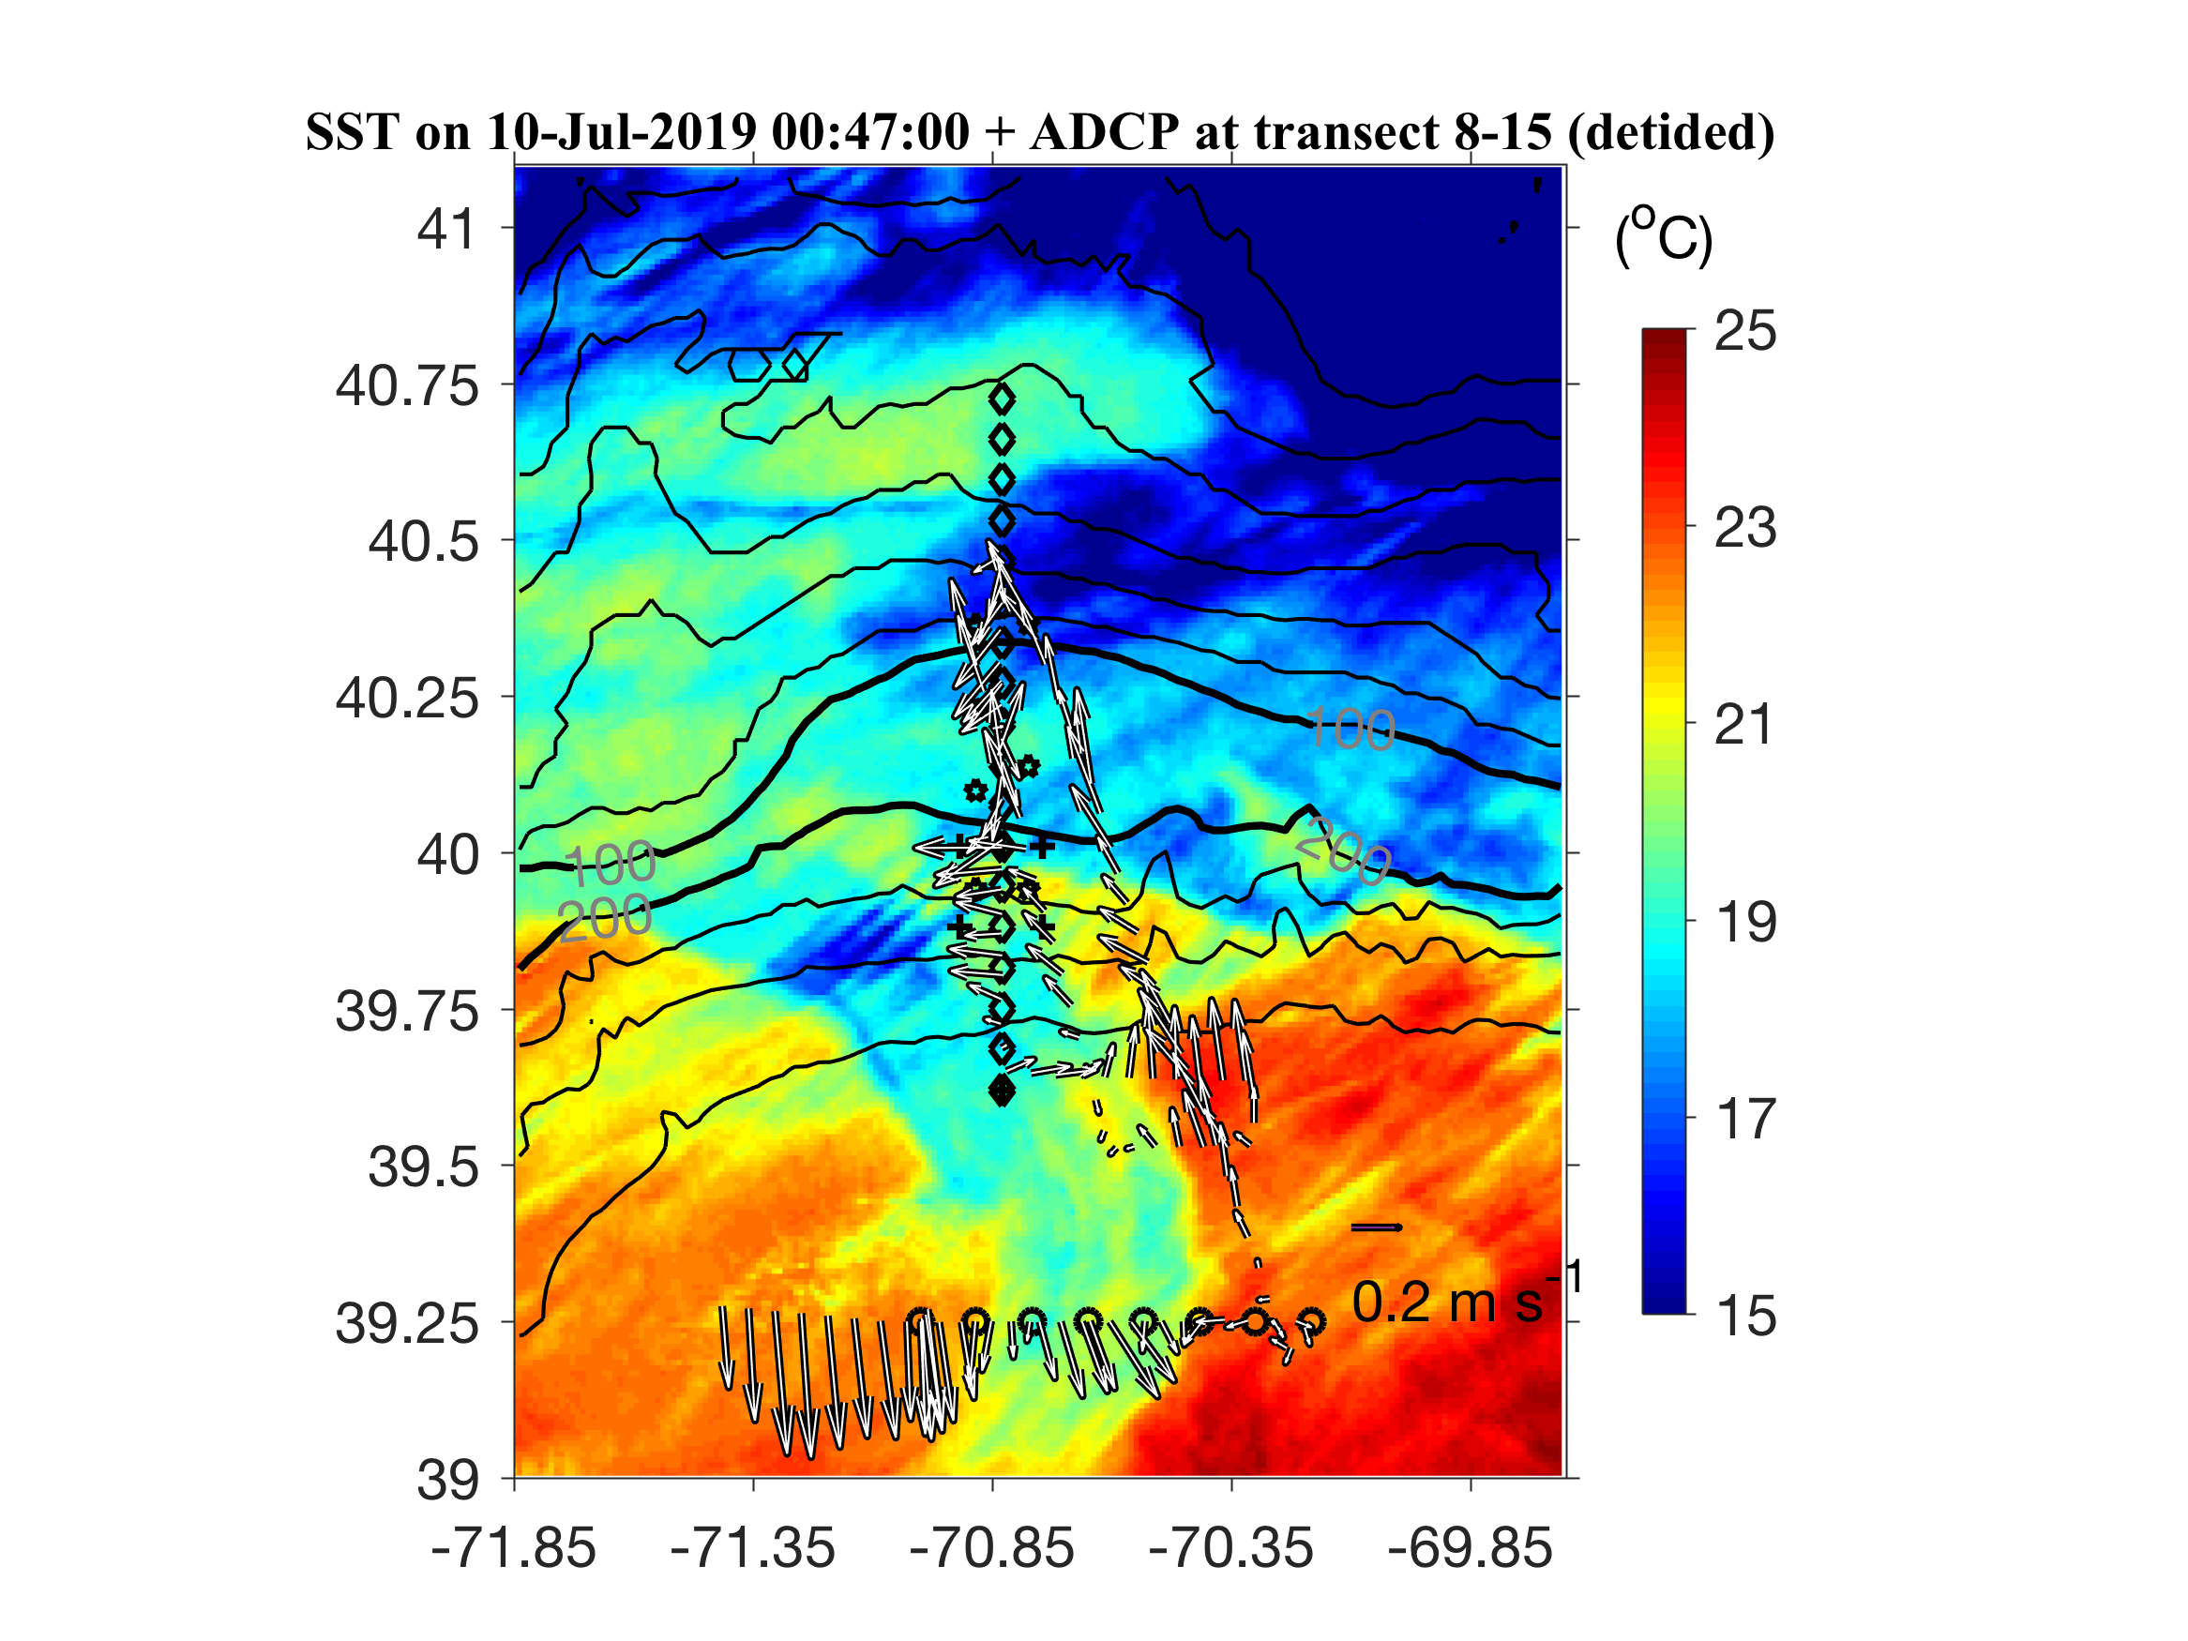
ADCP from VPR survey

Slide 32
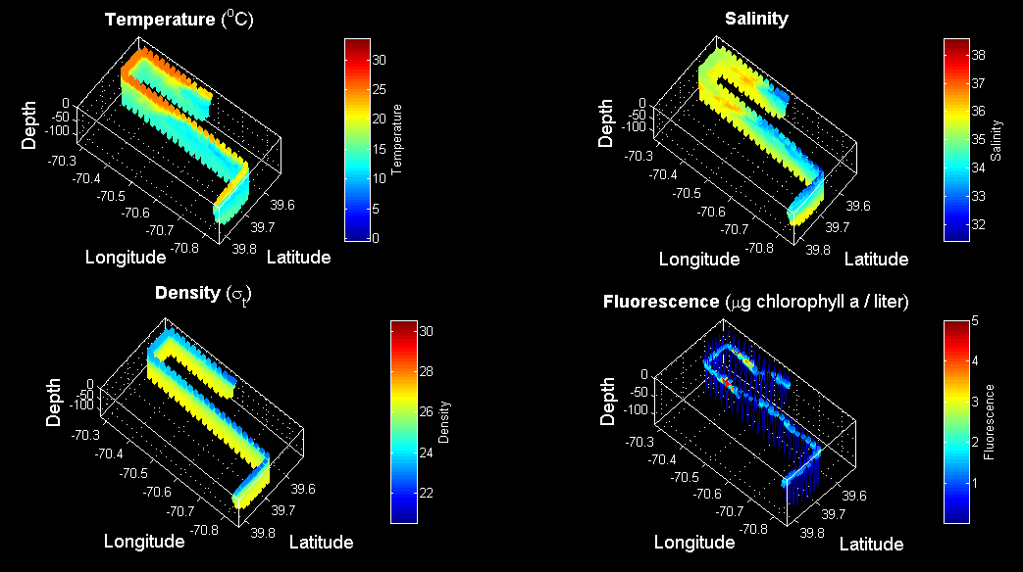
VPR3 Survey July 9

Slide 33
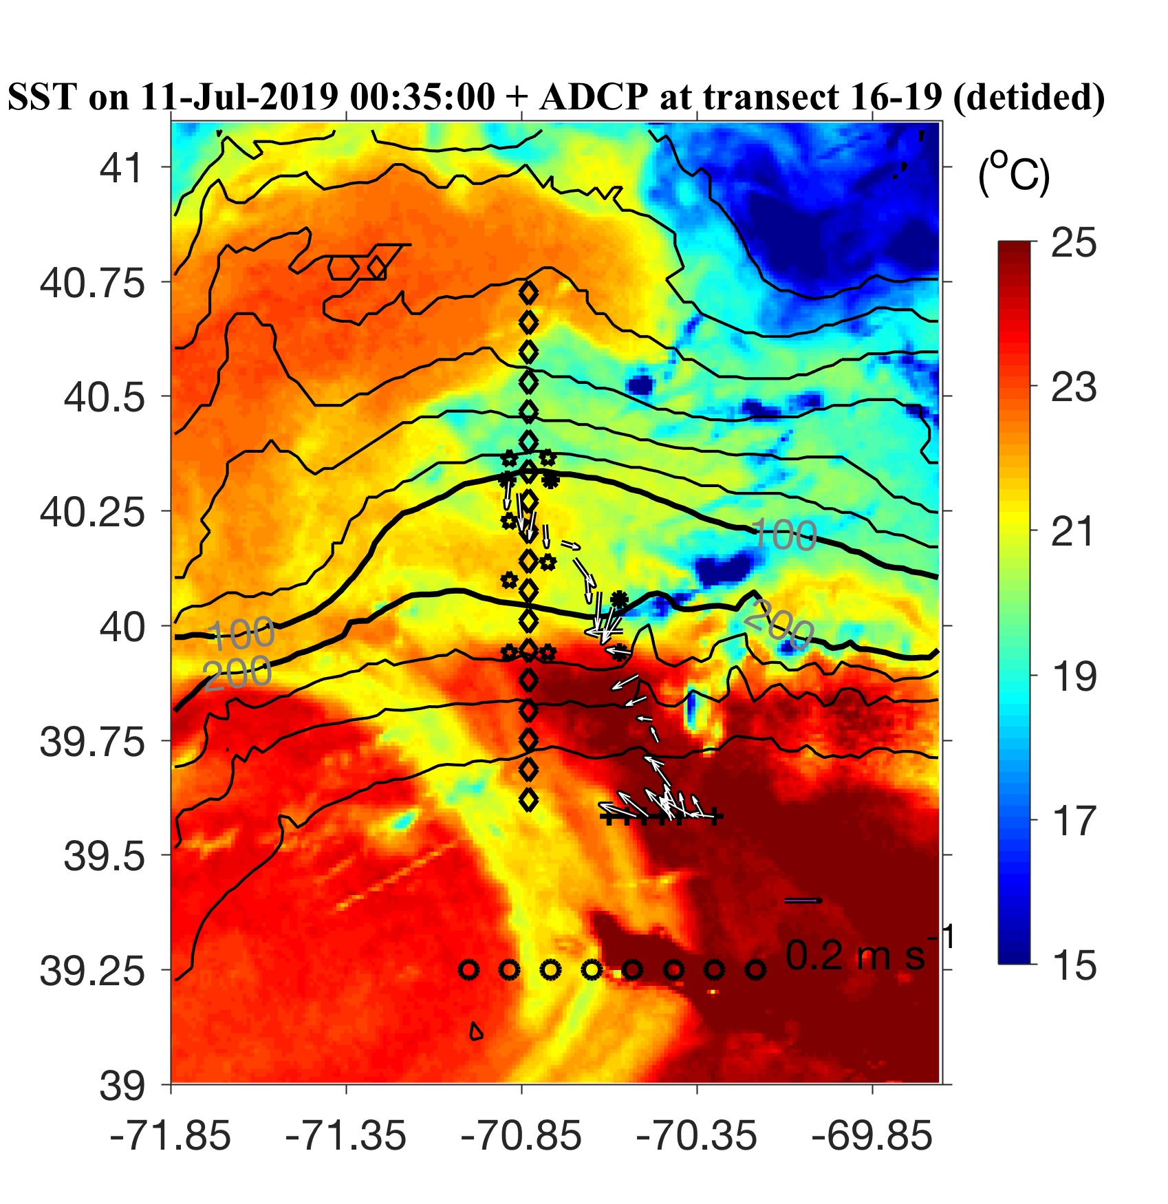
ADCP from Streamer / slope front transect

Slide 34
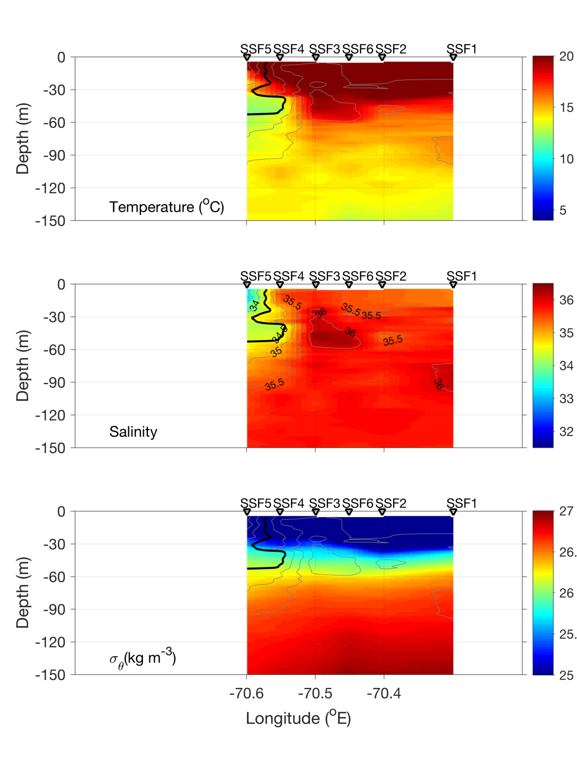
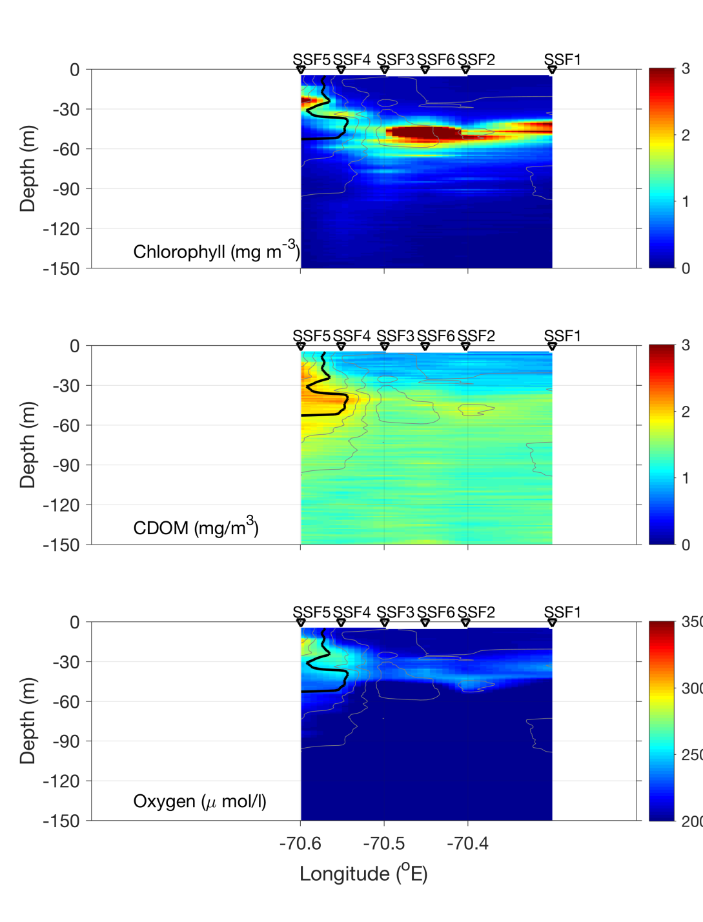
Streamer / slope front transect – July 10

Slide 35
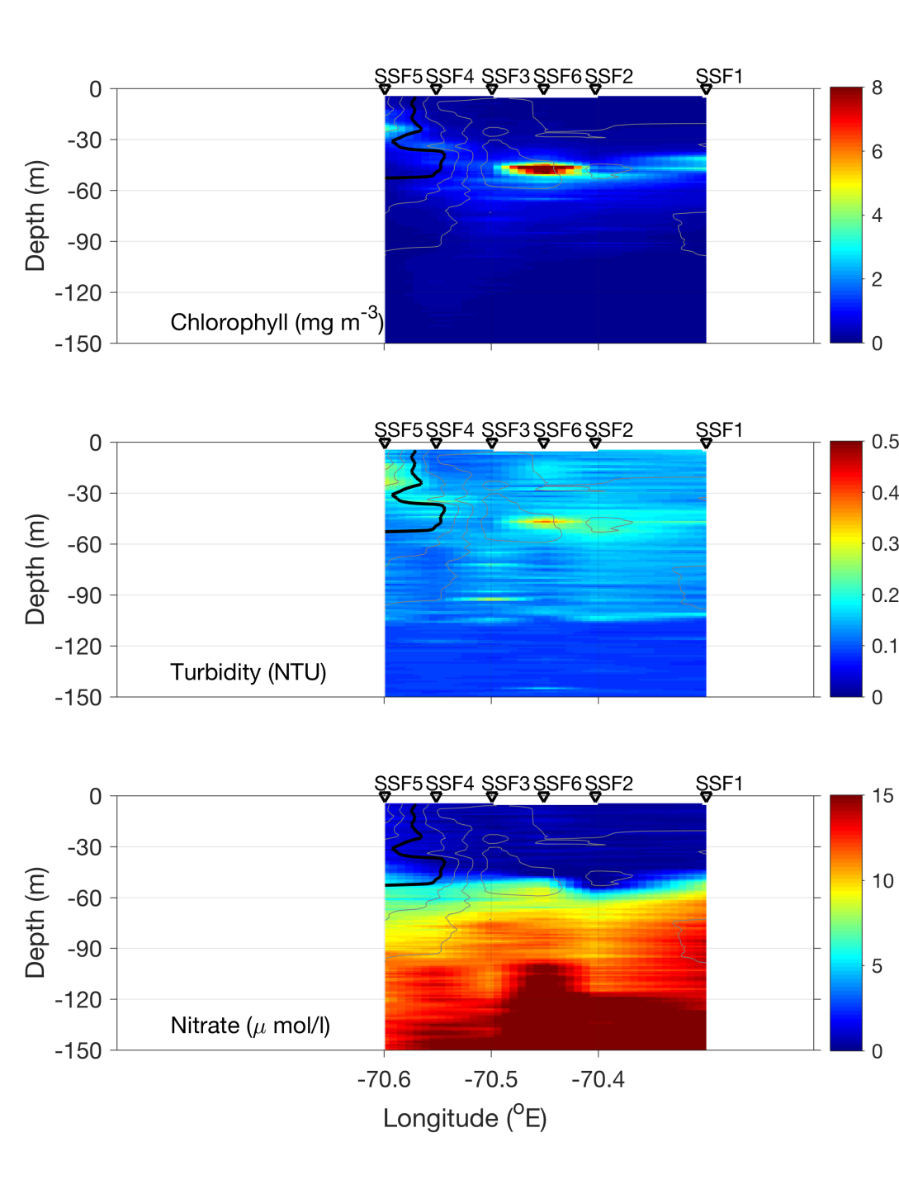
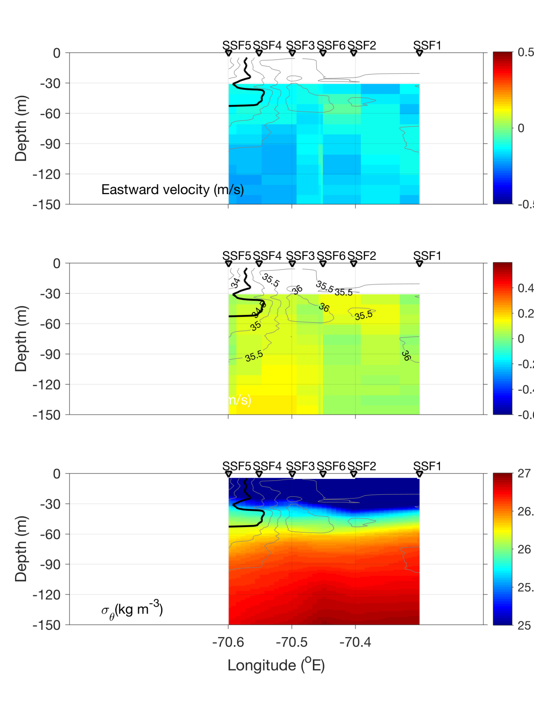
Streamer / slope front transect – July 10

Slide 36
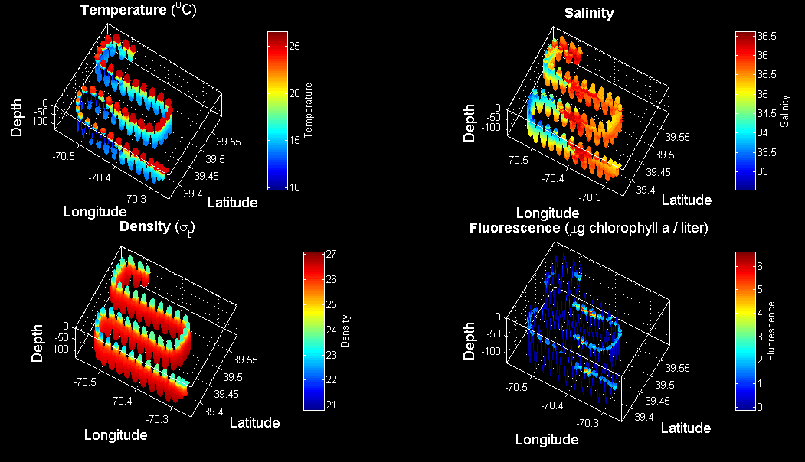
VPR4 July 10-11

Slide 37
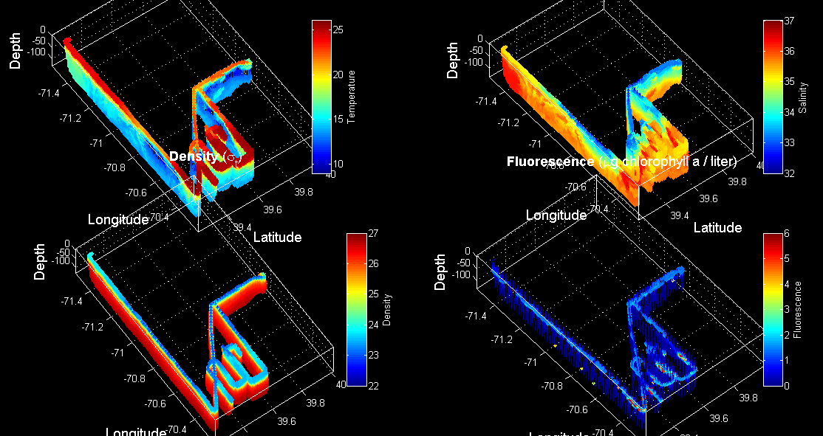
VPR 2,3,4

Slide 38
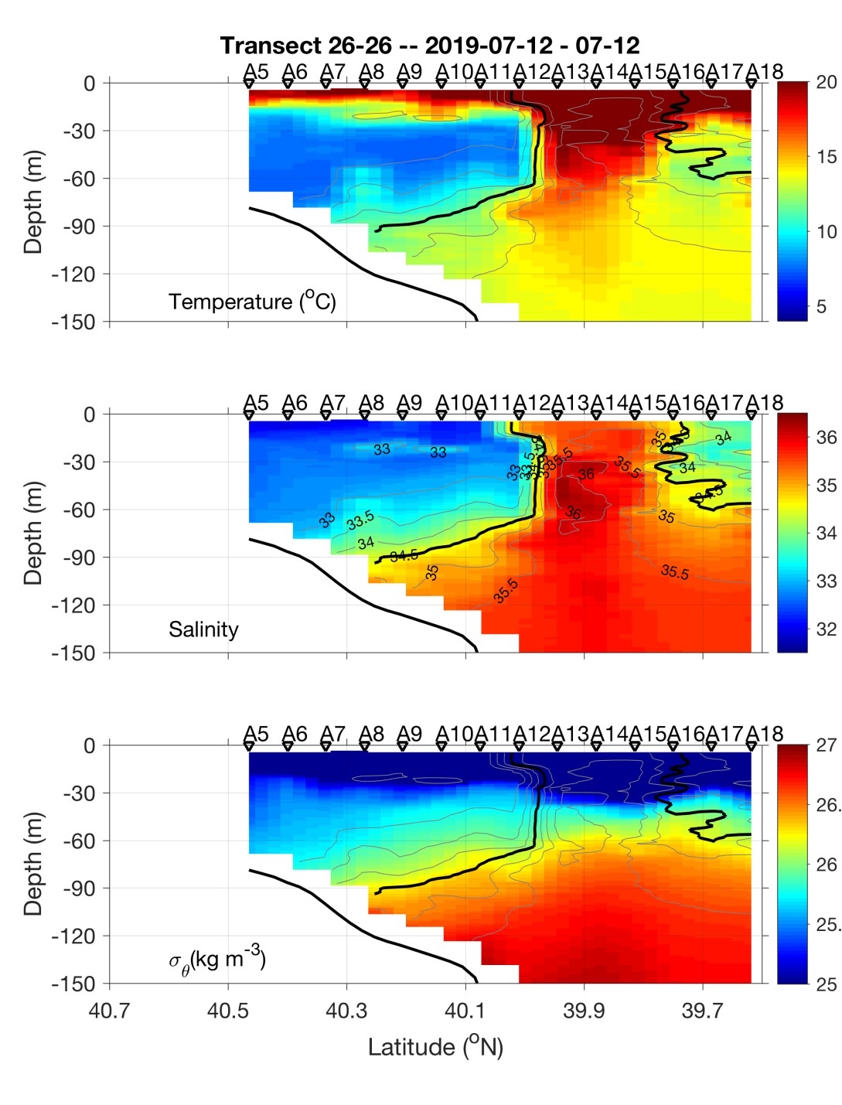
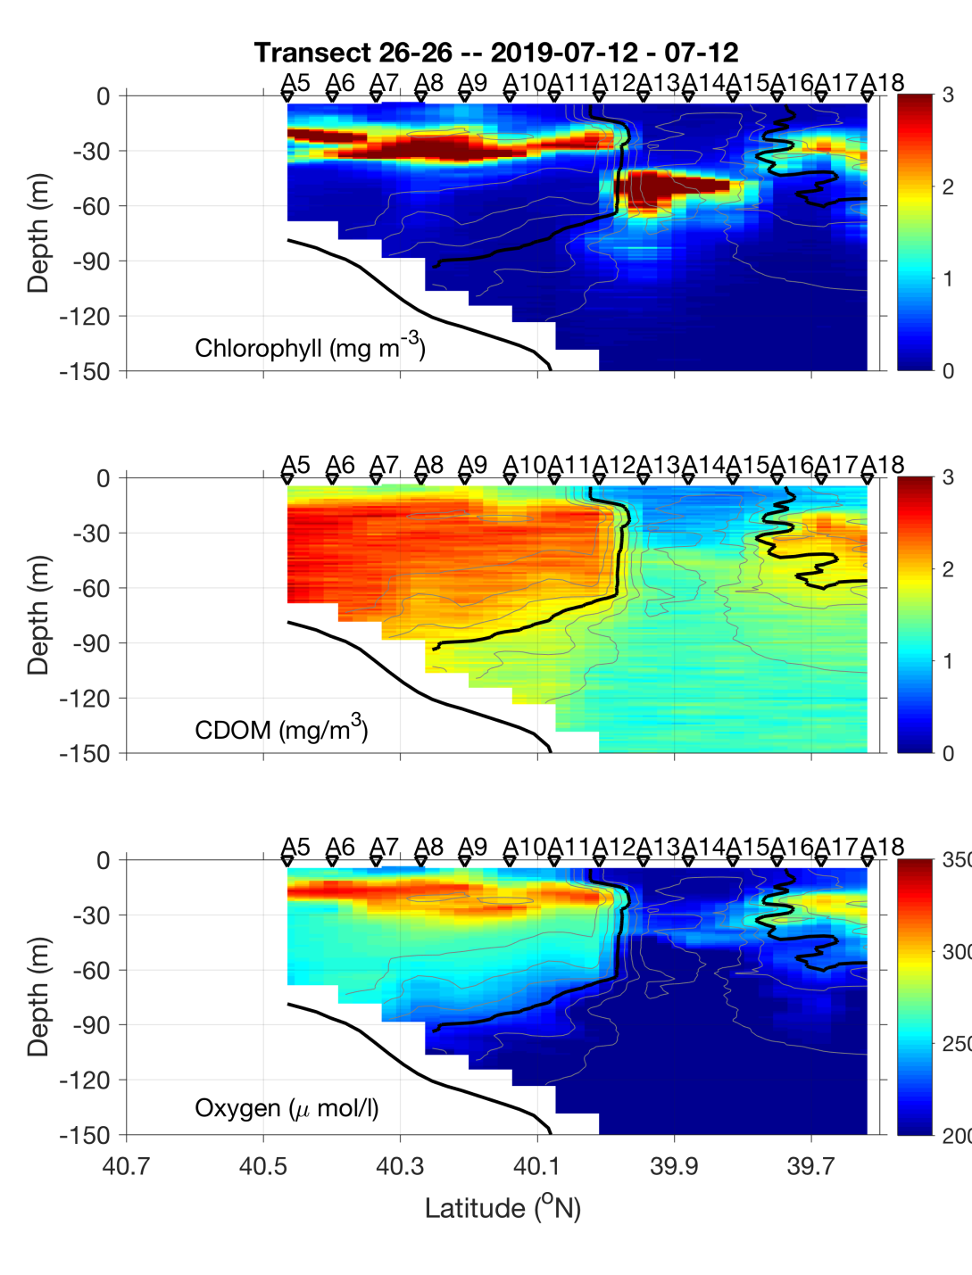
CTD transect – July 11-12

Slide 39
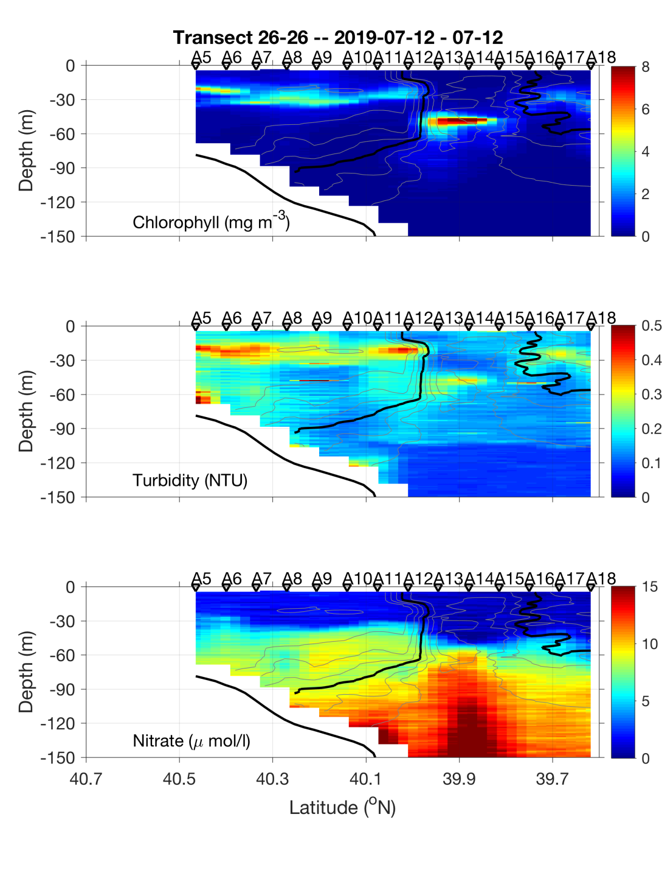
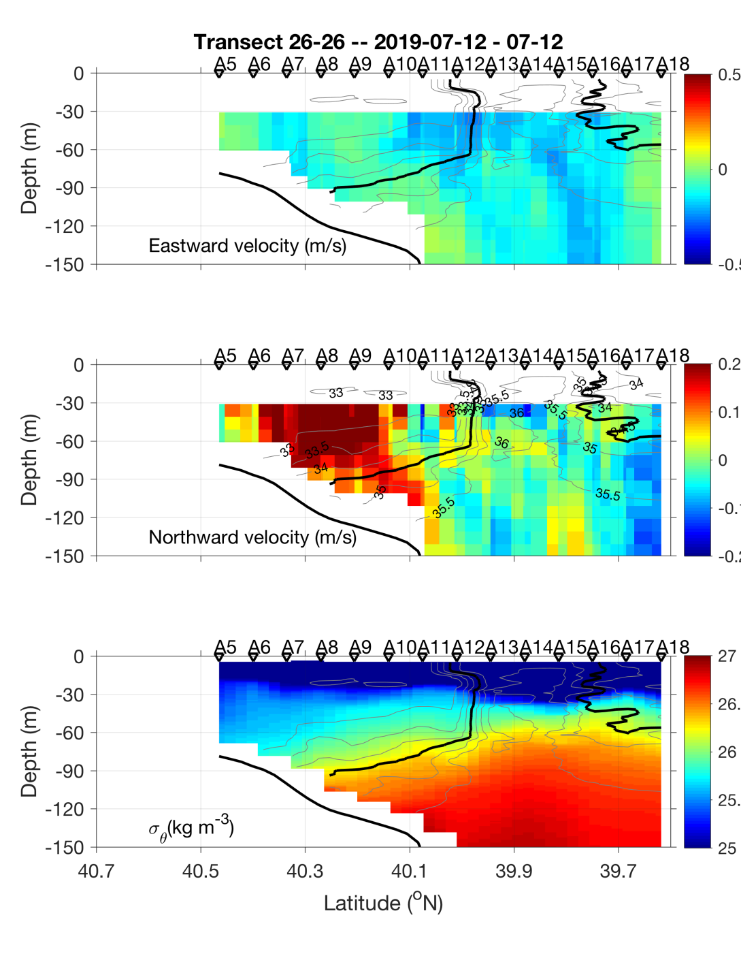
CTD transect – July 11-12

Slide 40
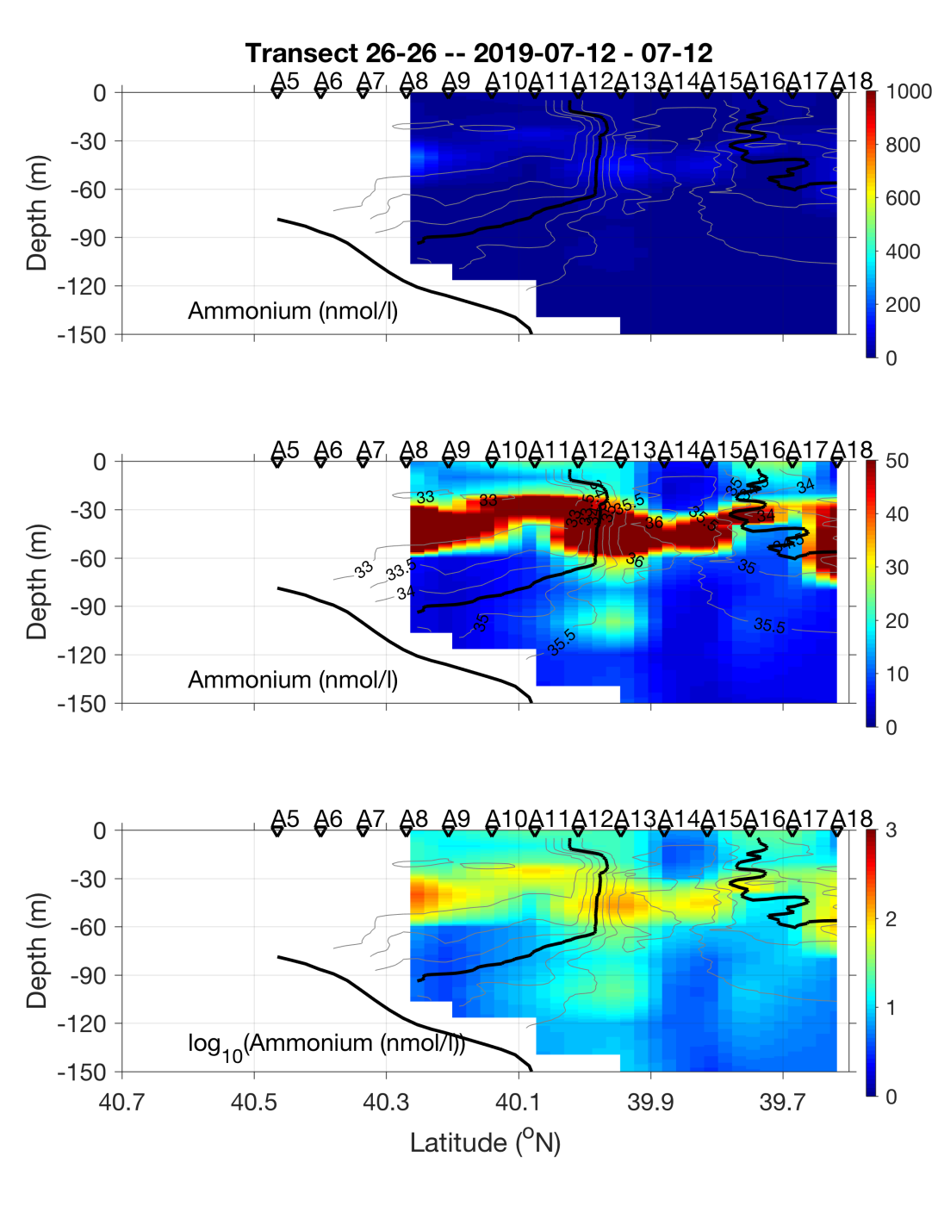
CTD transect – July 11-12

Slide 41
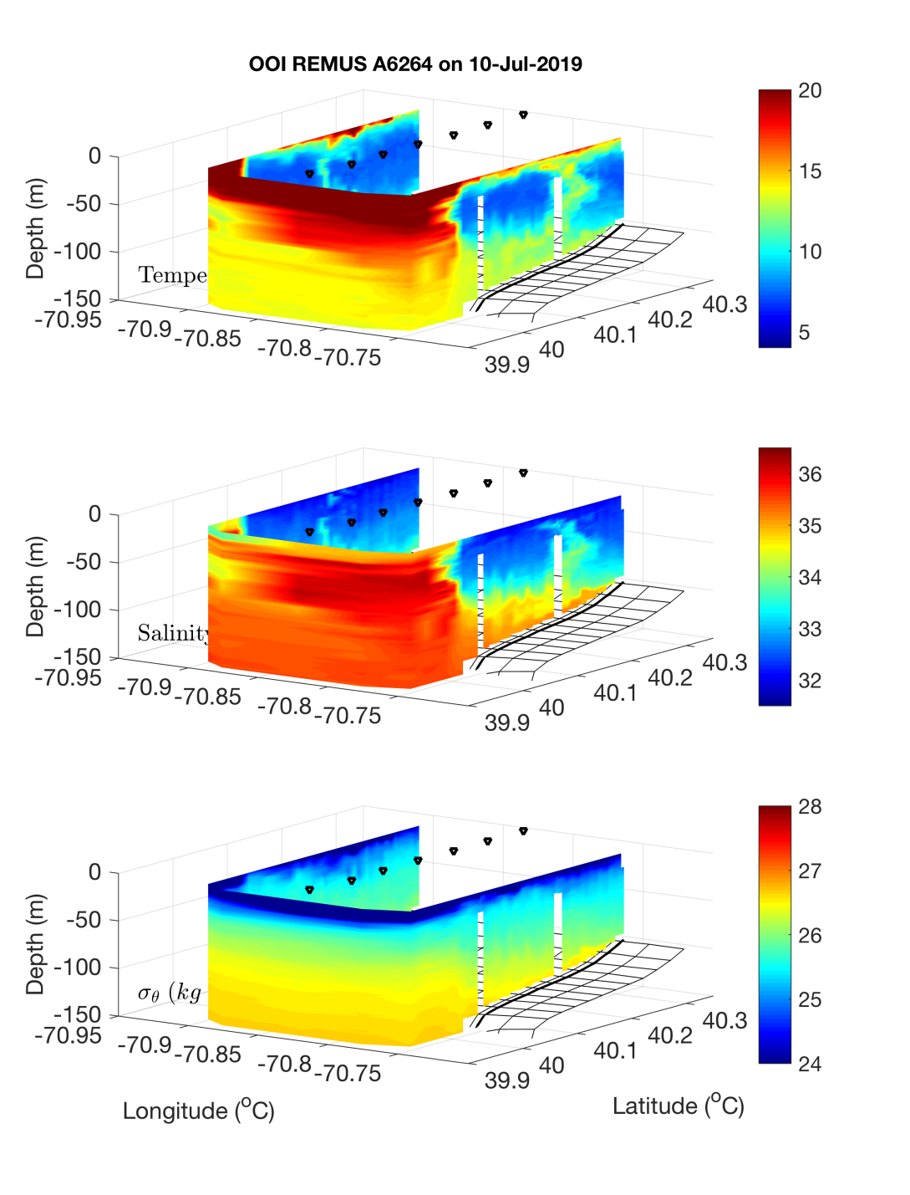

OOI REMUS : Across – front mission July 10
A7
A13

Slide 42


OOI REMUS : Along – front mission July 10
A10
A12

Slide 43

OOI REMUS : Along – front mission July 10

Slide 44


OOI REMUS : Bottom boundary layer mission July 11
A13
A7

Slide 45

OOI REMUS : Bottom boundary layer mission July 11

Slide 46

VIIRS Chl 11 July

Slide 47
VIIRS Chl 11 July

Slide 49

VPR5 July 12

Slide 50

SST July 9

Slide 51

VPR6 July 13

Slide 52

VIIRS Chl July 13

Slide 53

REMUS 4 – diatom hotspot

Slide 54


REMUS 4 – diatom hotspot
Temperature Salinity

Slide 55


REMUS 4 – diatom hotspot
Nitrate Oxygen

Slide 56


REMUS 4 – diatom hotspot
Fluorescence Backscatter

Slide 58


REMUS 5 – BBL survey

Slide 59


REMUS 6 – diatom hotspot
Temperature Salinity

Slide 60


REMUS 6 – diatom hotspot
Fluorescence Backscatter

Slide 61


REMUS 6 – diatom hotspot
Nitrate Oxygen

Slide 62

VPR 7-8 July 15

Slide 63

SST July 13

Slide 64

Satellite altimetry July 13

Slide 65

Shipboard ADCP July 15

Slide 66
Diatom / Alatalosphera bloom: synthesis
High salinity waters are the niche (ca. 36 ppt)
The cyclonic eddy identified in altimetry provides transport from a gulf stream / ring source
The jet in between the cyclone and the ring forming to its east impacts the edge of the continental shelf
Westward flow in the northwestern lobe of the cyclone deliver the source waters to our sampling area
Highest fluorescence occurs when the high salinity waters are illuminated via shoaling of that water mass
cyclone, along the shelf break front, streamers

Slide 67

TN368 Highlights
An extraordinary bloom of diatoms and colonial plankton stimulated by deep ocean / shelf interaction
Cross-shore fluxes of heat, salt, and biomass in a WCR streamer
Fine-scale patchiness in hotspots
Testing of the bottom boundary layer hypothesis
Observations of turbulent billows associated with internal wave breaking

Slide 69

Frontal positions – TN368

Slide 70


Frontal positions
AR29
RB1904
TN368

Slide 71

VIIRS Chl July 16

Slide 72

VPR 9 July 16

Slide 73


CTD transect – July 14

Slide 74


CTD transect – July 14

Slide 75
CTD transect – July 14

Slide 76


CTD transect July 16-17

Slide 77


CTD transect July 16-17

Slide 78


Along-shelf transect July 16

Slide 79


Along-shelf transect July 16

Slide 80
SPIROPA Highlights
AR29
Frontal stratification enhances chlorophyll
Ring forcing of cross-shelf excursions of the front
Frontal Gorduction
Regional bloom of Phaeocystis
RB1904
Upwelling induced by formation of a shelf break eddy
Ring forcing of cross-shelf excursions of the front
Diatom bloom on the slope side of the front
TN368
Cross-shore fluxes of heat, salt, and biomass in a WCR streamer
An extraordinary bloom of diatoms stimulated by deep
ocean / shelf interaction
Fine-scale patchiness at the front
Testing of the bottom boundary layer hypothesis

Slide 81
Extras

Slide 82

Satellite altimetry July 16

Slide 83

VPR 7 – July 15

Slide 84
SST July 13

Slide 85


CTD Transect – July 8-9

Slide 86


CTD Transect – July 8-9

Slide 87

CTD Transect – July 8-9

Slide 88

MODIS Chl July 6

