Slide 1
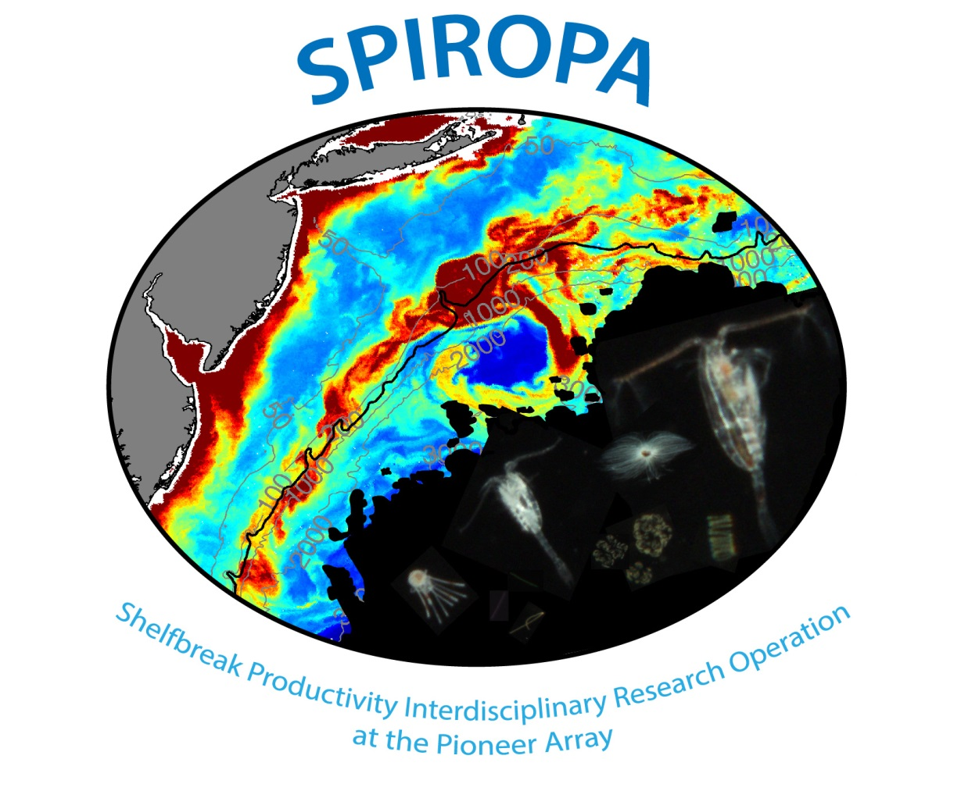

Slide 2
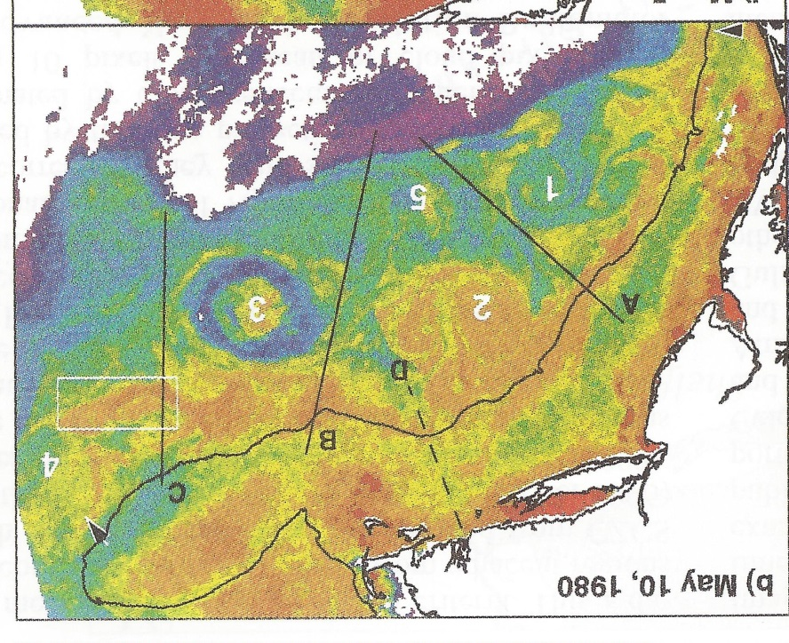
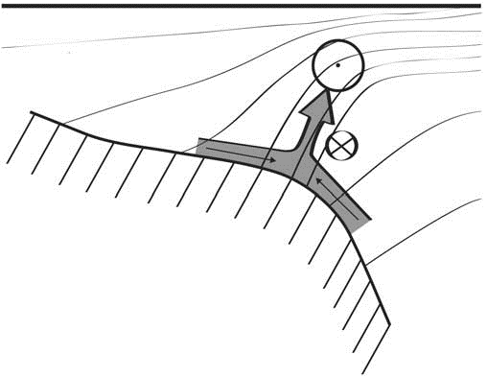
Shelfbreak frontal dynamics: mechanisms of upwelling, net community production, and ecological implications
Ryan et al. 1999
Linder et al. 2004
Gawarkiewicz and Chapman 1992
Chapman and Lentz 1994
Marra et al. 1990

Slide 3


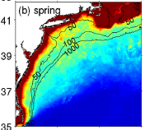

2013, JGR
Satellite CHL climatology
Why is there no mean enhancement of chlorophyll at the shelf break front?
H₁: Top-down control by zooplankton grazing
H₂: Spatial and temporal intermittency of the upwelling events causes their net impact to be smoothed out in long-term means.

Slide 4

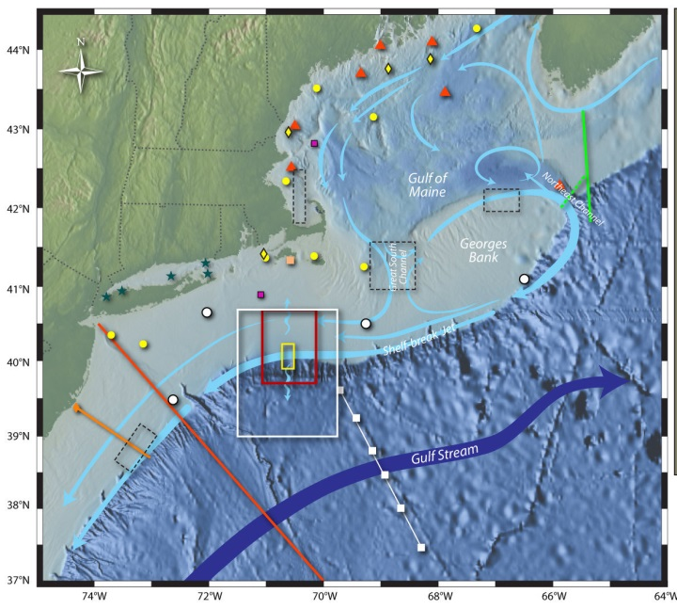
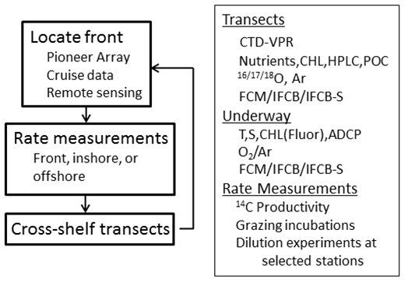
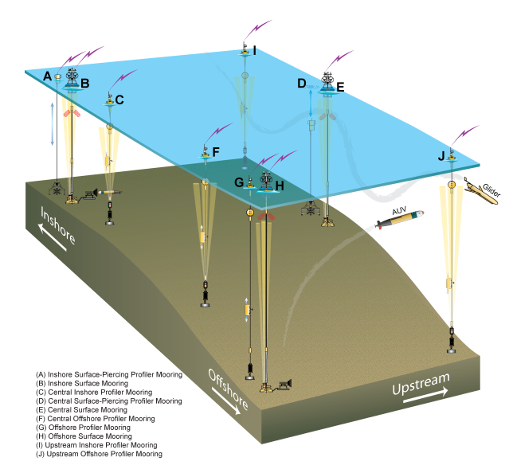
Shelfbreak frontal dynamics: mechanisms of upwelling, net community production, and ecological implications
Dennis McGillicuddy, Heidi Sosik, Gordon Zhang (WHOI)
Walker Smith (VIMS) Rachel Stanley (Wellesley College)
Jefferson Turner, Christian Petitpas (UMass Dartmouth)
3 Cruises R/V Neil Armstrong
NSF Ocean Observatory Initiative Pioneer Array

Slide 5
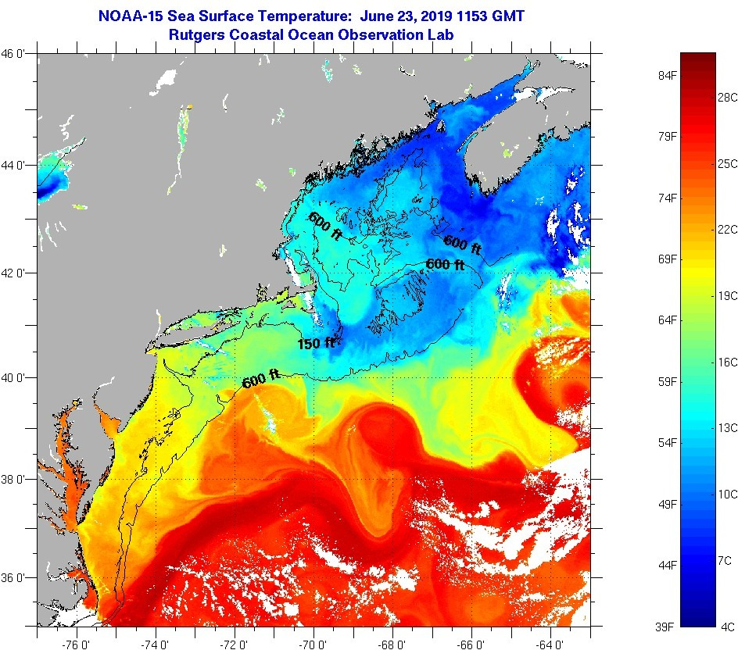
SST - June 23 2019

Slide 6
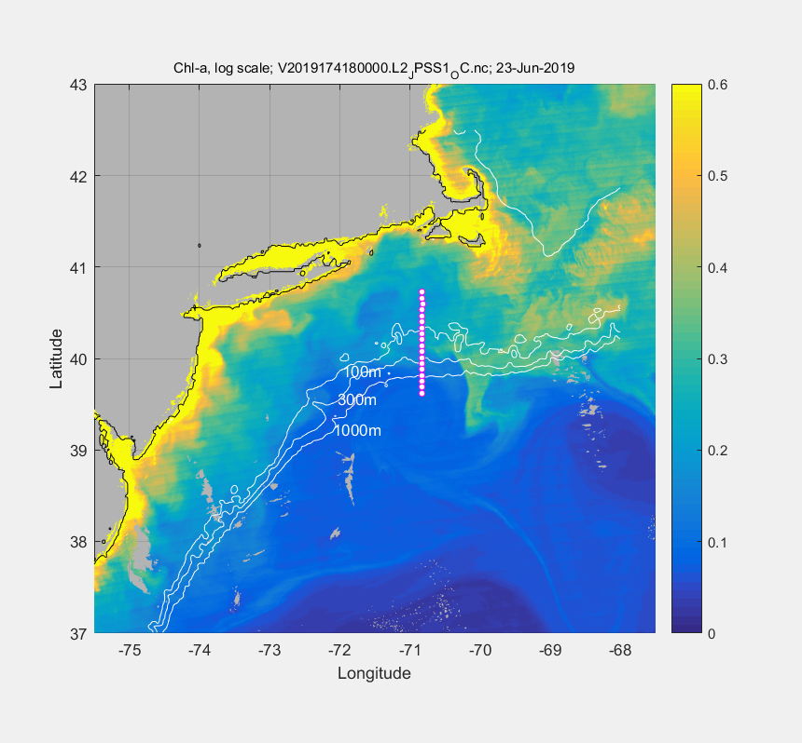
VIIRS Chl - June 23

Slide 7
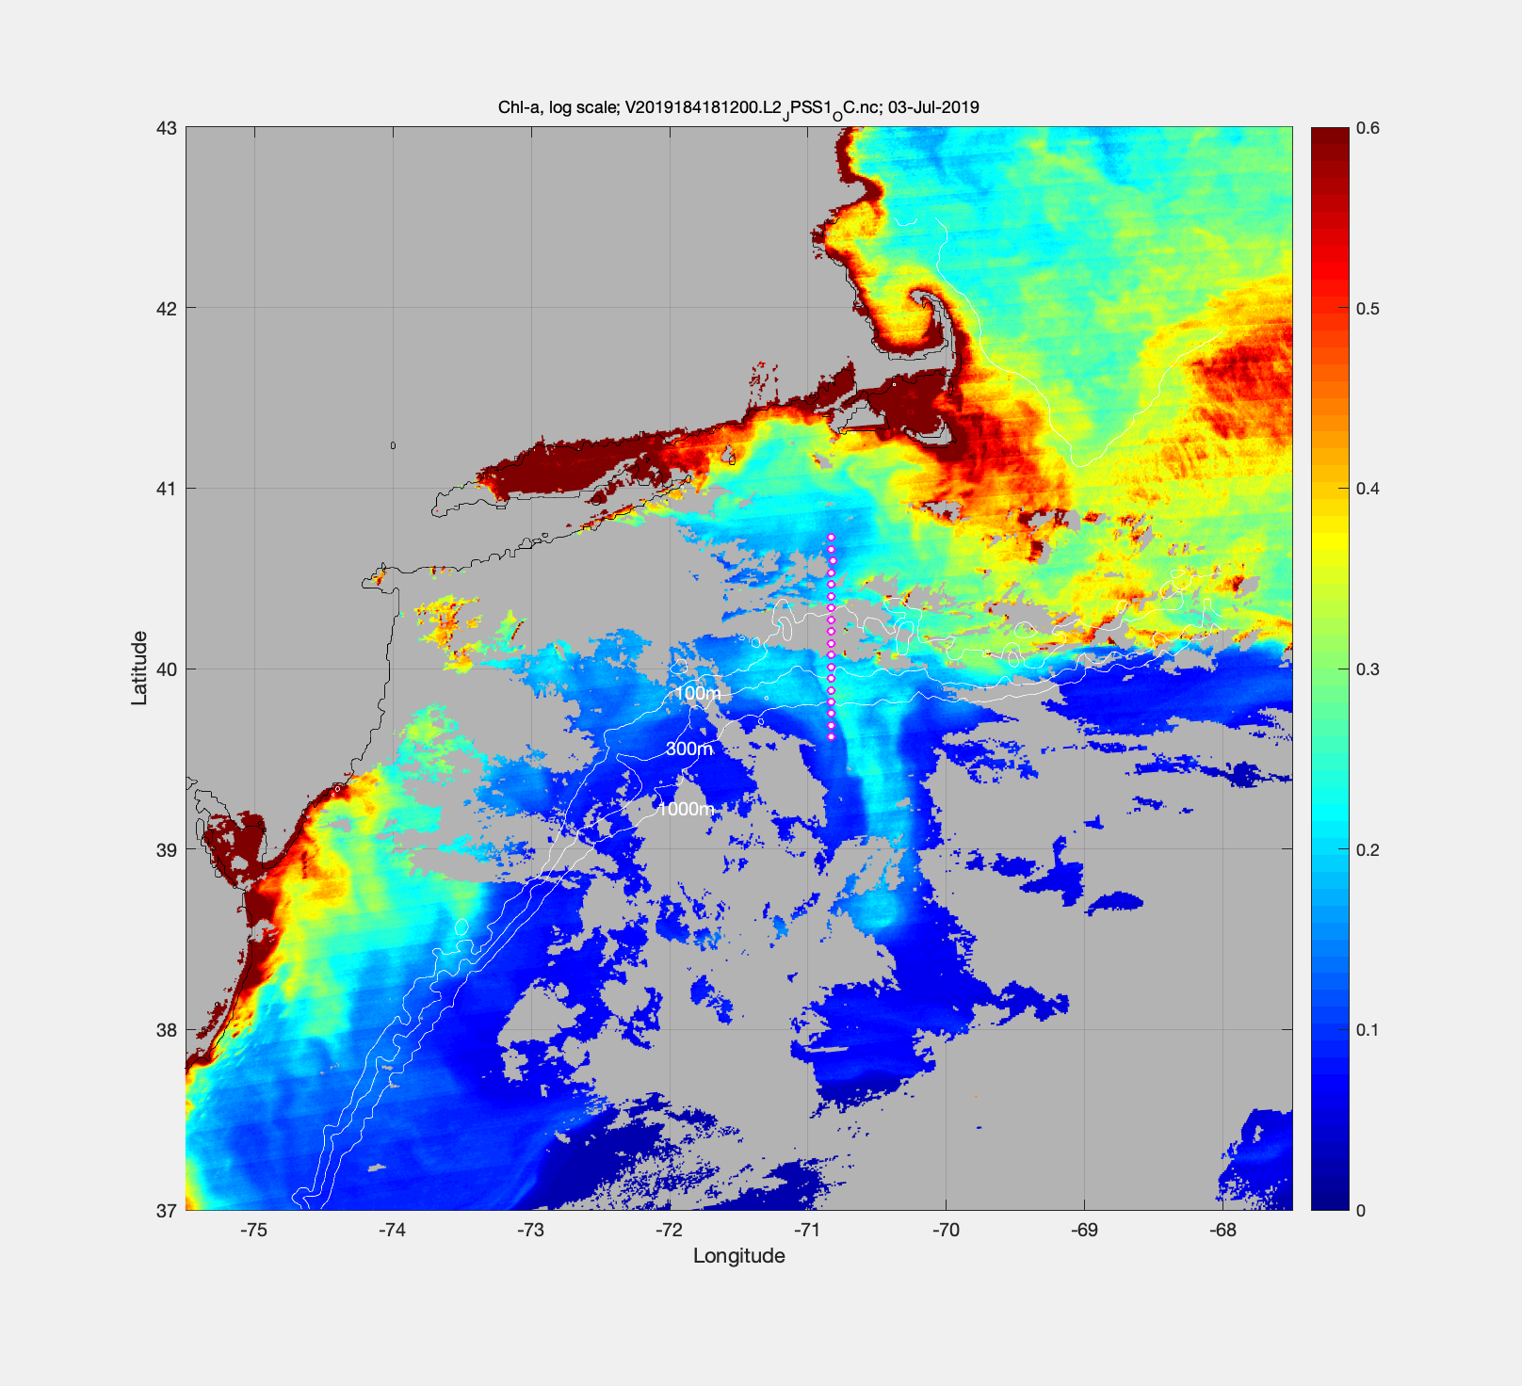
July 3 – VIIRS Chl

Slide 8
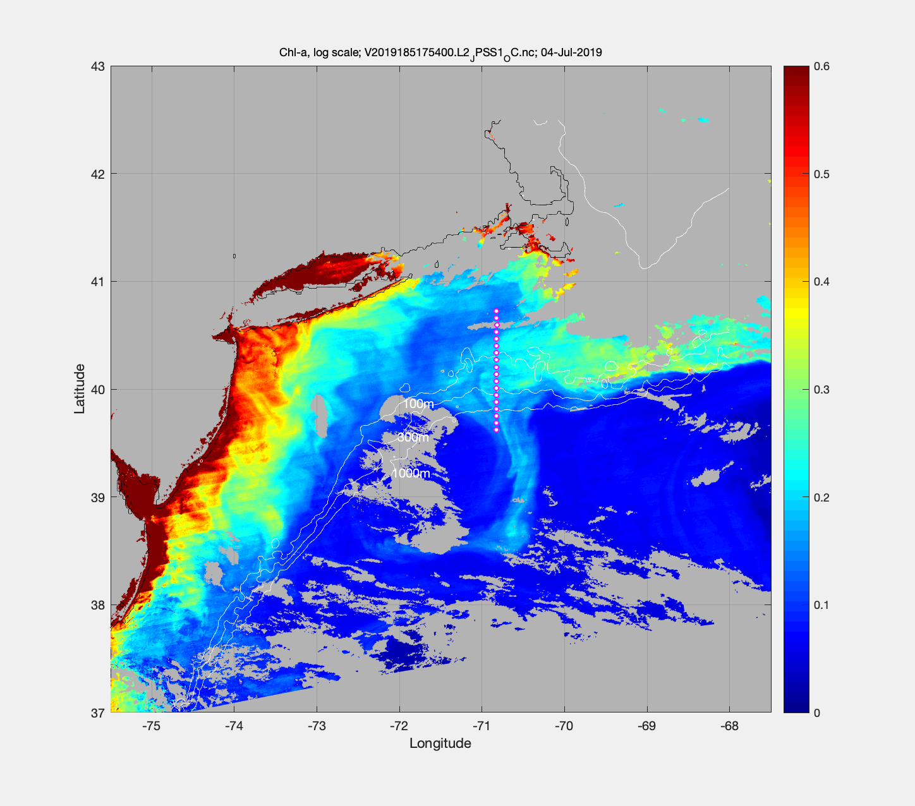
July 4 – VIIRS Chl

Slide 10
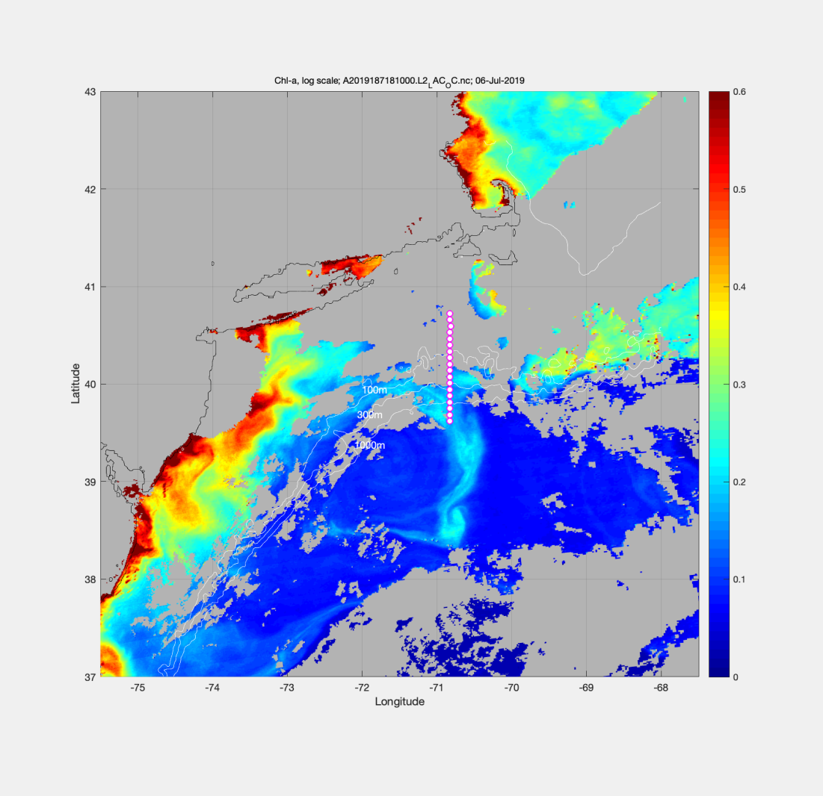
VIIRS Chl June 23 MODIS Chl July 6

Slide 11
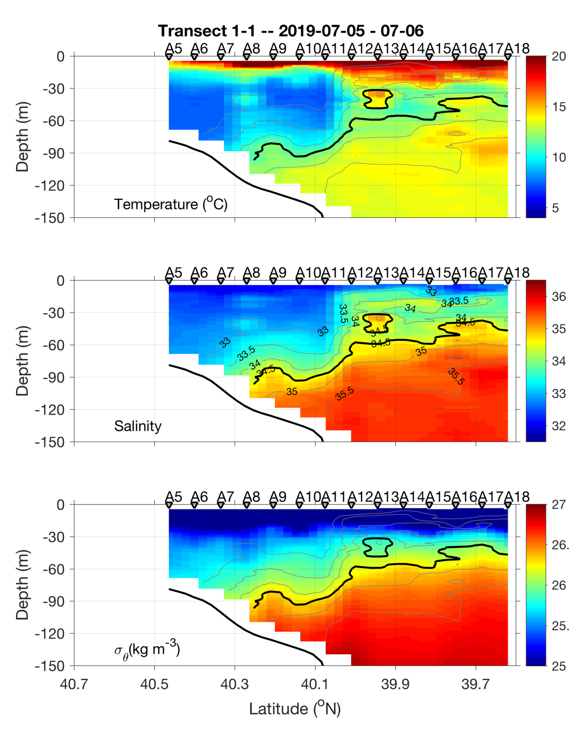
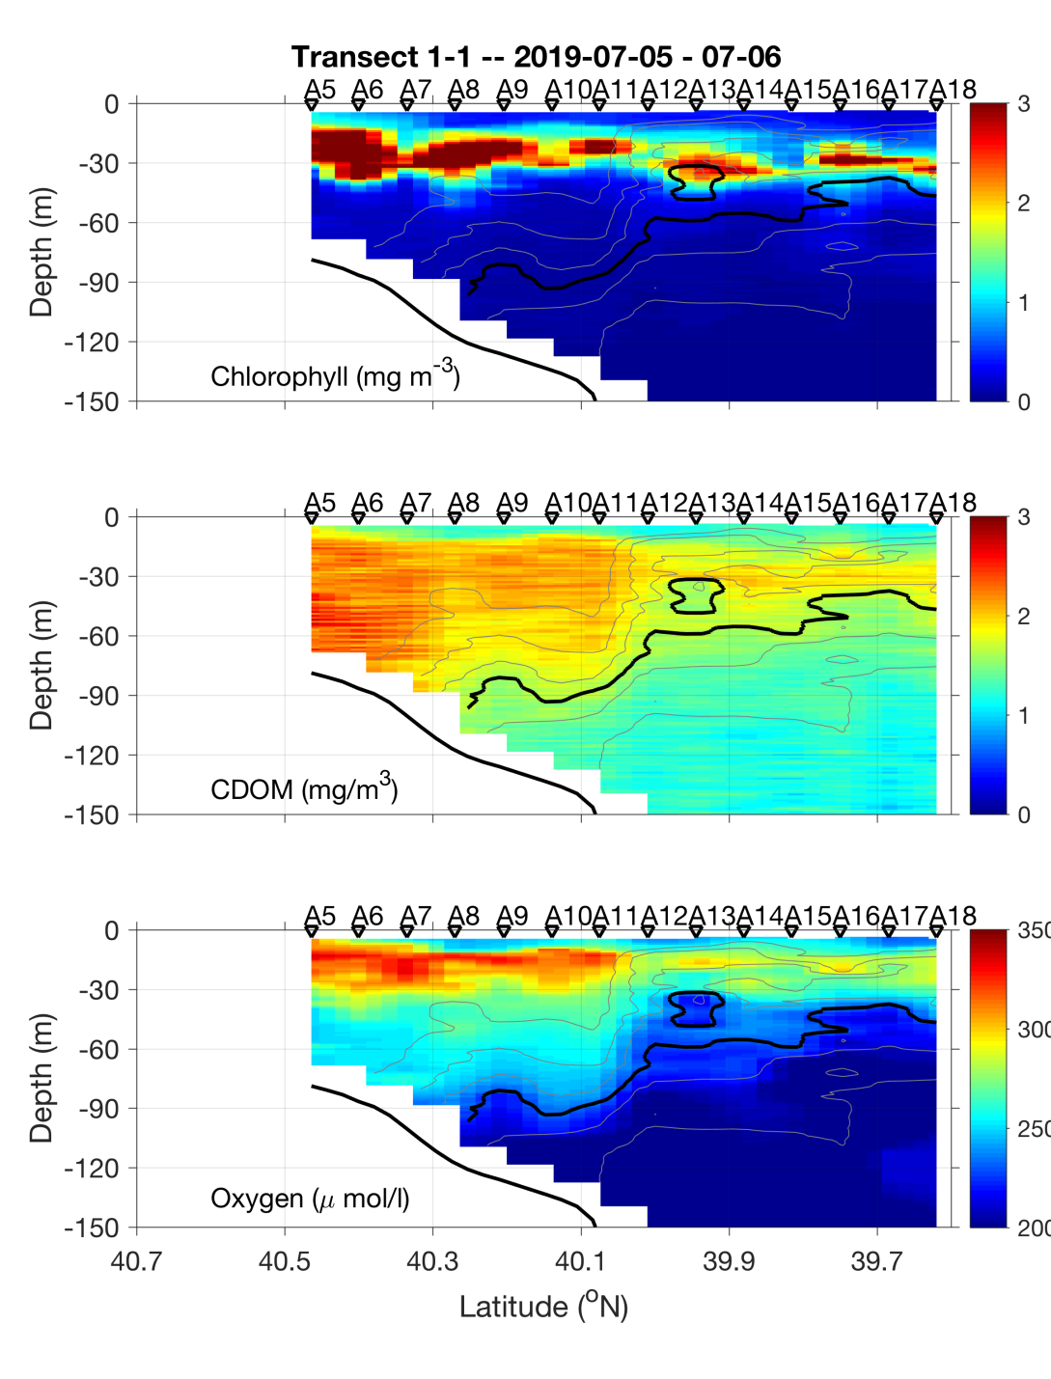
Transect 1 – July 5-6

Slide 12
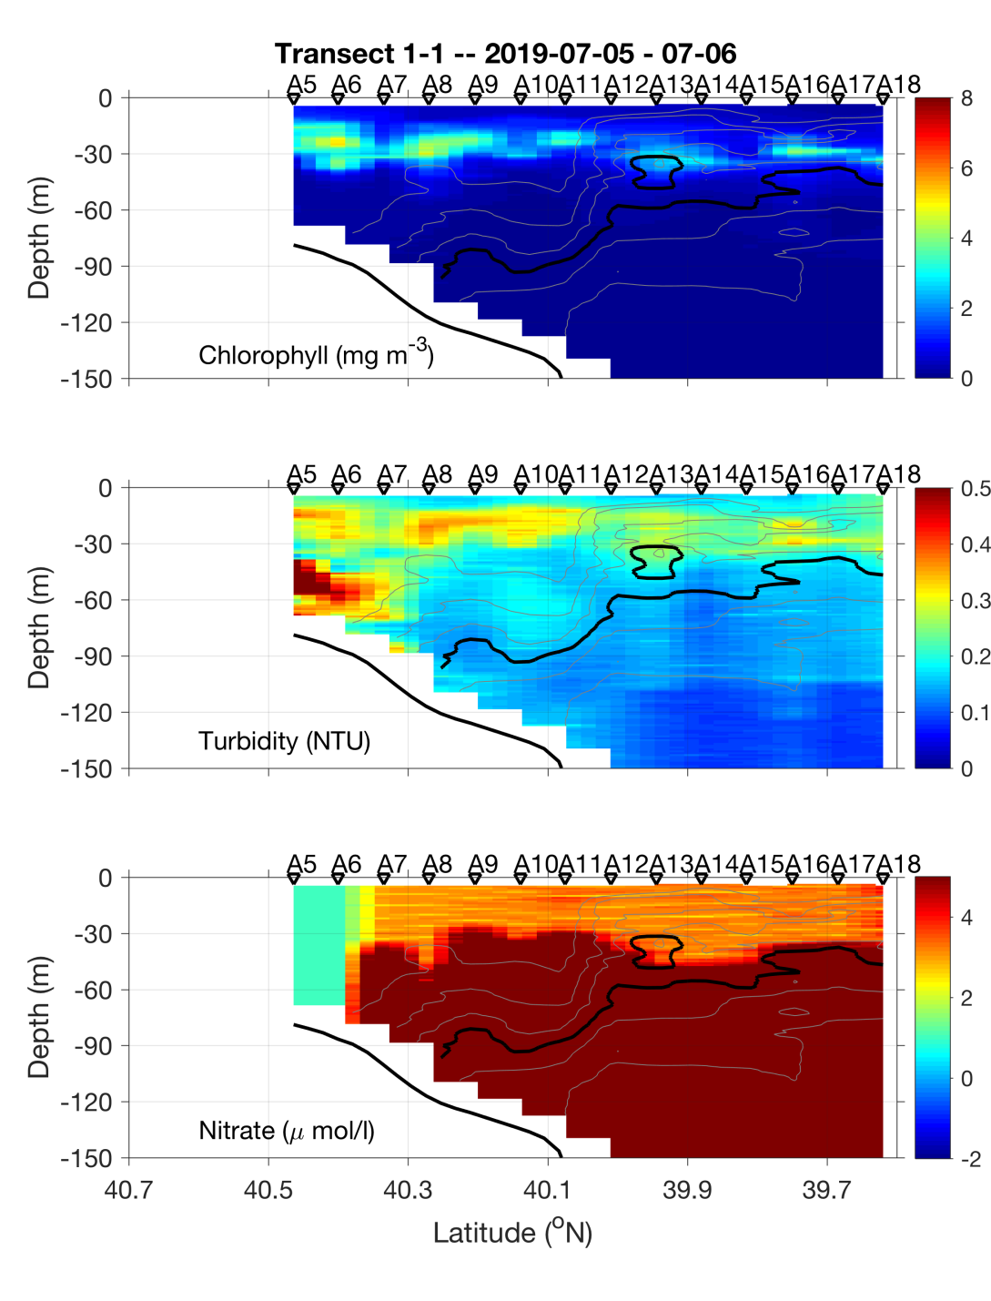
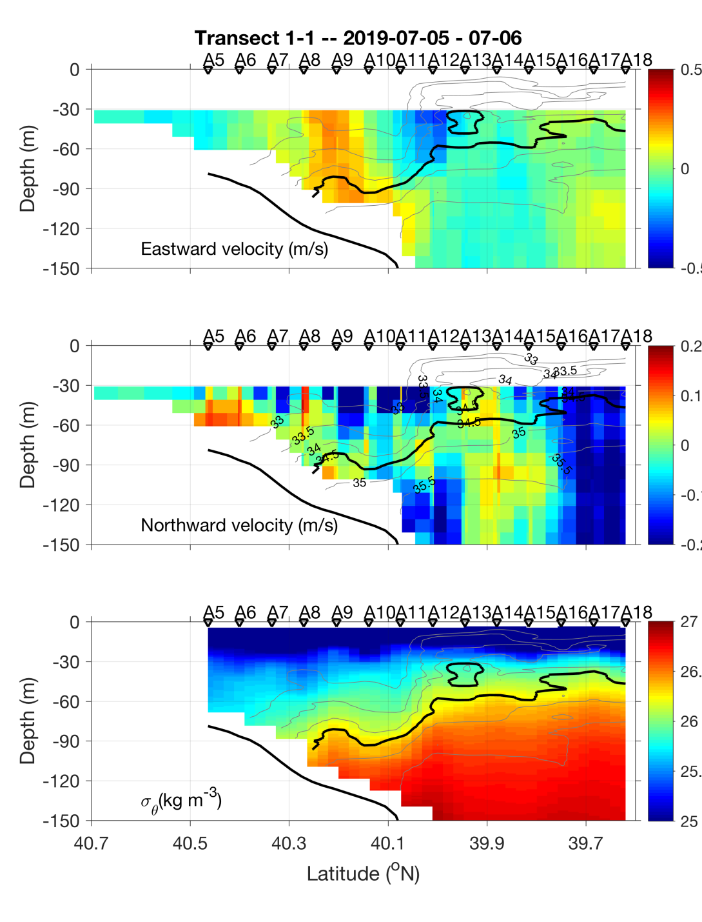
Transect 1 – July 5-6

Slide 13
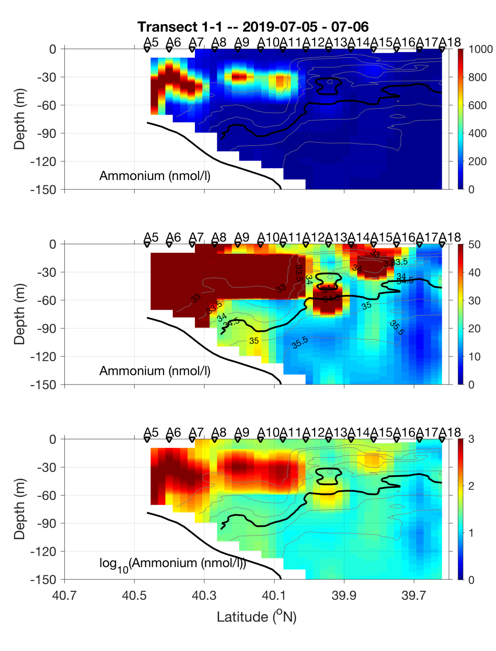
Transect 1 – July 5-6

Slide 14
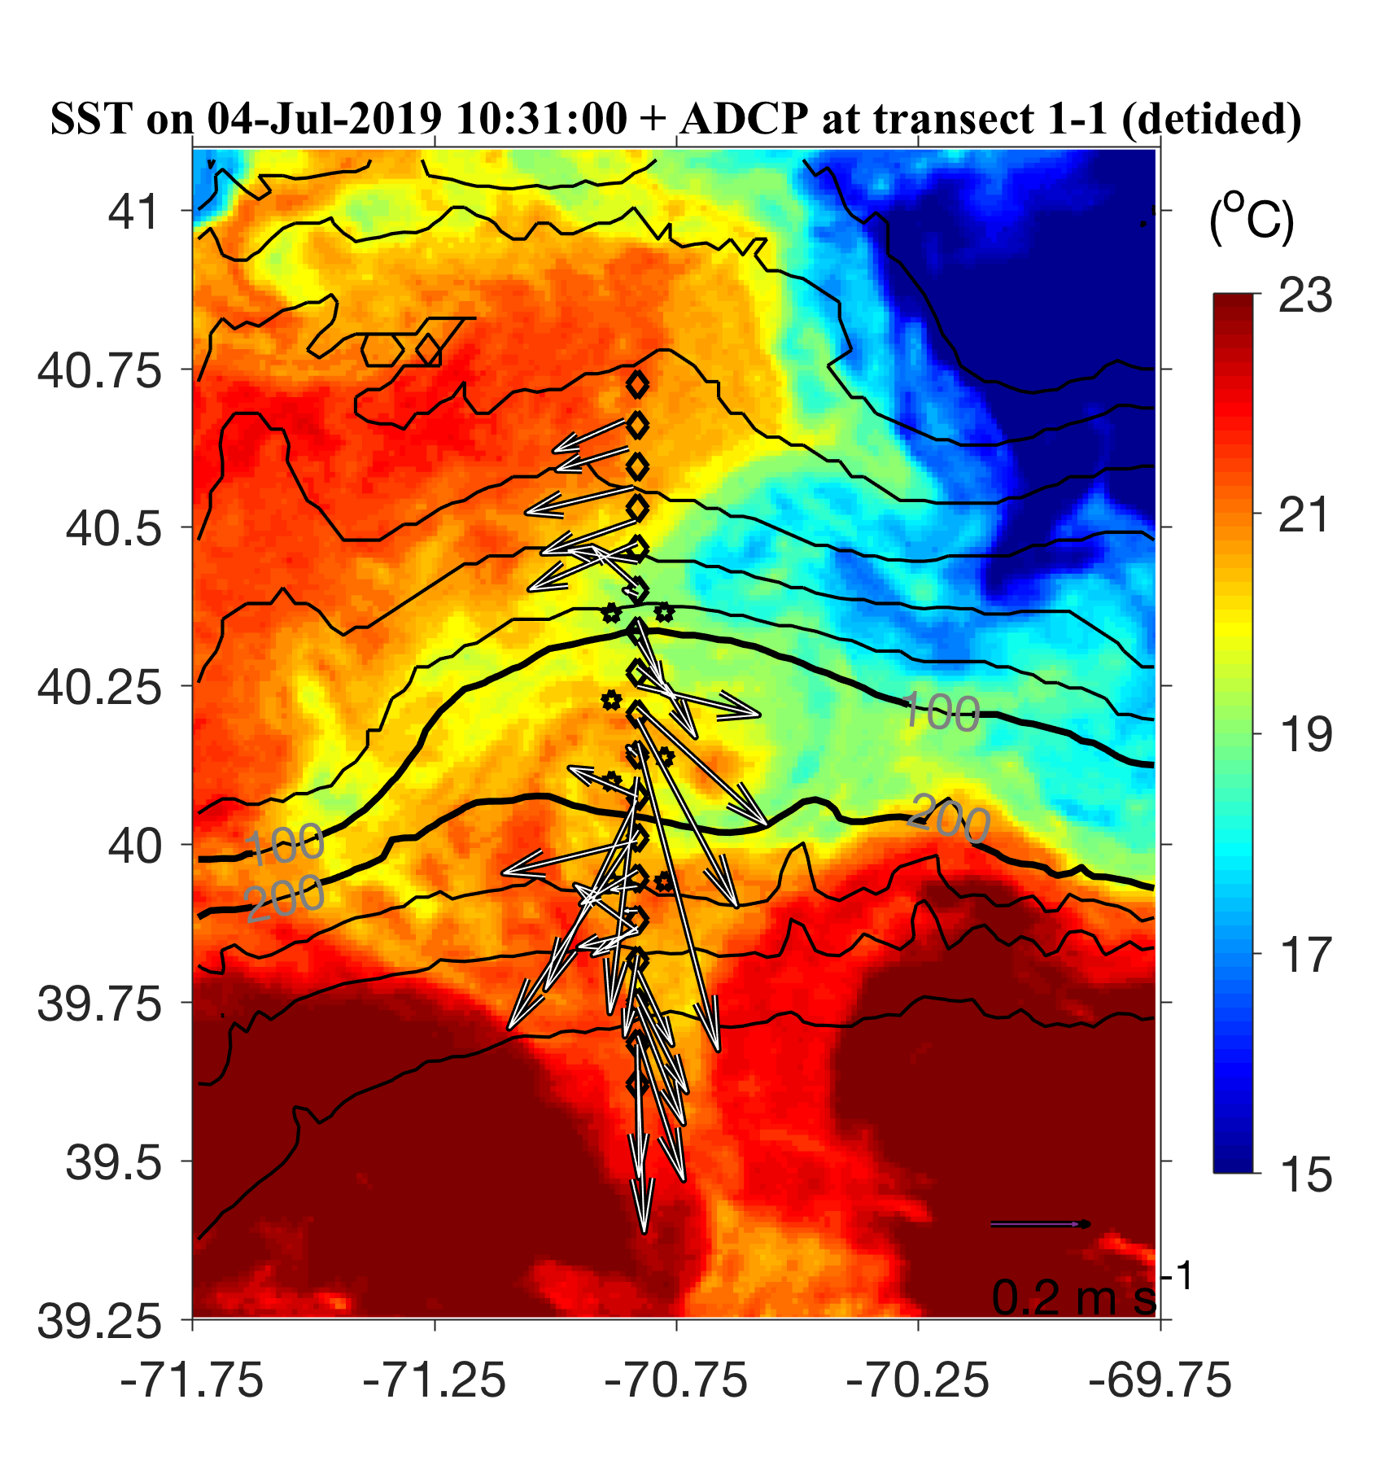
July 5-6 ADCP overlayed on July 4 SST

Slide 15
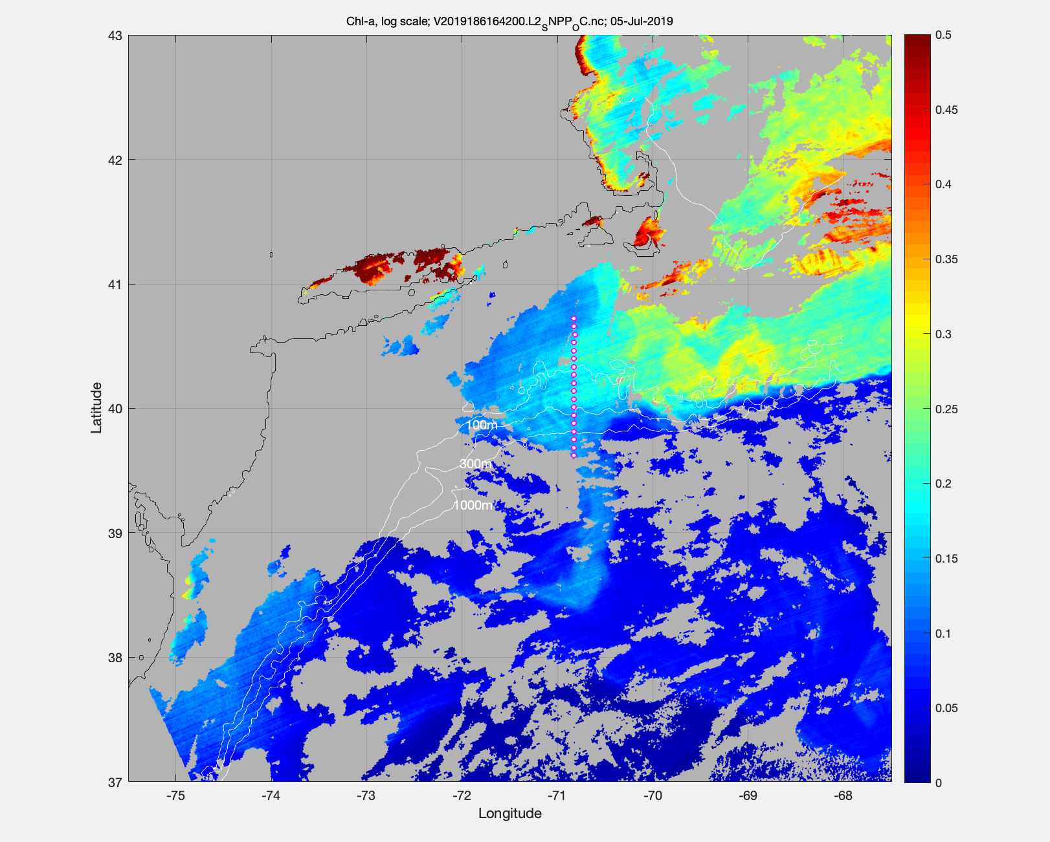
MODIS Chl July 5

Slide 16
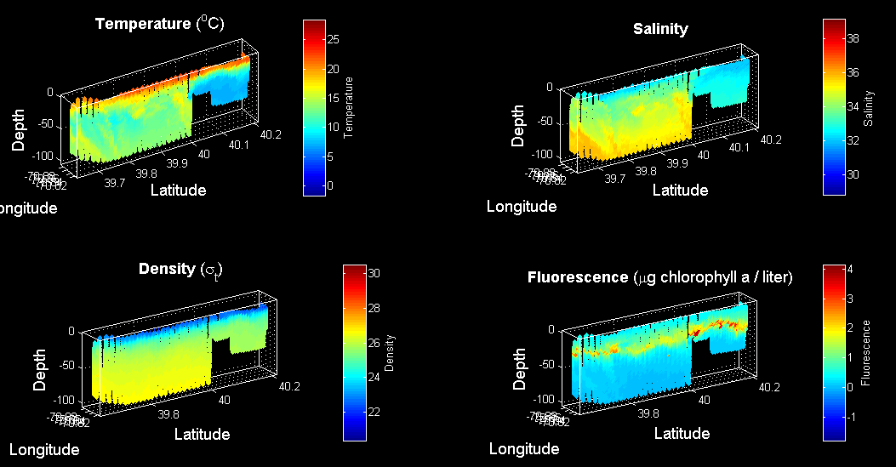
VPR survey July 6

Slide 17
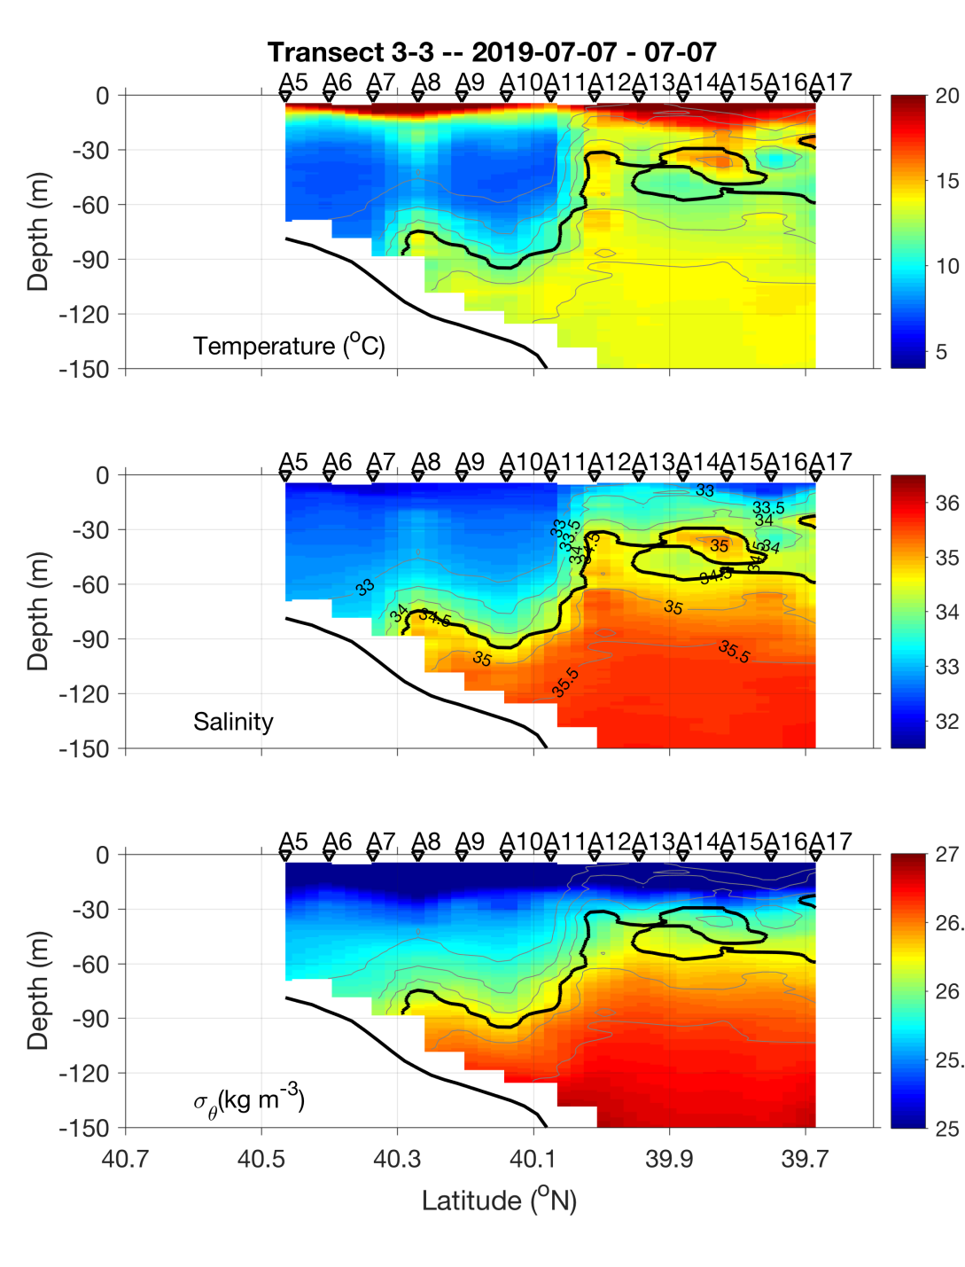
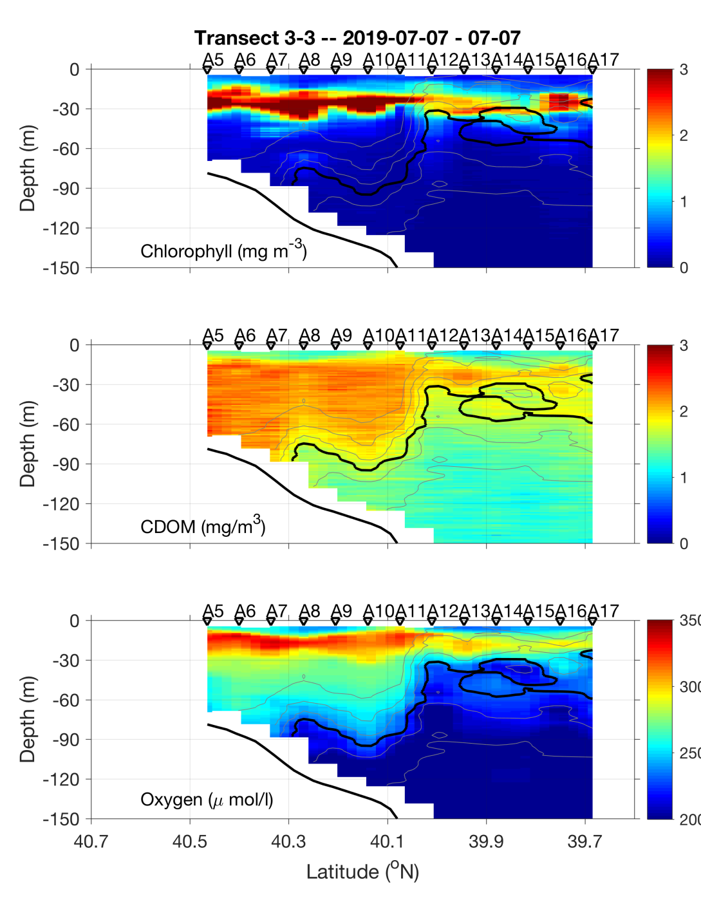
Transect 2 – July 6-7

Slide 18
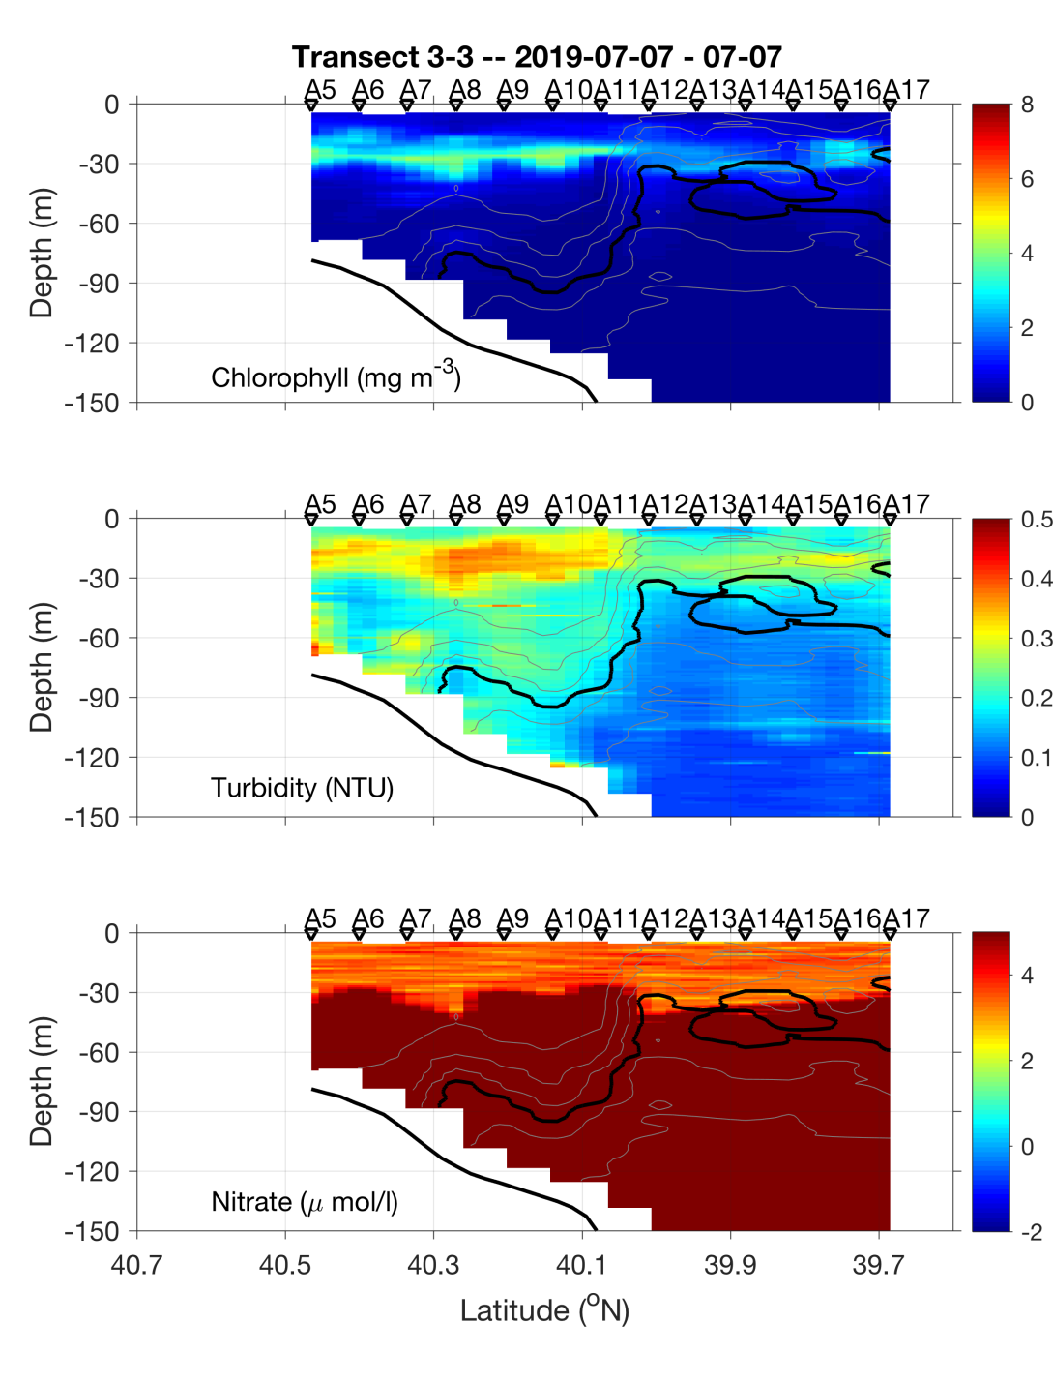
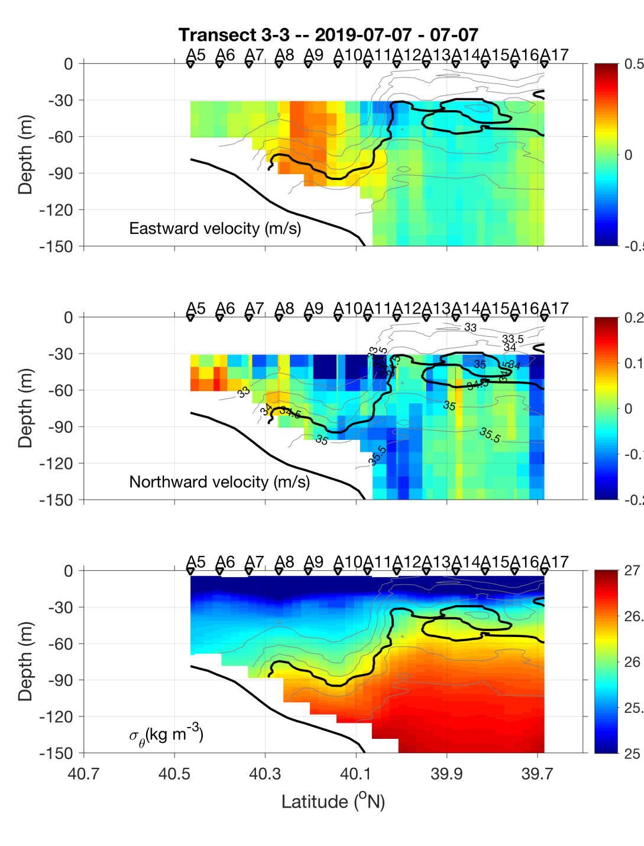
Transect 2 – July 6-7

Slide 19
Transect 2 – July 6-7

Slide 20
VIIRS Chl June 23 MODIS Chl July 6

Slide 21
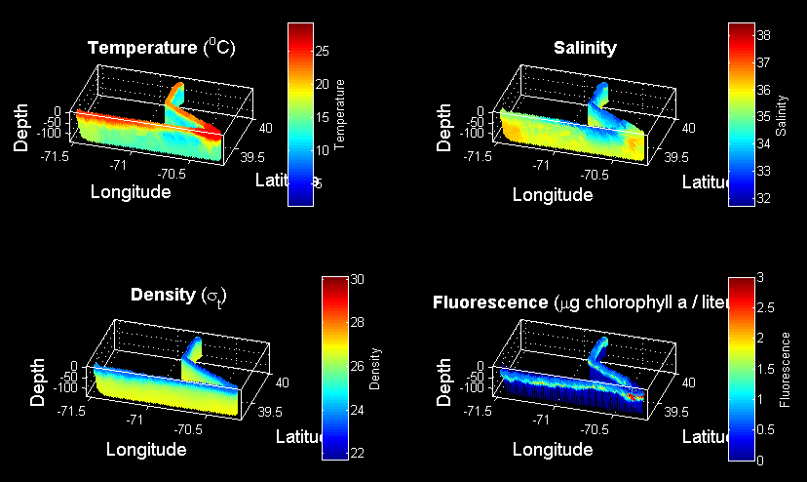
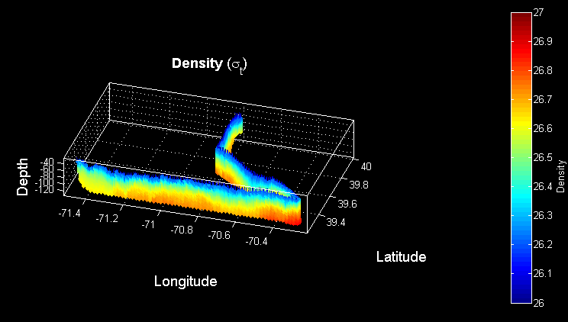
VPR Survey July 7-8
Density

Slide 22
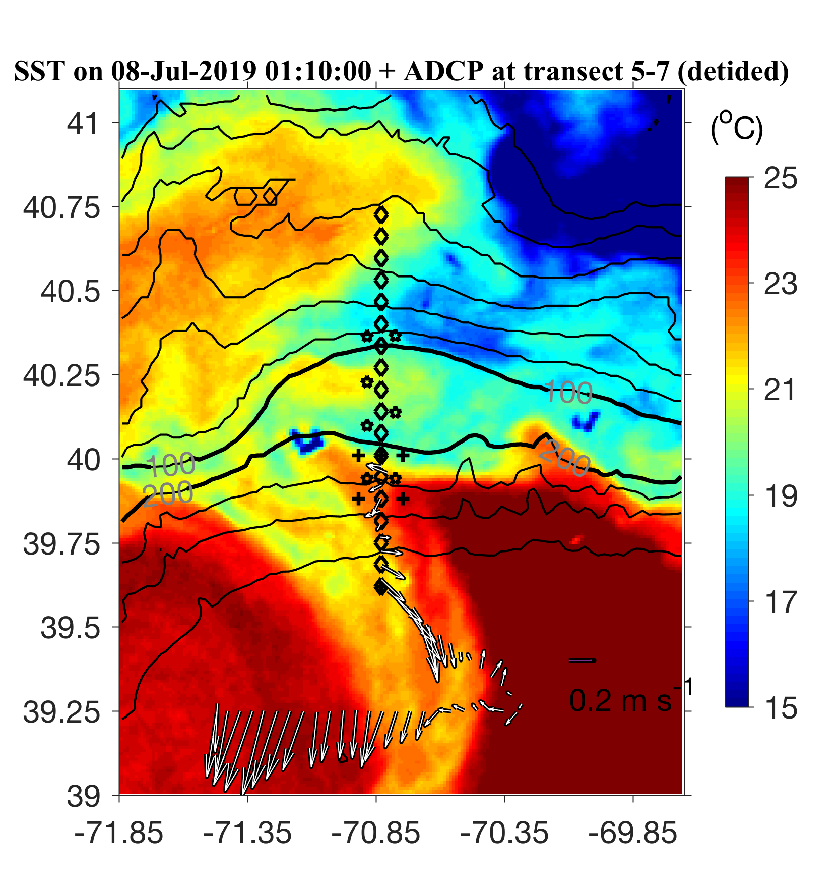
ADCP from VPR survey

Slide 23
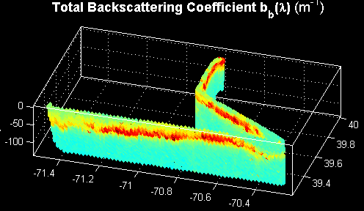


VPR Survey July 7-8

Slide 25
ADCP from VPR survey

Slide 26
VPR1 Survey July 7-8
Density

Slide 27
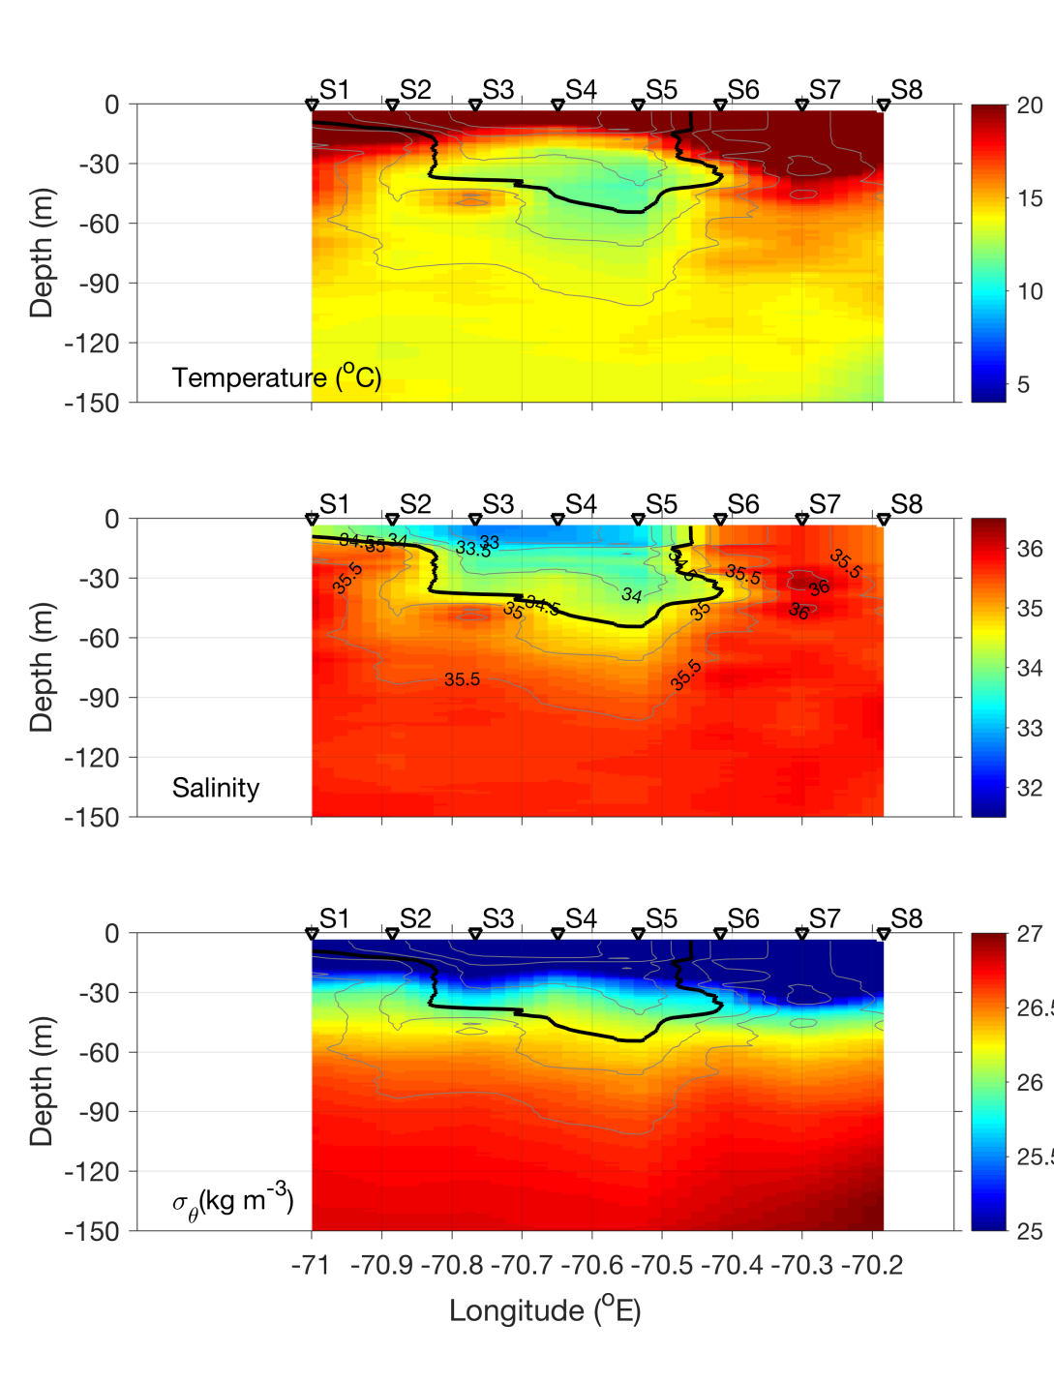
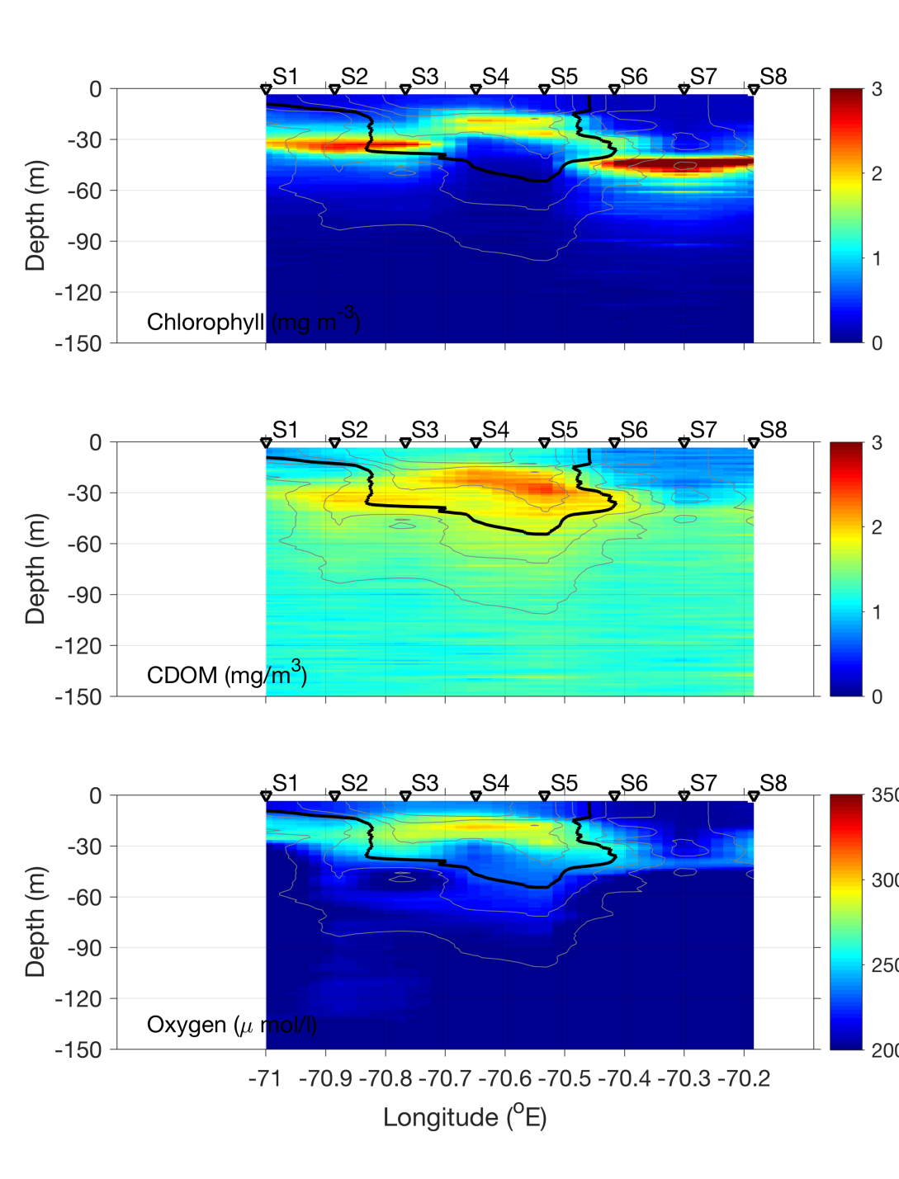
Streamer CTD transect – July 8

Slide 28
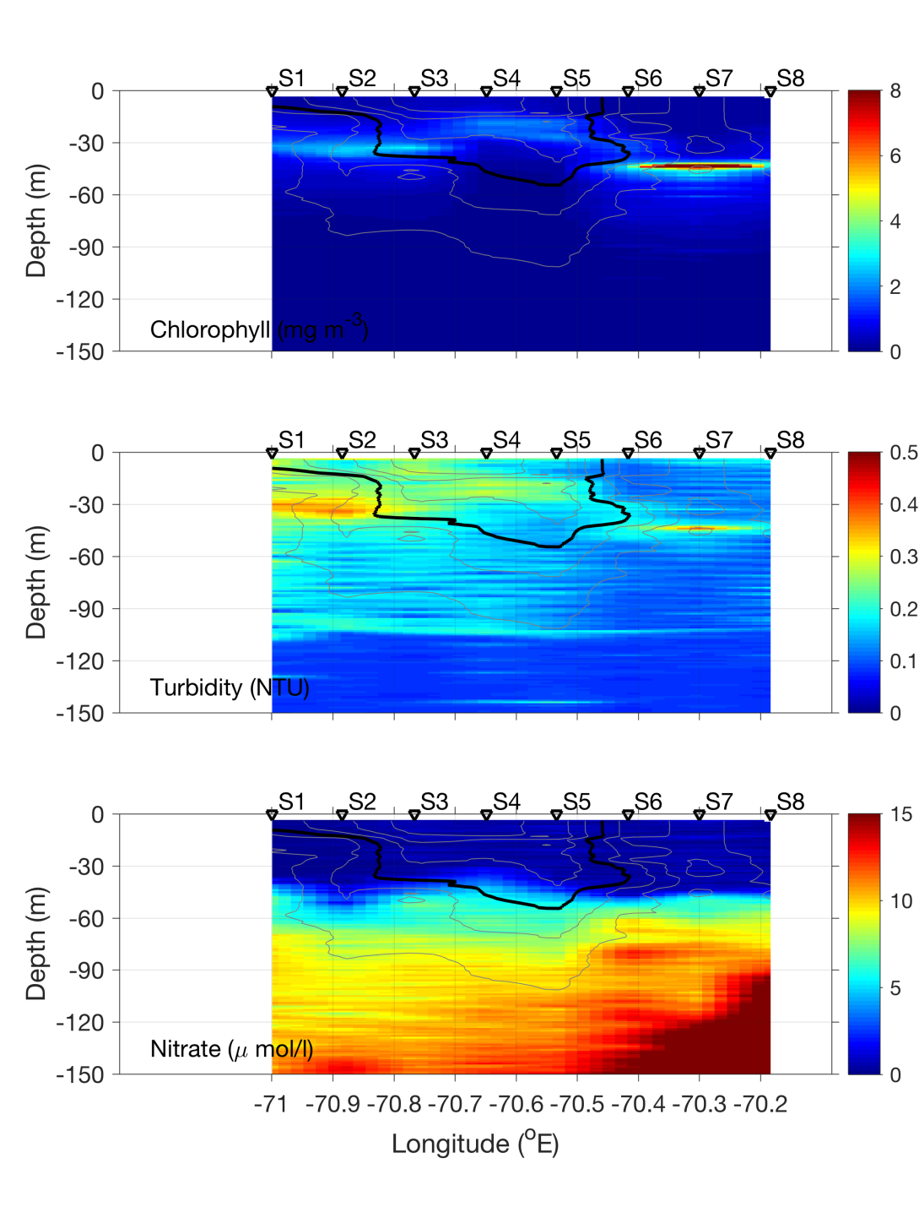
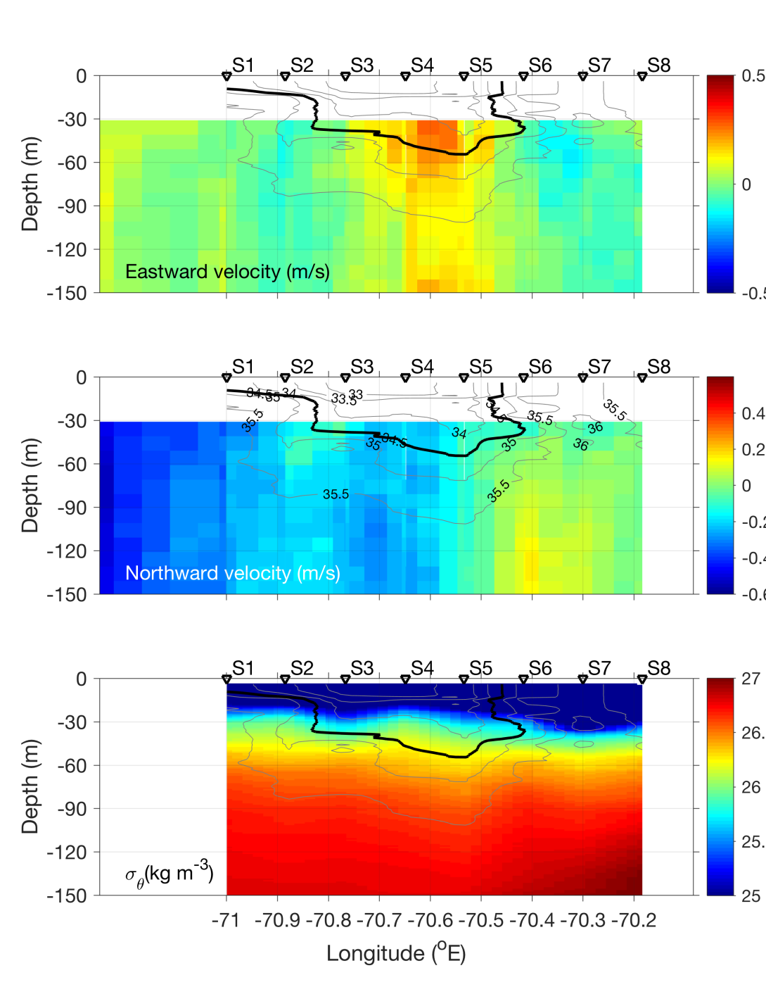
Streamer CTD transect – July 8

Slide 29
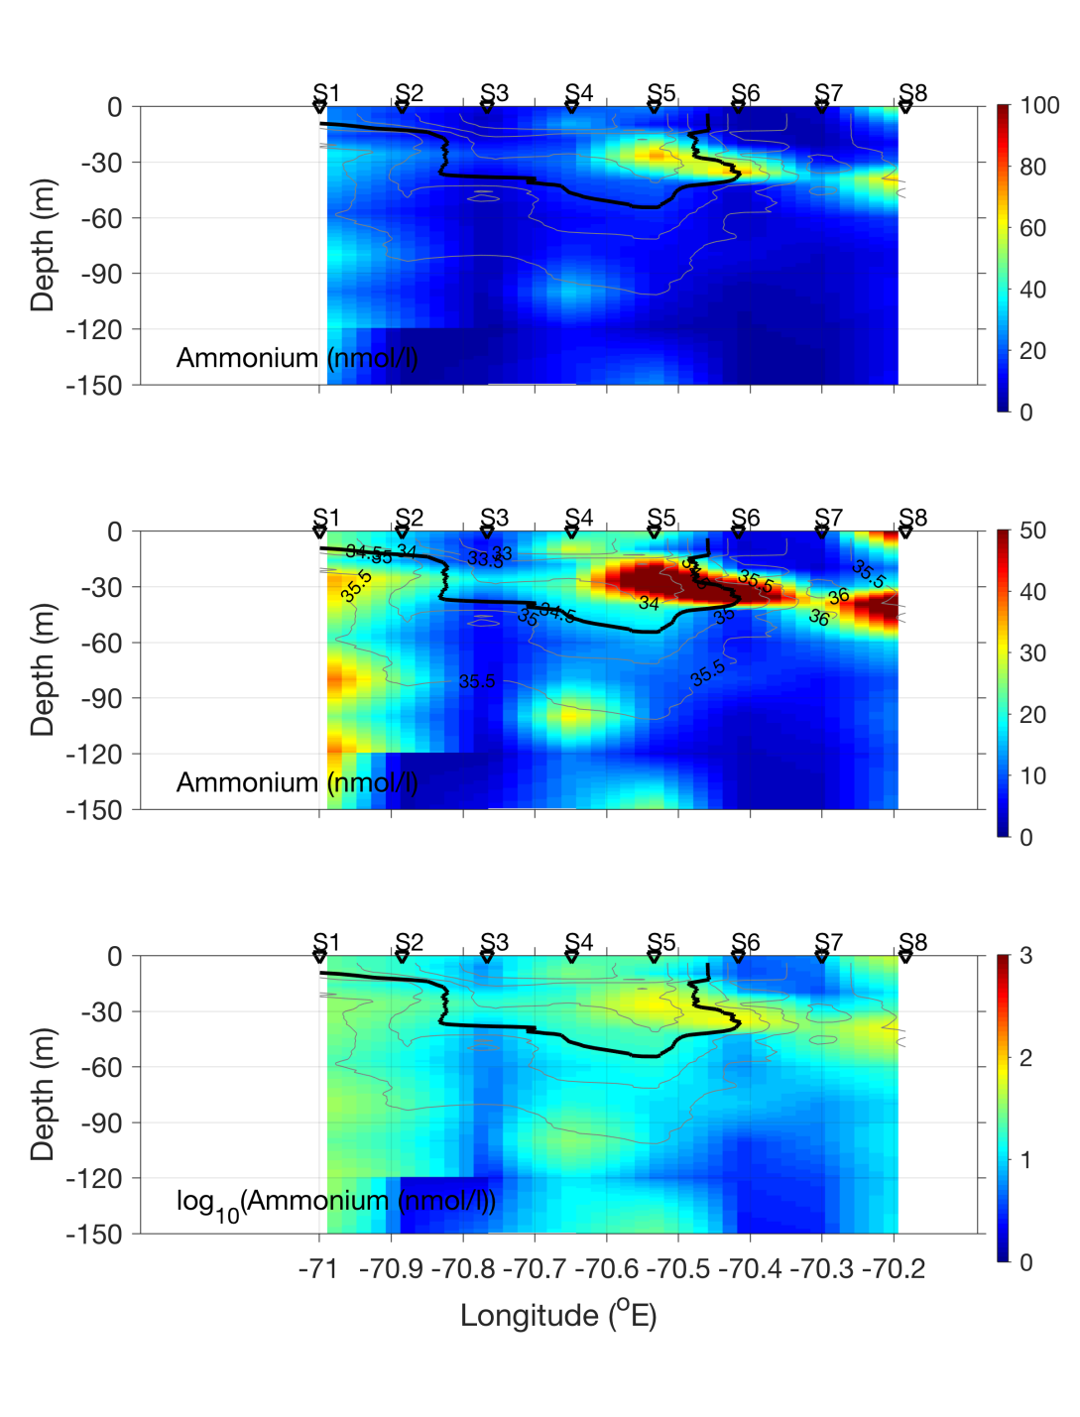
Streamer CTD transect – July 8

Slide 30
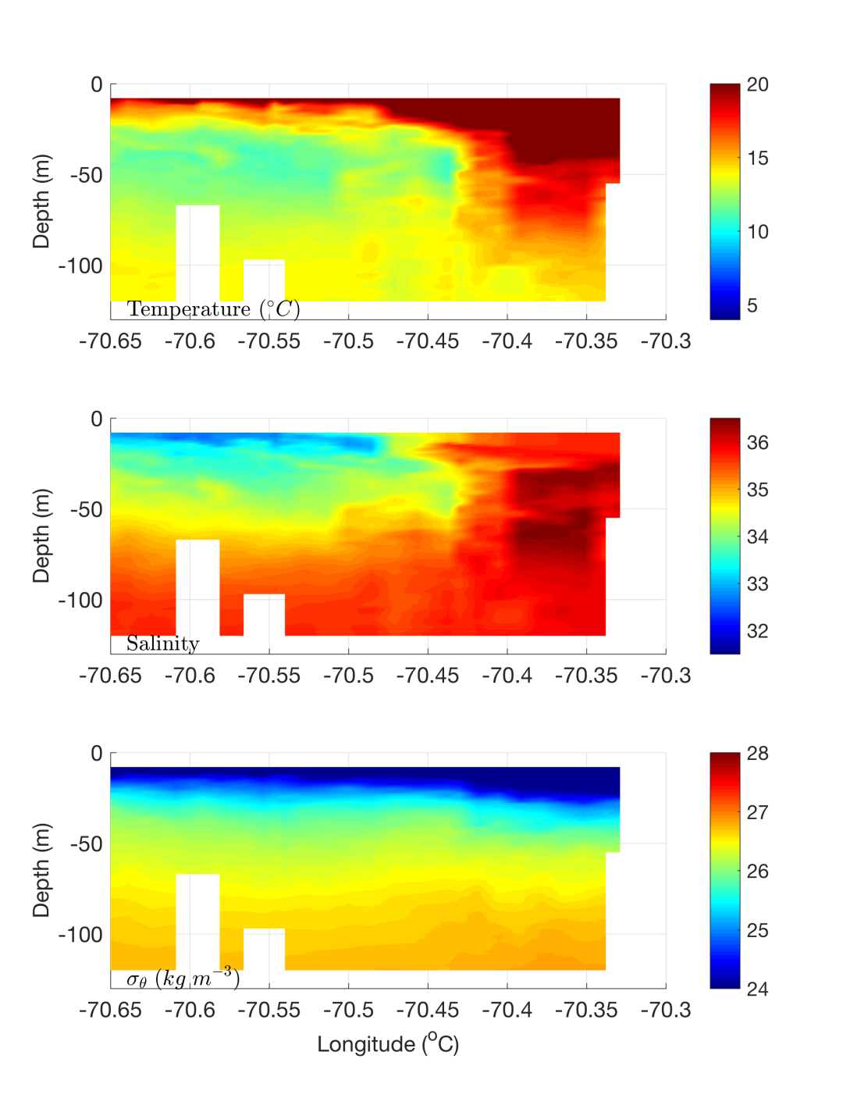
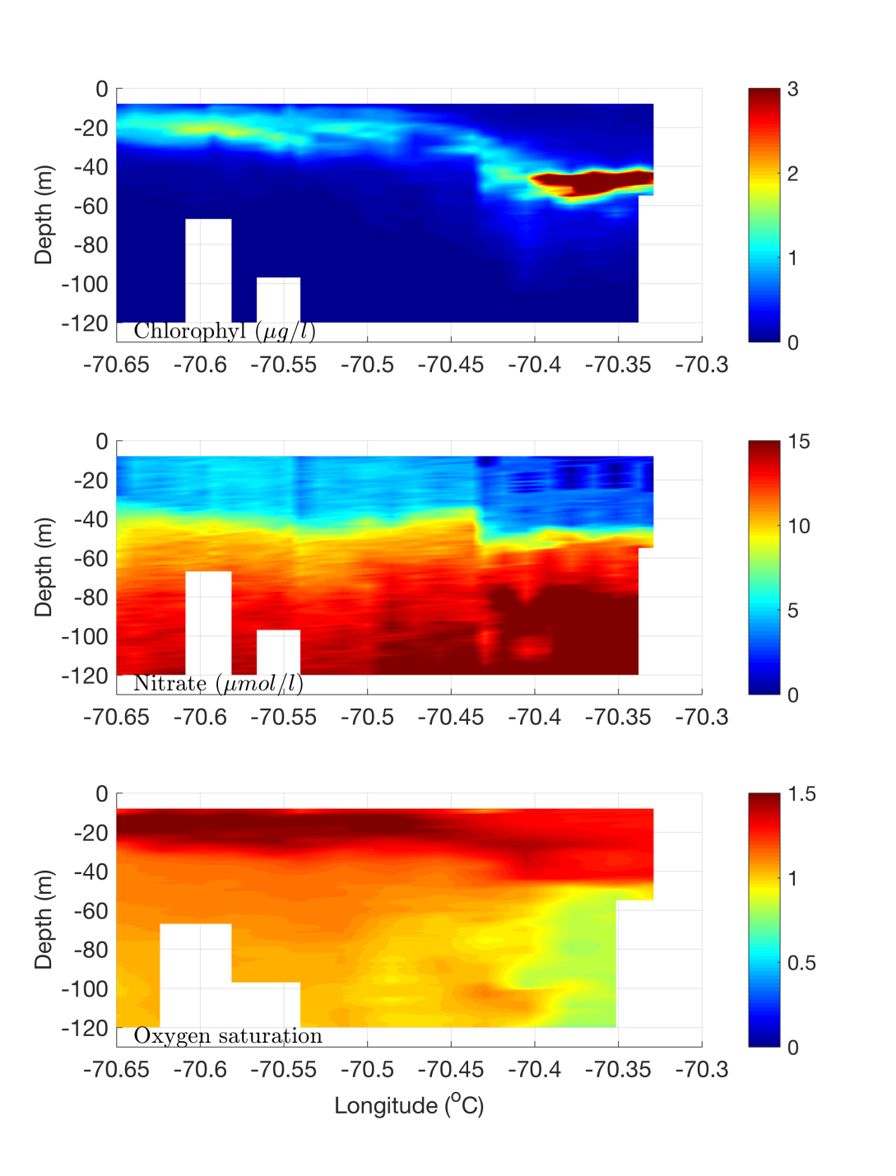
Streamer REMUS transect – July 8

Slide 31
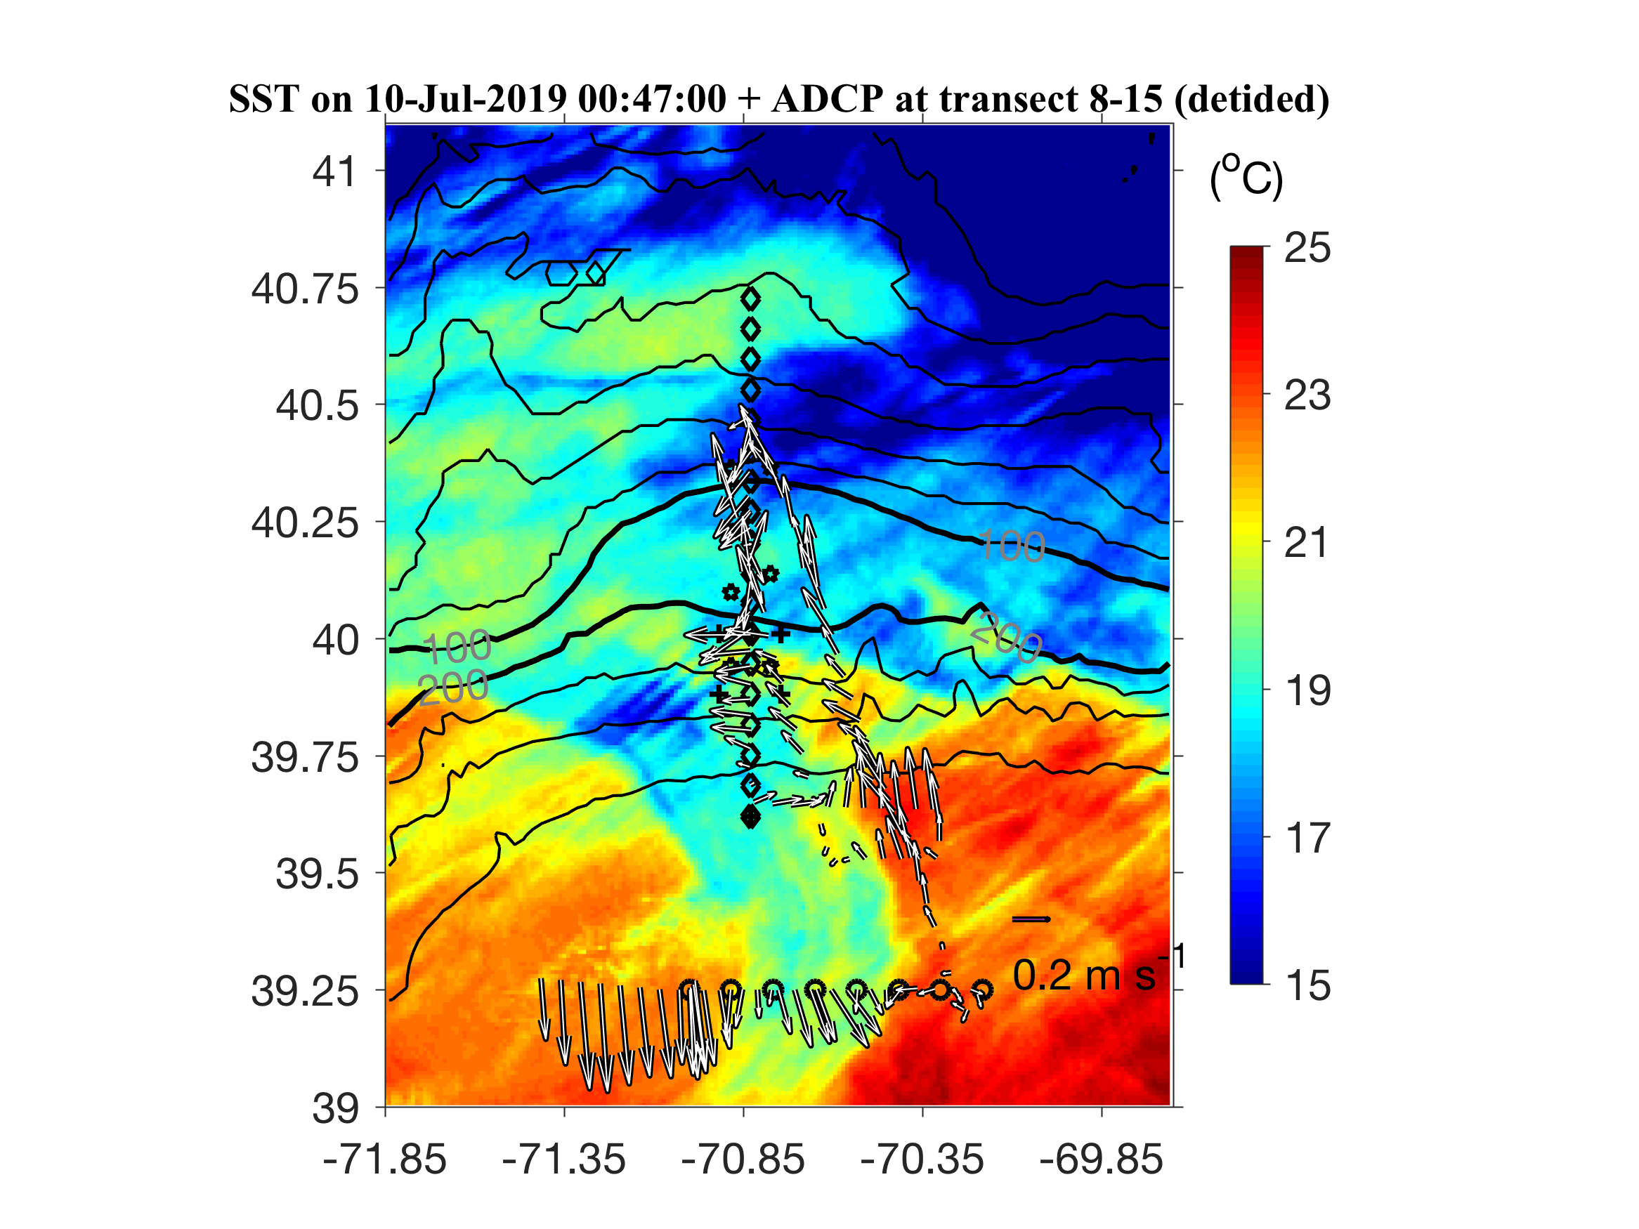
ADCP from VPR survey

Slide 32
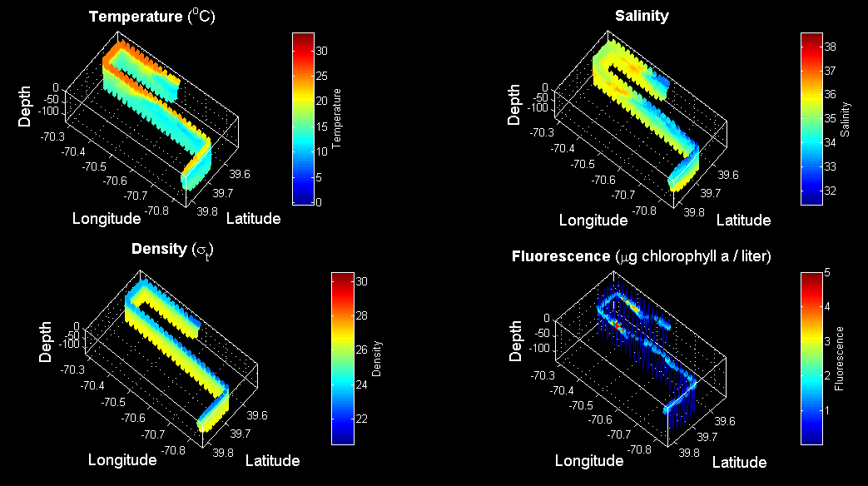
VPR3 Survey July 9

Slide 33
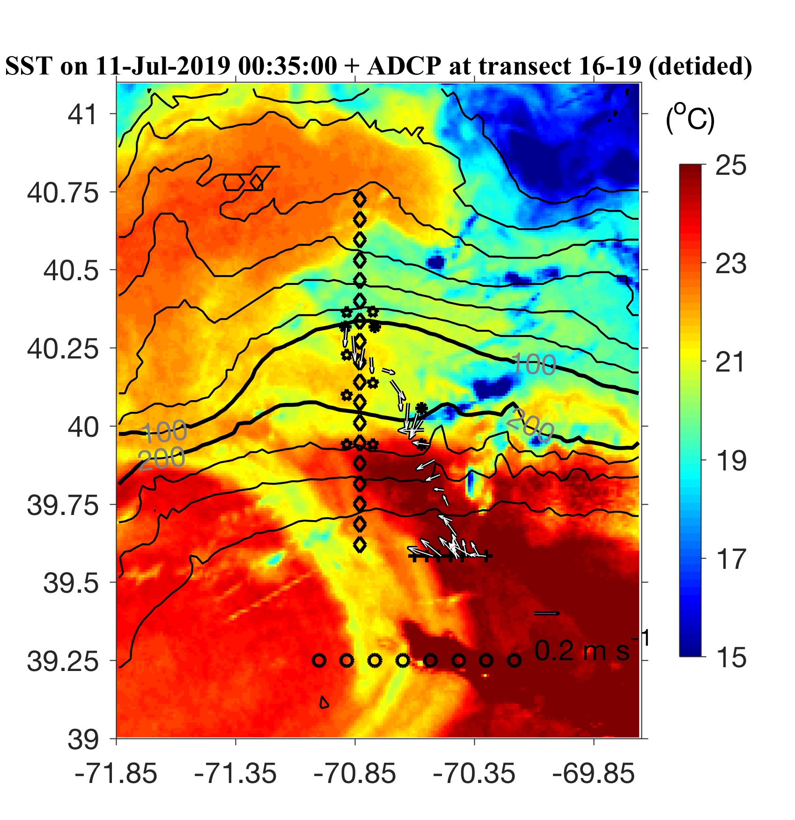
ADCP from Streamer / slope front transect

Slide 34
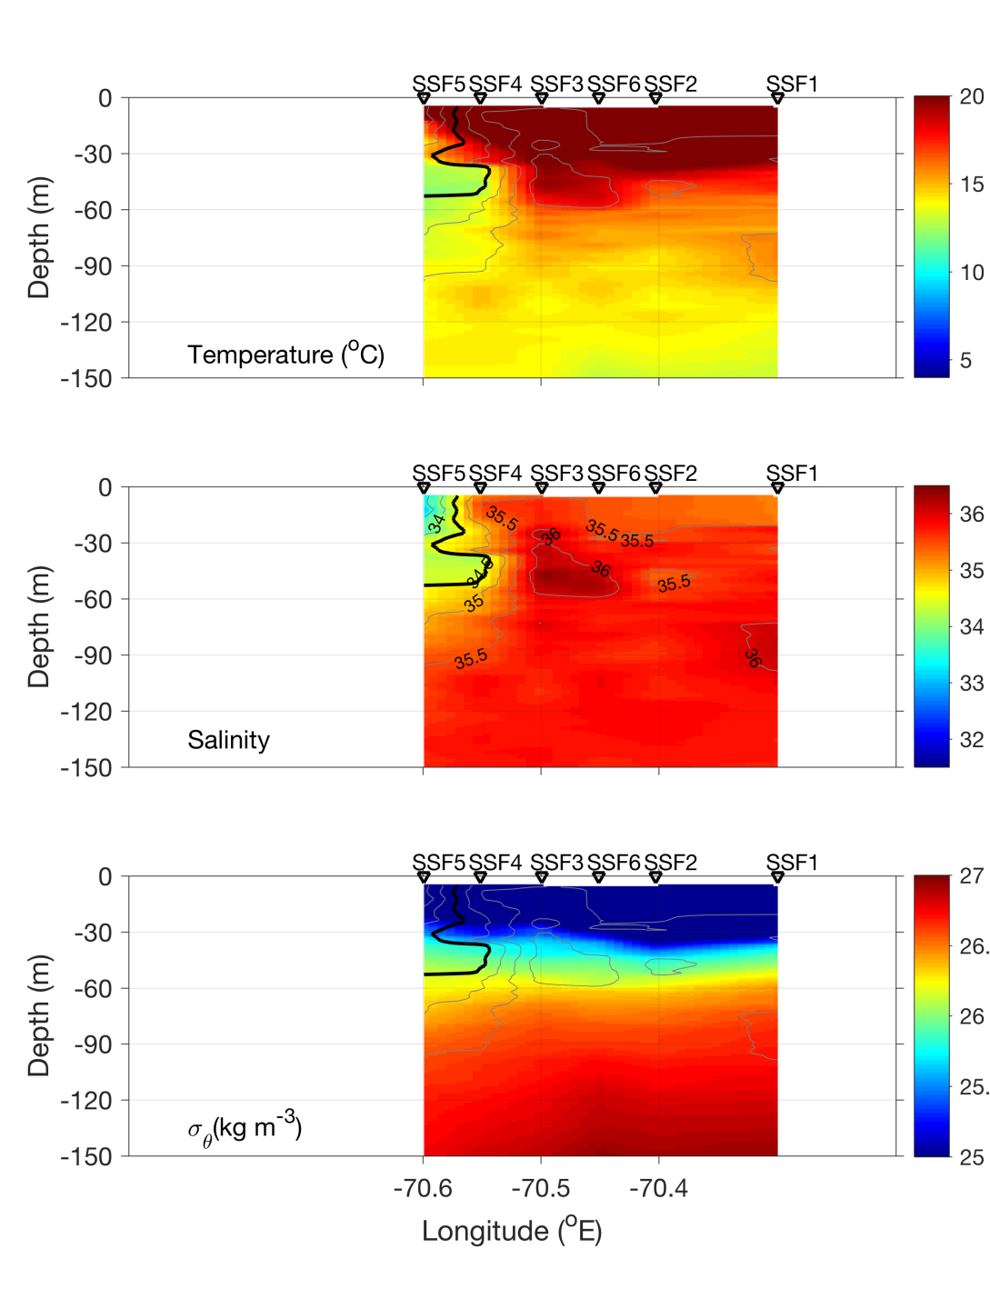
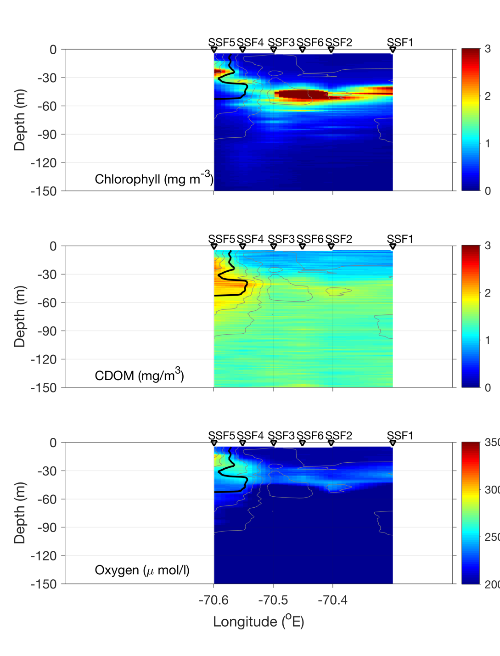
Streamer / slope front transect – July 10

Slide 35
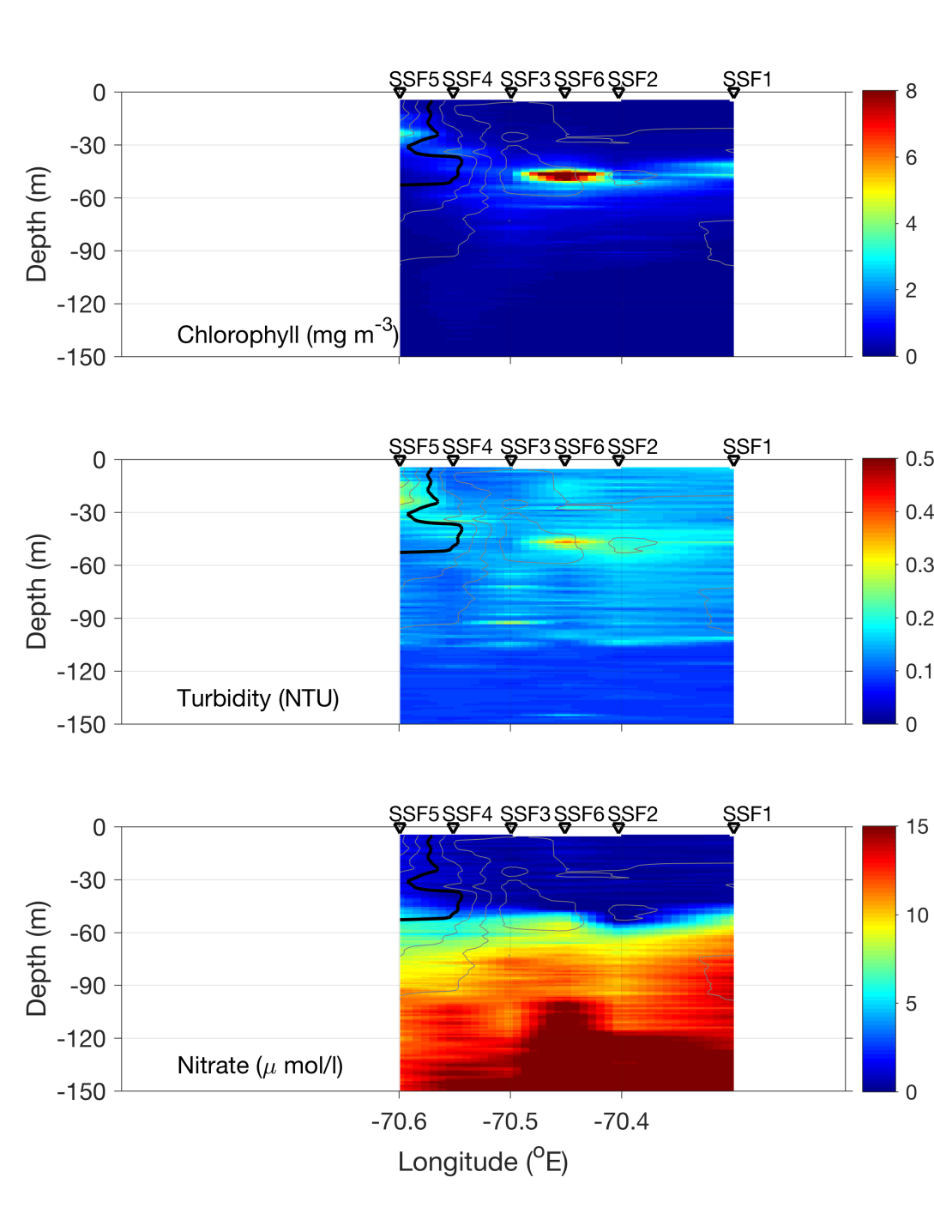
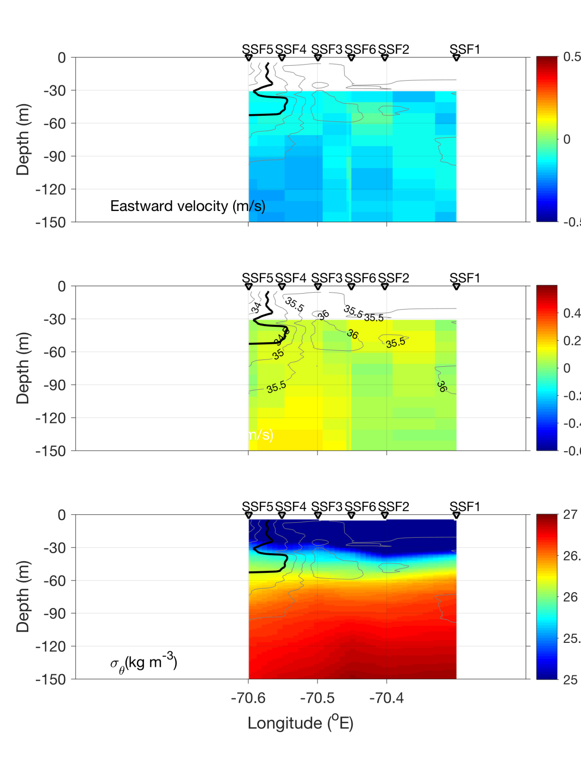
Streamer / slope front transect – July 10

Slide 36
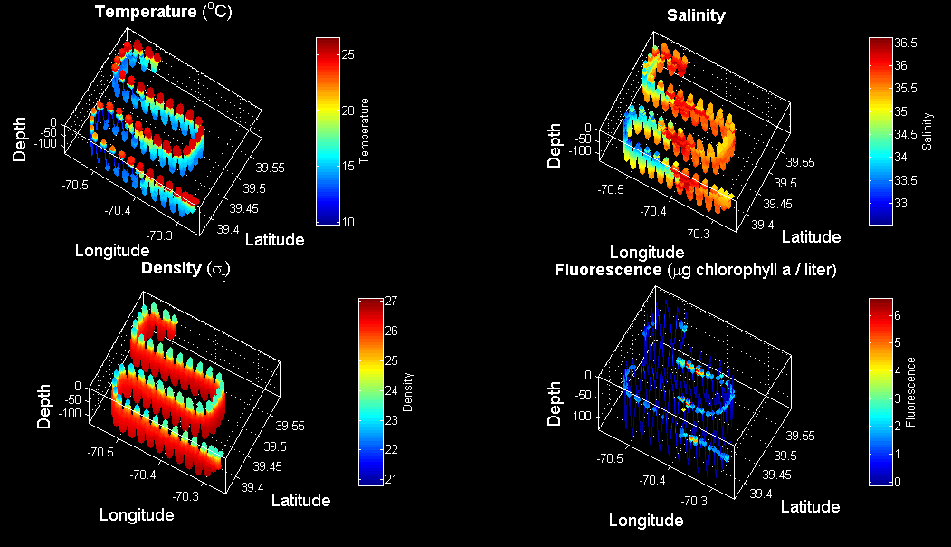
VPR4 July 10-11

Slide 37
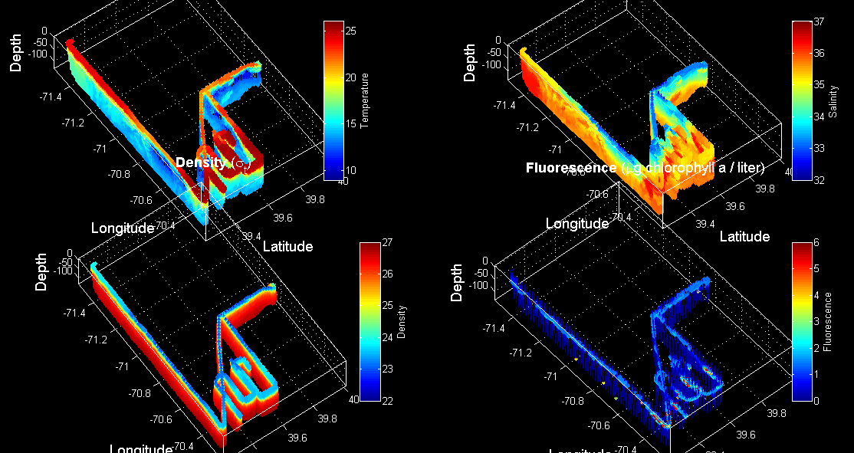
VPR 2,3,4

Slide 38
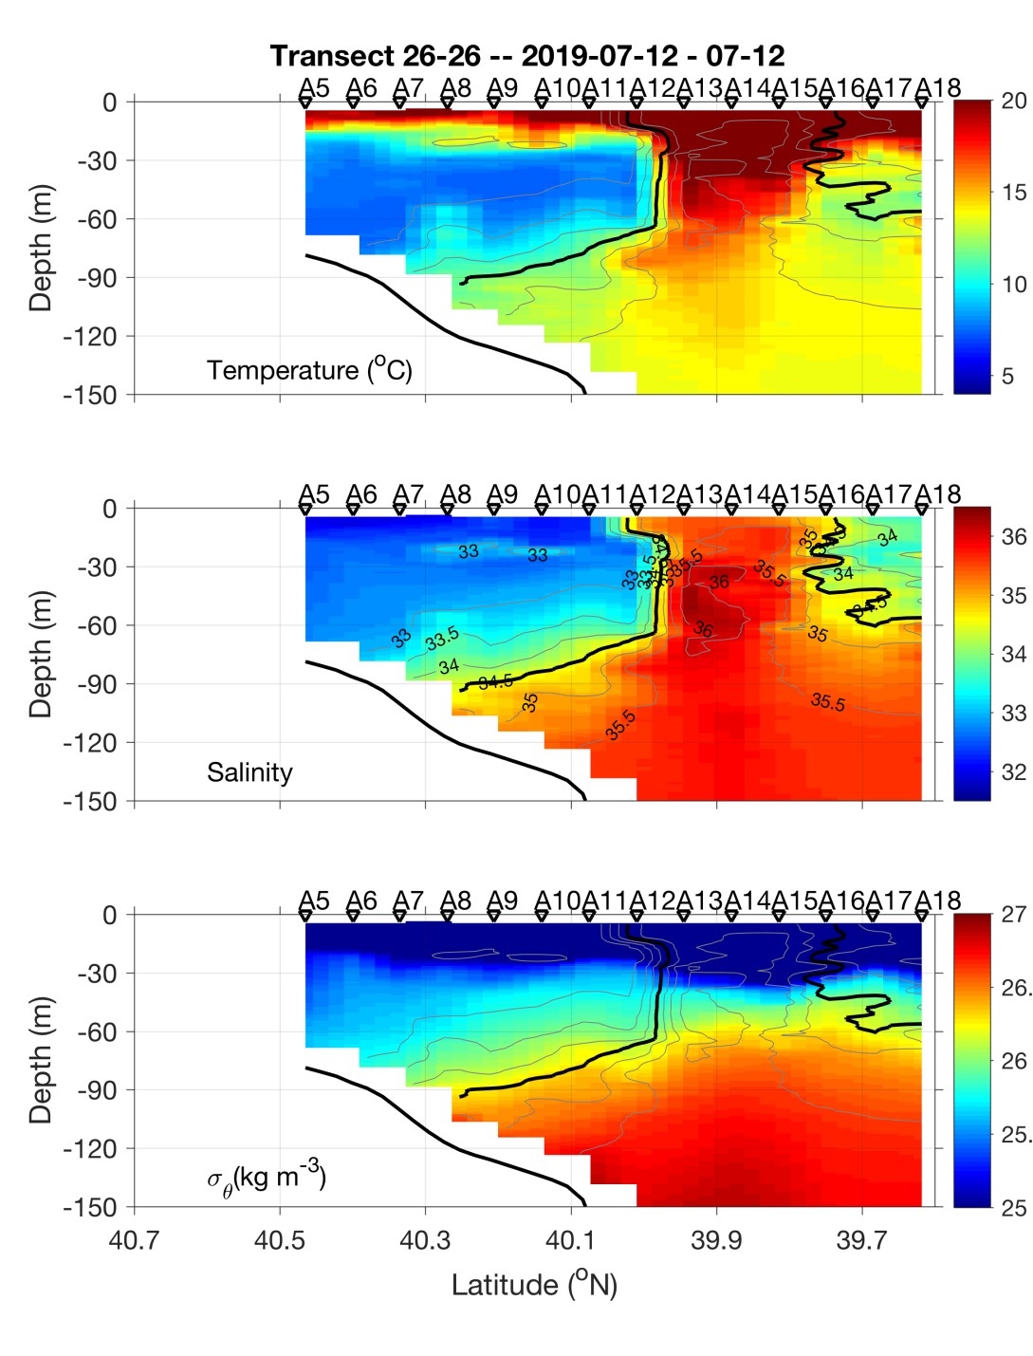
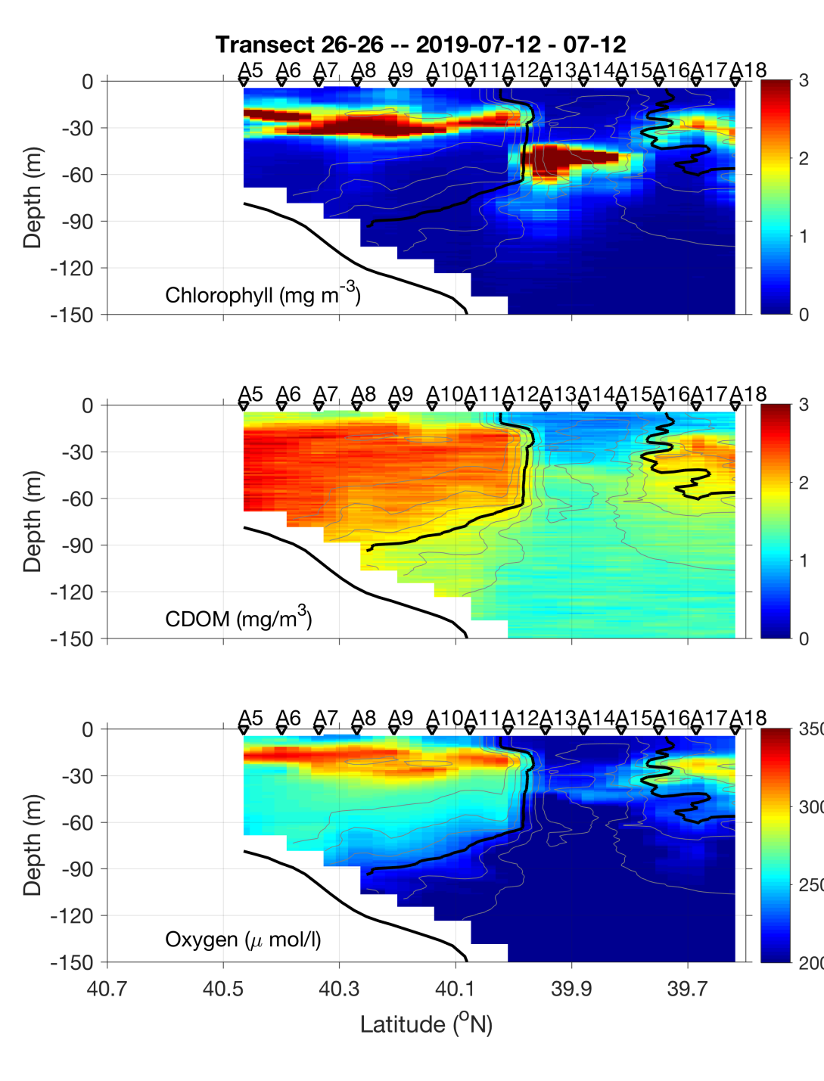
CTD transect – July 11-12

Slide 39
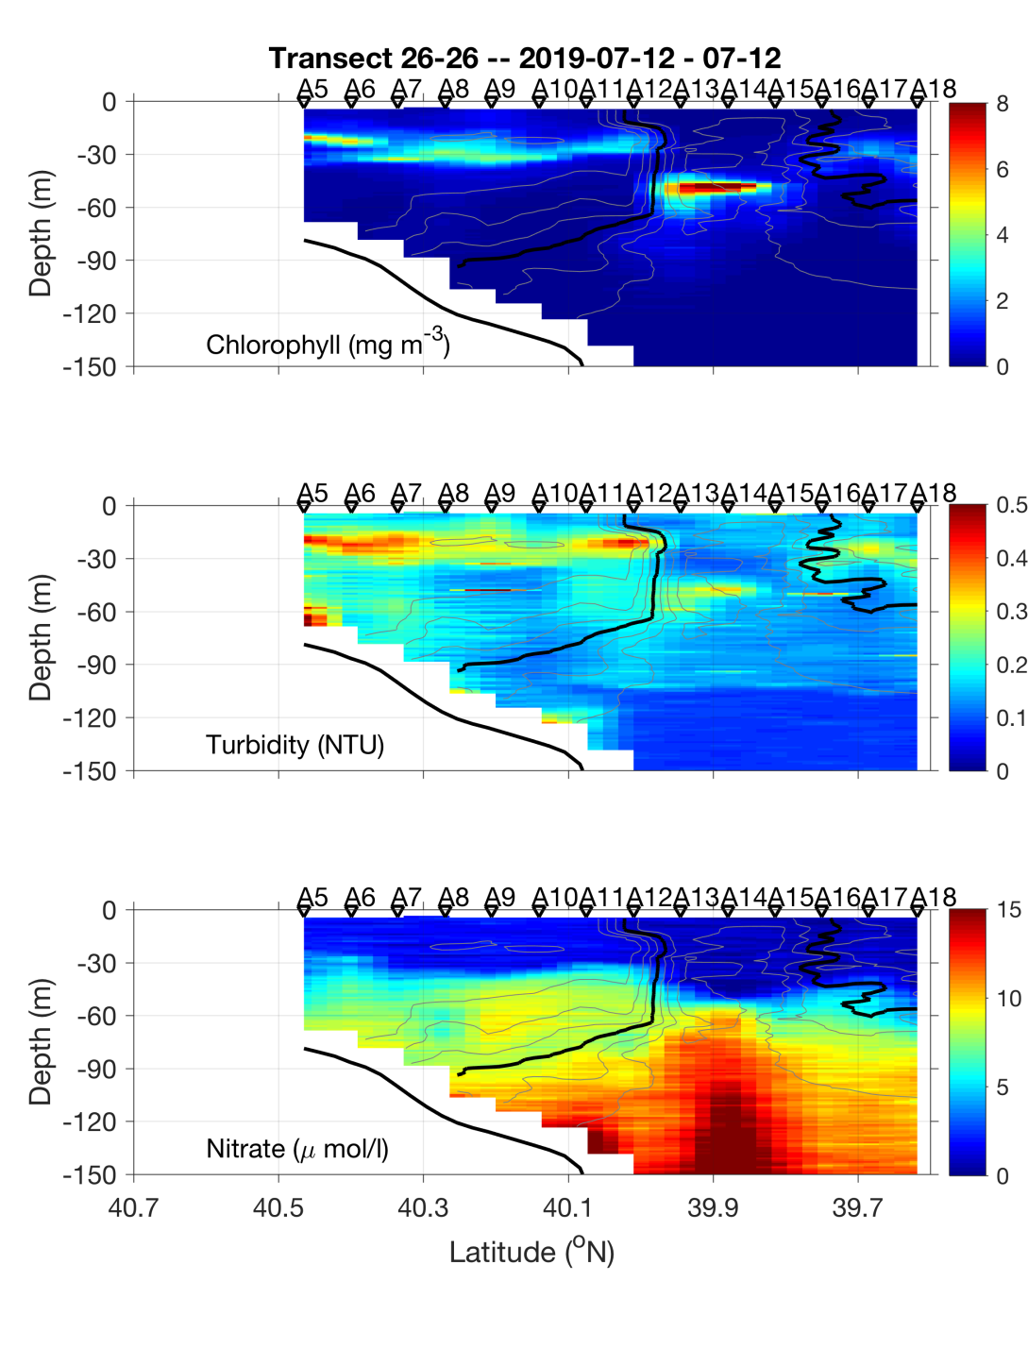
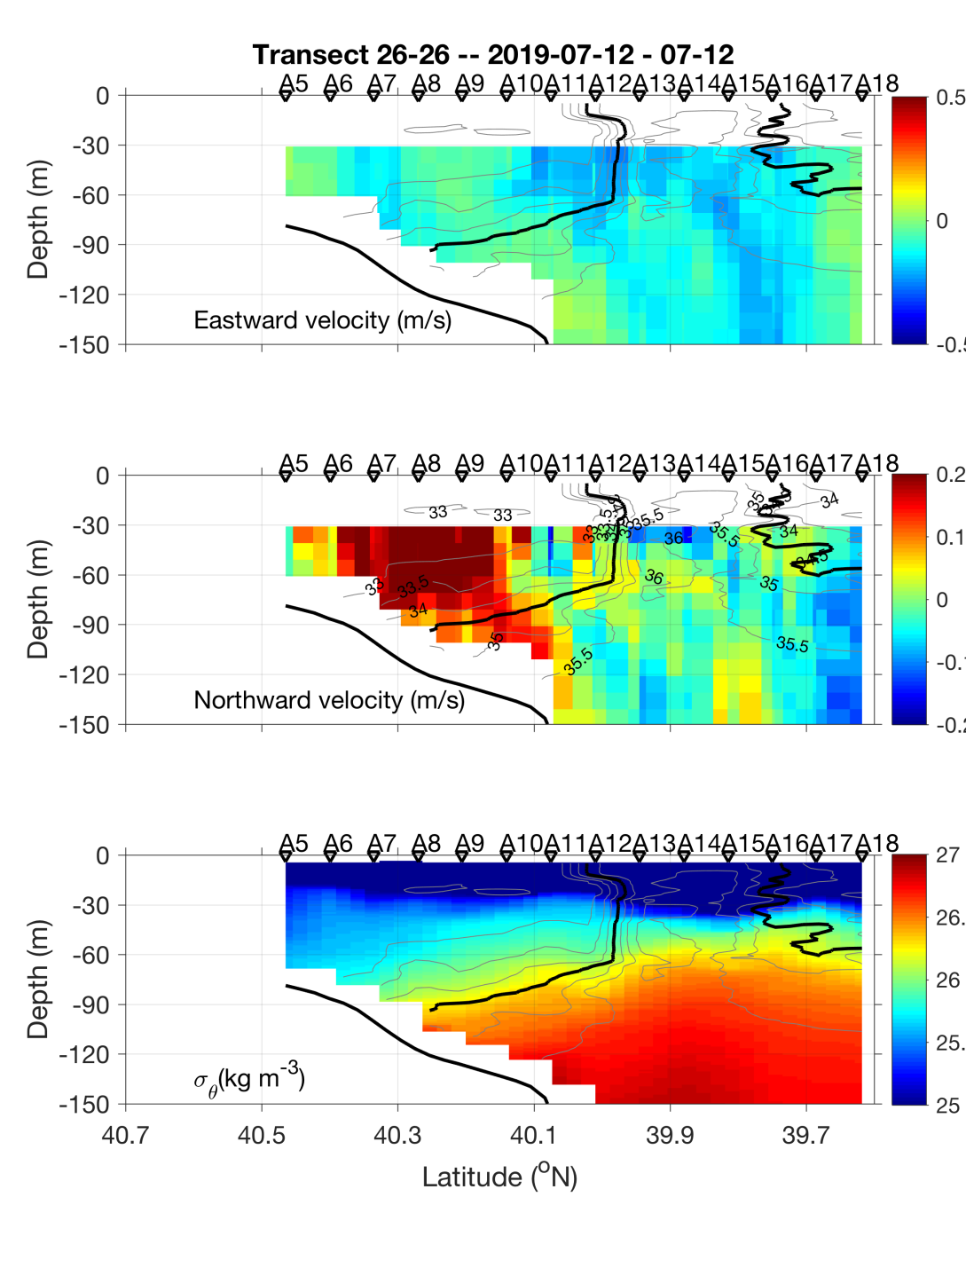
CTD transect – July 11-12

Slide 40
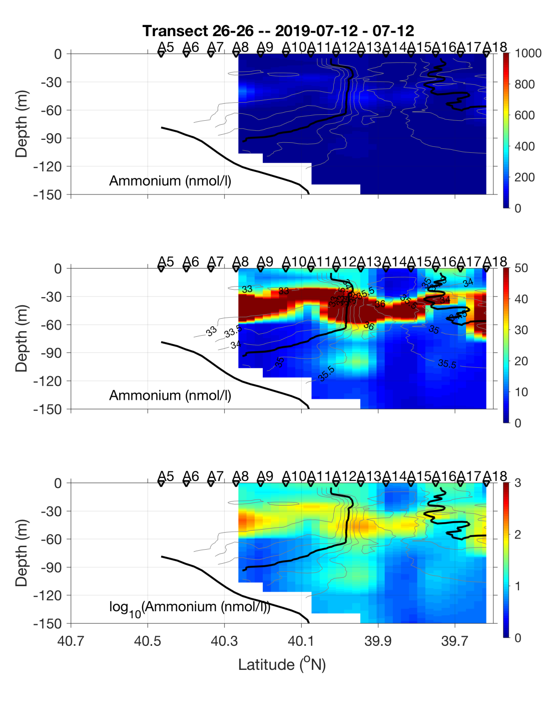
CTD transect – July 11-12

Slide 41
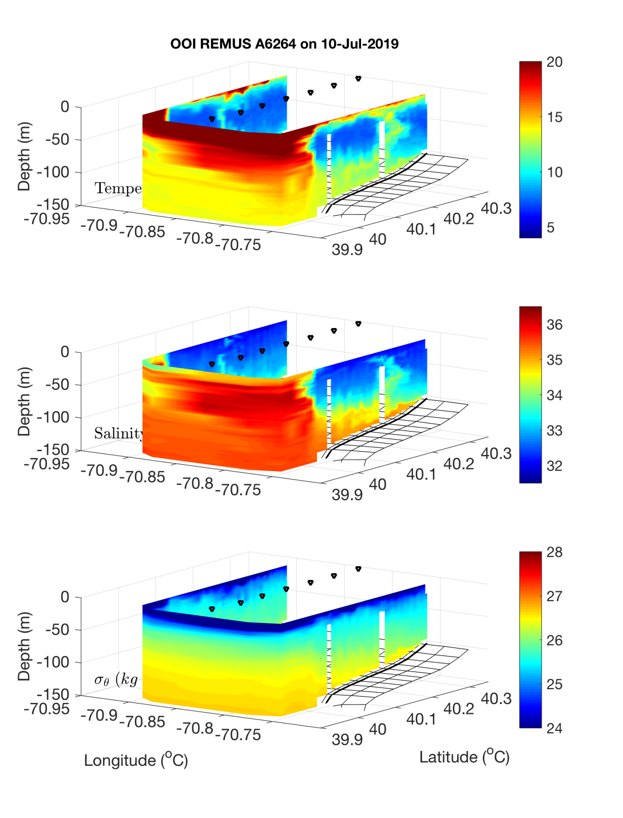

OOI REMUS : Across – front mission July 10
A7
A13

Slide 42


OOI REMUS : Along – front mission July 10
A10
A12

Slide 43

OOI REMUS : Along – front mission July 10

Slide 44


OOI REMUS : Bottom boundary layer mission July 11
A13
A7

Slide 45

OOI REMUS : Bottom boundary layer mission July 11

Slide 46

VIIRS Chl 11 July

Slide 47
VIIRS Chl 11 July

Slide 49

VPR5 July 12

Slide 50

SST July 9

Slide 51

VPR6 July 13

Slide 52

VIIRS Chl July 13

Slide 53

REMUS 4 – diatom hotspot

Slide 54


REMUS 4 – diatom hotspot
Temperature Salinity

Slide 55


REMUS 4 – diatom hotspot
Nitrate Oxygen

Slide 56


REMUS 4 – diatom hotspot
Fluorescence Backscatter

Slide 57
Extras

Slide 58


CTD Transect – July 8-9

Slide 59


CTD Transect – July 8-9

Slide 60

CTD Transect – July 8-9

Slide 61

MODIS Chl July 6

