Slide 1
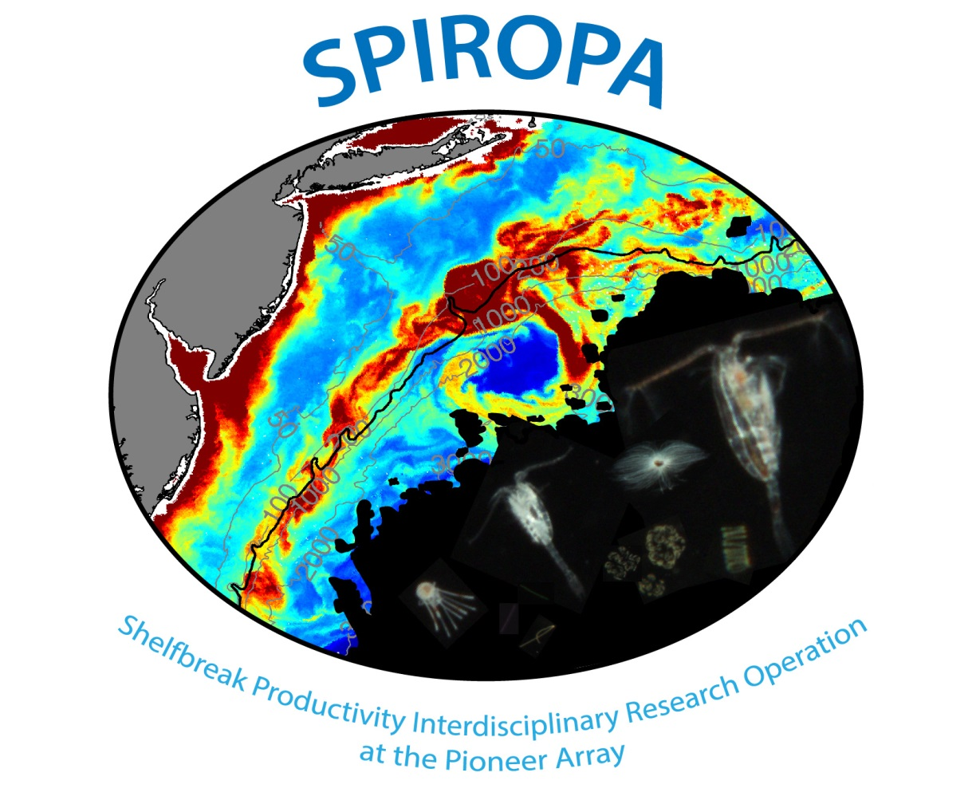

Slide 2
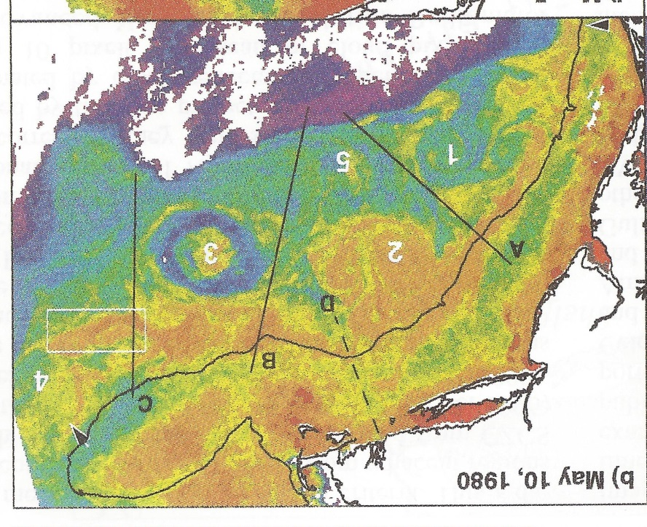
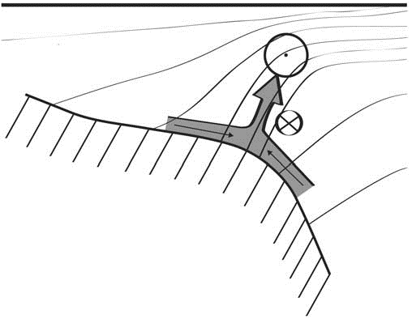
Shelfbreak frontal dynamics: mechanisms of upwelling, net community production, and ecological implications
Ryan et al. 1999
Linder et al. 2004
Gawarkiewicz and Chapman 1992
Chapman and Lentz 1994
Marra et al. 1990

Slide 3


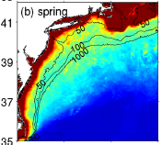

2013, JGR
Satellite CHL climatology
Why is there no mean enhancement of chlorophyll at the shelf break front?
H₁: Top-down control by zooplankton grazing
H₂: Spatial and temporal intermittency of the upwelling events causes their net impact to be smoothed out in long-term means.

Slide 4

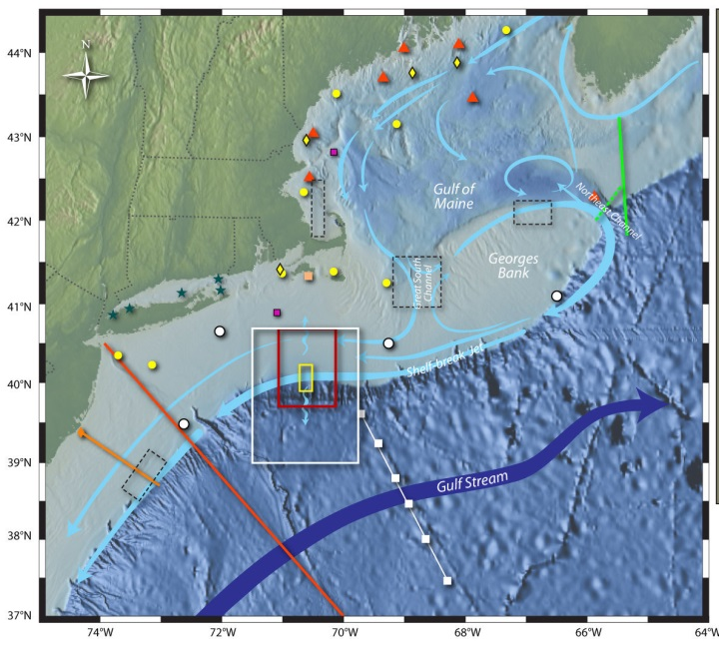
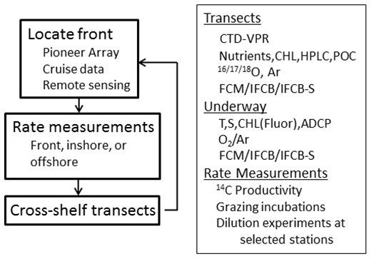
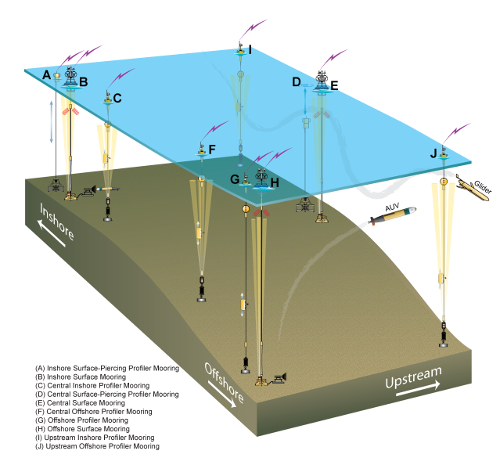
Shelfbreak frontal dynamics: mechanisms of upwelling, net community production, and ecological implications
Dennis McGillicuddy, Heidi Sosik, Gordon Zhang (WHOI)
Walker Smith (VIMS) Rachel Stanley (Wellesley College)
Jefferson Turner, Christian Petitpas (UMass Dartmouth)
3 Cruises R/V Neil Armstrong
NSF Ocean Observatory Initiative Pioneer Array

Slide 5
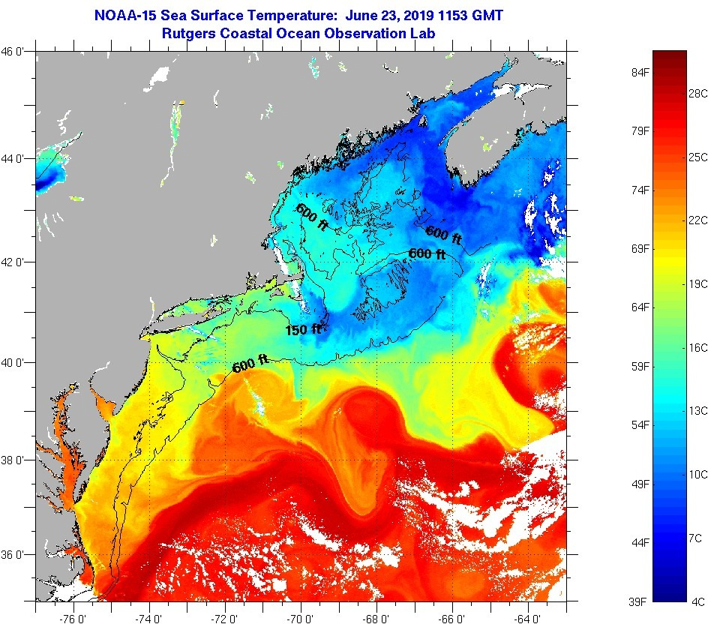
SST - June 23 2019

Slide 6
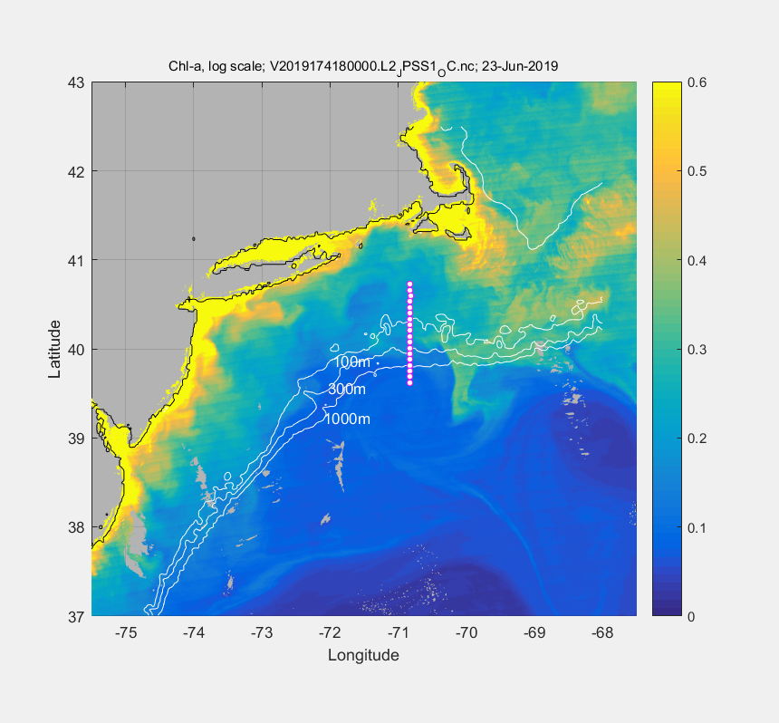
VIIRS Chl - June 23

Slide 7
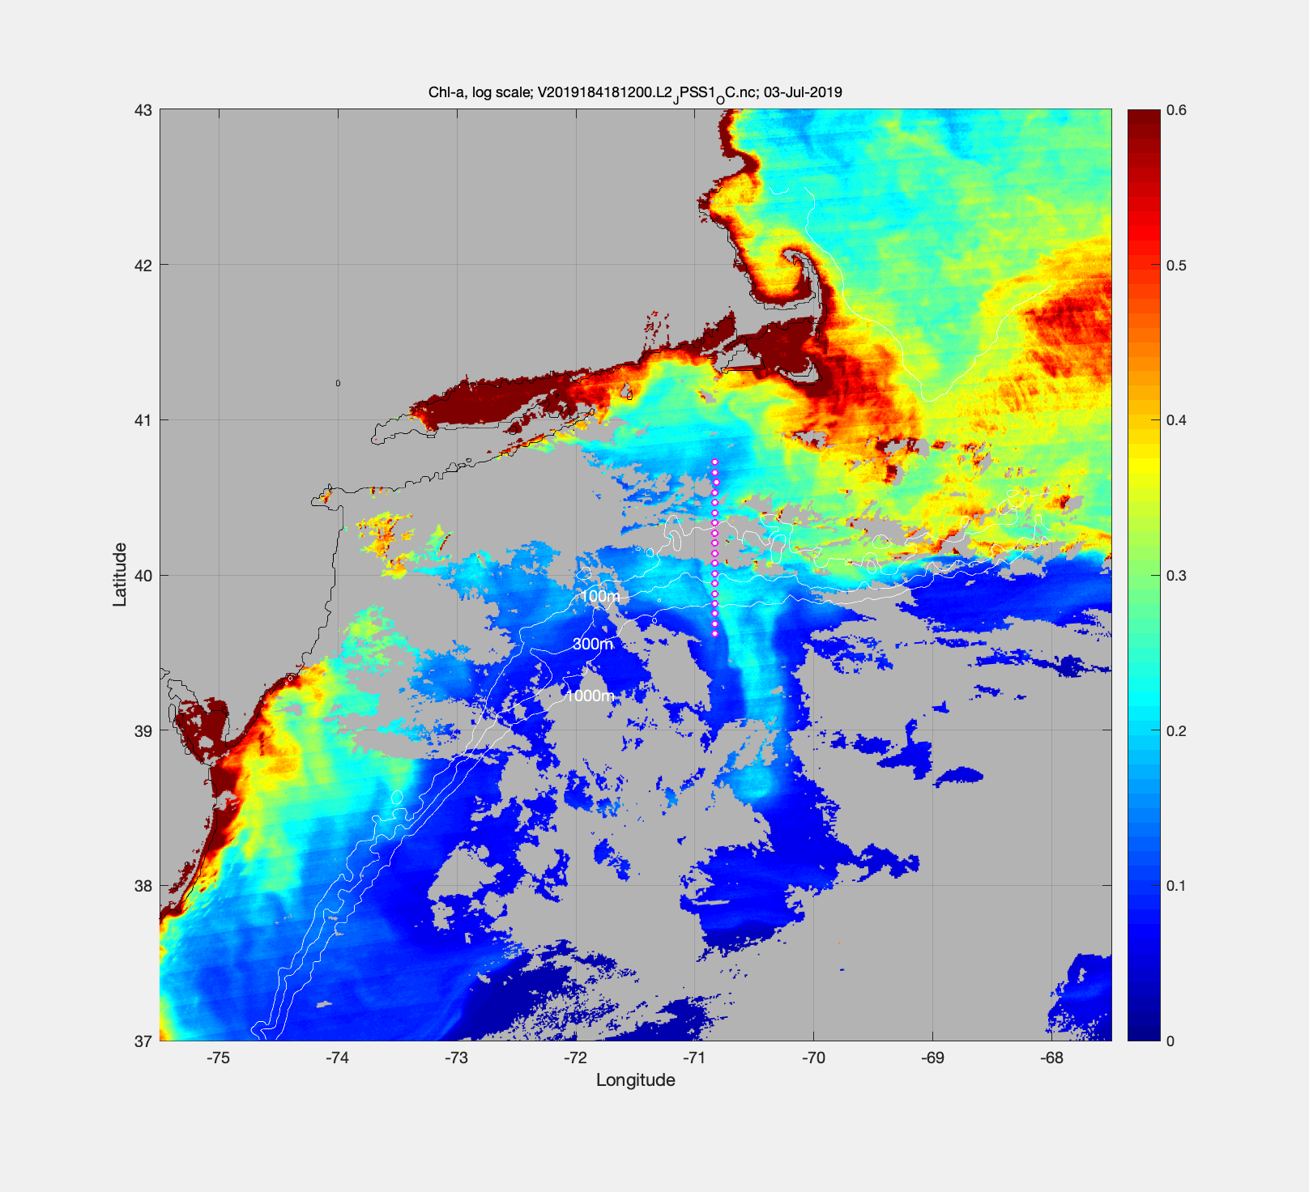
July 3 – VIIRS Chl

Slide 8
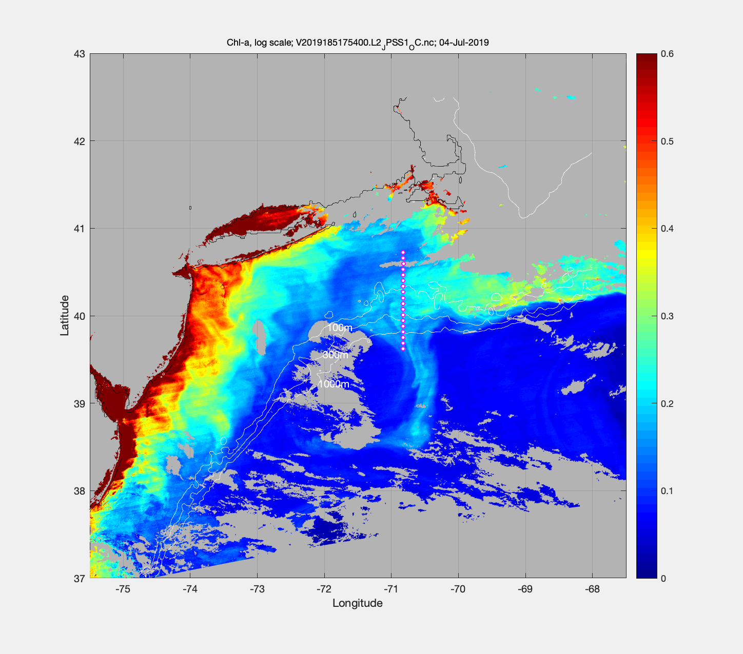
July 4 – VIIRS Chl

Slide 10
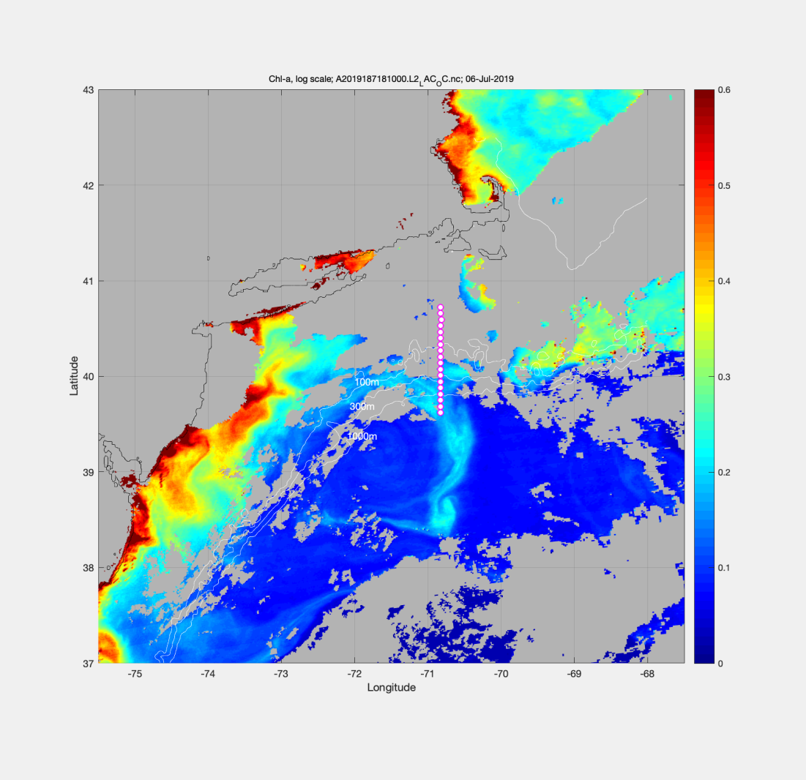
VIIRS Chl June 23 MODIS Chl July 6

Slide 11
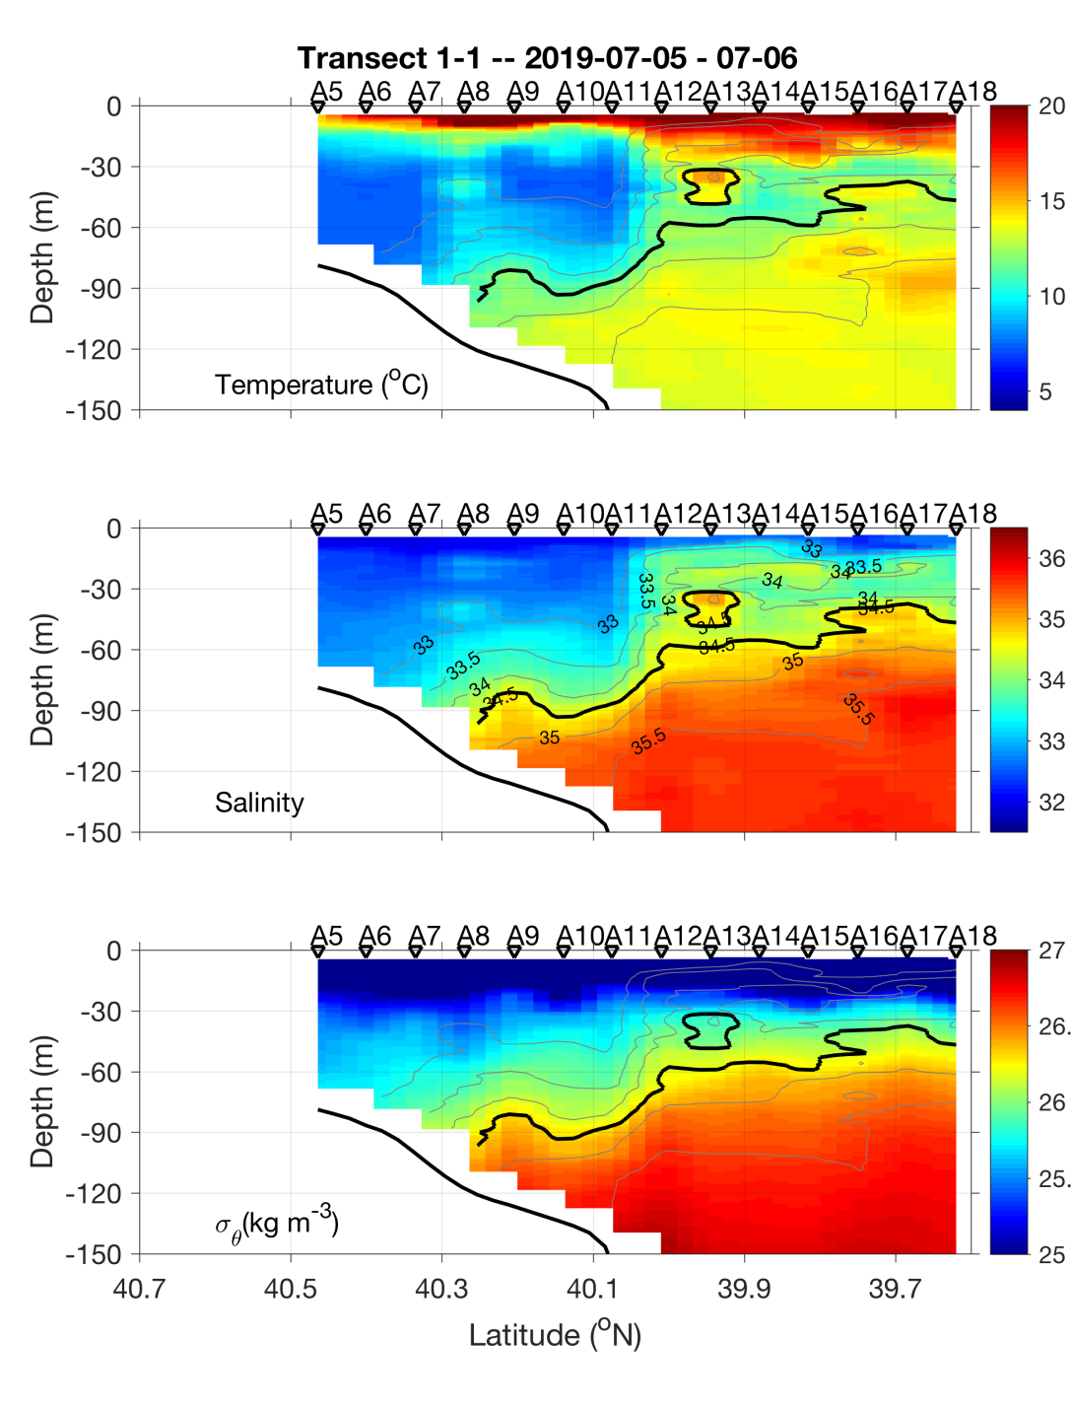
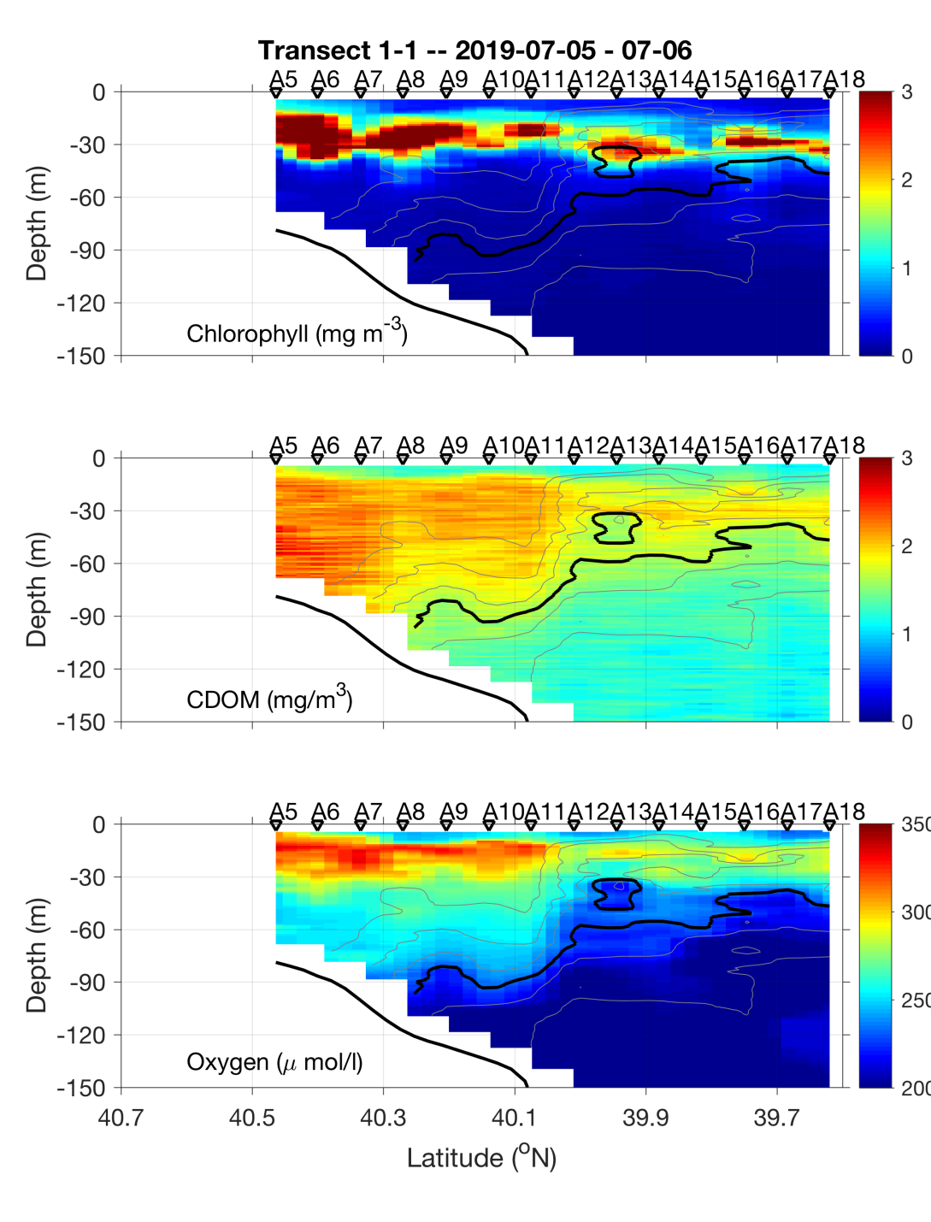
Transect 1 – July 5-6

Slide 12
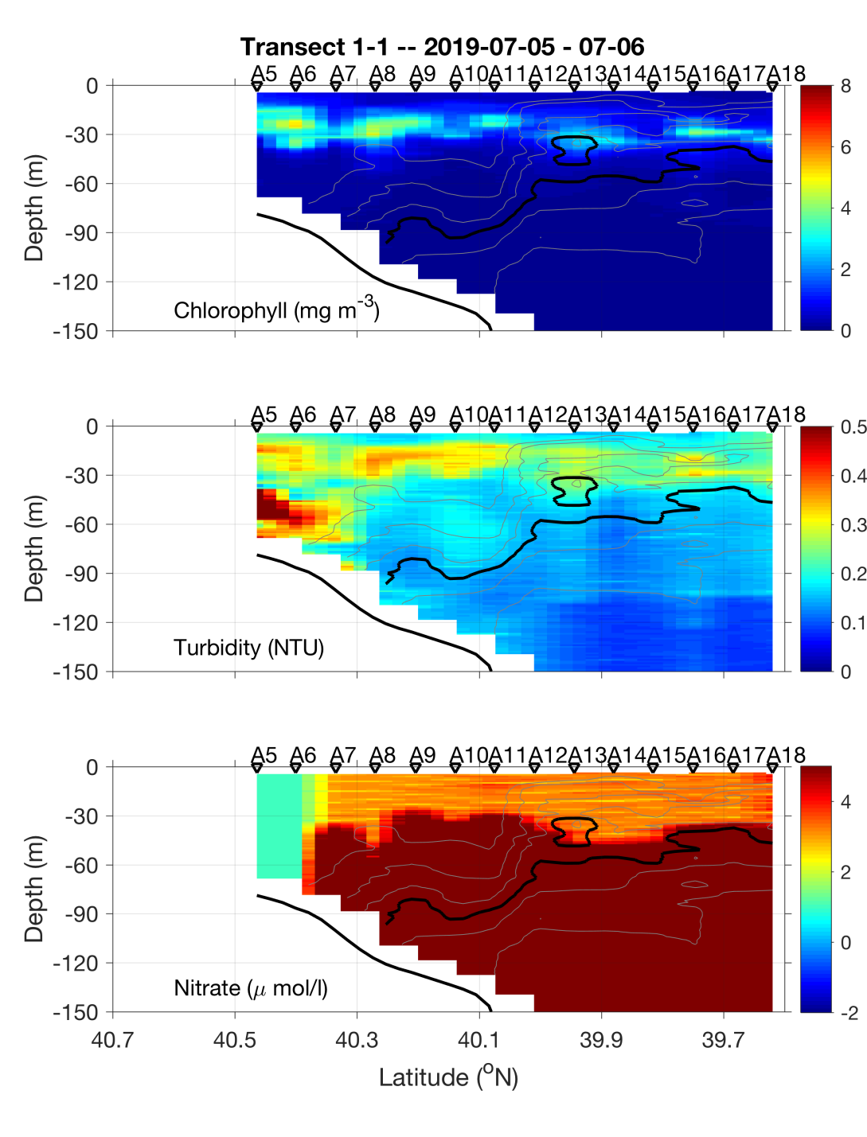
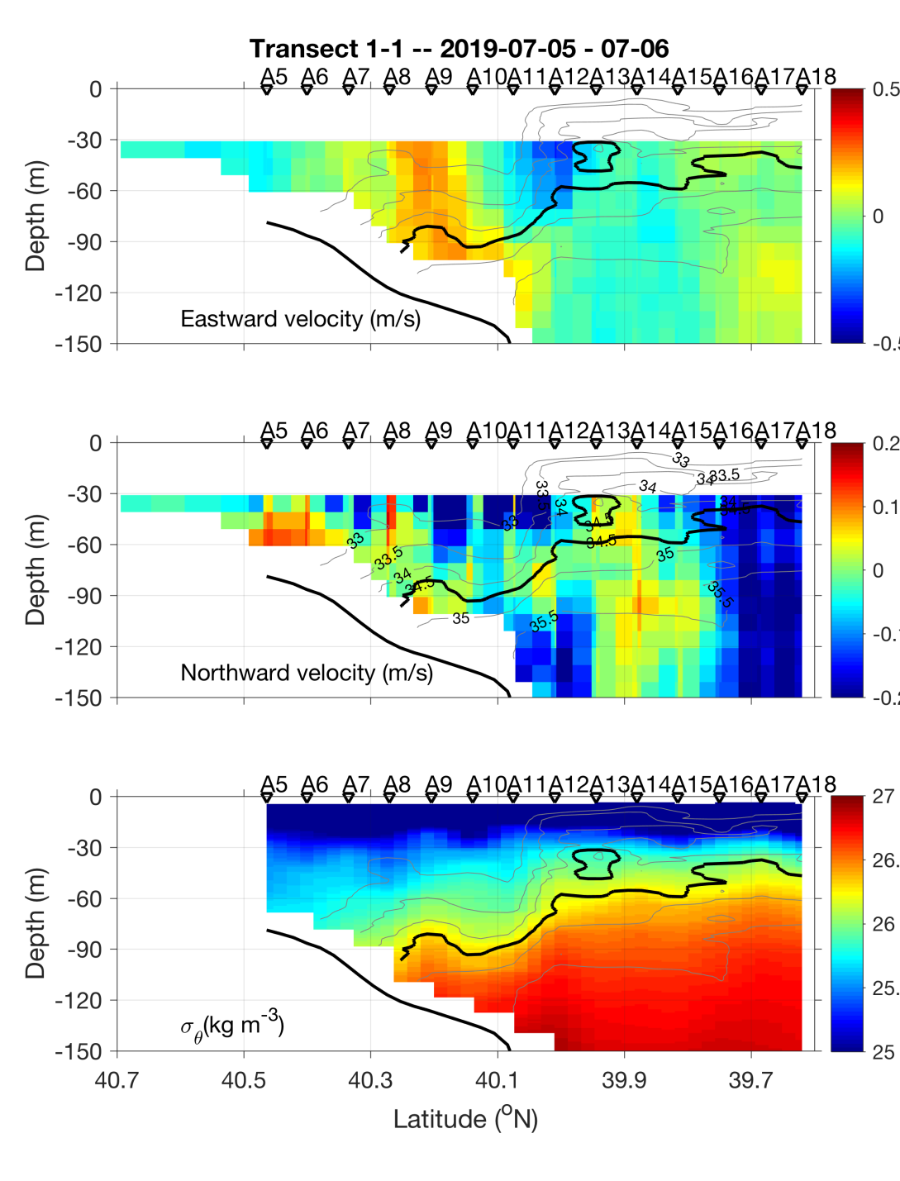
Transect 1 – July 5-6

Slide 13
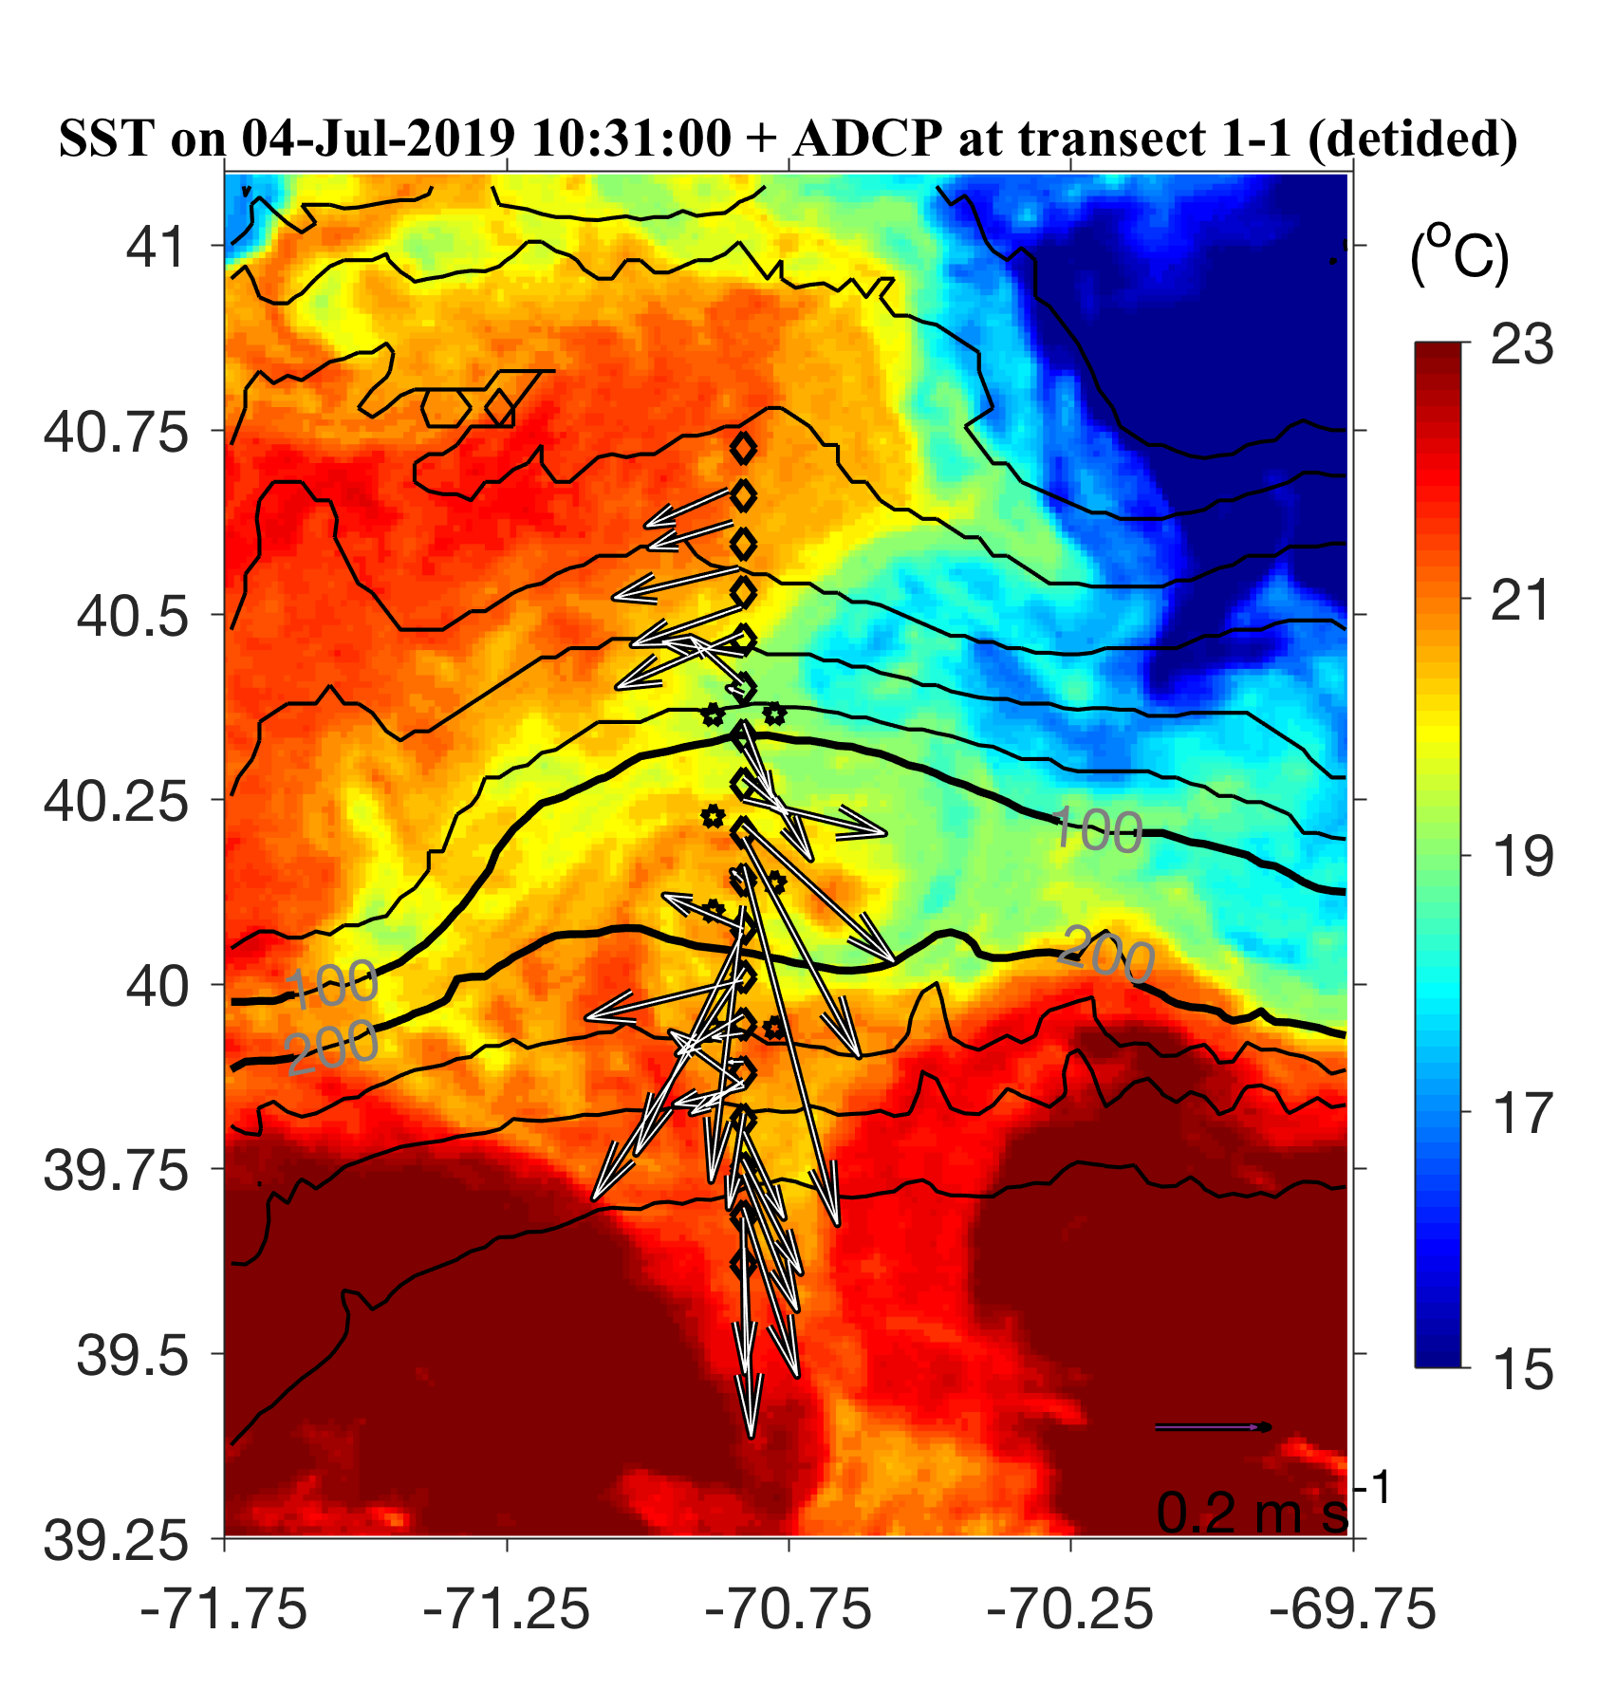
July 5-6 ADCP overlayed on July 4 SST

Slide 14
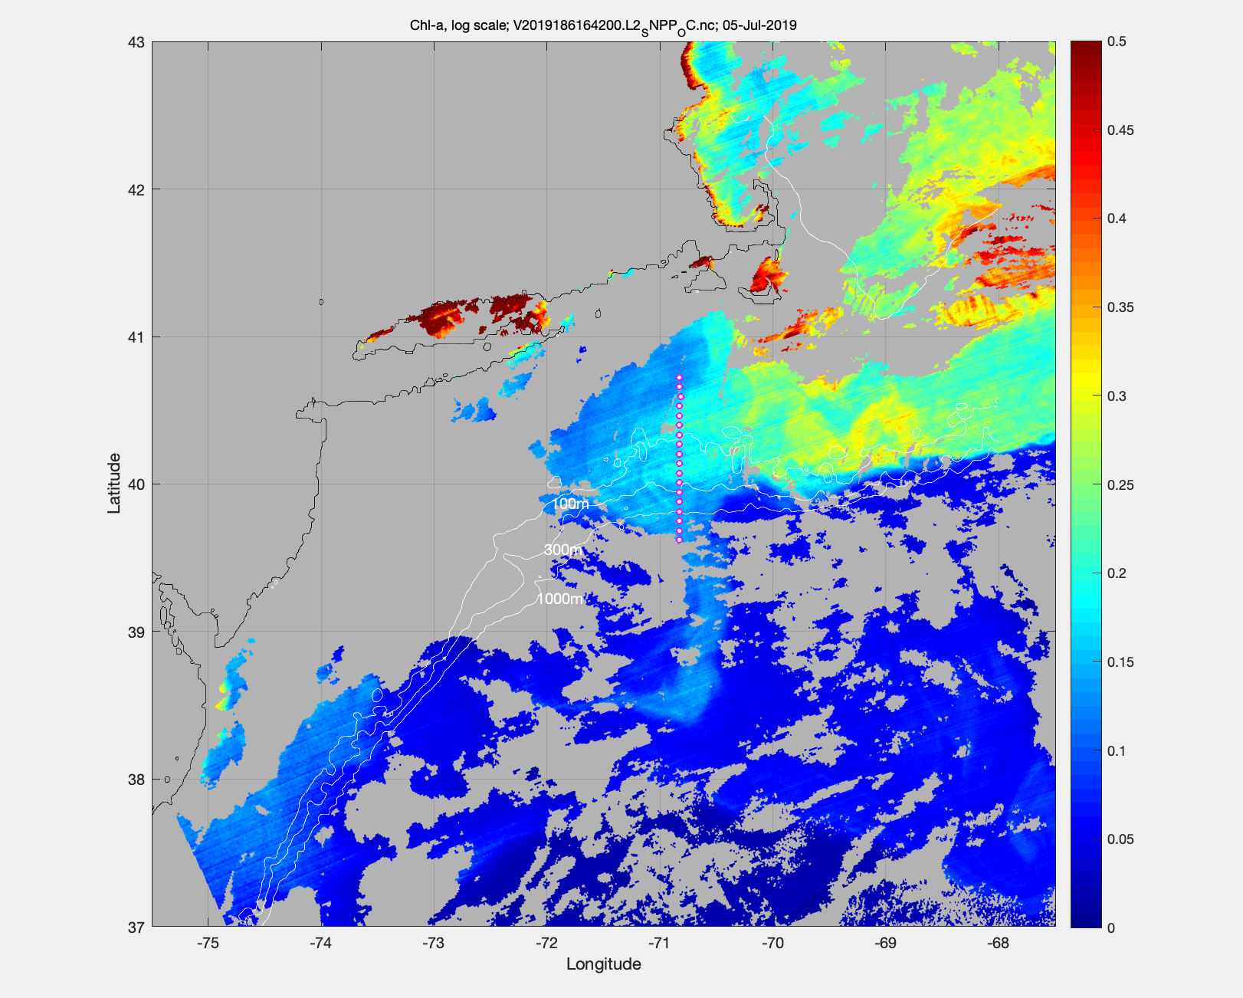
MODIS Chl July 5

Slide 15
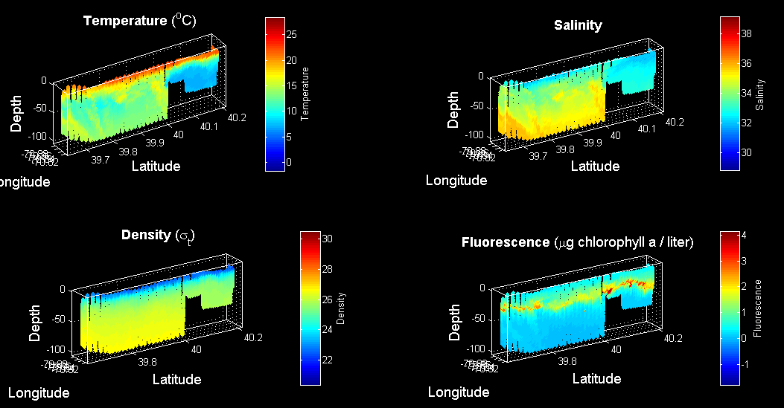
VPR survey July 6

Slide 16
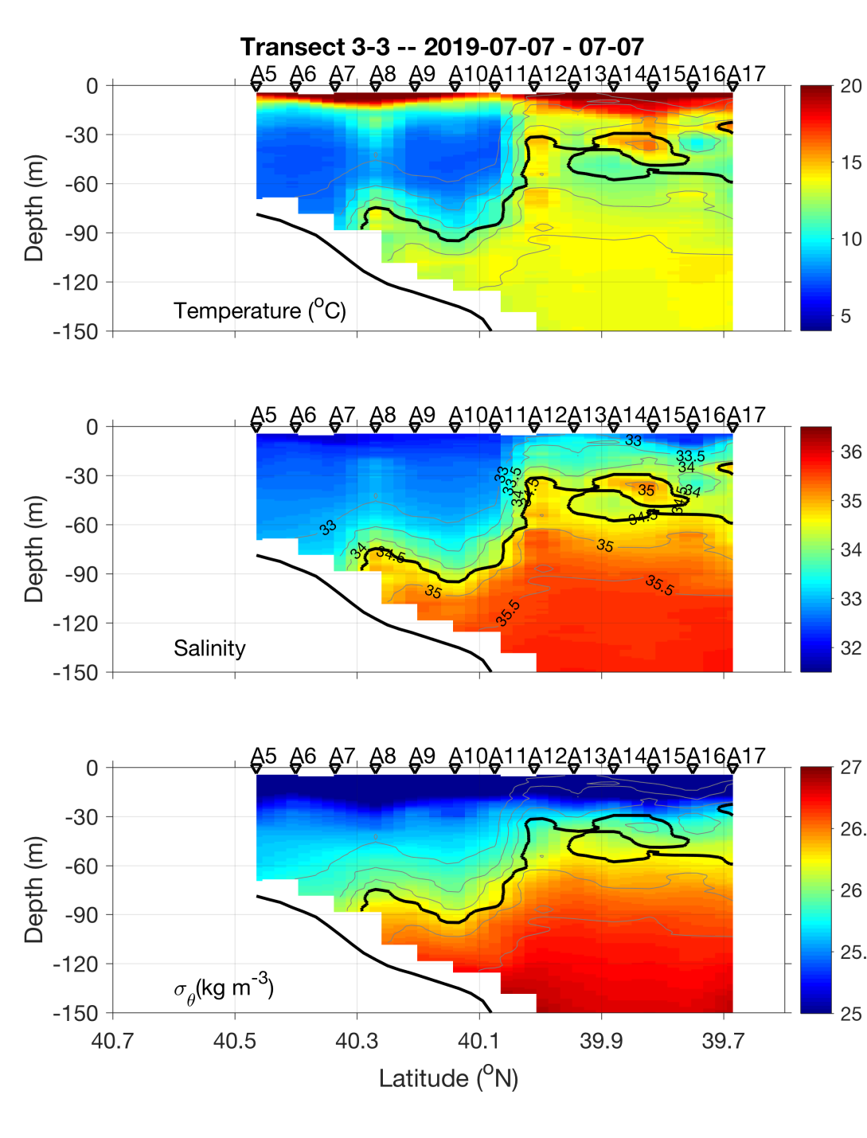
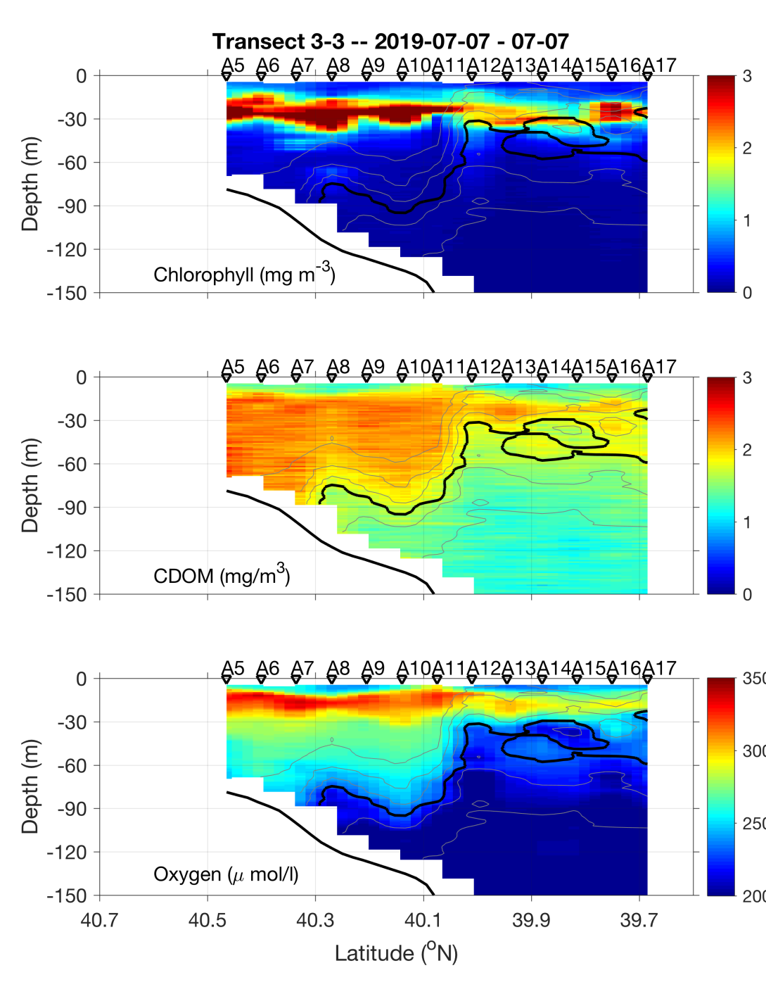
Transect 2 – July 6-7

Slide 17
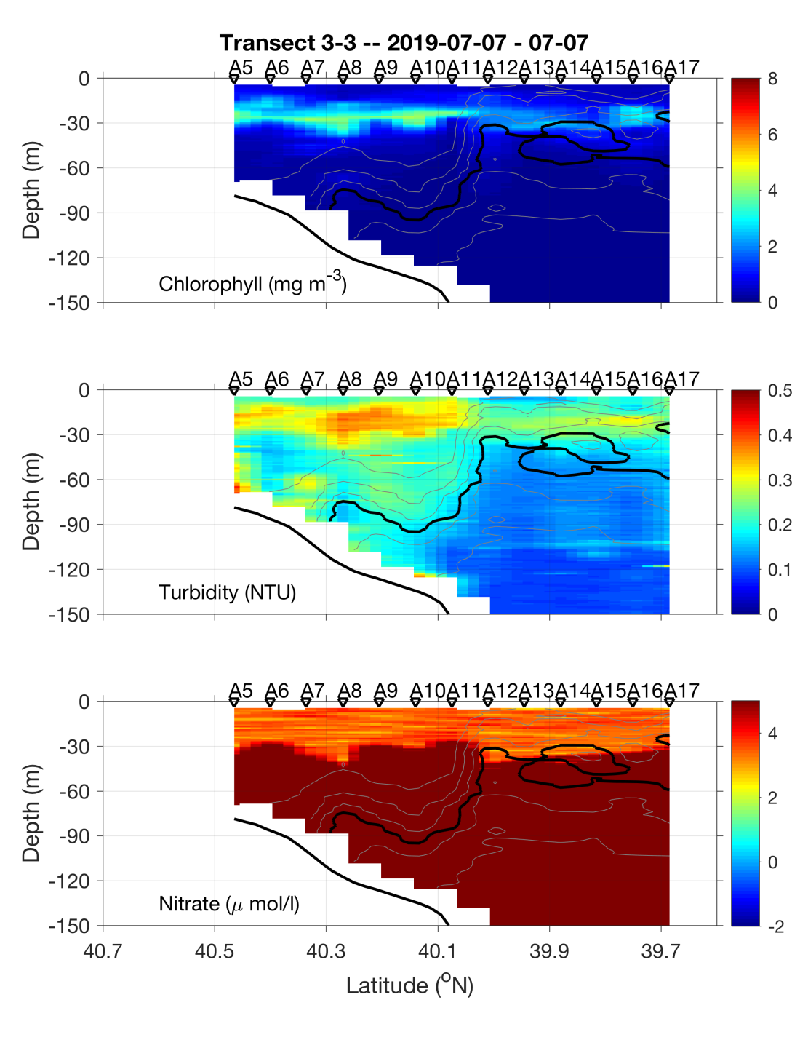
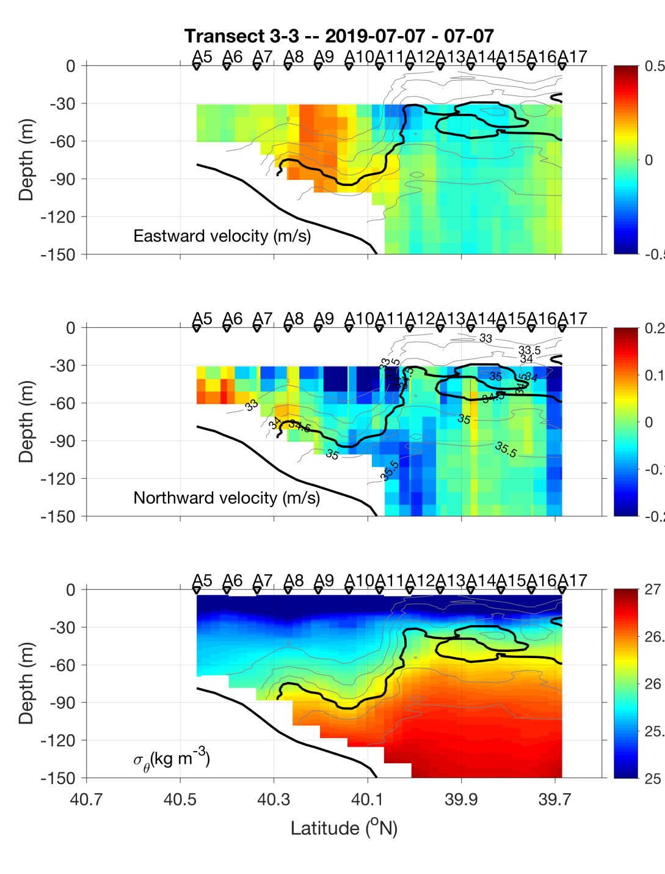
Transect 2 – July 6-7

Slide 18
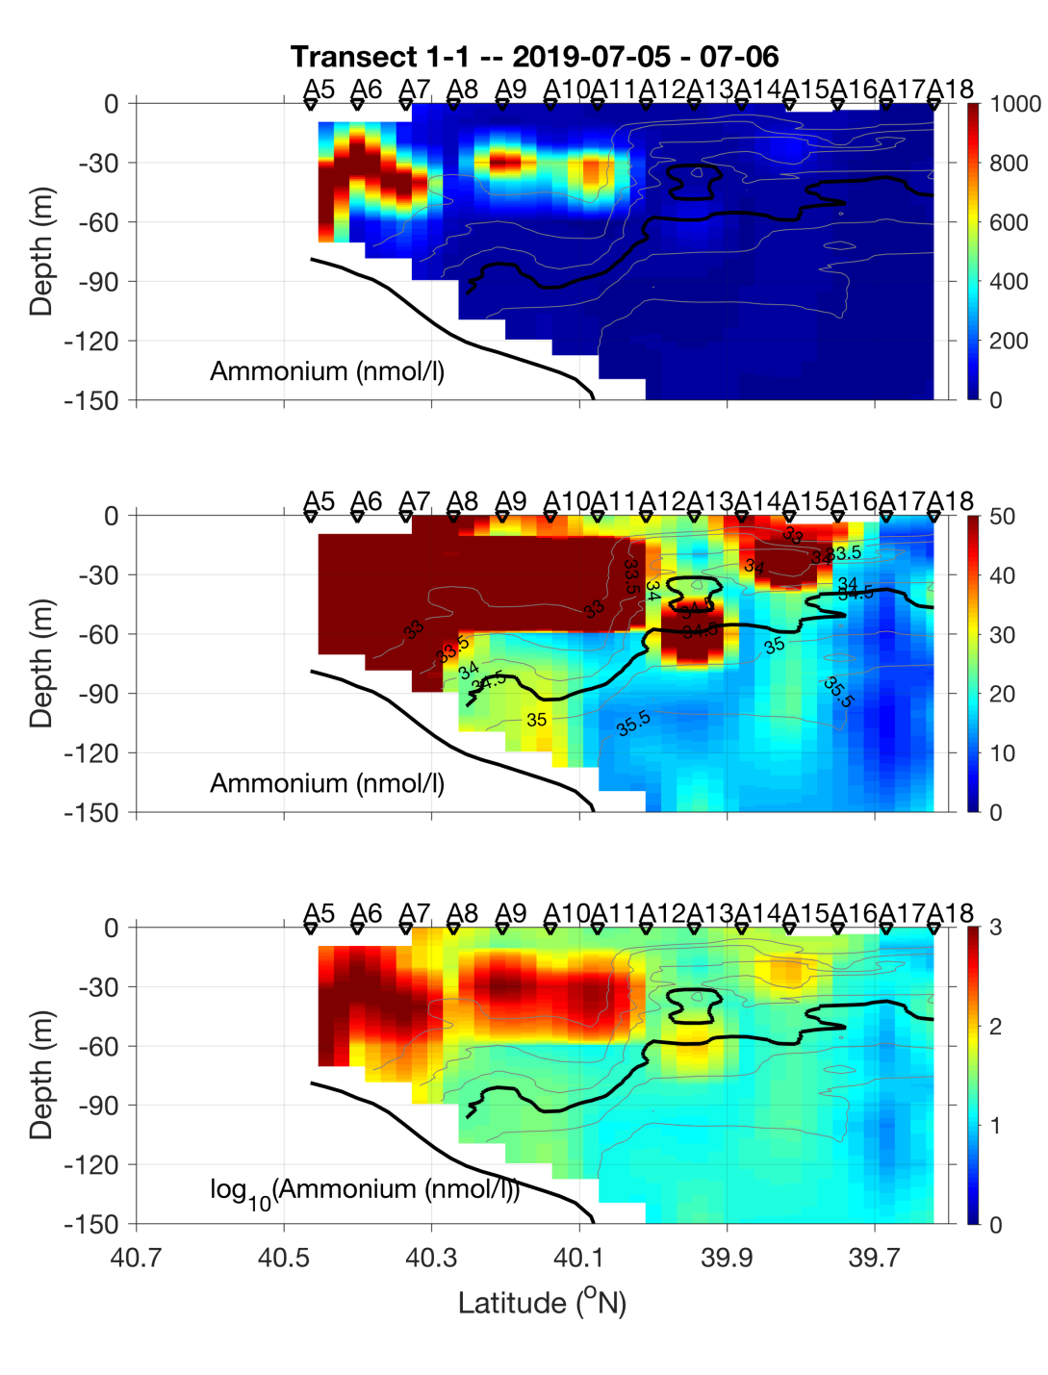
Transect 2 – July 6-7

Slide 19
VIIRS Chl June 23 MODIS Chl July 6

Slide 20
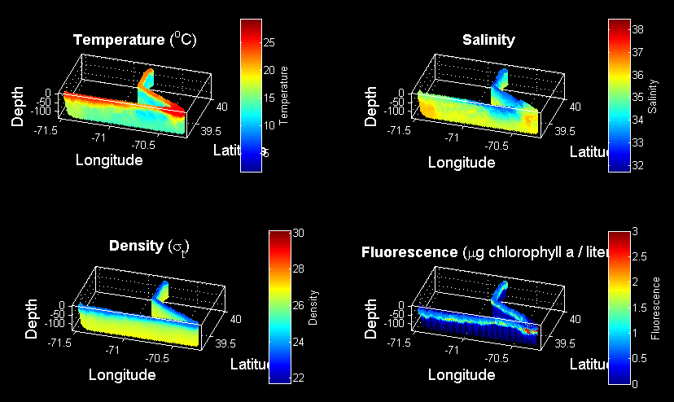
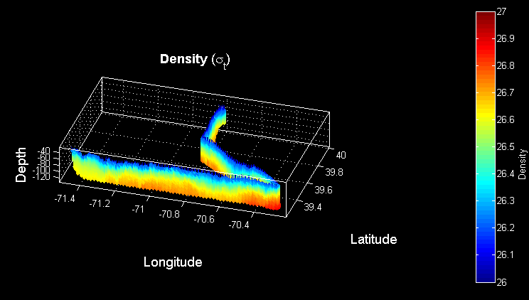
VPR Survey July 7-8
Density

Slide 21
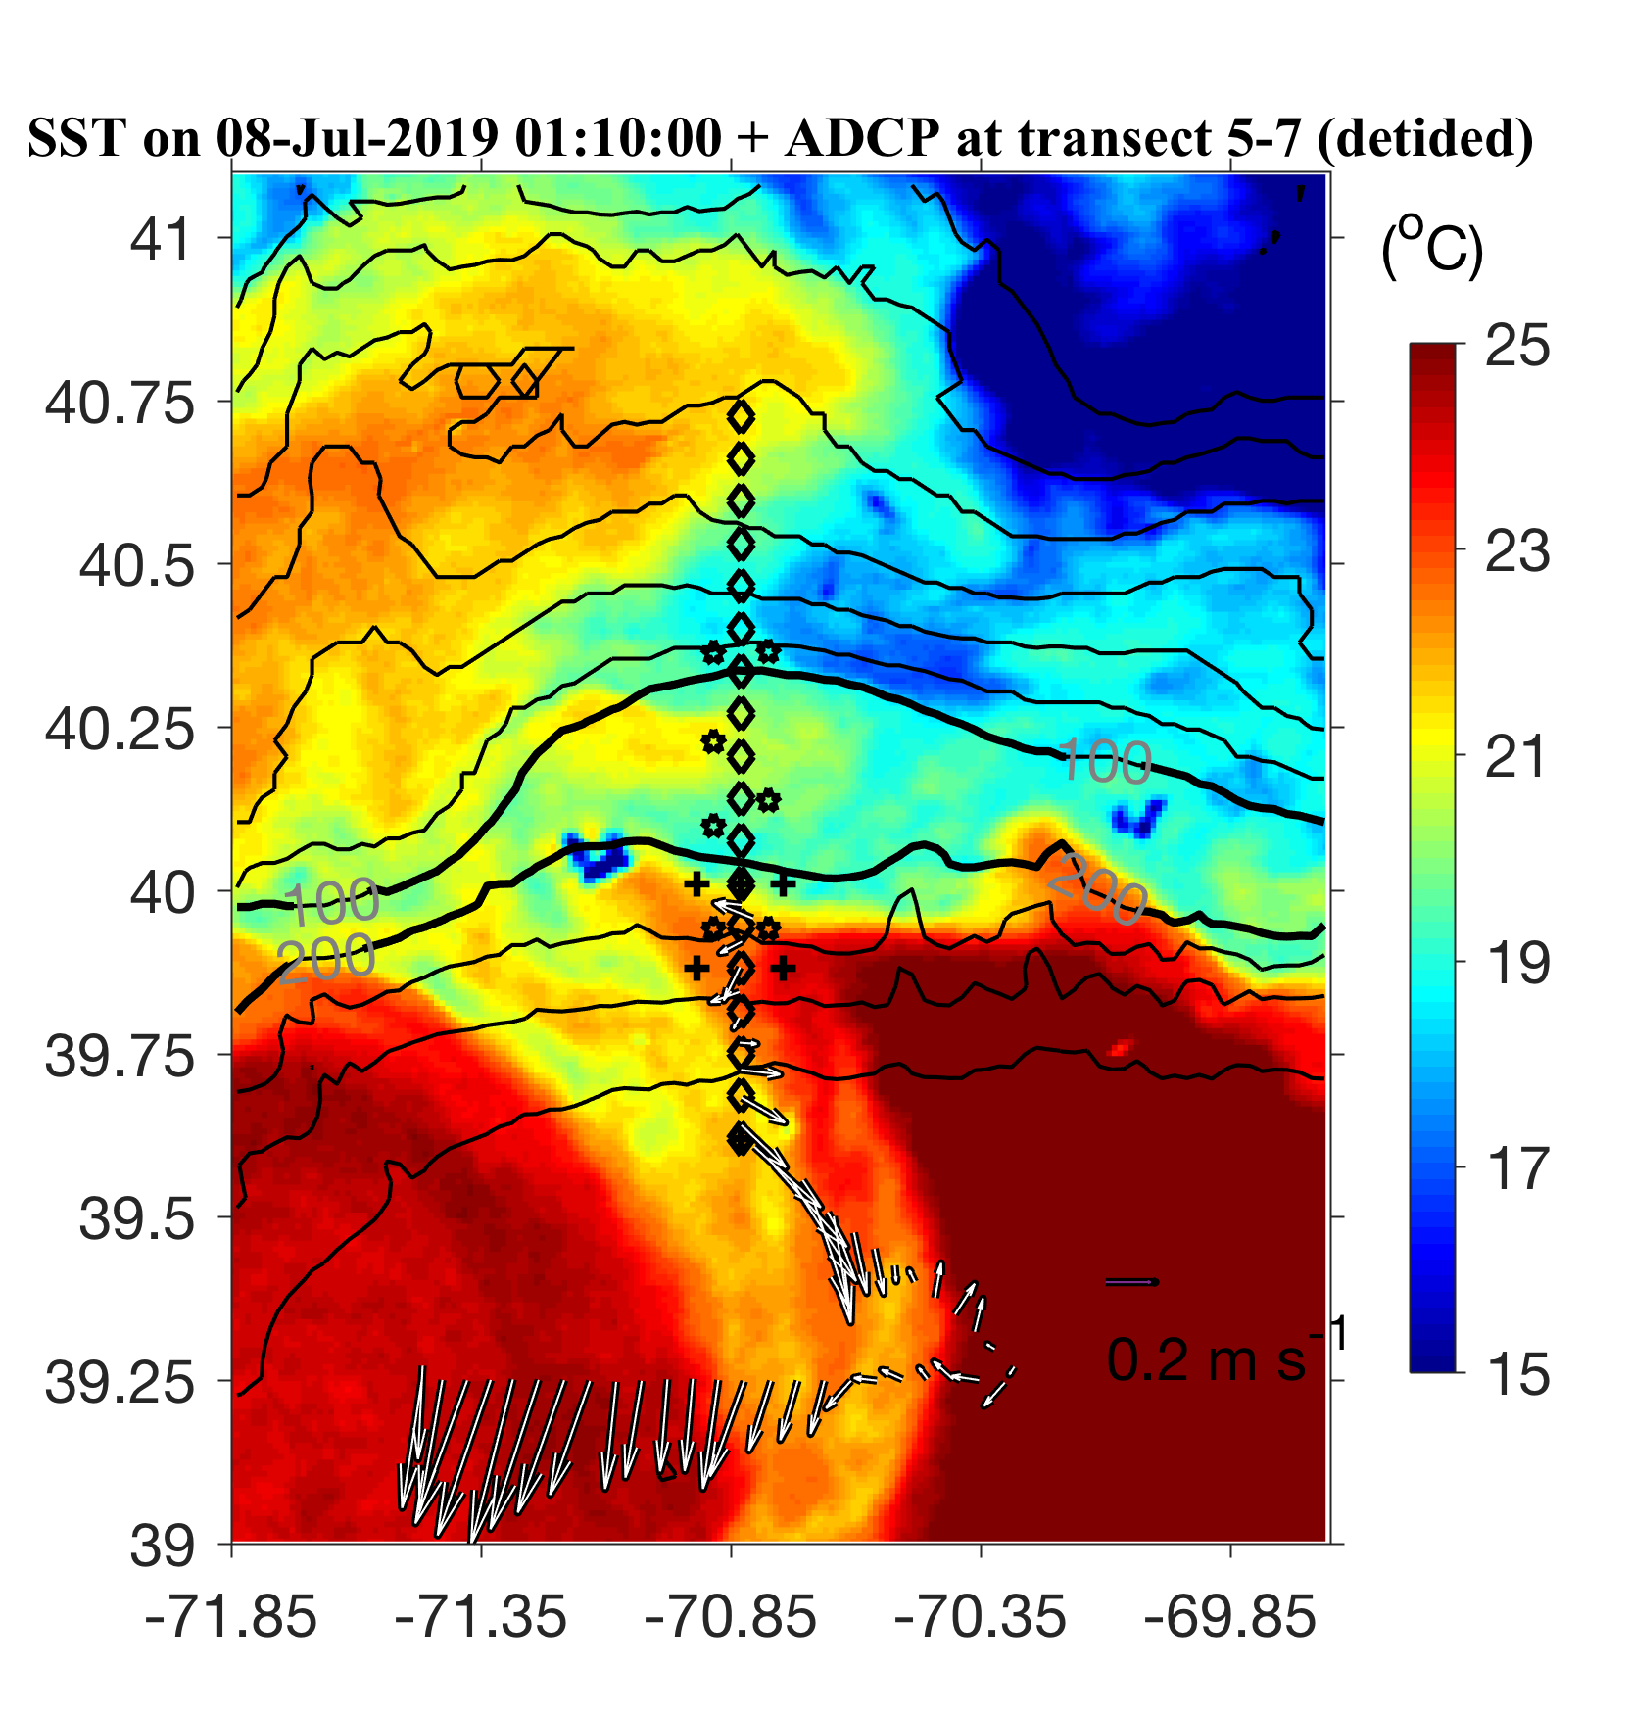
ADCP from VPR survey

Slide 22
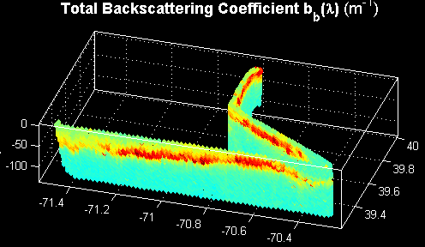


VPR Survey July 7-8

Slide 24
ADCP from VPR survey

Slide 25
VPR1 Survey July 7-8
Density

Slide 26
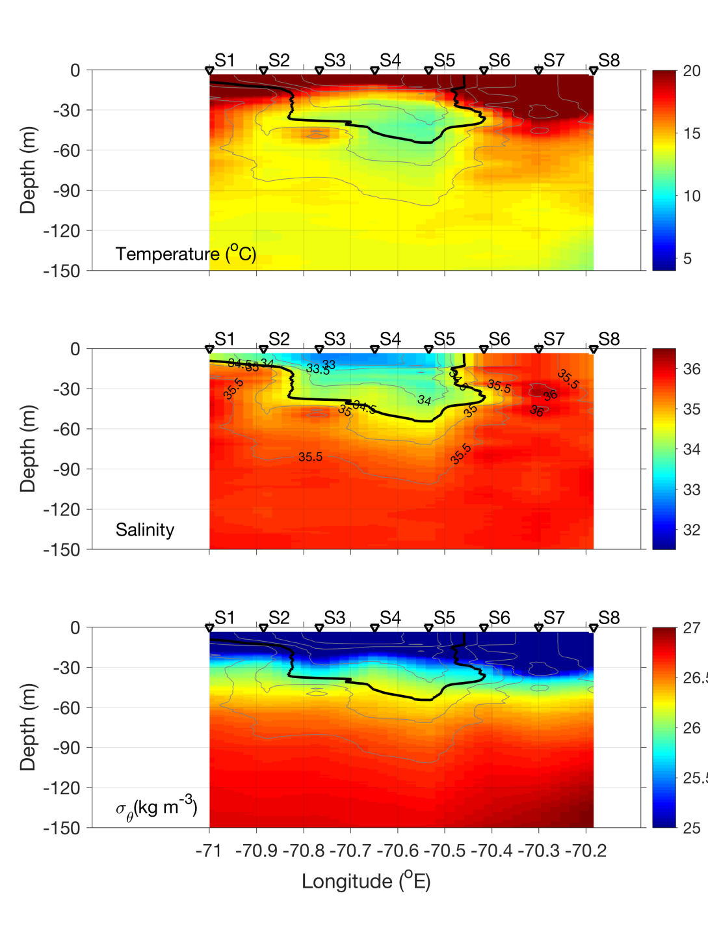
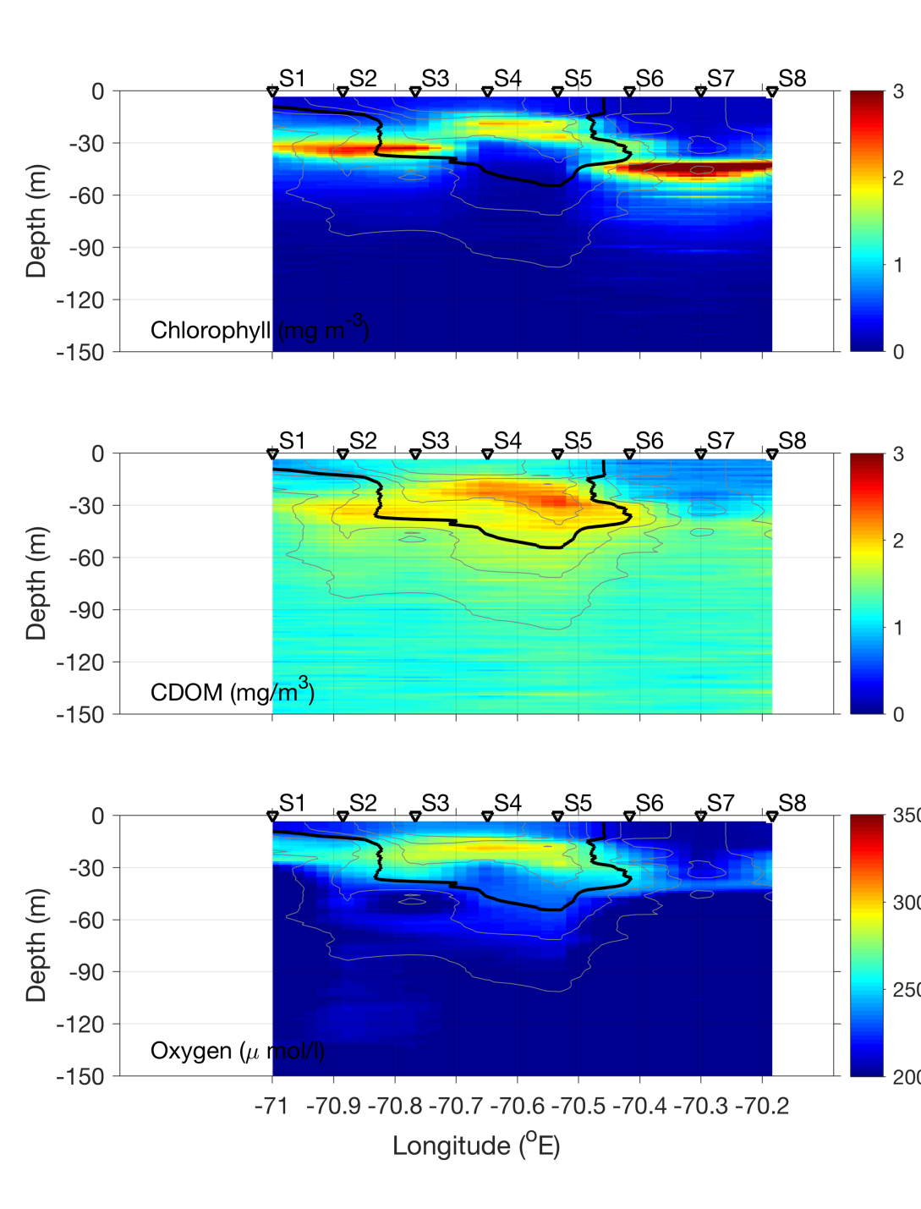
Streamer CTD transect – July 8

Slide 27
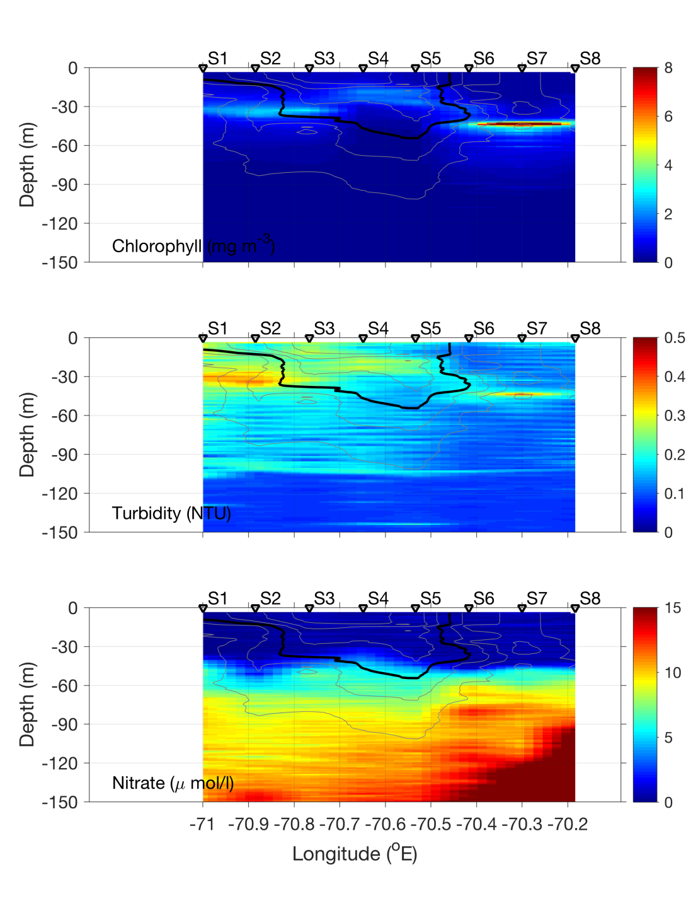
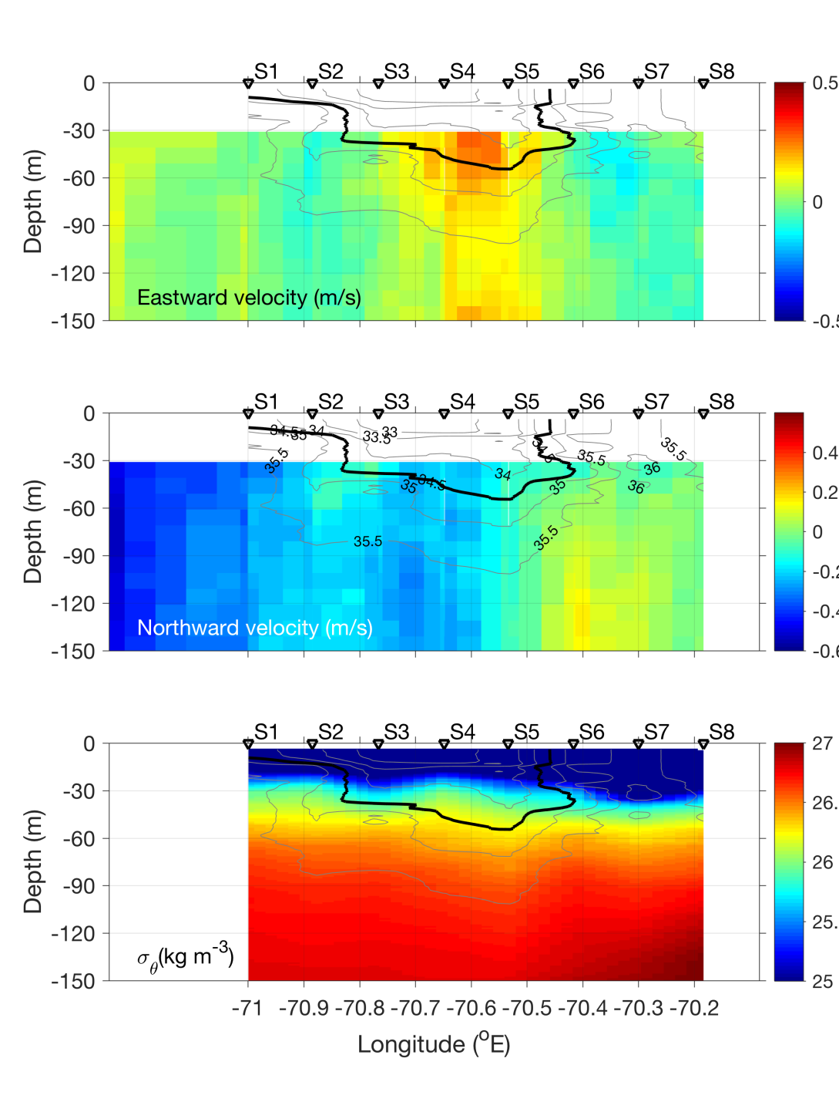
Streamer CTD transect – July 8

Slide 28
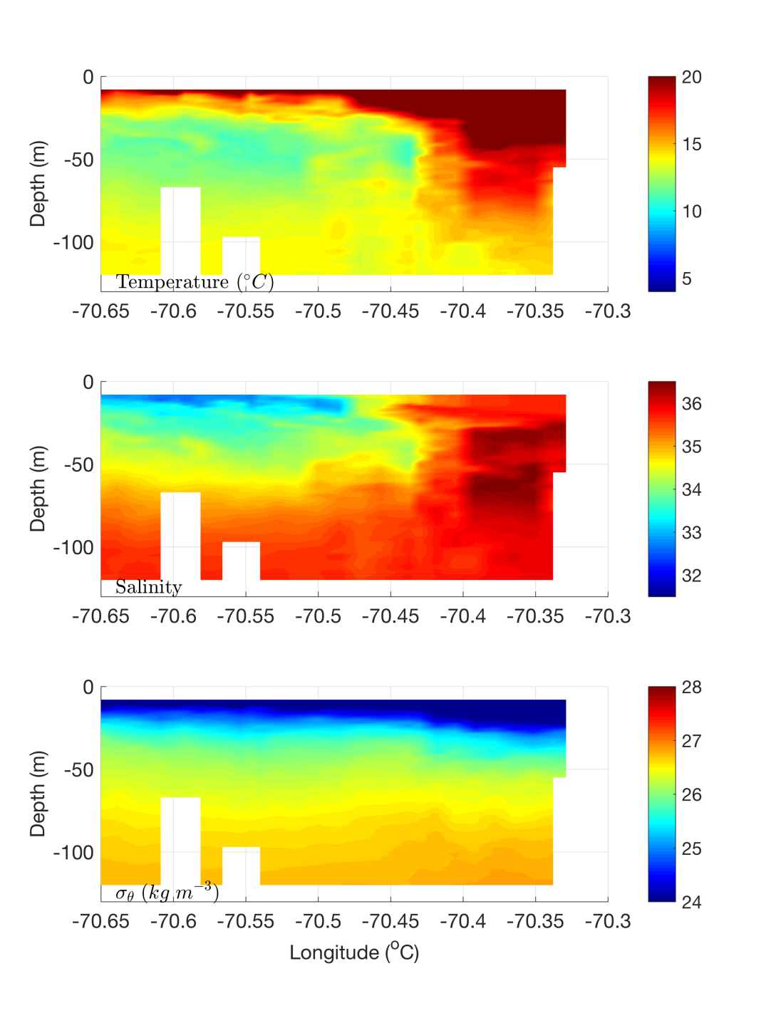
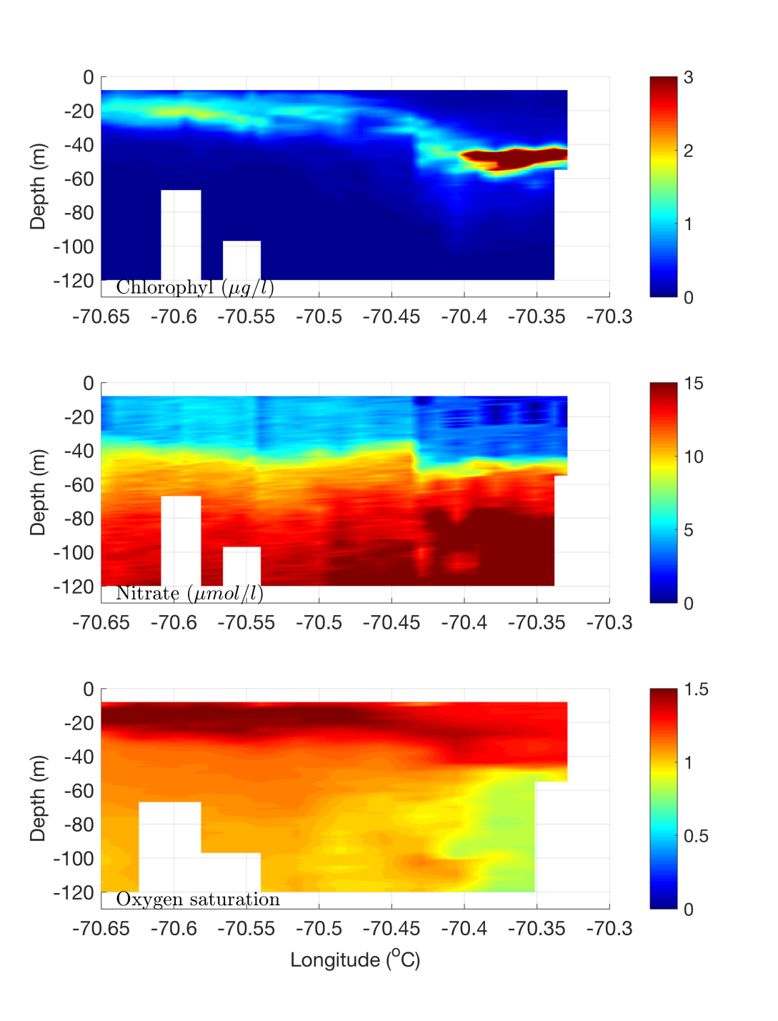
Streamer REMUS transect – July 8

Slide 29
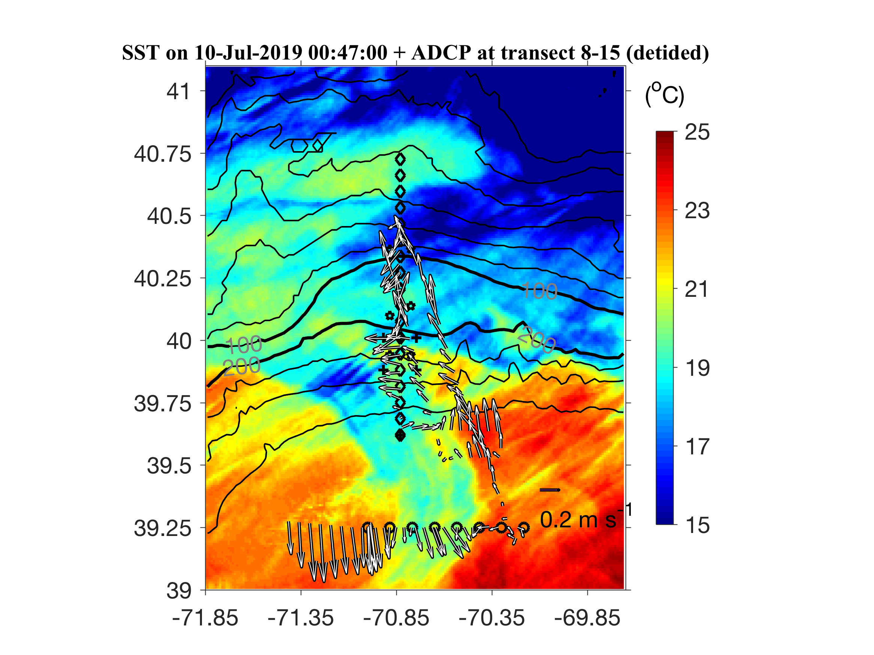
ADCP from VPR survey

Slide 30
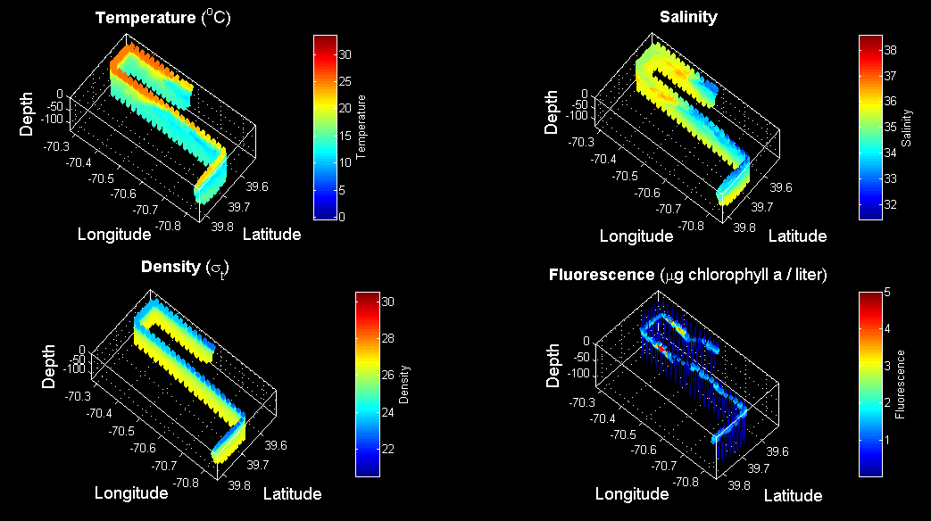
VPR3 Survey July 9

Slide 31
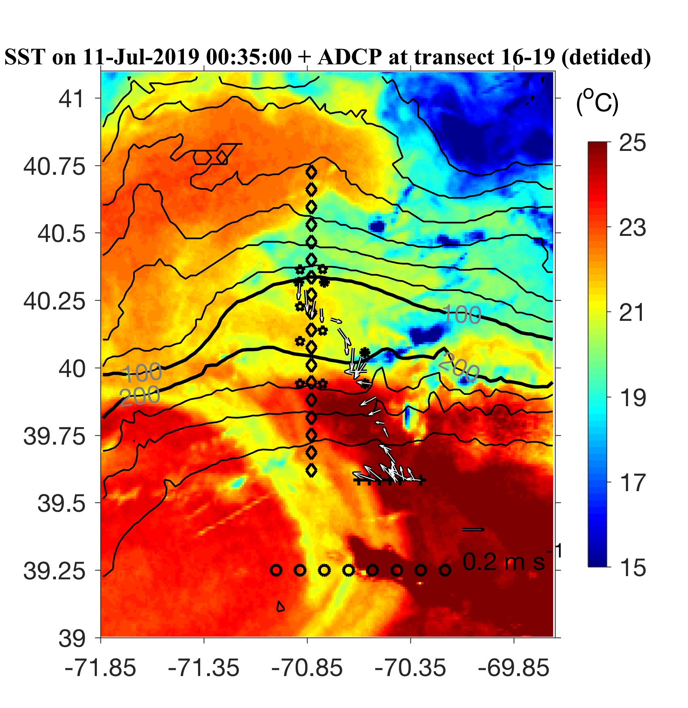
ADCP from Streamer / slope front transect

Slide 32
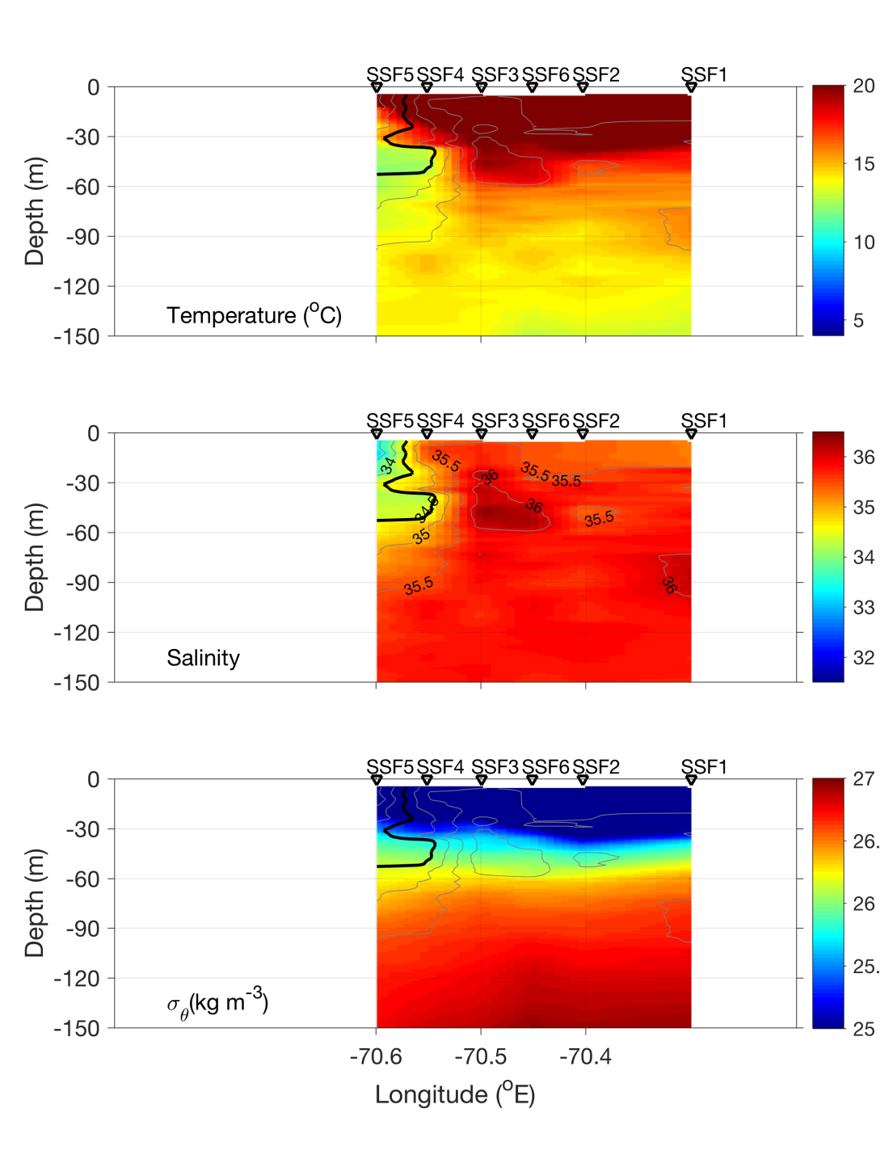
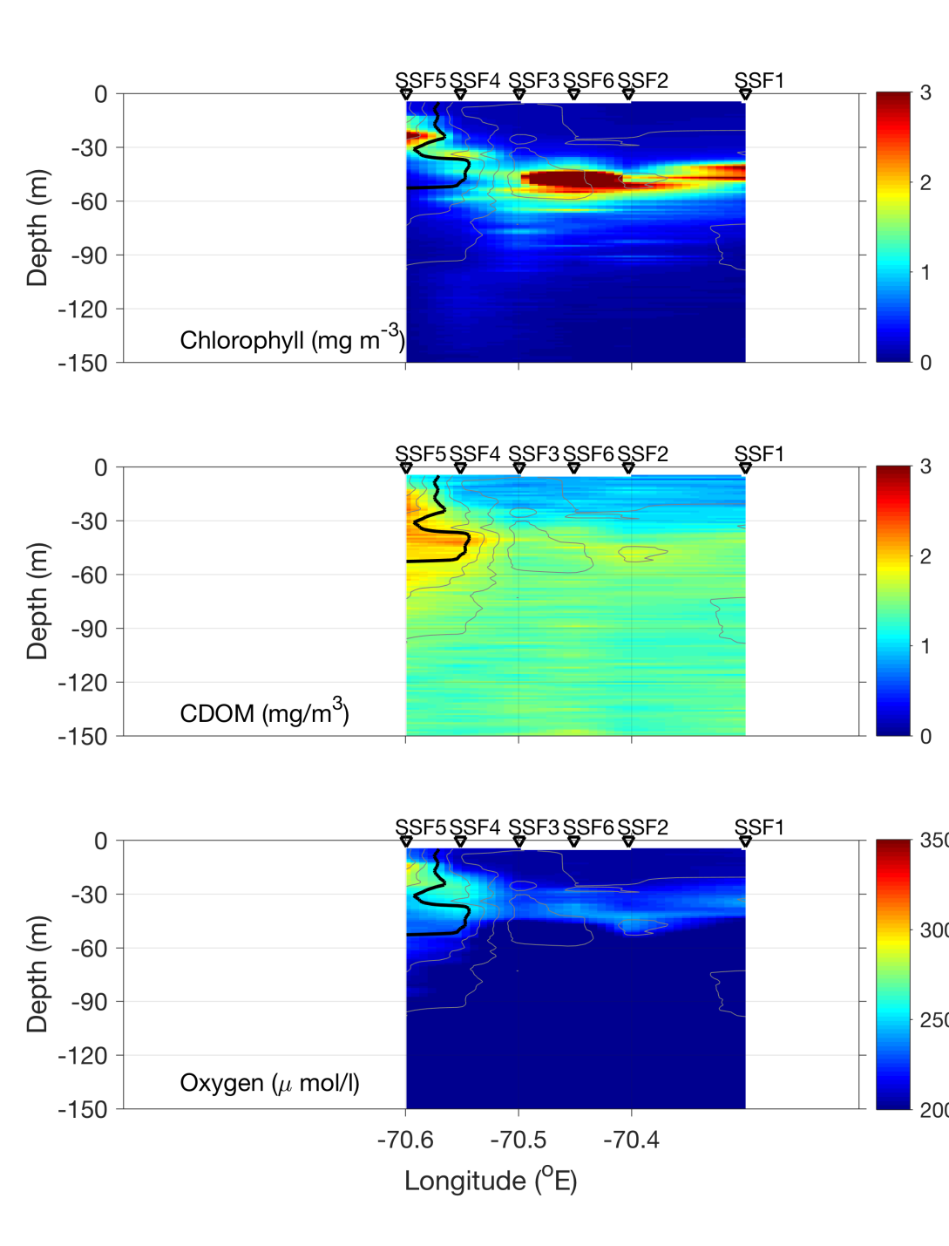
Streamer / slope front transect – July 10

Slide 33
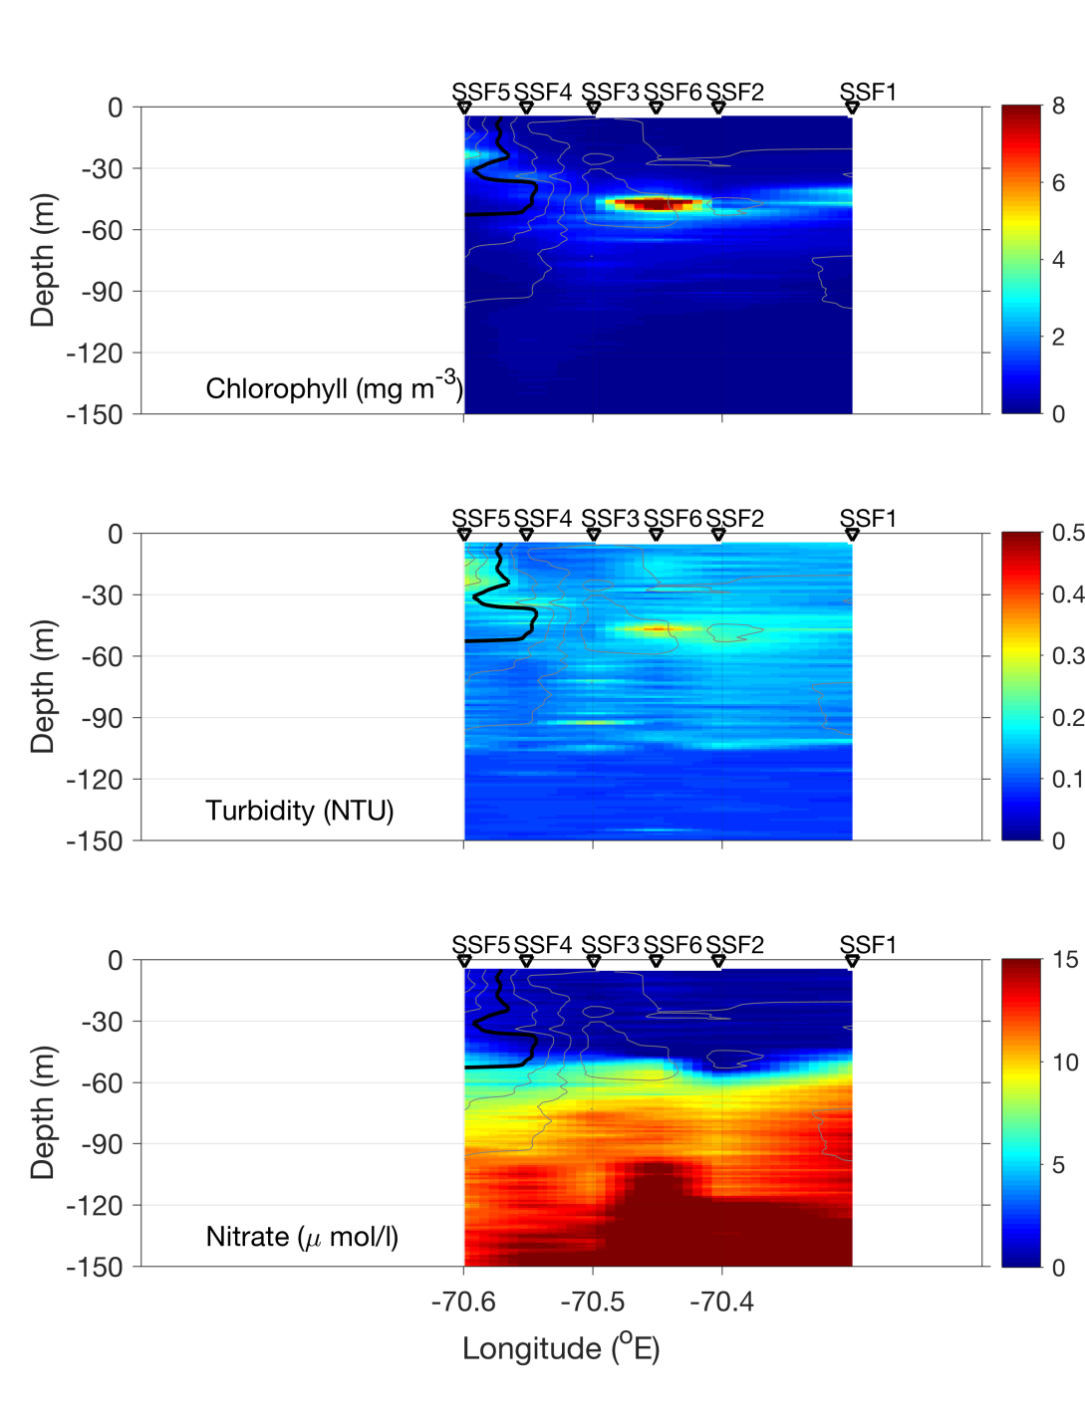
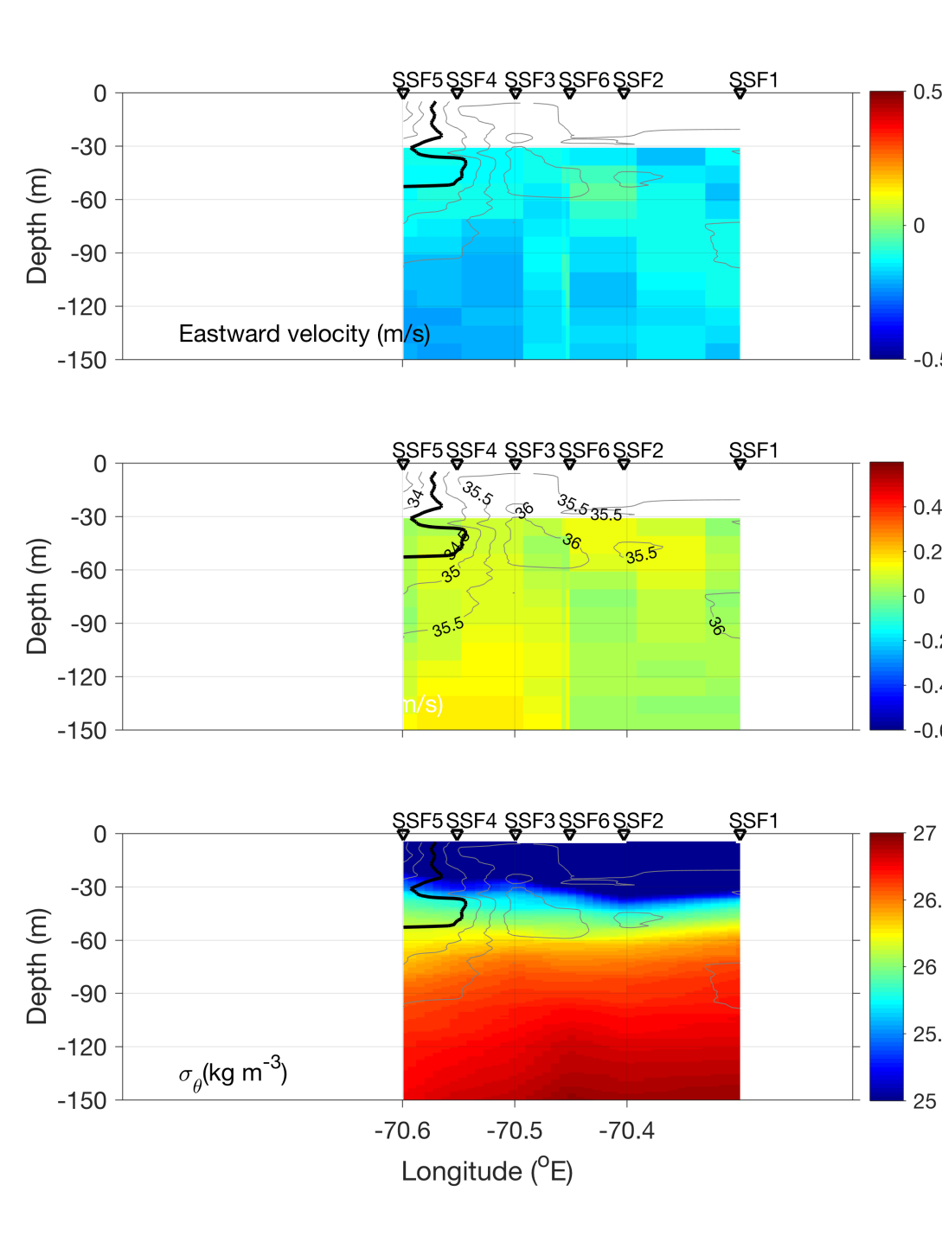
Streamer / slope front transect – July 10

Slide 34
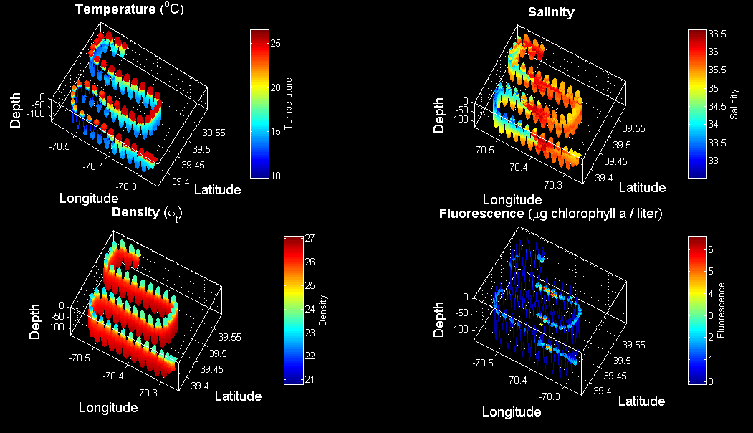
VPR4 July 10-11

Slide 35
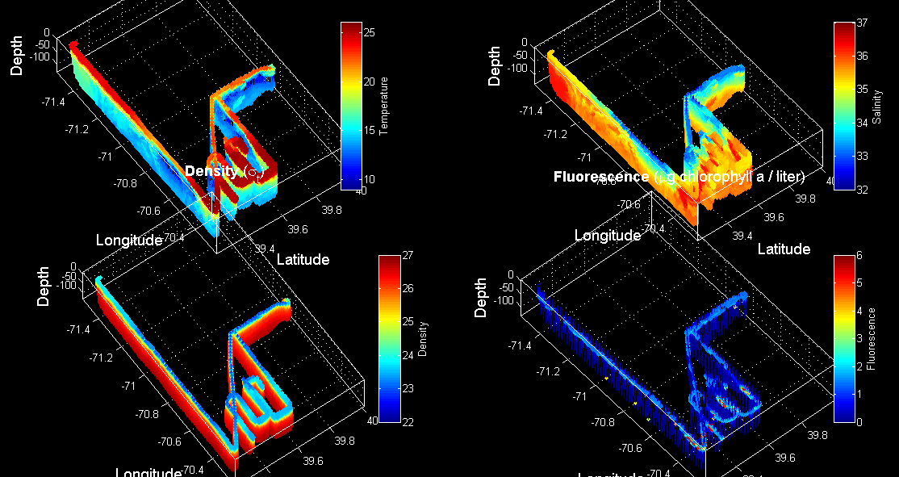
VPR 2,3,4

Slide 36
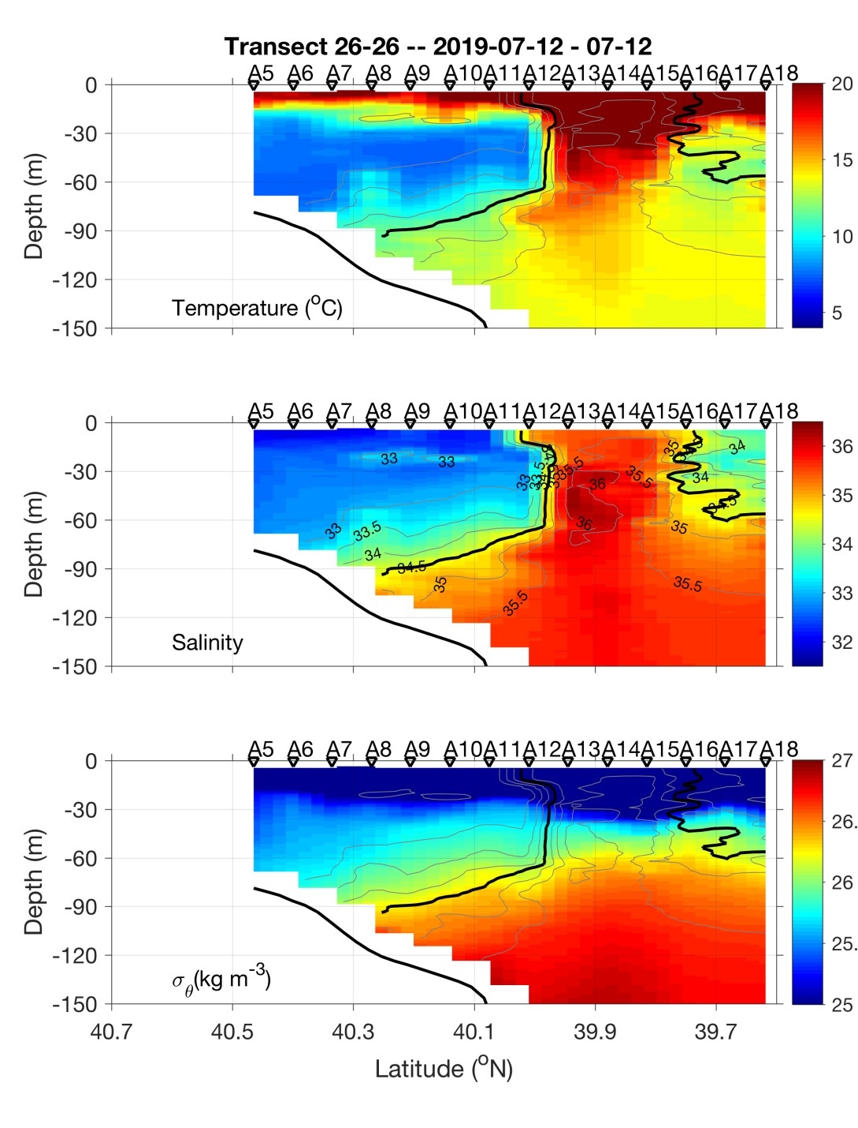
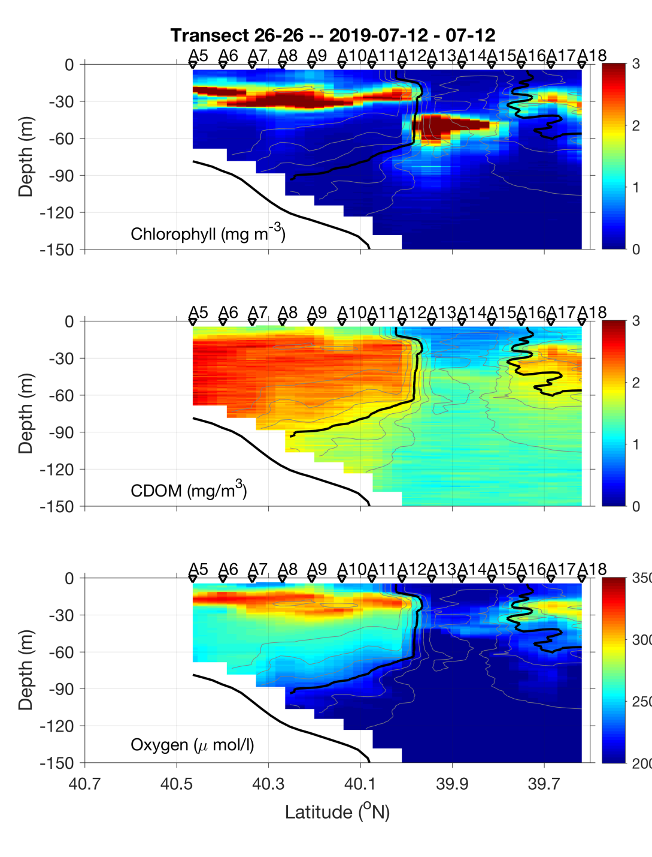
CTD transect – July 11-12

Slide 37
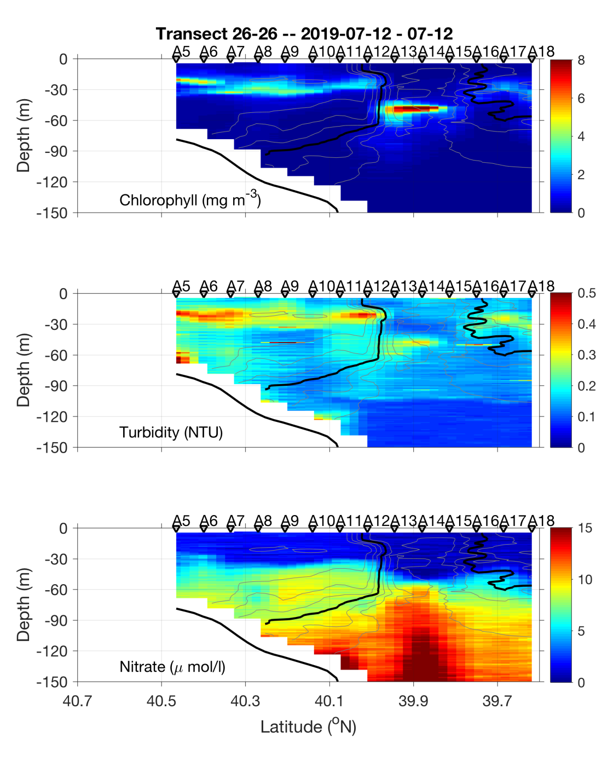
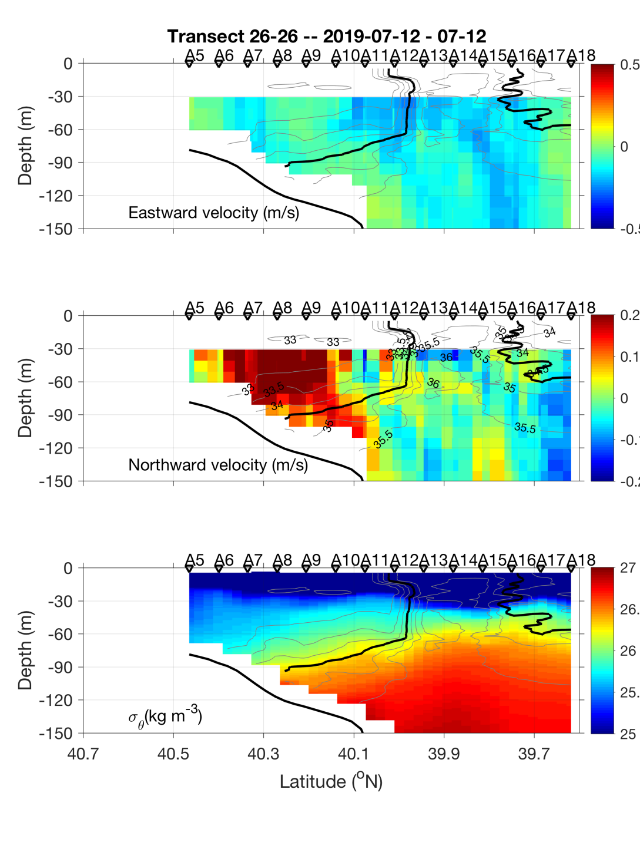
CTD transect – July 11-12

Slide 38
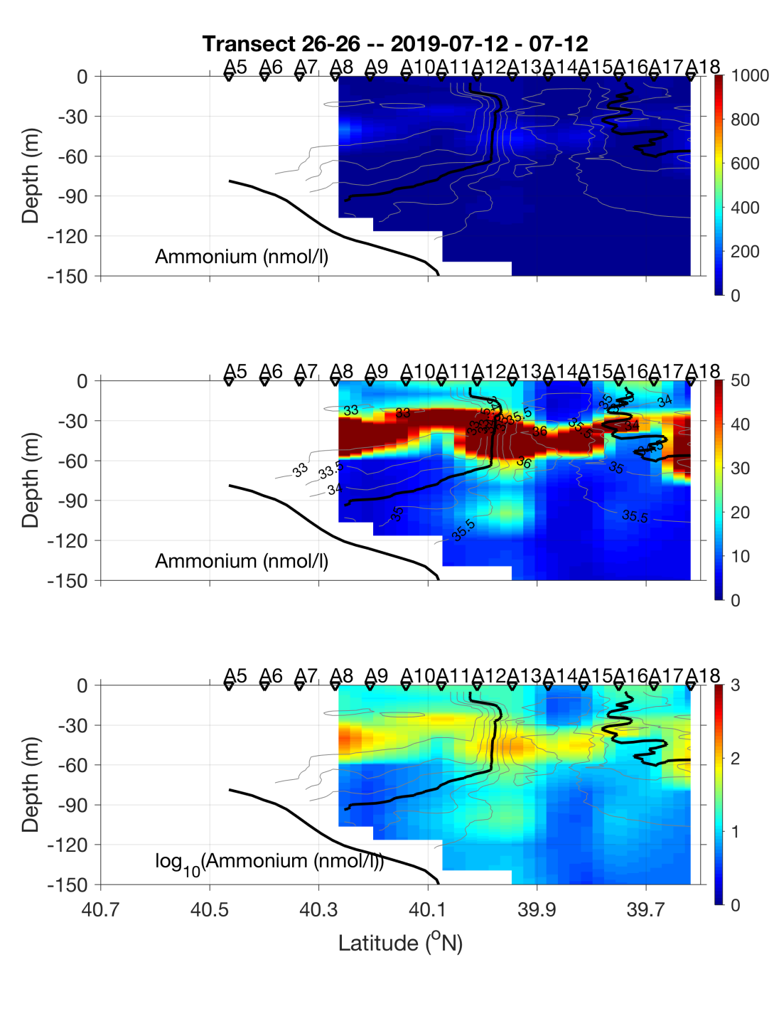
CTD transect – July 11-12

Slide 39
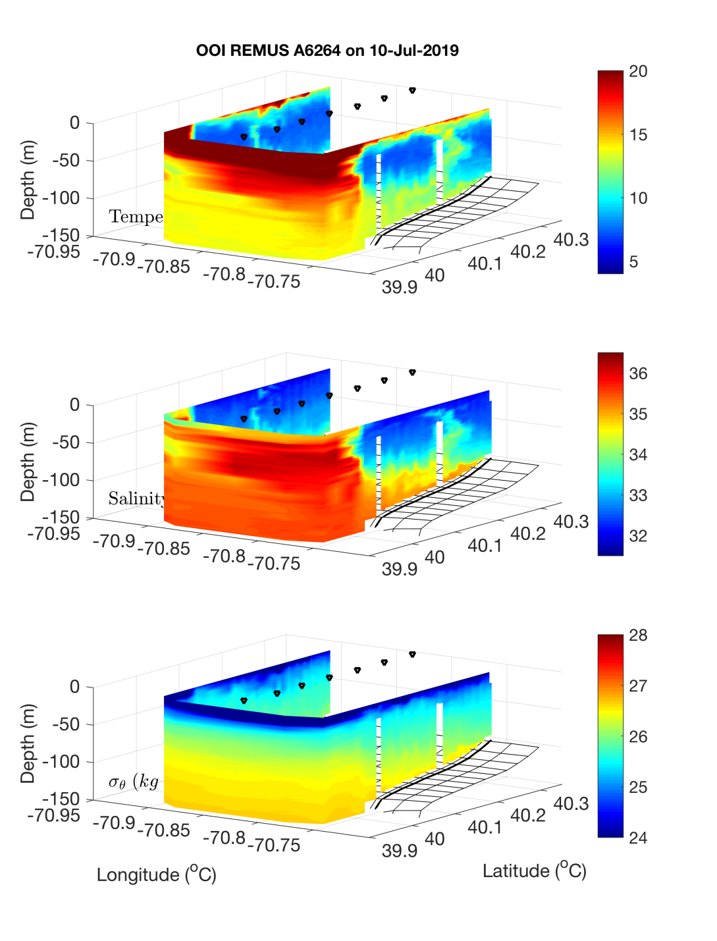
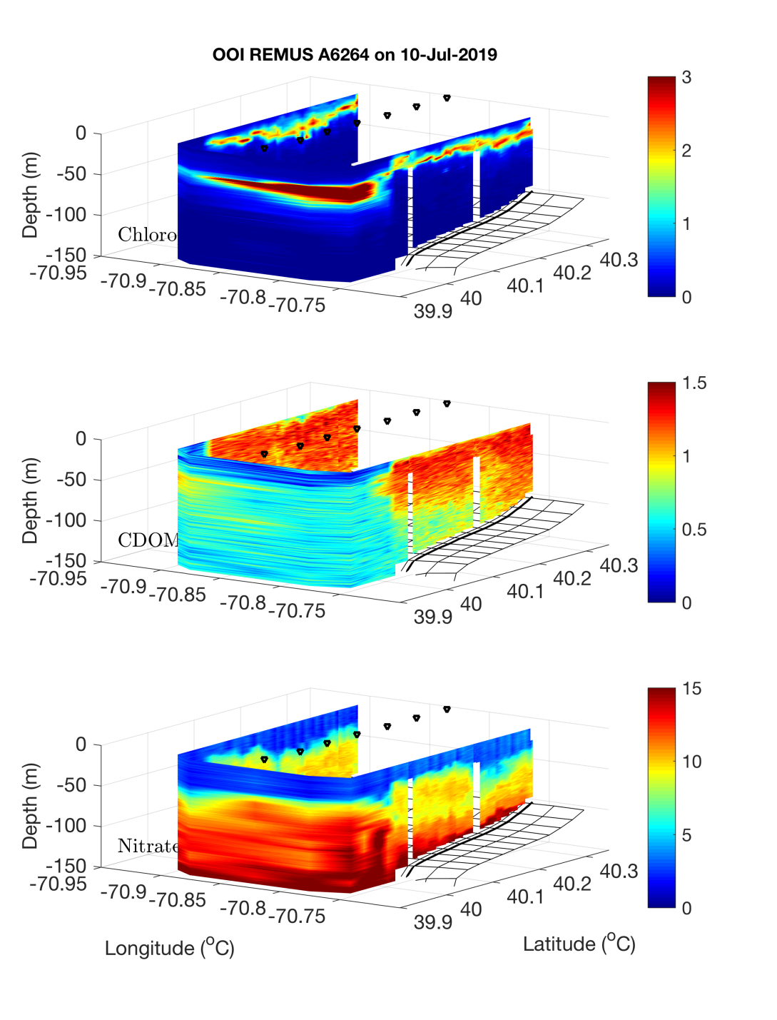
OOI REMUS : Across – front mission July 10
A7
A13

Slide 40


OOI REMUS : Along – front mission July 10
A10
A12

Slide 41

OOI REMUS : Along – front mission July 10

Slide 42


OOI REMUS : Bottom boundary layer mission July 11
A13
A7

Slide 43

OOI REMUS : Bottom boundary layer mission July 11

Slide 44

VIIRS Chl 11 July

Slide 45
VIIRS Chl 11 July

Slide 46
Extras

Slide 47


CTD Transect – July 8-9

Slide 48


CTD Transect – July 8-9

Slide 49

CTD Transect – July 8-9

Slide 50

MODIS Chl July 6

