Slide 1
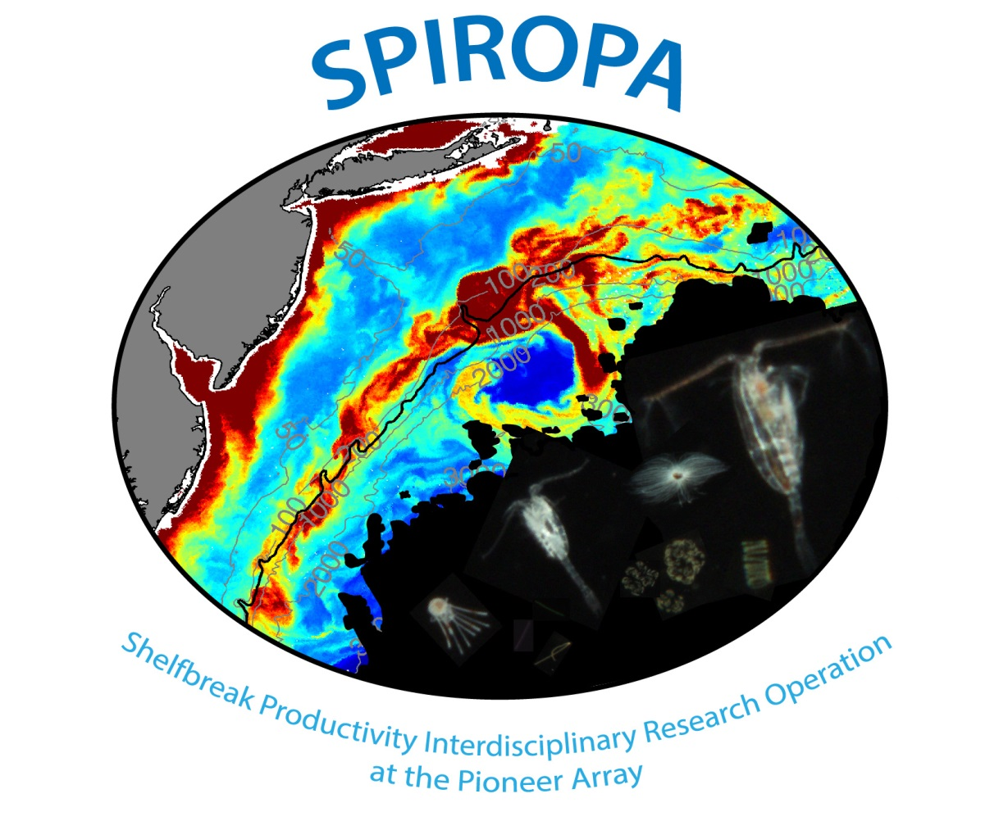

Slide 2
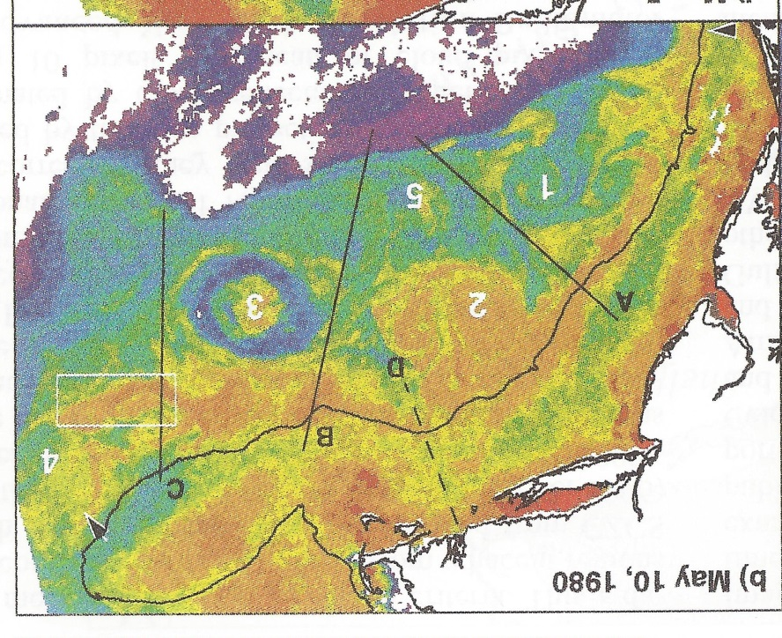
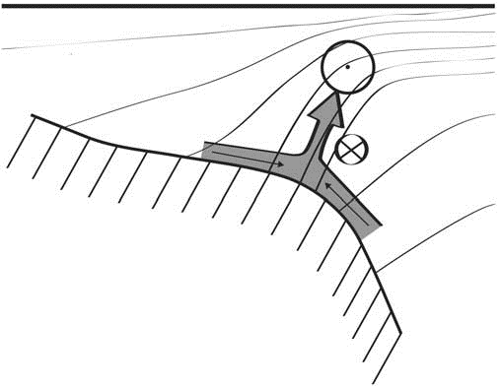
Shelfbreak frontal dynamics: mechanisms of upwelling, net community production, and ecological implications
Ryan et al. 1999
Linder et al. 2004
Gawarkiewicz and Chapman 1992
Chapman and Lentz 1994
Marra et al. 1990

Slide 3


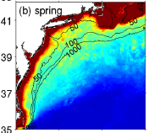

2013, JGR
Satellite CHL climatology
Why is there no mean enhancement of chlorophyll at the shelf break front?
H₁: Top-down control by zooplankton grazing
H₂: Spatial and temporal intermittency of the upwelling events causes their net impact to be smoothed out in long-term means.

Slide 4

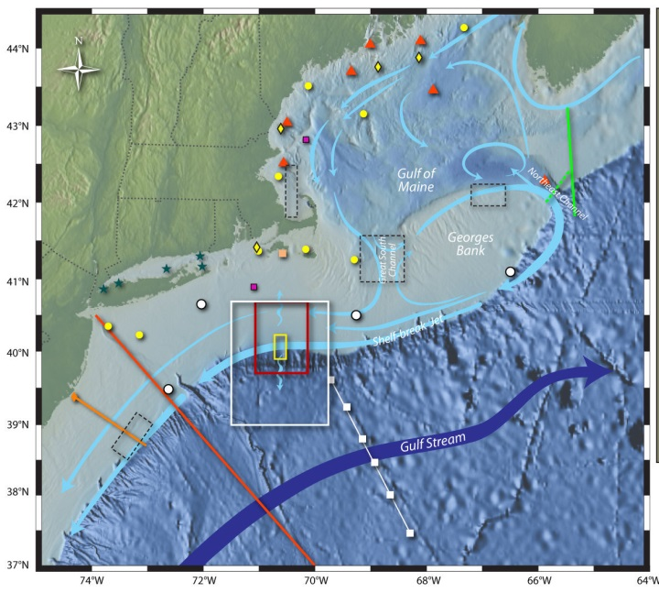
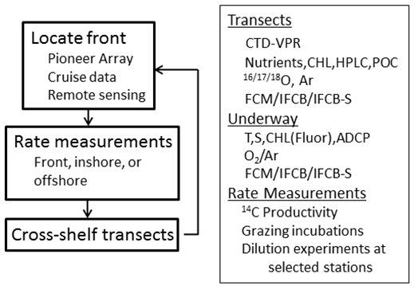
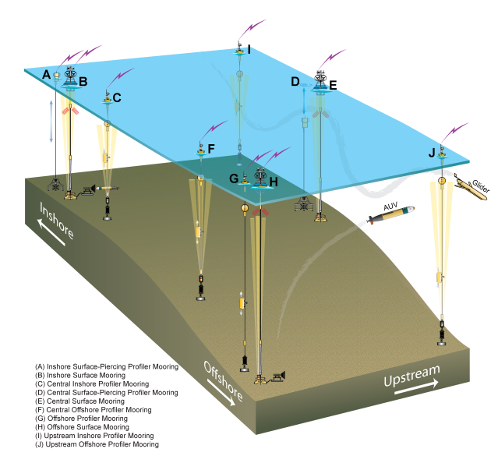
Shelfbreak frontal dynamics: mechanisms of upwelling, net community production, and ecological implications
Dennis McGillicuddy, Heidi Sosik, Gordon Zhang (WHOI)
Walker Smith (VIMS) Rachel Stanley (Wellesley College)
Jefferson Turner, Christian Petitpas (UMass Dartmouth)
3 Cruises R/V Neil Armstrong
NSF Ocean Observatory Initiative Pioneer Array

Slide 5
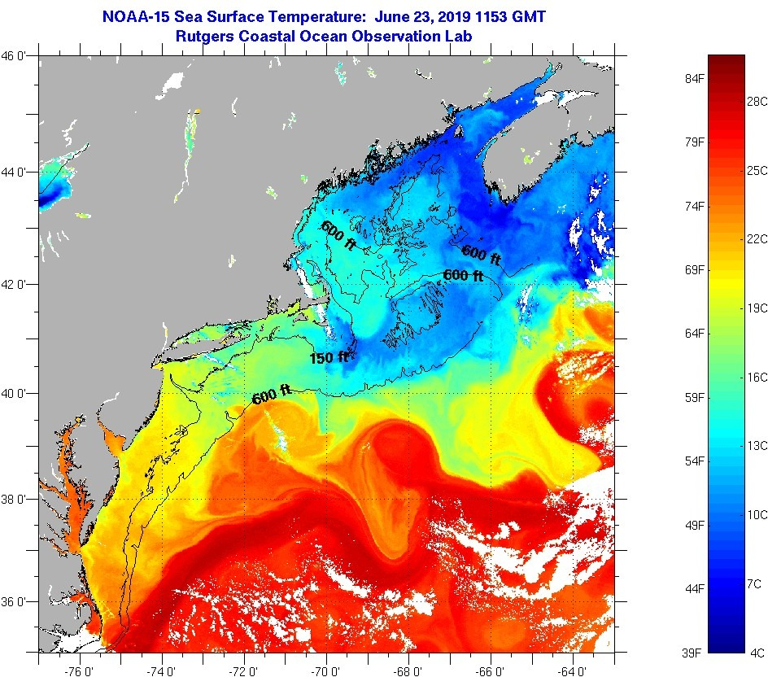
SST - June 23 2019

Slide 6
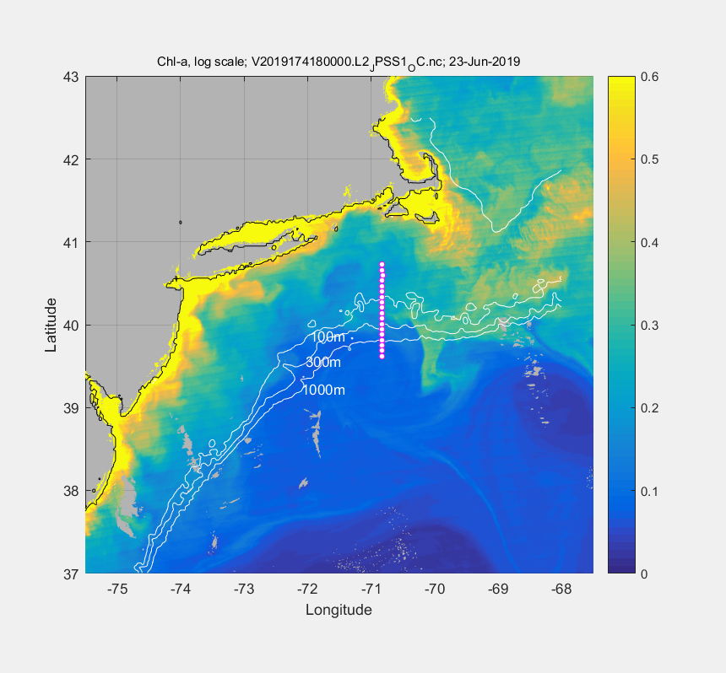
VIIRS Chl - June 23

Slide 7
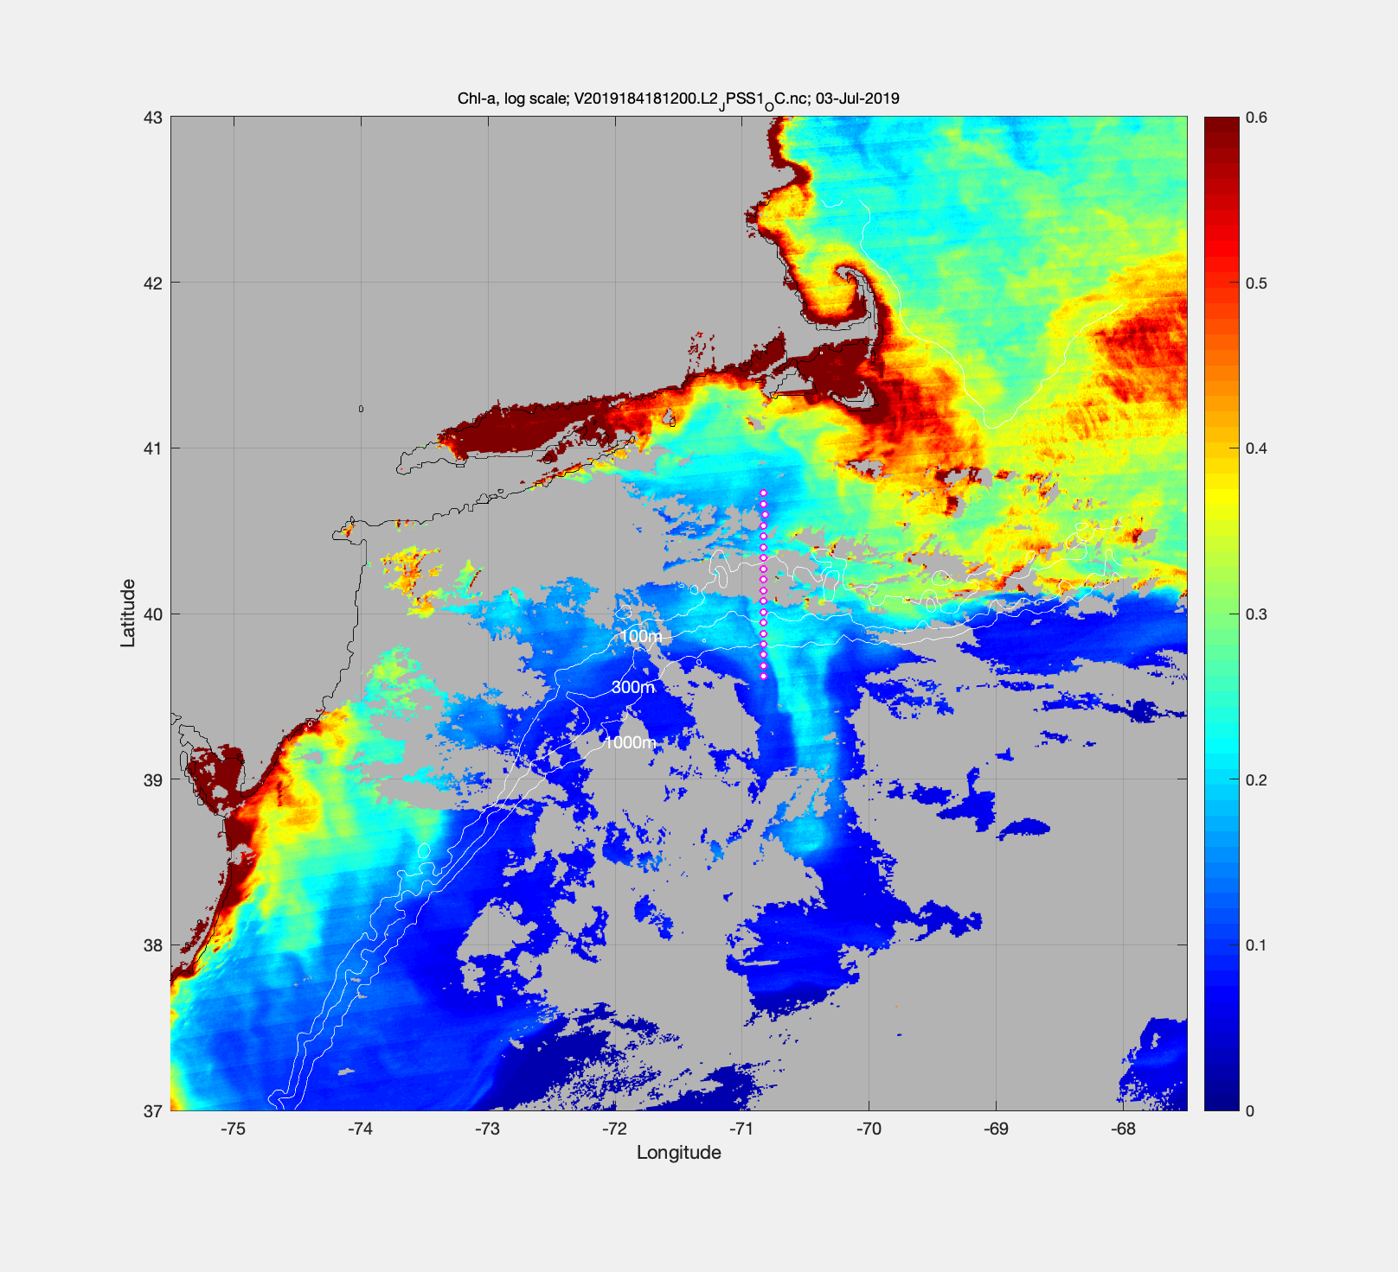
July 3 – VIIRS Chl

Slide 8
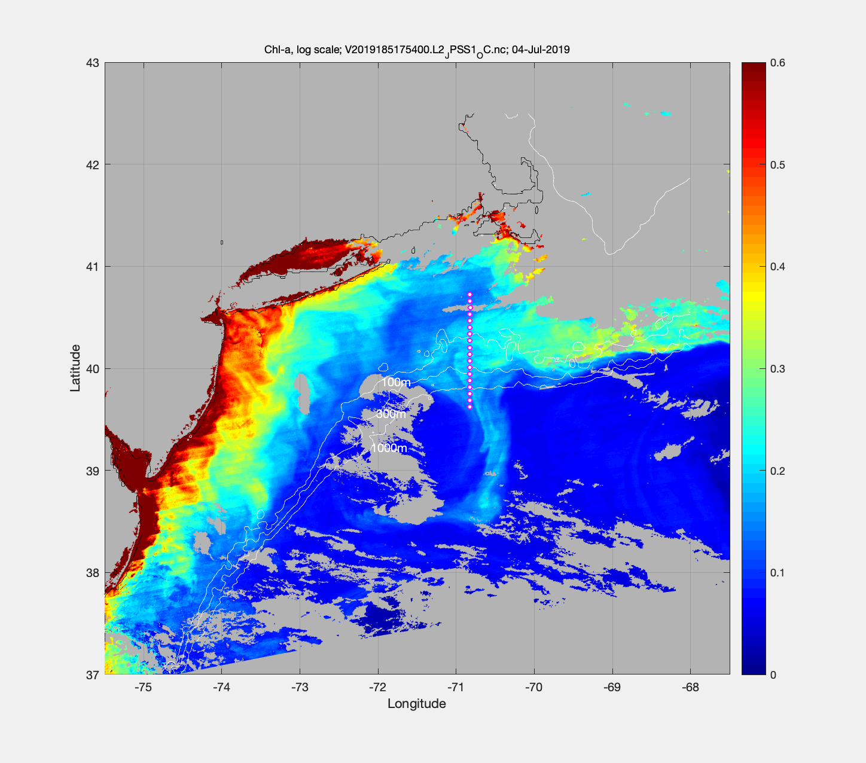
July 4 – VIIRS Chl

Slide 10
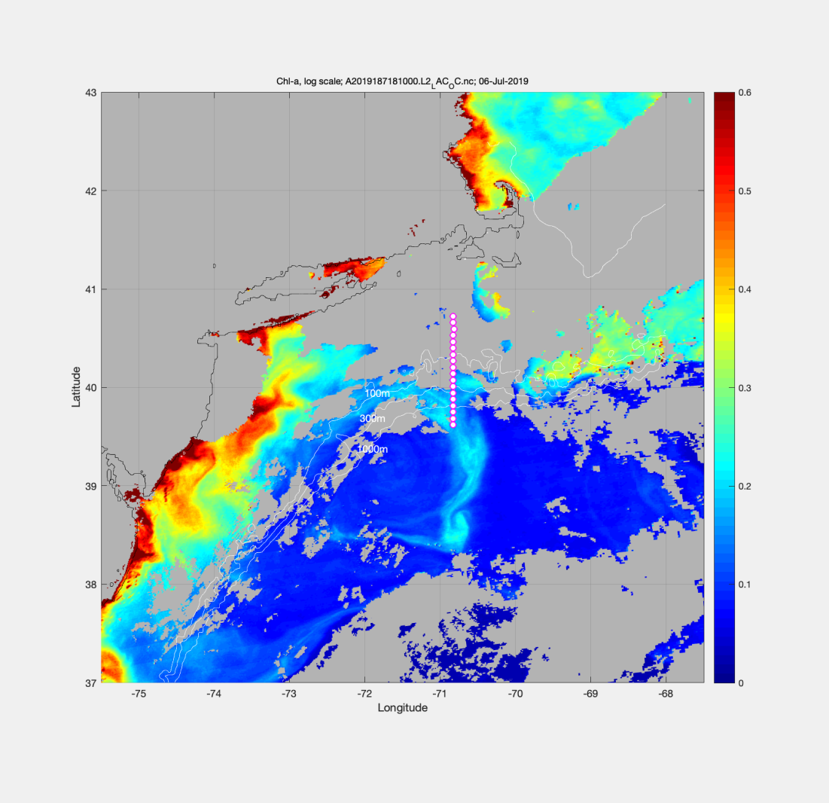
VIIRS Chl June 23 MODIS Chl July 6

Slide 11
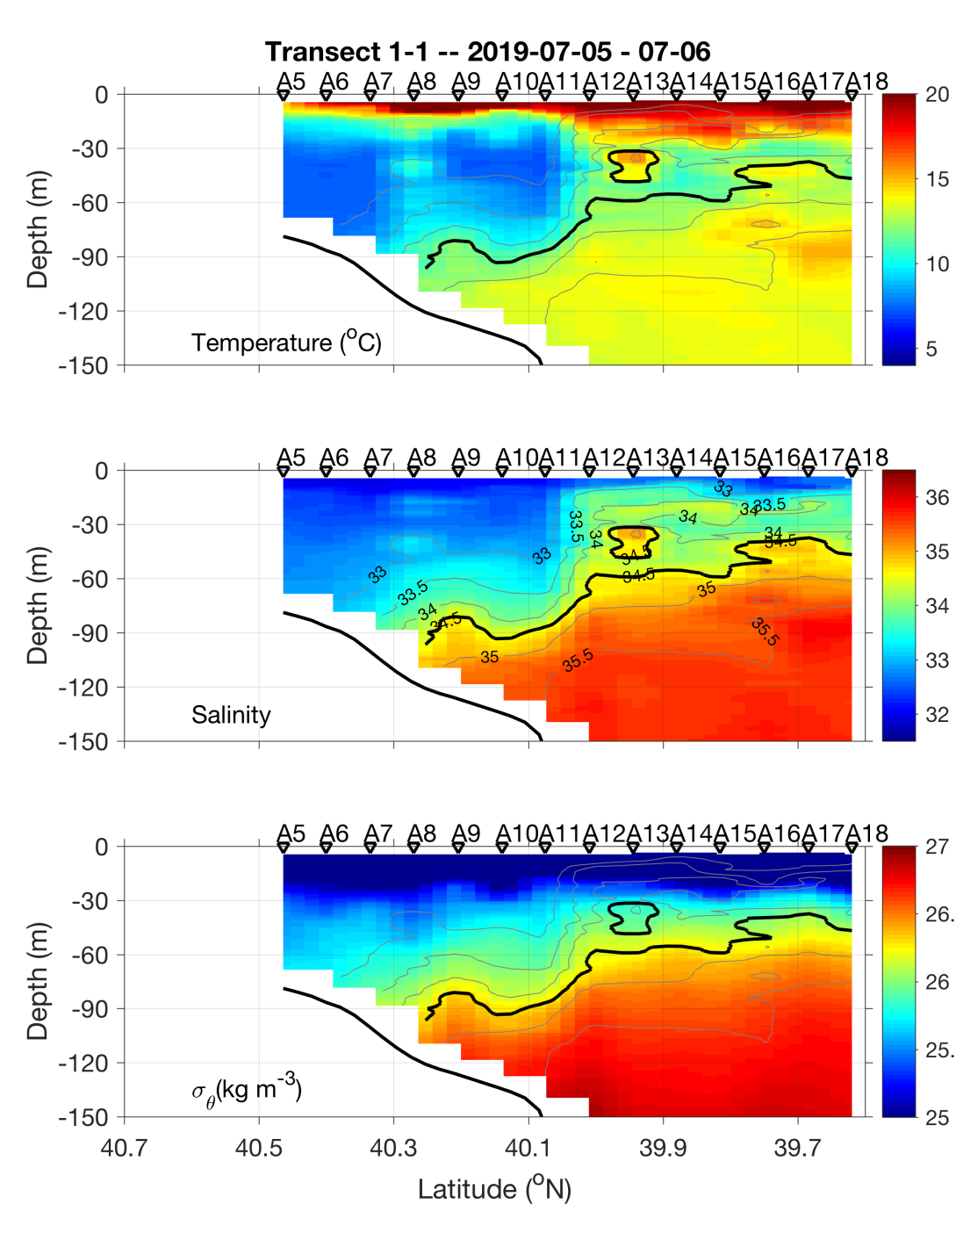
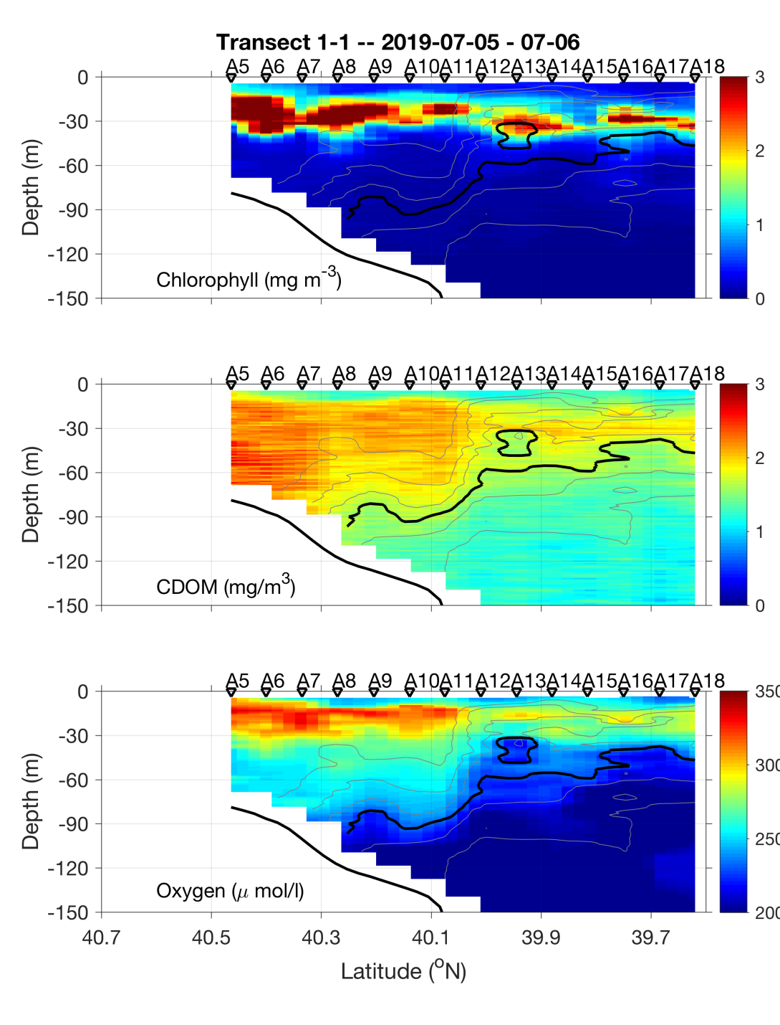
Transect 1 – July 5-6

Slide 12
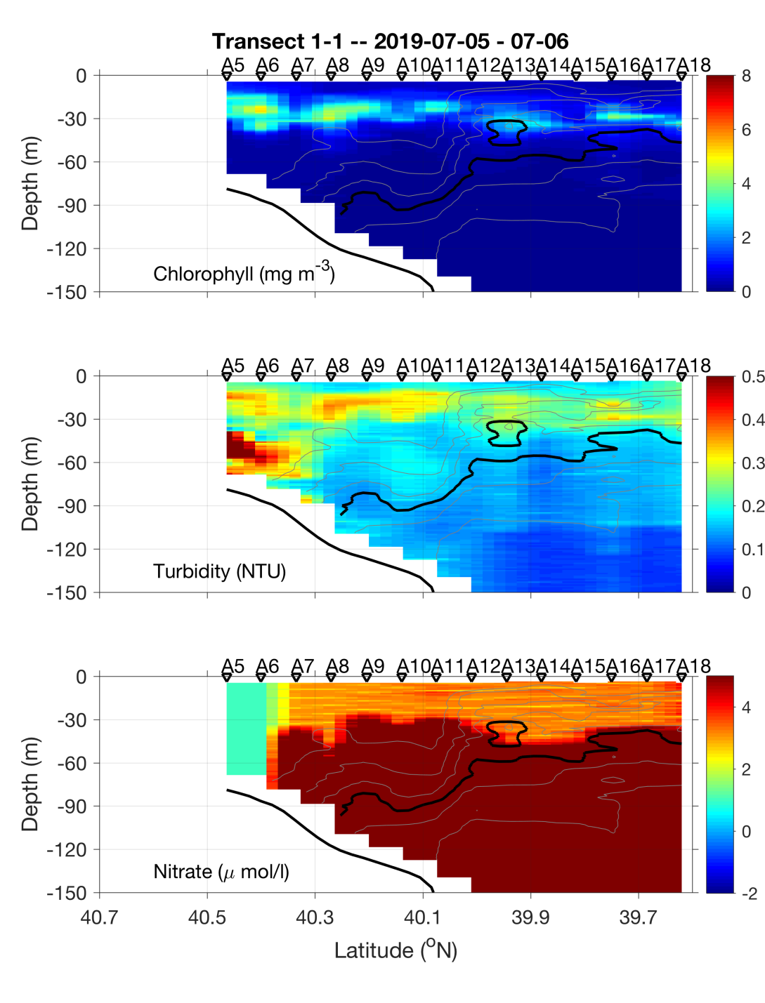
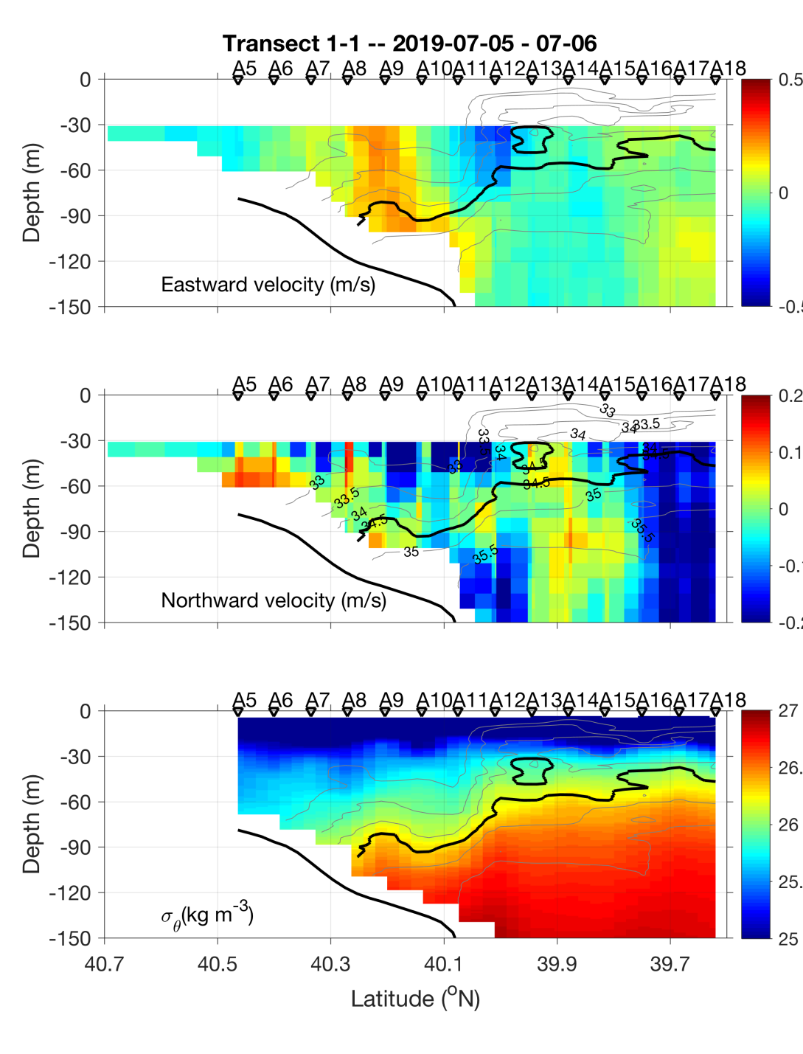
Transect 1 – July 5-6

Slide 13
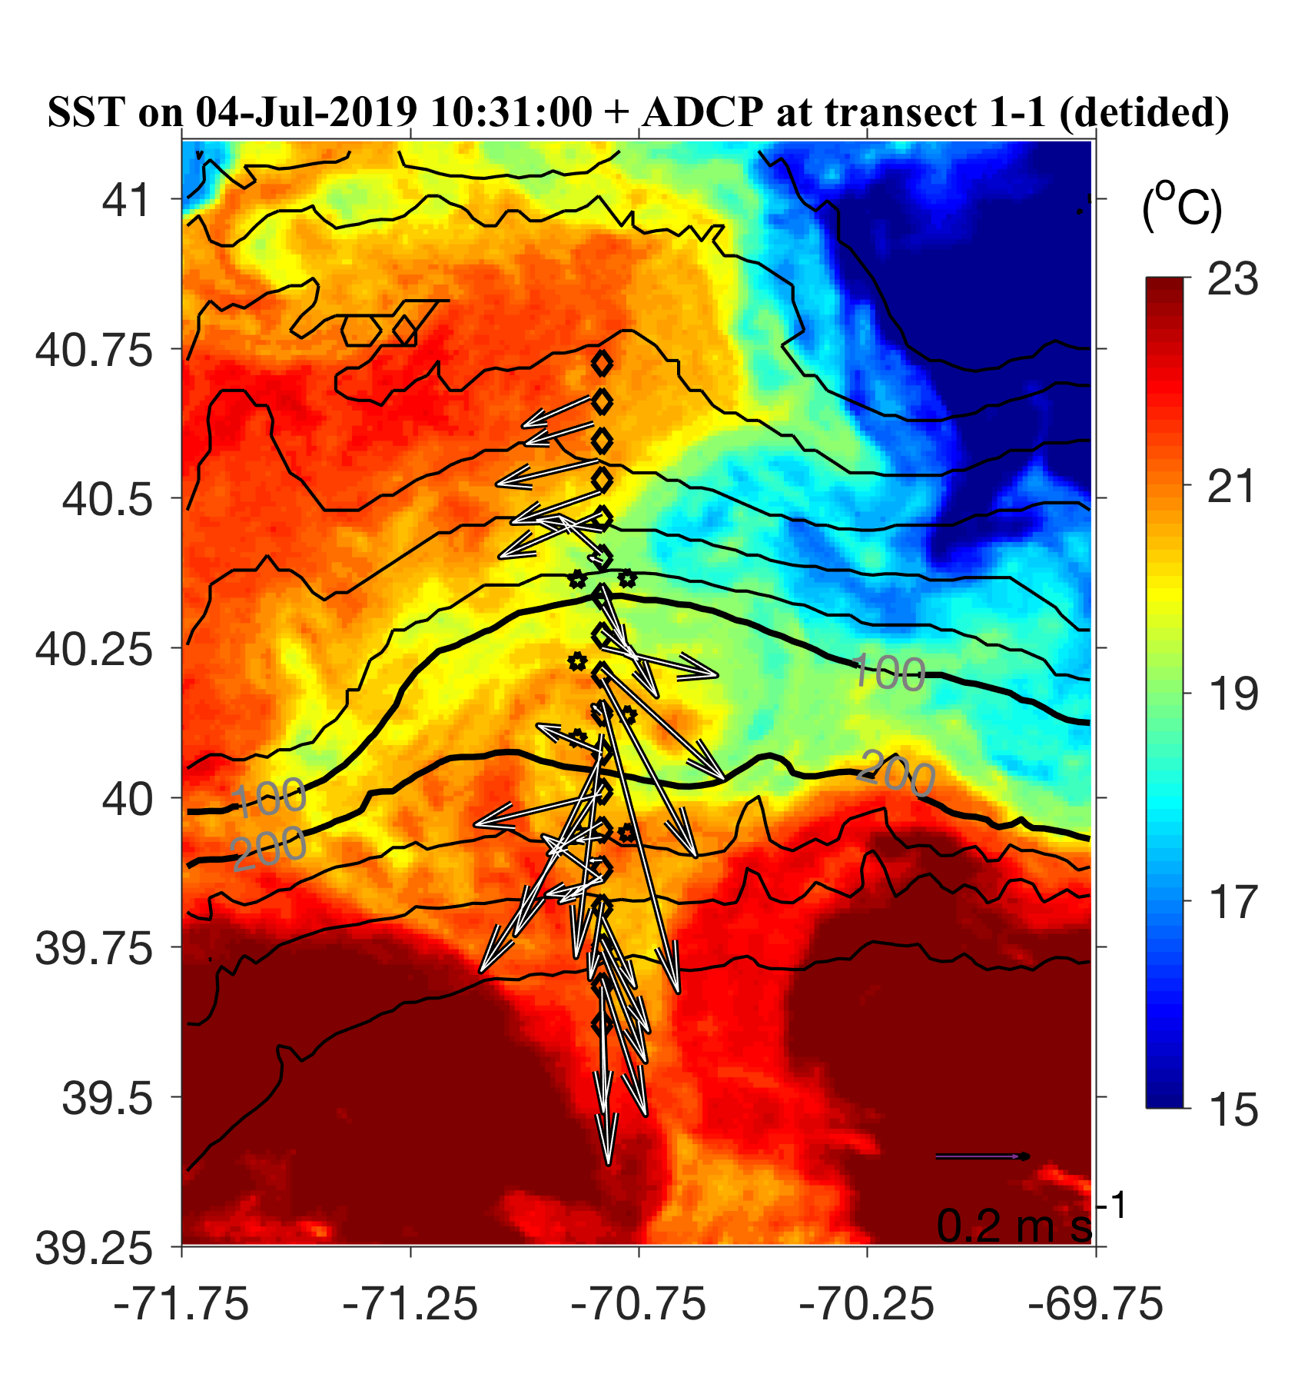
July 5-6 ADCP overlayed on July 4 SST

Slide 14
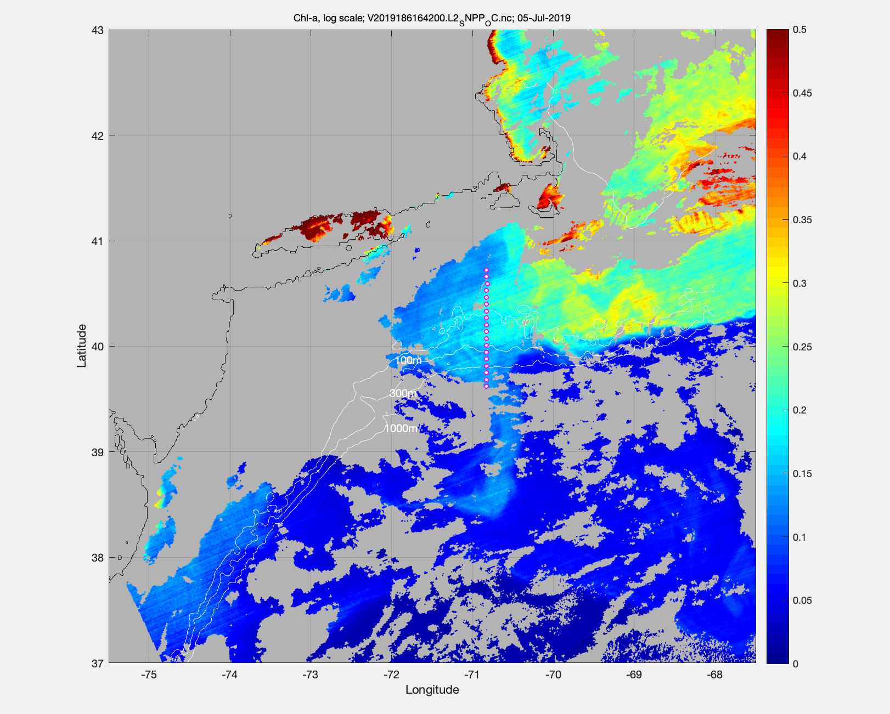
MODIS Chl July 5

Slide 15
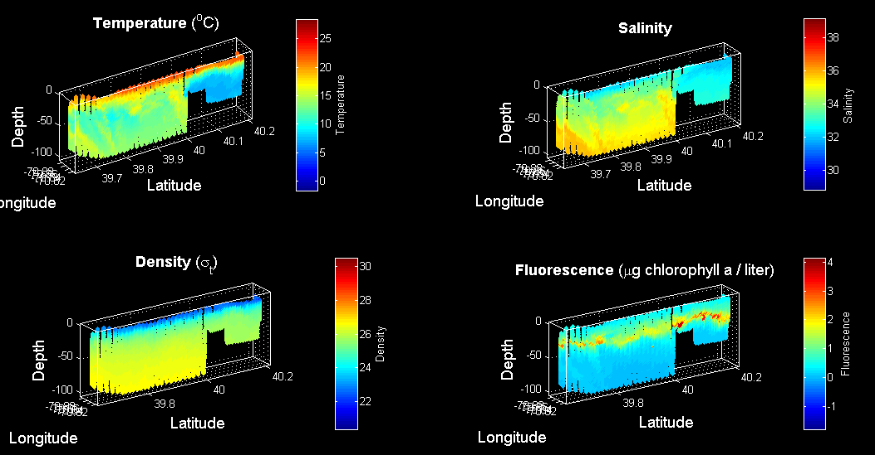
VPR survey July 6

Slide 16
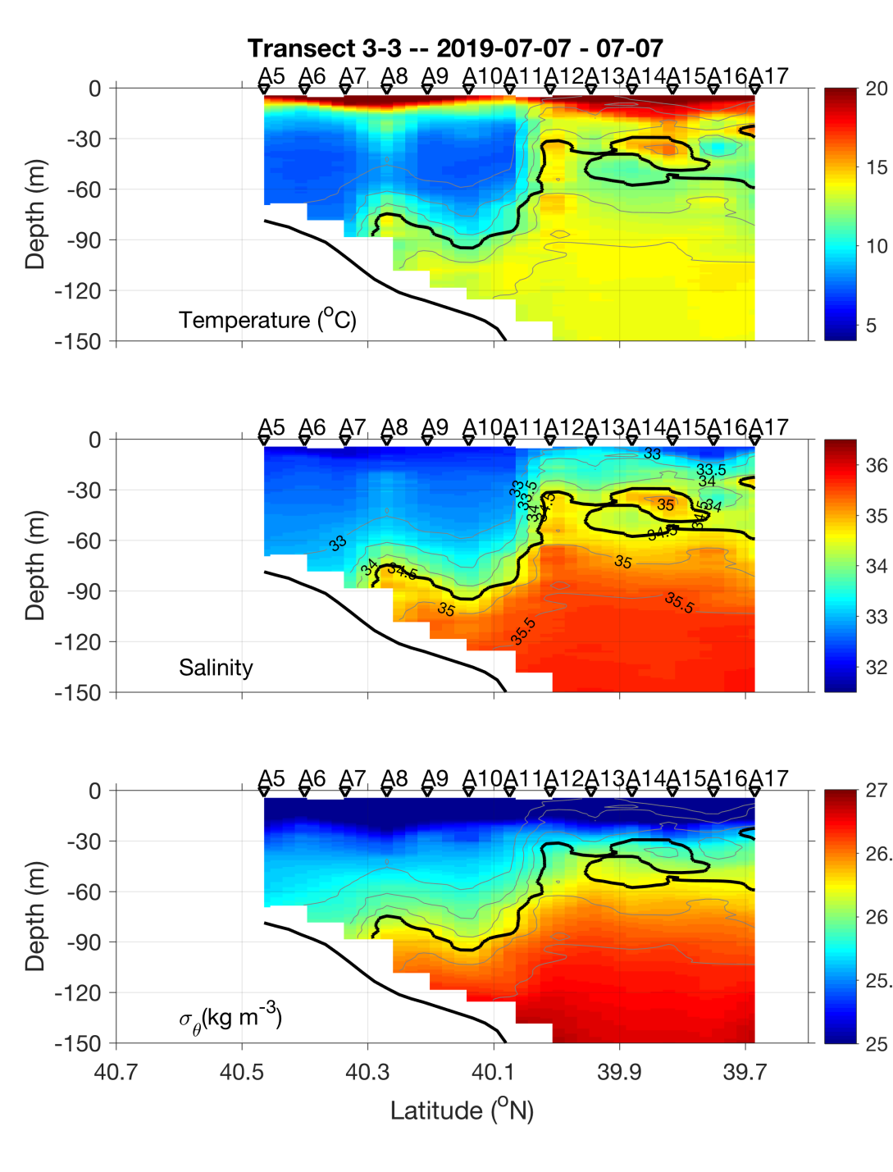
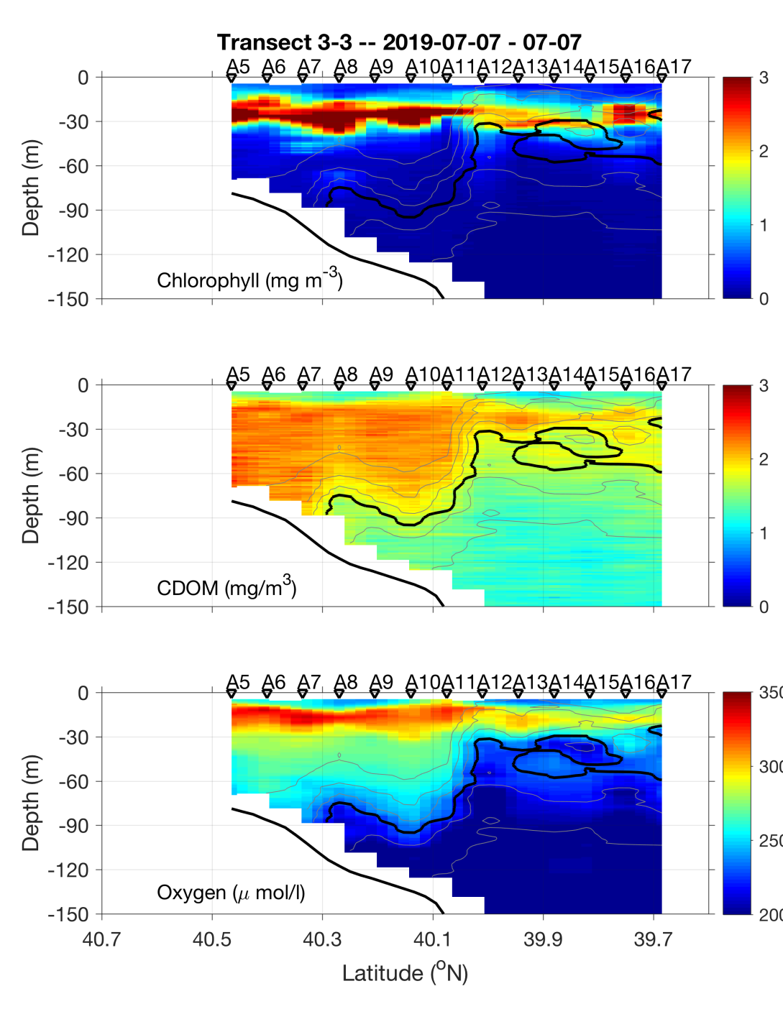
Transect 2 – July 6-7

Slide 17
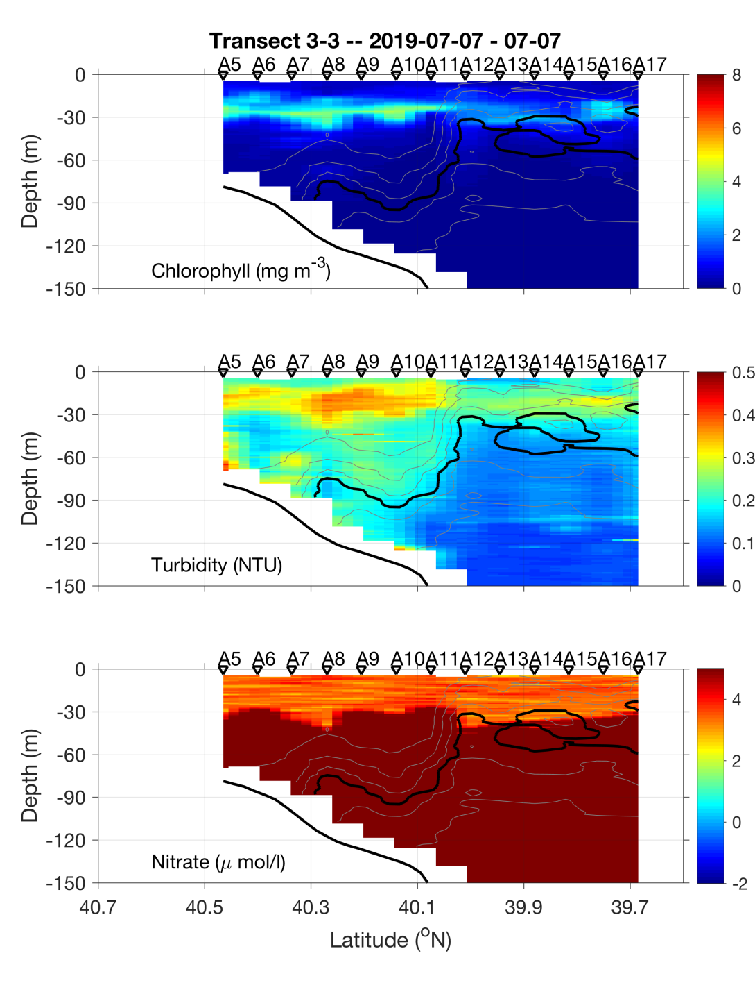
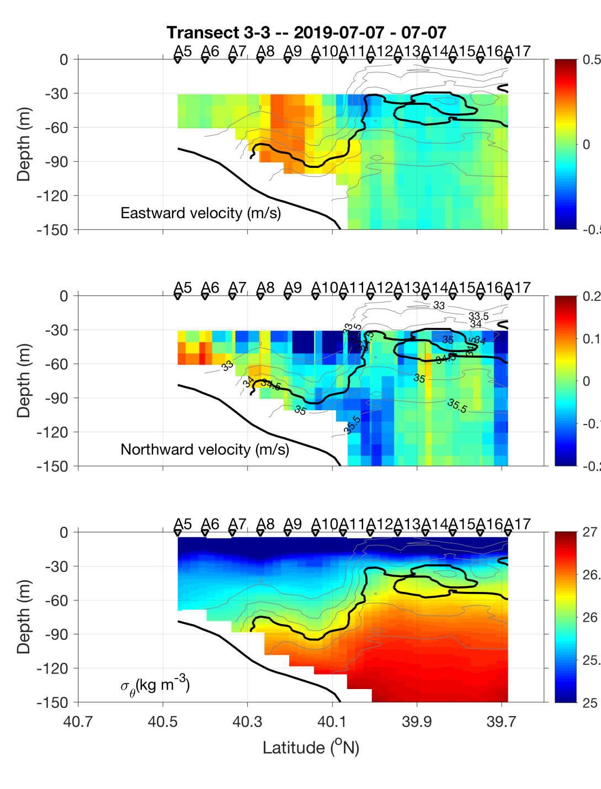
Transect 2 – July 6-7

Slide 18
VIIRS Chl June 23 MODIS Chl July 6

Slide 19
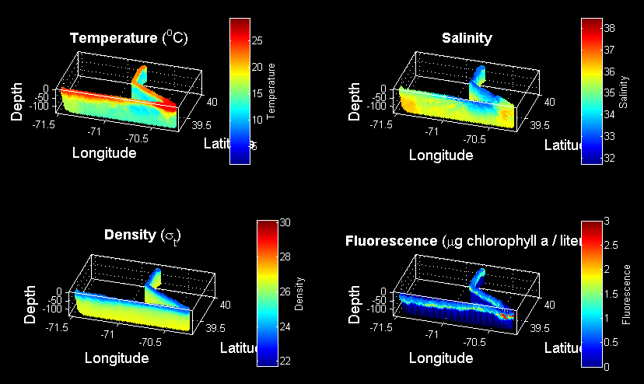
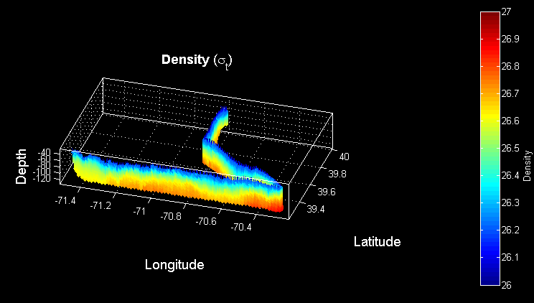
VPR Survey July 7-8
Density

Slide 20
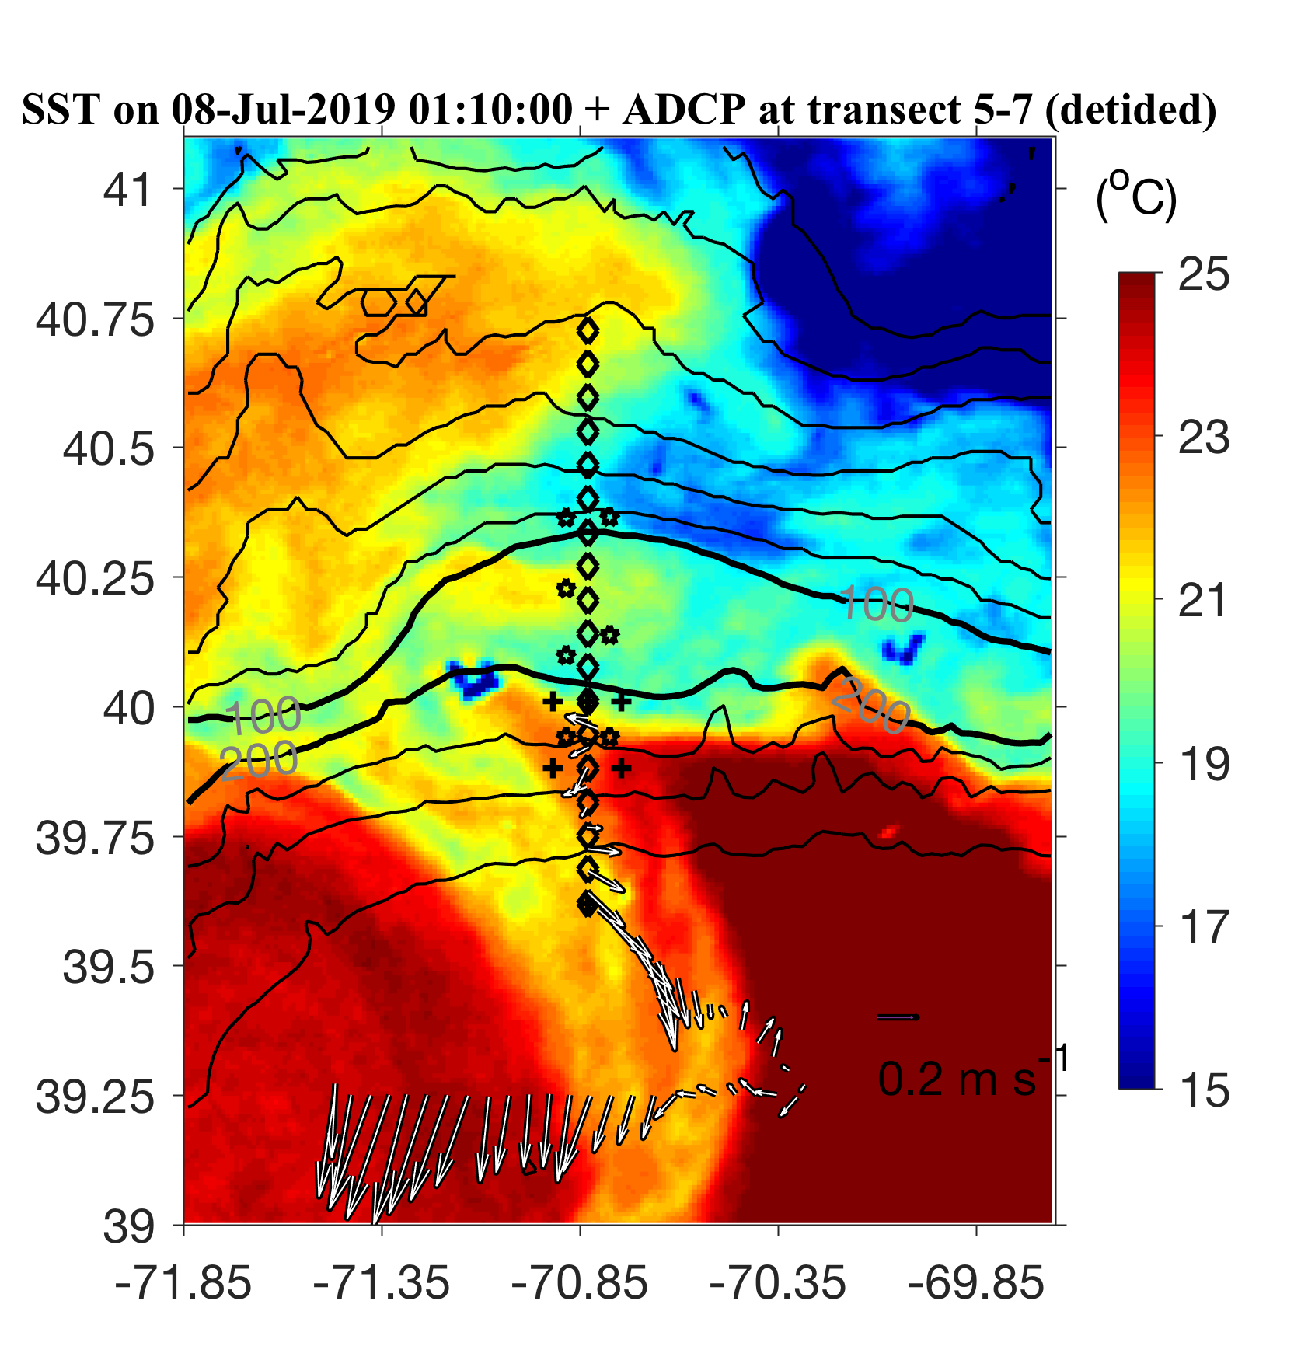
ADCP from VPR survey

Slide 21
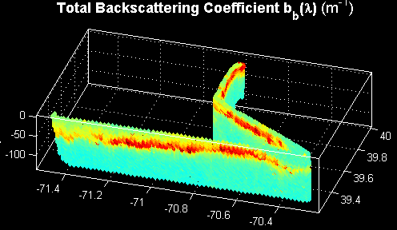


VPR Survey July 7-8

Slide 23
ADCP from VPR survey

Slide 24
VPR1 Survey July 7-8
Density

Slide 25
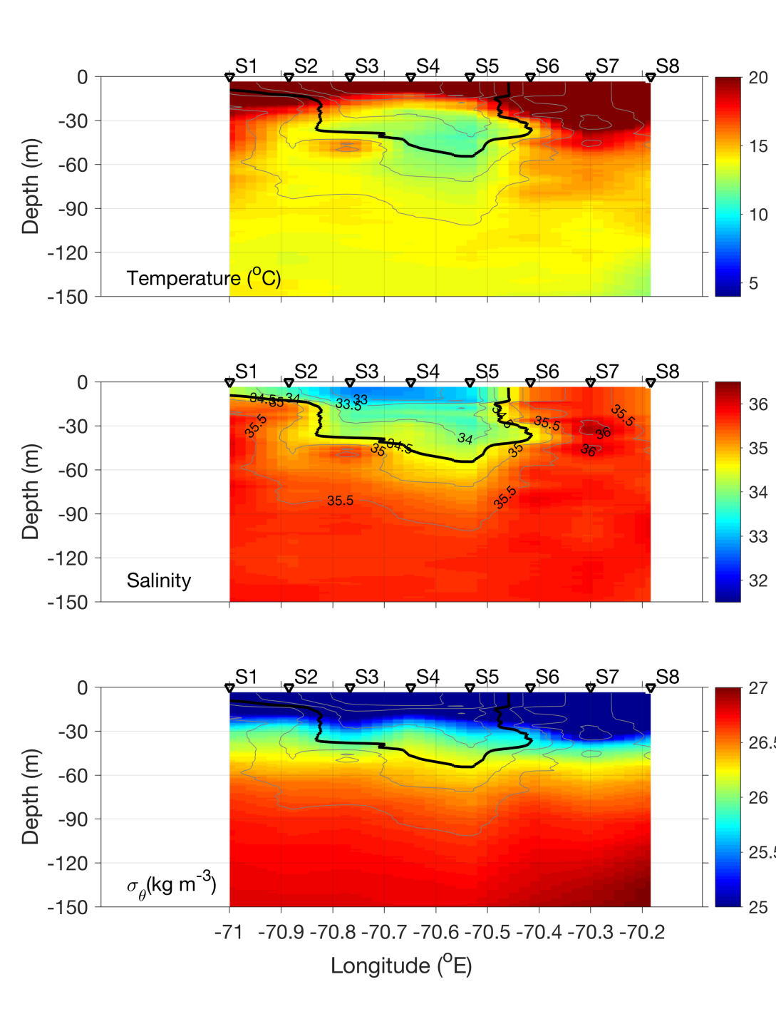
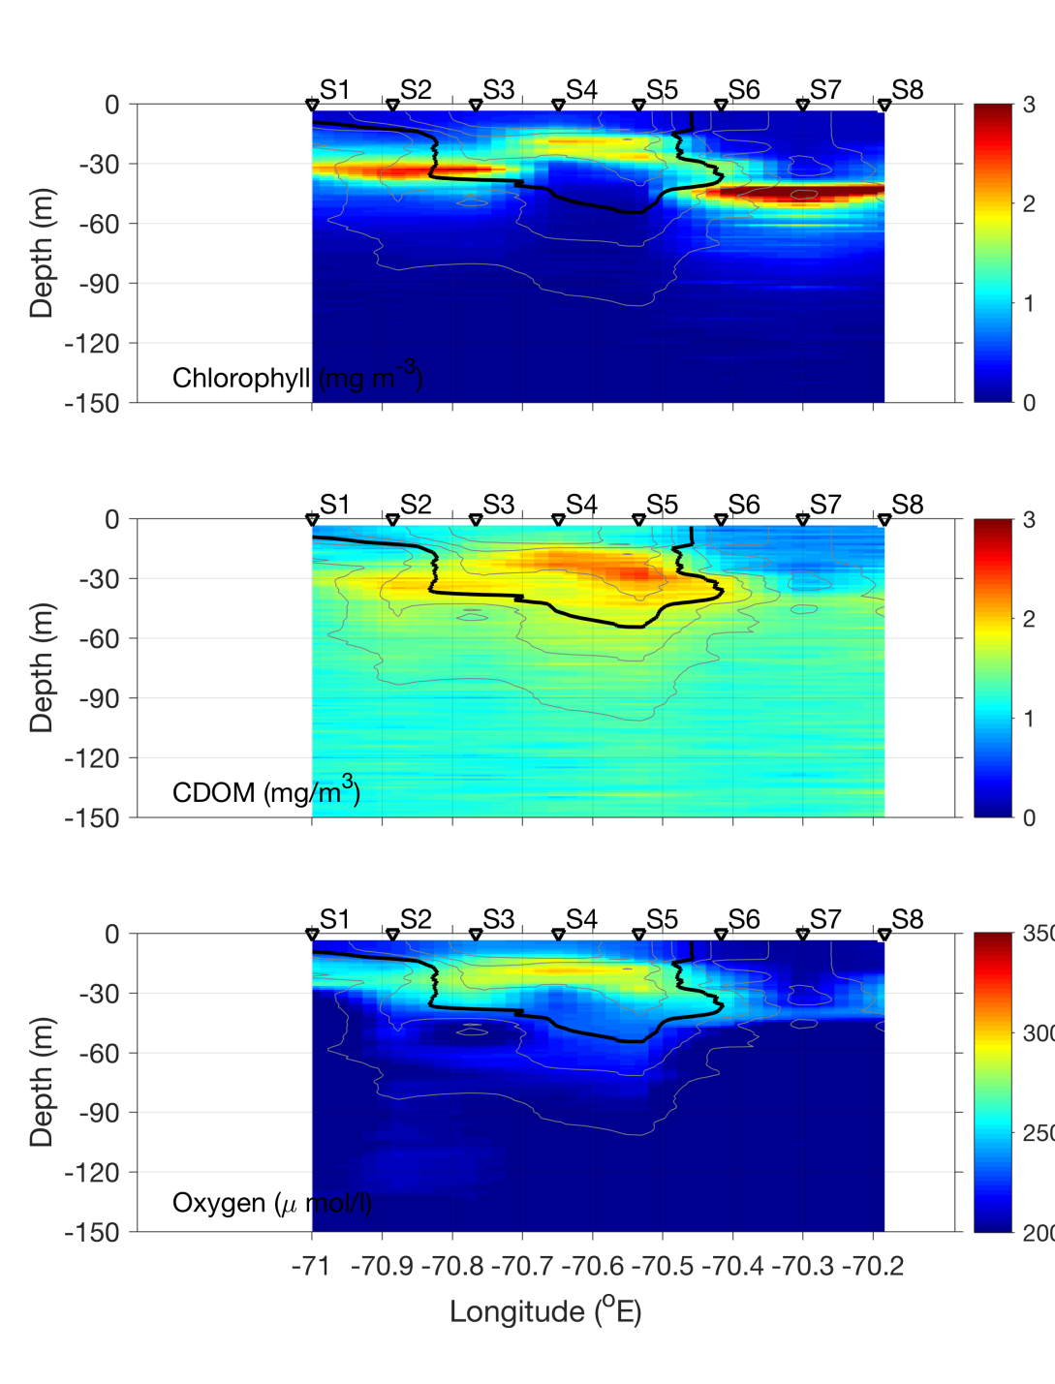
Streamer transect – July 8

Slide 26
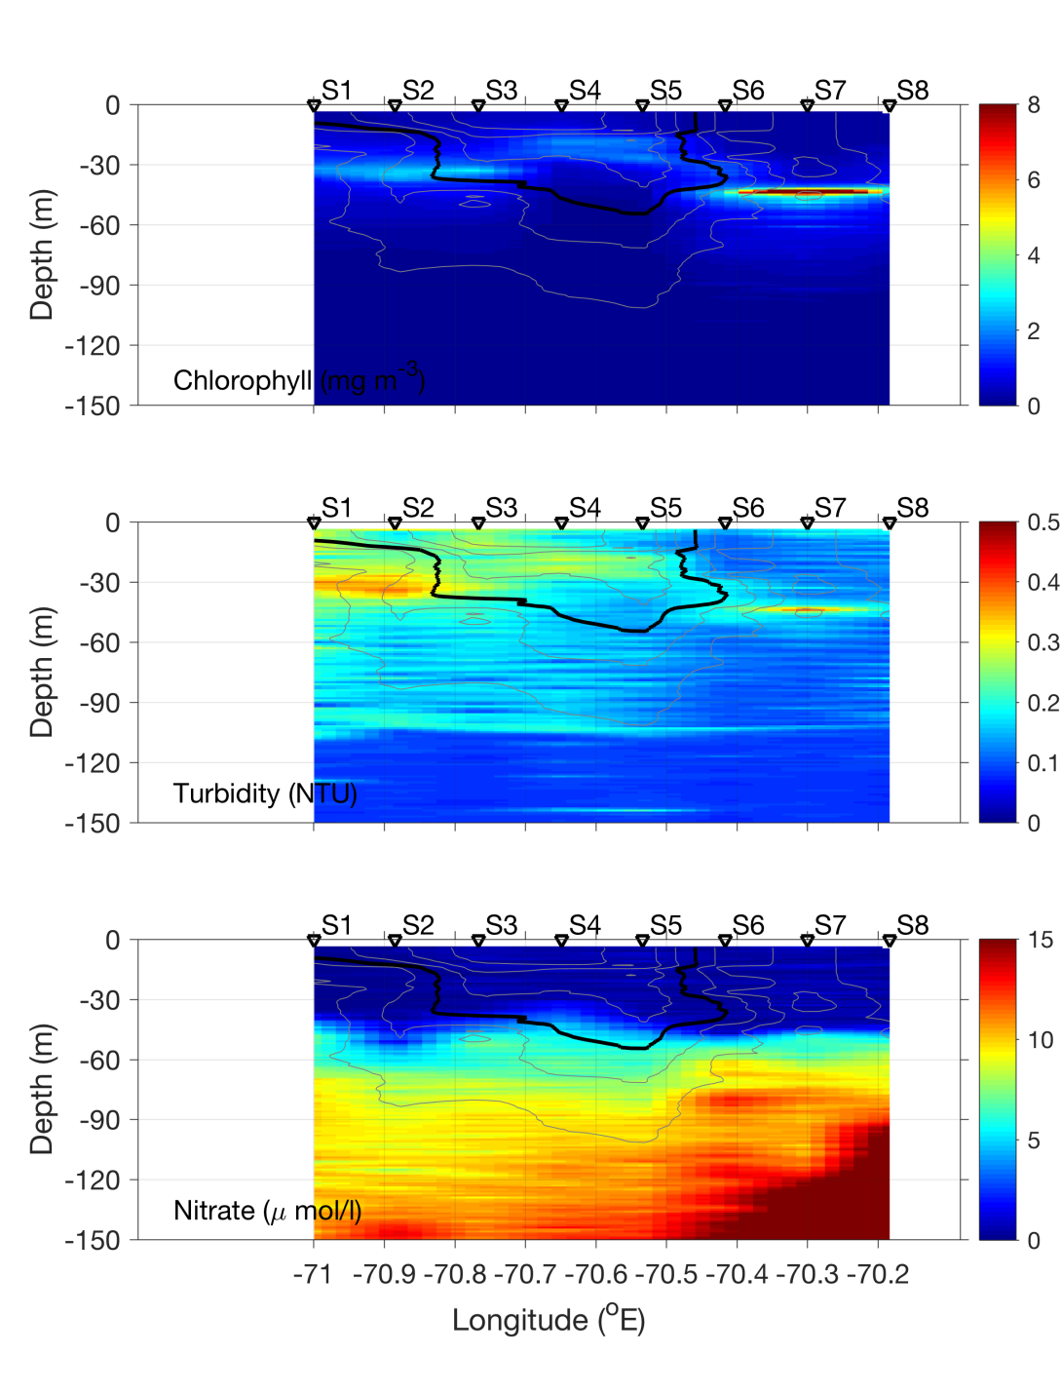
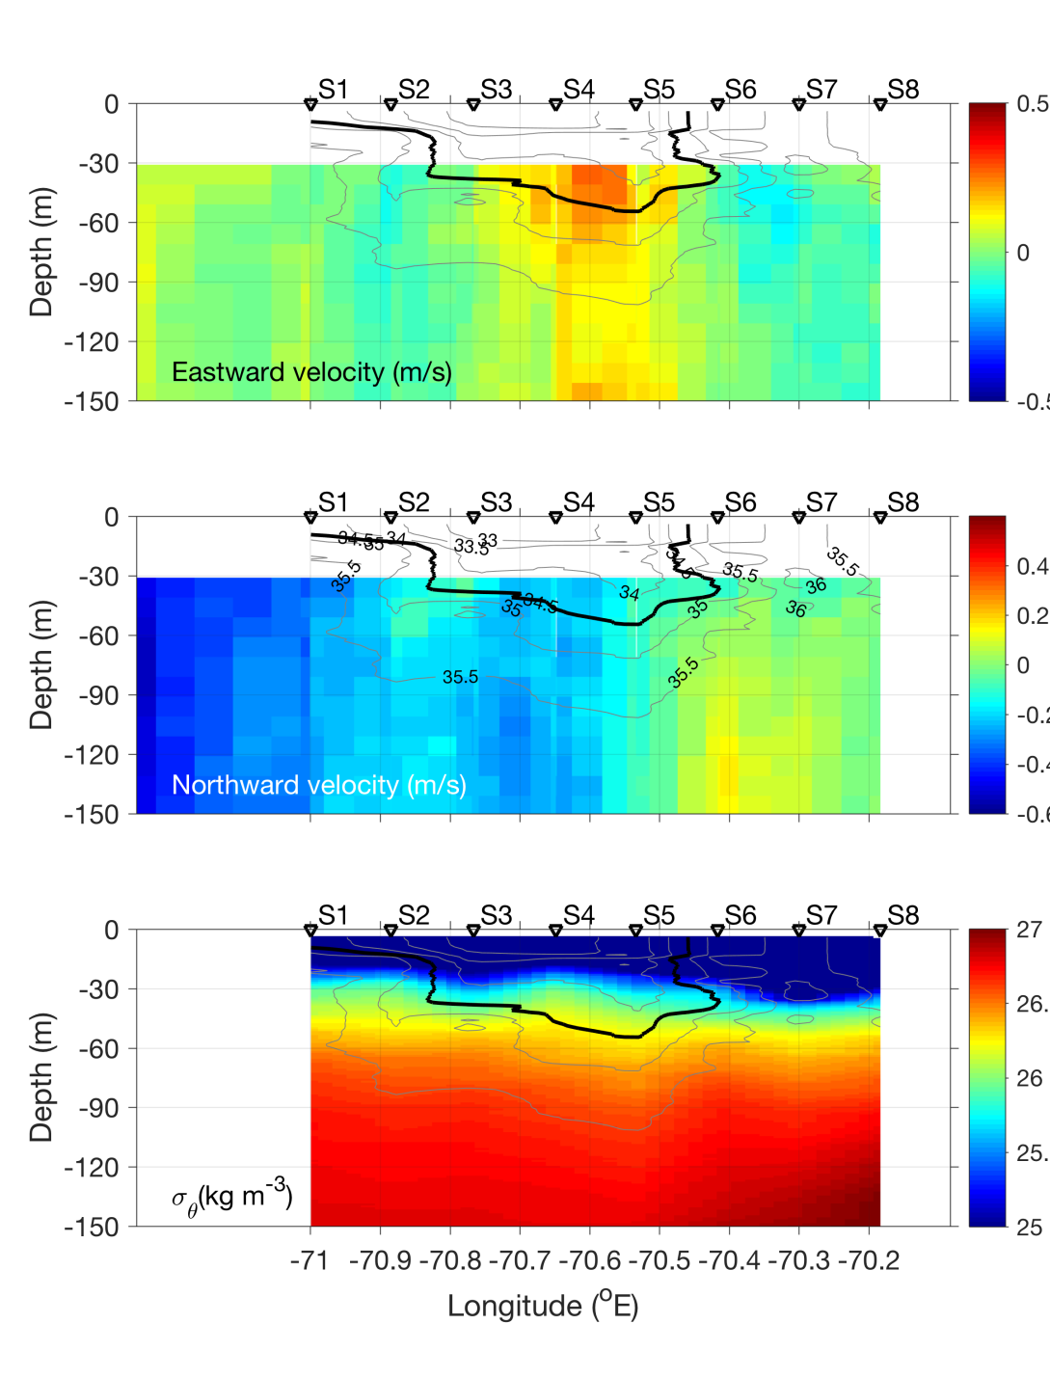
Streamer transect – July 8

Slide 27
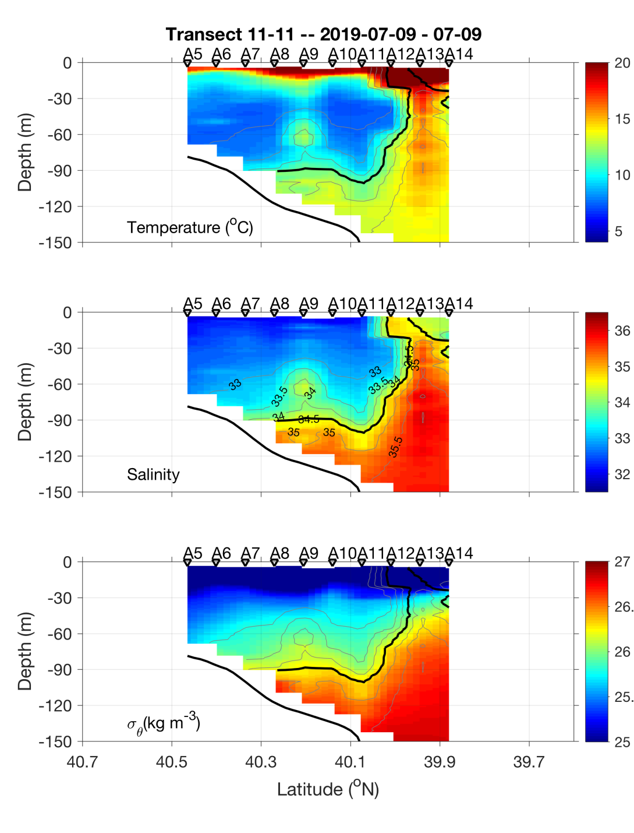
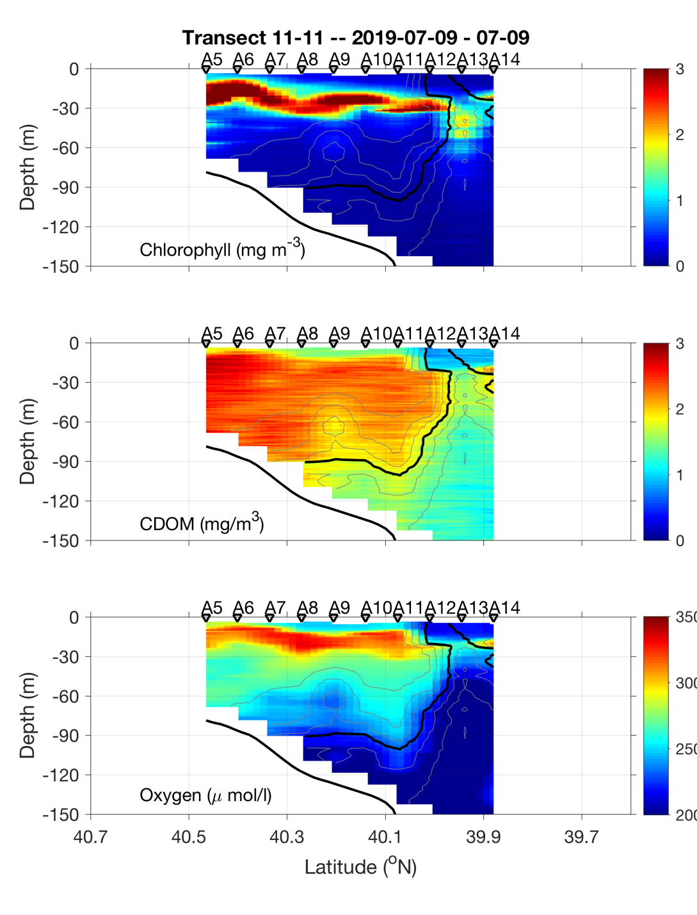
Transect 3 – July 8-9

Slide 28
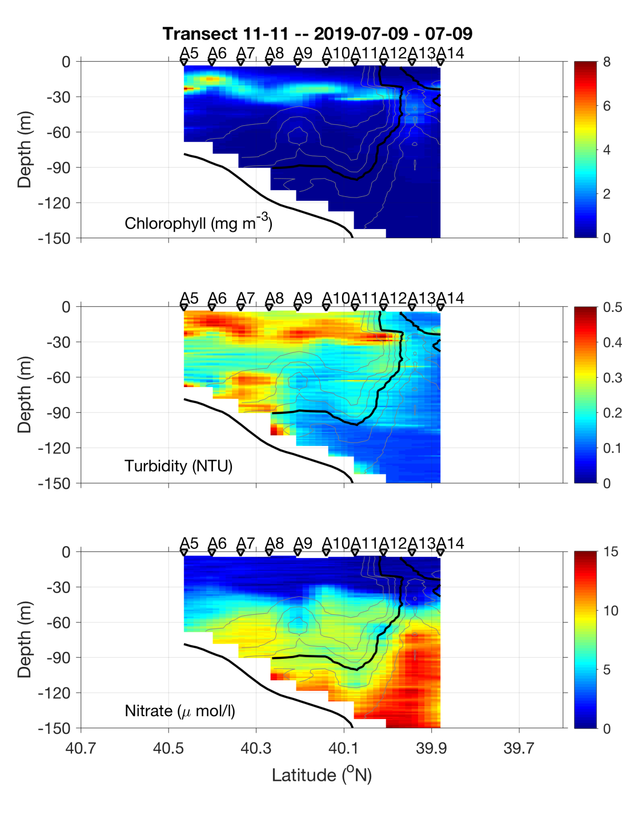
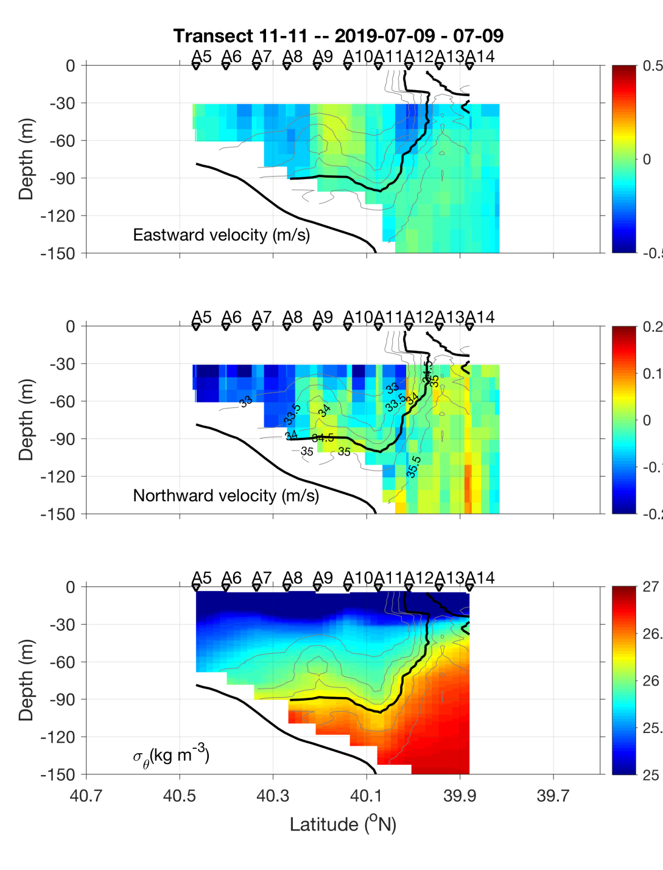
Transect 3 – July 8-9

Slide 29
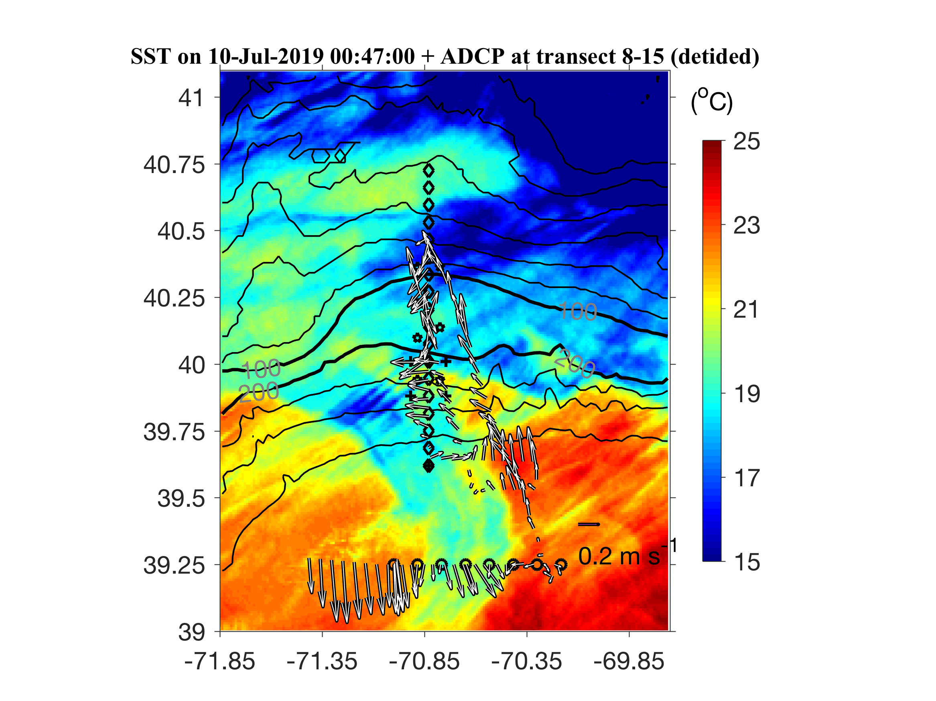
ADCP from VPR survey

Slide 30
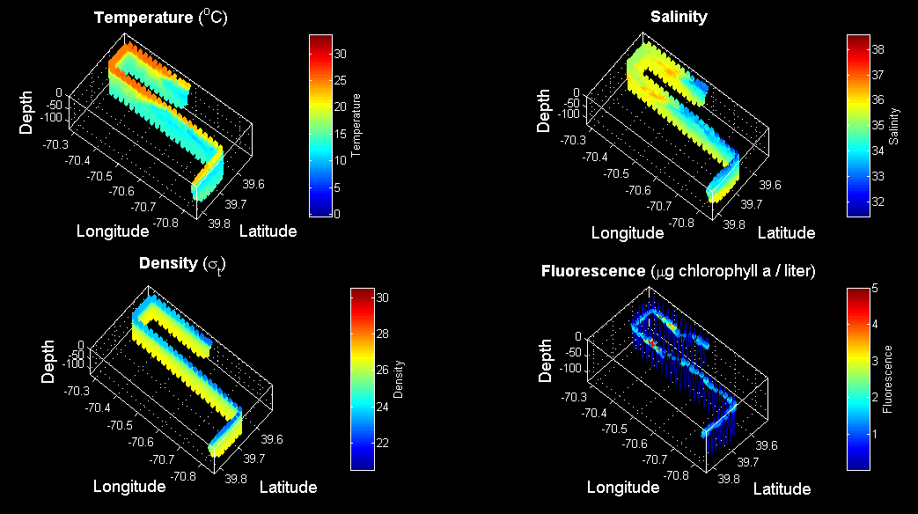
VPR3 Survey July 9

Slide 31
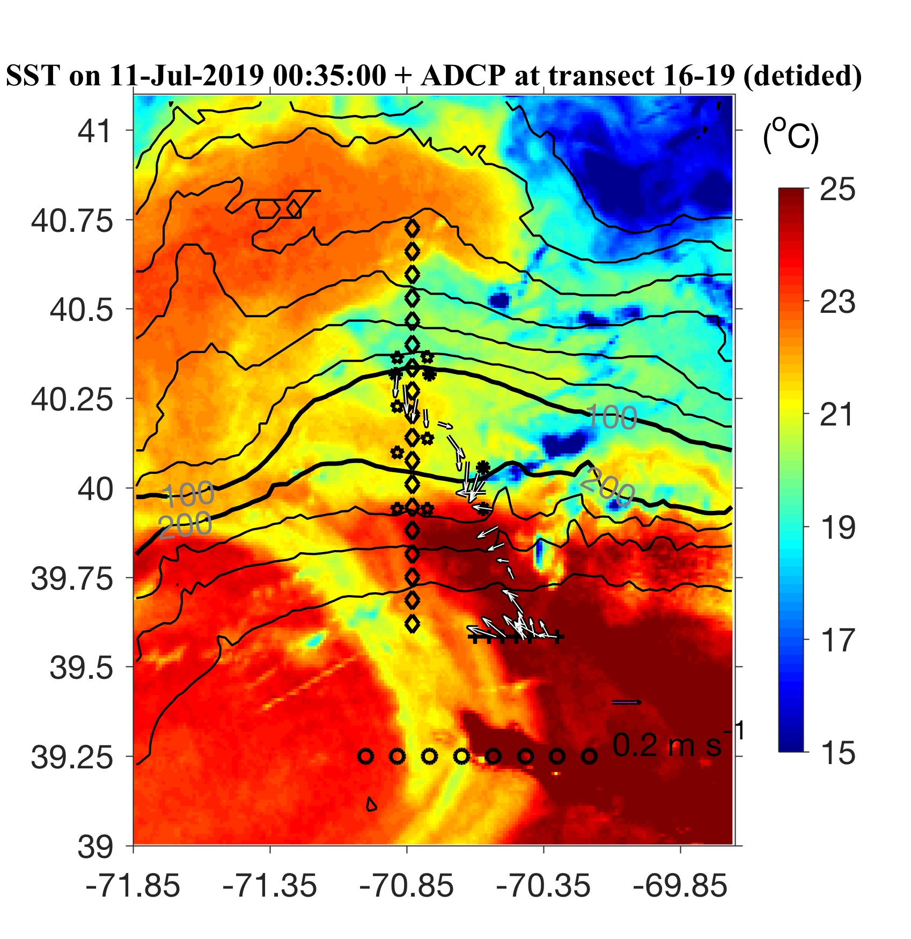
ADCP from Streamer / slope front transect

Slide 32
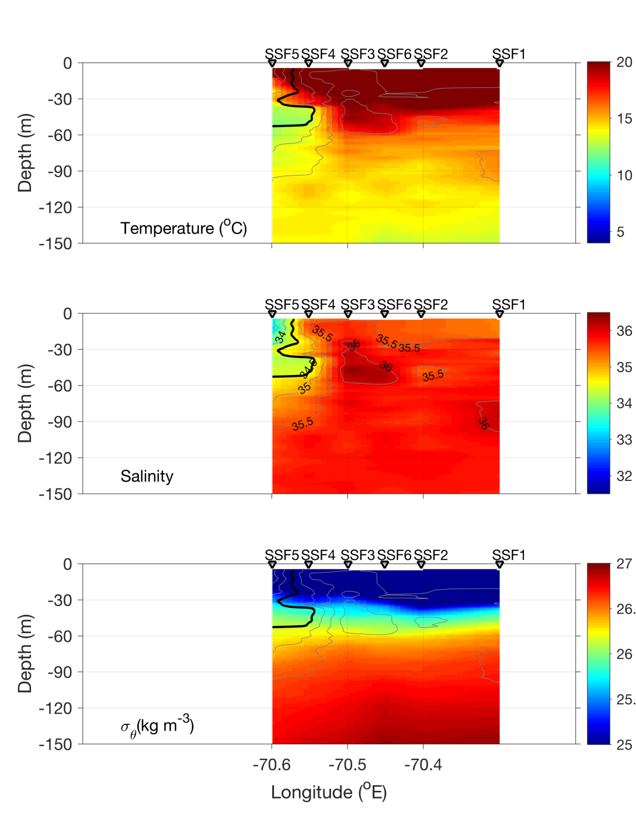
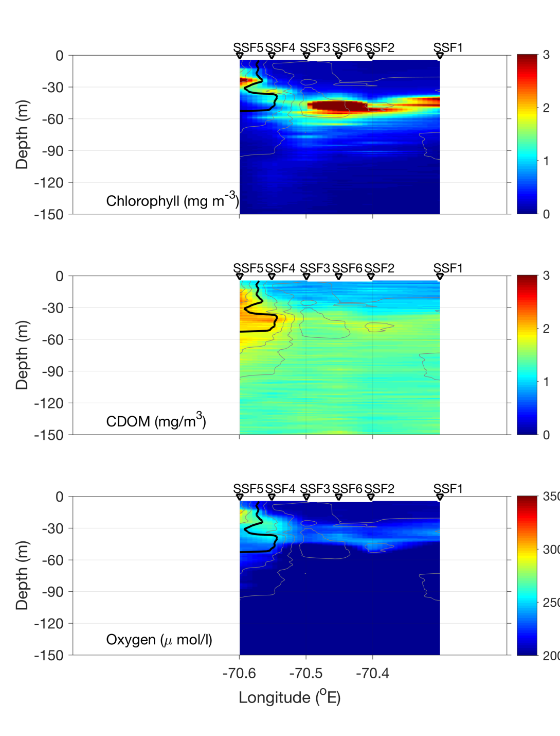
Streamer / slope front transect – July 10

Slide 33
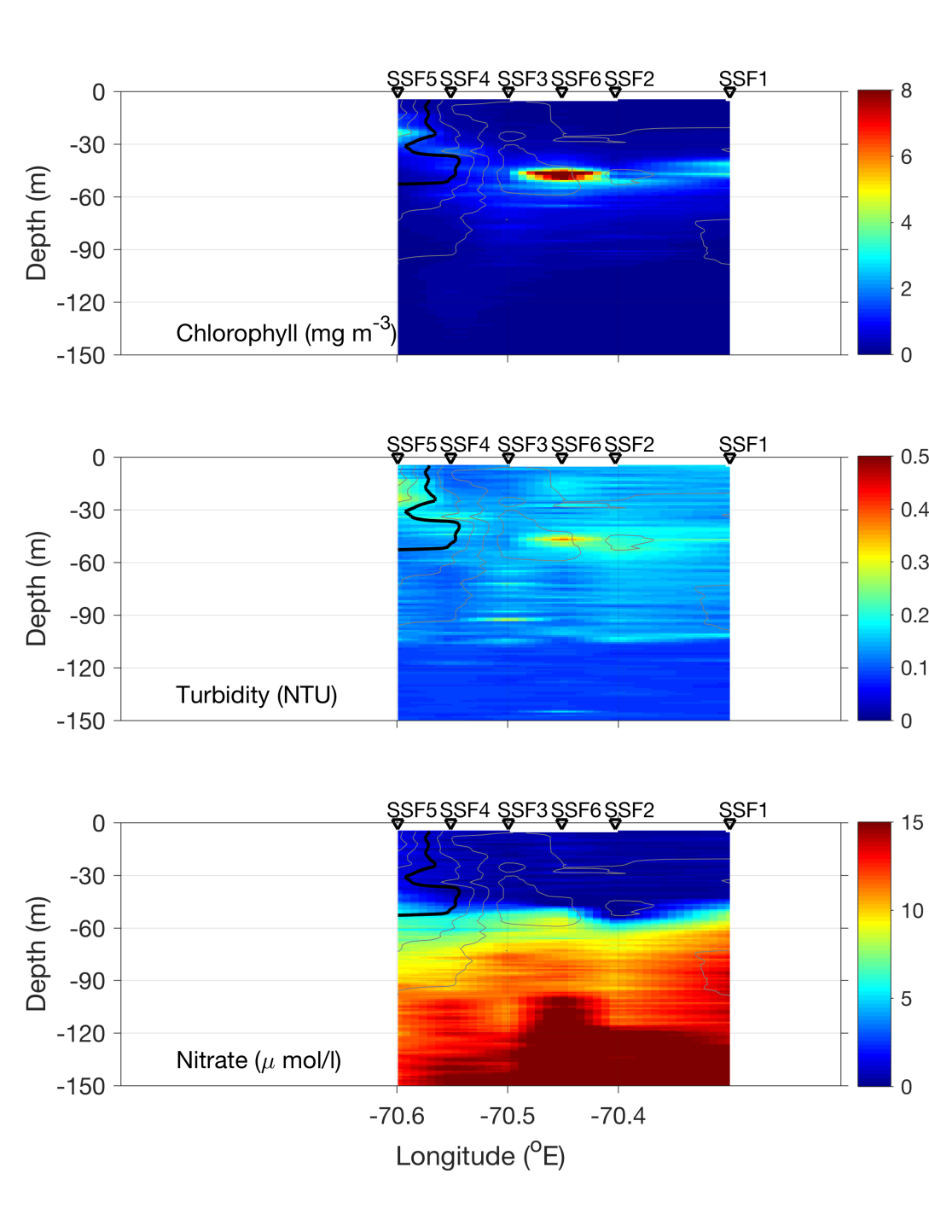
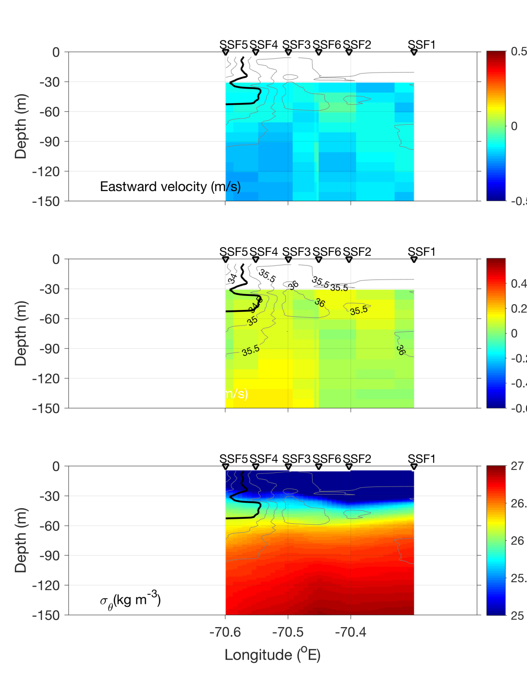
Streamer / slope front transect – July 10

Slide 34
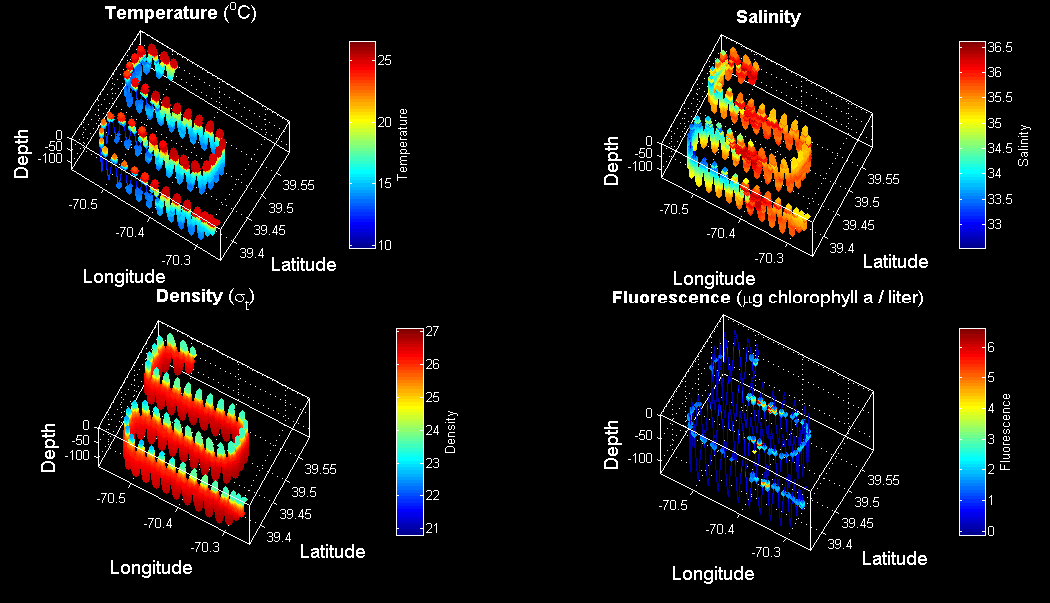
VPR4 July 10-11

Slide 37
Extras

Slide 38

MODIS Chl July 6

