Slide 1
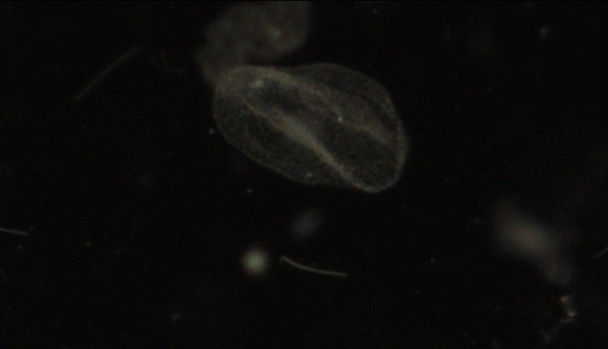
Cross Streamer Transect
(Bottom of Coathanger, not SSF)
Small Copepods
Diatoms Multi

Slide 2
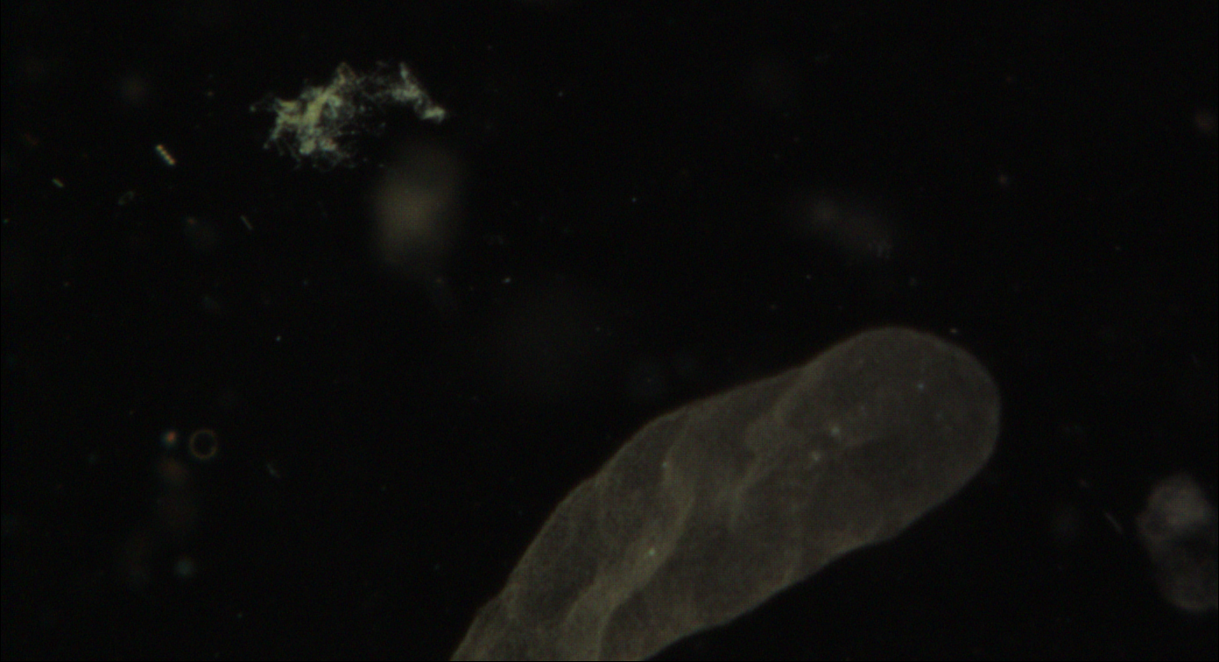
SSF6
A14 Most Recent Station

