Slide 1
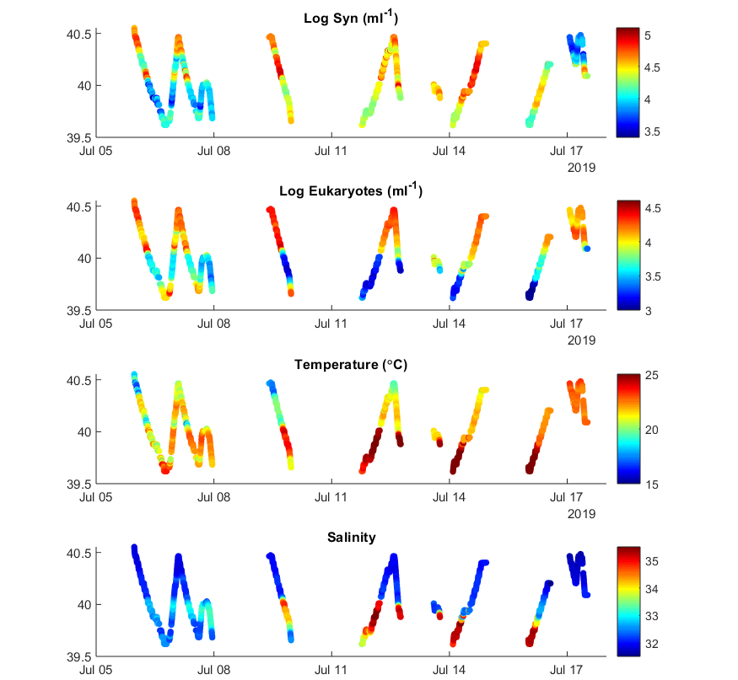
Underway sampling
along main transect

Slide 2
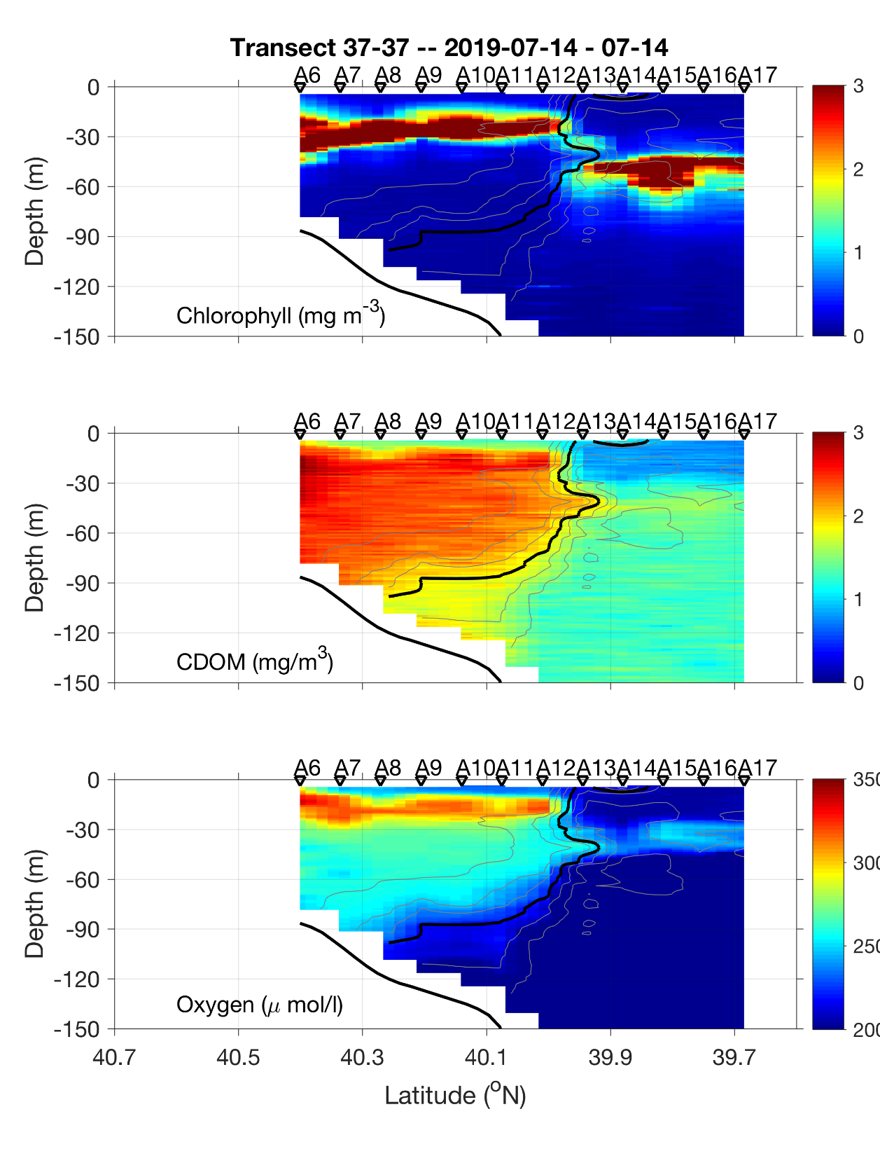

Slide 3
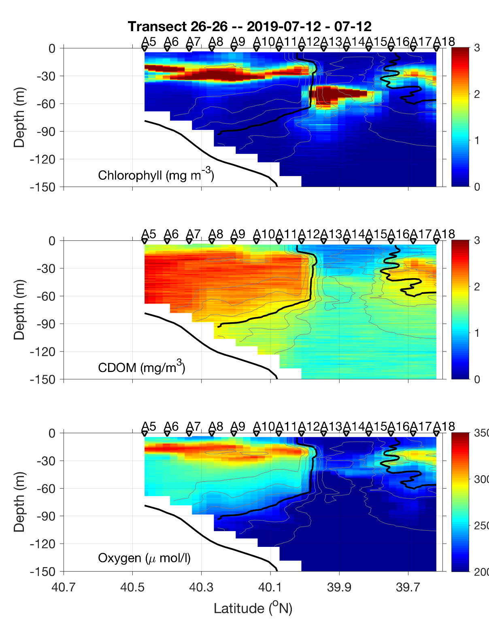

Slide 4
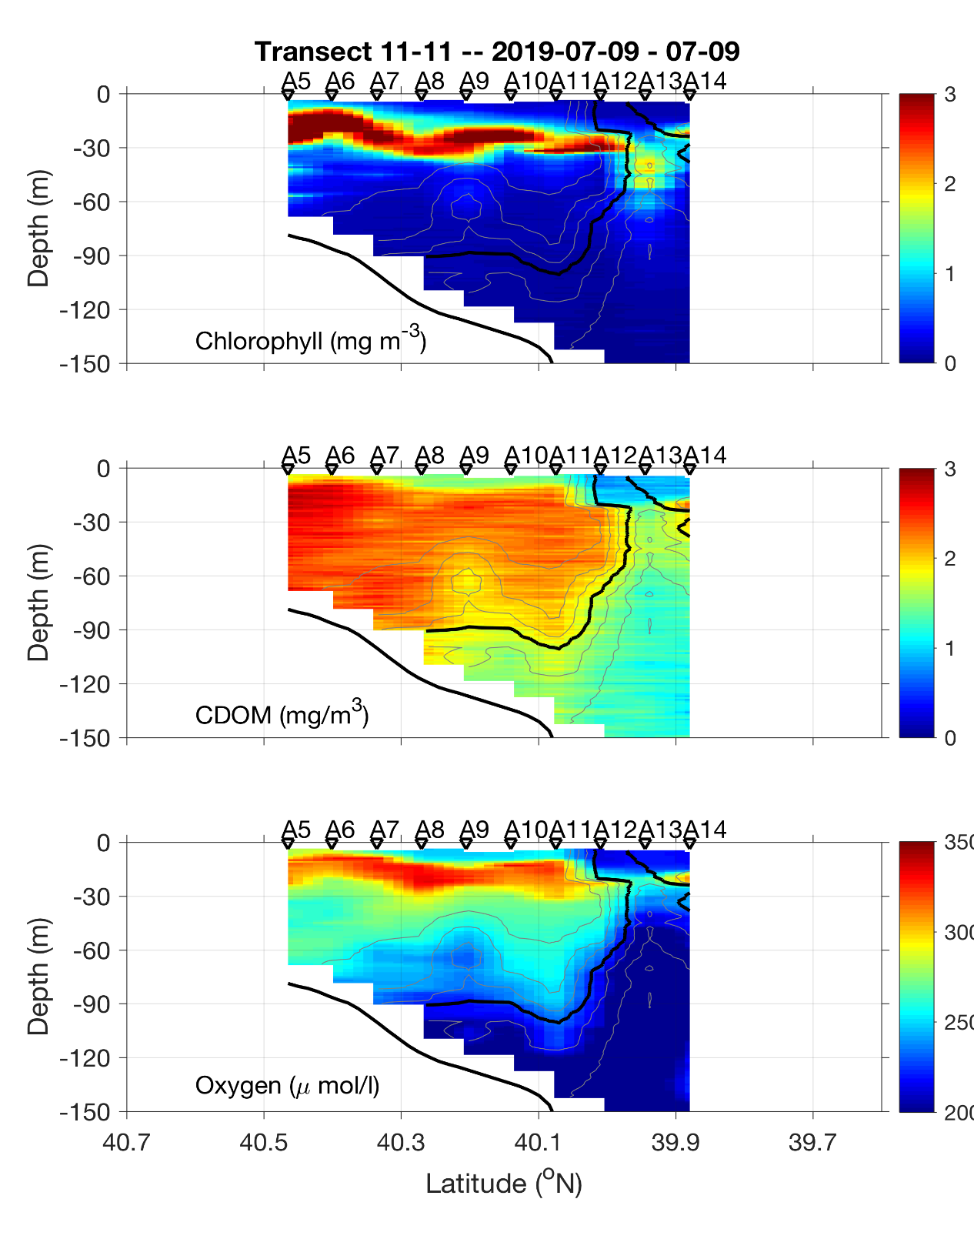

Slide 5
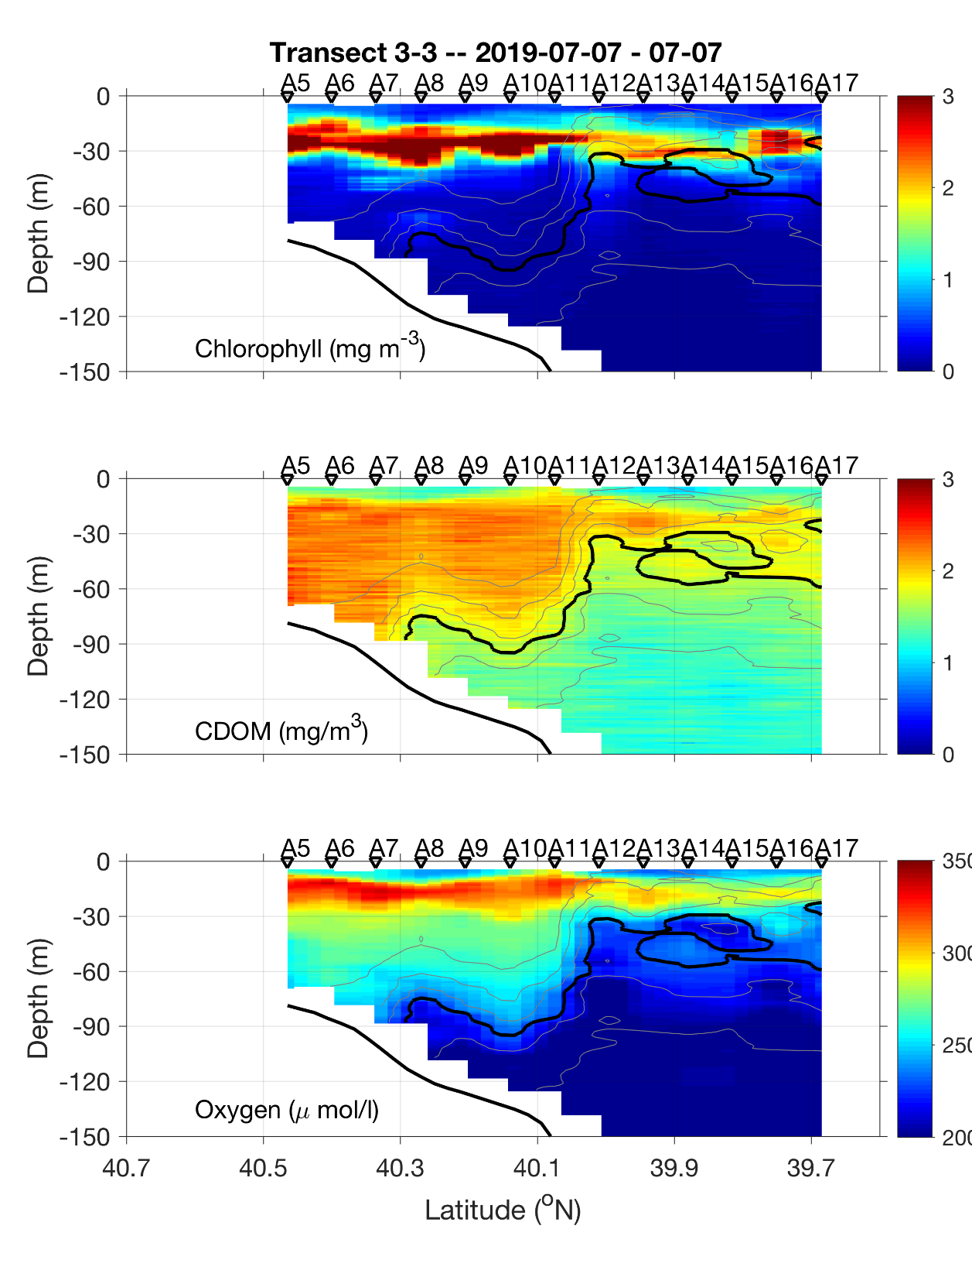

Slide 6
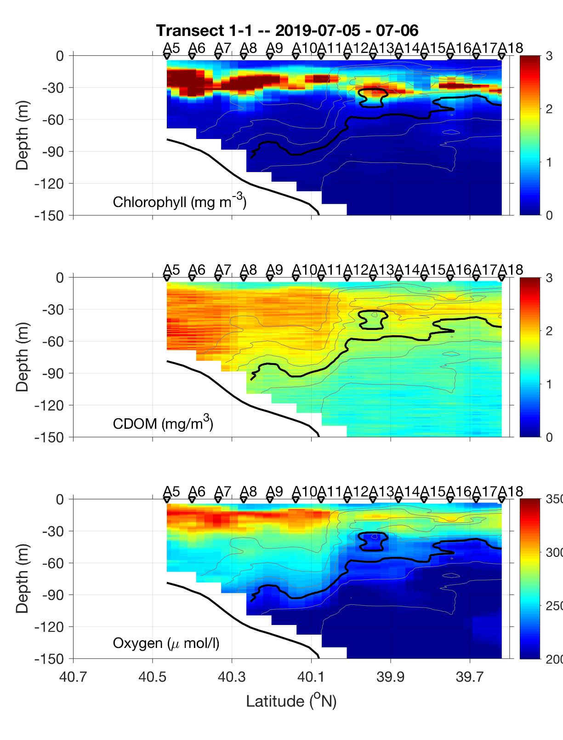

Slide 7
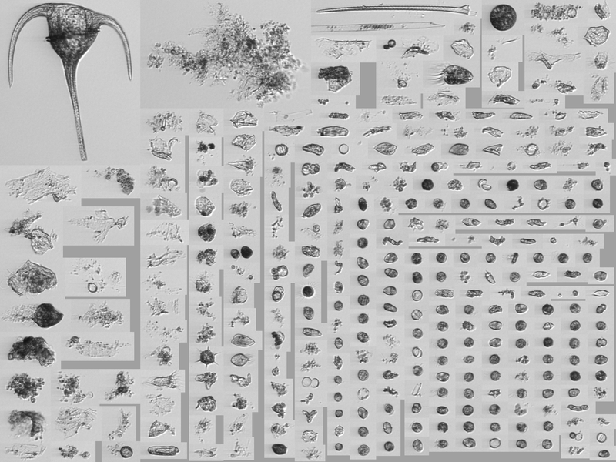
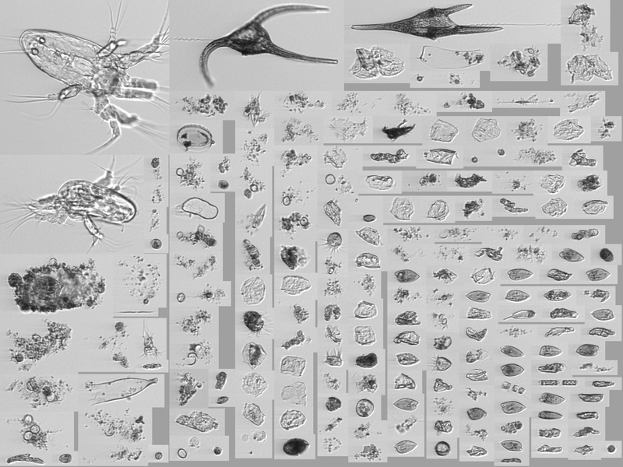
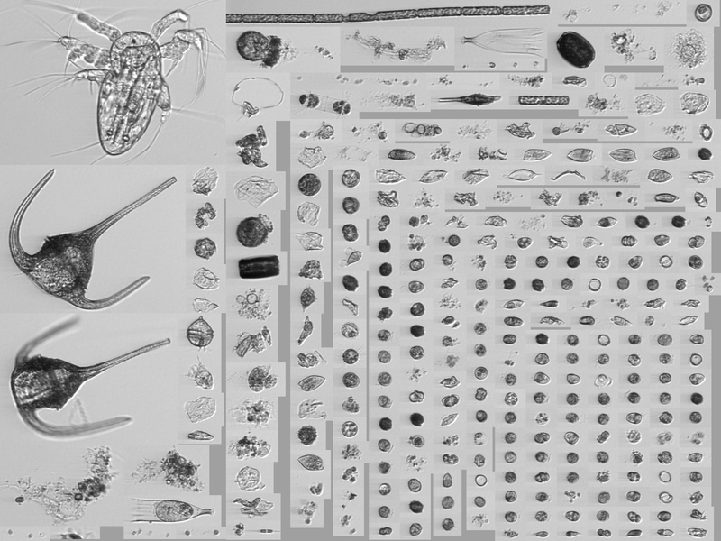
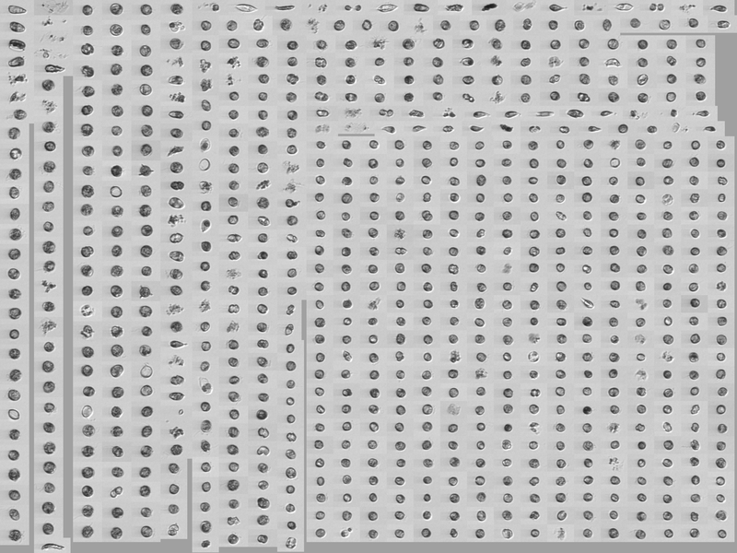
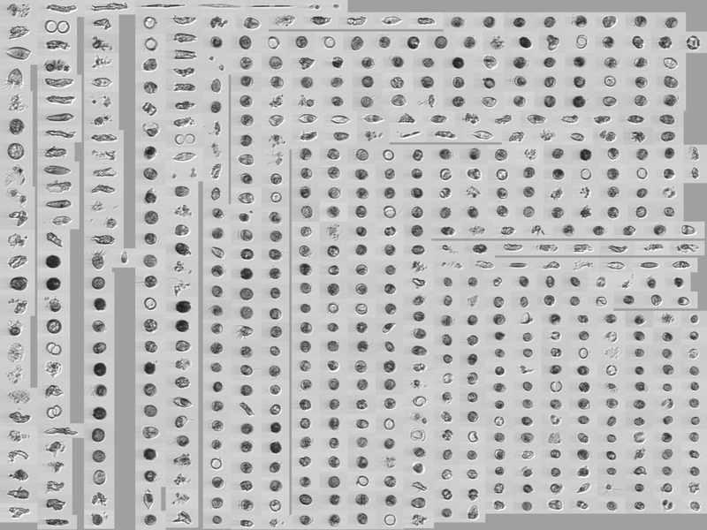
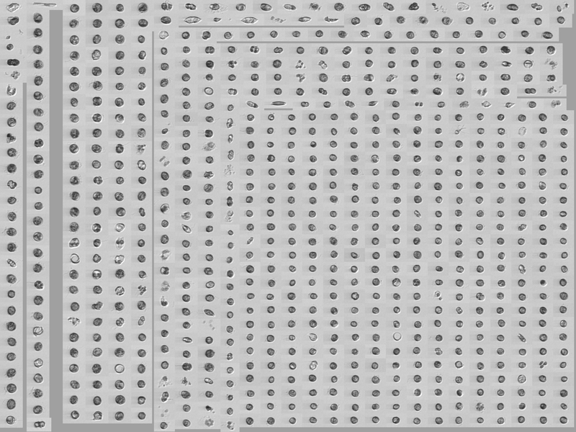
Chlorophyll Max- Shelf Water
A10
High concentrations
Small Cells
Relatively Round
July 6, 30 m
July 9, 47 m
July 12, 28 m

Slide 8
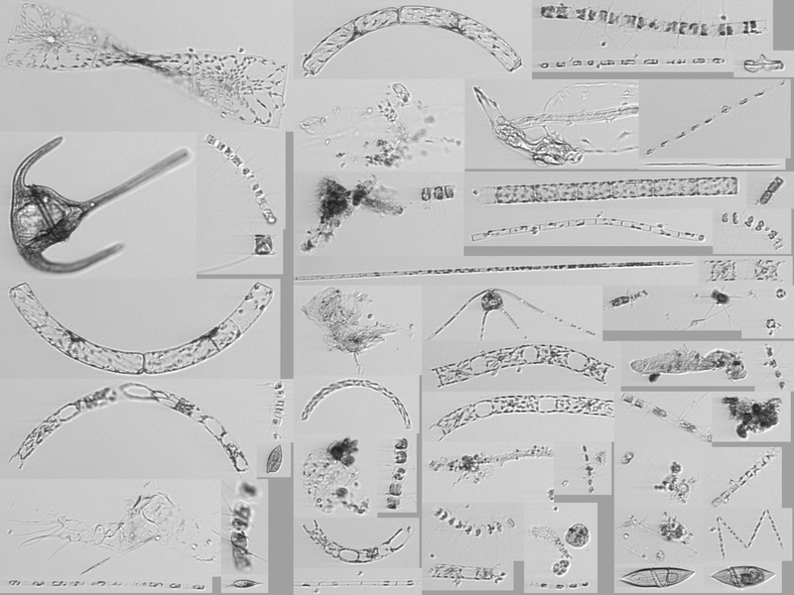
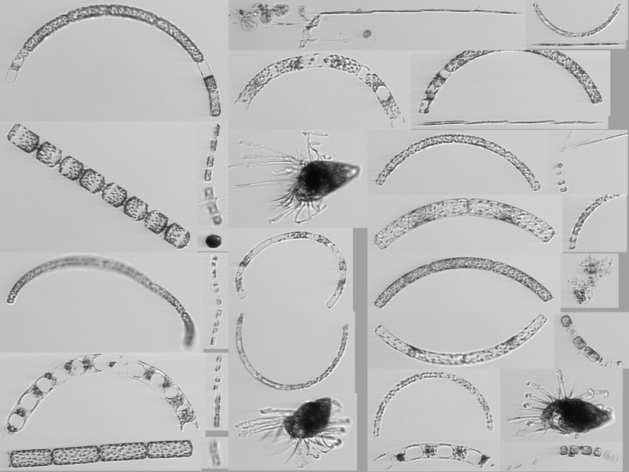
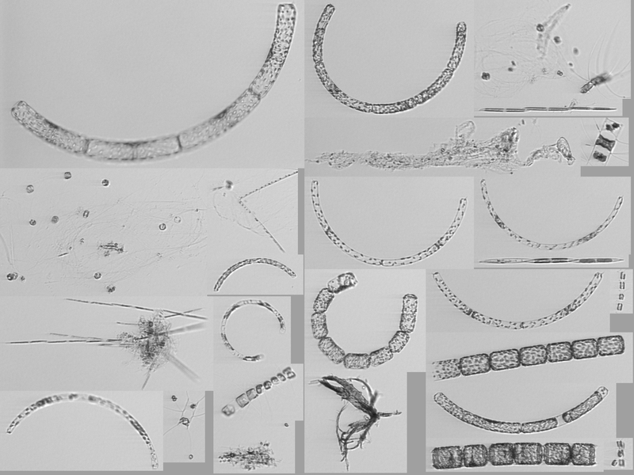
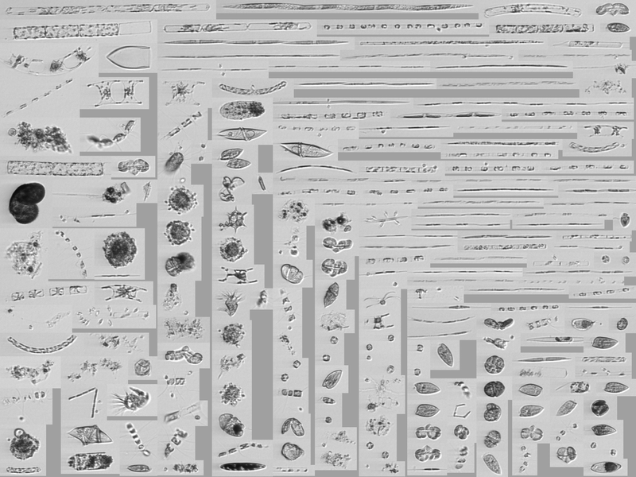
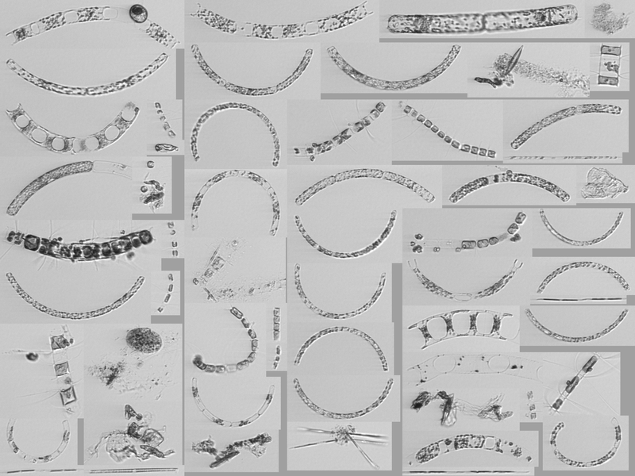
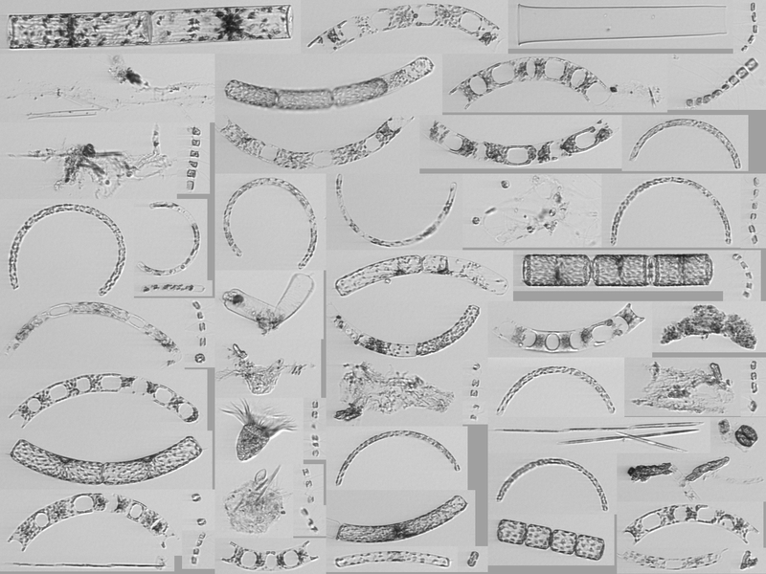
Chlorophyll Max- Slope Water
A14
High concentrations
Larger Cells
More Elongated cells
Variety of Diatom Chains
July 9, 20 m
July 12, 40 m
July 14, 49 m

Slide 9
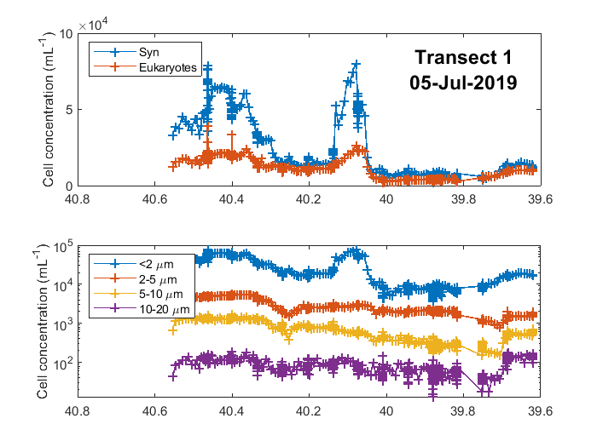
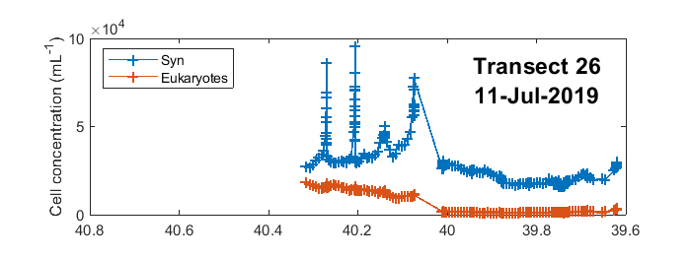
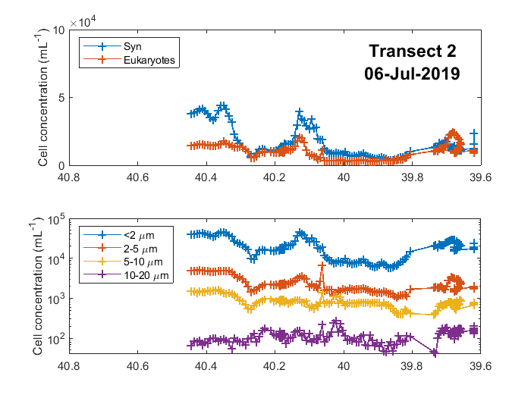
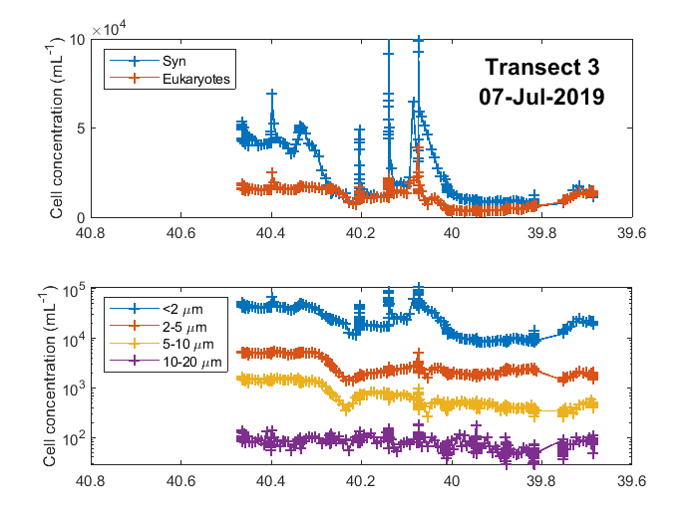
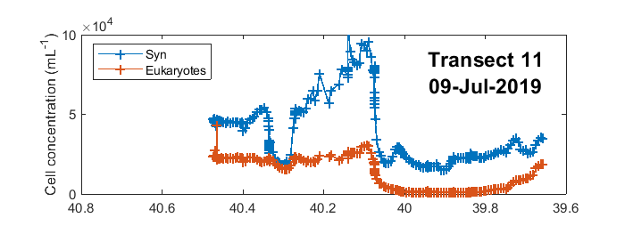

Slide 10
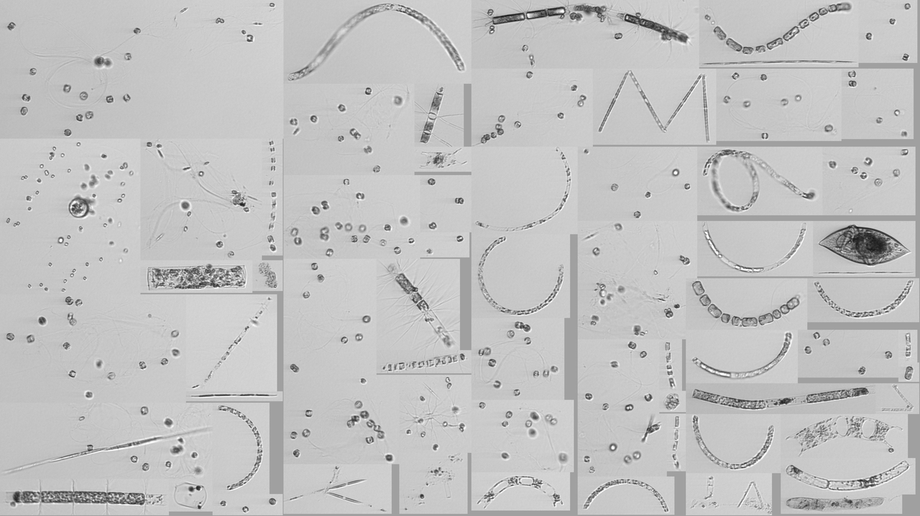
Diatom hotspot
D20190711T011510_IFCB129 C62, N15, 42 m, 3.36 ml

Slide 11
VPR tow
roi.8451536500.tif

Slide 12
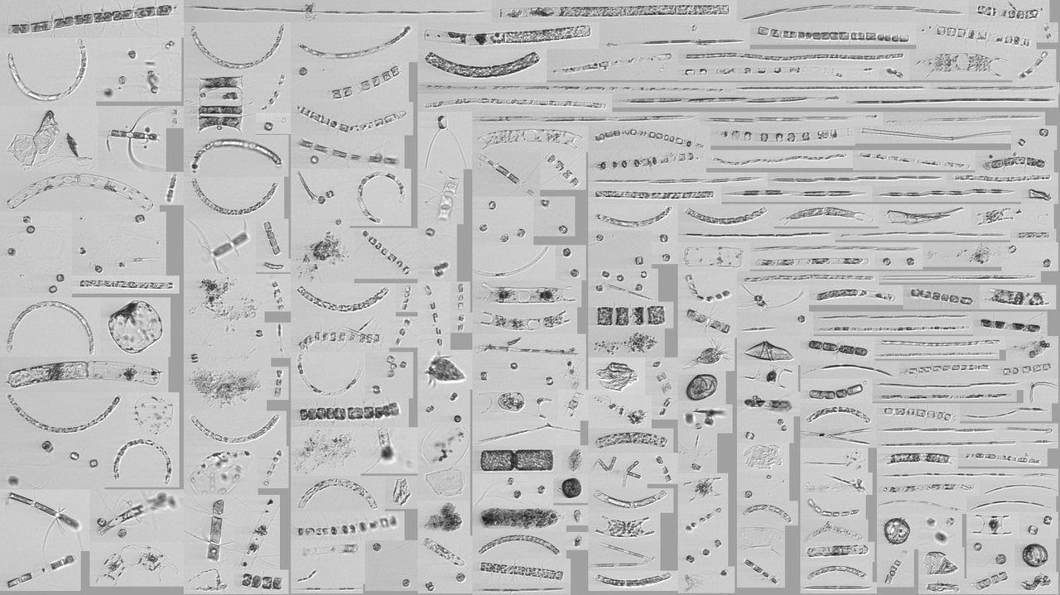
Diatom hotspot
D20190711T011510_IFCB129 C62, N15, 42 m, 3.36 ml

Slide 13
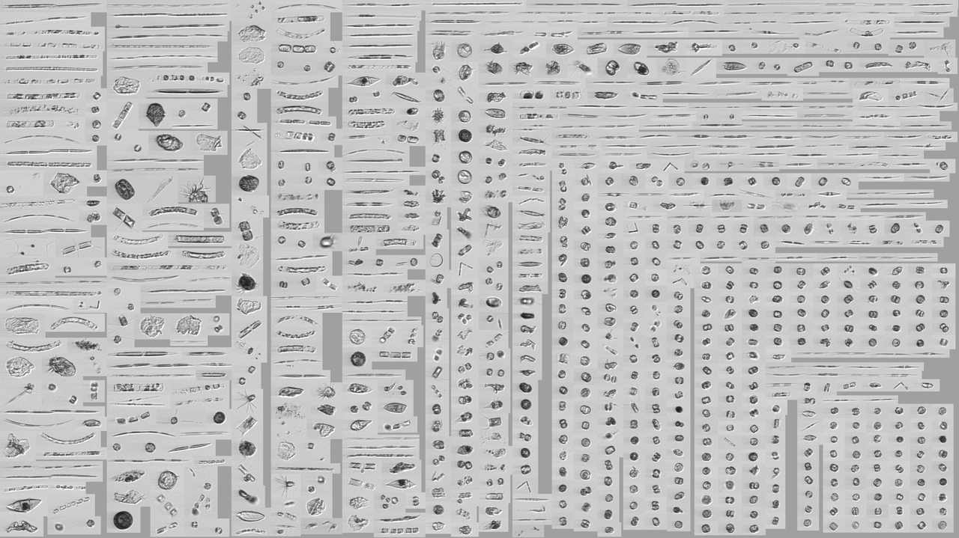
Diatom hotspot
D20190711T011510_IFCB129 C62, N15, 42 m, 3.36 ml

Slide 14
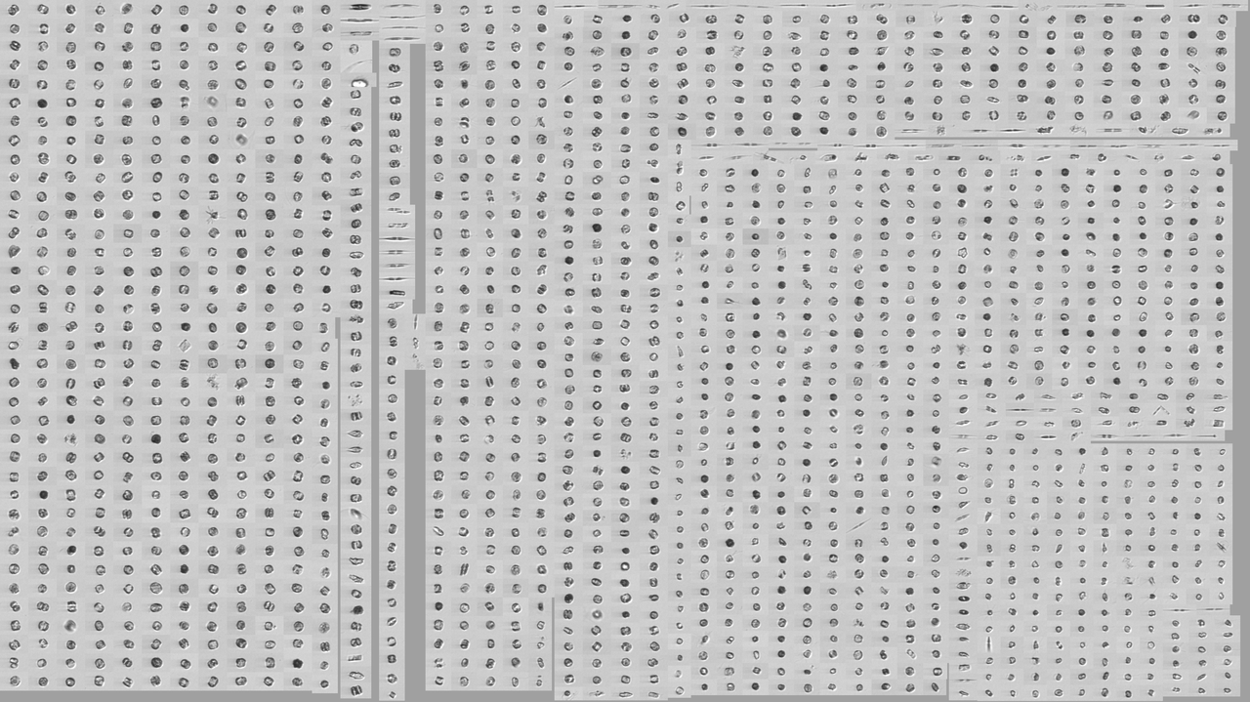
Diatom hotspot
D20190711T011510_IFCB129 C62, N15, 42 m, 3.36 ml

Slide 15
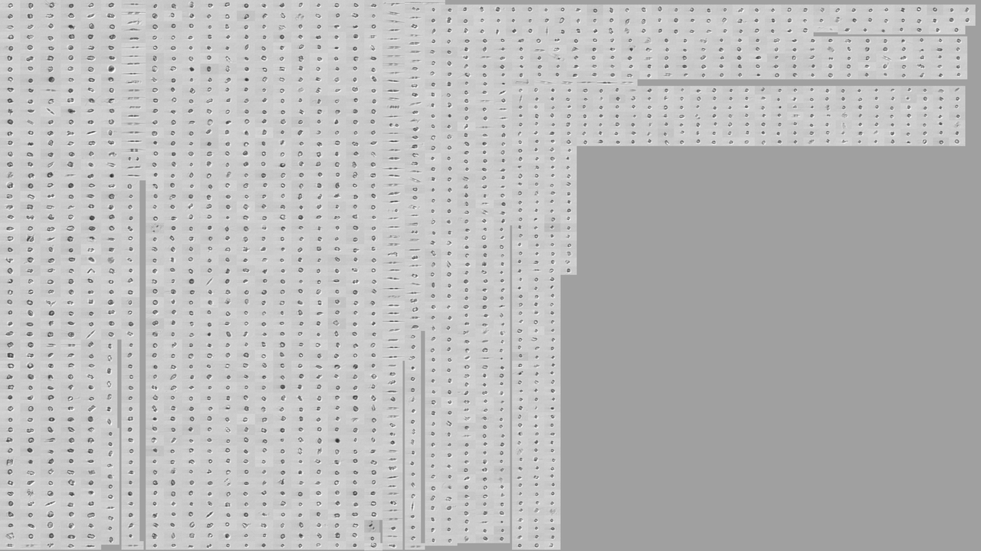
Diatom hotspot
D20190711T011510_IFCB129 C62, N15, 42 m, 3.36 ml

Slide 16
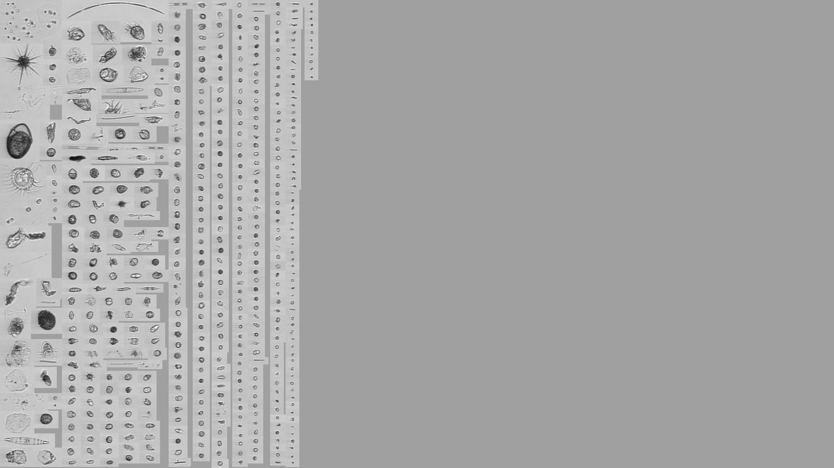
Surface at “hotspot”
D20190711T013934_IFCB109 C62, N24, ~3 m, 4.68 ml

Slide 17
Streamer transect S1-S8 – IFCB results

Slide 19
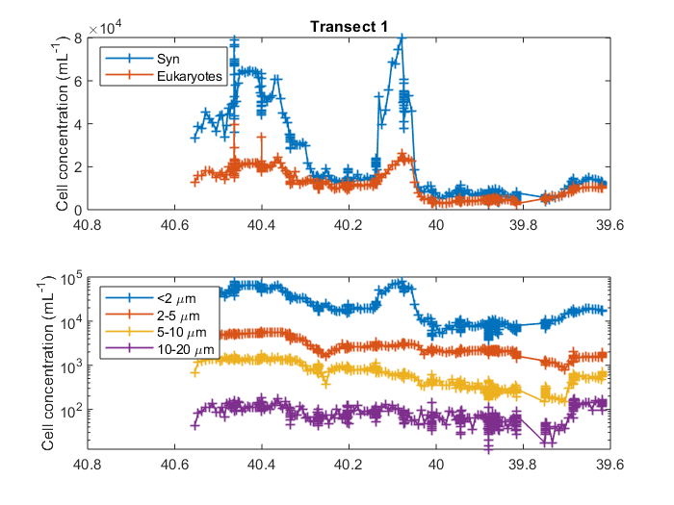
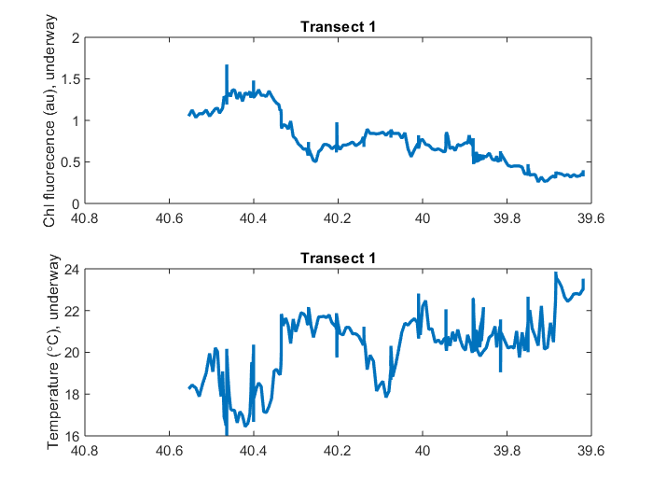
Phytoplankton concentration (Attune flow cytometer, surface)

Slide 20
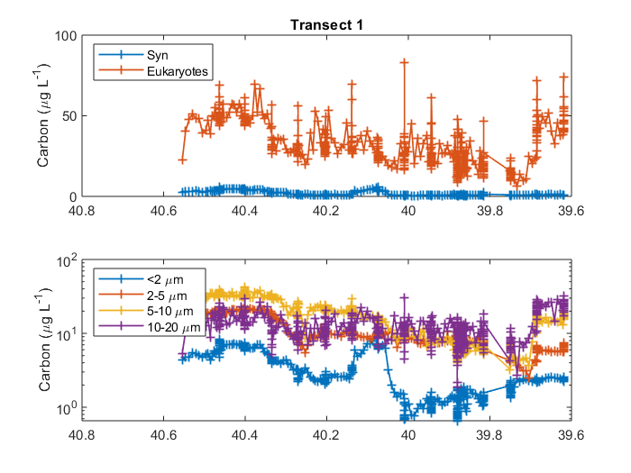
Phytoplankton cell concentration & carbon concentration

Slide 21
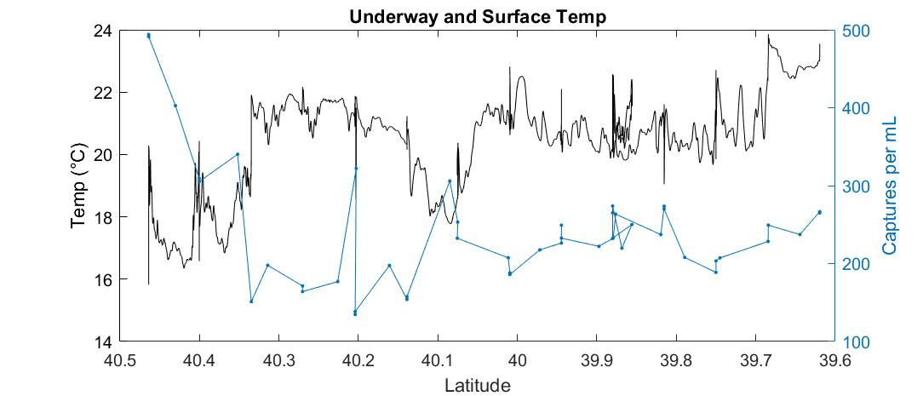
Phytoplankton images from IFCB

Slide 22
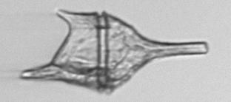
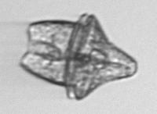






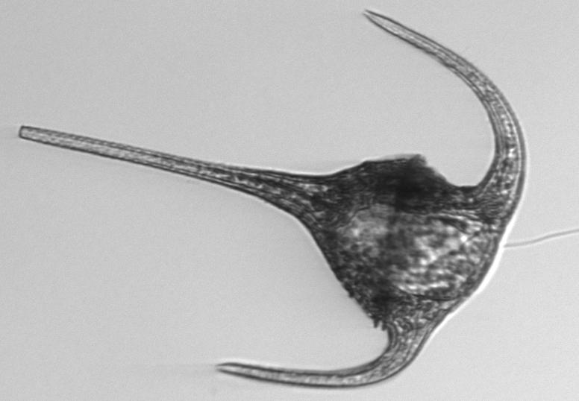
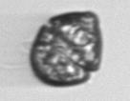
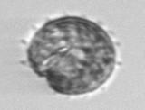

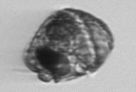



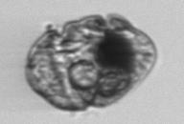
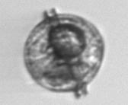
IFCB images – lots of dinoflagellates
Notes:
http://10.43.25.59:8888/underway/D20190708T073345_IFCB127_00428.png

Slide 23

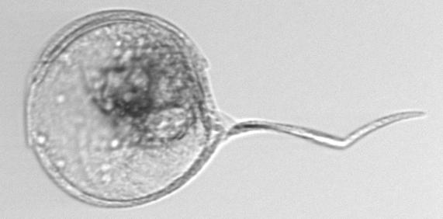
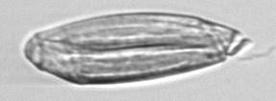
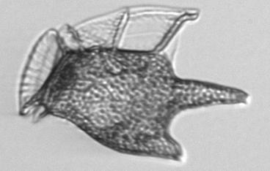
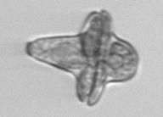
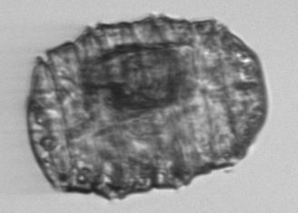
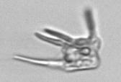
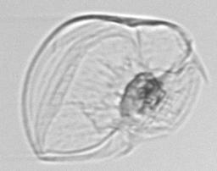
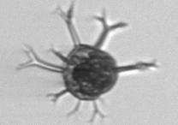
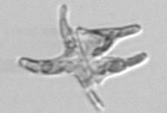





IFCB images – lots of dinoflagellates

Slide 24
















IFCB images – lots of ciliates

Slide 25








IFCB images – lots of ciliates

Slide 26



















IFCB images – coccolithophores, foraminfera, acantharia
Notes:
http://10.43.25.59:8888 /discrete coccos
http://10.43.25.59:8888/discrete/D20190708T190831_IFCB109_01403.html
http://10.43.25.59:8888/discrete2/D20190710T164926_IFCB129_00402.html ophiaster
http://10.43.25.59:8888/discrete2/D20190710T164926_IFCB129_00486.html ophiaster
http://10.43.25.59:8888/discrete2/D20190710T204101_IFCB129_00320.html - Calciosolenia
http://10.43.25.59:8888/discrete/D20190710T231452_IFCB109_00168.html

