Slide 1
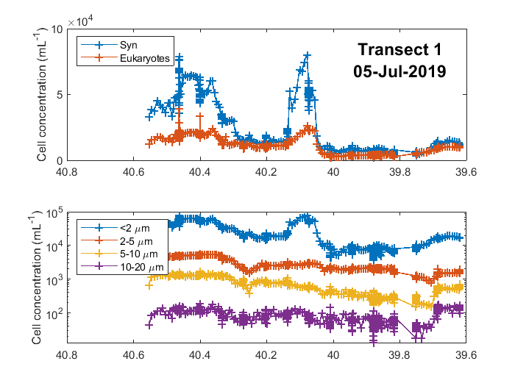
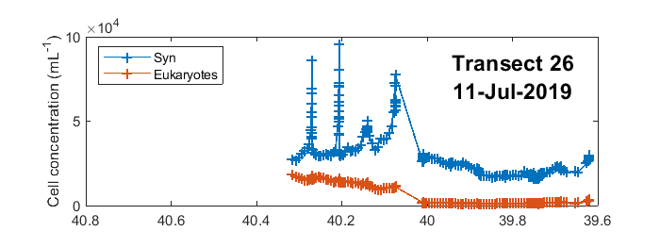
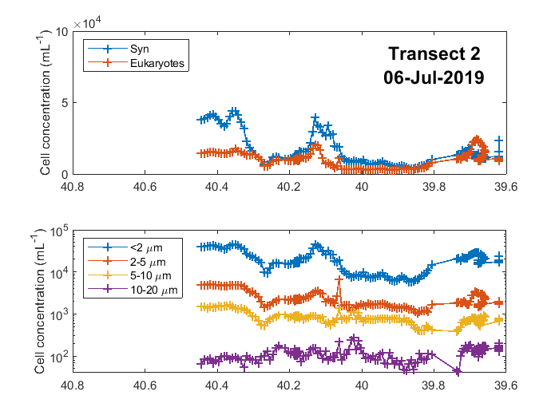
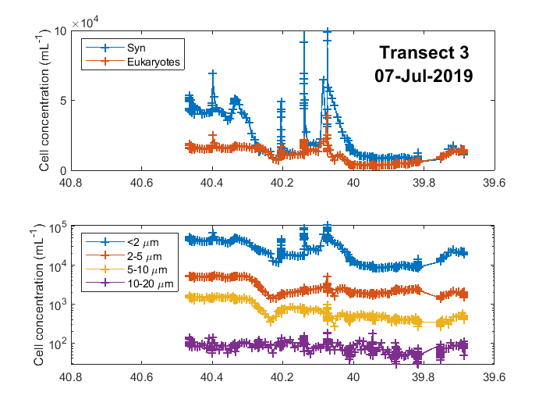
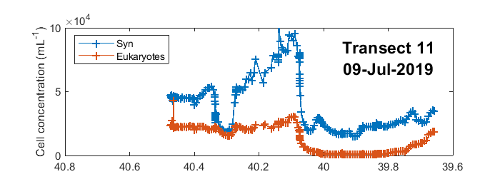

Slide 2
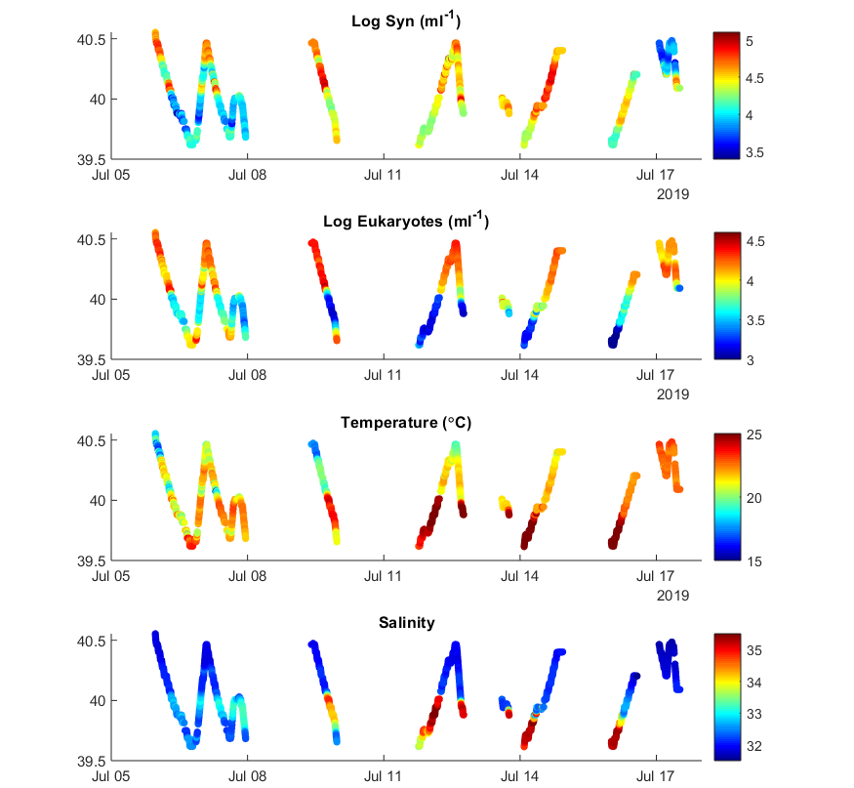
Underway sampling
along main transect

Slide 3
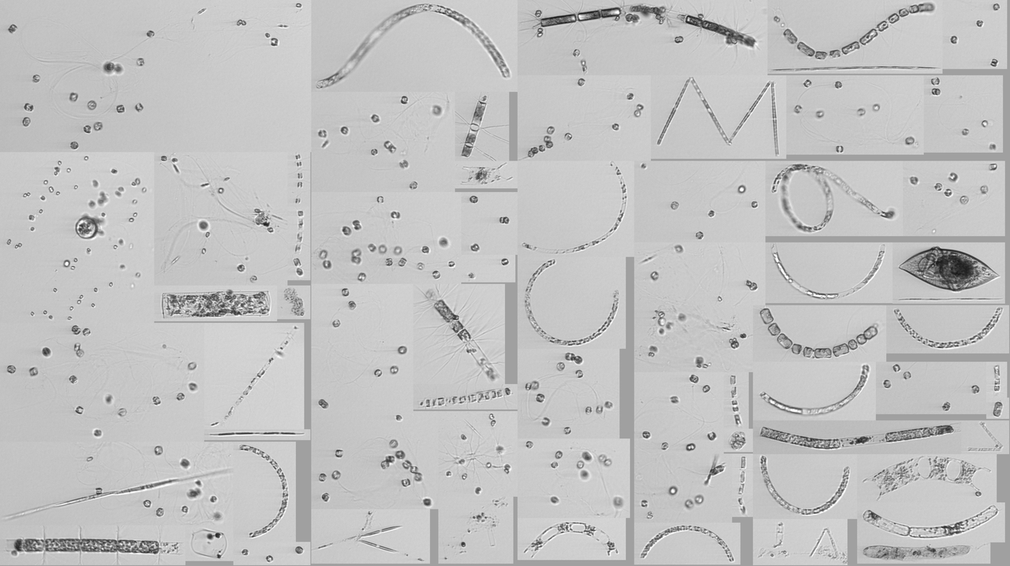
Diatom hotspot
D20190711T011510_IFCB129 C62, N15, 42 m, 3.36 ml

Slide 4
VPR tow
roi.8451536500.tif

Slide 5
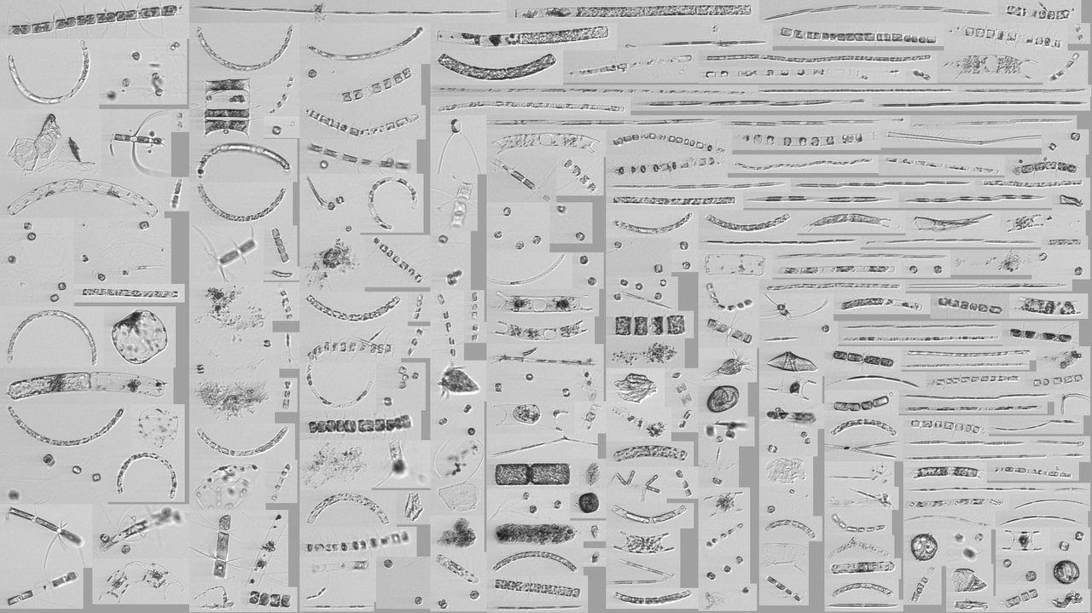
Diatom hotspot
D20190711T011510_IFCB129 C62, N15, 42 m, 3.36 ml

Slide 6
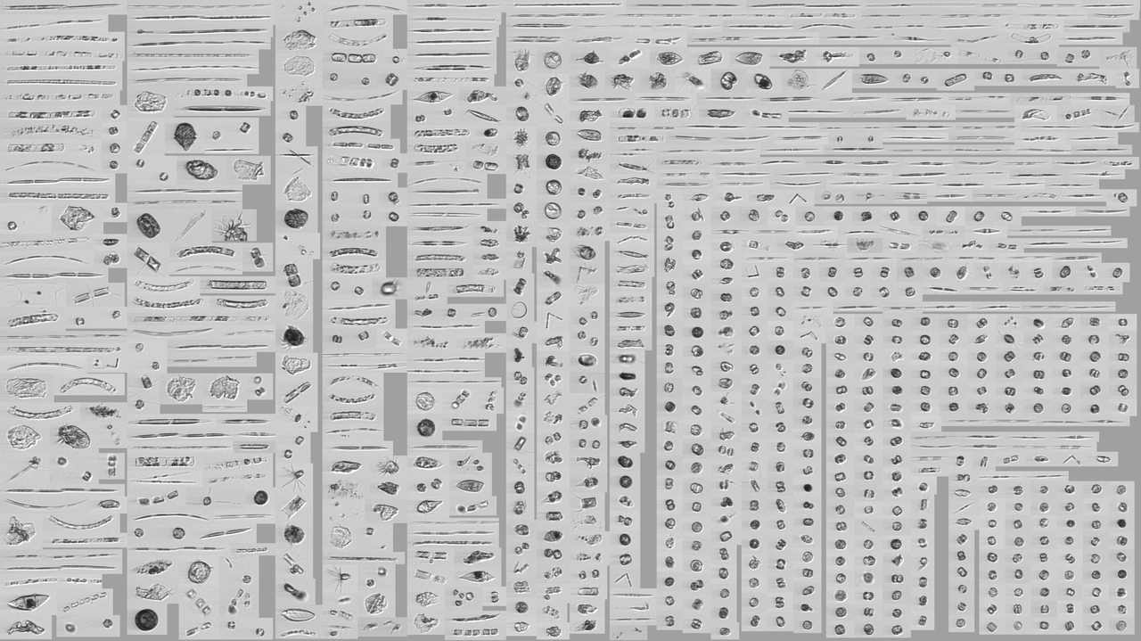
Diatom hotspot
D20190711T011510_IFCB129 C62, N15, 42 m, 3.36 ml

Slide 7

Diatom hotspot
D20190711T011510_IFCB129 C62, N15, 42 m, 3.36 ml

Slide 8

Diatom hotspot
D20190711T011510_IFCB129 C62, N15, 42 m, 3.36 ml

Slide 9

Surface at “hotspot”
D20190711T013934_IFCB109 C62, N24, ~3 m, 4.68 ml

Slide 10
Streamer transect S1-S8 – IFCB results

Slide 12
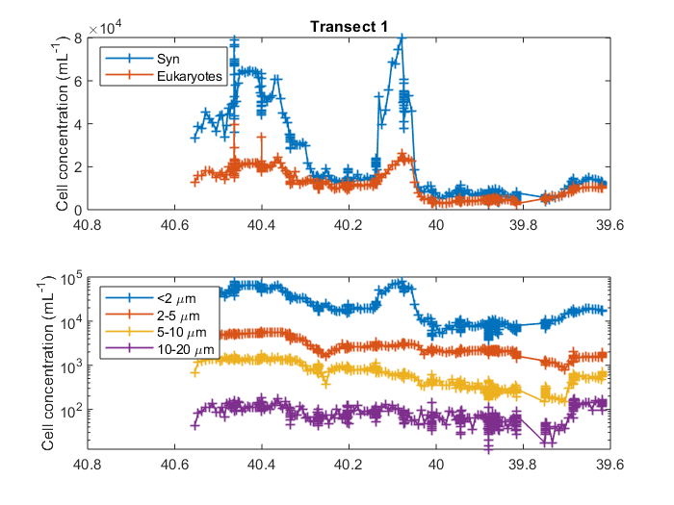
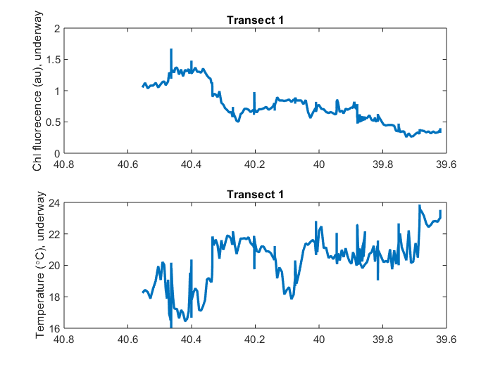
Phytoplankton concentration (Attune flow cytometer, surface)

Slide 13
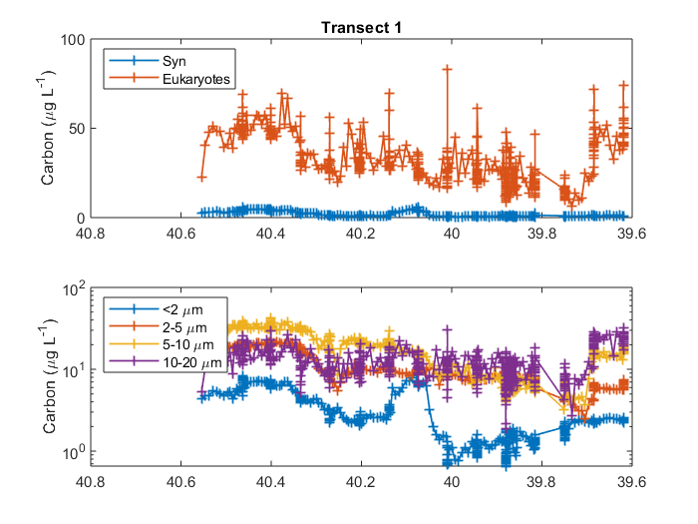
Phytoplankton cell concentration & carbon concentration

Slide 14
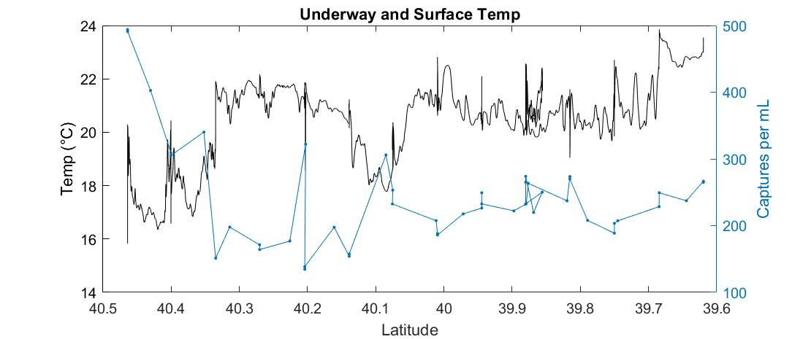
Phytoplankton images from IFCB

Slide 15
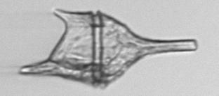
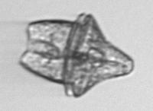






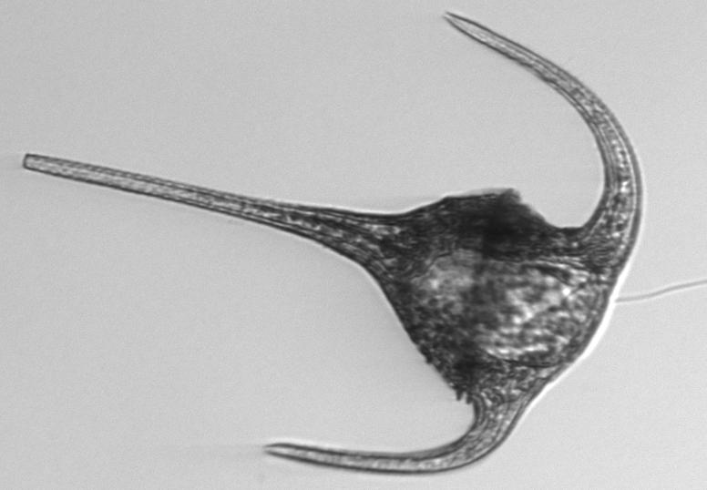
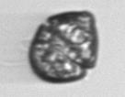
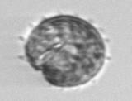

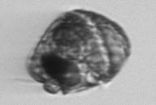



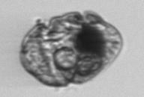
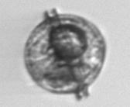
IFCB images – lots of dinoflagellates
Notes:
http://10.43.25.59:8888/underway/D20190708T073345_IFCB127_00428.png

Slide 16

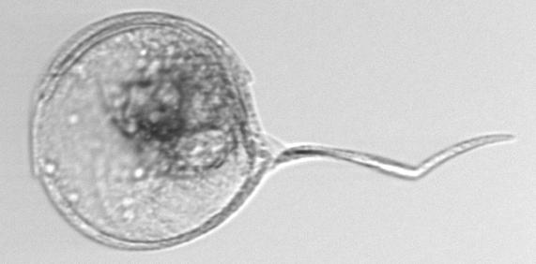
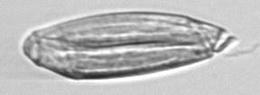
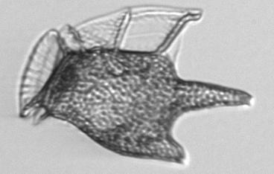
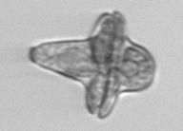
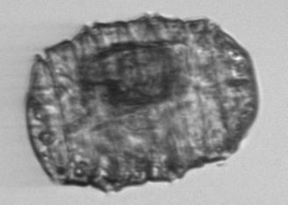
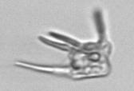
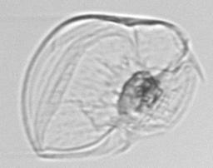
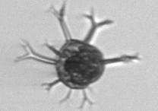
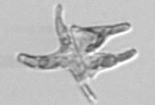
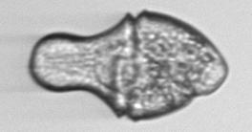
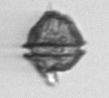
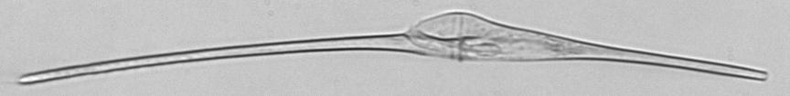


IFCB images – lots of dinoflagellates

Slide 17
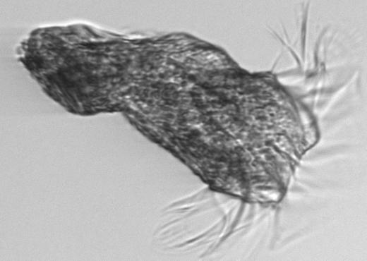
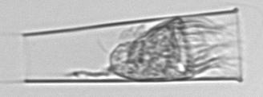
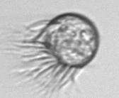
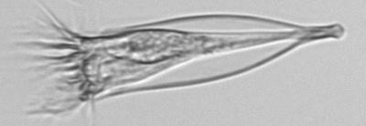
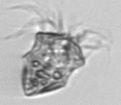
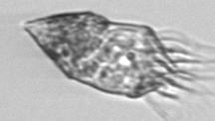


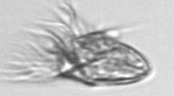
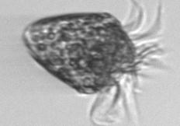
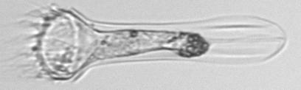
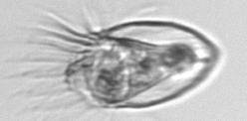
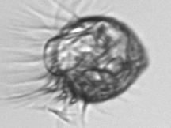
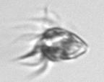
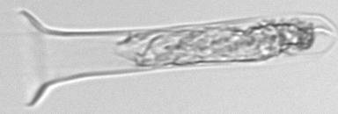
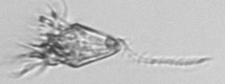
IFCB images – lots of ciliates

Slide 18
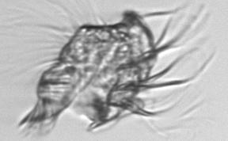
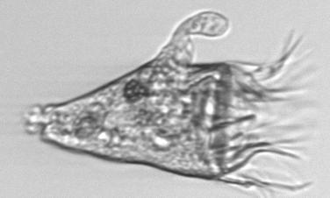
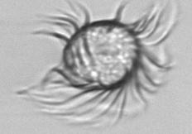





IFCB images – lots of ciliates

Slide 19



















IFCB images – coccolithophores, foraminfera, acantharia
Notes:
http://10.43.25.59:8888 /discrete coccos
http://10.43.25.59:8888/discrete/D20190708T190831_IFCB109_01403.html
http://10.43.25.59:8888/discrete2/D20190710T164926_IFCB129_00402.html ophiaster
http://10.43.25.59:8888/discrete2/D20190710T164926_IFCB129_00486.html ophiaster
http://10.43.25.59:8888/discrete2/D20190710T204101_IFCB129_00320.html - Calciosolenia
http://10.43.25.59:8888/discrete/D20190710T231452_IFCB109_00168.html

