Slide 1
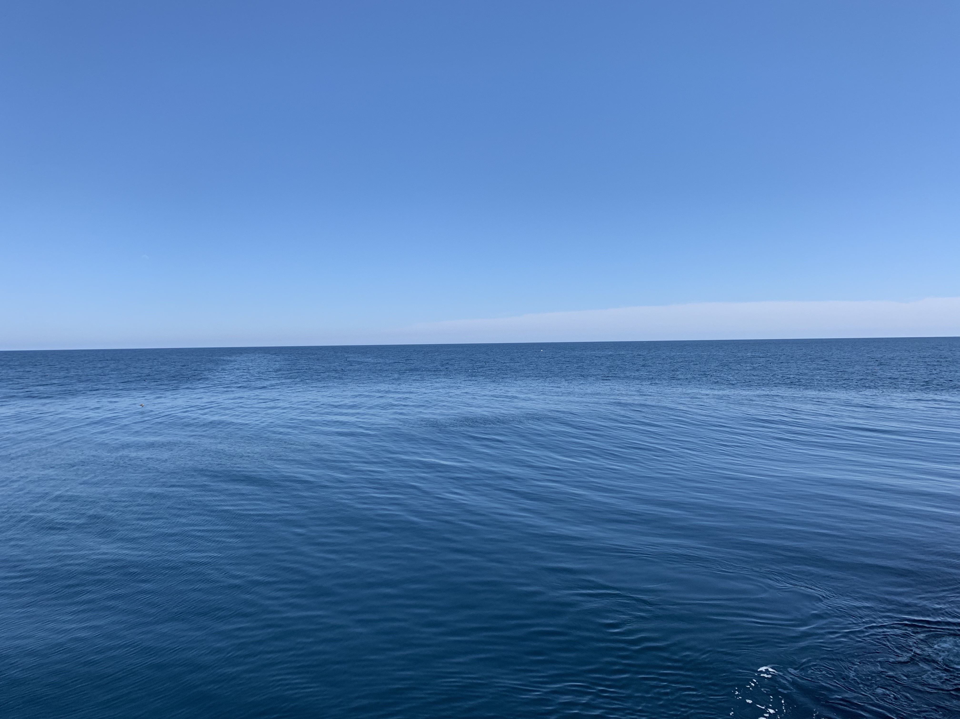
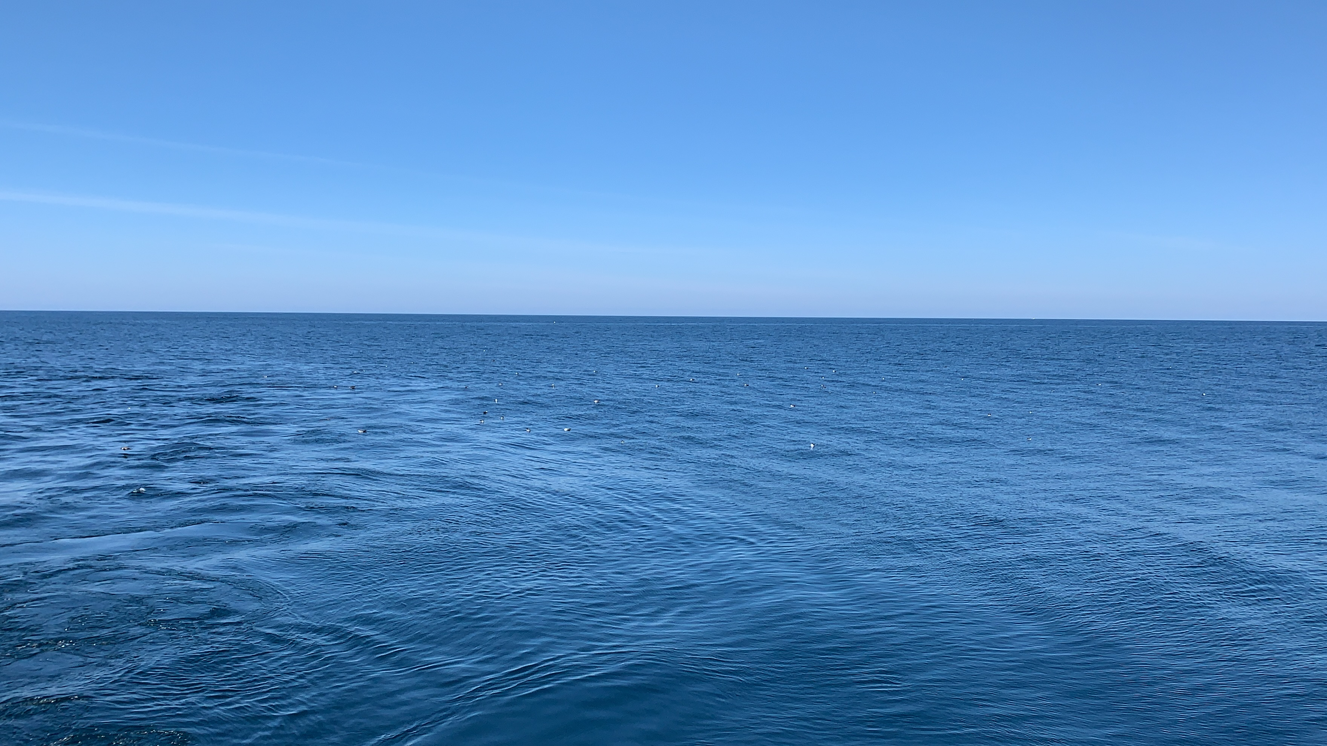
COOL
Internal Wave !

Slide 2
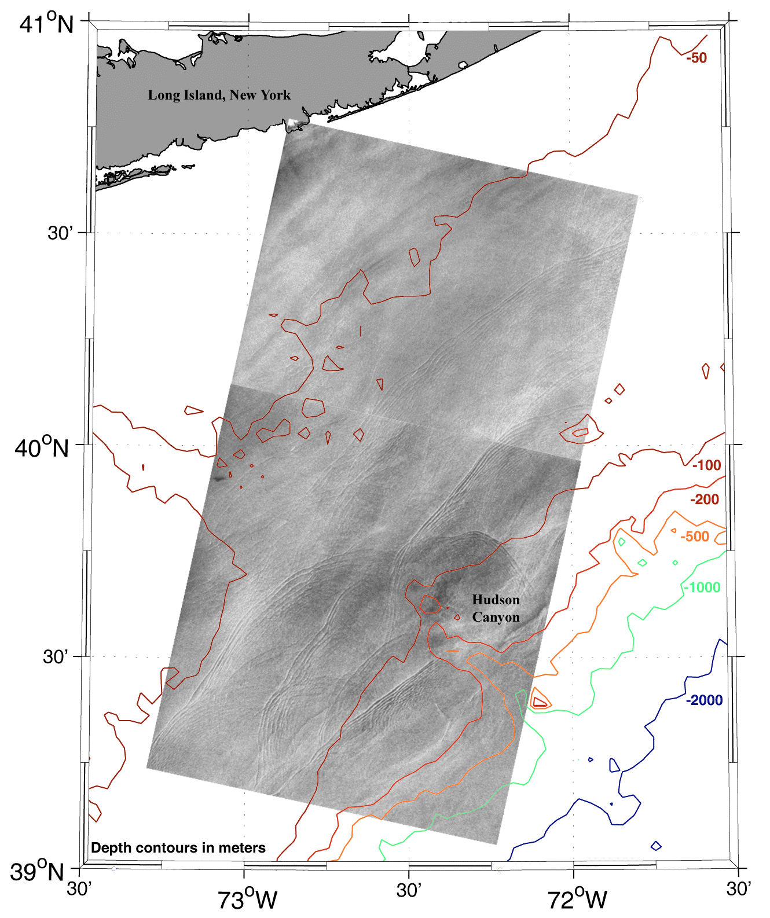
Satellite View

Slide 4
Kelvin-Helmholtz Billows in internal waves

Slide 6
CTD Cast at A9 on July 16

Slide 9
Question for us: how much mixing do the K-H billows and internal waves cause?

