Slide 1
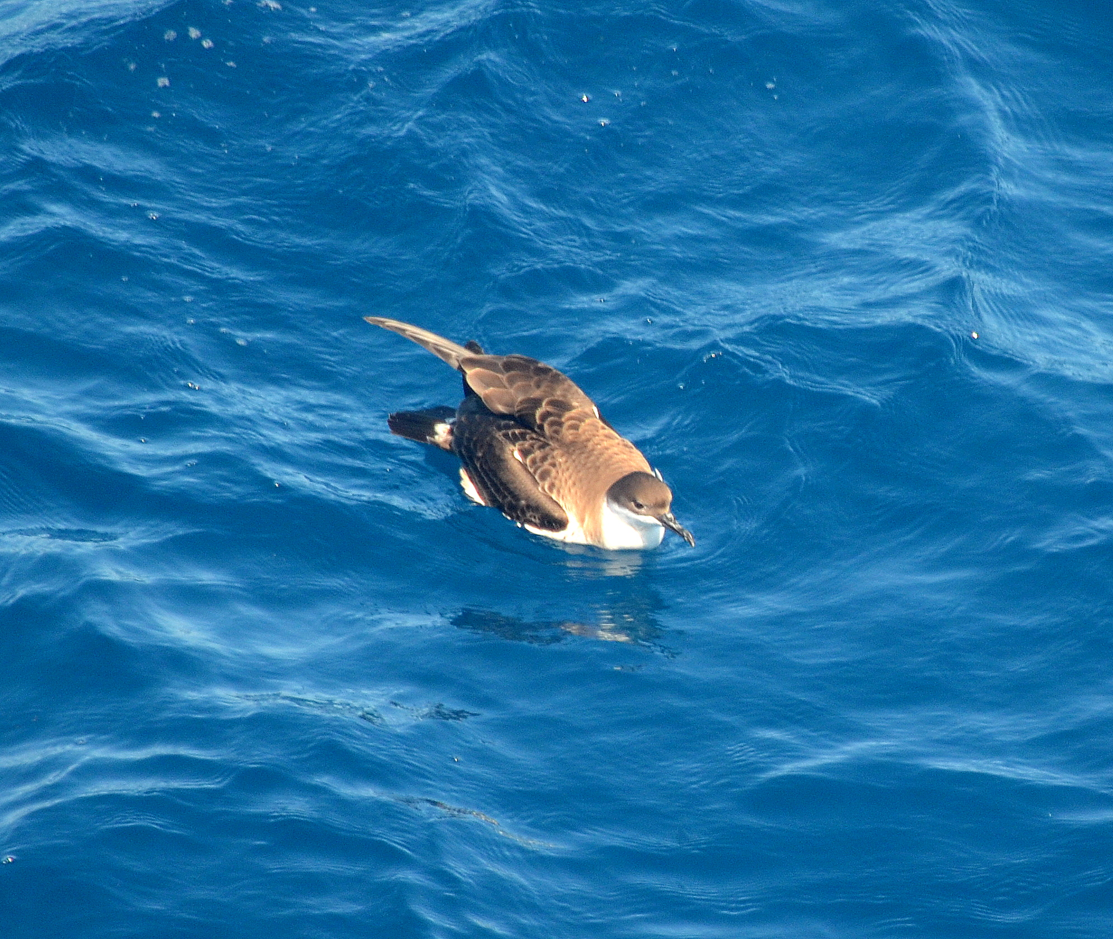
Bird Life
TN368
10 Bird Species (Up to 12) as of 7/11
1 Confirmed Marine Mammal Sp.

Slide 2
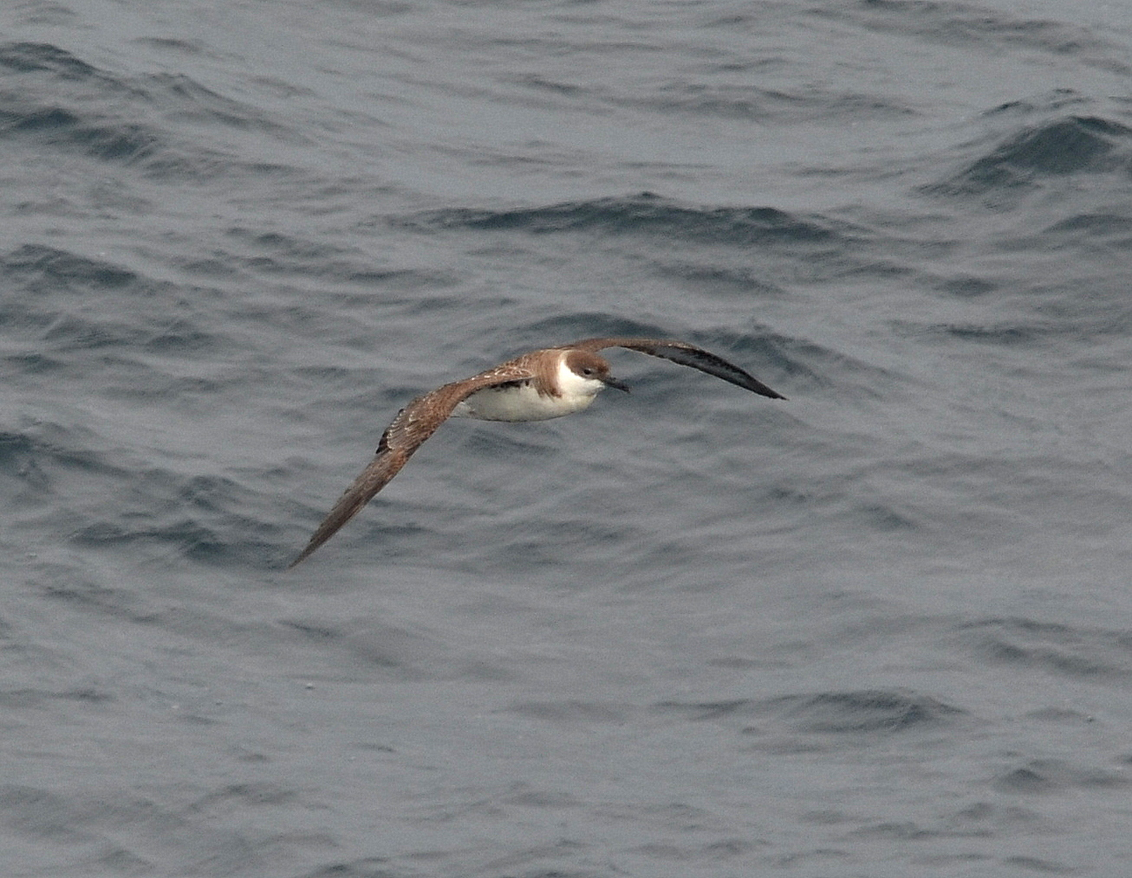

Slide 5
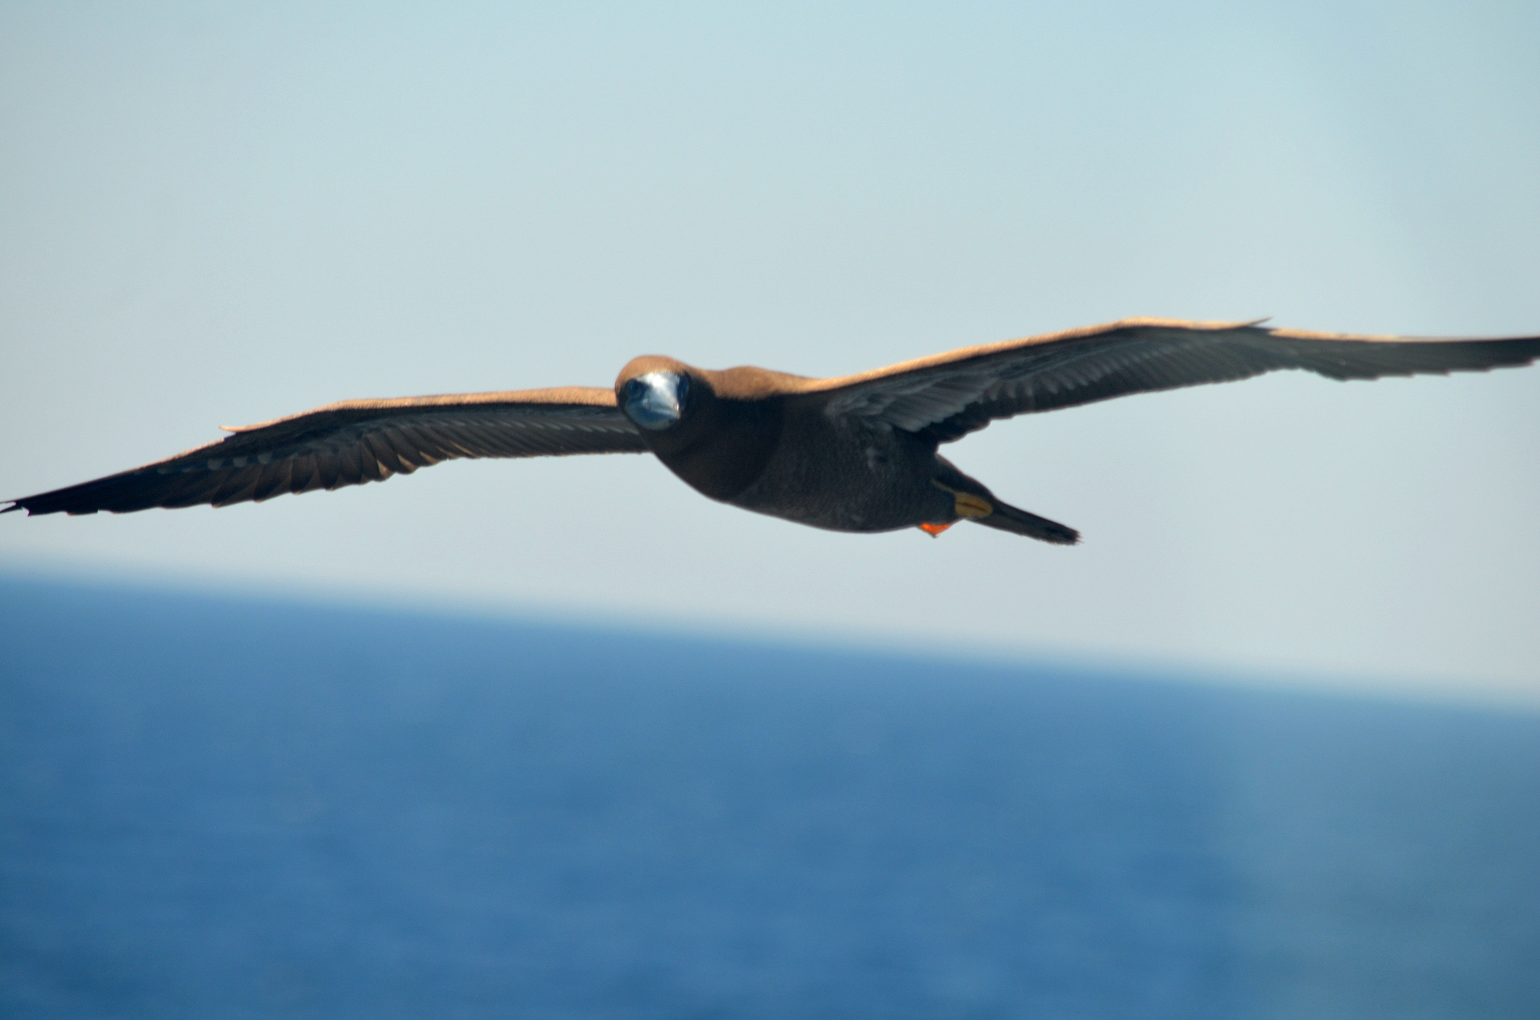

Slide 6
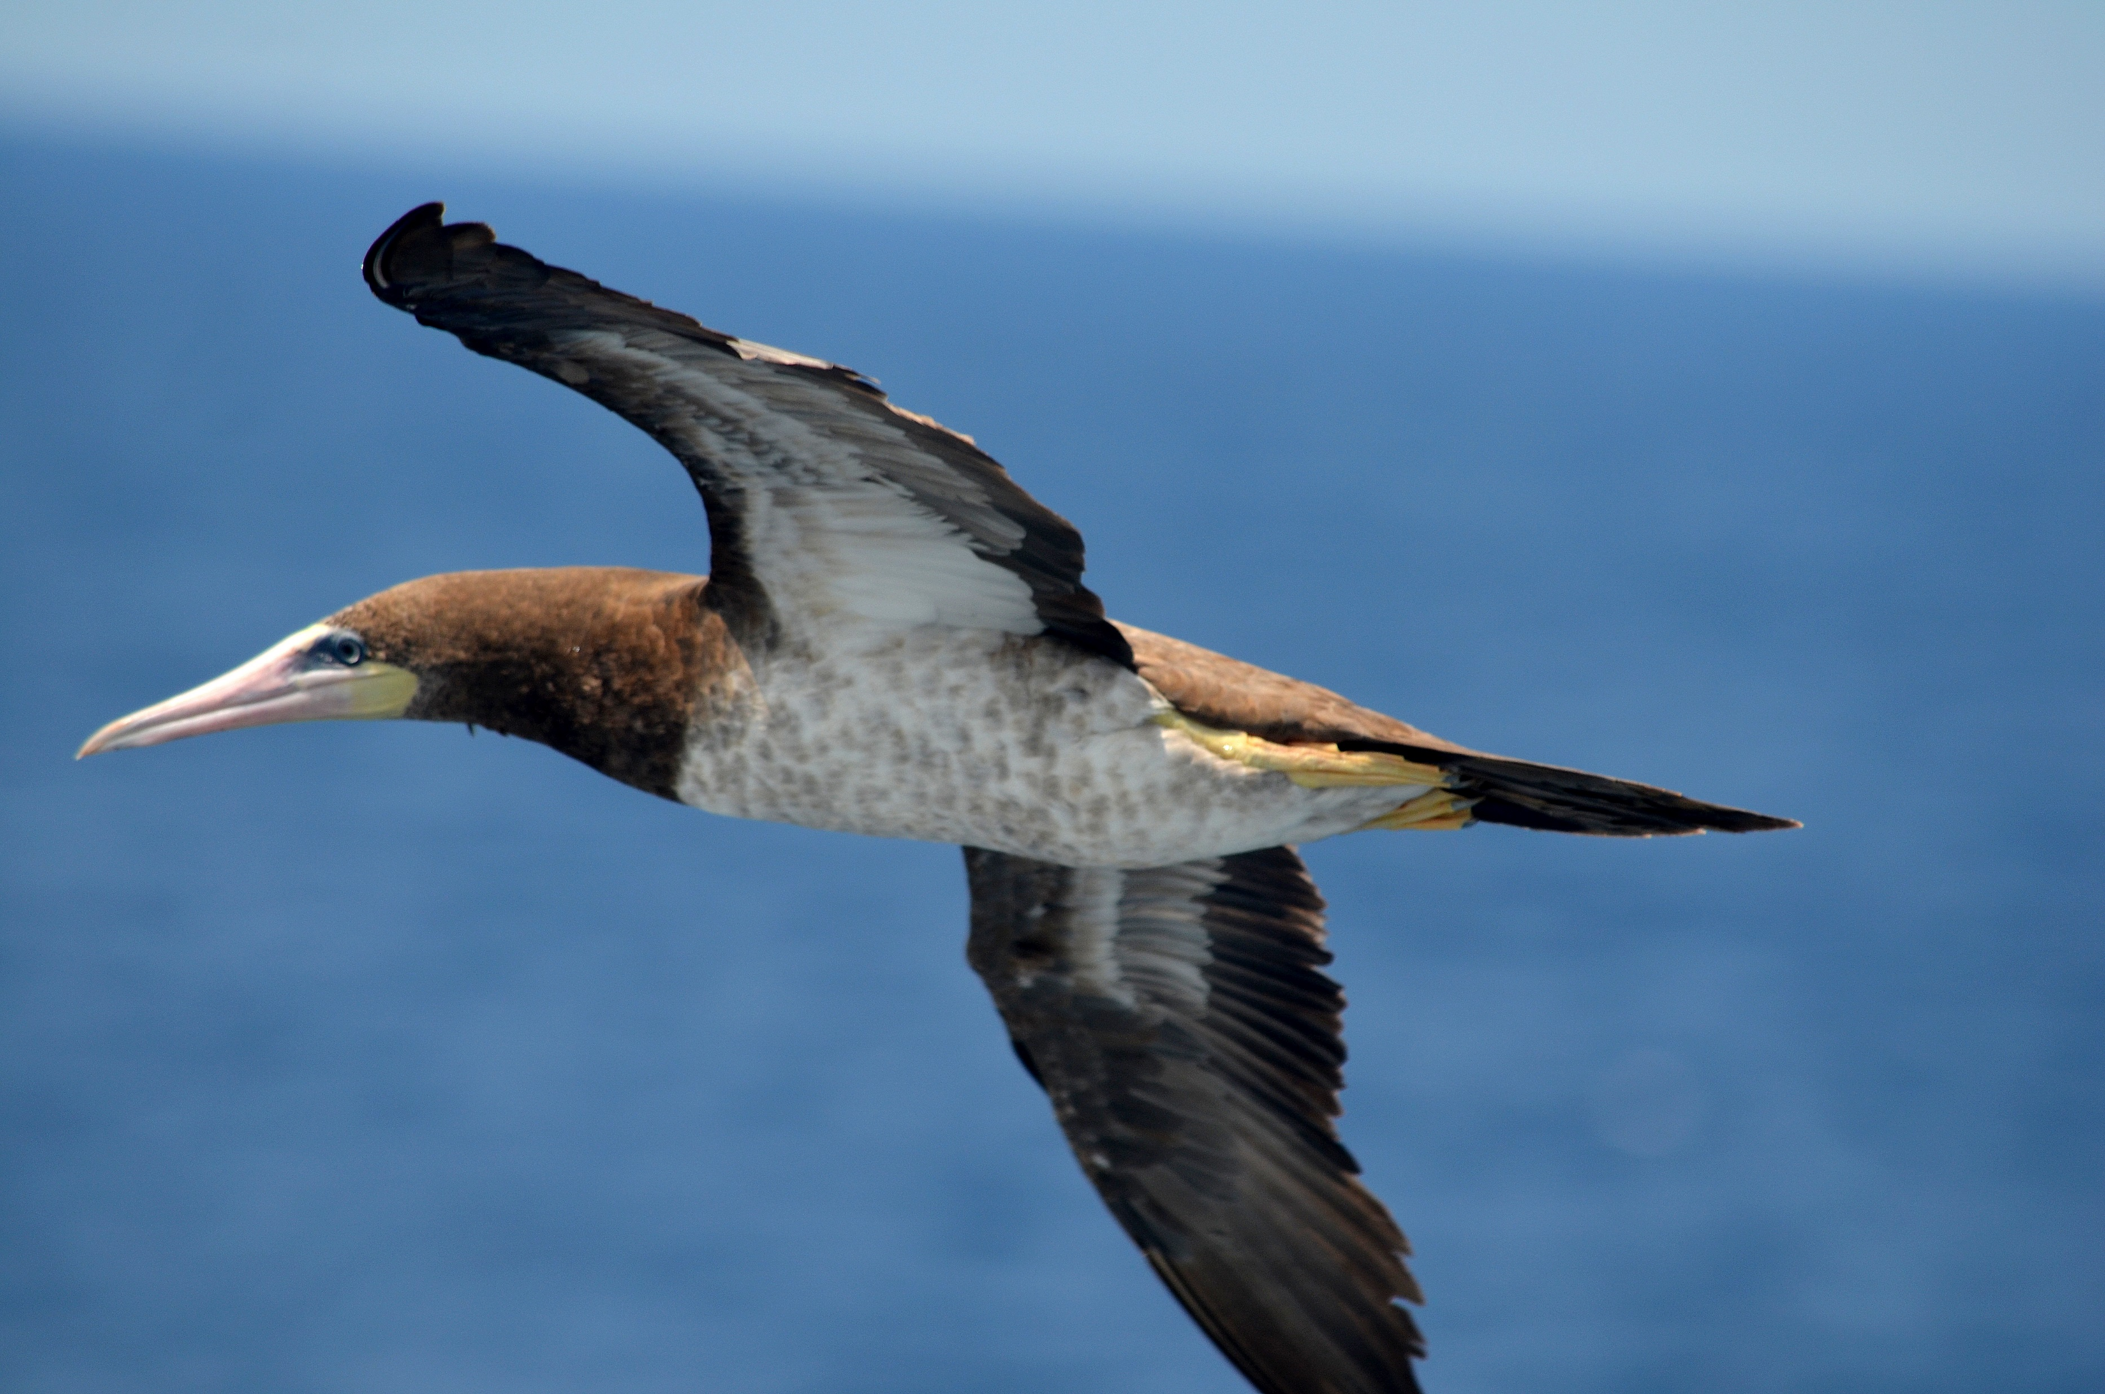

Slide 7
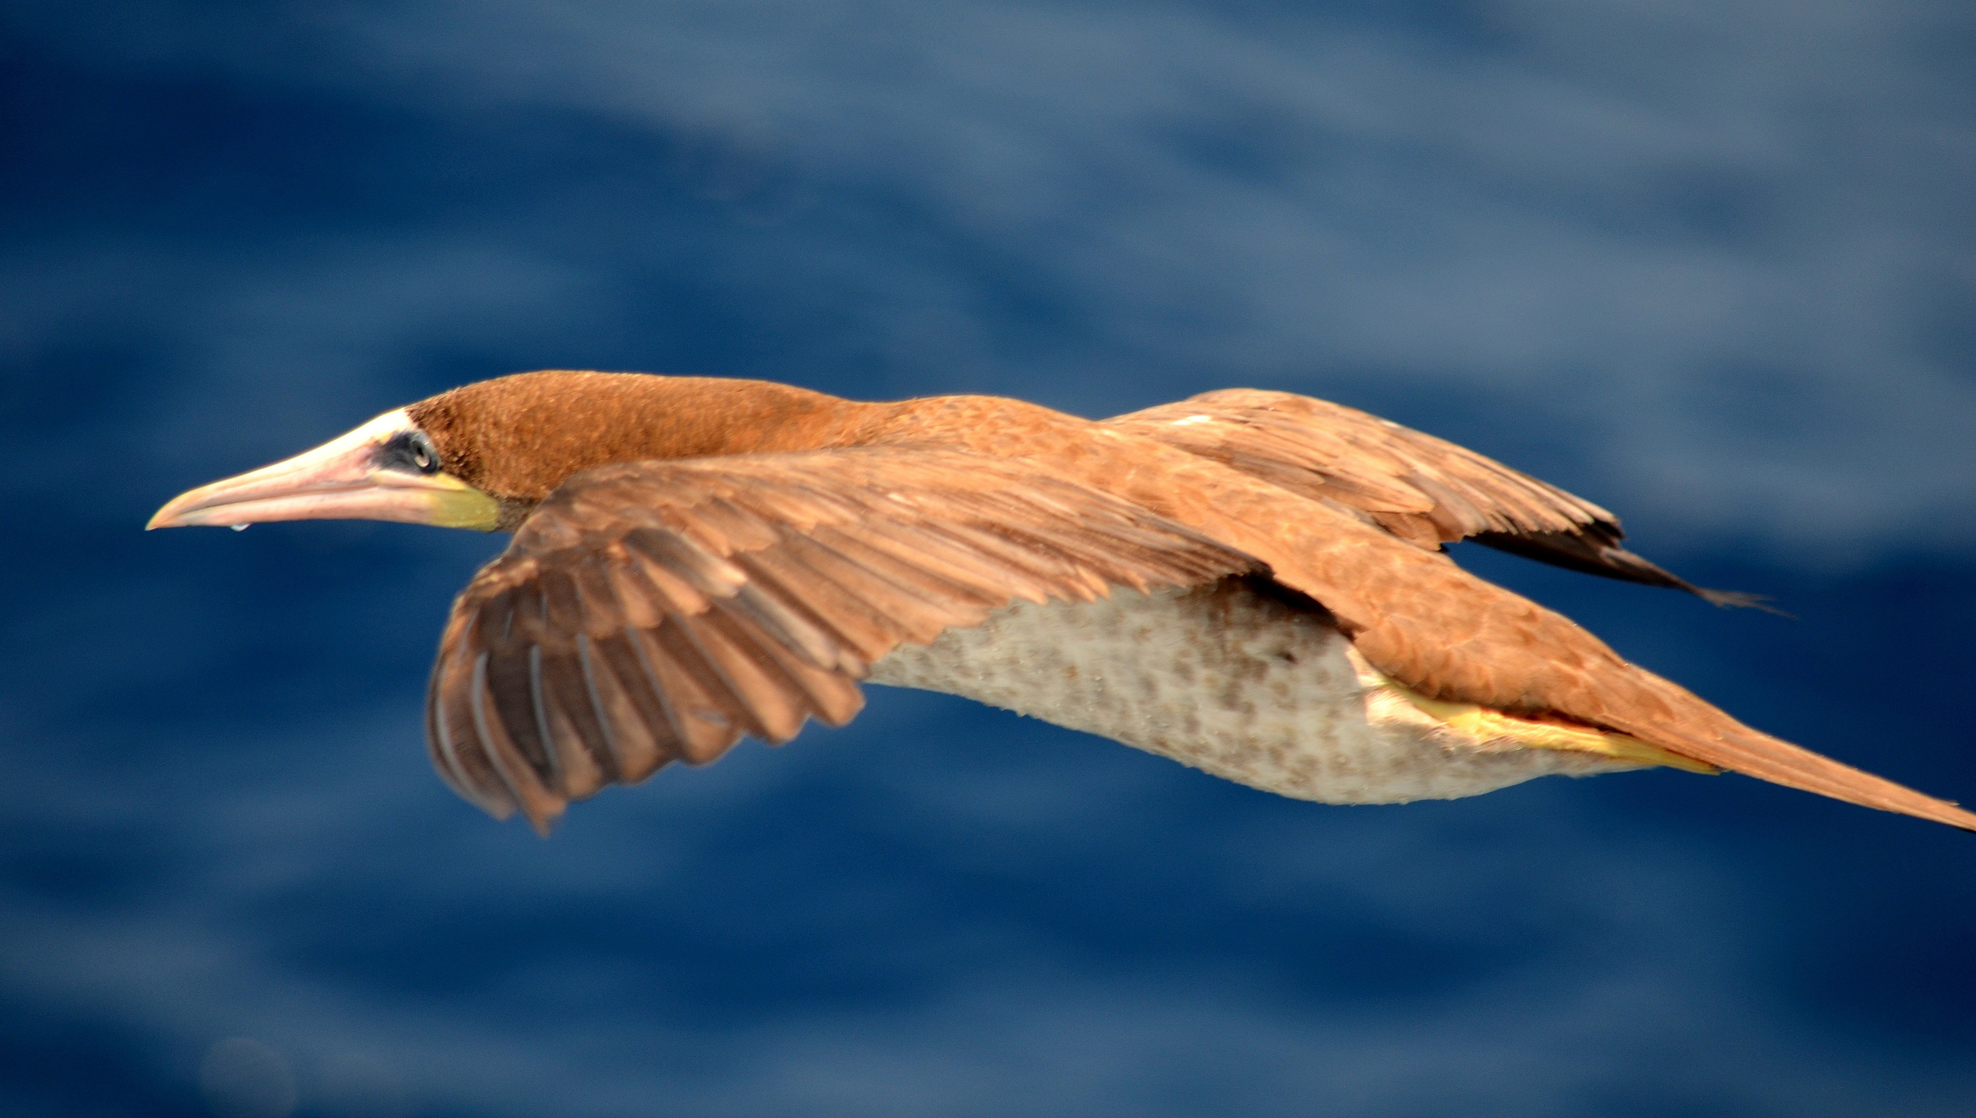

Slide 8
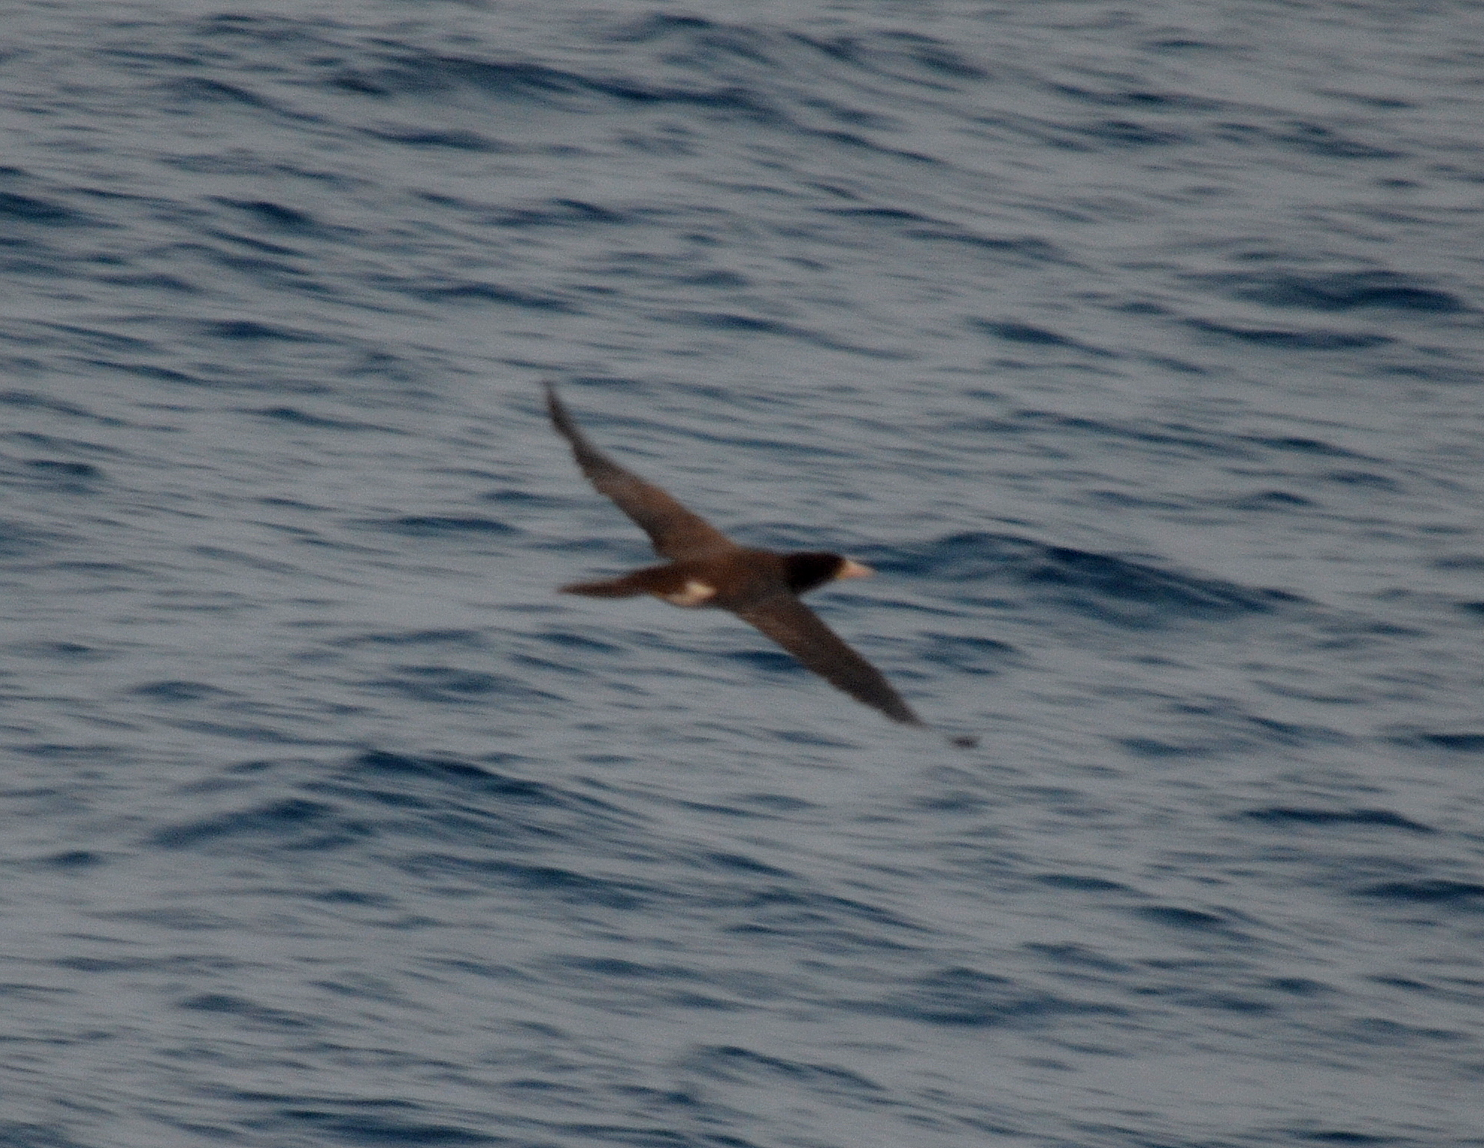

Slide 9
