Slide 1
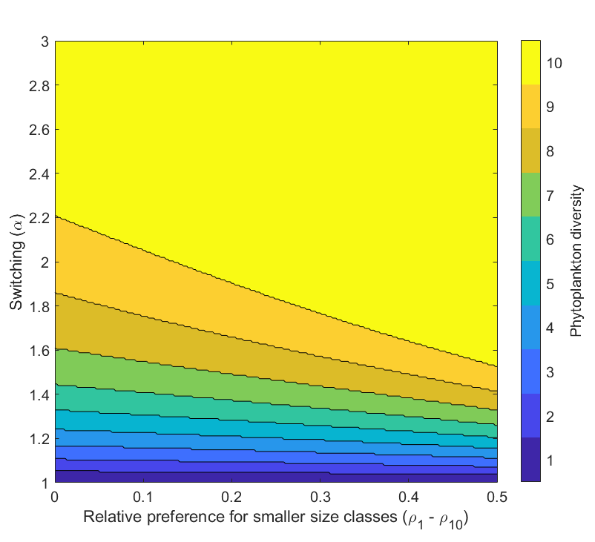
Preference and switching in the Kill-the-Winner functional response: Diversity, size structure, and synergistic grazing in plankton models
How does zooplankton grazing maintain diversity in phytoplankton communities?
Preference and switching are independent mechanisms that may allow coexistence between competing phytoplankton in situations that would otherwise lead to competitive exclusion.
Compared to preference, switching leads to coexistence and increased diversity over a much wider range of environmental conditions.
In a size-structured phytoplankton community model, diversity was positively related to zooplankton switching and preference for smaller phytoplankton size classes.

Slide 2
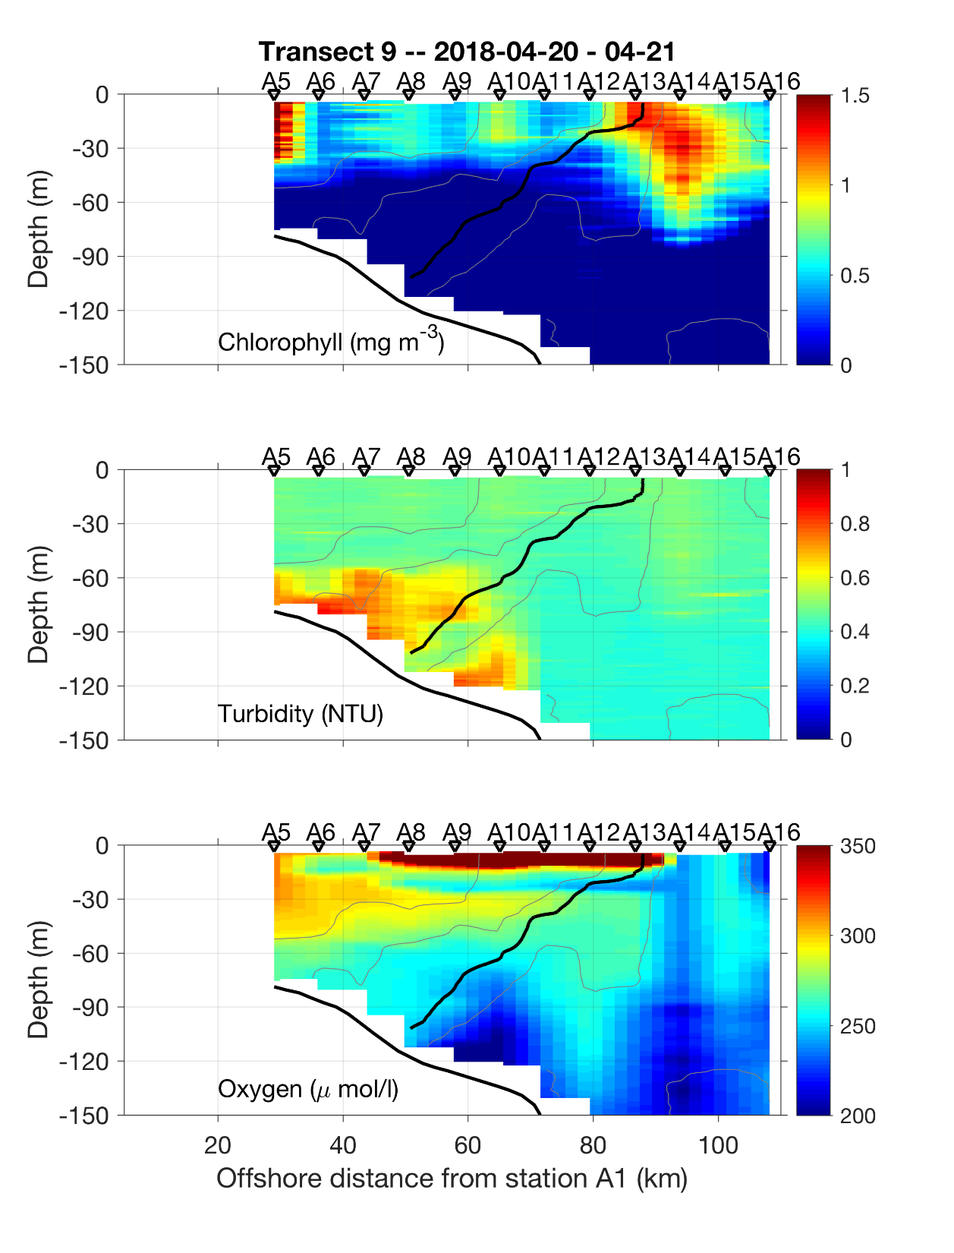
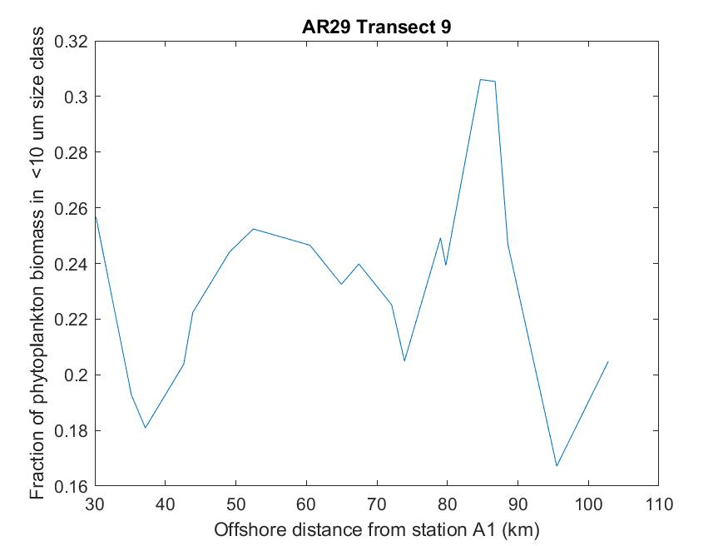

Slide 3
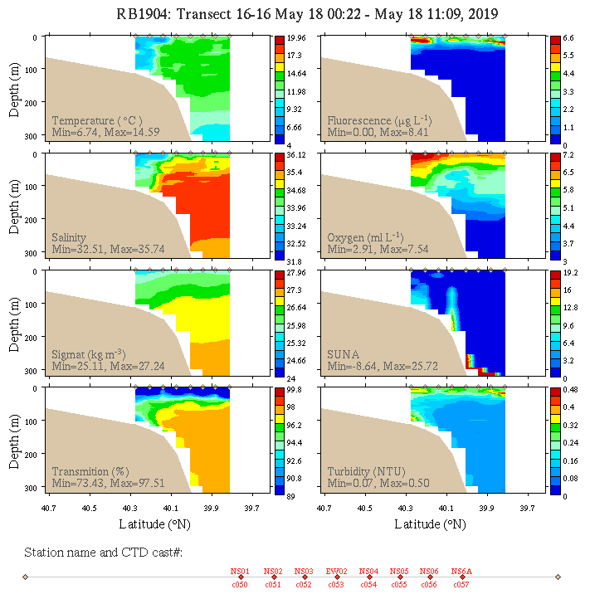
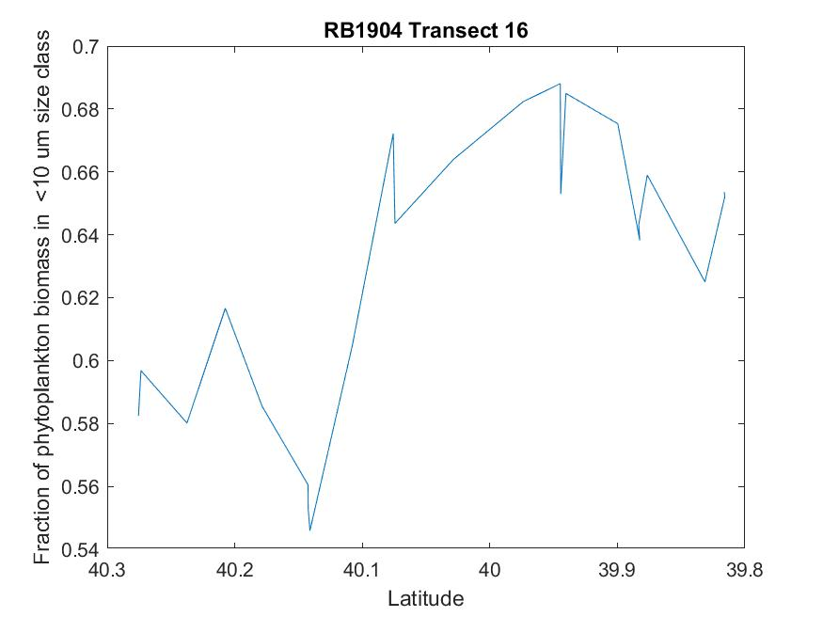

Slide 4
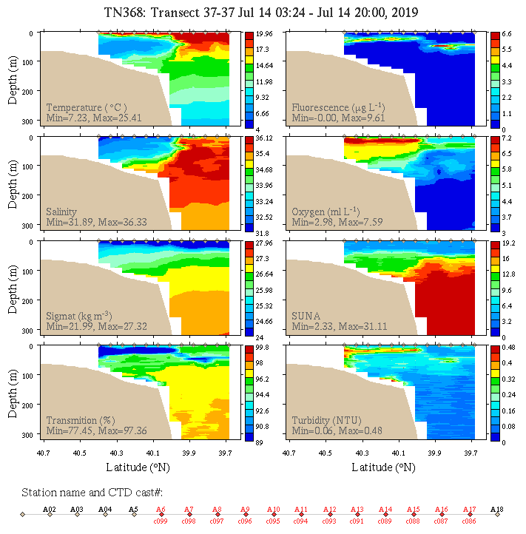
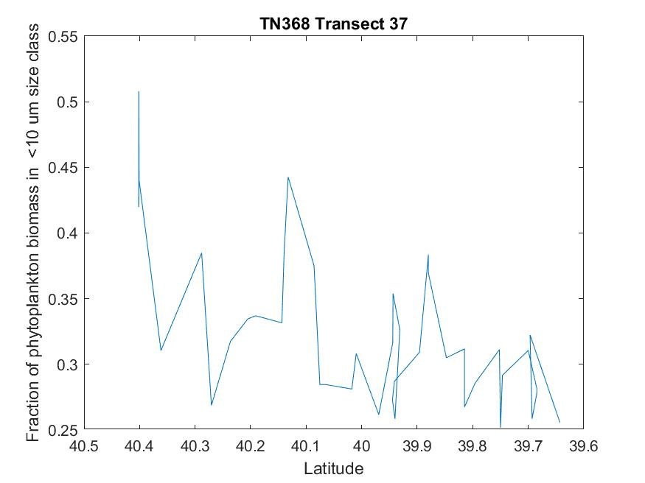

Slide 5
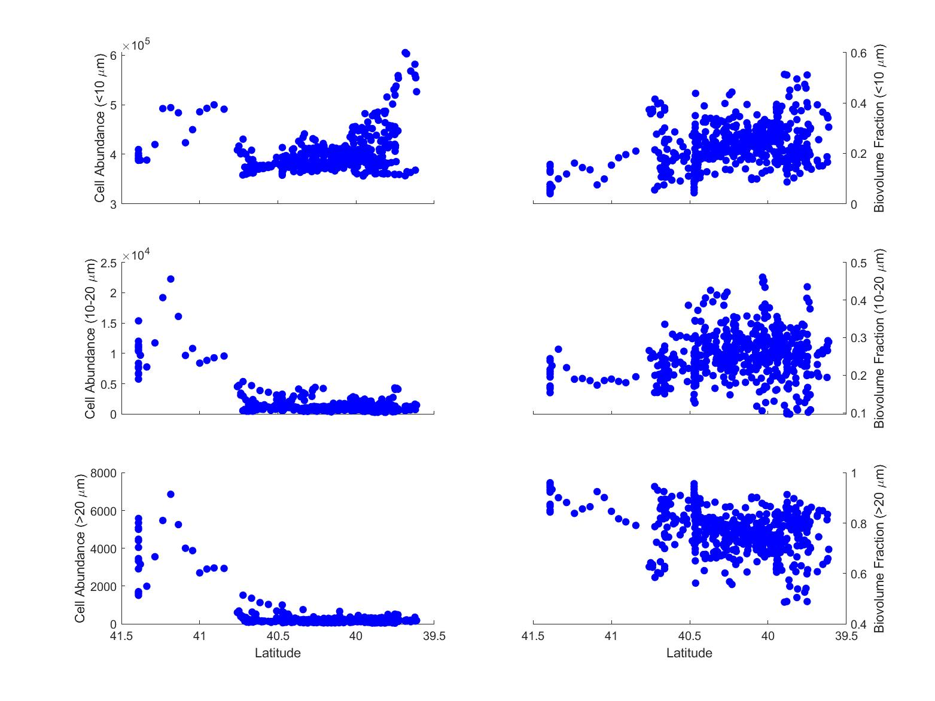
AR29

Slide 6
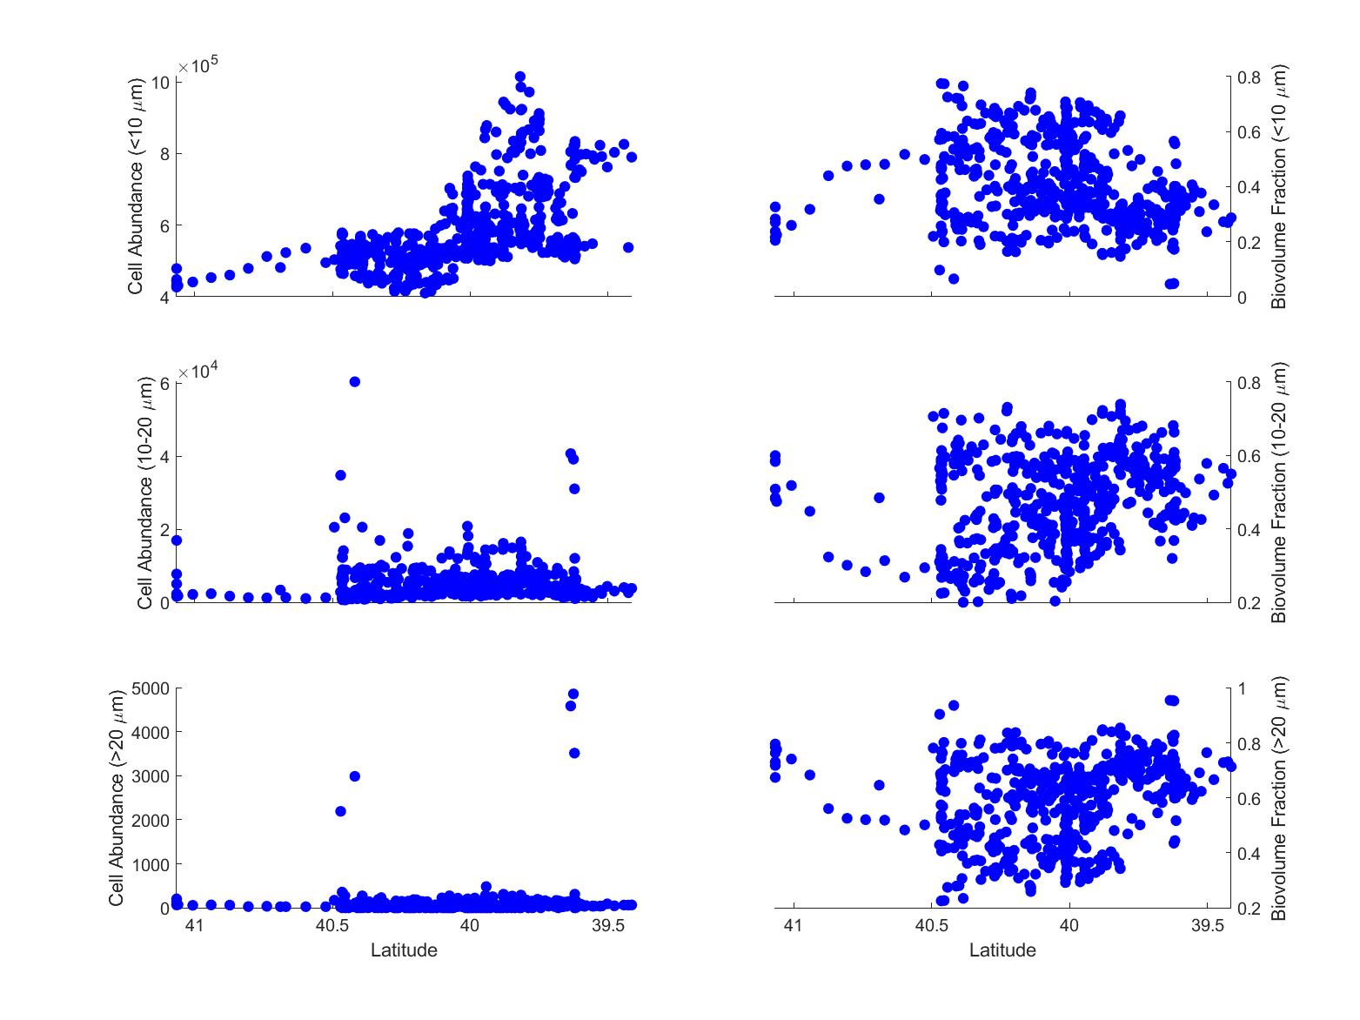
RB1904

Slide 7
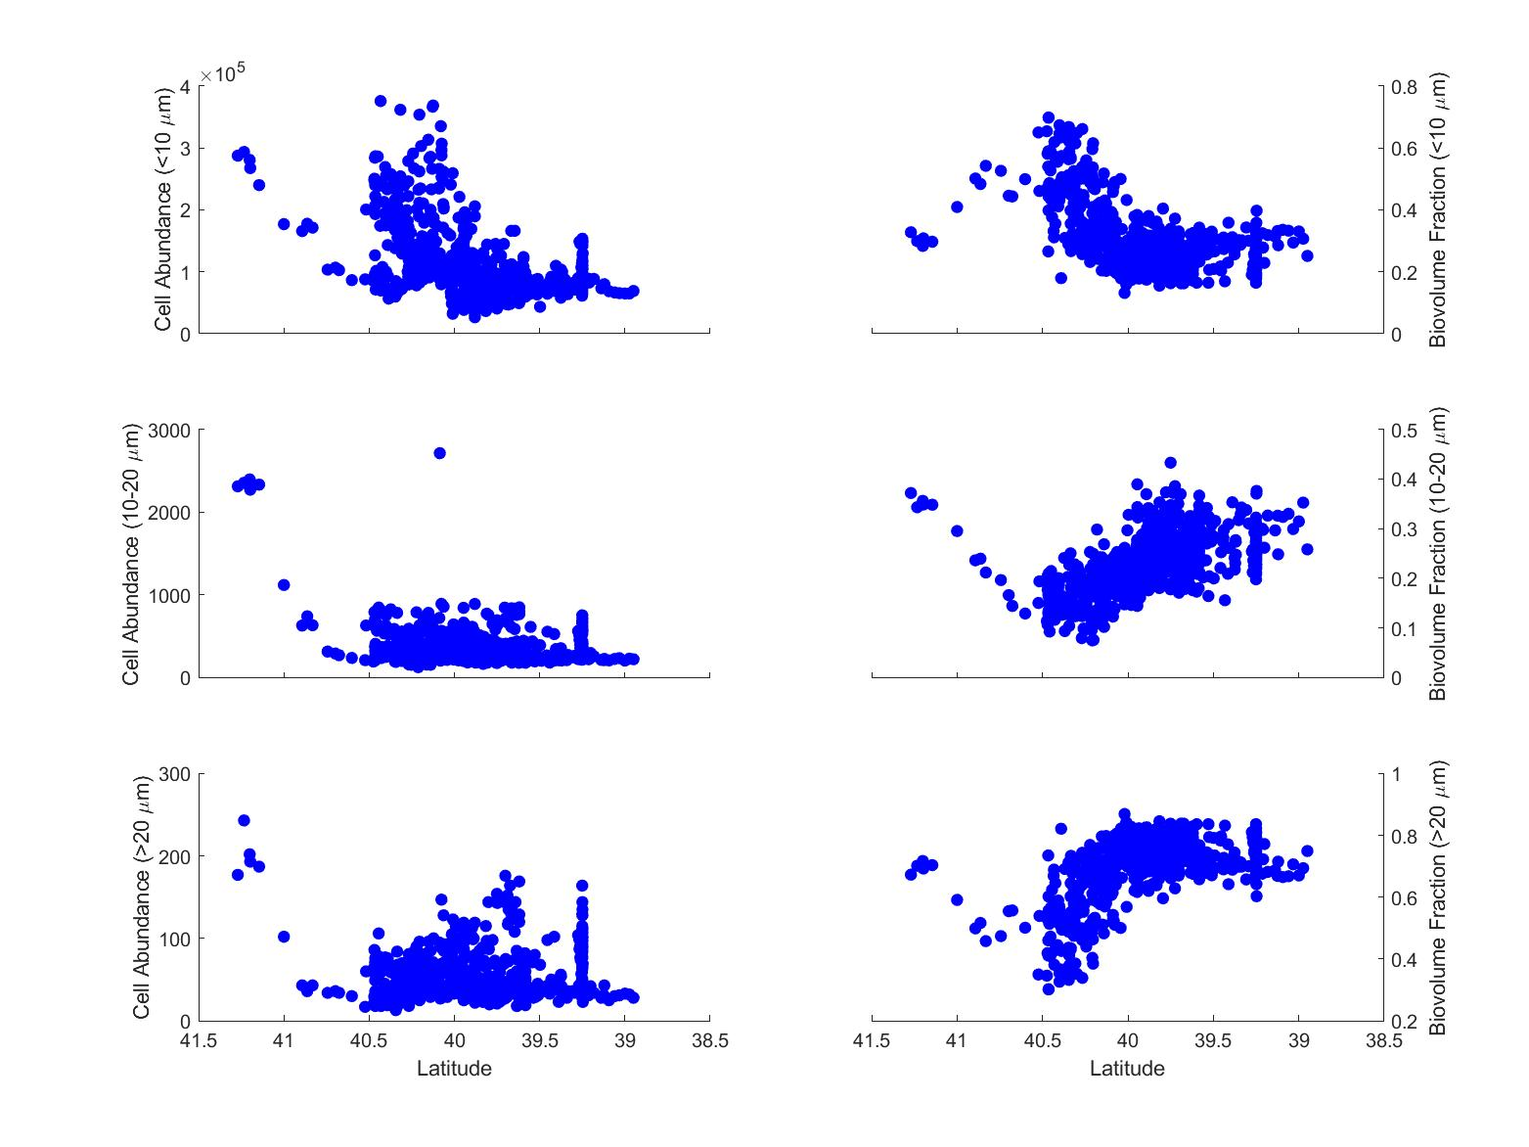
TN368

Slide 8
