Slide 1
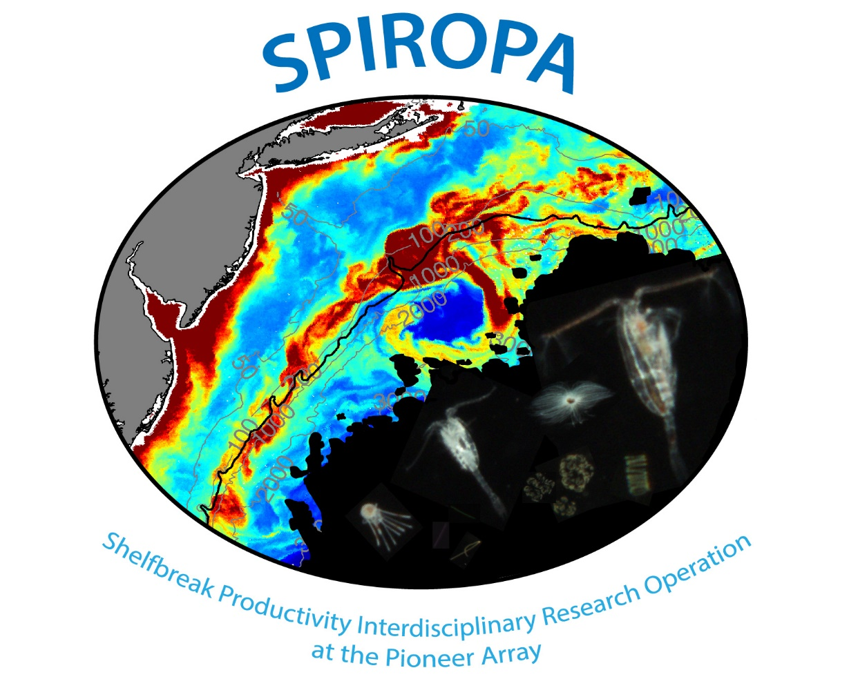

Slide 2
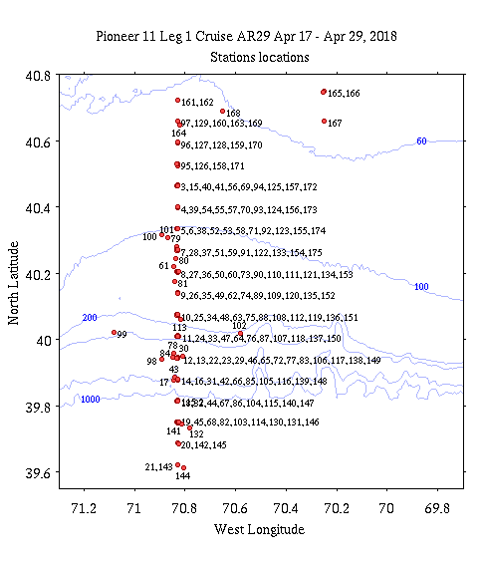

Slide 3
SPIROPA Armstrong 29
 | Mean | Min | Max | N | Stdev
Total Primary Productivity | 1754.9 | 196.4 | 4358.1 | 23 | 1117.3
> 20 µm Productivity | 86.1 | 1.9 | 260.4 | 20 | 82.3
Percentage > 20 µm | 5.0 | 0.6 | 14.5 | 20 | 4.40
Mean integrated productivity, all stations, both total (GFF filters) and productivity in the > 20 µm fractions
Conclusion:
On average large fraction contributed a small proportion of productivity; photosynthesis dominated by small forms
Overall productivity was quite substantial

Slide 4
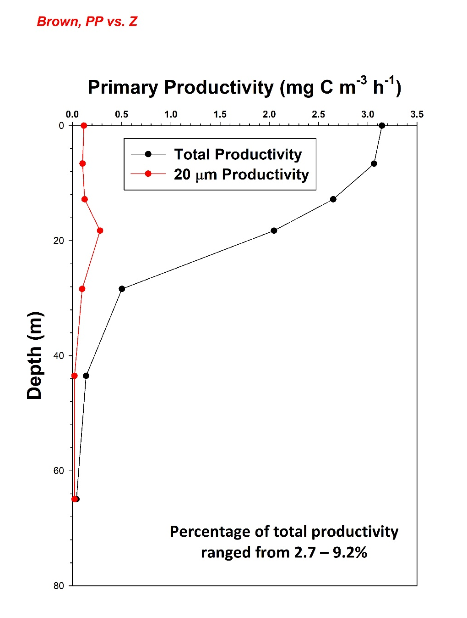
SPIROPA Armstrong 29
Mean productivity, all stations (sorted by light depth)
Both total (GFF filters) and productivity in the > 20 µm fractions
Conclusion: on average large fraction contributed a small amount of productivity; photosynthesis dominated by small forms

Slide 5
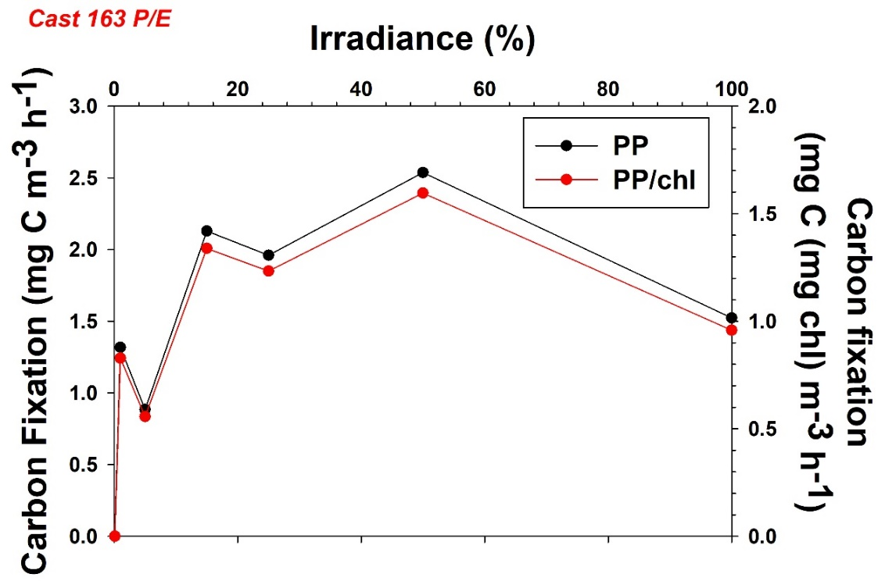
SPIROPA Armstrong 29
Photosynthesis-Irradiance Measurements
On two stations (129 and 163, both inshore at A2) that were apparently Phaeocystis rich, crude photosynthesis/irradiance measurements were made in which water from one depth was incubated at a range of irradiances
Conclusion: Productivity per unit chlorophyll was similar between the two stations and the maximal rate observed close to 15% E_{o} at Cast 129 and 50% E_{o} at Cast 163; inhibition at full light noted, but not unexpected
Water taken from 5% isolume (26 m); incubation 4 h

Slide 6
Question: Is primary productivity enhanced at the shelf break?
Location | A5 – A8 | A9 – A11 | A14 –A17
Primary Productivity (mg C m⁻² d⁻¹) | 1017.0 ± 475.2 (6) | 1523.7 ± 1525.4 (6) | 2059.1 ± 1261.1 (7)
Based solely on biased productivity data, and a limited number of stations, productivity at the shelf break appears to be slightly enhanced relative to inshore but less than that offshore

Slide 7
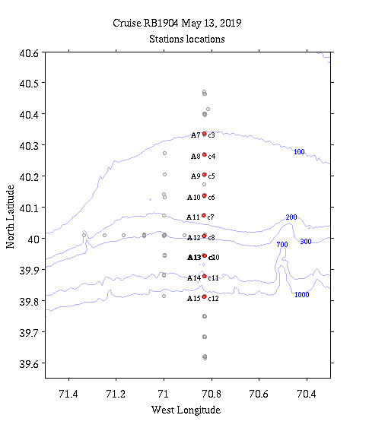

Slide 8
SPIROPA Brown 19-04
 | Mean | Min | Max | N | Stdev
Total Primary Productivity | 1370.0 | 170.3 | 3552.5 | 21 | 897.6
> 20 µm Productivity | 87.2 | 41.0 | 188.1 | 8 | 53.8
Percentage > 20 µm | 12.5 | 4.0 | 43.7 | 8 | 13.45
Mean integrated productivity, all stations, both total (GFF filters) and productivity in the > 20 µm fractions
Conclusion: On average large fraction contributed a small proportion of productivity, but a greater proportion than in the spring cruise on the Armstrong
Overall productivity was quite substantial, but slightly less than found on the Armstrong

Slide 9
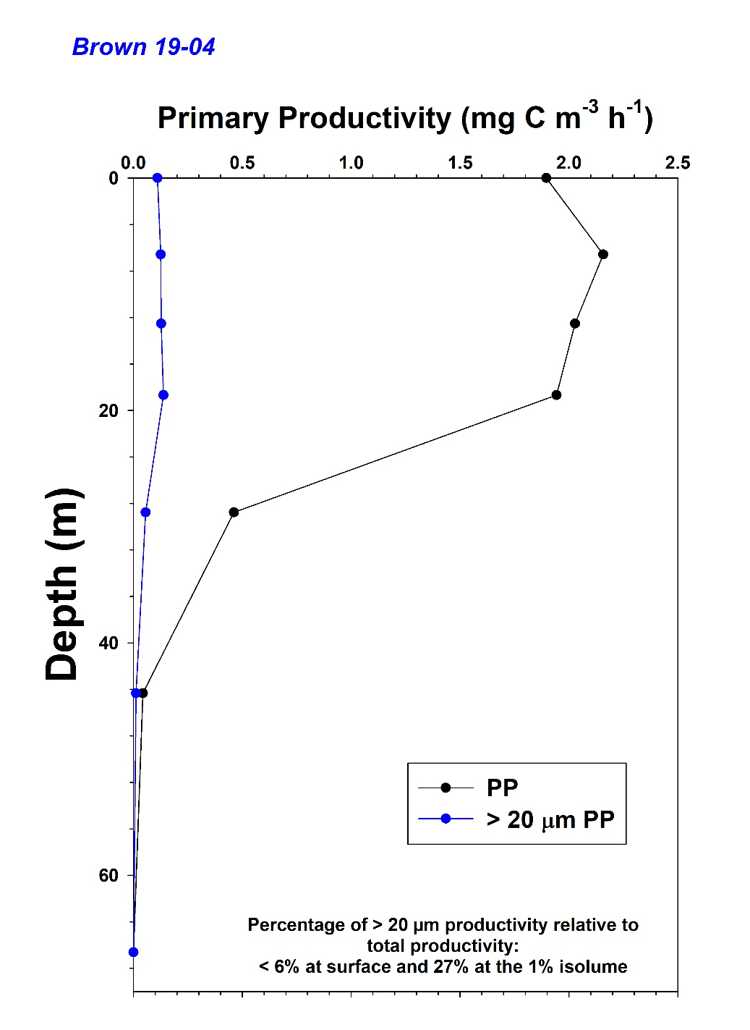
SPIROPA Brown 19-04
Mean productivity, all stations (sorted by light depth)
Both total (GFF filters) and productivity in the > 20 µm fractions shown
Conclusion: As in the Armstrong cruise, the large fraction contributed a small amount of productivity; photosynthesis dominated by small forms

Slide 10
Question: Is primary productivity enhanced at the shelf break?
Location | A5 – A8 | A9 – A11 | A14 –A17
Primary Productivity (mg C m⁻² d⁻¹) | 957.4 ± 148.2 (3) | 1487.7 ± 881.0 (9) | 1133 ± 1019.3 (3)
Based solely on biased productivity data, and a limited number of stations, productivity at the shelf break does appear to be slightly enhanced relative to inshore and offshore

Slide 11
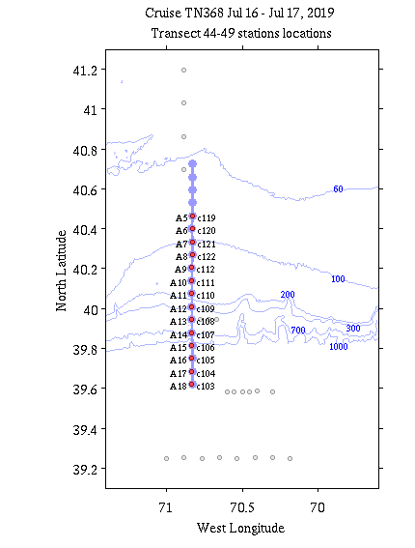
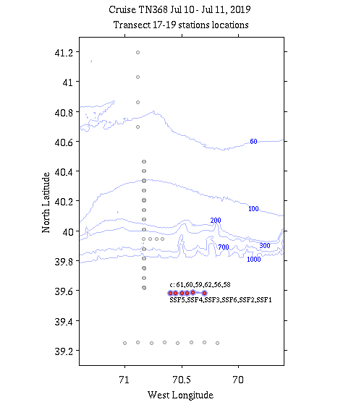

Slide 12
SPIROPA Thompson 368
 | Mean | Min | Max | N | Stdev
Total Primary Productivity | 500.2 | 174.7 | 1259.7 | 25 | 276.4
> 20 µm Productivity | 104.2 | 24.5 | 348.2 | 18 | 72.8
Percentage > 20 µm | 22.6 | 9.9 | 37.4 | 18 | 8.10
> 10 µm Productivity | 156.8 | 104.8 | 178.7 | 4 | 34.8
Percentage > 10 µm | 32.5 | 39.5 | 46.2 | 4 | 21.5
Mean integrated productivity, all stations, both total (GFF filters) and productivity in the > 20 µm fractions
Conclusion: On average large fraction contributed a significant proportion of productivity, being greater by percentage of any cruise
Overall productivity was quite modest and less than the other cruises
Productivity in the 10 µm was also relatively high, consistent with the 20 µm fraction; the question is what is driving this! And what does it mean!

Slide 13
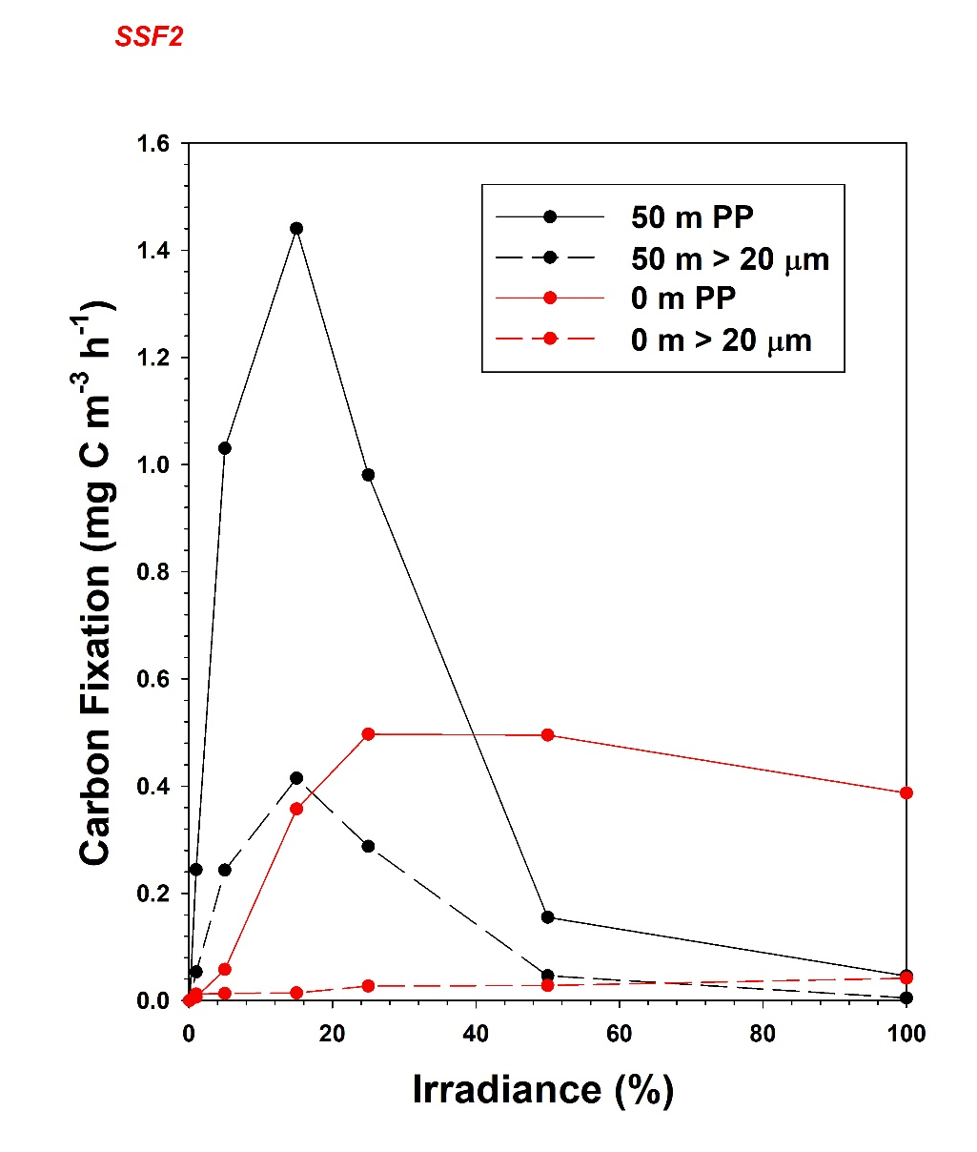
Photosynthesis-Irradiance Measurements
Station SSF2 apparently had a deep maximum of chlorophyll (at ca. 50 m); a P/E experiment was run on the surface and 50 m assemblages (also size fractioned)
Note: not expressed per unit chlorophyll
Conclusion: Productivity maximum was greater at the 50 m sample, but is driven by the greater biomass; substantial photoinhibition was observed, suggesting a marked adaptation to low irradiances; estimated P_{max} occurred at 15% Eo;
In contrast, the surface assemblage had little large cell contribution, and was well acclimated to high irradiances

Slide 14
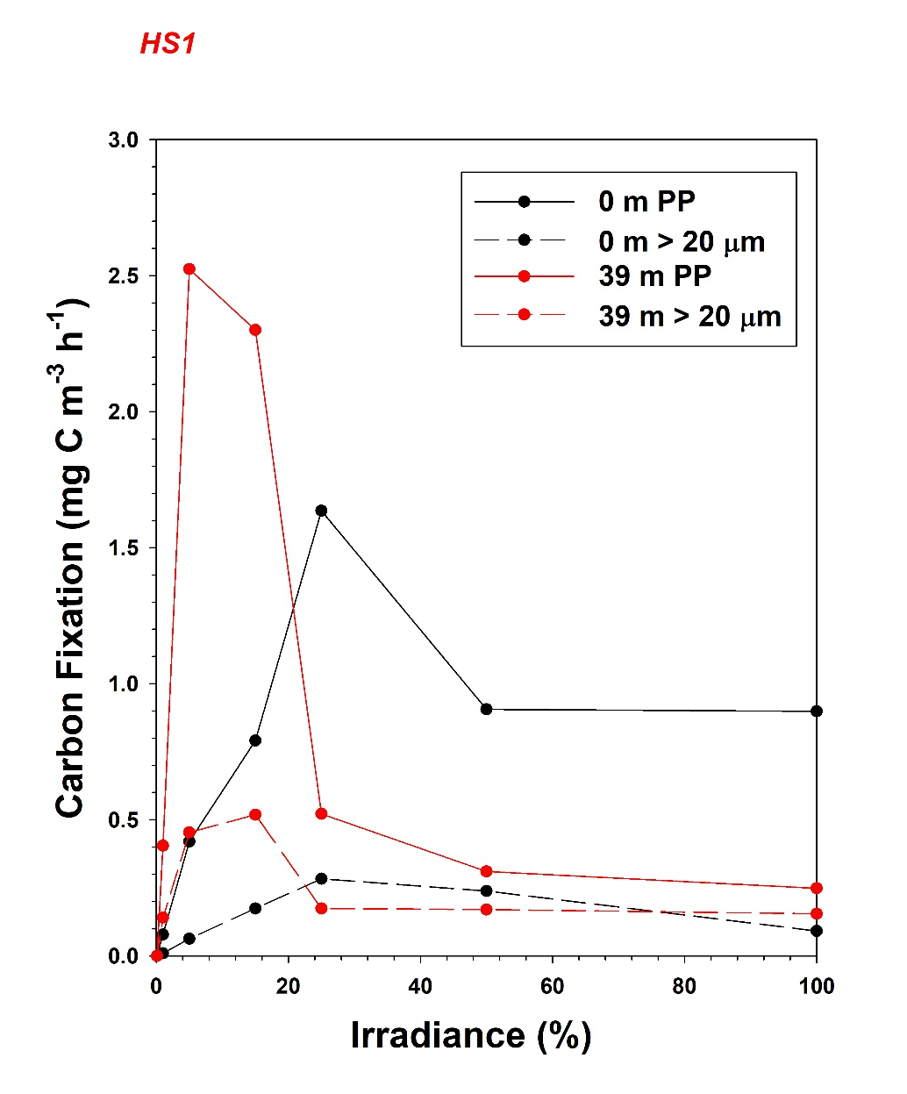
Photosynthesis-Irradiance Measurements
Station HS1 also had a deep maximum of chlorophyll (at ca. 40 m); a P/E experiment was run on the surface and 39 m assemblages (also size fractioned)
Note: not expressed per unit chlorophyll
Conclusion: Productivity maximum was greater at the 39 m sample, but is driven by the greater biomass; substantial photoinhibition was observed, suggesting a marked adaptation to low irradiances; estimated P_{max} occurred at 5-15% E_{o};
In contrast, the surface assemblage again was well acclimated to high irradiances; contribution of larger cells was similar between the two depths and assemblages

Slide 15
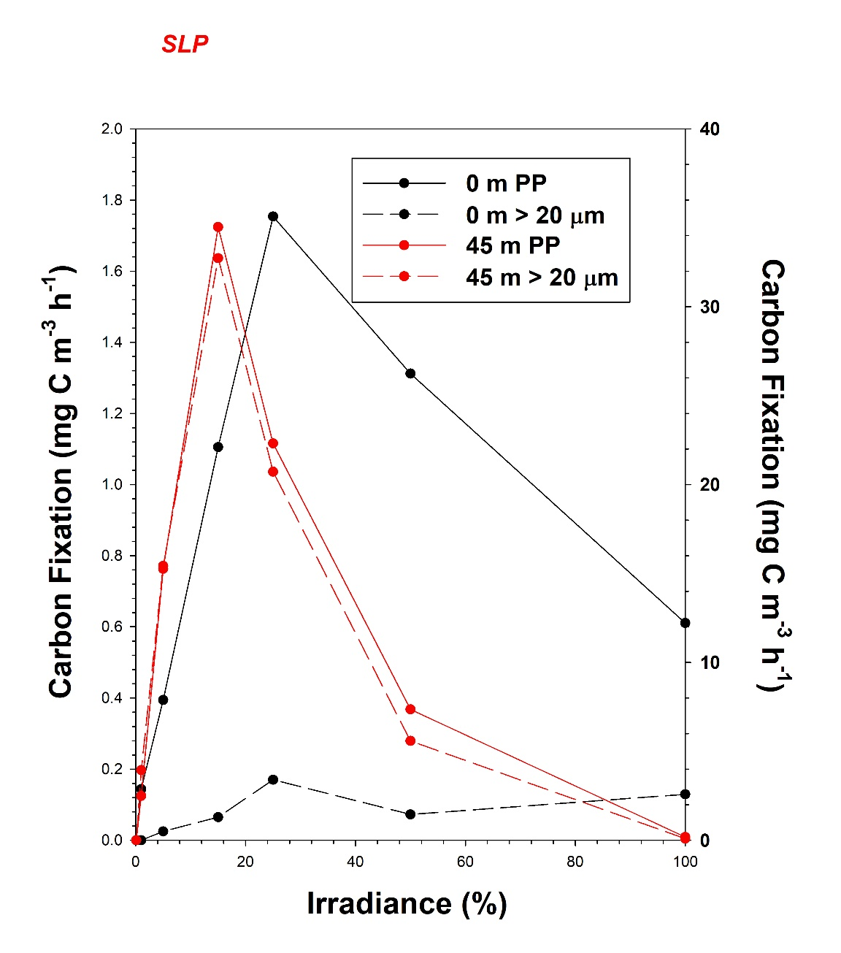
Photosynthesis-Irradiance Measurements
Station SLP also had a deep maximum of chlorophyll (at ca. 45 m); a P/E experiment was run on the surface and 45 m assemblages (also size fractioned)
Note: not expressed per unit chlorophyll
Conclusion: Productivity maximum was much greater at 45 m sample, but is driven by the greater biomass; substantial photoinhibition was observed, suggesting a marked adaptation to low irradiances; estimated P_{max} occurred at 15% E_{o};
The surface assemblage also showed photoinhibition; contribution of larger cells was extreme at 45 m (nearly 100%) but much less at the surface

Slide 16
Question: Is primary productivity enhanced at the shelf break?
Location | A5 – A8 | A9 – A11 | A14 –A17
Primary Productivity (mg C m⁻² d⁻¹) | 807.2 ± 498.6 (4) | 539.4 ± 45.1 (4) | 402.1 ± 235.0 (10)
Based solely on biased productivity data, and a limited number of stations, productivity at the shelf break does not appear to be greatly enhanced relative to inshore and offshore

