Slide 1
Rates of Net Community Production and Gross Primary Production from in situ Gas Tracers
Rachel H. R. Stanley, Zoe O. Sandwith
Frannie Adams, Alice Choe, Arshia Mehta
Erin Kim, and Lumi Kinjo
Wellesley College, WHOI
rachel.stanley@wellesley.edu

Slide 2
“Flavors” of productivity
Net community production (NCP) = photosynthesis – community respiration = net CO₂ drawdown by biological pump
Gross primary production (GPP) = photosynthetic rate only
Photosynthesis –
Community Respiration

Slide 3

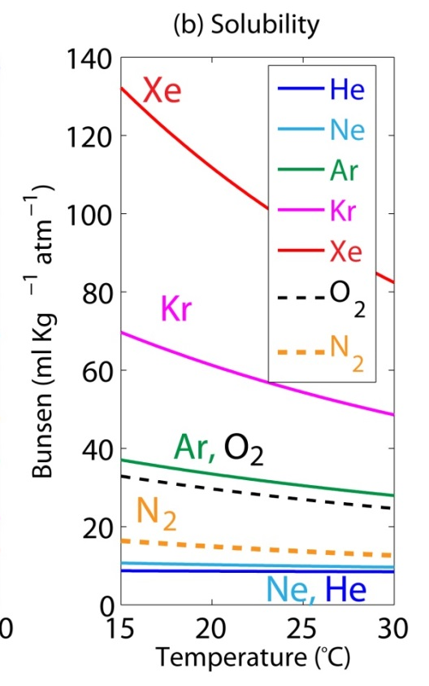
NCP from O₂/Ar
Solubility in Seawater
CO₂ + H₂O CH₂O + O₂
Oxygen: a biogenic gas
Argon: an inert gas, similar solubility to O₂
Ratio O₂/Ar → corrects for some physical processes → net community production
Notes:
Explain why don’t just measure CO2 directly! B/c of buffer system changes very slowly, harder to pinpoint effects of respiration though can do it. doesn’t have good abiotic analogue.

Slide 4
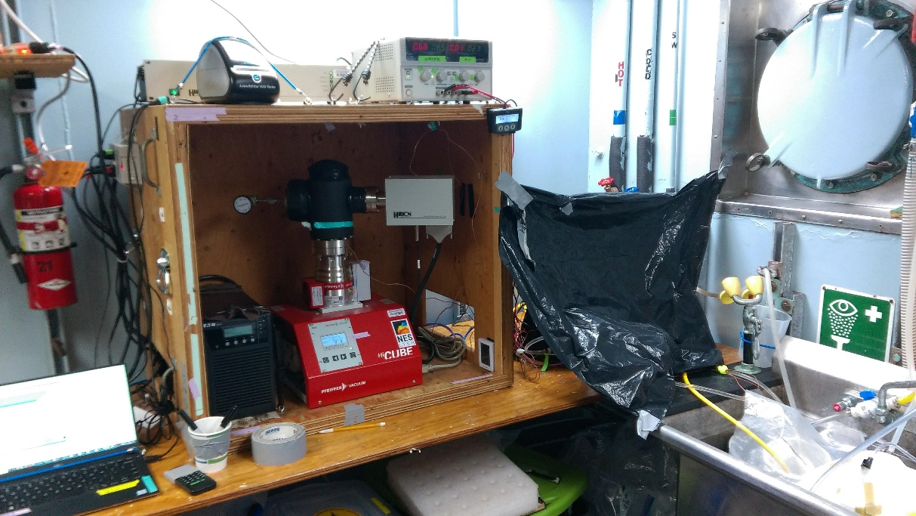
NCP from O₂/Ar
CO₂ + H₂O → CH₂O + O₂
Oxygen: a biogenic gas
Argon: an inert gas, similar solubility to O₂
Ratio O₂/Ar → corrects for some physical processes → net community production
Can measure from underway system, ~2 km resolution
Notes:
Explain why don’t just measure CO2 directly! B/c of buffer system changes very slowly, harder to pinpoint effects of respiration though can do it. doesn’t have good abiotic analogue.

Slide 5
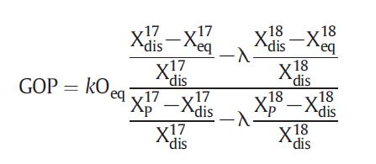
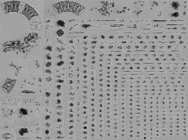
GPP from Triple Oxygen Isotopes
¹⁷Δ = measure of ratio of ¹⁶O, ¹⁷O, and ¹⁸O
= ln(δ¹⁷O/1000+1)-0.5179ln(δ¹⁸O/1000+1)x10⁶
The larger the ¹⁷Δ, the higher the percentage of photosynthetic oxygen.
Atmosphere
UV Radiation → Mass Independent Fractionation
more ¹⁷O then ¹⁸O
GPP
¹⁷Δ of O₂ = 0 per meg
Photosynthetic O₂ → Mass Dependent Fractionation
derived from H₂O more ¹⁸O than ¹⁷O
Calculate GPP
¹⁷Δ of O₂ = 249 per meg
Ocean
Notes:
Add some statement htat both of these gas techniques are in situ
They dont

Slide 6
Progress Update
We have calculated rates of NCP from continuous data for all 3 cruises
We have calculated GOP and NCP:GOP from TOI (triple oxygen isotope) discrete samples for Ar29 and RB1904
TOI samples from TN368 will finish running next week
Next steps:
Calculate GOP from TN368
Interpret!
Apply corrections for physical transport to the data

Slide 7
Continuous rates of
Net Community Production

Slide 8
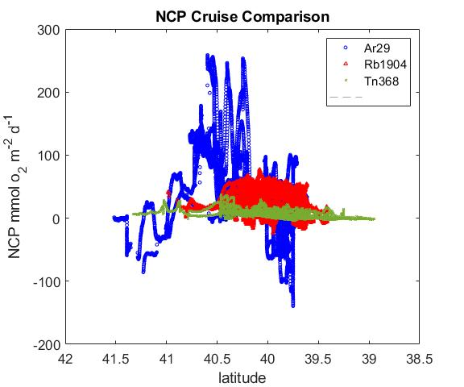
NCP on the 3 Cruises

Slide 9
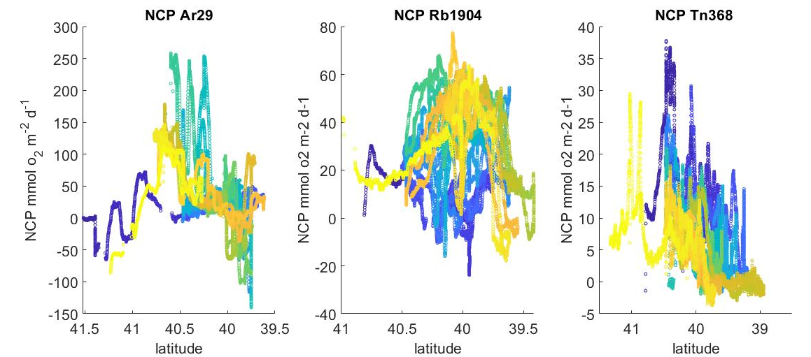
NCP on each cruise
Color represents days since the cruise started
Note the different axis ranges
AR 29
RB 1904
Tn368
Spring 2018
Spring 2019
Summer 2019

Slide 10
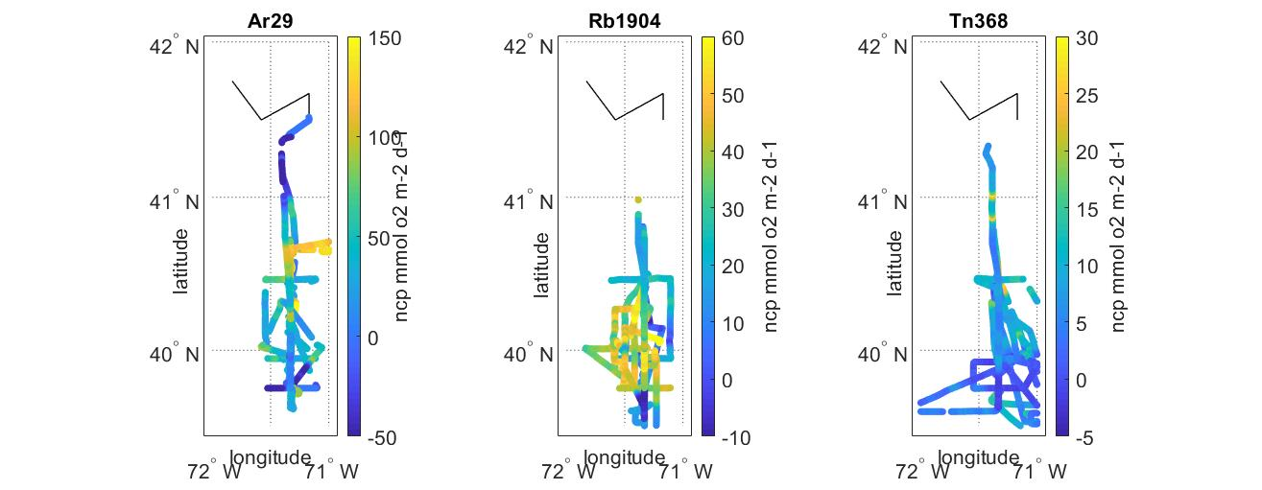
Spatial maps of NCP on each cruise
NCP
NCP
NCP
Units of NCP = mmol O₂ m⁻² d⁻¹

Slide 11
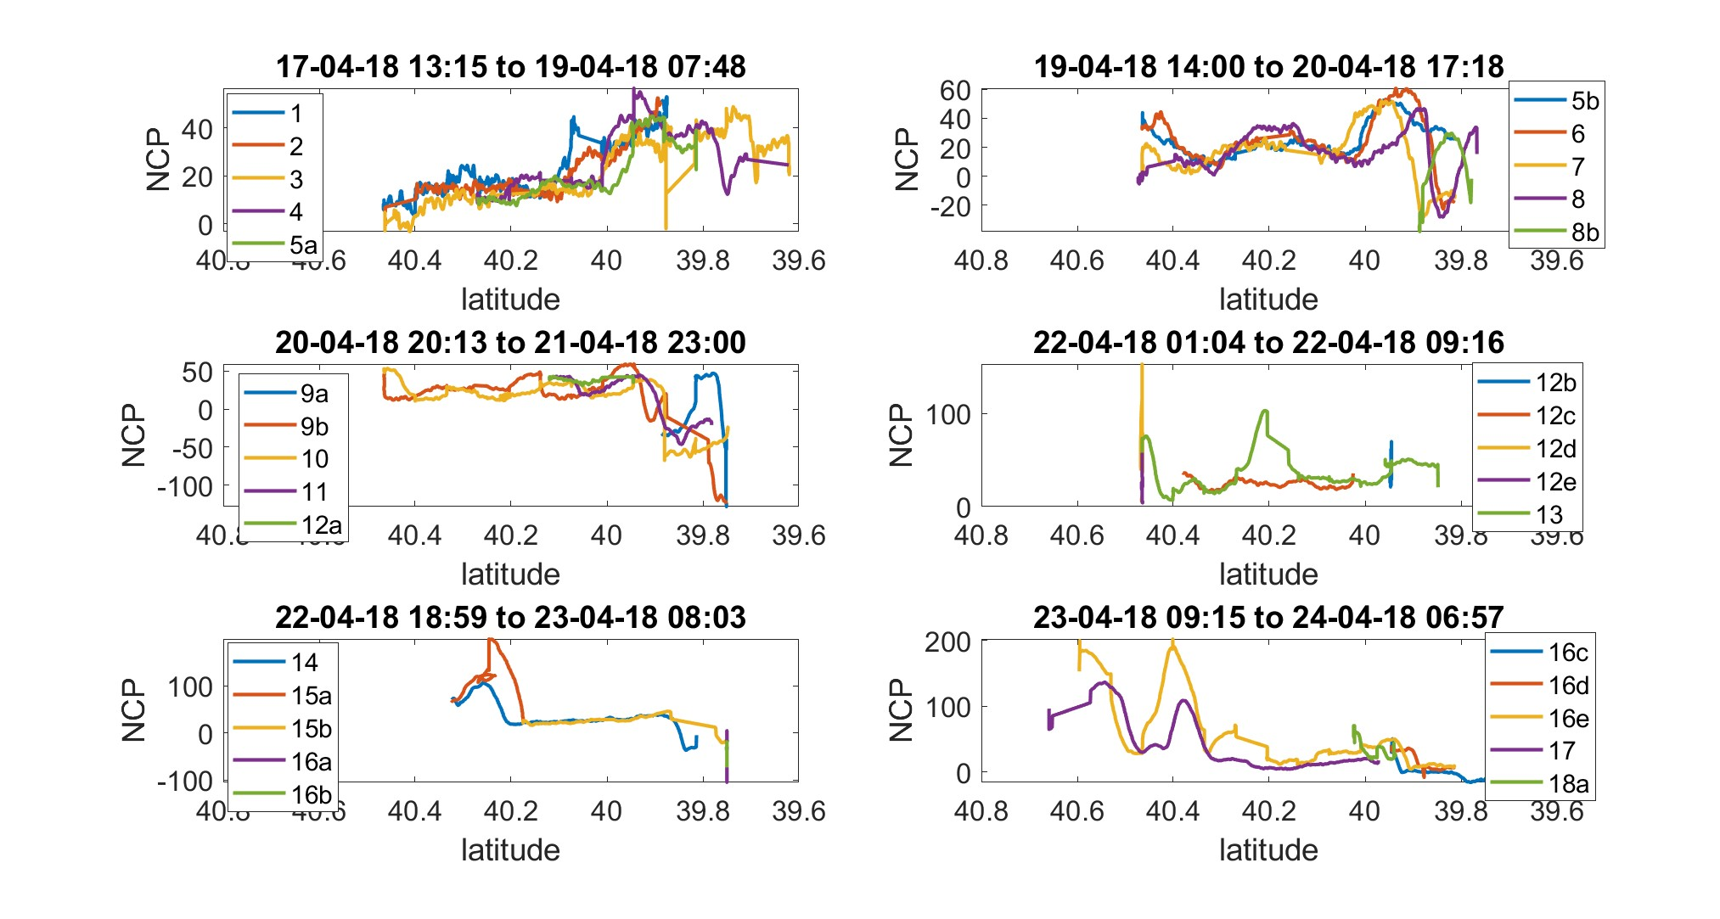
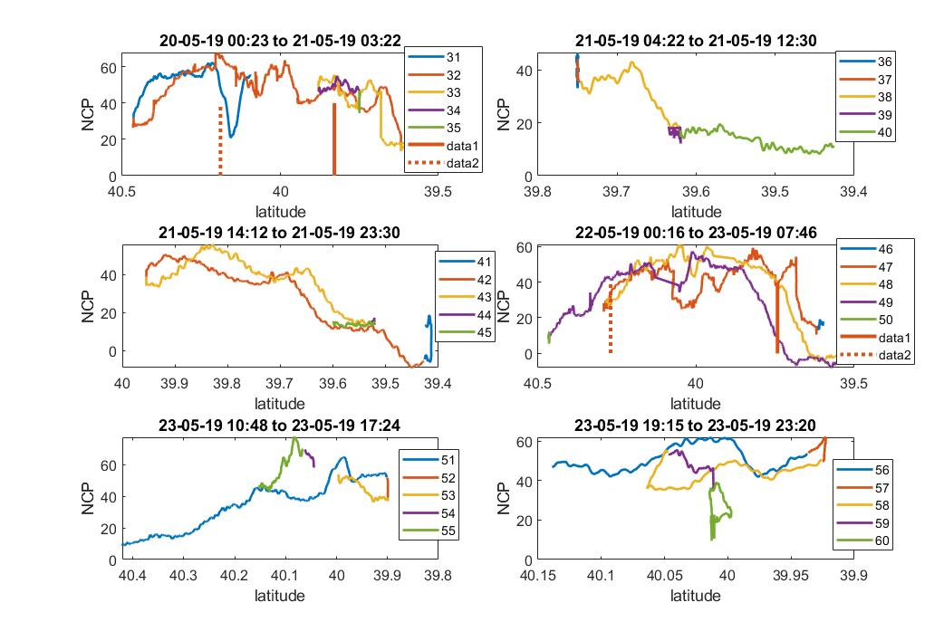
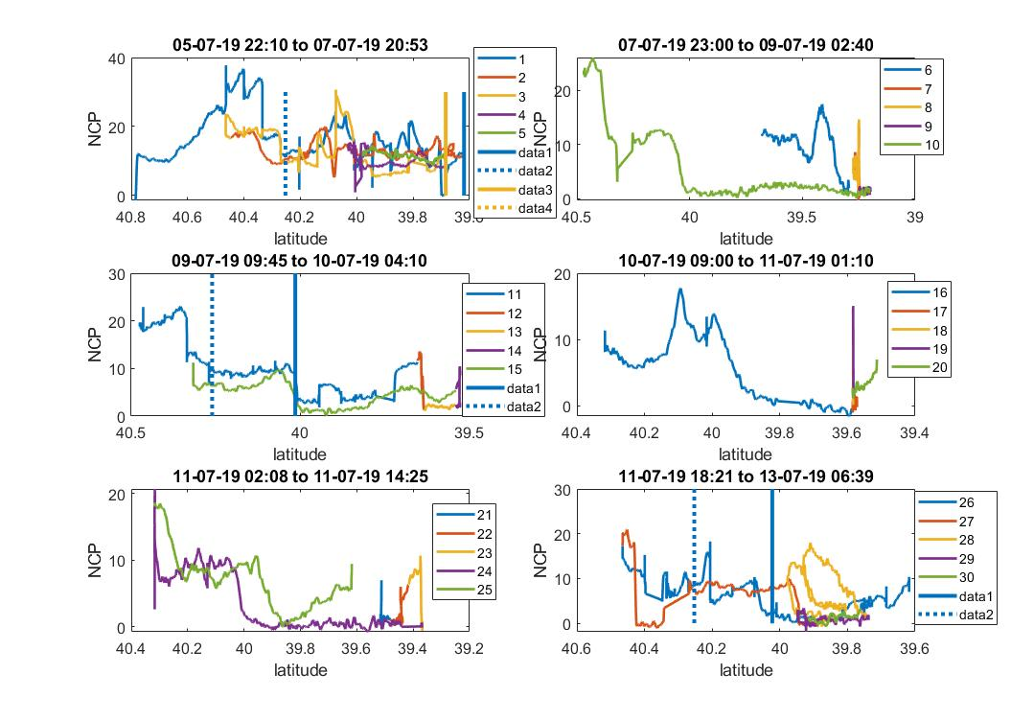
Selected transects (more at end)
Title is start and end date of transects on figure
Ar29
Rb1904
Front
foot
Tn368
Front
foot

Slide 12
Rates of Gross Primary Production and the NCP/GPP ratio
NCP/GPP Ratio is a measure of carbon cycle efficiency
Higher ratio → system with high export
Low ratio → system that efficiently recycles its carbon

Slide 13
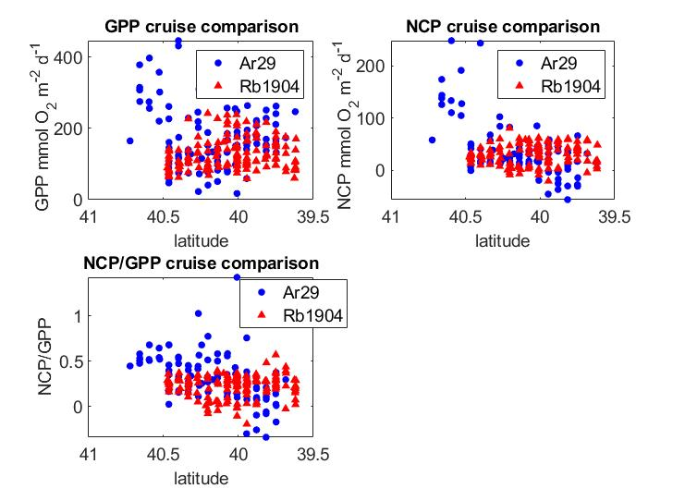
Comparing the
Spring Cruises

Slide 14
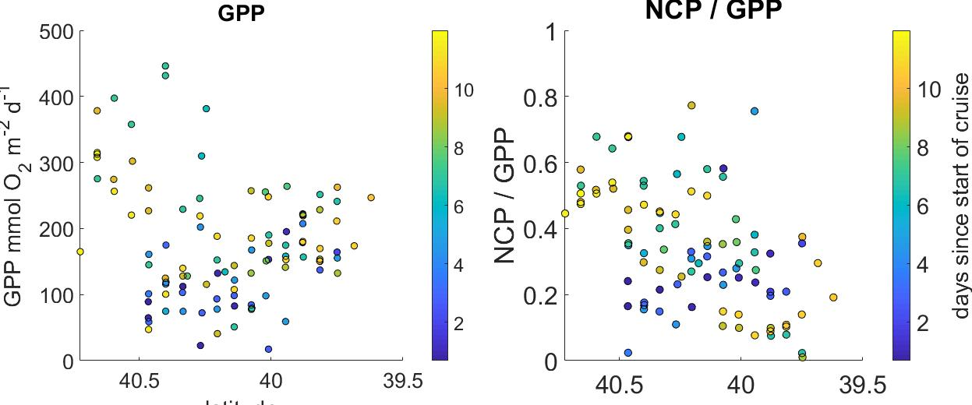
Ar29
latitude
latitude

Slide 15
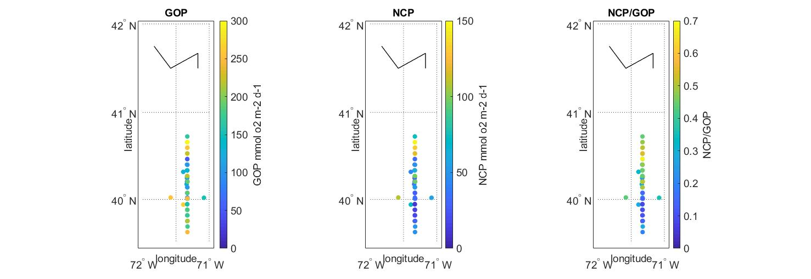
Ar29

Slide 16
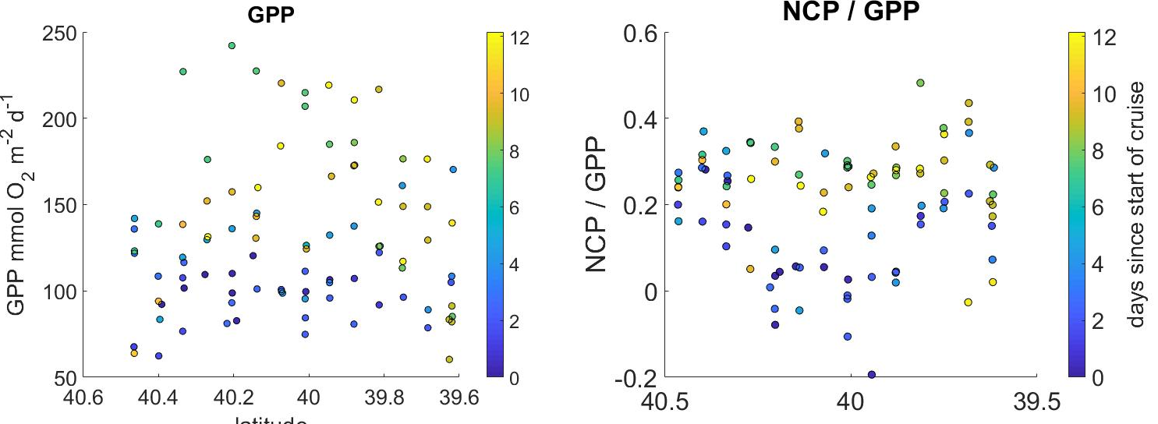
Rb1904
(along the main transect line)
latitude
latitude

Slide 17
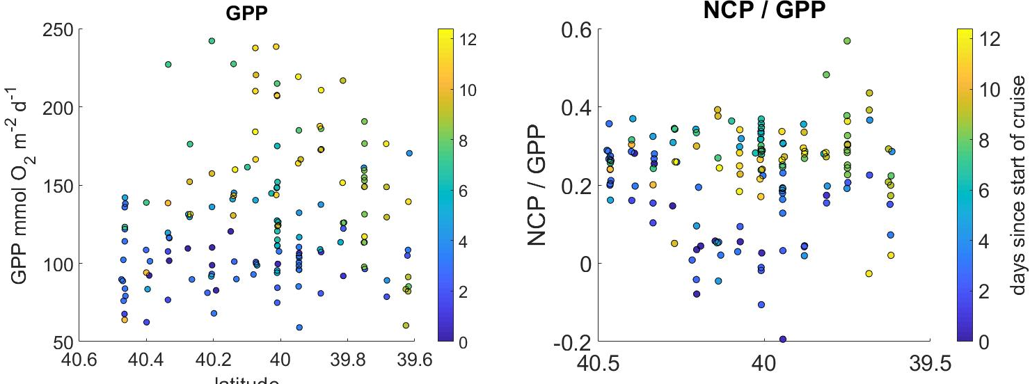
Rb1904
(all the data)
latitude
latitude

Slide 18
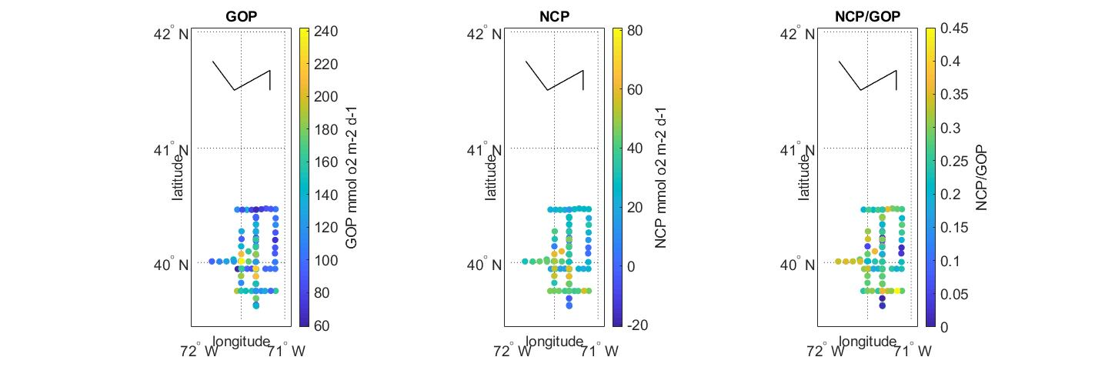
RB 1904

Slide 19
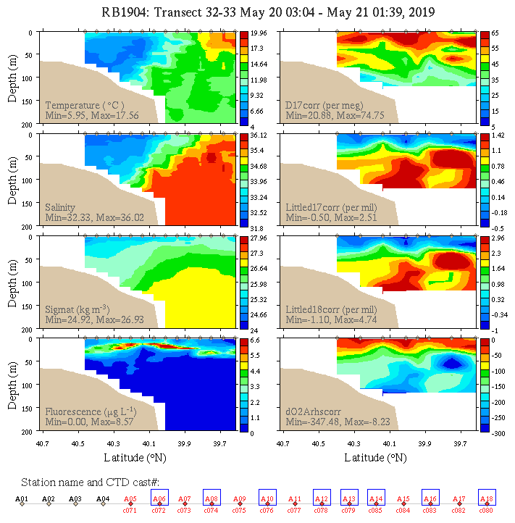
Contour Maps of D17
Larger D17 means higher percentage of oxygen comes from photosynthesis (as opposed to air-sea gas exchange)
Thanks Olga for making these figures!

Slide 20
Slides for seeing details and looking at your favorite transect!
NCP as function of time for each cruise separately
All transects

Slide 21
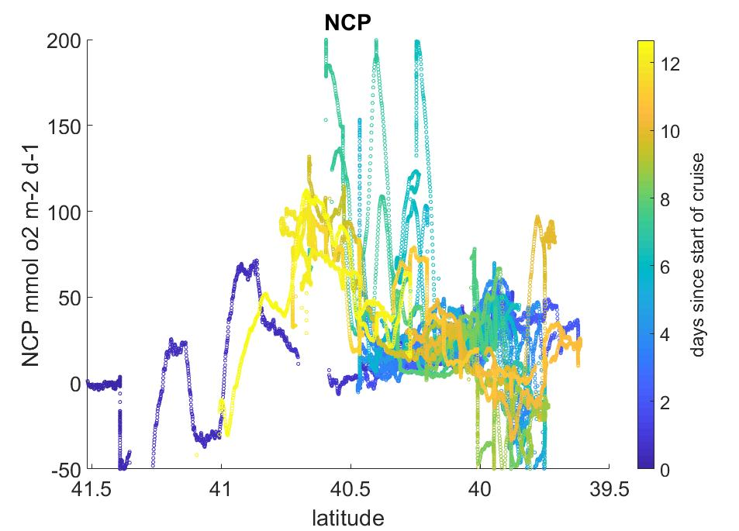
NCP Ar29

Slide 22
Ar29a transects #1-18a

Slide 23
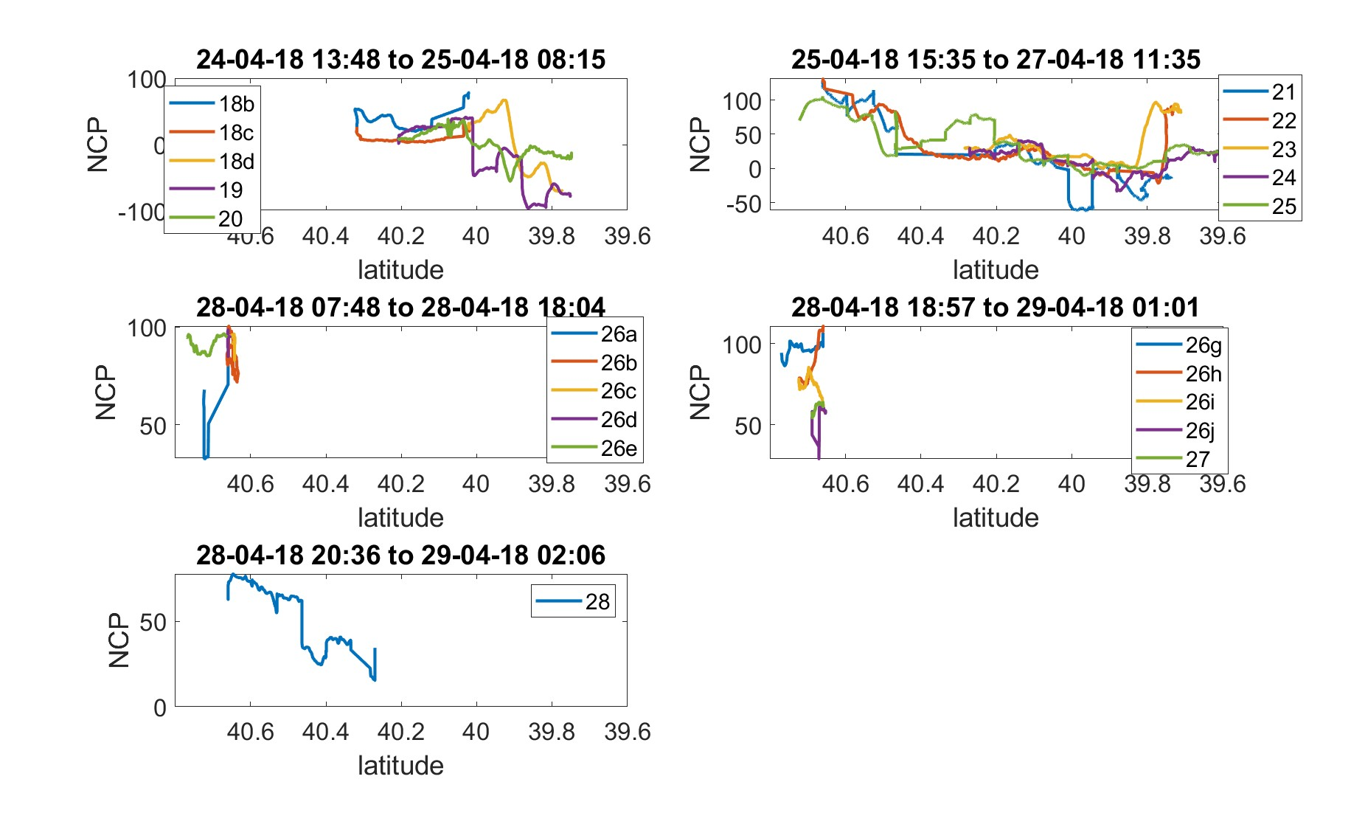
Ar29a transects #18b to #28

Slide 24
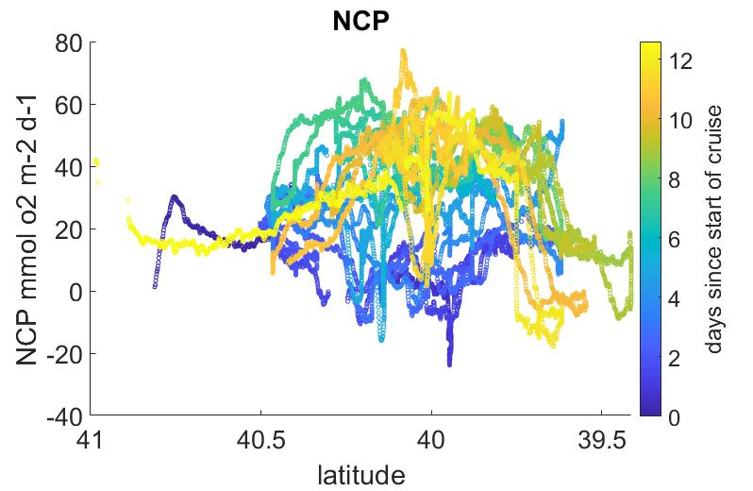
NCP RB1904

Slide 25
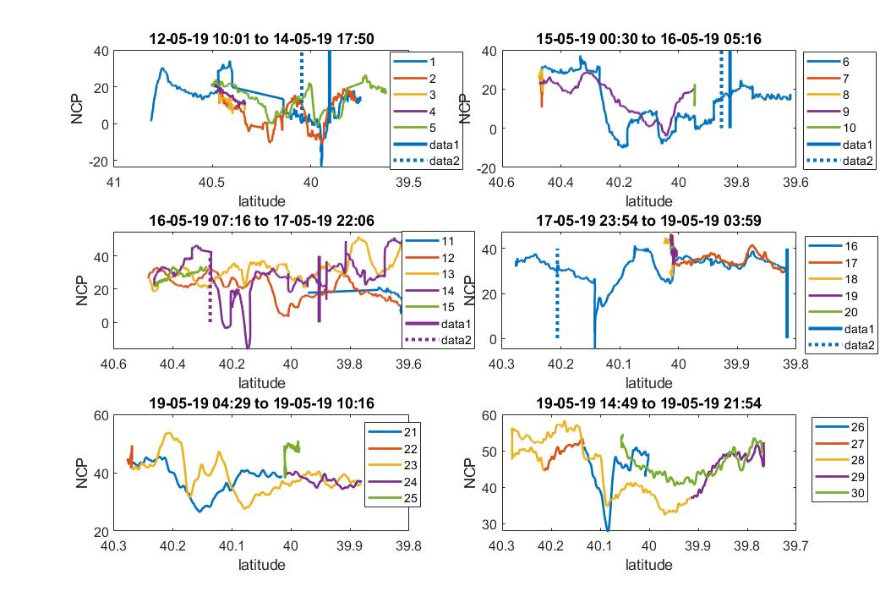
Rb1904 Transects #1-#30

Slide 26
Rb1904 Transects #31-#60

Slide 27
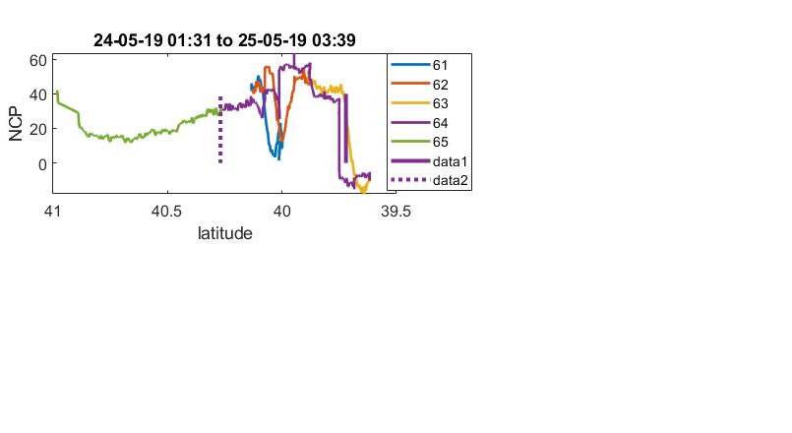
Rb1904 Transects #61 to #65

Slide 28
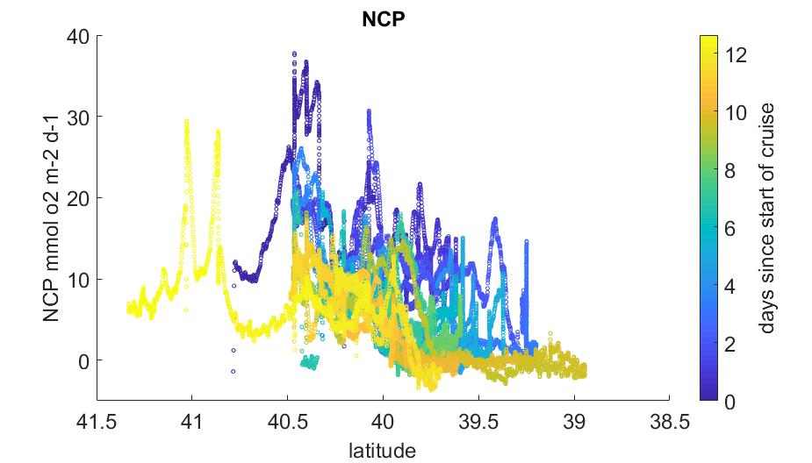
NCP Tn368

Slide 29
Tn 368 Transects #1-#30

Slide 30
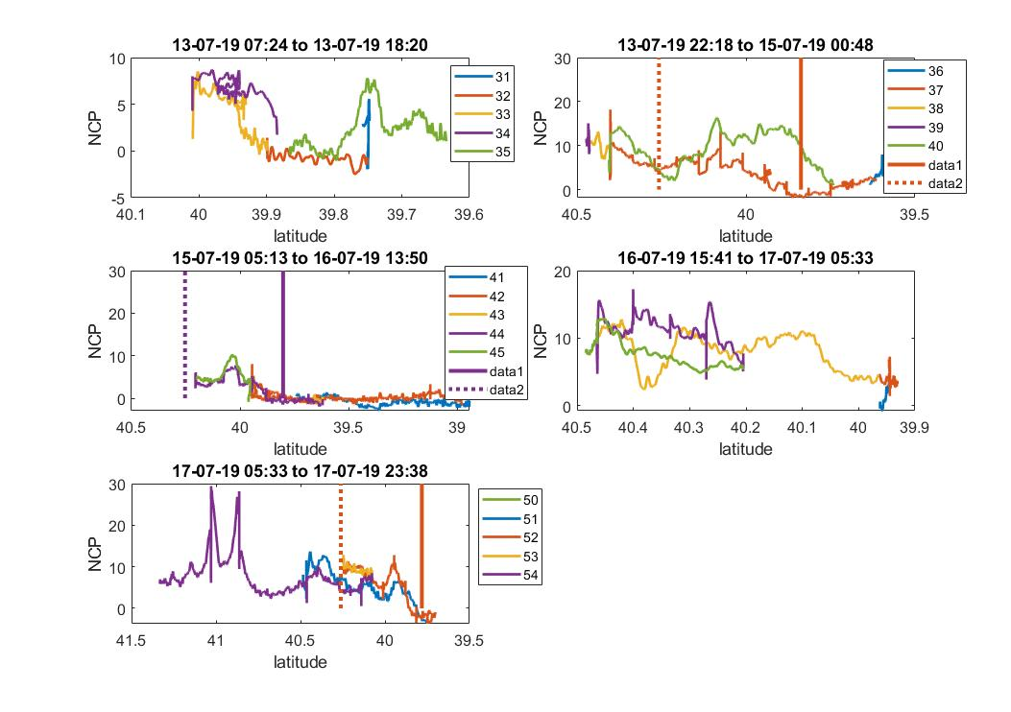
Tn 368 Transects #31-#54
46
47
48
49
50

