Slide 1
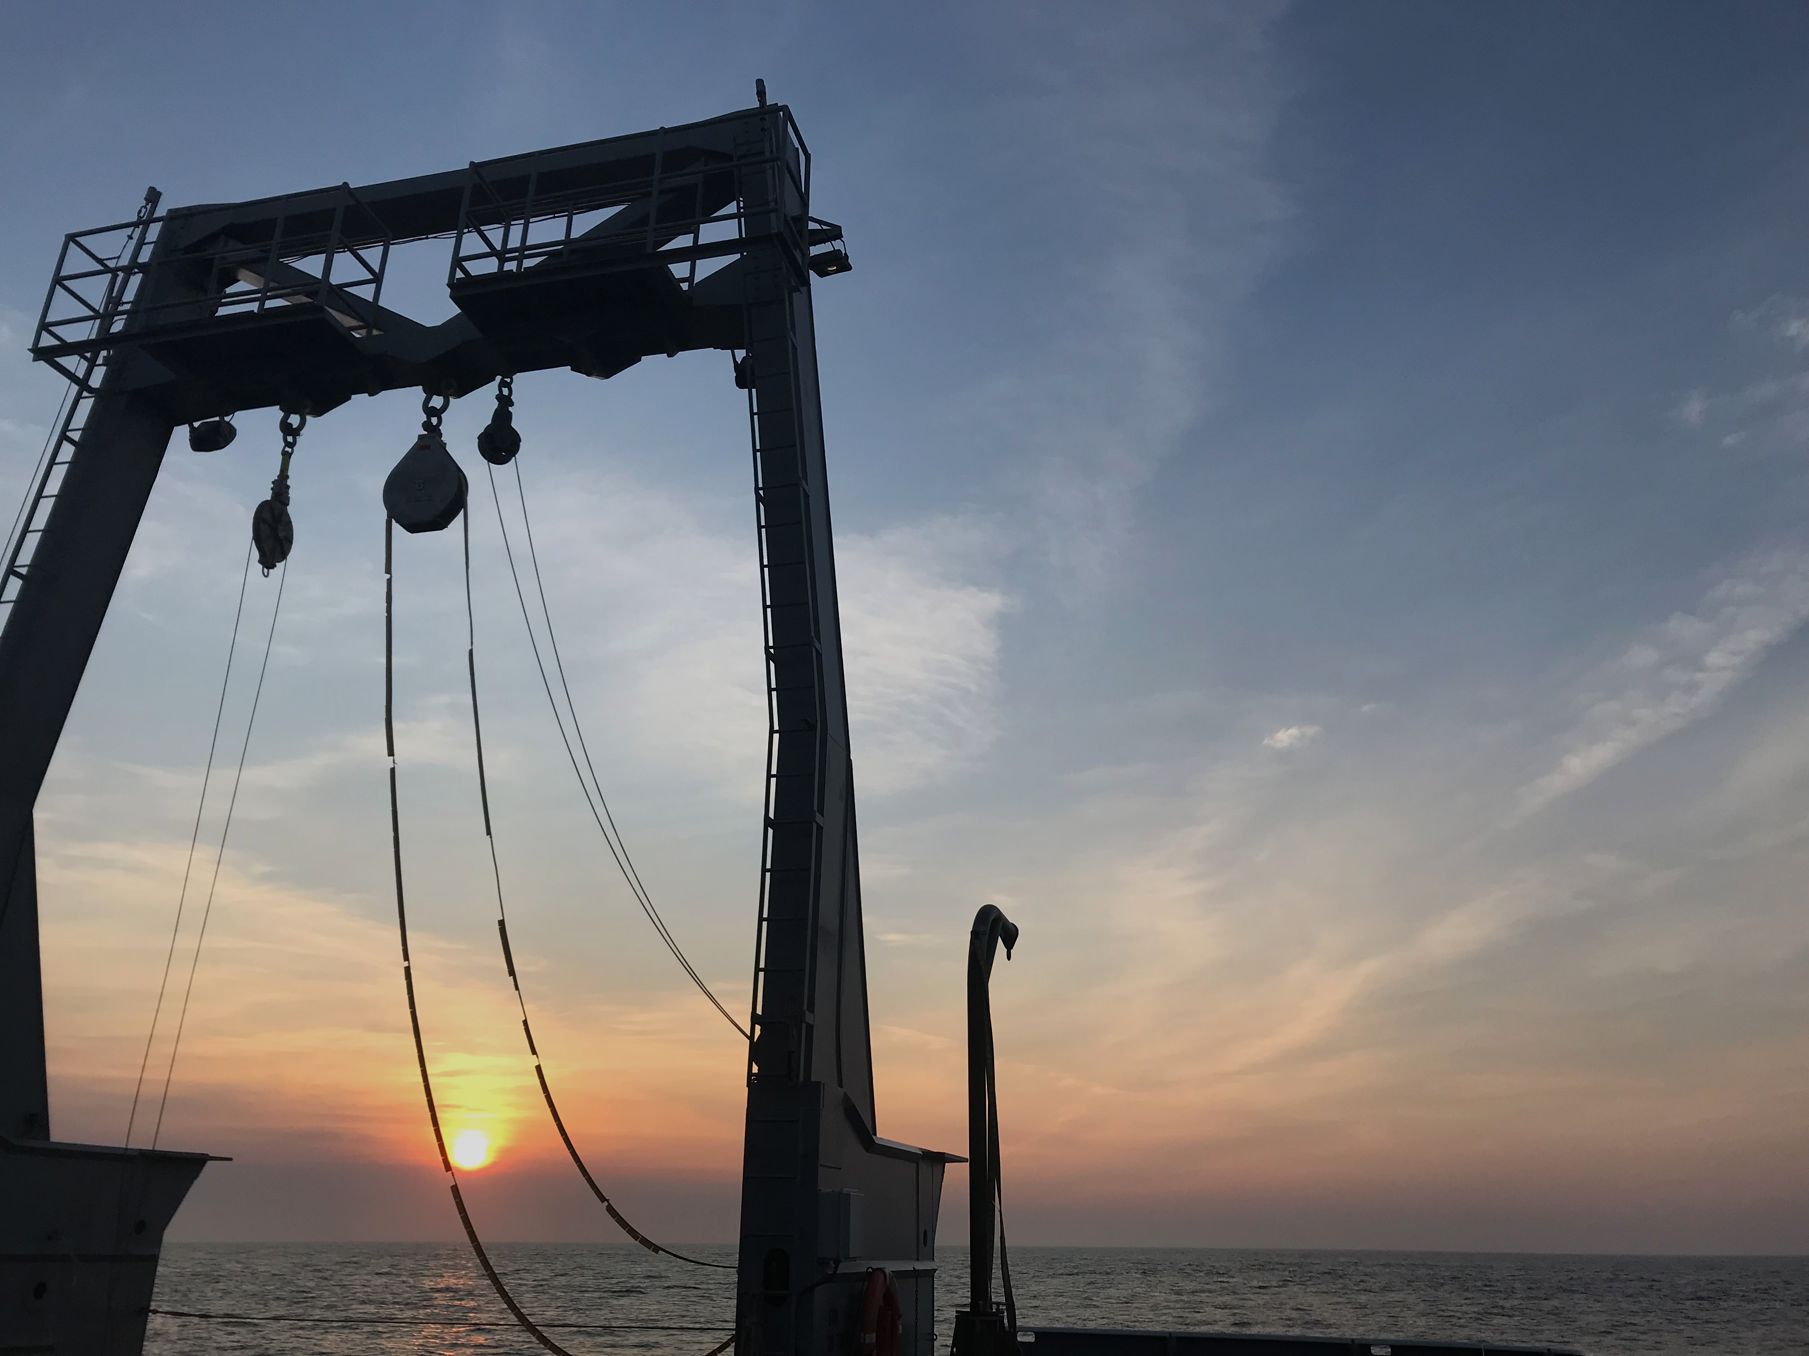
SPIROPA RB1904 and TN368: N₂ fixation rates
November 7-8, 2019
ODU

Slide 2
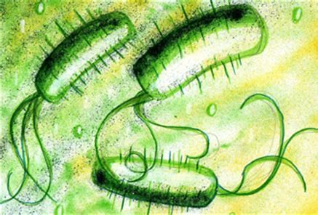
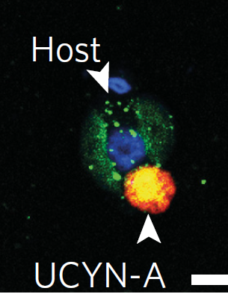
BACKGROUND
Marine N₂ fixation historically ascribed primarily to cyanobacteria (e.g., Trichodesmium) in warm, oligotrophic waters
Called into question by geochemical models suggesting global
underestimation of marine N₂ fixation^{1,2,3}
Proteobacteria
Range of planktonic diazotrophs has since been expanded to include:
  higher latitude temperate oceanic regions⁴
  temperate and tropical coastal systems^{5,6,7}
  coastal Arctic Seas^{8,9,10}
  both euphotic and mesopelagic waters with significant
  concentrations (>1 μM) of dissolved inorganic nitrate (DIN)^{7,11}
N₂ fixation in these environments likely mediated by organisms with diverse metabolic requirements and sensitivities that likely differ substantially from those of Trichodesmium
Martinez-Perez et al., 2016 Nat Microbiol
¹Codispoti L (2007). Biogeosciences 4(2):233-253. ²Gruber N & Sarmiento JL (2002). The sea 12:337-399. ³Gruber N (2004). The ocean carbon cycle and climate. (Springer), pp 97-148. ⁴Moisander PH, et al. (2010). Science 327(5972):1512-1514. ⁵Voss M, et al. (2006). Geophysical Research Letters 33(7). ⁶Grosse J, et al. (2010). Limnology and Oceanography 55(4):1668-1680. ⁷Mulholland M, et al. (2012). Limnology and Oceanography 57(4):1067-1083. ⁸Blais M, et al. (2012). Global Biogeochemical Cycles 26(3). ⁹Sipler RE, et al. (2017). Limnology and Oceanography Letters 2(5):159-166. ¹⁰Knapp AN (2012). Frontiers in microbiology 3.

Slide 3
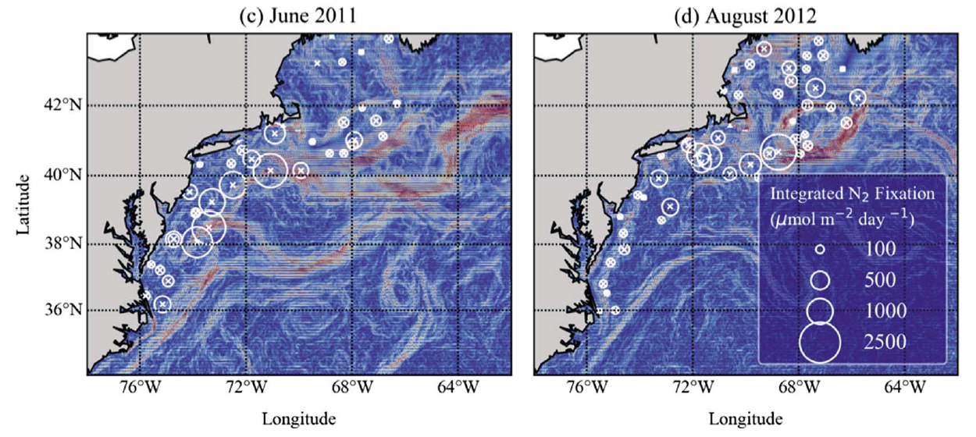

PRIOR WORK
Shelf waters between Cape Hatteras and the Gulf of Maine alone account for as much N₂ fixation as previous estimated for entire shelf (0.02 Tmol N/yr or ~7% of the estimated basin-wide N₂ fixation N inputs), despite accounting for only 6% of the total area (Mulholland et al., GBC 2019)
Depth-integrated N₂ fixation rates (NFR) over SST gradient (Mulholland et al., GBC, 2019)

Slide 4
PRIOR WORK
Highest rates often associated with frontal features, including at the Cape Hatteras Gulf Stream front (Selden et al., in prep.)
Depth-integrated N₂ fixation rates (NFR) over SST gradient (Mulholland et al., GBC, 2019)

Slide 5
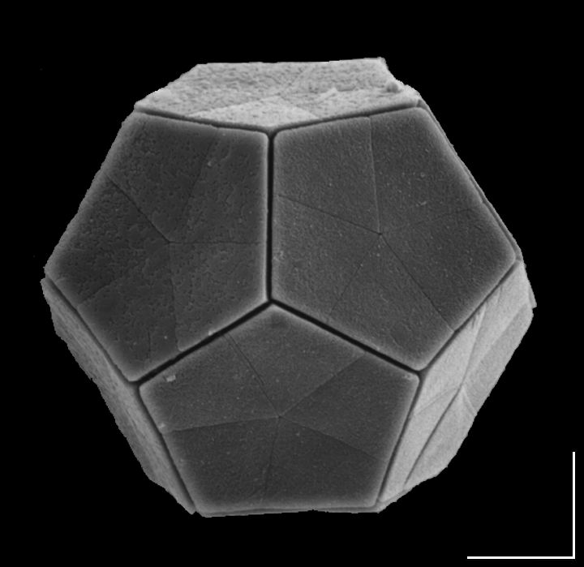
SPIROPA FOCUS
Given that diazotrophs in MAB shelf waters contribute substantially to N Atlantic N inputs…
What physical and chemical factors regulate the distribution and activity of diazotrophs across the shelf?
  Which major groups are active here?
  What are their ranges and sensitivities?
Do (sub)mesoscale physical features affect diazotroph community composition, diversity, or activity?
[No sequencing data yet, but stand by!]
Braarudosphaera bigelowii—coccolithophore host of UCYN-A known to occur in this region

Slide 6
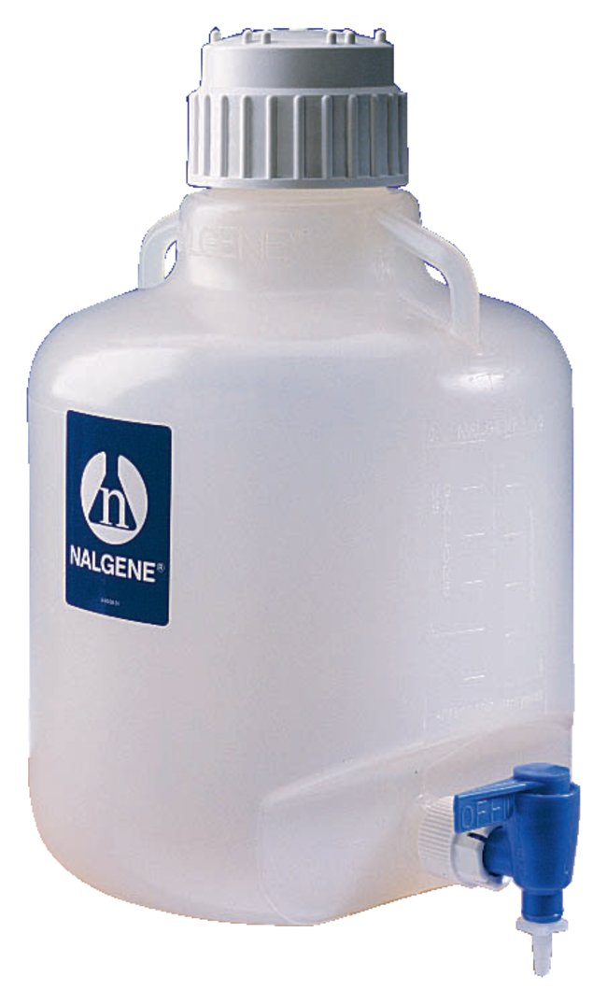
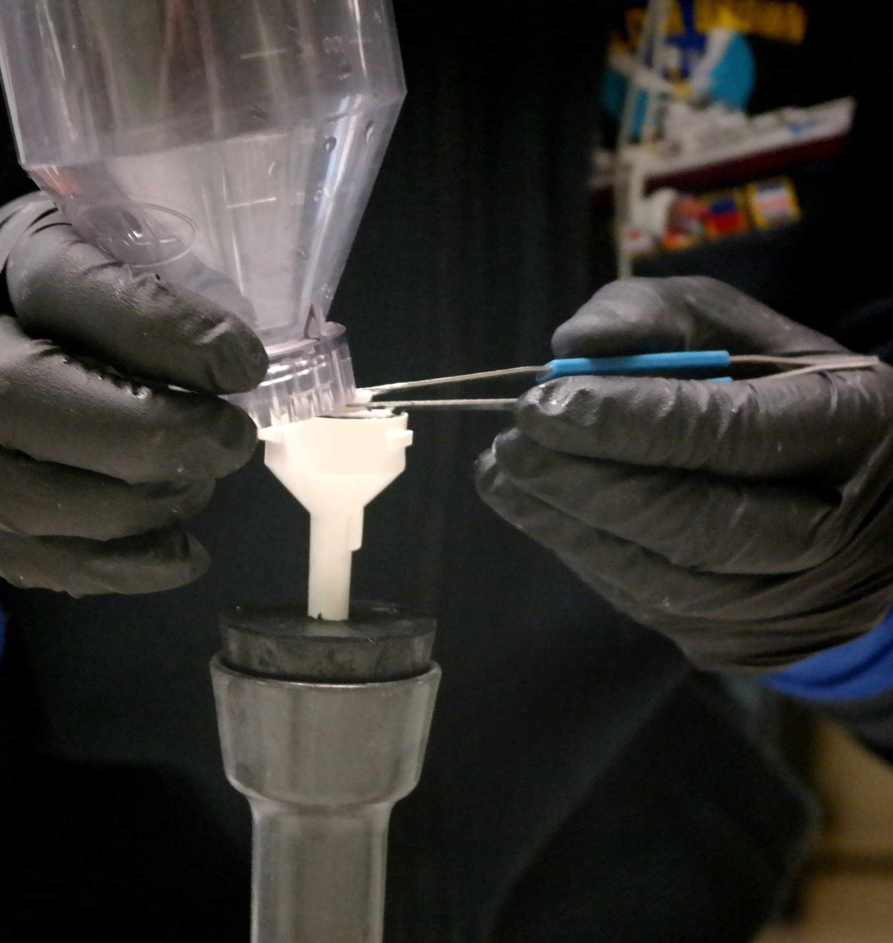

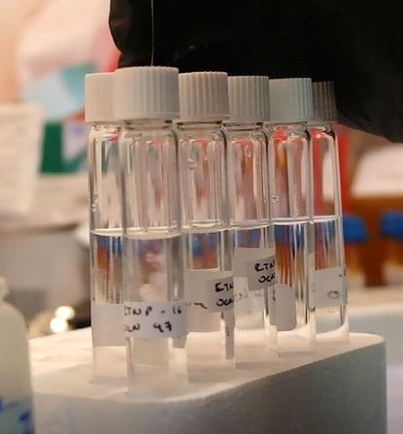
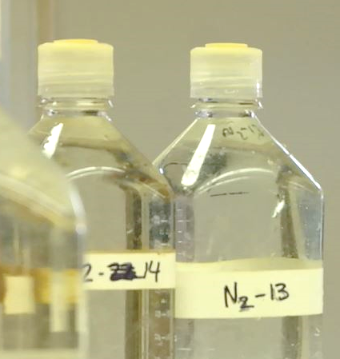
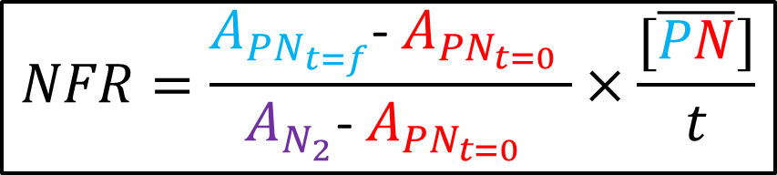
NFR CALCULATION
$$NFR=\frac{A_{{PN}_{t=f}}\text{− }A_{{PN}_{t=0}} }{A_{N_{2}}\text{− }A_{{PN}_{t=0}} }×\frac{[\overline{PN}]}{t}$$
mass & ¹⁵N enrichment
COLLECT SAMPLE
COLLECT PN_{t=0}
N₂ GAS ALIQUOT
¹⁵N enrichment
mass & ¹⁵N enrichment
¹⁵N₂ ADDITION
24 h INCUBATION
COLLECT PN_{t=f}

Slide 7
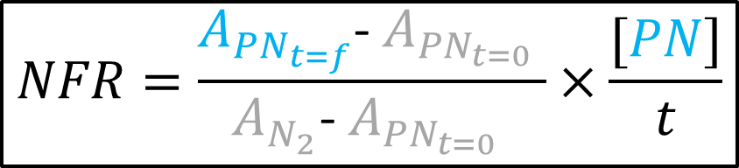
NFR CALCULATION
$$NFR=\frac{A_{{PN}_{t=f}}\text{− }A_{{PN}_{t=0}} }{A_{N_{2}}\text{− }A_{{PN}_{t=0}} }×\frac{[PN]}{t}$$
mass & ¹⁵N enrichment
COLLECT SAMPLE
COLLECT PN_{t=0}
N₂ GAS ALIQUOT
¹⁵N enrichment
mass & ¹⁵N enrichment
¹⁵N₂ ADDITION
24 h INCUBATION
COLLECT PN_{t=f}

Slide 8
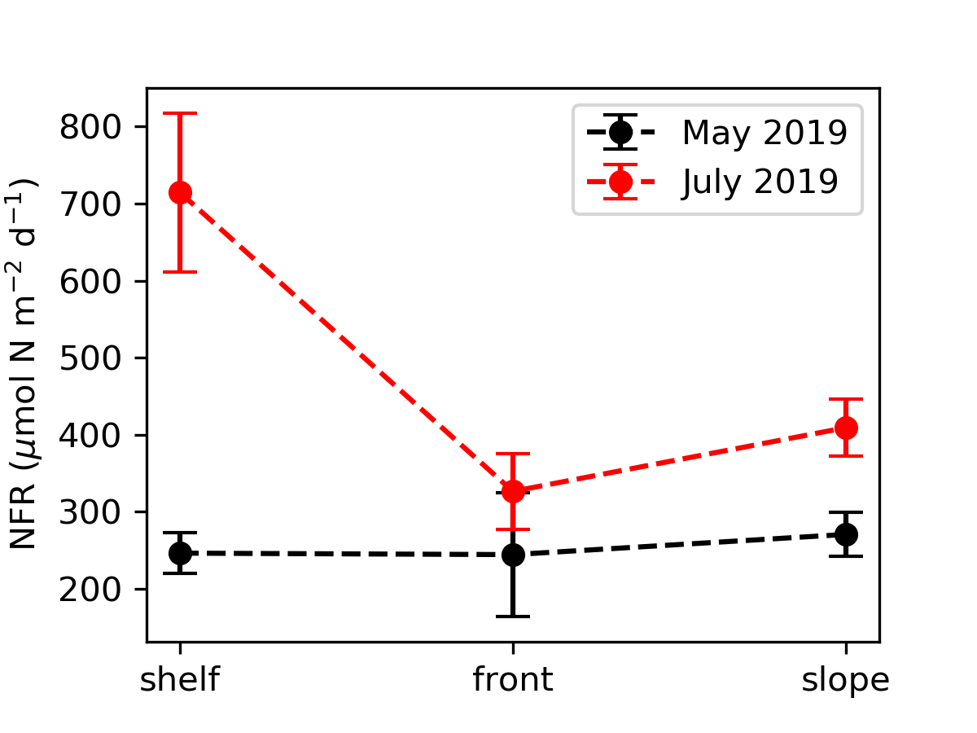
MEAN DEPTH-INTEGRATED NFR FOR TWO CRUISES
N₂ fixation rates (NFR) depth-integrated to bottom or 100 m and averaged by group (shelf, front, slope)
Error bars represent propagation of the sd of triplicate A_{PNt=f} measurements
Enhanced rates observed in July relative to May and across shelf in May

Slide 9
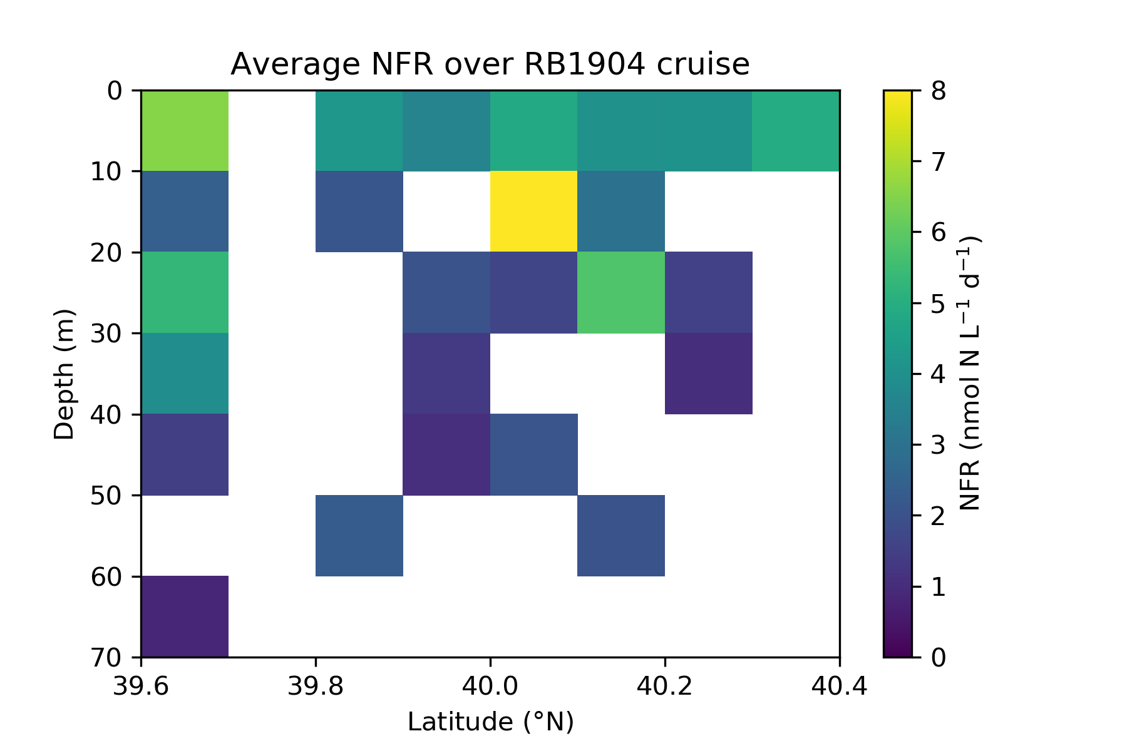
NFR BINNED ALONG MAIN LINE DURING TWO CRUISES
May
S (slope) N (shelf)

Slide 10
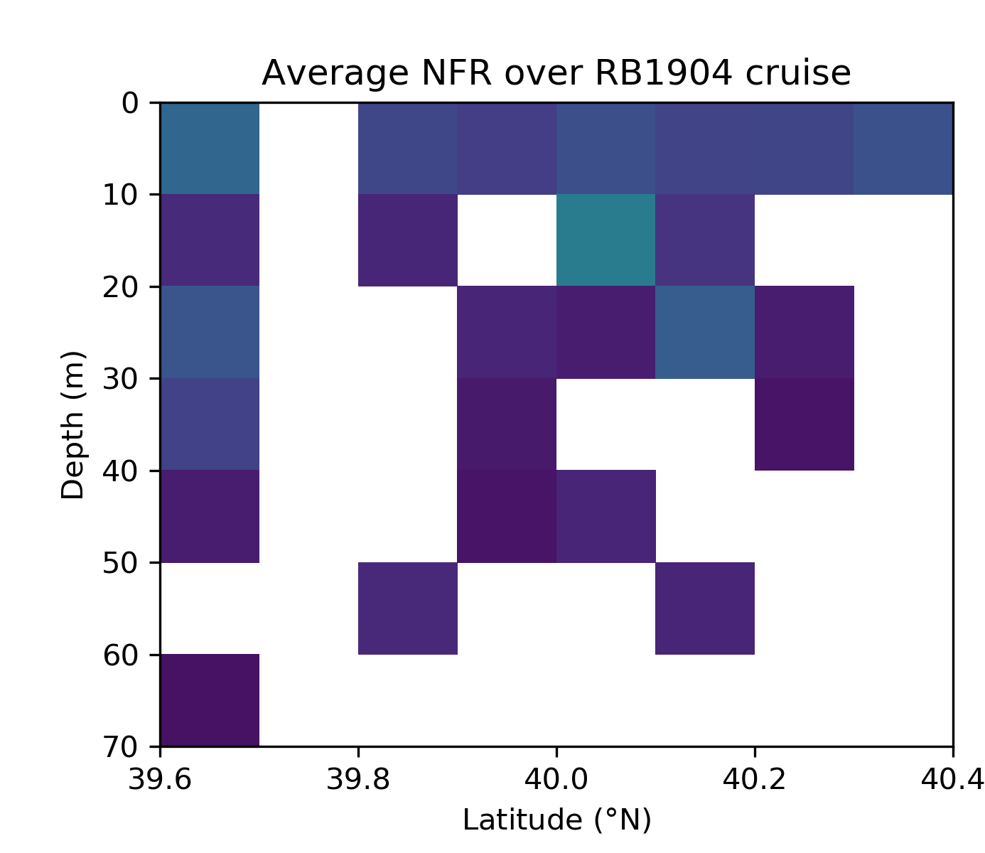
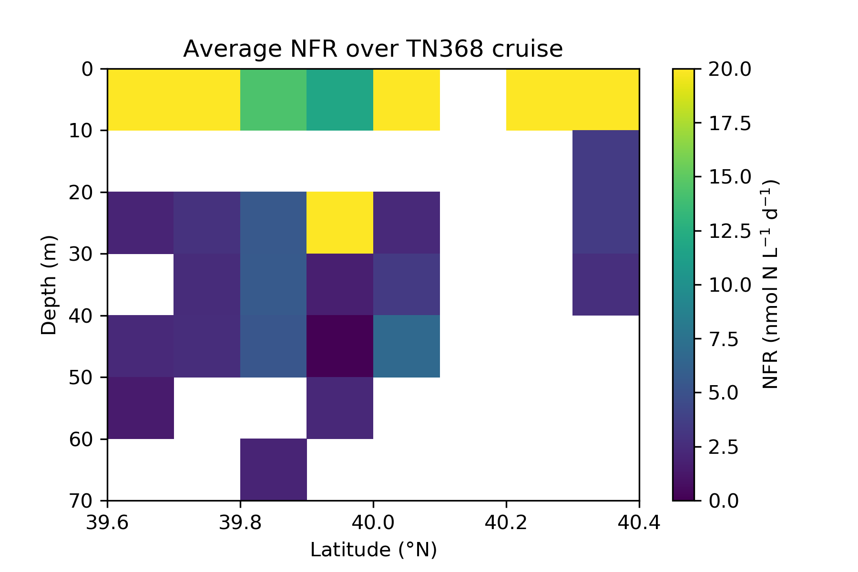
NFR BINNED ALONG MAIN LINE DURING TWO CRUISES
May
July
+
S (slope) N (shelf)
S (slope) N (shelf)

Slide 11
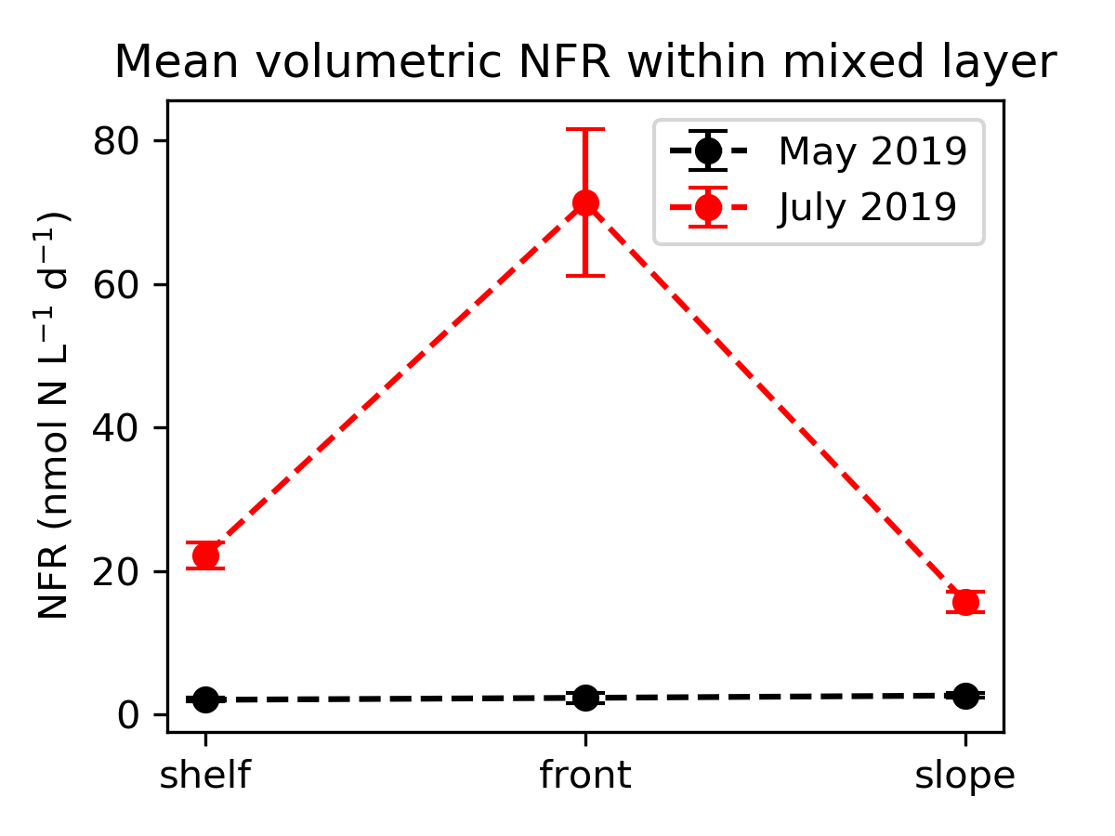
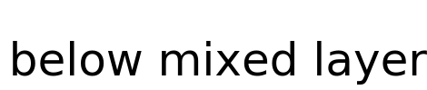
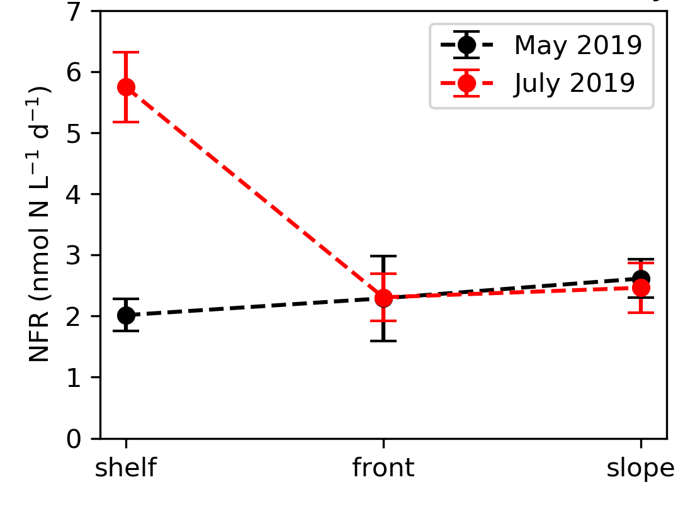
MEAN VOLUMETRIC NFR BY DEPTH REGIME

Slide 12
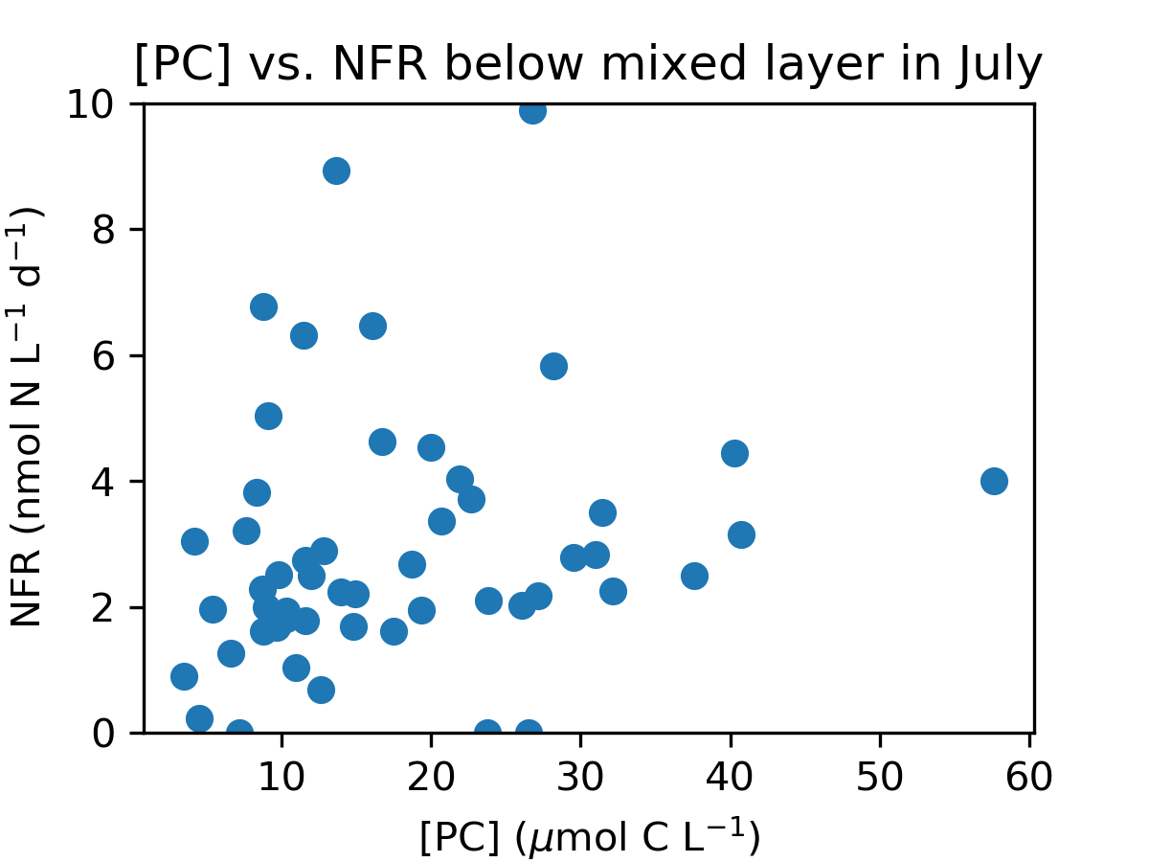
MEAN VOLUMETRIC NFR BELOW MIXED LAYER
No linear relationship with [PC] (linear regression, , R² = 0.001, p = 0.80) as observed for (presumably heterotrophic) diazotrophs in sub-euphotic ocean waters (e.g. Benavides et al., GBC 2016; Selden et al., in prep.)
TBD: More N limiting conditions in late summer?

Slide 13
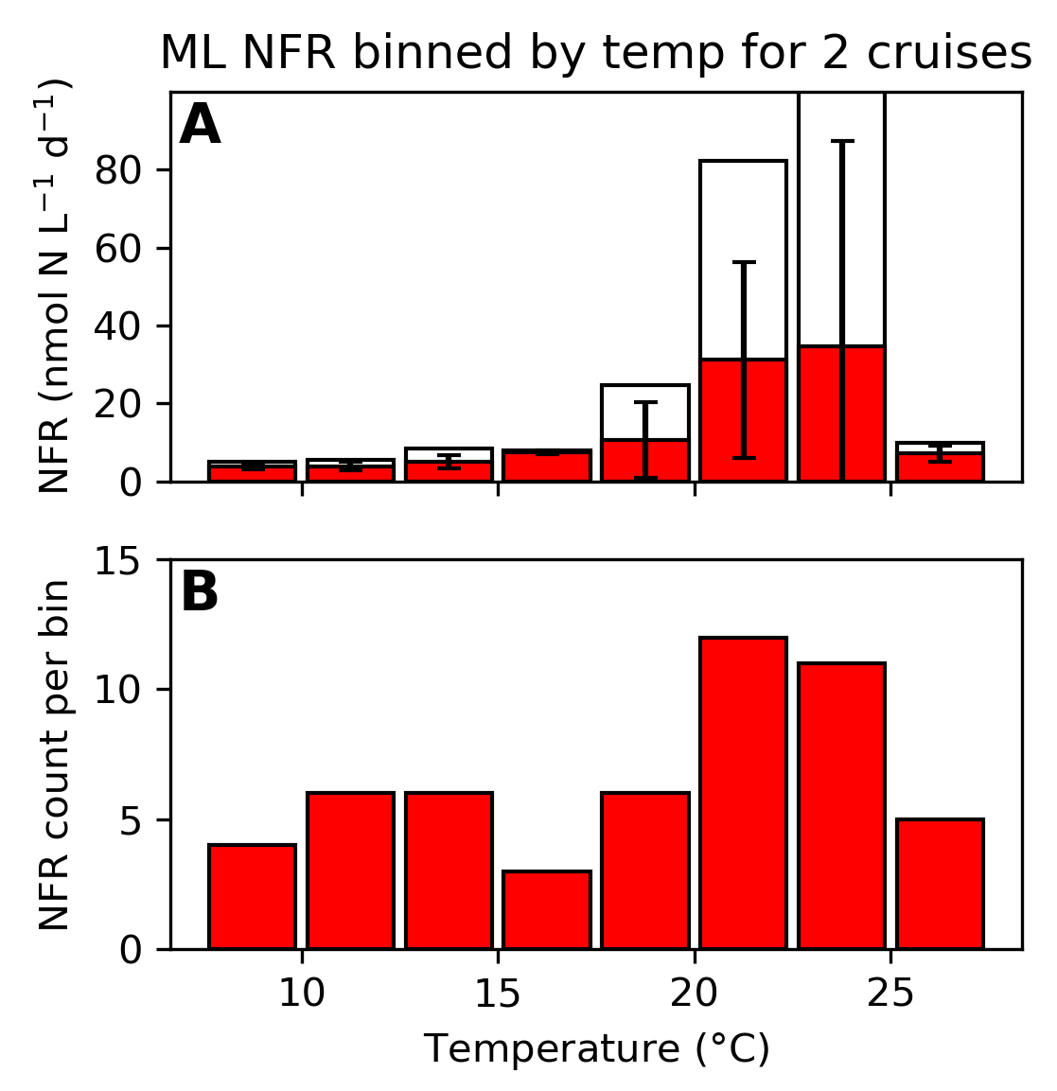
MEAN VOLUMETRIC NFR BY DEPTH REGIME
Panel A (right): White = max NFR in bin; red = mean NFR in bin
Greater max NFR and variability within 17.5 – 25°C range (observed in July)
TN368 (July)
RB1904 (May)

Slide 14
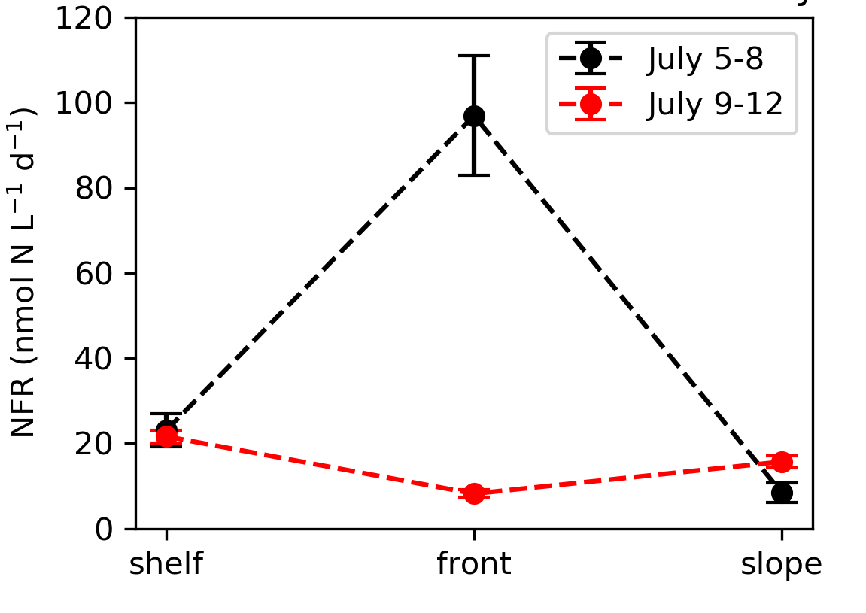
MEAN VOLUMETRIC NFR WITHIN MIXED LAYER
averaged across cruises
during and after streamer in July
Enhance N₂ fixation rates within ML at streamer frontal stations

Slide 15
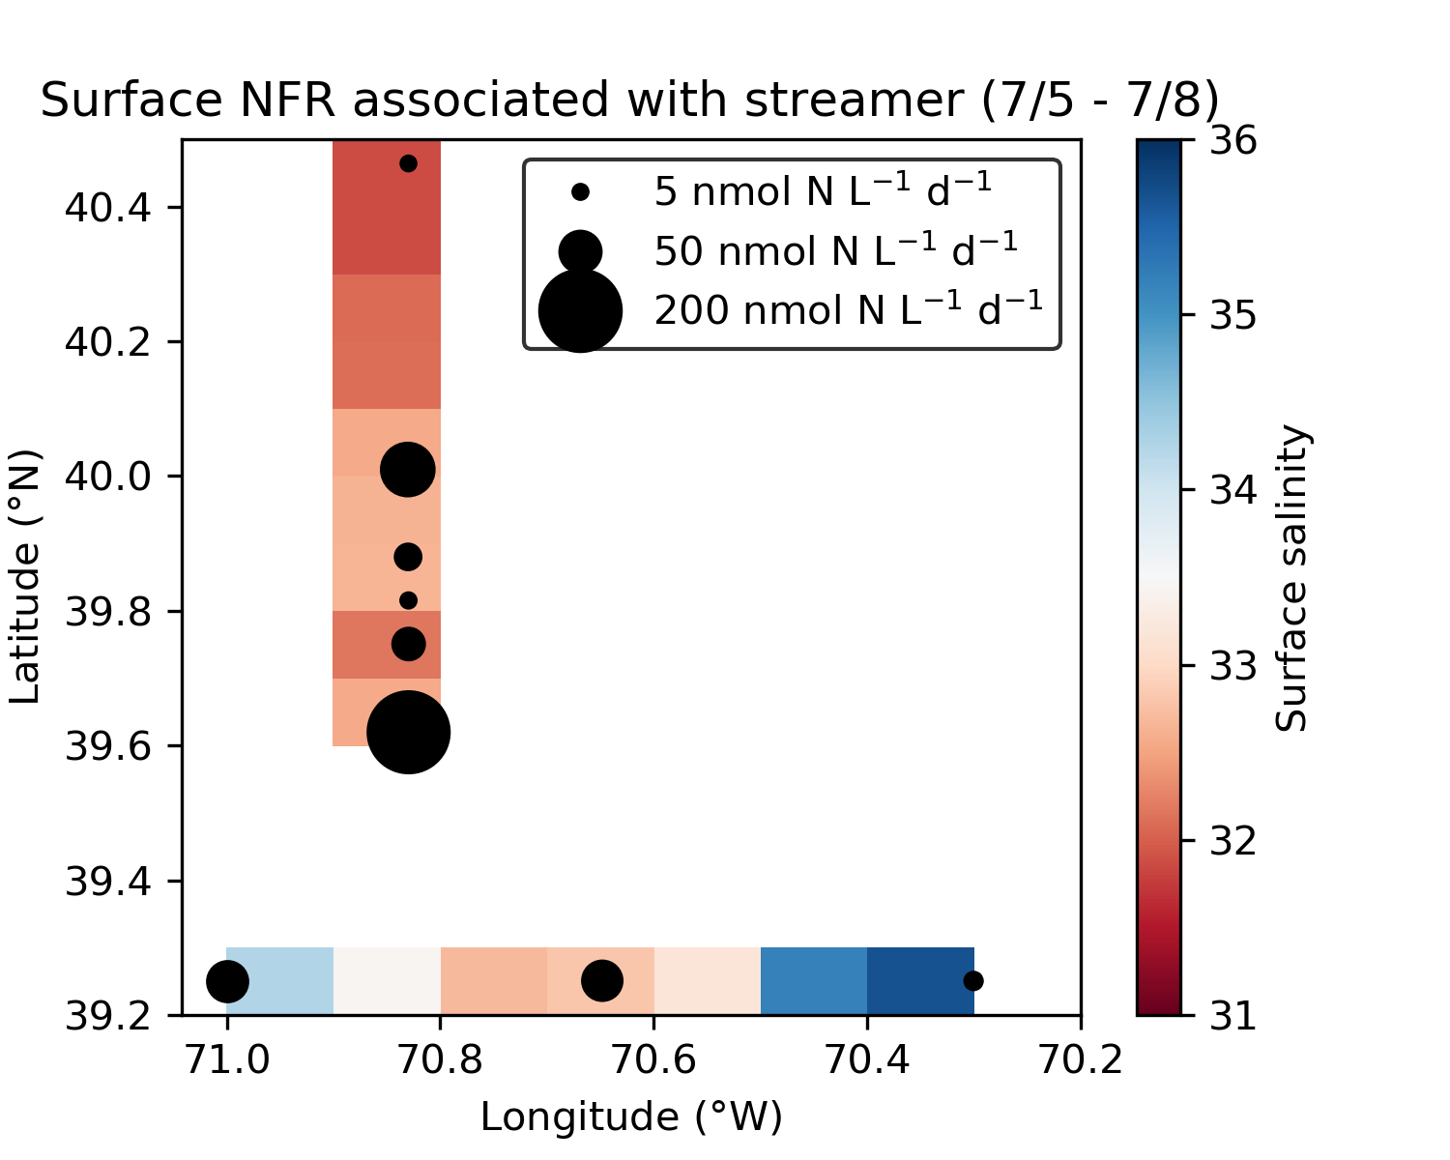
SURFACE VOLUMETRIC NFR DURING STREAMER EVENT
Point of reference: In tropical, oligotrophic N. Atlantic basin, NFR typically <5 nmol N L⁻¹ d⁻¹; ~30 nmol N L⁻¹ d⁻¹ is “high” (e.g., Martinez-Perez et al., Nat. Microbiol. 2016)

Slide 16
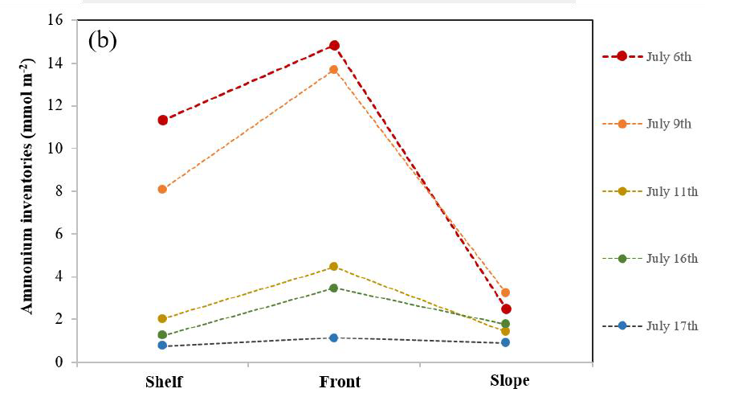
MEAN VOLUMETRIC NFR WITHIN MIXED LAYER
during and after streamer in July
[NH₄⁺] depth-integrated to 100 m
Y. Zhu
Enhanced NH₄⁺ inventory indicating enhanced recycling at front, potentially due to increased contribution of N₂ fixation to fixed N pool → TO DO: estimate contribution of N₂ fixation to primary production

Slide 17
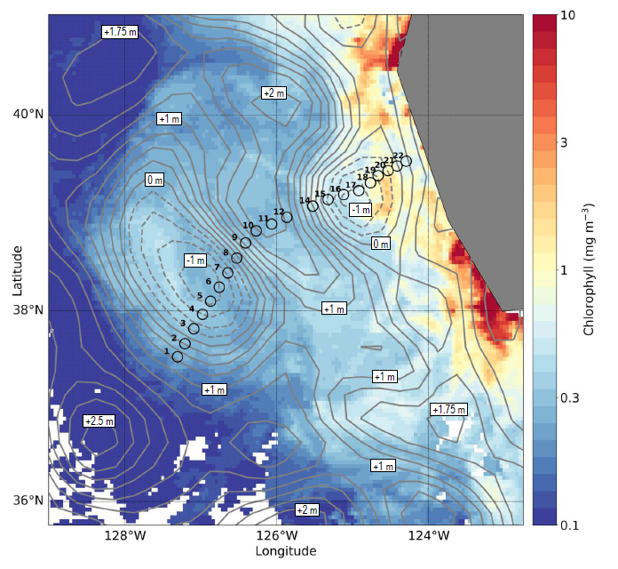
PRIOR WORK RE: N₂ FIXATION IN EDDIES
Chappell lab MS student Zuzy Abdala
Eddy off California
Grey contours represent sea level anomalies
Stations in eddy center (NO₃⁻ drawn down) dominated by Rhizosolenia, which can carry a diazotrophic endosymbiont
Similar findings from Brown et al., DSRII 2008

Slide 18
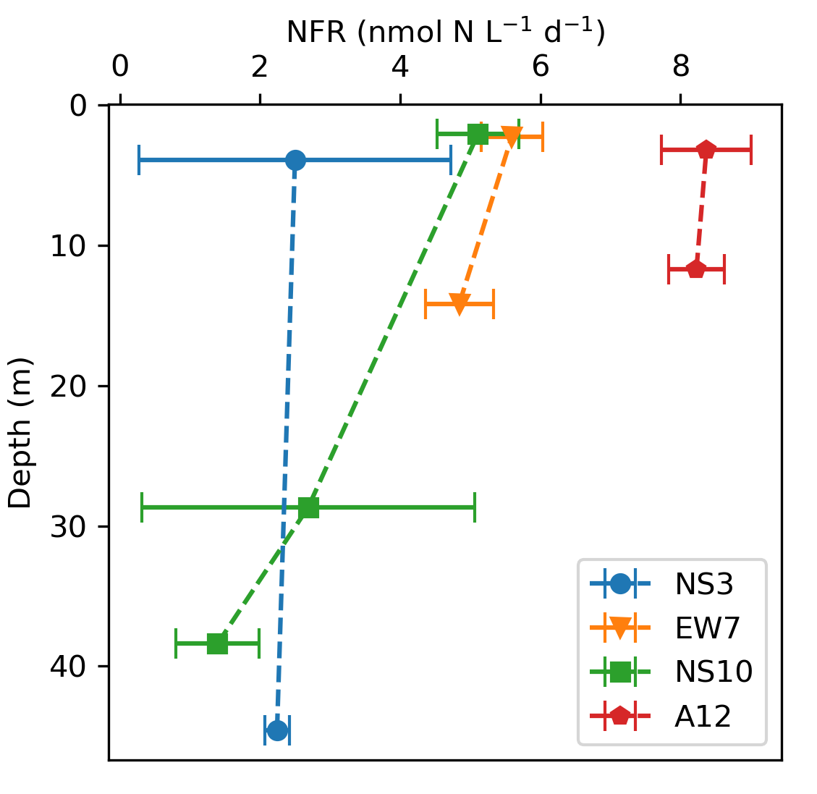
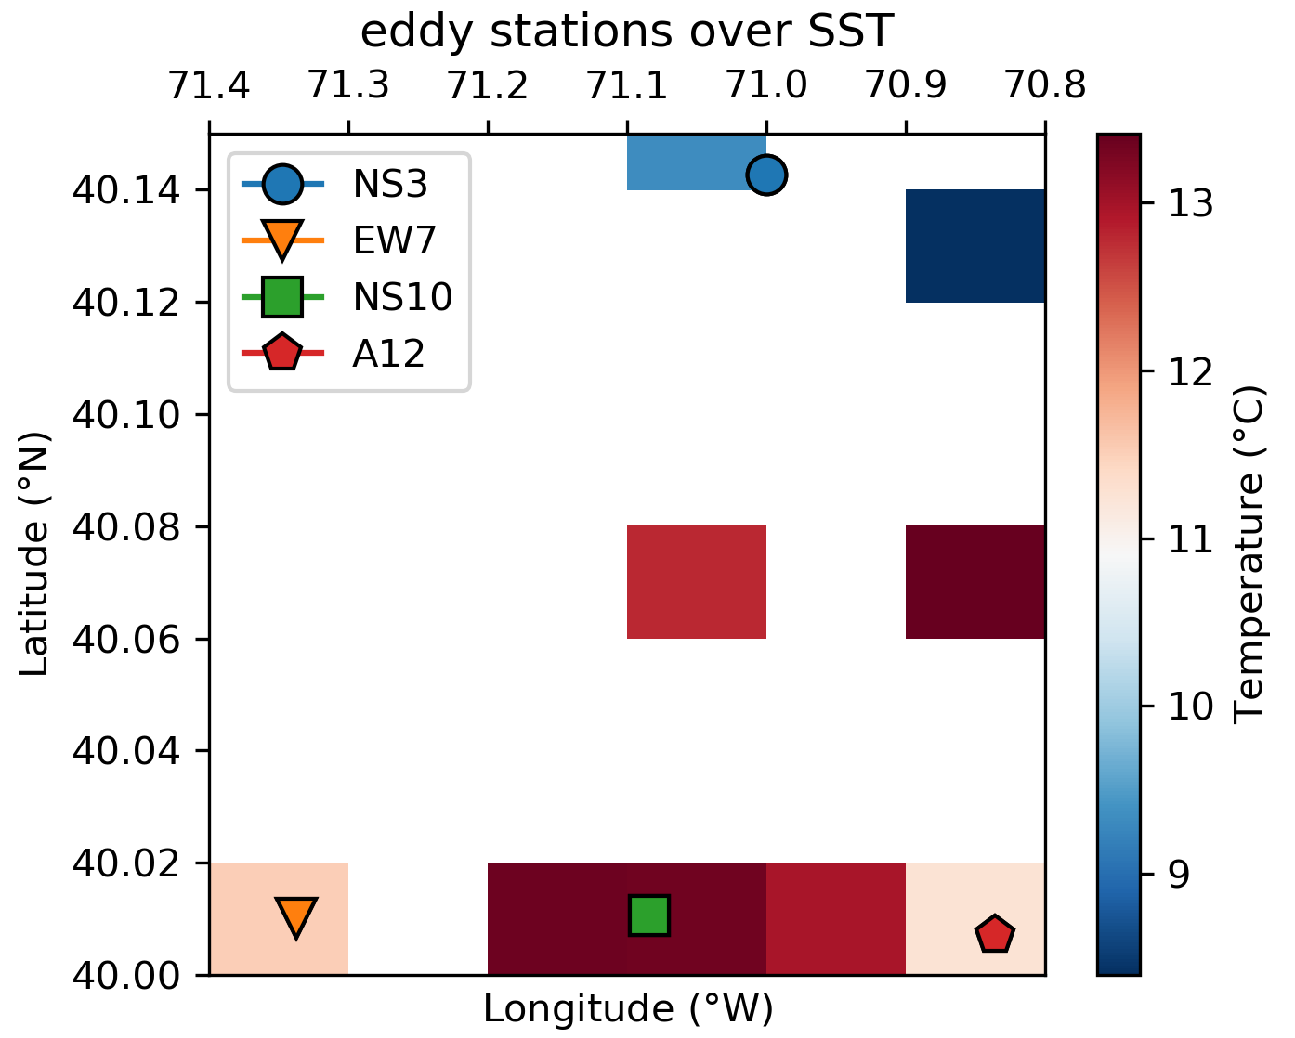
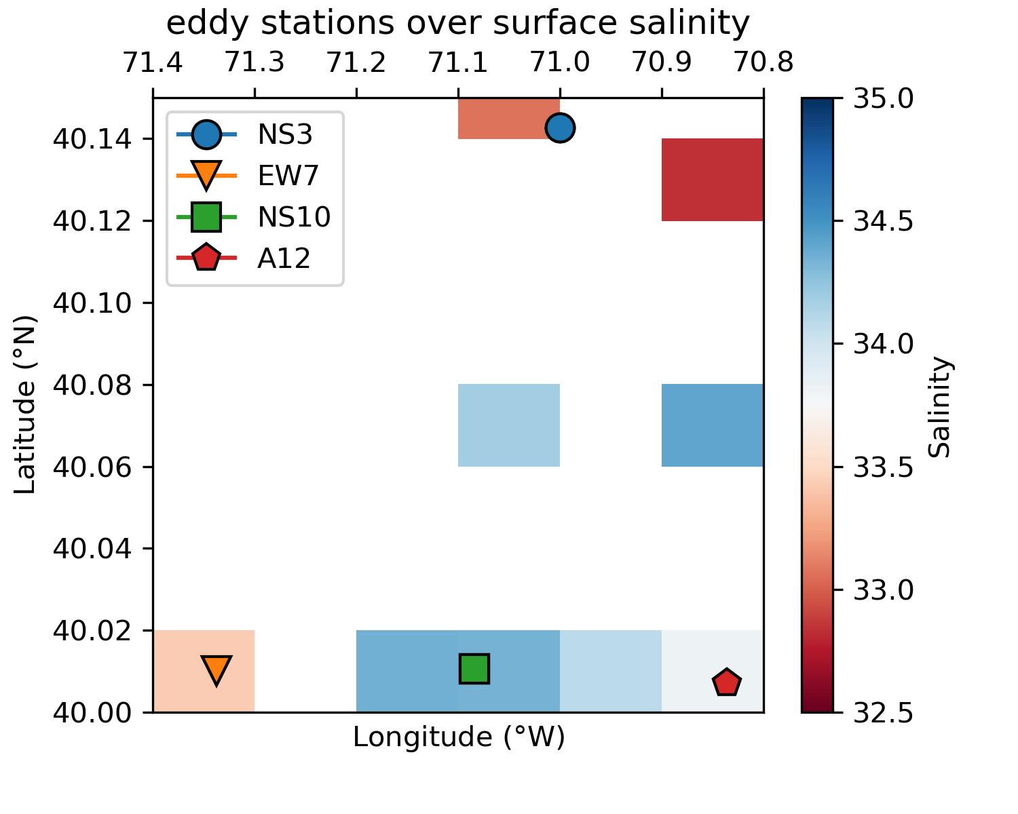
RB1904 EDDY N₂ FIXATION
NFR measurements made at surface and at chl-max; at NS10, the third measurement is just below the chlorophyll max
Rates at A12 elevated above regional seasonal average (3.45 ±0.14 nmol N L⁻¹ d⁻¹)

Slide 19
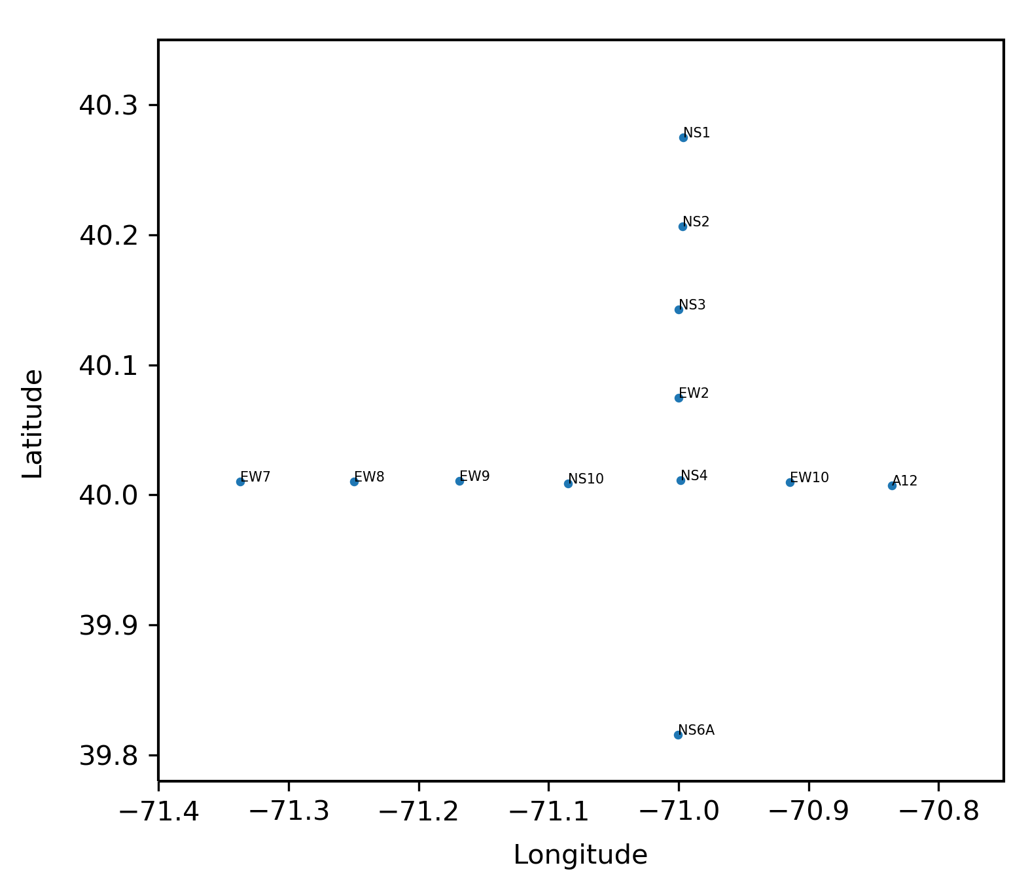
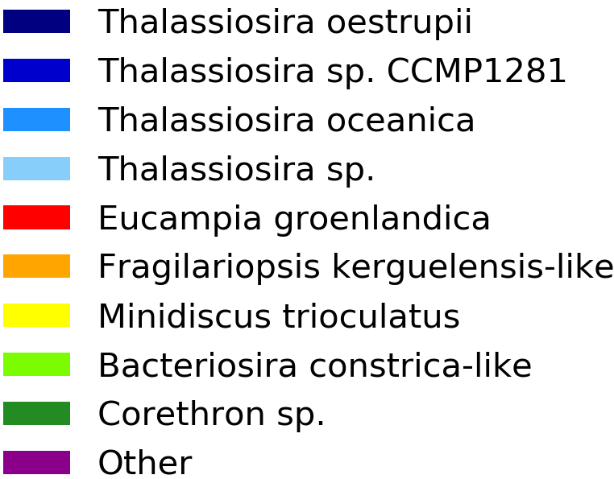
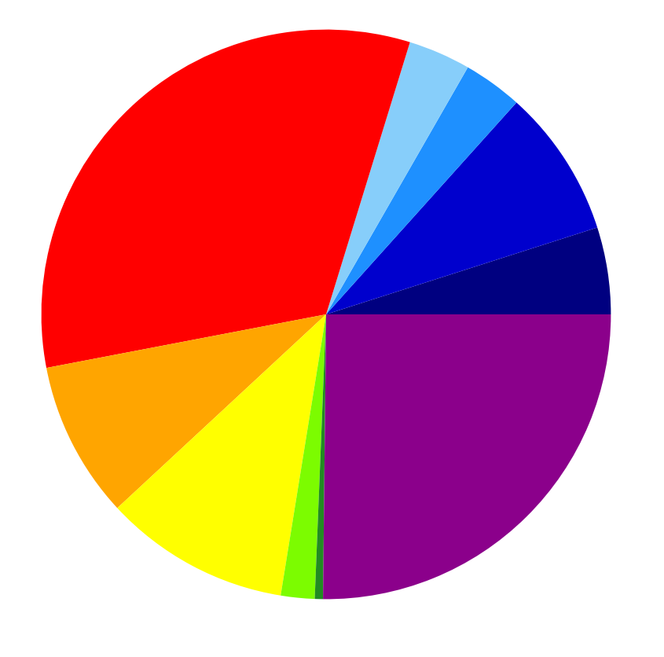
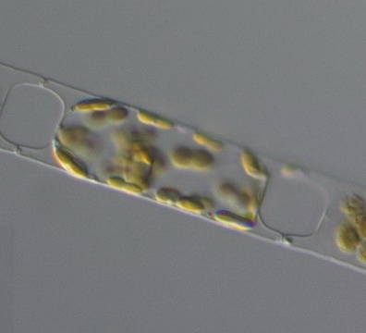
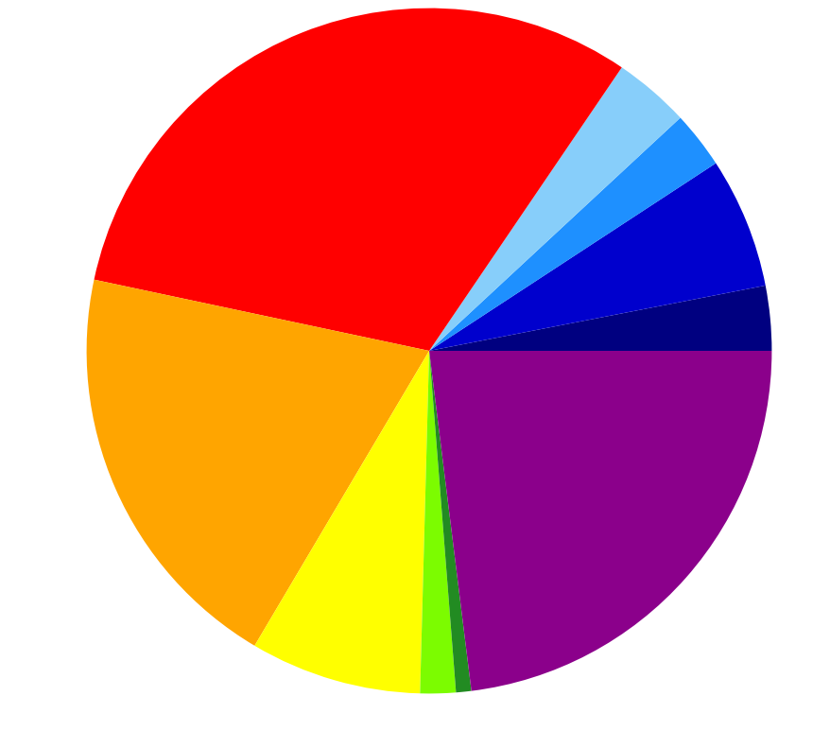
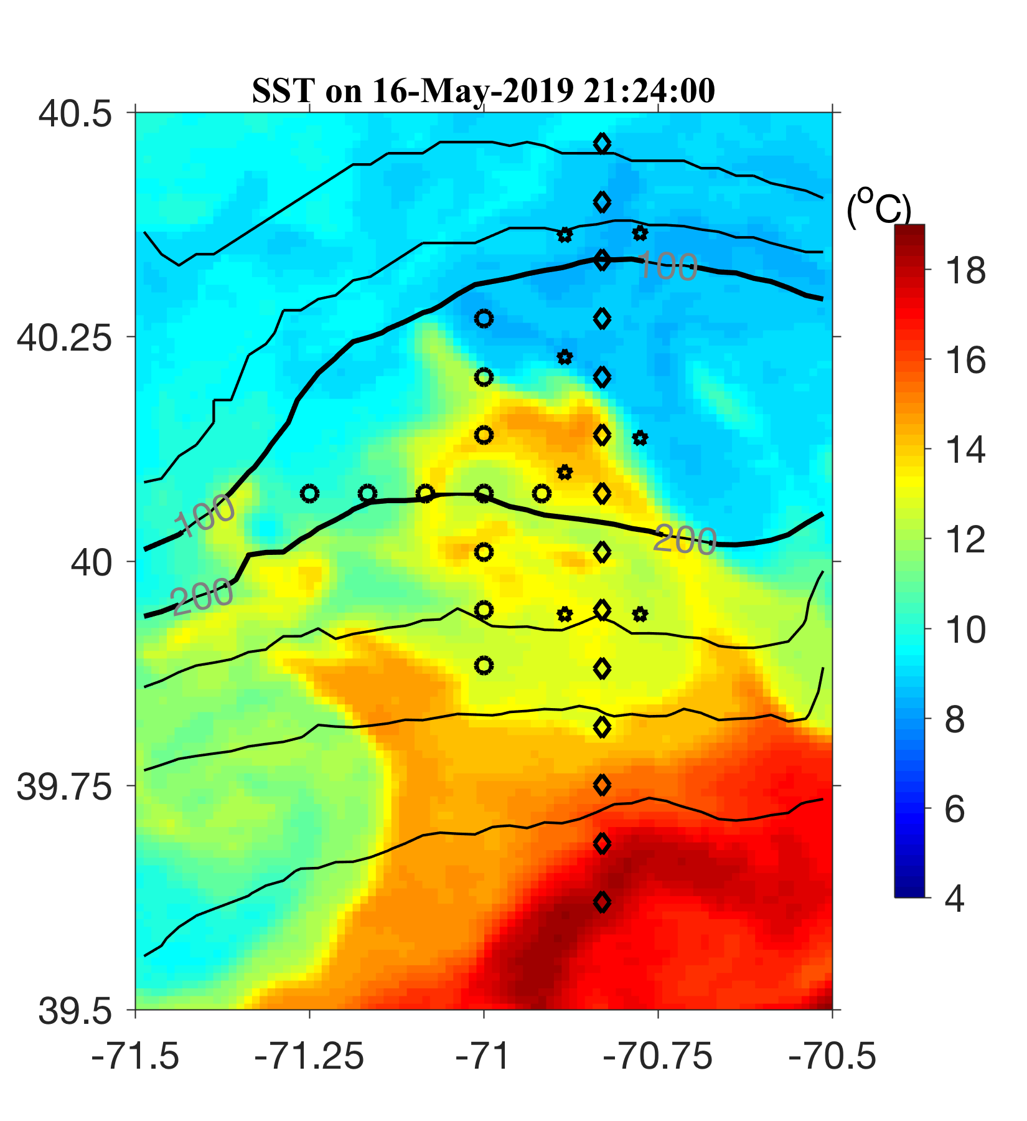
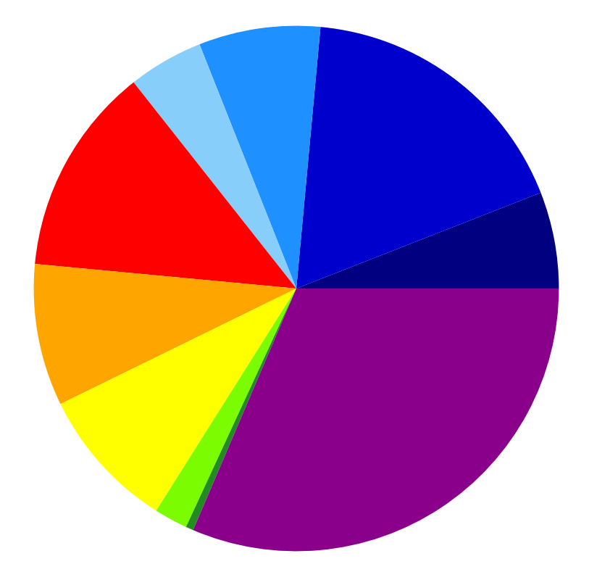
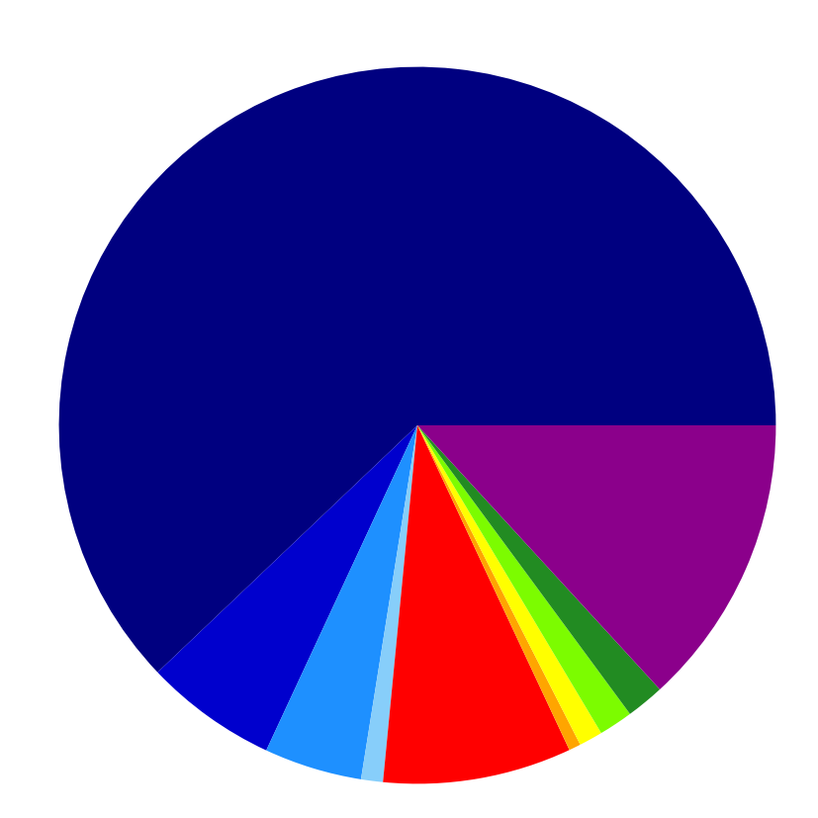
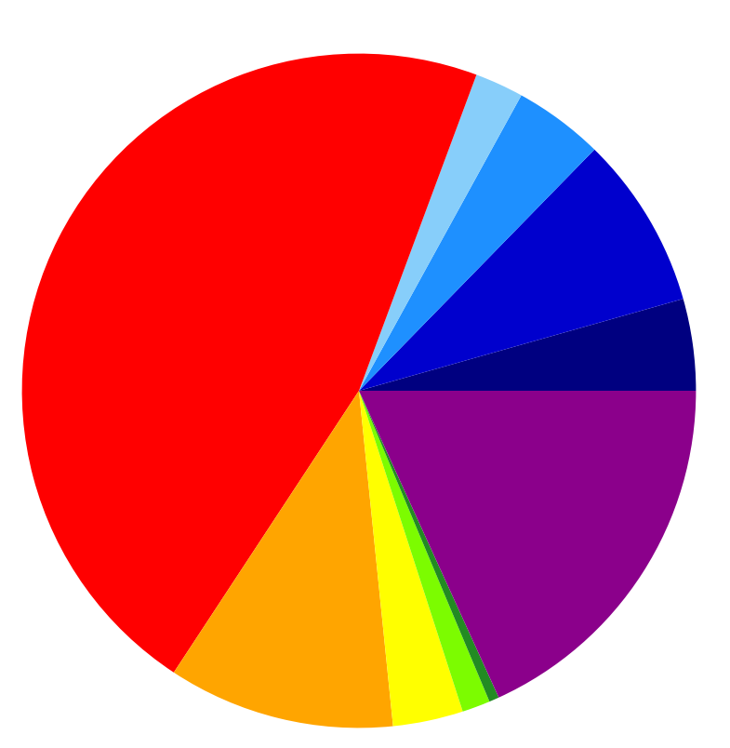
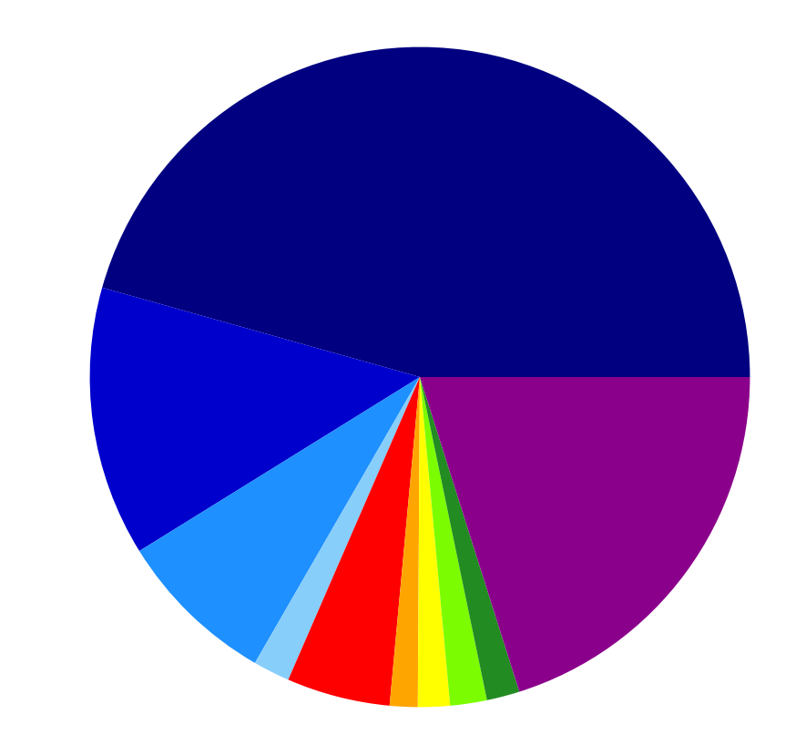
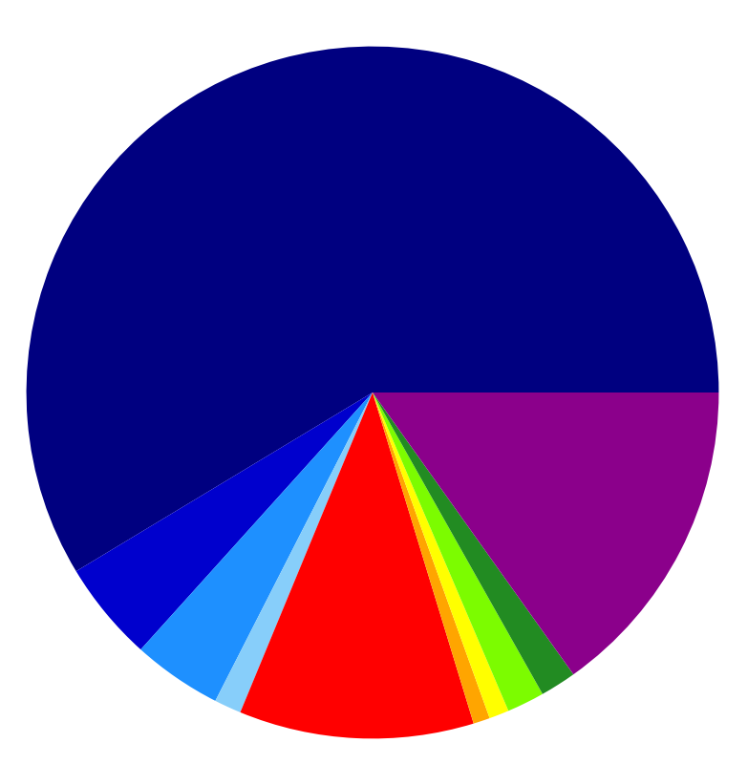
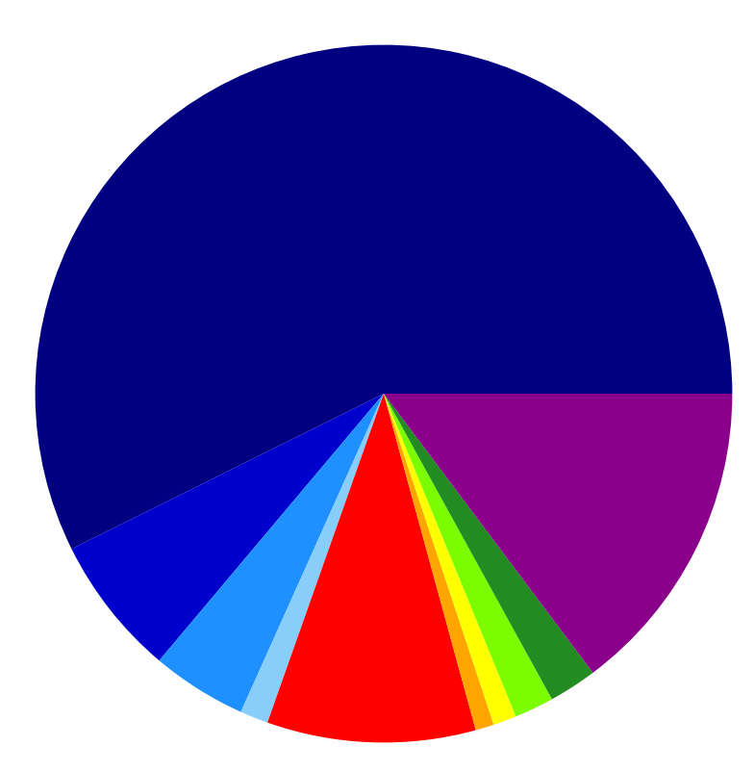
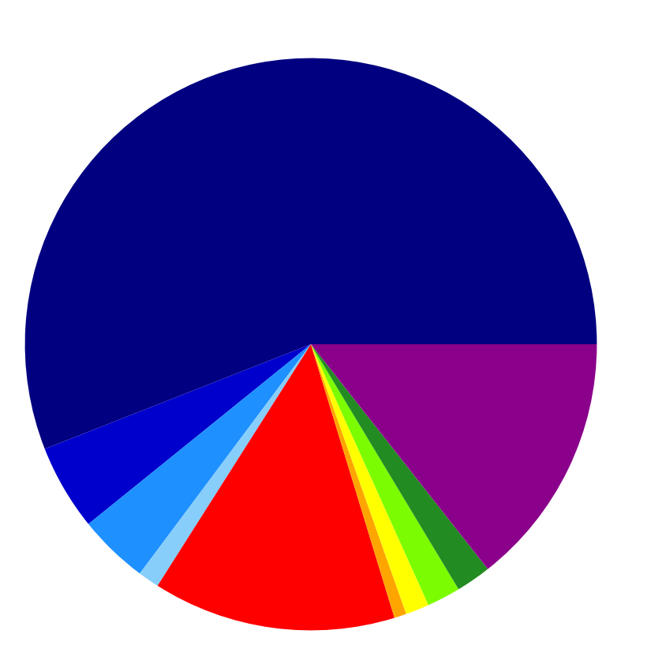
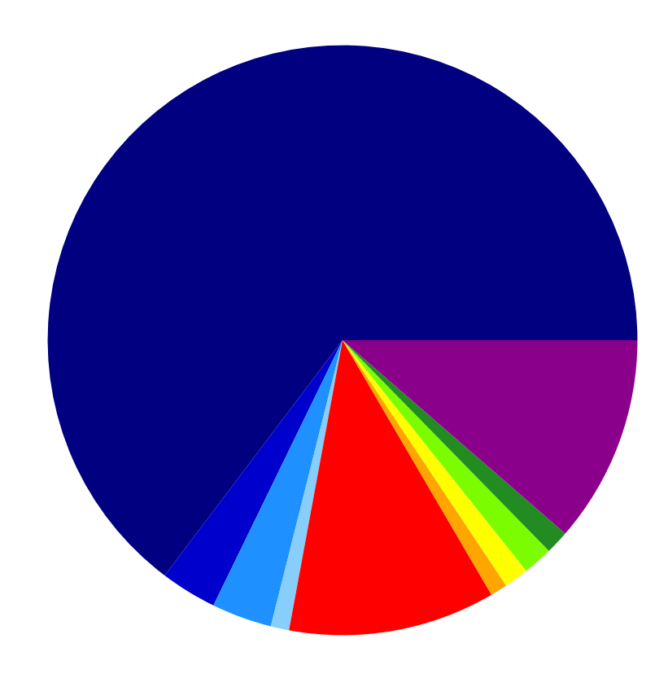
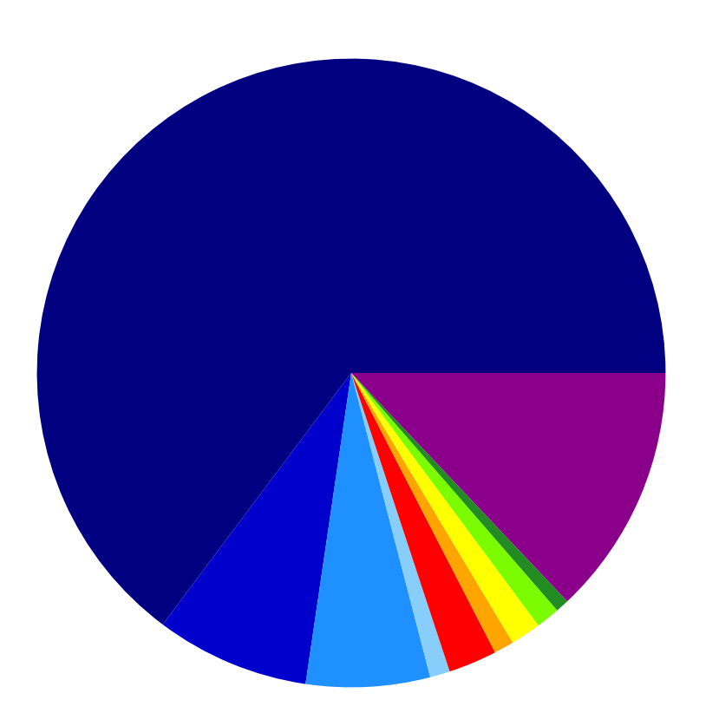
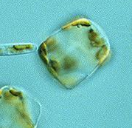
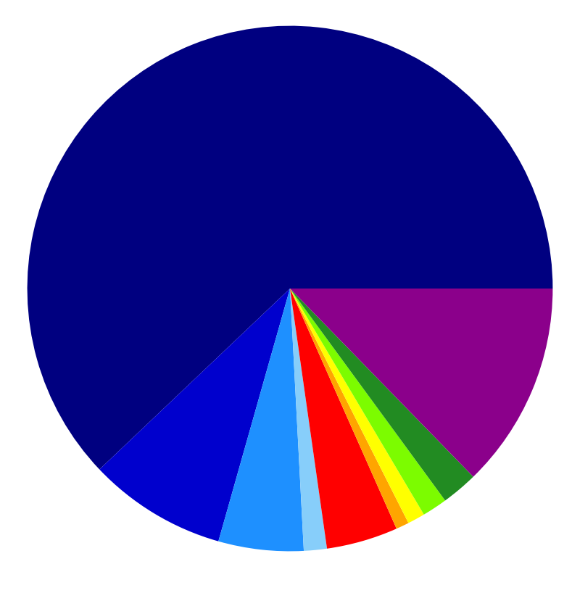
EDDY SURFACE DIATOM
COMMUNITIES
Chappell Lab REU student Ruric Bowman (Lycoming College)
W. Zhang
Low abundance of diazotroph-hosting diatom groups

Slide 20
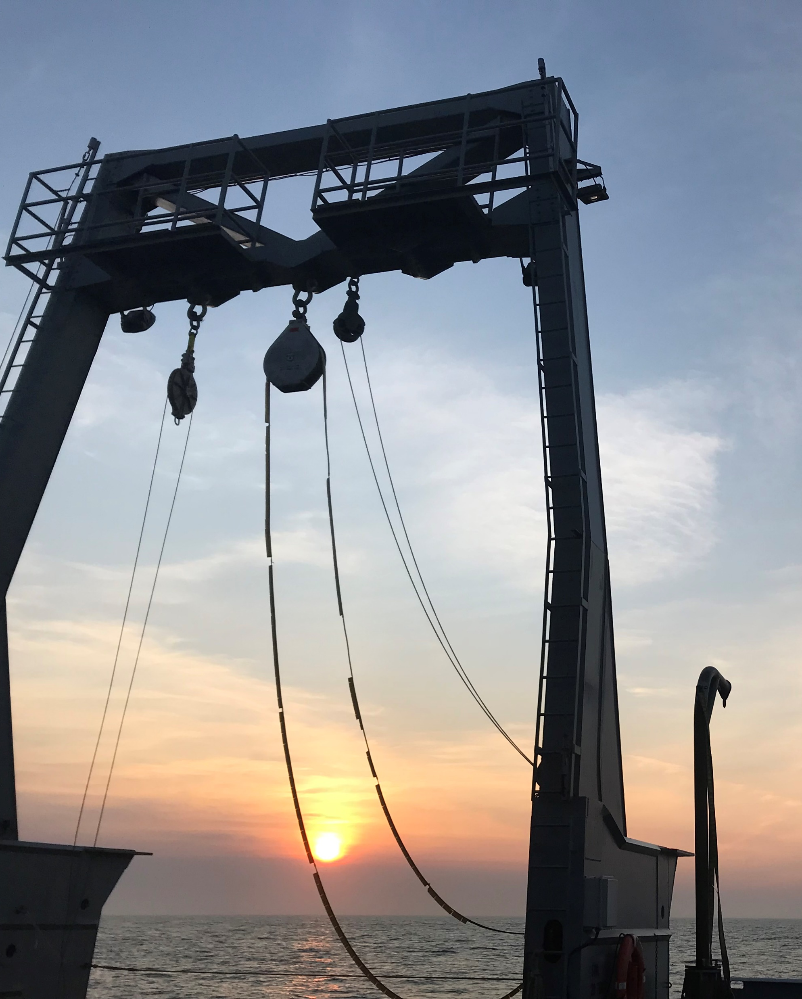
TO DO:
N₂ fixation work:
For finalized NFR measurements:
  Analyze PN_{t=0} samples
  Analyze ¹⁵N₂ samples
nifH sequencing (currently working on DNA/RNA extractions)
Data analysis
Yifan’s work looking at the effects of frontal mixing on cyanate production/consumption:
Analyze cyanate samples (underway)
Analyze DON samples

Slide 21
SUPPLEMENTAL SLIDE

Slide 22
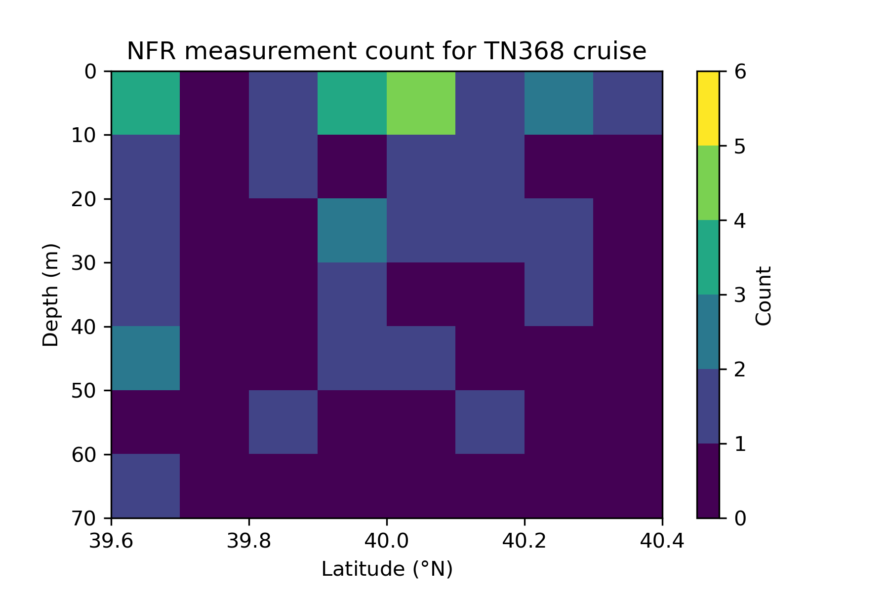
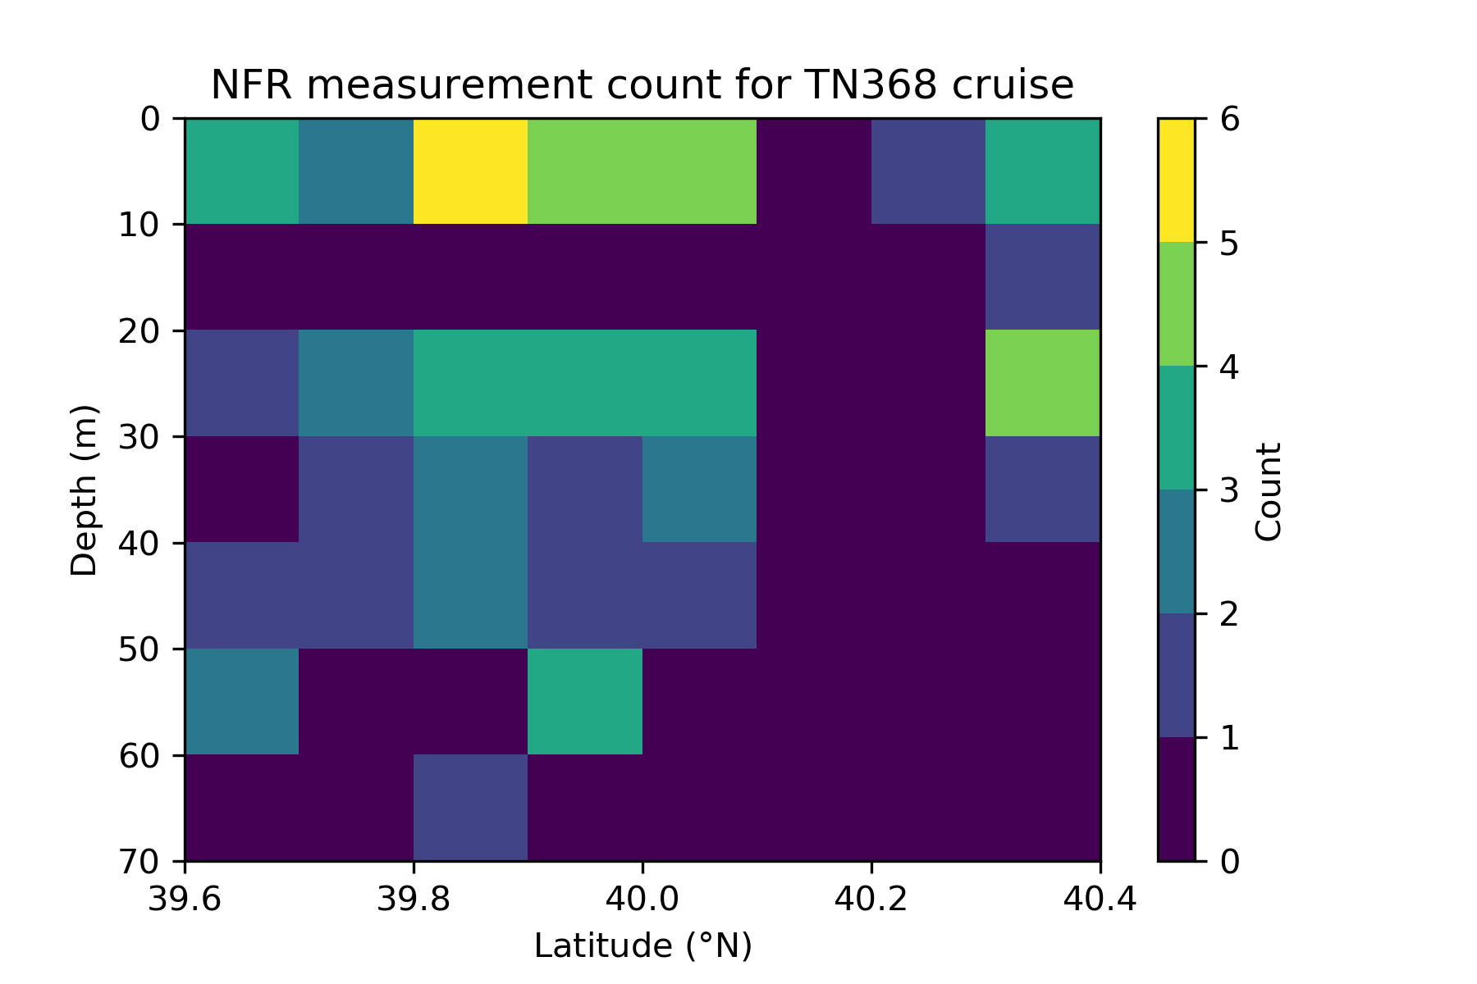
SUPPLEMENTAL SLIDE

Slide 23
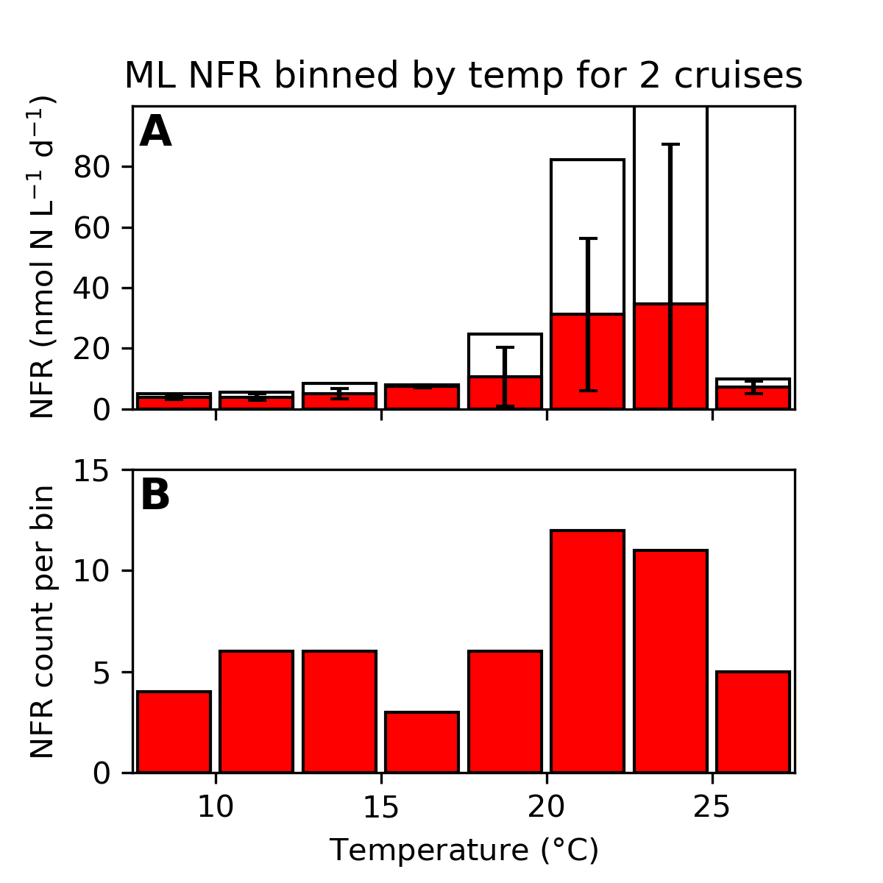
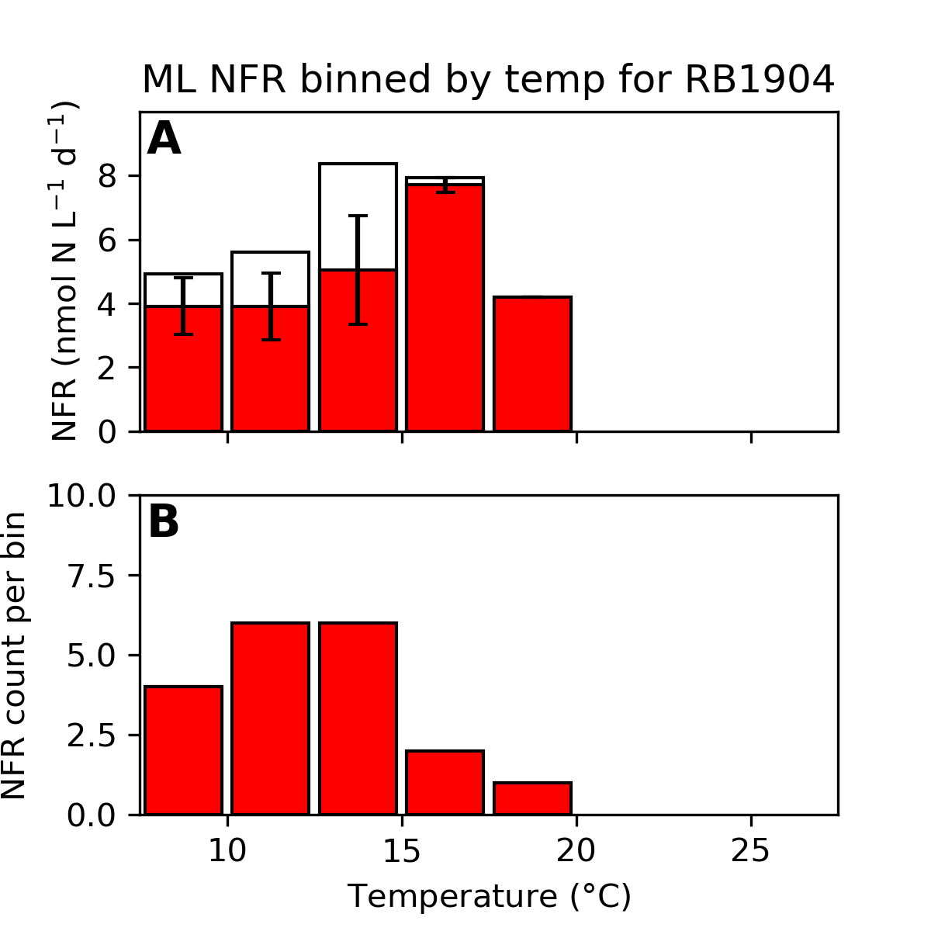
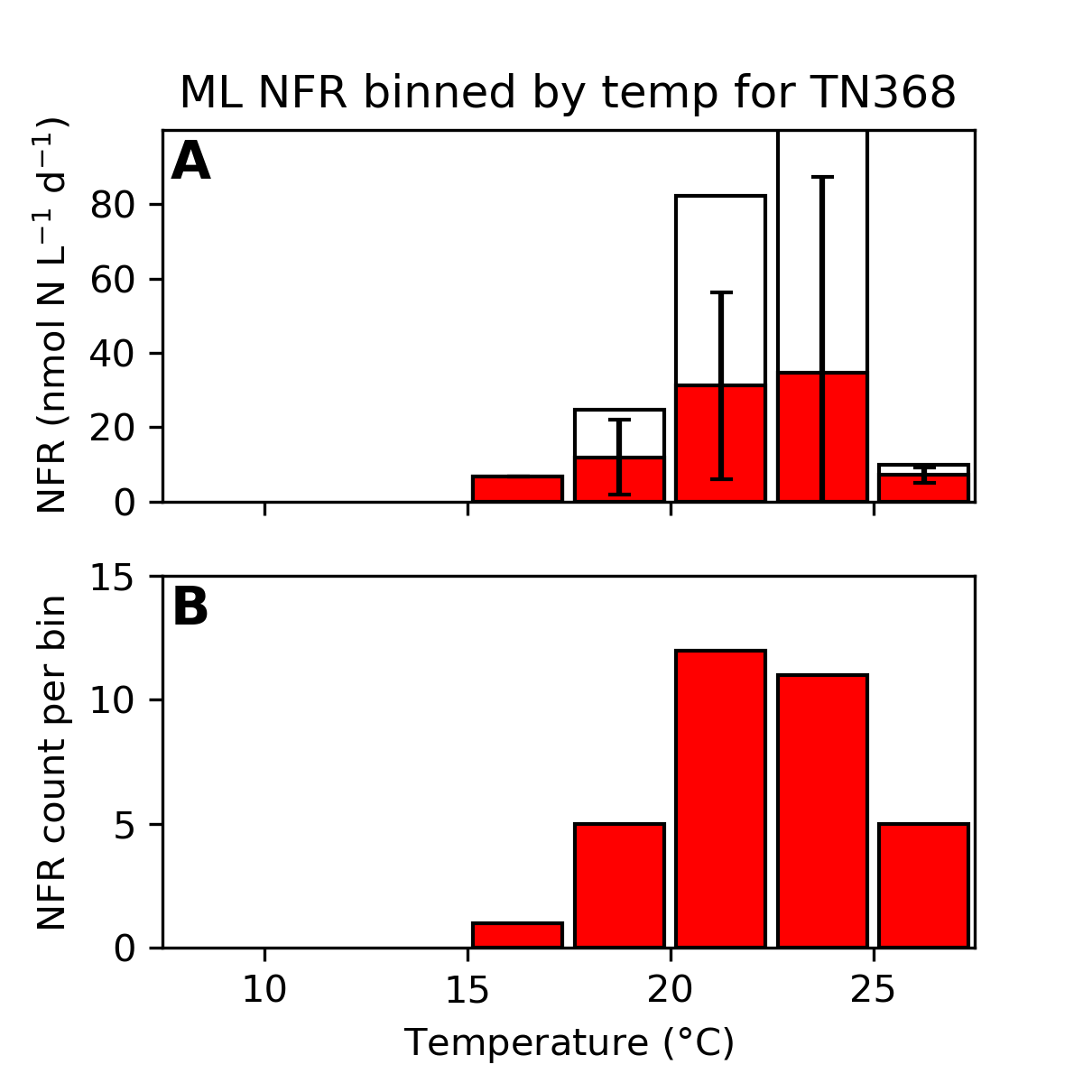
SUPPLEMENTAL SLIDE

Slide 24
SUPPLEMENTAL SLIDE
NFR measurements made at surface and at chl-max; at NS10, the third measurement is just below the chlorophyll max
Rates at A12 elevated above regional seasonal average (3.45 ±0.14 nmol N L⁻¹ d⁻¹)

