Slide 1
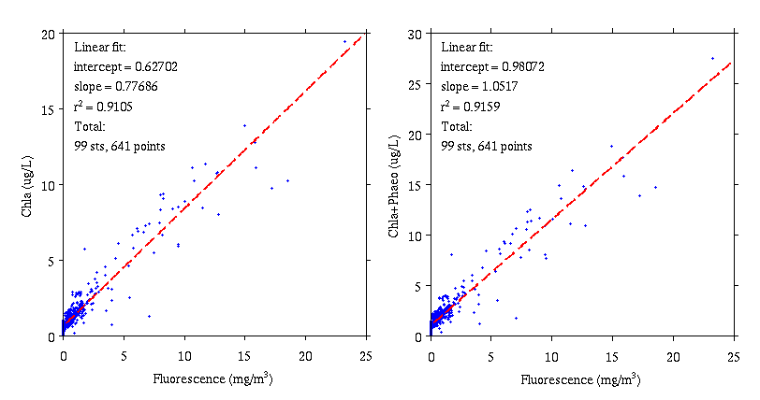
Phytoplankton – Sosik Lab
Fluorometric chlorophyll concentration
~3886 samples filtered and frozen
~2760 extracted and analyzed, integrated with bottle data
~1100 remain frozen
HPLC pigment concentrations
789 samples filtered and frozen
Under analysis at UMCES analytical facility
Half of RB1904 expected in December, AR29 priority 2
Budget to complete all ? [$83.50 vs $70, 789 vs. 720 → $15,500]

Slide 2
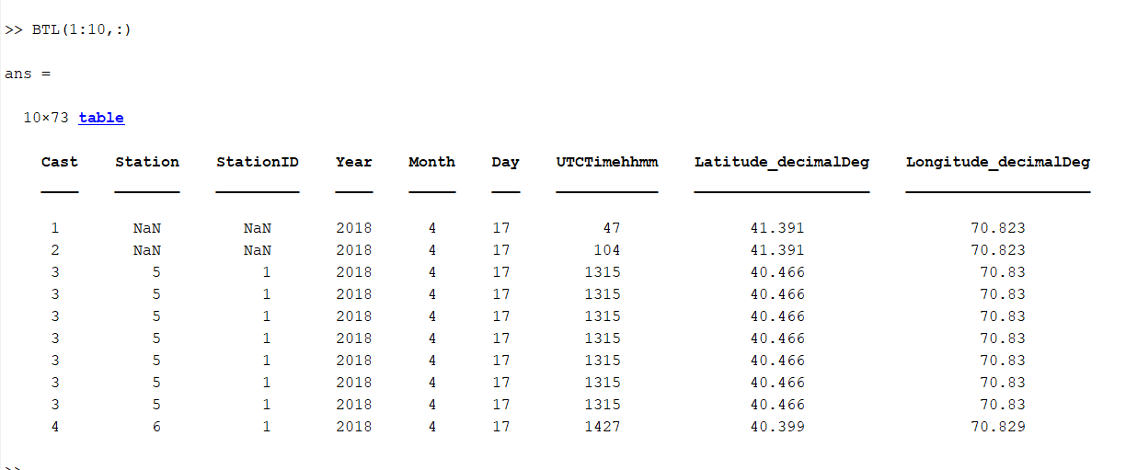
Phytoplankton – Sosik Lab
Fluorometric chlorophyll concentration
~3886 samples filtered and frozen
~2760 extracted and analyzed, integrated with bottle data
~1100 remain frozen
HPLC pigment concentrations
789 samples filtered and frozen
Under analysis at UMCES analytical facility
Half of RB1904 expected in December, AR29 priority 2
Budget to complete all ? [$83.50 vs $70, 789 vs. 720 → $15,500]
GitHub repo:
\SPIROPA-project\Tools\btlmat2table.m
(ar29_bottle_data_Jan_2019_v2_table.mat)

Slide 3
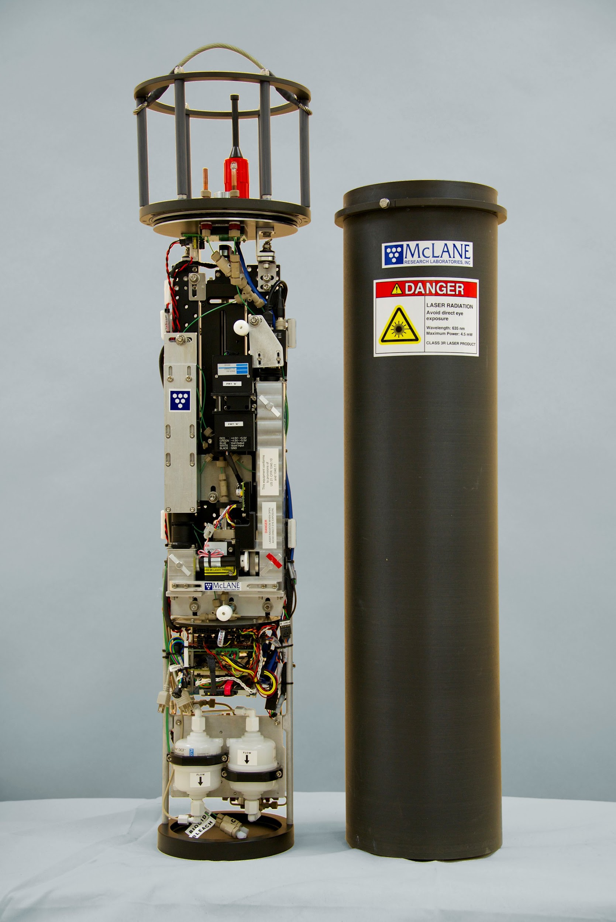
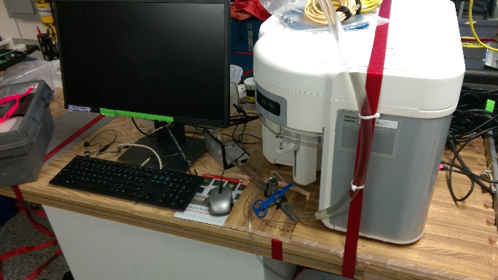
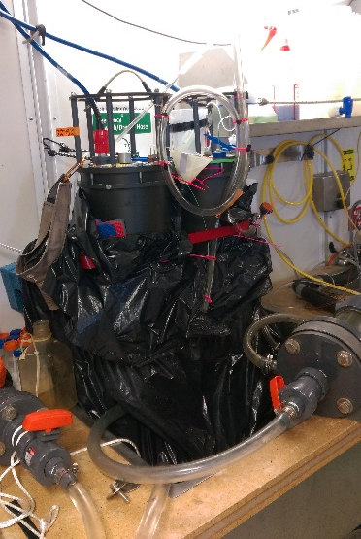
Phytoplankton – Sosik Lab
Attune NxT
IFCB
Attune NxT flow cytometer
~18000 automated samples (0.4 ml every 2 min) from underway seawater flow
Samples from Niskins, preserved and frozen → Under analysis now
IFCB (Imaging FlowCytobot)
~2300 automated samples (~2-5 ml every 20 min) from underway seawater flow
~700 samples from Niskins (typically surface and “chl max”)
Staining IFCB
~670 automated samples (~2-5 ml every 20 min) from underway seawater flow
AR29 only, switched std IFCB to scattering trigger on RB1904 and TN368
Notes:
RB1904 6635 Attune 793 IFCB127
TN368 6631 779 IFCB127
AR29 5585 749 IFCB127
IFCB niskins ~220 AR29
247 TN368
247 RB1904

Slide 4
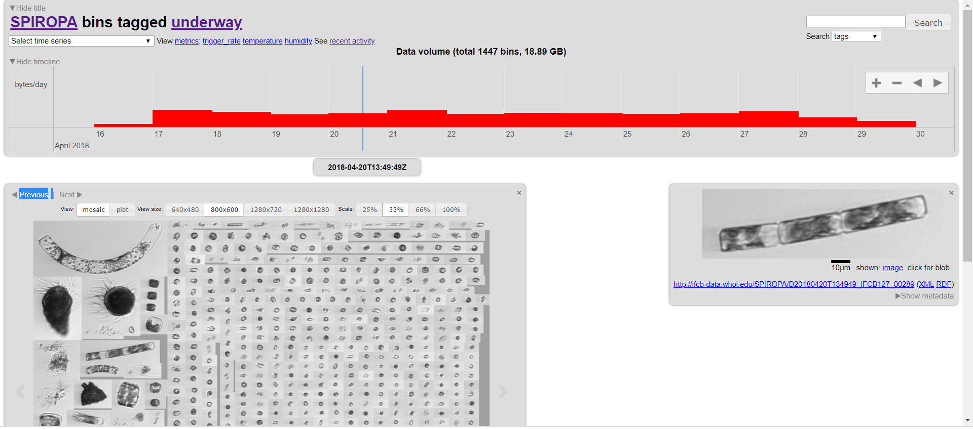
https://ifcb-data.whoi.edu/SPIROPA
Beta version with mapping (and many other new features):
http://ifcbdb.whoi.edu:8000/

Slide 5
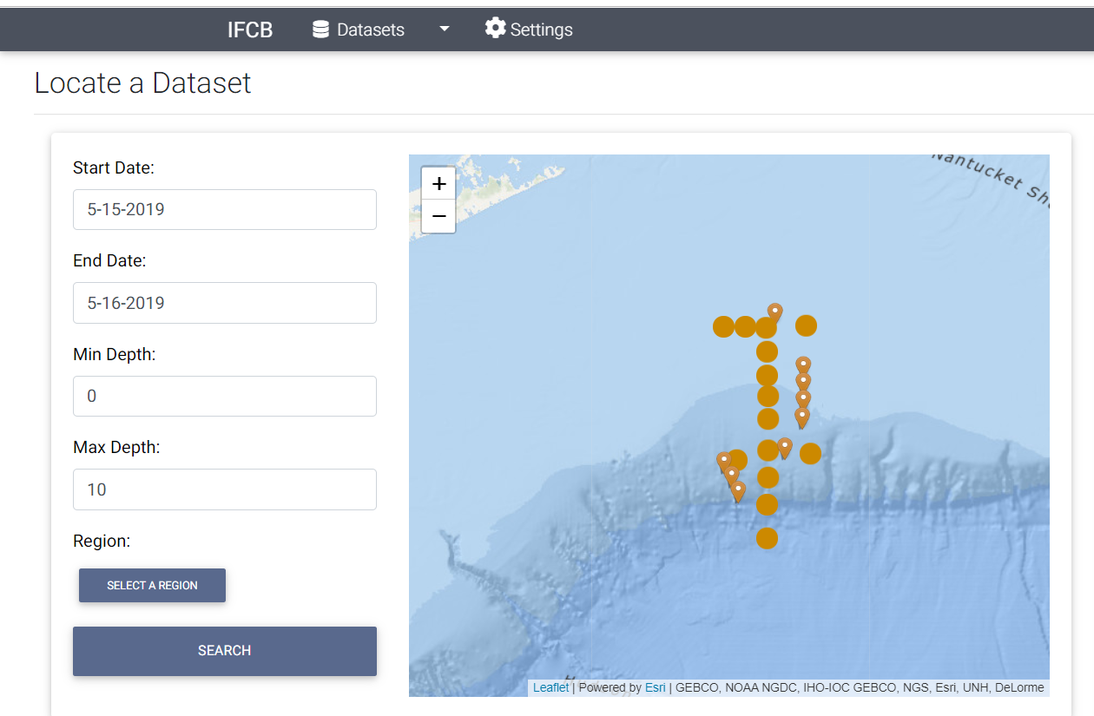
http://ifcbdb.whoi.edu:8000/

Slide 6
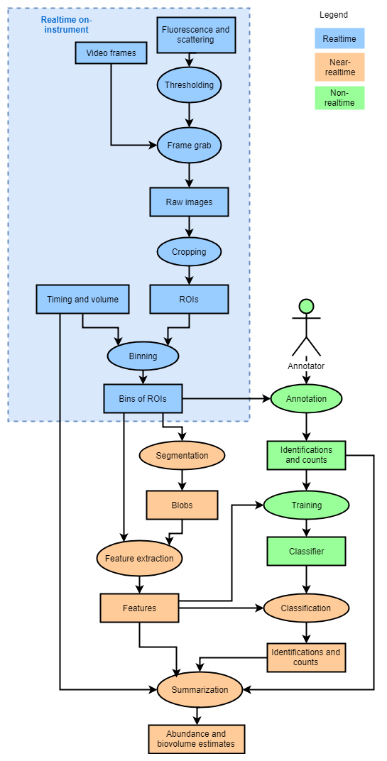

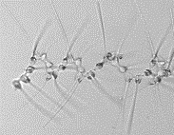


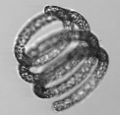

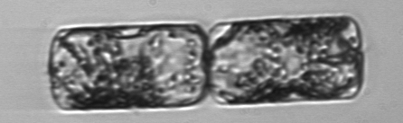
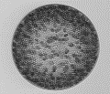
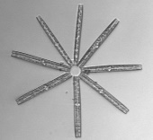




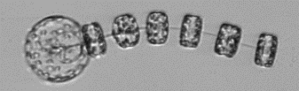



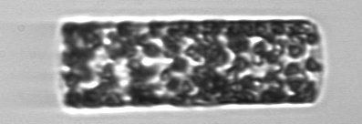

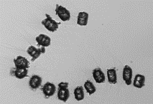
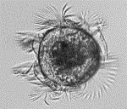



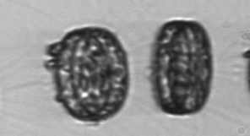
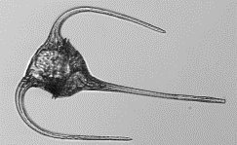
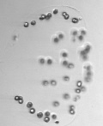


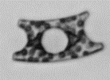


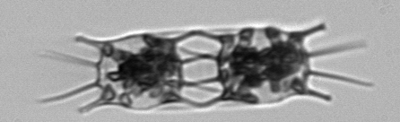





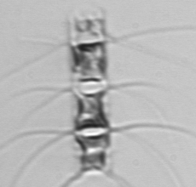

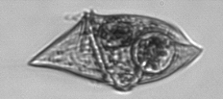



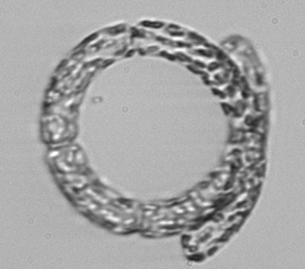
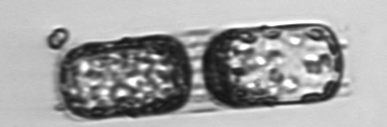
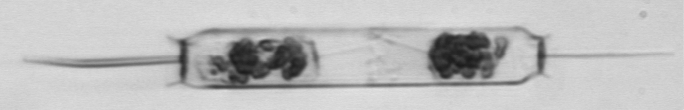


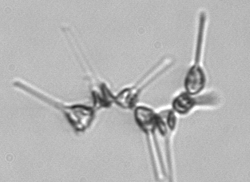



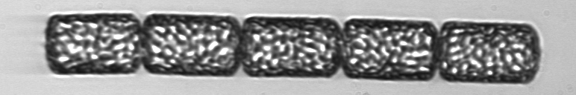


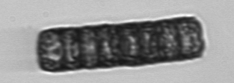



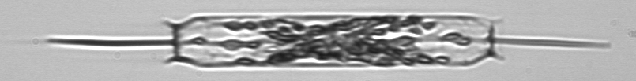

IFCB Analysis Workflow

Slide 7
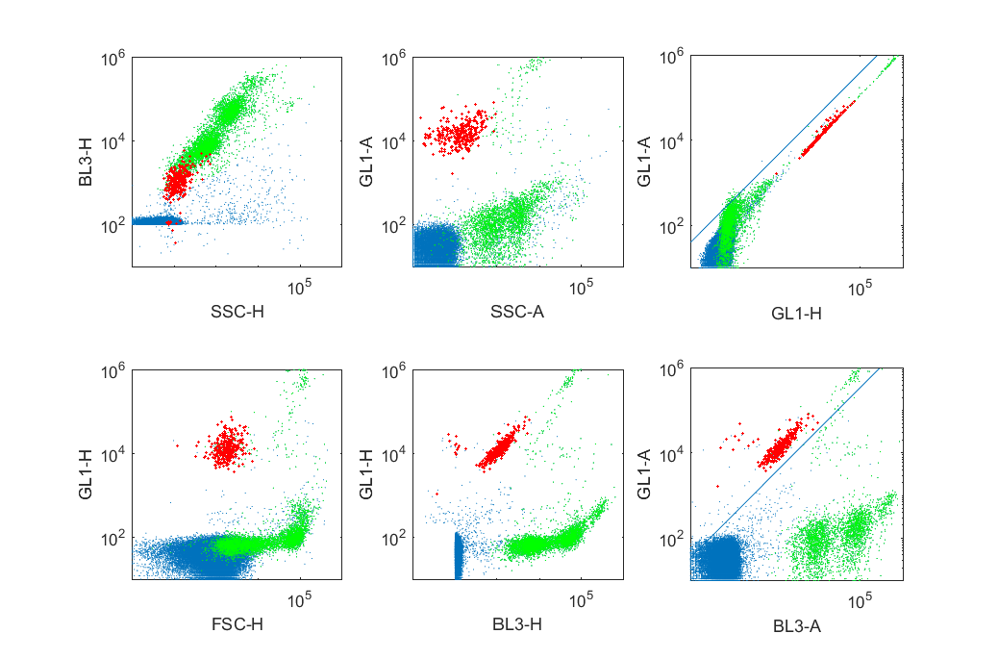
Attune data analysis and quality control

Slide 8
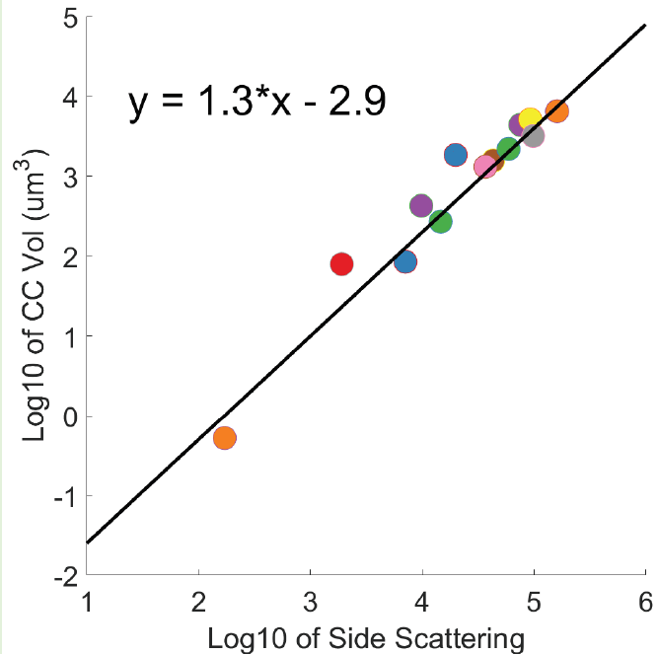


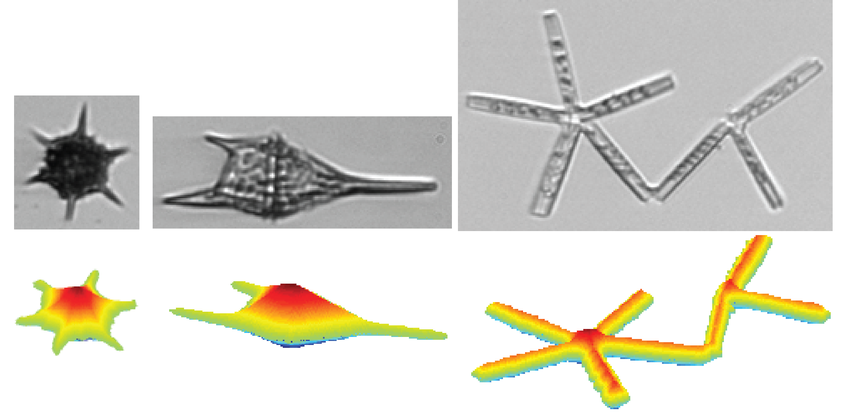

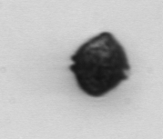
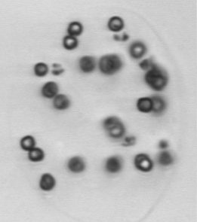
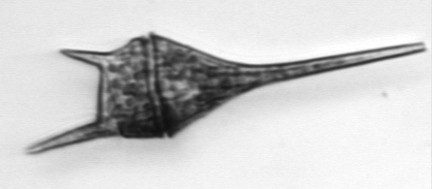

Size and biomass budgets
Pico/nanoplankton
Cell carbon from cell volume
$C_{i}=$ ${f(V}_{i})$
$$Carbon=\sum_{i}{C_{i}}$$
Cell volume from laser scattering
e.g., Menden-Deuer
& Lessard 2000
Nano/microplankton
Imaging FlowCytobot
Cell volume from image analysis
“distance map” approach
Sosik and Olson 2007
Moberg & Sosik 2012

Slide 9
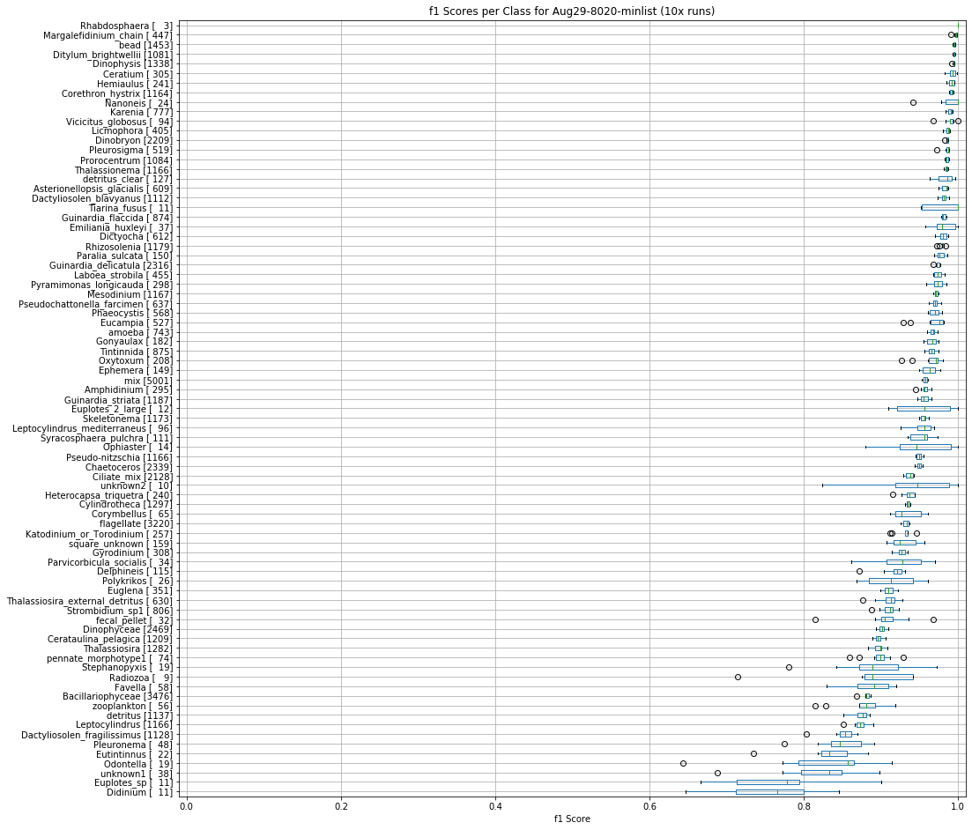
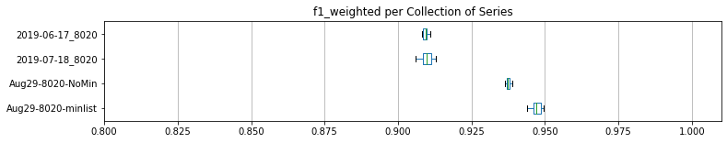
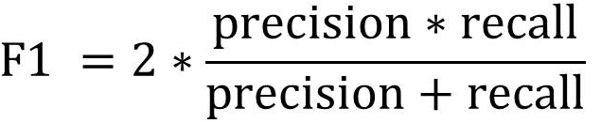
81-Class CNN
129
125
147
81

