Slide 1
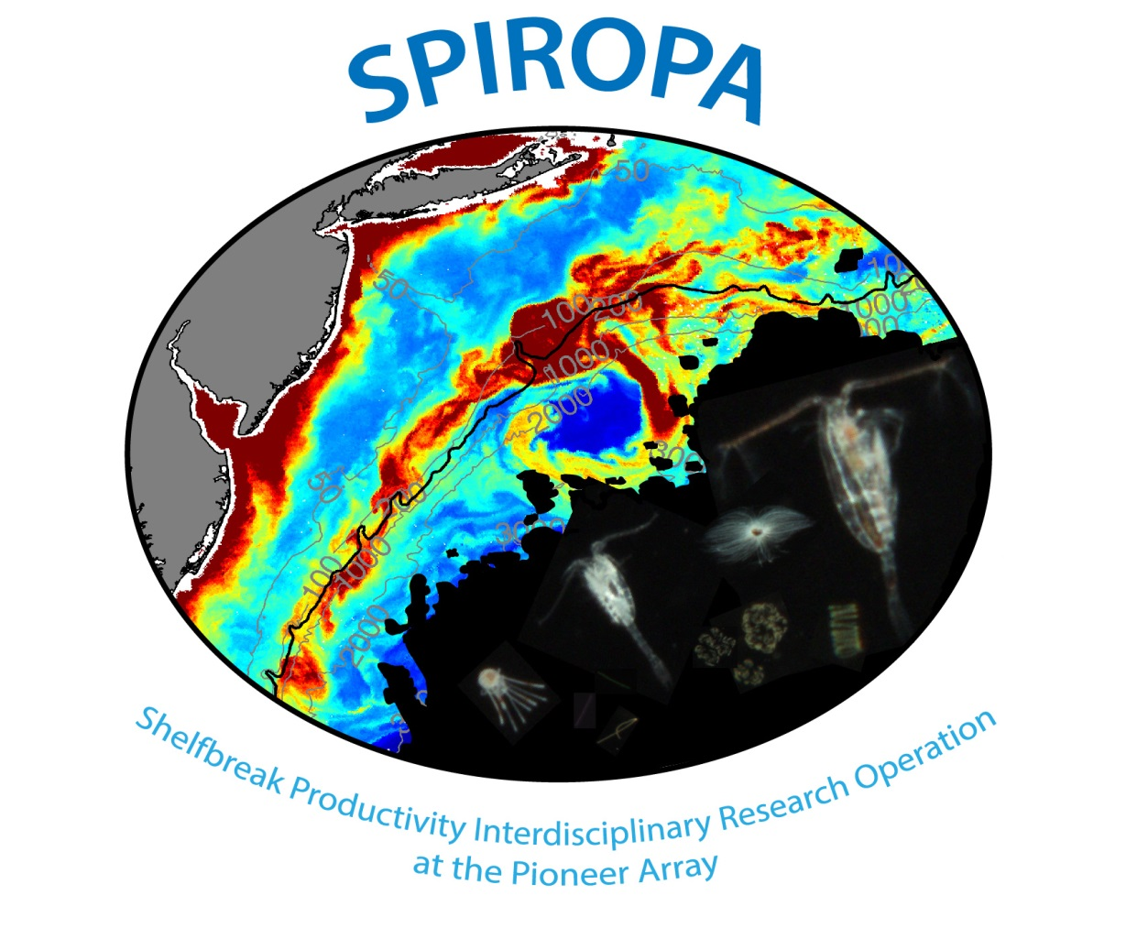

Slide 2
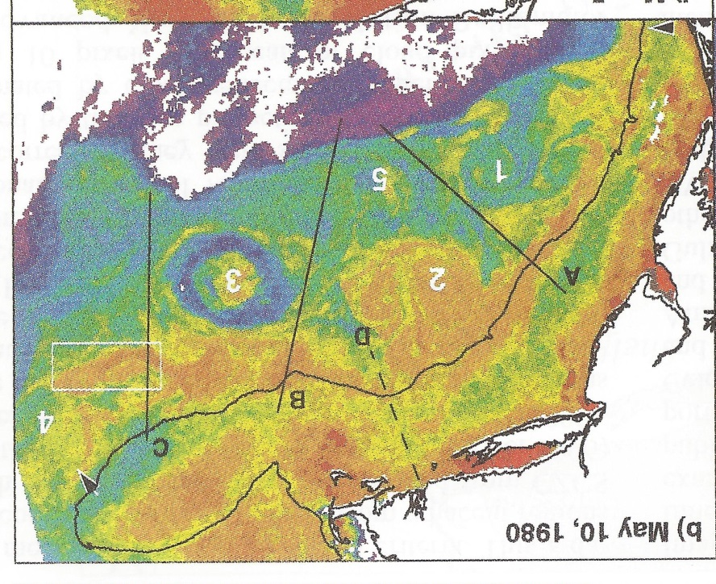
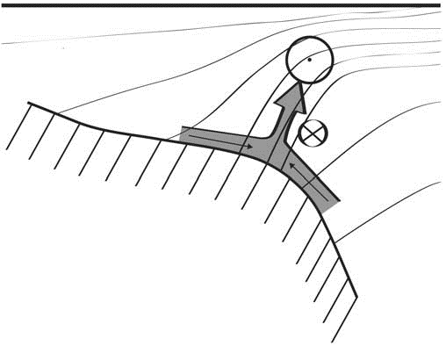
Shelfbreak frontal dynamics: mechanisms of upwelling, net community production, and ecological implications
Ryan et al. 1999
Linder et al. 2004
Gawarkiewicz and Chapman 1992
Chapman and Lentz 1994
Marra et al. 1990

Slide 3


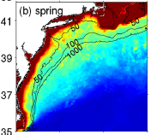

2013, JGR
Satellite CHL climatology
Why is there no mean enhancement of chlorophyll at the shelf break front?
H₁: Top-down control by zooplankton grazing
H₂: Spatial and temporal intermittency of the upwelling events causes their net impact to be smoothed out in long-term means.

Slide 4

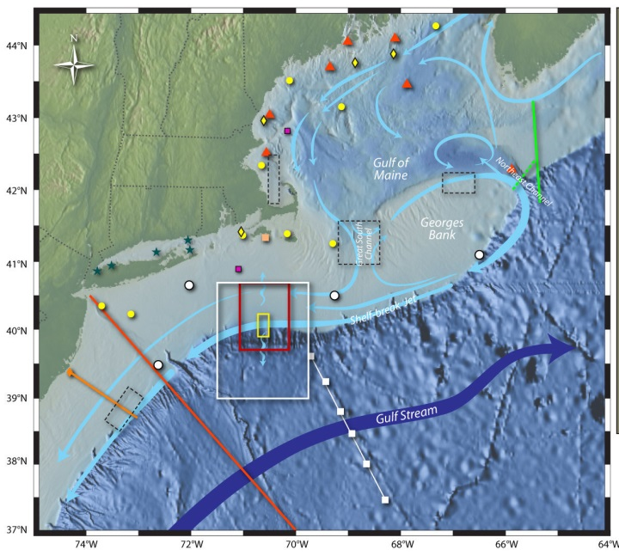
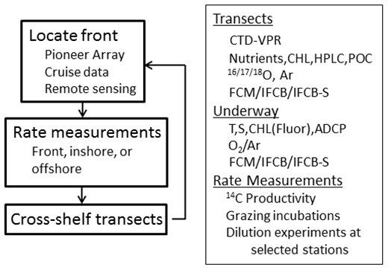
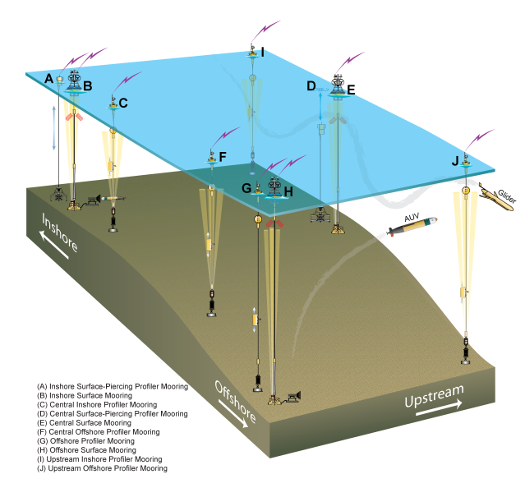
Shelfbreak frontal dynamics: mechanisms of upwelling, net community production, and ecological implications
Dennis McGillicuddy, Heidi Sosik, Gordon Zhang (WHOI)
Walker Smith (VIMS) Rachel Stanley (Wellesley College)
Jefferson Turner, Christian Petitpas (UMass Dartmouth)
3 Cruises R/V Neil Armstrong
NSF Ocean Observatory Initiative Pioneer Array

Slide 5
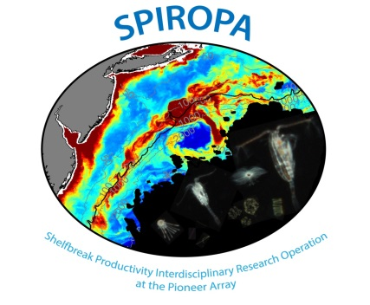
SPIROPA Highlights
AR29
Frontal stratification enhances chlorophyll
Ring forcing of cross-shelf excursions of the front
Frontal Gorduction
Regional bloom of Phaeocystis
RB1904
Upwelling induced by formation of a shelf break eddy
Ring forcing of cross-shelf excursions of the front
Diatom bloom on the slope side of the front
TN368
Cross-shore fluxes of heat, salt, and biomass in a WCR streamer
An extraordinary bloom of diatoms stimulated by deep
ocean / shelf interaction
Fine-scale patchiness at the front
Testing of the bottom boundary layer hypothesis

Slide 6
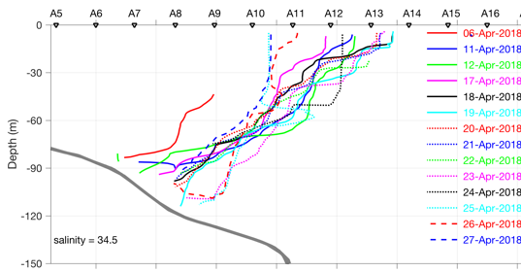
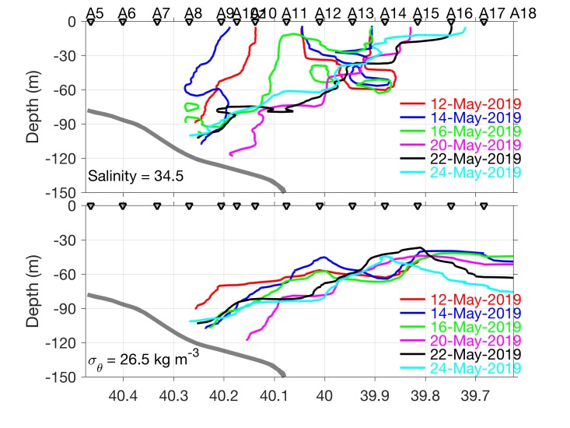
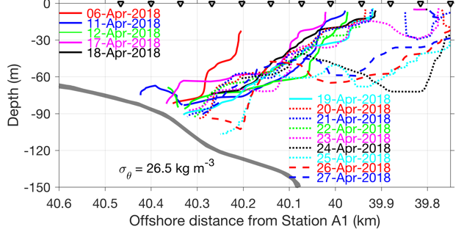
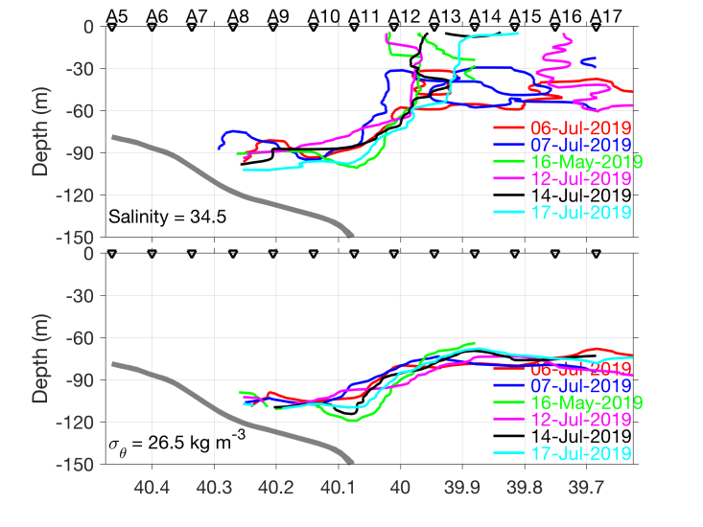
Frontal positions
AR29
S=34.5
RB1904
S=34.5
σ=26.5
TN368
S=34.5
σ=26.5
σ=26.5

Slide 7

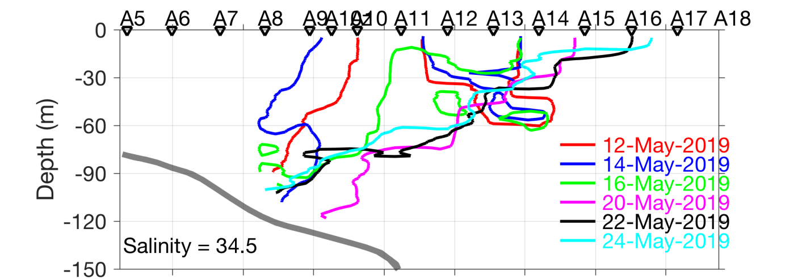
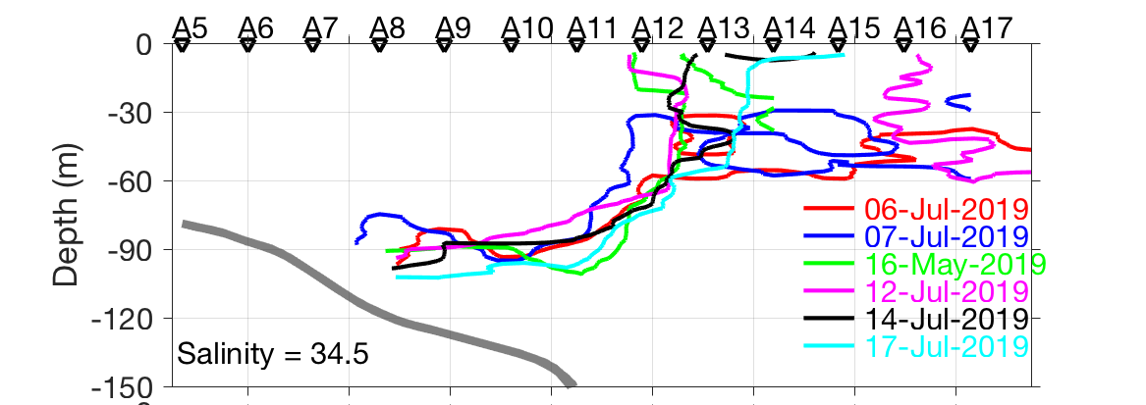
Frontal positions
AR29
RB1904
TN368

Slide 8
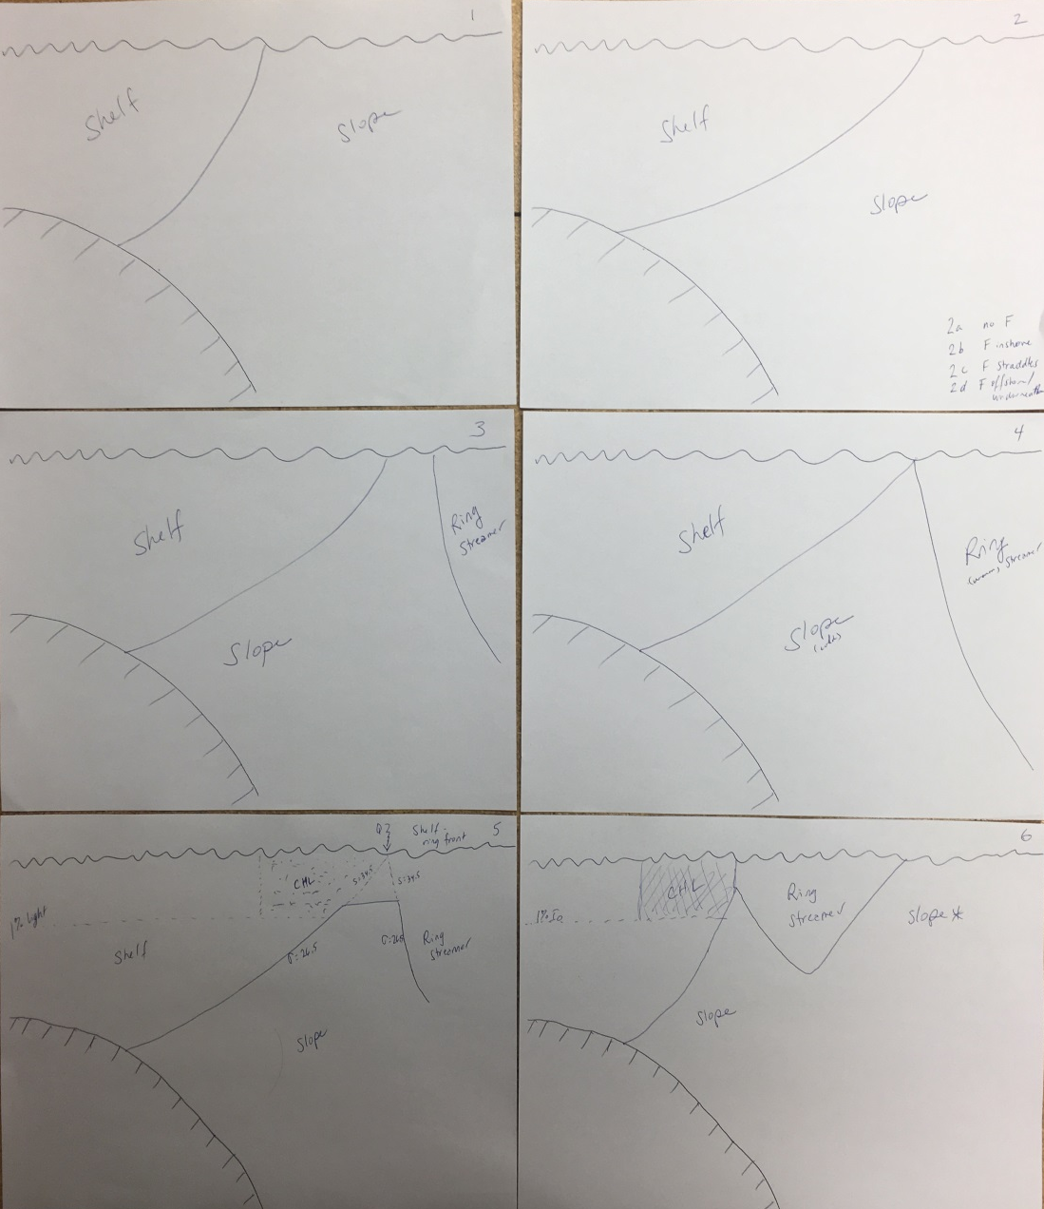
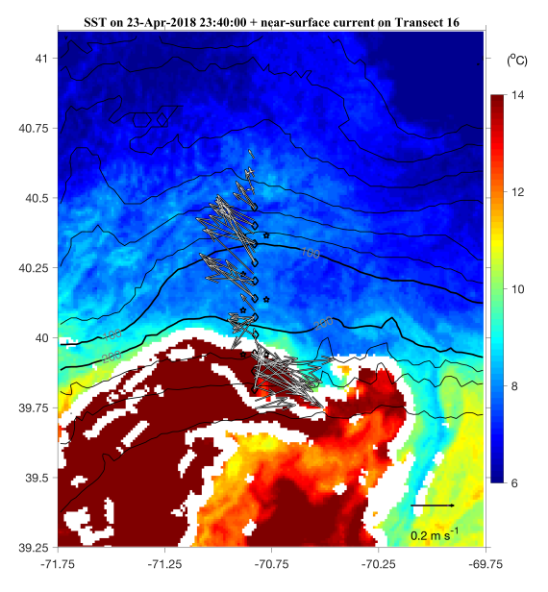
AR 29 Ring streamer – front interaction

Slide 9
SPIROPA Highlights
AR29
Frontal stratification enhances chlorophyll
Ring forcing of cross-shelf excursions of the front
Frontal Gorduction
Regional bloom of Phaeocystis
RB1904
Upwelling induced by formation of a shelf break eddy
Ring forcing of cross-shelf excursions of the front
Diatom bloom on the slope side of the front
TN368
Cross-shore fluxes of heat, salt, and biomass in a WCR streamer
An extraordinary bloom of diatoms stimulated by deep
ocean / shelf interaction
Fine-scale patchiness at the front
Testing of the bottom boundary layer hypothesis

Slide 10
AR28B section

Slide 11
AR29 April 23 Section

Slide 12
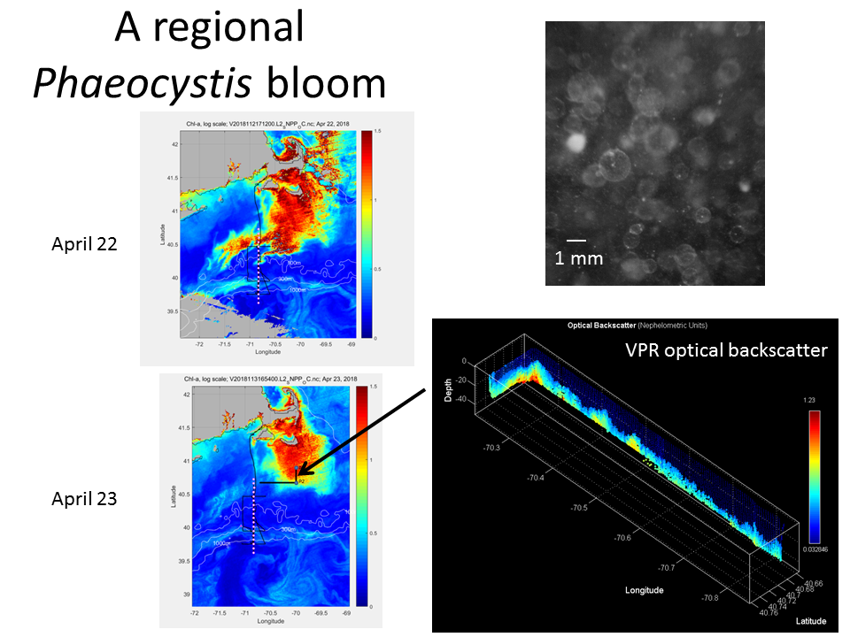

Slide 13
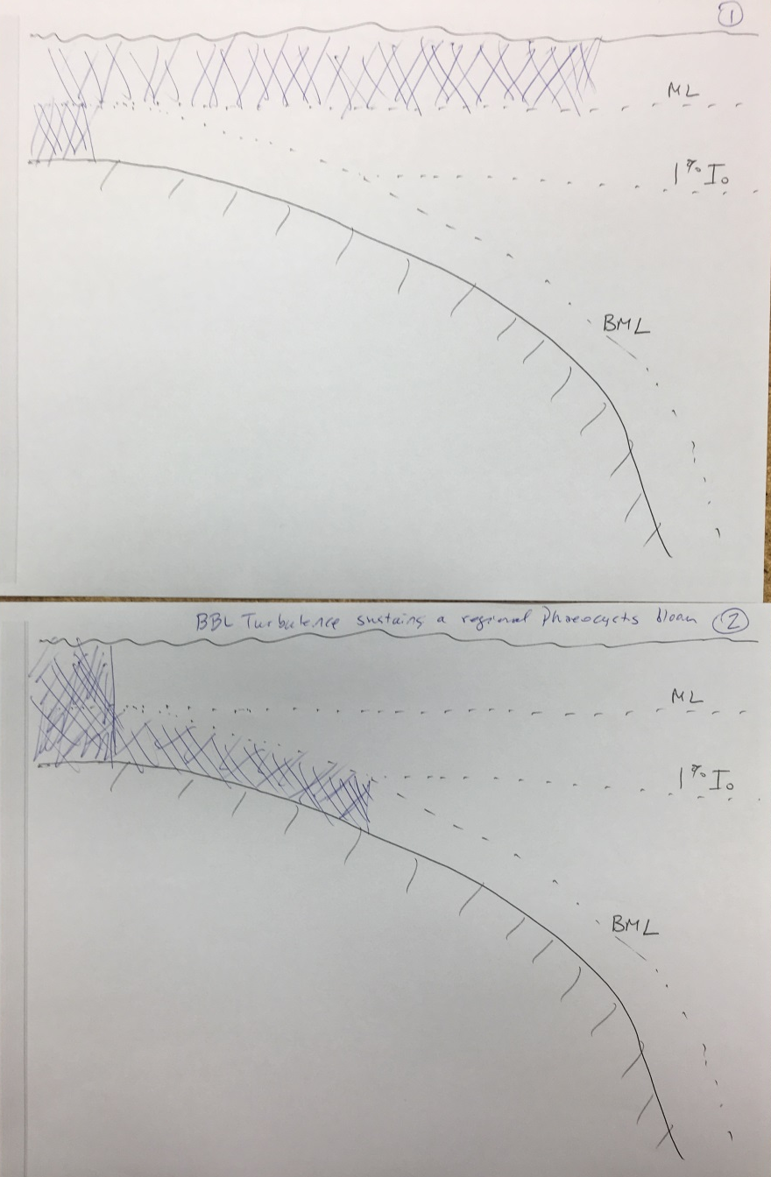
A conceptual model

Slide 14
SPIROPA Highlights
AR29
Frontal stratification enhances chlorophyll
Ring forcing of cross-shelf excursions of the front
Frontal Gorduction
Regional bloom of Phaeocystis
RB1904
Upwelling induced by formation of a shelf break eddy
Ring forcing of cross-shelf excursions of the front
Diatom bloom on the slope side of the front
TN368
Cross-shore fluxes of heat, salt, and biomass in a WCR streamer
An extraordinary bloom of diatoms stimulated by deep
ocean / shelf interaction
Fine-scale patchiness at the front
Testing of the bottom boundary layer hypothesis

Slide 15
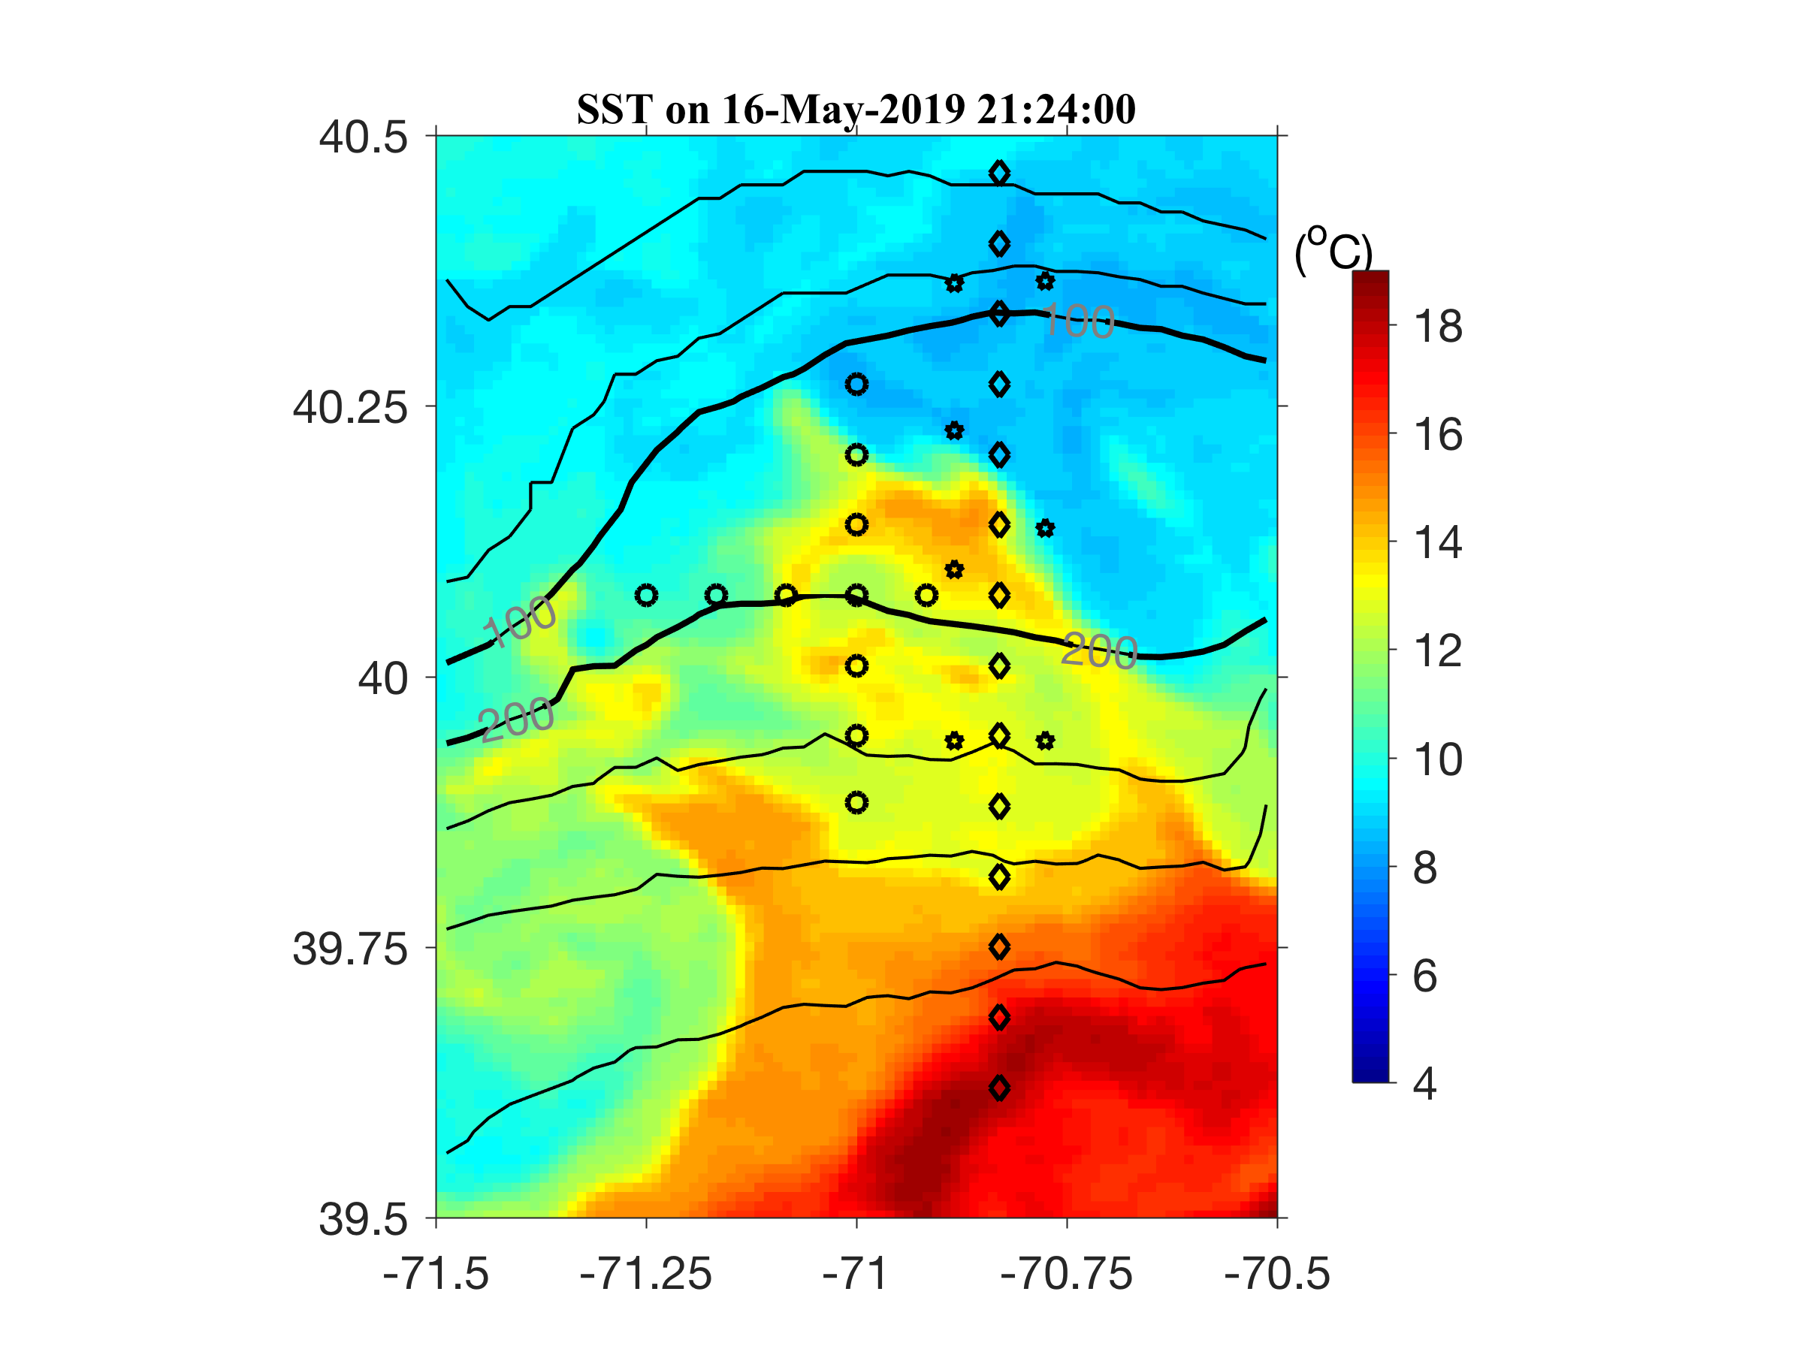
Eddy survey 17-18 May

Slide 16
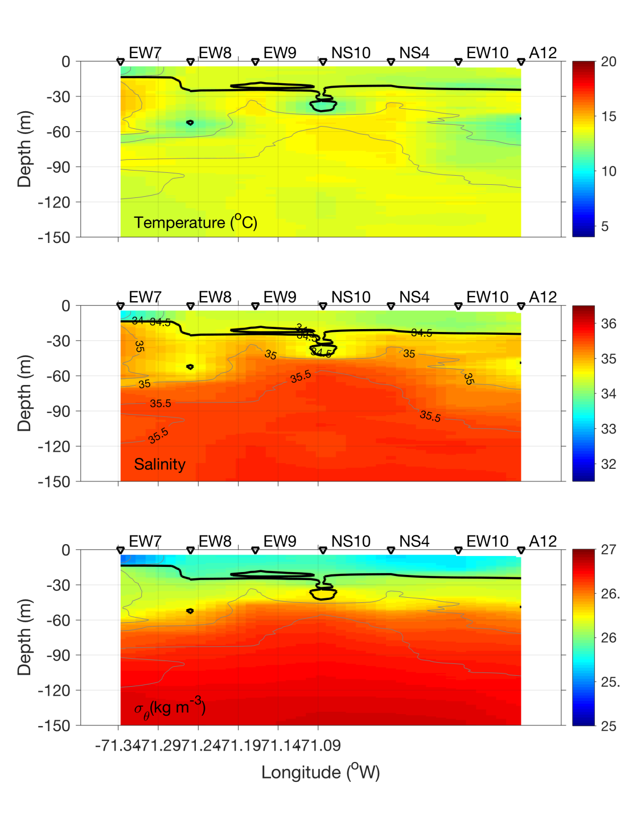
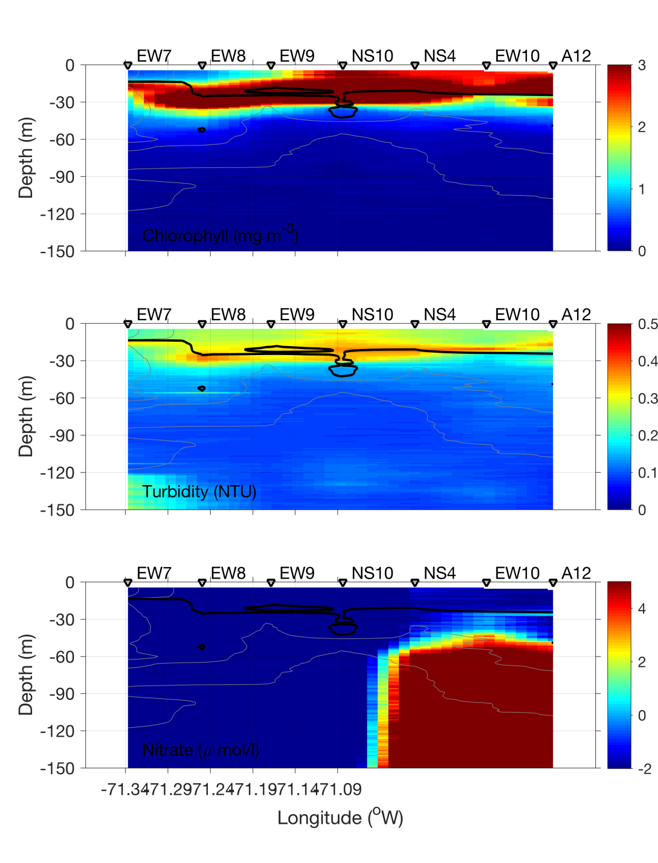
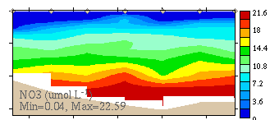
Eddy Survey – EW Section
Eddy
Center
Eddy
Center

Slide 17
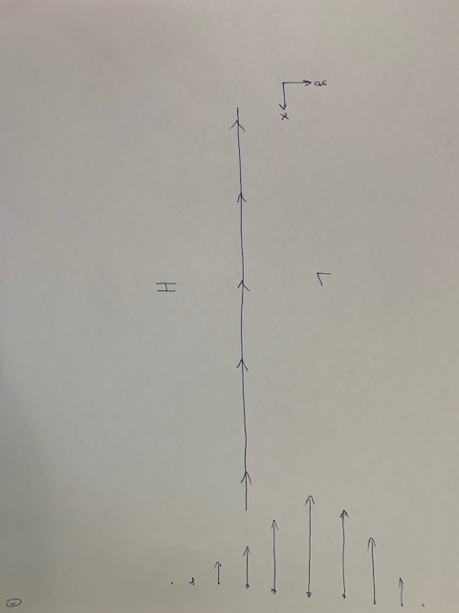
Shelf break jet: mean state

Slide 18
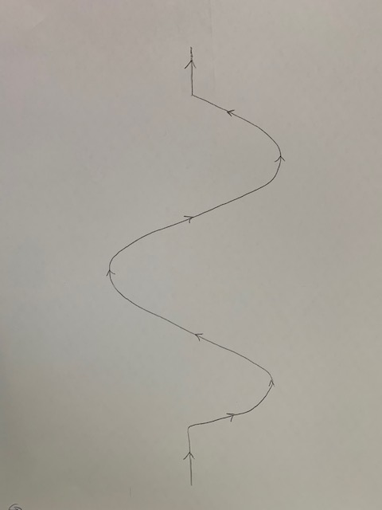
Meander formation

Slide 19
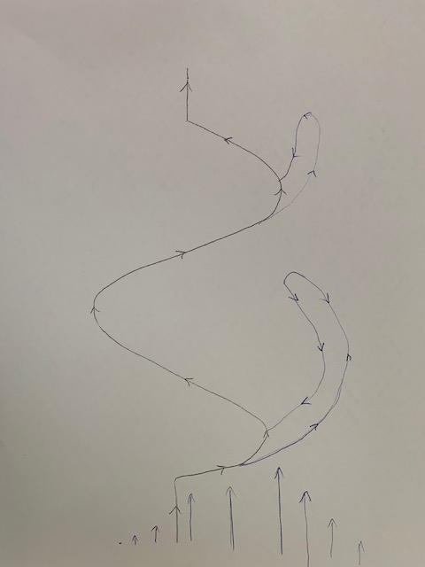
Shingle formation

Slide 20
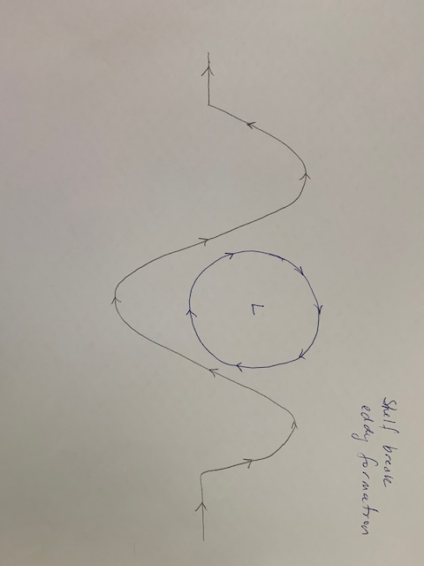
Shelf break eddy formation

Slide 21
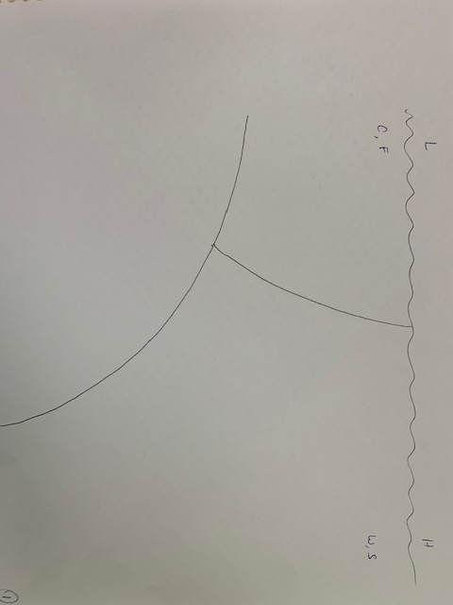
Vertical section: mean state

Slide 22
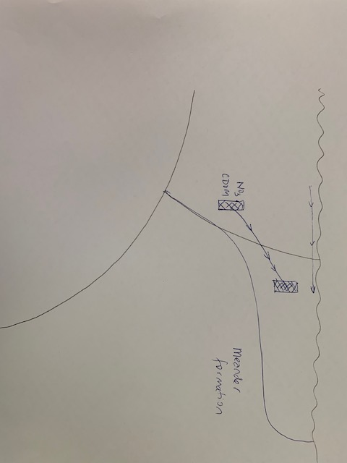
Vertical section: meander formation

Slide 23
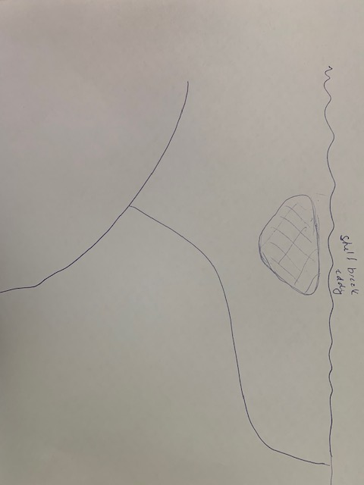
Vertical section: shelf break eddy formation

Slide 24
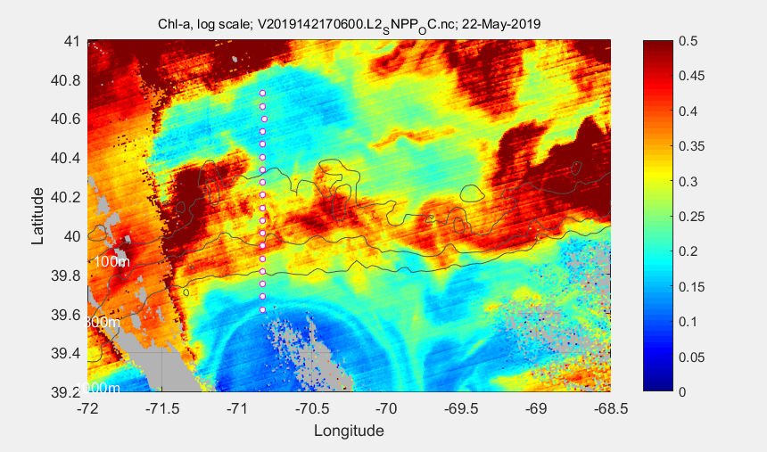
VIIRS Chl May 22
A
C
D
B
Youngest to oldest? B, D, C, A

Slide 25
SPIROPA Highlights
AR29
Frontal stratification enhances chlorophyll
Ring forcing of cross-shelf excursions of the front
Frontal Gorduction
Regional bloom of Phaeocystis
RB1904
Upwelling induced by formation of a shelf break eddy
Ring forcing of cross-shelf excursions of the front
Diatom bloom on the slope side of the front
TN368
Cross-shore fluxes of heat, salt, and biomass in a WCR streamer
An extraordinary bloom of diatoms stimulated by deep
ocean / shelf interaction
Fine-scale patchiness at the front
Testing of the bottom boundary layer hypothesis

Slide 26
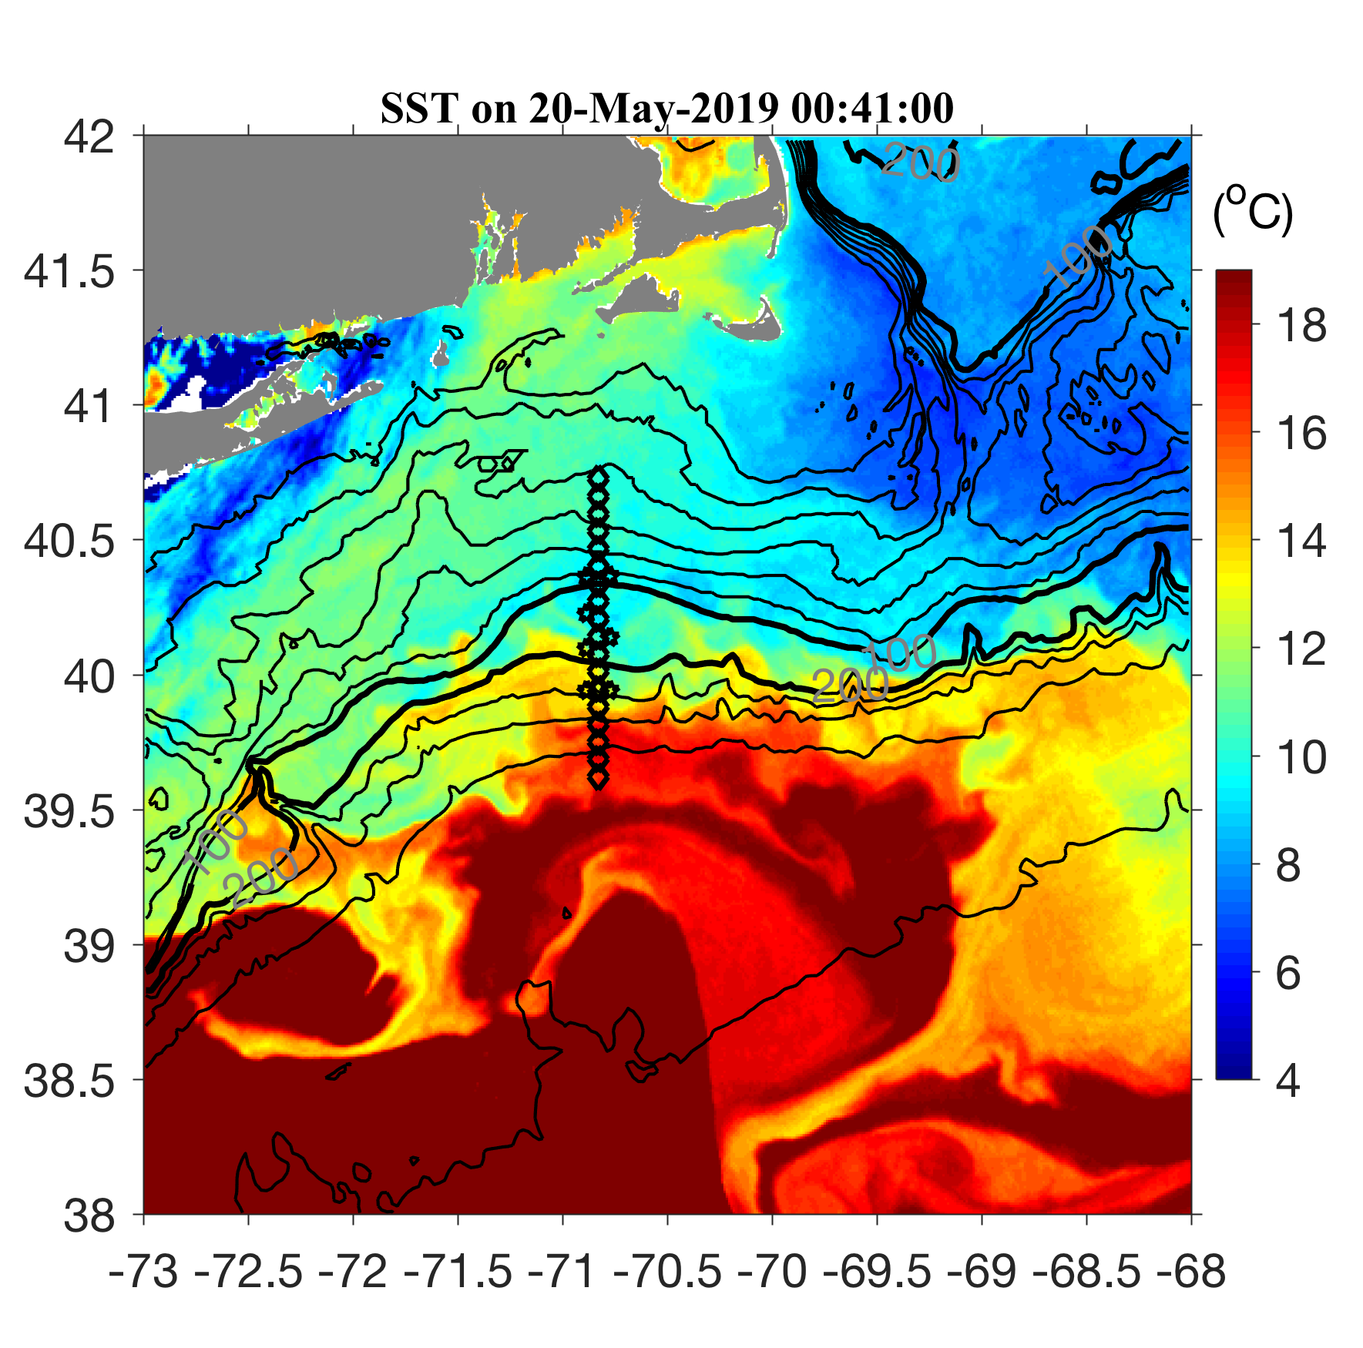
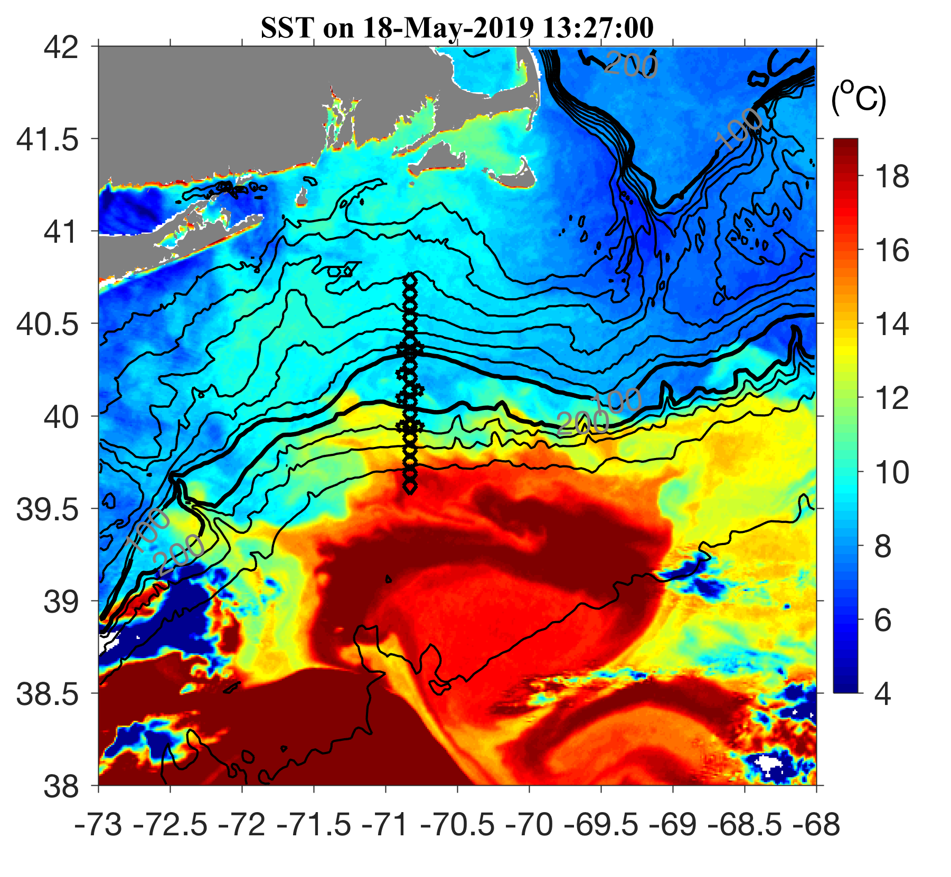
SST on 18 and 20 May

Slide 27
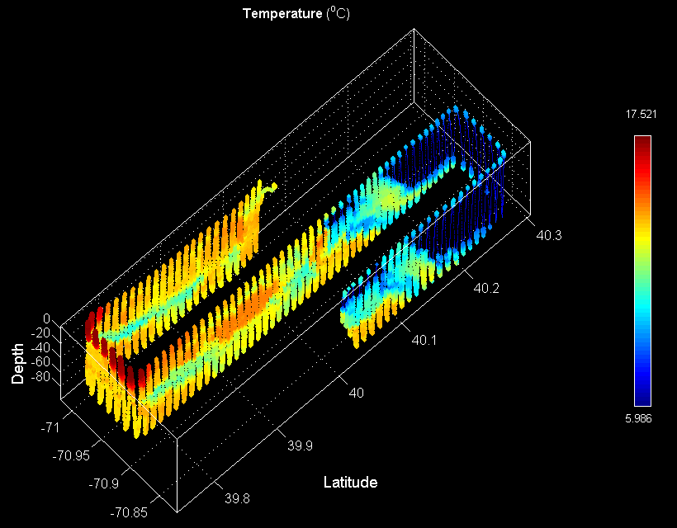
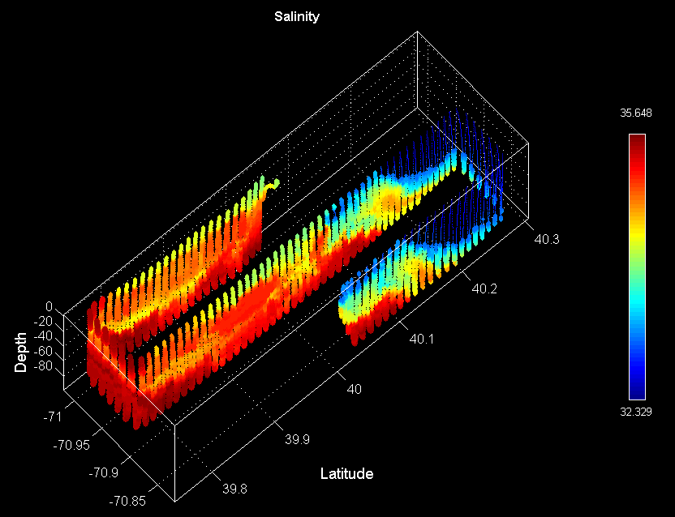
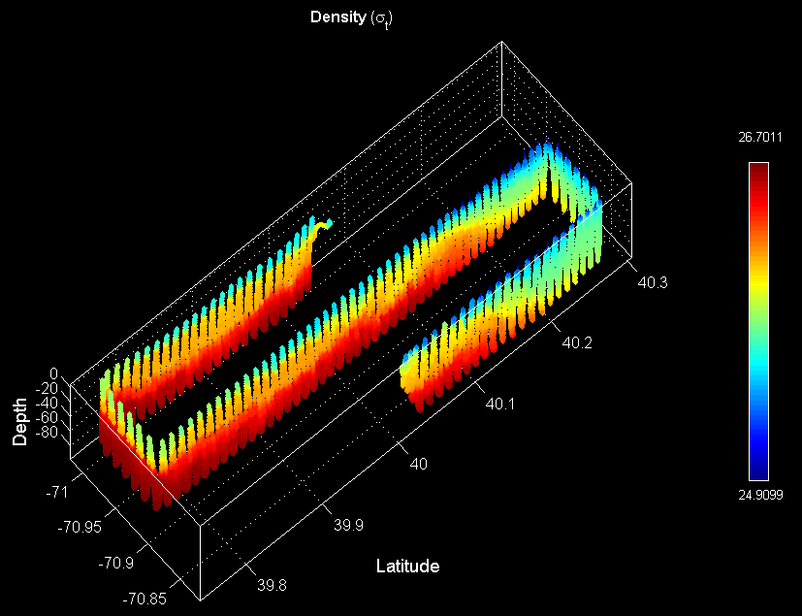
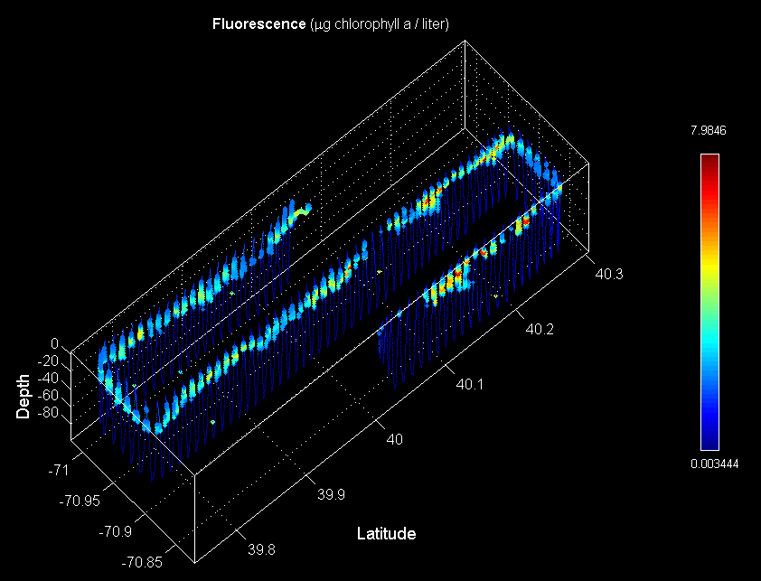
VPR Survey May 19
North
Temperature Salinity
Density Fluorescence
A5
A12
South
Diatoms aplenty

Slide 28
VPR diatom images

Slide 29
SPIROPA Highlights
AR29
Frontal stratification enhances chlorophyll
Ring forcing of cross-shelf excursions of the front
Frontal Gorduction
Regional bloom of Phaeocystis
RB1904
Upwelling induced by formation of a shelf break eddy
Ring forcing of cross-shelf excursions of the front
Diatom bloom on the slope side of the front
TN368
An extraordinary bloom of diatoms stimulated by deep
ocean / shelf interaction
Cross-shore fluxes of heat, salt, and biomass in a WCR streamer
Fine-scale patchiness at the front
Testing of the bottom boundary layer hypothesis

Slide 30
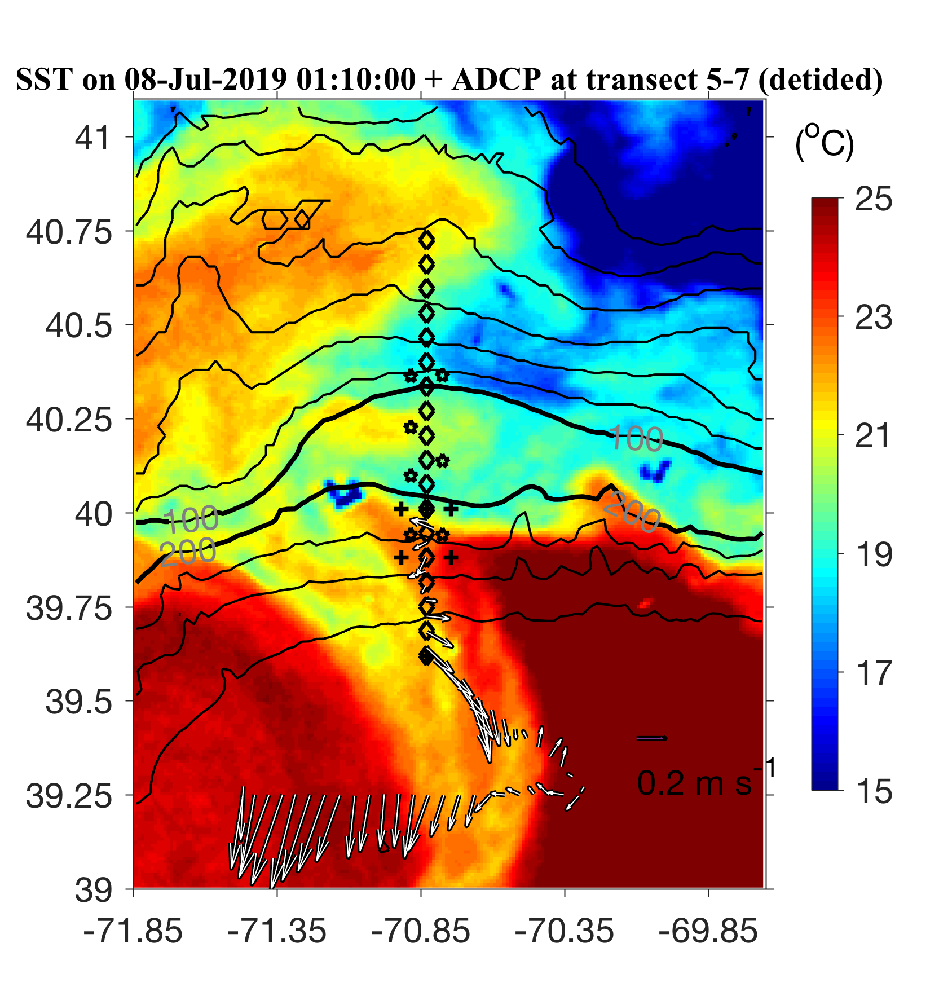
ADCP from VPR survey

Slide 31
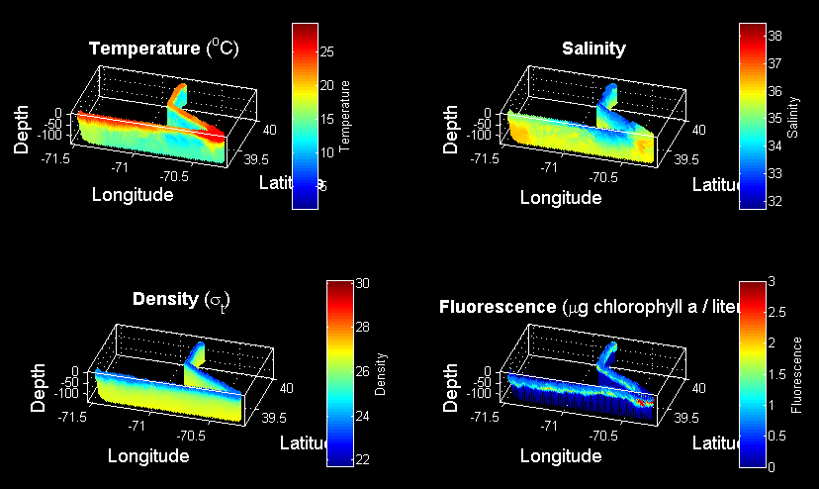
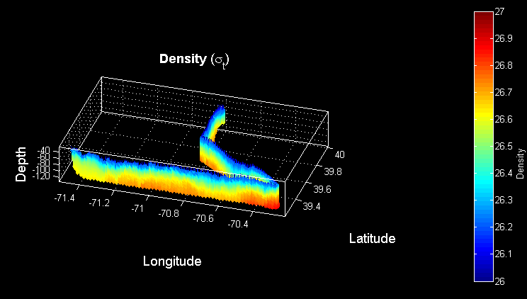
VPR1 Survey July 7-8
Density

Slide 32
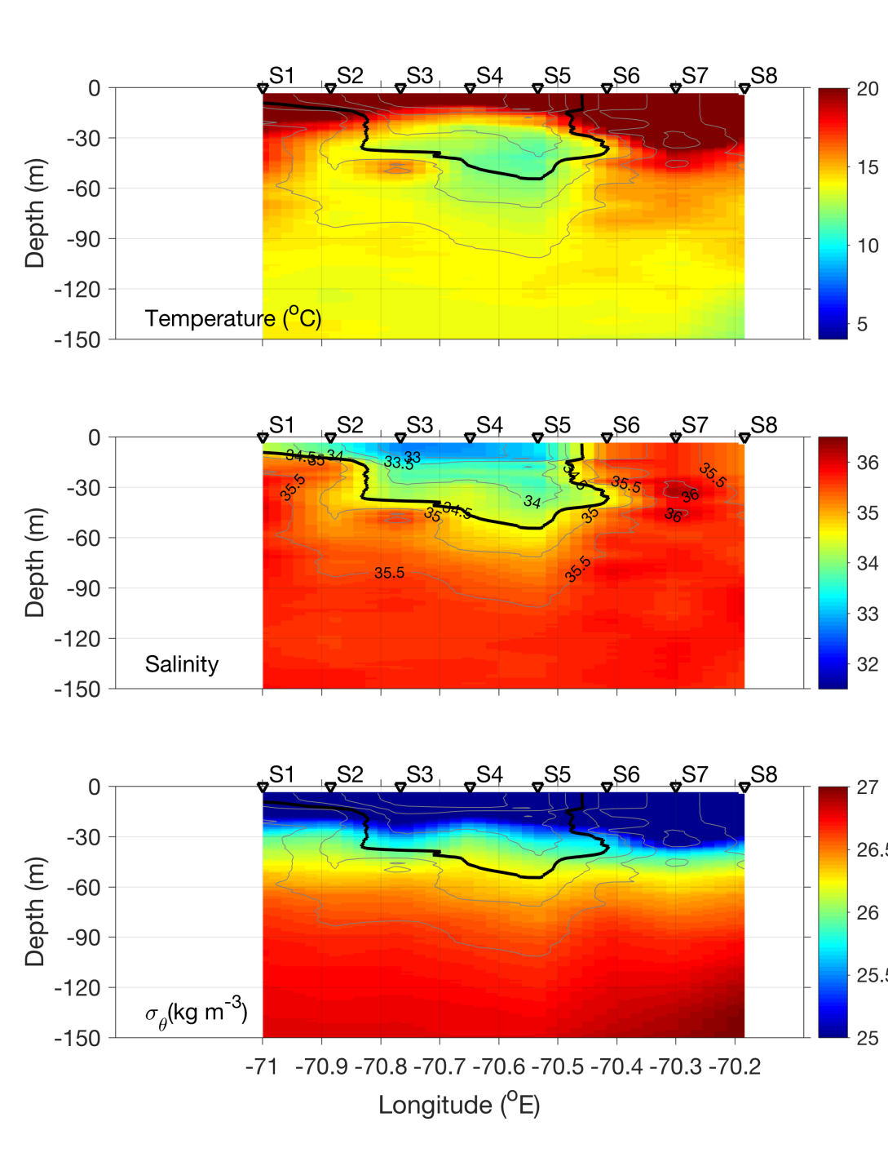
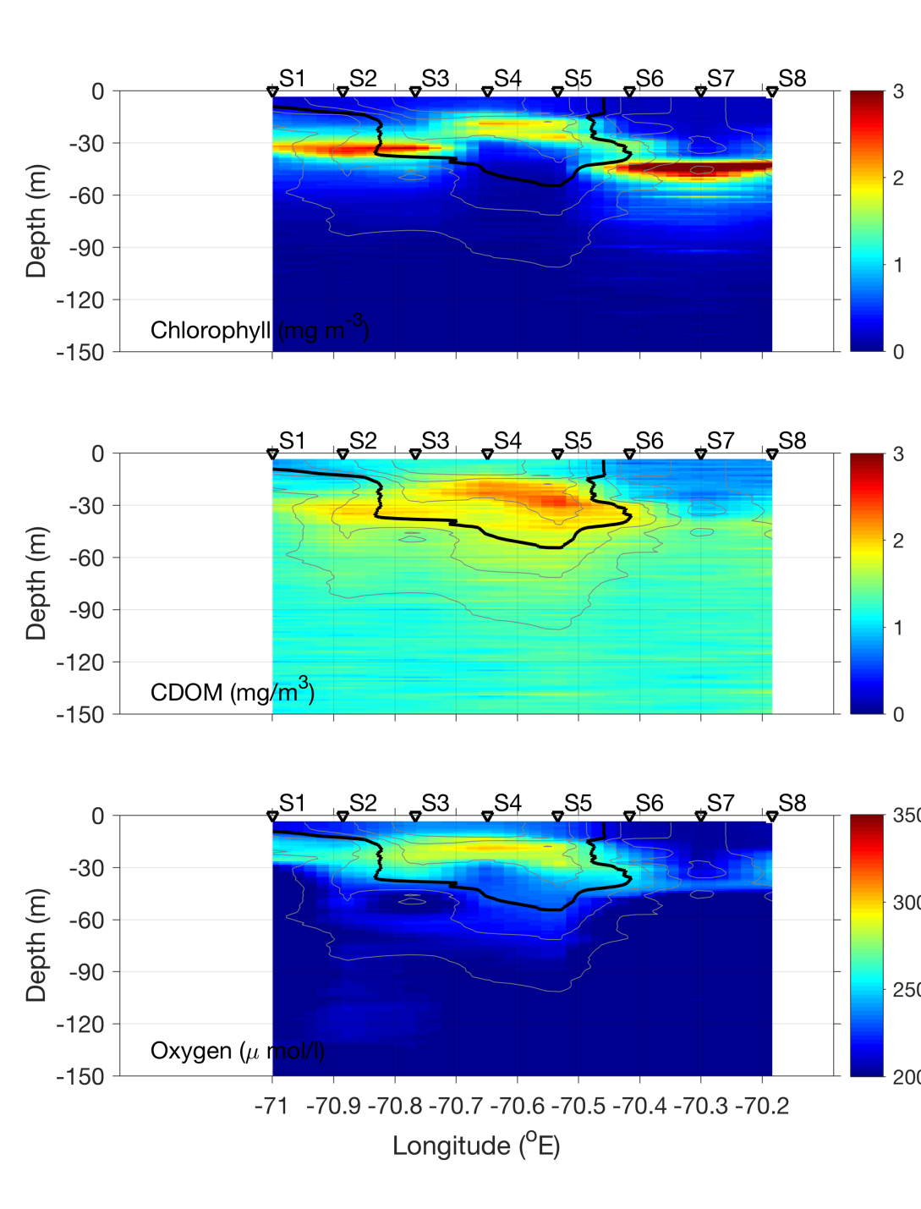
Streamer CTD transect – July 8

Slide 33
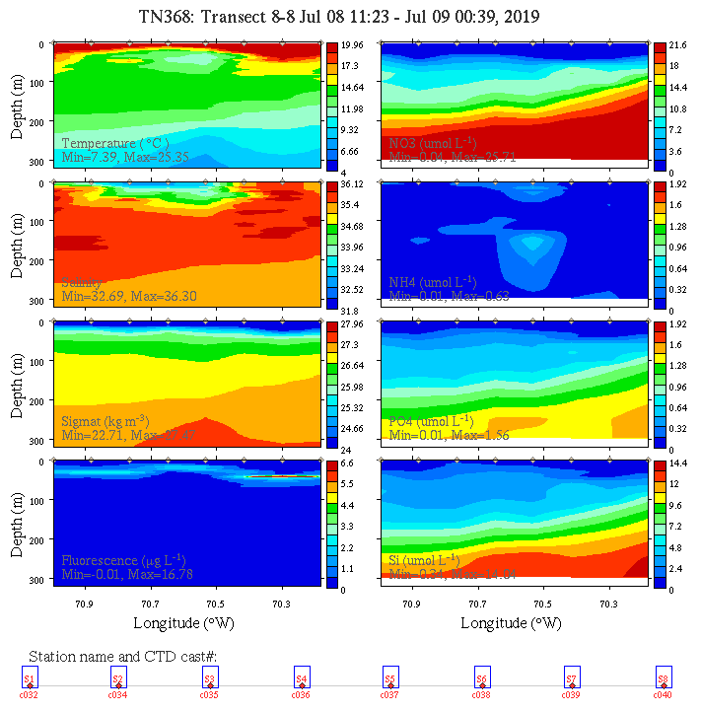
Streamer CTD transect – July 8

Slide 34
ADCP from VPR survey

Slide 35
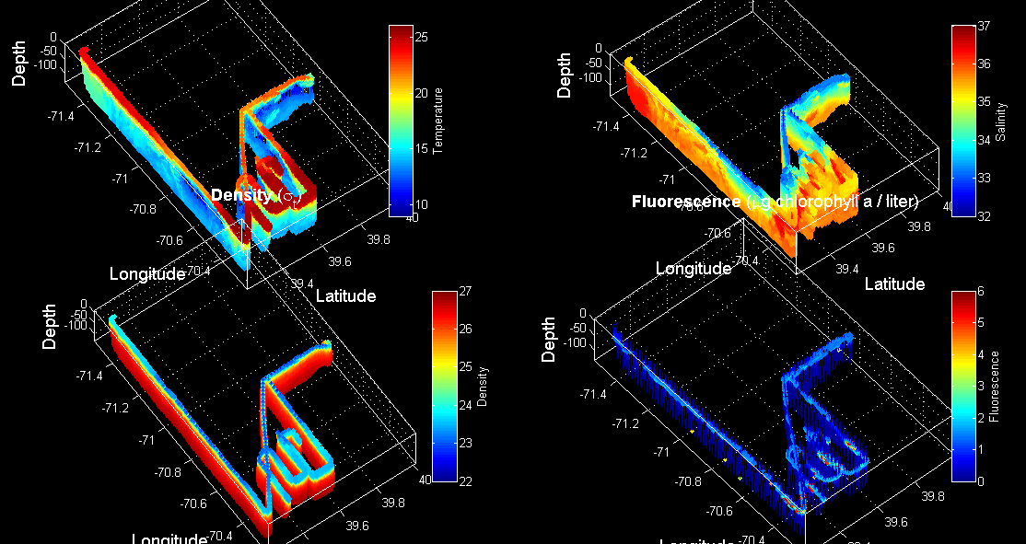
VPR 2,3,4

Slide 36
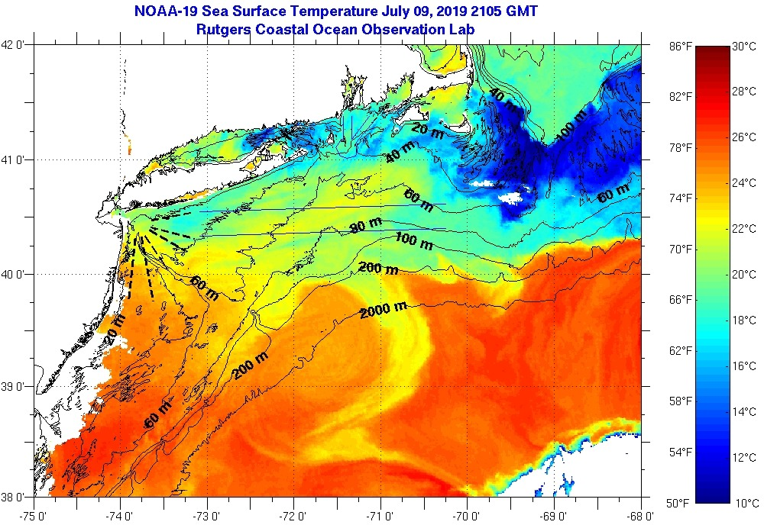
SST July 9

Slide 37
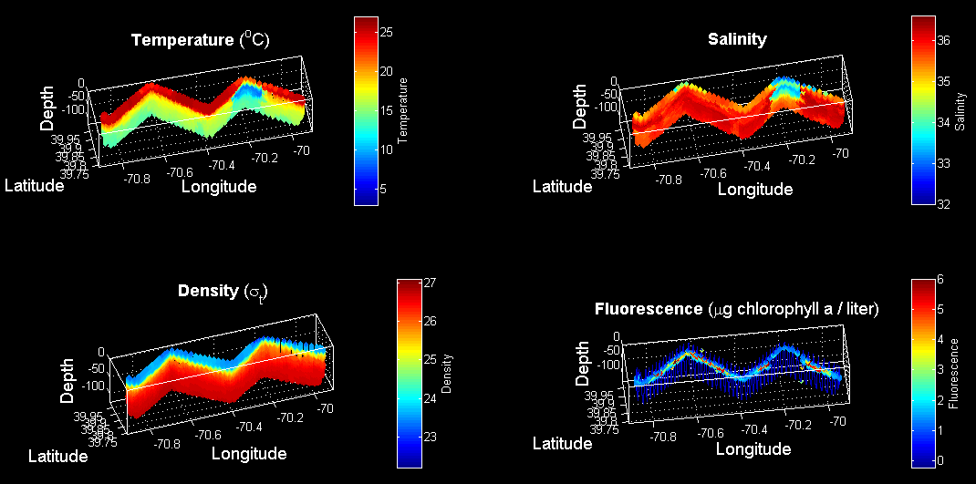
VPR5 July 12

Slide 38
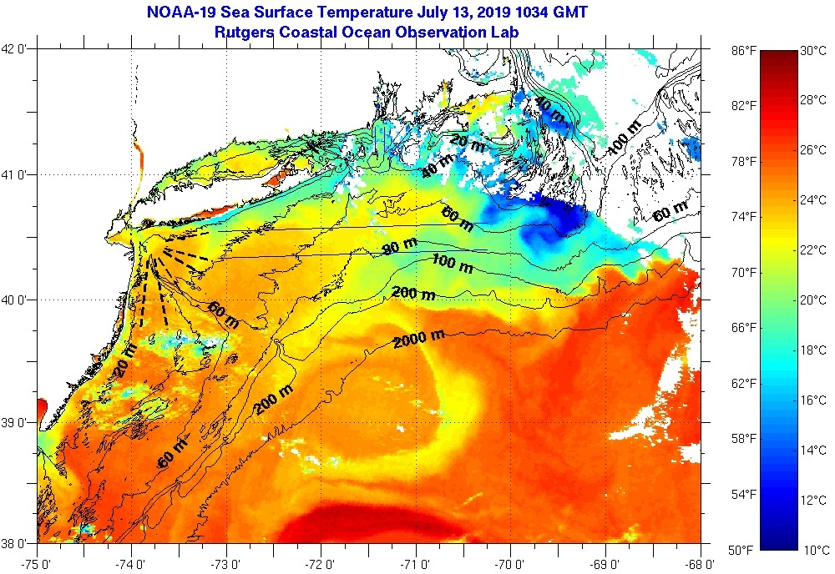
SST July 13

Slide 39
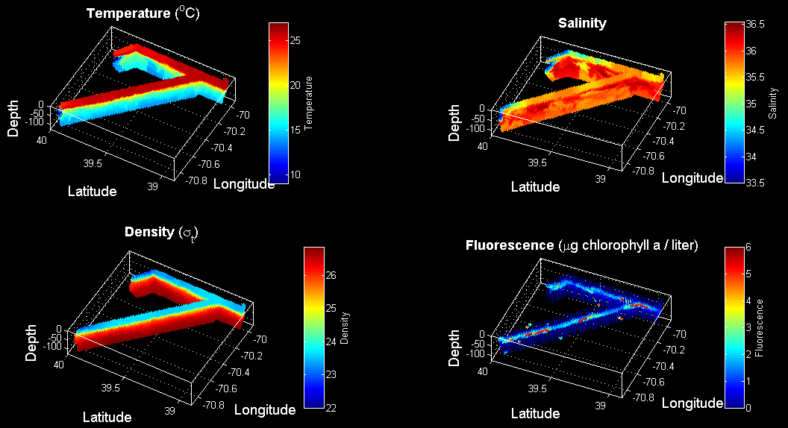
VPR 7-8 July 15

Slide 40
SST July 13

Slide 41
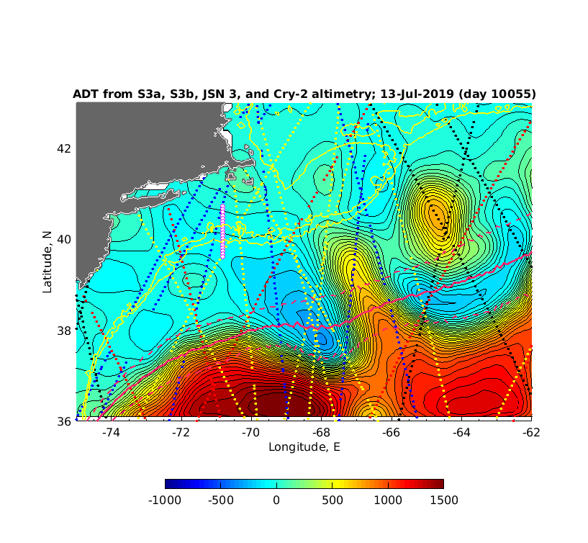
Satellite altimetry July 13

Slide 42
Diatom / Alatalosphera bloom: synthesis
High salinity waters are the niche (ca. 36 ppt)
The cyclonic eddy identified in altimetry provides transport from a gulf stream / ring source
The jet in between the cyclone and the ring forming to its east impacts the edge of the continental shelf
Westward flow in the northwestern lobe of the cyclone deliver the source waters to our sampling area
Highest fluorescence occurs when the high salinity waters are illuminated via shoaling of that water mass
cyclone, along the shelf break front, streamers

Slide 43
SPIROPA Highlights
AR29
Frontal stratification enhances chlorophyll
Ring forcing of cross-shelf excursions of the front
Frontal Gorduction
Regional bloom of Phaeocystis
RB1904
Upwelling induced by formation of a shelf break eddy
Ring forcing of cross-shelf excursions of the front
Diatom bloom on the slope side of the front
TN368
Cross-shore fluxes of heat, salt, and biomass in a WCR streamer
An extraordinary bloom of diatoms stimulated by deep
ocean / shelf interaction
Fine-scale patchiness at the front
Testing of the bottom boundary layer hypothesis

Slide 44
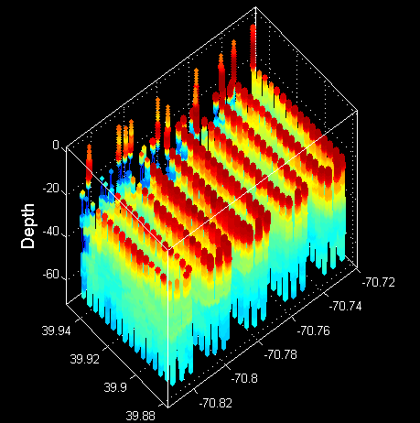
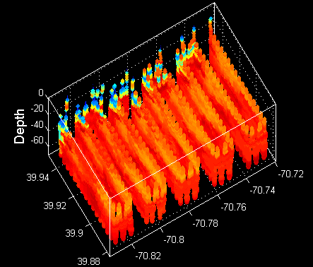
REMUS 6 – diatom hotspot
Temperature Salinity

Slide 45


REMUS 6 – diatom hotspot
Fluorescence Backscatter

Slide 46


REMUS 6 – diatom hotspot
Nitrate Oxygen

Slide 47
SPIROPA Highlights
AR29
Frontal stratification enhances chlorophyll
Ring forcing of cross-shelf excursions of the front
Frontal Gorduction
Regional bloom of Phaeocystis
RB1904
Upwelling induced by formation of a shelf break eddy
Ring forcing of cross-shelf excursions of the front
Diatom bloom on the slope side of the front
TN368
Cross-shore fluxes of heat, salt, and biomass in a WCR streamer
An extraordinary bloom of diatoms stimulated by deep
ocean / shelf interaction
Fine-scale patchiness at the front
Testing of the bottom boundary layer hypothesis

Slide 48


REMUS 5 – BBL survey

Slide 49
SPIROPA Highlights
AR29
Frontal stratification enhances chlorophyll
Ring forcing of cross-shelf excursions of the front
Frontal Gorduction
Regional bloom of Phaeocystis
RB1904
Upwelling induced by formation of a shelf break eddy
Ring forcing of cross-shelf excursions of the front
Diatom bloom on the slope side of the front
TN368
Cross-shore fluxes of heat, salt, and biomass in a WCR streamer
An extraordinary bloom of diatoms stimulated by deep
ocean / shelf interaction
Fine-scale patchiness at the front
Testing of the bottom boundary layer hypothesis

Slide 50

Quantification of streamer transport of heat, salt, and biomass
Observations of turbulent billows associated with internal wave breaking
Biogeography of the shelf break front: from the Gulf of Mexico to the Gulf of Maine and everything in between
And more to come!

