Slide 1
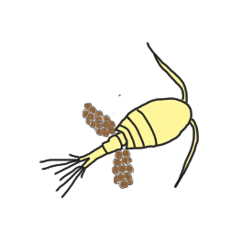
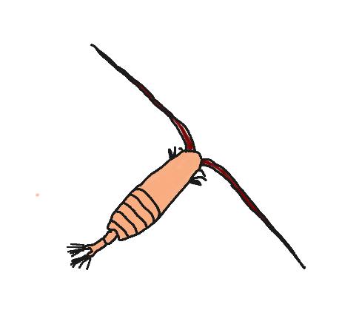
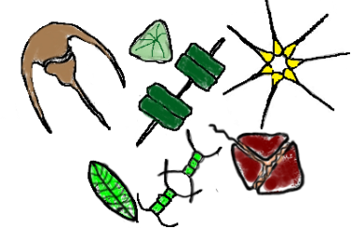
SPIROPA PI MEETING:
Shelfbreak Frontal Dynamics: mechanisms of upwelling, net community production, and ecological implications
Zooplankton Grazing Component
Jefferson Turner
University of Massachusetts Dartmouth School for Marine Science and Technology
Christian Petitpas
Massachusetts Division of Marine Fisheries
and
University of Massachusetts Dartmouth School for Marine Science and Technology
November 7, 2019

Slide 3
May 13, 2019
May 15, 2019

Slide 4
May 16, 2019
May 17, 2019

Slide 5
May 18, 2019
May 20, 2019

Slide 6
May 20, 2019
May 21, 2019

