Slide 1
An Overview of the Physical Environment during AR29, RB1904, and TN368

Slide 2
AR29 (April 16-30, 2018)

Slide 3
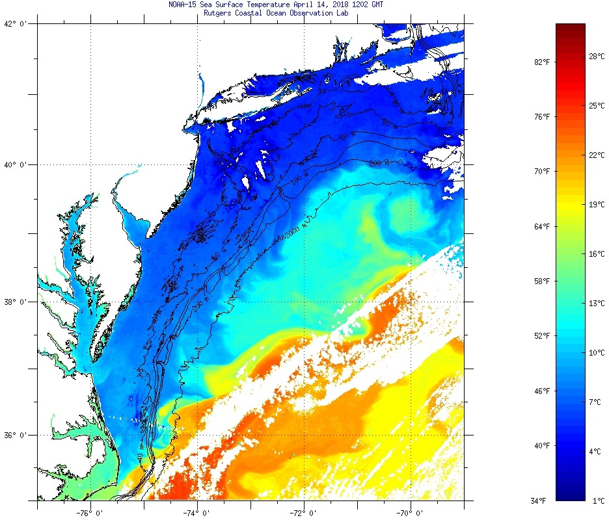
Satellite-measured Sea Surface Temperature
2018 Apr 14
Beginning of the cruise

Slide 4
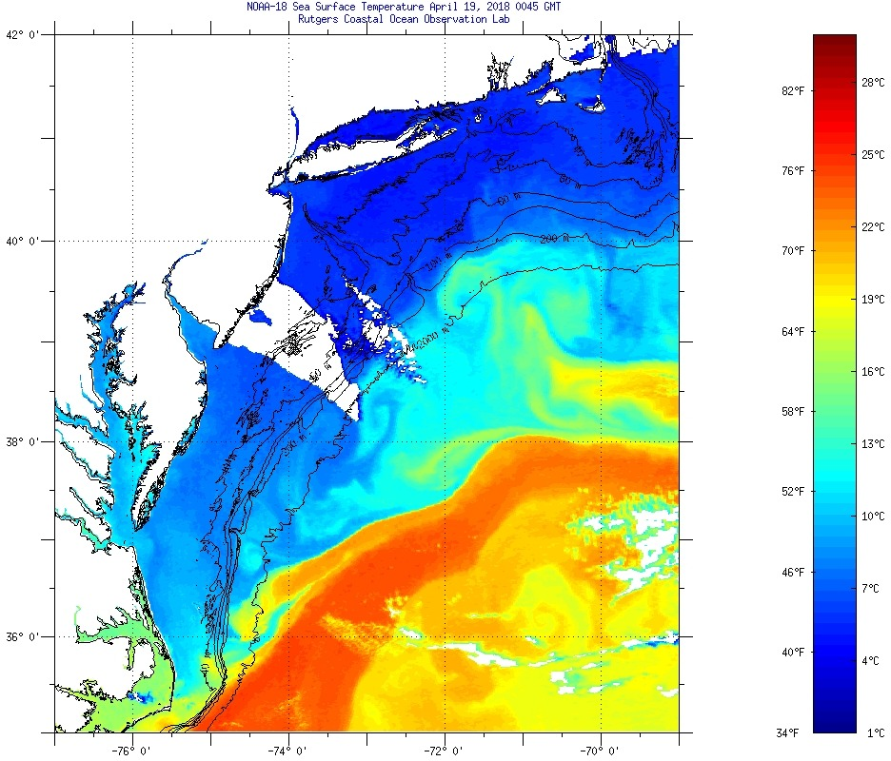
Satellite-measured Sea Surface Temperature
2018 Apr 19
Shelf/slope water streamer
warm streamer

Slide 5
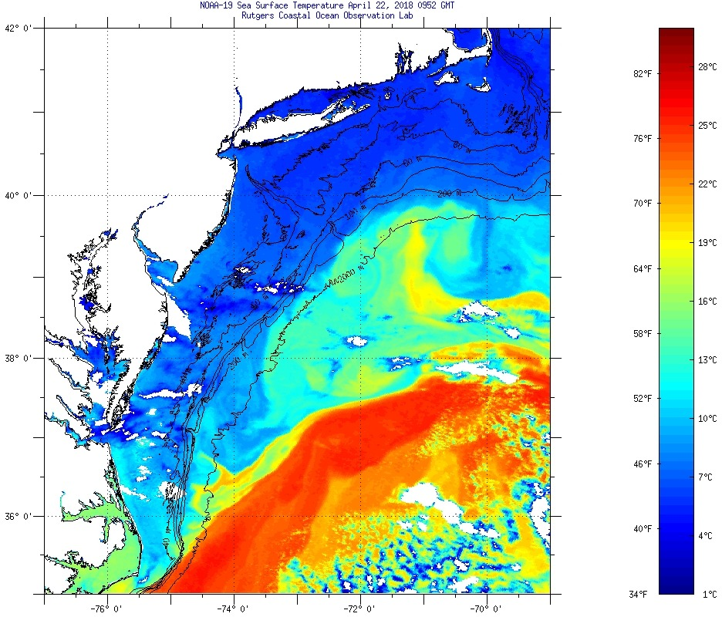
Satellite-measured Sea Surface Temperature
2018 Apr 22

Slide 6
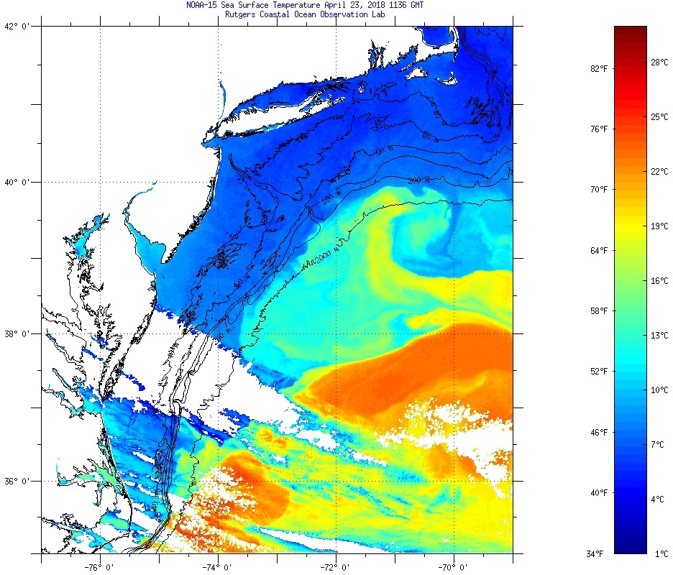
Satellite-measured Sea Surface Temperature
2018 Apr 23
warm streamer
Shelf water streamer

Slide 7
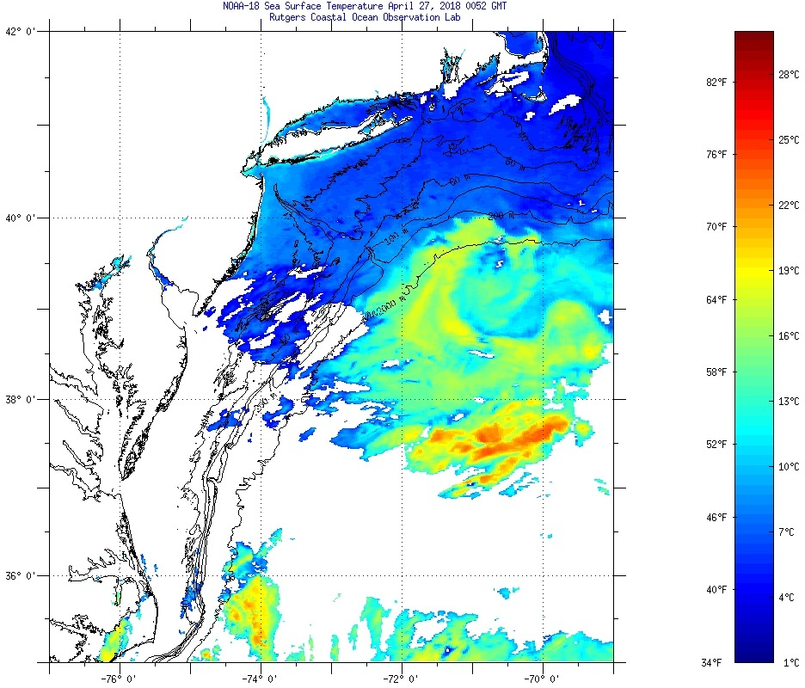
Satellite-measured Sea Surface Temperature
2018 Apr 27
It is an old warm-core ring with weak surface temperature signal, but complex surface structure: interleaving filaments of ring, shelf and slope waters

Slide 8
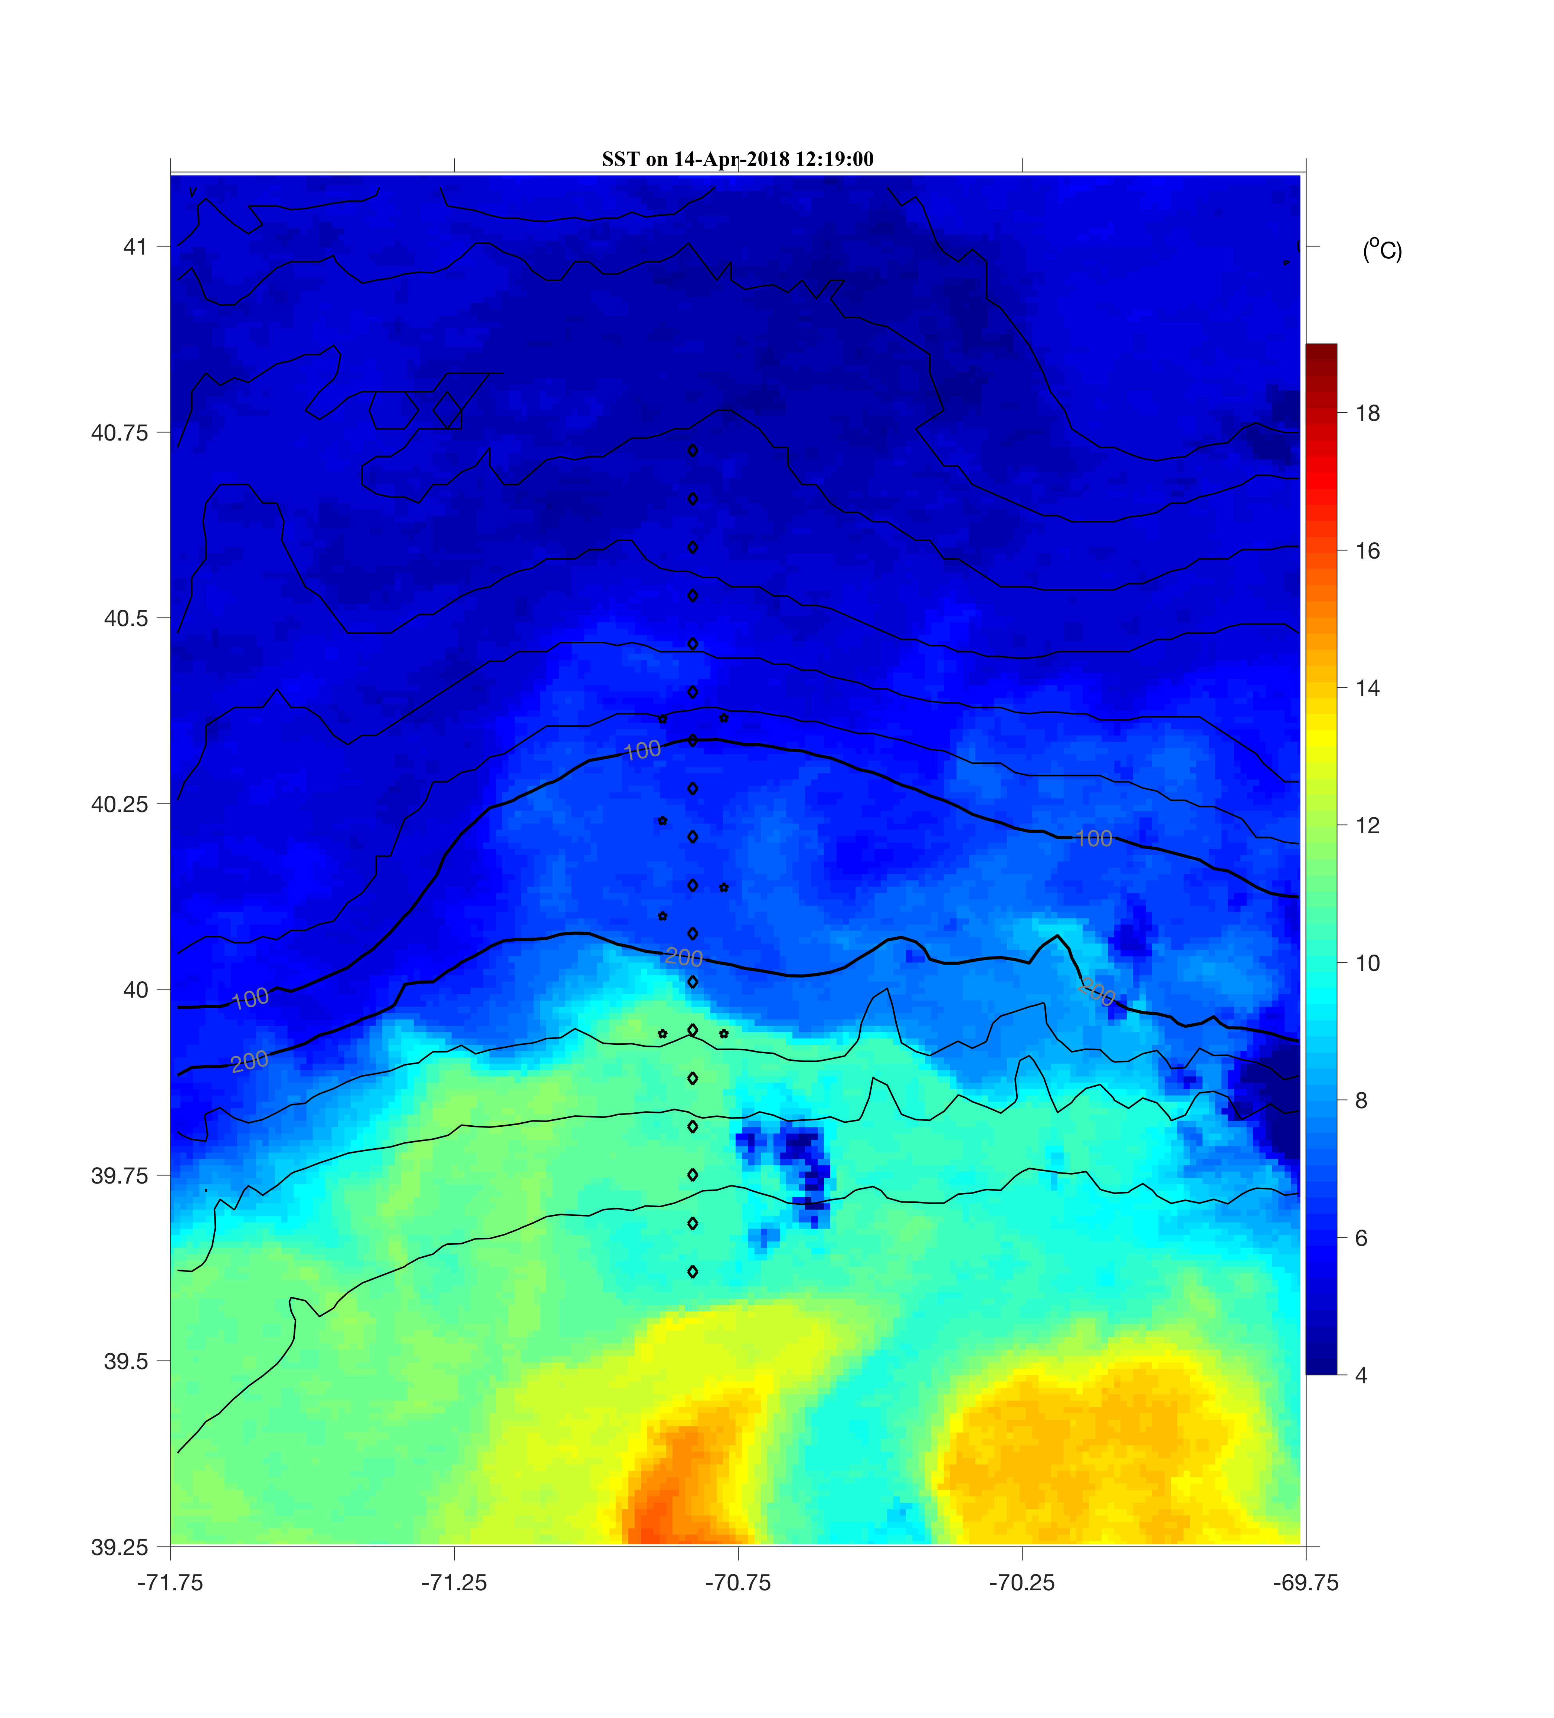
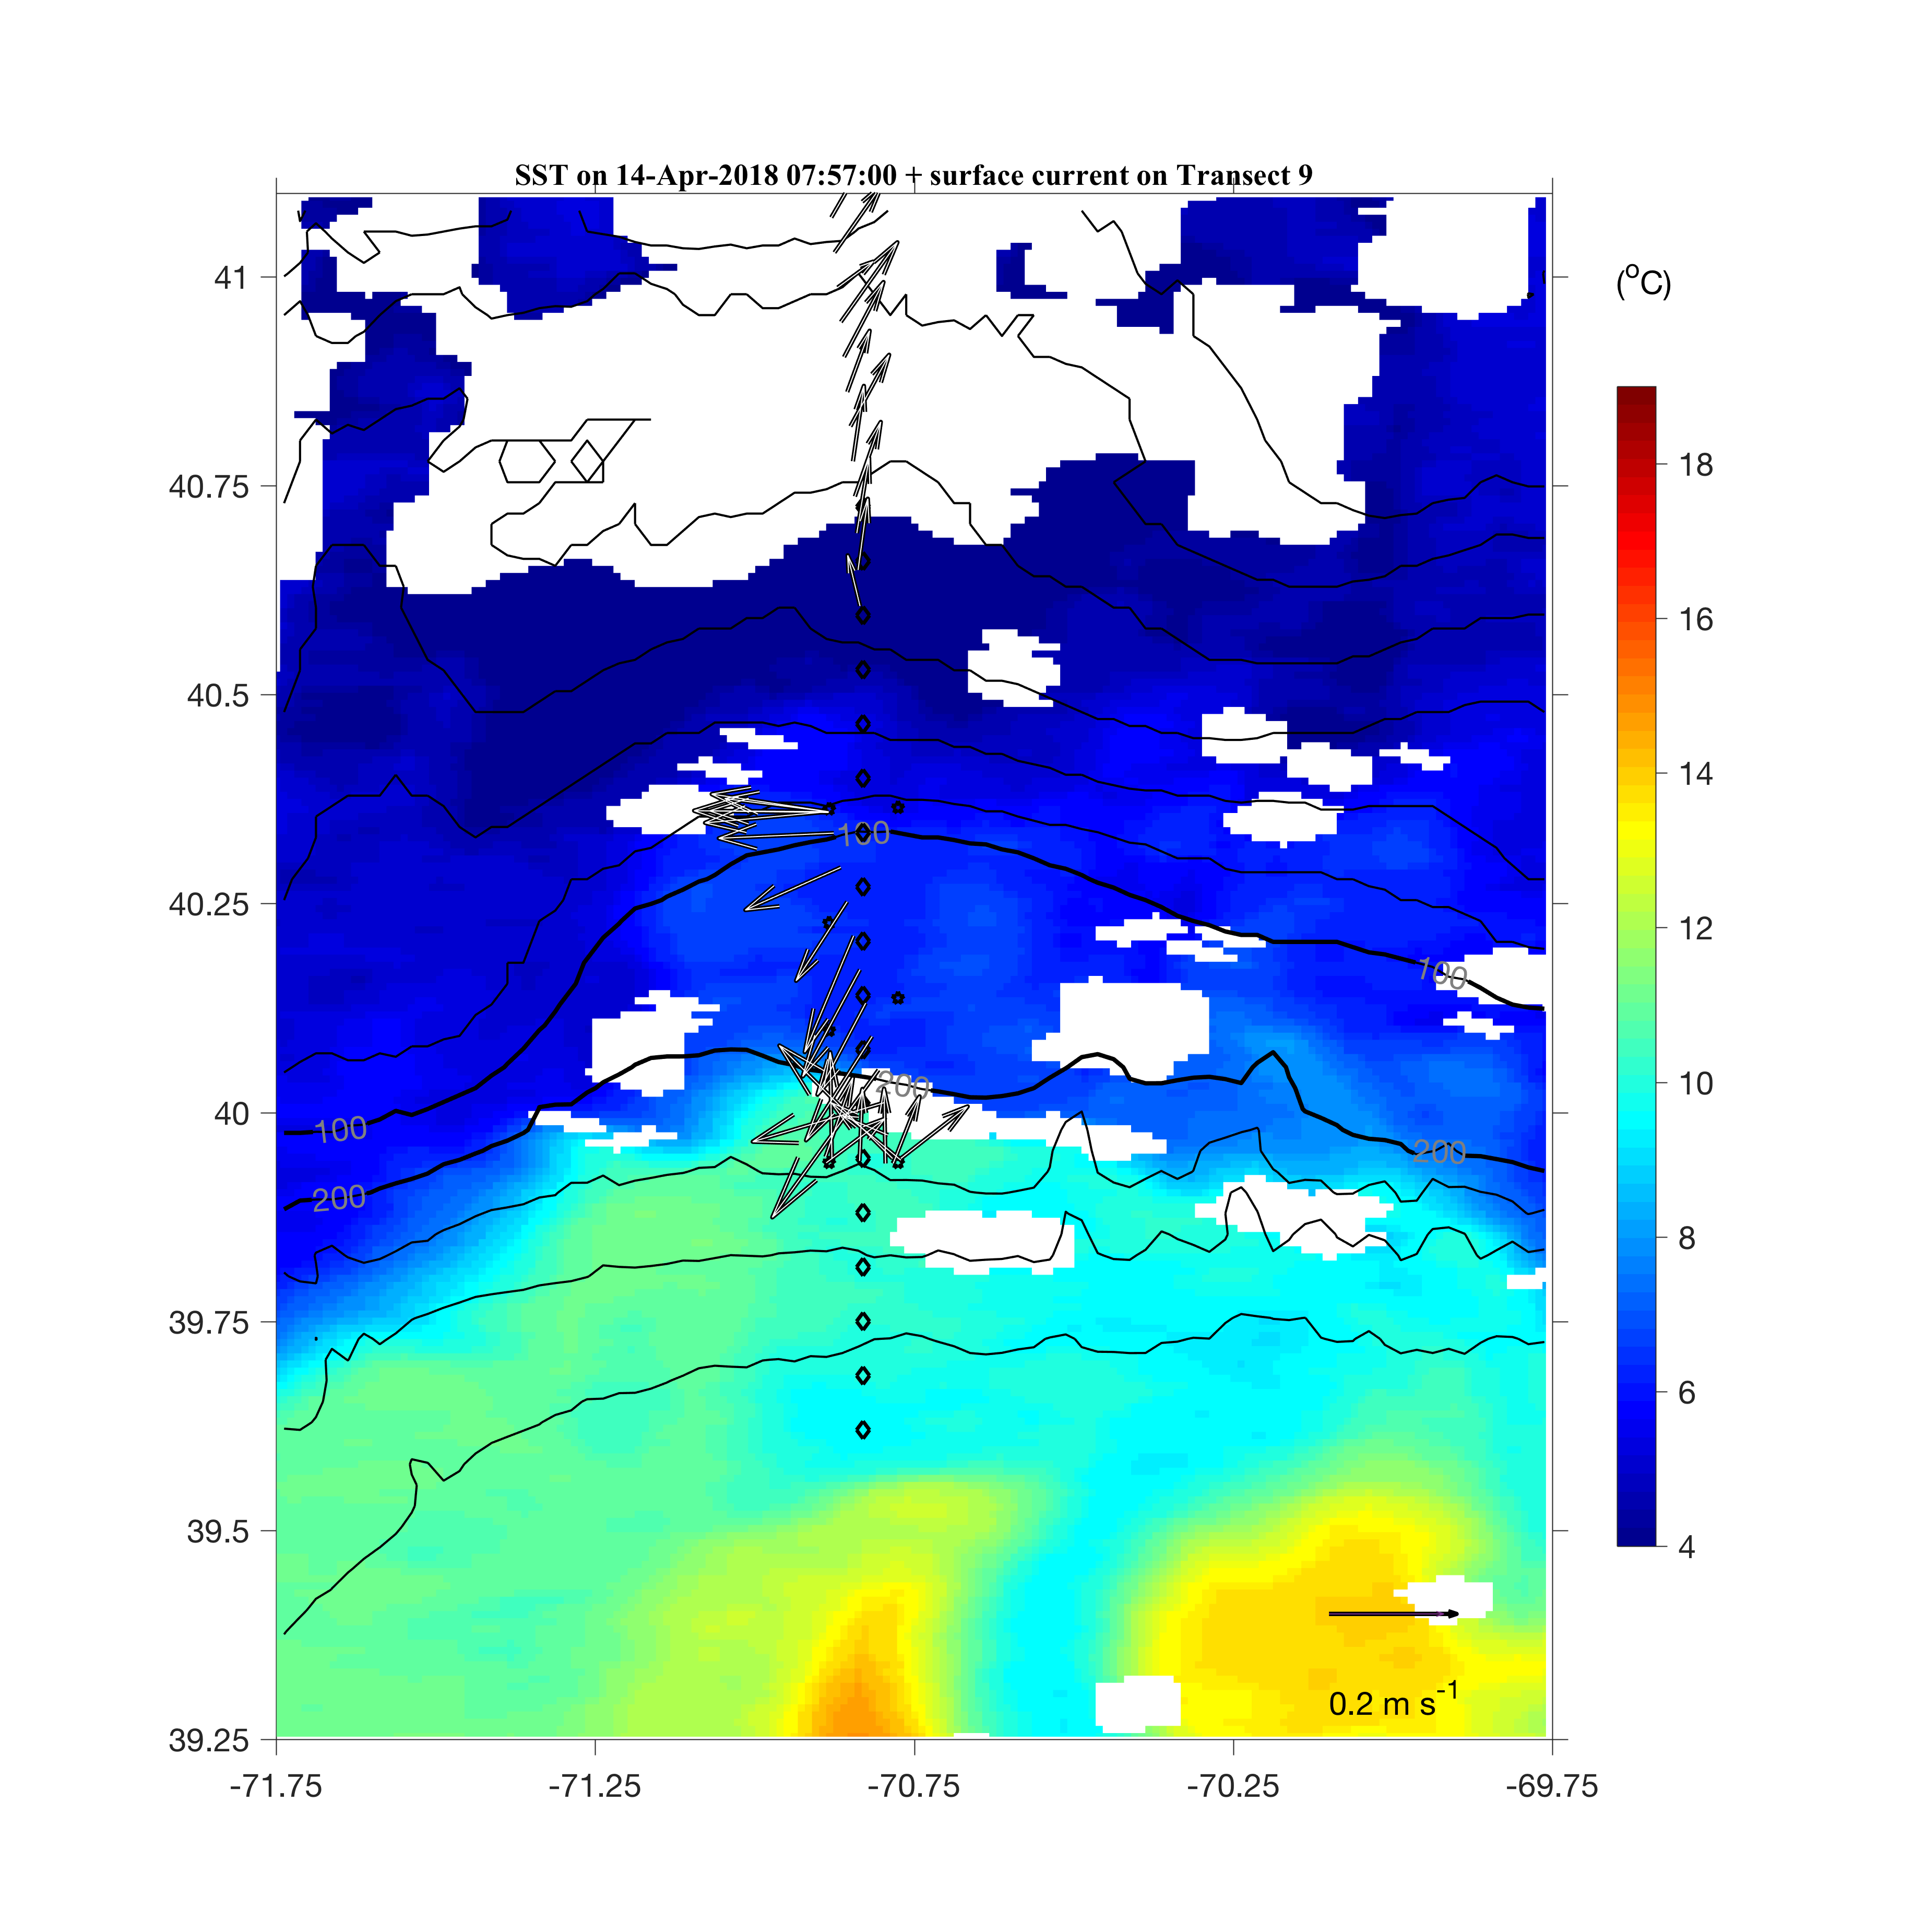
Zoom-in view of the SST
2018 April 14
No clear influence of the ring

Slide 9
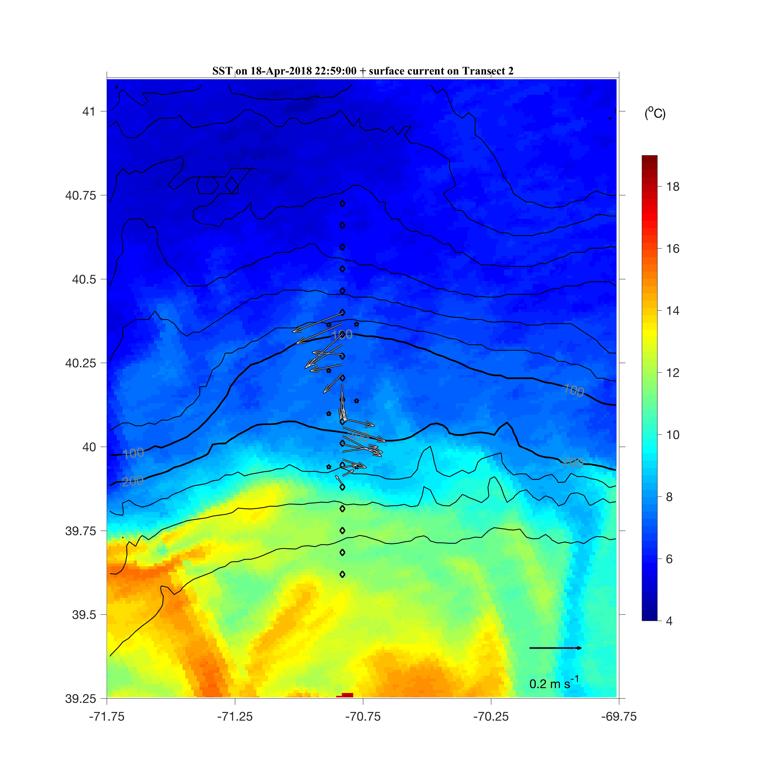
Zoom-in view of the SST
2018 April 18
Clear influence of the ring current

Slide 10
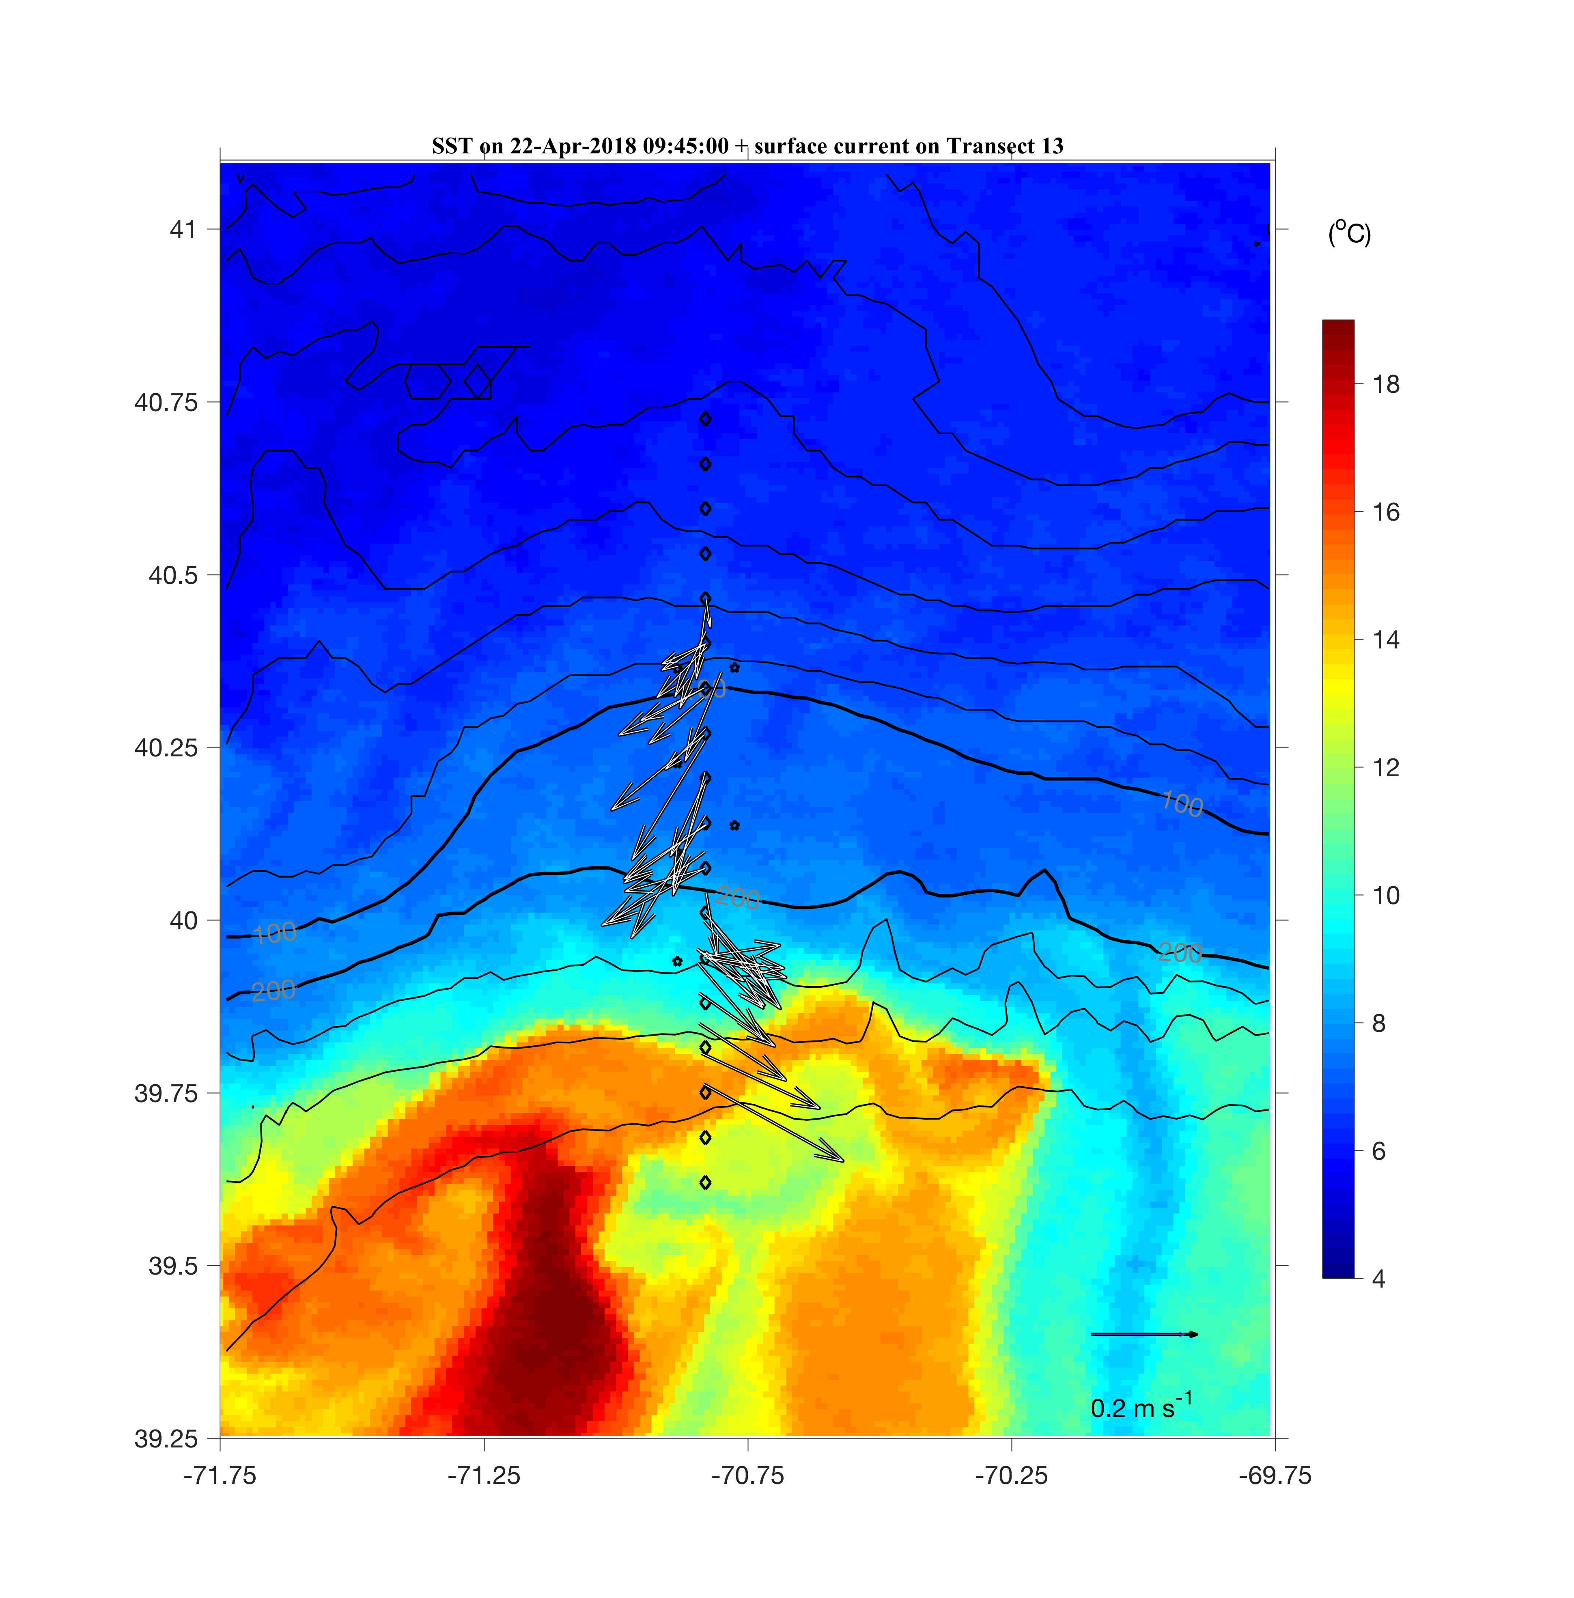
Zoom-in view of the SST
2018 April 22
Persistent influence of the ring current

Slide 11
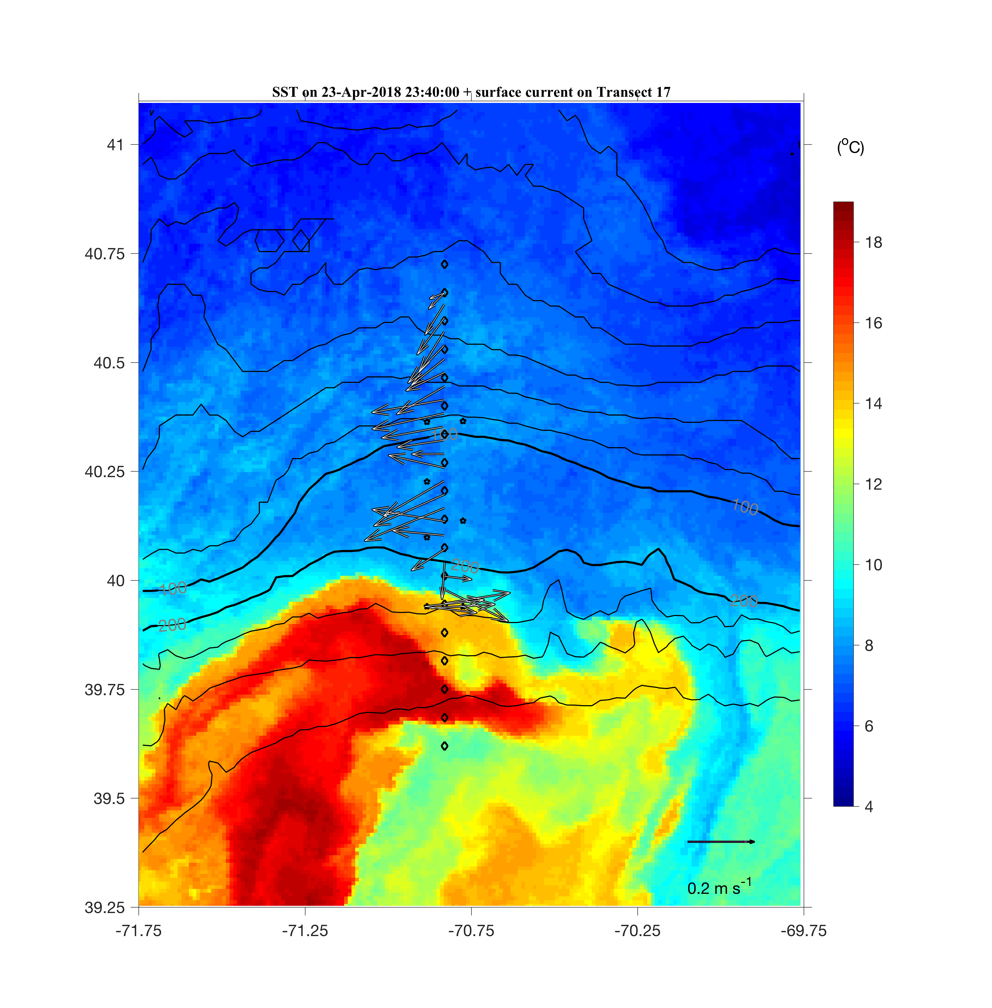
Zoom-in view of the SST
2018 April 23
Persistent influence of the ring current

Slide 12
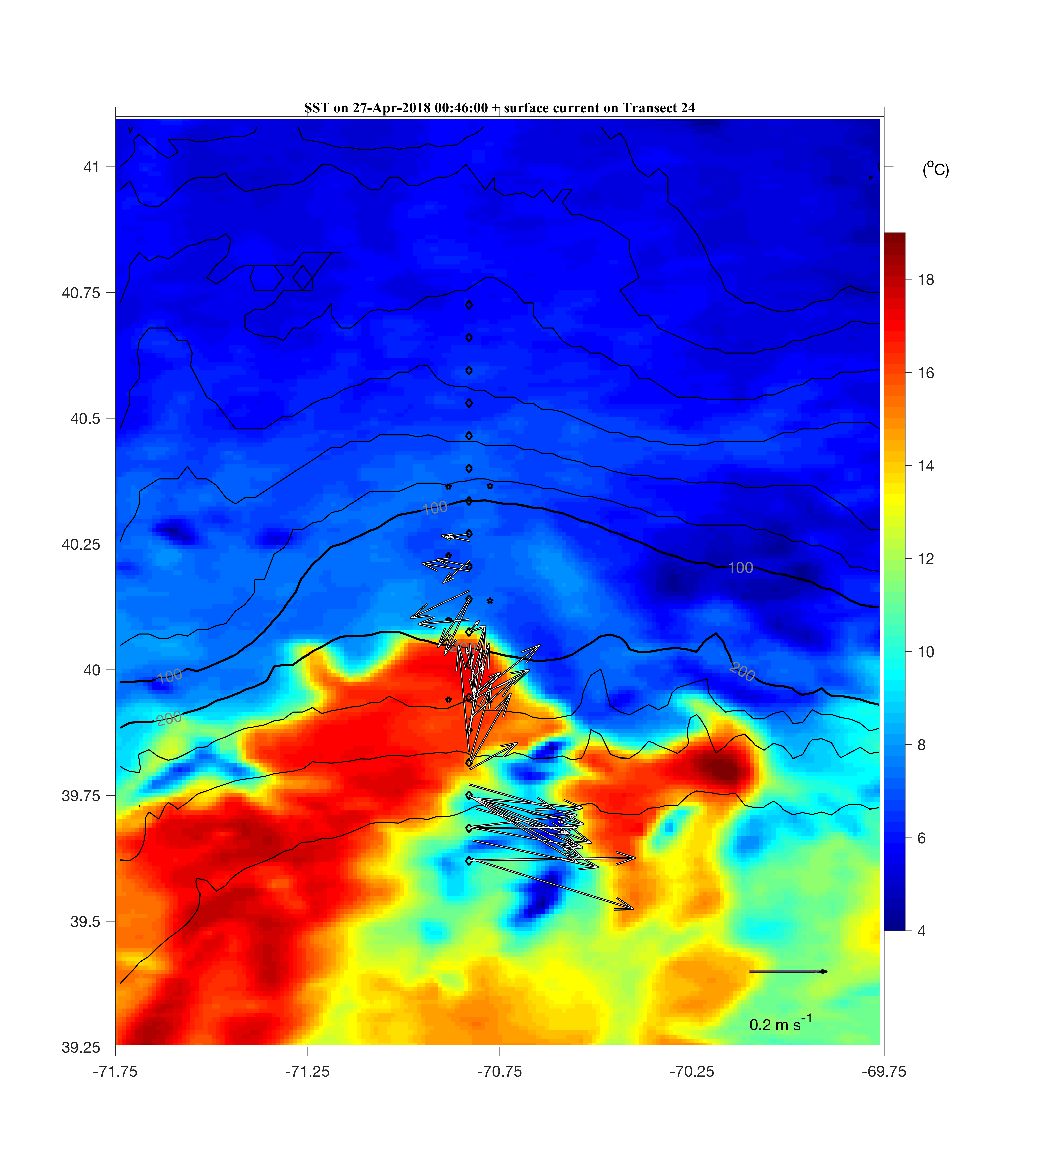
Zoom-in view of the SST
2018 April 27
Persistent influence of the ring current

Slide 13
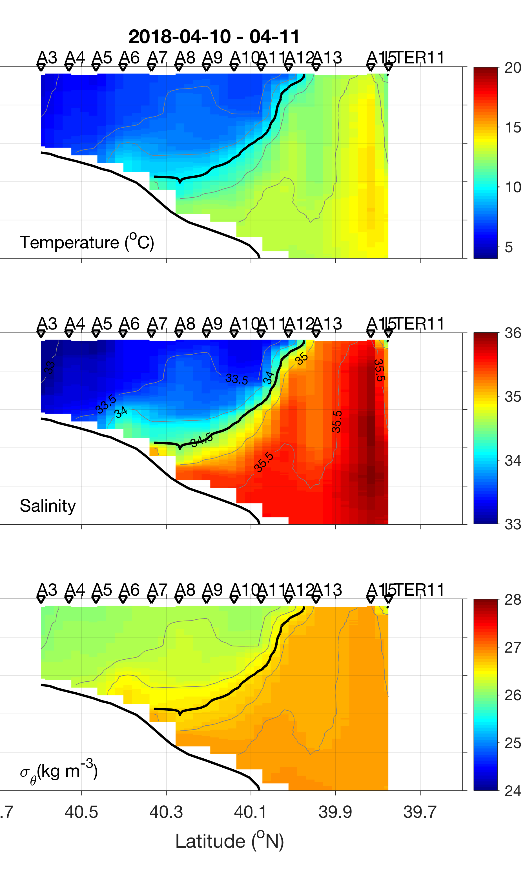
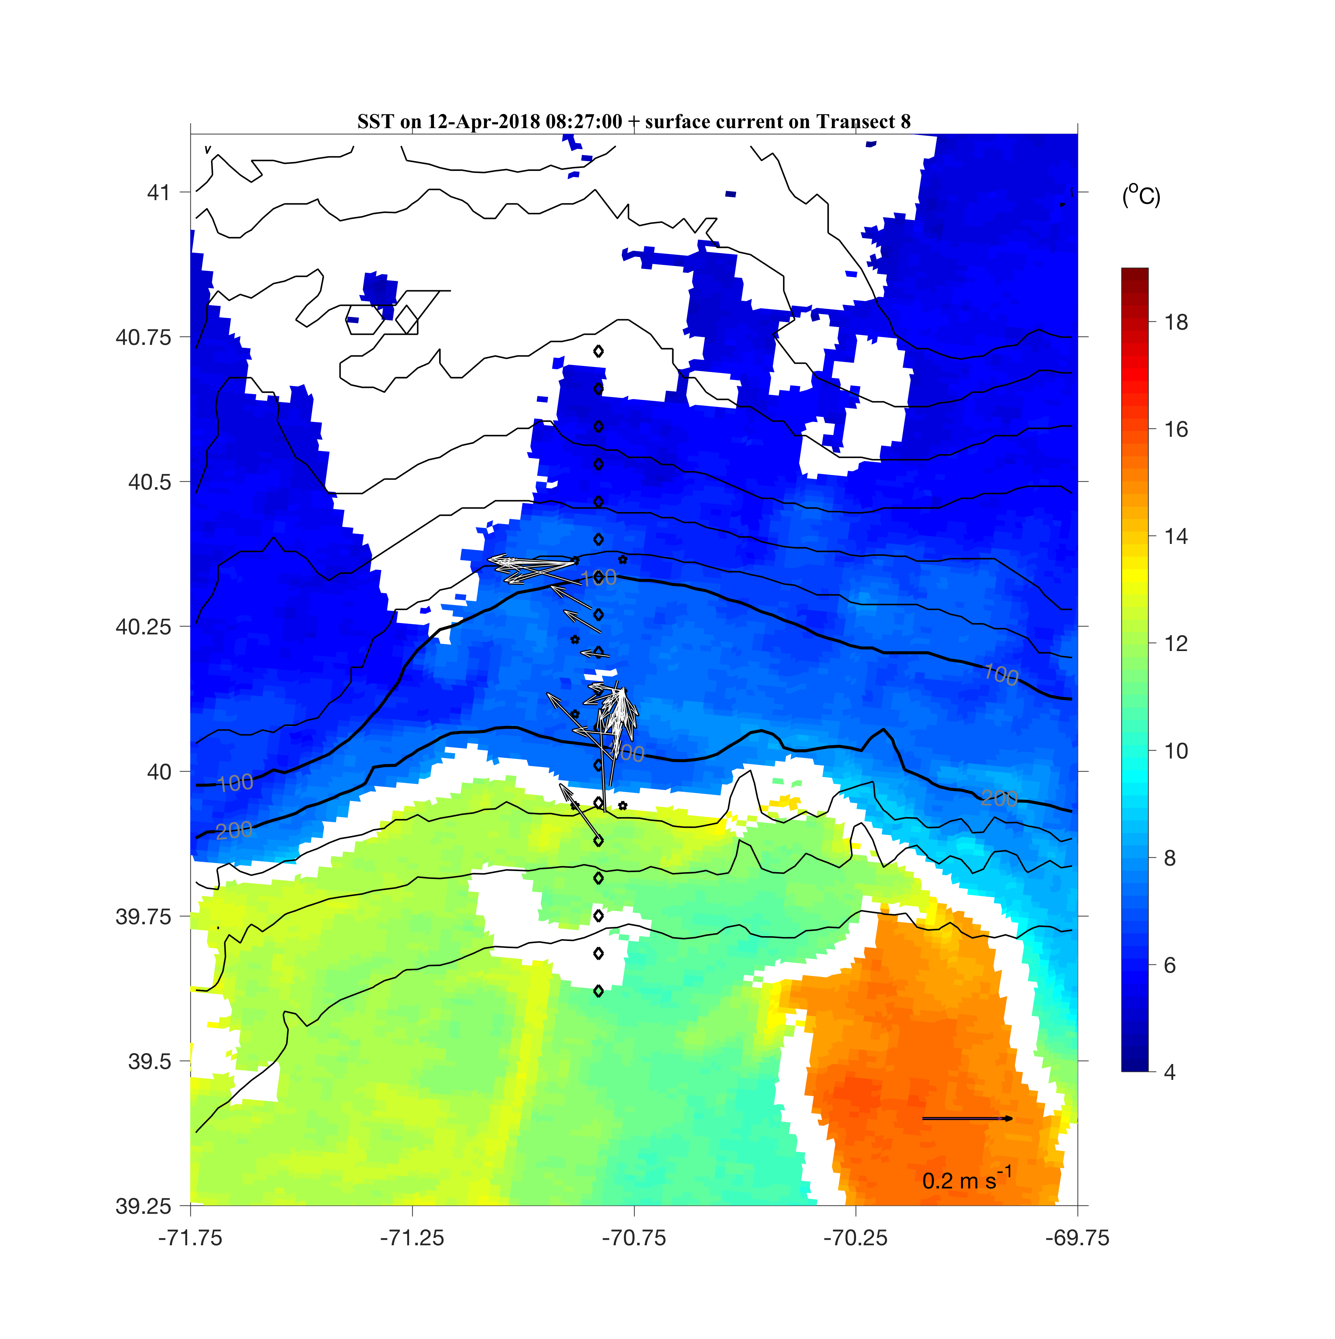
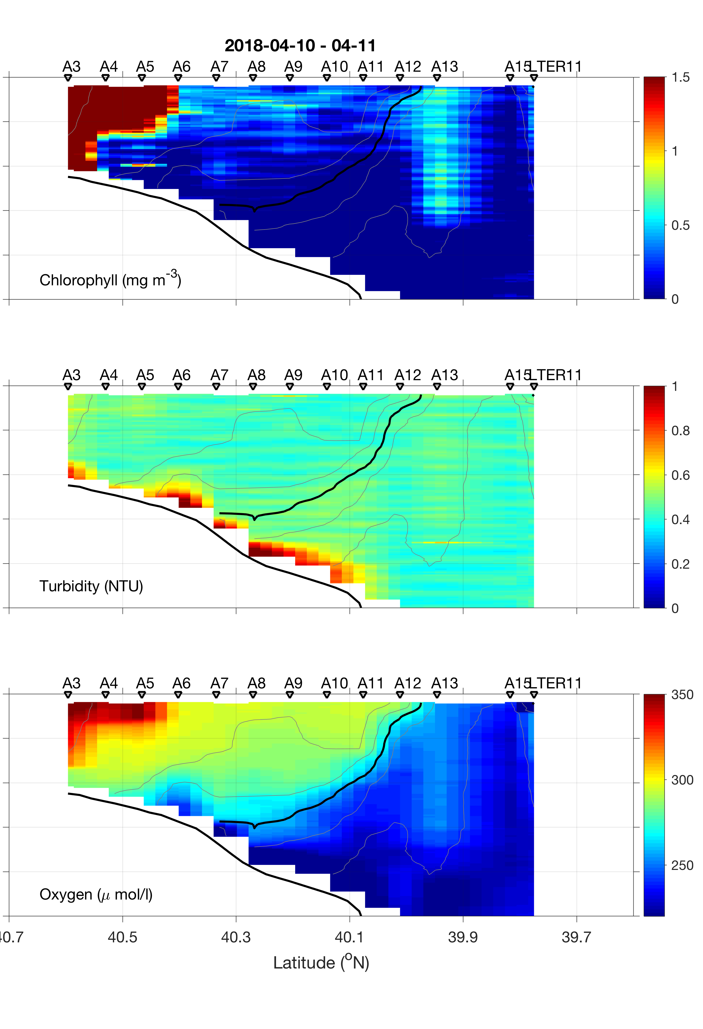
Frontal Evolution
2018 Apr 12
A typical wintertime shelfbreak front
no clear enhancement of fluorescence at the front

Slide 14
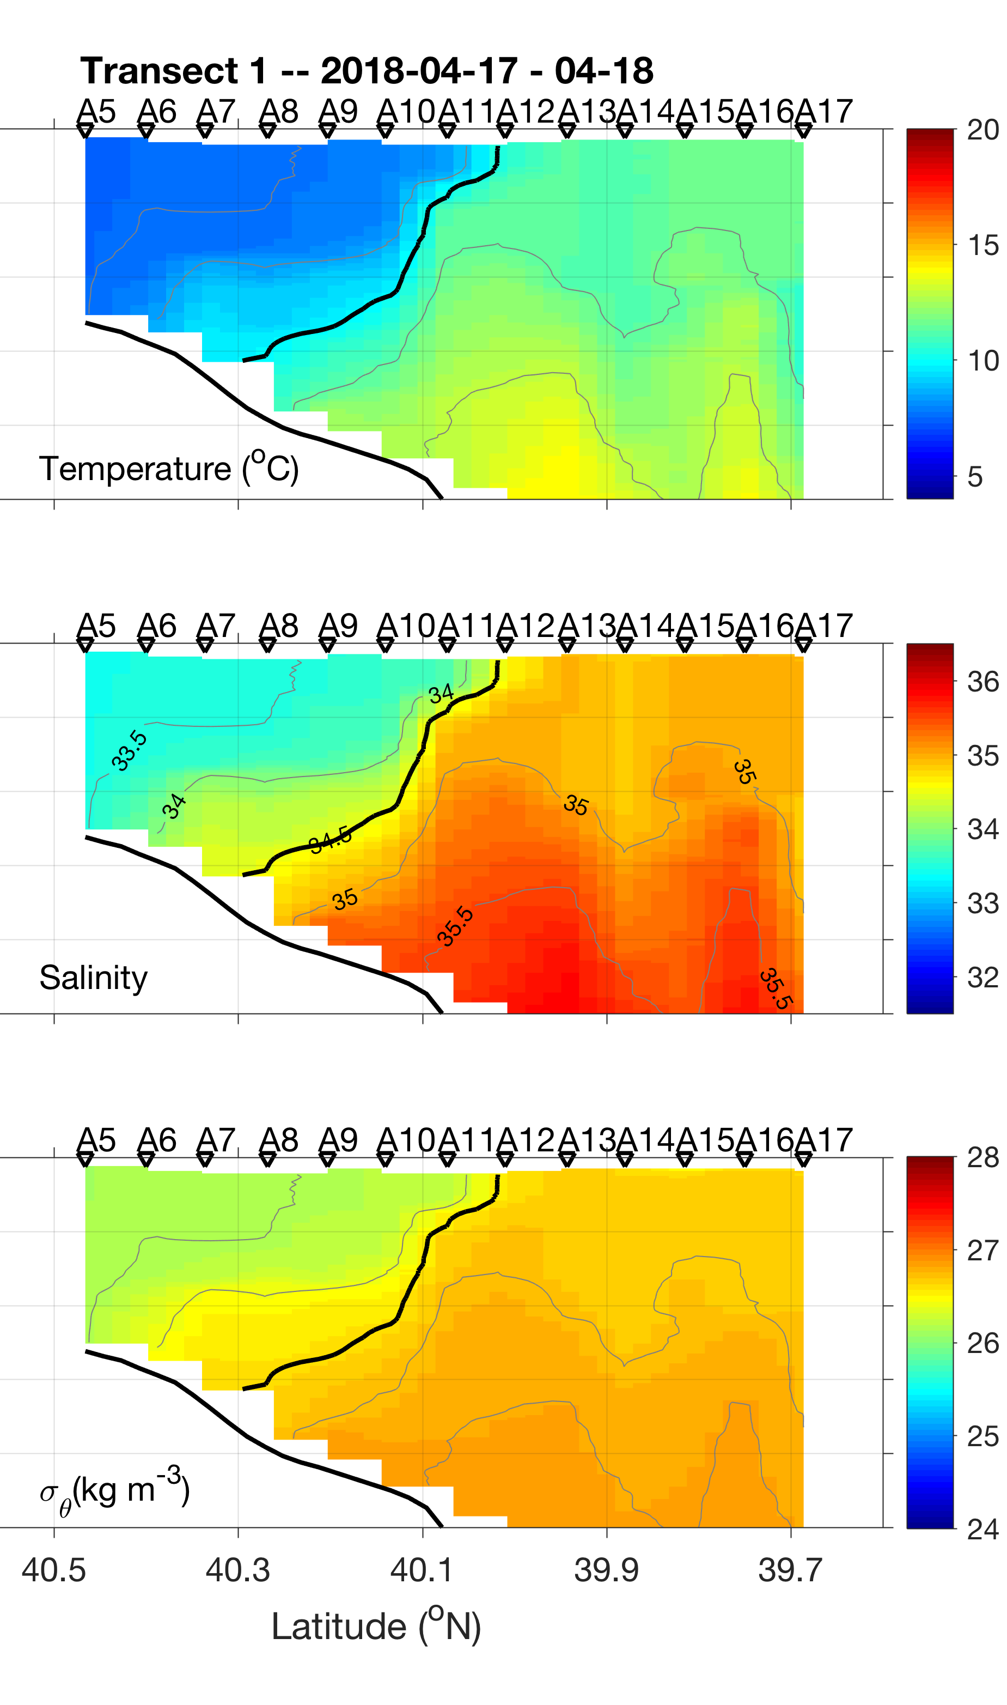
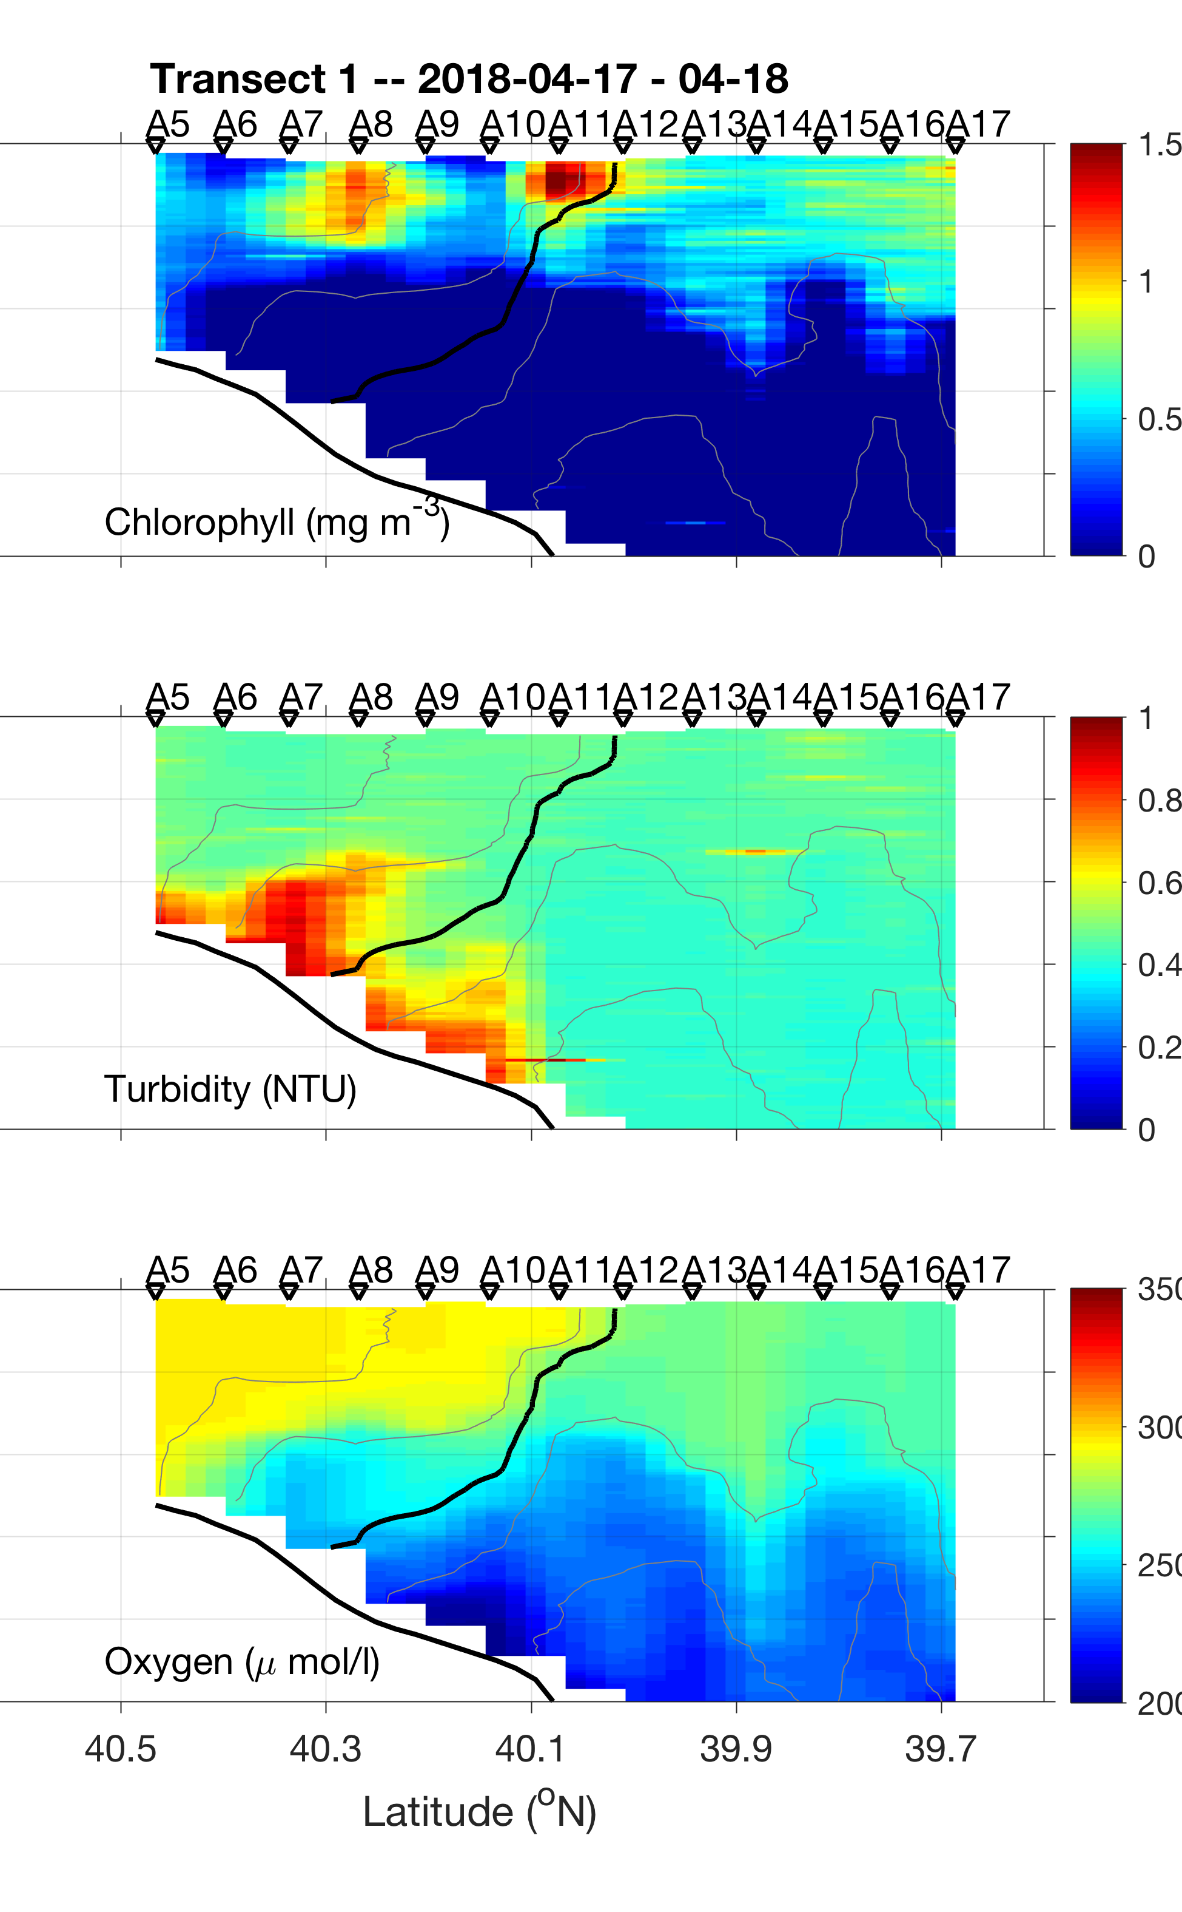
Frontal Evolution
2018 Apr 18
Ring-edge jet at A11-A13 influencing the shelfbreak front
Enhanced fluorescence at the offshore end of the front where SML is shallow

Slide 15
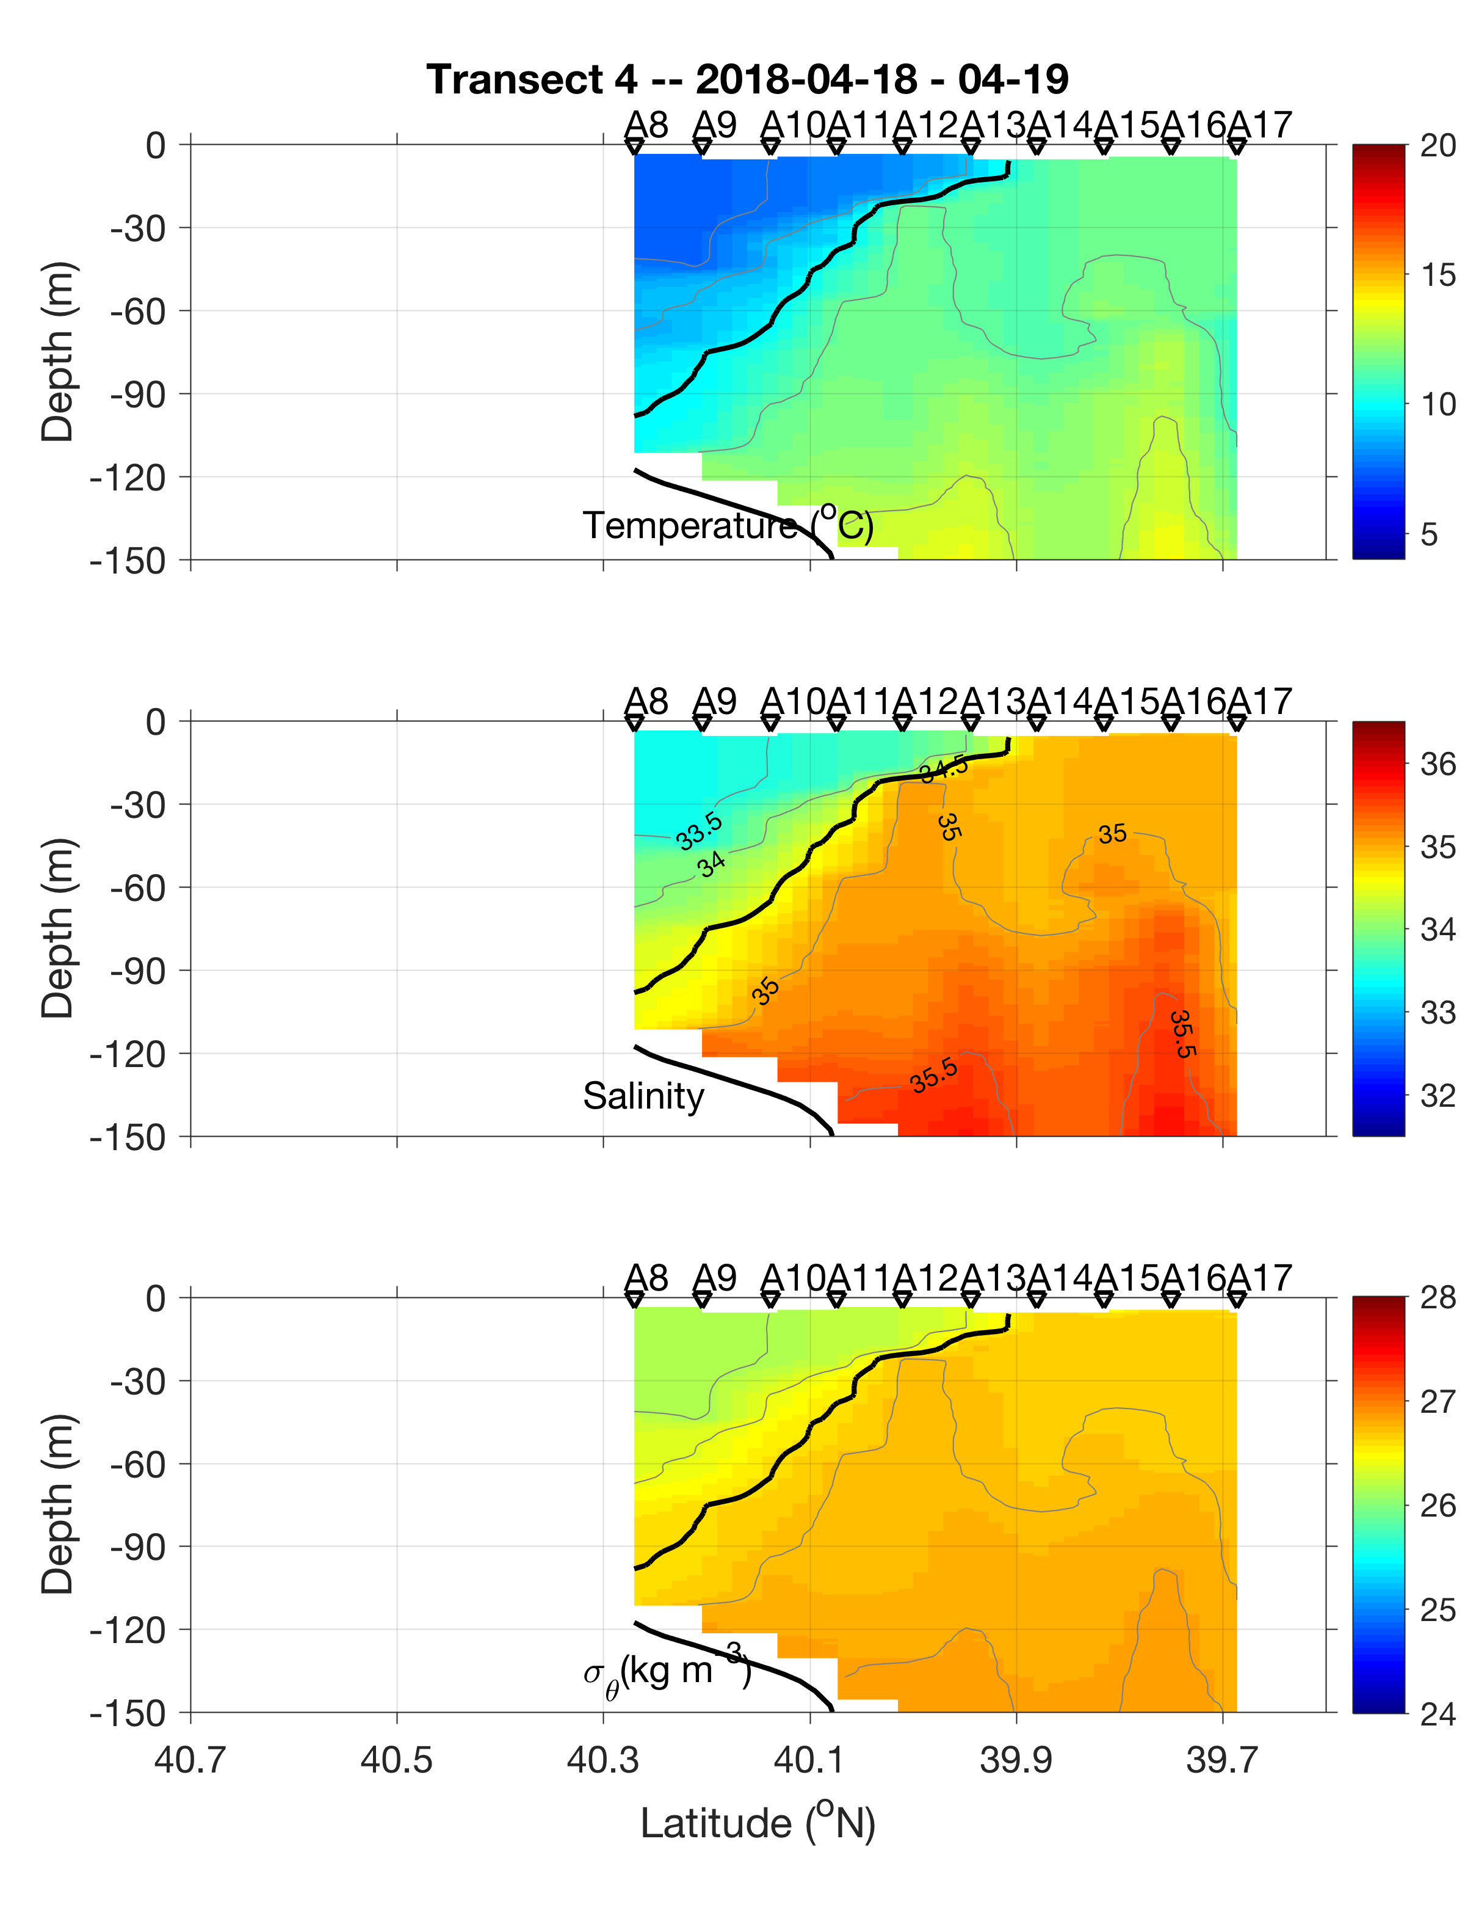
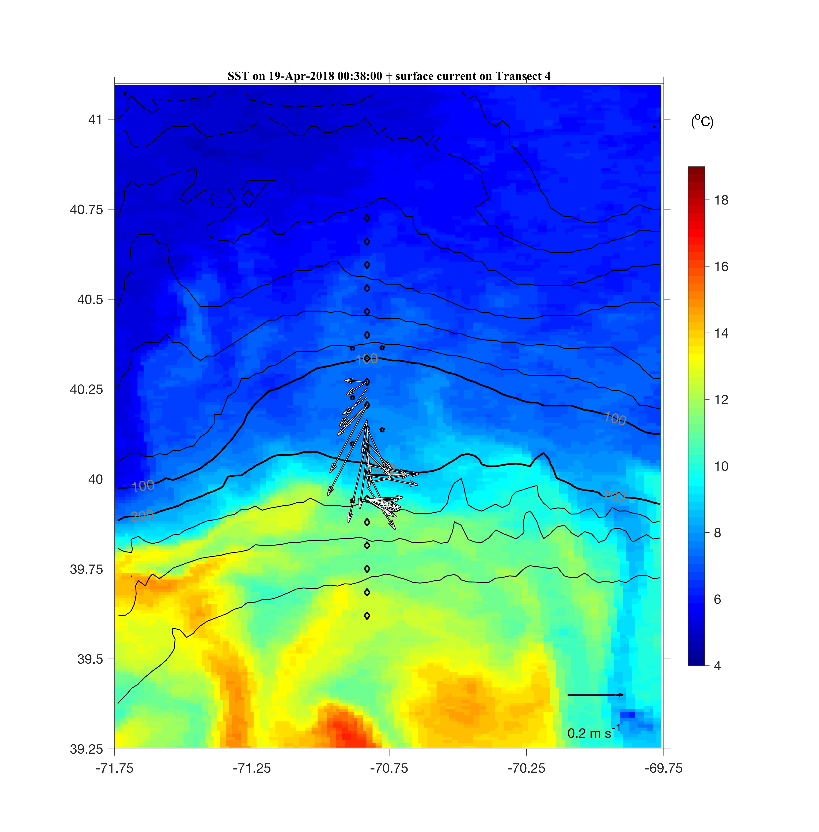
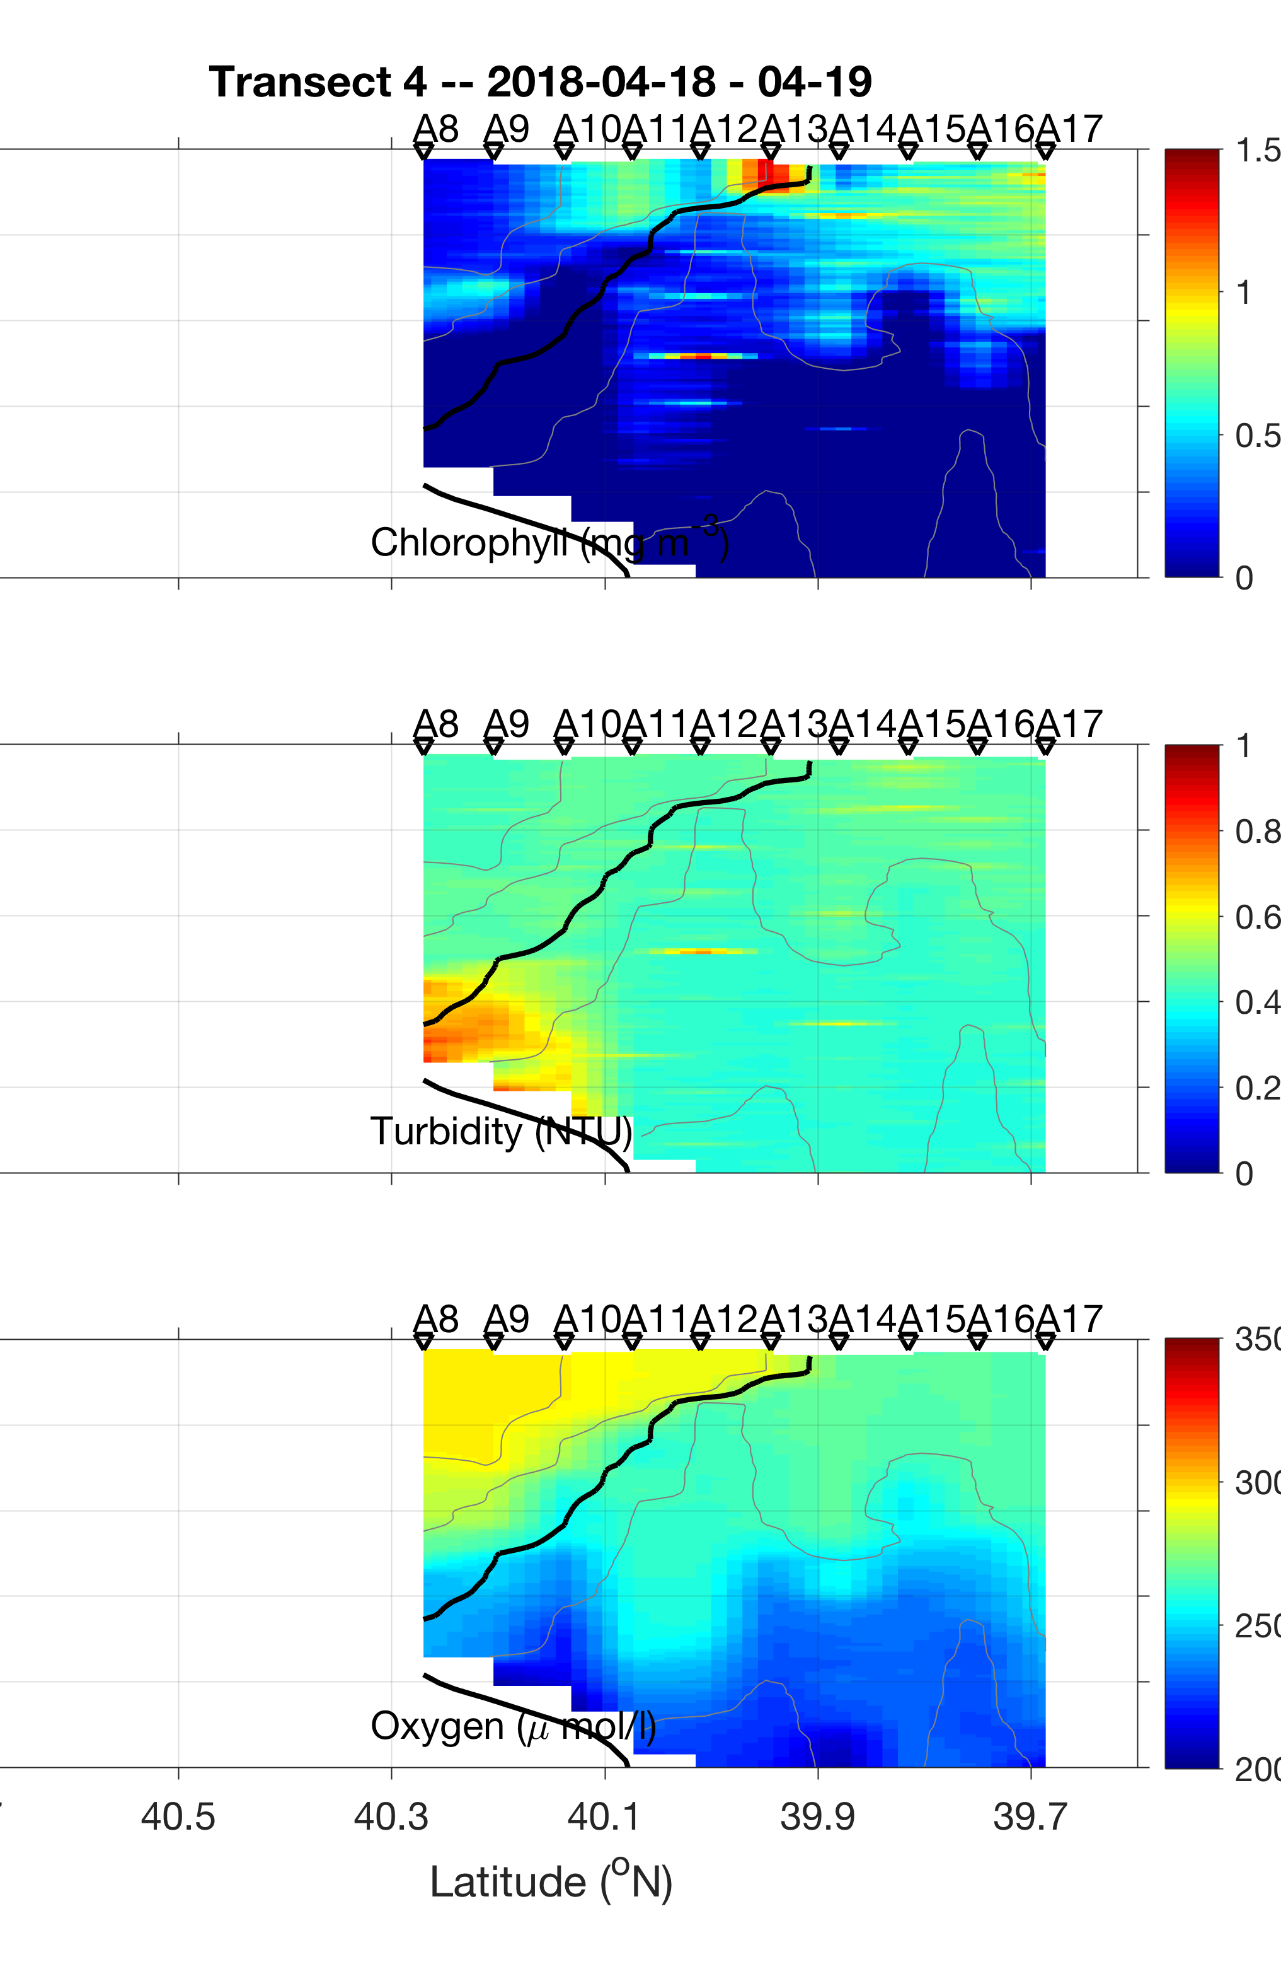
Frontal Evolution
2018 Apr 19
Persistent fluorescence enhancement at the offshore end of the front

Slide 16
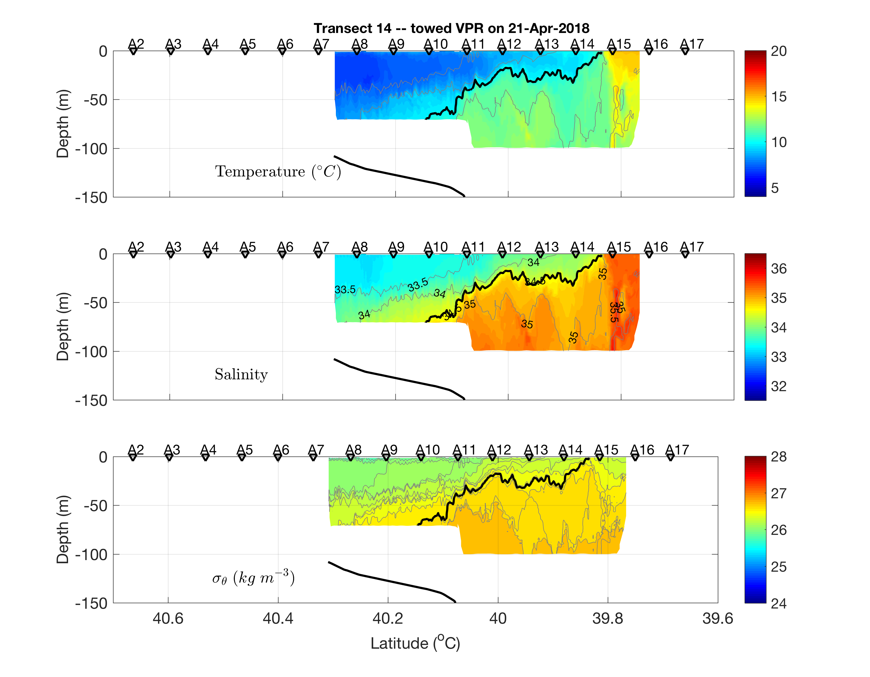
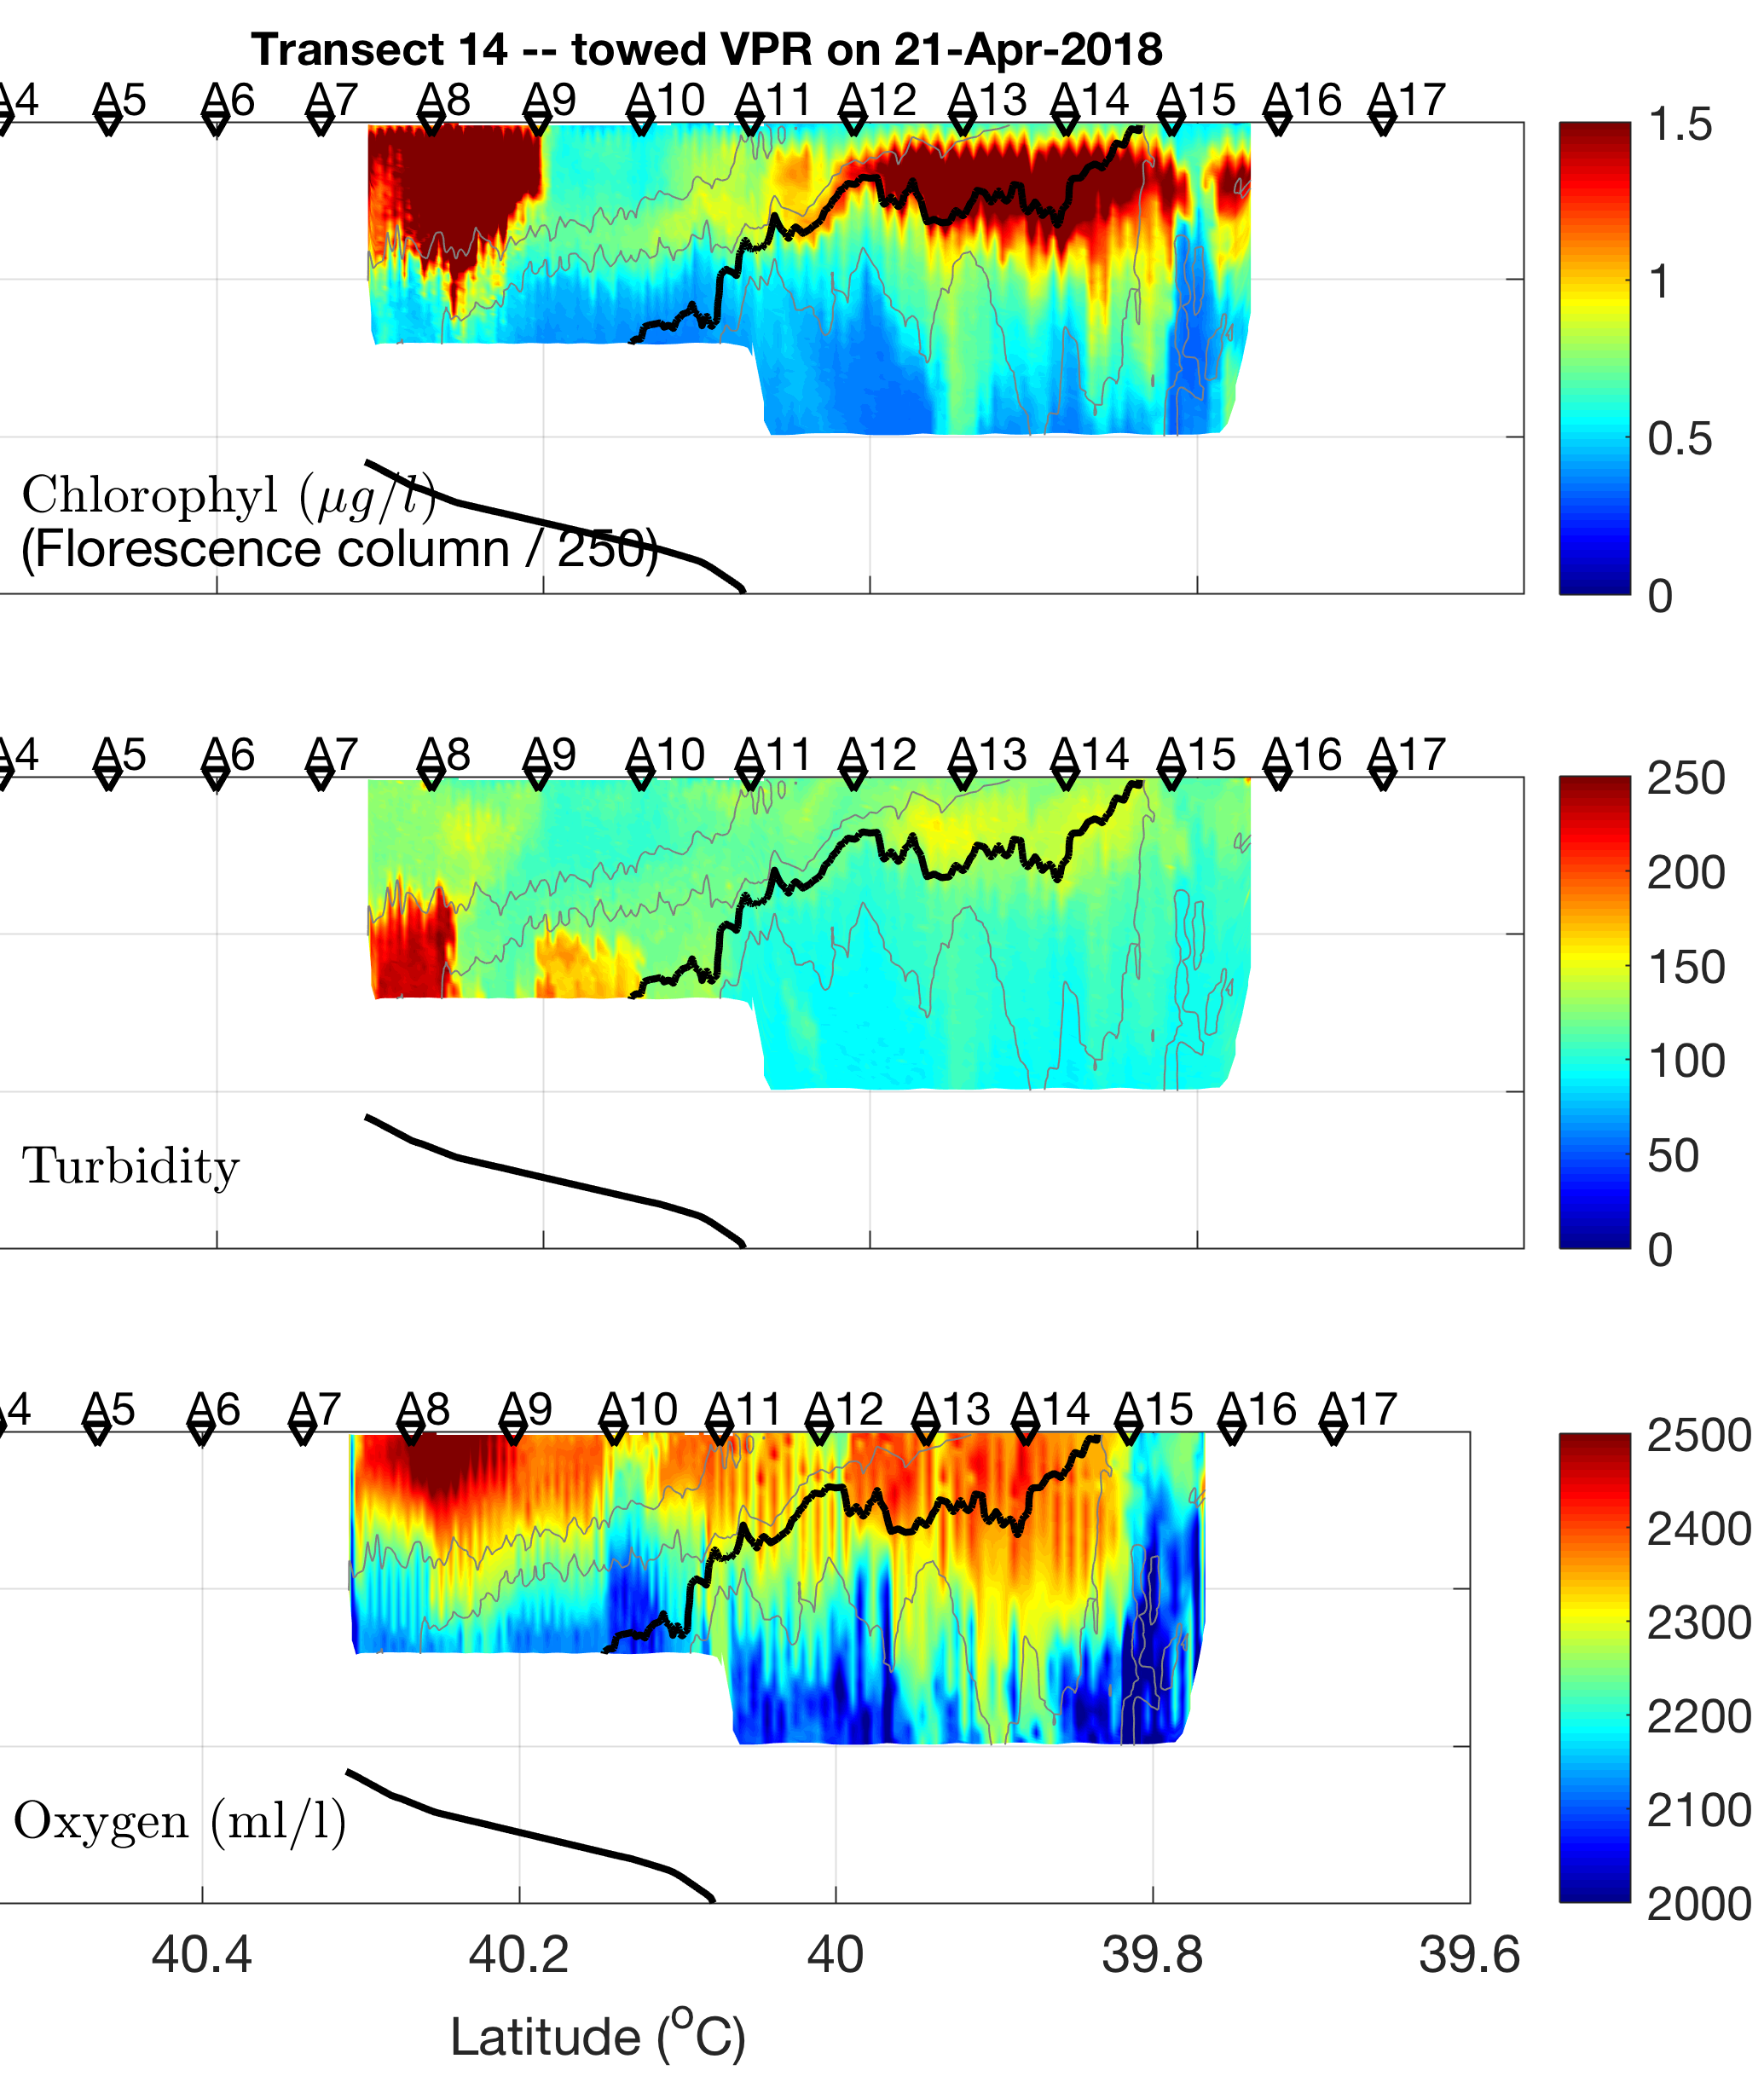
Frontal Evolution
2018 Apr 22
Persistent fluorescence enhancement at the offshore end of the front

Slide 17
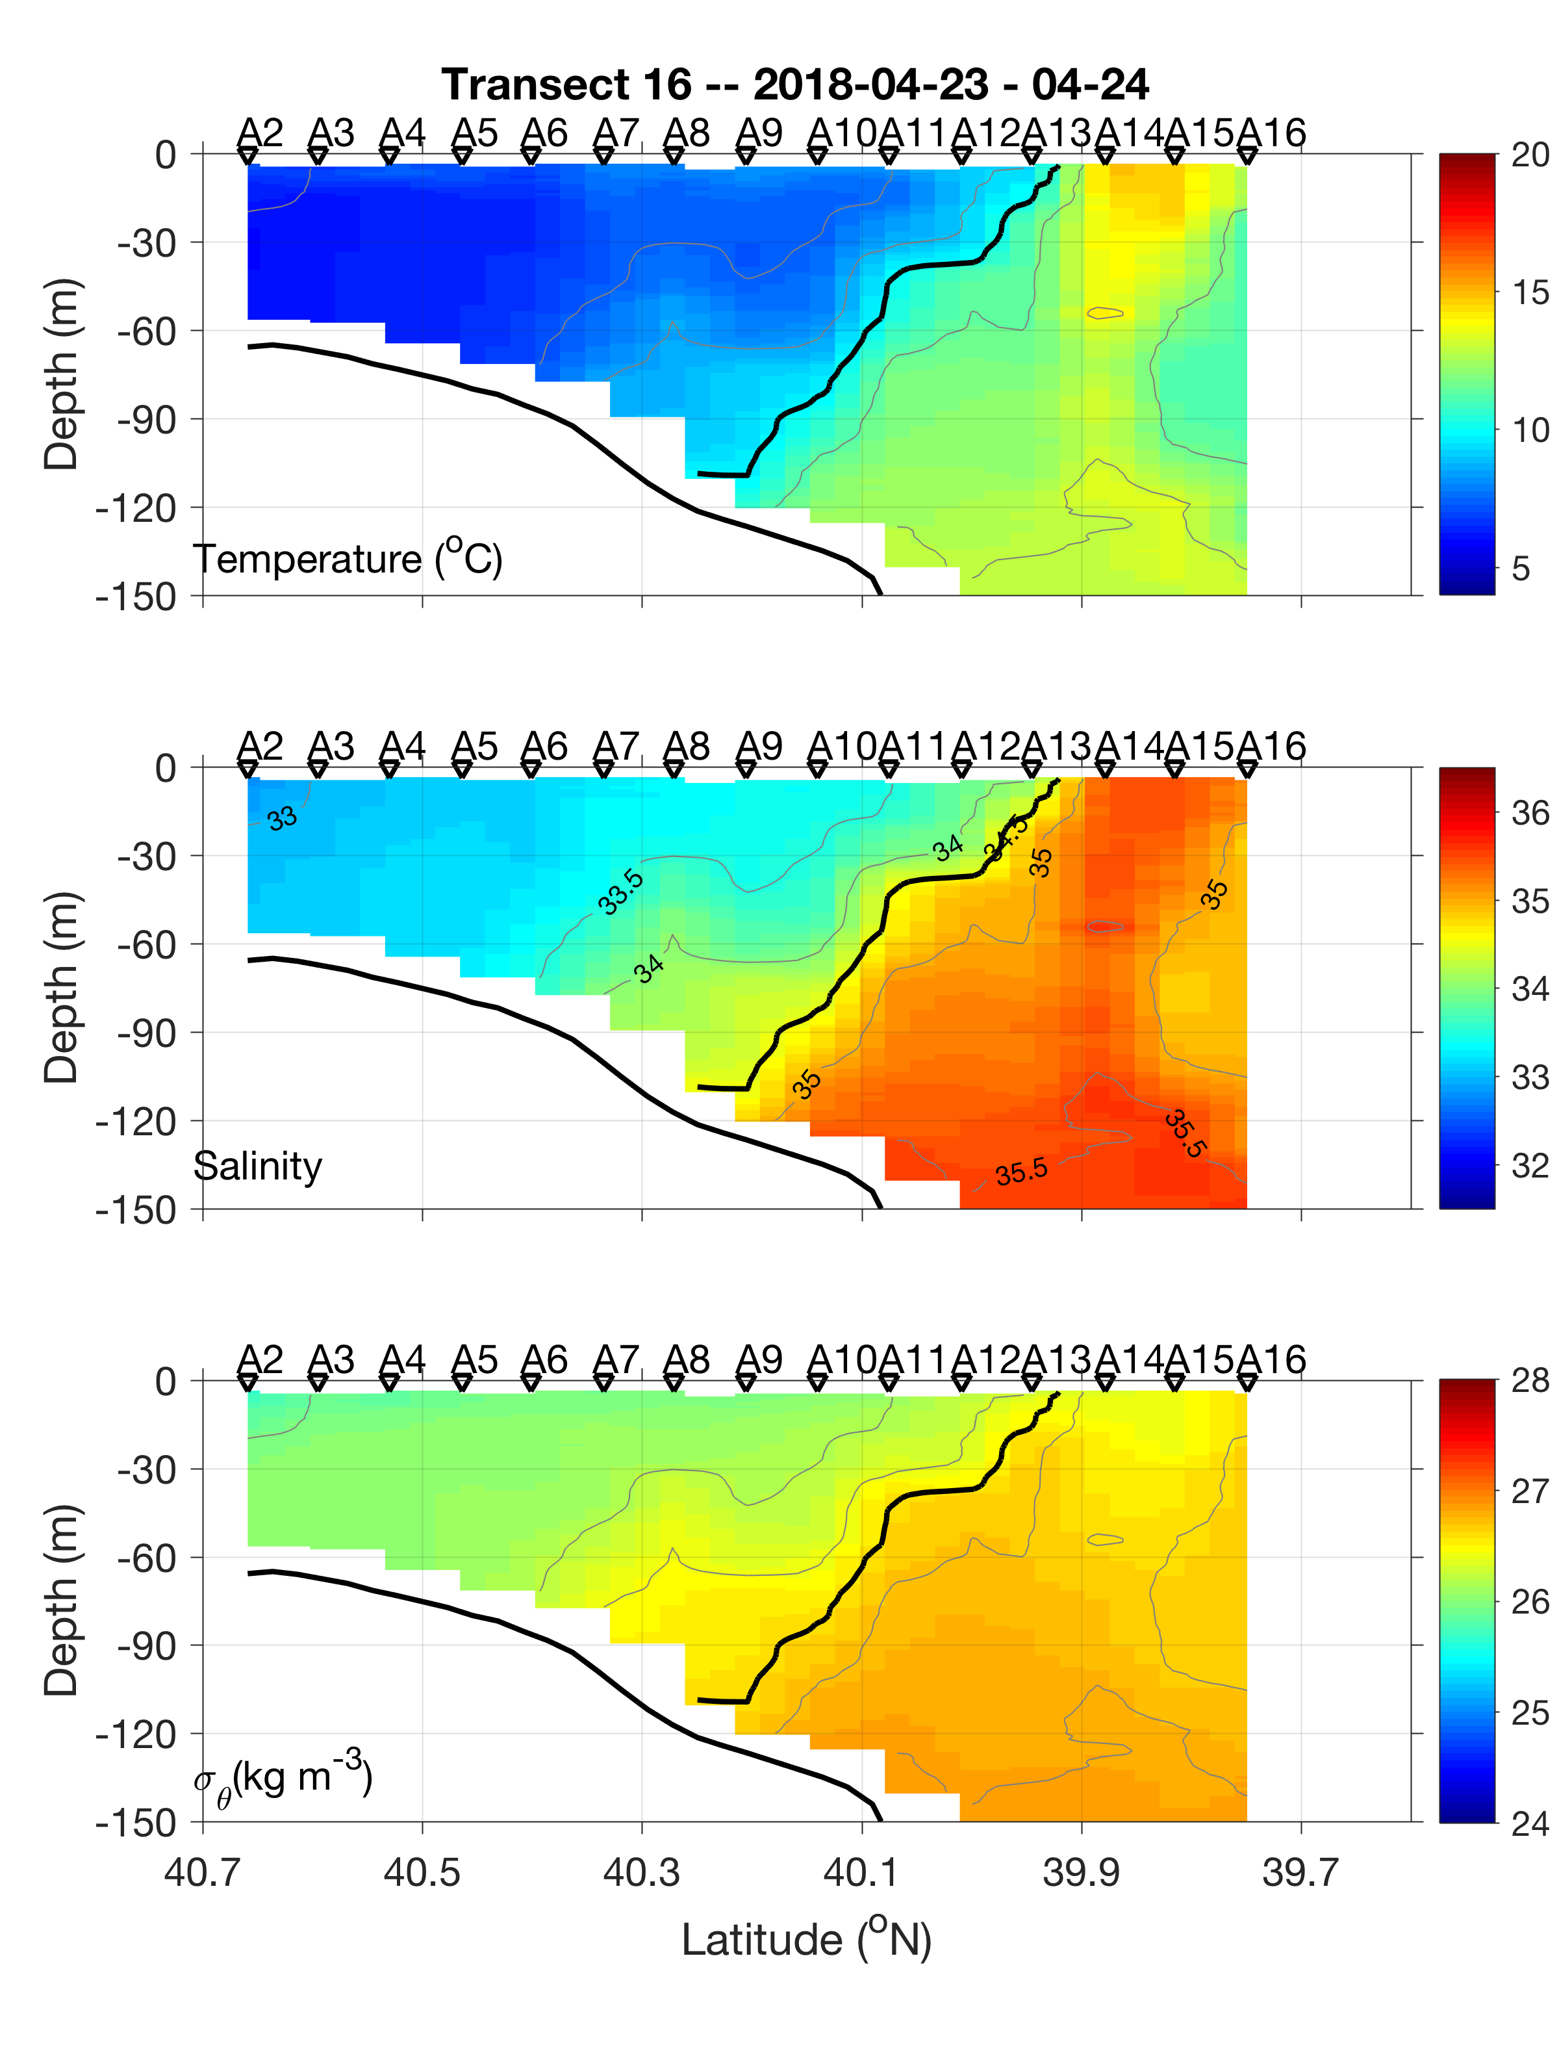
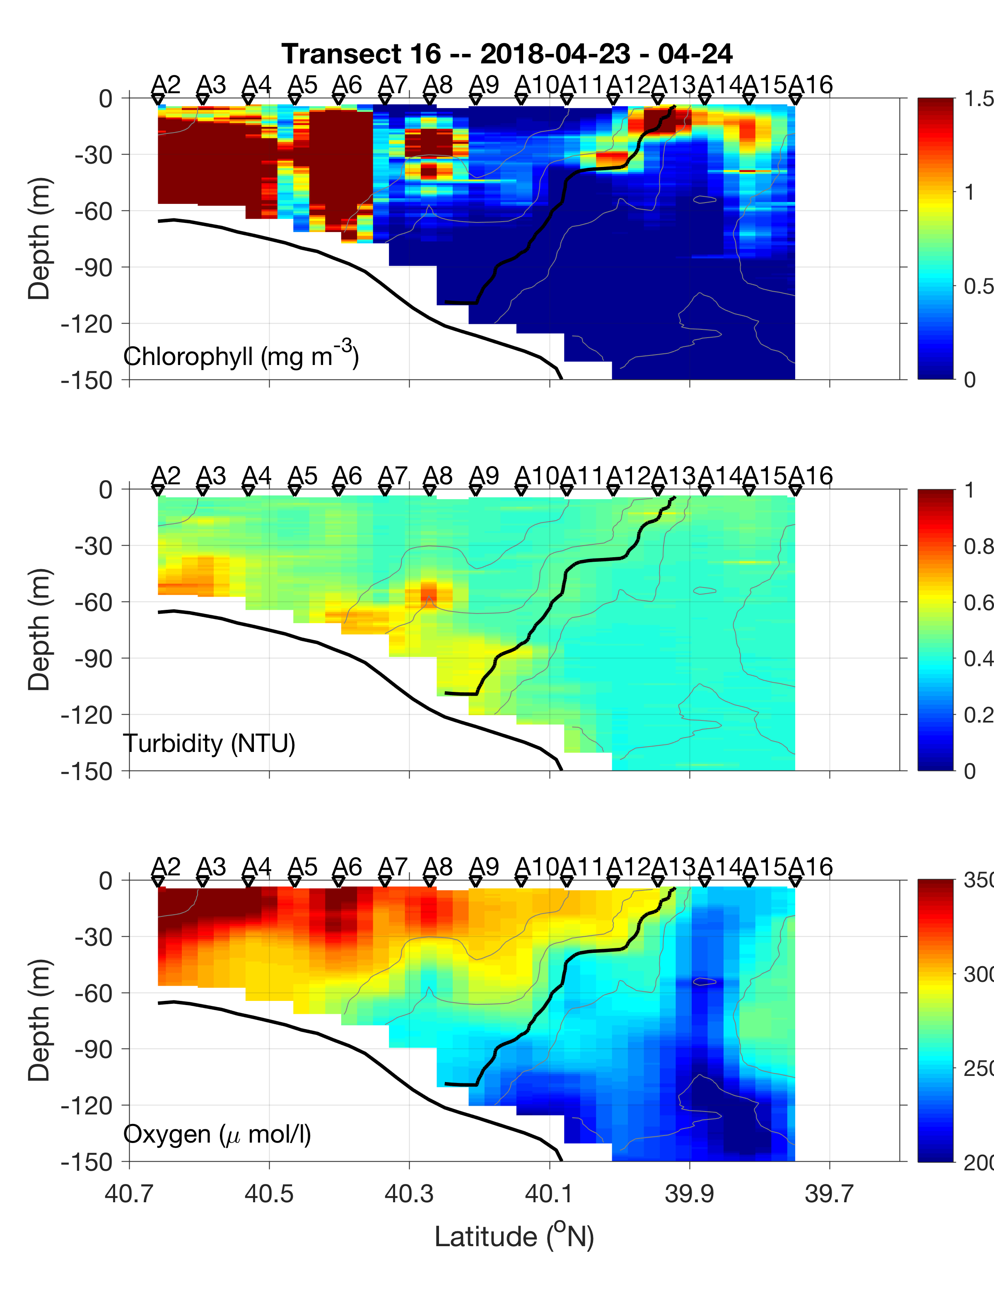
Cruise Data
2018 Apr 23
Persistent fluorescence enhancement at the offshore end of the front

Slide 18
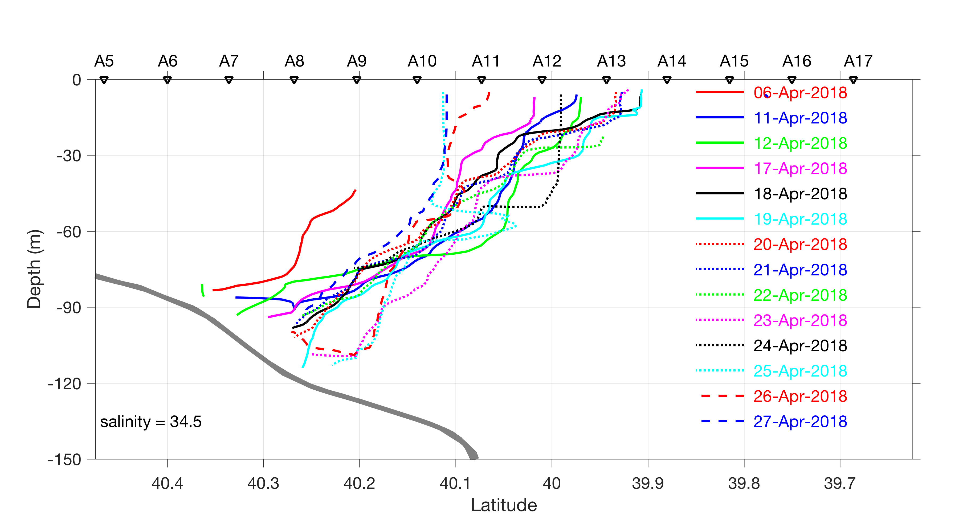

Slide 19
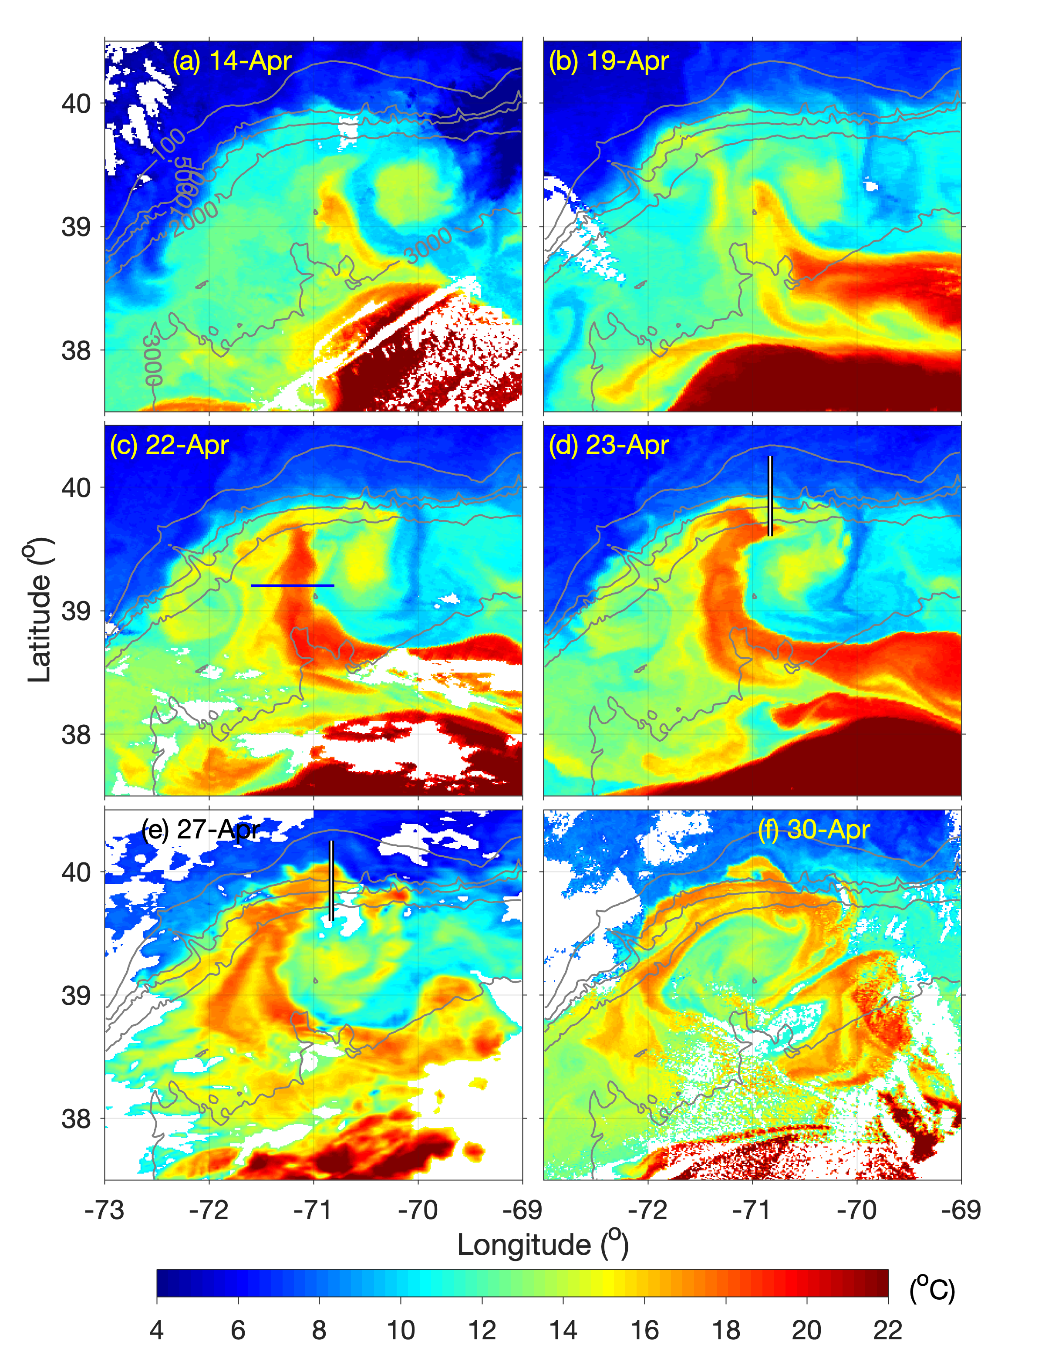
Warm spiral over WCRs

Slide 20
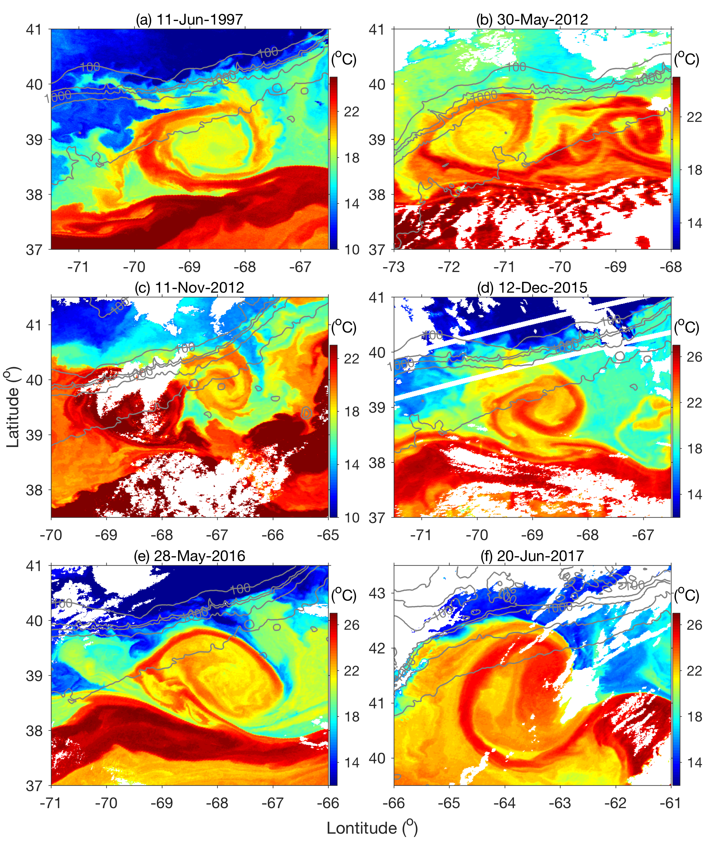
Warm spiral over WCRs

Slide 21
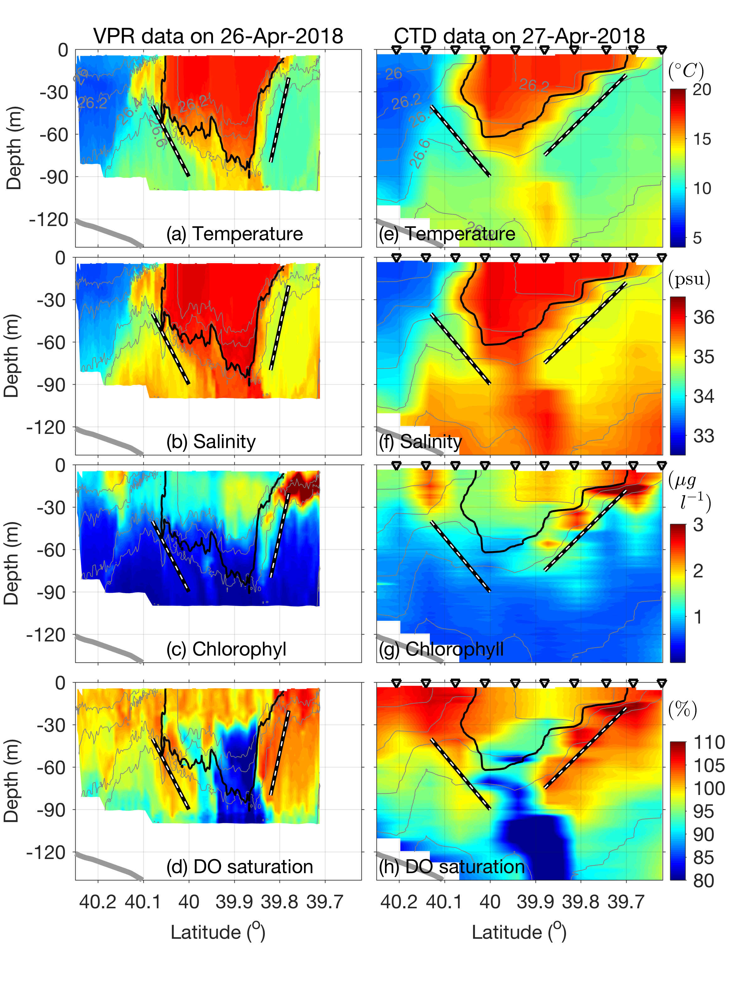
Streamer-edge Subduction
Strong signal of frontal subduction on both edges of the warm streamer
Indication of upwelling on associated with the frontal subduction

Slide 22
Summary of AR29
The shelfbreak front was influenced by an old warm-core ring from the beginning of the cruise
Eastward ring edge current pulls the shelf break front offshore, stretches it, and shoals the surface mixed layer at the offshore end of the front
There is a strong correspondence between shoaling of the surface mixed layer and fluorescence enhancement at the offshore end of the shelf break front – A potential mechanism for the onset of the phytoplankton bloom along the shelf break
A warm spiral streamer over the WCR is a shallow feature moving over the ring
There are indications of frontal upwelling and subduction at the interface between the streamer and ring/shelf waters on both sides of the streamer – implication for biogeochemistry?

Slide 23
RB1904 (May 12-25, 2019)

Slide 24
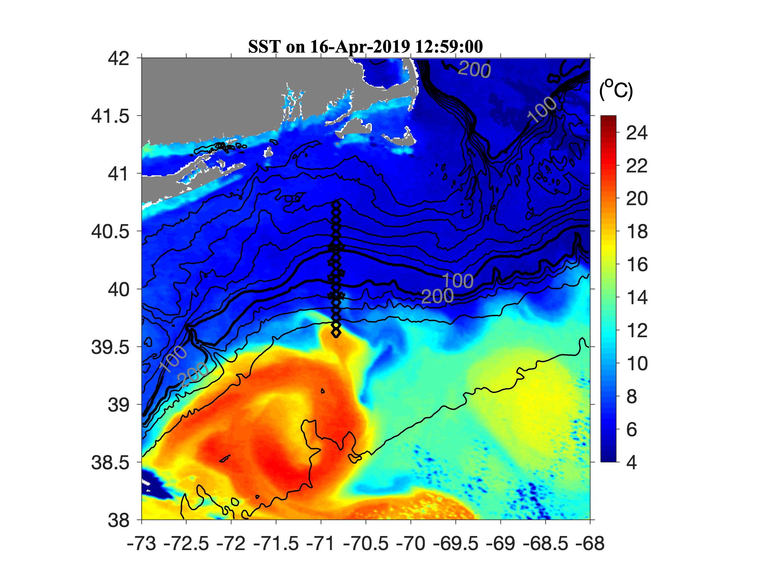
Large-scale processes
Warm-core rings
Large-scale frontal meanders

Slide 25
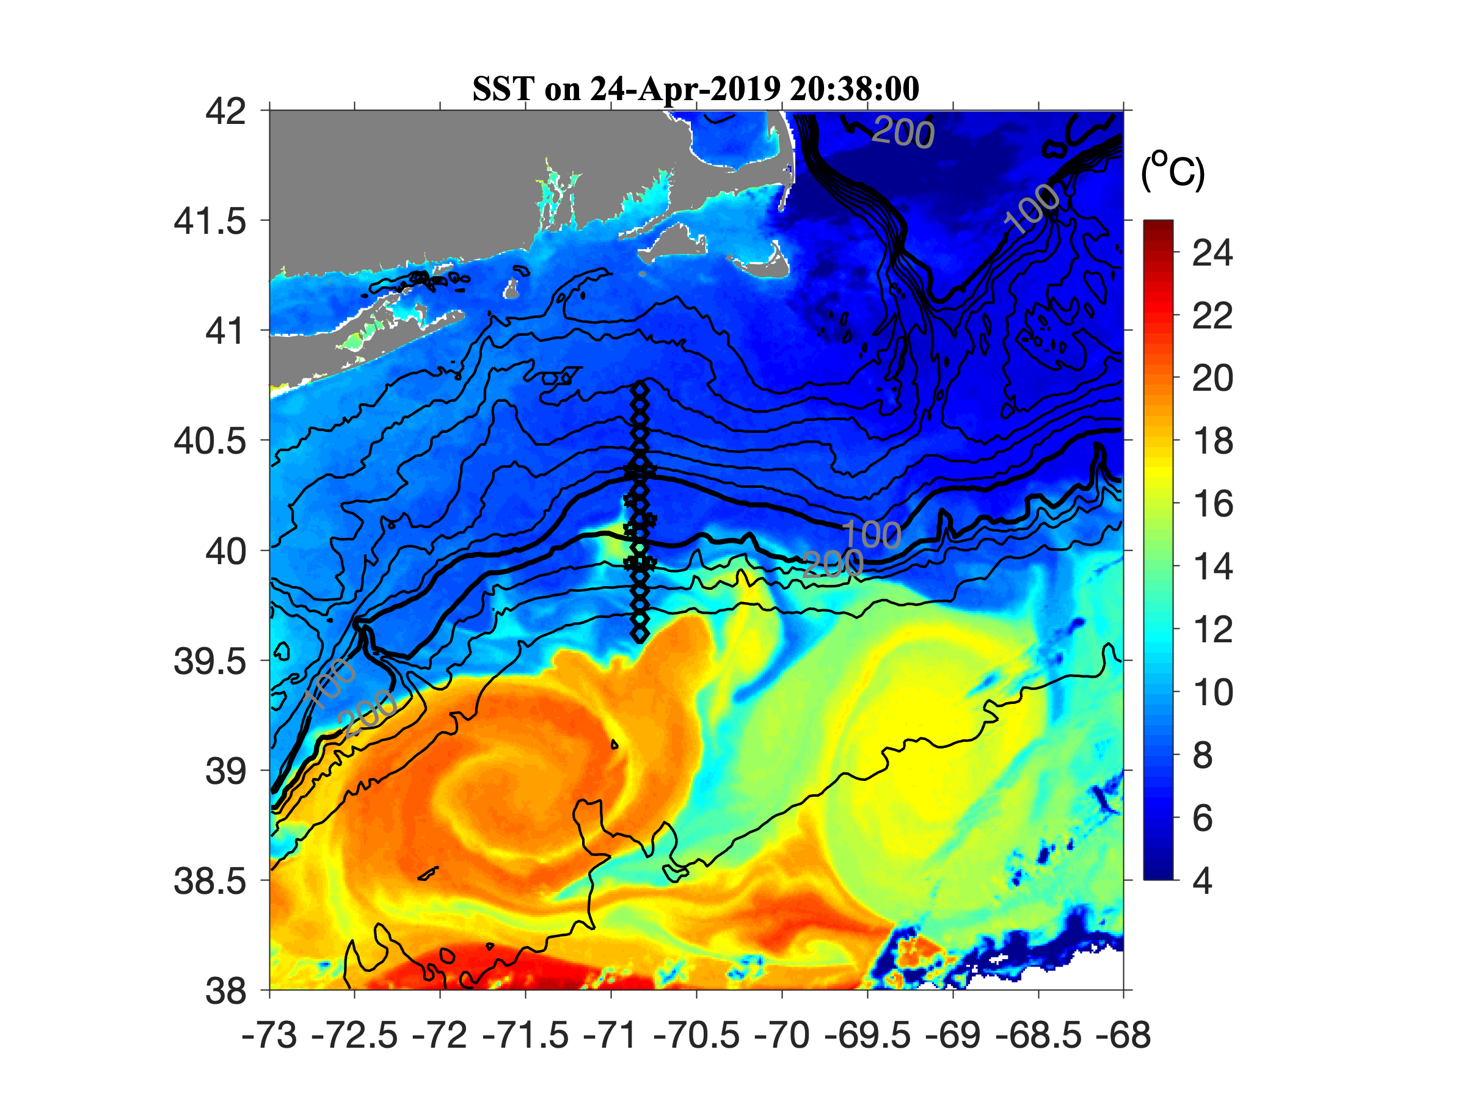
Large-scale processes

Slide 26
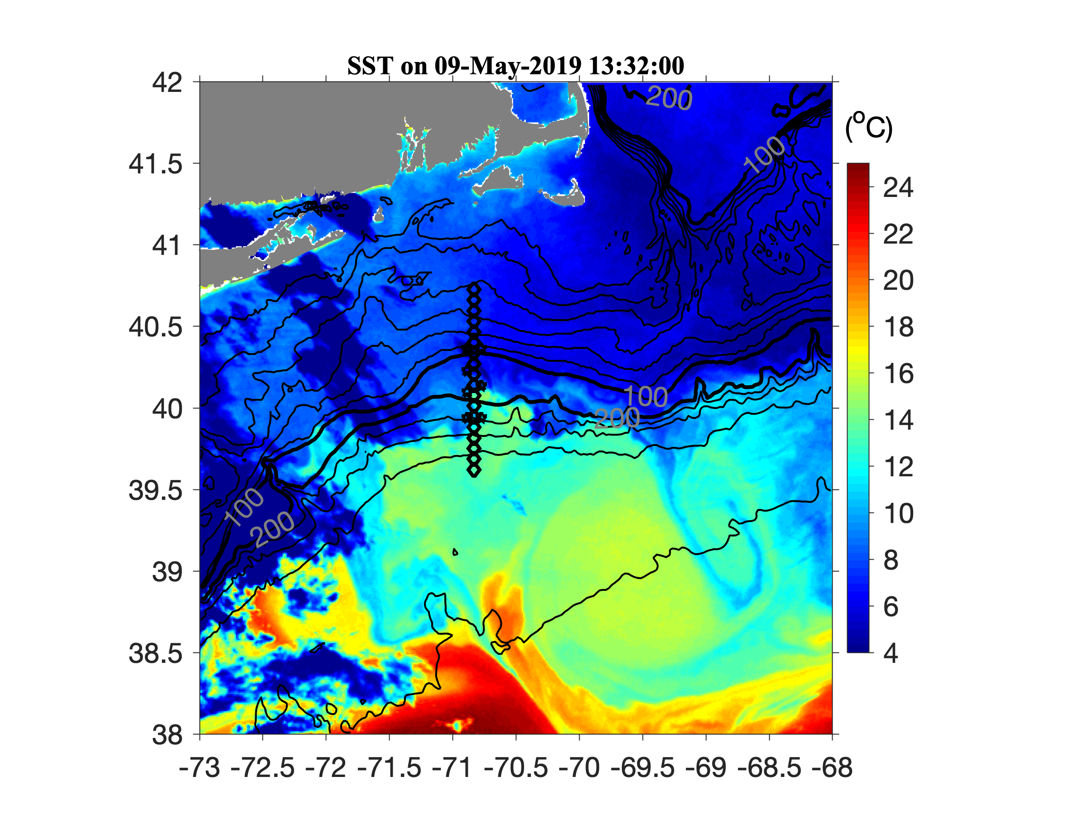
Large-scale processes

Slide 27
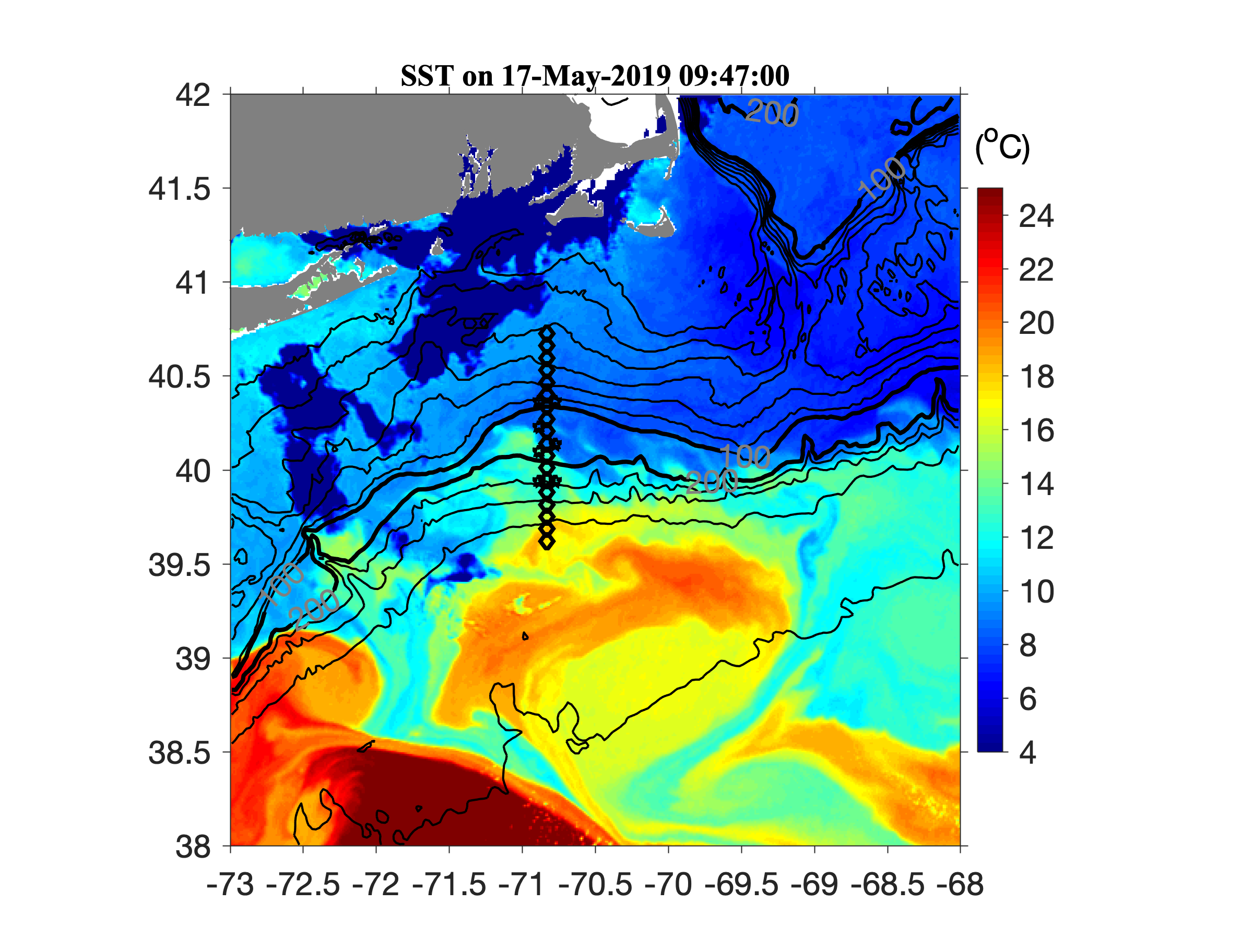
Large-scale processes

Slide 28
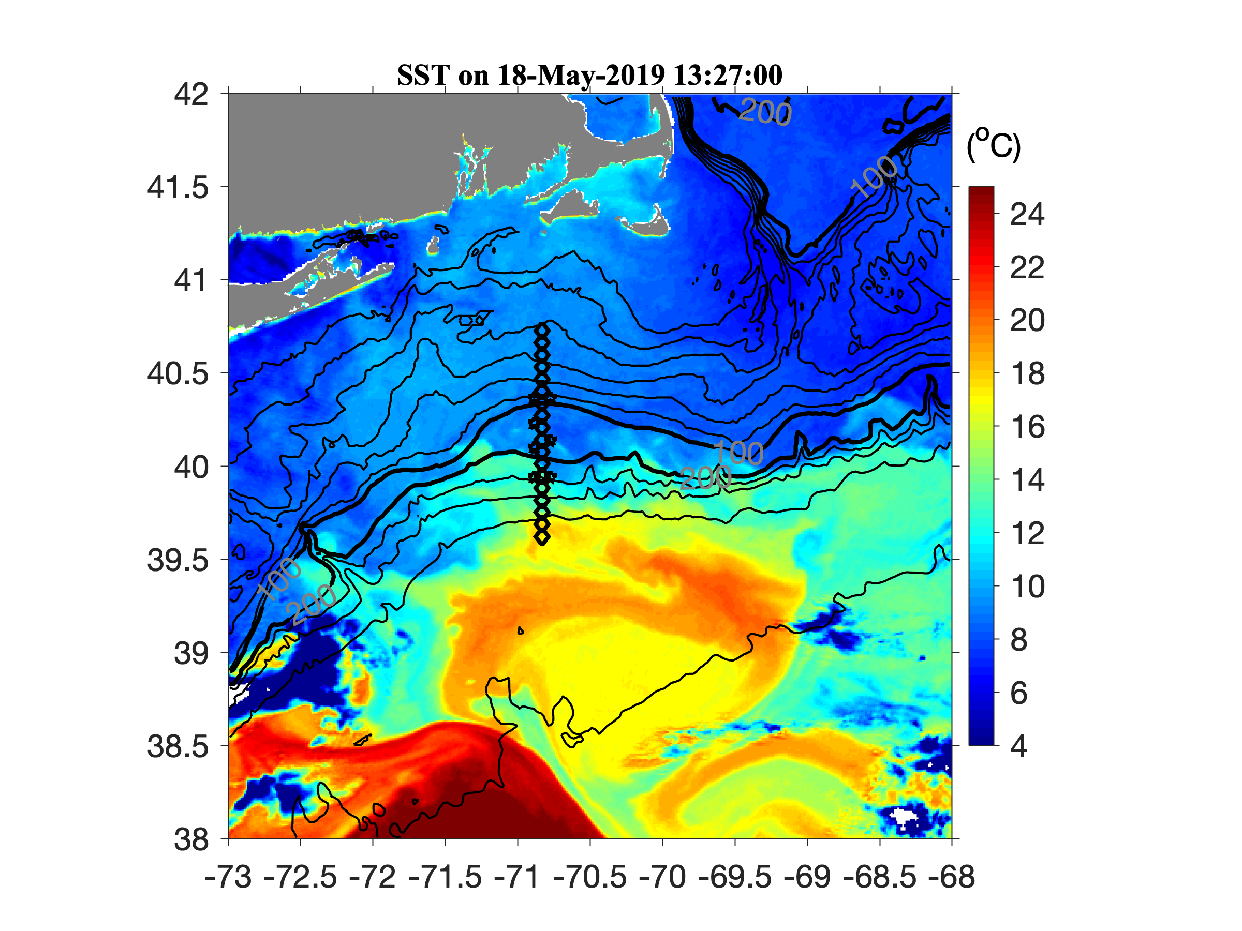
Large-scale processes
Intrusion of the new Gulf Stream water

Slide 29
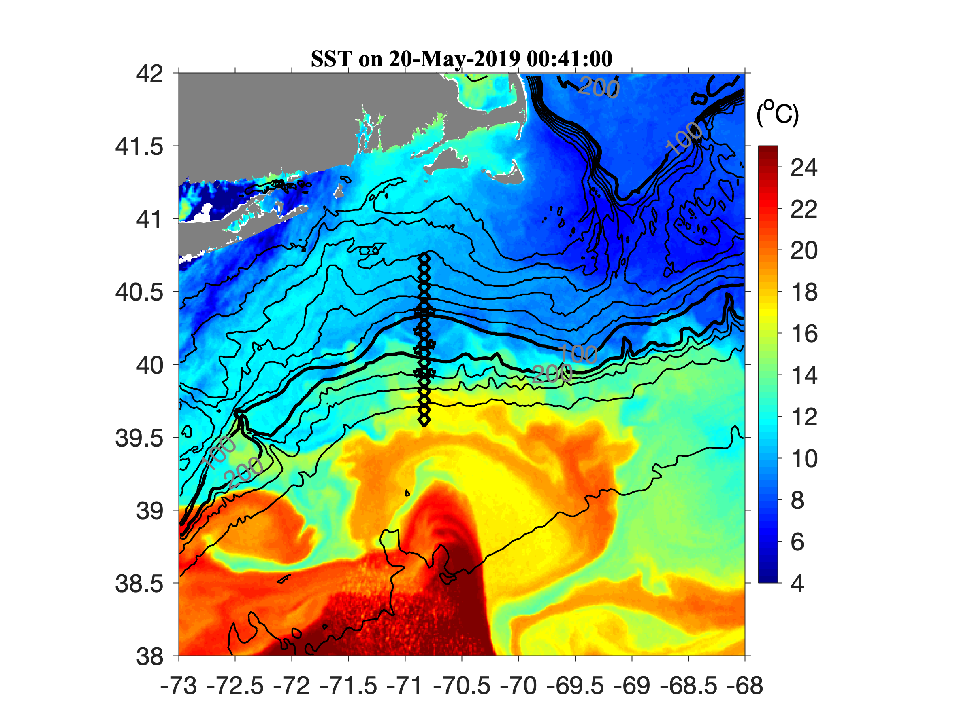
Large-scale processes
Intrusion of the new Gulf Stream water

Slide 30
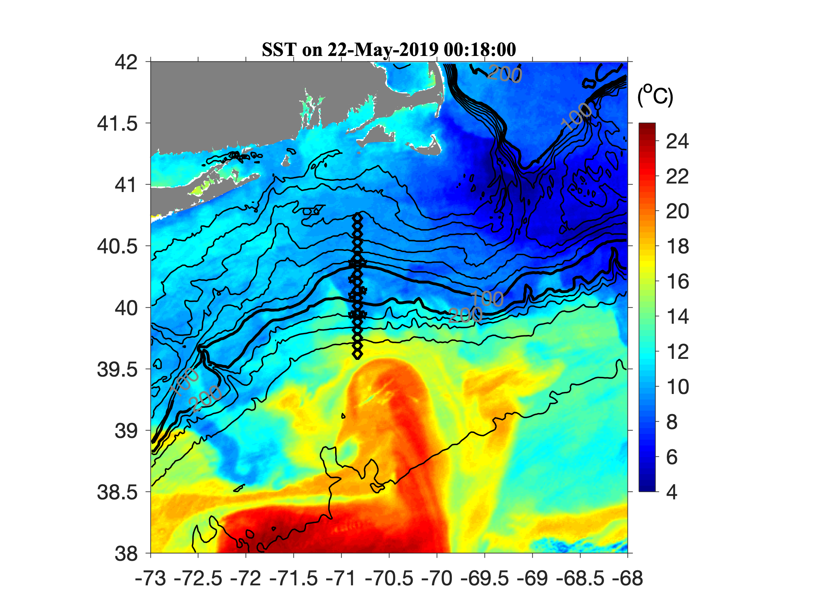
Large-scale processes
Intrusion of the new Gulf Stream water

Slide 31
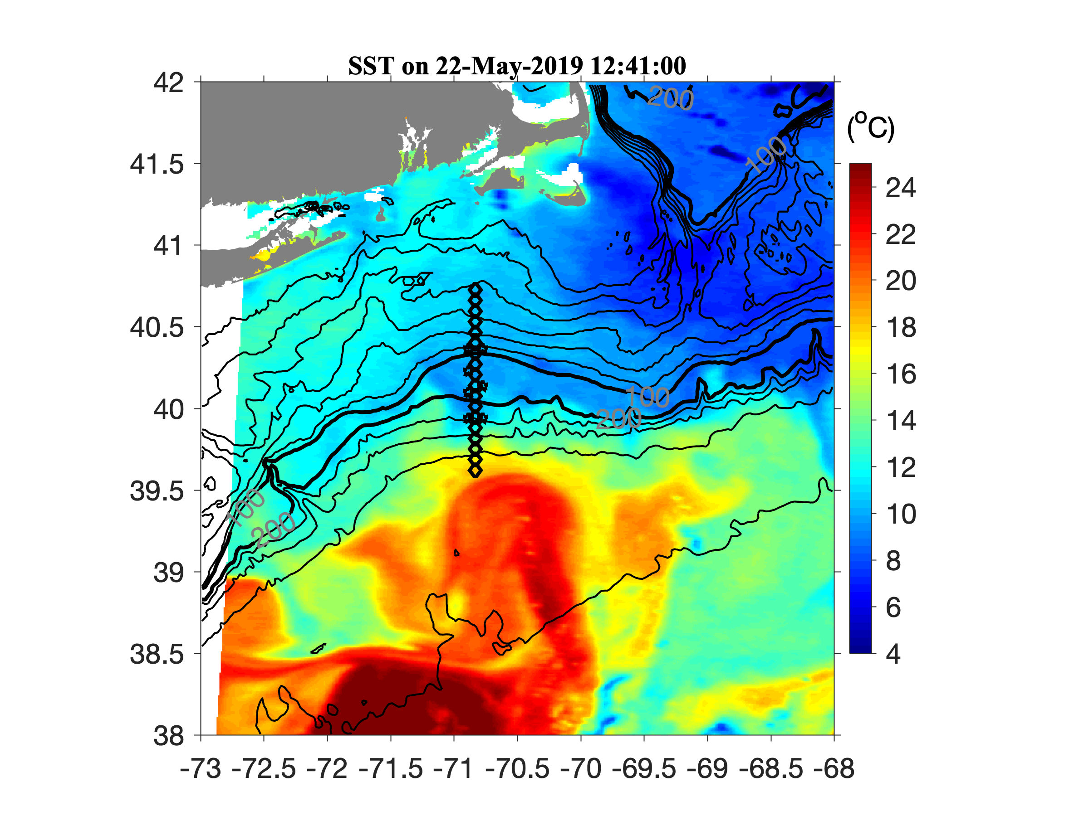

Slide 32
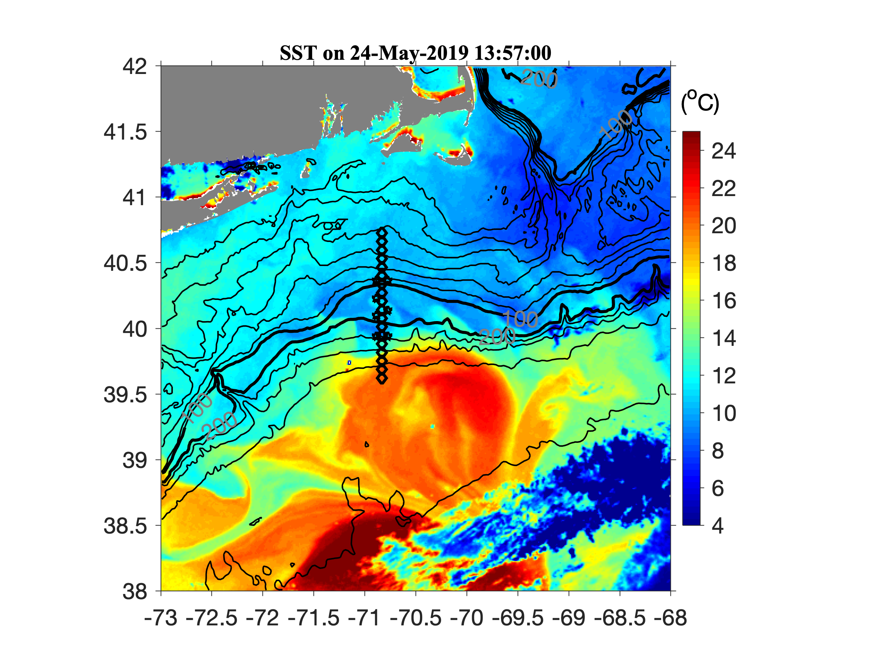
Large-scale processes
Frontal meanders
Intrusion of the new Gulf Stream water

Slide 33
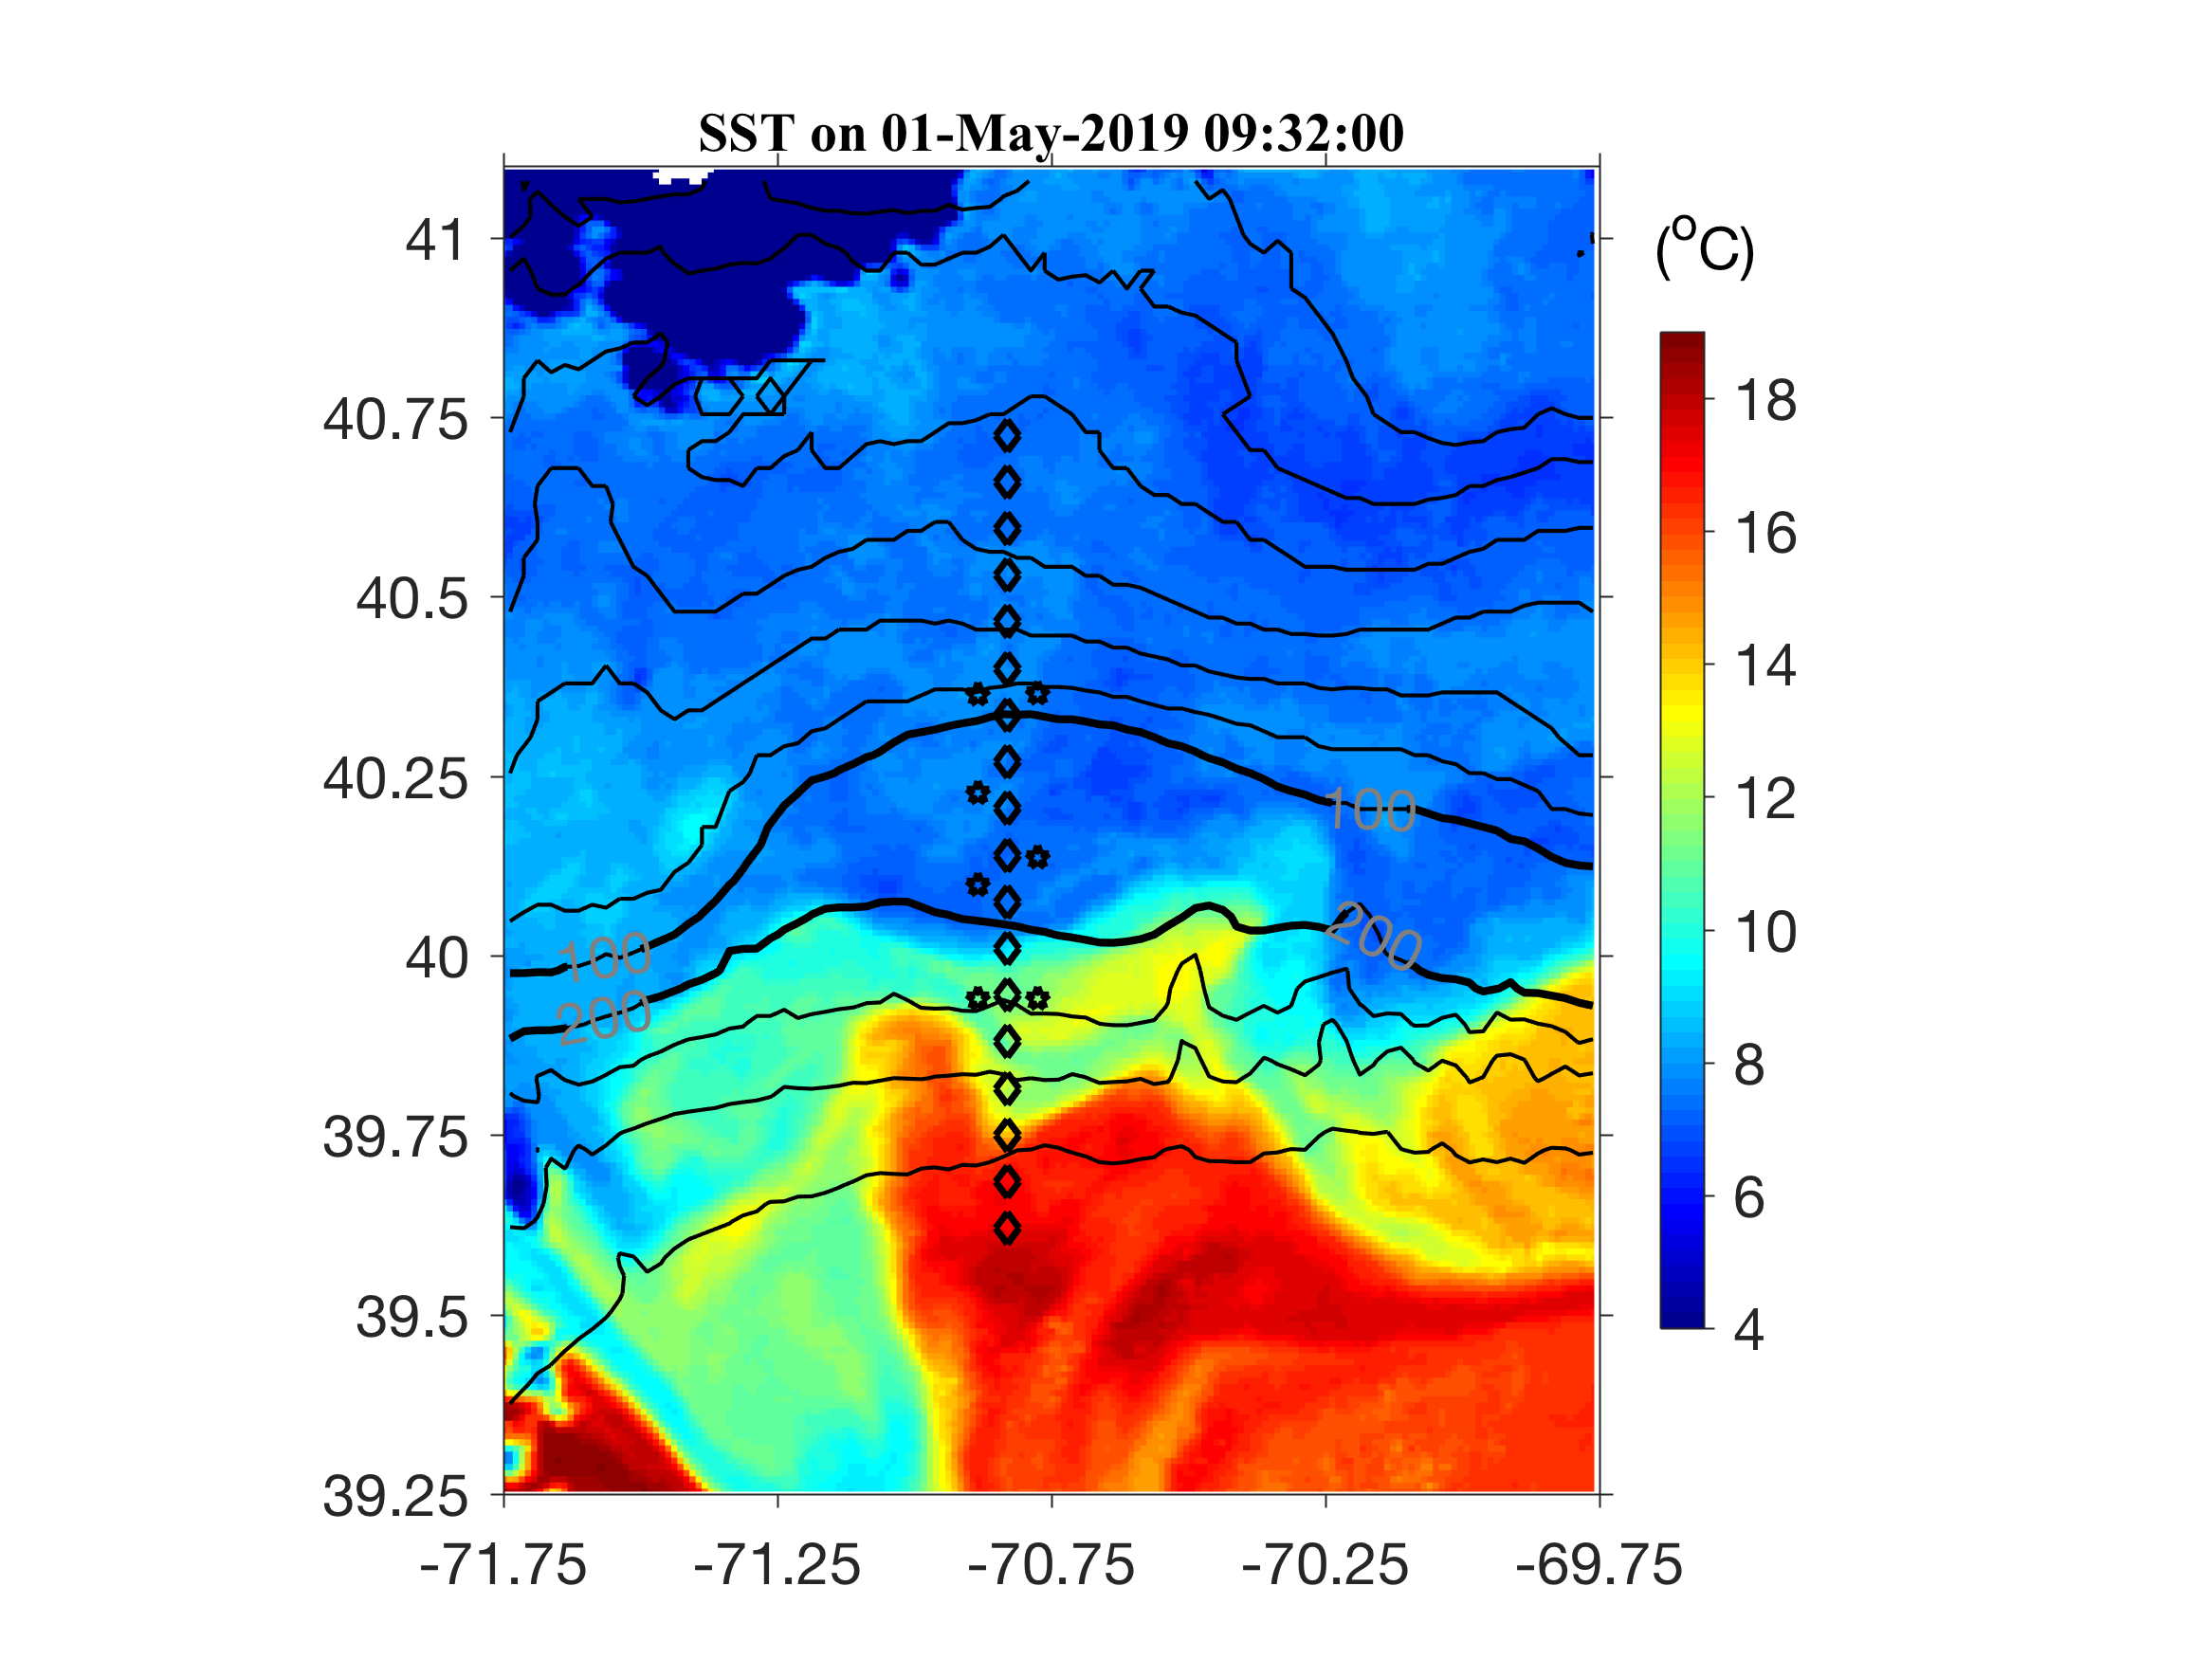
Shelf break front

Slide 34
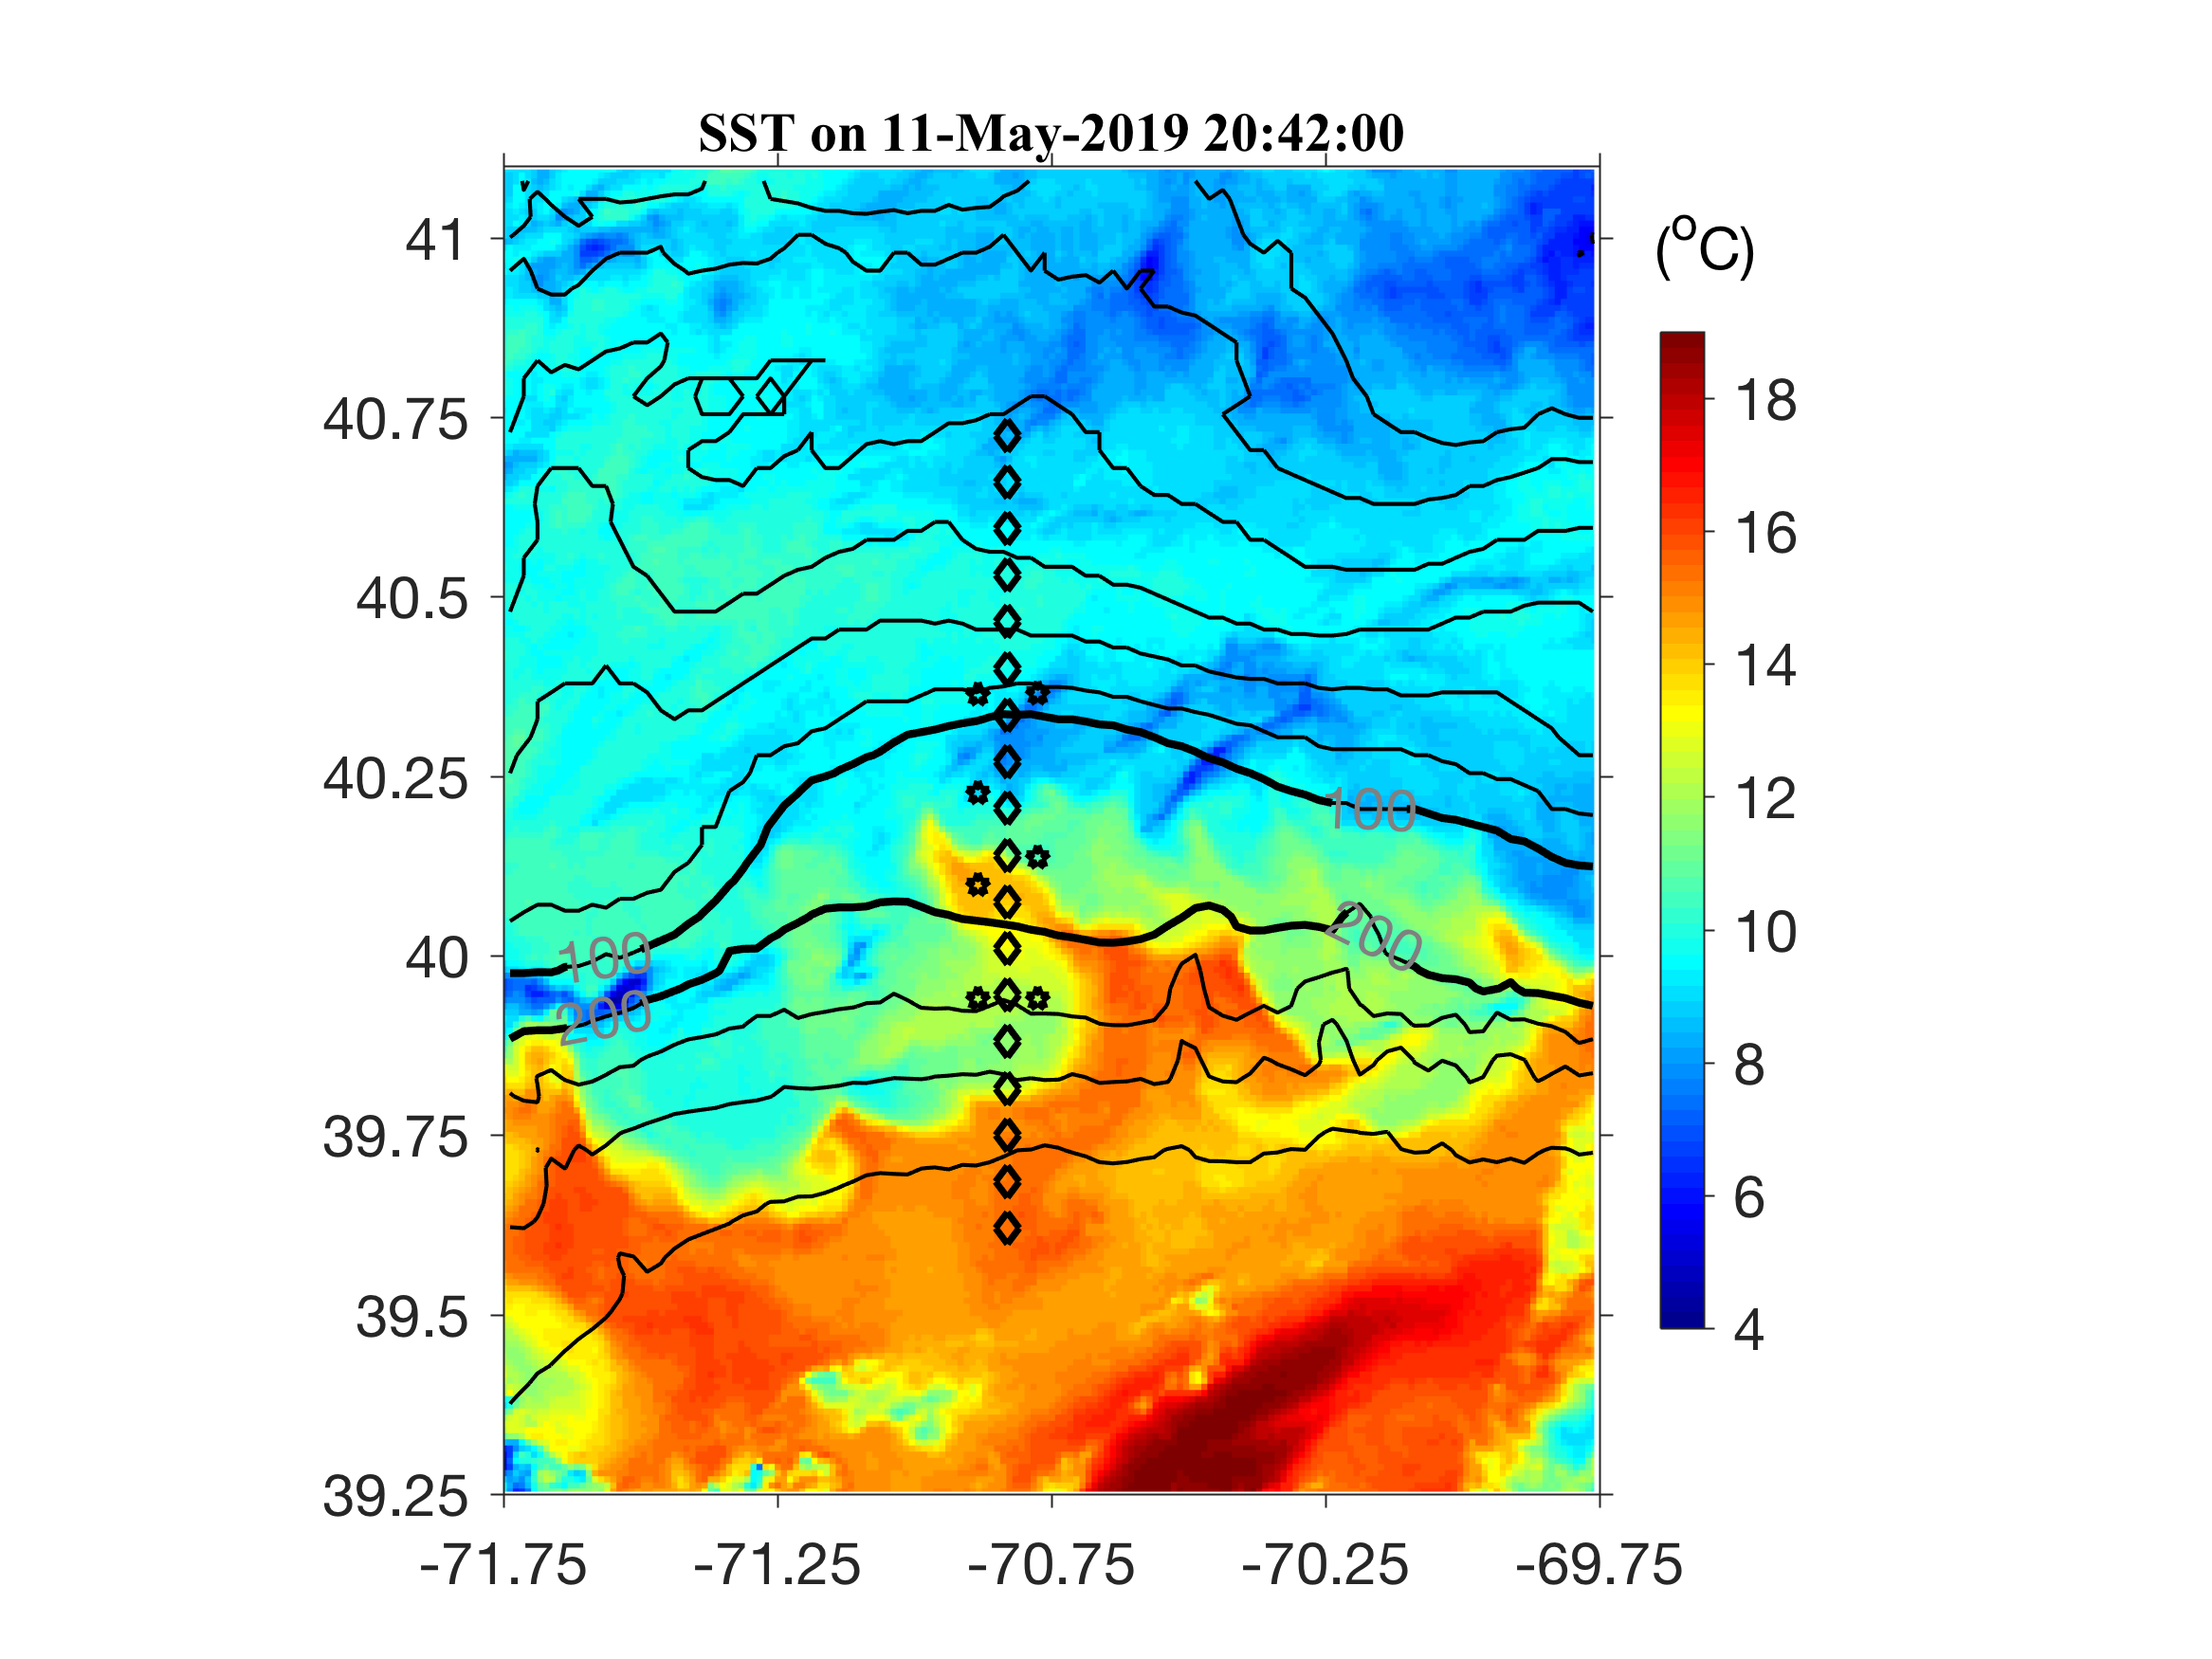
Frontal filament

Slide 35
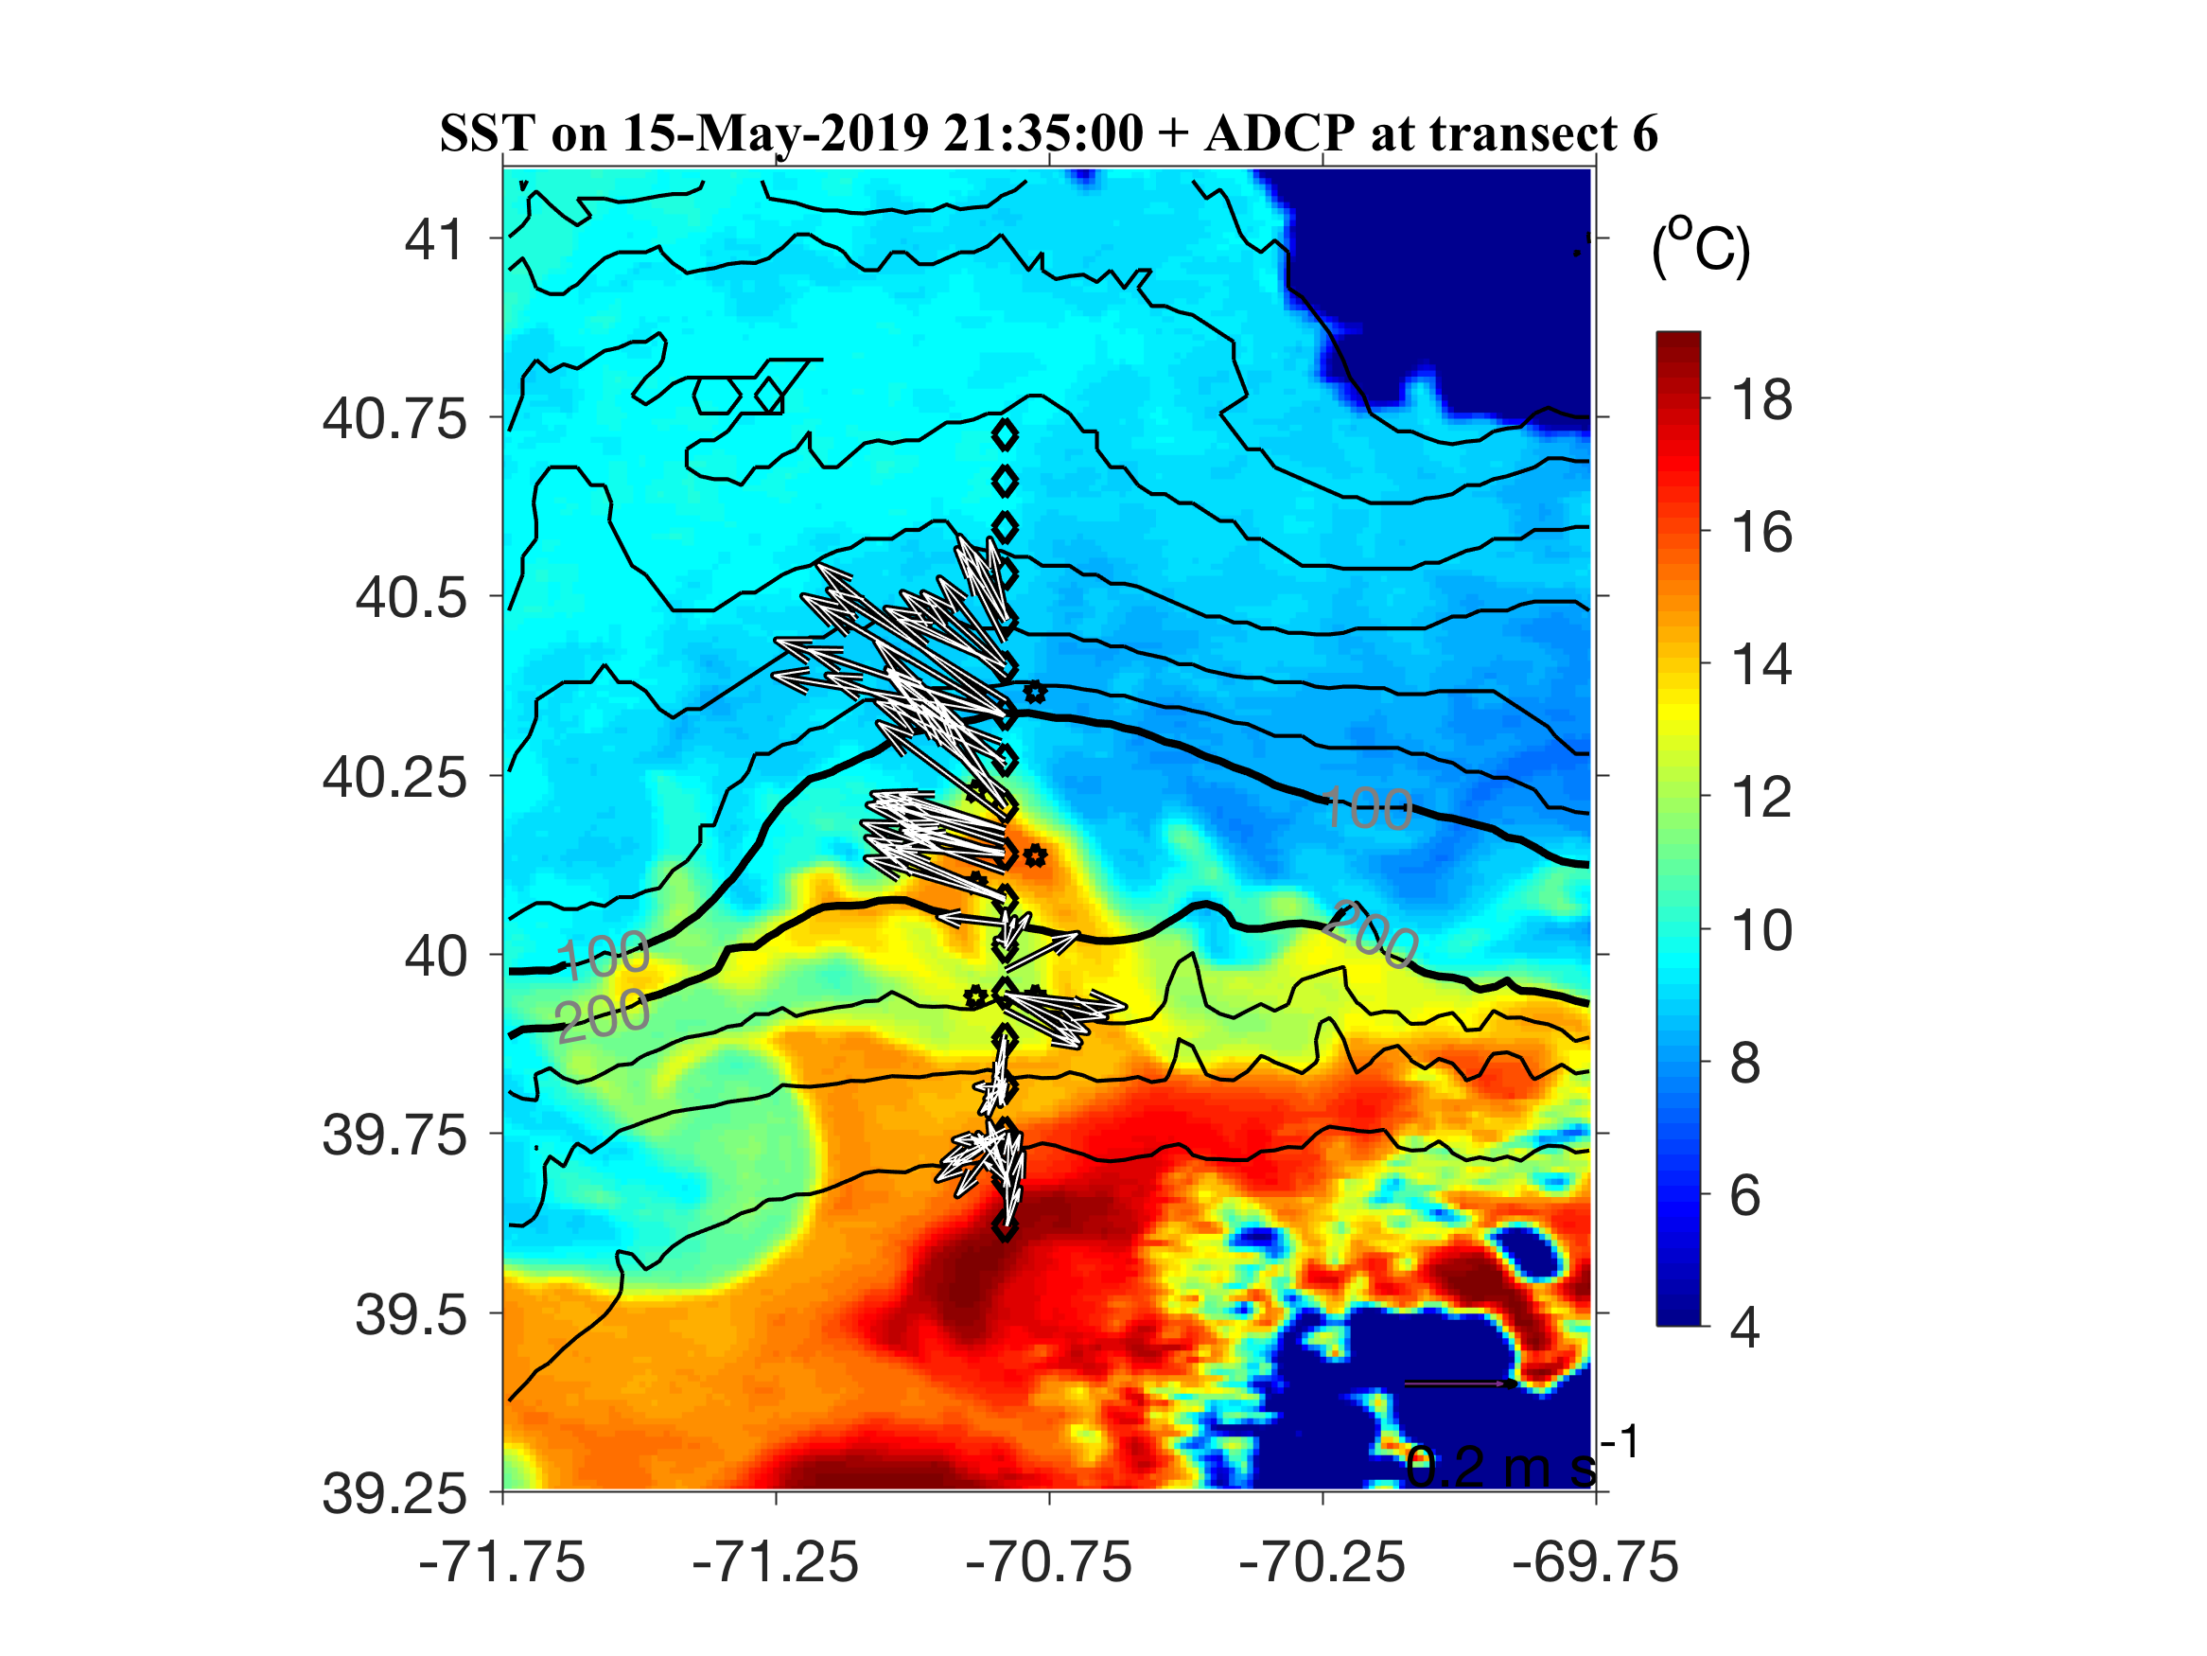
Frontal eddy formed

Slide 36
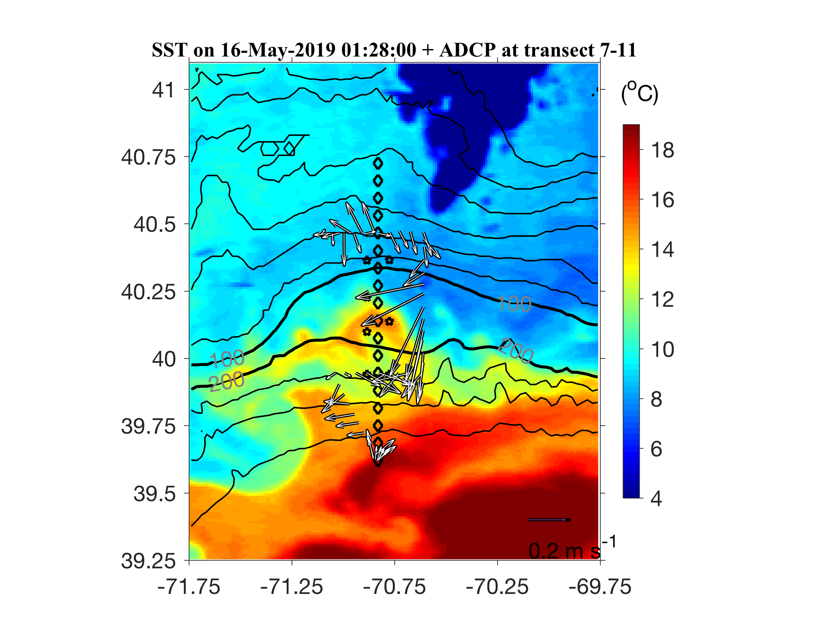
Frontal eddy

Slide 37
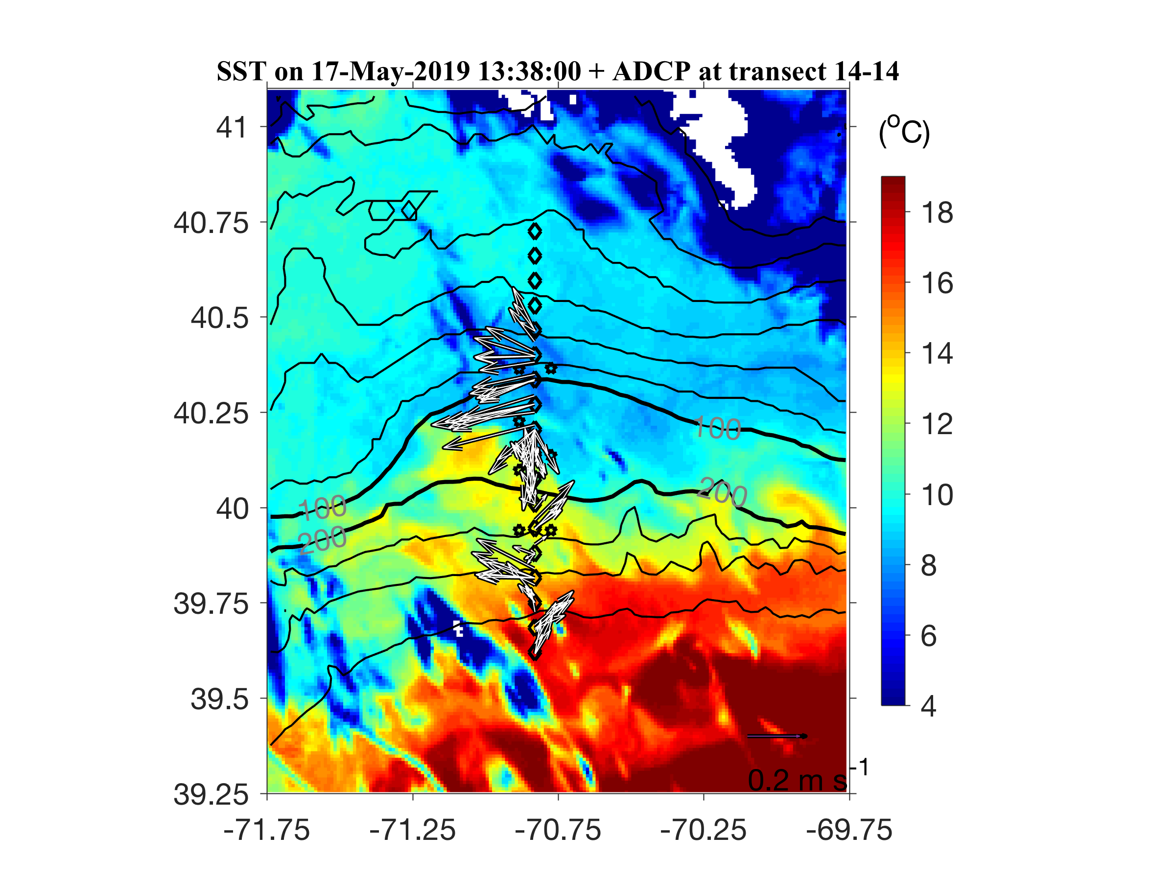
Frontal eddy moving westward

Slide 38
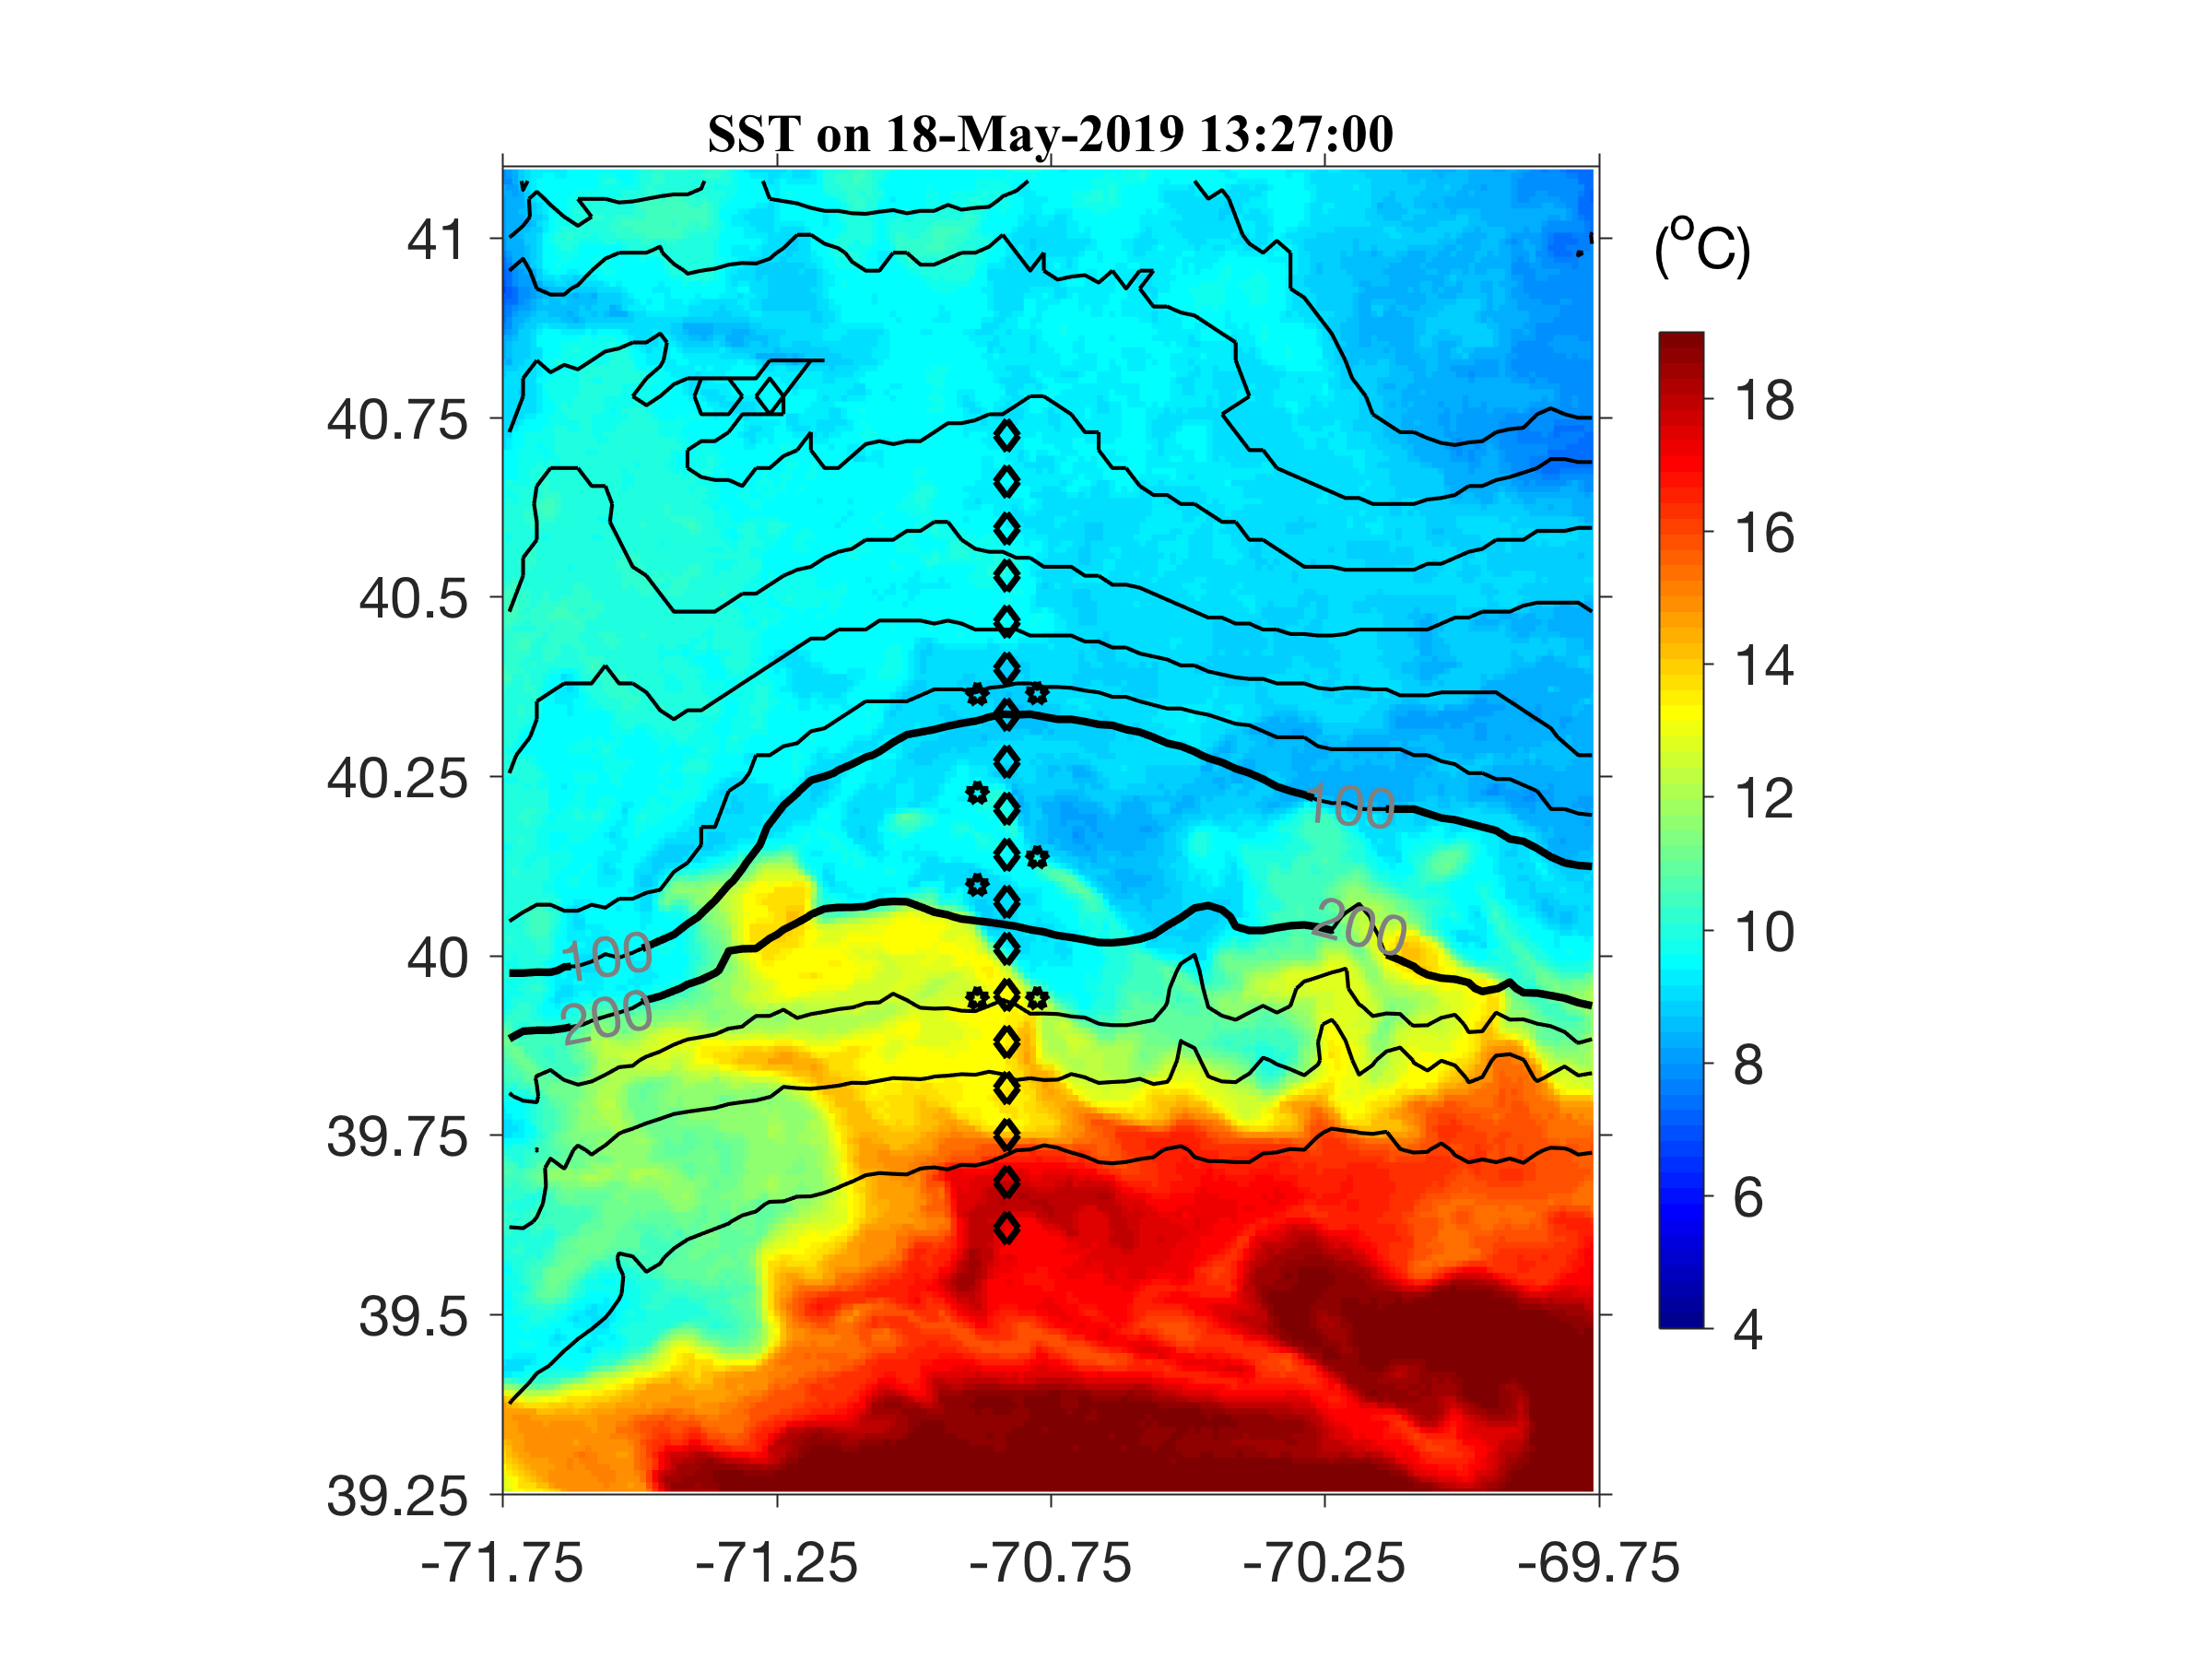
Frontal eddy moving westward

Slide 39
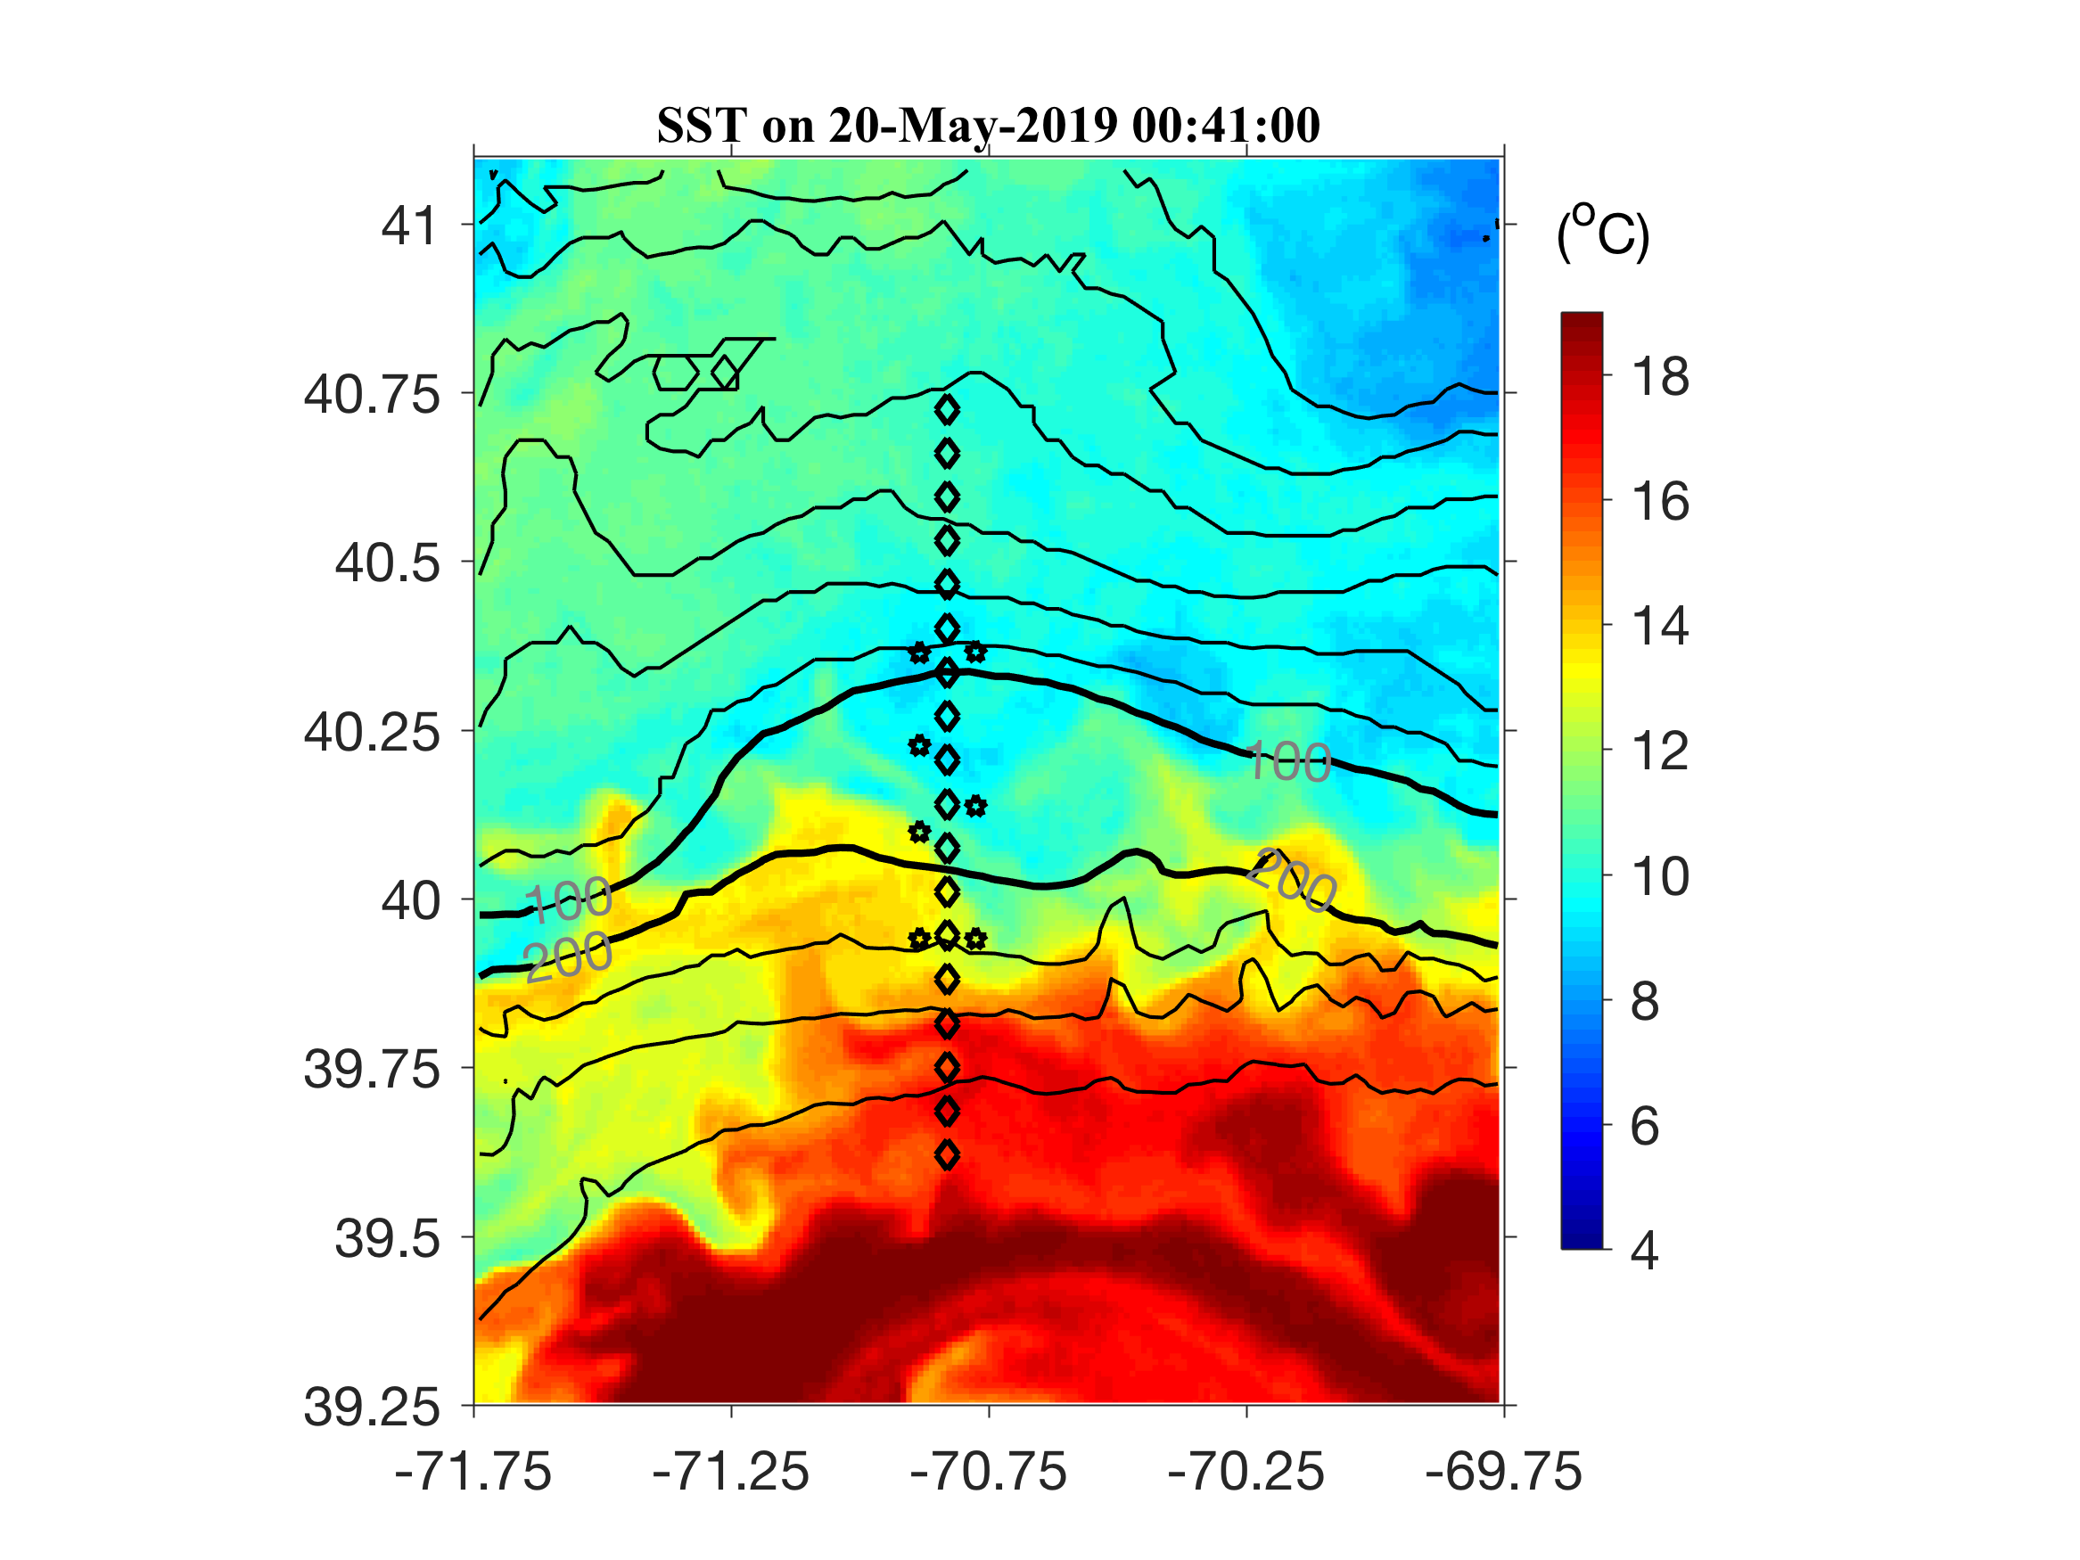
A trough of the frontal wave

Slide 40
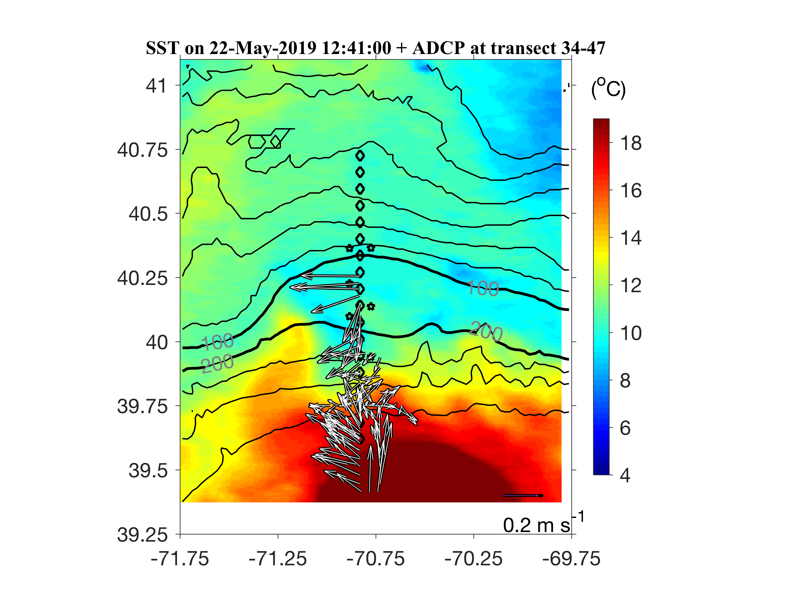
WCR intrusion

Slide 41
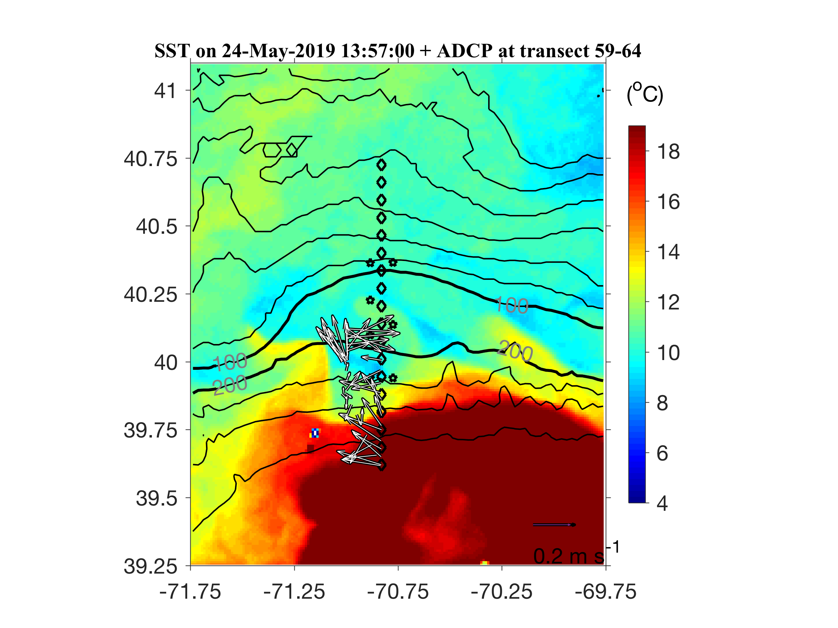
WCR intrusion

Slide 42
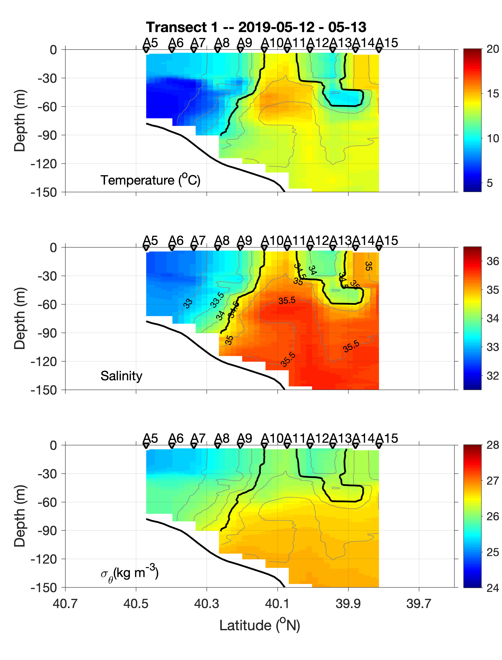
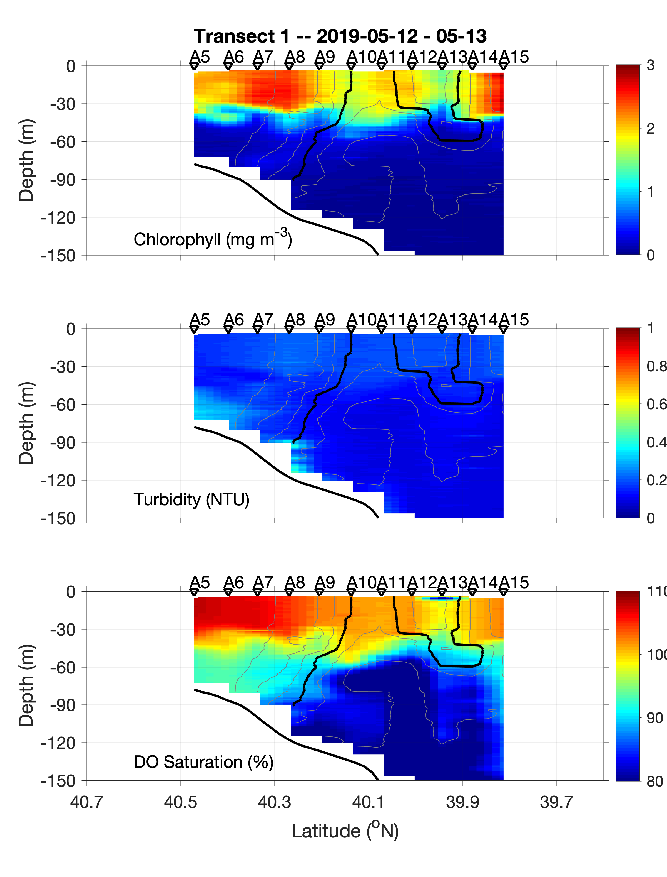
Frontal eddy

Slide 43
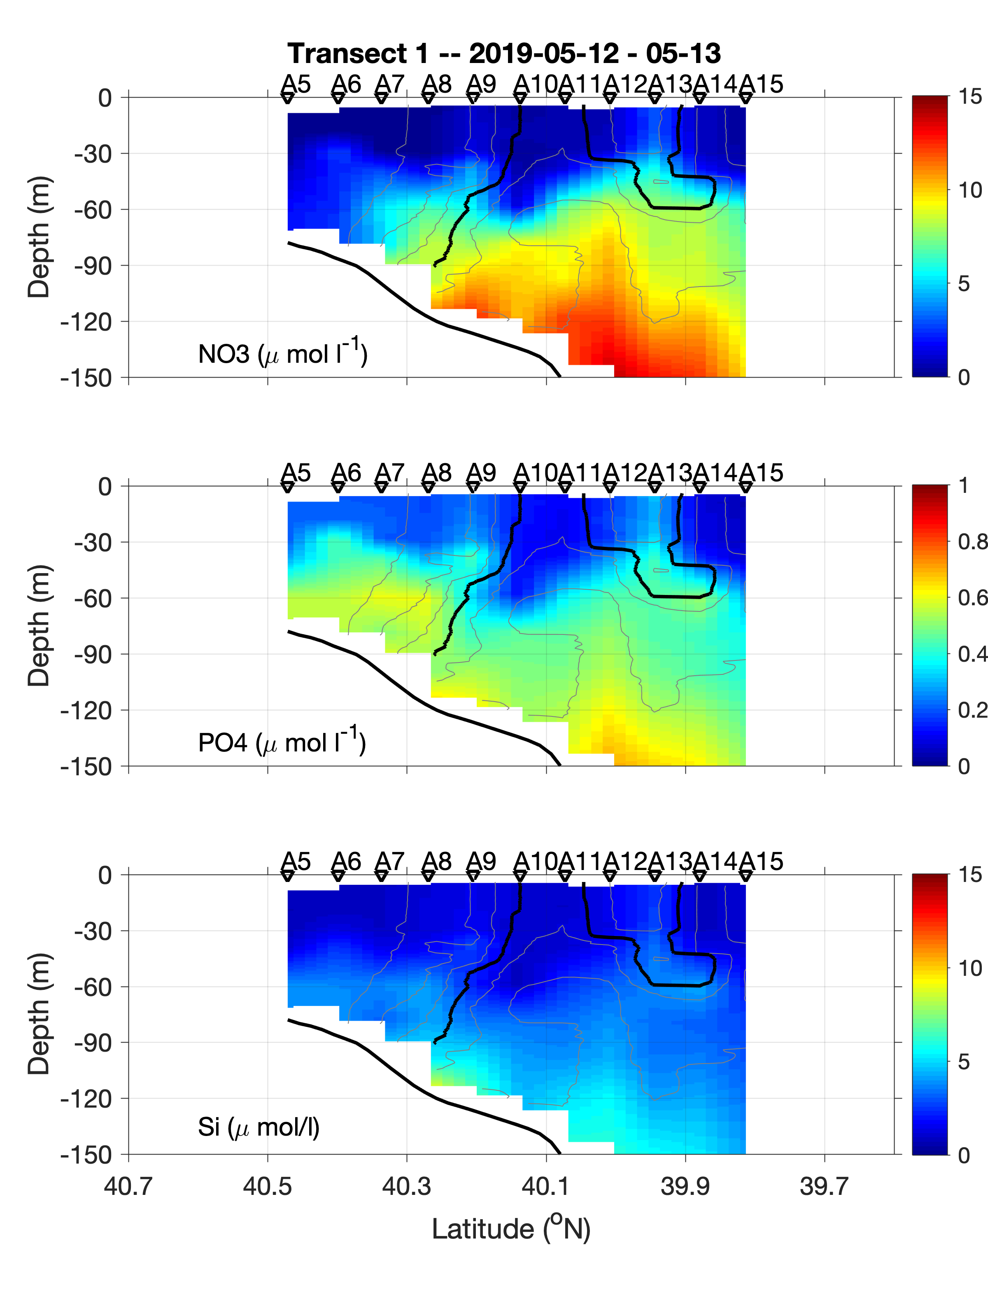
Frontal eddy

Slide 44
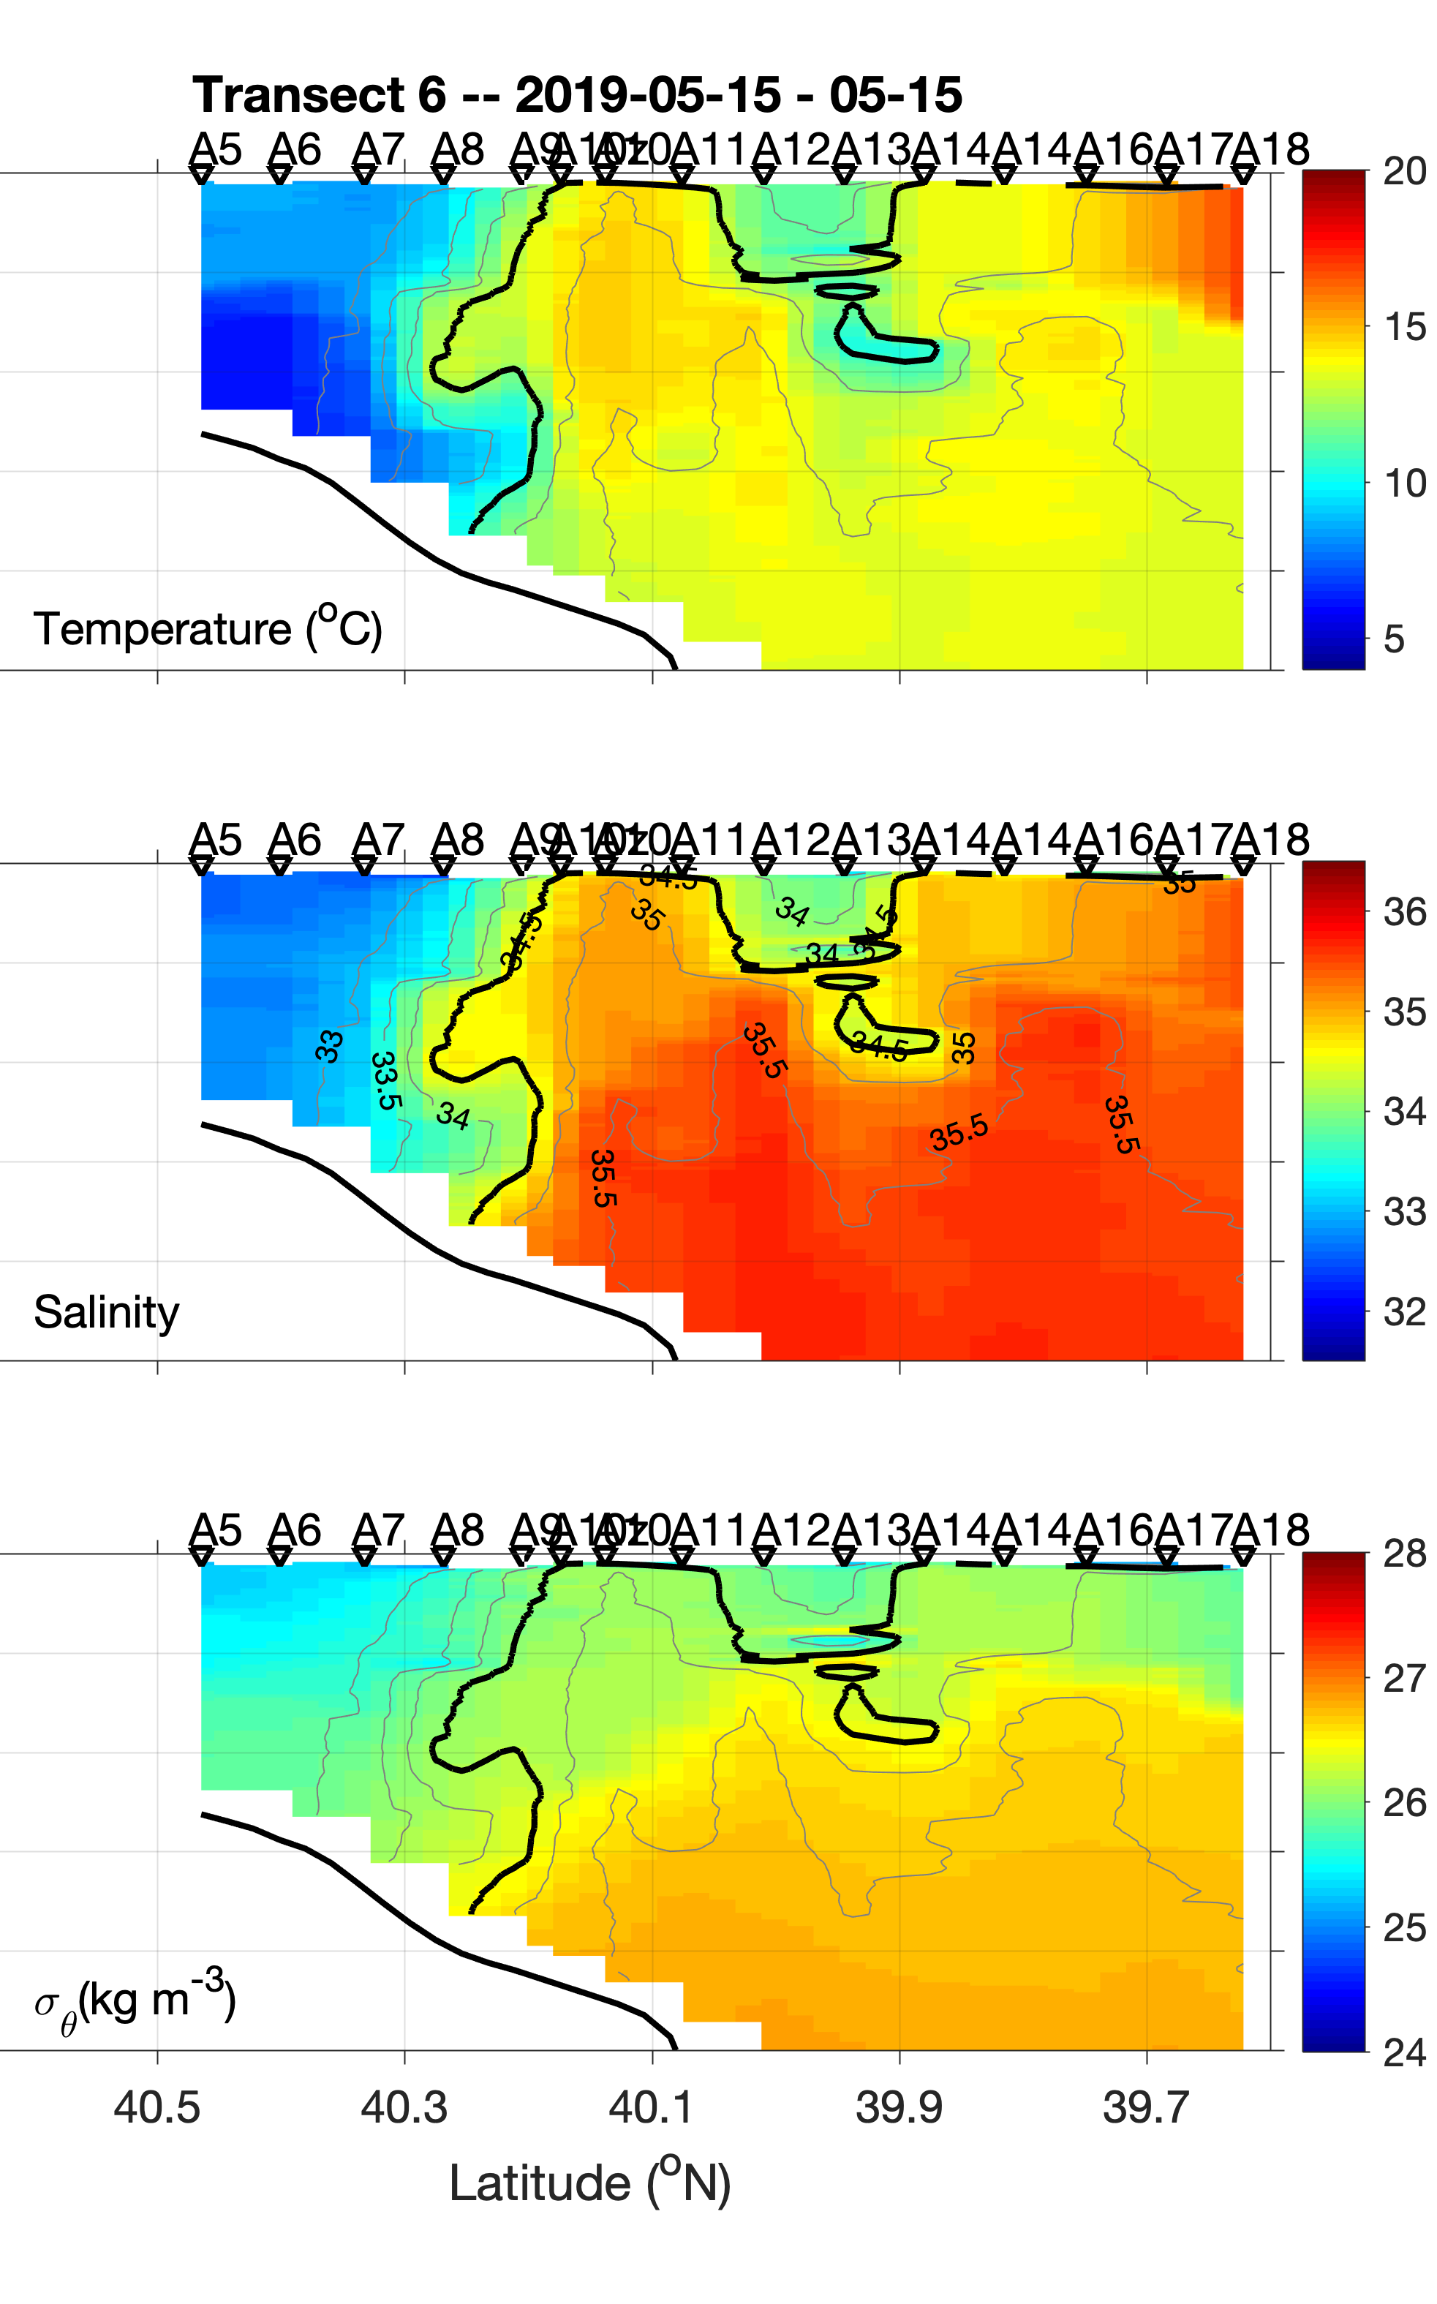
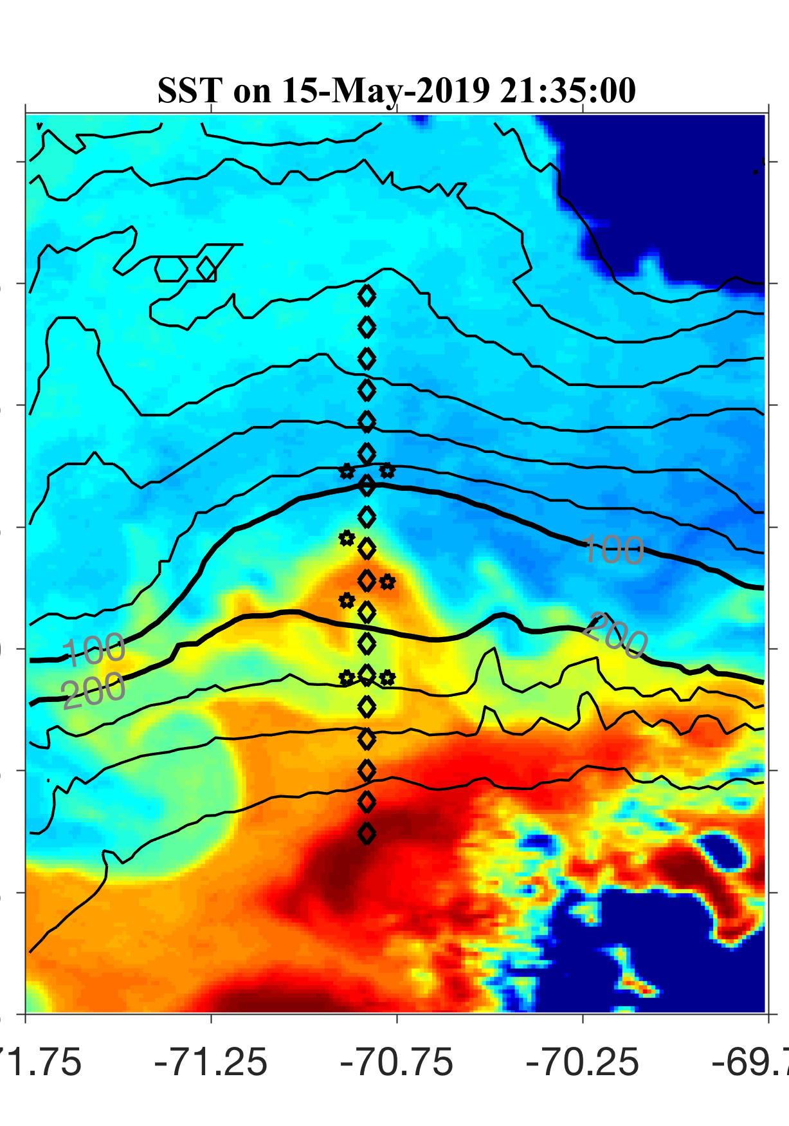

Frontal eddy

Slide 45

Frontal eddy

Slide 46


Frontal eddy

Slide 47

Frontal eddy

Slide 48


Typical shelf break front

Slide 49

Typical shelf break front

Slide 50



Frontal upwelling

Slide 51

Frontal upwelling

Slide 52


Slide 53
Summary of RB1904
Pronounced eddy activities at the shelf break front
Detailed sampling of the physical and biogeochemical environment in and around the frontal eddies (first time!)
Submesoscale frontal subduction and upwelling occur along the cyclonic frontal eddies
Influence of a warm-core ring at the offshore end of the transect toward the end of the cruise

Slide 54
TN368 (July 05-18, 2019)

Slide 55

TN368 (July 03-19, 2019)

Slide 56

Evolution of the WCR from May to July

Slide 57

Evolution of the WCR from May to July

Slide 58

Evolution of the WCR from May to July

Slide 59

Evolution of the WCR from May to July

Slide 60

Evolution of the WCR from May to July

Slide 61

Evolution of the WCR from May to July

Slide 62

Evolution of the WCR from May to July

Slide 63

SST over the cruise period
Shelf water streamer

Slide 64

SST over the cruise period
Shelf water streamer migrated westward

Slide 65

SST over the cruise period
Shelf water streamer

Slide 66

SST over the cruise period
warm water from the east moves westward

Slide 67

SST over the cruise period
warm water from the east moves further westward

Slide 68

Large-scale circulation
?

Slide 69



Westward propagation of the leaked ring water at the shelf break front

Slide 70



Westward propagation of the leaked ring water at the shelf break front

Slide 71



Westward propagation of the leaked ring water at the shelf break front

Slide 72

Density-compensated temperature and salinity front at the shelf break
AUV track

Slide 73


Density-compensated temperature and salinity front at the shelf break

Slide 74
Lateral intrusion at the density-compensated TS front

Slide 75
Lateral intrusion at the density-compensated TS front

Slide 76


Lateral intrusion at the density-compensated TS front forming interleaving water masses
Jeff: “Gulf of Maine water on the top, Gulf of Mexico water below, everything in between”

Slide 77
Large-scale circulation
?

Slide 78


Offshore transport in the shelf water streamer
First time a shelf-water streamer being measured in detail!

Slide 79

Offshore transport in the shelf water streamer

Slide 80

Questions:
How much heat, salt, carbon, nutrients, DO, … do the streamer carry?

Slide 81
Summary of TN368
The ring we encountered in May remained in the region till July
The ring and Gulf Stream meanders together form a large-scale counterclockwise circulation in the slope sea, carrying warm and salty Gulf Stream water from the east westward along the shelf break
The interface between the Gulf Stream and shelf water at the shelf break is density compensated with dramatic gradient of temperature and salinity
Surface Ekman transport and subsurface lateral intrusion carry the waters across the interface, form interleaving water masses, and induce cross-shelf exchange
Pronounced shelf-water streamer carrying cold, fresh, highly productive shelf water offshore
Some of the Gulf Stream water from the east flows southward along the eastern edge of the shelf-water streamer

Slide 83
A quick review of the physical processes at the shelf break front

Slide 84

Regional Setup
Mid-Atlantic Bight (MAB)
Sea Surface Temperature on 13 April 2014
cold fresh
Less dense
Shelfbreak front
Slope water
denser
Warm-Core Ring
warm saline
Gulf Stream

Slide 85



Shelfbreak front in Jun 2016

Slide 86

Short-term variability of the shelfbreak front
1. Frontal instability
Frontal instability develops into finite-amplitude meanders in 2-3 days
Frontal meanders propagate westward in the speed of ~0.1 m/s (~10 km/day)

Slide 87


Vertical Motion Associated with the Instability

Slide 88


Short-term variability of the shelfbreak front
2. Impact of the warm-core ring
Sea Surface Temperature
Ring-water onshore intrusion develops several days
The intrusion feature propagates westward in the speed of O(10 km/day)

Slide 89

Biological impacts of the Warm-core ring
Low chlorophyll ring water

Slide 90


Frontal subduction on the edge of a warm-core ring
Shelf water streamer
Day in Jun 2014

Slide 91
(a)
Ring edge front
Shelf water
Onshore impinging
Warm-core ring
Subduction
Shelfbreak
Ring edge isopycnals

Slide 92



OOI Pioneer Array
(http://oceanobservatories.org/array/coastal-pioneer/)

