Slide 1
Understanding slope-shelf-streamer regimes/intense phytoplankton blooms with 1-D NPZD models
Hilde Oliver
Postdoc Scholar @ WHOI
Supervised by Dennis and Gordon

Slide 2
Hypothesis for bloom
The nutrient-rich subsurface (leaked?) ring water is raised to the base of the euphotic zone after interacting with the shelf water, driving the intense subsurface slope bloom observed during TN368

Slide 3
Objective: what can we achieve in 1D?
1D = depth considered only, no horizontal variation
  No advection
How would tracers evolve without any sources or sinks, only biogeochemical cycling?
  1D model necessarily NOT in steady state
If observed conditions (i.e. a phytoplankton bloom) cannot be achieved in 1D, what is missing?
  Hint to magnitude of the nutrient supply

Slide 4
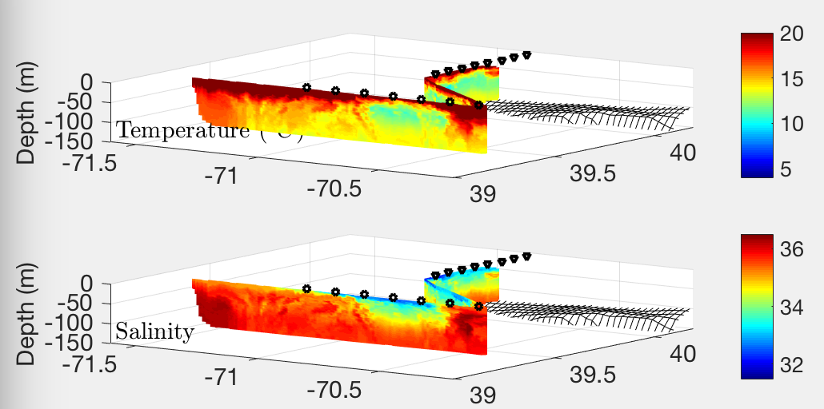
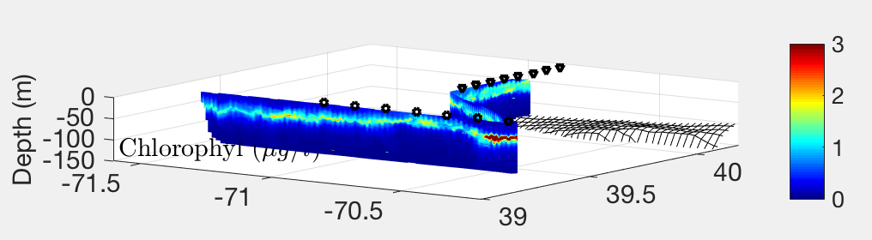
Where do we see high slope Chl a?
Narrow band of enhanced chlorophyll to east of streamer
“Coathanger”
towed VPR transect
Bloom also observed at the interface of the shelf and ring water along the shelf break

Slide 5
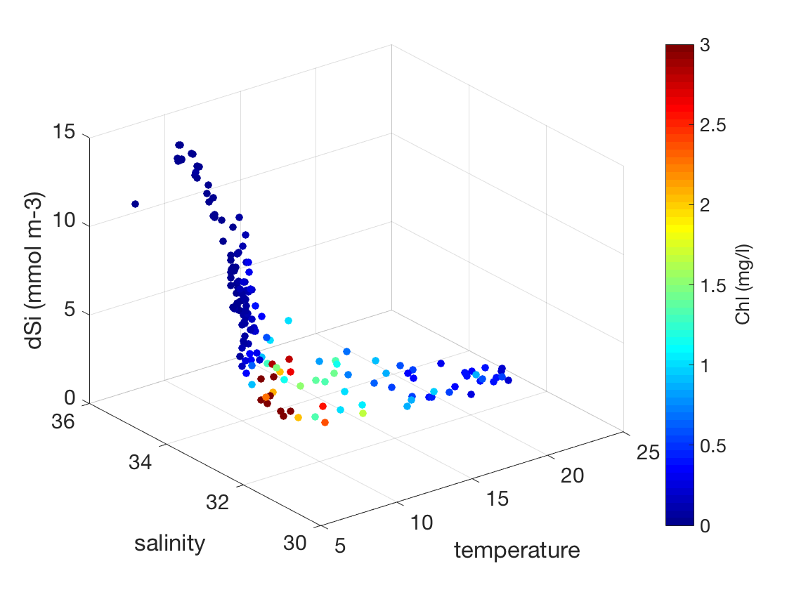
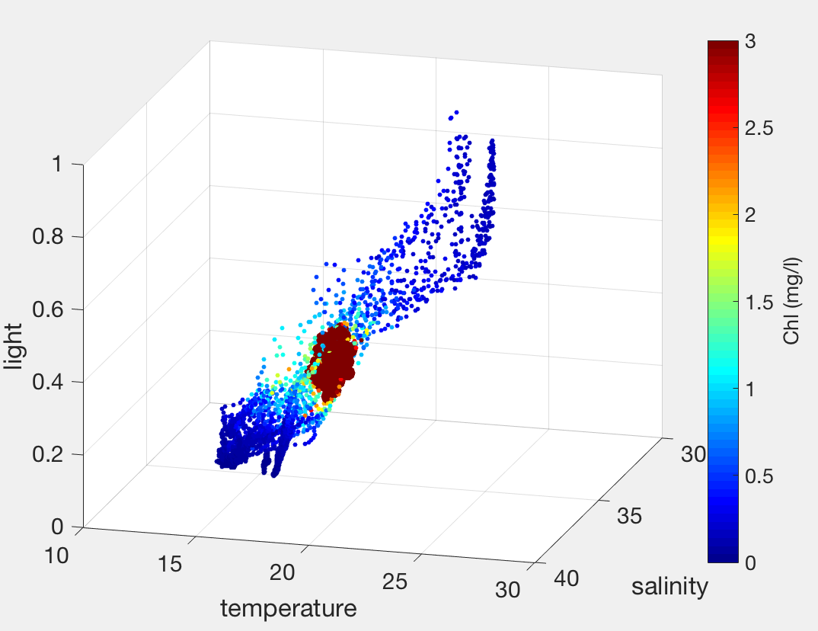
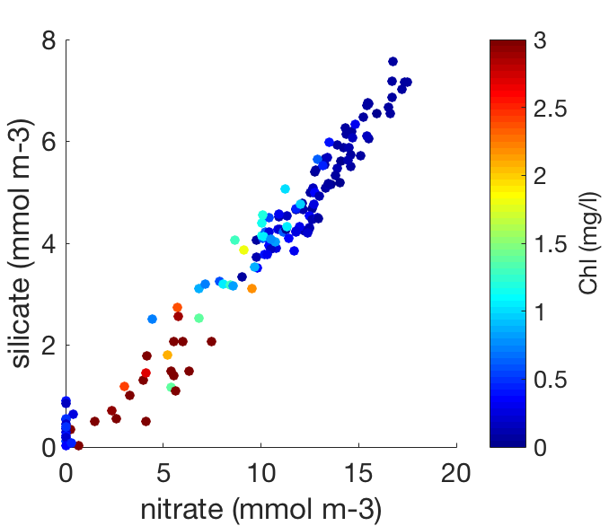
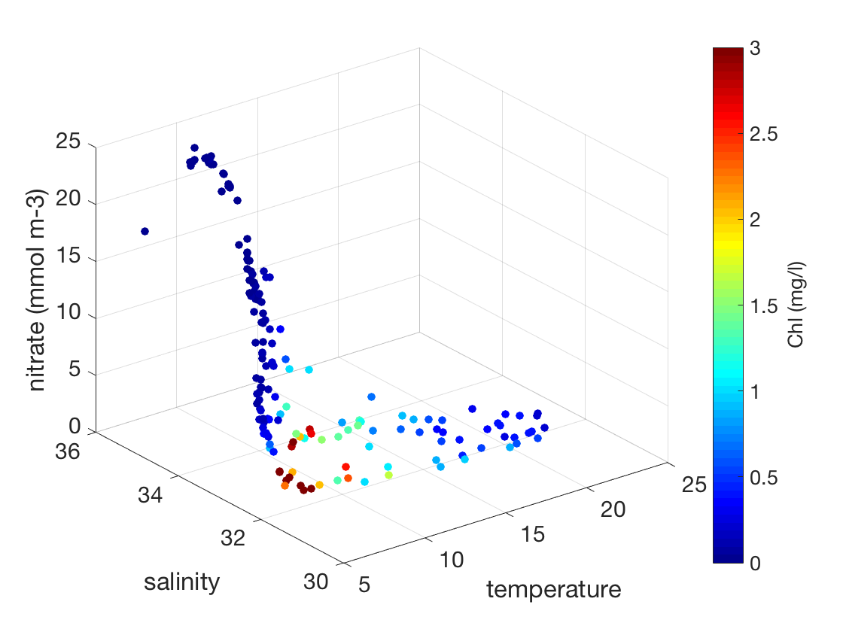
Where do we see high slope Chl a?
“Coathanger”
towed VPR transect
Narrow band of temperature, salinity, and nutrient availability

Slide 6
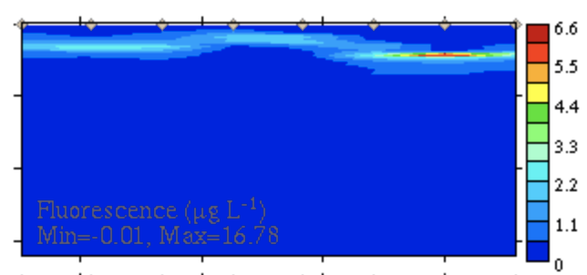
4 regimes
Slope (cast 100)
Shelf (e.g. cast 79)
Inside streamer (cast 36, station S4)
Outside streamer (cast 39, station S7)
Transect 8
(streamer transect)

Slide 7
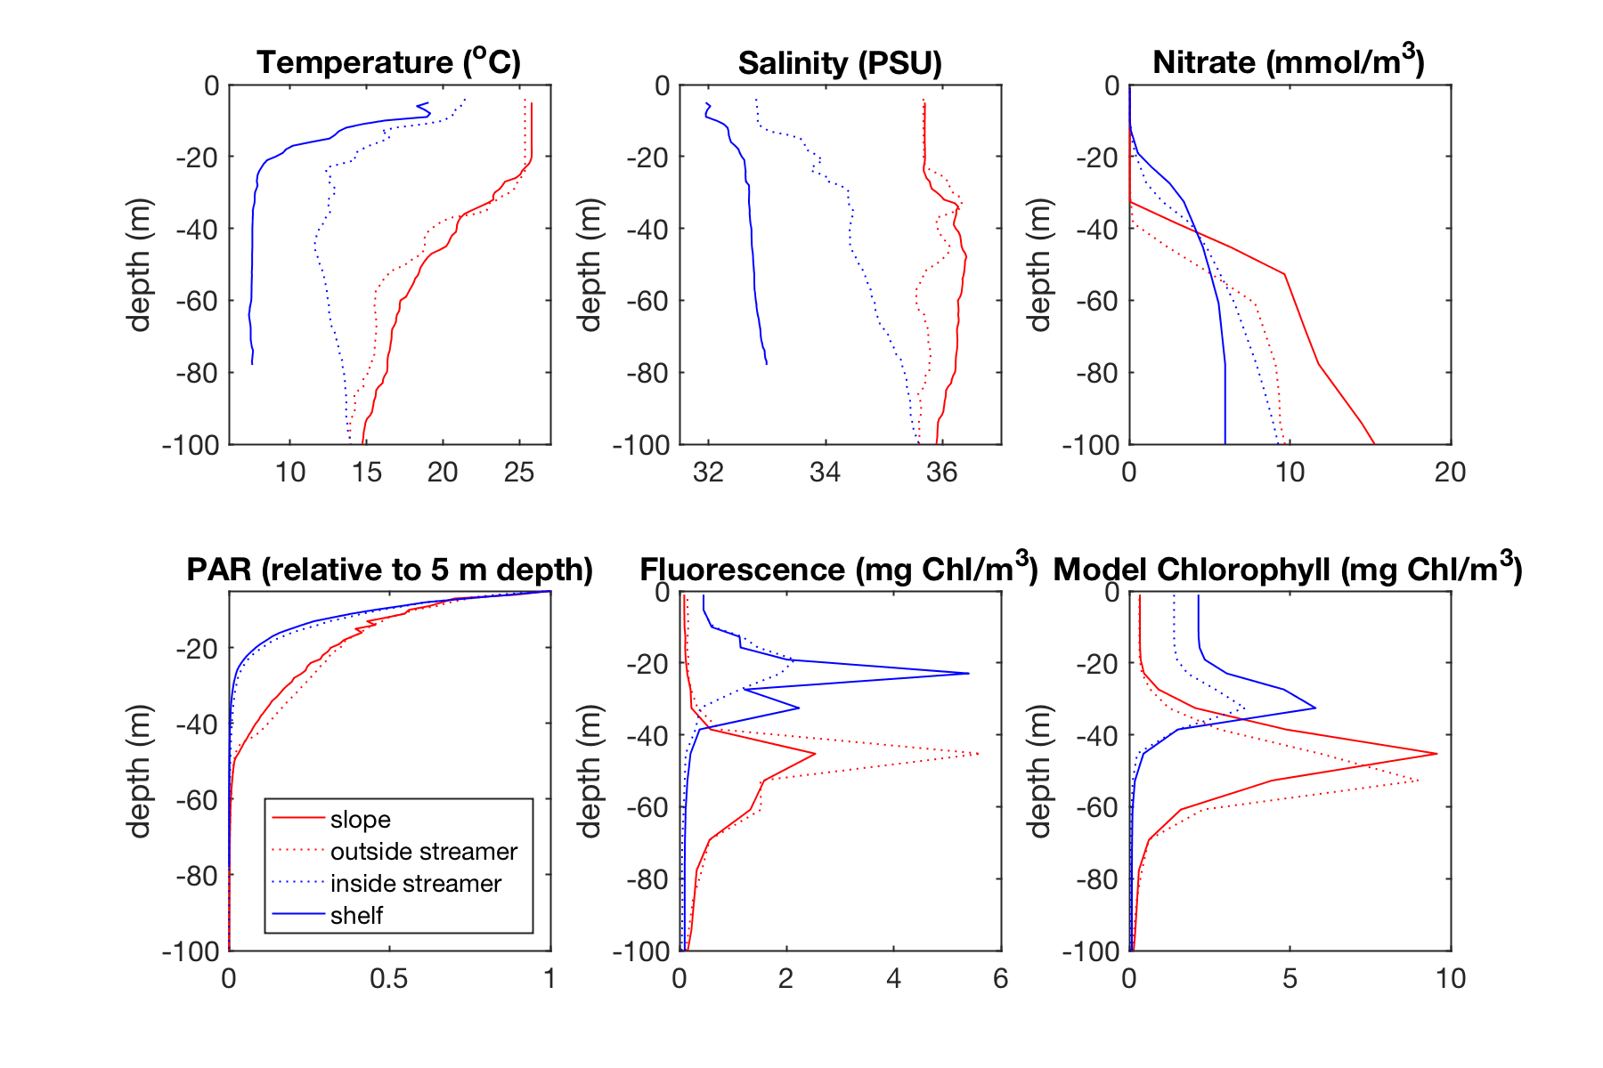
Regime characteristics - light
Kz ~ 0.07 for slope and outside streamer
Kz ~ 0.12 for shelf and streamer

Slide 8
Regime characteristics - nitrate
Integrated over top 50 m, the outside streamer cast (station S7) has 53 mmol less nitrate than slope profile (cast 100)

Slide 9
1D Model- ROMS ”biotoy”
Nitrate limited NPZD model – Powell et al. 2006
Parameterized as in Zhang et al. 2013
200 m depth
Initial conditions
  Nitrate set using bottle nutrient data, interpolated over top 200 m
  Initial phytoplankton concentrations set using fluorescence, converted to mmol N m-3
  Temperature and salinity profiles set from CTD downcasts
Use shipboard PAR for model forcing
Calculated light attenuation coefficient kz from PAR sensor on CTD

Slide 10
Model results- how do tracers evolve in current configuration?
Initialized (observed)
2.5 days later
Phytoplankton growth in both slope and outside-streamer regimes
Nutrients available for more growth?

Slide 11
Moving forward
Incorporate silicate into model
Increase 1D vertical resolution
Model upwelling mechanism?

