Slide 1
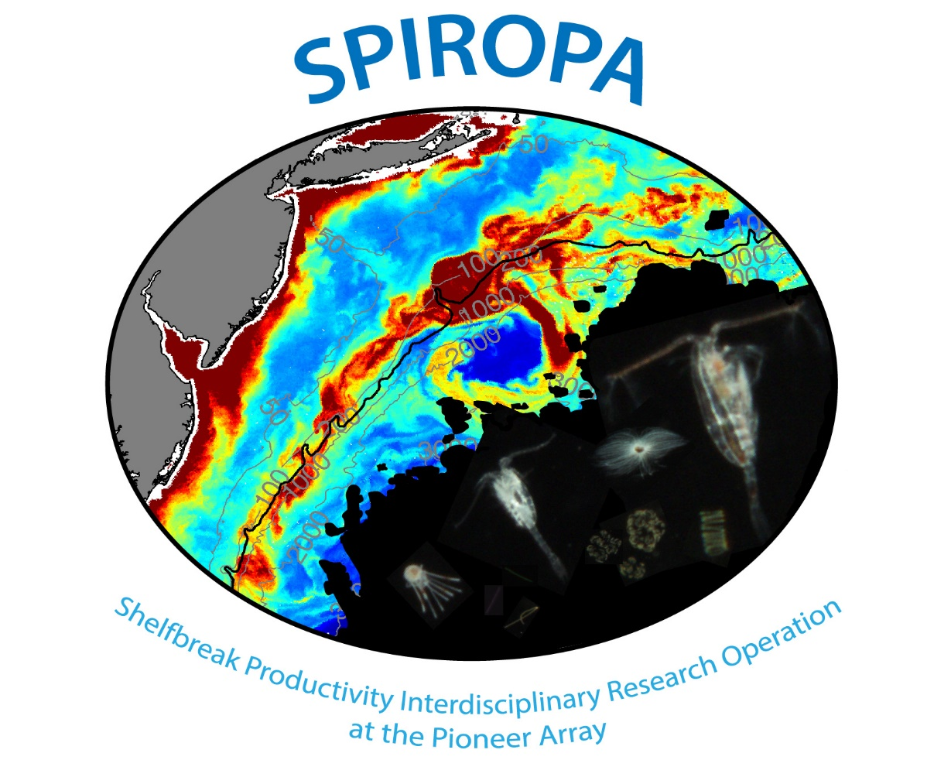

Slide 2
AR29 POC, POC:Chl, & BSi

Slide 3
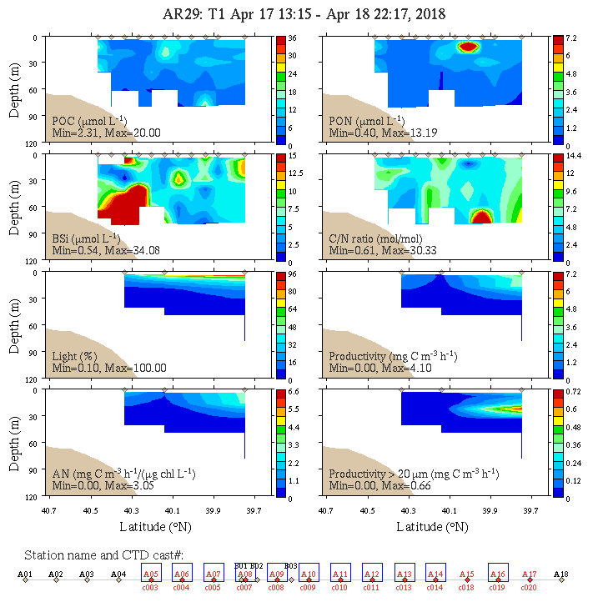
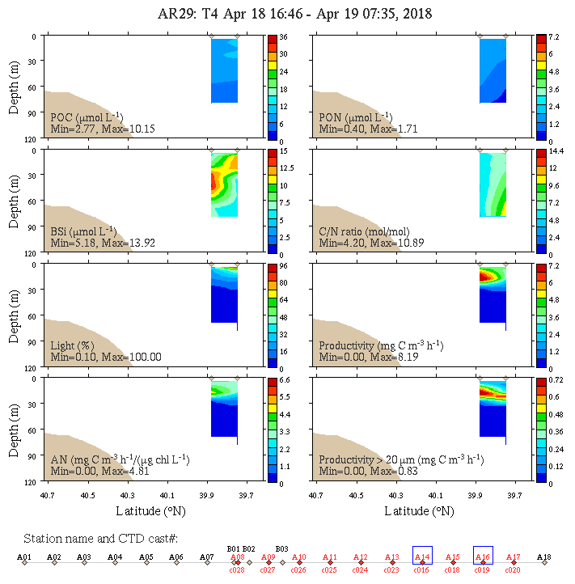
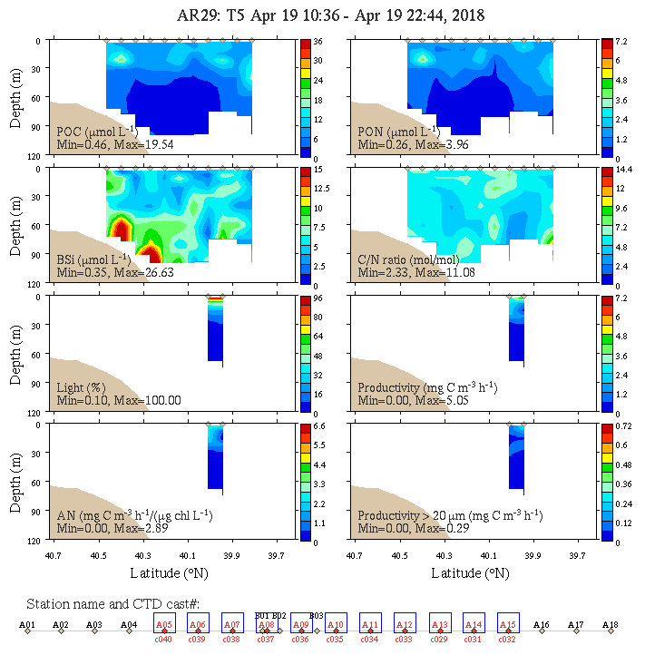
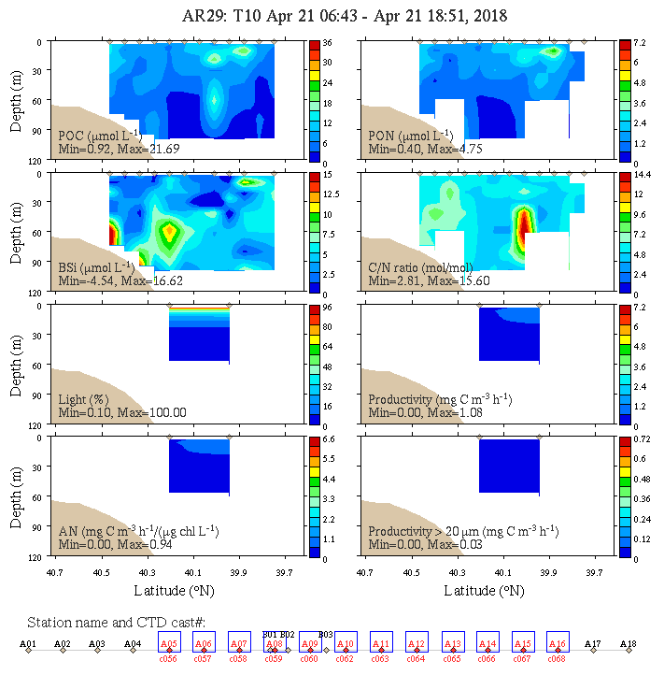
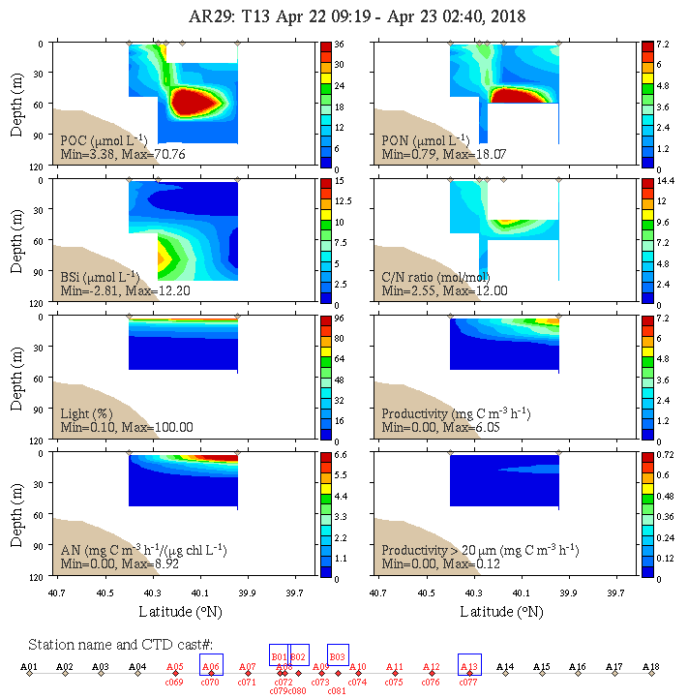
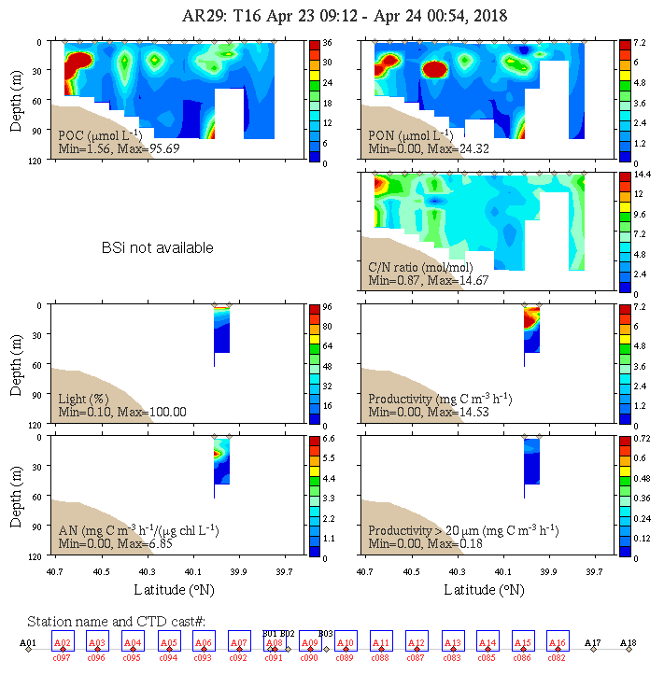
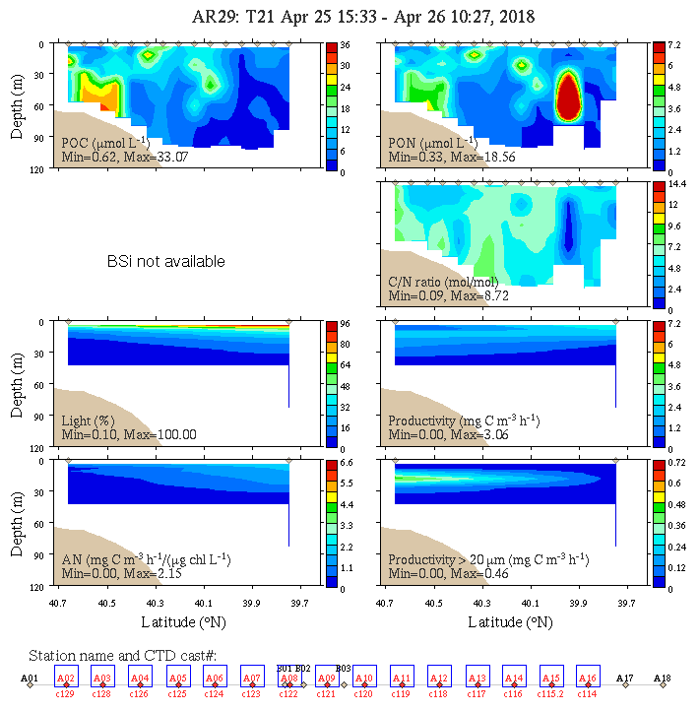
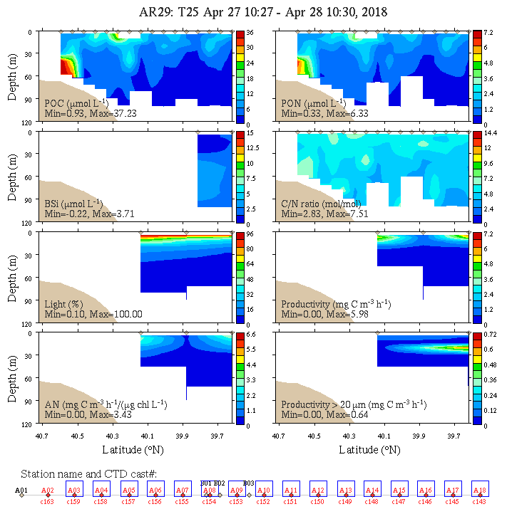
Transect 1 April 17
Transect 4 April 18
Transect 5 April 19
Transect 10 April 21
Transect 13 April 22
Transect 16 April 23
Transect 21 April 25
Transect 25 April 27

Slide 4
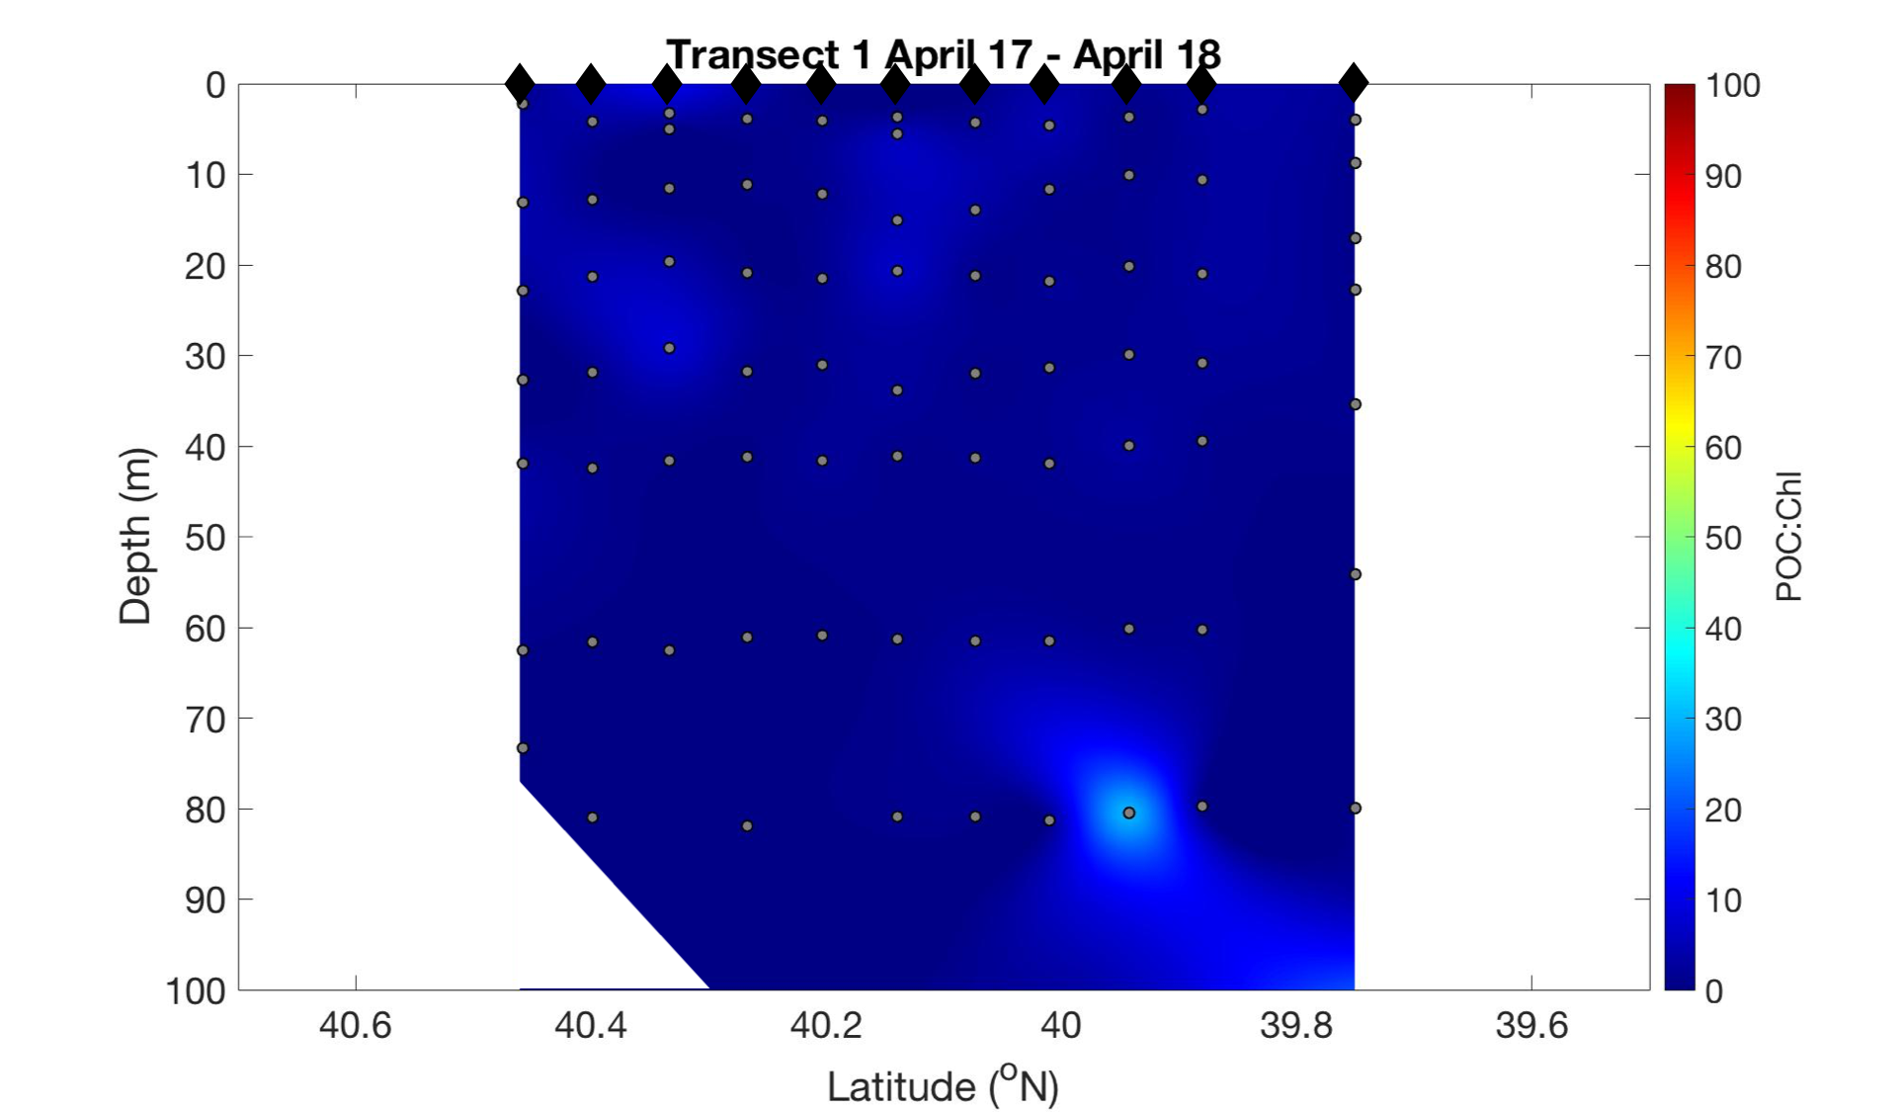
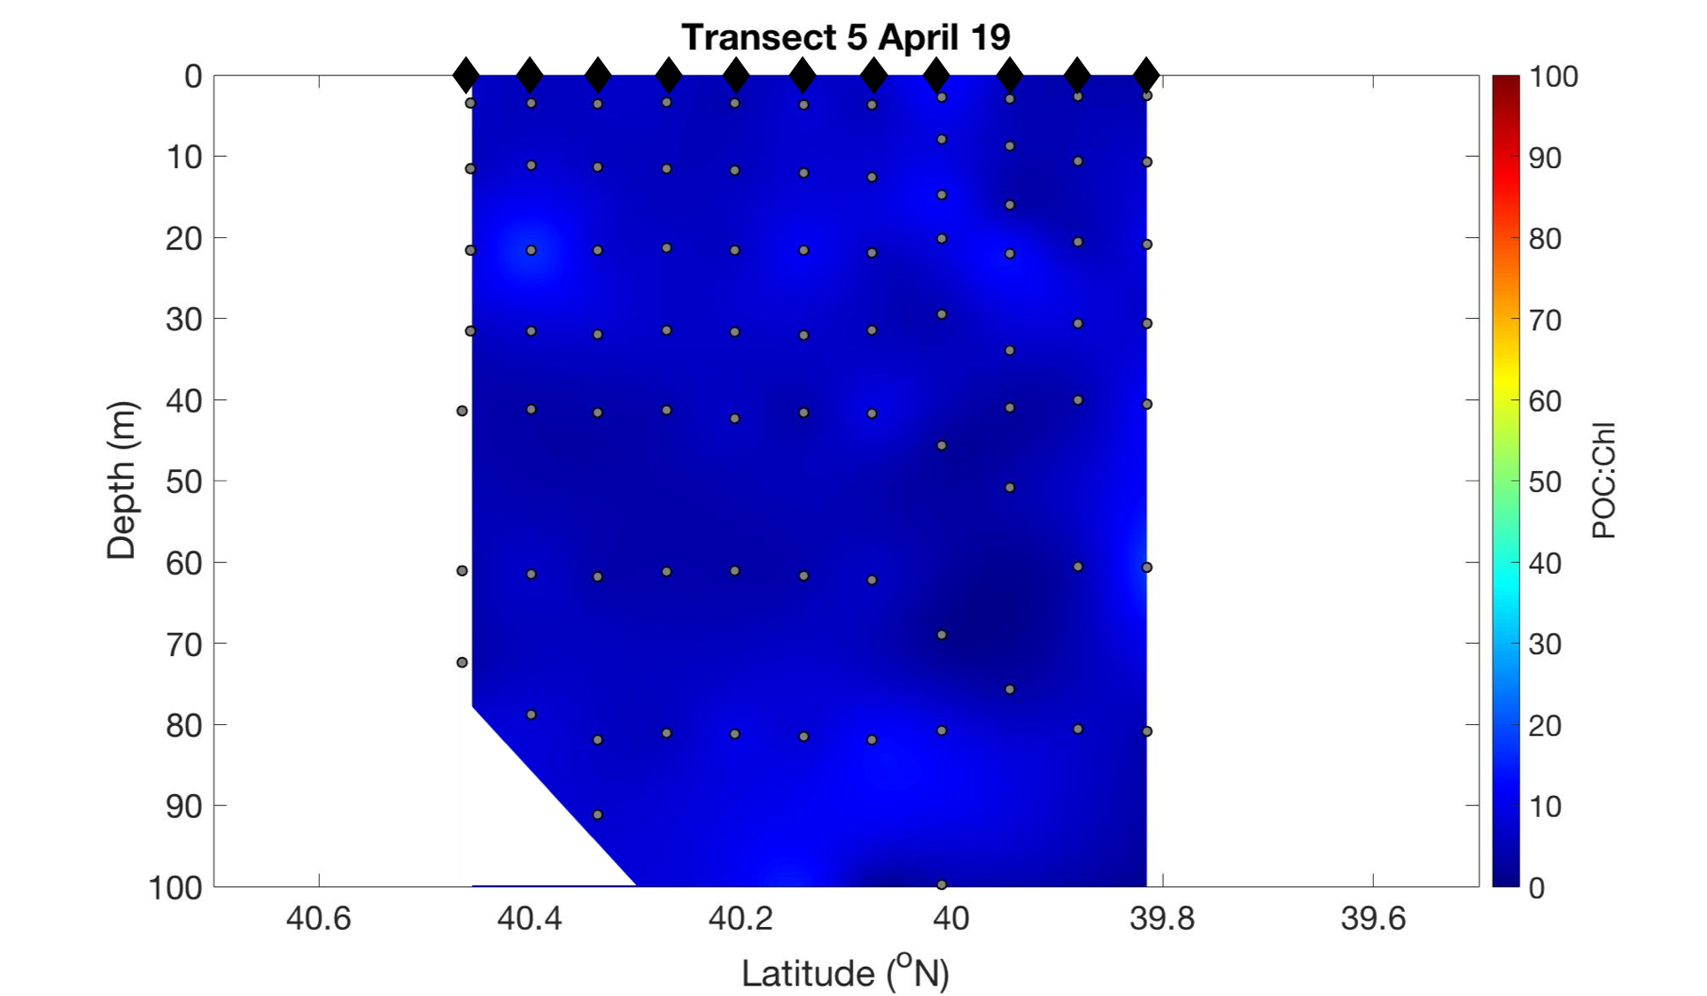
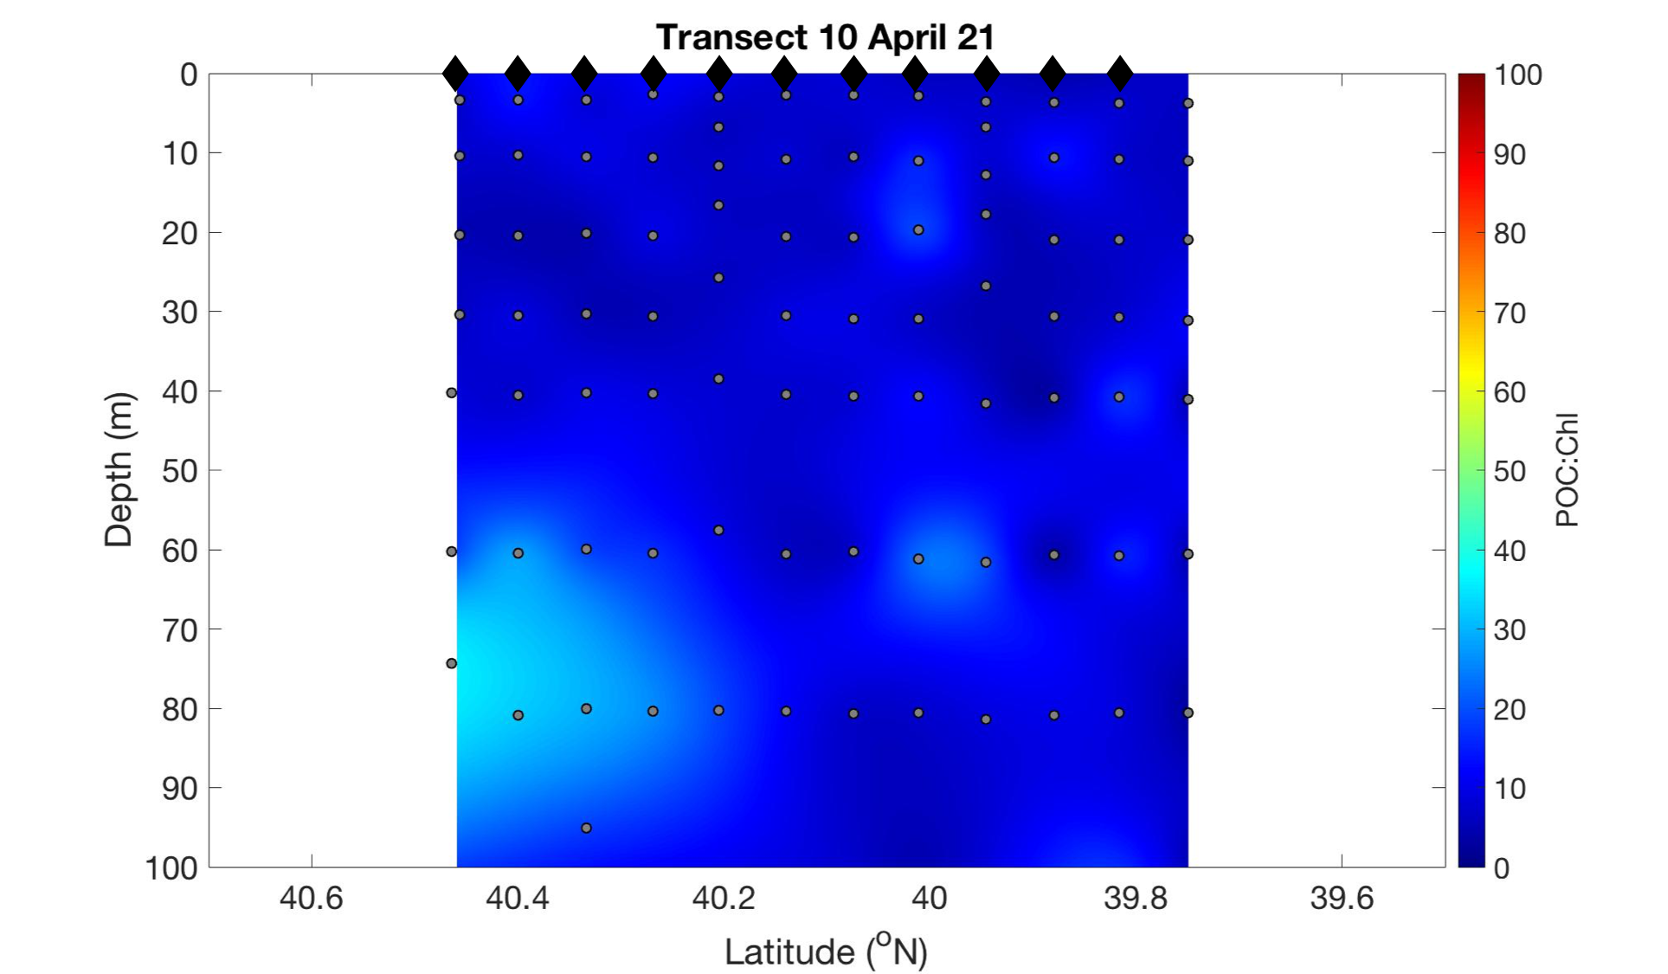
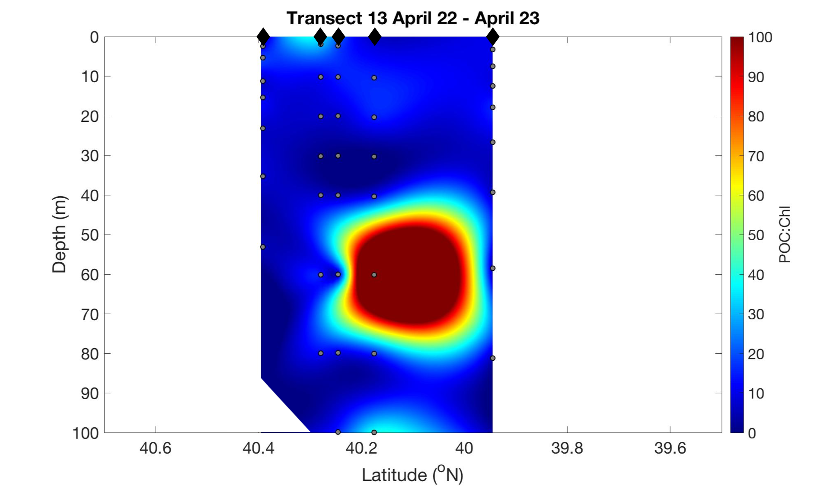

Notes:
Relatively low POC:Chl values, indicative that the phytoplankton are growing (larger concentrations to come)
However, the highest ratio is in the later portion of the cruise; Saw many ratios of POC:Chl in the 100s in the July cruise based on the fluorometric data
Very high POC:Chl value corresponds to the large POC patch, unsurprisingly

Slide 5
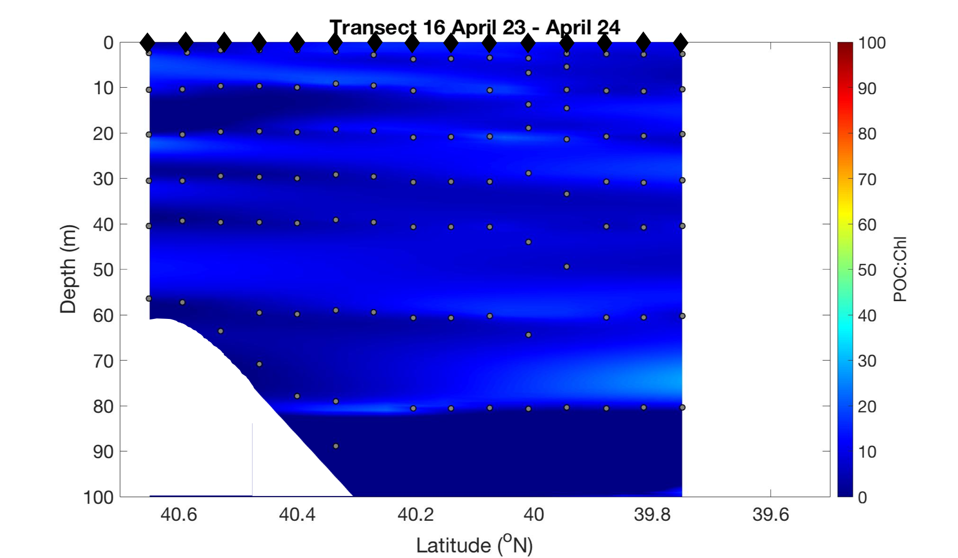
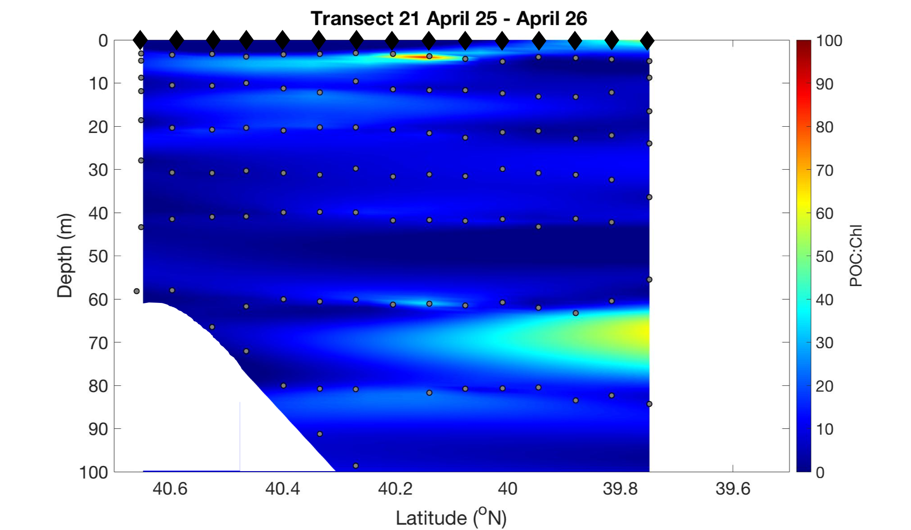
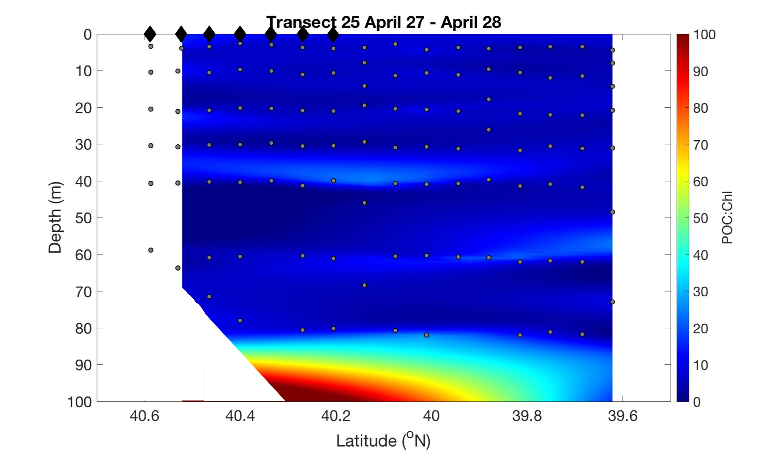
Notes:
Again, starting to see higher POC:Chl ratios but not totally surprising

Slide 6
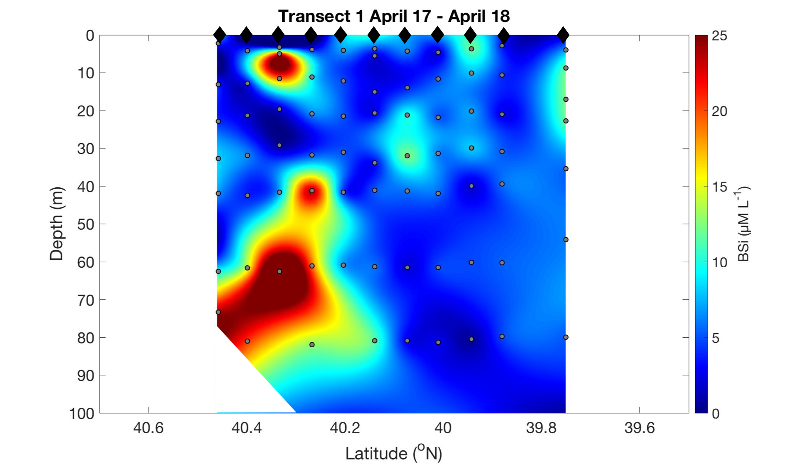
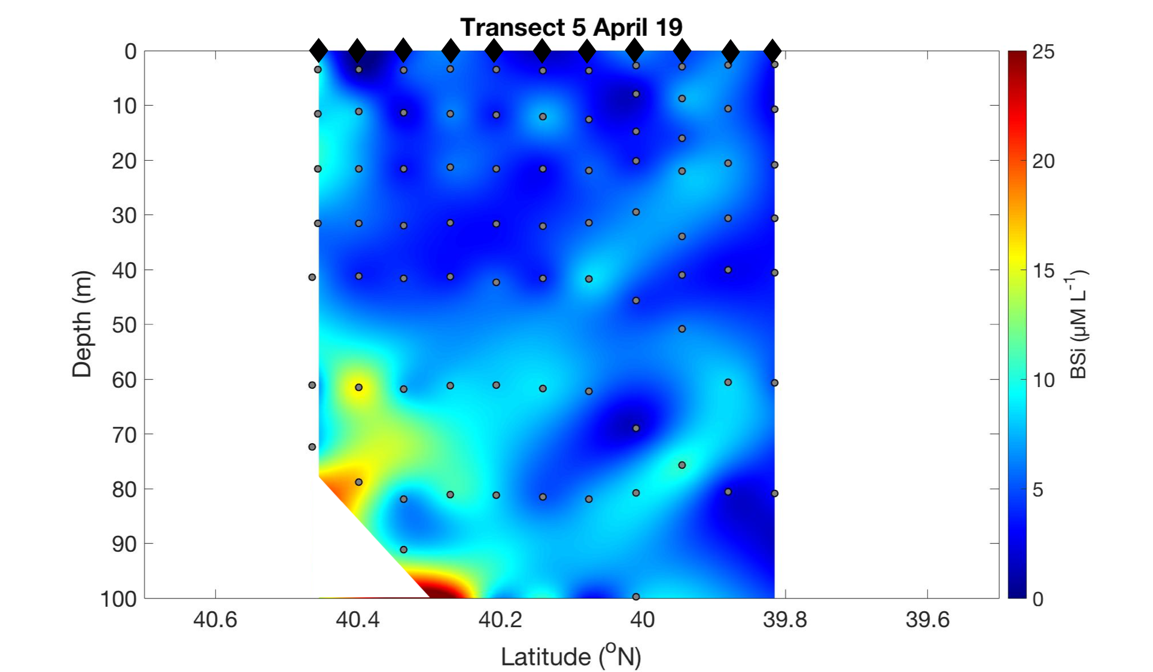
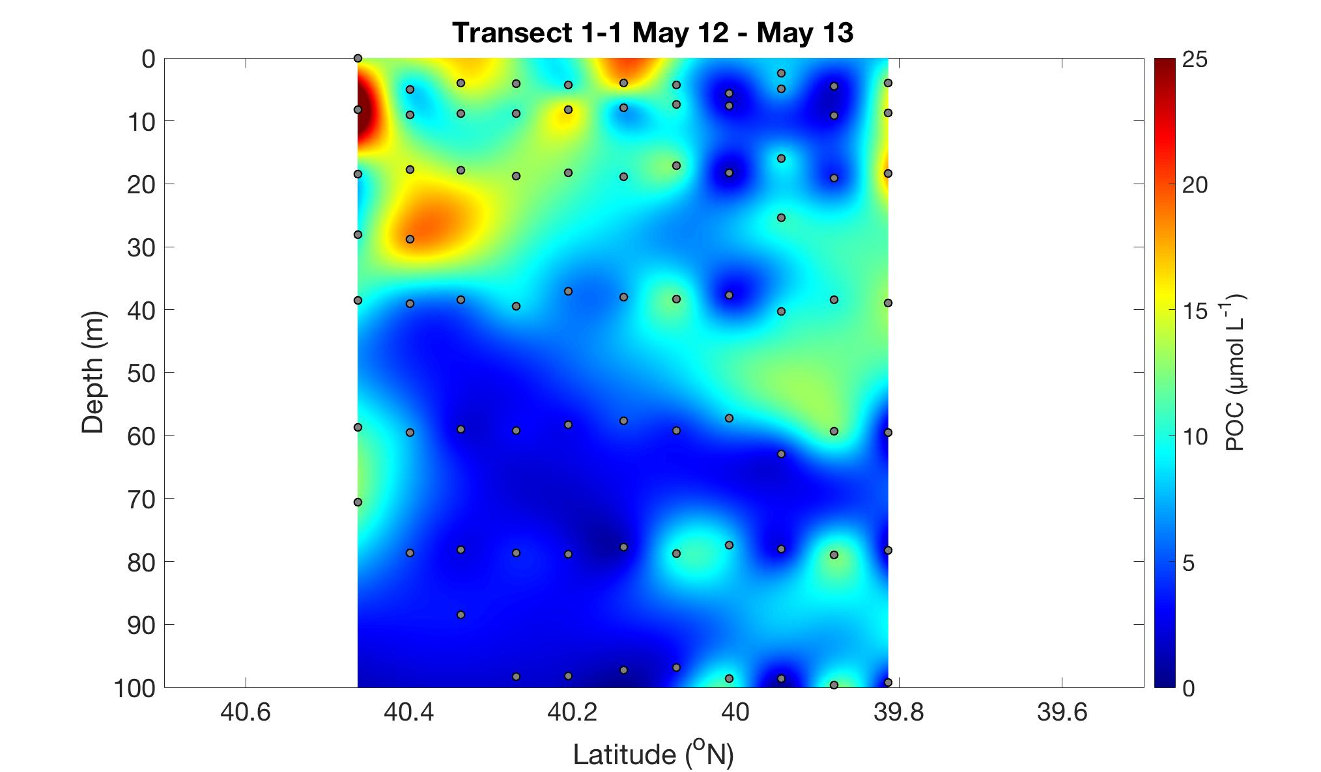
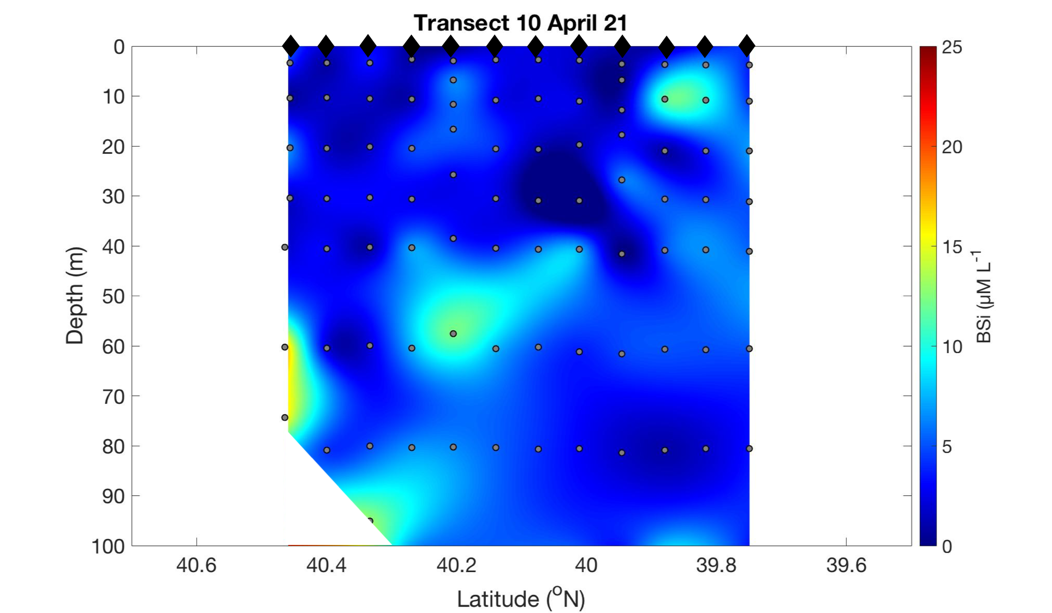
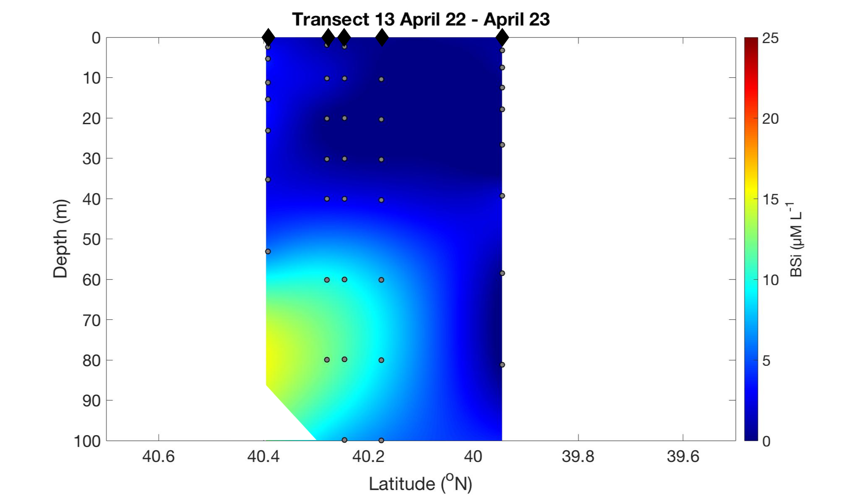
Notes:
Higher Bsi concentrations in deep waters along the shelf; consistent with VPR data (discussed last meeting)
We don’t yet have Bsi values from the later cruises, but should have substantially higher values when we are going through the diatom patches in our off-path transects

Slide 7
RB- 1904 POC Data
We have POC data from 5 transects on the main line, spanning the full 12 days, and 3 additional off-track transects.

Slide 8
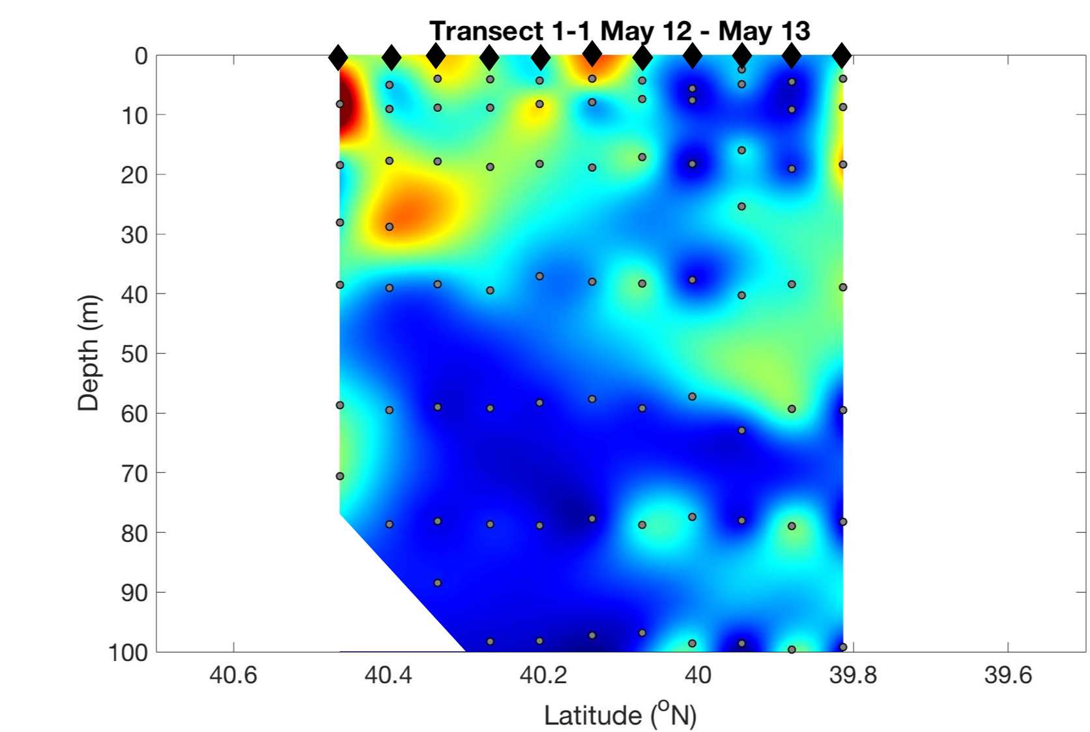
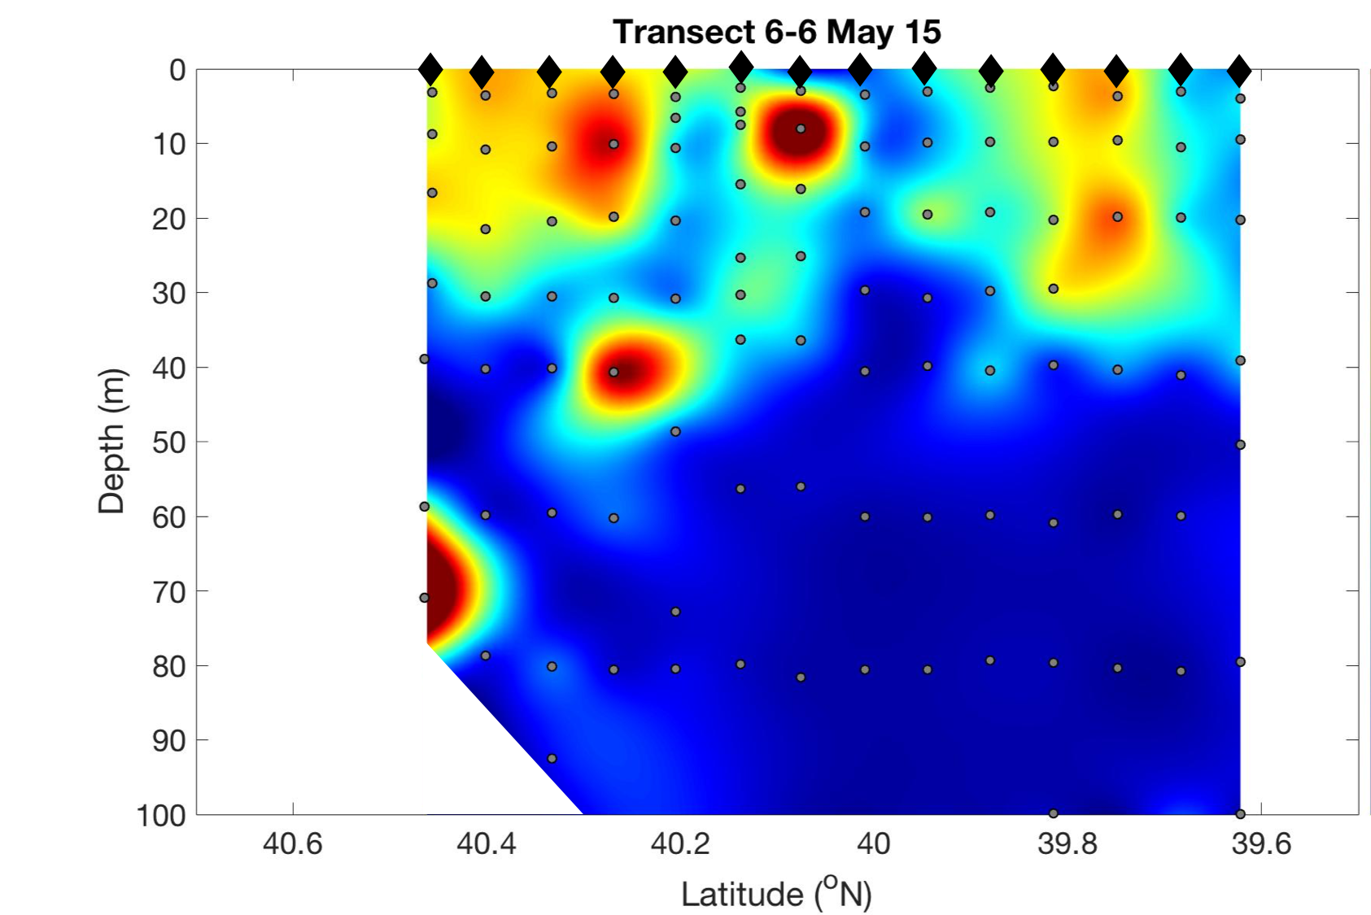
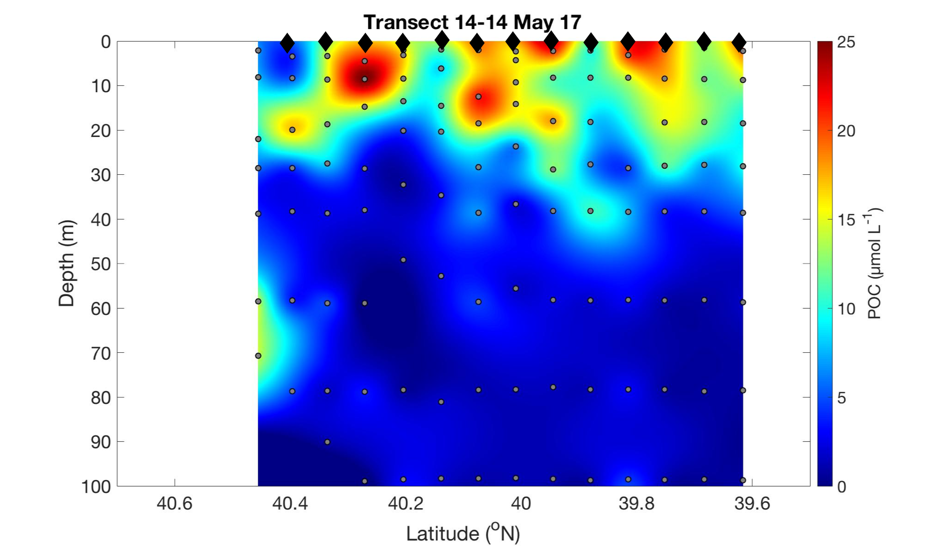
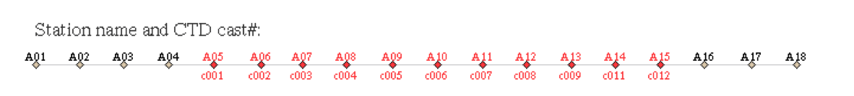
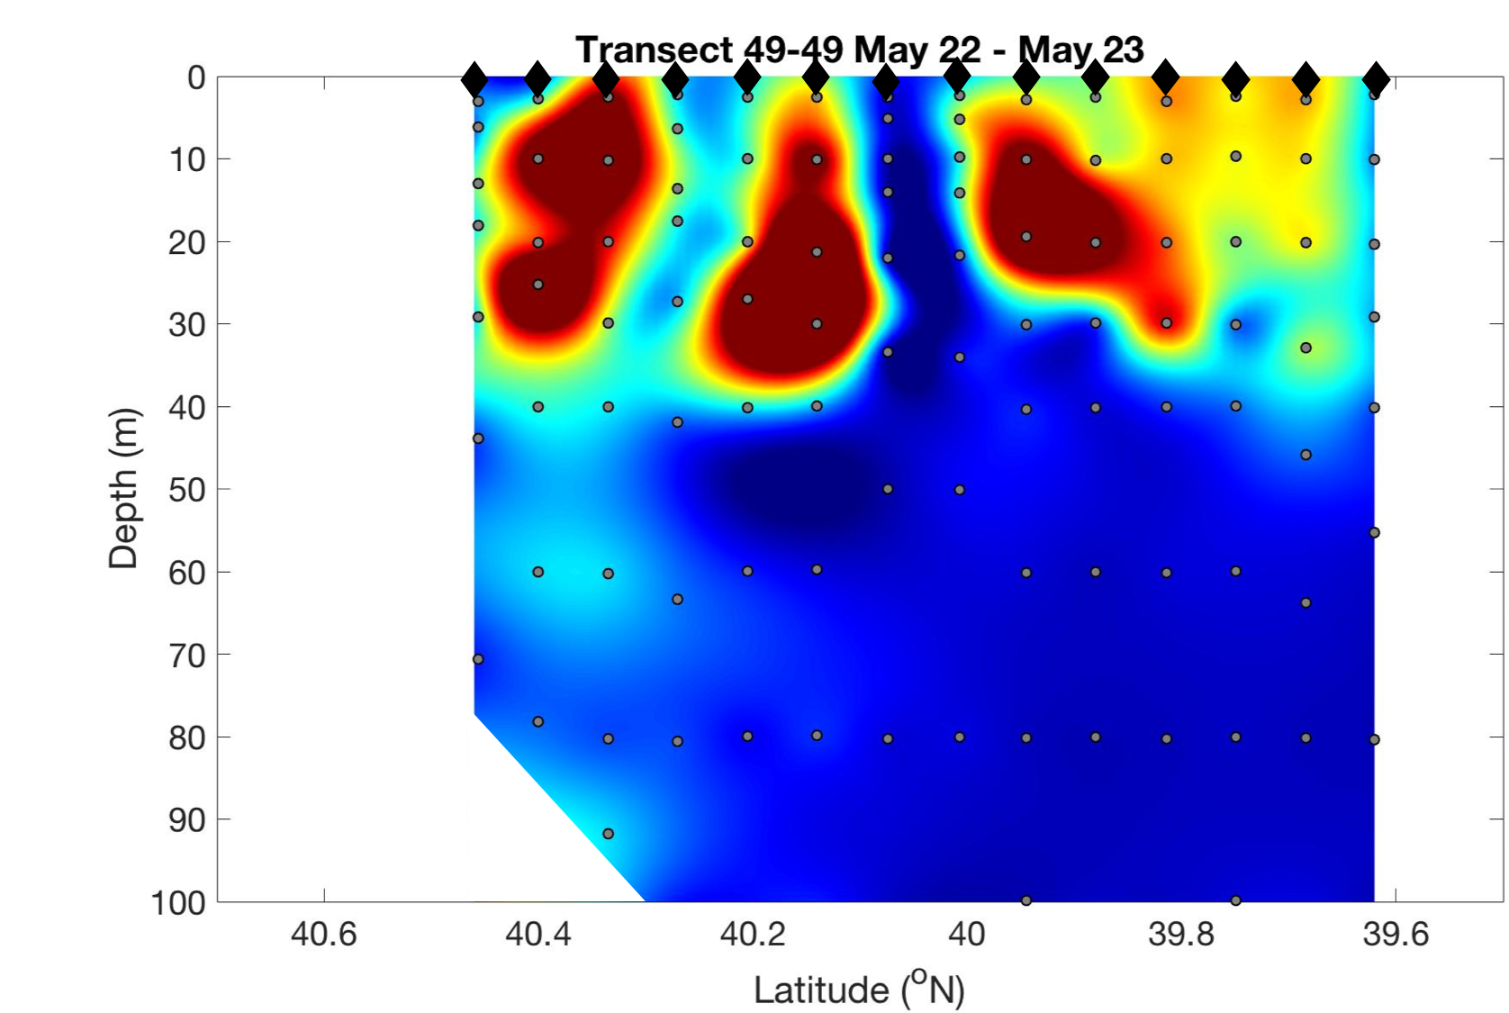
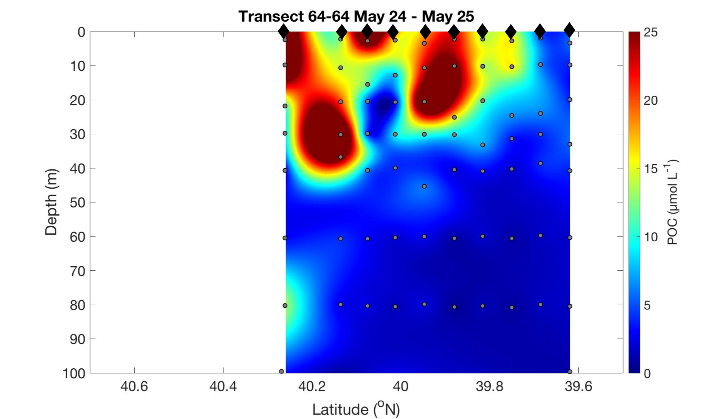
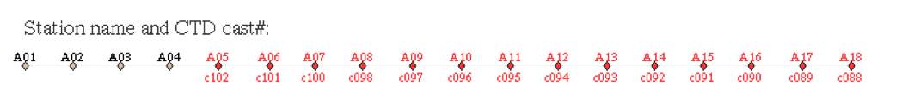
Notes:
Note this is a different scale bar than the AR29 data
From the start of the cruise to the end, pretty clear evidence of increasing POC, increasing productivity through the transect, particularly at the shelfbreak
Look at A10-A11, region where front generally migrates around

Slide 9
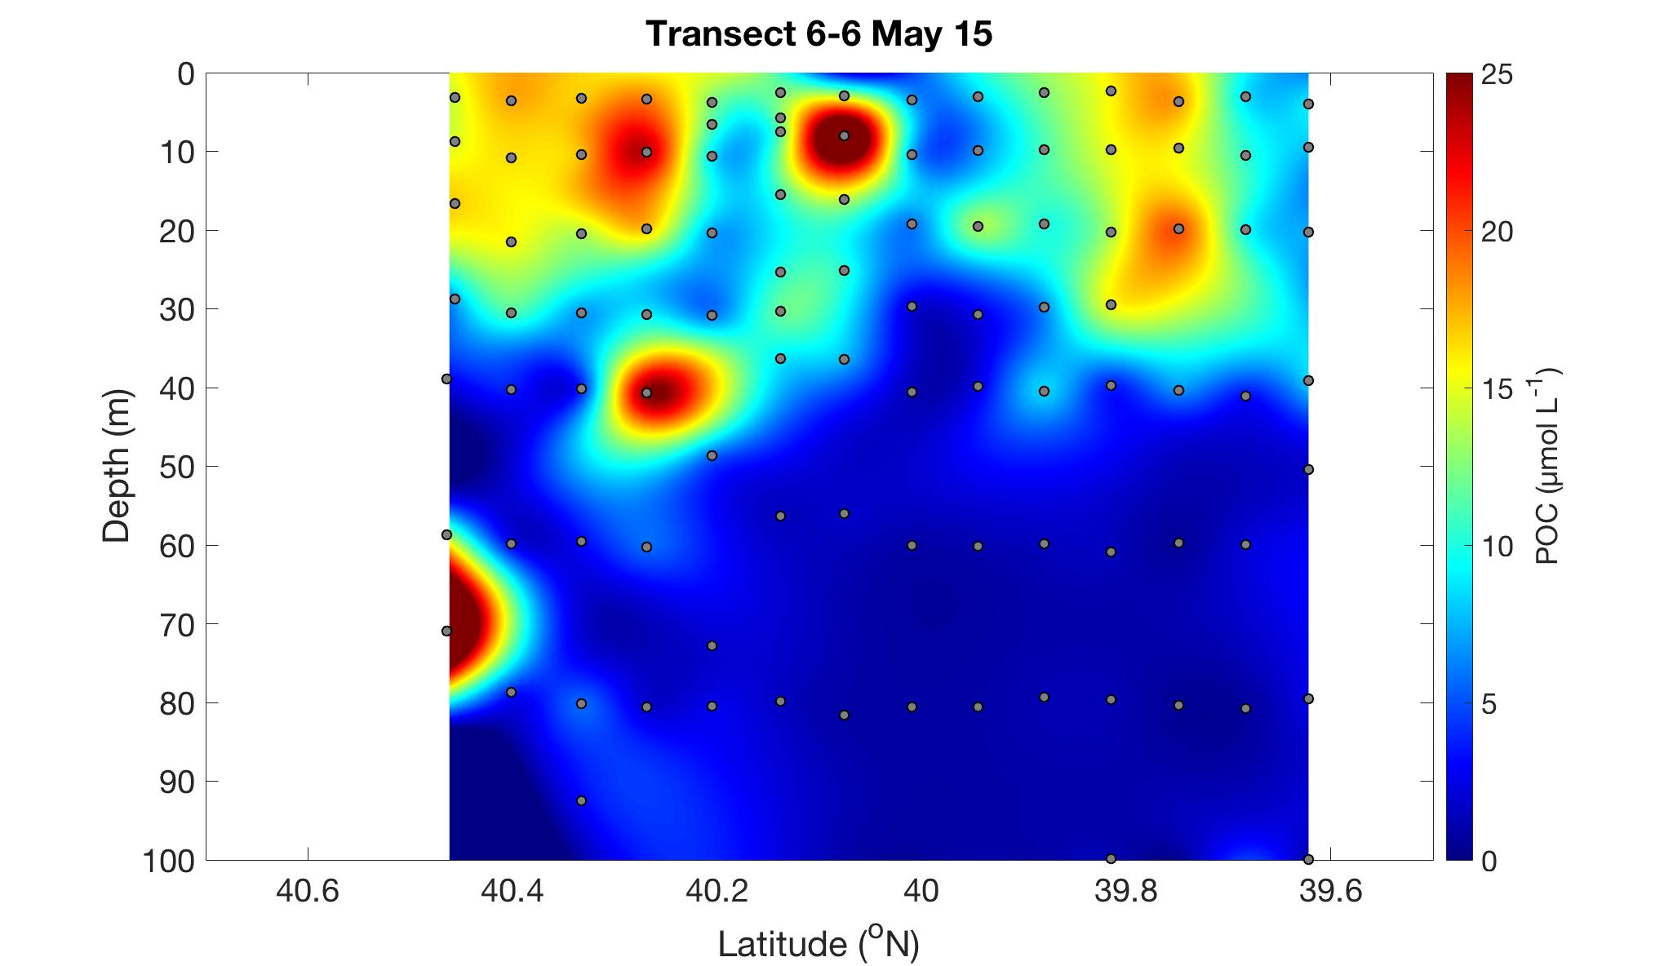
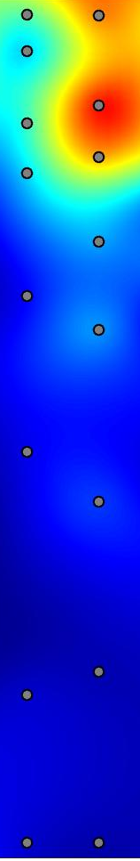
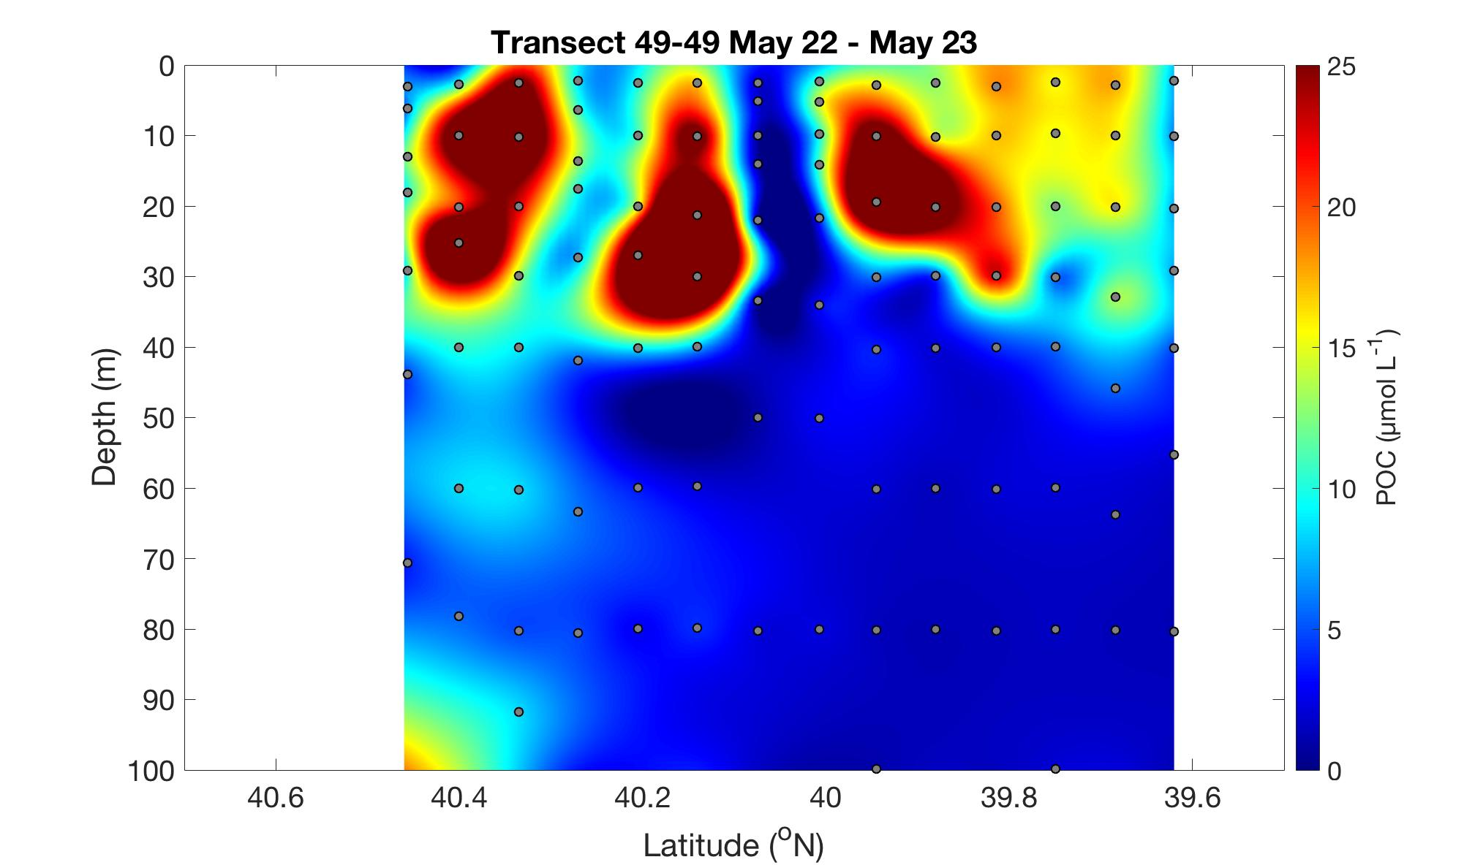
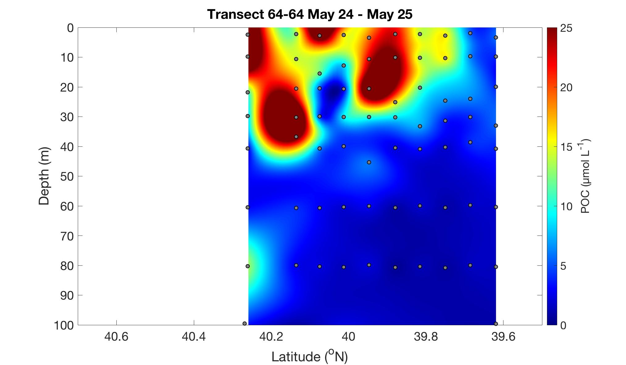
Section A10 – A11
May 12-13
May 15
May 17
May 22-23
May 24-25
Notes:
Can see the increase in POC concentrations over the cruise period: nearly 15-18 µmol L-1 increase with a maximum around May 22-23
Steady deepening of the max POC concentrations → something we definitely see in July: overall deeper POC conc

Slide 10
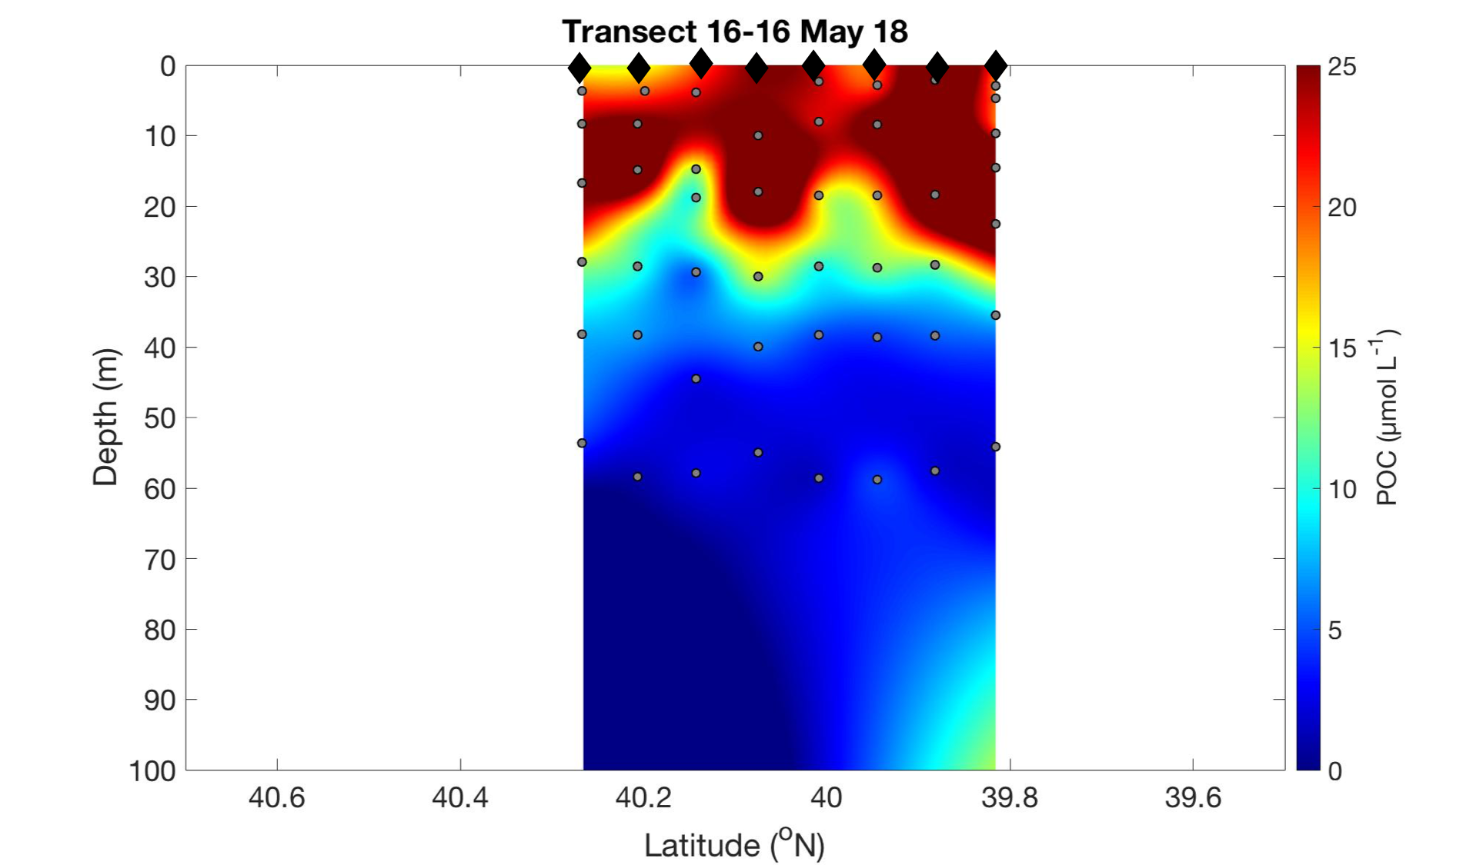
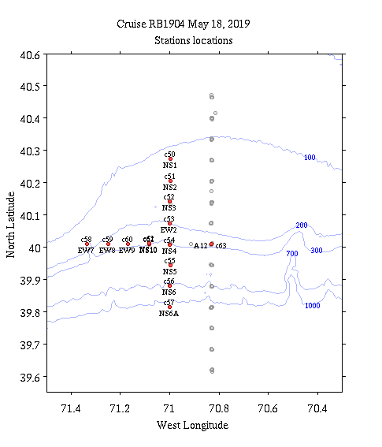
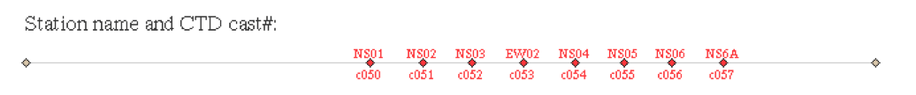
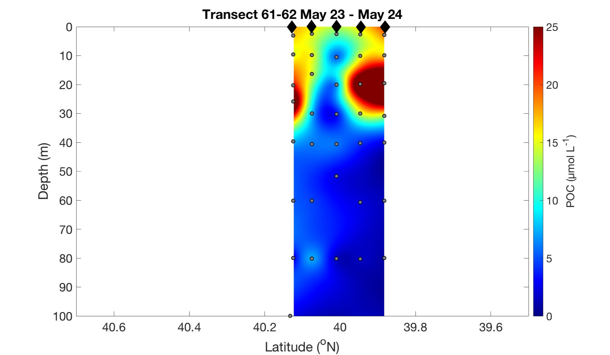
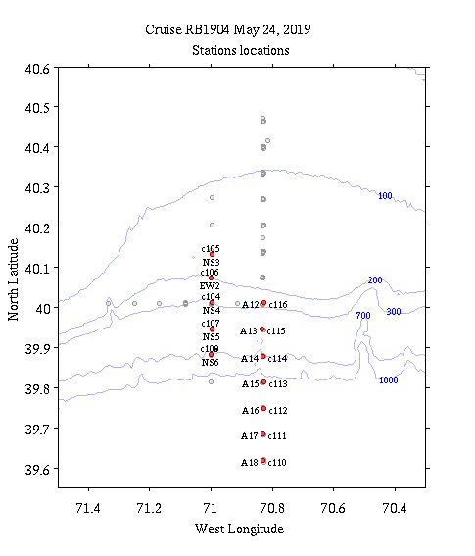
Eddy survey showing high and extended concentrations of POC.
Survey looking at the signature of the eddy with the noteworthy “fluorescence desert”.
Notes:
Meanders evident in all of these eddies

Slide 11
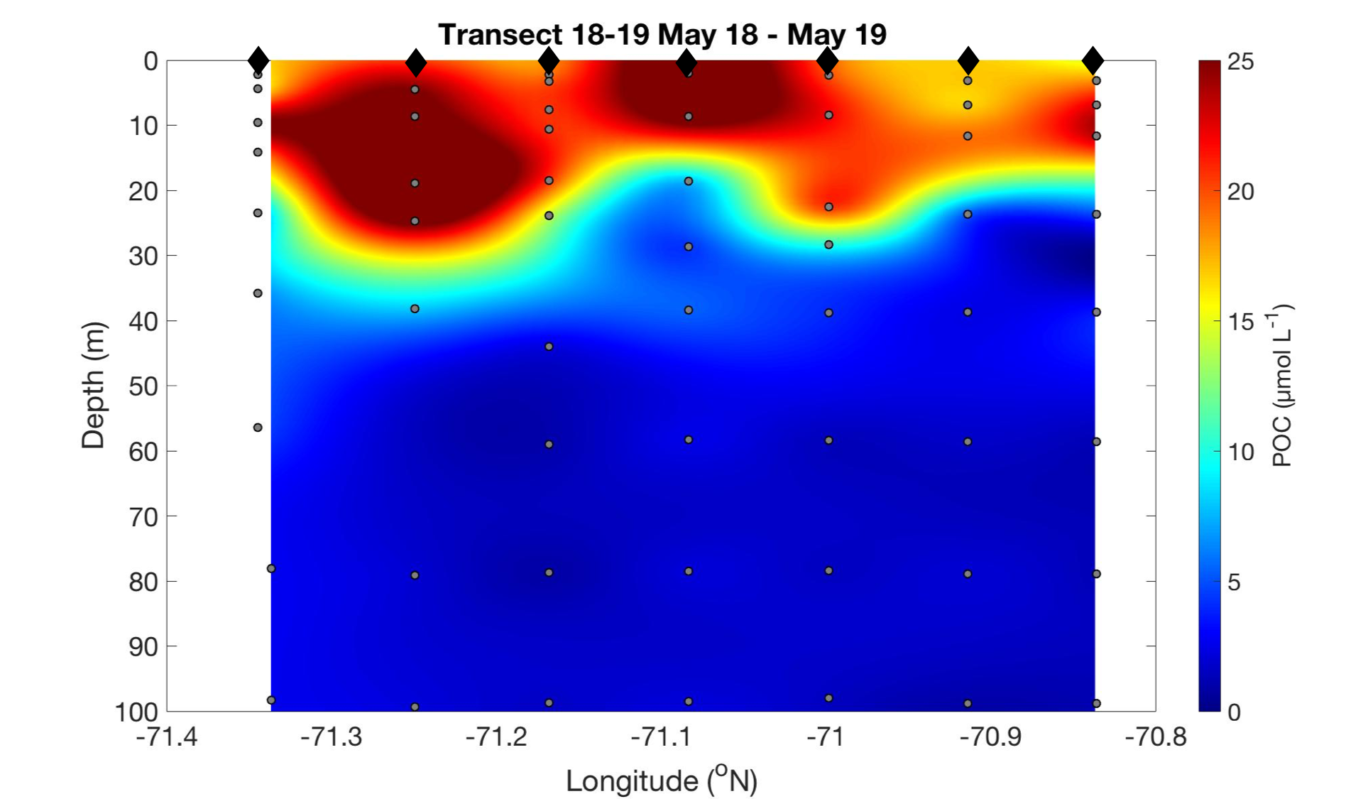
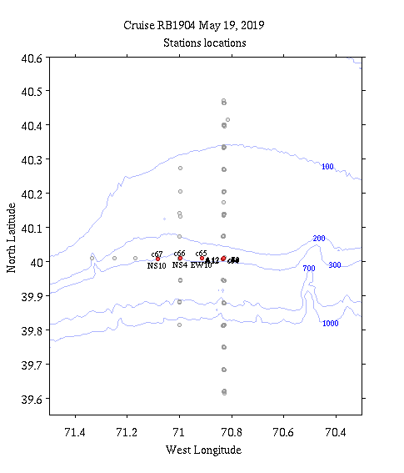
Survey through an eddy with high fluorescence. Center of the eddy appears to be at NS10. VPR evidence of a diatom bloom around 20m.

Slide 12
TN-368 POC Data
We have POC data from 6 transects on the main line, spanning the full 12 days, and 3 additional off-track transects.

Slide 13
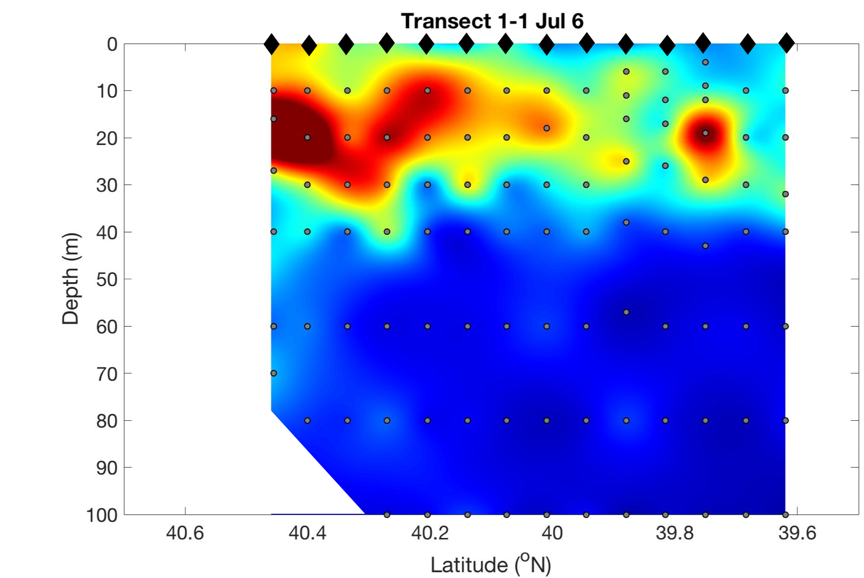
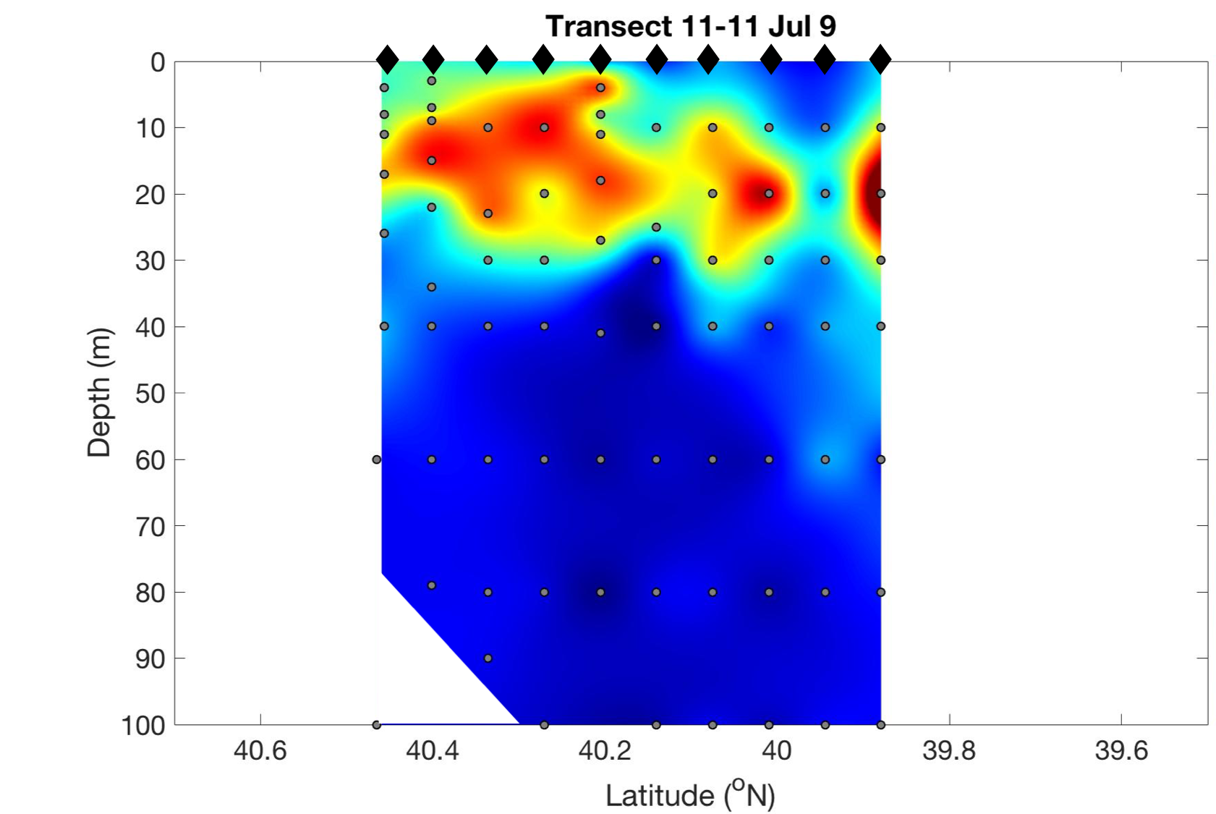
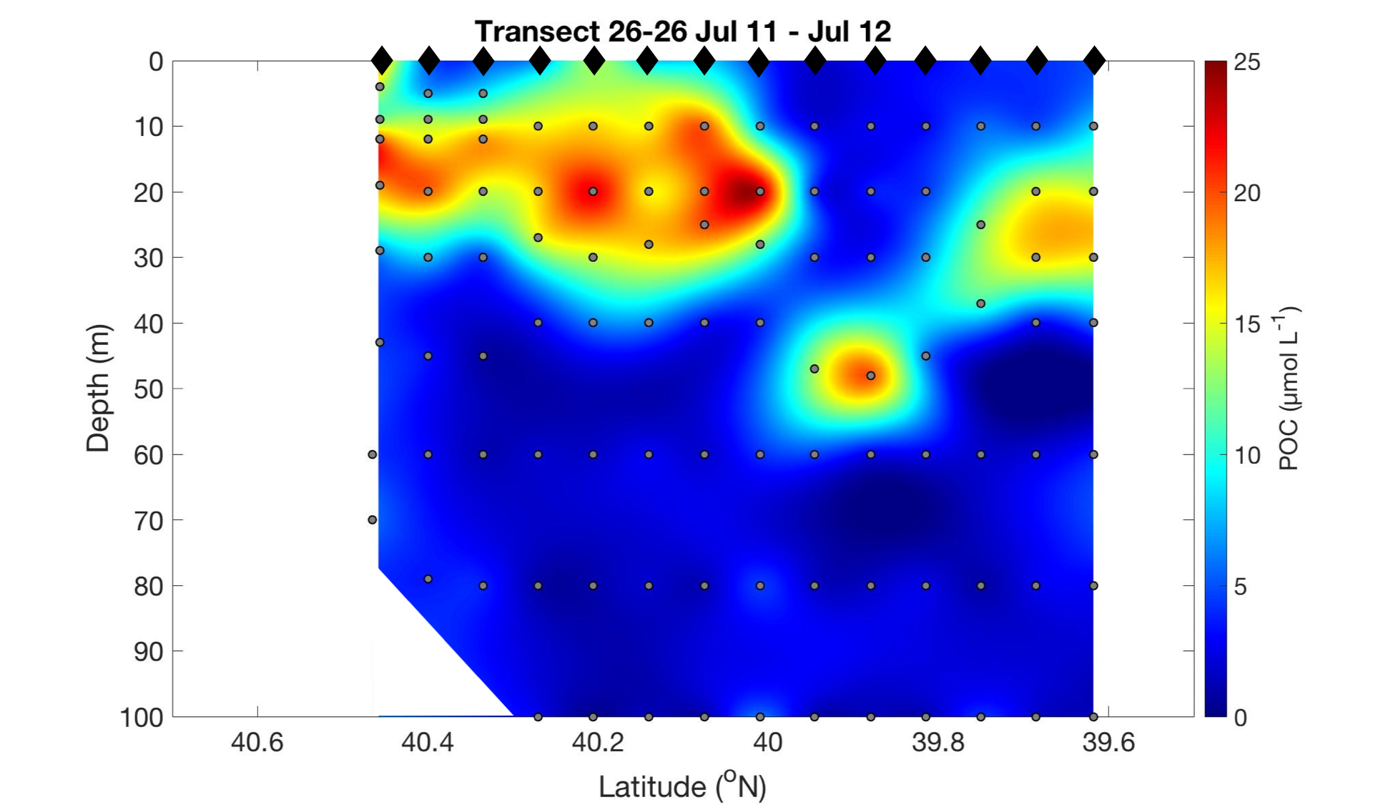
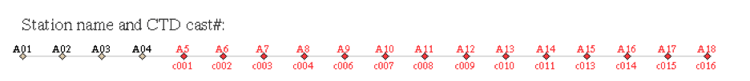
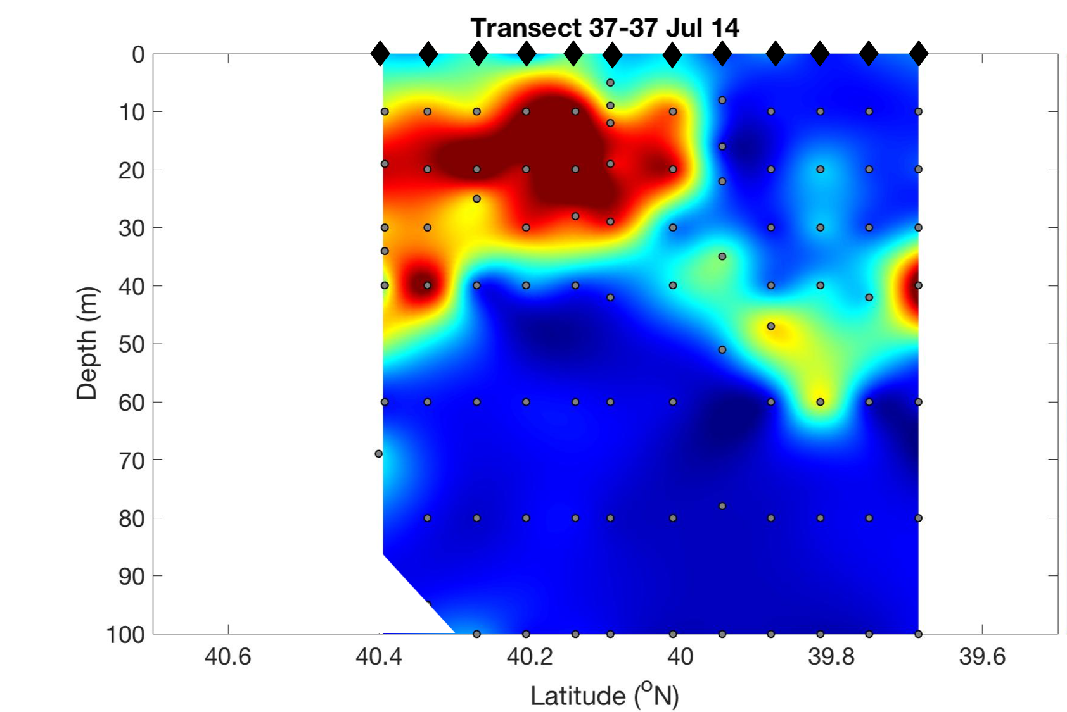
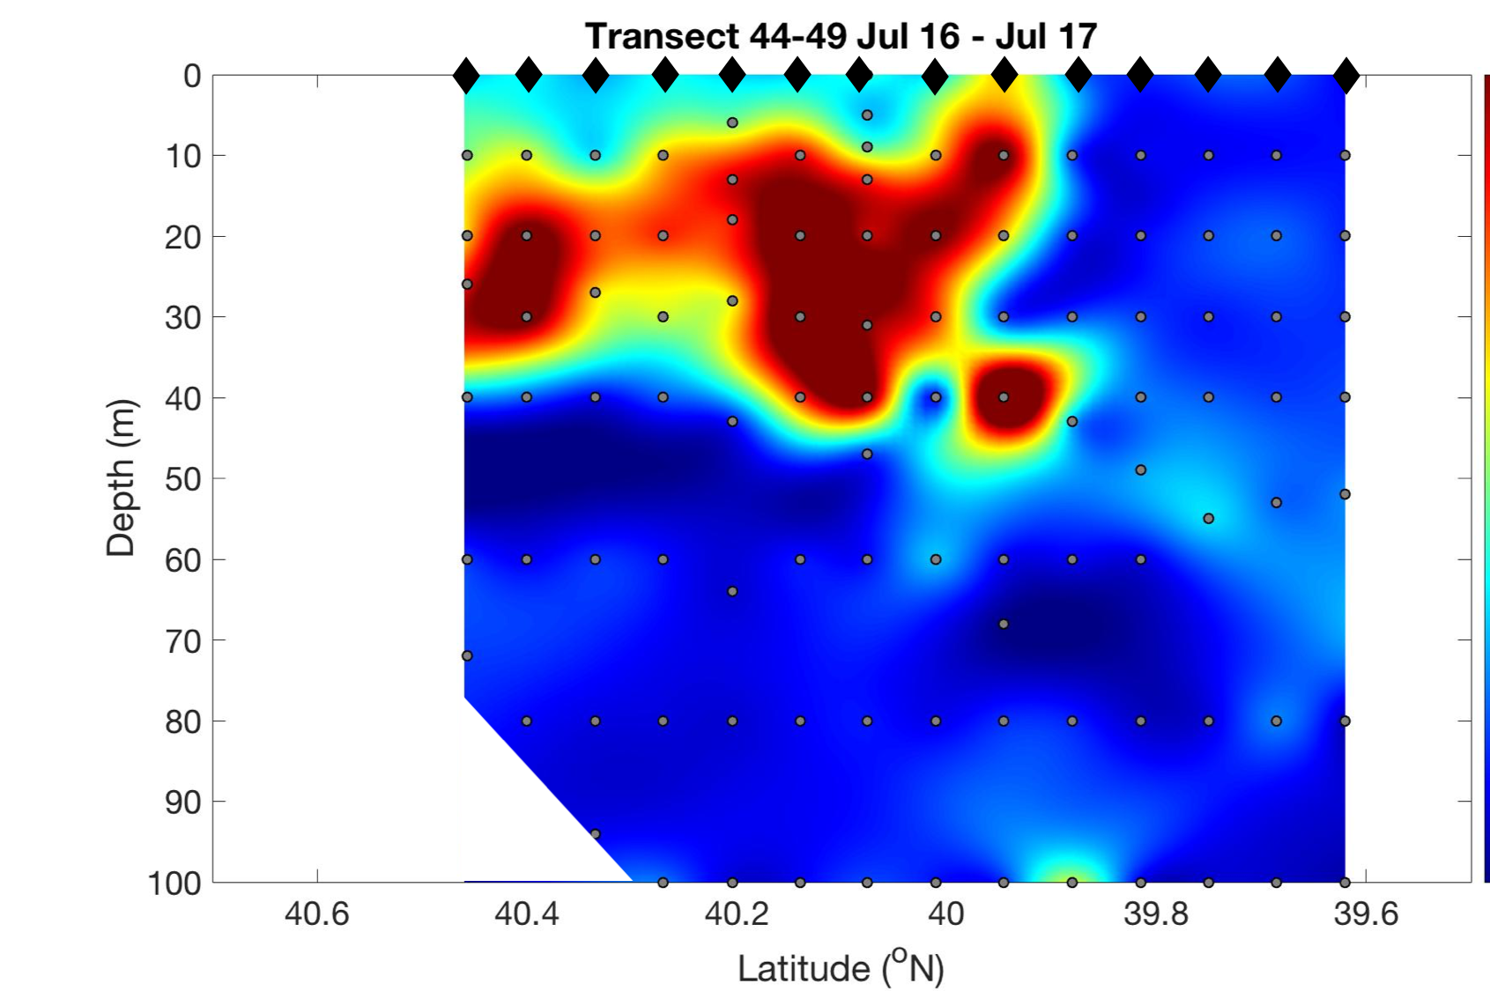
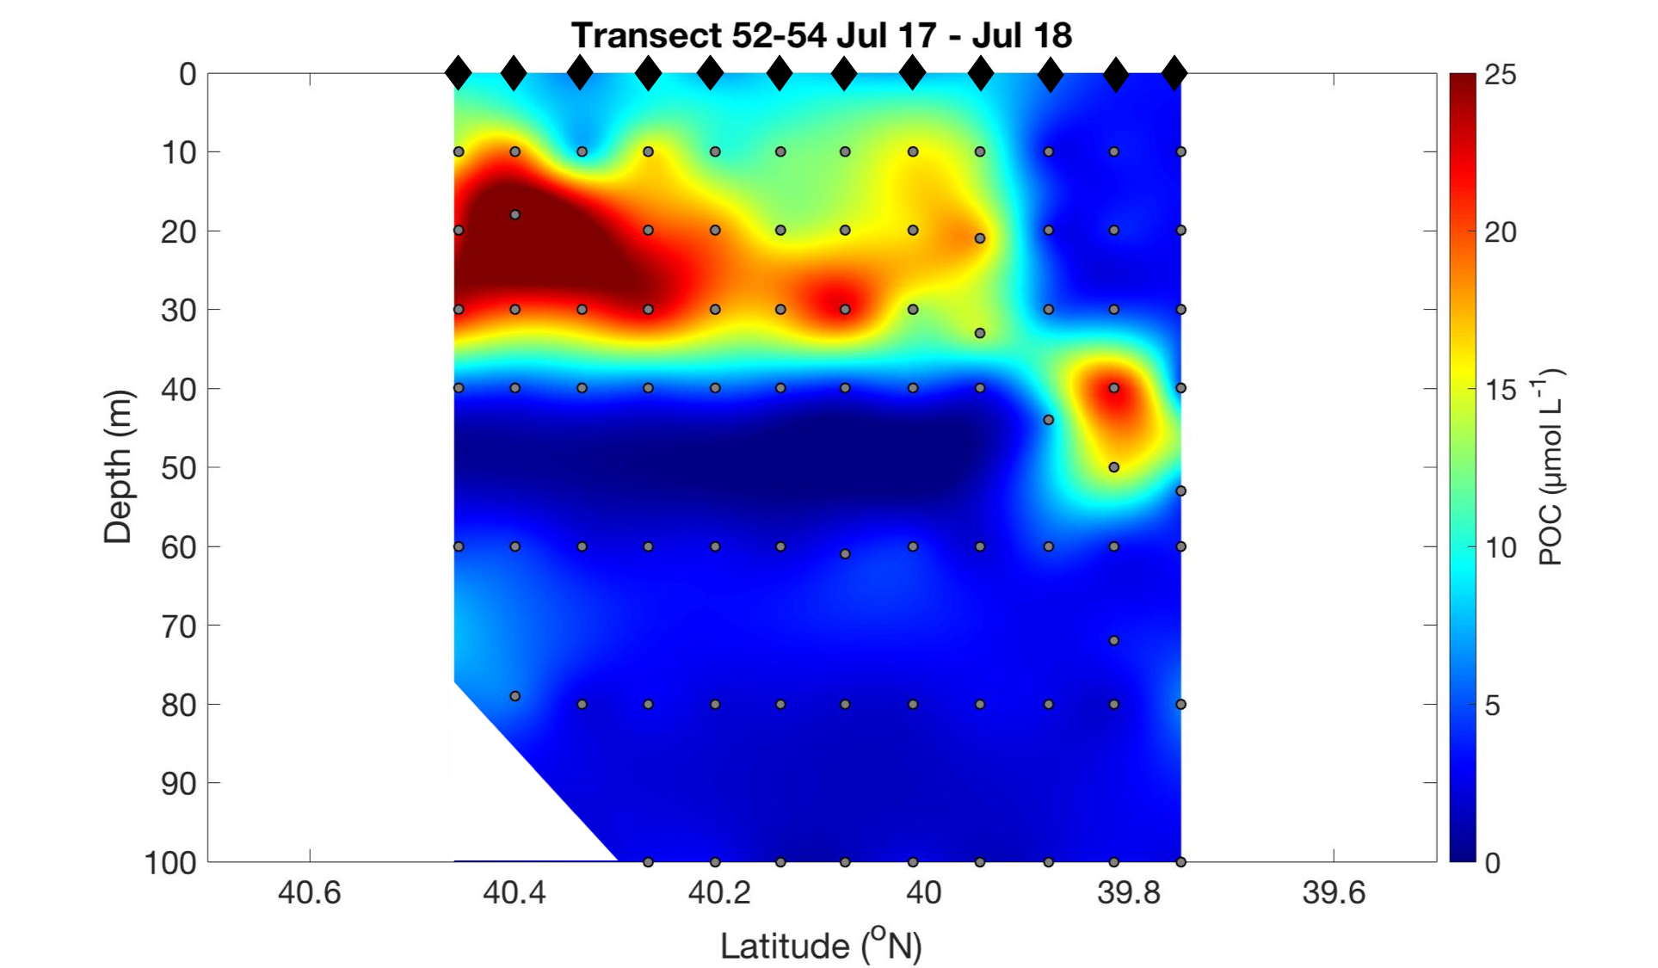
Notes:
Notice that the POC is much deeper now than in May. Walker remarked that productivity is higher in July than he expected. The POC conc through depth might be an indicator that satellite chl isn’t accurately reflecting total productivity (back to original hypothesis)
Physics of the shelf and upwelling could be playing the dominant role

Slide 14
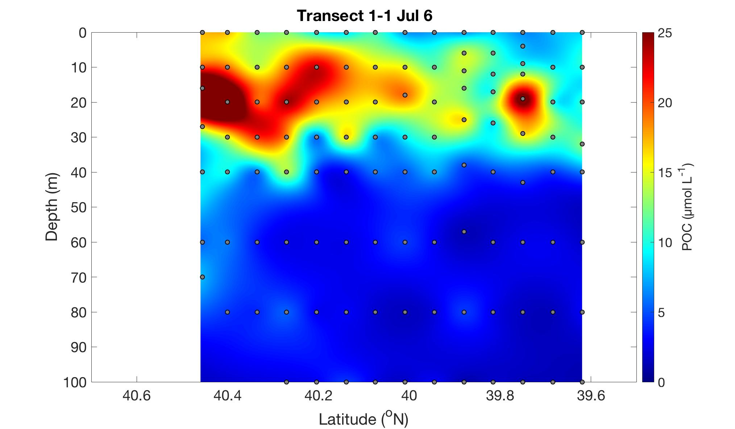
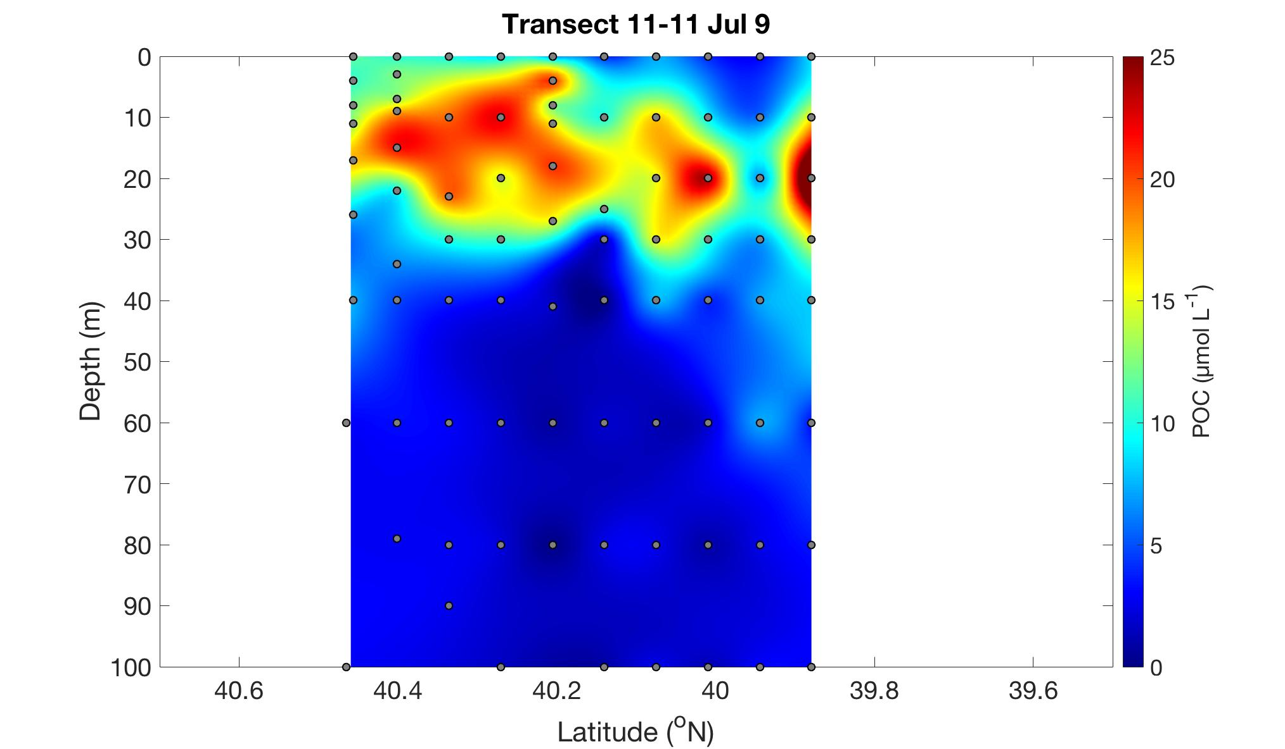
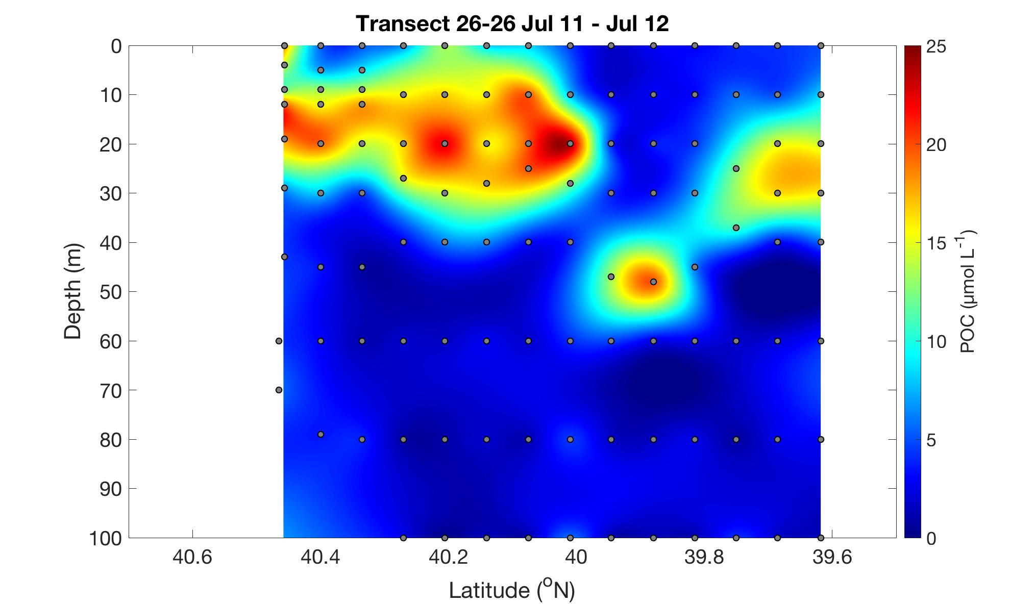
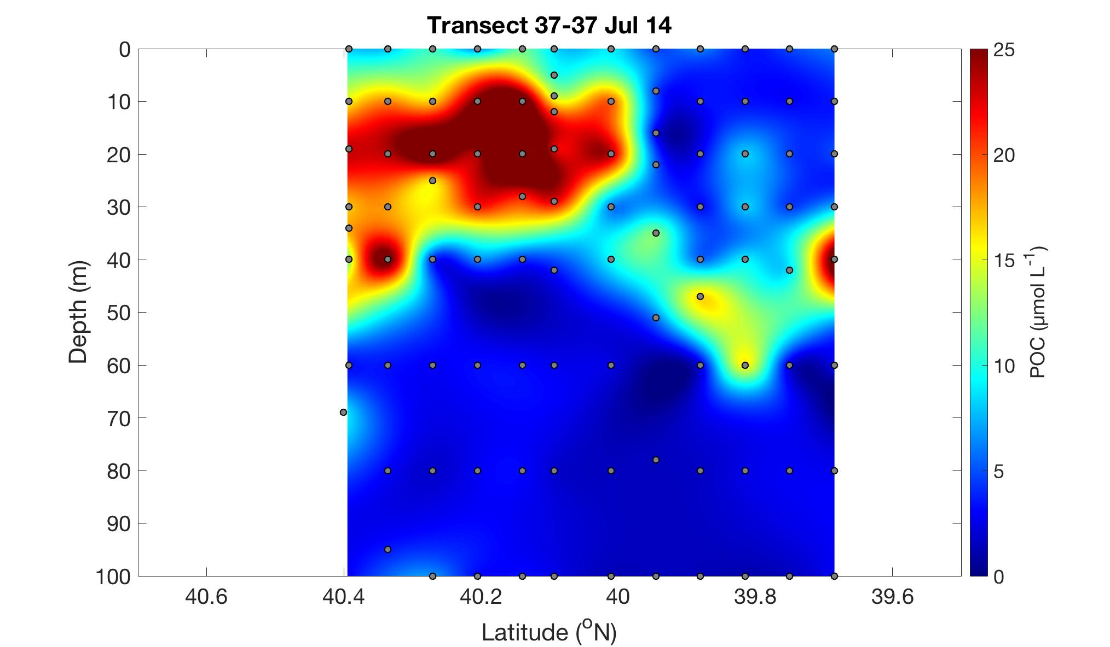


Section A10 – A11
July 6
July 9
July 11-12
July 14
July 16-17
July 17-18
Notes:
Overall, POC concentrations remain highest below the 10m depth, a notable difference with the May profiles
Concentrations increase over time, reaching a maximum around July 16-17 and then taper off

Slide 15




The “S” and “SSF” tracks went through a streamer with significantly high fluorescence values and VPR evidence of a high concentration of diatoms, indicating a bloom.

Slide 16



Additional region of elevated fluorescence and high diatom concentrations
Notes:
Note all of these regions of diatom blooms show elevated POC concentrations but are not the highest concentrations seen on the cruise.

Slide 17

Surface POC concentrations vary significantly by cruise, with RB-1904 values being the highest. All cruises show highest POC concentrations around ~20m. POC concentrations at discrete depths are relatively consistent considering the significant differences in total primary productivity between cruises.
 | AR-29 | RB-1904 | TN-368
Total Primary Productivity (mg C m-3 h-1) | 1754.9 | 1370.0 | 500.2
Notes:
RB1904 corresponding frontal enhancement
TN368 significantly larger POC values at ~20m vs. surface (makes sense given the greater stratified waters
AR29 experiences the least amount of POC change through the water column → highest productivity
**Significant difference in the SURFACE POC but not all that different through the rest of the euphotic zone

