Slide 1


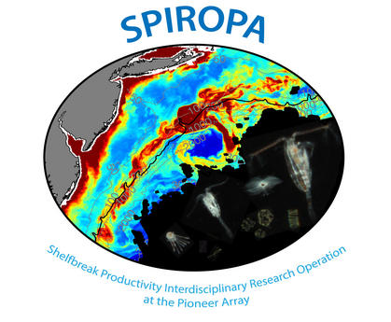
DAVPR Results:
2019-11-07 PI Meeting
Andrew Hirzel
Advisor: Dennis McGillicuddy

Slide 2
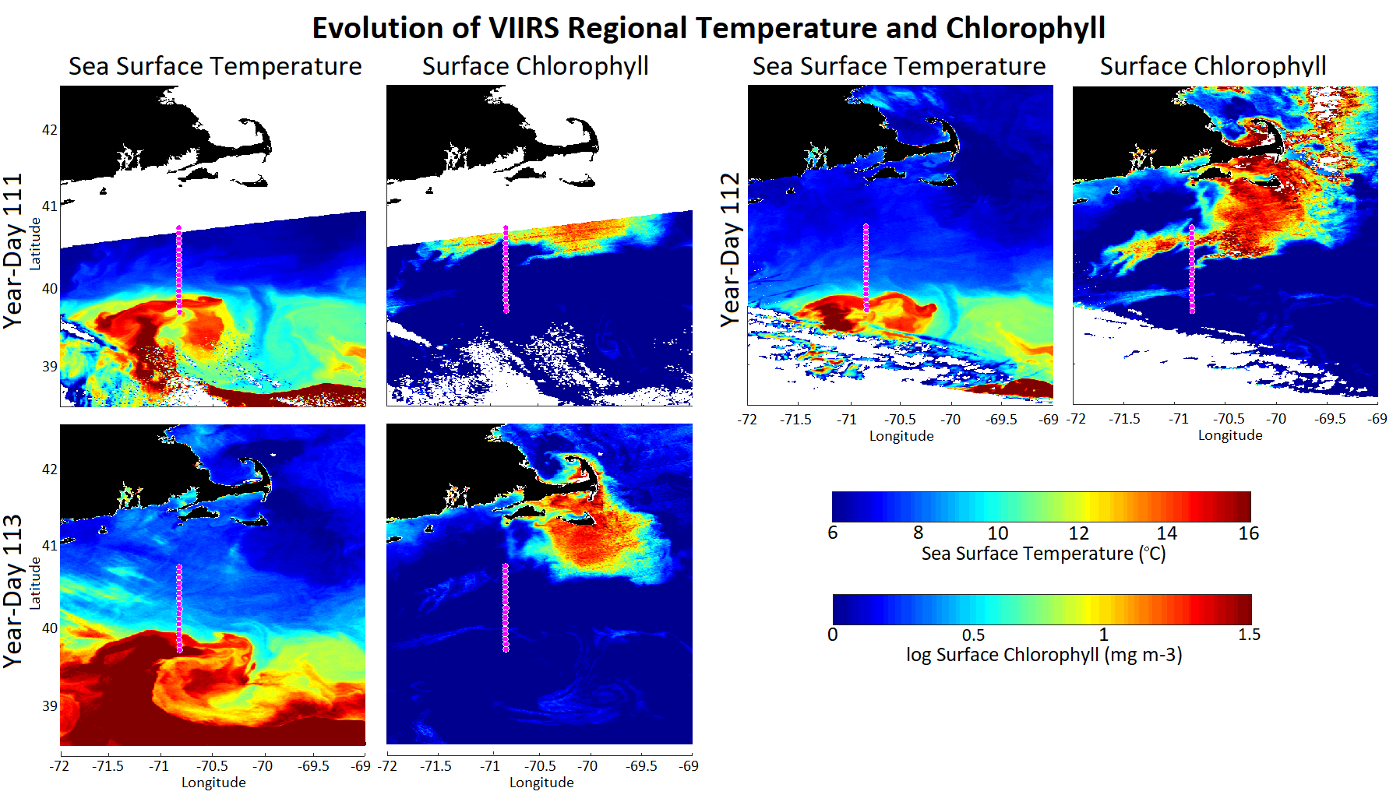
AR29 Eddy Filament (West of Transect)

Slide 3
Overview:
1. TN368 High Salinity Diatom Bloom
2. Overview of variability of chlorophyll at the front
(all three cruises)

Slide 4
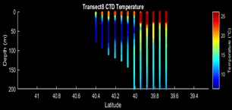
TN-368 Transect 37

Slide 5
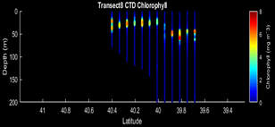
TN-368 Transect 37 Chlorophyll

Slide 6
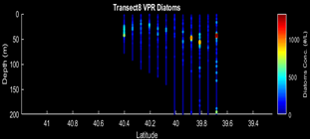
TN-368 Transect 37 Diatom Chains

Slide 7
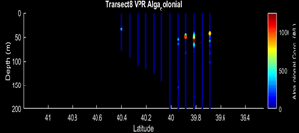
TN-368 Transect 37 Colonial Alga

Slide 8
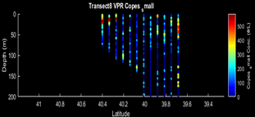
TN-368 Transect 37 Small Copepods

Slide 9
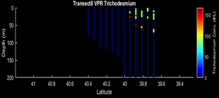
TN-368 Transect 37 Trichodesmium

Slide 10
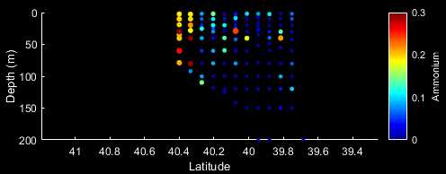
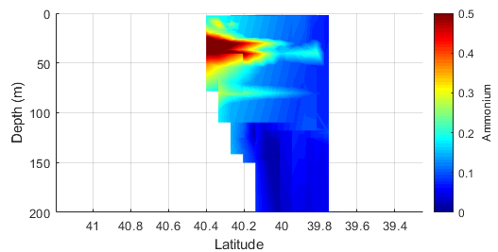
TN-368 Transect 37 Ammonium

Slide 11
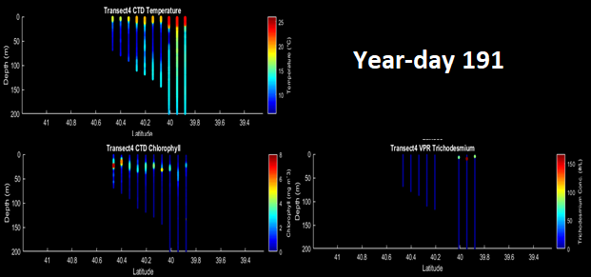
TN-368 Transect 11

Slide 12
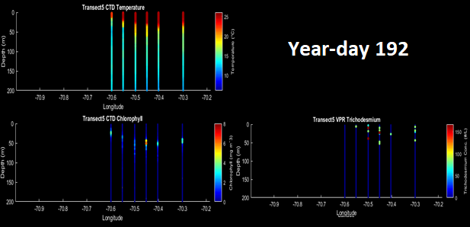
TN-368 Transect 17-19

Slide 13
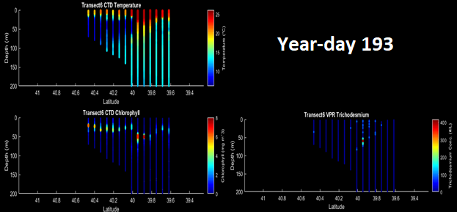
TN-368 Transect 26

Slide 14
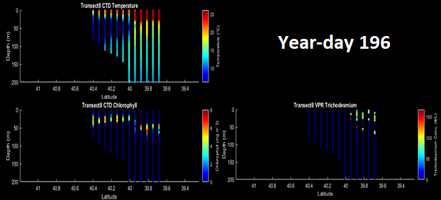
TN-368 Transect 37

Slide 15
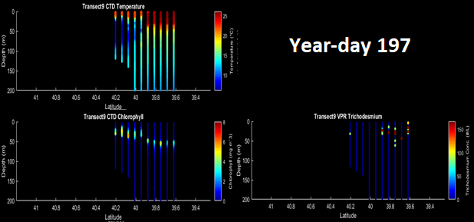
TN-368 Transect 44

Slide 16
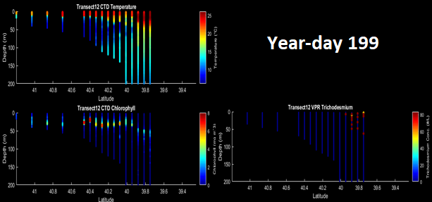
TN-368 Transect 52

Slide 17
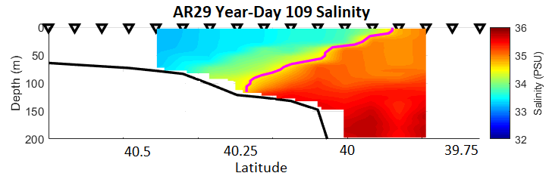
Frontal Alignment Methodology
1
3

Slide 18
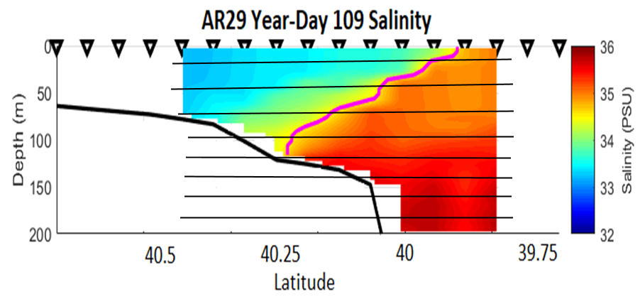
Frontal Alignment Methodology
1
2

Slide 19
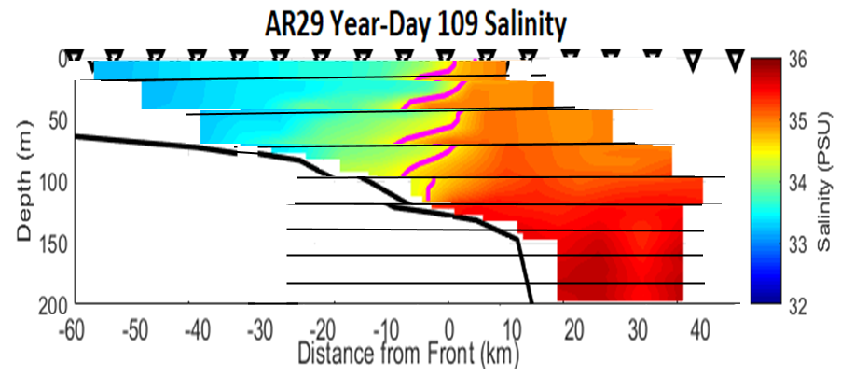
Frontal Alignment Methodology
1
2
3

Slide 20
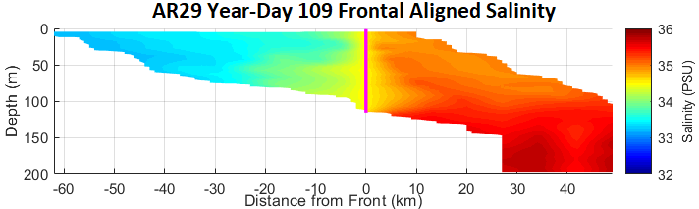
Frontal Alignment Methodology
1
2
3
Result

Slide 21
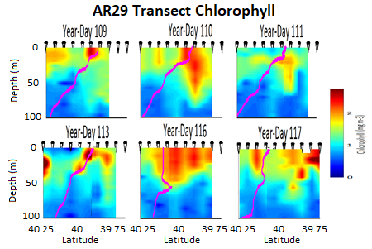
AR29 Preliminary Results

Slide 22
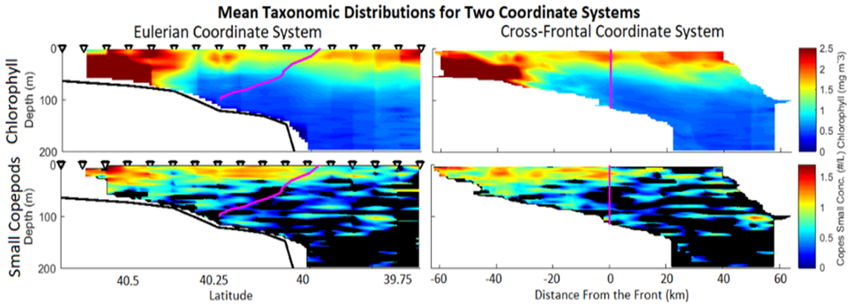
AR29 Preliminary Results

Slide 23
AR29 Preliminary Results

Slide 24
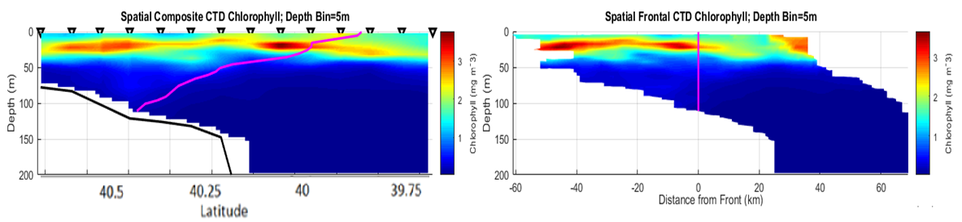
RB19-04 Preliminary Results

Slide 25
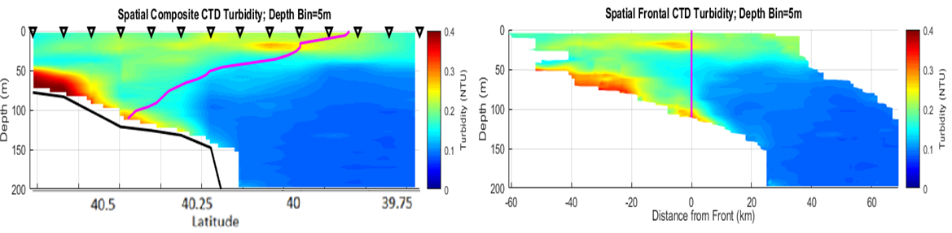
RB19-04 Preliminary Results

Slide 26
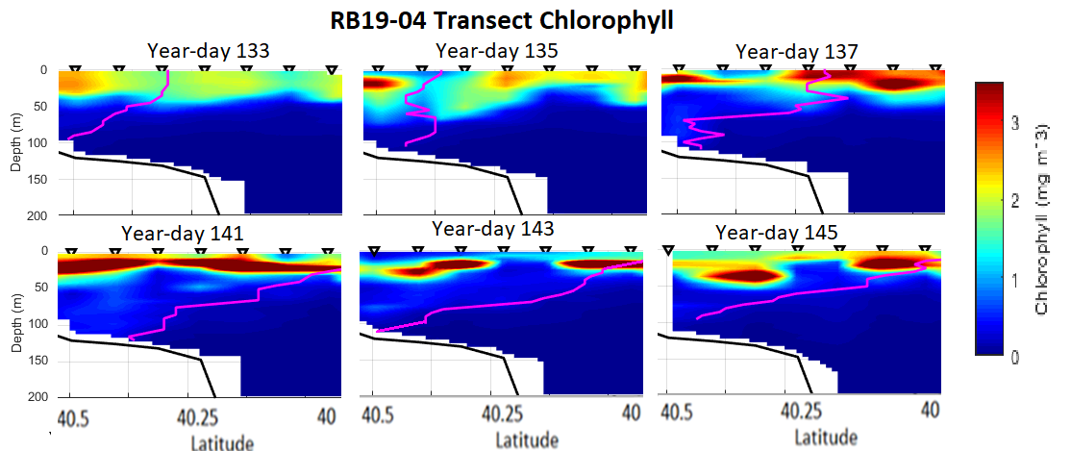
RB19-04 Preliminary Results

Slide 27
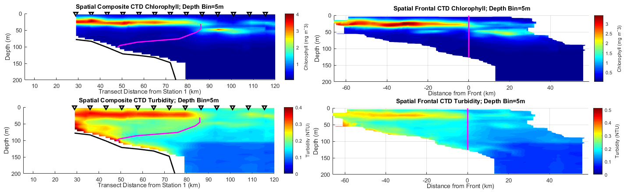
TN368 Preliminary Results

Slide 28
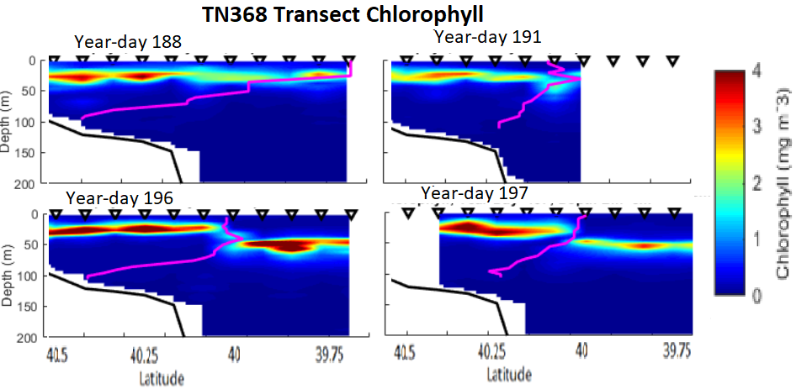
TN368 Preliminary Results

Slide 29
Conclusion

Slide 30
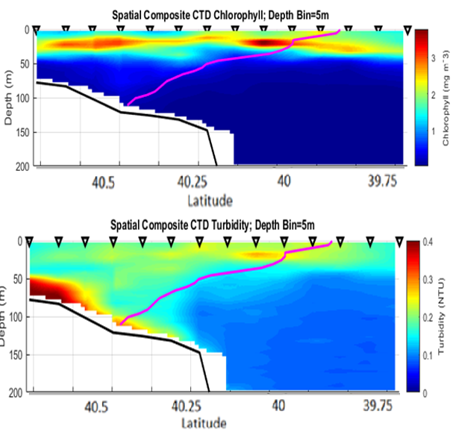
Conclusion
RB19-04/TN368

