Slide 1
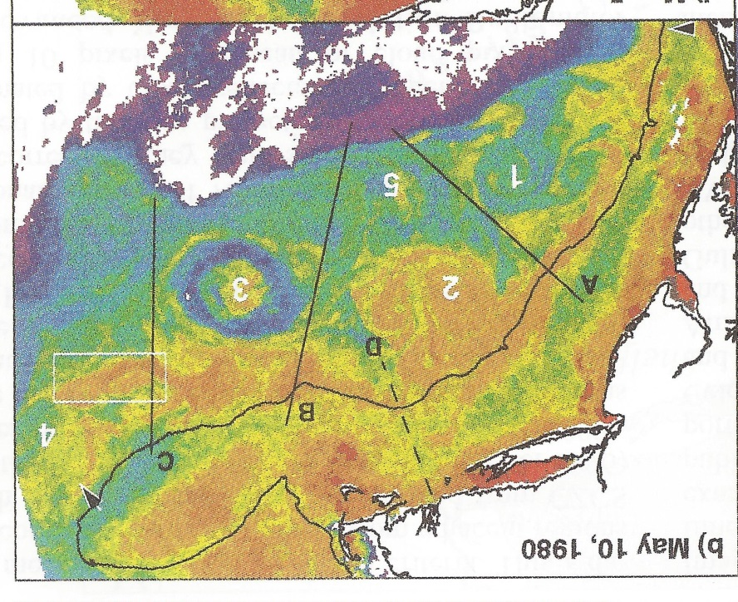
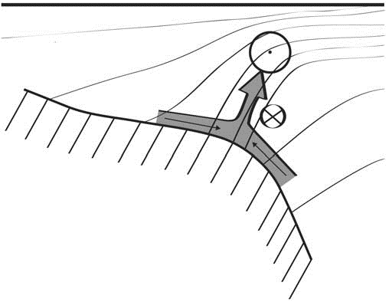
Shelfbreak frontal dynamics: mechanisms of upwelling, net community production, and ecological implications
Ryan et al. 1999
Linder et al. 2004
Gawarkiewicz and Chapman 1992
Chapman and Lentz 1994
Marra et al. 1990

Slide 2


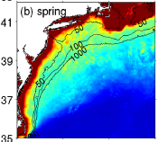

2013, JGR
Satellite CHL climatology
Why is there no mean enhancement of chlorophyll at the shelf break front?
H₁: Top-down control by zooplankton grazing
H₂: Spatial and temporal intermittency of the upwelling events causes their net impact to be smoothed out in long-term means.

Slide 3

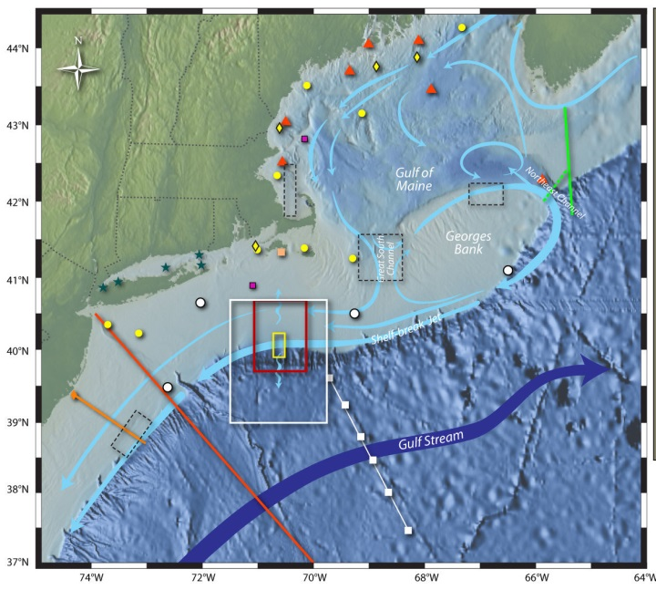
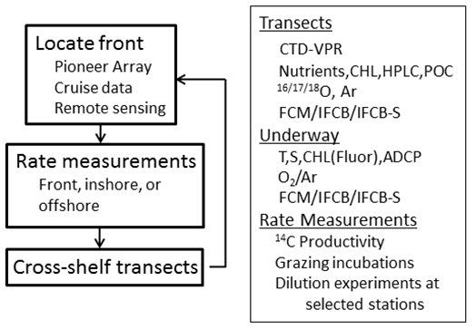
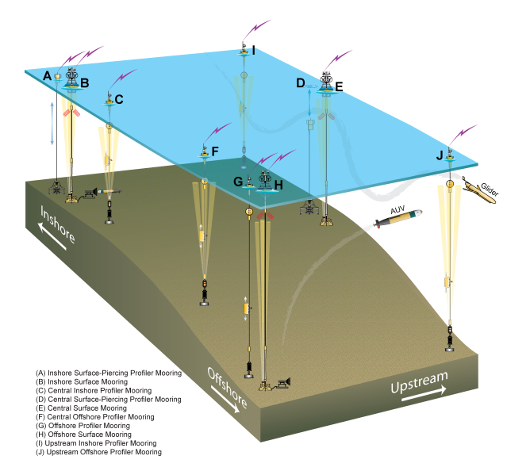
Shelfbreak frontal dynamics: mechanisms of upwelling, net community production, and ecological implications
Dennis McGillicuddy, Heidi Sosik, Gordon Zhang (WHOI)
Walker Smith (VIMS) Rachel Stanley (Wellesley College)
Jefferson Turner, Christian Petitpas (UMass Dartmouth)
3 Cruises R/V Neil Armstrong
NSF Ocean Observatory Initiative Pioneer Array

Slide 4
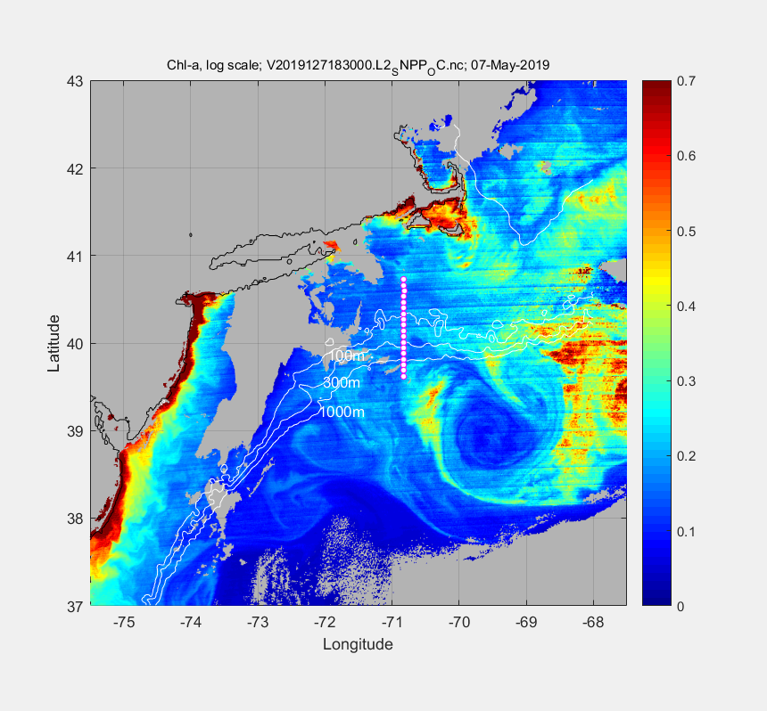
May 7 2019

Slide 5
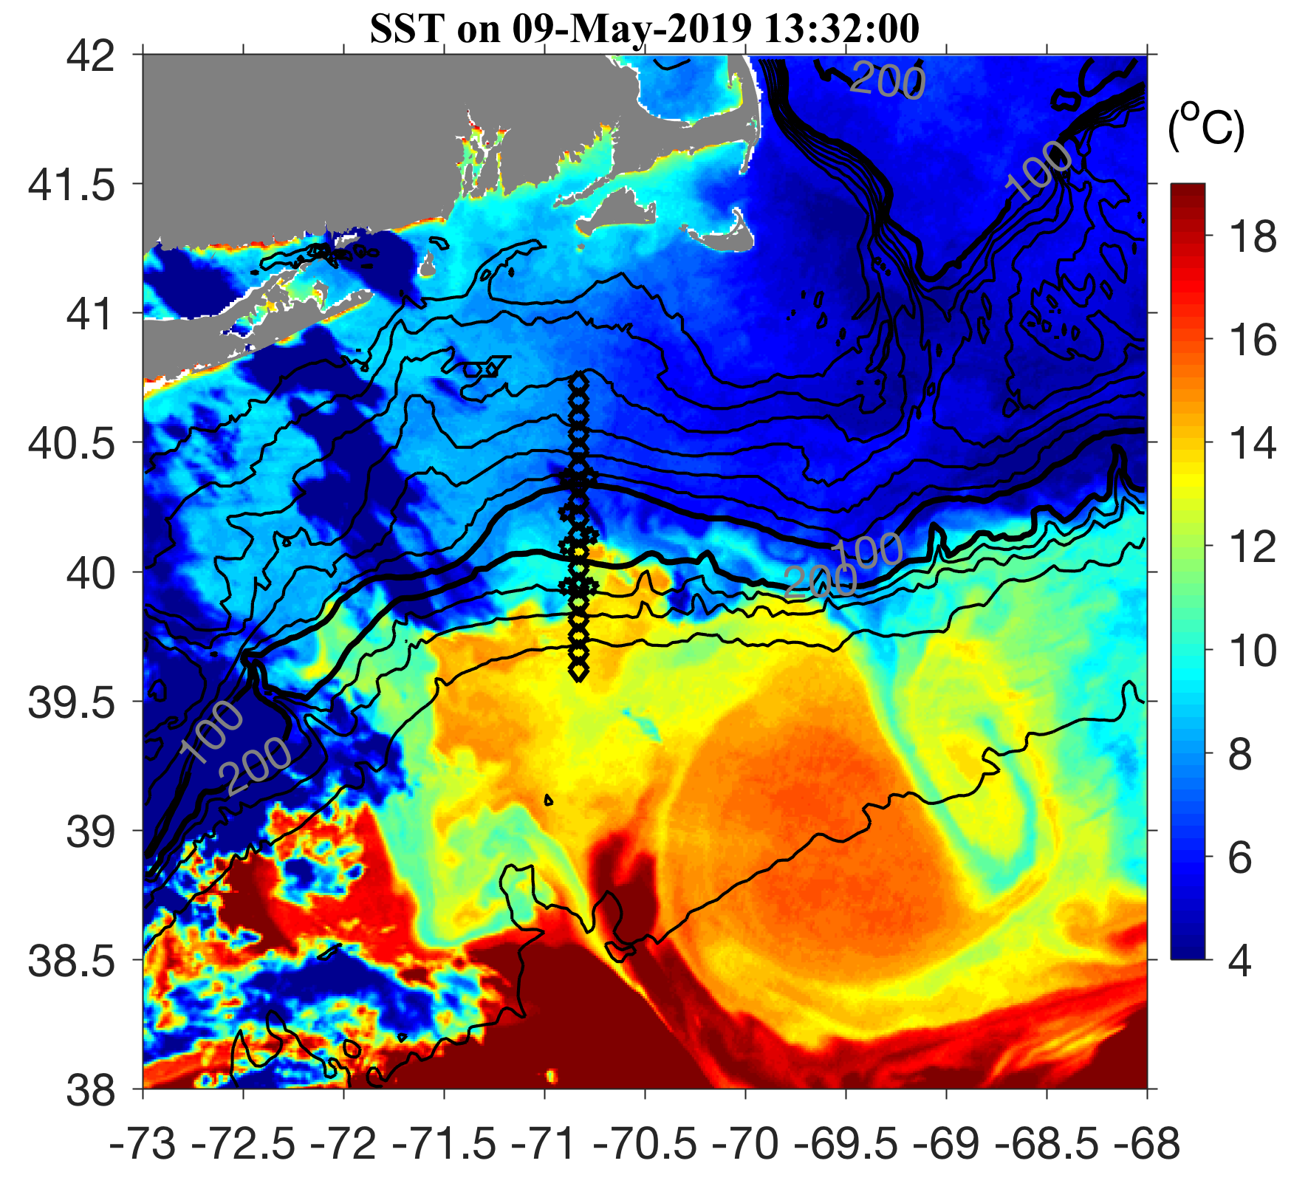
May 9 2019

Slide 6
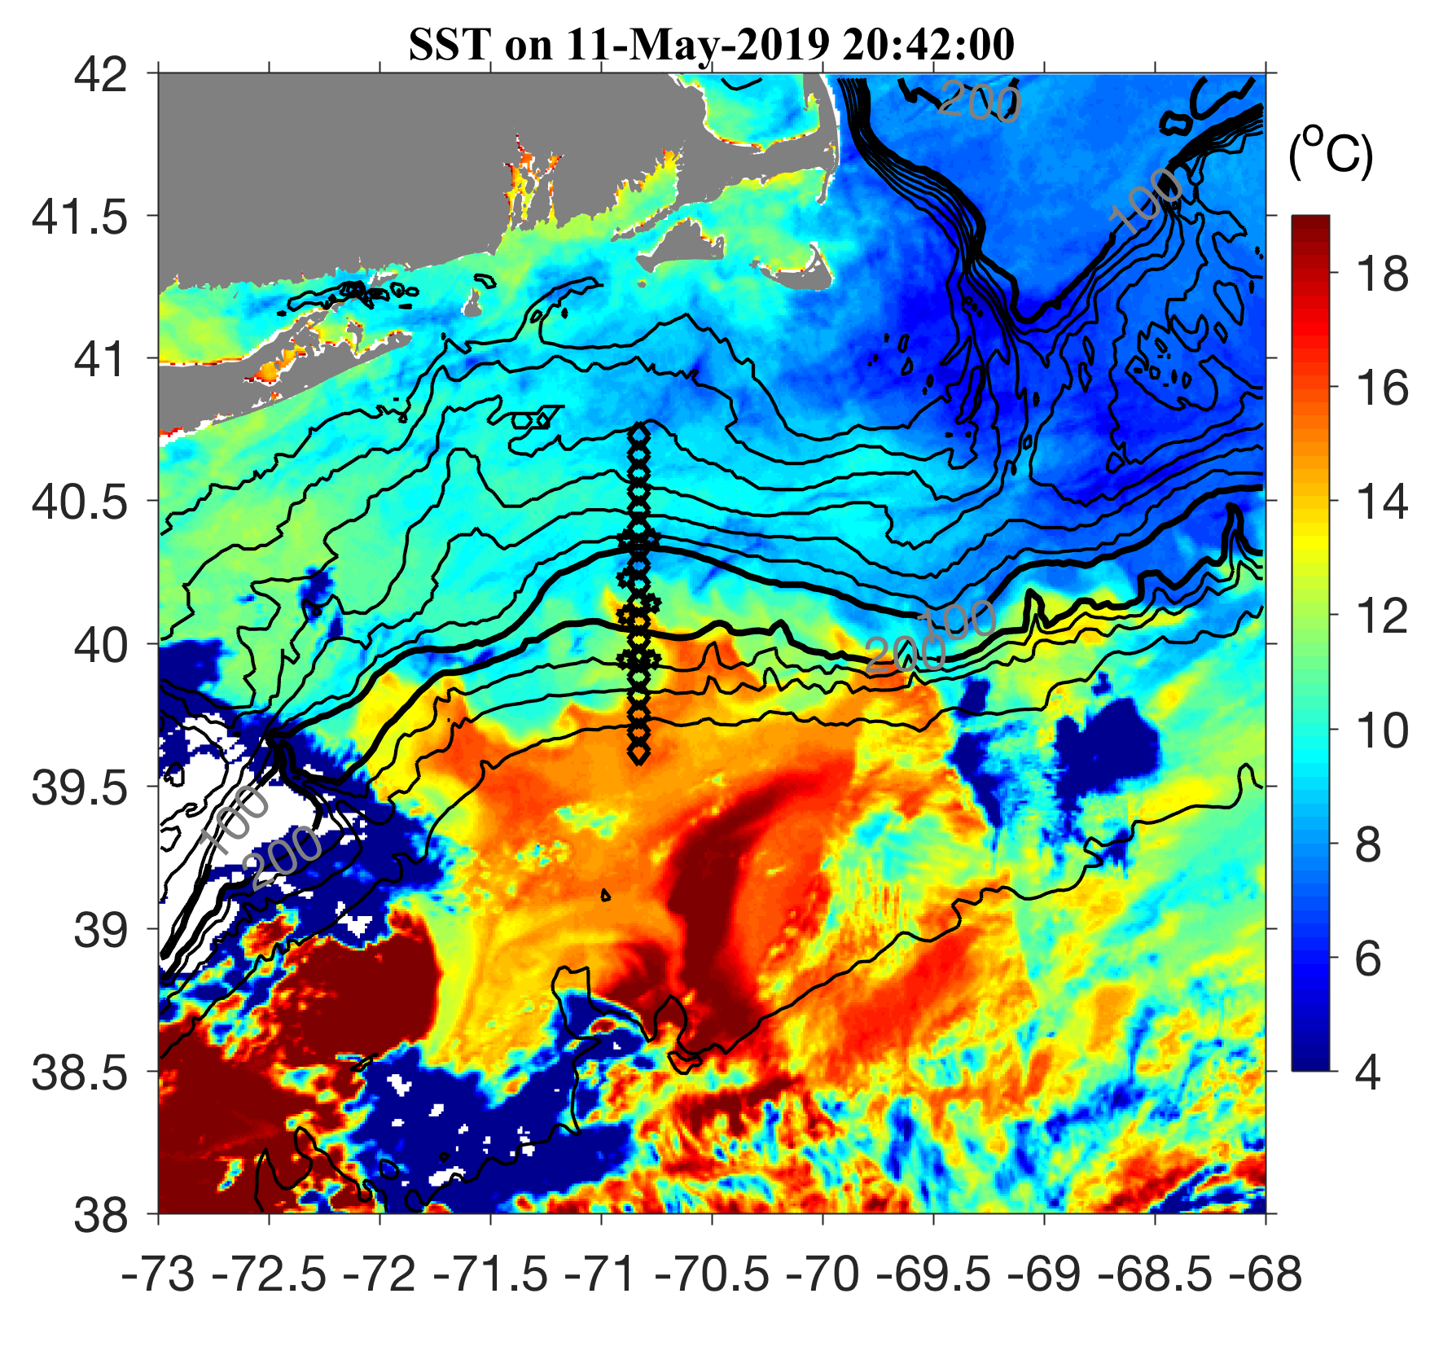
May 11 2019

Slide 7
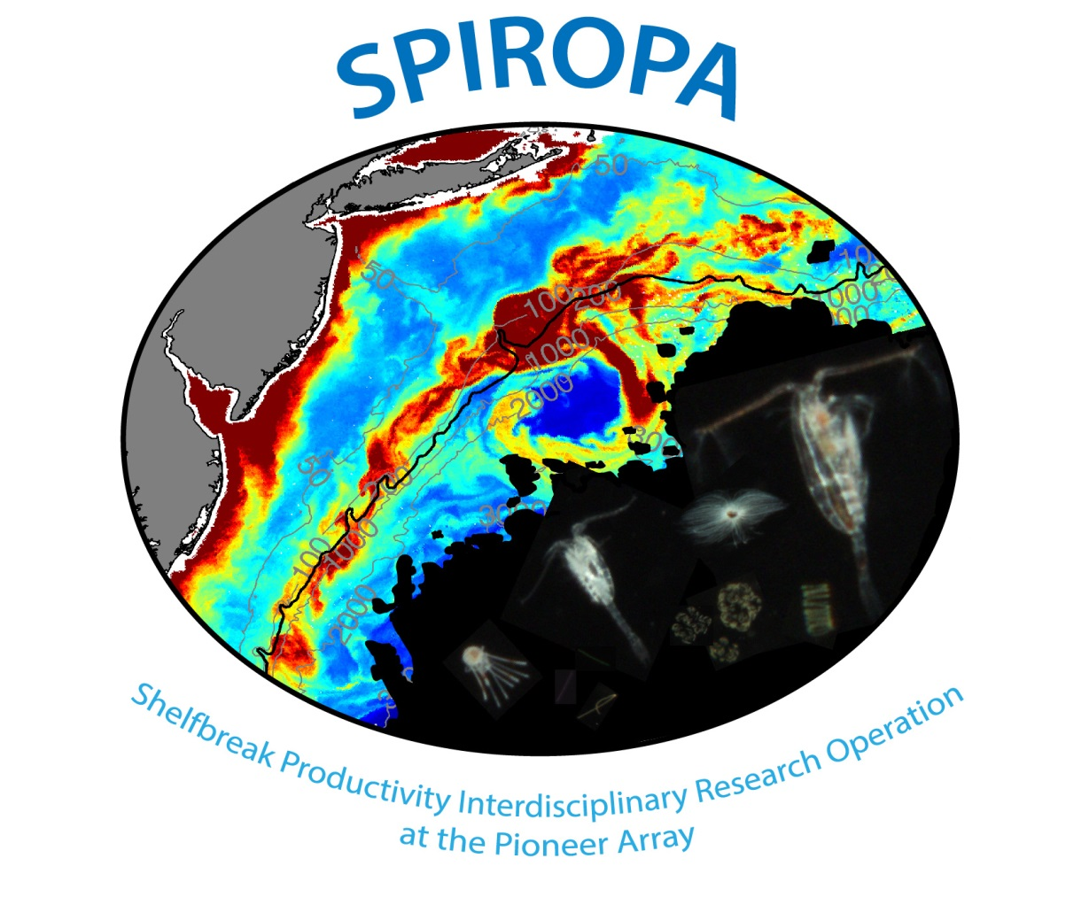

Slide 8
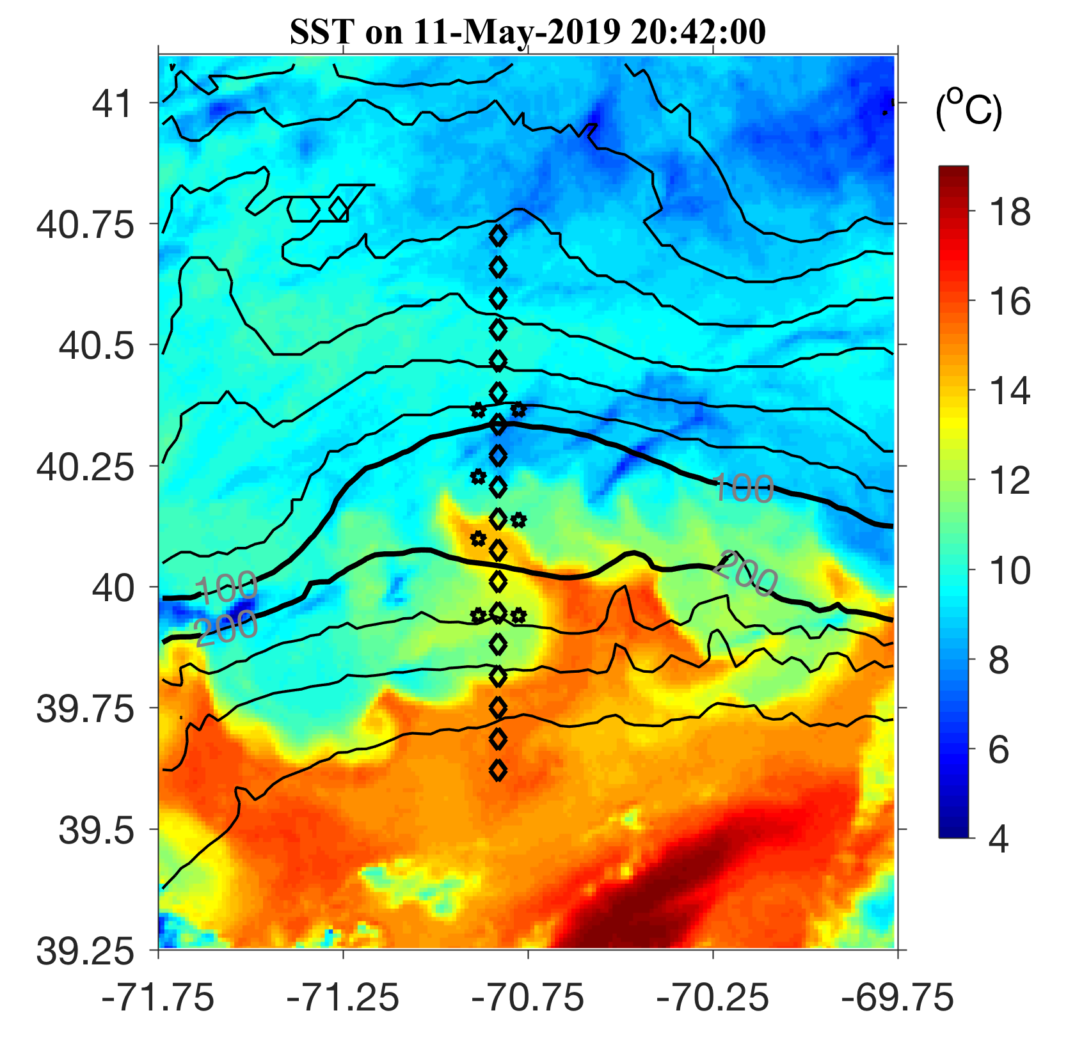
May 11 2019

Slide 9
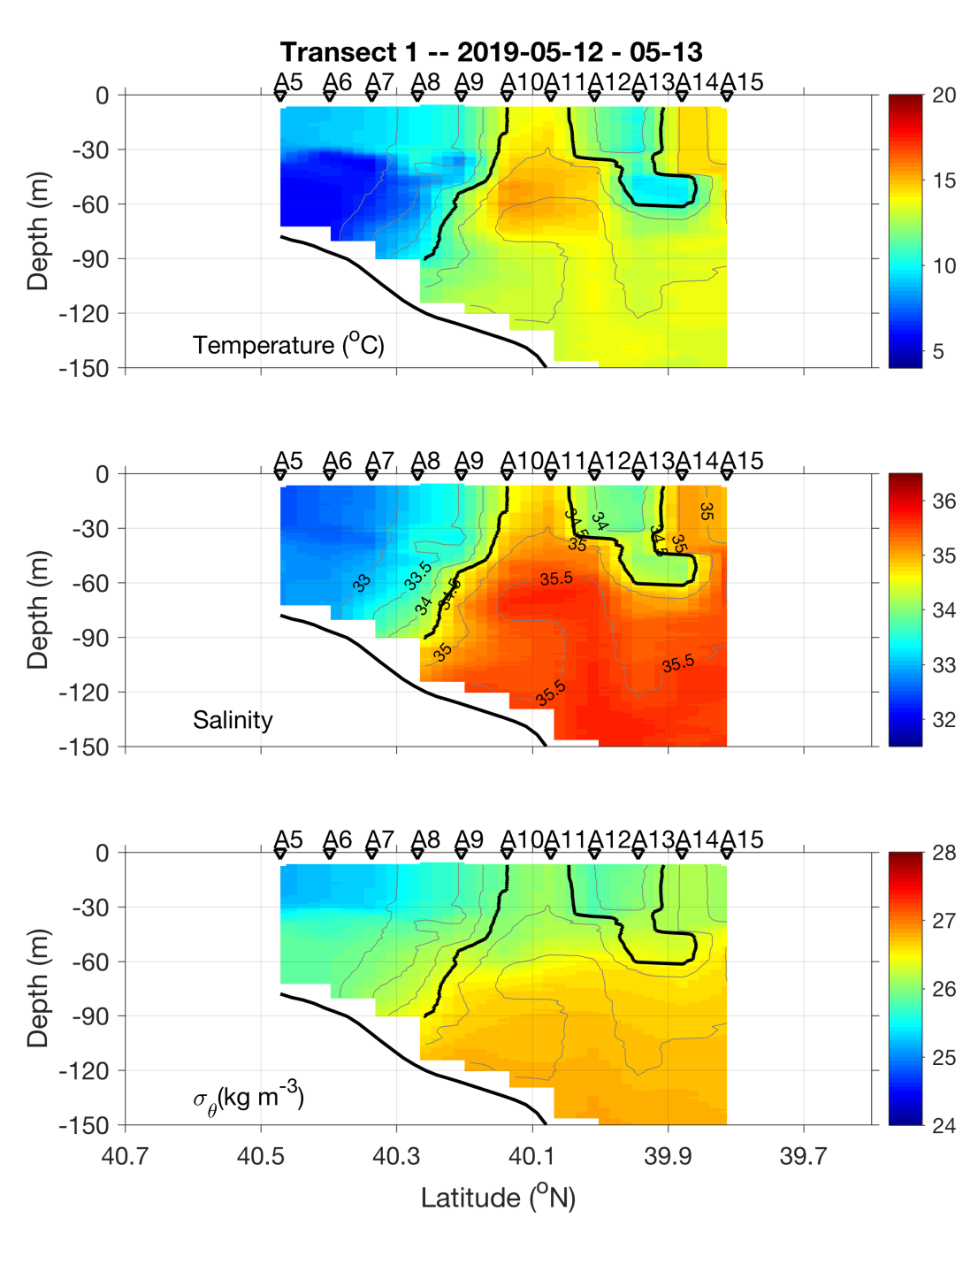
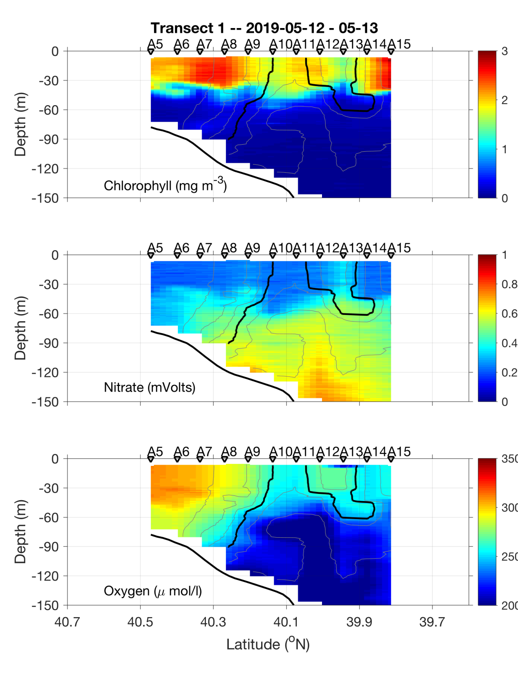
Transect 1 – May 12-13

Slide 10
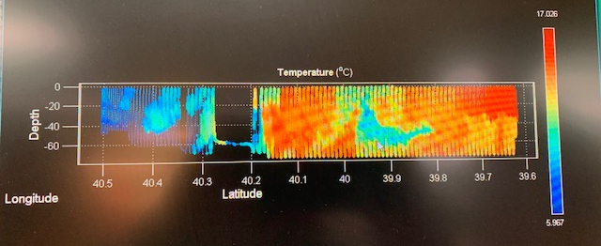
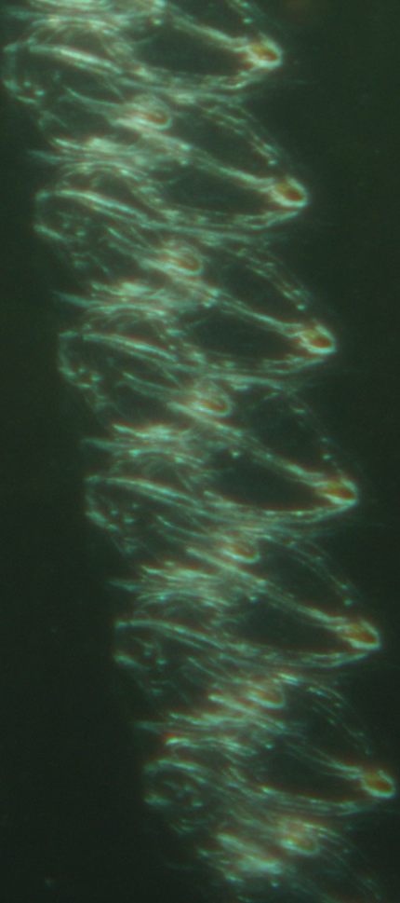
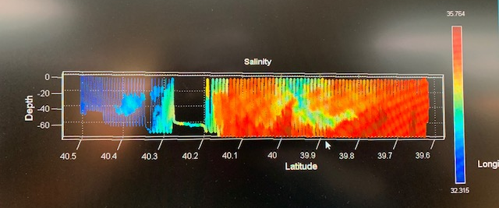
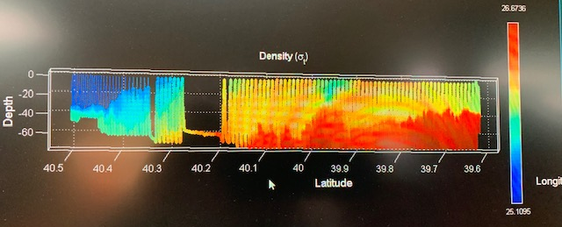
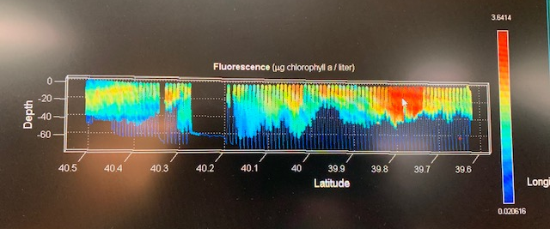
VPR Survey
May 14

Slide 11
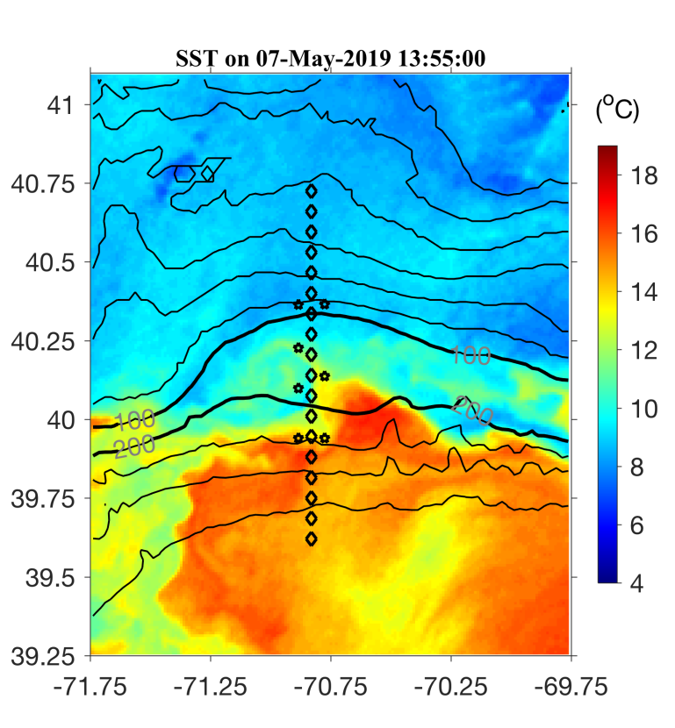
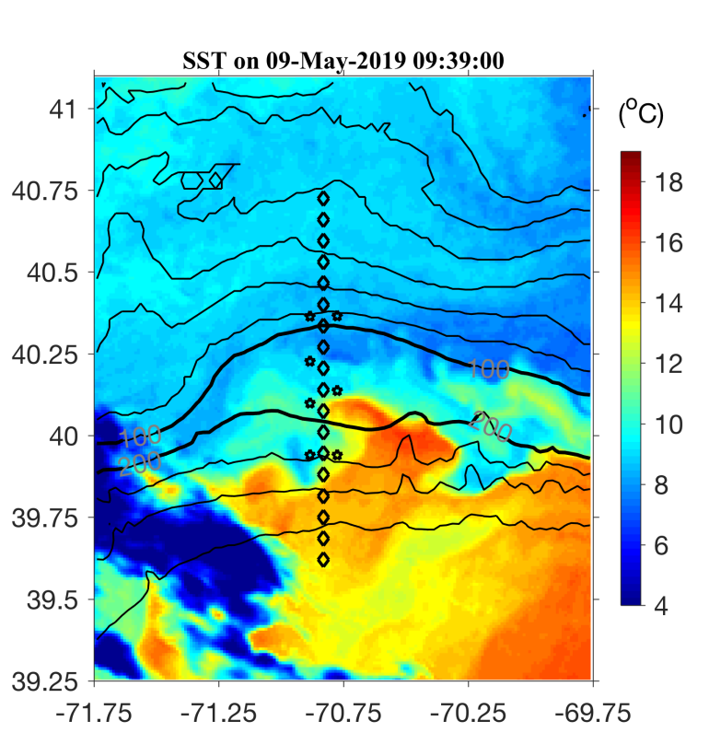

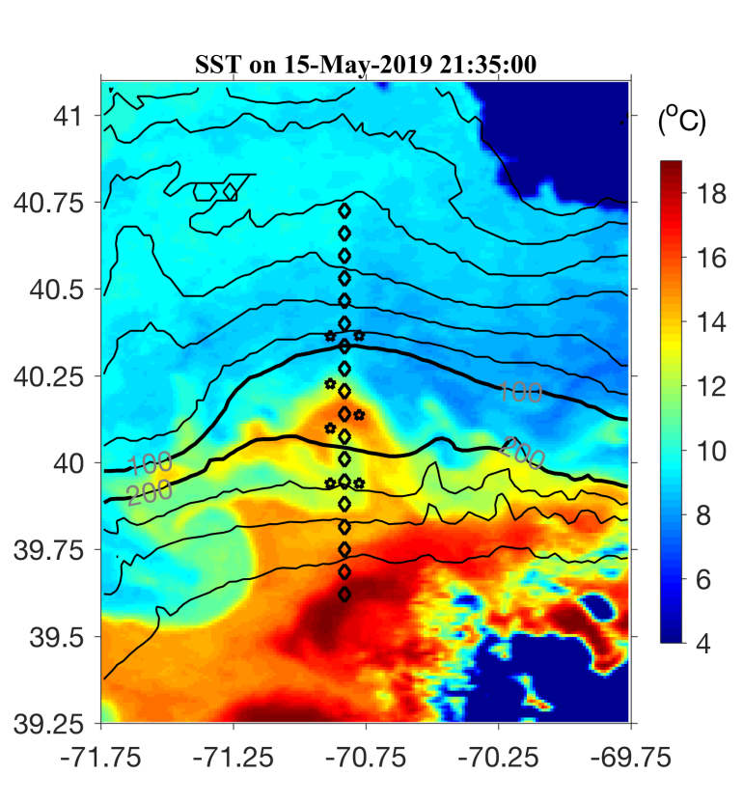
May 7 May 9
May 11 May 15

Slide 12
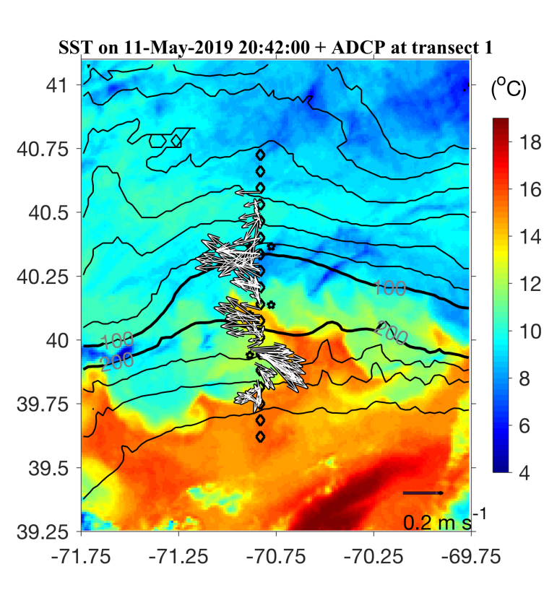
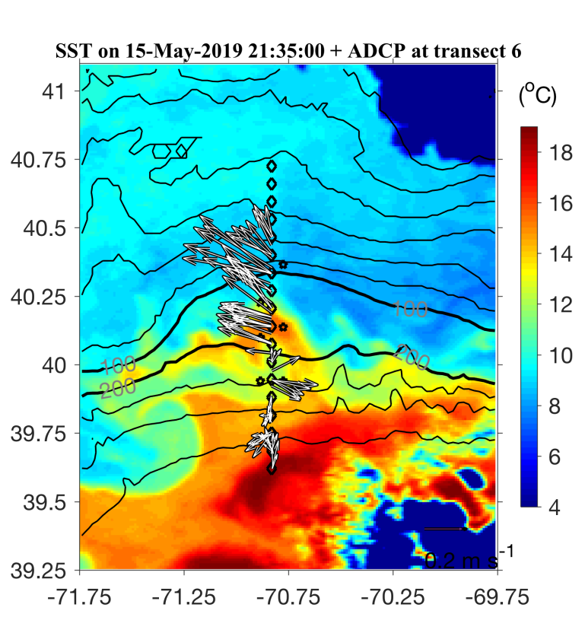
May 7 May 9
May 11 May 15

Slide 13
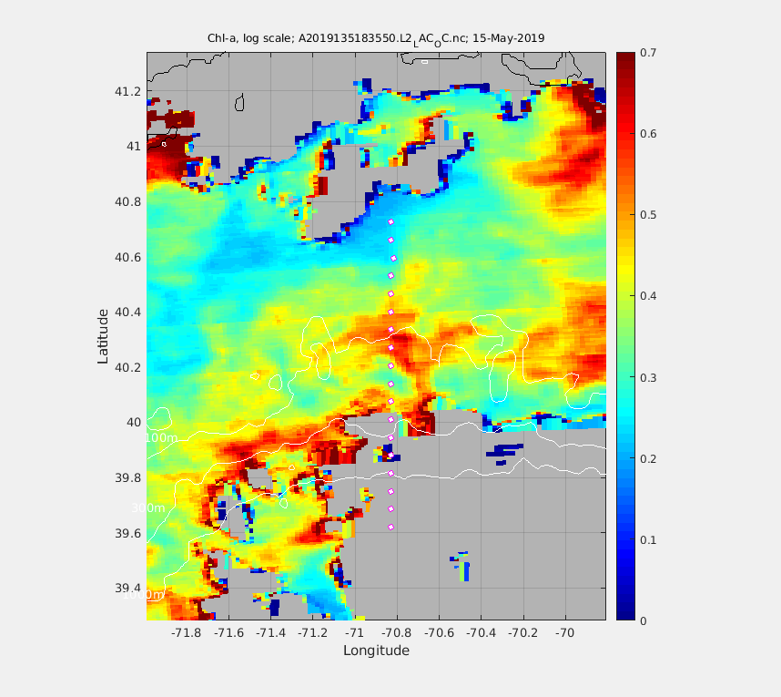
MODIS Chl 15 May 2019
A6
A8

Slide 14
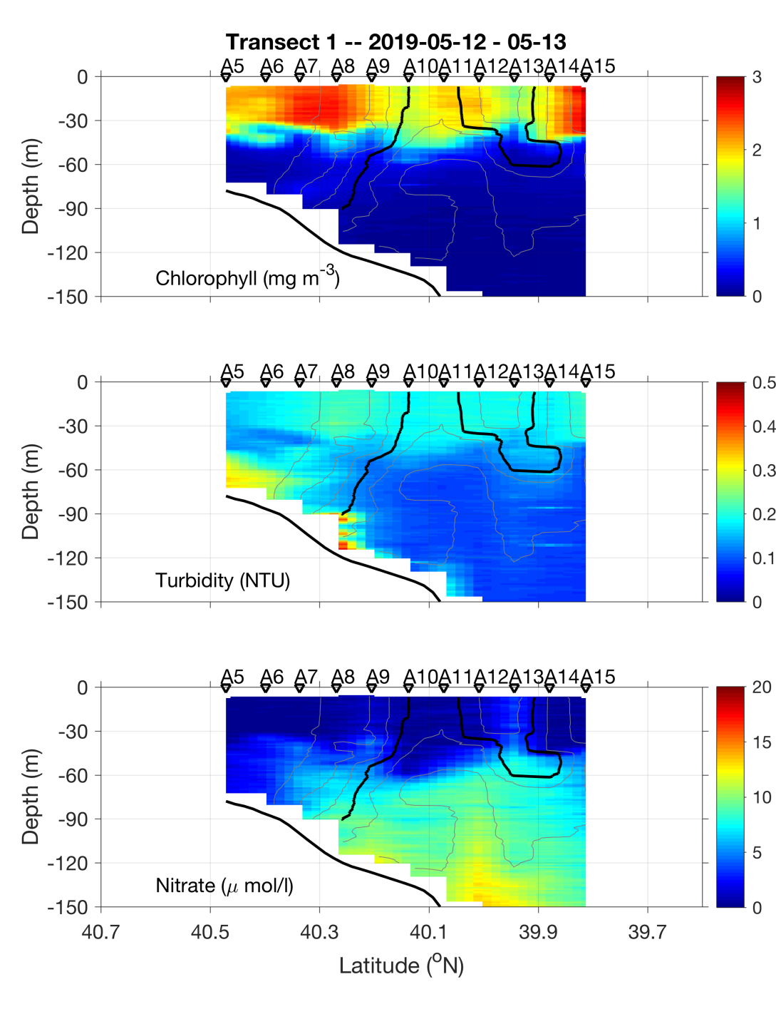
May 12-13

Slide 15
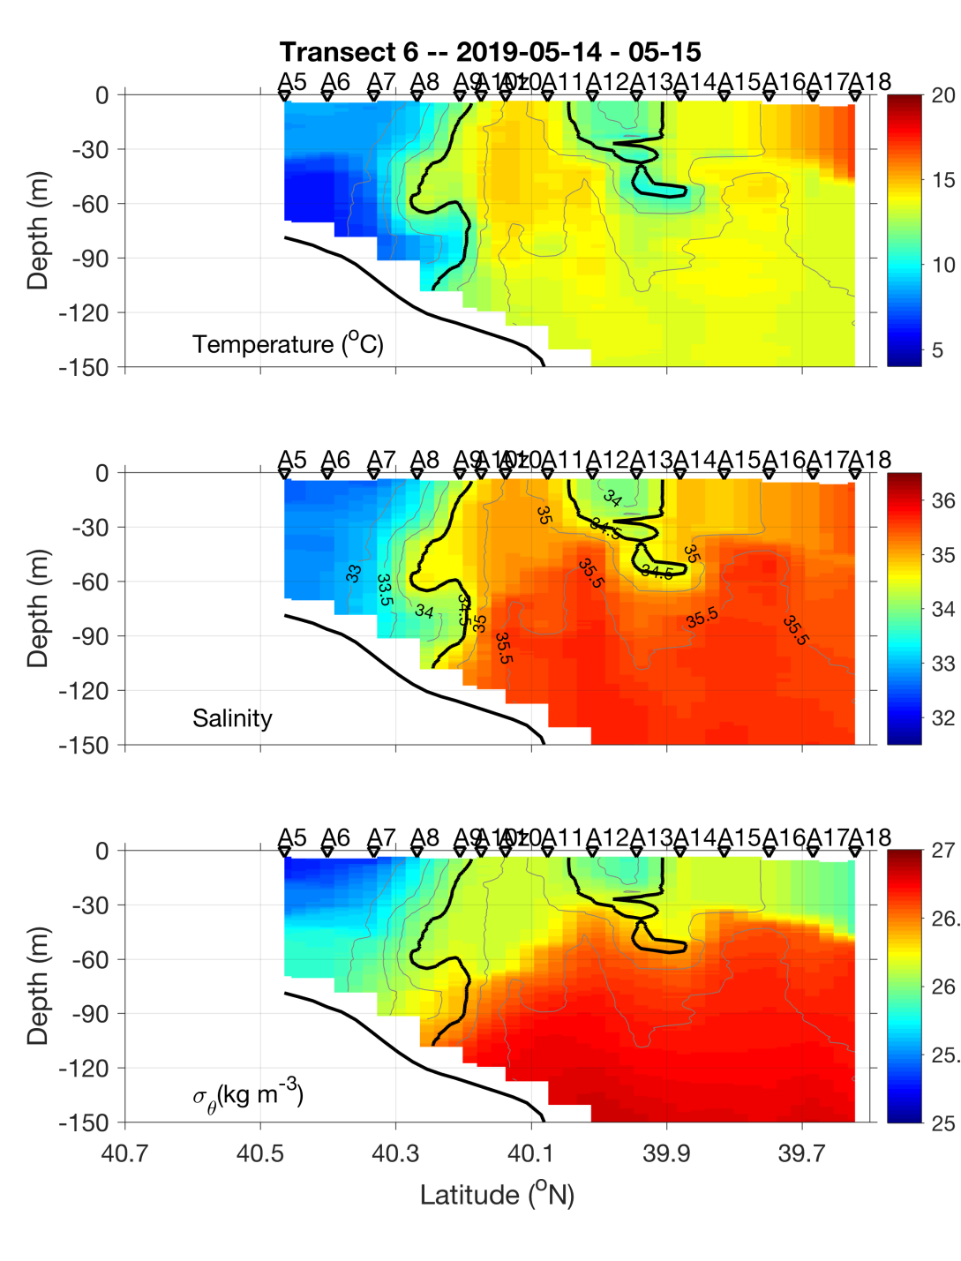
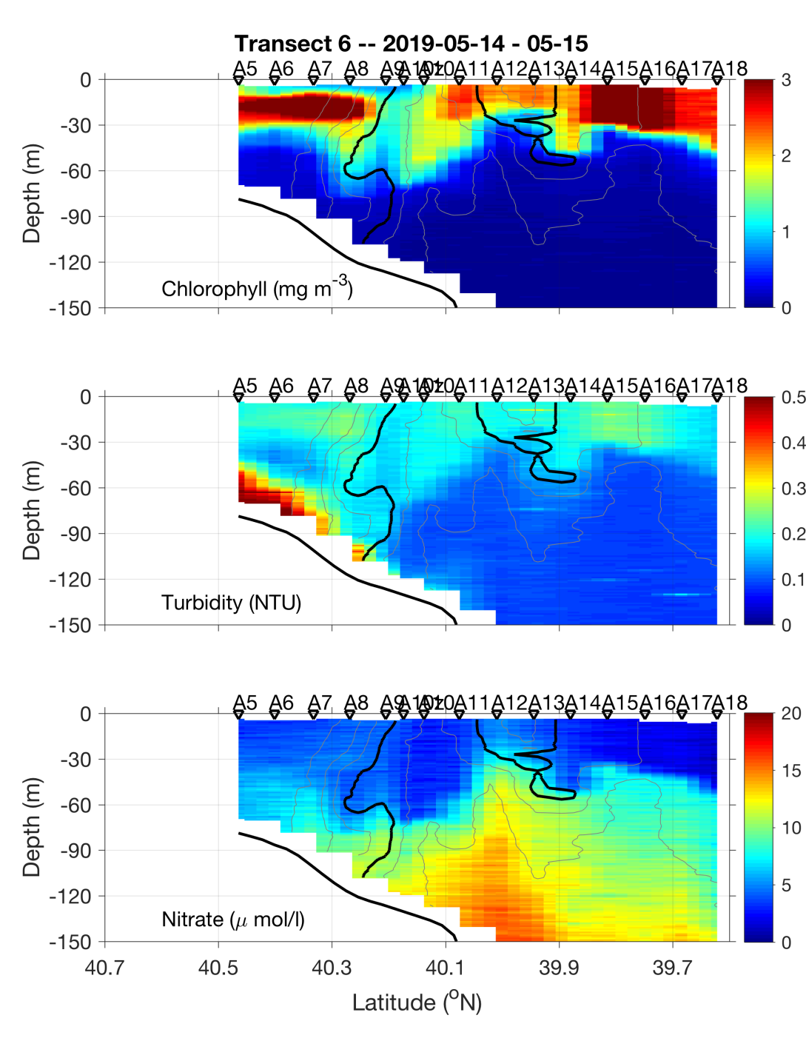
May 14-15

Slide 16
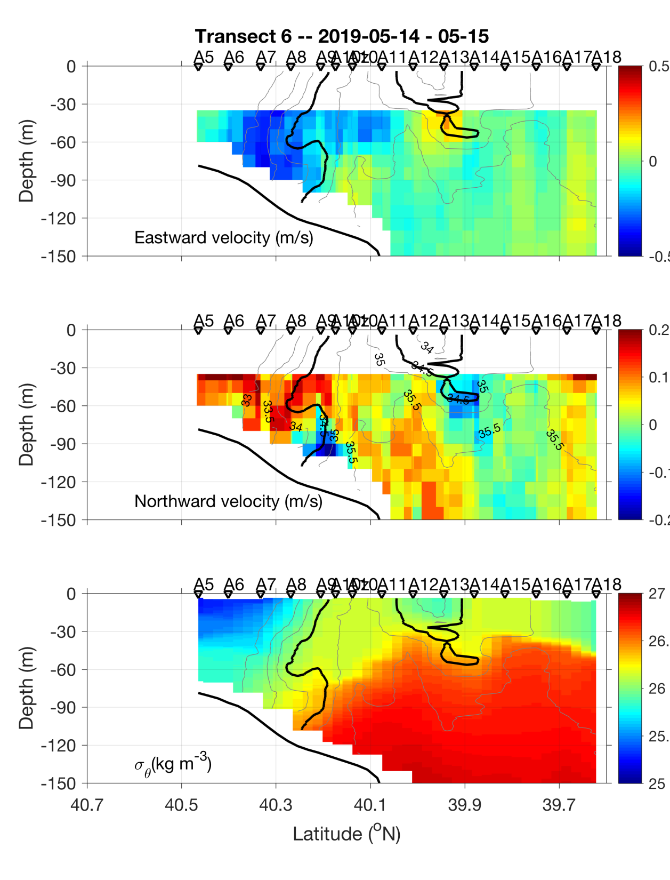
ADCP velocities
Eastward
Northward

Slide 18
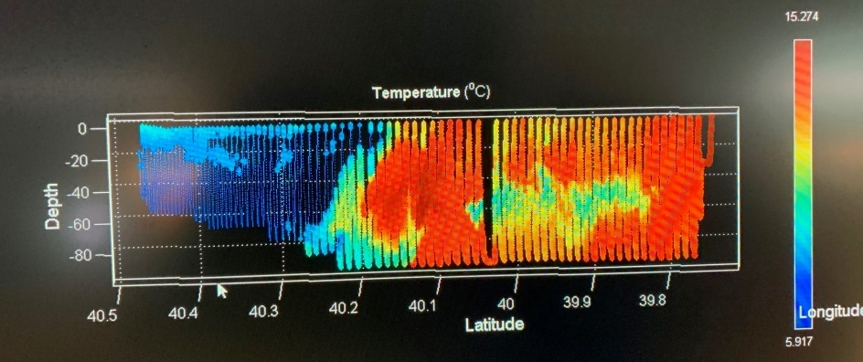
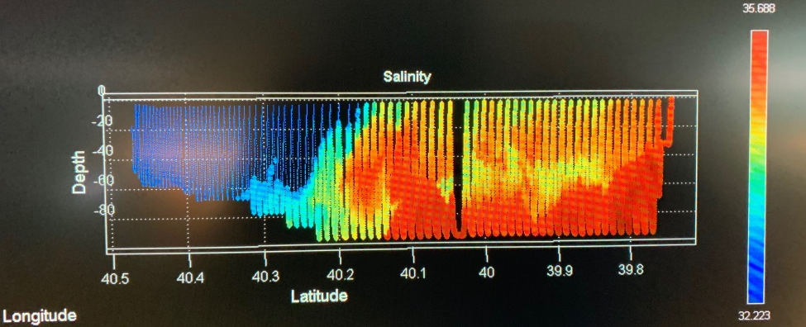
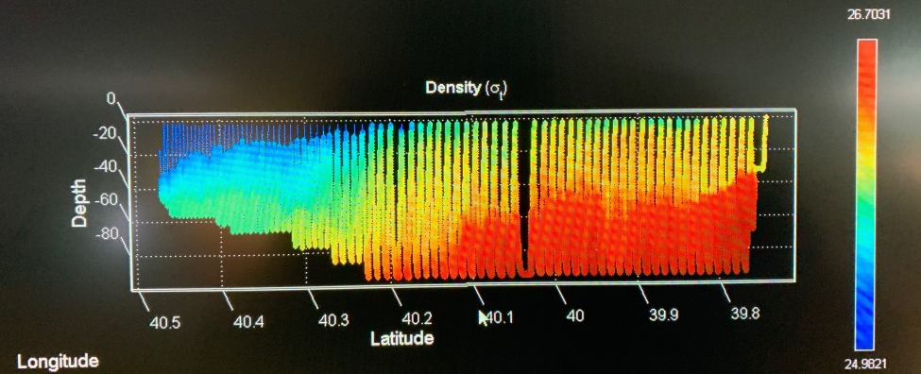
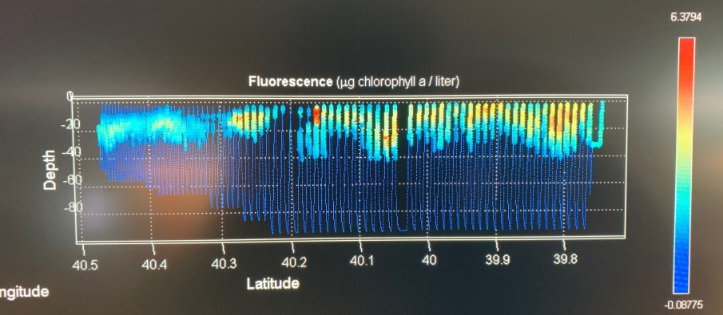
VPR Survey
May 16

Slide 19
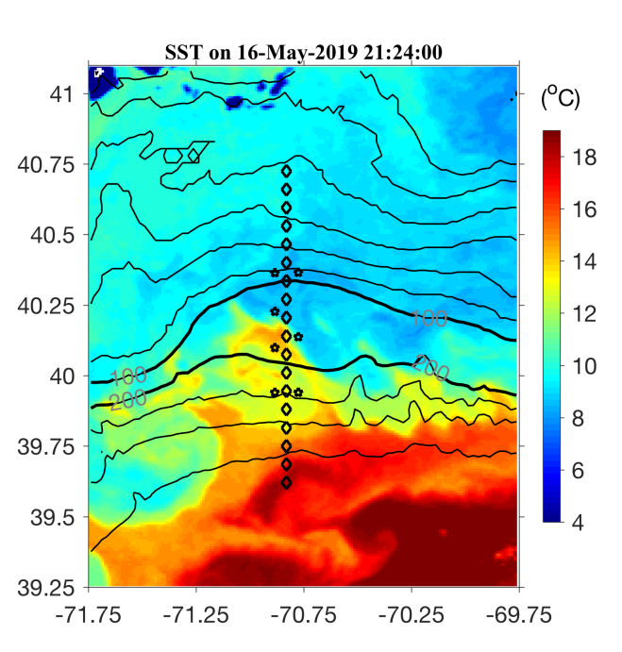
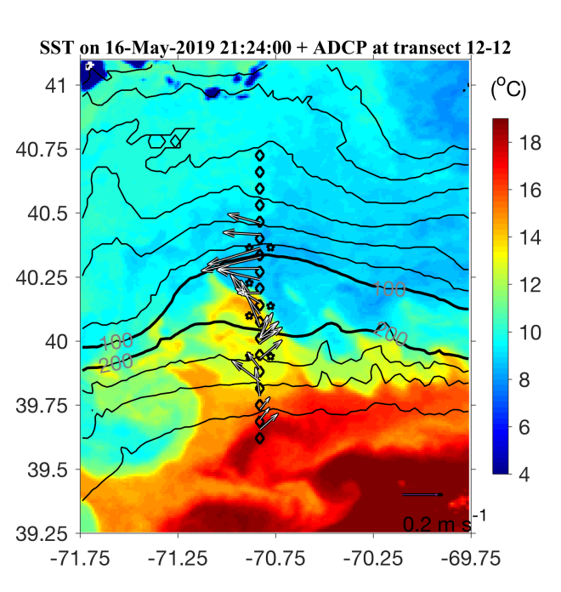
SST 16 May 2019

Slide 20
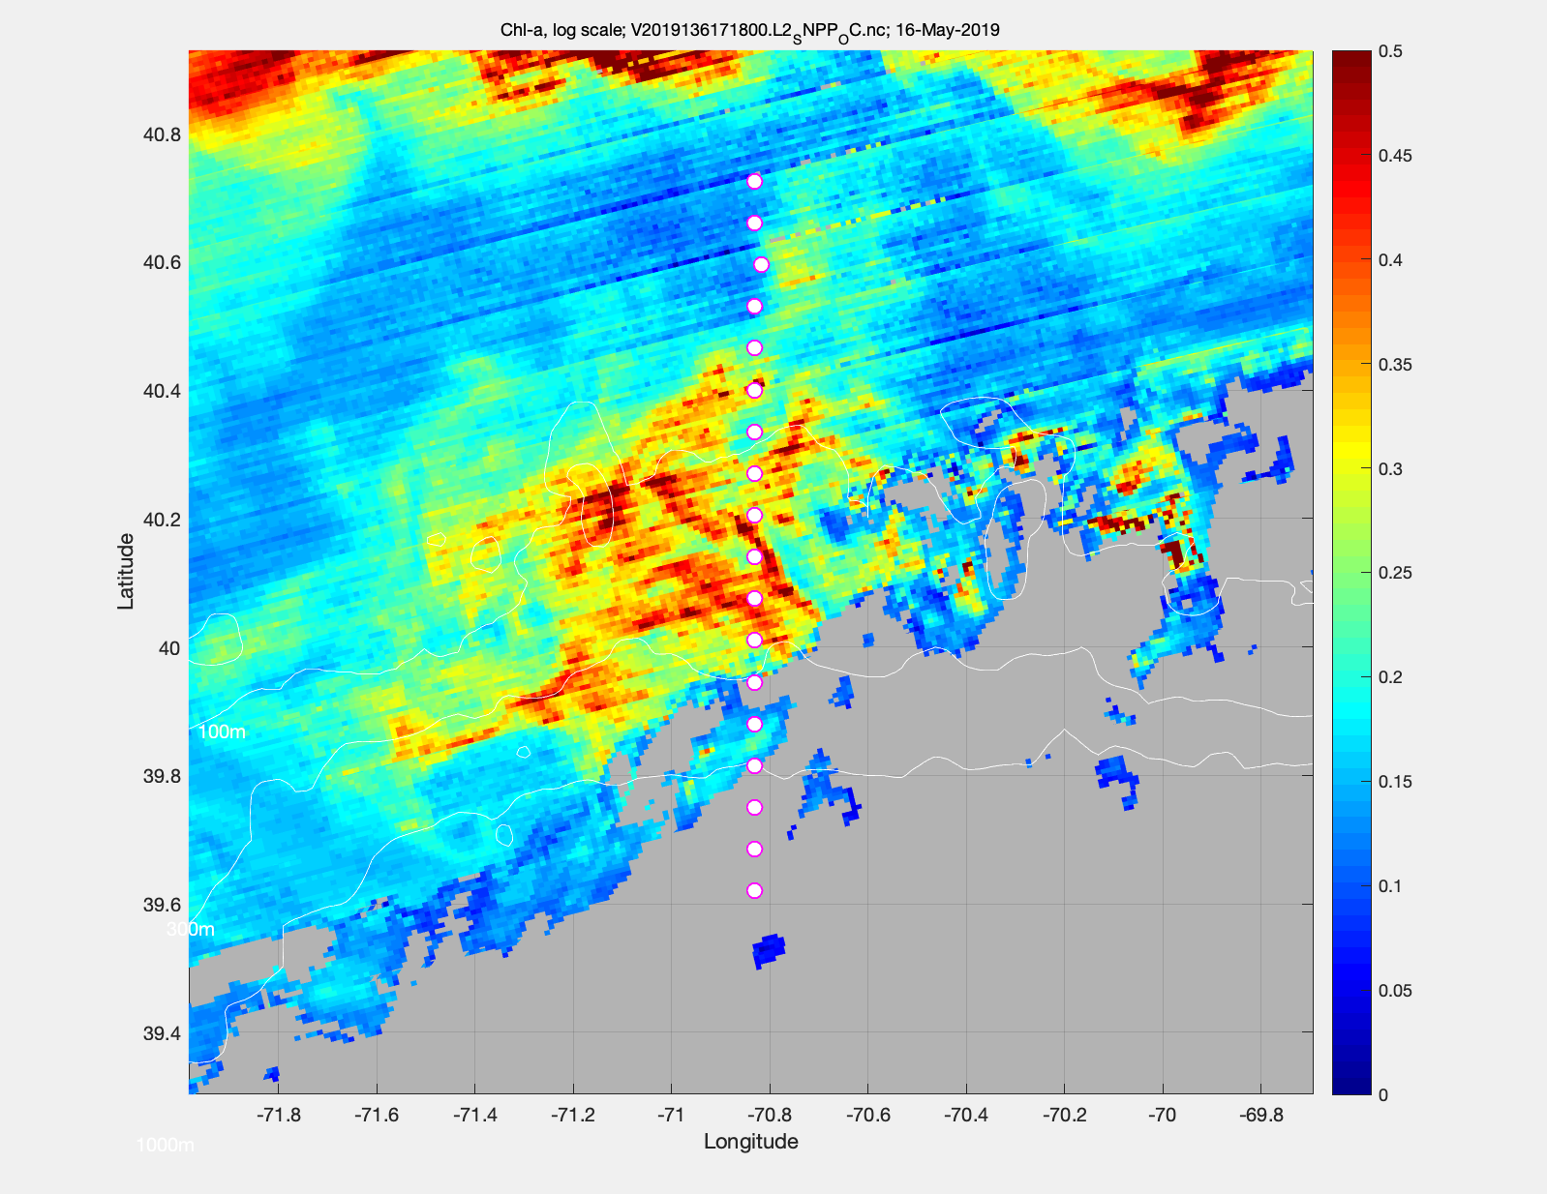
Chl 16 May 2019

Slide 21
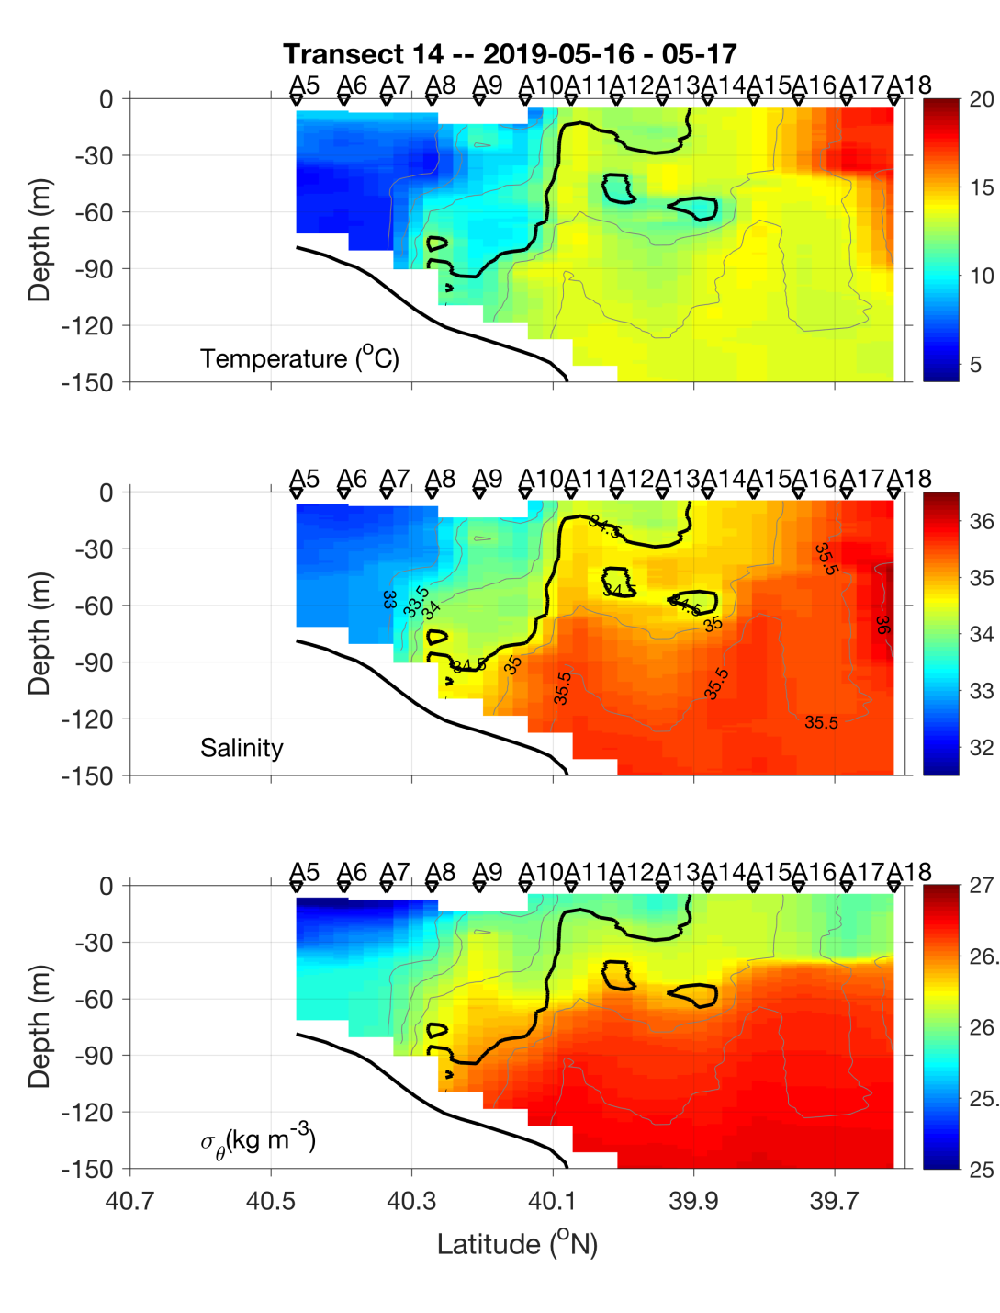
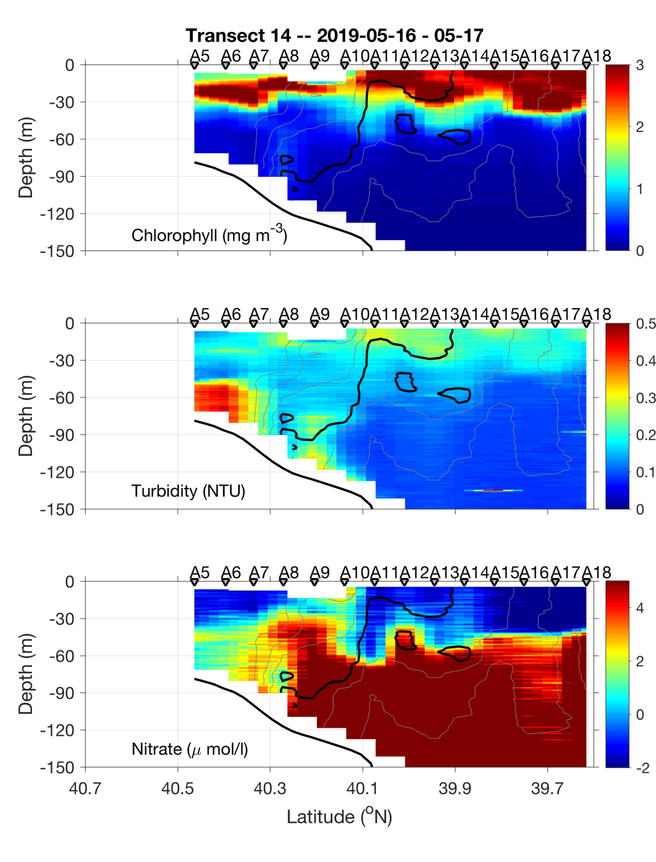
May 16-17

Slide 22
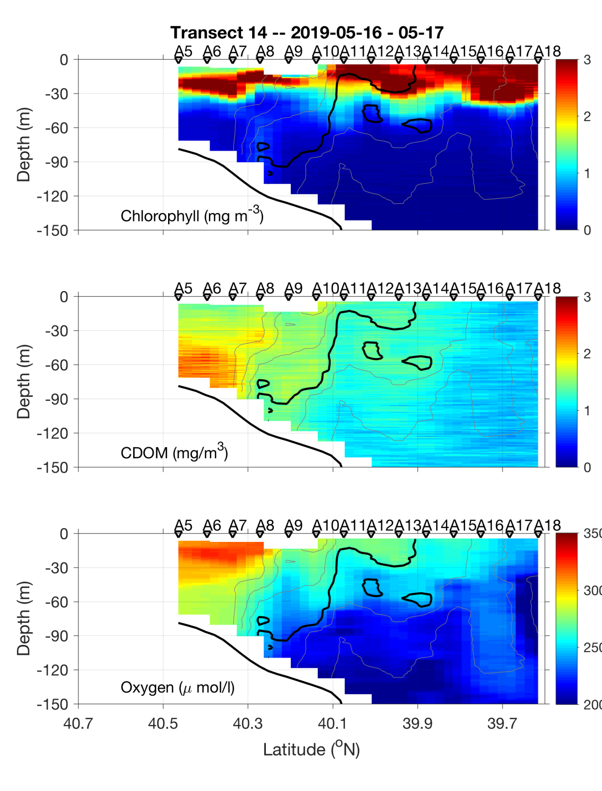
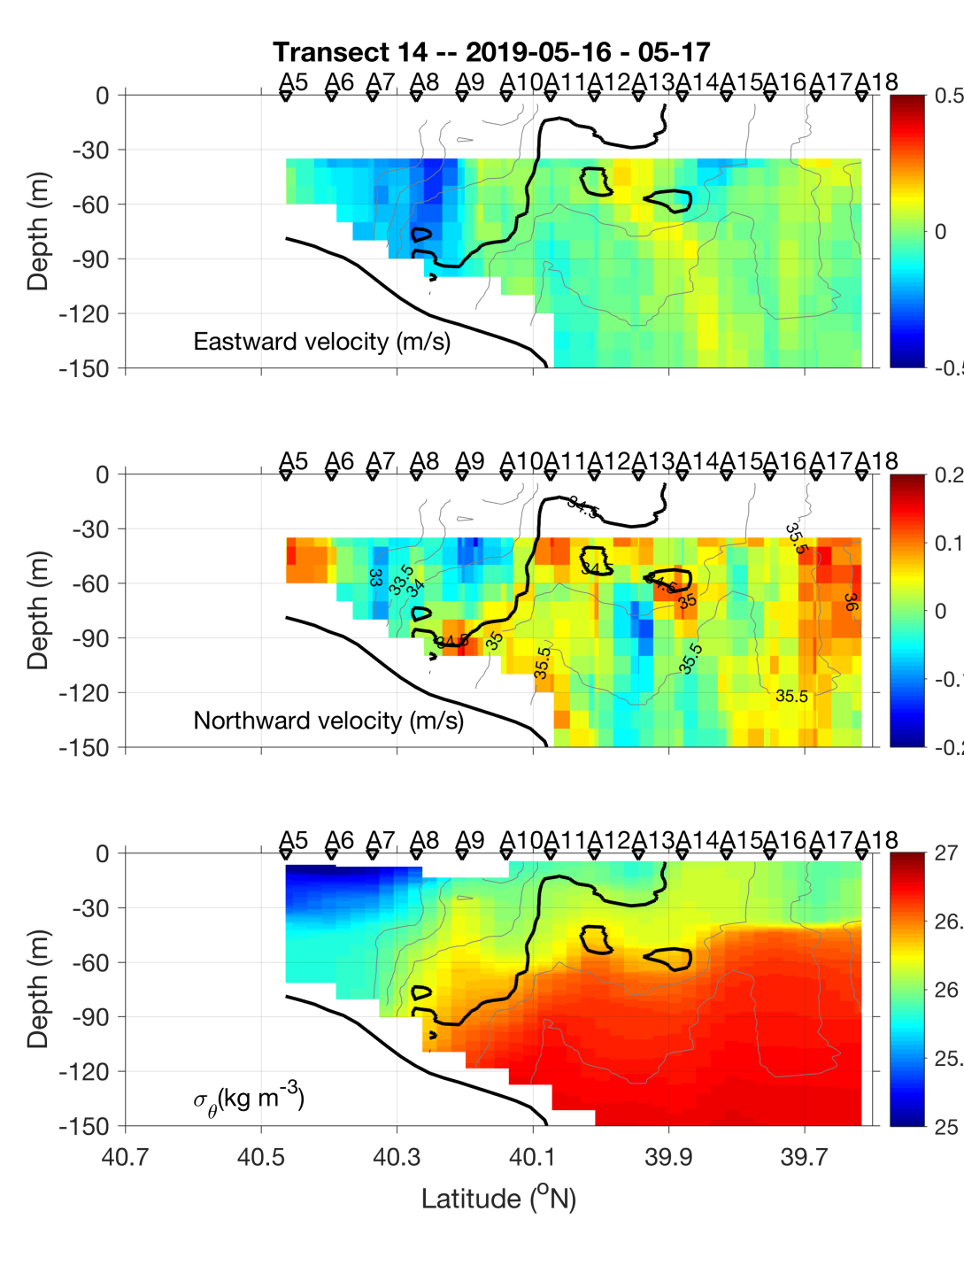
May 16-17

Slide 23
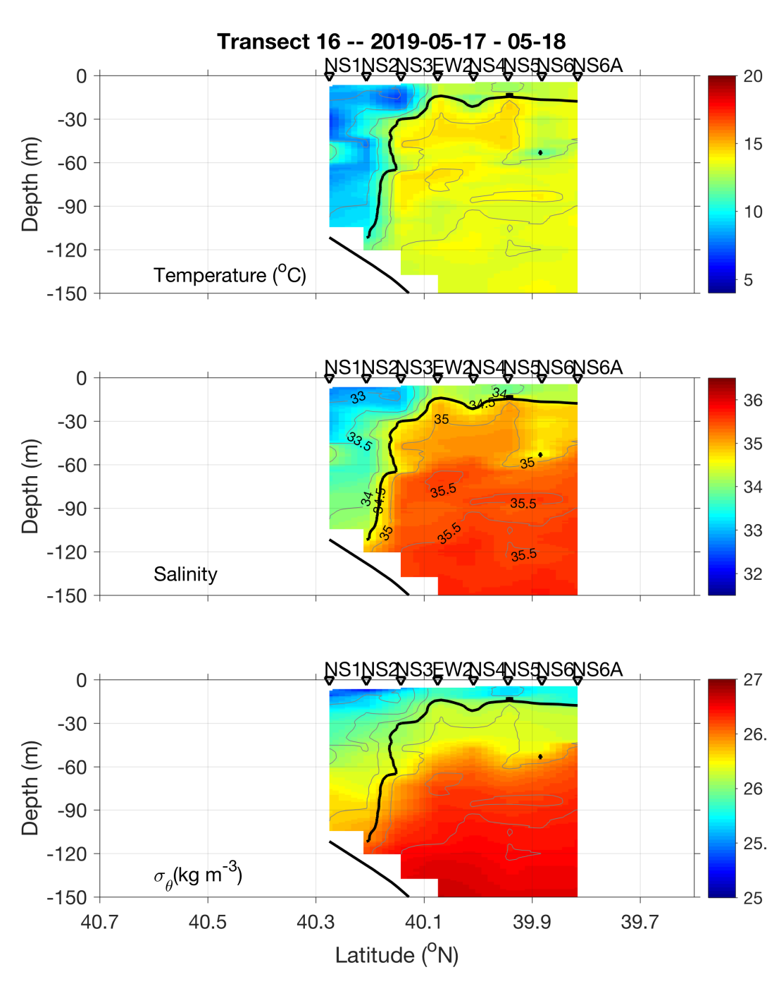
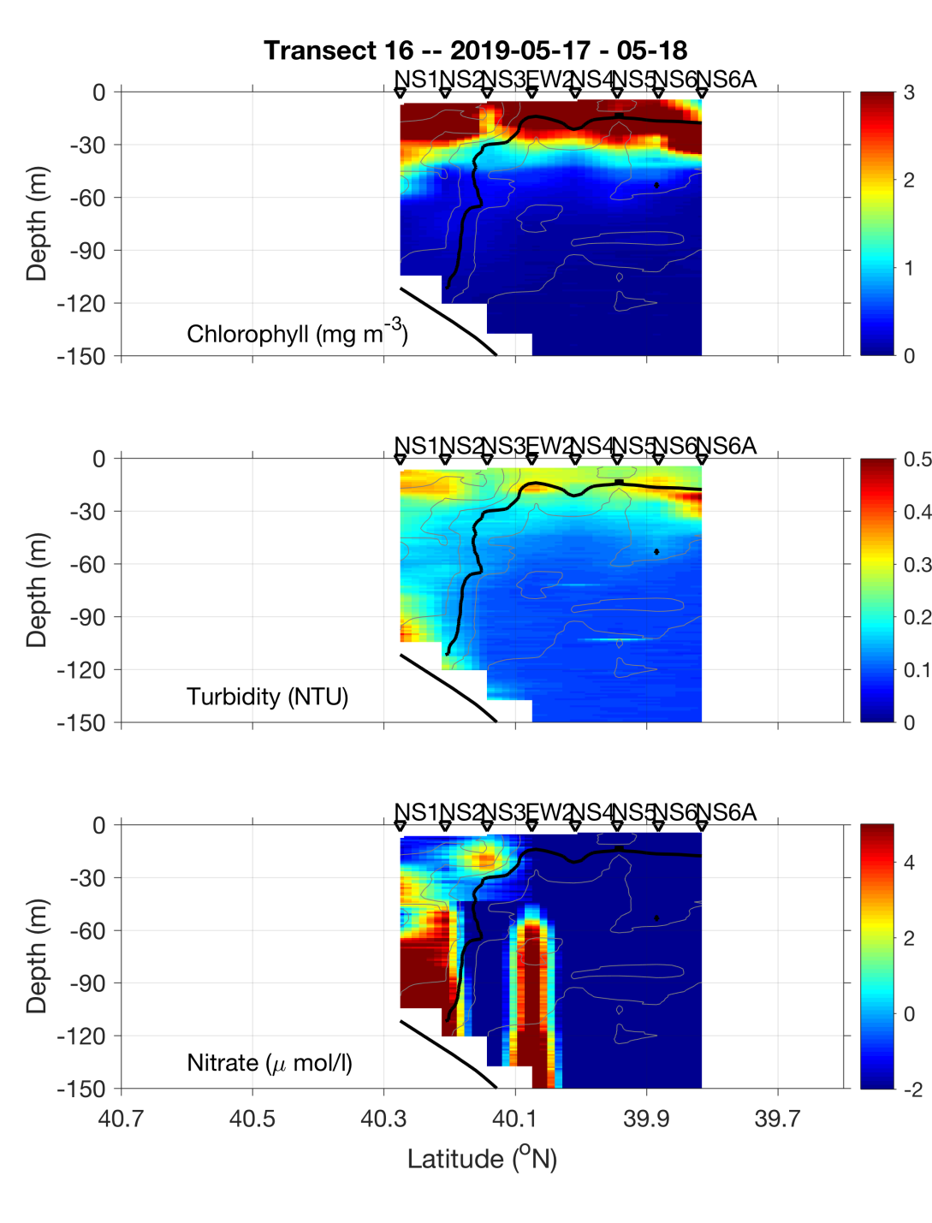
Eddy Survey – NS Section
Eddy
Center
Eddy
Center

Slide 24
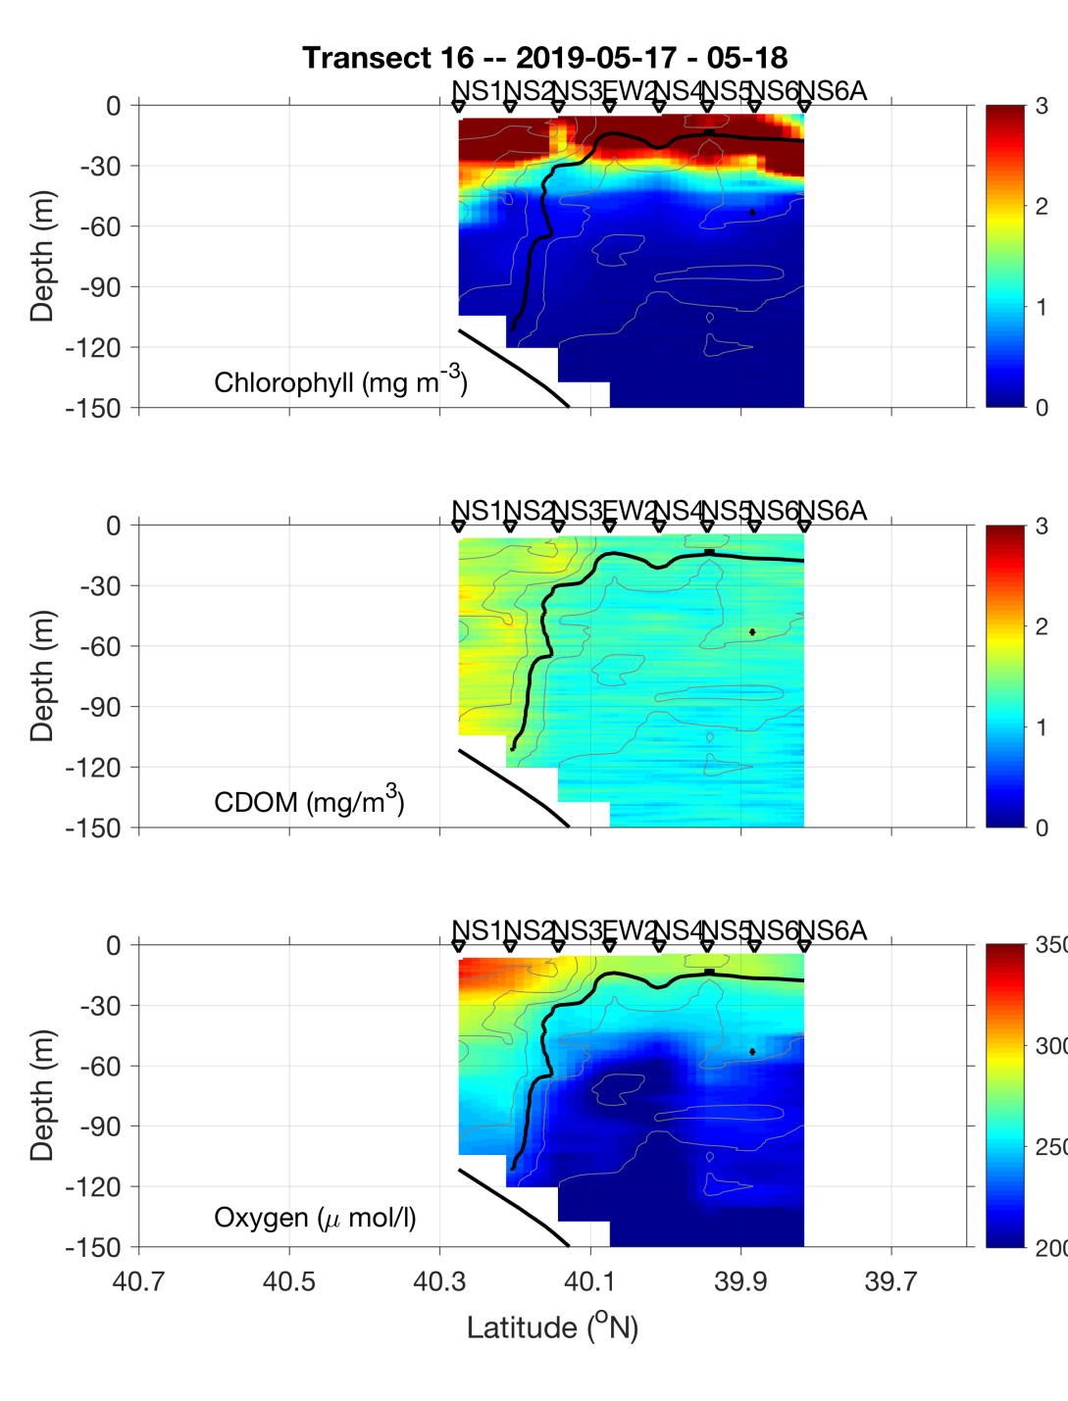
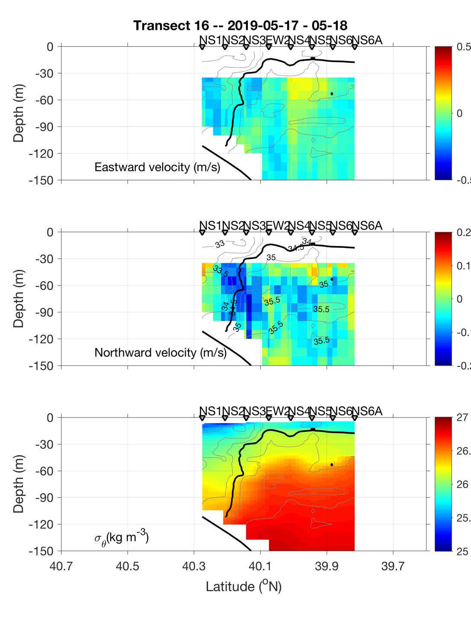
Eddy Survey – NS Section
Eddy
Center
Eddy
Center

Slide 25
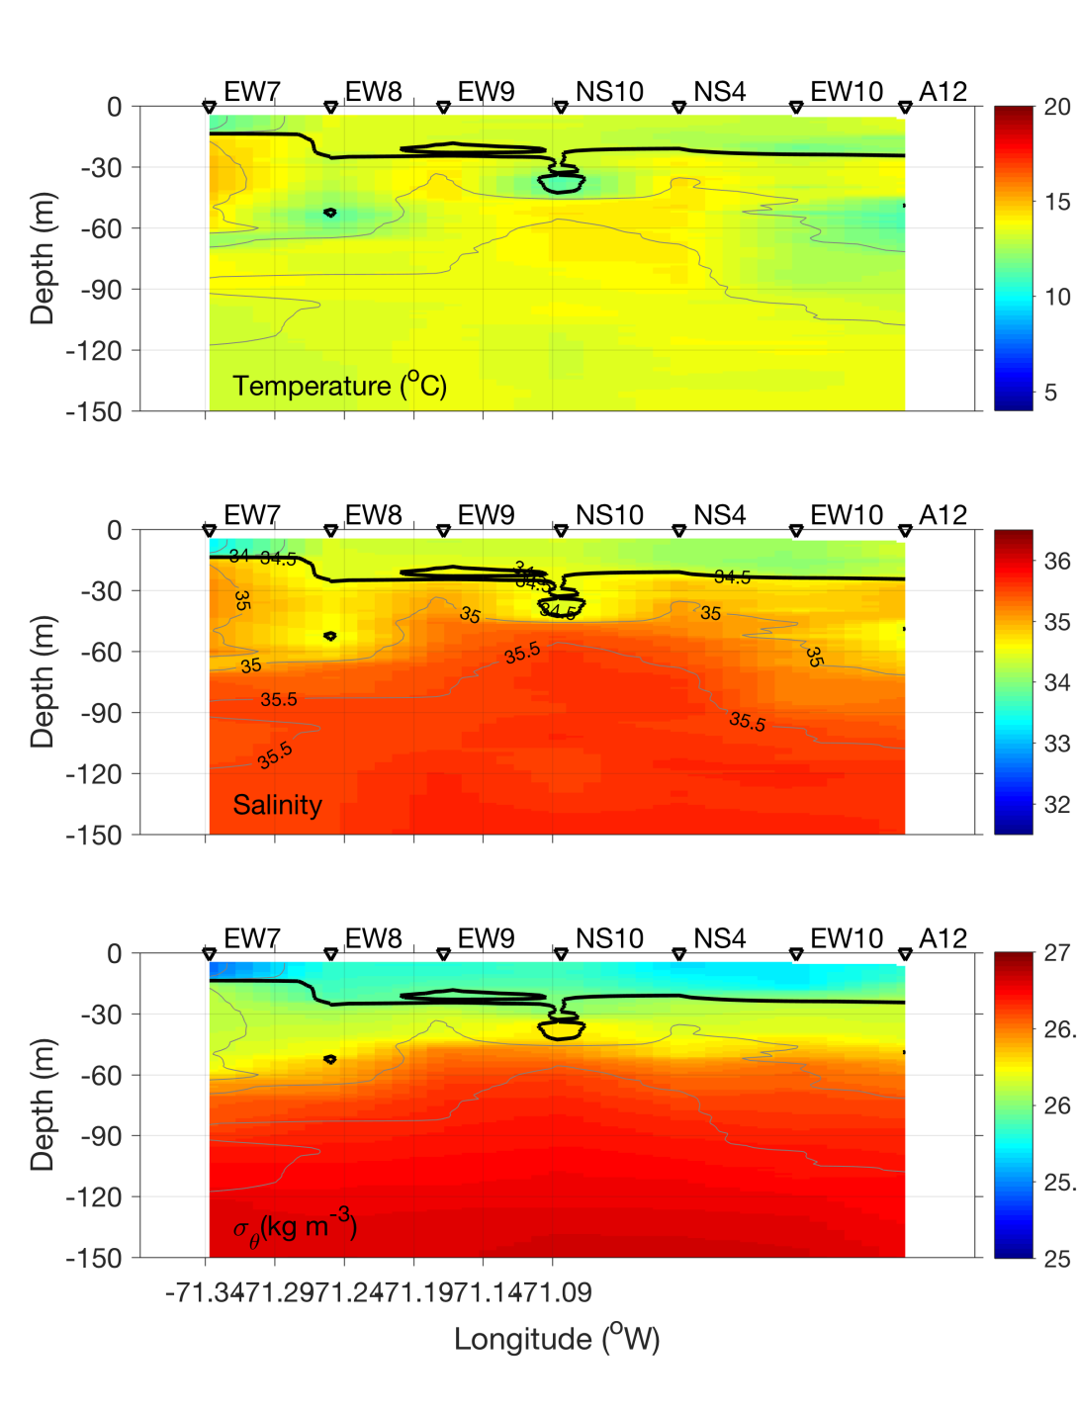
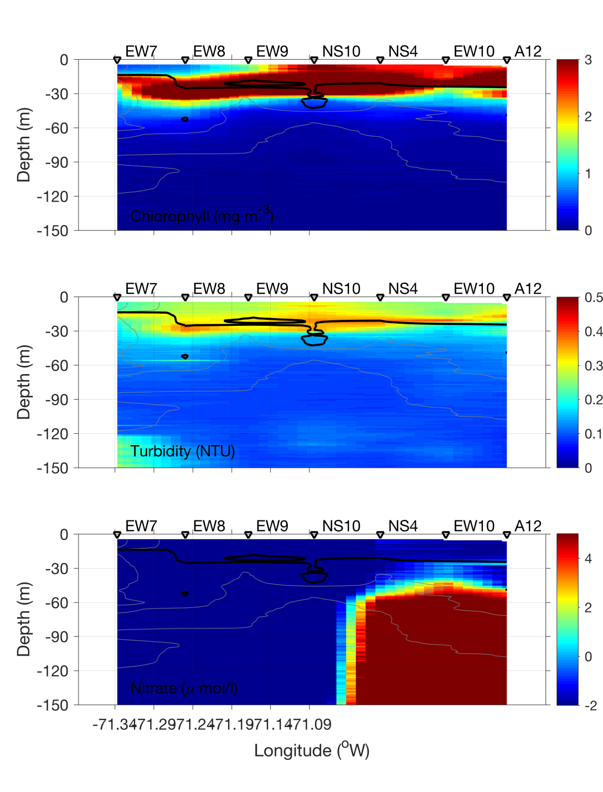
Eddy Survey – EW Section
Eddy
Center
Eddy
Center

Slide 26
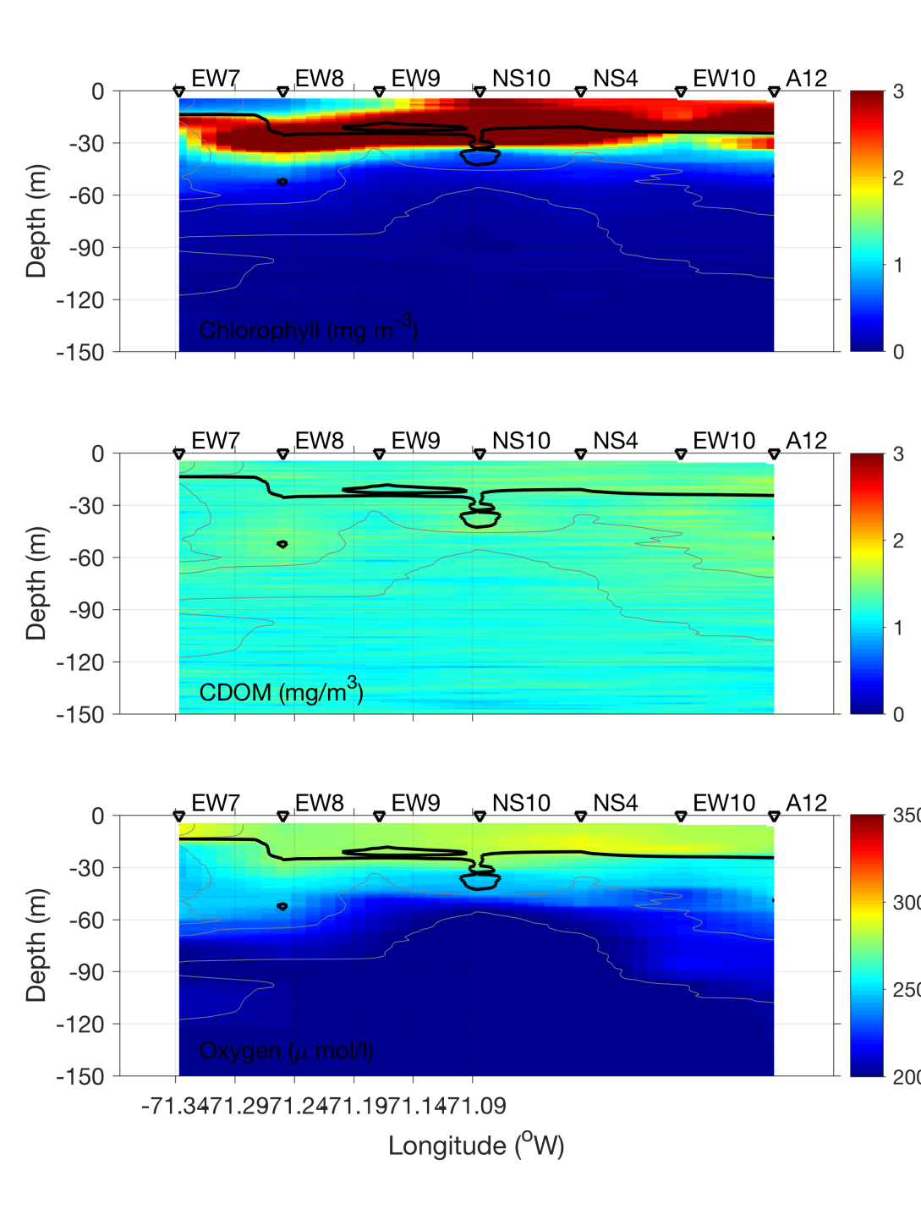
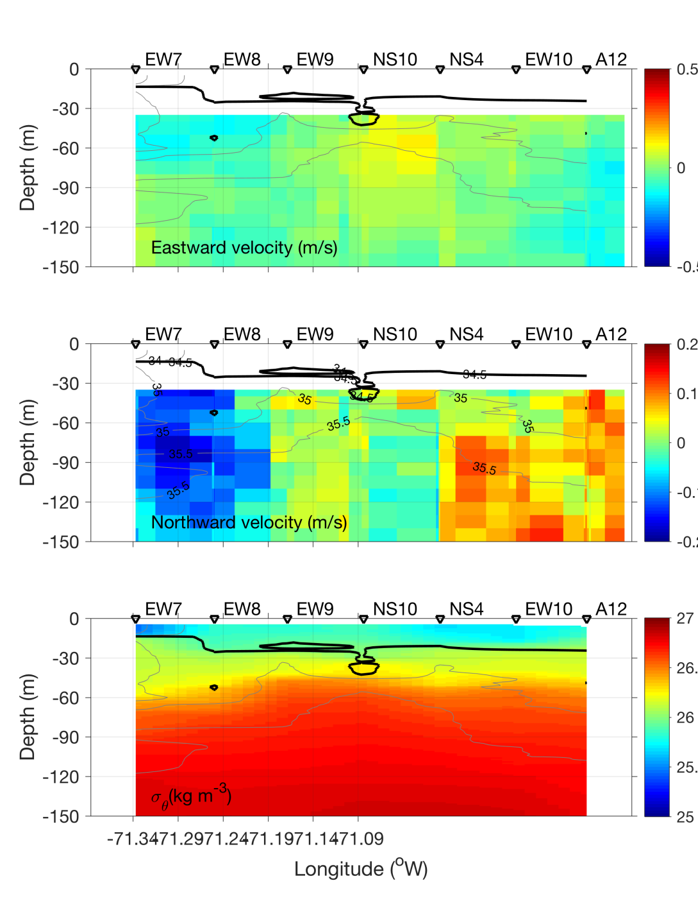
Eddy Survey – EW Section
Eddy
Center
Eddy
Center

Slide 27
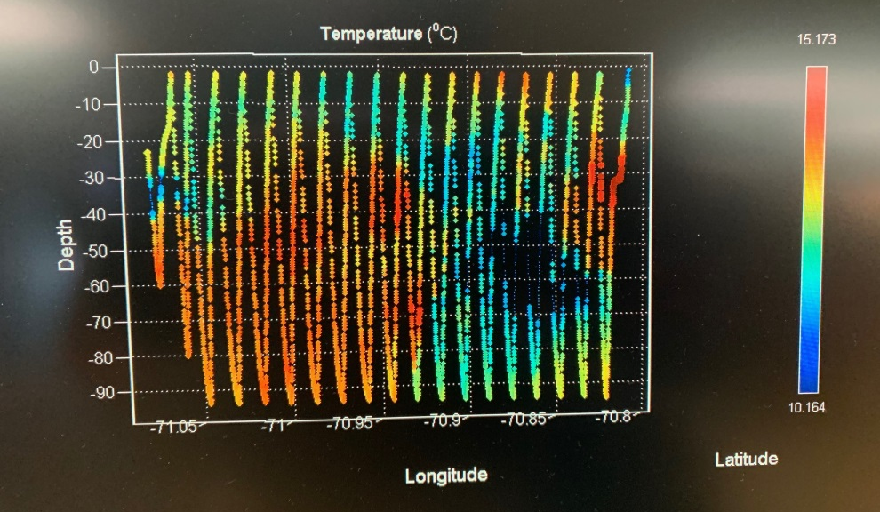
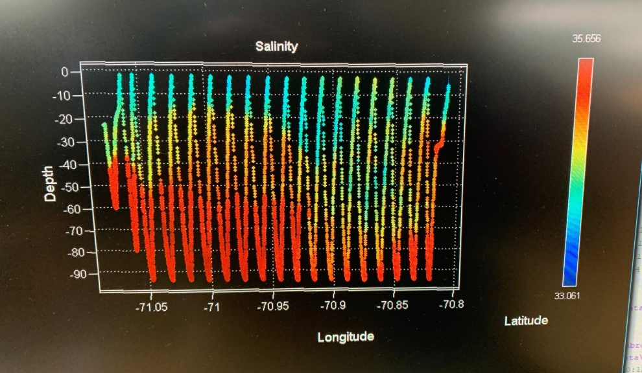
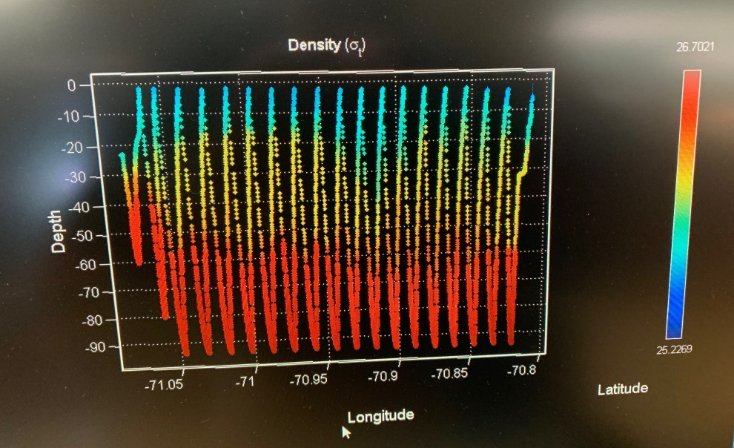

VPR radial survey May 18
Eddy center
Eddy edge
Temperature Salinity
Density Fluorescence

Slide 28

VIIRS Chl May 18

Slide 29

+

Slide 30

SST 18 May

Slide 32

Satellite Altimetry May 15, 2019

Slide 33


