Slide 1
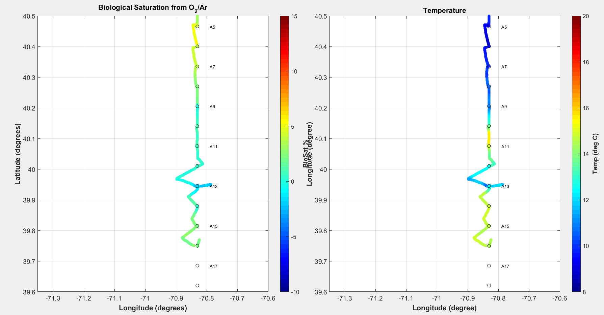
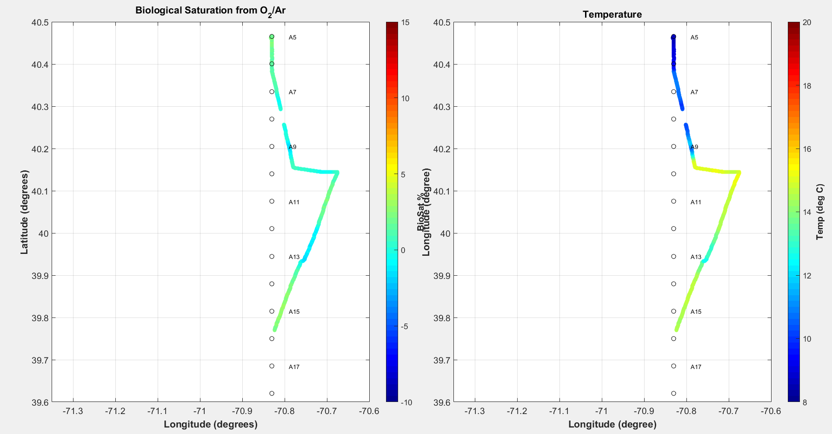
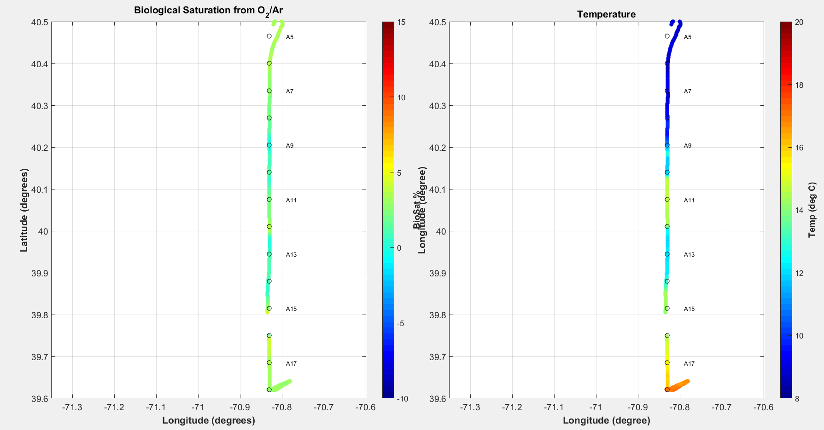
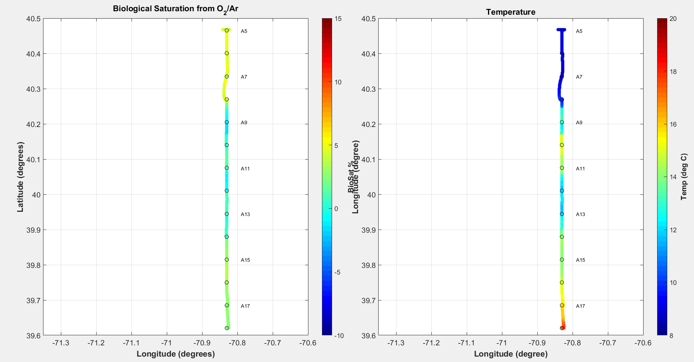
Transect 1 (12th)
Transect 2 (13th)
Transect 5 (14th)
Transect 6 (15th)

Slide 2
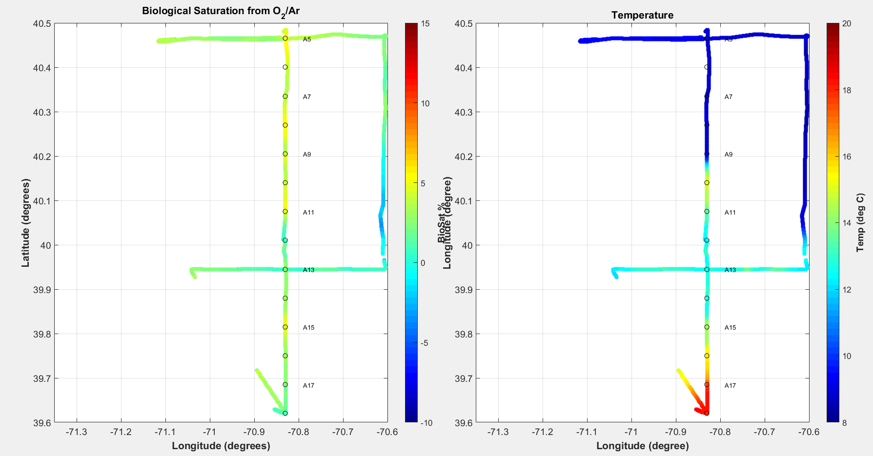
Transects 7-11 (5/15 22:30 to 5/16 9:30)

Slide 3
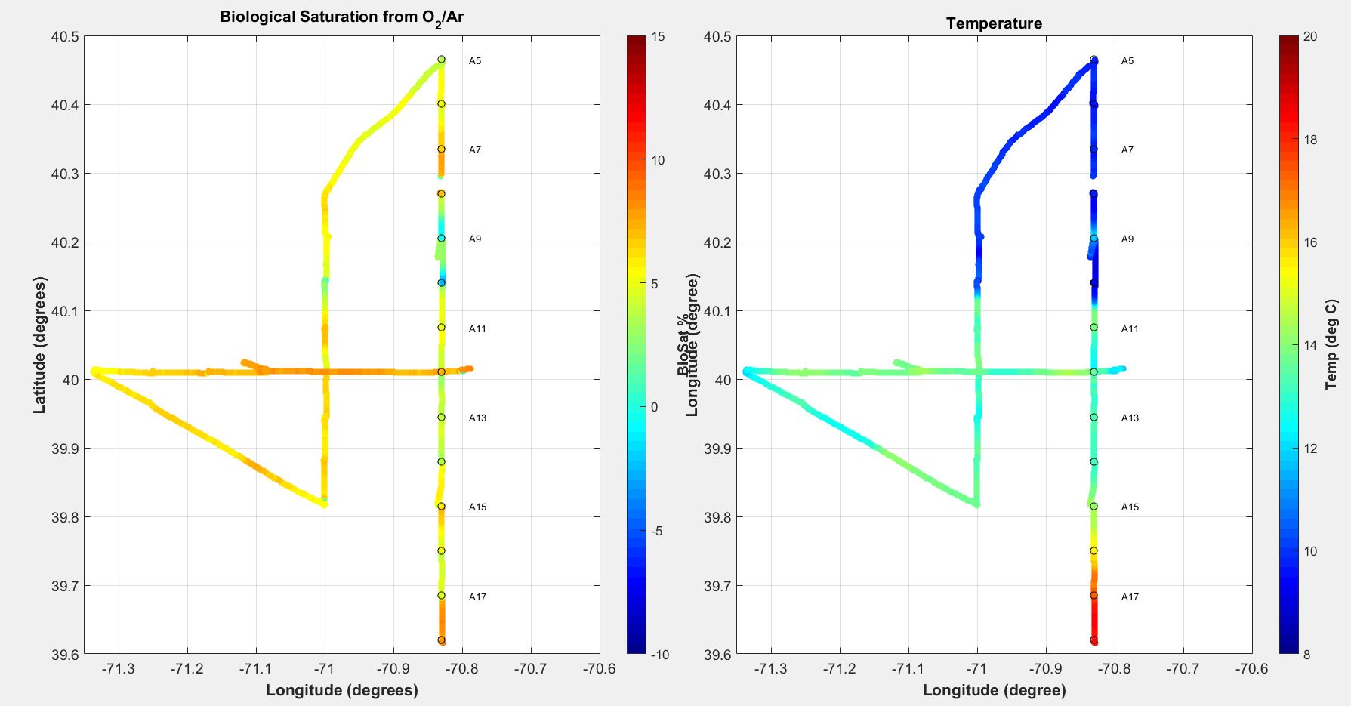
Transects 14 – 18 (17th-18th)

Slide 4
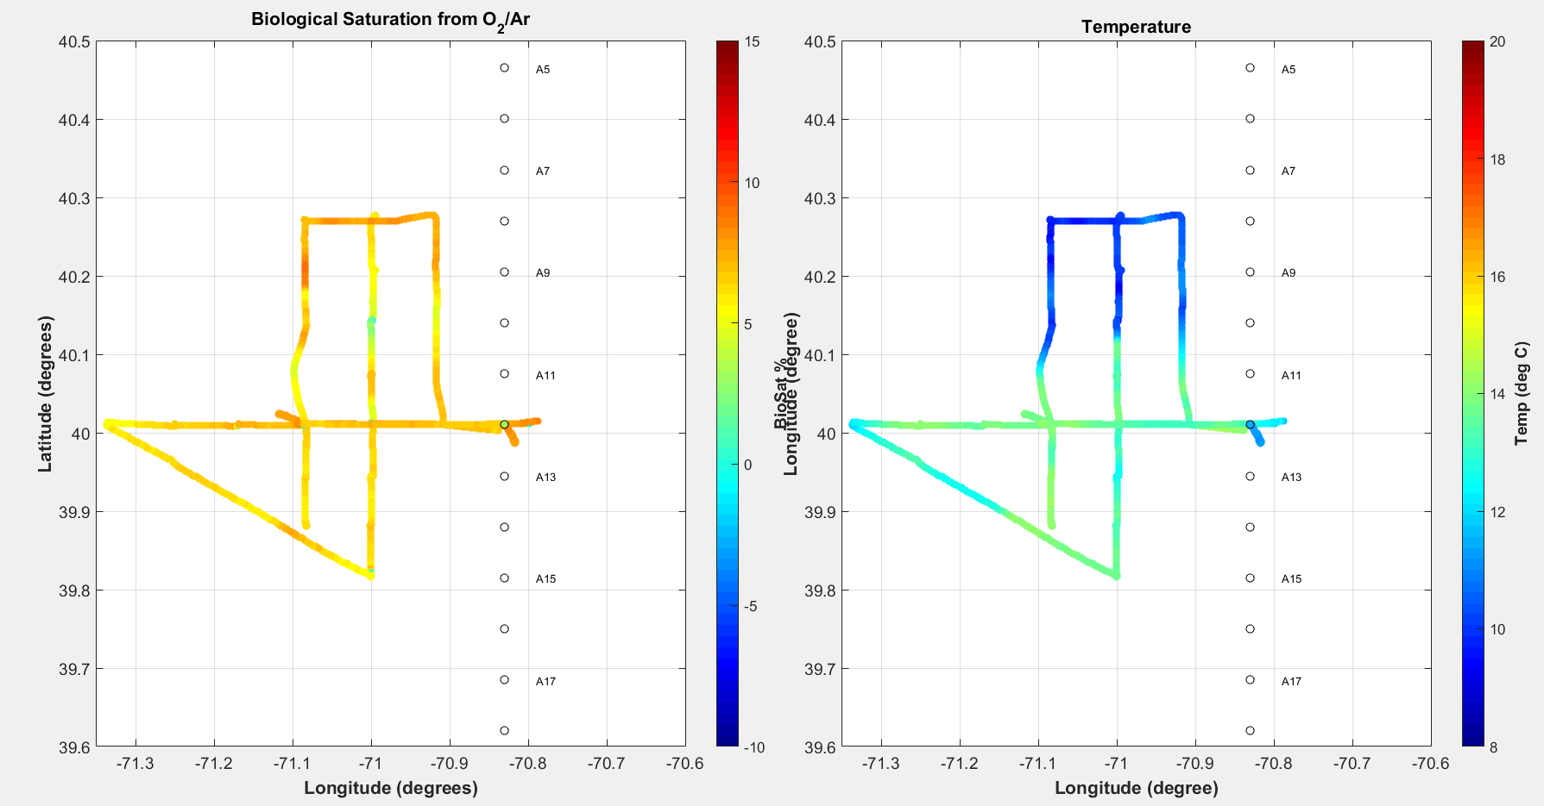
Eddy Survey Underway Transects 16-25 (17th-19th)

Slide 5
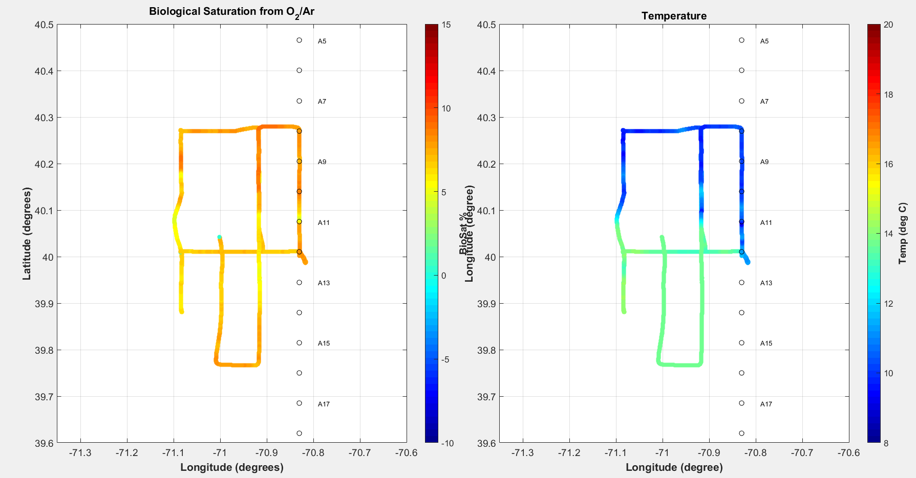
Transects 20 – 30 VPR Survey+ (19th)

Slide 6
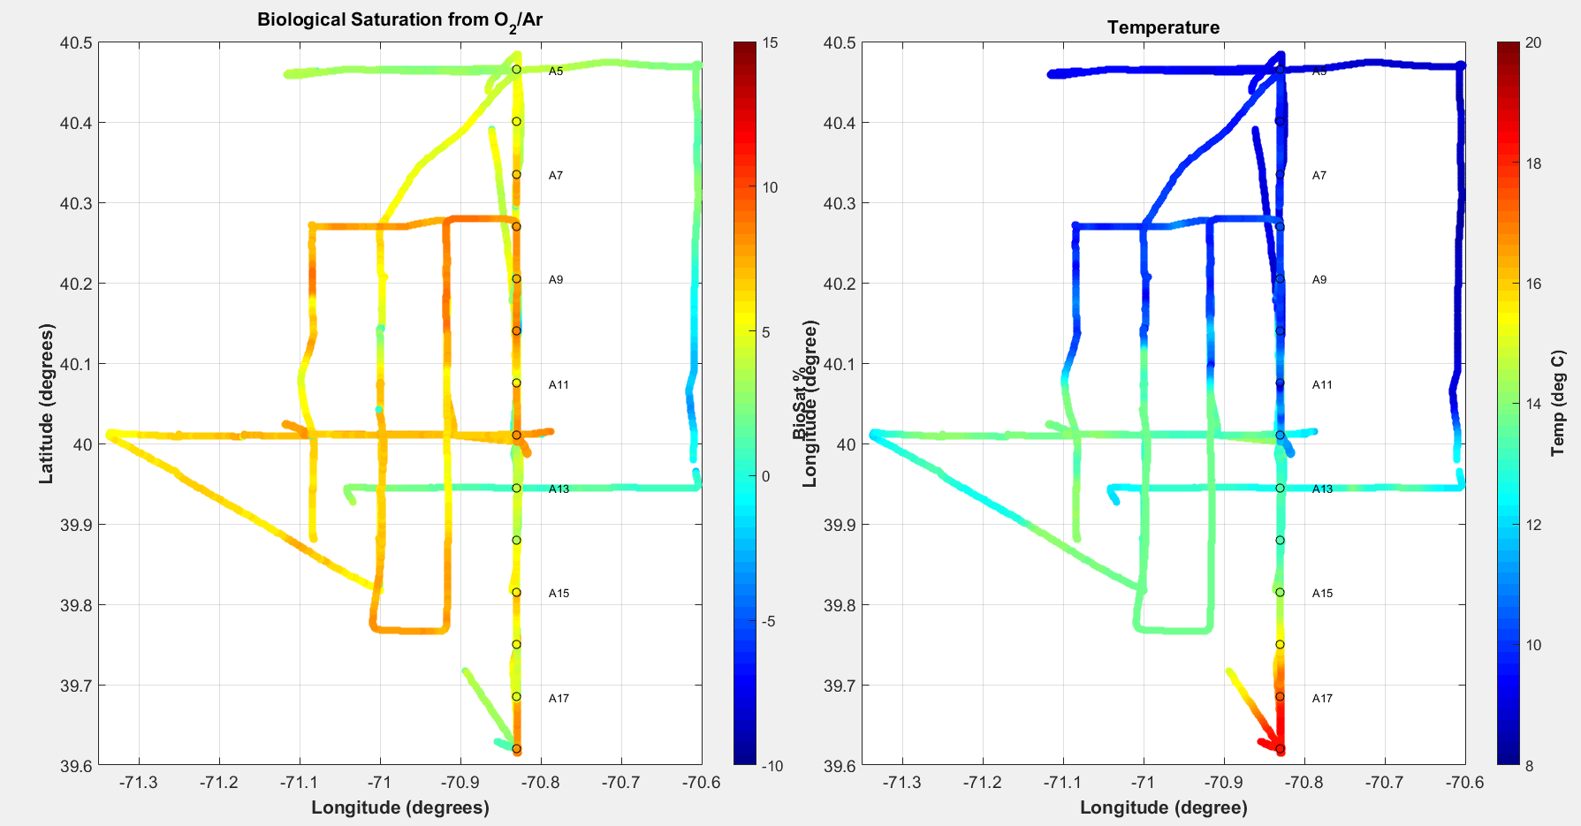
Transects 7 – 30 (15 – 19th)

