Slide 1
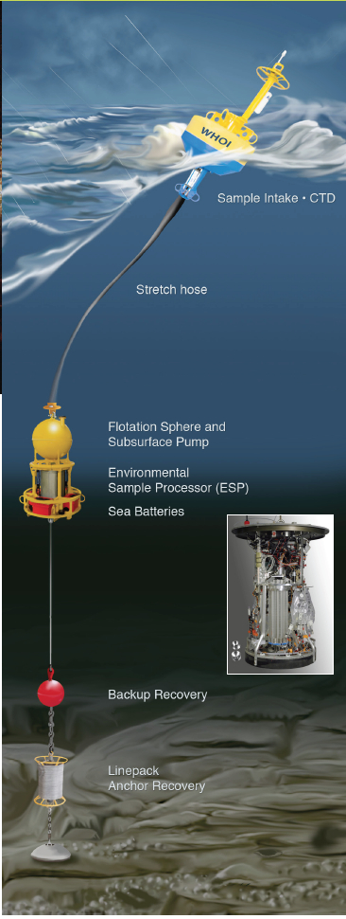
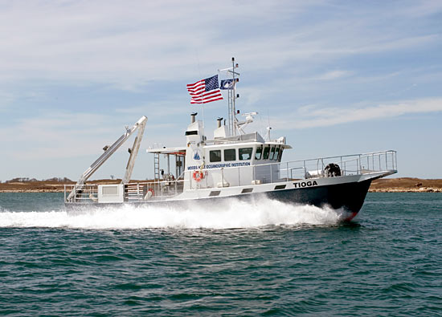
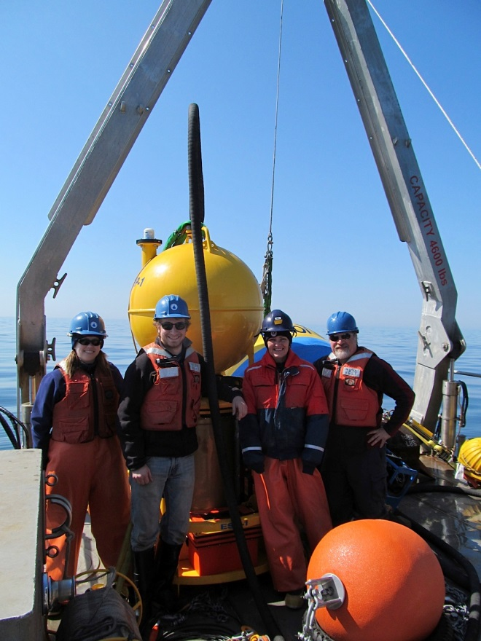
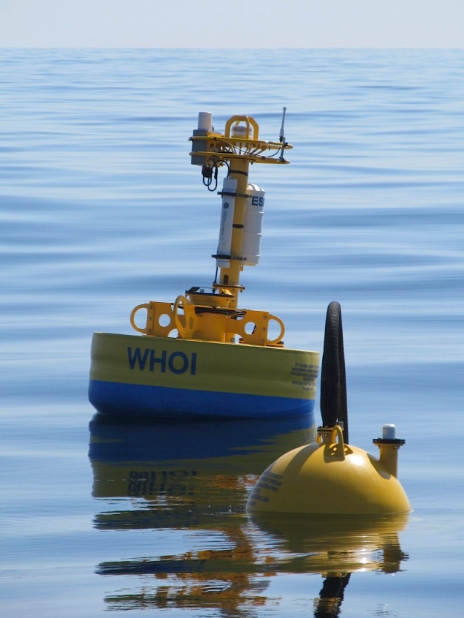
Dynamics of harmful algal blooms:
rapid response sampling of key processes
Dennis J. McGillicuddy, Jr., Project PI
Donald M. Anderson, Co-Investigator
Katherine A. Hubbard, Co-Investigator

Slide 2
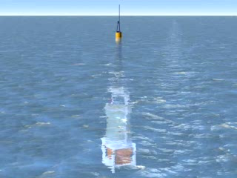
Environmental Sample Processor (C. Scholin)

Slide 3
Specific Aims
1. Monitor ESP real-time data to identify key bloom events (A. fundyense, Pseudo-nitzschia spp.)
2. Carry out rapid-response sampling of key bloom processes identified by ESP data streams
3. Conduct laboratory measurements of vital rates of toxic Pseudo-nitzschia species
4. Incorporate process understanding into models

Slide 4
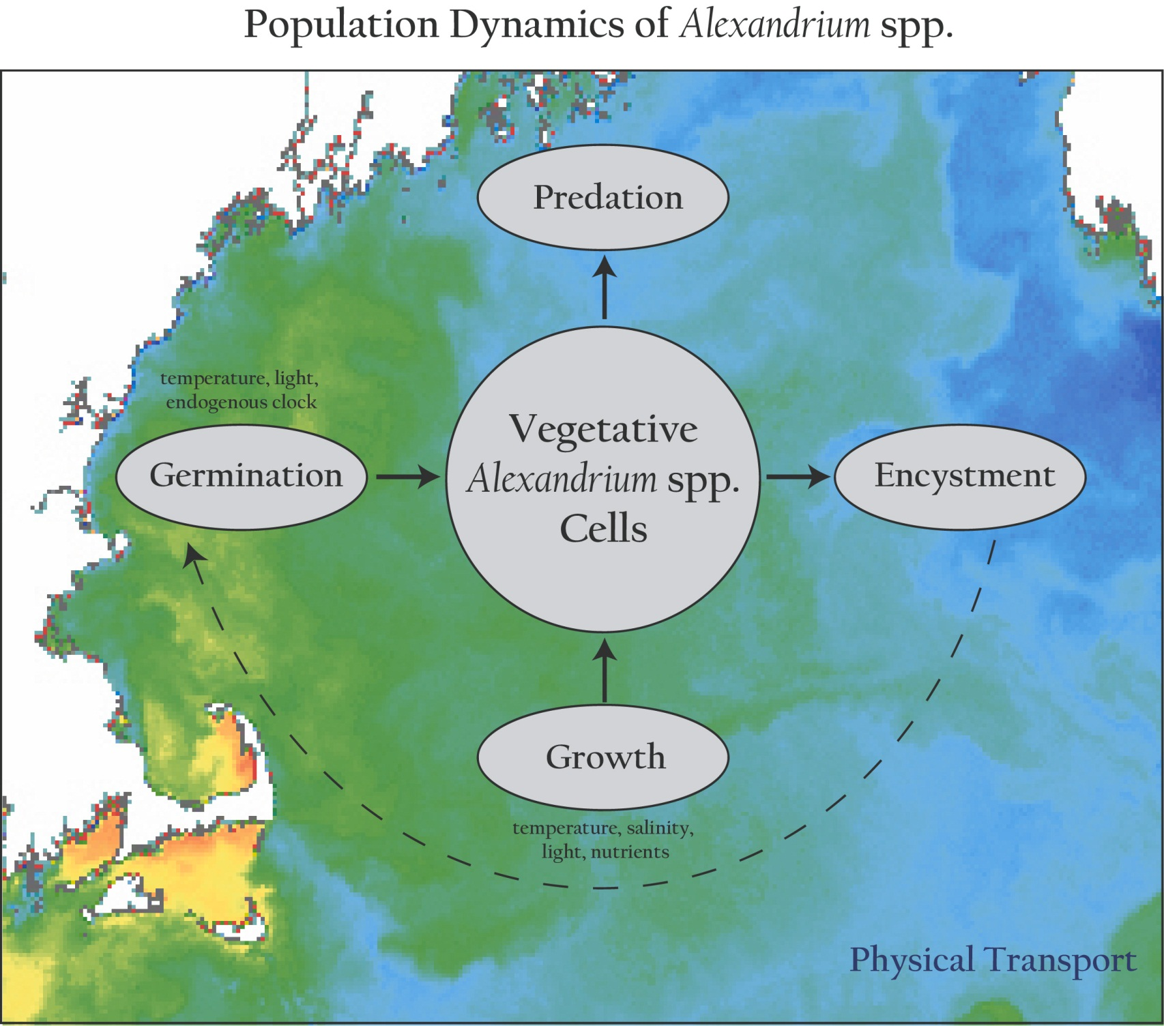
Population dynamics of Alexandrium spp.
Notes:
Our approach in this modeling effort is to incorporate what is known about the population dynamics of Alexandrium into 3-d circulation models of the region.
Fundamental to this approach is the concept that the ecosystem in which A.f. resides is not explicitly modeled. This is justified on the basis that, with very few exceptions, A.f. constitutes a very small fraction of the total phytoplankton species assemblage in the GOM. As such, it does not materially affect either the ambient nutrient concentrations nor predator abundances. Therefore these “ecosystem effects” can be parameterized through their influence on the vital rates of A.f.’s population dynamics.
These processes within the population dynamics are complex functions of environmental parameters, such as temperature, salinity, light and nutrients in the case of vegetative growth, and temperature, light and an endogenous clock in the case of germination.
All of this takes place in an complex, turbulent, three-dimensional fluid medium, some characteristics of which are evident in the sea surface temperature image on which this cartoon is overlayed.
What I’d like to emphasize here is that the linkage between the population dynamics of Alexandrium (or any other planktonic species for that matter) and the physical environment is twofold: first, the rates of the population dynamics processes are influenced by environmental variables, and second, the spatial distributions of the populations themselves are constantly being stirred and rearranged the currents. The duality of this linkage between the population dynamics and the physical environment is what makes coupled physical/biological problems in the ocean so incredibly complex. Our hope is that the use of models will help untangle this complexity, and provide insight into what controls blooms of Alexandrium in the Gulf of Maine.

Slide 5
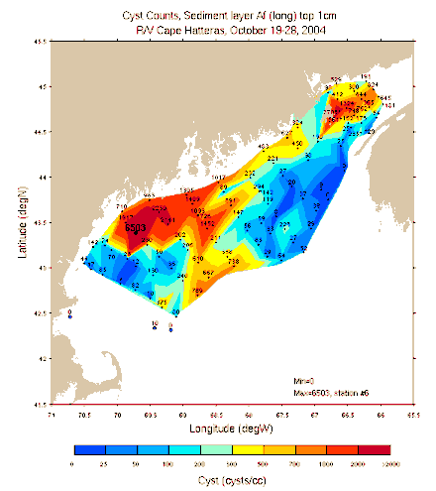
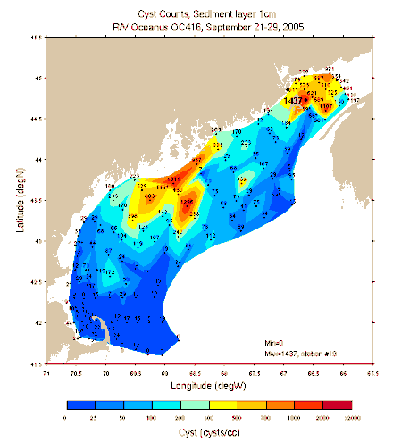
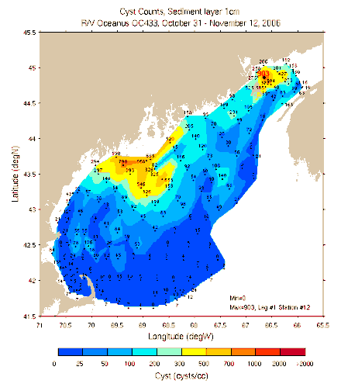
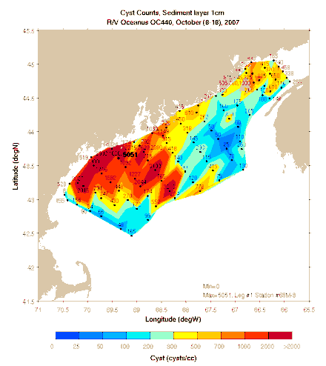
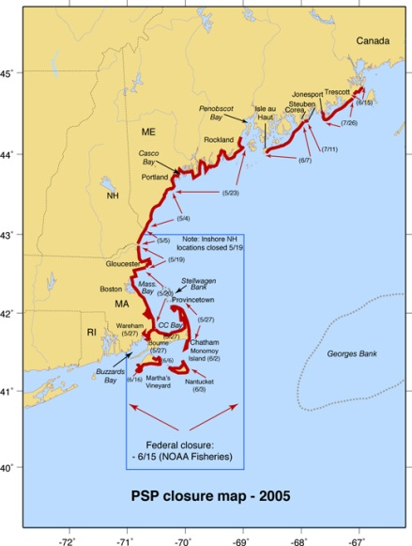
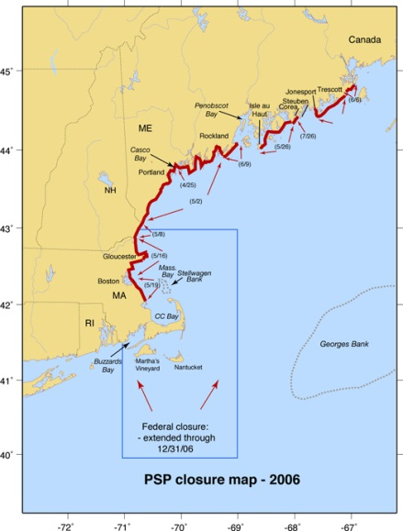
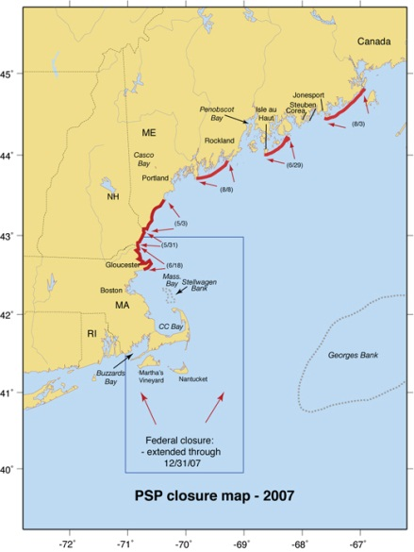
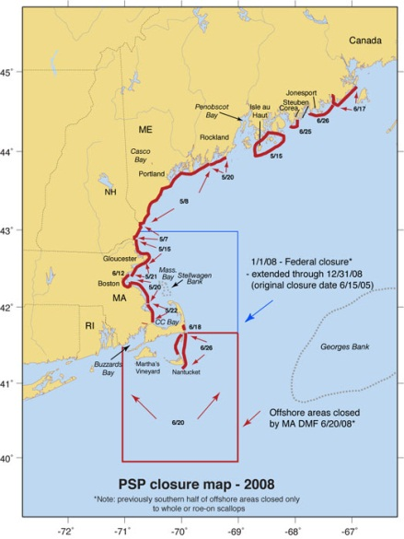
H₁: Interannual variations in bloom severity result from fluctuations in cyst abundance
Cysts 2004 2005 2006 2007
Toxicity 2005 2006 2007 2008

Slide 6
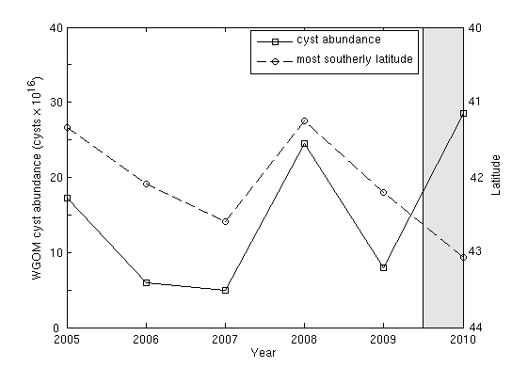
Cyst abundance and toxicity
2005-2009: r=-0.93
Toxicity extent
Cysts
McGillicuddy et al. 2011 L&O

Slide 7
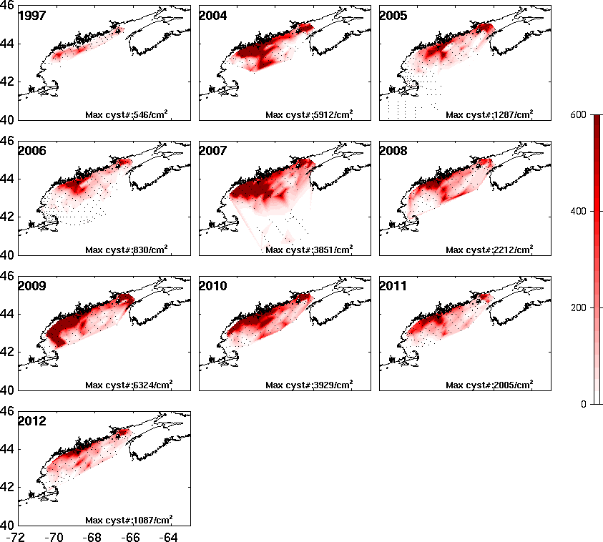

Cyst abundance used for
2013 seasonal ensemble forecast
Cyst abundance 2004-2013

Slide 8
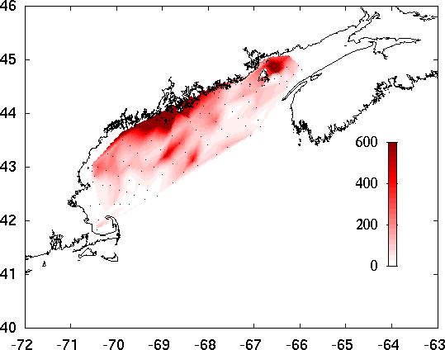
2013 seasonal
ensemble forecast
Hydrodynamics
2004
Benthic cyst
abundance
Scenario 1
Scenario 2
Scenario 3
Scenario 4
Scenario 5
Scenario 6
Scenario 7
Scenario 8
Scenario 9
2005
2006
2013
2007
2008
2009
2010
2011
2012
Notes:
8

Slide 9
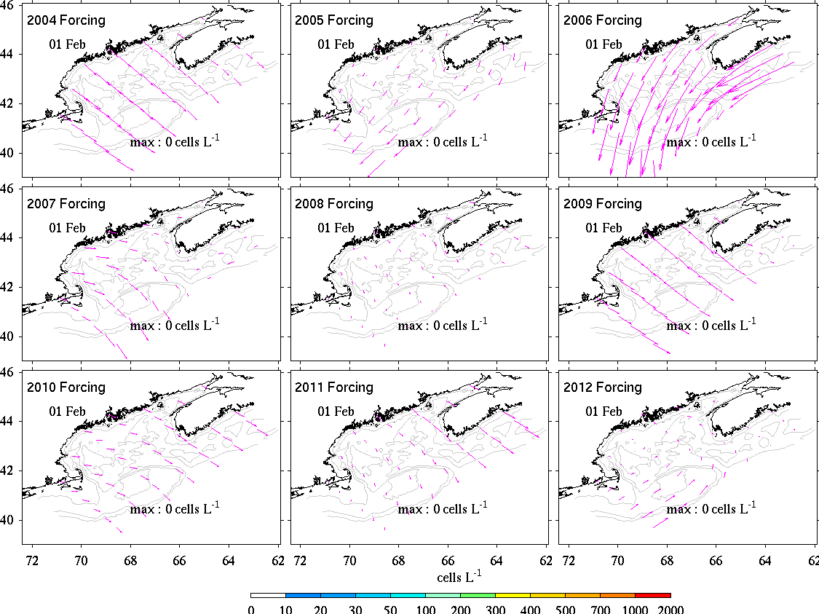
Online animation: http://omglnx3.meas.ncsu.edu/yli/13ensemble_2d/dino_13ensemble.htm

Slide 10
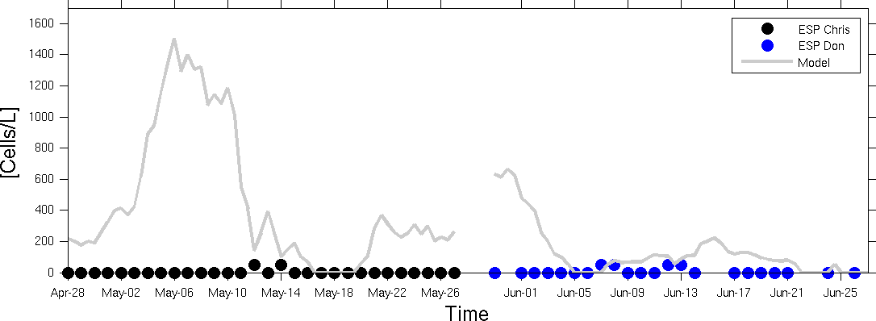
ESP observations and
model forecast concentrations
Model

Slide 11
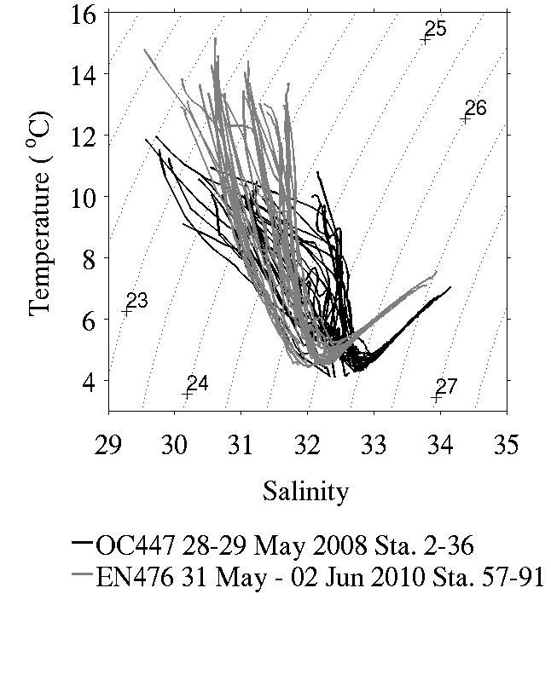
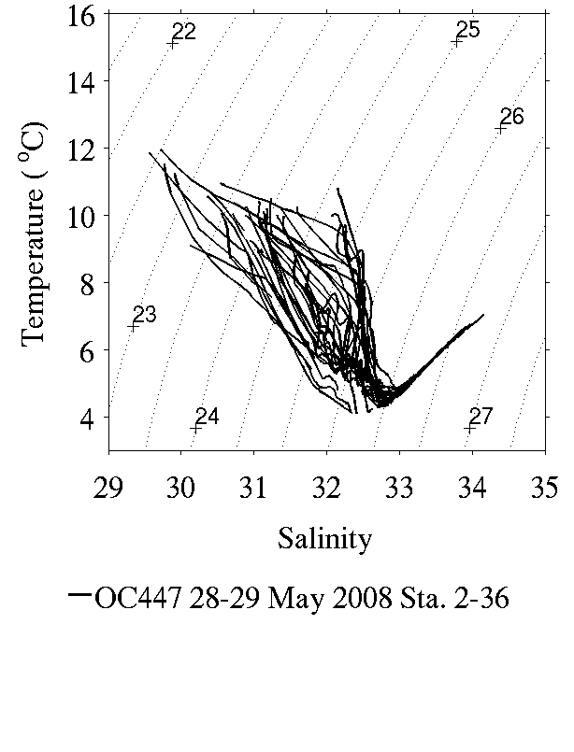
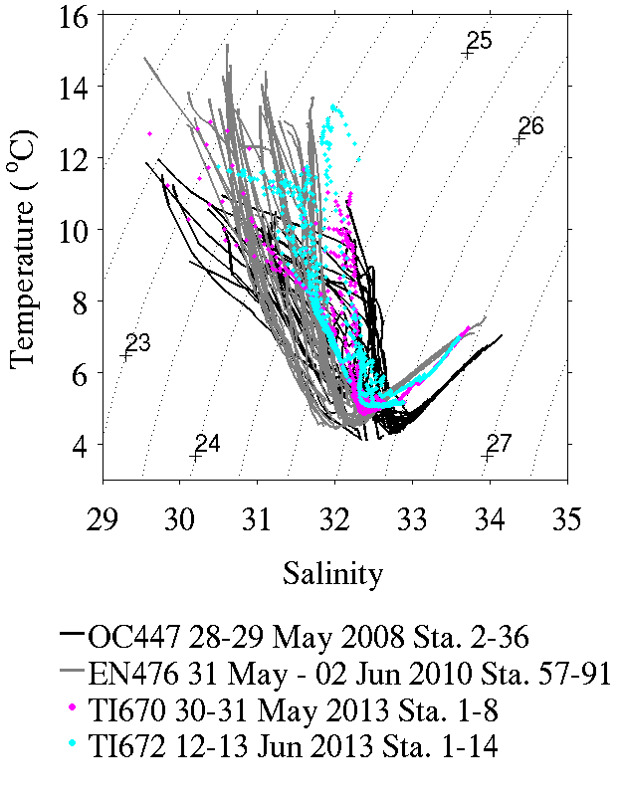
WGOM water mass characteristics
2013
2010
anomaly
2010
anomaly
2008
“normal”
2008
“normal”

Slide 12
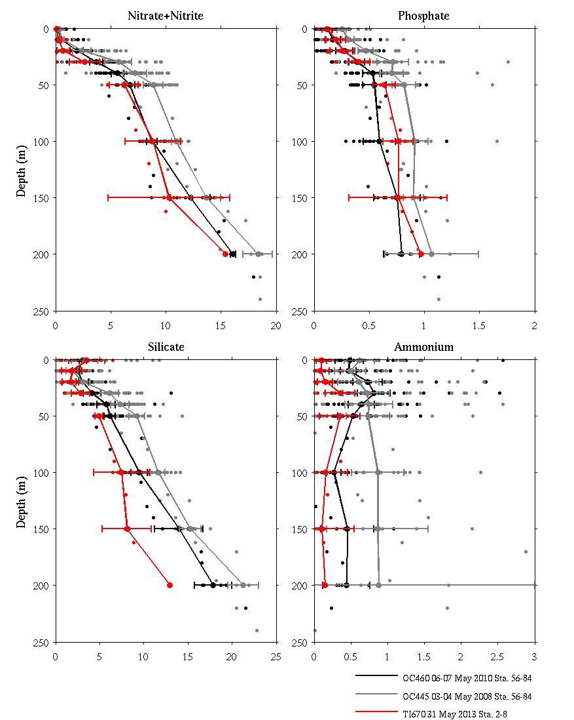
WGOM nutrient concentrations
May 2008
May
2013
May 2010
Nitrate + Nitrite (µM)

Slide 13
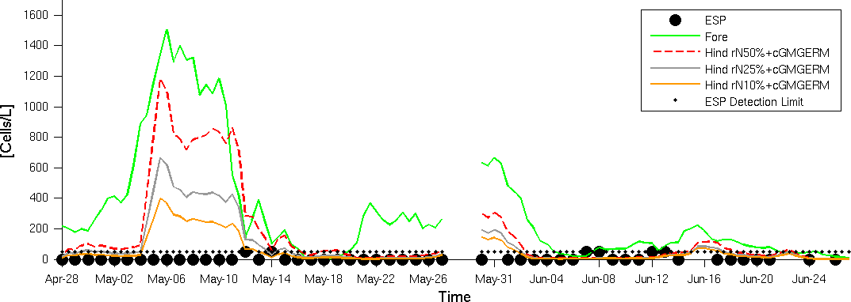
ESP observations and
model hindcast concentrations
Forecast
Hindcast T, 50% NO₃
Hindcast T, 25% NO₃
Hindcast T, 10% NO₃
ESP
Forecast
Hindcast T bias, 50% NO₃
Hindcast T bias, 25% NO₃
Hindcast T bias, 10% NO₃
ESP Detection limit

Slide 14
Summary: A. fundyense in 2013
Fall 2012 cyst abundance suggested a moderate bloom of A. fundyense in spring 2013, all other things equal
Water mass anomaly similar to 2010 led to unfavorable growing conditions; potential for moderate bloom not realized
Hindcast simulations (warmer, lower nutrients) more consistent with observations
ESP data stream essential in assessing offshore abundance of A. fundyense
COHH rapid-response sampling essential for measurement of oceanographic conditions.

Slide 15
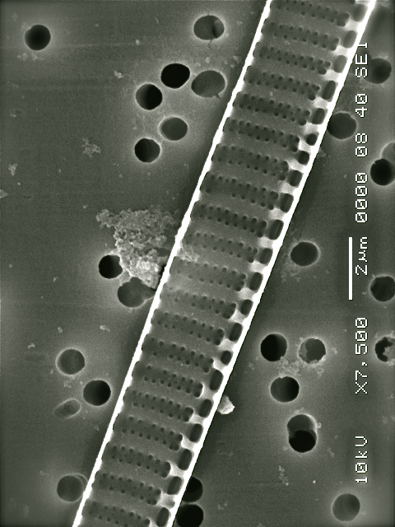
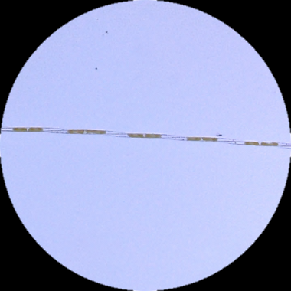
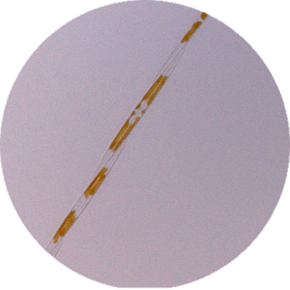
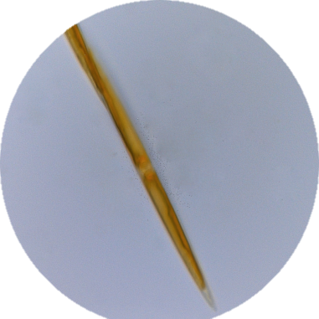
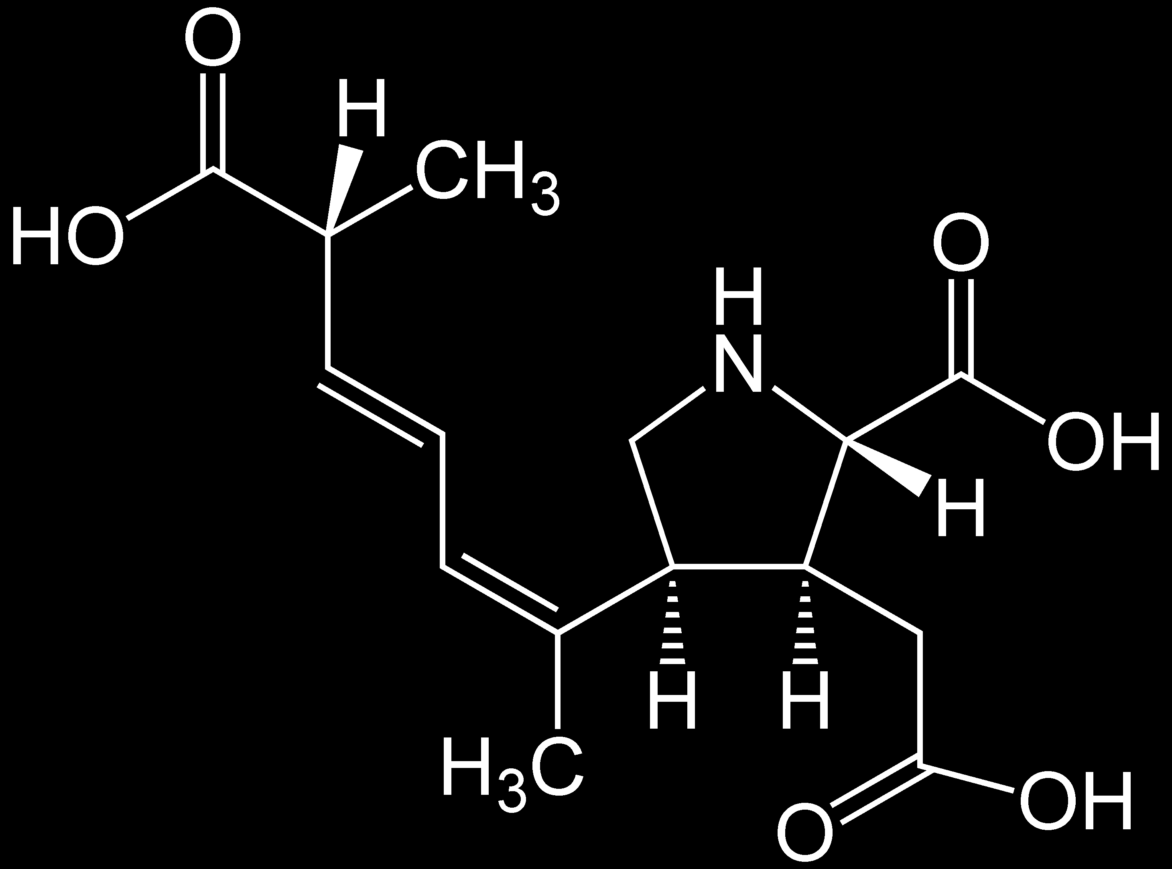
The toxigenic diatom Pseudo-nitzschia
Broadly distributed
  In all major oceans
  From the equator to the poles
  Toxic blooms and shellfish harvest closures common on US West Coast; 1st FL closure 2013
2 μm
O’Dea et al. poster
Currently >40 described species in genus
Some species produce neurotoxin domoic acid (DA)…
Domoic acid
but toxin production is not constitutive.
Notes:
http://www.alaskaoutdoorjournal.com/Articles/recordclams.html
http://www.q13fox.com/news/kcpq-redtides-061310,0,485967.story

Slide 16
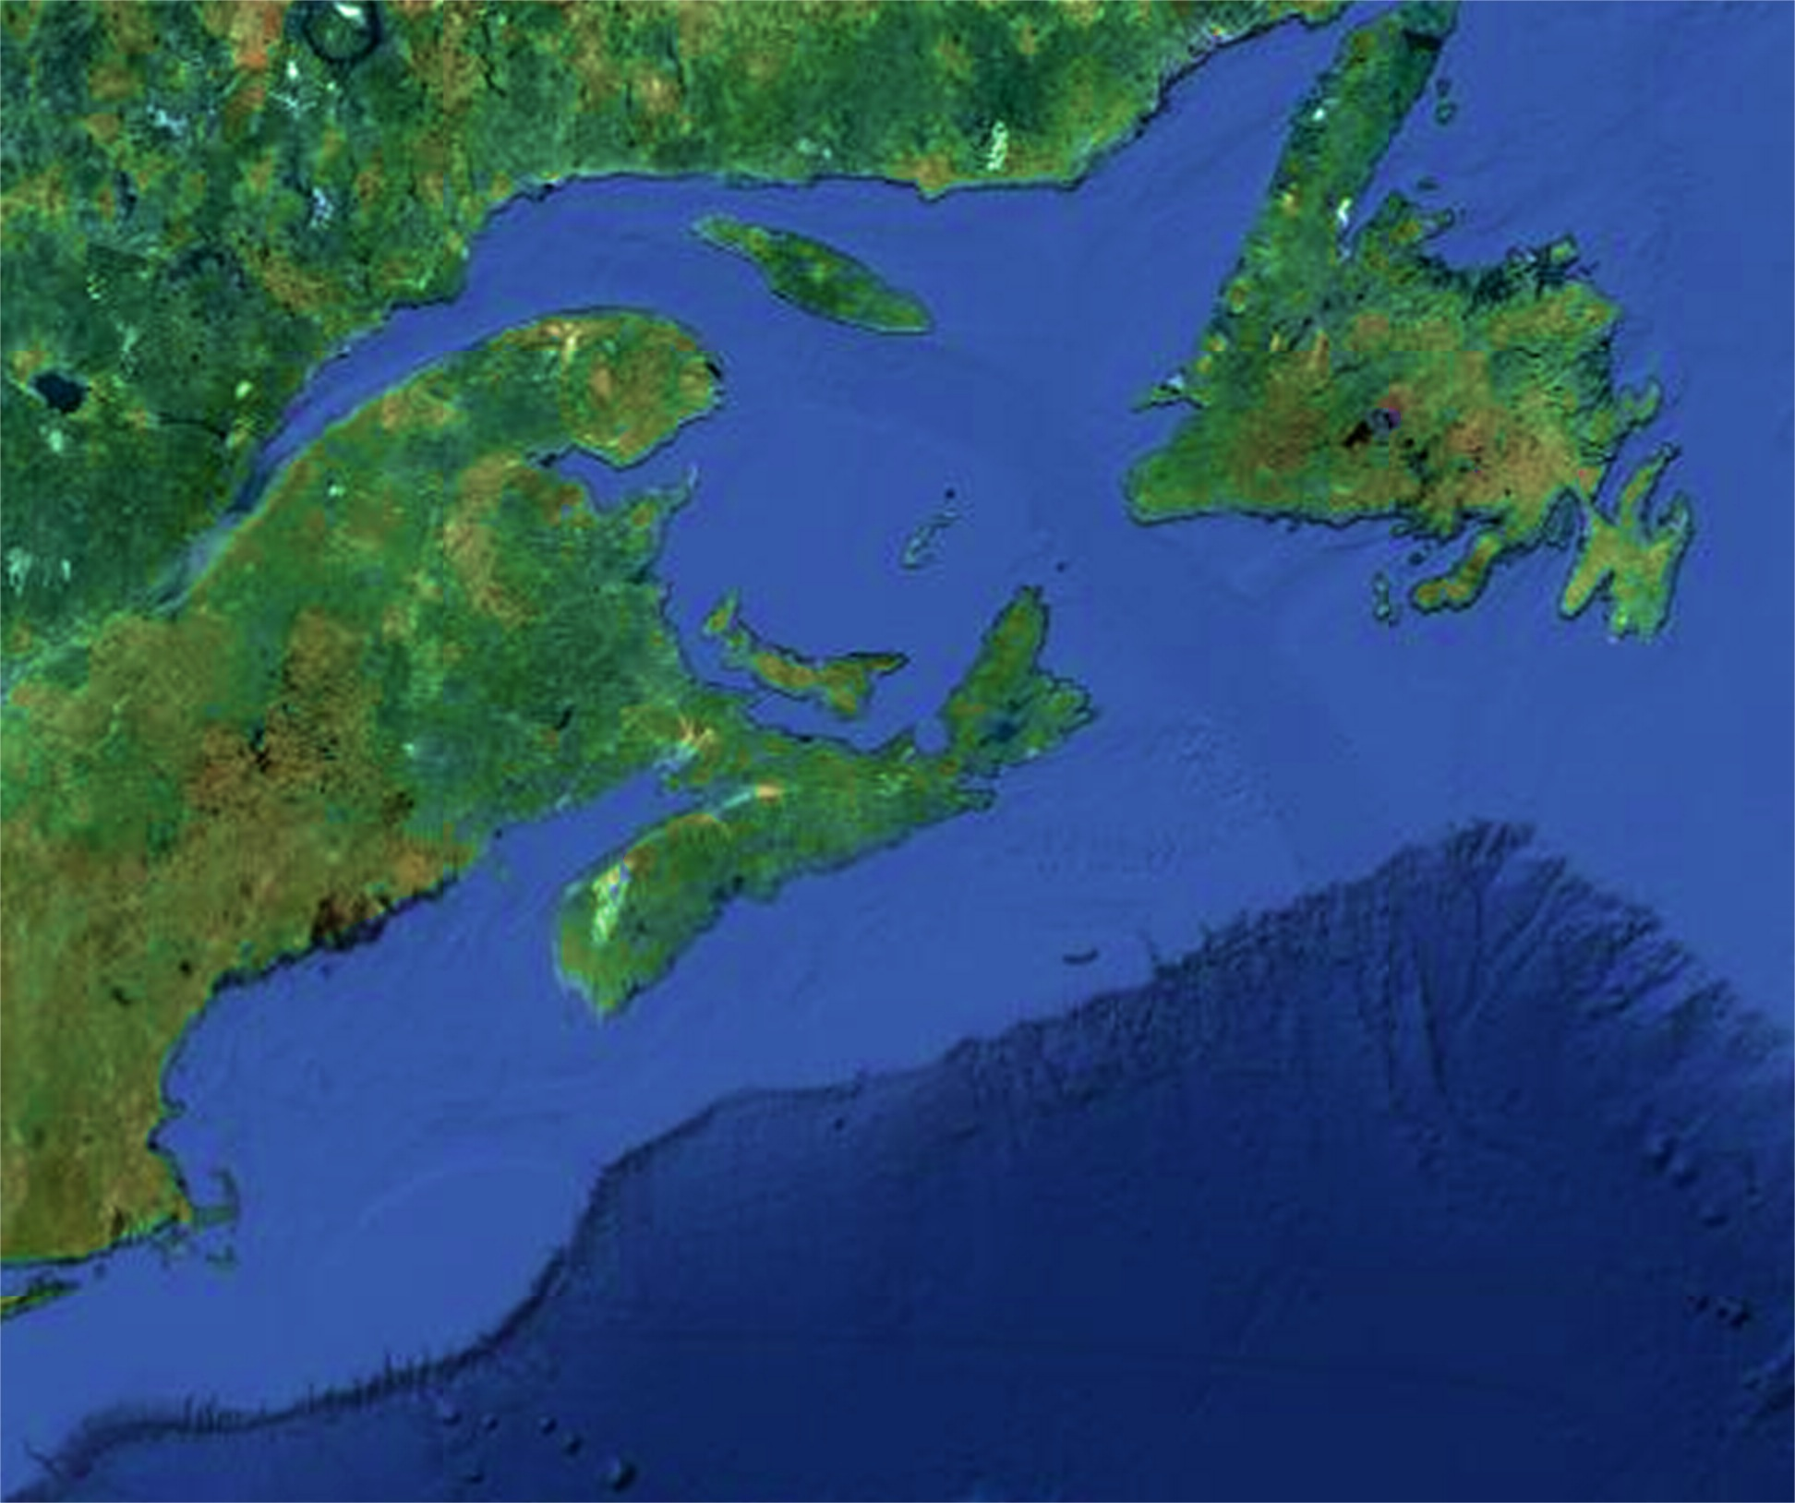
Historical perspective of regional Pseudo-nitzschia blooms
ASP Closures in eastern Canadian provinces (> 20 ppm in shellfish)
87
88
89
90
91
92
93
94
95
96
97
98
99
00
01
02
03
04
05
06
07
08
09
10
11
12
13
Closures in one province
Closures in more than one province
Quebec
Newfoundland
DA observations in eastern US
Regulatory testing not routinely conducted
Low levels (trace or below regulatory limit 20 ppm)
1991 Shellfish, Nantucket Shoals (Nassif and Timperi 1993)
2003 N/A; Whale mortalities (NOAA NEFSC 2003)
2004-2006 Scallop study, Georges Bank (Day et al. 2008)
2005-2006 Whale feces, krill (Leandro et al. 2010 )
2012, 2013 Eastern ME Precautionary DA closures
Toxic levels
1995 Scallops, Browns and Georges Banks (Stewart et al. 1997)
PEI
New Brunswick
Nova Scotia
ME
Gulf of
Maine
NH
MA
Notes:
Severe toxicity event in 1987 PEI; widespread intoxication and several deaths
Episodic phenomenon; 5 years in a row of toxicity, 4 years in a row of no toxicity
Management very challenging
Eastern US

Slide 17
Cell size variability in GOM P-n species
P. seriata
P. plurisecta
Cell volume (μm³)
Lundholm et al. (2006)
Fernandes et al. (2014)
Notes:
Turgidula, hasleana, calliantha

Slide 18
Domoic acid variability in GOM P-n species
P. seriata
>1200 μm³
600- 1200 μm³
Not tested
200-600 μm³
Not tested
Not toxic
0-200 μm³
P. plurisecta
Trainer et al. (2012)
Fernandes et al. (2014)
fg DA cell⁻¹
DA production in the field is complex→
Species, strain, life cycle, nutrients, temperature, salinity, trace metals, vitamins, pH

Slide 19
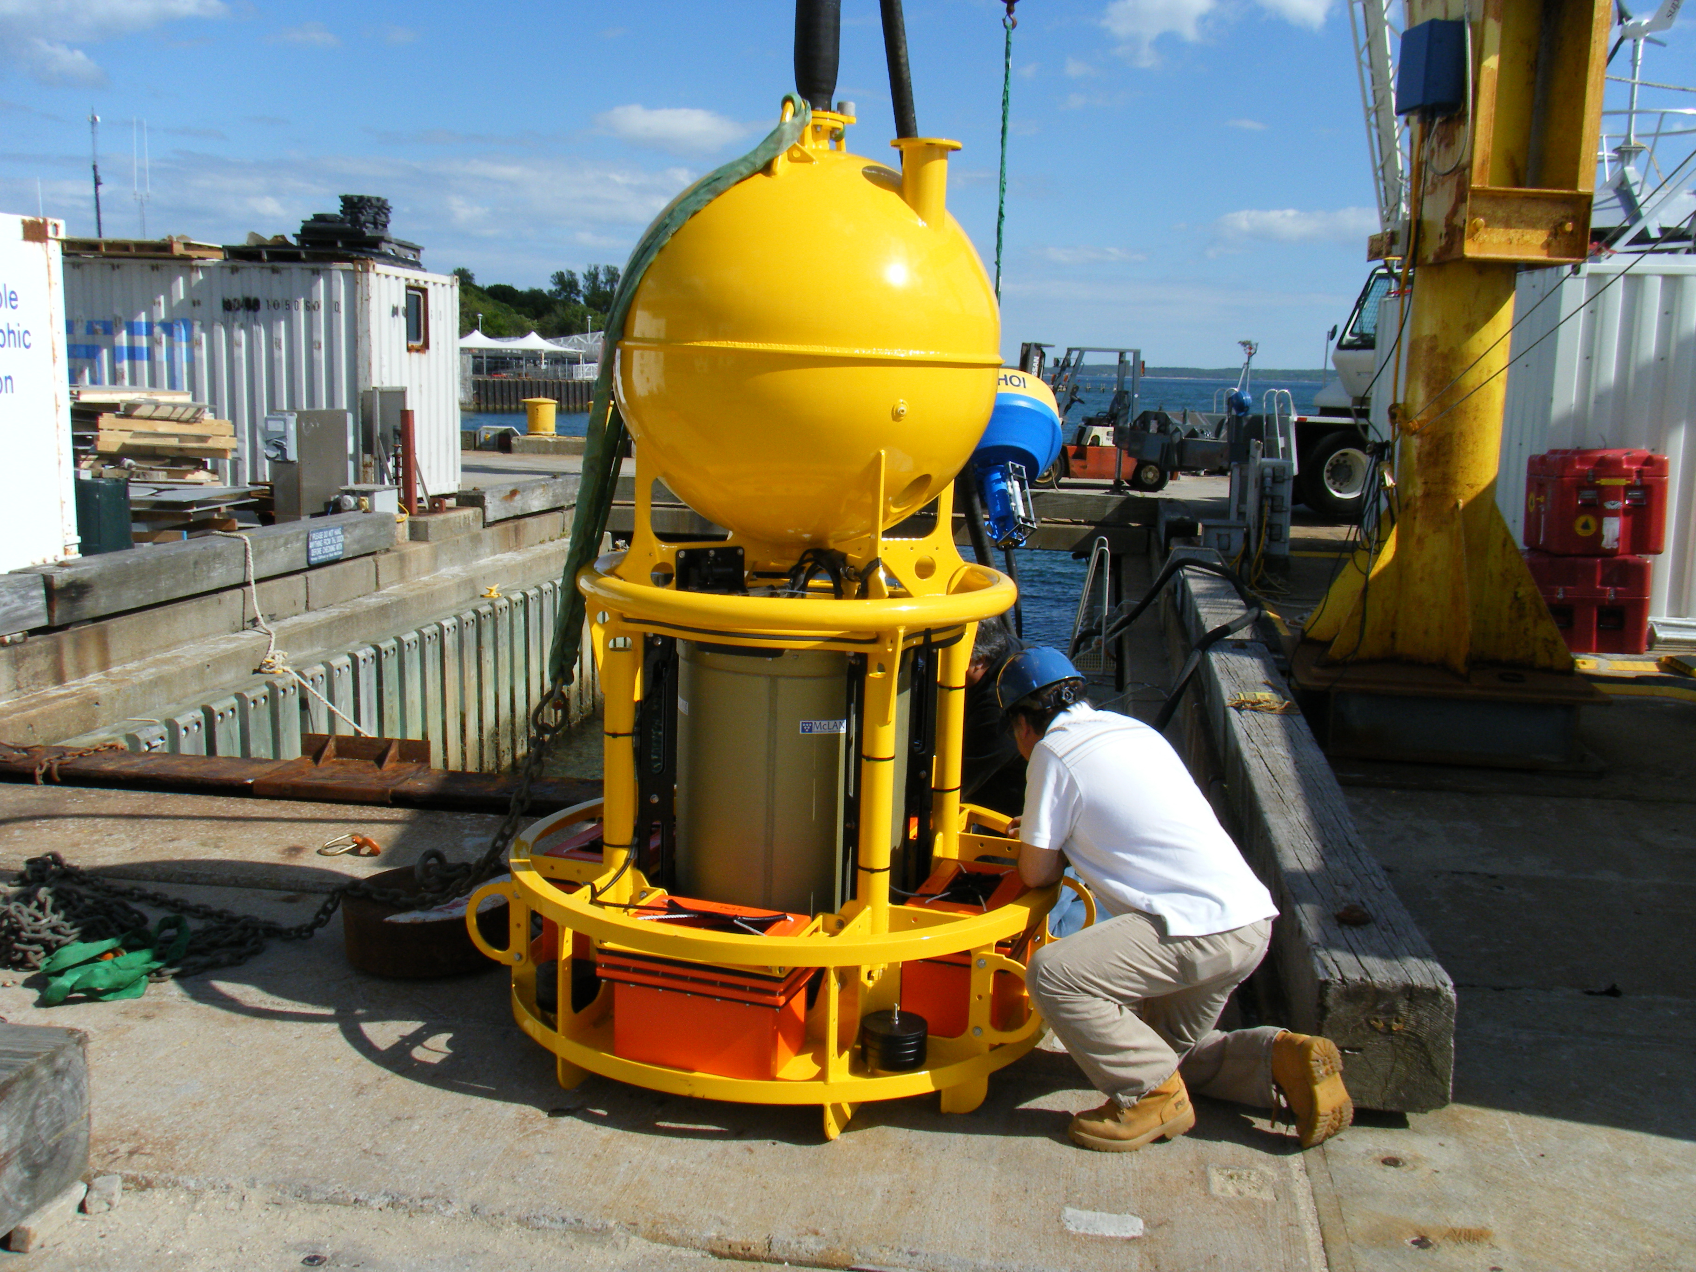
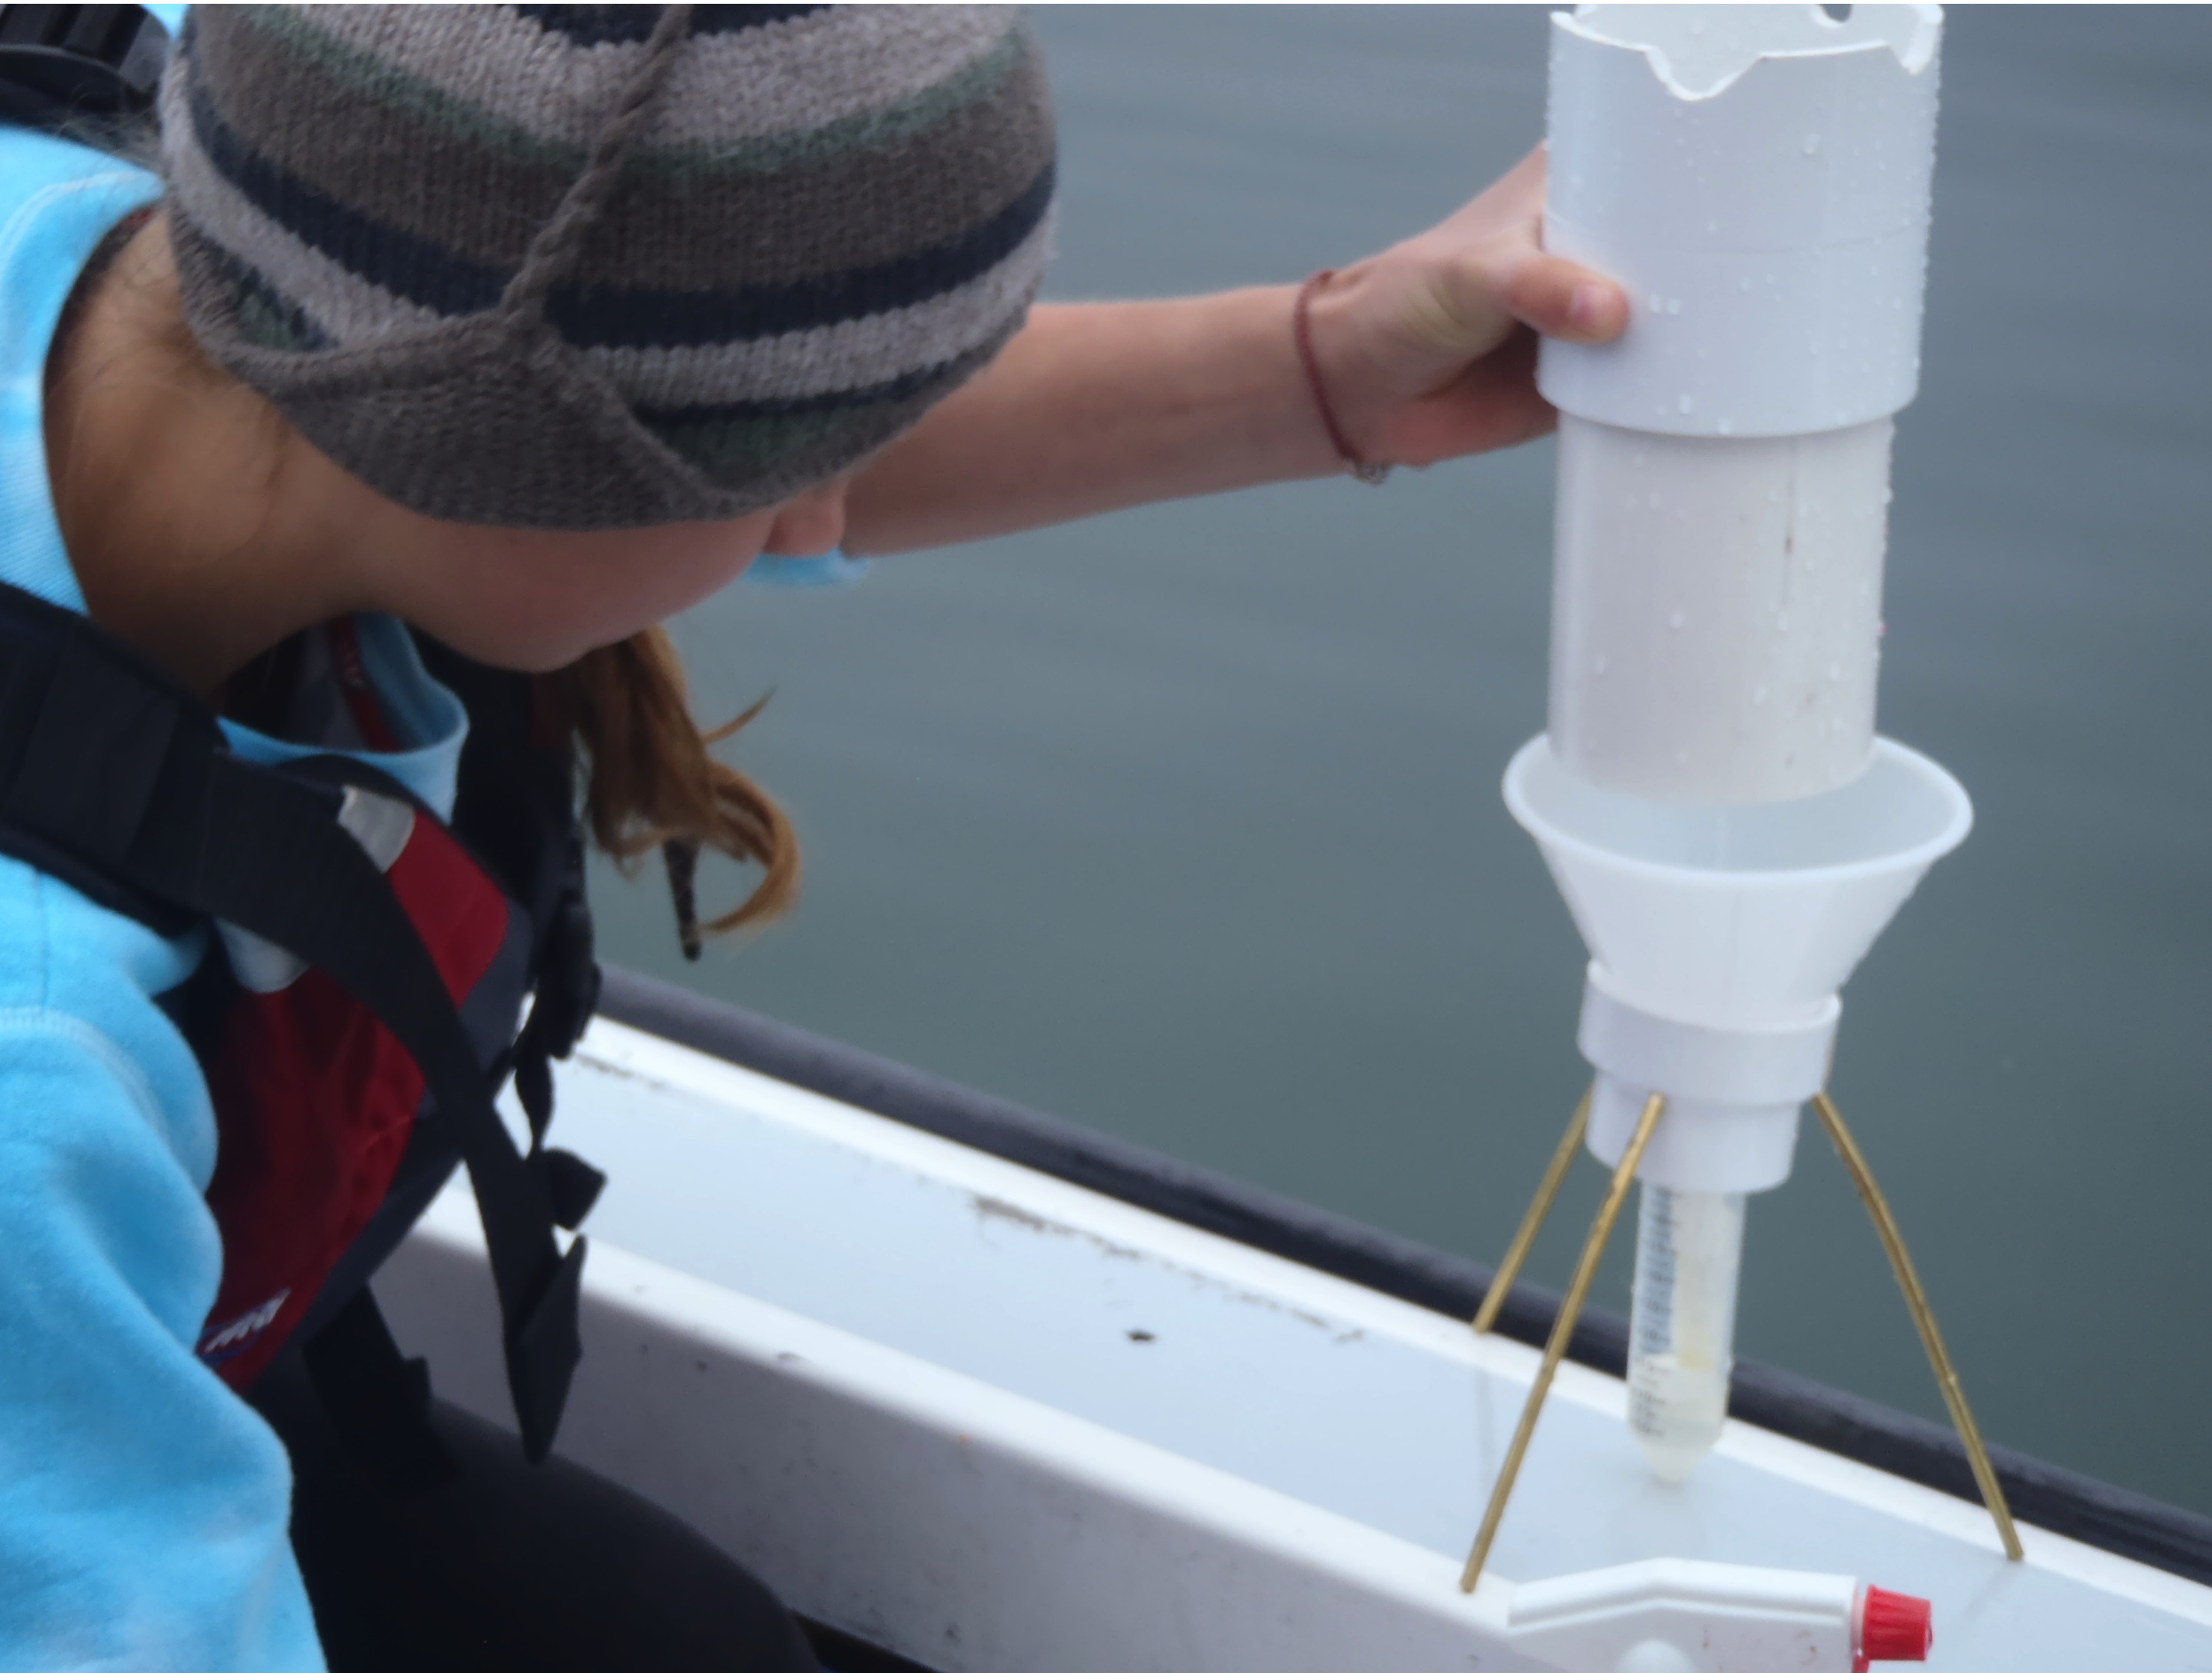
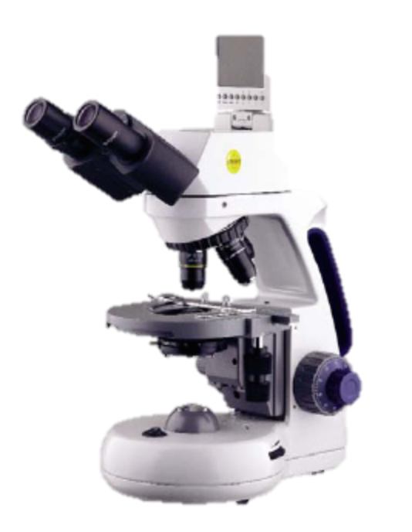
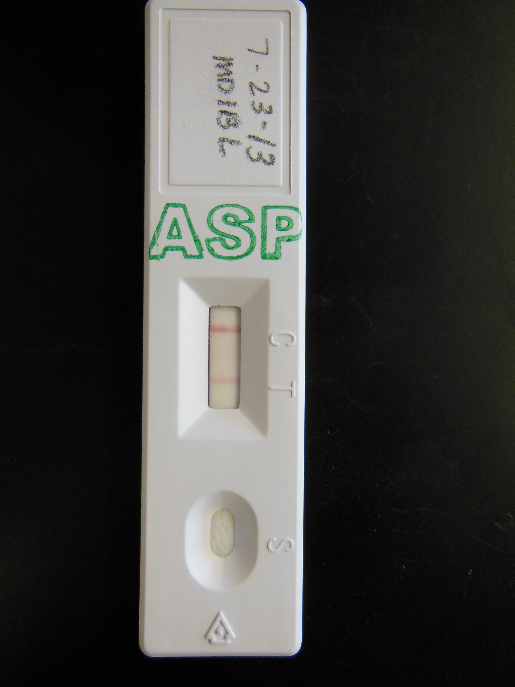
Triggering rapid response for Pseudo-nitzschia
Environmental Sample Processor HAB Array for GOM
Alexandrium tamarense
Pseudo-nitzschia australis
P. seriata
P. multiseries
P. pseudodelicatissima
**No probe for P. plurisecta yet
Weekly phytoplankton monitoring in Maine/ New Hampshire and limited DA testing
Event response cruises during 2012/2013 triggered by precautionary ASP closures to shellfish harvests (ME DMR)
Mogensen et al. poster
Notes:
The East Coast HAB array on the ESP has Pseudo-nitzschia probes for P. seriata, P. australis, P. multiseries, and P. pseudodelicatissima. The ESP did not detect these species during the deployments.
A recent publication by PIs Hubbard, Anderson, and colleagues describes the species diversity and toxicity of Gulf of Maine Pseudo-nitzschia isolates (see Fernandes et al. in press). In culture, higher levels of toxicity were observed in isolates of P. seriata and the recently described P. plurisecta, a member of the P. pseudodelicatissima species complex. Approximately 9 Pseudo-nitzschia spp. in the Gulf of Maine exhibit morphological and/or genetic features that are similar to P. plurisecta. We are in the process of calibrating and validating ESP detection of P. plurisecta; it is unclear what level of resolution (species vs. species-complex) will ultimately be possible with the ESP. Accordingly, we have strengthened collaborations with local and regional monitoring groups to gain knowledge of when and where Pseudo-nitzschia blooms are occurring in New England waters. These collaborations allowed us to use changes in Pseudo-nitzschia cell abundance, positive ASP Jellet tests (targeting phytoplankton and shellfish), and the initiation of closures by the Maine Department of Marine Resources to trigger two separate rapid response efforts in eastern Maine aboard the R/V Tioga: August 4-5, 2012 (funded by NOAA CSCOR; Fig. 1) and August 4-7, 2013. We also elicited the help of colleagues and students at Mount Desert Island Biological Laboratory in archival of weekly DNA and particulate DA (pDA) samples at three stations in or near the closure area in eastern Maine (Fig. 2). Both time series and 2012 rapid response survey samples were analyzed in the Hubbard lab, using sensitive and quantitative detection approaches for species diversity (e.g. Automated Ribosomal Intergenic Spacer Analysis or ARISA) and pDA (LS-MS/MS).

Slide 20
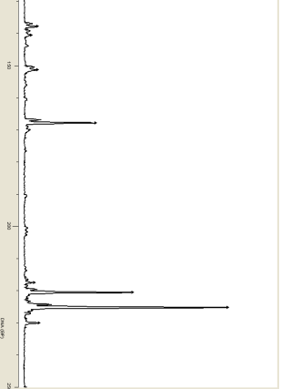
Species identification
Relative fluorescence units
Automated Ribosomal Intergenic Spacer Analysis (ARISA) used to ID and quantify species
Unknown
138 bp
P. pungens
142 bp
150
P. seriata
151 bp
P. delicatissima
168 bp
Extract DNA
PCR
purification
DNA base pairs
200
Unknown
218 bp
Small P-n. cells have less DNA and fewer ITS1 copies than large P-n. cells.
Unknown
220 bp
P. plurisecta
226 bp
P. pseudodelicatissima
230 bp
ARISA profile from GOM
Hubbard et al. 2008
250

Slide 21
Surface variability in domoic acid and Pseudo-nitzschia cell abundance
Temperature (°C)
Pseudo-nitzschia spp. abundance (cells L⁻¹)
Salinity (°C)
Domoic acid (ng L⁻¹)
LC-MS/MS LOD 12 ng L⁻¹
Notes:
Higher abundance offshore, but some inshore.
Note three stations with high abundace, 30K cells per liter and above;
Two to the SW are high in pDA, the one to the NE is low.

Slide 22
Patchy, diverse Pseudo-nitzschia spp. in surface communities
Pseudo-nitzschia spp.
P. seriata
Temp (°C)
P. plurisecta
P. pungens
P. americana/P. heimii
P. delicatissima
P. cuspidata
Latitude [°N]
Fragment 223
Fragment 157
Longitude [°W]
Notes:
Plurisecta inshore, pungens offshore
In the areas of high cell abundance, high toxicity plurisecta dominates
Lower toxicity, more pungens.

Slide 23
Bar Harbor Town Pier
Weekly monitoring, June-October 2013
Tioga cruise
Correlation between cell abundance and pDA (Spearman’s R = 0.788, p<0.01)
Highest pDA ~ highest abundance of P. plurisecta
Coexistence of toxic species
Bar Harbor
Cells L⁻¹
ng pDA L⁻¹
All four sites
6/10
6/30
7/20
8/9
8/29
9/18
10/8
10/28
11/17
Date (2013)
Particulate DA ng L⁻¹
Pseudo-nitzschia spp.
P. seriata
P. plurisecta
P. pungens
P. americana/P. heimii
P. delicatissima
P. cuspidata
Fragment 223
P. fraudulenta
Pseudo-nitzschia cells L⁻¹
Notes:
Time-series of cell concentration and pDA.
Correlation
1st peak: plurisecta
2nd peak: pungens

Slide 24
Pseudo-nitzschia: What we know now
Many species, half of them toxic, some species very toxic
Toxic and nontoxic species look similar- difficult for monitoring
  Molecular detection
Toxic species have different environmental preferences but also coexist
Toxin levels in environment vary over space/time, co-vary with species composition
Pseudo-nitzschia: Where we are headed
Expanded observational basis
  Broader temporal window (April-October)
  Improved remote detection capabilities for Pseudo-nitzschia
Science questions
  Basic ecology – how and why do communities change over space/time?
  Better understanding of trophic transfer during toxic events
Build more integrative predictive and response network for ASP events with states
  Identify user-friendly approaches for species and toxin detection
  Coupled biophysical models

Slide 25
Pseudo-nitzschia: What we know now
Lots of different species, half of species are toxic, some species are really toxic
Toxic and nontoxic species look similar- difficult for monitoring
  Molecular detection
Toxic species have different environmental preferences but CAN coexist
Toxin levels in environment vary over space/time
Pseudo-nitzschia: Where we are headed
More routine monitoring and forecasting for protection of public health
  Broad temporal window (April-October)
  As needed- identify and adopt species-specific guidelines for monitoring/ managing phytoplankton and shellfish
  Basic ecology – how and why do communities change over space/time?
  Better understanding of trophic transfer during toxic events
Build more integrative predictive and response network for ASP events with states
  Identify user-friendly approaches for species and toxin detection
  Develop improved remote detection capabilities for Pseudo-nitzschia
  Coupled biophysical models to better understand transport during past events, as well as in real-time as events develop

Slide 26
End; extra slides follow

Slide 27
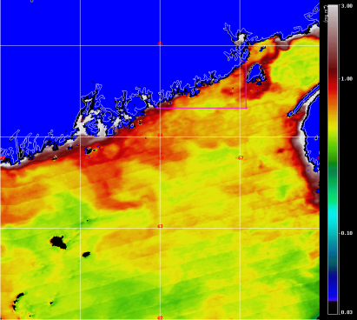
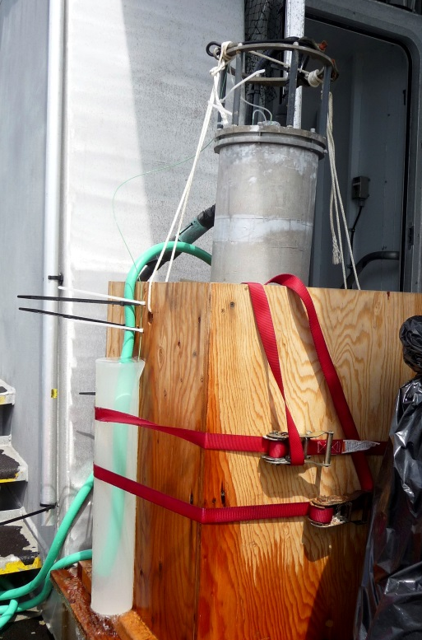
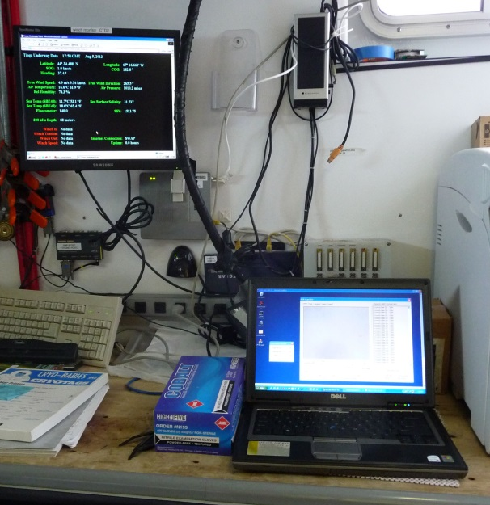
Adaptive bloom sampling: incorporating the IFCB into rapid response
Rapid response discrete sampling
Dissolved nutrients
CTD profiling
Lugol’s samples for cell counts
Filtration for DNA, particulate DA
pDA analyzed by LC/MS/MS
Mapping Pseudo-nitzschia spp.
On deck…
IFCB
In the ship’s lab…
Seawater pumped in from ~2 m depth

Slide 28
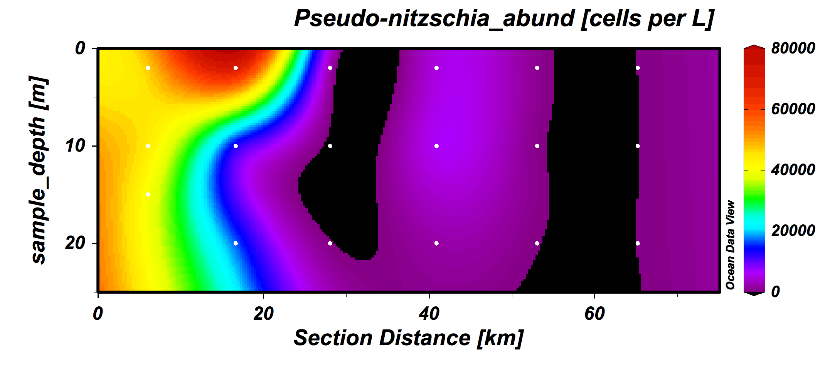
Variability in DA and Pseudo-nitzschia spp. abundance and diversity
8 x 10⁴
6 x 10⁴
4 x 10⁴
2 x 10⁴
≤583
Pseudo-nitzschia spp.
P. seriata
Spearman’s R (p<0.05) N=25 | Pseudo-nitzschia cells L⁻¹ | ng pDA L⁻¹
ng pDA L⁻¹ | 0.716
NH₄ (μm) | 0.504 | 0.394
N:NH₄ | -0.350 | -0.327
N:P | -0.287 | -0.346
P. plurisecta
P. pungens
P. americana/P. heimii
P. delicatissima
P. cuspidata
Fragment 223
Fragment 157

Slide 29
Prior observations of Pseudo-nitzschia spp. diversity in Gulf of Maine
Pseudo-nitzschia spp.
P. seriata
Toxic species
P. plurisecta
P. pungens
May
June
10 μm
July
Aug
P. delicatissima
Salinity
10 μm
Temperature (°C)

Slide 30
Prior and current observations of P. spp. diversity in Gulf of Maine
Pseudo-nitzschia spp.
P. seriata
Toxic species
P. plurisecta
P. pungens
May
June
10 μm
July
Aug
P. delicatissima
Salinity
10 μm
Temperature (°C)

Slide 31
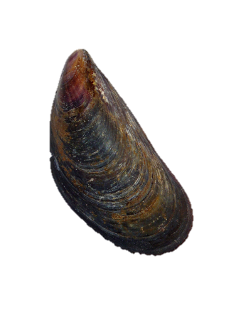
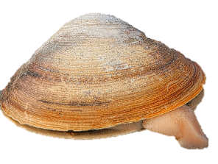
Temporal variability in domoic acid and Pseudo-nitzschia spp.
7/30-7/31
8/5/2012
P. plurisecta
P. plurisecta
and
P. pungens
P. plurisecta,
P. pungens, P. cuspidata, Frag. 157
P. plurisecta, P. pungens, P. cuspidata, P. seriata, P. pseudodelicatissima, P. americana
 | Won-squeak | Corea | Won-squeak | Corea
DA in Mytilus edulis | 5.77 ppm | 1.28 ppm | 0.22 ppm | 0.06 ppm
DA in Mya arenaria | 5.68 ppm | 3.16 ppm | 0.31 ppm | 0.05 ppm
P-n. abundance (cells L⁻¹) | 3.5 x 10⁵ | 1.2 x 10⁶ | 4.5 x 10⁴ | 4.0 x 10⁴
pDA (ng L⁻¹) | 234 | 846 | 49.6 | 15.2
cellular pDA (pg cell⁻¹) | 0.77 | 0.70 | 1.10 | 0.4
Mytilus
Shellfish samples collected by ME DMR, analyzed by Dauphin Island FDA labs
pDA analyzed by Florida Fish and Wildlife Conservation Commission
Mya
Notes:
Pic of tioga
p. Seriata at depth as well…

Slide 32
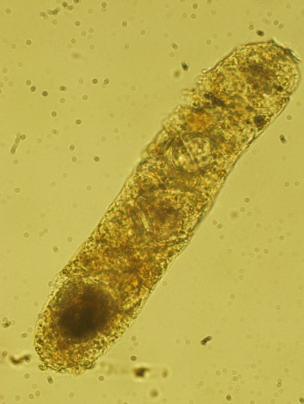
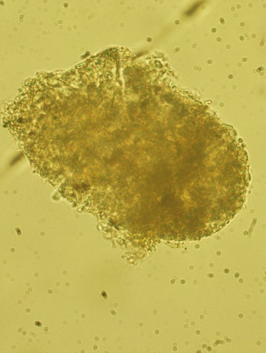
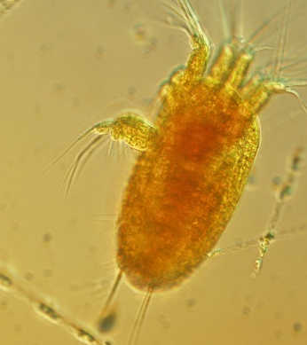
Temporal variability in domoic acid and Pseudo-nitzschia spp.
7/30-7/31
8/5/2012
P. plurisecta
P. plurisecta
and
P. pungens
P. plurisecta,
P. pungens, P. cuspidata, Frag. 157
P. plurisecta, P. pungens, P. cuspidata, P. seriata, P. pseudodelicatissima, P. americana
 | Won-squeak | Corea | Won-squeak | Corea
DA in Mytilus edulis | 5.77 ppm | 1.28 ppm | 0.22 ppm | 0.06 ppm
DA in Mya arenaria | 5.68 ppm | 3.16 ppm | 0.31 ppm | 0.05 ppm
P-n. abundance (cells L⁻¹) | 3.5 x 10⁵ | 1.2 x 10⁶ | 4.5 x 10⁴ | 4.0 x 10⁴
pDA (ng L⁻¹) | 234 | 846 | 49.6 | 15.2
cellular pDA (pg cell⁻¹) | 0.77 | 0.70 | 1.10 | 0.4
Evidence of grazers at Wonsqueak H.
Lugol’s preserved material
Notes:
Pic of tioga
p. Seriata at depth as well…

Slide 33
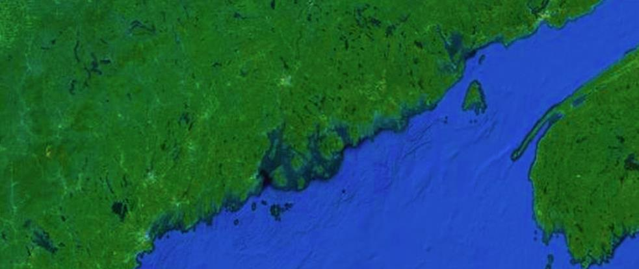
Data provided by ME DMR
>5000 Pseudo-nitzschia cells per liter
+ Jellet ASP test
- Jellet ASP test
1000-5000 Pseudo-nitzschia cells per liter
<1000Pseudo-nitzschia cells per liter
April/May
August
WGOM
EGOM
WGOM
EGOM
June
September
July
October
1.2 million cells L⁻¹
350,000 cells L⁻¹
2012
Notes:
Purple is below 1000
Orange is 1000-5000

Slide 34
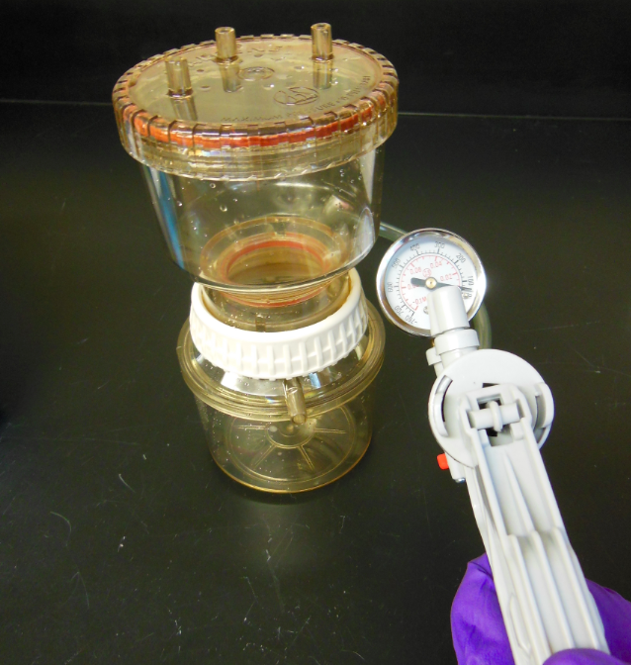
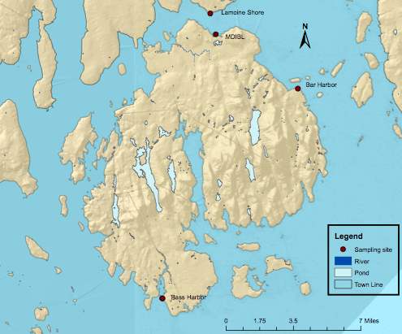
Weekly monitoring stations June-October 2013
Undergraduate research thesis, Hanna Mogenson, Smith College
Maine Department of Marine Resources Phytoplankton Monitoring
Concentrated samples for rapid DA testing/enumeration
ME
Mount Desert Island, ME
NH
Gulf of
Maine
Archived filters for DA/DNA
MA
LAMOINE
inland
MDIBL
BAR HARBOR
Mount Desert Island
BASS HARBOR
coastal

Slide 35
Dynamic transitions in Pseudo-nitzschia species composition
DOMINANT SPECIES
P. pungens
P. plurisecta
P. seriata
P. pungens
P. plurisecta
LAMOINE SHORES
inland
MDIBL DOCK
BAR HARBOR PIER
BASS HARBOR
coastal
Pseudo-nitzschia spp.
P. seriata
WEEK OF STUDY (JULY-OCTOBER 2013)
P. plurisecta
P. pungens
P. americana/P. heimii
P. delicatissima
P. cuspidata
Fragment 223
P. fraudulenta

Slide 36
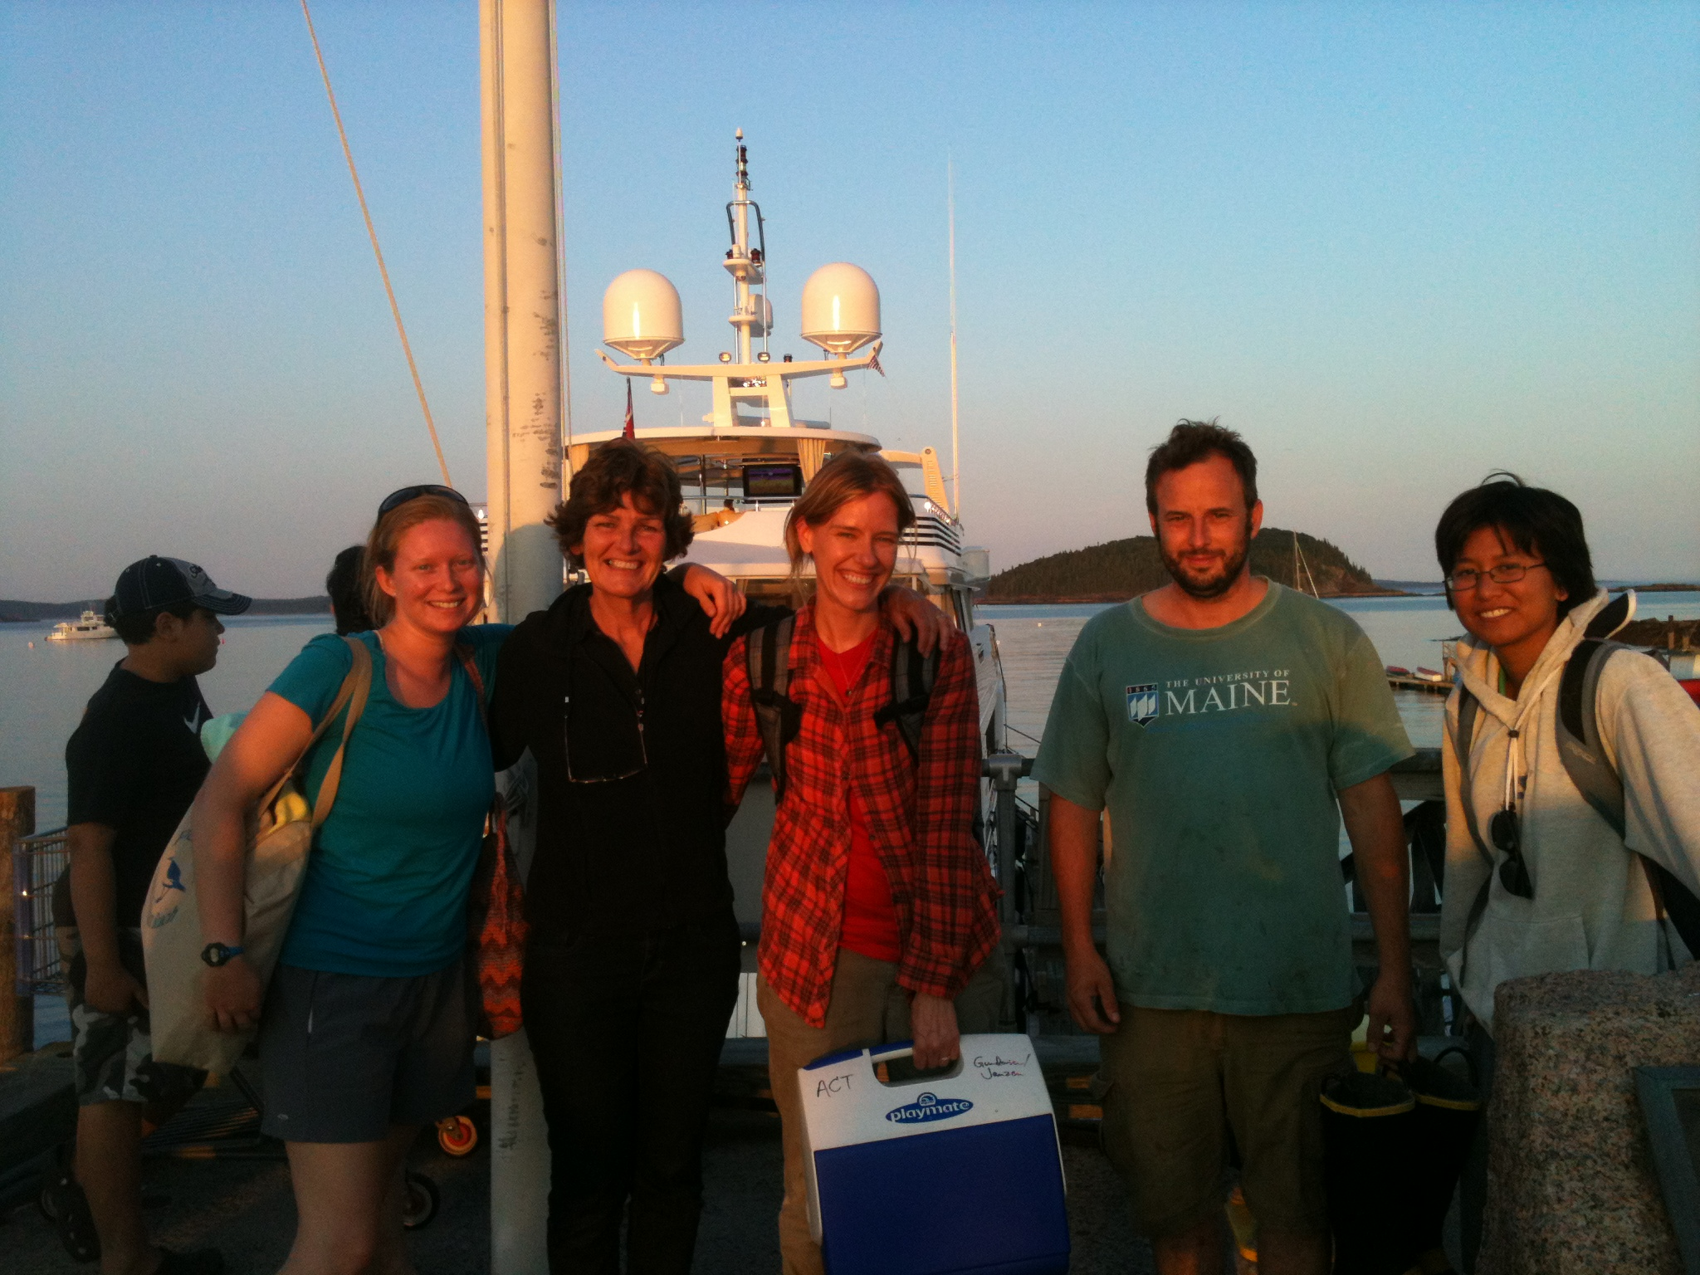


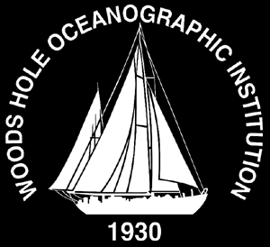








Slide 37

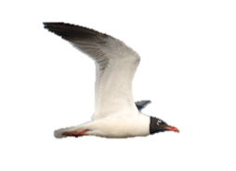







Dynamics of Pseudo-nitzschia spp. in the Gulf of Maine
Nutritional and physical processes
Pseudo-nitzschia bloom dynamics
Pseudo-nitzschia spp. ecology
Trophic transfer of domoic acid
Domoic acid production

Slide 38
Capturing bloom dynamics: COHH
Rapid Response: Where, when, and why are Pseudo-nitzschia species producing domoic acid?
Insight into P. spp. ecology in Y1-Y3→ informs vital rate experiments in Y4 →Species-specific biophysical models developed/modified in Y5
Inter-project collaboration
Integration of Imaging Flow Cytobot for Rapid Response
Establish duration and magnitude of environmental toxicity
Evaluate trophic transfer of toxins

Slide 39

Capturing bloom dynamics: rapid response surveys
DMR/MDIBL/WHOI TIME SERIES
July-October, 2013
NOAA CSCOR EVENT RESPONSE
August 4-5, 2012
WH OCEANS AND HUMAN HEALTH RESPONSE
August 4-7, 2013
Latitude (°N)
44.8
44.6
Latitude (°N)
44.6
44.4
44.4
44.2
44.2
44.0
44.0
43.8
43.8
68.4
68.0
67.6
67.2
43.6
Longitude (°W)
43.4
43.2
69.2
68.8
68.4
68.0
67.6
67.2
Longitude (°W)

Slide 40
May 2008
May
2013
May 2010

Slide 41

NERACOOS M – Jordan Basin
Jan-Jun 2013

Slide 42

ESP observations and
model hindcast concentrations
Forecast
Forecast
50% NO₃
50% NO₃, T(Growth, mortality)
50% NO₃, T(Growth, mortality, germination)
25% NO₃, T(Growth, mortality, germination)
10% NO₃, T(Growth, mortality, germination)
Model

Slide 43
Why was the 2010 forecast wrong?
Conditions were outside the envelope of prior observations used to construct the ensemble forecast
Water mass anomalies indicate a regional-scale change in circulation with direct influence on A. fundyense niche (warmer, more stratified, lower nutrients)
Weaker-than-normal coastal current lessened A.fundyense transport into WGOM and Mass Bay
Spring 2010 phytoplankton bloom more intense and crashed earlier than usual
Did earlier-than-normal nutrient depletion cause a mismatch with A. fundyense’s endogenous clock?
McGillicuddy, D.J., Townsend, D.W., He, R., Keafer, B.A., Kleindinst, J.L., Li , Y., Manning, J.P., Mountain, D.G., Thomas, M.A., and D.M. Anderson, 2011. Limnology and Oceanography, 56(6), 2411–2426.

Slide 44

Online animation: http://omglnx3.meas.ncsu.edu/yli/13ensemble_2d/dino_13ensemble.htm

Slide 45

Cysts and toxicity 2004-2009

Slide 46

Hydrodynamic basis: multi-nested circulation modeling

Slide 47


Slide 48

In situ observations and model forecast comparisons (cont’)
Tioga
ESP

Slide 49


In situ observations and model forecast comparisons
MRWR
MRWR

Slide 50

NERACOOS M – Jordan Basin

Slide 51

NERACOOS M – Jordan Basin
July-Dec 2013

Slide 52

NERACOOS M – Jordan Basin
Jan-Feb 2014

Slide 53
Cyst abundance and toxicity
2005-2009: r=-0.93

Slide 54
Cyst abundance and toxicity
2005-2009: r=-0.93

